Slide 1
Earth Orientation and GPS
Dave Boboltz & Ken Johnston (USNO)
Outline
Geodetic VLBI background
Applications of Geodetic VLBI
VLBI for Earth Orientation
Synergy with the VLBA

Slide 2
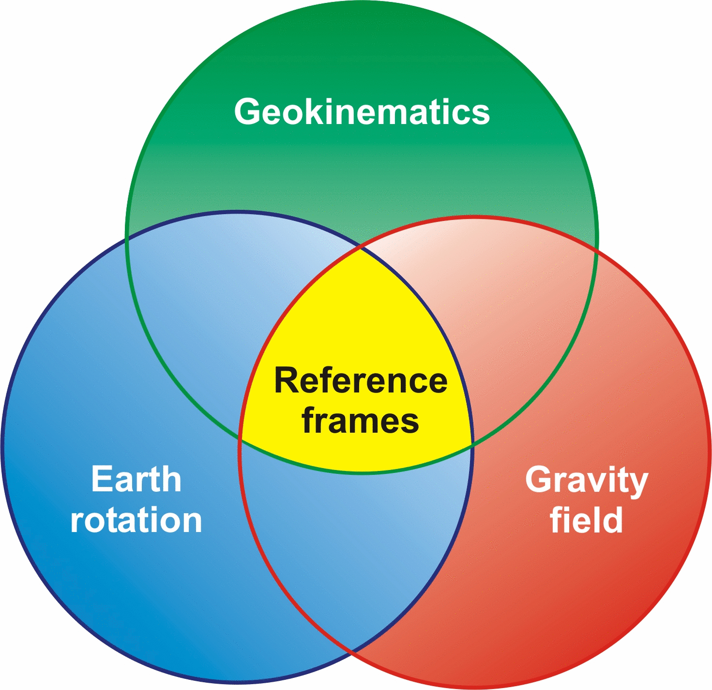
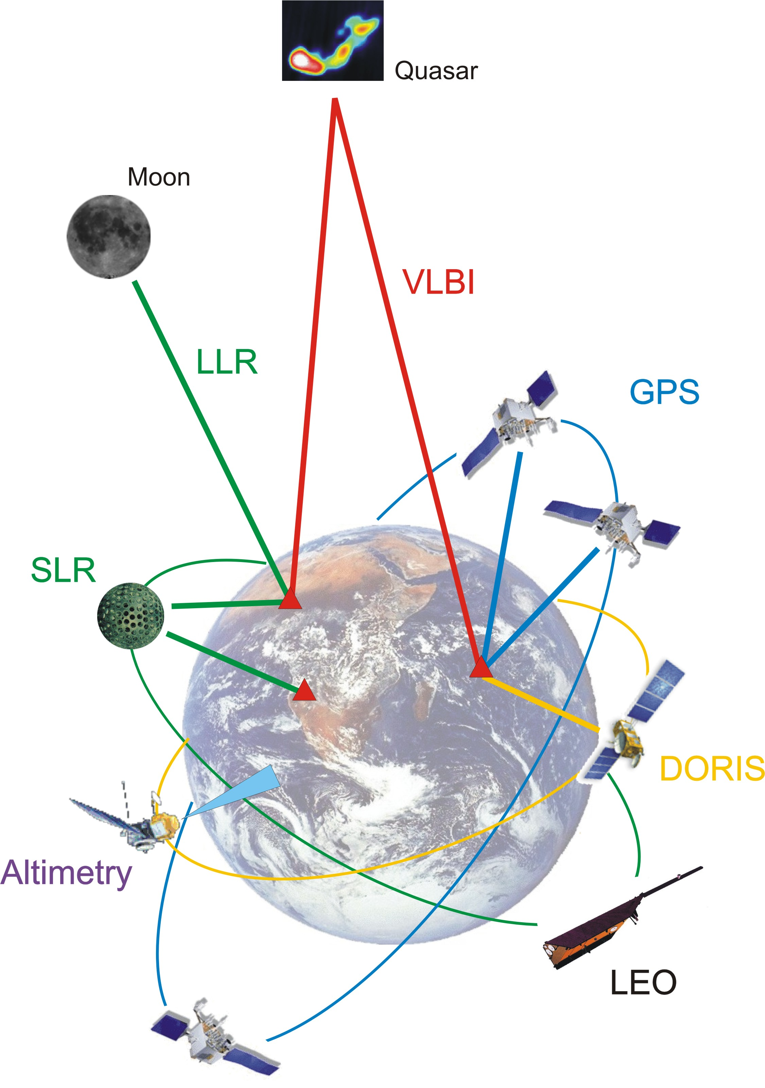
VLBI Part of a Global Geodetic Observing System
Integrated Earth observing system
Space Geodetic Techniques
VLBI, GPS, LLR, SLR, DORIS
Global network of ground stations
Dedicated space missions
Gravity Field, Altimetry, SAR, InSAR, Magnetic Field

Slide 3
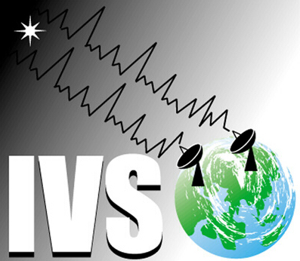
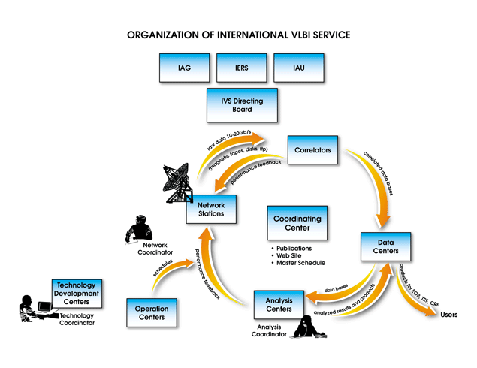
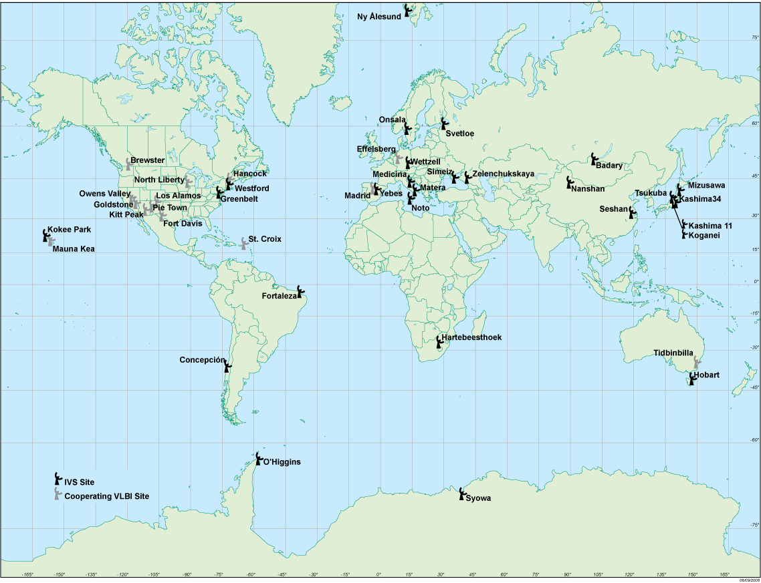
Geodetic VLBI and the IVS
Geodetic VLBI is coordinated through the International VLBI Service for Geodesy and Astrometry (IVS).
http://ivscc.gsfc.nasa.gov/

Slide 4
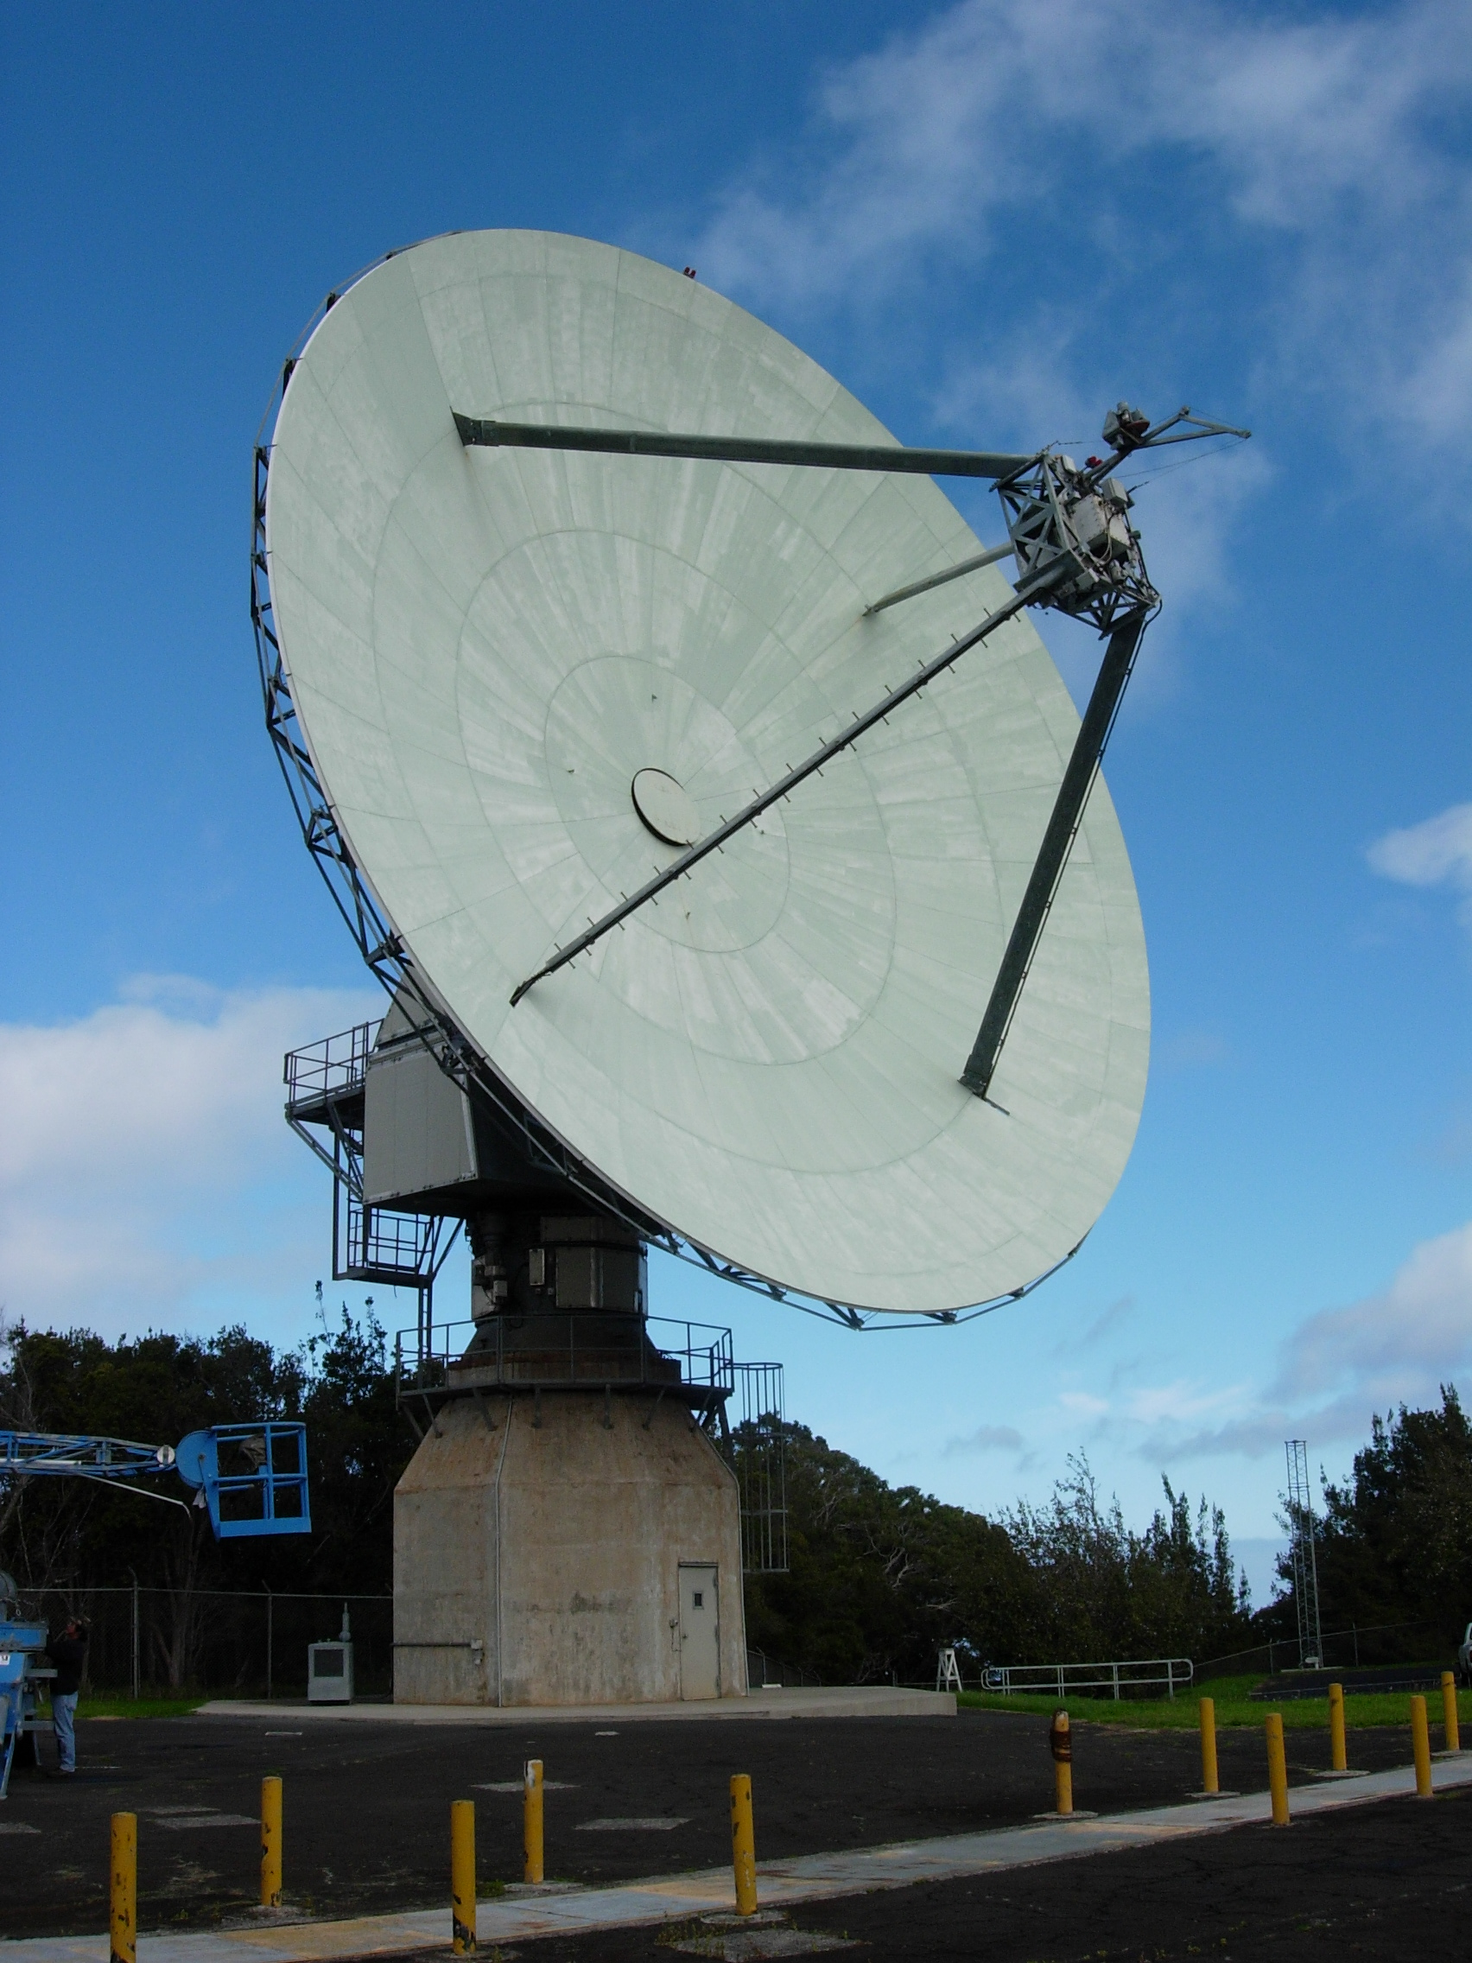
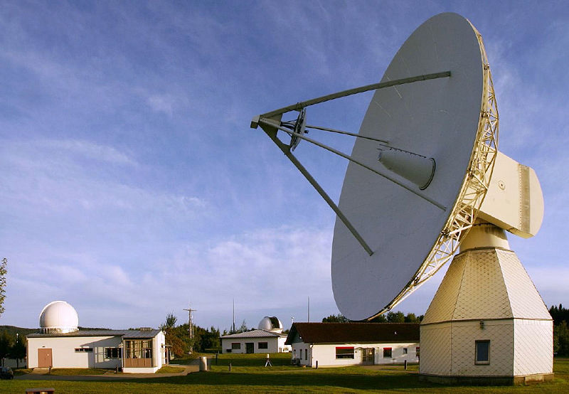
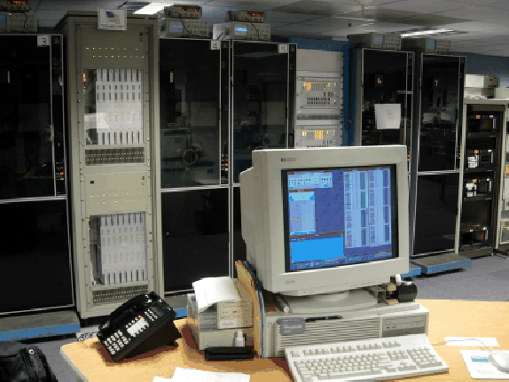
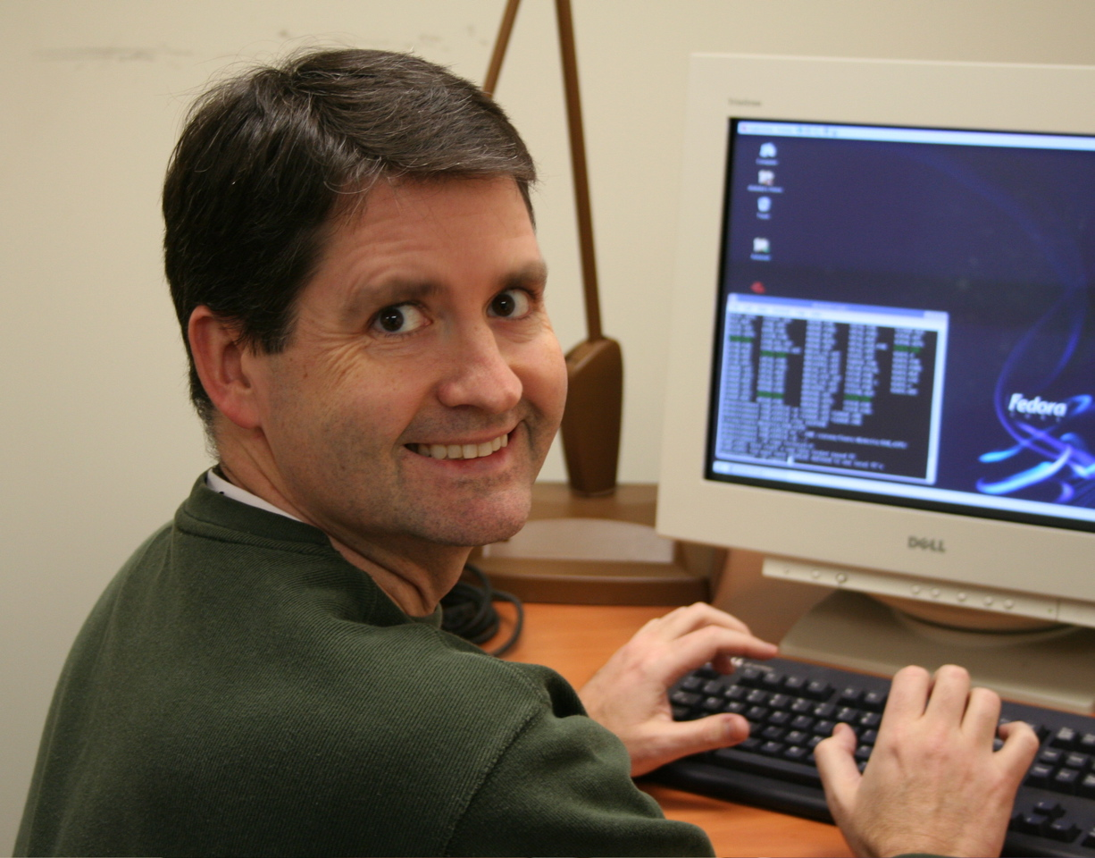
Geodetic VLBI Data Path
Observations
24-hr sessions 2+ times per week
1-hr “intensive” sessions daily
Data transmission
Mark5 modules shipped
Electronic transmission (e-VLBI)
Correlation
Mark 4 geodetic VLBI correlators
DiFX software correlators
Post-processing
Calibration, Fringe-fitting
Experiment analysis

Slide 5
Applications: Celestial Reference Frame
ICRF: quasi-inertial reference frame defined by VLBI estimates of the coordinates of 295 extragalactic radio sources
Realization of International Celestial Reference System (ICRS)
ICRF2 Adopted by the IAU January 1, 2010
The ICRF enables narrow-angle astrometry and precise spacecraft navigation
295 ICRF2 Defining Sources

Slide 6
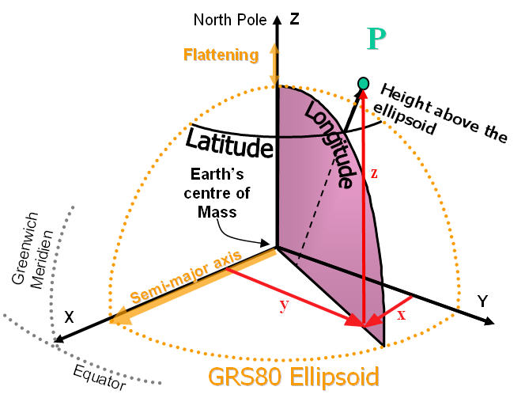
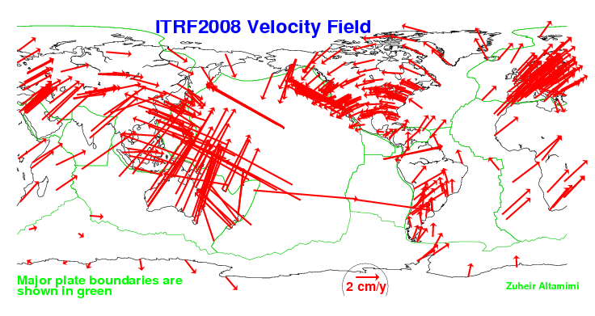
Applications: Terrestrial Reference Frame
ITRF: reference frame defined by estimates of the coordinates and velocities of a network of stations (VLBI, GPS, LLR, SLR, DORIS) on the surface of the Earth
Enables a wide range of geophysical science
Structure and deformations of Earth’s crust, mantel & core
Sea level change, earthquakes

Slide 7
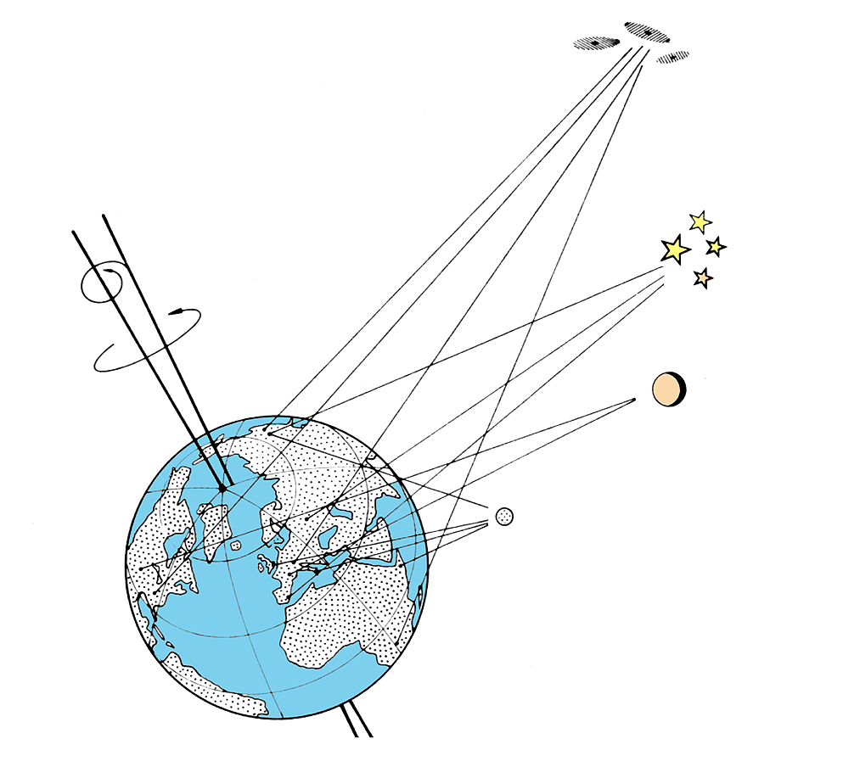
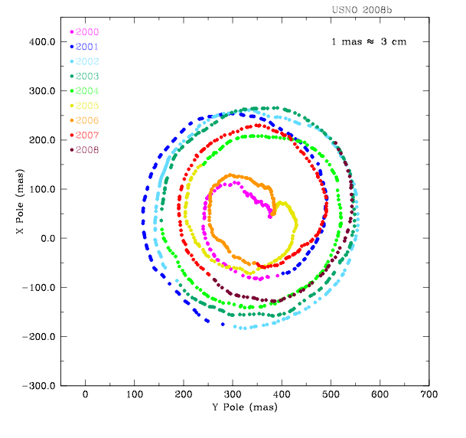
Applications: Earth Orientation
Earth Orientation Parameters (EOP) describe the orientation of the space axes of the Earth and provide the transformation between the CRF and the TRF
Include:
Polar Motion (X-pole, Y-pole)
Nutation (longitude Δψ, obliquity Δε)
Rotation rate (UT1-UTC)
Enable a variety of applications
Transportation, geo-location, communications, navigation
Nutation
Polar Motion
Rotation Rate
(UT1-UTC)

Slide 8
Earth Orientation at USNO
Analyzed VLBI results are distributed through the IVS
VLBI results combined with results from other techniques (i.e. GPS, SLR, LLR, DORIS)
Combined data then used to predict EOP into the future
Combination predictions are distributed through the IERS Rapid Service/Prediction Center for EOP at USNO
IERS Bulletin A (finals.daily)
EOP results fed back to GPS
Update GPS satellite orbit predictions
Accurate EOP predictions critical to various Govt. Agencies
Future support for GPS III

Slide 9
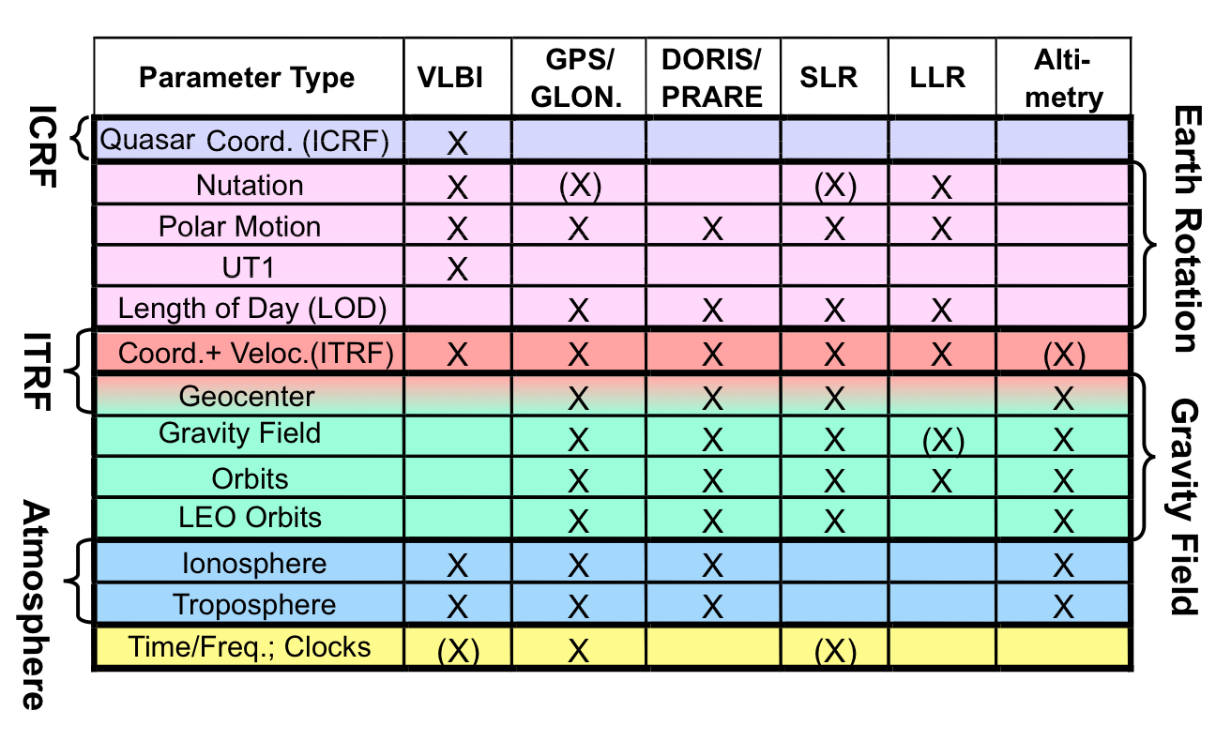
Combination of Space Geodetic Techniques
VLBI is only technique to uniquely determine
The Celestial Reference Frame (ICRF)
UT1 (Earth rotation angle relative to origin of ICRS)

Slide 10
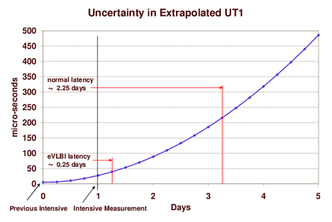
How Can UT1 Predictions be Improved?
Reducing data latency from 2.25 days to 6 hours results in:
Factor of 5 reduction in UT1-UTC prediction uncertainty
40% reduction UT1-UTC prediction errors 7 days out
Answer: e-VLBI

Slide 11
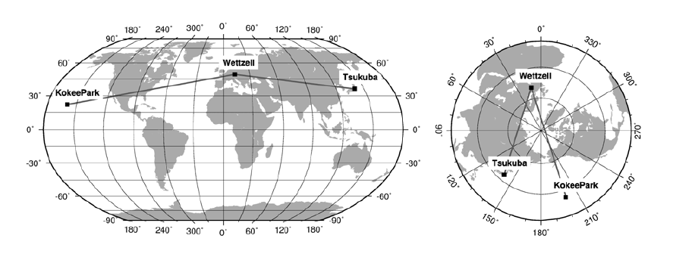
Current e-VLBI Measurements of UT1
Daily 1-hr Intensive experiments coordinated through the IVS
Int1 series Kokee Park, HI – Wettzell, Germany (Mon. – Fri.)
Int2 series Tsukuba, Japan – Wettzell, Germany (Sat., Sun.)
Data transferred via e-VLBI to reduce latency
Correlated in Washington, Japan, or Bonn

Slide 12
Synergy with the VLBA
USNO requirement to provide EOP to various Govt. Agencies
Want US-controlled assets
Plan for Continuity of Operations (COOP)
USNO and NASA-GSFC already collaborating with NRAO to maintain and improve the ICRF
RDV experiments important part of ICRF2
High-frequency (K/Q-band) reference frame observations
Could the VLBA provide a complimentary series of Intensive measurements for UT1?

Slide 13
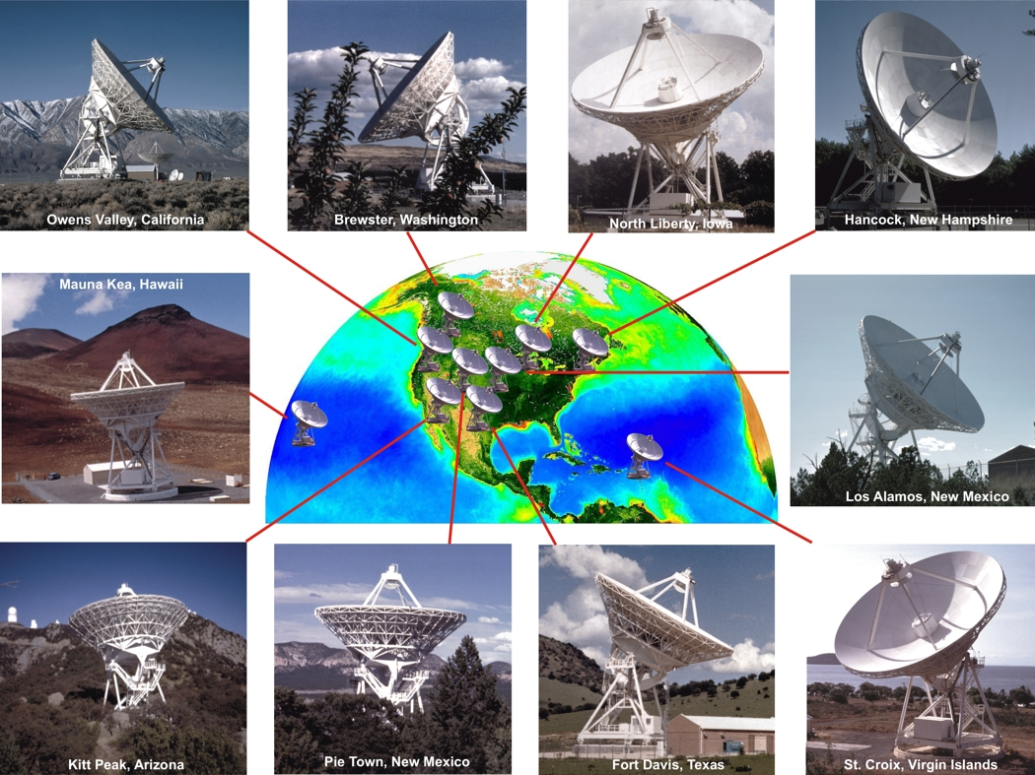
UT1 Testing With the VLBA
With in conjunction with NRAO, USNO began a series of “Pseudo-intensive” experiments to measure UT1
TC015
5 stations (HN, LA, MK, PT, SC)
13 experiments
Optimized for MK-SC baseline
TB014
3 stations (MK, LA, PT)
5 experiments
Optimized for MK-PT baseline

Slide 14
Results from Pseudo-Intensive Experiments
Shown are differences between VLBA UT1 measurements and IERS C04 combination solution as a function of baseline length
Longer baselines more tightly distributed
At the altitude of GPS constellation: 5μs ~ 1 cm
Despite shorter baselines, VLBA measurements meet present and future requirements for UT1

Slide 15
So Why Choose MK-PT Baseline?
Mauna Kea
provides long east-west baseline necessary for UT1
Infrastructure mostly there except for last mile
Redundancy with Kokee Park geodetic VLBI station
Pie Town
All fiber infrastructure already in place
Cost sharing for some legs
Proximity to NRAO-AOC

Slide 16
USNO-NSF-NRAO MOU
USNO to make a significant contribution to VLBA operating costs beginning in 2012
In return USNO will receive:
Access to MK - PT baseline for ~1.5 hr/day
Single VLBA intensive experiment 7 days/week
Back-up antenna (without e-VLBI) if needed
Data to be streamed back to USNO via high-speed links
Continued VLBA participation in the RDV experiments
Six 24-hr experiments per year
Vital to the CRF and TRF

Slide 17
Current Status of the VLBA Intensive Program
Contracts in place to connect the Pie Town and Mauna Kea VLBA stations to high-speed networks in 2011
Contract with AUI/NRAO
1 Gbps link from VLA to PT (Western NM Telecom)
Access to shared 1 Gbps connections from the VLA to UNM
Access to 10 Gbps NLR pop at UNM
Equipment for both MK and PT
Contract with Univ. of Hawaii
1 Gbps link from the MKOCN to the VLBA site
Access to 10 Gbps Internet2 pop on Oahu back to mainland
Subcontracted to Hawaiian Telecom
Expect in-service: March 2011

Slide 18
Pie Town to USNO Network Routing

Slide 19
MKOCN Connectivity

Slide 20
Summary
Geodetic VLBI is part of an integrated Earth observing system
Applications of Geodetic VLBI include: CRF, TRF, EOP
Earth Orientation vital to U.S. interests
VLBI is the only space geodetic technique that can provide CRF and UT1
VLBA is a useful asset for geodesy and increased interaction with the geodetic community (i.e. IVS, VLBI2010) is highly desirable
Geodetic VLBI is beneficial to astronomy:
Correlator model inputs (TRF and EOP)
Reference sources (CRF) for narrow-angle astrometry
Observing techniques (DELZN troposphere)

