Slide 1
ALMA Development Studies Call NA
Al Wootten, Leonardo Testi, Daisuke Iono, Stuartt Corder, Alberto Bolatto

Slide 2
Small Development Projects & Upgrade Studies
NA Development Studies: FY2016 Call
Overview: Describe Call, priorities recently endorsed by ALMA Board (‘ALMA2030’), current studies and projects, other opportunities
New NA Call for Studies published March 2015
FY2016 funding, dependent upon budget
Funding would begin 1 October 2015
Deadline mid-June 2015
Goal: Develop new ideas for study, consistent with the ALMA 2030 vision, outcomes of previous studies

Slide 3
A ROAD MAP FOR DEVELOPING ALMA
ASAC Recommendations for ALMA 2030
Finish the Scope of ALMA (receivers, VLB capability)
Recommended development paths
1. Improvements to the ALMA Archive: enabling gains in usability and impact for the observatory.
2. Larger bandwidths and better receiver sensitivity: enabling gains in speed.
3. Longer baselines: enabling qualitatively new science.
4. Increasing wide field mapping speed: enabling efficient mapping.

Slide 4
Current and Past ALMA Development Programs
Thematically ordered
Projects from the First (2010, 2011) Calls are now reaching fruition:
Band 5 (163-211 GHz) receivers
Fiber optic connection from ALMA to the World
ALMA Phasing Project (VLB)
Several from subsequent Calls continue
Studies from a number of Calls nearing completion

Slide 5
ALMA Phasing Project (APP)

Slide 6
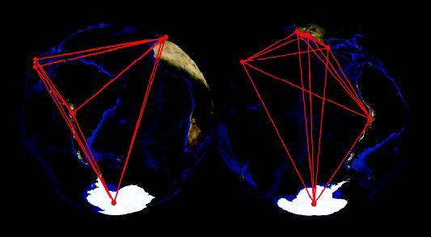
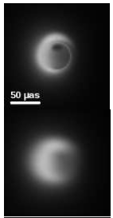
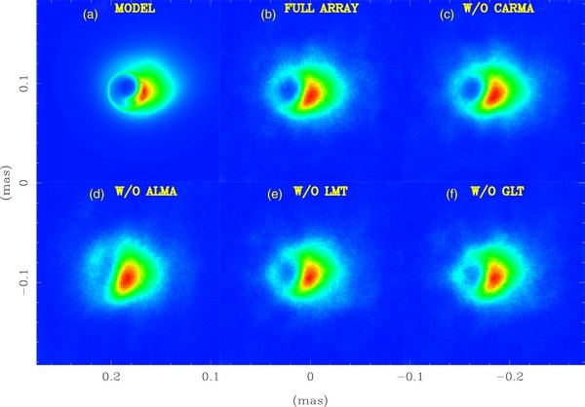
Longer Baselines: Enabling Qualitatively New Science
APEX—AOS fringes demonstrated 13 Jan 2015
24-31 March mission for APP: MIT: Matthews (APP), JAO-EOC: Phillips, Remijan
Discussion/work regarding execution sequences and integration with nominal observing modes
(Left) Image of SgrA* (top) as viewed by the array shown right above at 1.3mm (bottom)
1.3mm stations
M87 simulation
230 GHz
Lu et al. (2014)
Notes:
M87 simulation
230 GHz
Lu et al. (2014)

Slide 7
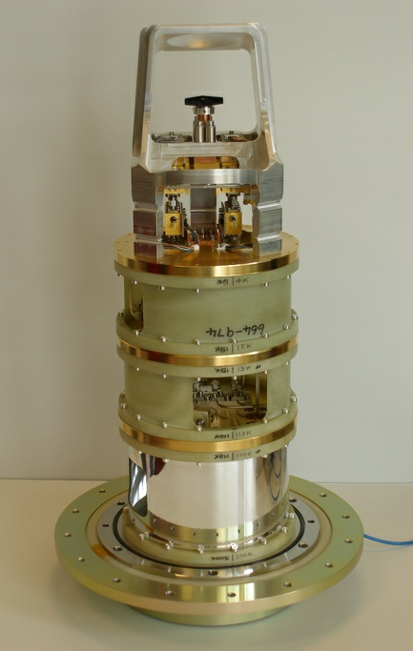
EU Led Projects/Studies Underway:
Band 5
1 Feb 2013 – Kick-off meeting
2013/14 – Design optimized for series production
Manufacturing Readiness Review (May 2014)
Two production type CCAs built, being tested
Decision to produce 73 units (up from 67)
Exactly same hardware, no mix with pre-production units
Cost difference small compared to refurbishment
Band 5 integration at OSF to start in April 2015
Using experience from B4/8/10 integration
Last cartridge integrated Q2-2017
Funded by ESO & NRAO, plan agreed with JAO
ESO/NRAO/JAO team testing equipment at OSF now
Notes:
Difficult customer

Slide 8
Band 5 – Technical Status
Tightened specs as compared to ALMA baseline
Receiver noise temperature
80 % of RF band (163 – 211 GHz): 65 K → 55 K (15% better)
Whole RF band (163 – 211 GHz): 108 K → 75 K (30% better)
Extended LO tuning range (WCA by NRAO)
166 – 203 GHz instead of 171 – 203 GHz (16% wider)
First Band 5 production cartridge shows good noise temperature performance
Science case summary: Laing et al 2010 Msngr 141, 14L

Slide 9
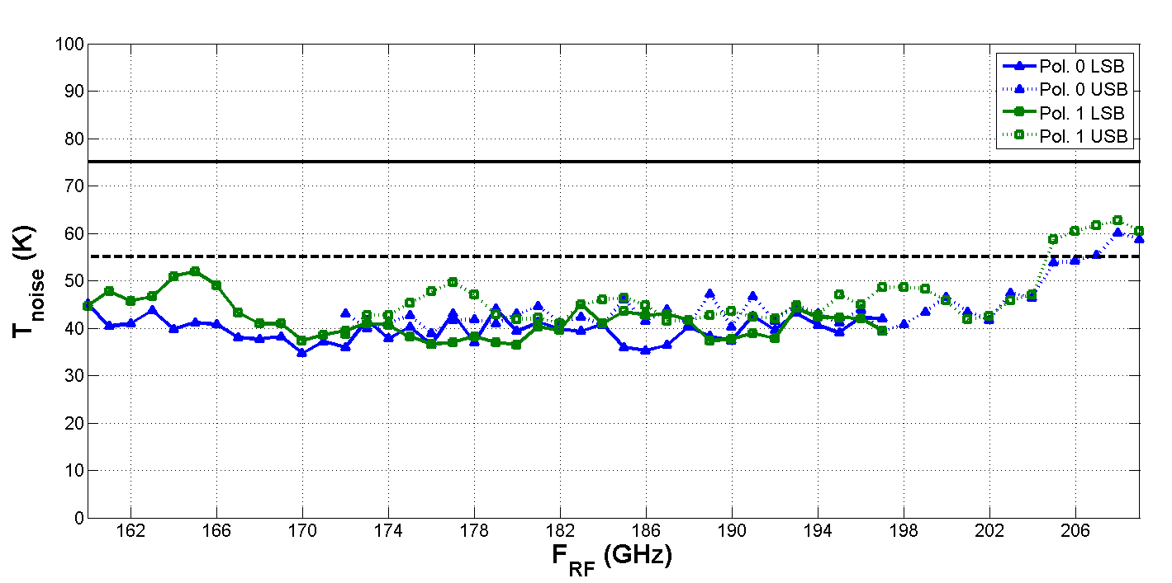
Band 5 – Sensitivity

Slide 10
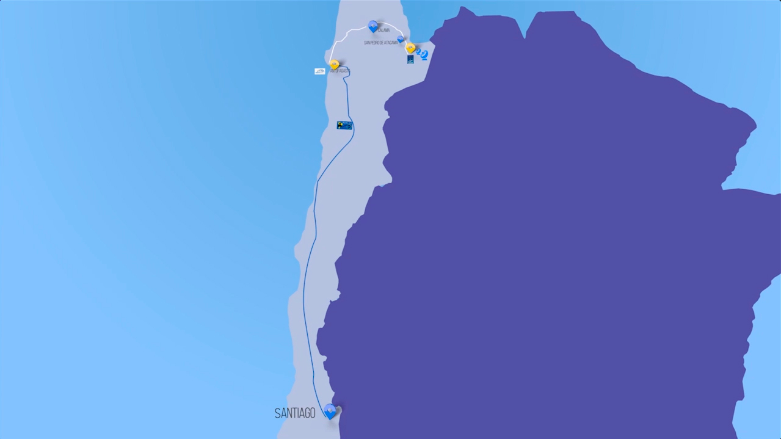
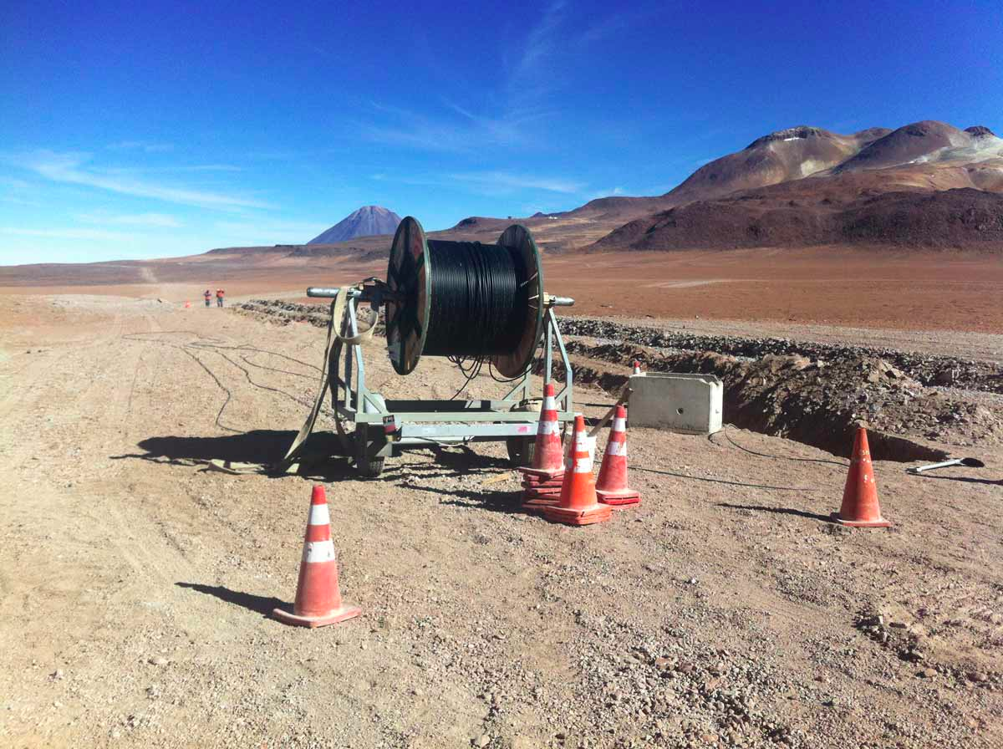
ALMA’s Connection to the World
150km of fiber connects ALMA/AOS to Chilean
Internet backbone (REUNA) thence to the World
Data transmission speeds increased by more than a factor of ten over the current microwave link

Slide 11
Improvements to the ALMA Archive
Three studies, two projects target this
Studies
NA FY2014 (Reports available)
Community Science Tool Development (Leroy et al.)
Development of spectral cube-domain analysis tools for use with ALMA data
New Calibration algorithms, refinements better long baseline imaging (Wilson)
correct for atmospheric influences on the image quality
Eu: Advanced data analysis and archive enhancement: Develop enhanced data analysis software system for CASA (UzK, Allegro, NBI)
MAGIX opt package, Auto-line-ID, Radiation transfer

Slide 12
ALMA NA Development Projects: Archive
Continuing for another year
Projects
ADMIT (Lee Mundy, U. Md.) Science Objective:
ADMIT provides easy, organized, immediate access to the science data in the cubes
provides tools for discovering and mining science from the data
provides efficient access to the science in archival data to empower data reuse
Next Generation ALMA Viewer: (E. Rosolowsky, U. Alberta) Science Objective:
To provide a visualization solution for ALMA/CASA that will meet long-term needs for (1) big data, (2) archive exploitation, and (3) extensibility.

Slide 13
Larger Bandwidths; Better Receiver Sensitivity
Improving sensitivity and spectral grasp
Construction/Upgrade of receivers to provide increased bandwidth to the digital system—there are Studies and Projects toward this end
New receiver Projects for uninstrumented ALMA Bands
Band 5 Project (Eu & NA): First of 73 of 8 GHz x 2 polzn 163-211 GHz receivers on ALMA in April; installation continues for ~2 years.
Band 2 (NA) Project: a 67-90 GHz prototype will present two 8 GHz sidebands, 2 polarizations to the system (currently of course only 16 GHz of this bonanza can be processed at once) Note Eu Study, below
Band 1 (EA & CL & NA) Project a prototype 35-50GHz, 8 GHz x 2 polzn receiver is under construction.

Slide 14
Larger Bandwidths; Better Receiver Sensitivity
Currently there are several studies moving in this direction:
Band 6 Study: (NA) Kerr is studying a 2nd generation B6 (211-270 GHz) receiver incorporating balanced sideband-separating SIS mixers providing flatter gain and noise characteristics over a full 4-12 GHz IF band.
Band 10 Study: (NA) B10 (787-950 GHz) currently DSB 8 GHz; Kerr is studying a 2nd generation B10 SSB receiver over a full 4-12 GHz IF band.
Band 2+3 Study: (Eu) Band 2+3 development:
Prototypes of horn and OMT meet specs over 67-116 GHz
LNA development:
UMan: excellent design over full range (being prototyped)
Other LNAs (EU foundries) and packaging (IRAM,INAF & RAL)
Bench system test by end of year, full prototype in 2 yrs w/ 16GHz/pol
Combination of B2+3 would leave a cryostat slot, Studies for B11?
An Eu study investigated B11 science and the ALMA site
An EA study: Hot Electron Bolometer mixer with SiGe HBT low noise amplifier has been tested and a new SIS device (Nb/Al-AlOx-Al/Nb) has been fabricated.

Slide 15
Larger Bandwidths; Better Receiver Sensitivity
Upgrade of existing Receivers:
Band 3 (84-116 GHz, NA) Project: Addition of deflux heater, magnets to improve stability, sensitivity
Band 3 (84-116 GHz, NA) Study of TKIP (traveling-wave kinetic inductance parameter) amplifier over the 55-175 GHz
Band 9 (602-720 GHz, (Eu) Study: upgrading Band 9 to 2SB with wider IF ready for implementation
Upgrades to backends
Digital Study (Eu): Upgrade of the digital system to process increased bandwidth--developing next generation digitizers
NAASC Memo 114: suggests upgrade of the correlators to process the increased bandwidth –future Study?

Slide 16
Gains in Usability
Optical Fiber Project near completion (NA & Eu)
Data currently moves from ALMA to JAO via microwave link
Fiber provides an order of magnitude increase in data volume transmission, better reliability
Dec 2014: fiber completed. Equipment installed in all nodes. System ready for end-to-end testing. 3-month penalty applied.
Jan 2015 end-to-end-end (i.e., AOS/OSF ↔ SCO) performed. Result confirms specification, namely two full-duplex channels of 1Gbps each.
Full operational use of the link awaits permits
Cryostat cooling upgrade Study (Eu, cost saving on power consumption)

Slide 17
Gains in Usability (continued)
Artificial Source at AOS Project (EA with JAO)
Upgrade of the optical comb generator and the optical noise source for wider bandwidth (800 GHz to 1.4 THz) is going on.
J-band (WR03) photomixer test at Band 8 frequency range is under preparation.
Expansion of the Central LO Article to 5 Subarrays Project (NA)
Objective: Add a 5th complete subarray, identical in every way to the four currently installed, completing the original subarray design specification of ALMA and allowing additional simultaneous engineering and scientific observing activities

Slide 18
Increasing Wide Field Imaging Speed
Concept Study of a Millimeter Camera for ALMA Study (NA)
Examines the construction of a focal-plane array instrument for Band 3 wavelengths to be installed on one of the antennas within the Total Power Array (TPA). Improve efficiency of TPA observations which provide data on large scales for combination with 12-m Array and 7-m Array data.
Solar Observing strategies Study (NA, Eu, EA): new science area
Open ALMA up for solar studies through the definition of total power and interferometric ALMA solar observing modes; development of detailed use cases, supported as appropriate by modeling; develop online/offline software requirements for solar observing modes, solar data calibration, and solar data reduction; development of solar observing modes to the ALMA operations to be implemented for Cycle 3 observing.

Slide 19
Notes:
http://arxiv.org/pdf/1502.06397v1.pdf
Figure 1. The large map in the middle left is the result of a sca
n over the full solar
disk with a single ALMA total power antenna at a frequency of 2
30 GHz (
Phillips
et al. 2015
). Despite the limited resolution, the map shows many featur
es which
are visible in H
α
, too (right middle). The small insets demonstrate potentia
l science
cases based on numerical simulations and observations at ot
her wavelengths

Slide 20
Pathways to ALMA Development!
Alberto Bolatto, Stuartt Corder, Daisuke Iono, Leonardo Testi, Al Wootten
Collection of possible development possibilities
For each possibility:
Science motivation
Readiness level
Timescale for development
Impact
Rough expected cost
Informed by Development Studies and observatory experience
No prioritization
Some limited cross-linking of items

Slide 21
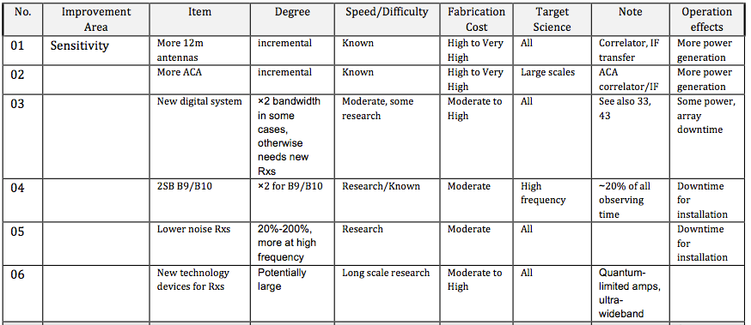
Examples from Matrix

Slide 22
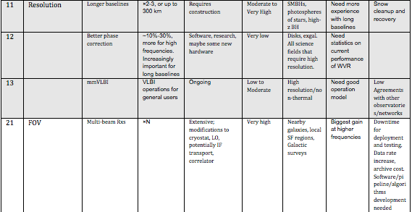

Slide 23
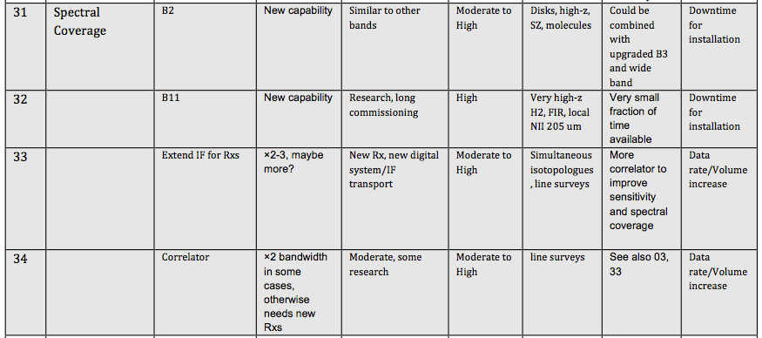

Slide 24
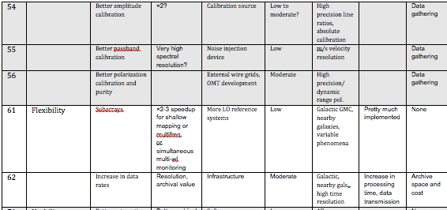

Slide 25
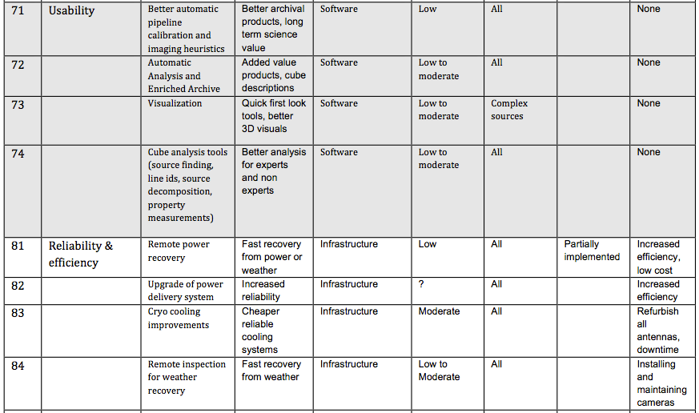

Slide 26
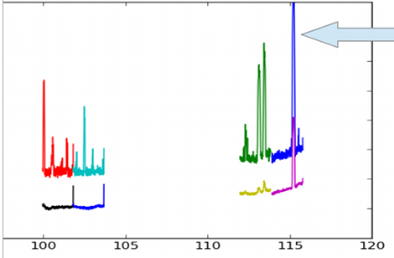
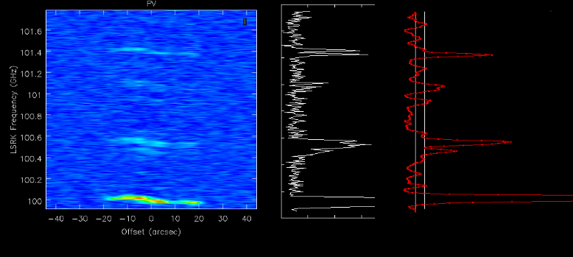
ADMIT Project (PI: Mundy)
The production of rich datasets is in the DNA of ALMA. The keys to unleashing the full power of ALMA for science are:
providing easy, organized, immediate access to the science data in the cubes
providing tools for discovering and mining science from the data
providing efficient access to the science in archival data to empower data reuse
The ADMIT Project will enable users in the following ways:
Basic Science Data Products: A post-reduction pipeline suite creates a detailed data overview including spectral searching, line identification, moment maps, spectra, overlap integrals, and other images and html tables. These Basic Science Data Products (BSDP) will be served to the user from the ALMA archive.
Compact summary (target < 20 MB) which can be delivered quickly, opened locally to examine and manipulate in advance of getting the full data.
Roadmap to the first-order science content in each project for archive users and community.
Overview of spectral lines in data cube
Two methods for spectral line identification
Notes:
The two figures are from our ALMA Study where we investigated methods for automated identification in data cubes. Line detections will be coupled with Splatalogue to assign species/transition information and velocity information.

Slide 27
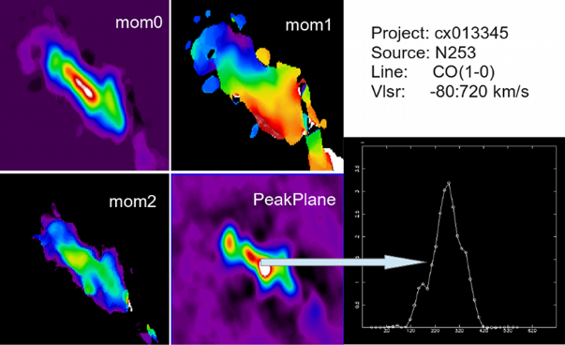
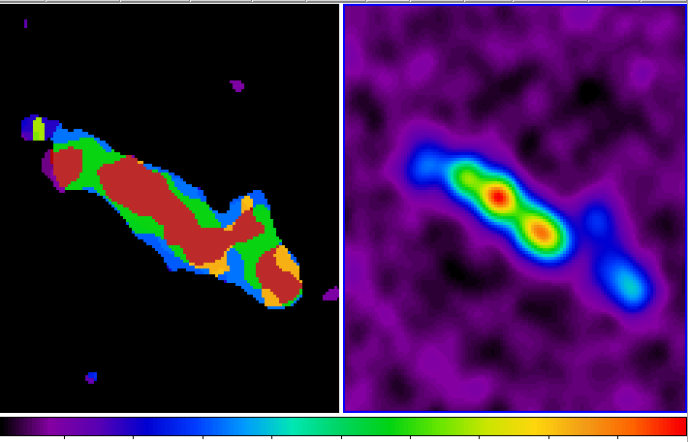
ADMIT
Moment maps for several lines and a spectrum from the peak emission
2. Scripts and Tools for Mining Science Content: A python-based toolkit distributed with CASA for the user to examine, recompute, and expand on the BSDPs. Also provides a platform for more advanced tools. ADMIT is NOT a visualization tool; it is a compute layer which can feed results into CASA viewer and the Next Gen. viewer
Flexible interface for re/computing the common science data products.
New tools for exploring data relationships .
Platform for development of new tools by users.
Design requirement to integrate with CASA and reuse CASA software.
3. Archive Mining: ADMIT provides the structured environment for bringing together archival datasets from multiple projects, analyzing and compare them in uniform ways.
Encourage new science with archival data by allowing user-defined criteria to create a new sample tailored to their science goal.
Encourage ALMA archive group to make our meta-data and science products available to a database query or xml search engine.
Overlap integral (left) where colors represent combinations of coincident line emission; right is moment zero for one line.
Notes:
The image on the middle right is an example from NGC 253 cycle 0 data where we are displaying several of the 50 lines detected in the nuclear regions of the galaxy. The lower right image is an example of an overlap integral for NGC 253. The moment zero map from 8 molecules are combined to make a bit-mask color representation of the emission data (left); the zero moment map for CO J=1-0 is shown on the right for reference. Bolatto Cycle 0 project. Also see recent Bolatto et al Nature paper and cover.

Slide 28
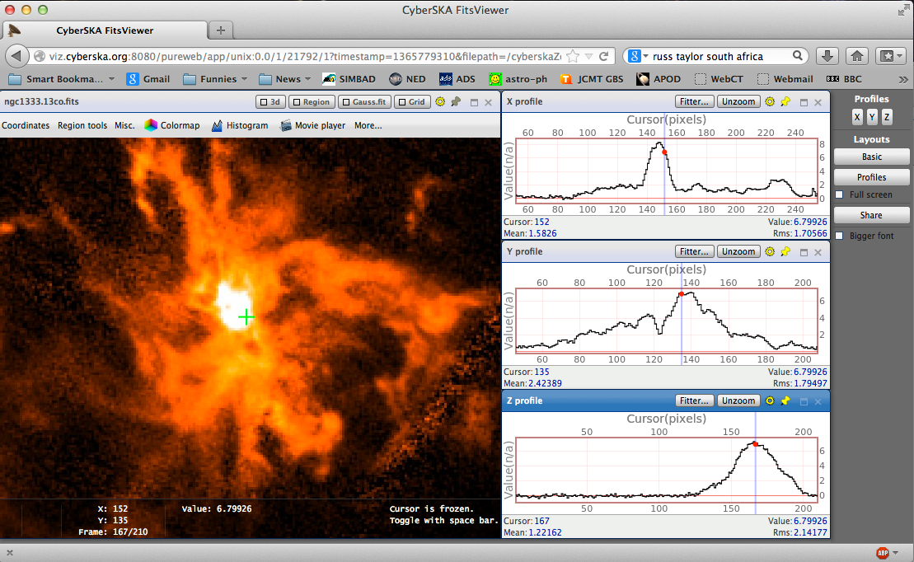
The Next Generation ALMA Viewer
Deliverables:
CASA viewer will hit performance and development limitations with main ALMA operations
Archive exploitation will become bandwidth limited
Current viewer code is isolated from novel community tools
Solutions:
Develop a modular, plug-in architecture for a new viewer application.
Fuses full feature set of CASA viewer with high performance and good UI of CyberSKA viewer.
Big data tractable through web-based vis. server at archive site.
Foster development of community plug-ins
In-browser visualization of data cubes

Slide 29
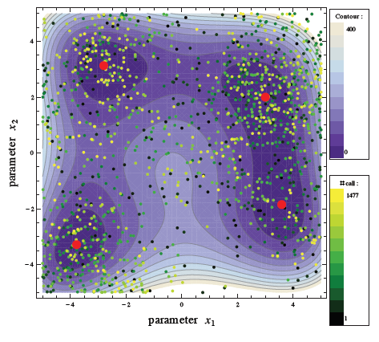
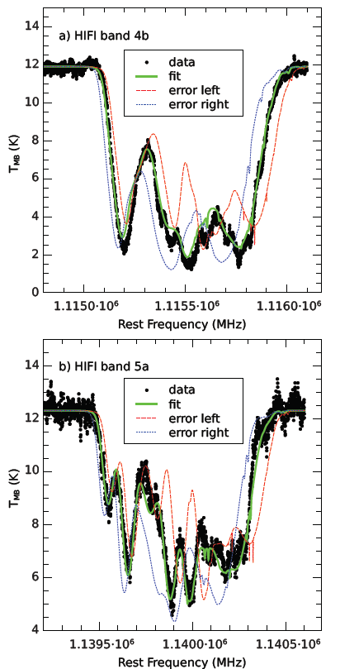
Data Analysis Software
Uni Koeln, Allegro, Niels Bohr Institut
MAGIX optimization
Automatic line identification - enhance archive
possibility to call and “fit” using radiative transfer package (Artist)
Case
Provide comprehensive optimization in CASA (for multiple purposes)
Line ID strongly enhances archive experience
Radiative transfer aids optimized modeling of (relatively simple) sources
(Moeller et al. 2013)

Slide 30
Small Development Projects & Upgrade Studies
NA Development Studies Status
2013 Call ALMA Studies are due to close out in December 2014 with close out reports expected in Q2 of FY2015. Two are granted no-cost extension
Goal: to investigate ways of providing new science consistent with New Horizons, ALMA 2030 vision
Second generation receivers for Bands 6, 10: enhanced spectral grasp, sensitivity
Study of concepts for focal plane receivers: enhanced Field of View
Solar Observing strategies (with Ondrejov/Zagreb): new science area
Community Science Tool Development
New Calibration algorithms, refinements better long baseline imaging
Reports to be issued in ALMA Memo Series

Slide 31
Development Projects
NA Development Projects Status
ALMA Projects continue from First Call (wrapping up) and most recent (2013) Call.
2011 Call
Band 5 LO: Band 5 WCAs have been manufactured, and have passed testing and PAI review. New band, water, [C II] focus
ALMA Phasing Project: All APP hardware is in place and thoroughly tested at the component level. Successfully passed the hardware acceptance review on 12 Dec 2014. Imaging Black Holes
Fiber Optic Connectivity Project: The construction work of the fiber is completed. System end‐to‐end testing was completed successfully. Awaiting a final use permit from SILICA. >Order of magnitude increase in data volume transmission, better reliability
Notes:
A Band 5 Change request has been submitted to allow for integration of the Photo detectors and testing as well as additional WCAs.

Slide 32
APP Project

Slide 33
Development Projects
NA Development Projects
2013 Call
Band 2 Cartridge Prototype:
Meeting at Arcetri March 2014
LNA MMICs contract signed with CRAL, delivery July 2015 expected.
Down-converter designed around existing MMIC mixer, housing fabrication and assembly complete; it is being tested and debugged.
Optics study complete, no dewar mods needed, manufactured CDL.
A prototype OMT fabricated, measured, meets specification.
RAL to deliver ALMA cryostat
Band 3 Magnet / Deflux Heater
L. Knee became Team Leader
Preliminary: installation of the lower-flux magnets improved cartridge stability while higher-flux magnets degraded stability and increased receiver noise temperature
Notes:
Band 2 Cartridge Prototype
We have a contract with CRAL for LNA MMICs. The work agreement was reached and the subrecipent agreement (2-year, $683 K) was signed with Caltech in July 2014. “Tape-out” for first wafer run is now scheduled for March 2015. We have iterated the MMIC schedule with CRAL and they will now deliver Qty. 2 amplifiers based on existing MMIC chips in July 2015 to enable us to build and evaluate the prototype cartridge with MMIC LNAs on schedule. We are sending external drawings of the MIC based LNAs so that CRAL can try to stay close to that envelope.
MIC based LNAs will be used initially for cartridge construction. The housings for those have been manufactured and delivered by CDL workshop. Amplifiers are being assembled/tested.
A room temperature down-converter has been designed around an existing MMIC mixer. The housing fabrication and assembly is complete and it is being tested and debugged.
Various optics design tradeoffs have been studied and the design of the selected optics configuration has been finalized and the horn and optics assembly can be manufactured in the CDL workshop. A modification of existing ALMA dewar (IR filters etc) is not necessary.
The horn design drawings were completed and checked prior to submission for fabrication.
Lens design is in progress and once that is finalized, drawings will have to be prepared.
A prototype of the OMT has been fabricated and measured and it meets specification.
Our plan is to use a standard ALMA Band-6 LO (WCA) for Band-2 (suitable). Parts for that are on order.
Design of vacuum RF feed through selected, parts are being machined in the CDL workshop. They are scheduled to be delivered in January 2015.
Will use a modified Band-6 cold cartridge body (we have a spare on hand), replacement being ordered from RAL.
Preliminary design and layout of cartridge/frame progressed further and waveguide runs were included. The model was reviewed by a Mechanical Designer for obvious issues and is being evaluated for deflections and resonances using the finite element model. Initial results indicate that the resonant frequencies are well above the specification values.
The current “frame” design doesn’t provide for accurate placement of the feed-horn, and we are in the process of determining tolerances based on the 5.5 mrad pointing accuracy requirement and tolerance stackup of the cartridge body, cartridge components as well as the cryostat body that supports the warm lens.
Waiting for RAL to deliver the ALMA cryostat (past due). RAL rebuilt the entire 4K stage but the cartridge 4K stage temperatures were still marginally over 4 K. Further review of test data revealed that the marginal non-compliance was with three cartridge worth of active heat load allocation distributed between all ten stages. We have requested that the test be repeated with the active heat load distributed over three cartridges to see if the non-compliance would still be tolerable. In any case, at this point, it appears that the problem is likely with the cold/head and since we are unlikely to ever populate all ten locations of the cryostat, the static heat load saving would be sufficient to make this cryostat usable as-is. After studying the results of the requested follow up tests, we are most likely to accept this cryostat with a caveat to possibly require an upgrade to the cold head at a later time.
Band 3 Magnet / Deflux Heater
Following the untimely death of Stephane Claude in September 2014, Lewis Knee became Team Leader and Frank Jiang took over as project manager at NRC-Herzberg. Pat Niranjanan and Dominic Garcia provided laboratory support. During 2014, two Band 3 cold cartridges (CCA-66, CCA-53) were outfitted with prototype magnets of different strengths and performance tests were done on antennas at the Array Operations Site. The preliminary conclusion is that the installation of the lower-flux magnets improved cartridge stability while higher-flux magnets degraded stability and increased receiver noise temperature. However, the individual intrinsic behavior of different cartridges makes general conclusions hazardous. Near term, Cold Cartridge CCA-33, which is currently in Victoria for service, will be put through an extensive series of tests. A new 4 K wiring harness will be installed to test the default heater concept. Also, stability tests will be performed with (a) no magnets, (b) lower-flux magnets, and (3) medium-flux magnets, in order to get a properly controlled comparison.

Slide 34
Development Projects
NA ‘13 Development Projects:
Defining Data Analysis Upgrade Paths
ALMA Data Mining Toolkit (ADMIT)
Designs and documents completed
AT for making moment maps utilizing the CASA moment program implemented.
Will work best with imaging of full ALMA data product
Next Generation Image Viewer
Developers hired, implemented scheme allowing python plugins
Implemented image specification derived from numpy
Assembling design and code into basic viewer meeting requirements for architecture (first milestone)
Notes:
ALMA Data Mining Toolkit
First major milestone completed on time. Paperwork demonstrating output from test associated with milestone and ADMIT design document submitted to NRAO as proof of completion. The flow manager design and implementation completed. The flow manager allows sequences of ADMIT Tasks (ATs) to be done in sequence and for the sequence to be repeated. The sequence can be edited. The manager checks a dependency list to decide if particular AT’s need to be re-run when the sequence is run and re-run. The BDP wrappers for file defined. AT for making moment maps utilizing the CASA moment program implemented.
Next Generation Image Viewer
Successfully hired 2 qualified developers, 1 at NRAO and 1 at University of Alberta, and implemented a plugin scheme that allows pure python image processing plugins to be run. Developed and implemented an image specification that is derived from the numpy image specification. Presented a proof-of-concept for a script-driven interface.
Currently assembling the design and preliminary code into a basic viewer that meets the architectural requirements. Making such a viewer is the first milestone. Plans for second major face-to-face development meeting are in place for January culminating in first milestone.

Slide 35
Development Projects
NA ‘13 Development Projects:
Expansion of the ALMA Central LO Article to 5 Sub-arrays: simultaneous multifrequency observations, commissioning array, VLBI subarray
Construction complete
Verification tests under way for all deliverables
Planned installation campaign in Q1-CY2015
Notes:
The project is on schedule: Construction complete. All deliverables are under verification tests. Site staff are already familiar with equipment to be delivered, no additional training required. Site is already aware of planned installation campaign in Q1-CY2015 and are eager to assist.

Slide 36
Development Projects
NA Development Projects Next Call
Current schedule: Call April 2016 for projects beginning FY 2017.
Expect to combine FY2016 plus FY2017 funds to augment funding during the FY 2017 Development Program cycle
Subject to the FY 2015 and 2016 Federal Budget and allocation of funds
Goal: Develop new projects for Development based on previous studies, consistent with ALMA 2030 vision.
Notes:
Our next Call for Project Proposals will be in April 2016 for projects to begin in FY 2017. Approximately $5 M will carry over from 2016 into 2017 and will augment funding projects during the FY 2017 Development Program cycle (subject to the FY 2015 and 2016 Federal Budget and allocation of funds).

Slide 37
Next Steps
Define the science priorities
From the Science Themes document
…and considering the other two docs
Interactions with regional priorities (eg. NWNH, ESO2030)
Link together the development blocks that will be required to reach each of the science priorities
Identify all the items that are required for each
Draw development scenarios
Identify if/where R&D is required
Identify/propose long term priority paths
Use these to guide long term development in the regions

