Slide 1
An Introduction to CASA and Simulations with Simdata
Notes:
Simdata is a tool in CASA for simulating interferometer (and specifically ALMA)
… observations of astronomical sources. The antenna configurations for other telescopes (e.g. SMA)
… are also included with the CASA installation
Simdata is a useful tool for both exploration and justification. It can give you an idea of what ALMA can see in a given situation
… and it can be used to aid your technical justification

Slide 2
General Description
CASA is the post-processing package for ALMA (and EVLA) both interferometric and single dish
The ALMA pipeline is is being built from CASA toolkit
Toolkit packaged into most commonly used tasks for users
Designed with parallelization in mind
CASA in active community use since October 2007
Release 3.2.0 available since May 18 2011
Most recent linux flavors, Mac OSX for Leopard & Snow Leopard
Available to anyone from CASA homepage:
http://casa.nrao.edu

Slide 3
CASA Documentation and Web Resources
http://casaguides.nrao.edu
Casaguides are fully annotated scripts including screen shots
There is also a complete CASA user manual
Currently there are millimeter guides for EVLA, CARMA, and SMA that serve as important learning tools for future ALMA data
CASAguides for ALMA Science Verification data on near horizon

Slide 4
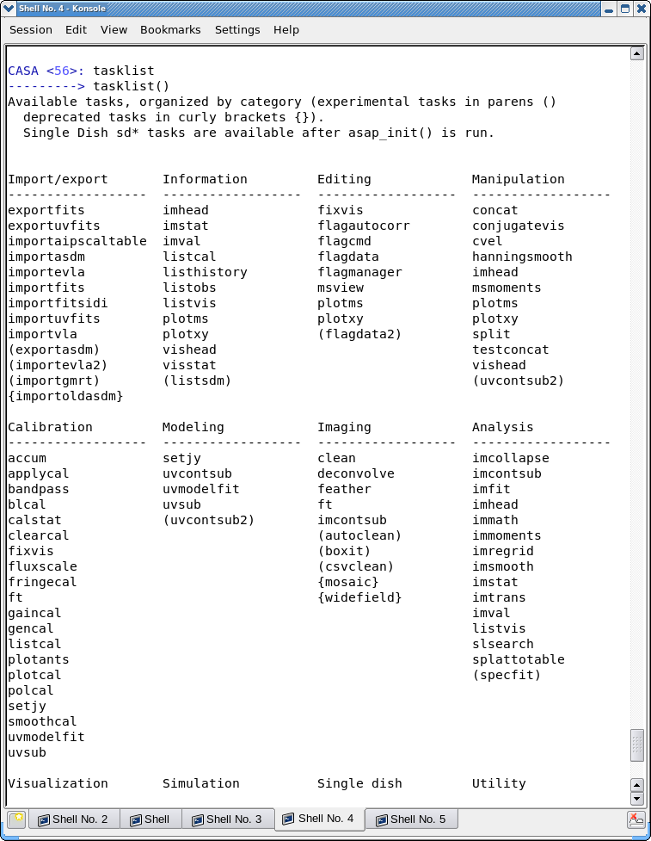
Inside CASA
> Tasklist
Will show an organized list of all currently available tasks
Opportunities for full ALMA related CASA tutorials will be available after the proposal call deadline (June 30)

Slide 5
What is Simdata Good For?
Take a model image and find out how it would look if observed with ALMA
Number of antennas
Antenna configuration
Length of observation
Noise*
Thermal Noise
Phase Noise
Notes:
Observing with an interferometer
… has a few complications above and beyond what you may encounter
… using an optical or single dish radio telescope
These are mostly related to the fact that interferometers
… sparsely sample the Fourier plane
Simdata lets you easily explore how realistic interferometer observations
… would recover a model source
… it incorporates the number and placement of antennas
… length of observation
… and allows you to model the effects of realistic noise
… including both thermal noise and phase noise, due e.g., to the atmosphere

Slide 6
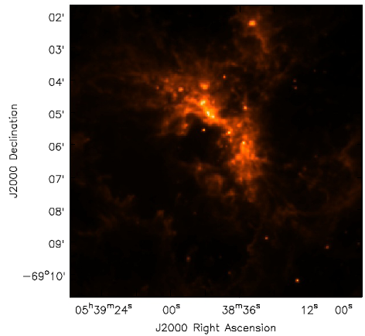
Model Image 30Dor Spitzer IRAC 8um image from SAGE
Field of view
at 230 GHz
Notes:
In this example we’ll step through simulations
… of dust emission from a 30 Doradus-like HII region
Now the real 30 Doradus is super-giant HII region in the Large Magellanic Cloud
… which is enormous on the sky
… it’s very extended compared to ALMA’s primary beam, as you can see here
… with the beam superposed on an image of 8 micron dust emission
… from the SAGE Spitzer Legacy Program

Slide 7
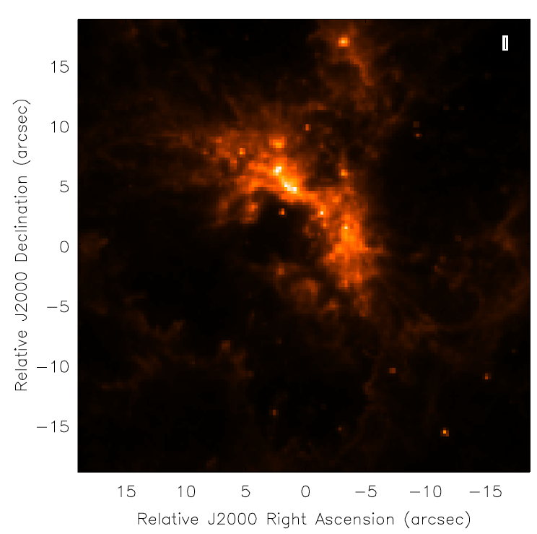
Model Image Resized and now at 230 GHz
Now ~15 times
more distant!
Field of view
at 230 GHz
Notes:
What we’ll do is explore the effects of observing
… a rescaled version of this image
This is the kind of calculation that you might do if you were
… interested in looking at a similar super-giant HII region
… in a more distant galaxy
We’ll effectively move 30 Doradus to about 15 times
… farther away than it is now
… by rescaling the pixels from 3.6 to 0.25 arcseconds
… this places it at about the distance of M33 or M31
The rescaled image fits within the field of view of ALMA at 230 Ghz
This is the kind of calculation you might do
… if you thought the 8 micron image was a good model for the 230 GHz continuum
… and you had a 30 Doradus analog at say 750 kiloparsecs away

Slide 8
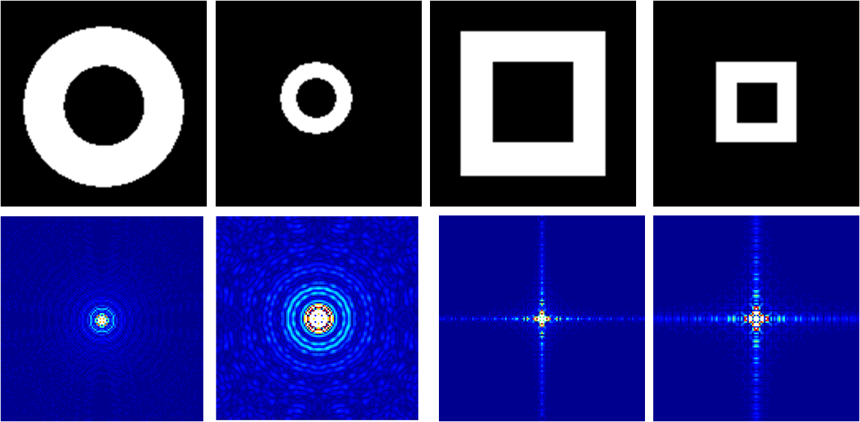
Fourier Transforms of Images
From http://carmilumban-ap186.blogspot.com
Notes:
As you build your experiment with ALMA
… you want to bear in mind that the interferometer
… sparsely samples the Fourier transform of the sky
So you want to think about how your astronomical structures of interest
… map to Fourier space
… and then how the interferometer will sample this structure
... Simdata does this work for you but it’s good to have some intuition
Generally extended structures on the sky
… map to compact structures in Fourier space and vice versa,
… with the most important example being a point source (2D delta function)
… which Fourier transforms into a flat, uniform value
… other examples are shown here
… with the Fourier transform of the top image shown on the bottom panel

Slide 9
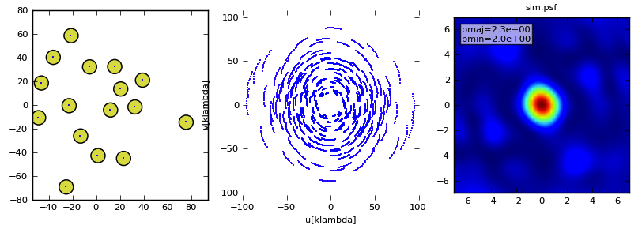
Scales Measured in Compact Early Science
Antenna Placement uv-coverage synthesized beam
Point Spread Function
bmaj = 2.3
bmin = 2.0
2 hour observation in Compact Configuration
Notes:
An interferometer samples only
… part of the Fourier transformed image of your source
… with each antenna pair sampling one Fourier component at each time.
The separation of the antennas
… determines the spatial frequency sampled:
… more separated antenna pairs sample higher spatial frequencies
… and so probe smaller scales
For long-duration observations, the rotation of the Earth helps you by
… causing the projected baseline to rotate and giving you more samples in Fourier space
But even with this, the coverage of the u-v plane isn’t perfect.
… here’s an example for a possible Early Science Compact configuration
You can see the PSF actually has a lot of structure at low levels

Slide 10
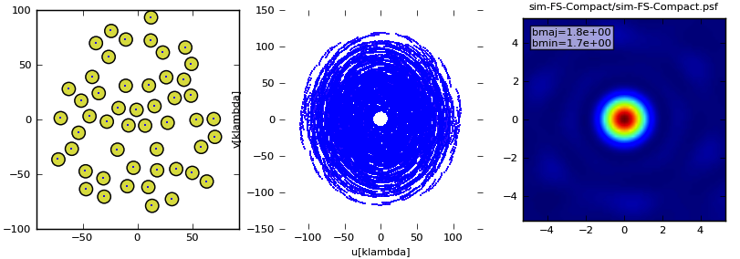
Full Science 12m Array - Compact
Antenna Placement uv-coverage synthesized beam
bmaj = 1.8
bmin = 1.7
2 hour observation
Note lower sidelobes
Notes:
U-V coverage gets much better when ALMA gets more antennas
… here’s an example of the coverage of the full 50-antenna 12m array
… in the most compact configuration (the max u-v range is a little better than the ES case)
… with the corresponding u-v coverage for a 2-hour observation
… and the response to a point source
Note that this point spread function, called the synthesized beam
… is much cleaner with the much larger set of baselines;
A better beam means image fidelity will be better in full science comapared to early science

Slide 11
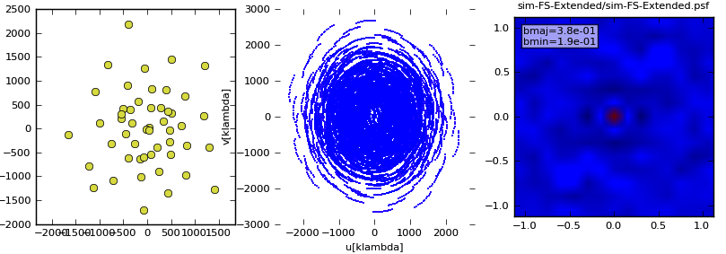
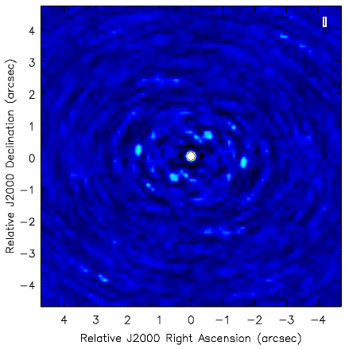
Full Science 12m Array - Extended
Antenna Placement uv-coverage synthesized beam
bmaj = 0.38
bmin = 0.19
2 hour observation
Notes:
But u-v coverage will still be something you need to think about
… with the full ALMA array
For example here is the same set of 50-m antennas
… now placed in a more extended configuration
… thereby providing higher resolution images
Notice that the axes of the u-v plane are a factor of 10 larger than in the previous slide
… and thus sample smaller spatial scales
… resulting in a smaller synthesized beam
… at the cost of sensitivity to smooth, extended structures

Slide 12
Model: Early Science Compact Configuration
Model Image
Convolved Model
“Observed” Image
2 hour observation
Notes:
To make this concrete, we’ll show examples
… of the distant-30-Doradus source
… observed with these different antenna configurations.
This slide shows the early science compact configuration observation

Slide 13
Model: Full Science Main Array - Compact
Model Image
Convolved Model
“Observed” Image
Large scale emission: Observe with ACA and possibly TPA
2 hour observation
Notes:
Here is the same set of images an observations with the full science array
… in its most compact configuration
Note how much better the full array does
… at recovering extended structure and suppressing artifacts
However you can still see this “bowl” surrounding the main structure
… caused because the u-v coverage misses the innermost part of the Fourier plane
This is a shortcoming that you can overcome
… by including the compact array of 7m antennas
… and the 12-m total power antennas.
… But neither array is part of this simulation.
… And neither will be available in Early Science

Slide 14
Model: Full Science Main Array - Extended
Model Image
Convolved Model
“Observed” Image
2 hour observation
Notes:
Here’s the effect of observing with the more extended configuration
… and now you can really see
… that this buys resolution at the expense of extended structure sensitivity

Slide 15
Model: Early Science Compact & Extended
Model
Image
Compact
Array
Extended
Array
2 hour observation
Notes:
Comparing the result of observing with the compact and extended early science configurations, side-by-side

Slide 16
Basic Simdata Workflow
Start CASA
Input image file into Simdata
Predict what ALMA would see using Simdata
Add noise (optional)
Compare ALMA image with input image
Notes:
Simdata is part of CASA
… the “Common Astronomy Software Applications” package
This is a package to reduce radio data – especially interferometric data
… it’s the reduction software for ALMA and the EVLA
… CASA includes a variety of powerful routines that can be accessed
… through a python shell
Here we’ll start CASA, input our source images into Simdata
… run the software to generate a simulated observation
… and then compare the simulated observation to the input model

Slide 17
CASA Basics
To start > casapy
To look at task inputs
> inp clean
Grey: expandable parameters
Red: invalid value
Blue: accepted value but not the default
To see full help > help clean
Reset defaults > default clean
To run > go
Or use script mode - only need to set non-default values: > clean(vis=‘visname’,field=‘2’,mode=‘channel’)

Slide 18
Basic Simdata Inputs
Image of target
Observing time
Antenna configuration
Optional noise parameters
Notes:
Fundamentally what we need here is
… a model image to be observed
… this could be a similar object
… perhaps a nearby analog or a prototype
… that we could move to larger distance
… or maybe a theoretical model of the source
We’ll need to specify details of the observation, too
… the length of time and the configuration of the antennas

Slide 19
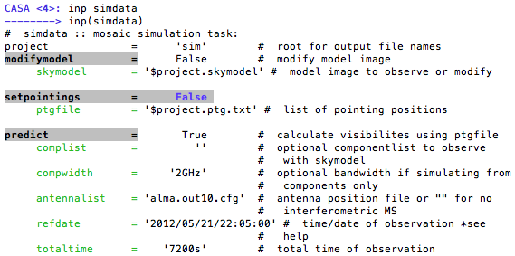
Basic Simdata Inputs
Current values of parameters
Parameters that can be changed
Explanation of what the parameters are
Notes:
Once we start CASA by just typing “casapy” we can access the task interface by typing “inp simdata”
That brings up this list here of input parameters that can be changed.
We see the current values of those parameters and shorthand explanations of what each parameter does

Slide 20
Basic Simdata Inputs
Notes:
The gray bars indicate expandable parameters.
… when you set them to True
… for example by typing “predict = True” at the prompt
… they open a list of extra options.
In yellow here are the things that we’ll set as part of this demo. The rest we’ll leave at their default values
First, we’re going to supply a model (and modify it)
… then we’ll specify antennas positions appropriate for early science
… and pick an integration time

Slide 21
Model Input FITS File Header must include:
Coordinates
Brightness units
Observing frequency
Pixel Scale (angular and spectral)
Polarization (if needed)
OR: Modify FITS image within Simdata
Notes:
The first thing is to specify the model image to be observed with Simdata
… Simdata needs coordinates,
… the flux per pixel in the image,
… the observing frequency,
… the pixel scale and velocity channel spacing,
… and possibly polarization
Your FITS file may perfectly specify all of these things
… and you could indeed prepare your input in another package
… then just feed the FITS file in
… but simdata also gives you the option to modify the input image
This is what we’ll do.

Slide 22
Change your input file: modifymodel
modifymodel = True
skymodel = “30dor.fits”
inbright = ”0.06mJy/pixel”
indirection = "J2000 10h00m00 -40d00m00”
incell = "0.15arcsec”
incenter = "230GHz”
inwidth = '2GHz'
Notes:
So to do this we’ll change modifymodel to true
… and if you rerun inp you’ll see that this opens a whole set of options
Then we’ll set the skymodel parameter to our fits image
… then we’ll modify the brightness, position, scale, and frequency of our target
Note that if you want to get a realistic signal to noise
… you need to work out what you think the brightness of the image should be
For example let’s say we thought the 8 micron emission was a good model
… for the 230 GHz continuum structure – which it probably isn’t
… (8 is probably PAHs while 230 GHz mixes dust and free-free emission)
… then we would need to work out what the expected 230 GHz flux is
… based on the 8 micron emission in the original image
So let’s say we’ve done that
… and now define the peak brightness to 0.1 mJy/pixel
… the direction to the location of our nominal source
… and the cell size to an appropriate value to rescale the image.
… If you have a look at the original header this divides the image scale by 14.4.
… Finally let’s tell simdata that the image at 230 GHz with 2 GHz bandwidth.

Slide 23
setpointings
integration = '600s’
Time average for each data point
Notes:
Next we’ll set the location of the individual fields to be observed
… flipping setpointings to True
… which opens these options
… and then setting the integration time to 600s (initially)
... it’s useful to have this be fairly coarse for any trial simulation
… as a full simulation with realistic integrations like the default 10s
… can be quite time consuming

Slide 24
predict
Total time for the observation
(must be ≥ integration
times the number of pointings)
To use the Early Science Configurations
repodir = os.getenv("CASAPATH").split(' ')[0]
antennalist = repodir+"/data/alma/simmos/alma.cycle0.compact.cfg”
antennalist = repodir+"/data/alma/simmos/alma.cycle0.extended.cfg”
Notes:
The next subheading we’ll take a look at is “predict”
This first entry in yellow is the location of the file that specifies the antenna positions
This lives in different places on different machines
… but these two lines at the bottom should work for most of you running CASA 3.2
If you are running CASA 3.1, you can download the ES configurations from the web. Go to:
… casaguides.nrao.edu → Simulating Observationsin CASA 3.1 → ALMA updates

Slide 25
predict
To use the most compact Full Science Configuration
repodir = os.getenv("CASAPATH").split(' ')[0]
antennalist = repodir+"/data/alma/simmos/alma.out01.cfg”
Notes:
This shows how to specify the most compact array that will be used in Full Science

Slide 26
Simdata Output
analyze = True
showarray = True
showconvolved = True
showdifference = False
showfidelity = False
Notes:
Finally we’ll specify the output that simdata will provide.
Set “analyze” to True
… tell it that we want to show the antenna positions
… and the image convolved with the beam size
Simdata will only plot up to 6 of these 9 possibilities for you at any one time so we set a few values to False
Now we can begin the simdata task by typing “go”!

Slide 27
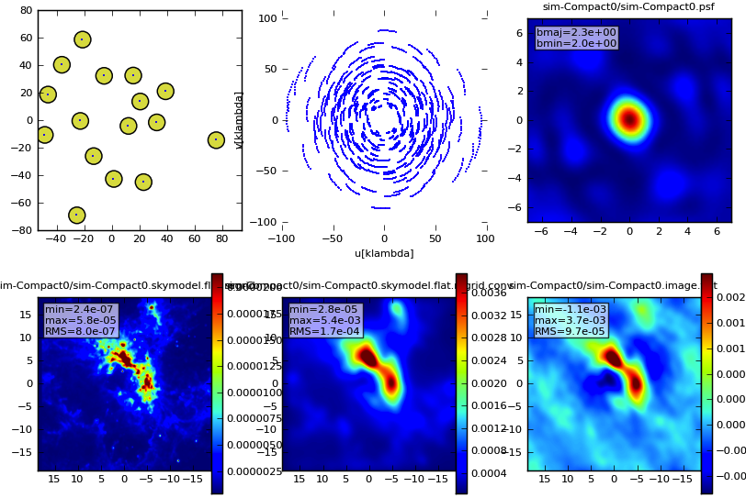
Simdata Output – ES Compact Array
Notes:
And here’s what you should see as it executes
… from left to right
… the antenna positions from our file
… the u-v coverage from the 2 hour (7200 s) observation
… the point spread function
… the input image, gridded to the specified scale
… then convolved with the target resolution
… and finally the image observed by the Early Science array

Slide 28
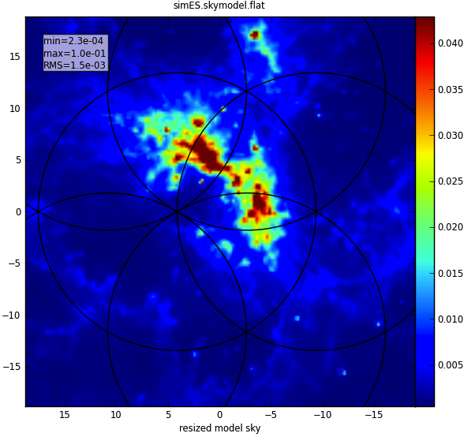
Simdata Output
Note that there are six pointings, and we previously set
integration time to 600 seconds, so this product is less than the
7200 seconds set in totaltime
Notes:
It makes a few graphics files as output.
For example, called something like simES.skymodel.png
… showing the skymodel with the pointings that simdata picked
… these are illustrated by their fields of view as black circles here
… and are also saved in an easily read text file.
Here you see 6 fields arranged in a hexagonal pattern spaced by half the primary beam width

Slide 29
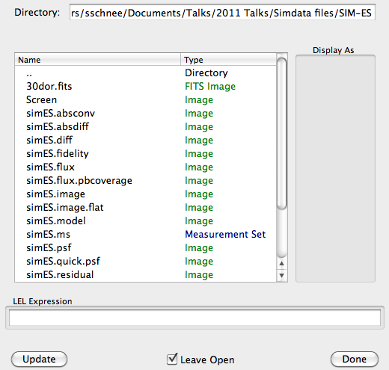
Simdata Output – Viewer
http://casa.nrao.edu/CasaViewerDemo/casaViewerDemo.html
Notes:
Simdata produces data files in addition to these plots, as seen in this list.
CASA has an interactive viewer that we can use to look over these.
See the demo pointed to in the above web link.

Slide 30
Other Simdata Options Thermal Noise
thermalnoise = ‘tsys-atm’
vis=‘$project.noisy.ms’
Notes:
So what we’ve done so far
… is to simulate what ALMA would see with limited UV sampling
But one of simdata’s most useful applications is actually
… to corrupt the image even more
… by adding thermal and atmospheric noise
Here we turn this on by setting thermalnoise to ‘tsys-atm’
… which will use the the atmospheric model in simdata
… to estimate the system temperature
… given the specified precipitable water vapor
To image this corrupted data we set vis under image to this value

Slide 31
Other Simdata Options Thermal Noise
Sky Model
No Thermal Noise
Thermal Noise
Notes:
So here’s what happens with thermal noise added
… the model on the left
… simulated without noise in the middle
… and then with noise on the right
Now of course this depended on the flux we set in modifymodel
… so to get the most out of the simulation
… you really need to work out a realistic flux

Slide 32
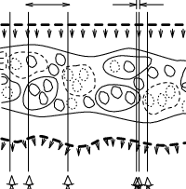
Atmospheric phase fluctuations
Variations in the amount of precipitable water vapor (PWV) cause phase fluctuations and result in
Low coherence (loss of sensitivity)
Radio “seeing”, typically 1″ at 1 mm
Anomalous pointing offsets
Anomalous delay offsets
Patches of air with different water vapor content (and hence index of refraction) affect the incoming wave front differently.
Notes:
Simdata also has some lower level capabilities
… including the ability to add atmospheric phase noise
… that will further corrupt your data beyond the effects of thermal noise
Phase noise tends to be worse for longer baselines
… because close antenna pairs will usually sample similar atmosphere

Slide 33
Other Simdata Options Phase Noise
Sky Model
No Phase Noise
Phase Noise
Notes:
Here’s an example of adding phase (but not thermal) noise to our image
… you can see the decrease in sensitivity as the phase noise smears out the structure

Slide 34
Other Simdata Options Phase Noise
Start with the visibilities (measurement set) created by simdata
Use the “toolkit” to add phase noise
http://casa.nrao.edu/docs/CasaRef/CasaRef.html
http://casaguides.nrao.edu/index.php?title=Corrupt
sm.openfromms("simPN.ms")
sm.settrop(mode='screen',pwv=1.0,deltapwv=0.15)
sm.corrupt()
sm.done()
Use clean (in CASA) to make the image
Notes:
So to get simdata to add phase noise we need to look under the hood a bit
… and take advantage of CASA’s toolkit
… which are utilities that contain the core functionality – you can read about them here
To do this, we’ll build the simulated data set
… here this is called “simPN.ms”
We then open it with the simulator tool
… and use these settrop and corrupt commands to corrupt the data.
… then close it and image it using CASA’s imaging tools, which are wrapped up in the CLEAN task.

Slide 35
Your Turn
Find a fits file of an object you want to image
Use simdata to see how it would look if observed with ALMA
Rescale image if necessary
Try different antenna configurations
Add noise if interested
Don’t be afraid to ask for help!
Notes:
Now we begin the hands-on part of the tutorial.
Grab a FITS file of an interesting object and use Simdata to simulate how ALMA would see it
You can think a bit about how you might rescale the image to test
… a particular science goal
… try out different antenna configurations – maybe see if you need the full ALMA
… and try adding noise

Slide 36
Your Turn
Sample images can be found at:
http://casaguides.nrao.edu/index.php?title=Sim_Inputs
Simdata walk-throughs available at:
http://casaguides.nrao.edu
Simulating observations in CASA 3.2

Slide 37
Extra Slides

Slide 38
Simdata output images
Most important images are:
$project.image – output simulated cube/plane
$project.image.flat – moment 0 of simulated cube/plane
$project.skymodel – input cube/plane
$project.psf – synthesized beam (point spread function)
$project.residual – residuals after cleaning

Slide 39
Simdata hands-on quickstart
Start CASA and look at simdata
casapy, inp simdata, help simdata
Go through simdata tutorial
http://casaguides.nrao.edu
Get image for your own simulation
http://casaguides.nrao.edu/index.php?title=Sim_Inputs

Slide 40
Simdata FAQ
Find the antenna configuration files
repodir = os.getenv("CASAPATH").split(' ')[0]
antennalist = repodir+"/data/alma/simmos/alma.cycle0.compact.cfg”
Problems with FITS file?
modifymodel = True
Set all parameters manually
“image detached” error message?
image = True
analyze = True

Slide 41
Simdata FAQ
Simulation running too long?
Increase value of “integration”
Decrease number of required pointings
Clean for fewer iterations
Can’t see effect of added thermal noise?
thermalnoise = ‘tsys-atm’
vis = ‘$project.noisy.ms’
Check brightness of input image vs expected noise

