Slide 2
Preparing for ALMA
http://science.nrao.edu/alma
National Radio Astronomy Observatory
North America ALMA Science Center
Charlottesville, Virginia U.S.

Slide 3
ALMA from the Users’ Perspective
Kelsey Johnson
University of Virginia / NRAO

Slide 4
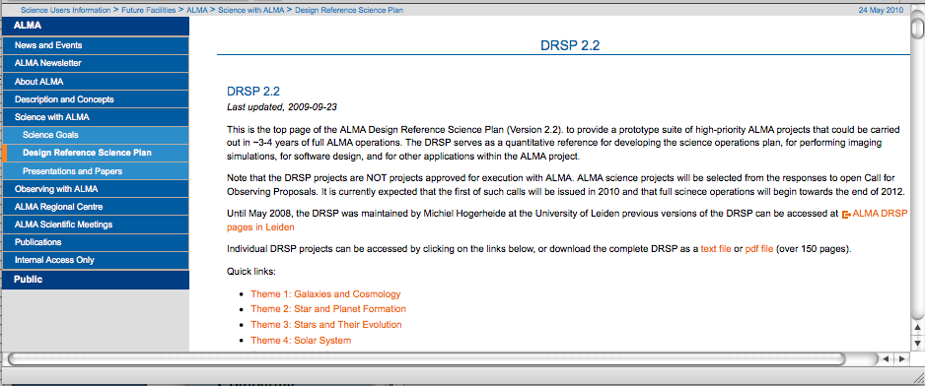
Step 1: Thinking of Proposing
Check out “Design Reference Science Plans” (DRSPs)
Think outside the box
Play with the ALMA tools!
Preparing for ALMA: 24 May 2010
4
Notes:
Panel 1: UV coverage snapshot
Panel 2: dirty beam
Panel 3: Input model, full res (Sebastian Wolf simultion of PP disk)
Panel 4: Output (clean image)
Panel 5: Different between input and output
Panel 6: Fidelity

Slide 5
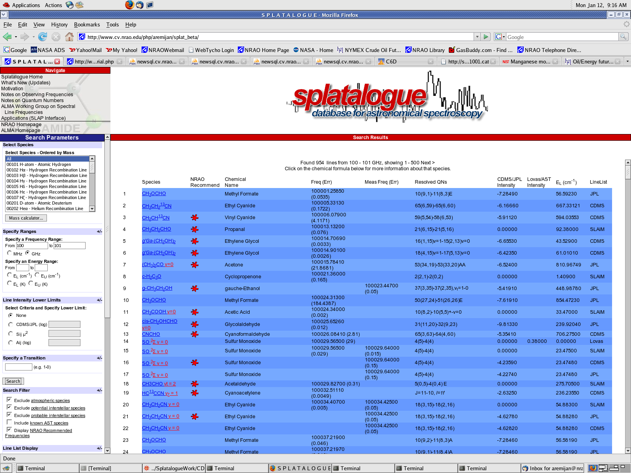
Step 1: Thinking of Proposing
⇒ tools to help refine your ideas: Splatalogue
Determine which species and transitions are the best diagnostics for your sciences
Look up line strengths & frequencies
Think about best band(s)
What other cool lines are there?
Preparing for ALMA: 24 May 2010
5

Slide 6
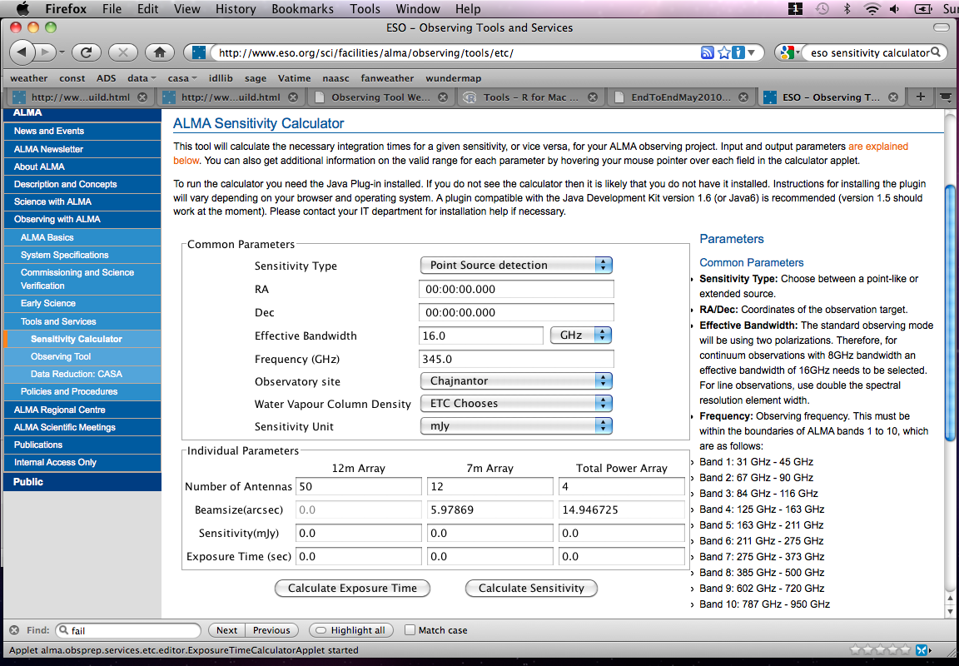
Step 1: Thinking of Proposing
⇒ tools to help refine your ideas: Sensitivity Calculator
Estimate observing time
Customize # of antennas
Vary conditions
Preparing for ALMA: 24 May 2010
6

Slide 7
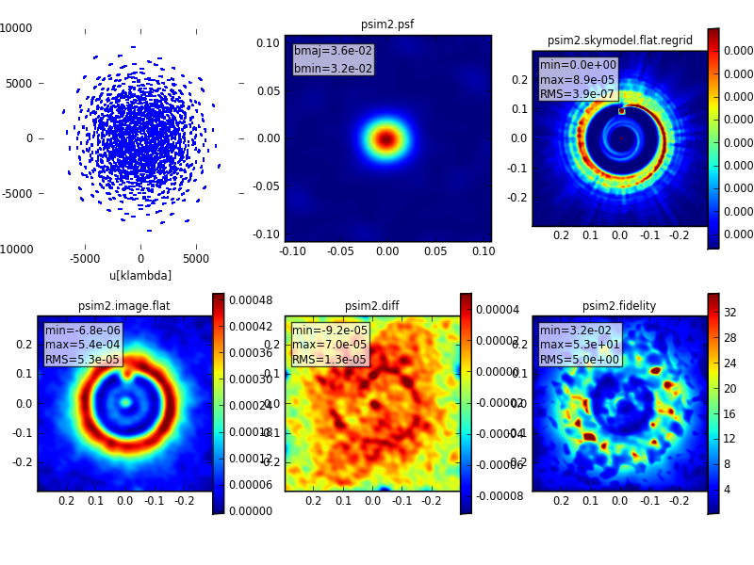
Step 1: Thinking of Proposing
⇒ tools to help refine your ideas: Simulator
Calculate visibilities
Calculate total power observation
Add noise
Re-image the data
Analyze the difference between output and input images
Notes:
Panel 1: UV coverage snapshot
Panel 2: dirty beam
Panel 3: Input model, full res (Sebastian Wolf simultion of PP disk)
Panel 4: Output (clean image)
Panel 5: Different between input and output
Panel 6: Fidelity

Slide 8
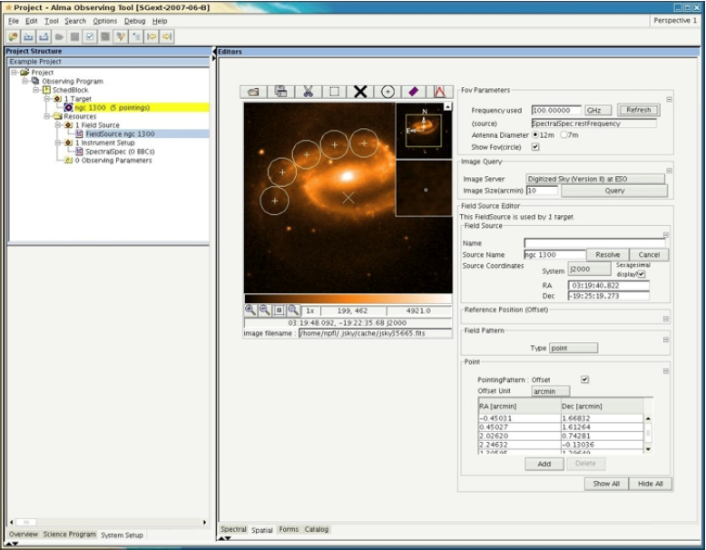
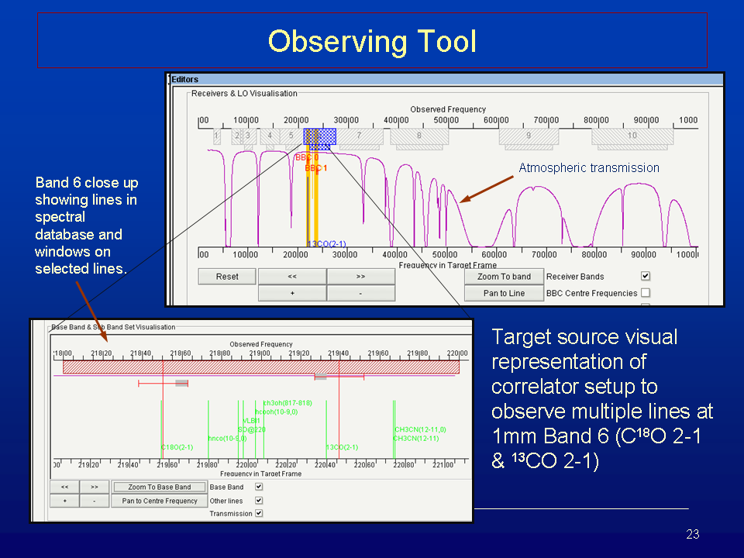
Step 2: Proposal Preparation:
⇒The Observing Tool (OT)
Visualize pointings
See fields-of-view
Determine spectra set-up
Generate schedule blocks
Standard proposal functions

Slide 9
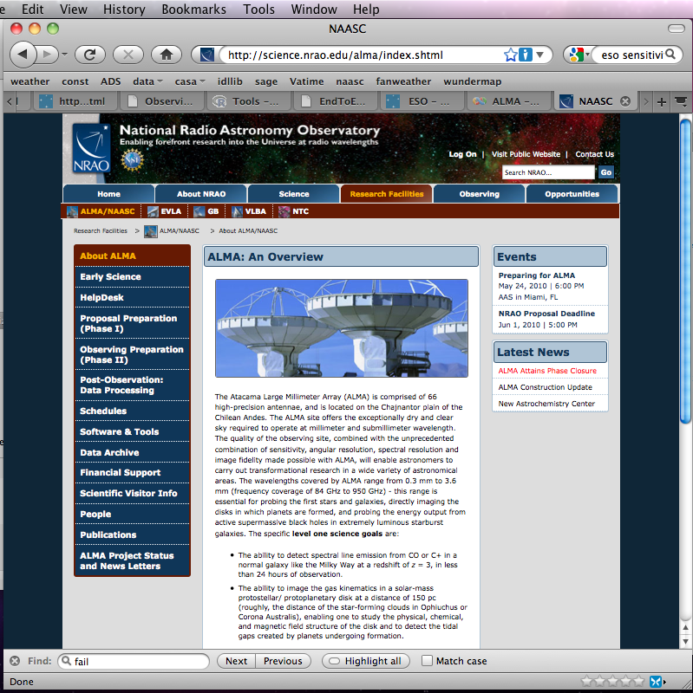
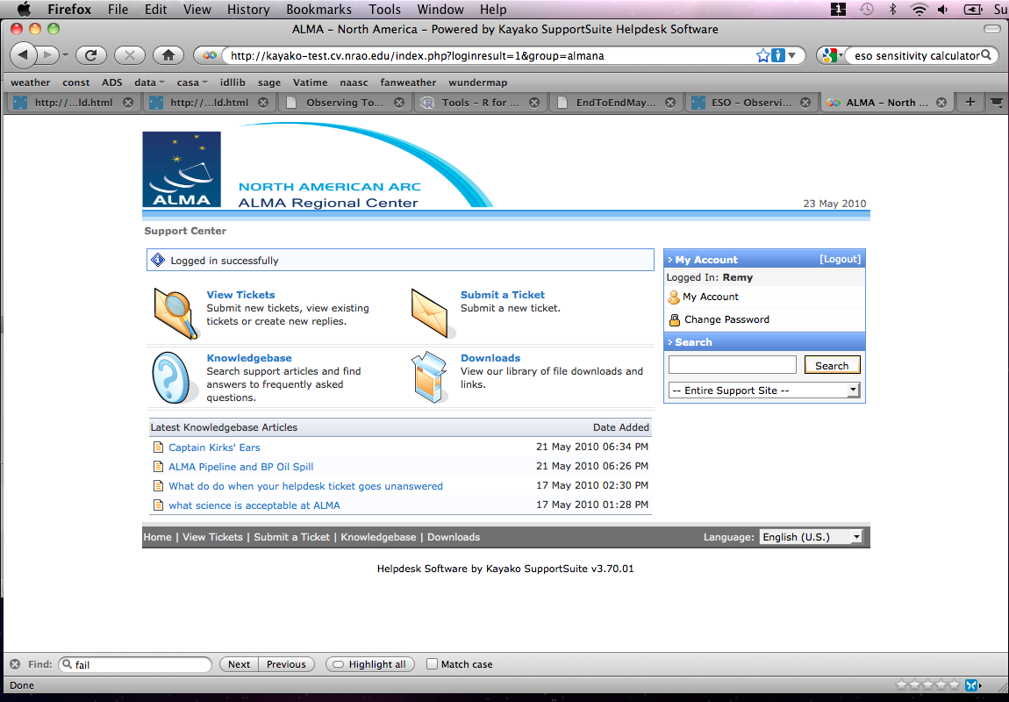
Step 2: Proposal Preparation
Info & FAQs on helpdesk portal
Support from NAASC staff
Preparing for ALMA: 24 May 2010
9

Slide 10
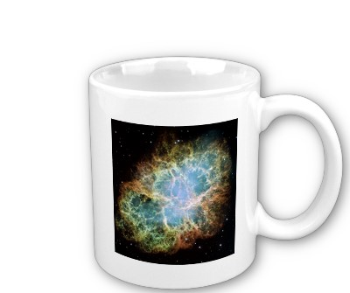
Step 3: Proposal Review
International TAC
(North America, East Asia, Europe; Chile TBD)
Face-to-face meetings
Twice per year (at least initially)
Proposals ranked, then merged
programs drained from queue w.r.t. weather, R.A., etc
Some DD time
~ 5%
“Open Skies” time distributed up to 5%
Phase 1 & Phase 2
Preparing for ALMA: 24 May 2010
10

Slide 11
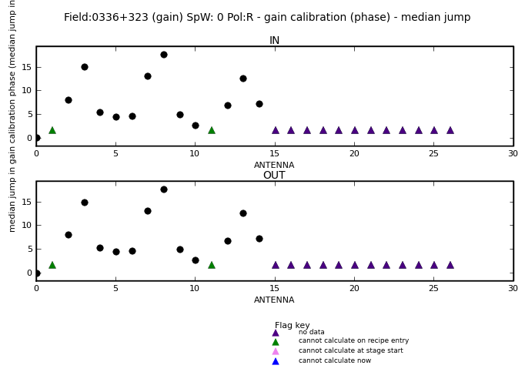
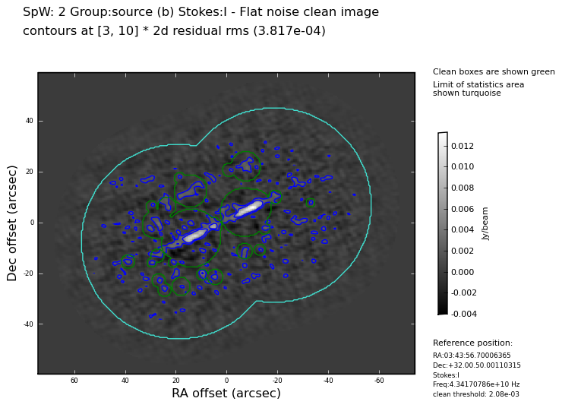
Step 4: Download “pipeline” data from the archive
Default flagging
Basic calibration
Cleaned image
diagnostics
Preparing for ALMA: 24 May 2010
11

Slide 12
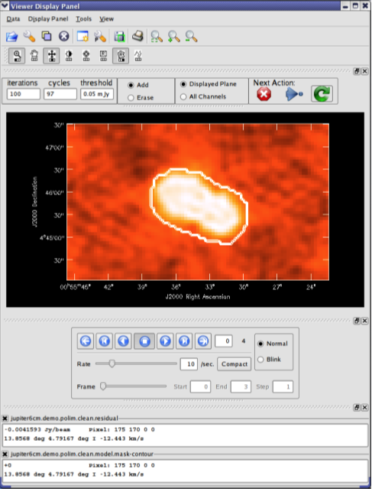
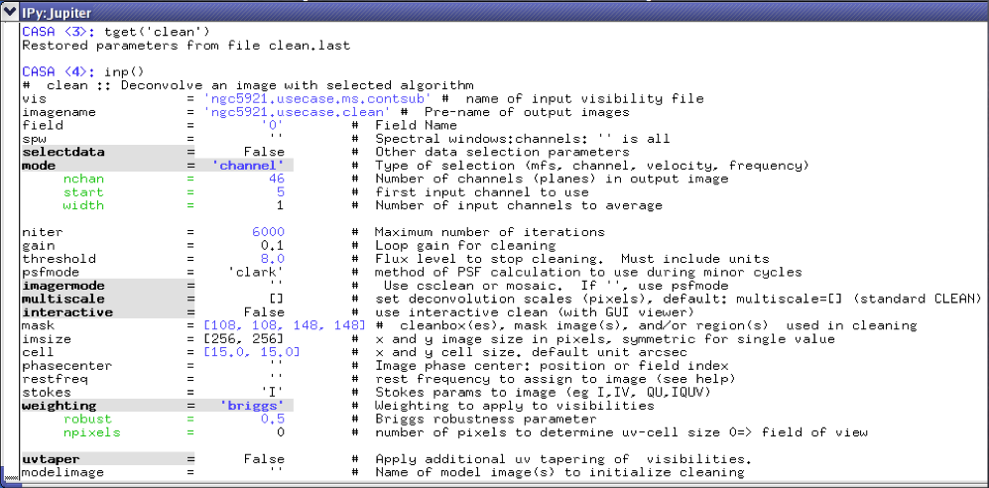
Step 5: Analyze data - CASA
Visualize data cubes
Overlay multi-wavelength data
Measure flux densities
Fit sources
Generate publication images
Preparing for ALMA: 24 May 2010
12

Slide 13
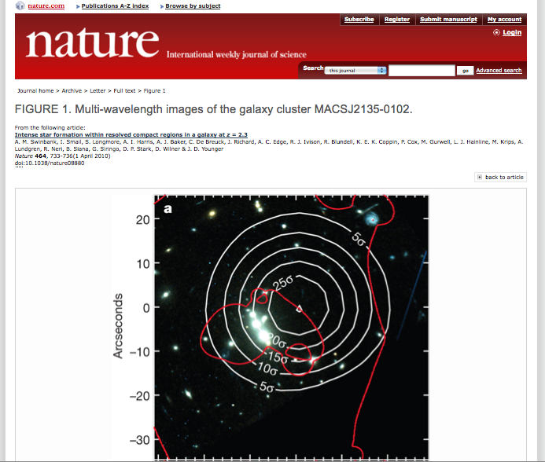
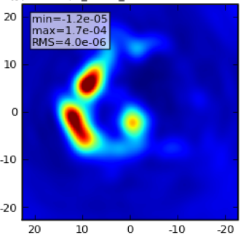
Step 6: Write cutting edge paper!
Cutting edge capabilities
= amazing science
best ideas yet to come
FIGURE 1. Multi-wavelength images of the coolest thing since sliced-bread
Universe’s most fascinating object revealed by ALMA
I.M. Famous, B. A. Collaborator, O. Postdoc, et al.
Nature 123, 456-458, April 2012
Preparing for ALMA: 24 May 2010
13

Slide 14
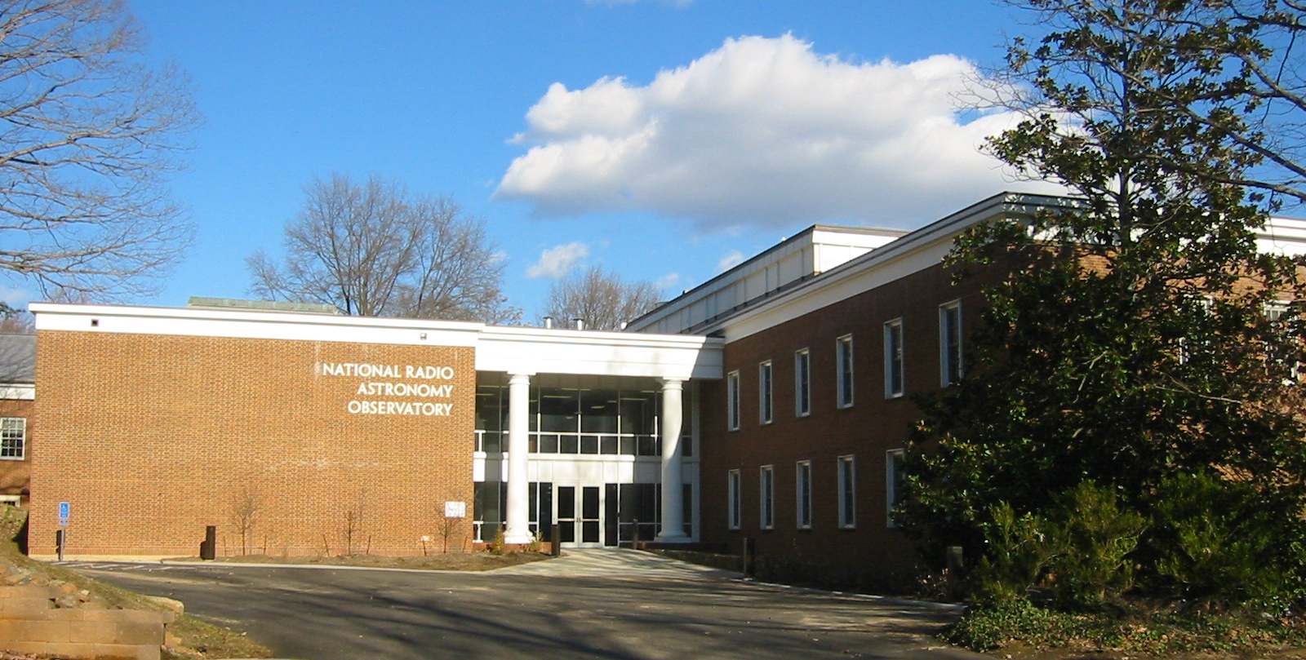
Take home points
This is your observatory
NAASC is here to help you
To get started:
-- NAASC tutorials
-- On-line tutorials
-- Science workshops
Call for proposals end of 2010
Be EXCITED!
Preparing for ALMA: 24 May 2010
14

Slide 15
PREPARING FOR ALMA
http://science.nrao.edu/alma
National Radio Astronomy Observatory
North America ALMA Science Center
Charlottesville, Virginia U.S.

