Slide 2
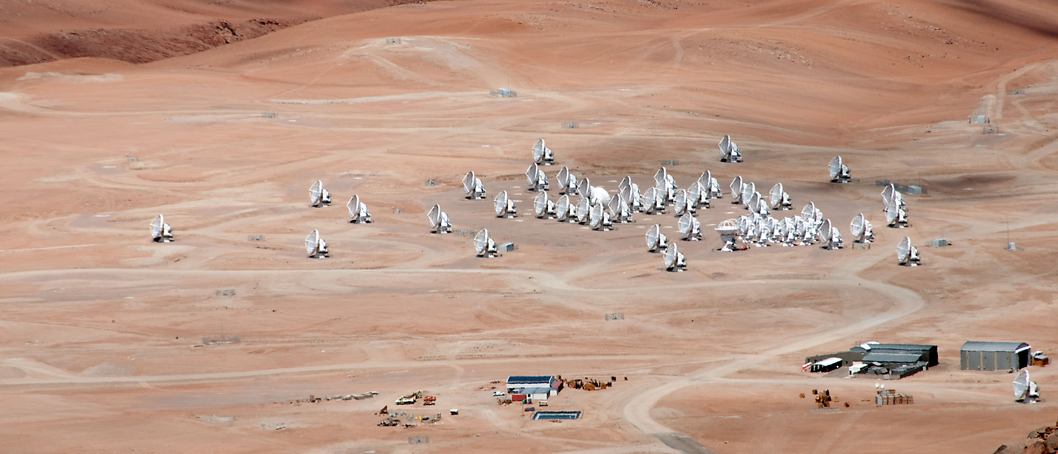
ALMA in the Coming Decade: NA Overview
NA Program Overview April 18, 2013
Al Wootten
ALMA seen from the peak of Chajnantor in March 2013 (courtesy M. Lindqvist, Onsala Space Observatory)
NA ALMA Program Scientist

Slide 3
Organization of Presentation
Science Drivers for ALMA in the Coming Decade
Current ALMA Development Studies Program NA
Current ALMA Development Projects NA
NA Plan Forward
EU ALMA Development Studies and Projects
EA ALMA Development Studies and Projects

Slide 4

NA ALMA Science Priorities
Sources of science priorities for ALMA, NA development focus:
  ASAC,ANASAC general categorization (2008-2010)
    Performance improvements judged according to science criticality, degree of improvement, technical readiness and speed, cost for the development
    For hardware, completing/upgrading bands figured prominently
    Phasing project to provide VLB resolution
    For software, improvements in imaging and usability rank highly
  Actual NA development study proposals received, reviewed and implemented (2012)
    62% involve NA millimeter community partners
    Science talks, 1st ALMA Development Workshop NA (Mar 2011)
      (https://science.nrao.edu/facilities/alma/alma2011/program)
    Studies of Bands 1, 2 and STHz received
    Upgrades for B6, B3
    Software: Datarate increase, improved visualizations, VLB software
Community science priorities: AS2010, particularly RMS panel recs
  The panel recommends a sustained and substantial program to enhance the NRAO telescope and ALMA capabilities, amounting to $90 million for NRAO and $30 million for the U.S. share for ALMA over the decade.
Notes:
Add slide on B6 upgrade science, B2 science, B1, STHz, visualization and datarate. Also VLBI.

Slide 5
Summary NWNH/RMS needed Capabilities
Fast mm/submm Surveys (and fast cm surveys)
Efficient high resolution imaging at cm/mm wavelengths
Ultra-high resolution
Complete wavelength coverage
Very sensitive cm wavelength coverage
Solar imaging capabilities

Slide 6

ASAC Development matrix (Mar 2010)
Orange: NA Development study targeting this received
Green, Blue: NA, EU (may be out of date)

Slide 7
NA Development Studies
First NA Call November 2011
  21 submissions were received involving 77 investigators from 26 institutions
  Reviewed by external panel with representatives of NA partners
  Eight highest ranked Study Proposals funded with available funds
  Studies now in final months
Primary aims of these studies are to:
  give groups in North America the opportunity to propose ALMA upgrades that may later be implemented as part of the ALMA Development Plan;
  support the development of conceptual and detailed designs for ALMA upgrades; and
  encourage relevant long-term research and development in areas important for ALMA.

Slide 8
NA ALMA Development Studies
Study | PI | Lead Institution | Collaborating Institution | Funding
2nd generation Receiver for Band 6 | Kerr | NRAO | U. Virginia | $84.045
Design Study Band 2 Cartridges | E. Bryerton | NRAO | U. Arizona | 98,119
Ultra-wideband Quantum Limited Amplifiers | D. Woody | CalTech |  | 92,498
Unleashing Large Dataset Science | L. Mundy | U. Maryland | U. Illinois | 34,320
A Visualization Portal for ALMA Data | E. Rosolowsky | U. British Columbia | U. Calgary | 73,438
ALMA Band 1 Receiver Development | P. Ho | ASIAA | HIA, U. Chile, NRAO | 100,000
Mm/submm VLBI with ALMA | J. Kern | NRAO | MIT, Haystack | 0
Increase the ALMA Data Rate | B. Glendenning | NRAO |  | 0
Notes:
62% of total Studies funding allocated to collaborating institutions

Slide 9
ALMA Band 1 (Ho)
Downselect meeting: 33-52 GHz
Key drivers:
  evolution of grains in protoplanetary disks (PSF Q2: What is the nature of the planet-forming environment?)
  Highly redshifted galaxies (GCT Q2, Q4: How do baryons cycle in and out of galaxies and what do they do while they are there? Q4: What are the first objects to light up the universe and when did they do it?)
Secondary Drivers
  Distant galaxies, and galaxy clusters (i.e., the Sunyaev-Zel'dovich Effect; reshifted molecules), very small dust grains in the ISM, pulsar wind nebulae, radio supernovae, X-ray binaries, the Galactic Center (i.e., Sgr A*), dense cloud cores, complex carbon-chain molecules, masers, magnetic fields in the dense ISM, jets and outflows from young stars
Complement to VLA, which has larger effective area over most of the band
  S. Hemisphere
  Broader beam, better sensitivity to extended structures.
Notes:
Find Brian Mason paper.

Slide 10
ALMA Band 2 (67-90 GHz) (Bryerton)
For continuum, science goals are similar to those for Band 1
No interferometric capability currently exists in most of this band anywhere. The fundamental, J = 1→ 0 transitions of the deuterium analogs of common, abundant interstellar molecules are unique to this band, including DCO+, DCN, and N₂D⁺. Studies of such species are crucial to our understanding of the evolution of cores in molecular clouds, and hence to star formation.
  Molecular spectroscopy of complex organic molecules and pre-biotic molecules in the ISM and comets: key for studying the conditions from which life eventually forms. (NWNH: Frontiers of Knowledge: The Chemistry of the Universe and the Origin of Life
  Evolution of grains in protoplanetary disks (PSF Q2: What is the nature of the planet-forming environment?)
    Cold gas in circumstellar disks: Where is the snow line?
  Redshifted CO, HCN at intermediate redshifts, where strong evolution occurs (GCT Q2, Q4: How do baryons cycle in and out of galaxies and what do they do while they are there? Q4: What are the first objects to light up the universe and when did they do it?)
Workshop planned for end of May (Eu), June (NA) to define science case.
Notes:
1. Frontiers of Knowledge: The Chemistry of the Universe and the Origin of Life –
Molecular spectroscopy of complex organic molecules and pre-biotic molecules in the ISM and
comets are key for studying the conditions from which life eventually forms.
2. Origins: The Context of Star Formation – Studies of the structure and physical properties
of cold cloud cores from which stars form will be revolutionized with molecular spectroscopy of
the deuterium species and other important species within the band.
3. Understanding the Cosmic Order: Galaxies Across Cosmic Time – The 4mm band would
permit the studies of CO(1→0) and HCN(1→0) at intermediate redshifts where there is strong
evolution of galaxies.

Slide 11
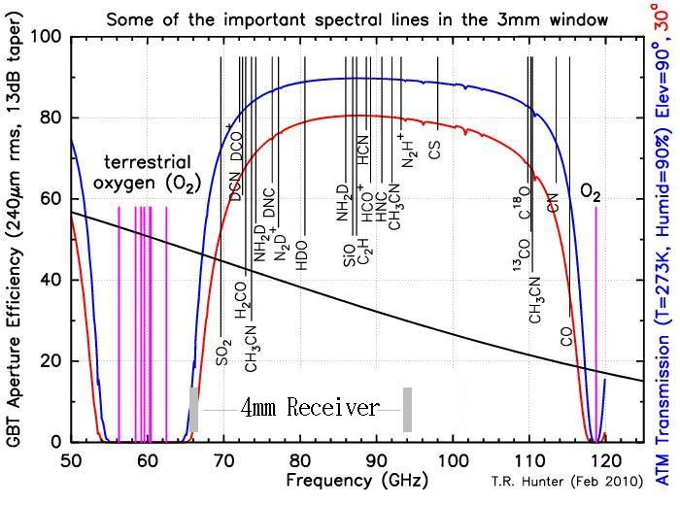
ALMA Band 2

Slide 12
Development of ultra‐wideband quantum limited amplifiers for mm/submm receiver frontends: Woody
New paramp design for ALMA band 3, 84-116 GHz Design & Simulation
  Current work on the paramp in the 9-14 GHz range yields noise temperatures <3.4 photons corresponding to <16 K single sideband at 100 GHz, a factor of two smaller than the current band 3 specification.
  Possibly could cover Band 2 & 3 in same device
Instrumental gains
  Sensitivity
  Calibration targets weaker, closer to source
  Increase in simultaneous bandwidth to >40 GHz
    More spectral lines
    Potential for continuum sensitivity increase
Enabled science
  SZ in galaxy clusters (increased sensitivity)
  Star formation in the Milky Way (access to many lines)
  Survey of Molecular Gas and Dust in Submillimeter Galaxies (large band=> large z coverage)
  Molecular Absorption lines at high redshifts

Slide 13
ALMA Band 6 Upgrade (Kerr)
Range 211-275 GHz designed ~10 years ago
Production pressures on as-built B6 resulted in elevated receiver noise temperature when the receiver is tuned for simultaneous observation of a group of molecules in the range 219-231 GHz; these include the important ¹²CO and ¹³CO lines. Current IF: 5.5 GHz cannot cover both in broad-lined sources simultaneously.
Could now build balanced sideband-separating mixers
  Cover entire 4-12 GHz IF, more uniform response
  Will reject LO sideband noise
  AlN junctions for higher critical current density to improve receiver noise at edges of band, thereby reducing system noise temperature up to 45% in best
Notes:
AlN junctions for higher critical current density to improve receiver noise at edges of band, thereby reducing system noise temperature up to 45% in best conditions

Slide 14
Mm/submm VLB with ALMA: Software (Kern)
Software to enable new observing mode with ALMA
CASA provides no data reduction support for VLB
  Needs include support for mixed polarization bases
  Advanced fringe fitting
  Features being developed at Haystack within Haystack Observatory Postprocessing System
Deliverables
  List of CASA functionalities needed to provide VLB support
  Detailed Development Plan
  Collaborative development model

Slide 15
Visualization: Software
Unleashing the Science in Large ALMA Datasets (Mundy) Develop the software infrastructure and tools to enable science-driven mining and visualization of sets of large image cubes. The overall goal is to give scientists the tools to derive science from large ALMA data cubes in an intuitive way.
  Deliverables from this study will be a series of memos on the methodologies, evaluations and outcomes in the technical areas
A Visualization Portal for ALMA Data (Rosolowsky) Develop a visualization portal on the web that will be the hub of data exploration for ALMA.
  Deliverables include: Portal with collaborative tools; distributed data management, user & group access management, metadata access for MS and FITS; search capability; Plane-based visualization tool for all ALMA image data formats (CASA and FITS), including profiles along all axes, and multi-party access.
  See CYBERSKA

Slide 16
Improving the Data Rate: Software (Glendenning)
At the beginning of operations, the construction project will deliver to the observatory a system which on average is delivering just over 1% of the capabilities of the correlator, and even the peak data rate will only be 12% of the correlator capability.
NAASC Memo 110: a straightforward extrapolation from the accepted Cycle 0 proposals would require a factor of three increase in the average data rate.
Deliverables:
  Sample science cases that would be enabled by high data-rate observing
  A baseline data rate evolution scenario for both the average and peak data rates.
  One or more scenarios to significantly advance the data rate faster than baseline within the Operations funding line
  Describe the technical impacts and strategy in the following areas: Management, LAN upgrades, wide area network upgrades, data processing needs, archiving needs, CASA/pipelining needs, impact on ACS and other systems

Slide 17
ALMA Development Projects NA
Band 5 LO (see science case for B5, one of the bands dropped in March 2000, after subsequent ASAC ranking of band importance)
ALMA Phasing Project: Beamforming ALMA for VLBI
and pulsar observations
  Primary motivation is extremely high resolution imaging of AGN, especially Sgr A* and M87
  Science case for more general VLB phasing in draft
  Not a part of construction since Feb 2004 System Review
Landline internet connection to the Chilean backbone (increased reliability and throughput from site to SCO and beyond).

Slide 18
ALMA Development Projects
Project | PI | Lead Institution | Collaborating Institutions(s) | Value
Band 5 Local Oscillator Production | E. Bryerton | NRAO | ESO, SRON, GARD (CCAs) | $3,328,718.
Fiber Optic Connectivity | J. Ibsen | JAO | Contractor | $1,854,002
ALMA Phasing Project (APP) | S. Doeleman | MIT, Haystack | NRAO, MPIfR, NAOJ, ASIAA, Onsala, U. Concepcion | $516,800*
APP Implementation | S. Doeleman | MIT, Haystack | JAO | $400,000
*ALMA Development Funds Only; an additional $4M provided by NSF/MRI;
Implementation costs excluded.
62% of total Studies funding allocated to collaborating institutions
45% of total Project funding allocated to collaborating institutions

Slide 19
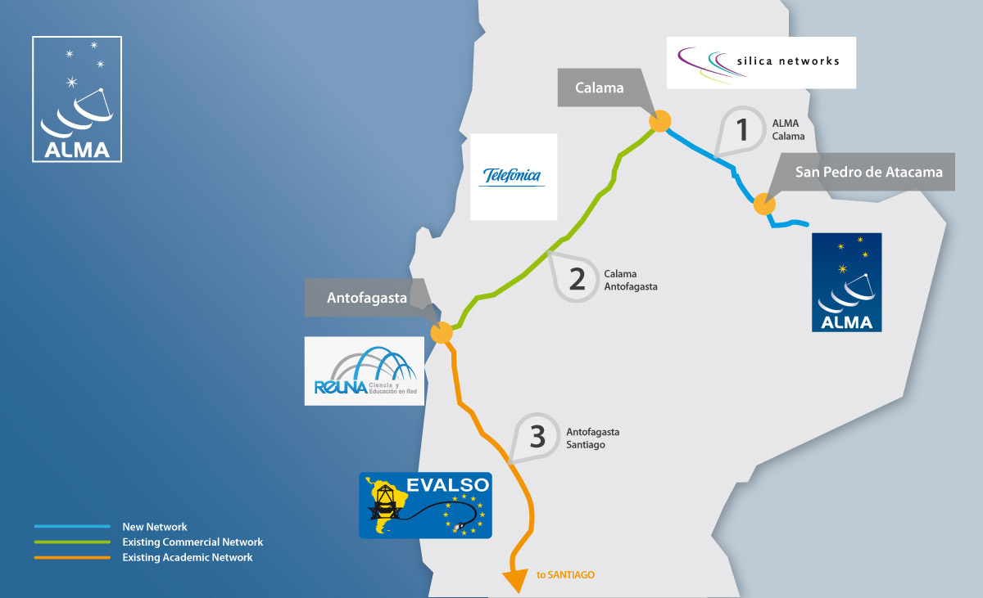
Upgrade of ALMA’s Digital Highway

Slide 20
Fiber Connection OSF-Santiago
Progress
  Contract signed on 2012 November 9 – AUI, Silica Networks, Telefonica
  Meets/exceeds technical requirements
  Contract timeline consistent with project plan – completion by end of 2013
Benefits
  Increased potential for ALMA Science: Can provide factor 25 data rate increase (8x Ops plan requirement)
  Benefits other Chajnantor Working Group observatories
  Cost Savings to operations $0.5M/yr; breakeven in 4 yrs
  Reliability: Will include redundancy via link through Argentina at no extra cost
  Remote operations facilitated

Slide 21
ALMA Development Program: 2013
Workshop in Tokyo with ASAC February; regional NA workshop April
All Development Calls include NA partners, selection by external review
  Emphasis on scientific merit
  Selection to conclude by September 2013
New Call for Development Studies 1 May
  Current round of Studies nearing completion
  Coordinated with East Asia and Europe
  Preceded by Workshop 18 April
  Two year period
  Total funding $1M, projects may seek up to $200K.
Call for Projects 3 June
  Total funding $1.63M available

Slide 22

The National Radio Astronomy Observatory is a facility of the National Science Foundation
operated under cooperative agreement by Associated Universities, Inc.
www.nrao.edu • science.nrao.edu
Notes:
Photos: ASAC meeting 21 March 2002 at National Museum of Emerging Science and Innovation
ASAC Meeting 2007 at University of Tokyo

