Slide 1
Deuterium-Bearing Molecules in Dense Cores
Scott Schnee
NRAO-CV

Slide 2
Layers of a Molecular Cloud
HI & CII
H₂ & CII
H₂ & CO
Notes:
Now after having happily equated CO luminosity and H2 mass for 20 minutes
I want to close with two points on the CO-to-H2 conversion factor
... this XCO or alpha that we use to go from CO luminosity to molecular mass
First, I just want to point out that this
… is not a one-parameter problem
… it’s not just metallicity, it’s not just temperature, it’s not just dynamics
I’d argue that this sketch of a cloud is a reasonable one to bear in mind
… it’s just a basic sketch of a PDR model
… you have an outer layer of HI, where the C is C+
… then a layer of H2 where the C is still C+, not CO
… then a layer of H2 where the C is CO
… inside that inner layer, CO can be thought of as optically thick to zeroth order
… with a spectrum that thus depends on line width and excitation temperature
Meanwhile the boundary between the C+ and CO-bearing H2 depends
… on dust shielding
… and through this on metallicity
So your CO-to-H2 ratio should depend on dust abundance, temperature, and line width

Slide 3
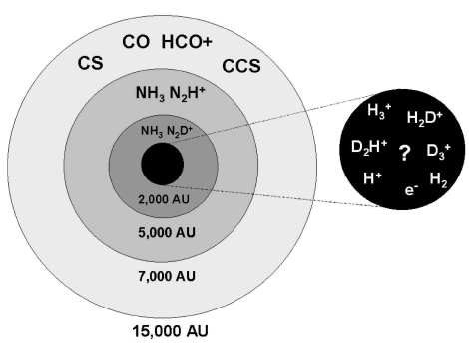
Layers of a Starless Core
(Di Francesco et al. 2007)

Slide 4
Dust vs Gas in L1498
(Tafalla et al. 2004)

Slide 5
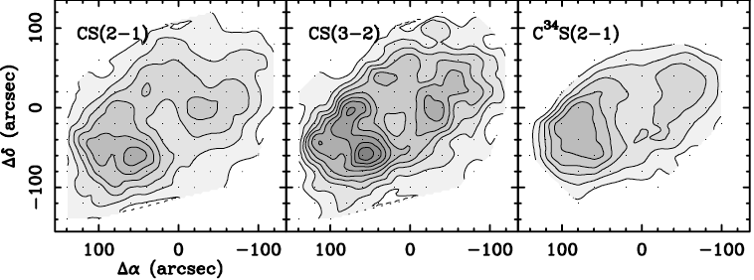
Dust vs Gas in L1498
(Tafalla et al. 2004)

Slide 6
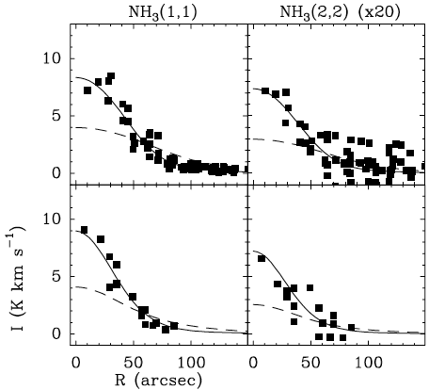
NH₃ is Enhanced in Core Interiors
Increased central NH₃ abundance
L1498
Line Brightness (K km/s)
Constant NH₃ abundance
L1517B

Slide 7
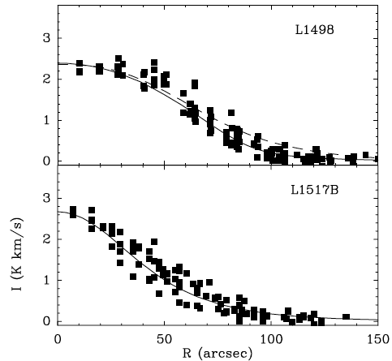
N₂H⁺ is Destroyed in Core Exteriors
Constant
N₂H⁺ abundance
Line Brightness (K km/s)
Decreased N₂H⁺ abundance at large radii

Slide 8
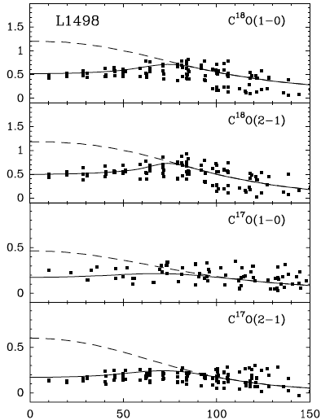
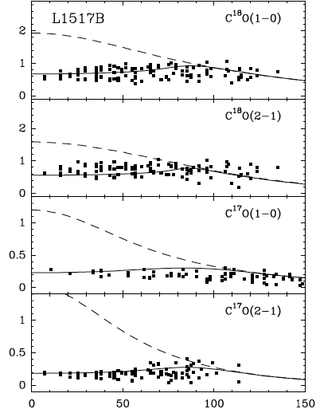
CO is Depleted in Core Interiors
Dashed line: Constant abundance
Solid line: Constant abundance with central hole

Slide 9
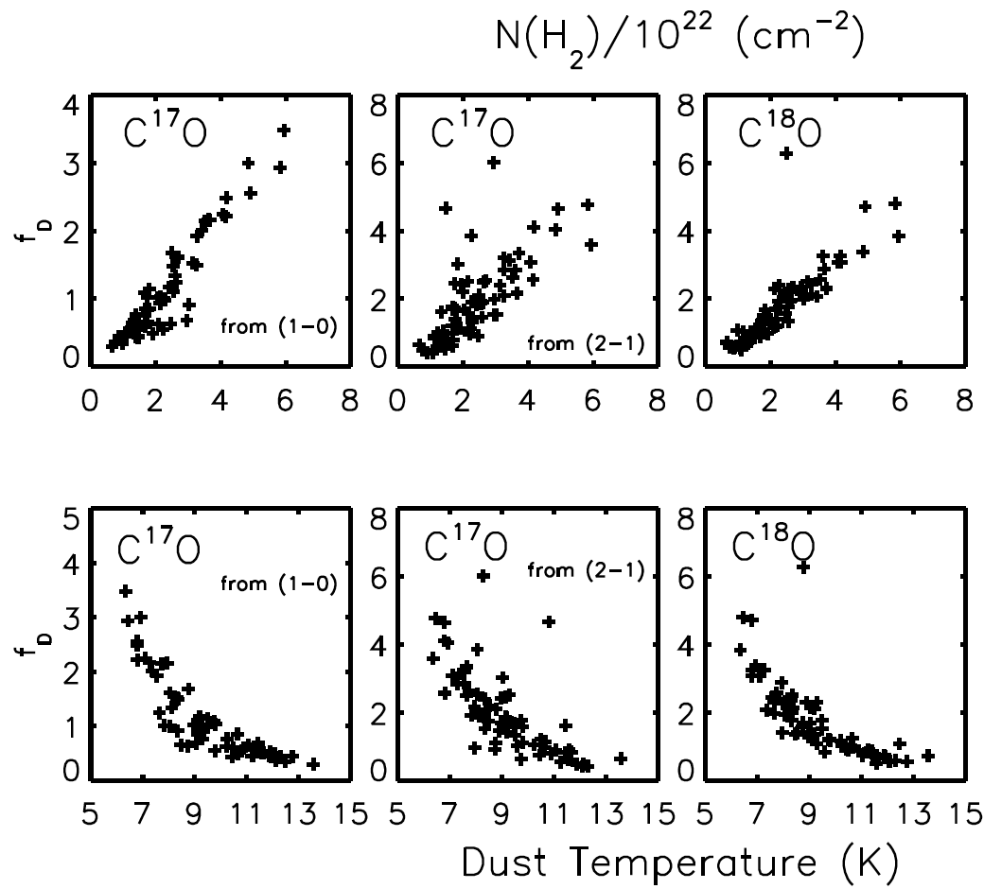
Depletion Increases in Dense/Cold Interior
(Schnee et al. 2007)
CO Depletion
Column Density (10²² cm⁻²)
CO Depletion
Temperature (K)
Notes:
Explain that by observing particular molecules, one is studying different regions within a core. The amount of depletion depends on temperature, density and time.

Slide 10
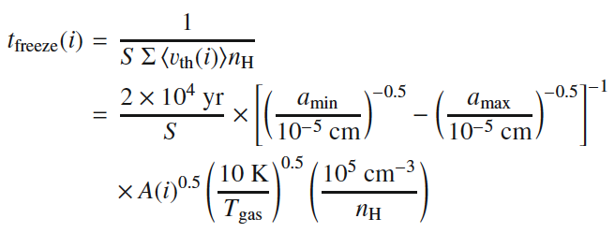
Depletion As Age Indicator in Cores
Grain size distribution
Temperature
Density
(Caselli et al. 2008)
Notes:
Explain that dust growth and deuteration timescales also depend on temperature and density

Slide 11
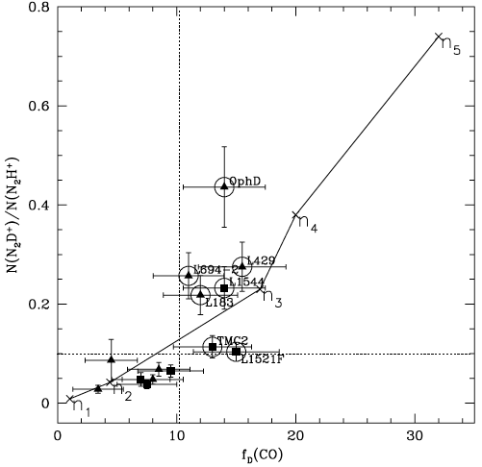
N₂D⁺/N₂H⁺ as Age Indicator in Starless Cores
N₂D⁺/N₂H⁺
(Crapsi et al. 2005)
CO depletion

Slide 12
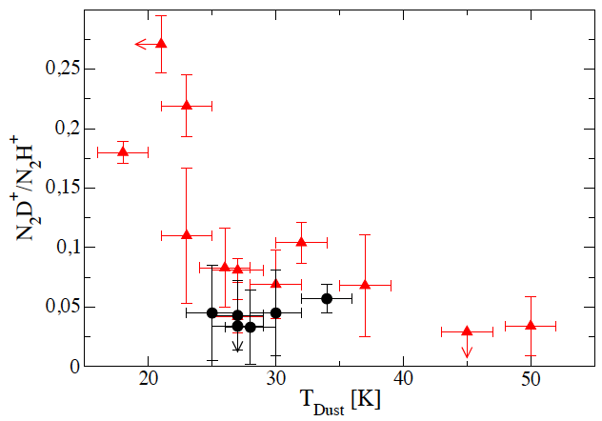
N₂D⁺/N₂H⁺ as Age Indicator in Class 0 Protostars
(Emprechtinger et al. 2005)

Slide 13
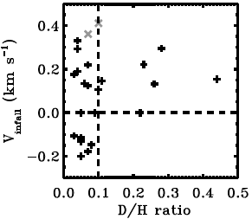
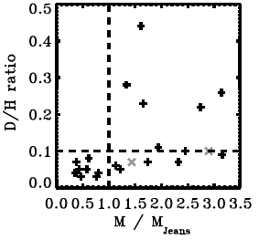
N₂D⁺/N₂H⁺ as Stability Indicator in Starless Cores
(Schnee et al. submitted to ApJ)

Slide 14
The Need for ALMA Band 2
Deuterated lines are faint
T_{B} < 1K for N₂D⁺ (1-0) at 77.1 GHz and similar lines
Line strength varies across core
Intensity is a strong function of density / temperature
Deuterated lines are narrow
Δv ~ 0.3 km/s, lines have nearly thermal FWHM
Need sensitivity, angular resolution, velocity resolution
ALMA Band 2!

Slide 15
Dust Emission
Notes:
Flux that you measure depends on temperature, column density, emissivity spectral index.

Slide 16
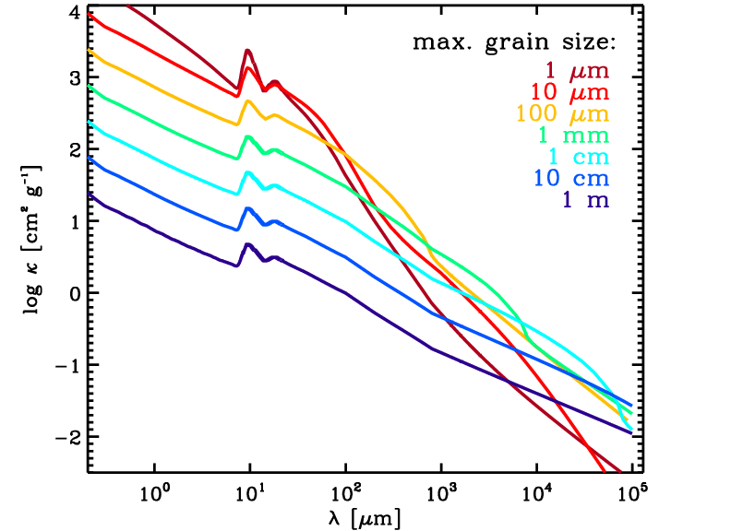
Grain Growth Revealed by β
β: 2 (small) → 0 (large, blackbody)
(Figure from D. Wilner’s AAS talk 2011; Draine 2006)

Slide 17
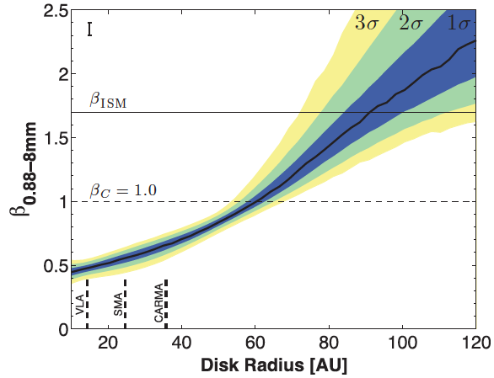
Grain Growth
(Perez et al. 2012)

Slide 18
Grain Growth as Age Indicator
Time
Density
Grain Size
Velocity
(Chakrabarti & McKee 2005)

Slide 19
Profiles of a Typical Starless Core
Density
Temperature
SED

Slide 20
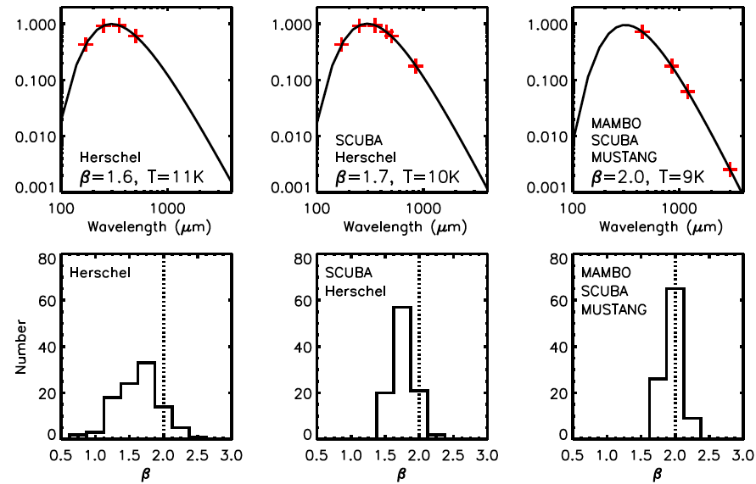
SED Fits Assuming Constant β,T

Slide 21
Dust Continuum in Band 2
Emission at 4mm is great for measuring β
Optically thin
On RJ tail of emission
Useful for cores and disks
For cores, need to recover emission on large angular scales
ALMA needed for sensitivity
S_{ν} ~ ν^{-(2+β)}

Slide 22
Band 2 Conclusions
Indirect measure of timescale of star formation
[D]/[H] ratio as chemical age indicator
Dust SED as grain growth age indicator
This talk focused on core-core variations
John Tobin’s talk focuses on intra-core observations

Slide 23
The End

Slide 24
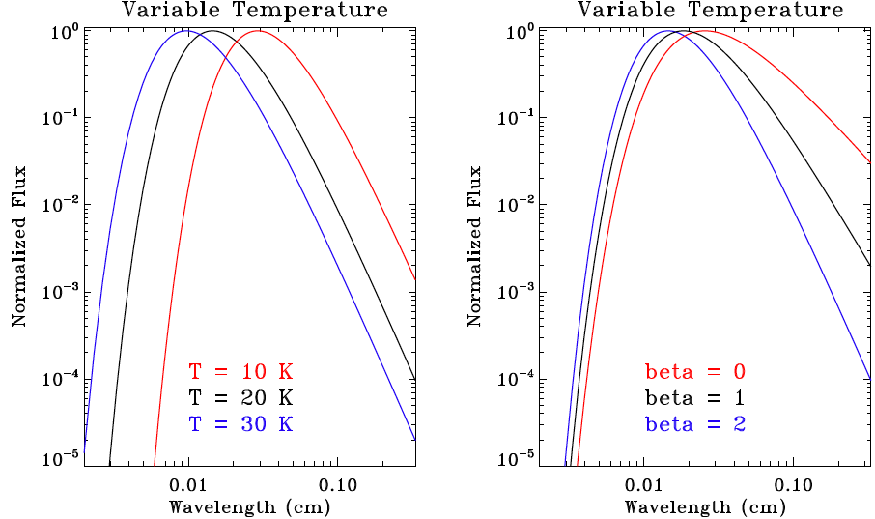
Measuring Temperature and β is Hard
Variable Temperature
Variable β

Slide 25
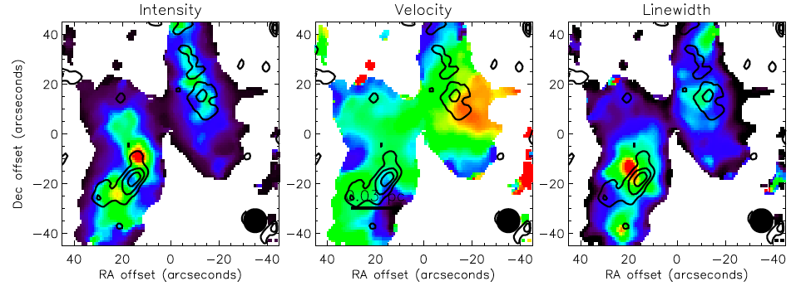
CARMA Deuteration Survey
N₂H⁺ in B5, CARMA D+E array 7-point mosaics
Intensity
Velocity
Linewidth
(Schnee et al. in prep)

Slide 26
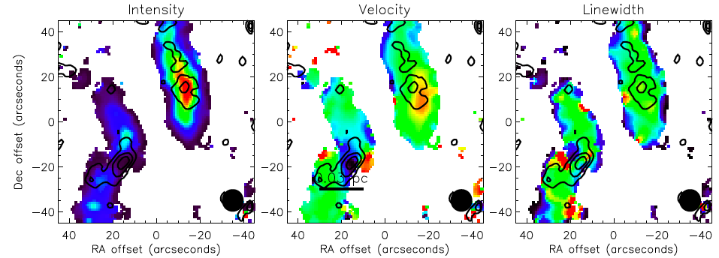
CARMA Deuteration Survey
NH₂D in B5, CARMA D+E array 7-point mosaics
Intensity
Velocity
Linewidth
(Schnee et al. in prep)

Slide 27
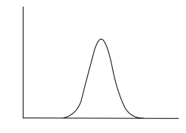
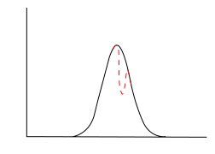
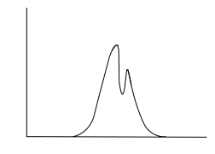
Infall Asymmetry
Gaussian
Asymmetric Double Peak
<
)
Intensity
Velocity
<
)
Intensity
Intensity
Intensity
Velocity
Velocity
Velocity

Slide 28
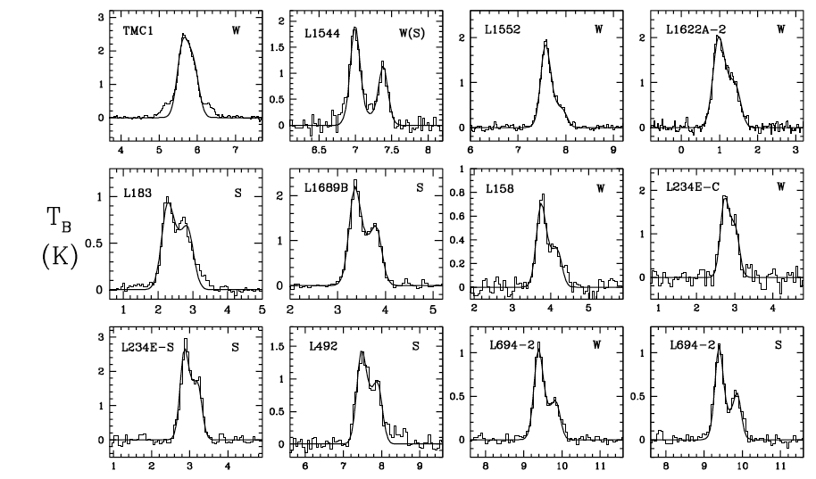
Infall Velocity in Starless Cores
(Lee, Myers & Tafalla 2001)
Notes:
FCRAO single dish data

Slide 29
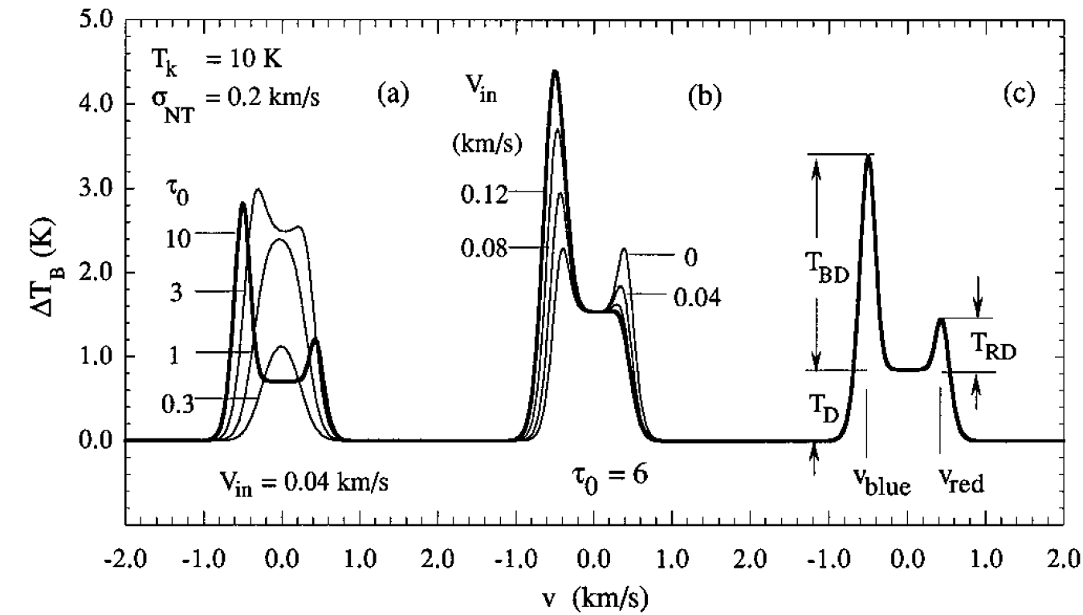
Infall Velocity Line Profiles
(Myers et al. 1996 )
Notes:
FCRAO single dish data

Slide 30
JCMT Survey of Starless Cores
Hypothesis 1:
High [D]/[H] ratio implies central condensed & cold cores, gravitational instability, infall motions
Hypothesis 2:
High [D]/[H] ratio implies long-lived core and no/small infall motions

Slide 31
JCMT Survey of Starless Cores
Does a high [D]/[H] ratio imply imminent
collapse?
JCMT HCO⁺ (3-2) @ 267.6 GHz pointings
[D]/[H] peak in all 26 cores in Crapsi et al. (2005) sample
<0.05 km/s spectral resolution
0.1 K rms
1 – 2 hours per core

Slide 32
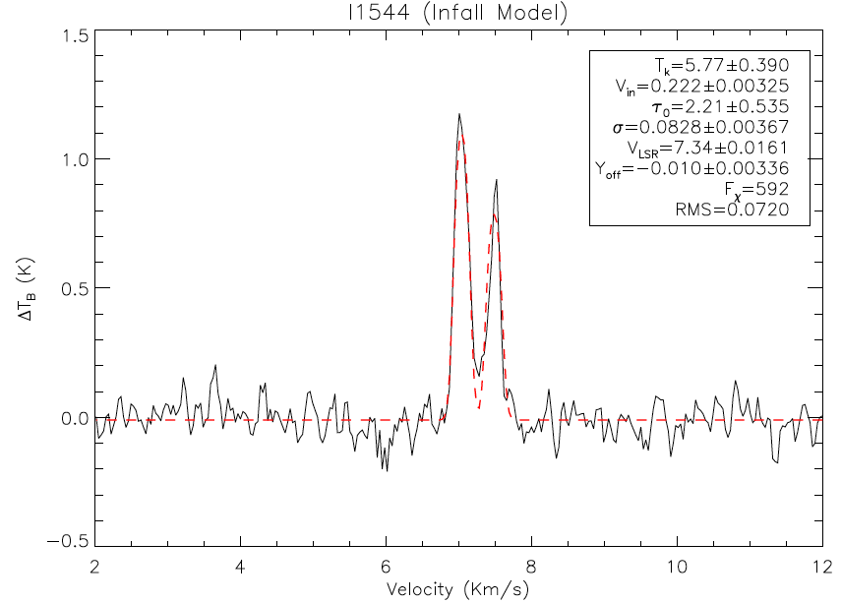
Infall Velocity in L1544
1.5
1.0
T_{B} (K)
0.0
-0.5
2
4
6
8
10
12
Velocity (km/s)

Slide 33
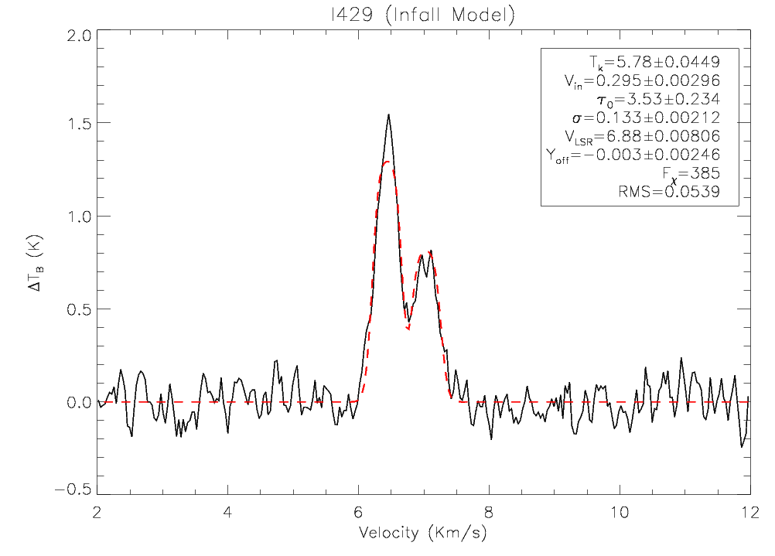
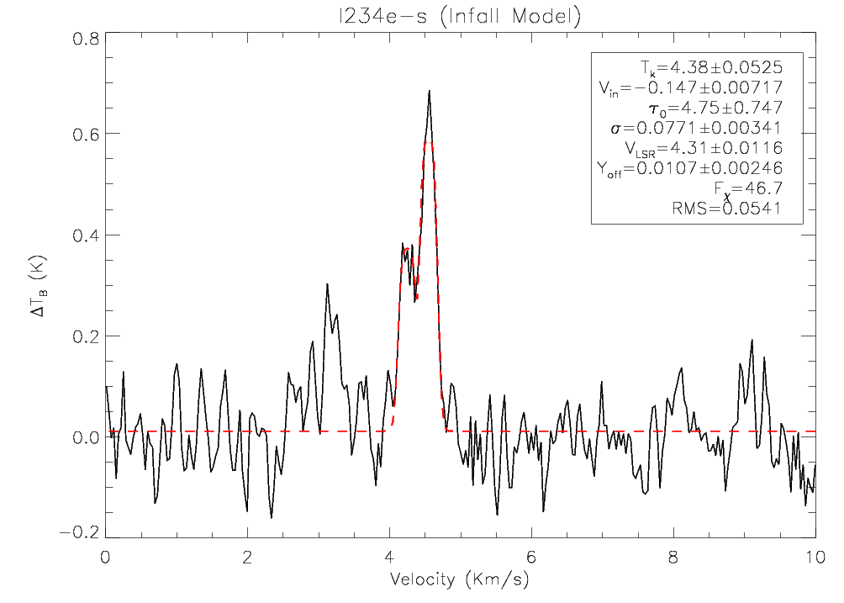
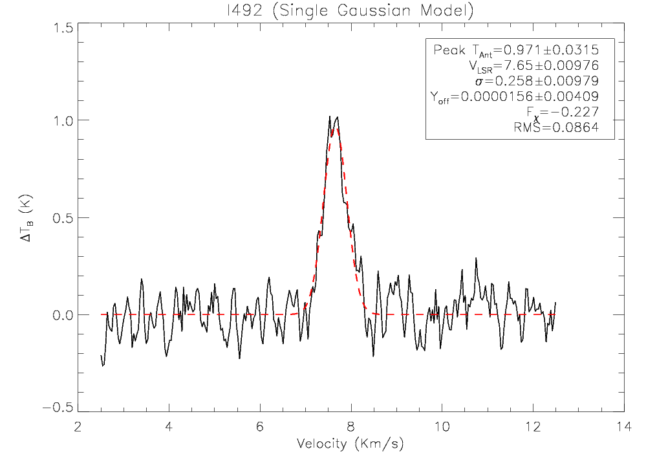
More Line Profiles & Fits

Slide 34
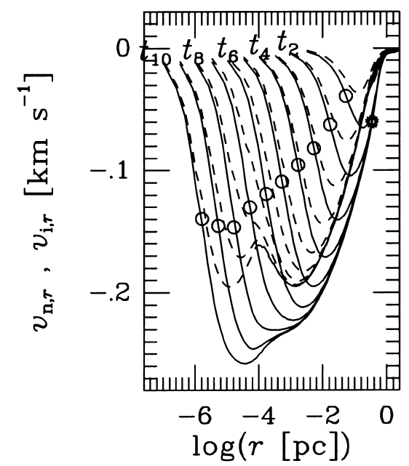
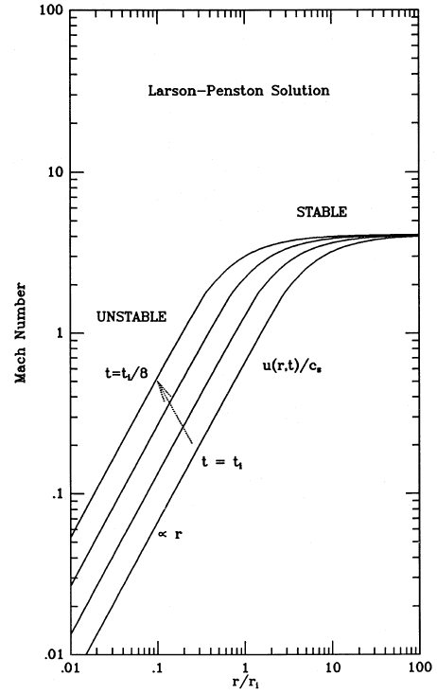
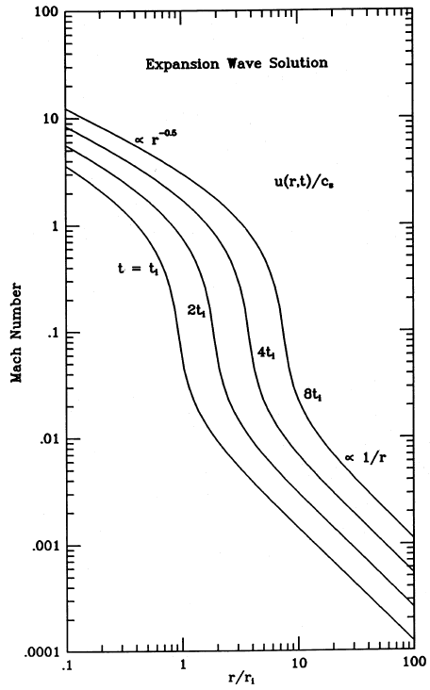
Infall Velocity vs. Radius
(Ciolek & Basu 2000)
(Silk & Suto 1988)
(Silk & Suto 1988)
Ambipolar diffusion
(slow)
Uniform Collapse
(fast)
Inside-Out Collapse
(fast)
c_{s} ~ 0.2 km/s

Slide 35
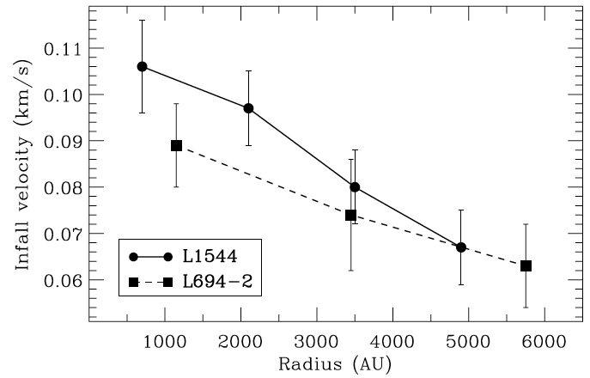
Infall Velocity vs. Radius – High Resolution
(Williams, Lee & Myers 2006)
Notes:
BIMA data with ~10” resolution
15+ hours on source per core

Slide 36
Infall Velocity vs. Radius – High Resolution
Williams, Lee & Myers (2006) used many 10s of hours of BIMA with ~10” resolution
BIMA misses ~50% of flux from starless cores
Only single-dish telescope capable of getting 10” resolution for J=1-0 transitions is GBT
This is also a possible ALMA project
No Cycle 0 projects studied infall
Cycle 1 project approved, PI: Neal Evans
Notes:
BIMA data with ~10” resolution
15+ hours on source per core

Slide 37
Main Points to Remember
Molecules with C are sticky
Molecules with N are pretty good tracers of H₂
The [D]/[H] ratio increases with density and decreases with temperature
Good tracer of centers of starless cores
Depletion and deuteration give “chemical age”
On small scales, nothing traces mass very well, so you should just give up

