Slide 1
Current and Future Capabilities of the VLBA
Walter Brisken
Outflows, Winds and Jets
NRAO-NAASC Workshop
2012 Mar 3

Slide 2

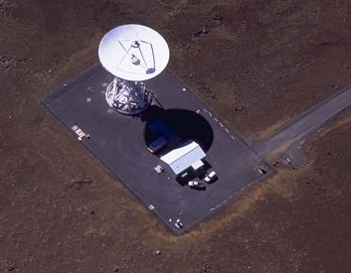
The VLBA stations
Form a dedicated VLBI array
Array dedicated in 1993
Cover frequency range 310 MHz to 90 GHz
10 identical stations on U.S. territory:
Brewster WA, Hancock NH, Fort Davis TX, Kitt Peak AZ,
Los Alamos NM, Mauna Kea HI, North Liberty IA, Owens Valley CA,
Pie Town NM and Saint Croix, US Virgin Islands
Each station has
25-m Cassegrain antenna
Station building with maser, electronics, recorders
Weather station, GPS Rx, security camera
Staff of 2

Slide 3
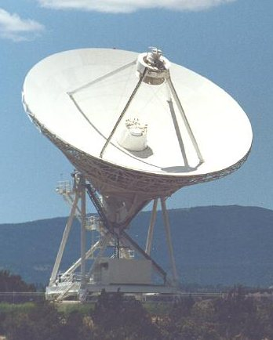
Current antenna capabilities
310 MHz and 90 GHz in 10 select bands
Most bands use high sensitivity cryogenic receivers
Dual circular polarizations
Simultaneous operation at 2.4 and 8.4 GHz possible
Can change observing bands in seconds
Relatively fast motion: 90 deg/min in Azimuth and 30 deg/min in Elevation
Baseband data acquisition rate of 512 Mbps (and 2048 Mbps; see later slide)
64 MHz bandwidth in two polarizations with 2 bits per sample
Via multiple 8 or 16 MHz sub-bands within a 512 MHz IF
Data is compatible with recordings made at most other VLBI antennas
See the VLBA observational Status Summary for more details
http://www.vlba.nrao.edu/astro/obsstatus/current

Slide 4
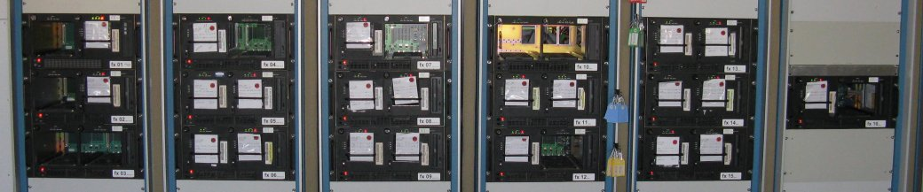
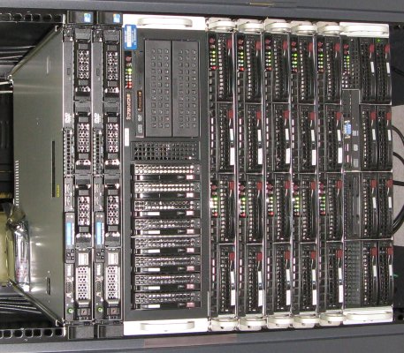
VLBA correlator
Socorro hosts the VLBA DiFX software correlator
DiFX has a global collaborative development team
It is now used at most VLBI processing centers
16-20 Mark5 units available for playback
Can process data from 10 stations at a rate of 1500 Mbps
Time resolution down to milliseconds (or less)
Frequency resolution down to 2 Hz
Some special features
Pulsar gating and binning
Simultaneous correlation at many positions
Extraction of calibration information (phase tones, Tsys)
Can dump high time resolution spectra for transient searching

Slide 5
The key capabilities of the VLBA
Long baselines yield high resolution
5 mas at 1.5 GHz
120 μas at 90 GHz → Highest resolution imaging in astronomy
Sensitive to brightness temperatures above about 10⁵ K
Instrumental stability and long baselines → astrometry
< 0.1 μ as achievable with minor effort, cooperative sources
0.01 μ as demonstrated in some cases
Allows distance measurements at 1 kpc with 1% accuracy
Identical 25-m antennas allow large field of view
30’ at 1.5 GHz
Can image hundreds of sources in one pointing
Full time operations
Suitable for transient response, dynamic scheduling, multi-epoch obs…
Rapid turnover to users: usually ~2 weeks
Pulsar processing (gating and binning)

Slide 6
Bandwidth expansion project
Goal: Increase the data rate from the VLBA from 512 Mbps to 2(4) Gbps
Three major components, all developed collaboratively
New back-end electronics (collab. w/ Haystack)
Remove downconverters, samplers and formatter
Replace with FPGA-based hardware (from CASPER group)
New recorder (Haystack, Conduant Corp.)
Mark5C unit with 10 Gb input port
New correlator (Adam Deller and global collaboration)
Replace VLBA hardware correlator with DiFX software correlator
Complete as of Dec 2009
Hardware is installed at all sites
First science is underway!
Memo series: https://science.nrao.edu/facilities/vlba/publications/memos/sensitivity-upgrade

Slide 7
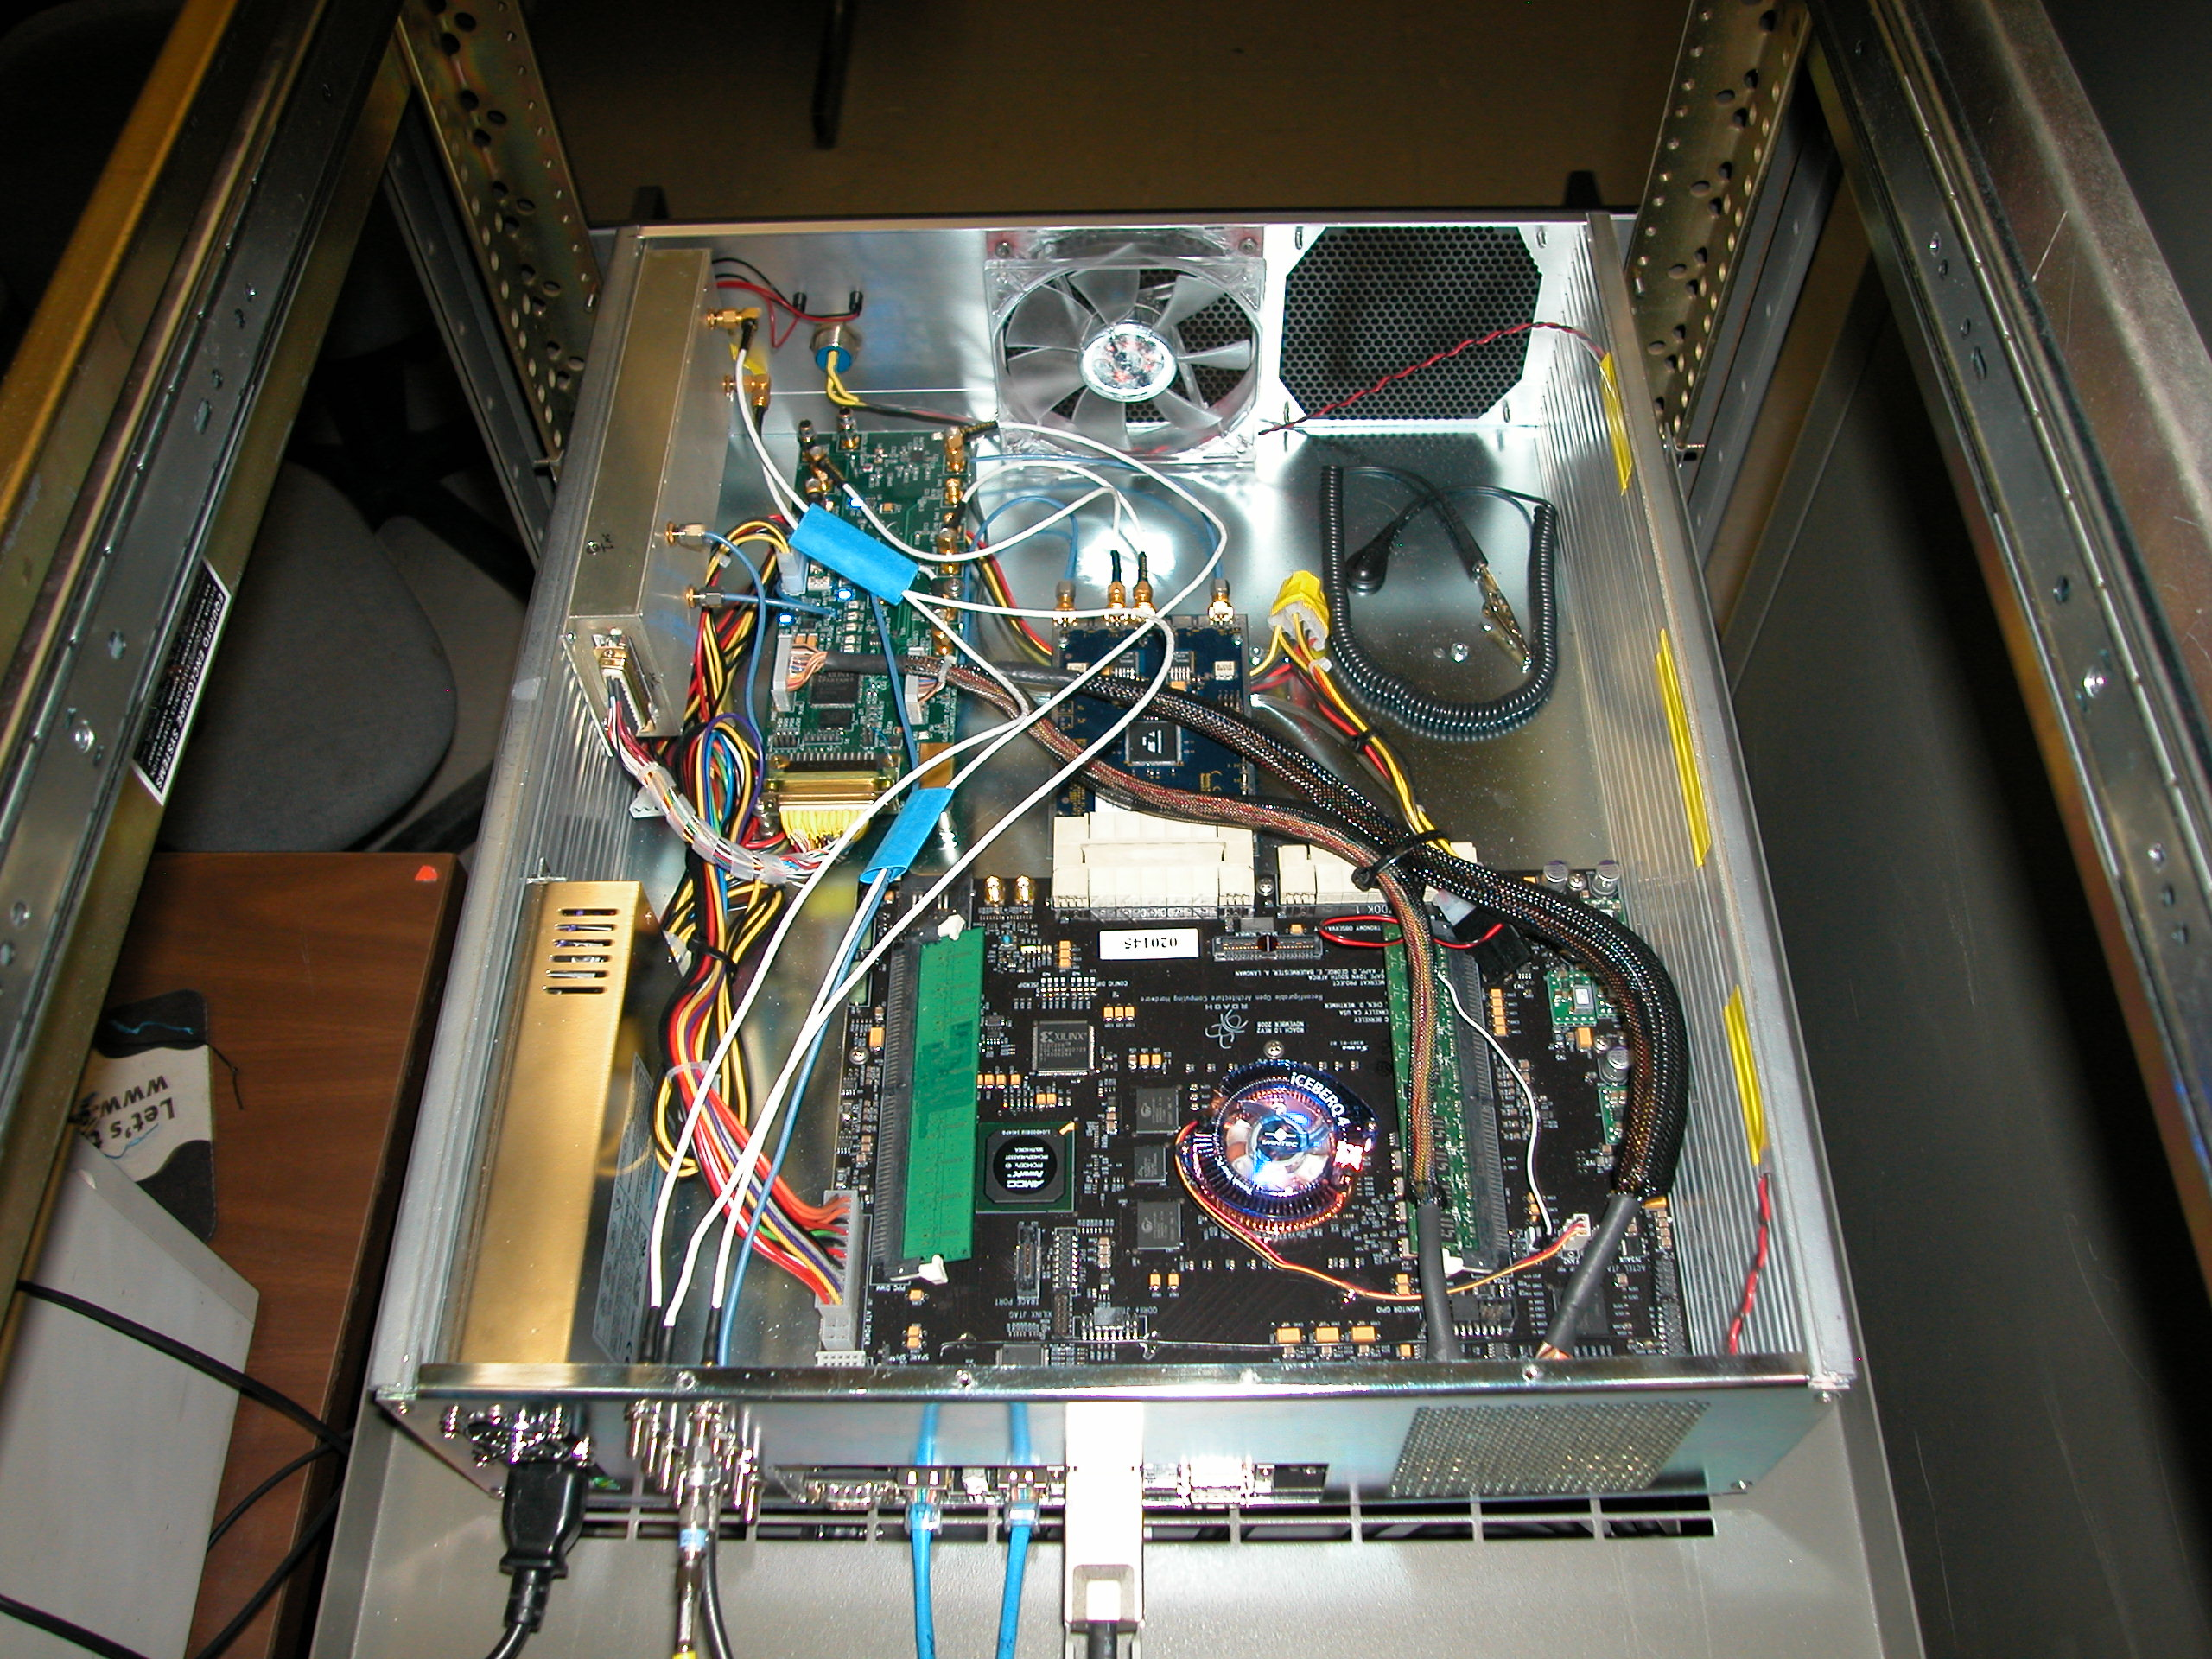
Bandwidth expansion hardware
ROACH Digital Back End

Slide 8
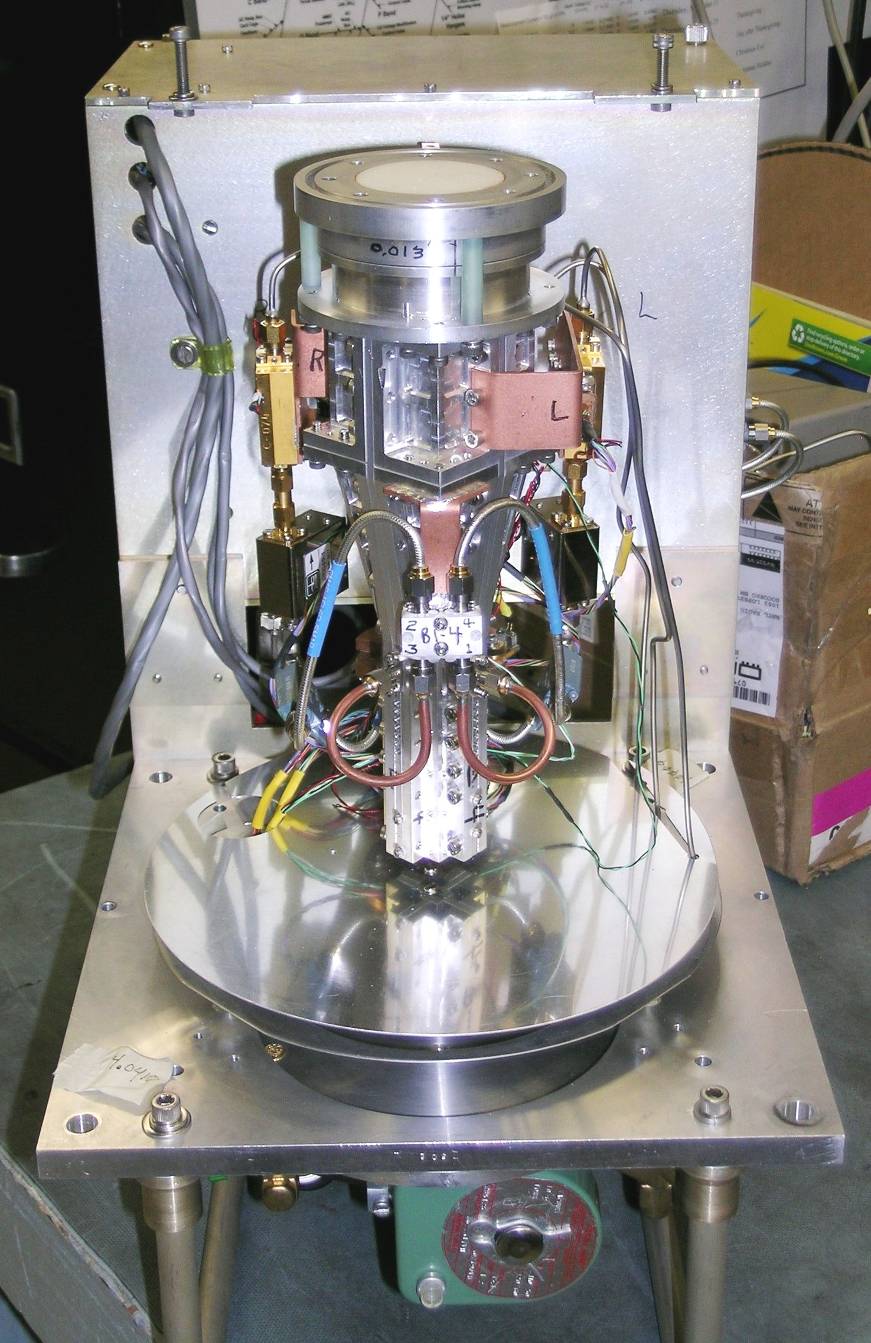
C-band receiver upgrade
Replace 4.5-5.1 GHz receivers with 4-7.9 GHz upgraded units
Primary science goal: Astrometry of 6.7 GHz methanol line found in star forming regions to map the structure of the Milky Way
This project will bring more of the VLBA to EVLA standards
Upgraded down-converter will allow 2 IF pairs to attach to this receiver at widely separated frequencies
Upgrade is in progress
Feed replacements done at 8 antennas
New receivers installed at 6 antennas
Rolling downtime of C-band receivers
Some observing impacted
First science to begin ~May 2012
Planned completion by August 2012

Slide 9
Performance of new C-band receiver
Performs even better than EVLA C-band receivers!
Notes:
EVLA to ultimately adopt the receiver changes (specifically the thermal gap and cryogenic hybrid) to reach the same levels of performance.

Slide 10
Topical VLBA science

Slide 11
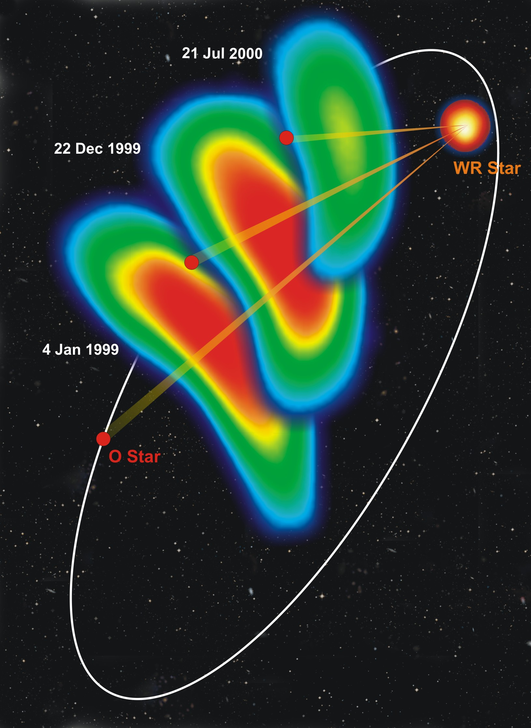
Imaging colliding winds
Resolution
80μas to 25 mas
In the galaxy (100pc-10kpc): 1 mas resolution is 0.1-10 AUs (even less than a stellar radius for nearby stars)
For nearby extragalactic (1-1000Mpc): 1 mas resolution is 1000 AU-5pc
E.g., WR140, colliding wind region in Wolf-Rayet binary star system
Dougherty et al. 2005

Slide 12
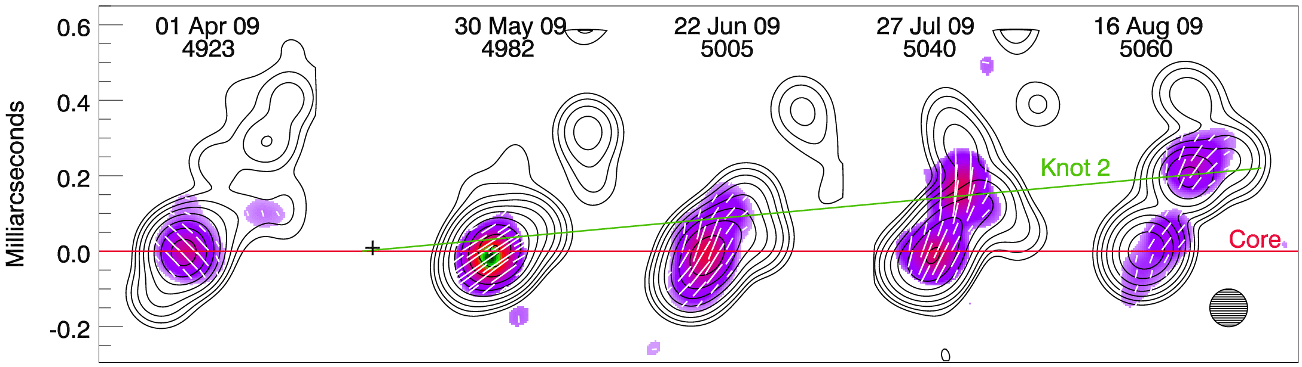
Comprehensive multi-waveband monitoring of γ-ray bright blazars Marscher & Jorstad
Monthly observations at 43 GHz of FERMI detected blazars
Goal: determine the source of γ radiation
Results to date: γ-rays emitted when blobs are ejected
These “blobs” are likely shock waves

Slide 13
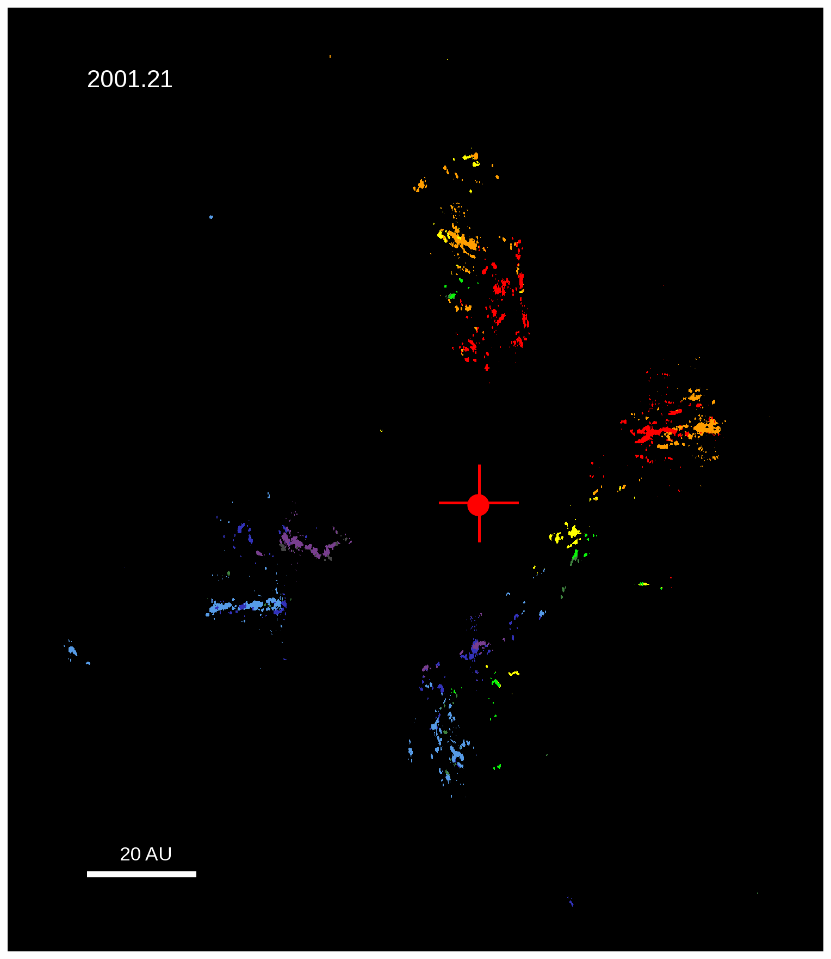
SiO maser emission from Orion Source I
Nearly edge-on massive (>8 Msun) YSO
SiO J=1-0 maser emission @ 43 GHz
0.2 AU resolution (for D=414pc)
Time evolution shows clear helical motion consistent with bipolar emission from rotating disk.
Maser trajectories are thought to be shaped by magnetic fields.
Supports disk-mediated accretion formation scenario
Matthews et al. 2010, ApJ, 708, 80

Slide 14
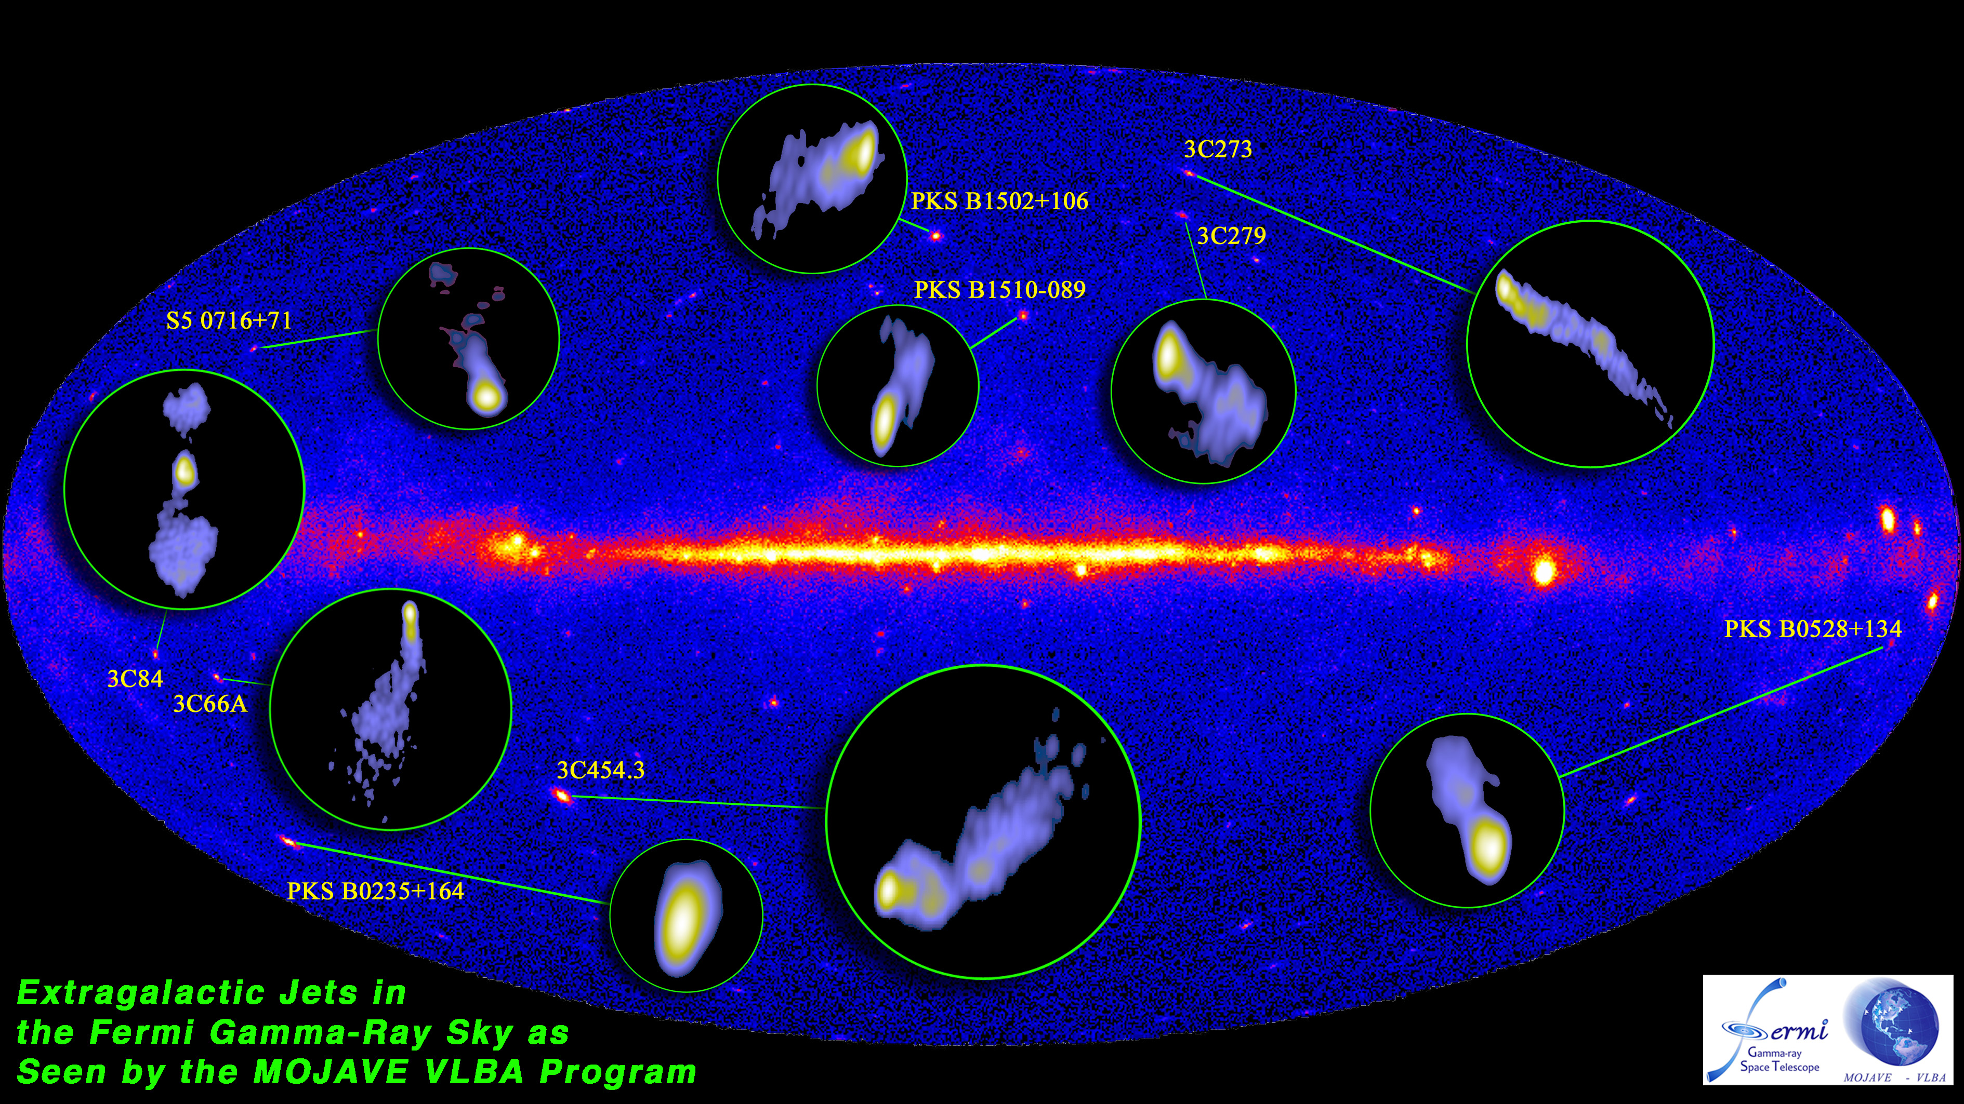
Monitoring of jets in active galactic nuclei with VLBA experiments (MOJAVE) Lister et al.
Observations made at 15 GHz frequency
A long term (already 20+ years) project to explore the variability of brightness and polarization in AGN jets on timescales of months to decades.
Optical, x-ray and γ-ray observations are being made in parallel

Slide 15
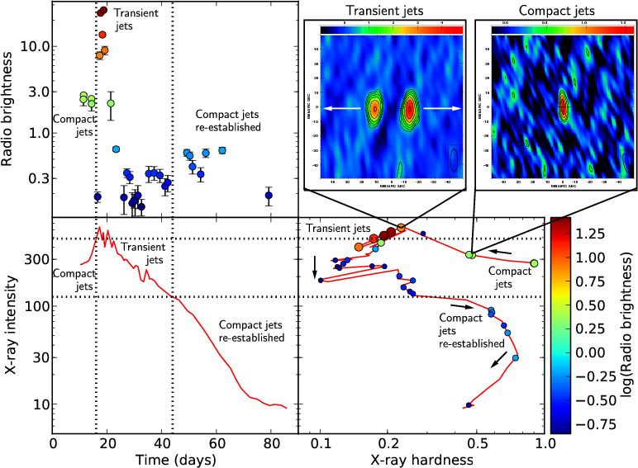
Jet acceleration and collimation probe of transient X-ray binaries (JACPOT) Miller-Jones et al.
Compare microquasar systems with white dwarf, neutron star and black hole companions
Explore role of gravitational fields, magnetic fields and surface on jet formation
Black hole system candidate H1743-322 in outburst. VLBA images show jet transitioning from compact to relativistically moving knots

Slide 16
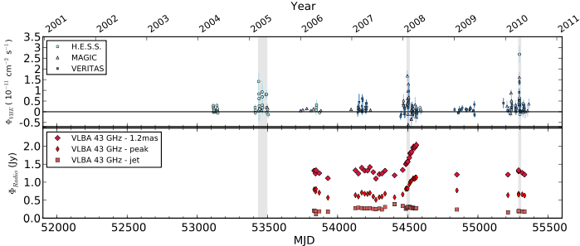
M87 Very High Energy flare seen in multi-wavelength monitoring
Flares in 2008 and 2010 caught during VHE observing campaigns (HESS, Veritas, and MAGIC),
and during VLBA monitoring campaigns.
Changes in the jet at VLBI scales were seen in 2008 but not 2010.
A third flare in 2005 was associated with X-ray flux changes in jet feature HST-1.
No unique set of features describes the three flares reported.
Abramowski et al., 2012, ApJ, 746, 151

Slide 17
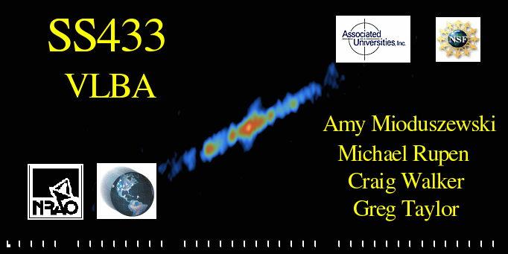
Precessing microquasar SS433
BH or NS accreting matter from companion star
The jet precesses with a 164 day period (movie spans ¼ cycle)
VLBA observations at 15 GHz yield 3 AU resolution (at d=5 kpc)
Jet material travelling at 0.26c
Contains baryons
Motions consistent with ballistic
Movie: Mioduszweski et al. in prep.

Slide 18
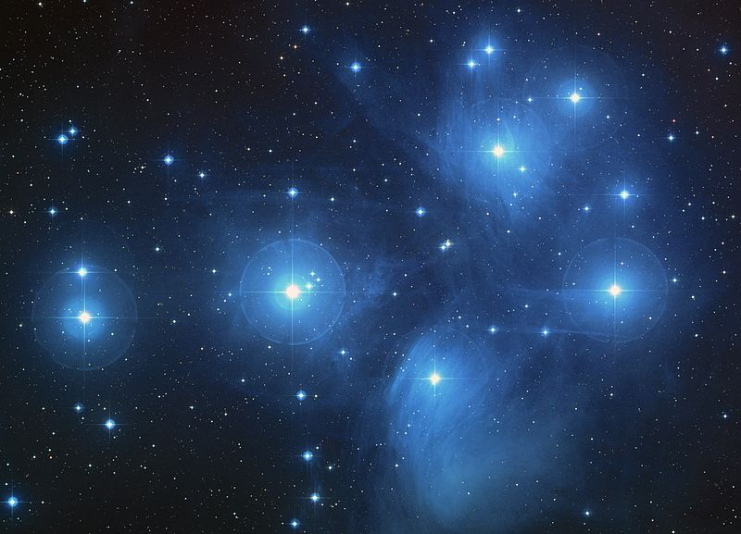
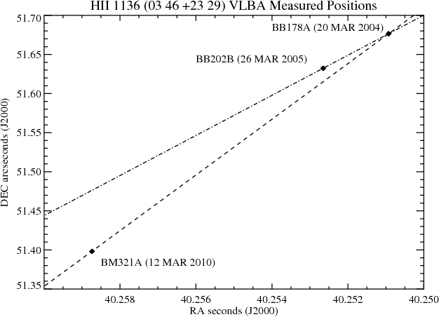
Pleiades distance Melis et al.
Pleiades are a key system for understanding stars in open clusters
It is close and young
Pleiades distance controversy:
Hipparcos measured 120 pc
Other methods yield ~133 pc
Goal: use VLBA to determine geometric distance
VLA being used to identify cluster members that are bright enough
Early VLBA results have demonstrated the feasibility
Non-linear stellar motion hints at multiplicity

Slide 19
Resident Shared Risk Observing (Opportunities for you to contribute!)
The VLBA is a very flexible instrument with many untapped possibilities
A RSRO program is available to those wanting to help implement new capabilities
As for EVLA RSRO there is a residency requirement (~2 months)
RSRO astronomers get early access to new capabilities
Some example projects:
Integration of phased EVLA into VLBA observations
Development of new correlator capabilities (Mark4 format output, on-the-fly calibration, new delay model options, …)
Single-dish observing capabilities
Implementation of “4-IF” modes
Visit https://science.nrao.edu/facilities/vlba/observing/rsro for details

Slide 20
Additional VLBA Science Examples

Slide 21
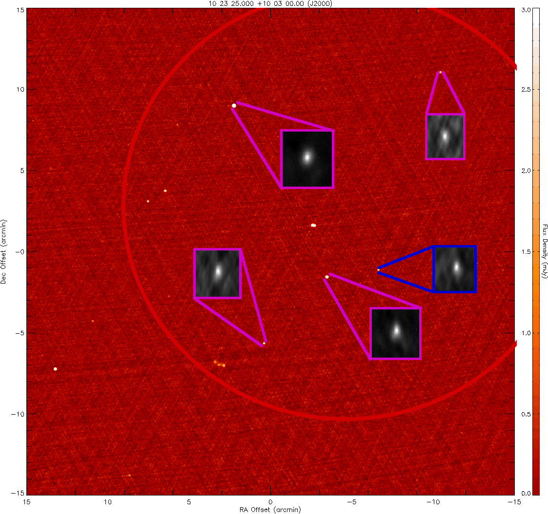
PSRπ : pulsar astrometry Adam Deller et al.
Goal: 60 more parallax distances to pulsars
Proper motions come for free
Luminosities can be calibrated
Can connect pulsars with SNR or other objects
Improve solar system to ICRF reference frame ties
Used to better calibrate the Galactic electron density model
Reduce covariances in pulsar timing array parameters
Observing strategy
Use 1.5 GHz
Calibrate using background quasars in field of view
Make use of pulsar gating and multi-phase center correlation

Slide 22
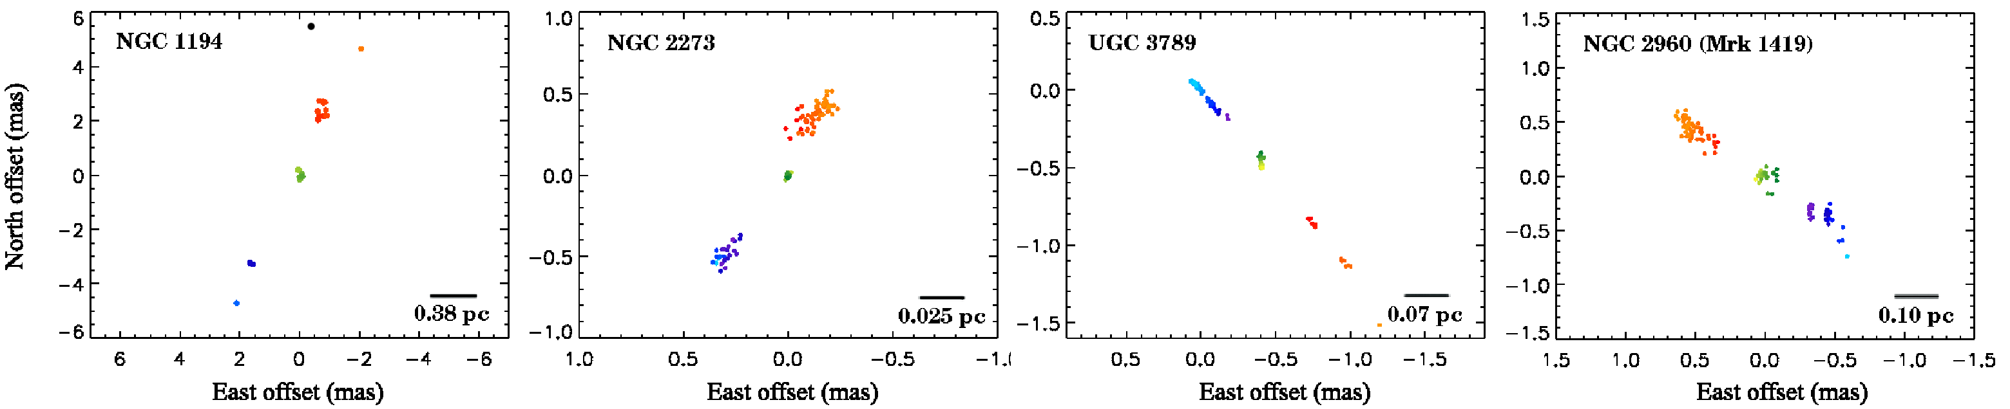
Megamaser cosmology project Braats, Kuo et al.
Goal: Measure Hubble constant
Determine geometric distance to AGNs hosting water maser disk through orbit modeling high velocity maser motions
Couple to redshift determined from systemic maser velocity
Goal: Measure black hole masses precisely
First results from galaxies within the Hubble flow suggest H₀=69±11 km/s
4 example maser spot maps

Slide 23
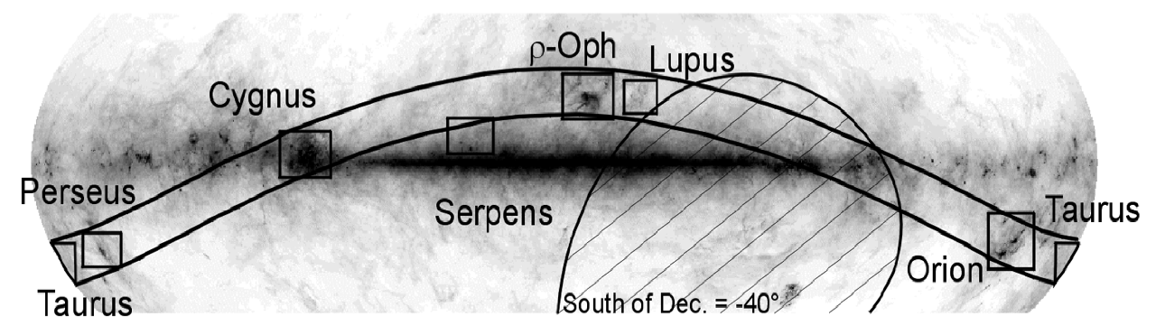
Gould’s belt distance survey Loinard et al.
Goal: determine distances to nearby star-forming regions
Perform parallax astrometry on young radio bright stars
EVLA being used to identify suitable stars
Results from studies of the Taurus star forming region are already mapping the three dimensional structure of the region
The unexpectedly close distance to Orion determined through this project has brought star forming models into accord

Slide 24
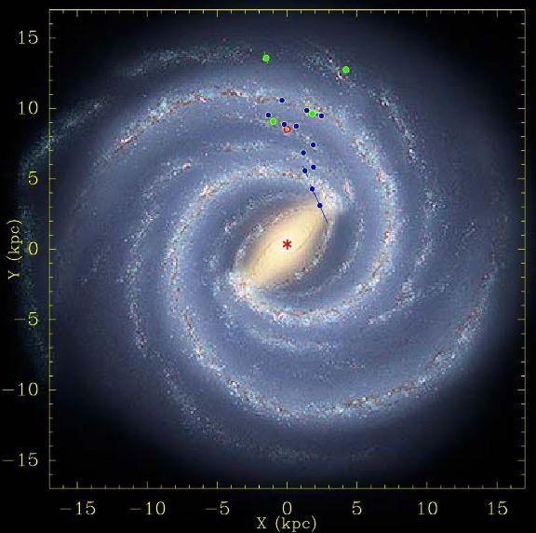
Bar and spiral structure legacy survey (BeSSeL) Reid et al.
Goal: determine structure and kinematics of the Milky Way Galaxy
Perform astrometry on masers in star forming regions
Water masers at 22 GHz
Methanol at 11 and (soon) 6.7 GHz
Early results have improved measurements of the distance to the Galactic Center and rotational velocity
R₀ = 8.4 ± 0.6 kpc
Θ₀ = 254 ± 16 km/s

Slide 25
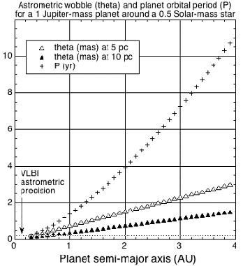
The radio-interferometric planet search (RIPL) Bower et al.
Goal: search for planets around M-dwarf stars
Via astrometric reflex
Sensitive to sub-Jupiter masses with long periods
Complementary to radial velocity methods

Slide 26
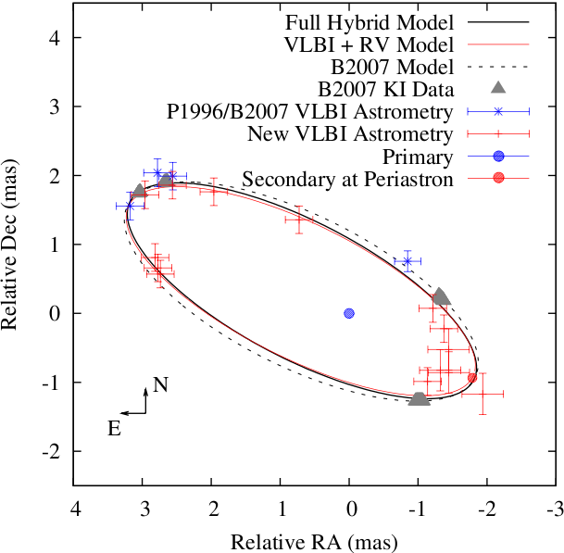
Mass, distance, and radio structure of V773 Tau A
Multi-epoch VLBA astrometric observations trace out 51-day orbit and determine distance (133+-2 pc).
Mass measurements of the binary members determined: 1.55 and 1.29 Msun.
Magnetospheric activity inferred from increased brightness of both stars at periastron.
Fit residuals show acceleration consistent with a 26-yr hierarchical orbit around 2.4 Msun star V773 B.
Torres et al. 2012, ApJ, 747, 18

Slide 27

V-FASTR: Fast transient detection with the VLBA
VLBA DiFX Software Correlator has been augmented with a transient detection pipeline
Looks for “Lorimer” type events
Commensally searches all projects correlated in Socorro
Short term (~2ms) accumulated spectra sent to processor
Data are reordered, flattened, and searched for dispersed pulses
Machine-learning algorithms exploited (Thompson et al., 2011, ApJ, 735, 98)
10 separated antennas used as coincidence detectors
Artificial pulses injected constantly to assess/set thresholds
Pulsar test datasets prove the concept (Wayth et al., 2011, ApJ, 735, 97)
Regular pulses from PSR B0329+54 detected
Giant pulses from the Crab Pulsar detected
B0834+08 pulses

Slide 28
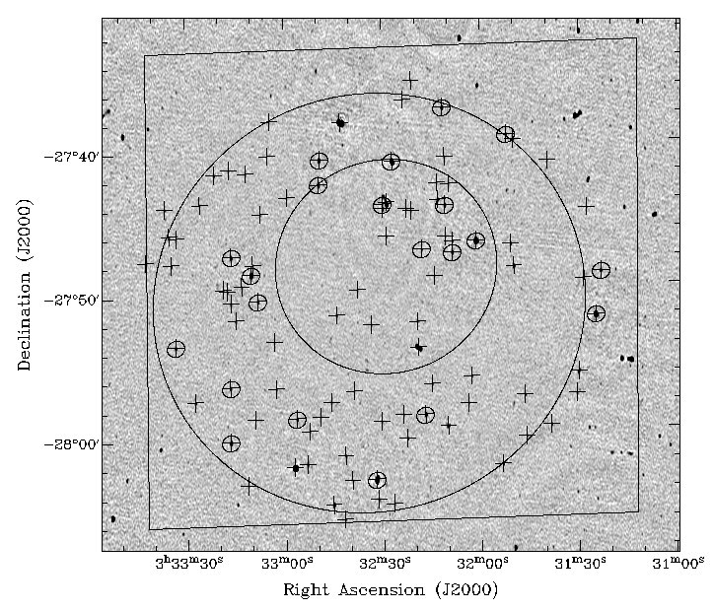
Wide-field VLBA Observations of the Chandra Deep Field South
VLBI fields of view are notoriously narrow
A new wide-field technique allows for 10s or 100s of sources to be simultaneously studied with the VLBA
This technique was used to target extra-galactic sources within the CDS
Results were used to classify sources as AGN or star bursts
With this advance VLBI can be used effectively alongside deep surveys made with other instruments
Middelberg et al., 2011, A&A 526, 74
Notes:
Notes: Background image is from ATCA. The large circle corresponds to the VLBA half-power primary beam. Objects marked with a + are ATCA detected sources that were imaged with the VLBA in this experiment. Objects inside a small circle were those detected by the VLBA. The medium sized circle represents the 2 megasecond Chandra Deep Field South (CDS).

Slide 29
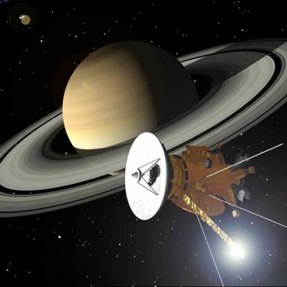
VLBA Astrometry of Cassini at Saturn
8 measurements of the position of Cassini were made between 2006 and 2009; each measurement was accurate to ~0.3 mas (2 km) relative to the quasar reference frame (ICRF).
This new data is contributing to the new DE422 planetary ephemeris. Ongoing observations will ultimately reduce uncertainty in Saturn’s position by a factor of about 3 as more of Saturn’s orbit is probed.
This will have implications for spacecraft navigation, solar system dynamics, relativity research, pulsar timing, and frame ties connecting the solar system to the ICRF.
Image: NASA
Jones et al., 2011, ApJ, 141, 29

Slide 30
Backup Material
Frequency bands and sensitivity
Daily USNO observations
The HSA and global VLBI
Important VLBA links

Slide 31
Frequency bands and sensitivity
λ(cm) | ν(GHz) | σ(μJy/beam) in 4 hrs at 2Gbps
90 cm | 0.312 - 0.342 | 277*
50 cm | 0.596 - 0.626 | 782*
21 cm | 1.35 - 1.75 | 13-14
13 cm | 2.15 - 2.35 | 14
6 cm | 4.6 - 5.1 | 13
6 cm (upgrade) | 4.1 - 7.9 | 8
4 cm | 8.0 - 8.8 | 13
2 cm | 12.0 - 15.4 | 24
1 cm | 21.7 - 24.1 | 18-22
7 mm | 41.0 - 45.0 | 66
3 mm | 80.0 - 90.0 | 316†
Maximum bandwidth 256 MHz with two polarizations - available Feb 2012 proposal deadline
More later about:
Increasing sensitivity by adding more/larger telescopes to the array
Sensitivity upgrade
C-band upgrade
* Narrower bandwidths
† 8 stations

Slide 32
Daily UT1-UTC observations
US Naval Observatory is contributing to VLBA operations in exchange for daily ~1 hour observations using 2 VLBA antennas: Mauna Kea and Pie Town
High speed network links have been installed at these two sites
MK and PT to Washington D.C. at ~250 Mbps
Daily ~1 hour observations to begin soon
VLBA science to face potential interruptions
Users have been contacted with tips to reduce impact on observing

Slide 33
High Sensitivity Array
HSA = VLBA + Phased EVLA + GBT + Arecibo + Effelsberg
1-hr integration at 1.7 GHz gives S_{rms} = 5 μJy/beam with 512 Mbps recording rate
Phased EVLA will be provided by the EVLA’s WIDAR correlator
Has not been available since the VLA correlator shutdown on Jan 11, 2010
Phased EVLA originally not due to be implemented until 2013, but RSRO program has made it likely that this will be complete earlier
Adam Deller & Joe Lazio demonstrated phased array recording
Lots of little issues to be addressed before scientific use can begin
2 Gbps operation at most/all HSA antennas hoped during CY 2012

Slide 34
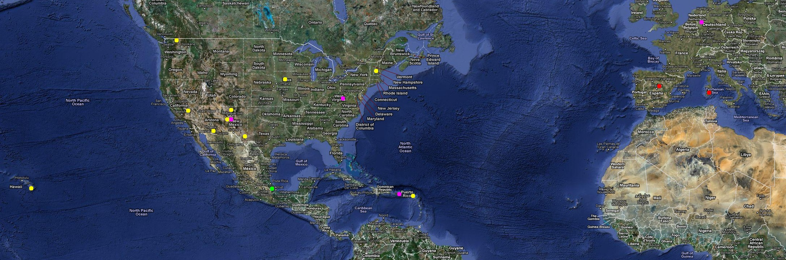
The High Sensitivity Array on the map
Yellow: VLBA antennas
Pink: Other current HSA members: VLA, GBT, Arecibo, Effelsberg
Red: Other antennas under some consideration: Yebes, Sardinia

Slide 35
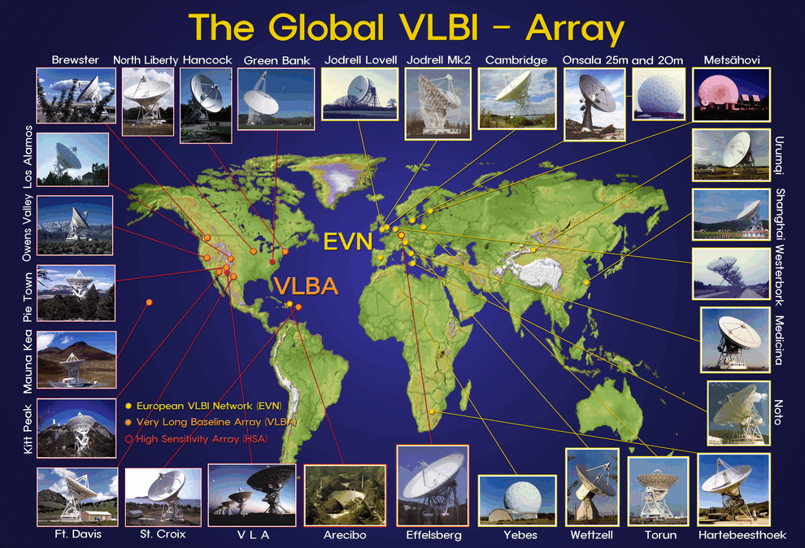
Global VLBI
Add telescopes from the European VLBI Network (EVN) to the VLBA.
The EVN has many large sensitive telescopes adding them increases the sensitivity as well as improving uv coverage (e.g., EVN has many more short baselines so can be more sensitive to larger structures.)

Slide 36
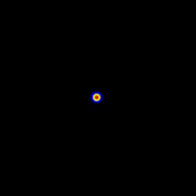
Important Links
SN1993J in M81
NRAO Help Desk
https://help.nrao.edu
VLBA Observational Status Summary
http://www.vlba.nrao.edu/astro/obstatus/current/
EVN Sensitivity Calculator
http://www.evlbi.org/cgi-bin/EVNcalc
Proposal Submission Tool
my.nrao.edu
SCHED – observation preparation software
http://www.aoc.nrao.edu/software/sched/index.html
AIPS – data reduction software
http://www.aips.nrao.edu/index.shtml
13th Synthesis Imaging Workshop (registration opened Feb 1)
http://www.aoc.nrao.edu/events/synthesis/2012/
10 mas
36,000 AU
Bartel et al. 2000
Notes:
Add helpdesk!

