Slide 1
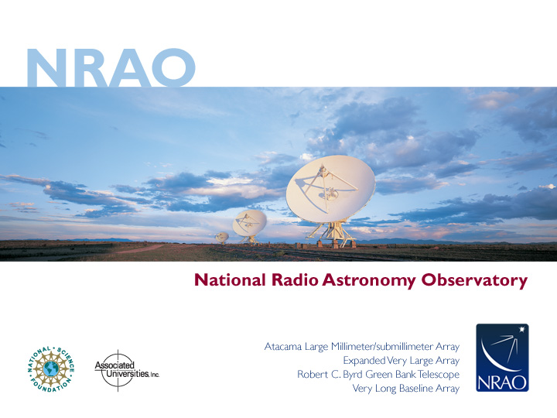
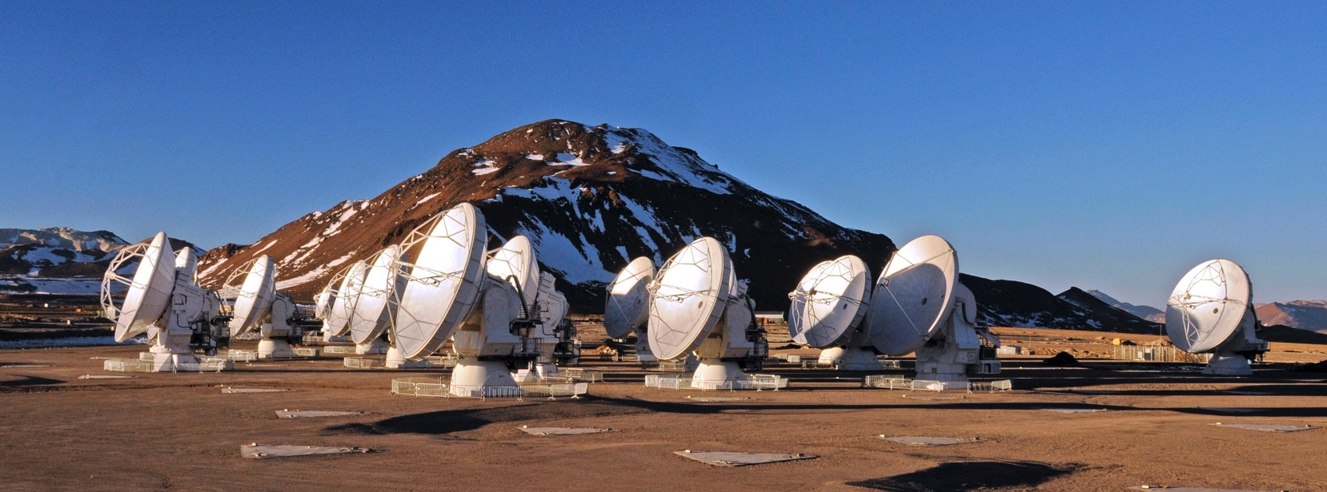
Introduction to Radio Interferometry
Kristina Nyland
Authors: Alison Peck, Jim Braatz, Ashley Bemis, Sabrina Stierwalt
Atacama Large Millimeter/submillimeter Array
Karl G. Jansky Very Large Array
Very Long Baseline Array
Notes:
this talk is key for understanding why you’re being asked to put in different parameters in the OT when you prepare your observations (like largest angular scale and resolution)

Slide 2
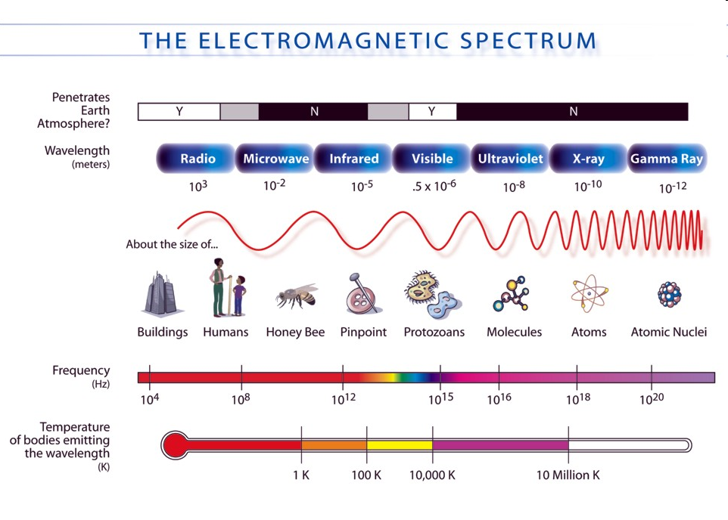
Radio Astronomy
Now used to refer to most telescopes using heterodyne technology
Notes:
Radio astronomy used to be defined with a rough wavelength cut where we have a block of atmospheric transmission and ground-based observations are possible but now this definition has expanded.

Slide 3
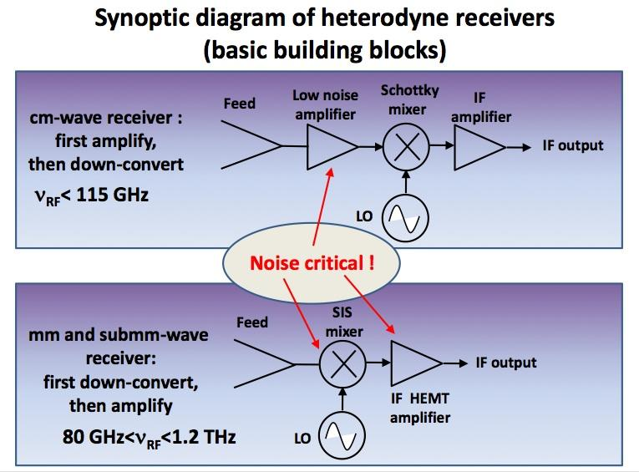
What is heterodyne?
In a heterodyne receiver, observed sky frequencies are converted to lower frequency signals by mixing with a signal artificially created by a Local Oscillator. The output can then be amplified and analyzed more easily while retaining the original phase and amplitude information.
Image from Alessandro Navarrini (IRAM)
Notes:
A newer definition of radio astronomy relates it to signals that require the use of heterodyne technology to detect. The process varies slightly at different wavelengths within the radio regime, but the important step is that observed sky frequencies are mixed with an LO to produce a lower frequency signal (i.e. they are down converted) so that they can be analyzed more easily (electronics can deal with them more easily).
Down converting helps because receiver only has to work at IF output frequency

Slide 4
Resolution of Observations
Angular resolution for most telescopes is ~ λ/D
  D is the diameter of the telescope and λ is the wavelength of observation
For the Hubble Space Telescope:
λ ~ 1um / D of 2.4m = resolution ~ 0.13”
To reach that resolution at λ ~1mm, we would need a 2 km-diameter dish!
Instead, we use arrays of smaller dishes to achieve the same high angular resolution at radio frequencies
This is interferometry!
Notes:
So to get these resolutions that we are showing in these images …
The biggest dishes we have are ~500m
What kind of resolutions can we get at radio wavelengths?
So we can build larger telescopes or go to smaller wavelengths
In a way like using a giant mirror which is very dirty. The only places that it’s reflective are where you have antennas on the ground.

Slide 5
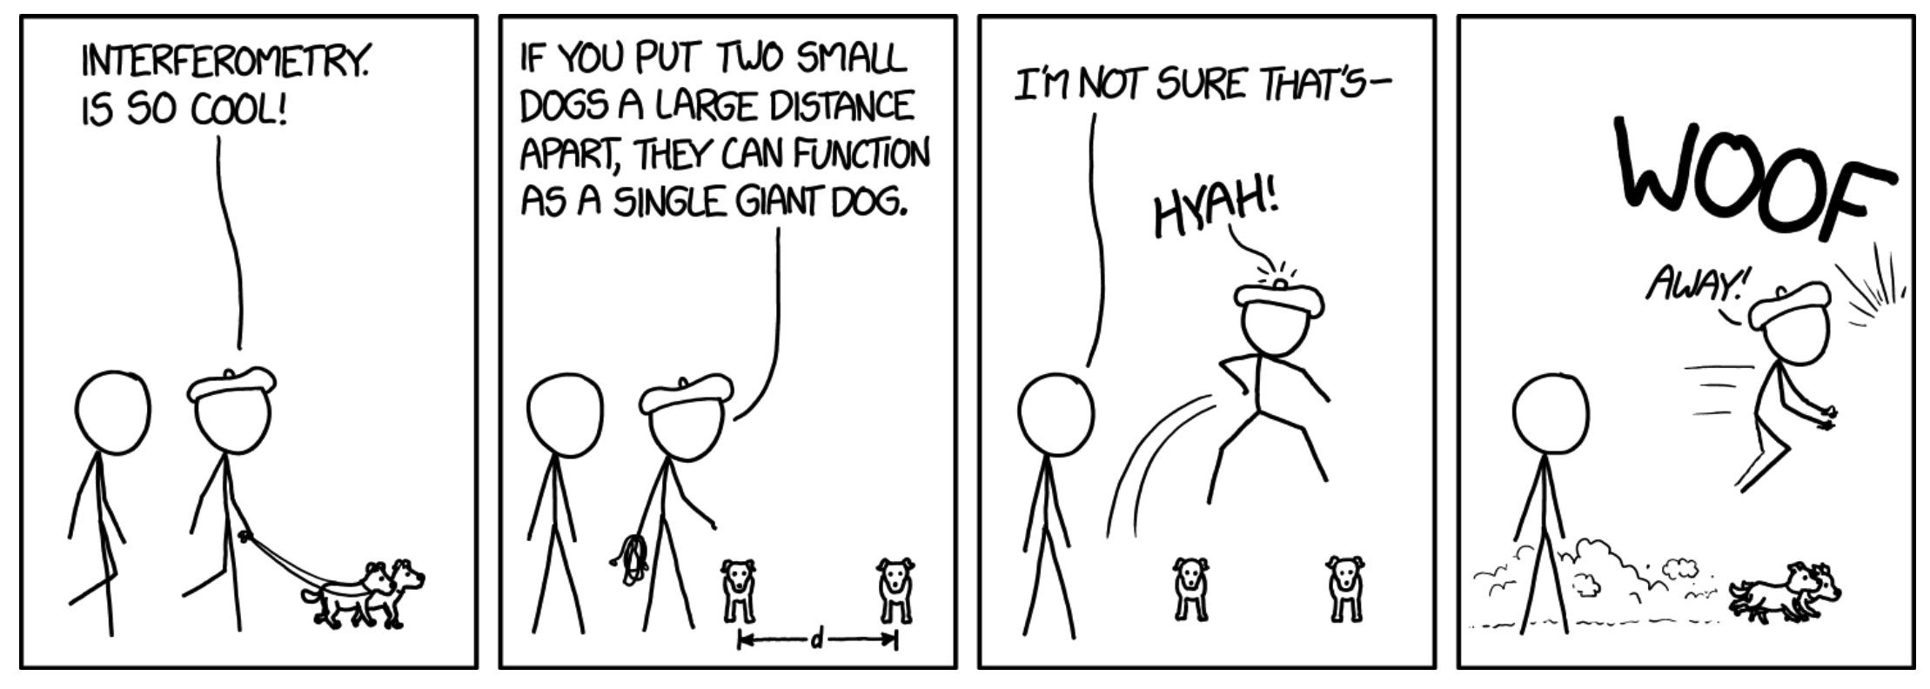
How Does Interferometry Work?

Slide 6
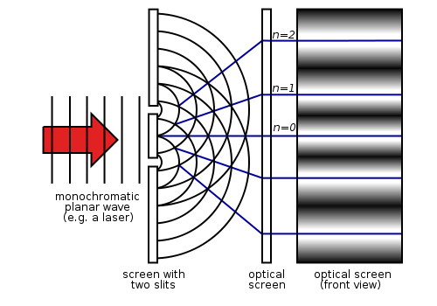
In reality . . .
An interferometer measures the interference pattern produced by multiple apertures, much like a 2-slit experiment
*However, the interference patterns measured by radio telescopes are produced by multiplying - not adding - the wave signals measured at the different telescopes (i.e. apertures)
Notes:
You may recall the double slit experiment from your first year physics classes …

Slide 7
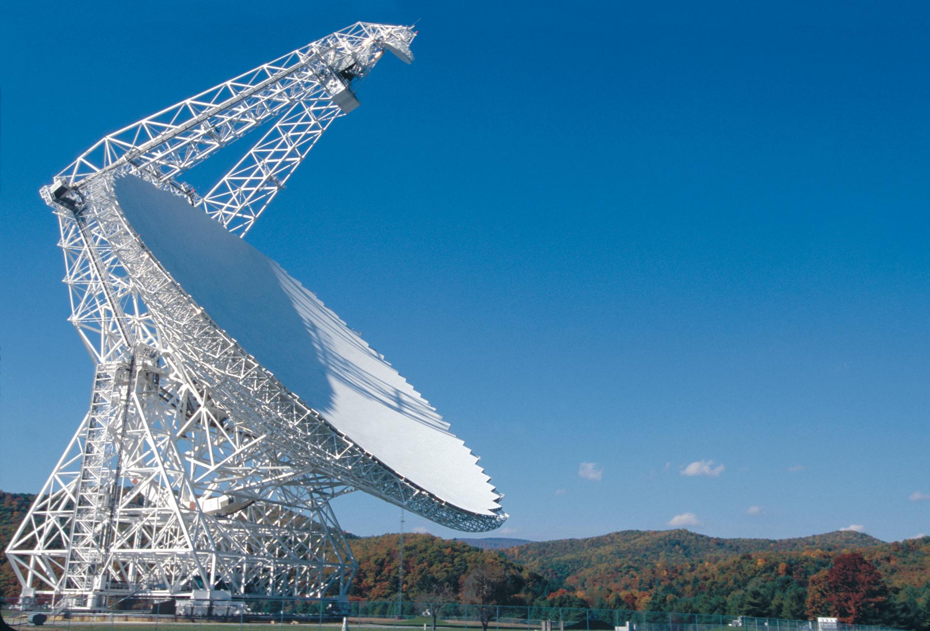
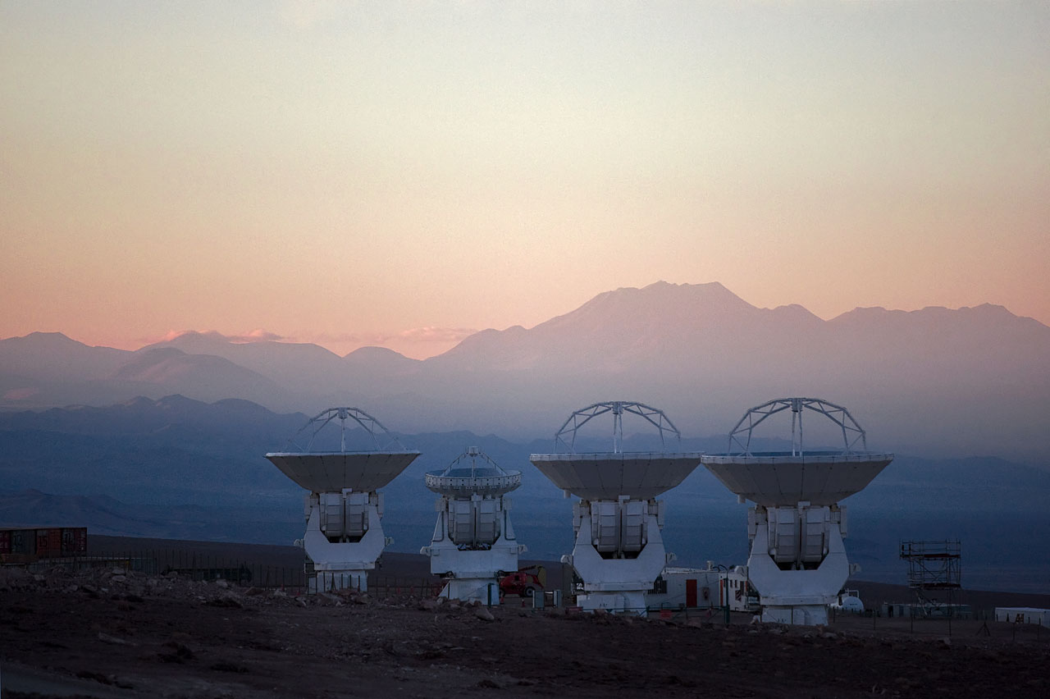
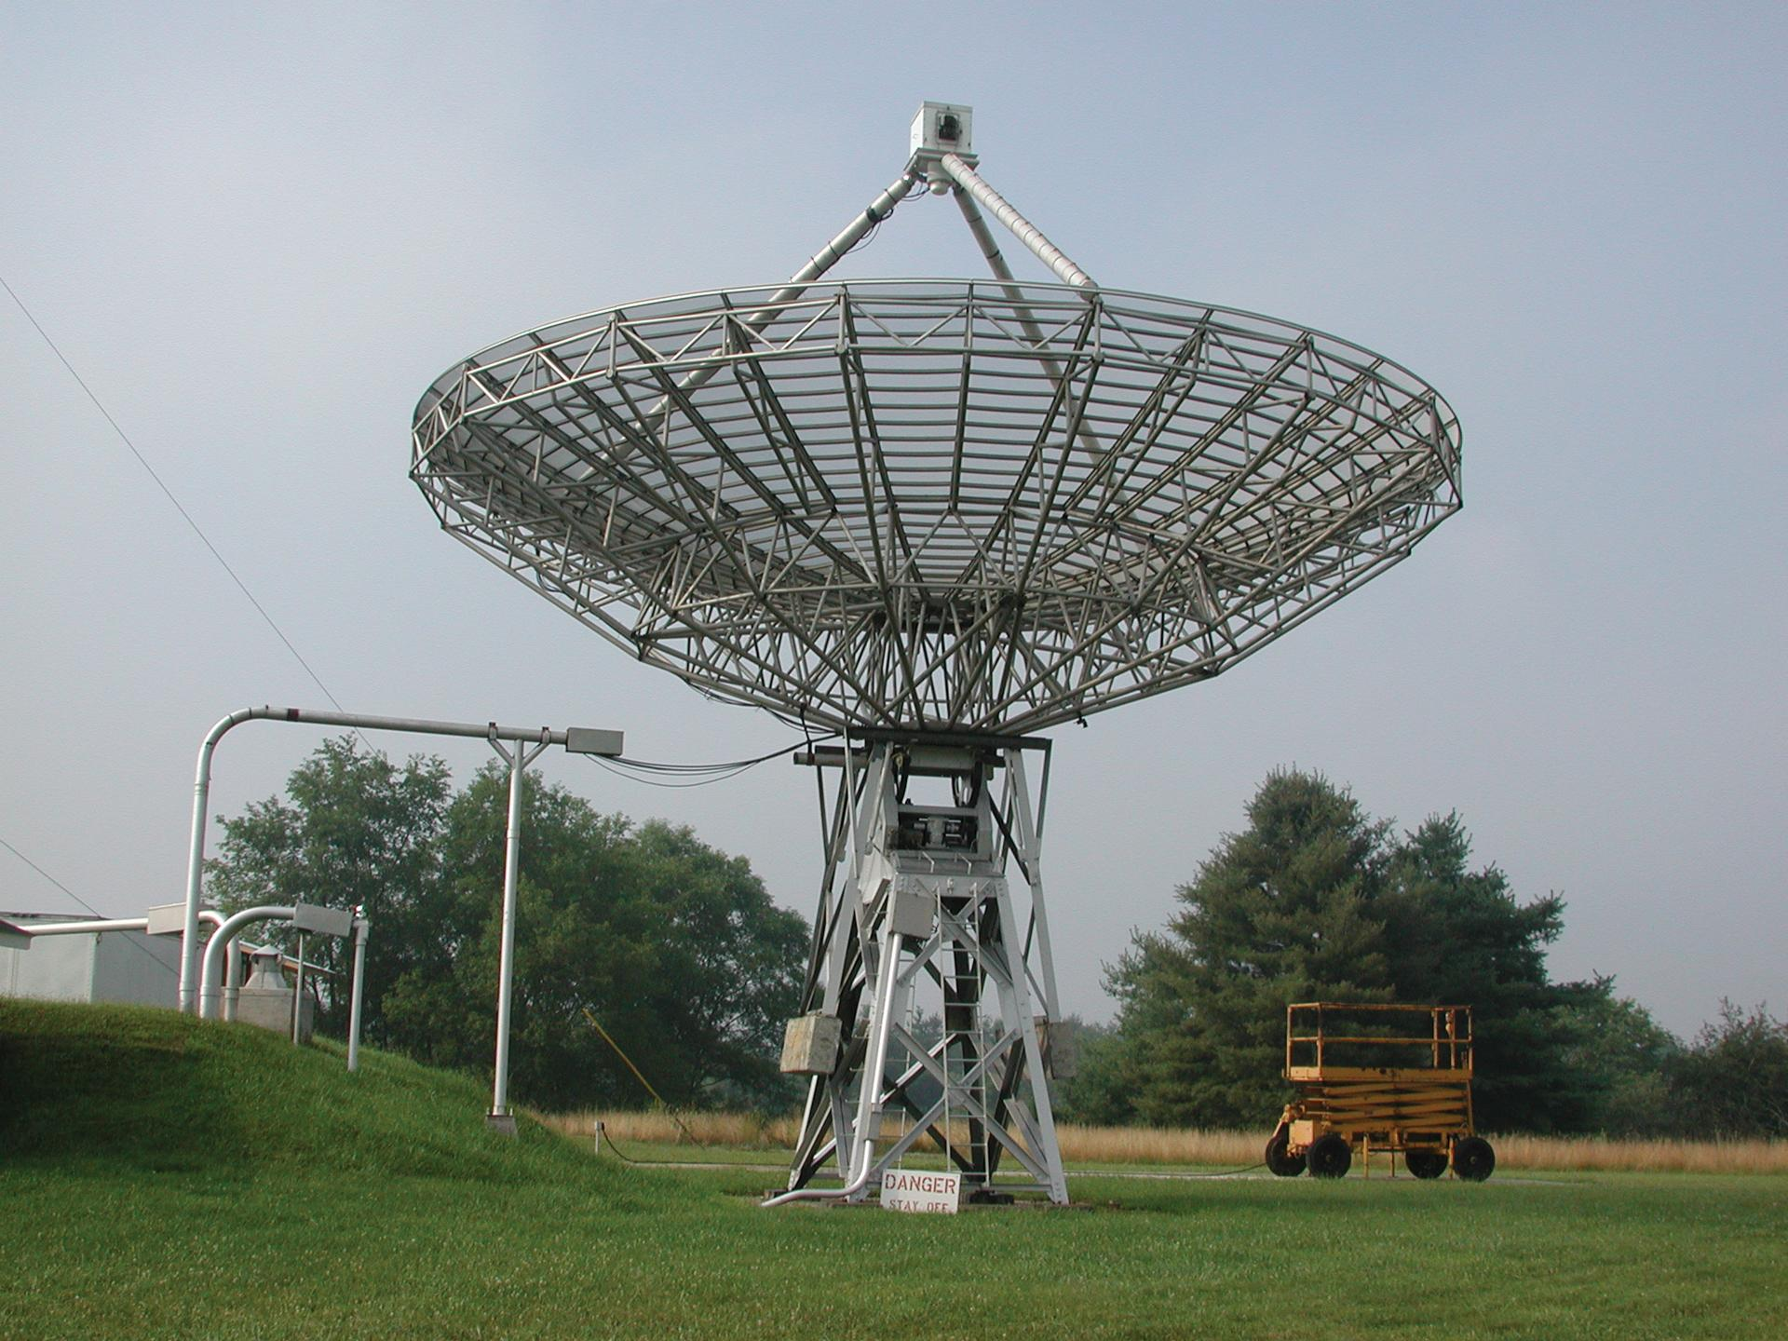
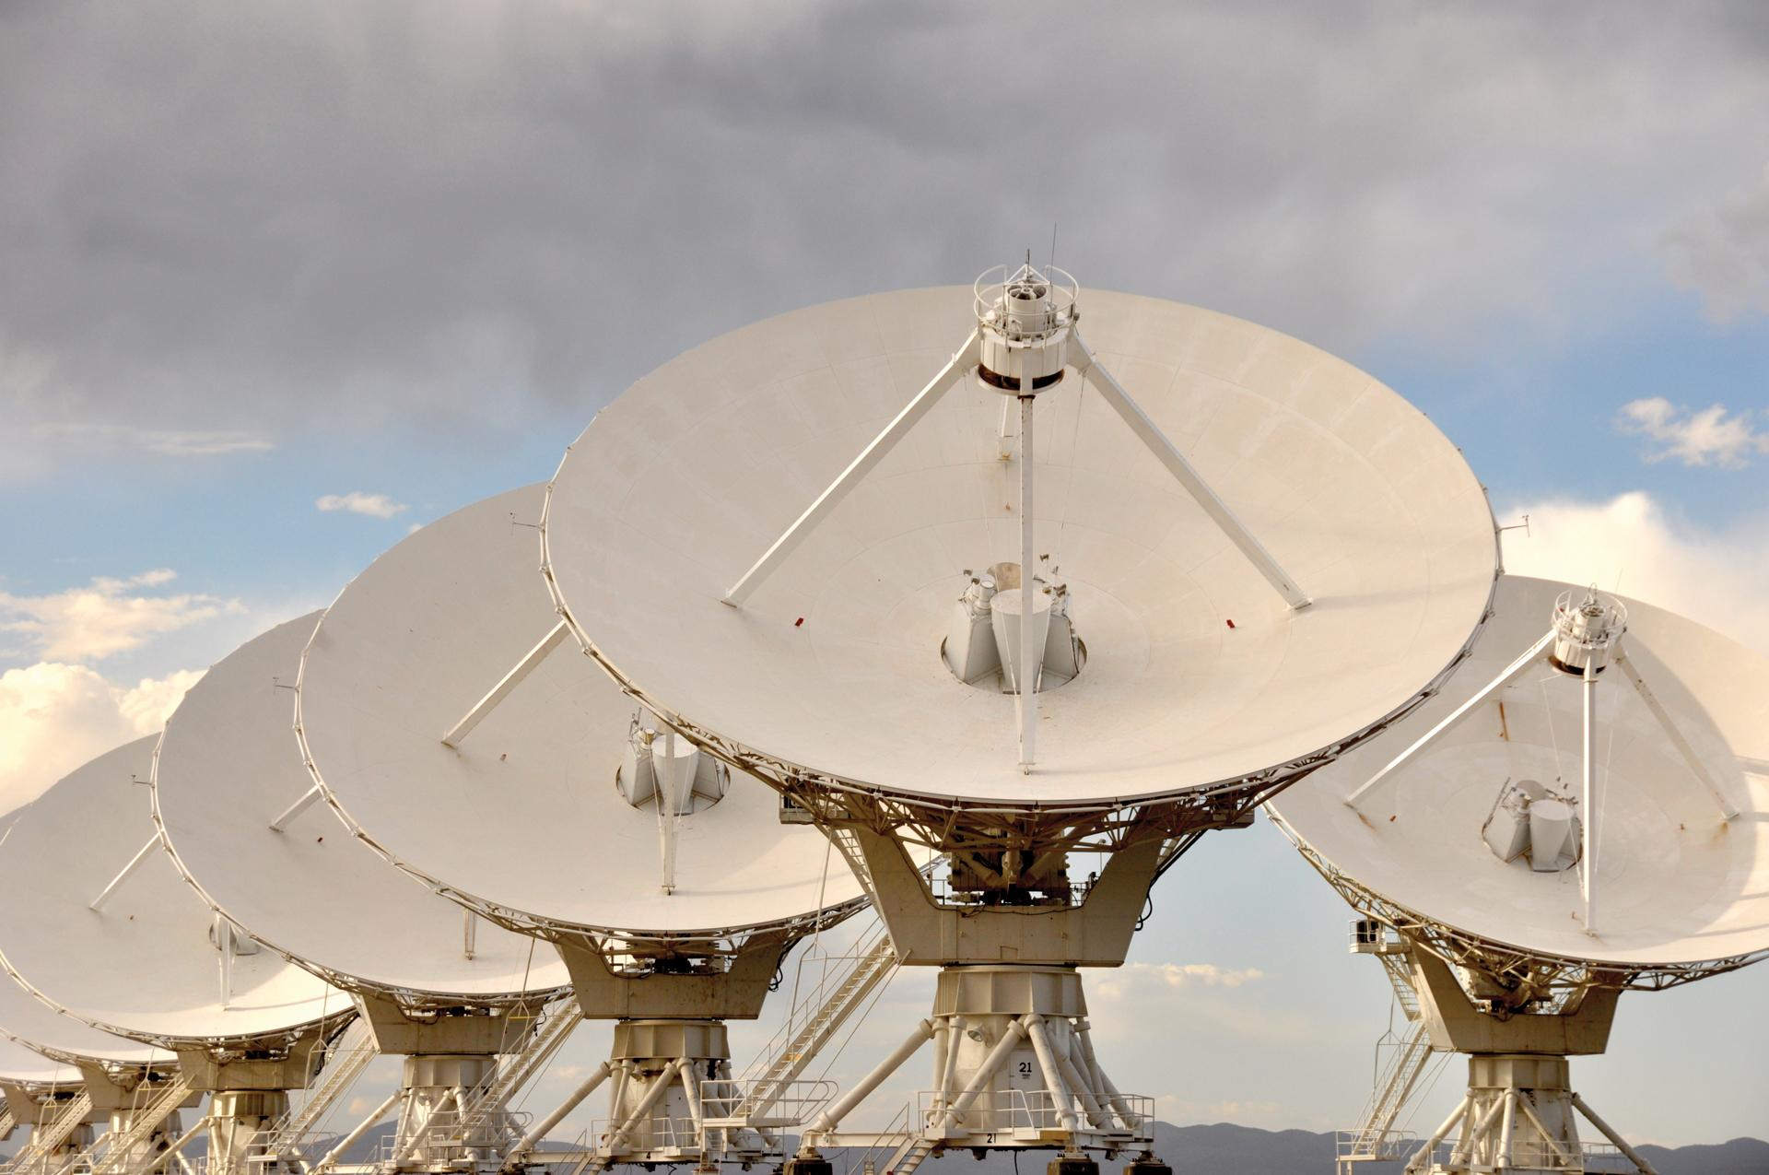
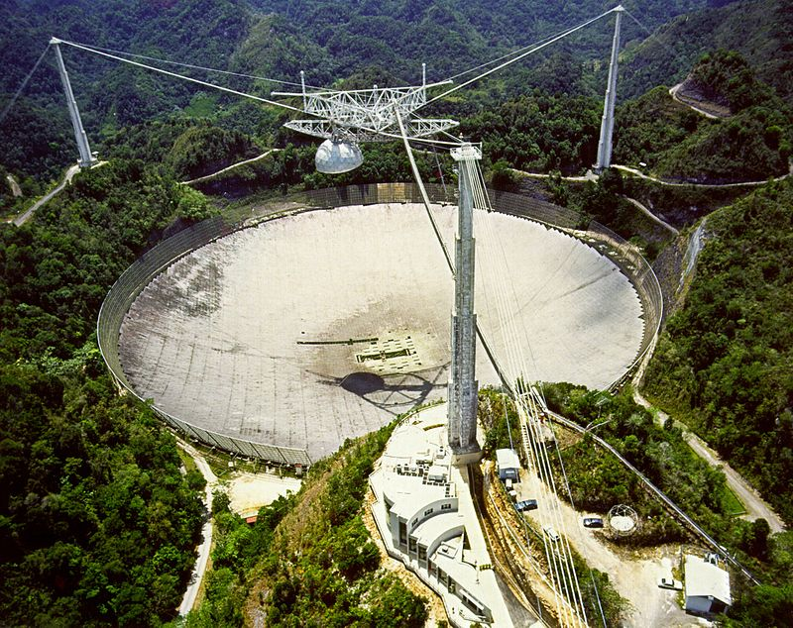
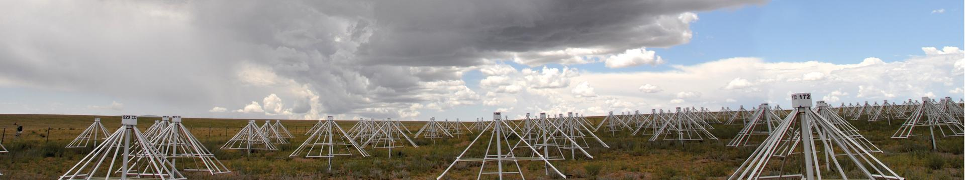
Long wavelength means no glass mirrors
Notes:
The imperfections in your dish can be relative to the wavelengths you are observing. No more pristine glass mirrors! On the bottom: LWA in New Mexico (decameter array i.e. 10 meters)

Slide 8
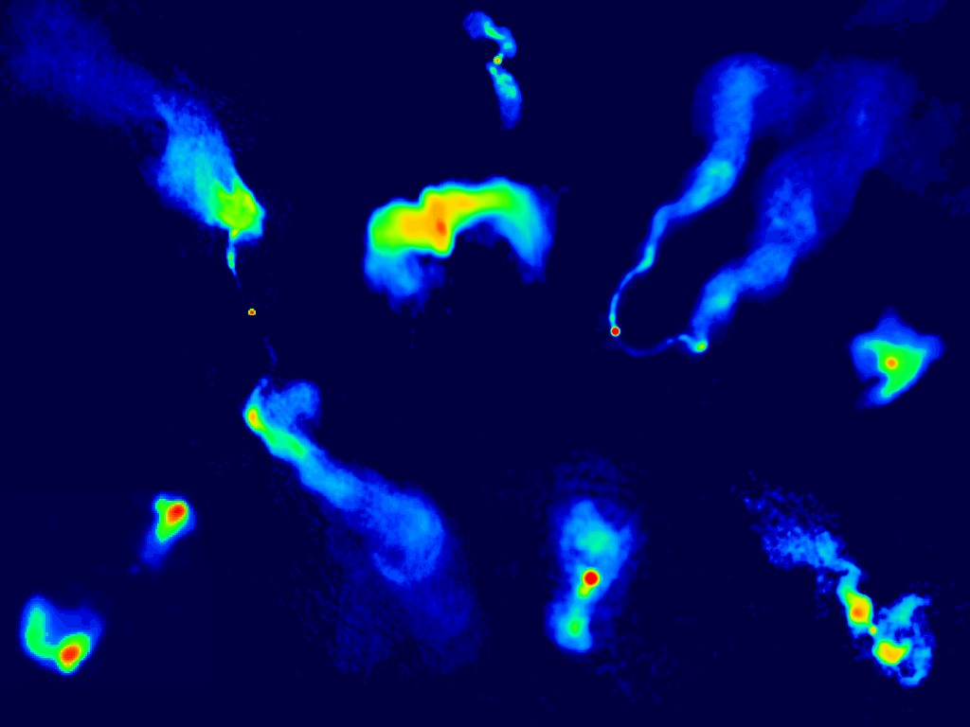
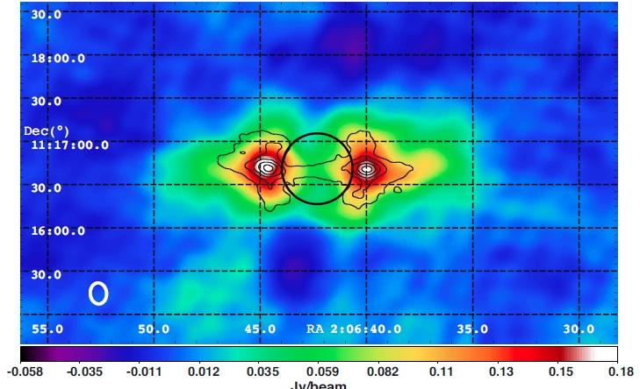
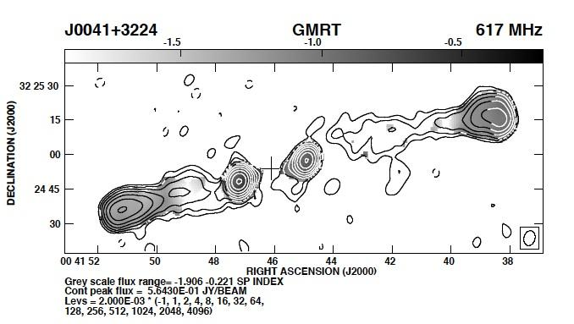
What can we observe? (MHz-GHz range)
Jupiter’s radiation belt at 100MHz
Relic emission from old radio galaxies
Synchrotron emission from extended radio galaxies (5 GHz)
Images from NRAO Image Gallery: http://images.nrao.edu/
Notes:
Synchrotron emission from Jupiter’s radiation belt
Emission is nonthermal so it doesn’t depend on temperature of source, just need electrons spiraling around a magnetic field

Slide 9
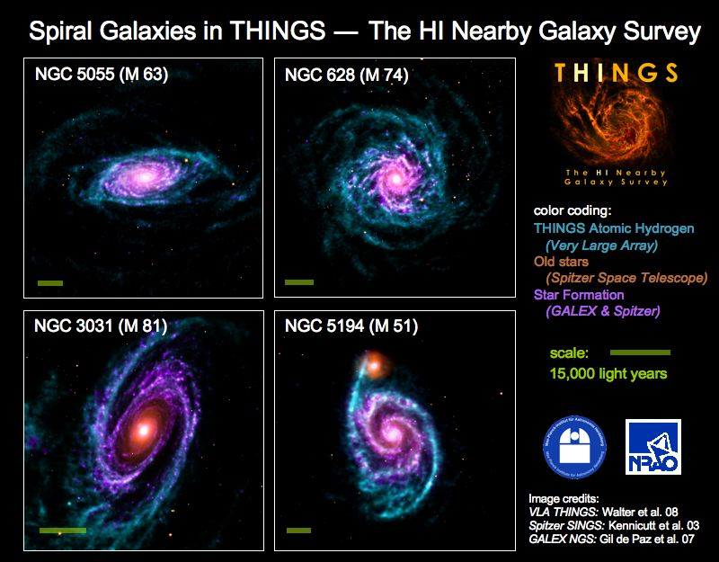
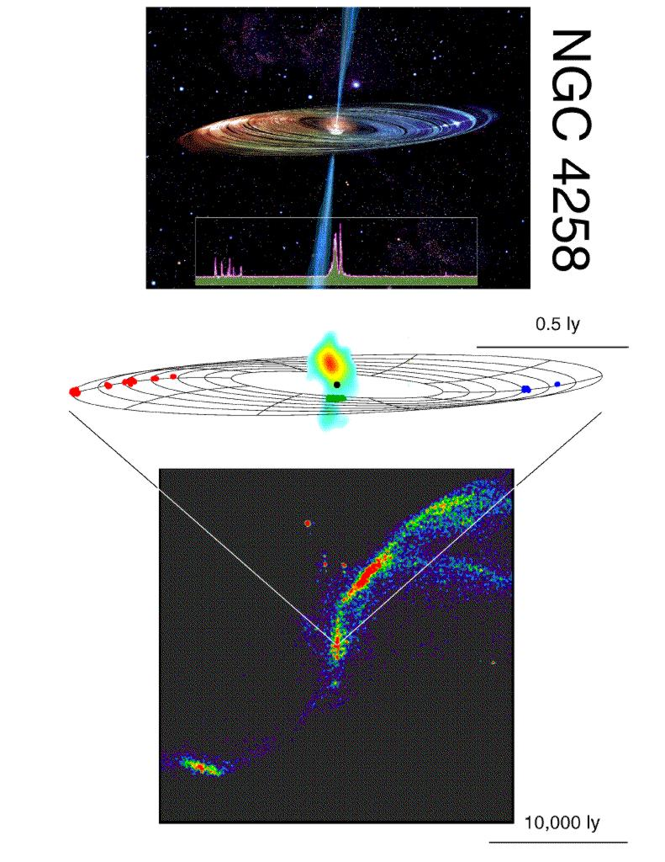
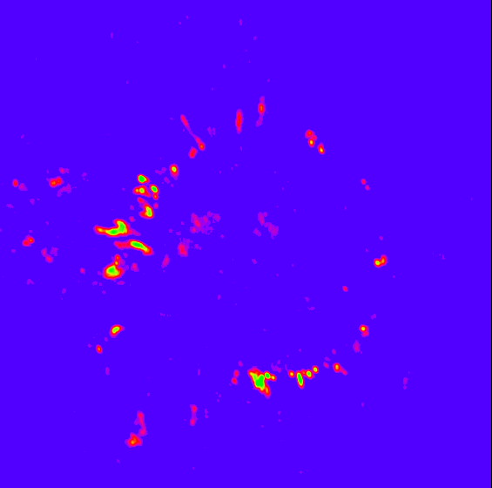
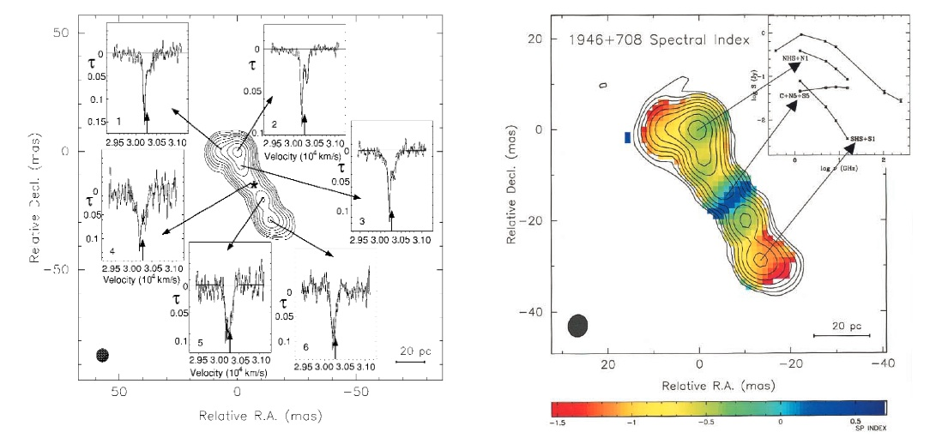
What can we observe?
Images from NRAO Image Gallery
http://images.nrao.edu/
At low frequencies (MHz-GHz):
H₂O, OH or SiO masers in galaxies and stars
HI emission and absorption, free-free absorption in galaxies
Notes:
Masers are similar to lasers, but at microwave frequencies (hence the name), and they occur in space. So when you have a region that has molecular gas, and enough energy is being dumped into it, either radiatively or collisionally, you can get population inversion which will amplify any ambient emission
Blue/purple in lower left: Watching the atmosphere of the Mira variable star via SiO masers as star fluctuates

Slide 10
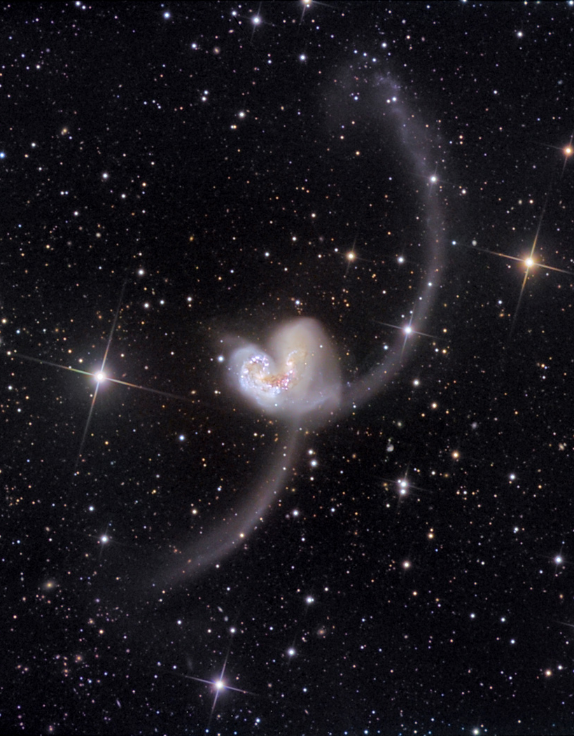
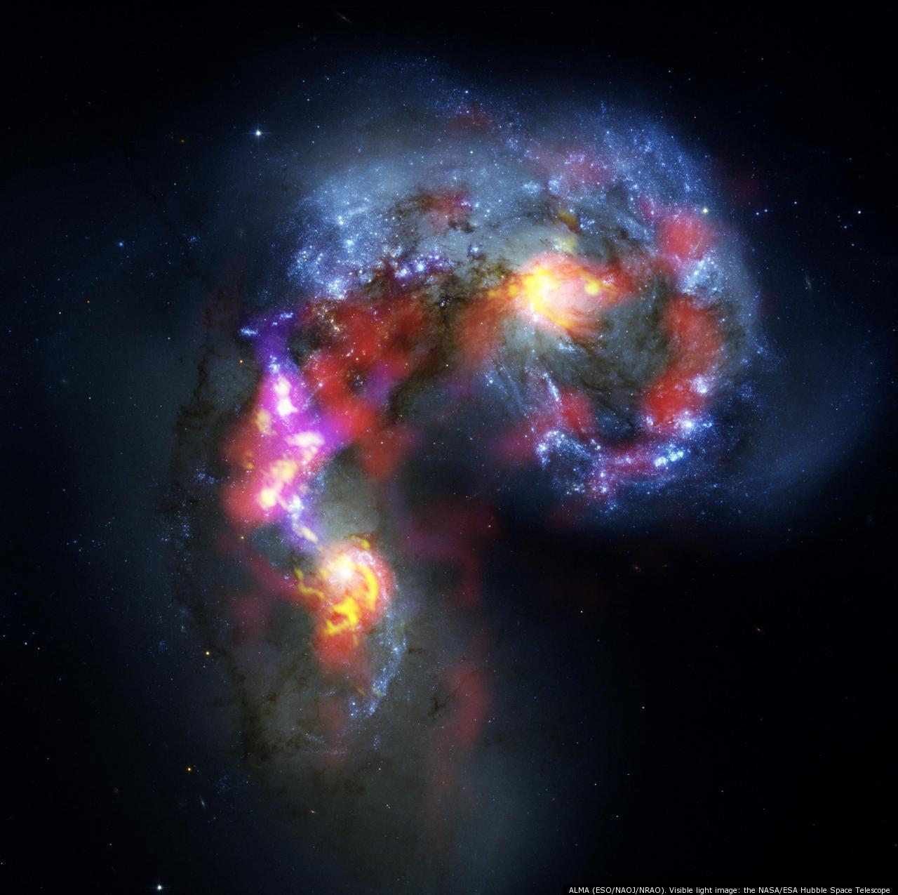
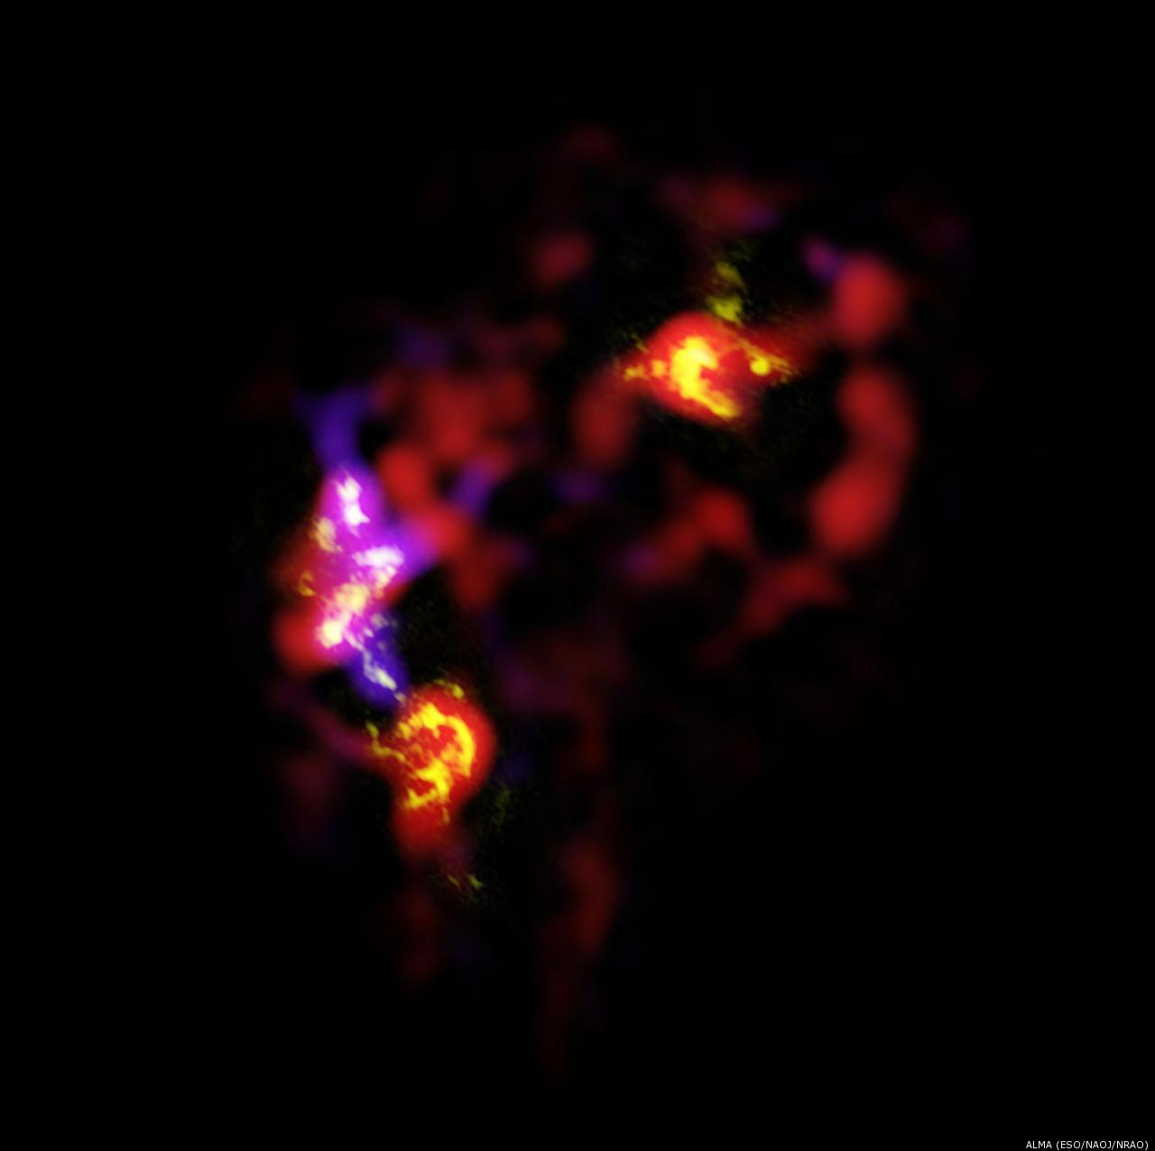
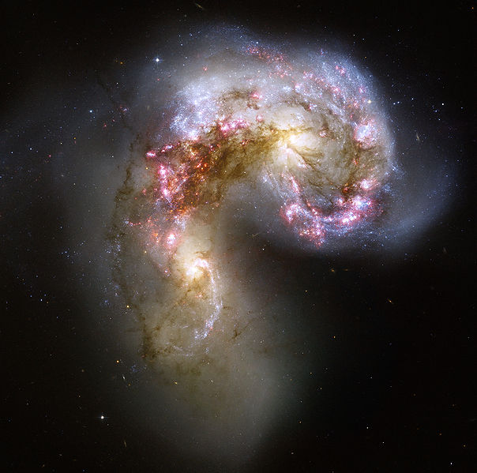
At higher frequencies we can observe a broad range of molecular lines
What can we observe?
ALMA Cycle 0 Image of CO gas
Notes:
These galaxies are in the process of colliding, and as a result there are regions where dense carbon monoxide gas traces very high rates of star formation in their overlap region
Very close example of recent merger (22 Mpc and 100 million years ago), five supergiant molecular cloud regions in the overlap region
Band 7 CO(3-2)

Slide 11
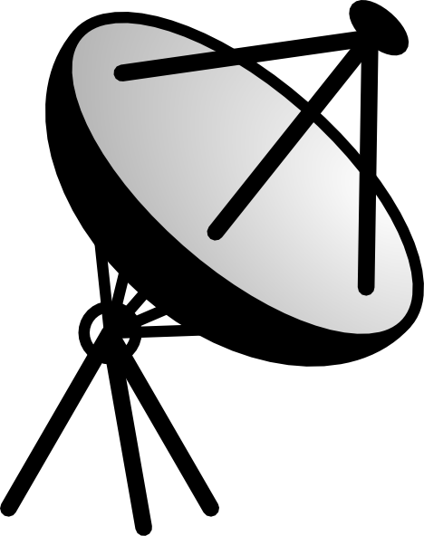
How Do We Use Interferometry?
Signal arrives at each antenna at a different time (due to different travel lengths) depending on the location of the antenna in the array
Signals are then combined in a correlator, where the time delay is measured and compensated for
Notes:
A signal from space arrives at each antenna at a slightly different time (due to different travel lengths) depending on the location of the antenna in the array.
The signal from each antenna is then combined with every other antenna in a correlator, where the time delay is measured and compensated for in the software.
The signals arriving from slightly different points in the sky arrive at slightly different times at each antenna. This provides location information within the telescope beam and thus positional information about the emitting object.

Slide 12
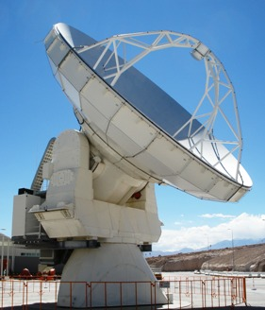
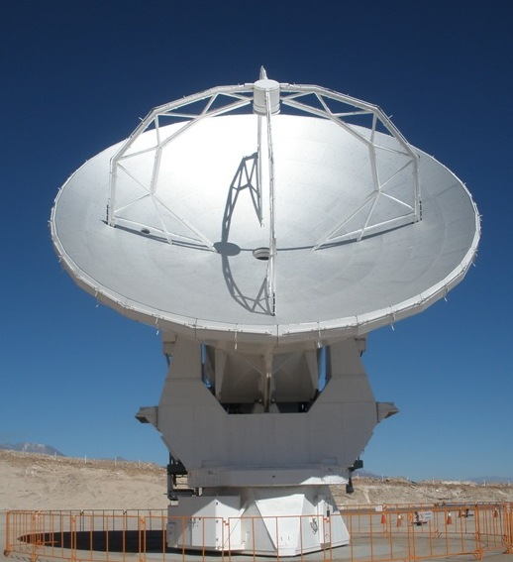
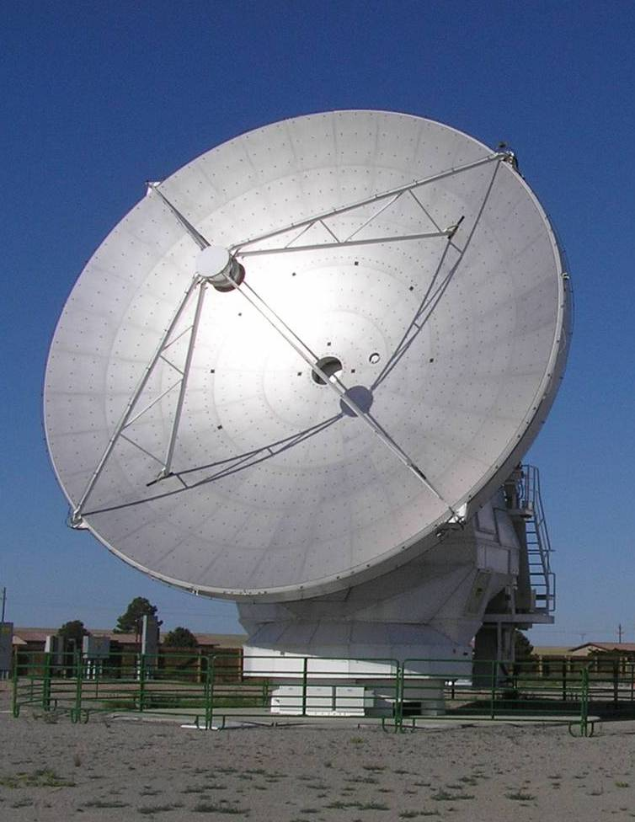
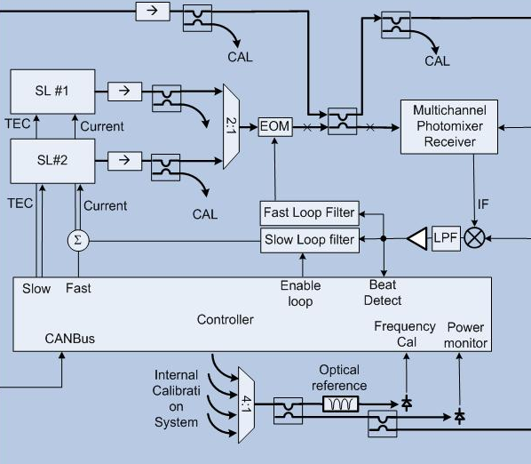
Some Instrument Details
Reference
To precisely measure arrival times we need very accurate clocks
At Band 10 one wavelength error = 1 picosecond = 10⁻¹² s (!!)
Need << 1 wavelength timing precision, so each antenna has an on-board clock with high sampling rates
Once determined, the reference time is distributed to all antennas
Notes:
Signals going out to the antennas involved control software for pointing and tracking sources, for tuning the receivers, for timing reference, for additional commands such as putting the hot load in the beam to measure the system temperature or to update the subreflector position. Signals coming back from the antennas involve device health, fiber polarization to check the fiber length, the astronomical signal that’s going into the correlator

Slide 13
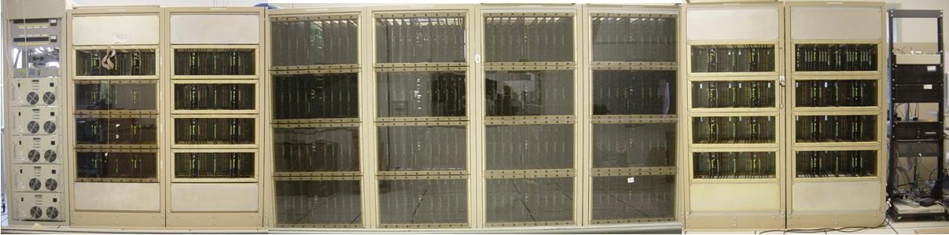
Some Instrument Details
Signals from each antenna are digitized and sent to the correlator for multiplication & averaging
For ~50 antennas, the data rate is 600 GB/sec for the correlator to process
Notes:
8 windows * 4Gsps * 3bits = 12GB per second from each antenna = 600 GB/sec for correlator to process

Slide 14
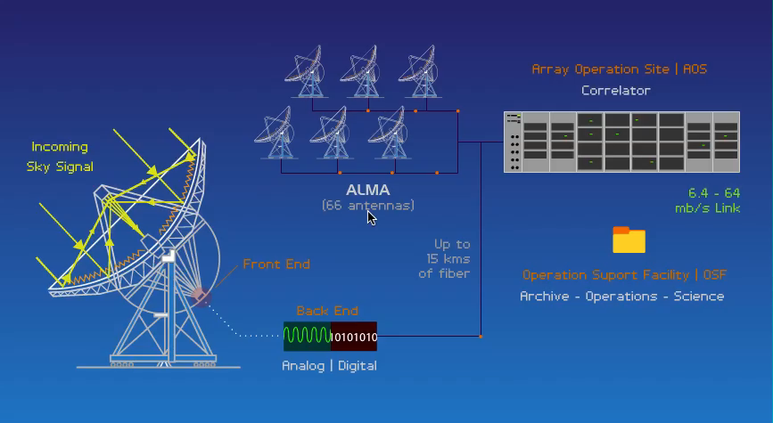
An Interferometer In Action
Notes:
Incoming signal comes in, gets focused and then converted to a digital signal in the receiver
This is done for all antennas and then the signals are sent to the correlator for multiplying and averaging

Slide 15
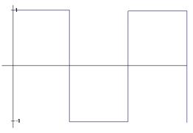
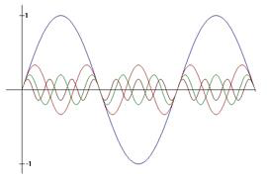
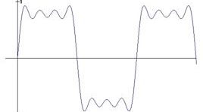
Introducing the Fourier Transform
Fourier theory states that any well behaved signal (including images) can be expressed as the sum of sinusoids
Reference signal
4 sinusoids
Sum of sinusoids & signal
The Fourier transform is the mathematical tool that decomposes a signal into its sinusoidal components
The Fourier transform contains all of the information of the original signal
Notes:
Now why does any of this (i.e. interferometry) work? Because of FTs! Thanks to FTs you can decompose any incoming periodic signal into a series of sine waves
No information is lost, so you can transform back and forth. That means that you can process interference patterns from the telescope, and also that you can simulate observations to help plan your observations, like what resolution you need, and how much time you should spend on source

Slide 16
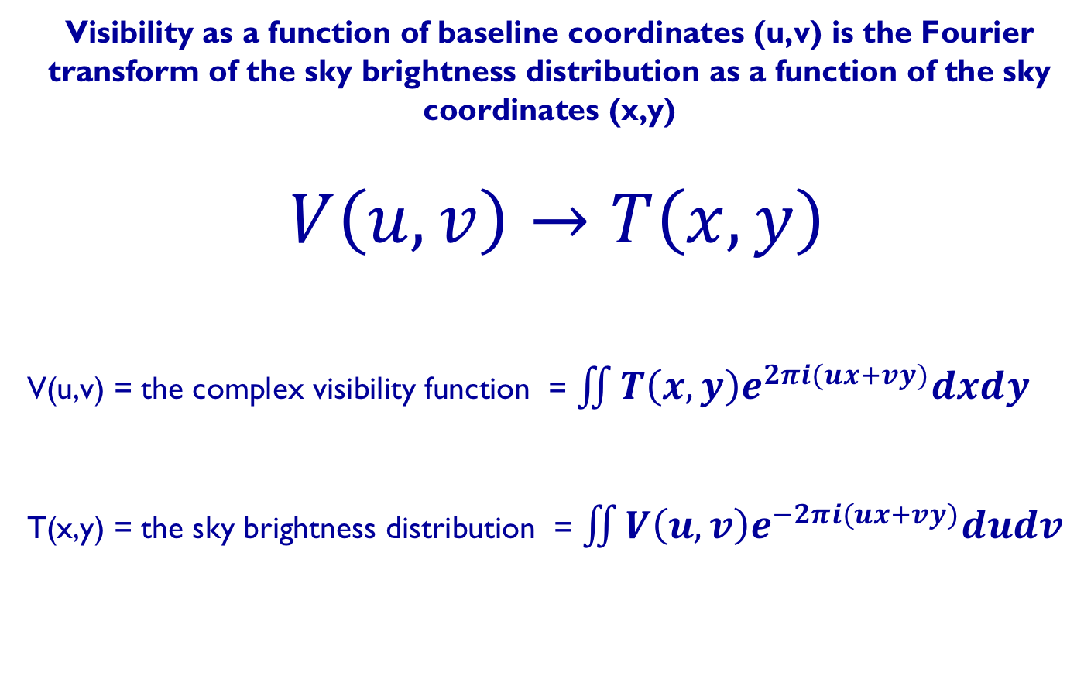
Visibility and Sky Brightness
The van Cittert-Zernike theorem
Visibility as a function of baseline coordinates (u,v) is the Fourier transform of the sky brightness distribution as a function of the sky coordinates (x,y)
$$V\left(u,v\right)→T\left(x,y\right)$$
V(u,v) = the complex visibility function = $\iint{T\left(x,y\right)e^{2πi(ux+vy)}dxdy}$
T(x,y) = the sky brightness distribution = $\iint{V\left(u,v\right)e^{−2πi(ux+vy)}dudv}$
FT
Notes:
The Fourier Transform relates the measured interference pattern to the radio intensity on the sky
An interferometer measures the interference pattern produced by pairs of apertures.
The interference pattern is directly related to the source brightness:
For small fields-of-view: the complex visibility, V(u,v), is the 2D Fourier transform of the brightness on the sky, T(x,y)
What we measure is the complex visibility and it has info about the phase and amp – this is what we transform
“small fields of view” just means on spatial scales where the sky can be considered flat (esp true for ALMA)

Slide 17
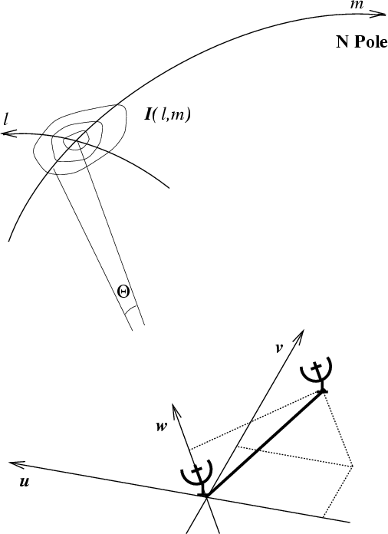
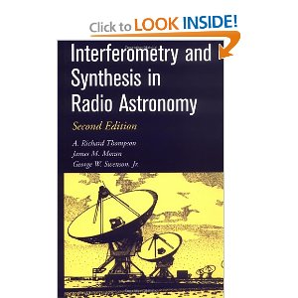
The Fourier Transform relates the measured interference pattern to the radio intensity on the sky
Fourier space/domain
image plane
y
x
T(x,y)
Image space/domain
uv plane
(for more info, see e.g. Thompson, Moran & Swenson)
Notes:
These equations are what allow us to convert the information that we receive in the u,v, plane down here at the antennas to the x,y plane that we see on the sky. You can learn more about how Fourier transforms make interferometry possible in this book.

Slide 18
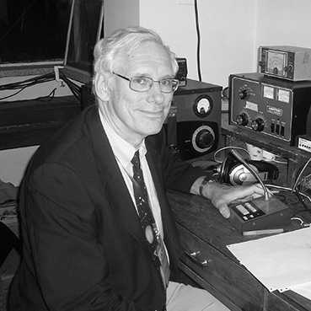
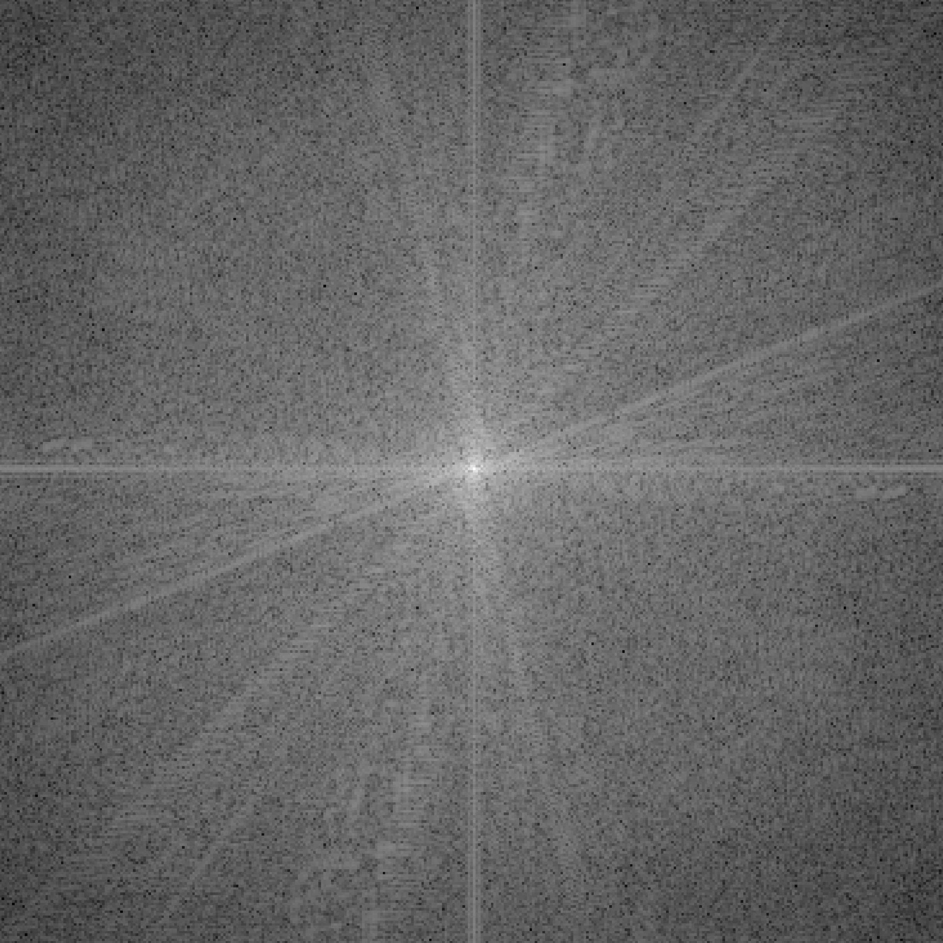
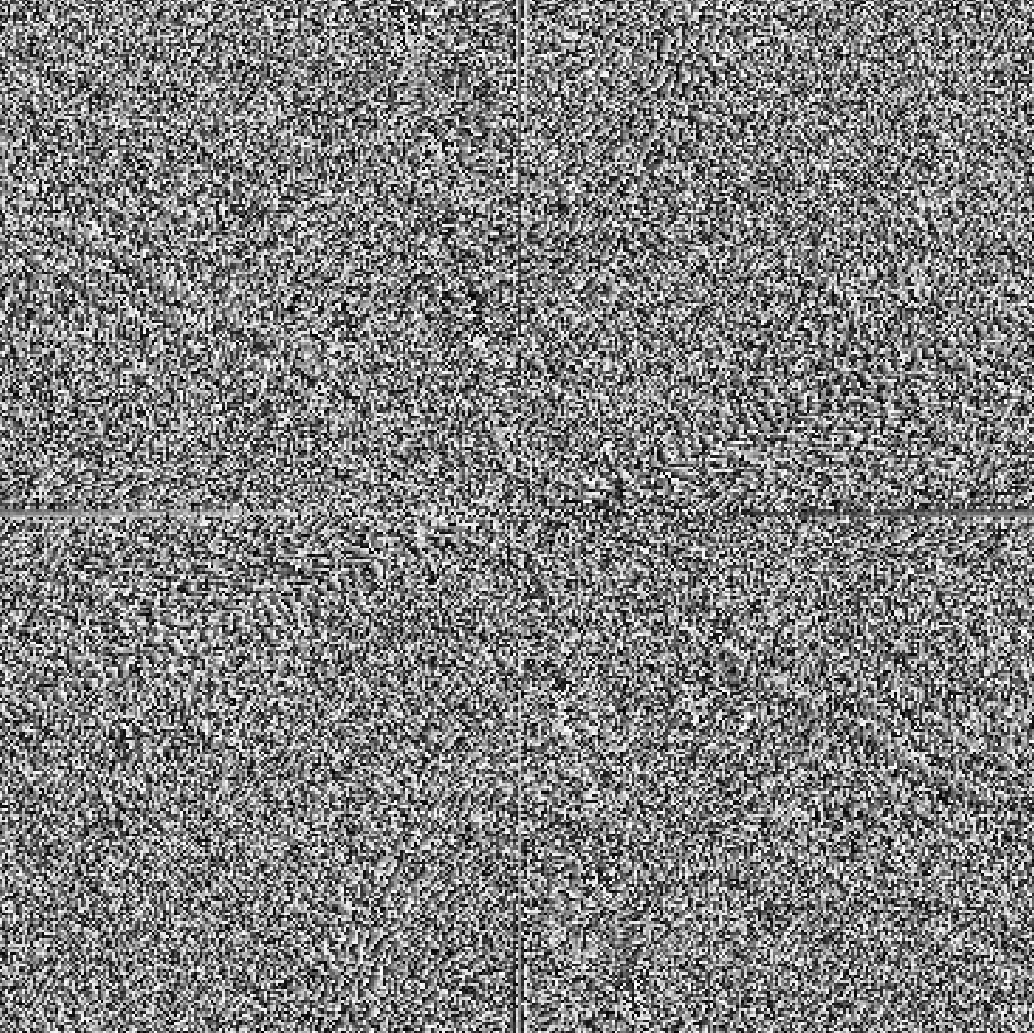
What Are Visibilities?
Each V(u,v) contains information on T(x,y) everywhere
Each V(u,v) is a complex quantity
Expressed as (real, imaginary) or (amplitude, phase)
FT
T(x,y)
V(u,v) amplitude
V(u,v) phase

Slide 19
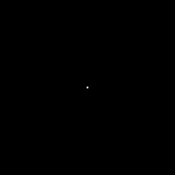

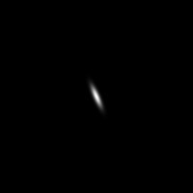
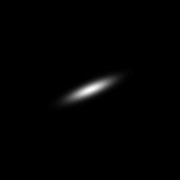
Examples of 2D Fourier Transforms
T(x,y)
V(u,v) amplitude
δ Function
FT
Constant
Elliptical Gaussian
FT
Elliptical Gaussian
Rules of the Fourier Transform:
Narrow features transform to wide features (and vice versa)

Slide 20

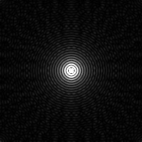
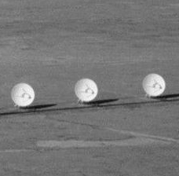
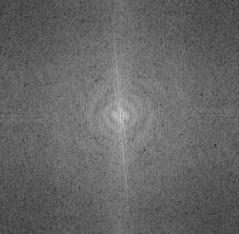
Examples of 2D Fourier Transforms
T(x,y)
V(u,v) amplitude
Uniform Disk
FT
Bessel Function
VLA Antennas
FT
Bessel Function!
Rules of the Fourier Transform:
Sharp features (edges) result in many high spatial features

Slide 21

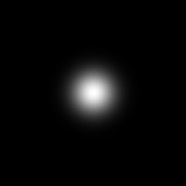


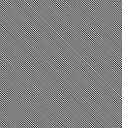
Examples of 2D Fourier Transforms
T(x,y)
V(u,v) amplitude
V(u,v) phase
Centered Gaussian
FT
Offset Gaussian
FT
Rules of the Fourier Transform:
Amplitude tells you ‘how much’ of a spatial frequency
Phase tells you ‘where’ the spatial frequency is
Notes:
The fringe spacing depends on wavelength and baseline length. A shorter baseline gives you a larger fringe spacing. A second unresolved source, off axis, will give you another fringe pattern which is shifted, or offset in phase.

Slide 22
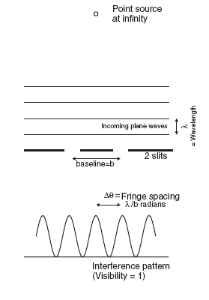
Visibility and Sky Brightness
Graphic courtesy Andrea Isella
1
|V|
0.5
b₂
b₁
0
b₂
b₁
Δθ=λ/b
b (meters)
Δθ=λ/b
The visibility is a complex quantity:
  - amplitude tells “how much” of a certain frequency component
  - phase tells “where” this component is located
phase
Notes:
The fringe spacing depends on wavelength and baseline length. A shorter baseline gives you a larger fringe spacing. A second unresolved source, off axis, will give you another fringe pattern which is shifted, or offset in phase.

Slide 23
Visibility and Sky Brightness
Graphic courtesy Andrea Isella
Resolved source
1
V
0.5
b₁
0
b₃
b₂
b₁
b (meters)
Notes:
For a resolved source, it’s a little bit more complicated. Assuming you point the telescope at the brightest part, you get a fringe pattern from the peak. You also get a fringe pattern from points further out, where the emission is weaker, and there is a phase offset because it’s off to the side. Here’s another point closer in, stronger, smaller phase offset. Shorter baselines are sensitive to larger areas on the sky, so you’re integrating more flux. The longest baselines may detect no signal at all…
We are building up information about our signal: the amplitude is telling you how bright it is and the phase is telling you WHERE it is

Slide 24
Basics of Aperture Synthesis
Idea: Sample V(u,v) at an enough (u,v) points using distributed small aperture antennas to synthesize a large aperture antenna of size (u_{max},v_{max})
One pair of antennas = one baseline
For N antennas, we get N(N-1) samples at a time
How do we fill in the rest of the (u,v) plane?
Earth’s rotation
Reconfigure physical layout of N antennas
One baseline = 2 (u,v) points

Slide 25
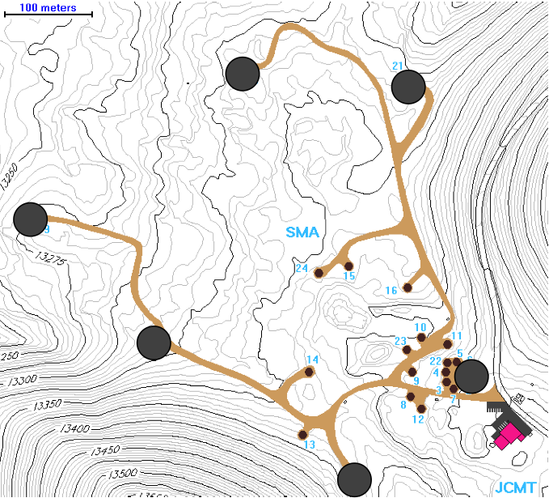
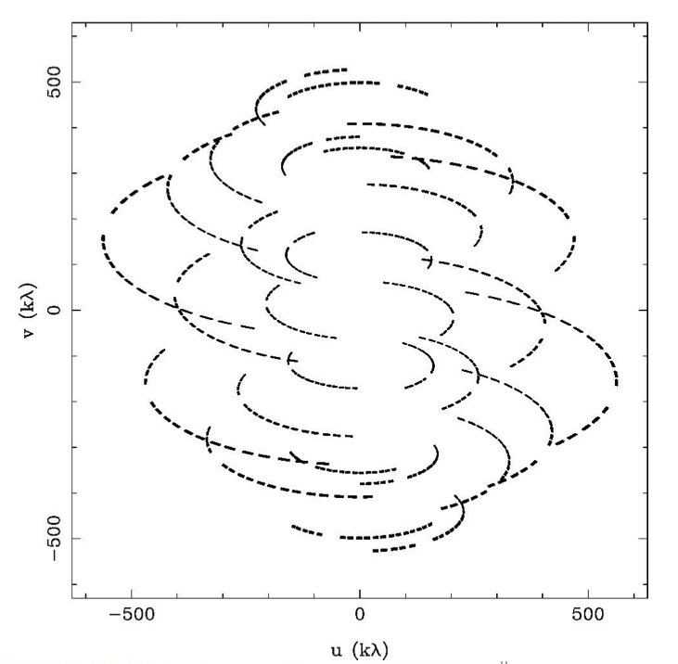
(u,v) Plane Sampling
Very Extended SMA configuration
(most extended baselines)
345 GHz, DEC = +22

Slide 26


(u,v) Plane Sampling
Extended SMA configuration
(extended baselines)
345 GHz, DEC = +22

Slide 27


(u,v) Plane Sampling
Compact SMA configuration
(compact baselines)
345 GHz, DEC = +22

Slide 28


(u,v) Plane Sampling
Combine multiple configurations to get the most complete coverage of the (u,v) plane

Slide 29






Implications of (u,v) Coverage
What does it mean if our (u,v) coverage is not complete?
V(u,v) amplitude
V(u,v) phase
T(x,y)
Missing High Spatial Frequencies
FT
Missing Low Spatial Frequencies
FT

Slide 30


Sampling Function
Each antenna pair samples only one spot; the array cannot sample the entire Fourier/uv domain resulting in an imperfect image
Small uv-distance: short baselines (measure extended emission)
Long uv-distance: long baselines (measure small scale emission)
Orientation of baseline also determines orientation in the uv-plane
Notes:
Note the incomplete filling of the uv plane. Central hole means missing total flux

Slide 31
uv coverage: why the central hole?
The central hole in the sampling of the uv plane arises due to short baselines
The largest angular scale that an interferometer is sensitive to is given by the shortest distance between 2 antennas.
The field of view is given by the beam of a single antenna.
A single antenna diameter will always be < the shortest distance between two antennas.
So the field of view is always > the largest angular scale
If your source is extended, you will always have some flux at short spacings (i.e. extended emission) that is not recovered.
Solutions: We can extrapolate to these shorter spacings after our observations are taken (more on this tomorrow!) or we can fill in the information with 7m observations or ultimately single dish data.

Slide 32
Characteristic Angular Scales
Angular resolution of telescope array:
~ λ/B_{max} (B_{max} = longest baseline)
Maximum angular scale:
~ λ/B_{min} (B_{min} = shortest distance between antennas)
Field of view (FOV):
~ λ/D (D = antenna diameter)
*Sources more extended than the FOV can be observed using multiple pointing centers in a mosaic
An interferometer is sensitive to a range of angular sizes: λ/B_{max} < θ < λ/B_{min}
Notes:
This slide is super important!!! (as you add arrays it adds time to your proposal and determines when it can be scheduled)
At other wavelengths or with single dishes/mirrors we are used to thinking about resolution. But with interferometry we also have to think about LAS. This is bad because it means that if you have a star-forming region, for example, with hot cores and diffuse gas in between, you don’t gain any information about the diffuse gas. You just don’t detect it, it’s resolved out. On the other hand, this is good because we don’t need to worry about sky brightness on large scales, or atmospheric effects very much, you simply don’t see them. This is called spatial filtering.

Slide 33

Characteristic Angular Scales: M100
ALMA 12m
ACA 7m
Combined
ALMA 12m shows smaller spatial scales (denser, clumpier emission)
ACA 7m data shows larger spatial scales (diffuse, extended emission)
To get both — you need a combined image!
Notes:
Let’s have a look at what this looks like (all moment 0 maps of grand design spiral in Virgo)
We’ll discuss later that there is a way to enter in your desired resolution and your LAS and the OT will tell you if you need additional 7m data

Slide 34
Interferometry: Spatial Scales
The sensitivity is given by the number of antennas times their area
The field of view is given by the beam of a single antenna (corresponding to the resolution for a single dish telescope or the primary beam)
The resolution is given by the largest distance between antennas (called the synthesized beam)
The largest angular scale that can be imaged is given by the shortest distance between antennas

Slide 35

Angular Scales — A Proposal Tip!
Interferometers act as spatial filters - shorter baselines are sensitive to larger targets, so remember …
Spatial scales larger than the smallest baseline cannot be imaged
Spatial scales smaller than the largest baseline cannot be resolved
From the ALMA Cycle 6 Proposal Guide
Notes:
This slide is super important!!! (as you add arrays it adds time to your proposal and determines when it can be scheduled)
At other wavelengths or with single dishes/mirrors we are used to thinking about resolution. But with interferometry we also have to think about LAS. This is bad because it means that if you have a star-forming region, for example, with hot cores and diffuse gas in between, you don’t gain any information about the diffuse gas. You just don’t detect it, it’s resolved out. On the other hand, this is good because we don’t need to worry about sky brightness on large scales, or atmospheric effects very much, you simply don’t see them. This is called spatial filtering.

Slide 36




The Dirty Beam
s(x,y)
“Dirty Beam”
S(u,v)
FT
*
(Convolution)
T_{D}(x,y)
“Dirty Image”
T(x,y)
Notes:
To move to the next slide: the dirty beam is critical to get a good sky brightness. A good psf, make things easier when finding the spatial distritbution of the emission in the sky.

Slide 37



Example: Fringe pattern with 3 Antennas
(3 baselines)
Notes:
Now we are starting to get a little bit more information although still mostly focused in one direction

Slide 38


Example: Fringe pattern with 2 Antennas
(one baseline)
Notes:
With two antennas you can measure the size of an object, or the distance between things, but it’s tough to learn more: you can only constrain your fringe pattern in one direction!

Slide 39


Example: Fringe pattern with 4 Antennas
(6 baselines)
Notes:
With 4 antennas it’s better, but you still get a lot of sidelobes, which is what we call the peaks caused by the point spread function

Slide 40


Example: Fringe pattern with 8 Antennas
(28 baselines)

Slide 41


16 Antennas – Compact Configuration
Notes:
Things quickly improve as we add more and more antennas

Slide 42



16 Antennas – Extended Configuration
Notes:
Remember that longer baselines translate to smaller spatial scales on the sky (FT means bigger to smaller) so your more extended baselines give you higher resolution (but cut out more extended emission)

Slide 43



32 Antennas – Instantaneous
Notes:
With alma you have 50 antennas so n(n-1)/2 = 1225 pairs (and twice as many points on the uv plane) So you can add more visibilities by adding more antennas or …

Slide 44


32 Antennas – 8 hours
Notes:
Here we fill in more uv coverage by letting the earth rotate (i.e. letting time pass) rather than adding more antennas
How much you filli n your uv plane (how well sampled it is) determines your image quality
1974 nobel prize went to earth rotation aperture synthesis

Slide 46

Not only 2D imaging, but 3D
Output of interferometric observation is in the form of a “cube” of data – the third dimension is frequency.
Notes:
So we’ve been talking a lot about the 2d image, With ALMA, you can make a 2D image (a continuum image). Sometimes you are only interested in an image in the x,y plane, and you can average all of these channels together to get a 2 dimensional image. Other times you are only interested in a spectrum, to determine molecular abundances in a region, for example, so you can integrate over an area in the x,y plane, and just plot the intensity as a function of frequency. But you always have the option to do both, or to keep the whole cube, after the observations are made.

Slide 47


Sometimes the most interesting science lies in the third dimension
Band 6
J. Turner & ALMA CSV team
Young Low Mass Stars: IRAS16293
Note narrow lines toward preprotostellar core B (top) with infall apparent in methyl formate and ketene lines.
Notes:
This is a source where the image is not all that interesting, but when you look at the spectra, you see that the chemistry is very different between these sources, even though they are very close together on the sky.

Slide 49


A Brief Word on Calibration
Interferometers measure visibilities, i.e., the amplitude and phase of the cross-correlated signals between pairs of antennas, as a function of time and frequency.
We calibrate these data by determining the complex gains (amplitude and phase), the frequency response (bandpass) and flux scale for each antenna.
Phase
source
Bandpass
Flux
Bandpass
Flux
source
Phase

Slide 50
A Brief Word on Calibration
Calibration requirements
(Handled by ALMA):
  Gain calibrator
  Bright quasar near science target
  Solves for atmospheric and instrumental variations with time
  Bandpass calibrator
  Bright quasar
  Fixes instrumental effects and variations vs frequency
  Absolute flux calibrator
  Solar system object or quasar
  Used to scale relative amplitudes to absolute value
Phase
Bandpass
Flux
Source
Notes:
As far as calibrators go, note that to plan observations, you don’t need to pick these! ALMA does it for you!

Slide 51
Calibration Process
Calibration is the effort to measure and remove the time-dependent and frequency-dependent atmospheric and instrumental variations.
Steps in calibrating interferometric data:
(Note: You don’t have to worry about these in your observational set up!)
Bandpass calibration (correct frequency-dependent telescope response)
Phase and amplitude gain calibration (remove effects of atmospheric water vapor and correct time-varying phases/amplitudes)
Set absolute flux scale
Notes:
Also point/focus/delay calibration step and system temperature step and step for flagging bad data

Slide 52


Bandpass Calibration: Phase
* Analogous to optical “flat fielding” + bias subtraction for each antenna.
* Primarily correcting for frequency dependent telescope response (i.e. in the correlator/spectral windows)
* Done once in an SB, uses bright point sources like quasars
* Typically, baseline responses are inverted to antenna-based correction
Baselines to one antenna
Antenna-based Bandpass Solutions
Notes:
Typically, baseline responses are inverted to antenna-based correction
Imperfections = channel to channel variation in the phase
Goal is to get flat spectra

Slide 53

Bandpass Phase vs. Frequency (Before)

Slide 54

Bandpass Phase vs. Frequency (After)

Slide 55


Bandpass Calibration: Amplitude
Baselines to one antenna
Amplitude Before Bandpass Calibration
Bandpass solutions for individual antennas

Slide 56

Atmospheric Phase Correction
Variations in the amount of precipitable water vapor cause phase fluctuations that result in:
  Low coherence (loss of sensitivity)
  Radio “seeing” of 1arcsec at 1mm
  Anomalous pointing offsets
  Anomalous delay offsets
Patches of air with different water vapor content (and hence index of refraction) affect the incoming wave front differently.

Slide 57
Phase & Amplitude Gain Calibration
Determines the variations of phase and amplitude over time
First pass is atmospheric correction from Water Vapor Radiometers readings
Final correction from gain calibrator (point source near to target) that is observed every few minutes throughout the observation (analogous to repeat trips to a standard star)

Slide 58

Water Vapor Correction on ALMA
Phase vs. Time
One 600m Baseline
~600 GHz
Before WVR, After WVR

Slide 59


Phase Calibration
The phase calibrator must be a point source close to the science target and must be observed frequently. This provides a model of atmospheric phase change along the line of sight to the science target that can be compensated for in the data.
Phase
Time
Corrected using point source model
Notes:
Assume phase calibrator is a quasar which has zero phase and constant amplitude

Slide 60

Flux (or Amplitude) Calibration
Two Steps:
1. Use calibration devices with known temperatures (hotload and ambient load) to measure System Temperature frequently.
2. Use a source of known flux to convert the signal measured at the antenna to common unit (Janskys). If the source is resolved, or has spectral lines, it must be modeled very well.
The derived amplitude vs. time corrections for the flux calibrator are then applied to the science target.
Notes:
These are somewhat analogous to standard stars in the optical
flux calibration sets your absolute scaling and your phase calibrator sets how that changes throughout your observation

Slide 61

Amp-Calibrators Amp vs. uv-distance (Before)

Slide 62

Amp-Calibrators Amp vs. uv-distance (Model)

Slide 63

Amp-Calibrators Amp vs. uv-distance (After)

Slide 64
Good Future References
Thompson, A.R., Moran, J.M., Swensen, G.W. 2017 “Interferometry and Synthesis in Radio Astronomy”, 3rd edition (Springer) http://www.springer.com/us/book/9783319444291
Perley, R.A., Schwab, F.R., Bridle, A.H. eds. 1989 ASP Conf. Series 6 “Synthesis Imaging in Radio Astronomy” (San Francisco: ASP) www.aoc.nrao.edu/events/synthesis
IRAM Interferometry School proceedings www.iram.fr/IRAMFR/IS/IS2008/archive.html

