Slide 1
North American ALMA Development Program
Cycle 7 Call for Study Proposals - Process
Stephen Leff, Program Manager 16 January 2019

Slide 2
NA ALMA Development Program
Overview
Goals:
fair and transparent process
easy and equal access to information (web-based)
confidentiality of proposals
unbiased evaluation and selection of proposals
Proposal categories:
advanced techniques
advanced hardware
advanced software
Primary selection criteria are:
alignment with NA ALMA Operations Partnership strategic goals and ALMA Development Roadmap
the strength of the Proposer’s scientific case
The Proposal process is similar to previous cycles
NA ALMA Development

Slide 3
NA ALMA Development Program
Scope and Scale of the Cycle 7 Call
Scope of the Cycle 7 Call for Proposals is Studies only
Total award pool is $500k
Maximum award per Study is $200k
Period of performance is twelve months
Proposers seeking partial financial support (i.e. projects with outside funding sources) are also invited to participate
Anticipate 2 or 3 studies funded from this call
NA ALMA Development

Slide 4
NA ALMA Development Program
Study Deliverables
Closeout Report:
should be completed at an appropriate level of detail
includes relevant findings from study and other details for a follow-on project or implementation
will be made public via the ALMA Memo Series
a basic template will be provided to PI’s at a later date
Monthly Progress Reports:
submitted to NA ALMA Development Program Manager
must address cost, technical, schedule, and risk management
no specific format (4-square is possible option)
Other Deliverables (as necessary):
prototypes
software package
Proposal acceptance does not guarantee follow-on funding or implementation.
NA ALMA Development

Slide 5
NA ALMA Development Program
Eligibility
North American ALMA Operations Partners
At-large members of the North American radio astronomy community
Note:The Principal Investigator need not be an astronomer.
Collaborative efforts are encouraged
NA ALMA Development

Slide 6
NA ALMA Development Program
Cycle 7 Call for Study Proposals - Calendar
Milestone | Date
Release of Cycle 4 Call for Study Proposals | 2018 December 03
Informational Meeting | 2019 January 16
Notice of Intent | 2019 March 15
Proposal Deadline (closing date) | 2019 May 01
Notification of Awards | 2019 July 31
Study Start Date | 2019 October 01
Study Completion Date | 2020 September 30
Study Proposal Deadline is 01 May
NA ALMA Development
Page 6 of 12

Slide 7
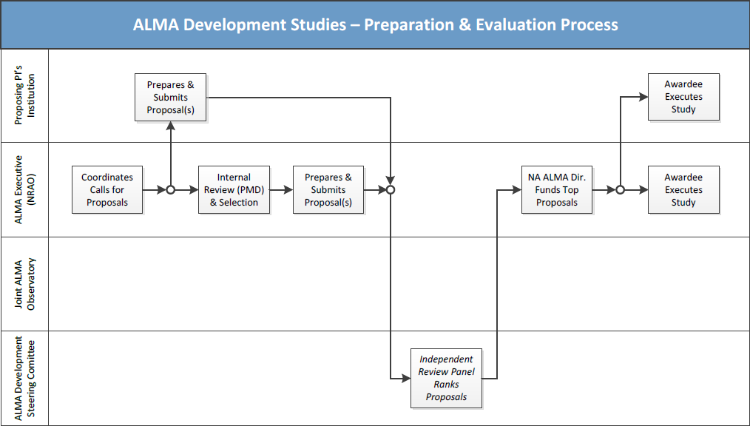
NA ALMA Development Program
Proposal Preparation and Evaluation Process - Studies
NRAO Proposers must follow PMD guidelines for internal review
NA ALMA Development
Page 7 of 12

Slide 8
NA ALMA Development Program
Proposal Evaluation Process
Evaluation will be conducted by a committee of non-NRAO reviewers
Committee membership will be reviewed and consented to by the National Science Foundation (NSF)
Committee members involved with development proposals will be recused from considering their own or closely-related proposals
NA ALMA Operations Partners will be represented on the Evaluation Committee
NSF will have final approval of all funded Studies
The evaluation and selection process will be objective and unbiased
NA ALMA Development
Page 8 of 12

Slide 9
NA ALMA Development Program
Intellectual Property Management
Confidentiality of Proposer’s information
NRAO personnel will conduct business in accord with professional conventions.
Non Disclosure Agreements may be enacted on a case-by-case basis.
Intellectual Property rights
Proposer’s IP rights pertaining to technical data,copyrightable material,patents and utilization of subject inventions are subject to the terms of the NRAO’s standard Subrecipient Agreement and any negotiated amendments thereto.
Note: the Proposer’s Science Case will be made available to the ALMA Science Advisory Committee (ASAC).
NRAO personnel will safeguard Proposer’s and Subrecipient’s intellectual property
NA ALMA Development
Page 9 of 12

Slide 10
NA ALMA Development Program
Contractual Requirements
Federal Funding Accountability andTransparencyAct (FFATA)
applicable to Subrecipients of Federal awards in excess of $25K.
successful Proposers must complete a Subrecipient Profile Questionnaire.
Terms and Conditions
Subrecipients (non-NRAO) will engage by means of a Subrecipient Agreement.
compliance with Federal laws, regulations, and award provisions ismandatory.
Subrecipients will also be bound by supplemental requirements imposed by the NRAO (or negotiated amendments thereto).
Representations and Certifications
Subrecipients must complete a “Reps & Certs” Form as required by the Federal Acquisition Regulations.
Purchase Orders
Cost-reimbursable Purchase Orders will be issued to non-NRAO Subrecipients.
Invoicing monthly (or greater) for allowable costs.
The entire Proposal process will be conducted electronically (“paperless”).
NA ALMA Development
Page 10 of 12

Slide 11
NA ALMA Development Program
Proposal“Validity”
Studies
proposals shall bind the Proposer to the contractual terms, conditions, and total cost presented therein until September 30, 2020
no amendments to the Proposal within this period of time will be accepted without the express consent of the NRAO
requests for amendment, withdrawal or resubmission of the Proposal will be granted if the Proposer can complete the associated action before the Deadline
Amendments, withdrawal or resubmission permitted before the closing date.
NA ALMA Development
Page 11 of 12

Slide 12
NA ALMA Development Program
Summary
Cycle 7 Development Program budget is secure
The entire Proposal process will be conducted electronically (“paperless”)
Proposal acceptance does not guarantee follow-on funding or implementation
Collaborative efforts are encouraged.
The evaluation and selection process will be objective and unbiased
For further information, please visit the NA ALMA Development website at https://science.nrao.edu/facilities/alma/science_sustainability/cycle7-cfs
Thank you for your participation in the ALMA Development Program
NA ALMA Development
Page 12 of 12

