Slide 1
Summary on Status of NA Development Projects and Studies: Jan 2019
A. Wootten

Slide 2
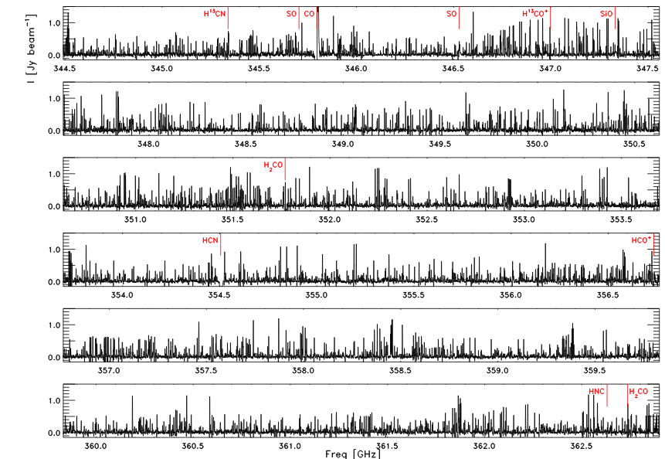
Acting on ALMA2030 vision
Expanding ALMA’s processed bandwidth
  Correlator Upgrade Project (CUP) The Correlator Upgrade Project (CUP) will significantly enhance the spectral capabilities of the ALMA 12-m array correlator and allow for processing of twice the instantaneous bandwidth compared to what is presently possible. The CUP has been split into two phases, based on technology readiness:
  Phase 1 – 8 times more channels per baseband
    All changes happen in the correlator and downstream to handle increased data rate
    4x4 bit sampling (all but 4GHz bands): the spectral sensitivity improves by 12.2%. This is equivalent to adding 6 antennas to a 48-antenna array!
  Phase 2 – Double the total bandwidth
    With changes to the digitizers, tunable filter bank cards
  Phase 1 of the CUP was passed PDR Feb 28-March 1, 2018 and received ALMA Board approval for construction in April. It will be deployed in Cycle 10 2022/2023
PILS was executed in Band 7, 18 executions
Post Phase 1 CUP provides 4x larger bandwidth at the same spectral resolution; would take 1/3 the time.
Two Projects began during FY2018.

Slide 3
NA Development Program
Current NA Project Overview
ALMA Phasing Project, Phase 2 began FY18
  Building on Cycle 3 & 4 Studies, APP-1 Project
  a Delay Fix,
  a Source Modeler,
  Additional phasing bands (B7, B1),
  Phasing on weak sources,
  Spectral Line mode,
  Single-dish VLBI
See VLBI slides
Pulse profile of the Vela pulsar at 86 GHz, using Pipeline 1 to analyze 10 min of data. One cycle of phase is shown after folding the data at the predicted 89ms pulsar period. (Cordes+,2017)
Two Projects began during FY2018.

Slide 4
Upgrading the Receivers
Increasing receiver sensitivity, bandwidth
  Upgraded ALMA B3 mixer block – Henke study completed
  2nd generation SIS receiver development –Kerr
    B6v2 passed conceptual design review Sept ’18
    Band 6 v2, ALMA’s Bread and butter band
    Current ALMA Band 6 receiver’s limited IF range of 5 to 10 GHz imposes limitations to the science that ALMA can conduct
    Wider IF bandwidth, flatter and improved noise performance
    In conjunction with correlator and IF upgrade, will result in Band 6 science meeting the new Key Science Goals
    A PILS-like B6 survey could be done in 3 hours rather than ~26 now
Project being developed during FY2018.

Slide 5
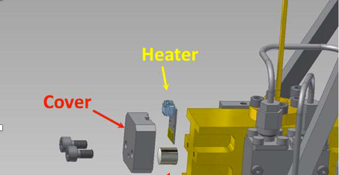
Upgrading the Receivers
B3 upgrade to deliver improved TP stability
Project continues during FY2019.

Slide 6
NA Development Study Overview
Cycle 5 Study Overview
Acting on the ALMA2030 vision:
Increasing receiver sensitivity, bandwidth
  Wideband Low-Noise Balanced IF Amplifiers for ALMA Band 6, with Future Application to ALMA Bands 3-10 -Kerr
Expanding/increasing ALMA's instantaneous RF bandwidth
  Quantum-Limited Very-Wideband 4-Kelvin RF and IF Amplifiers for ALMA - Noroozian
Improved data characterization
  Neural Network Analysis of ALMA Datasets - Merenyi
Full-field primary beam models will be developed for use in imaging software
  Full-Mueller Mosaic Imaging with ALMA, PI Sanjay Bhatnagar
All discussed at 2018 URSI ALMA2030 session; presentations available.
Neural Network analysis highlights departures from Keplerian disk motion in HD142527.
Imaging with different antennas
Four Cycle 5 Studies Commenced FY2018.

Slide 7
NA Development Study Overview
Cycle 4 Study Overview
Acting on ALMA2030 vision:
Increasing receiver sensitivity, bandwidth
  2nd generation SIS receiver development –Kerr
  Upgraded ALMA B3 mixer block – Henke
Expanding ALMA’s processed bandwidth
  Upgrade of Backend Antenna Article to match correlator upgrade - Ford
Improved data use
  Improved interactive CLEAN
  Improved imaging with combined arrays
Maximizing point source sensitivity and resolution
  Weak source and spectral line VLBI-merged into APP2 Project
A comparison of three cleaned channel maps of Cloud 197 with TP (left) and without TP (right). The red, green, and blue correspond to the TP, 7m, and 12m visibilities. (Koda)
Six Cycle 4 Studies delivered.
Notes:
DL-2SB

Slide 8
NA Development Study Overview
Focus on ALMA2030 science improvements:
Correlator upgrade:
  Delivering more channels, higher spectral resolution and wider bandwidth
  Next generation correlator
Maximizing point source sensitivity, spatial resolution
  Extending VLB phasing to B7, optimize phasing, data reduction
  Enable a phased ALMA for pulsars & transients
Improved data use
  Improved calibration through atmospheric spectral features
  Data cube visualization enhancements
Increased sensitivity
  2nd generation receiver mixer studies
Example of applying the results after applying simulated FDM T_{sys} spectrum (cyan) to PI astronomy data of calibrated Band 6 spectra of a quasar vs after applying the observed TDM Tsys (green profile). TDM application misses fine ozone line structure.
Seven Cycle 3 Studies delivered.
Notes:
CARTA is currently being developed by a joint team from Academia Sinica Institute of Astronomy and Astrophysics in Taiwan, the Institute for Data Intensive Astronomy in South Africa, and NRAO. We are nearing completion on the initial development and anticipate a first release to the community in late fall or early winter. We are planning to make available a beta release within the next few weeks for user experimentation and feedback.

Slide 9
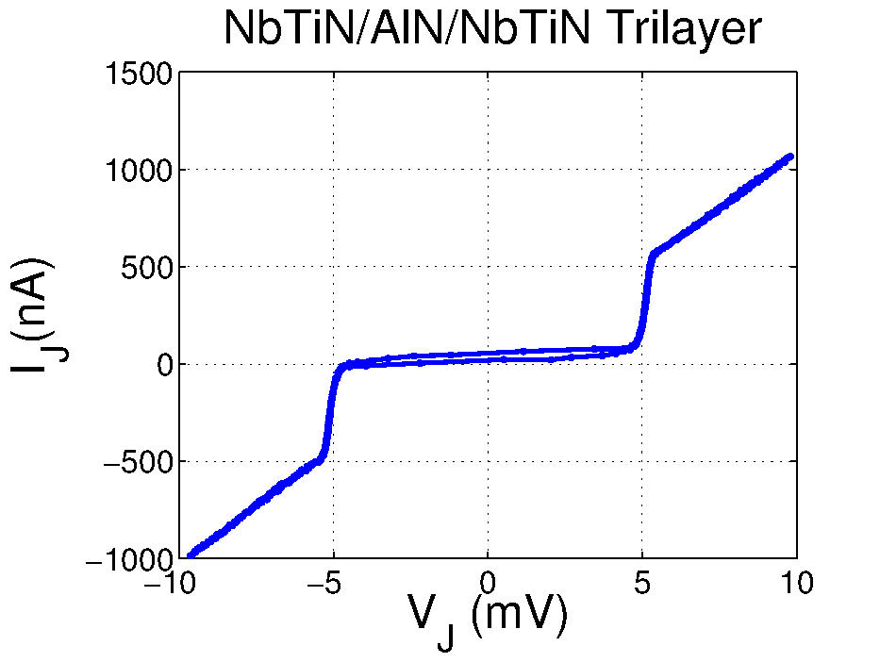
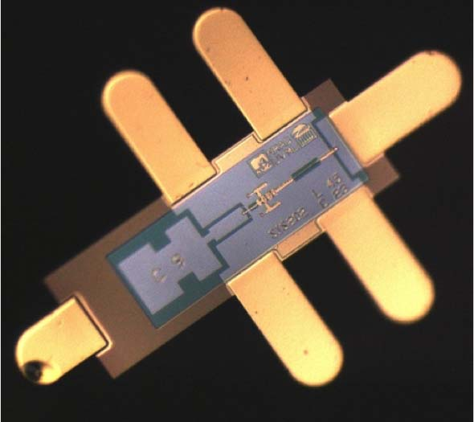
We are excellently positioned for the next generation of ALMA SIS mixers
SIS Material Systems suitable for 2nd gen ALMA
Nb/Al-AlN/Nb (B6, B7)
Nb/Al-AlN/NbTiN (B8-B10)
NbTiN/AlN/NbTiN (B10)
SOI Architecture (3-5um Si chip w/beamleads)
More accurate chip size and registration to metallization
No time intensive lapping-thinning/dicing required
Close to drop in chip placement in waveguide block
All NbTiN 5mV gap
0.8
mm
Miscellaneous
Developing rapid, whole wafer, dc cryogenic probing/screening of mixer chips
Miscellaneous circuits (superconducting RF & IF Hybrids & LO Couplers)

Slide 10
Immediate Future
Projects
  NA has two new projects, Correlator Upgrade 2 and B6v2 ready
  New Call for Projects forseen Cycle 8 = FY 2021
    Anticipated dates (TBC):
    Project CfPs: 1 Dec 2019
    Deadline for submission: 15 Mar 2020
    Funding start: 1 Oct 2020
Studies
  NA: Call closed 1 May 2017; four new Studies selected.
  Current Call planned for Cycle 7 = FY 2020
  Anticipated dates (TBC):
    Study CfPs: 1 Dec 2018
    Deadline for submission: 15 Mar 2019
    Funding start: 1 Oct 2019

