Slide 1
Summary on Status of NA Development Projects and Studies: Jan 2020
Al Wootten, Deputy ALMA Program Scientist for NA
Crystal Brogan, ALMA Program Scientist for NA

Slide 2
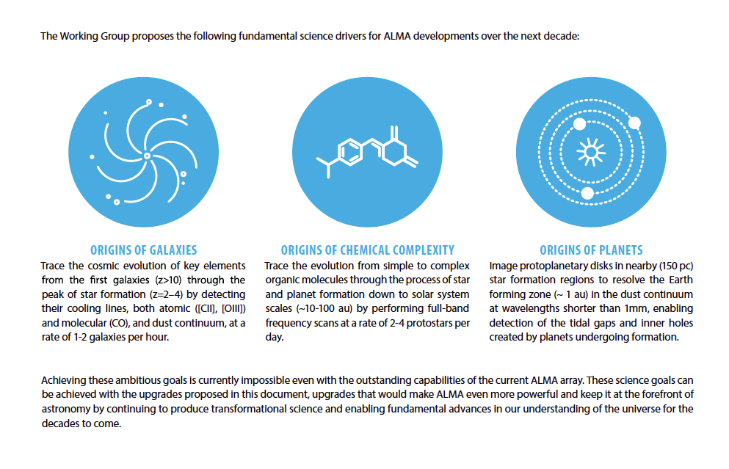
ALMA2030 Science Goals
Having met its original science goals, new goals have been set (See ALMA Memo 612):
Notes:
As ALMA approaches completion of its initially envisaged capabilities, the
original fundamental science goals of ALMA have essentially been demonstrated.
Looking to the future, the ALMA Board tasked the ALMA Science Advisory Committee (ASAC)
to recommend future developments that ALMA should consider implementing by the year 2030. A working group prioritized those recommendations into a strategic ALMA2030 Development Roadmap, which was endorsed by the ALMA Board in 2017

Slide 3
Science Goals Drive Development Goals
The Roadmap identifies three main areas to drive the developments over the next decade.
The top development priority, based on scientific merit and technical feasibility, is to broaden the receiver IF bandwidth by at least a factor of two and to upgrade the associated electronics and correlator to process the entire bandwidth. Receiver line sensitivity should be simultaneously improved.
Identify and add the functionality needed for the community to mine the ALMA Science Archive efficiently, especially in view of the increased receiver bandwidth envisioned in the Roadmap.
Continued exploration of development paths which have potentially large impacts on ALMA science, but for which the science case and technical feasibility require further investigation. These include (i) extending the maximum baseline length by a factor of 2--3 to image the terrestrial planet forming zone in nearby protoplanetary disks; (ii) develop focal plane arrays to significantly increase ALMA's wide-field mapping speed; and (iii) increasing the number of 12-m antennas, to benefit all science programs by improving the sensitivity and image fidelity.

Slide 4
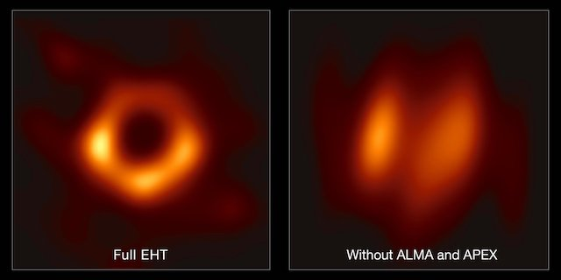
NA Development Program
Current NA Project Overview
One active FY20 project: APP𝞿2
ALMA Phasing Project, Phase 2 began FY18
Addresses improved resolution, sensitivity
Building on Cycle 3 & 4 Studies, APP-1 Project
a Delay Fix,
a Source Modeler,
Additional phasing bands (B7, B1),
Phasing on weak sources,
Spectral Line mode,
Single-dish VLBI
APP𝜑1 success: M87 BH image from EHT
Small Project: HiLs correlator
Provides efficient and representative testing environment for software/firmware
Possible science payback: 10% more science time
The Event Horizon Telescope (EHT) image of the M87 black hole. The left hand image shows a reconstruction of the black hole image using the full array of the Event Horizon Telescope (including ALMA and APEX); the right-hand image shows what the reconstruction would look like without data from ALMA and APEX. (EHT)
Pulse profile of the Vela pulsar at 86 GHz, using Pipeline 1 to analyze 10 min of data. One cycle of phase is shown after folding the data at the predicted 89ms pulsar period. (Cordes+,2017)
Two Projects continued during FY2019.

Slide 5
Next Generation ALMA Correlator Workshop
Feb. 11-13
The Graduate Hotel, Charlottesville, VA
Key Topics:
ALMA 2030 Science Goals / Capabilities
Digital Front-End Progress
Working Group Study outcomes
Requirements Group report
Presentation and discussion/refinement of straw correlator requirements
Tradeoffs GPUs vs FPGAs vs ASIC
Lessons from Current Digital Correlator efforts: SWARM, NOEMA, SKA, etc
Cover correlator software and hardware
Presentations on ALMA correlator concepts that speak to a set of straw requirements (under development)
Should include a notional plan for prototype, testing, and deployment
http://go.nrao.edu/NextALMACorrelator
Registration closes 20 Jan!

Slide 6
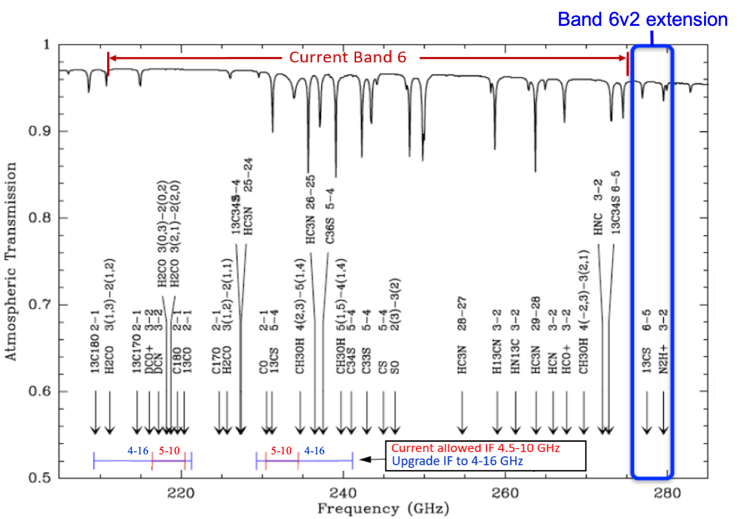
Upgrading the Receivers: B6v2
Increasing receiver sensitivity, bandwidth
2nd generation SIS receiver development –Kerr
B6v2 passed conceptual design review Sept ’18
Band 6 v2, ALMA’s Bread and butter band (used in 37% of Cycle 7A/B proposals)
Current ALMA Band 6 receiver’s limited IF range of 5 to 10 GHz imposes limitations to the science that ALMA can conduct B6v2 will increase this to 4-16GHz.
Wider IF bandwidth (≥8GHz, goal ~12GHz), Increased frequency range (to 280GHz), flatter and improved noise performance
In conjunction with correlator and IF upgrade, will result in Band 6 science capabilities meeting the ALMA2030 Key Science Goals
A PILS-like B6 survey could be done in <3 hours rather than ~26 now
Project being developed during FY2020.
Notes:
proposed mixer-preamp subassemblies is increased
from the existing 5-10 GHz to 4-12 GHz or 4-16 GHz and the RF coverage is increased from the
present 211-275 GHz to 211-280 GHz while continuing to meet ALMA specifications.

Slide 7
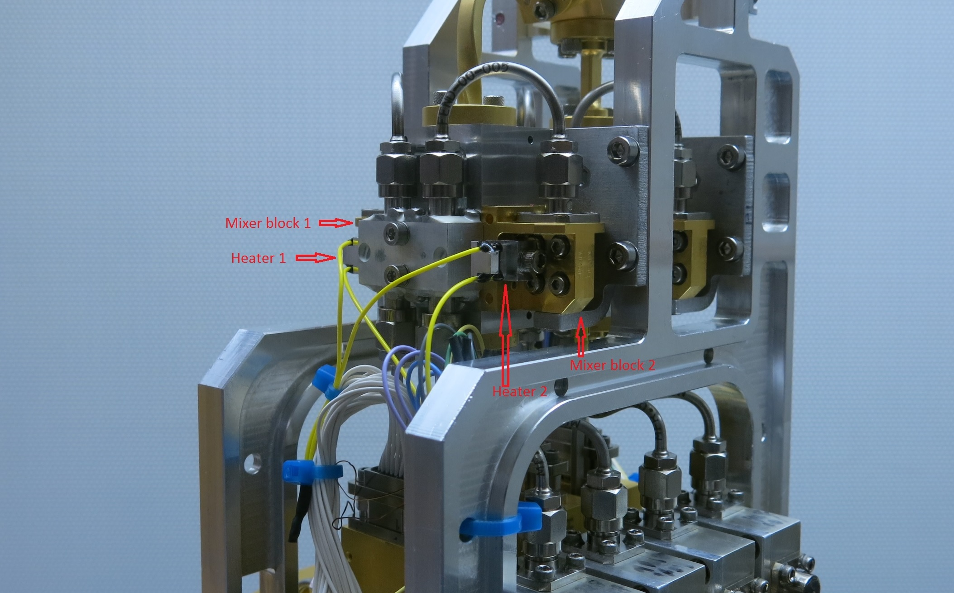
Upgrading the Receivers
B3 upgrade to deliver improved TP stability (led by NRC)
Upgrade process approved by JAO
To be done in parallel with B1 installation, to begin Q1 2020 with successful B1 CDMR (Nov19)
Completed within 3 years
Project continues during FY2020.

Slide 8
Development projects at ESO
Integrated Alarm System (finished Q2 2019)
Band 2 (approved for prototype and pre-production)
► Building on prior Studies
►67 -116 GHz (See arXiv:1912.10841)
►Contributi on from NAOJ
ARI-L (kick-off Q2 2019)
►Reimagi ng of all suitable Cycle 2-4 observations
OT upgrade (expected start first half 2020)
Projects in EA see below
ESAC meeting Garching I F Kemper I 10 October 2019
1 1- 1 1 1 1 =- • CCJ ::
+-
D
I.

Slide 9
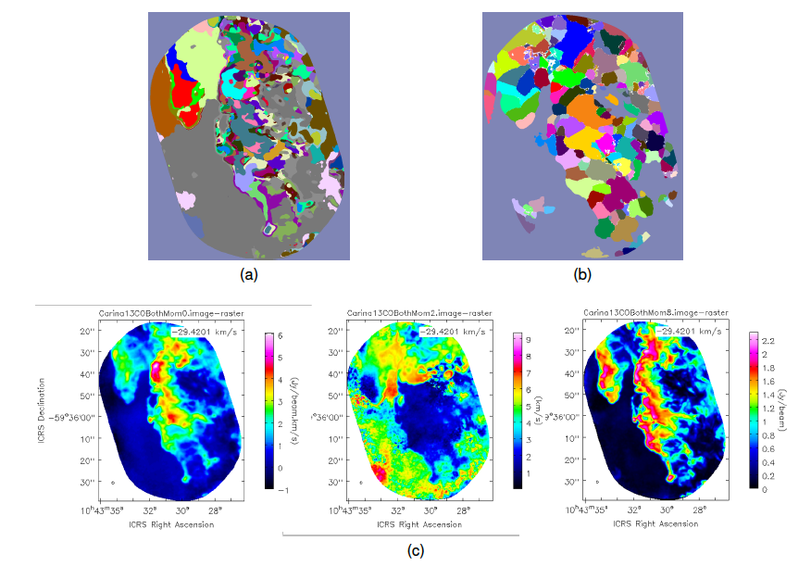
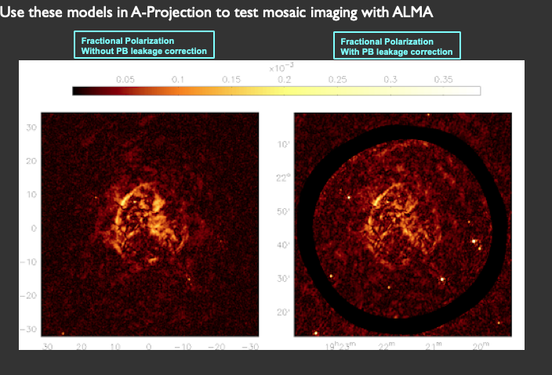
NA Development Study Overview
Cycle 5 Study Overview
Acting on the ALMA2030 vision:
General Studies (one year)
Improved data characterization
Neural Network Analysis of ALMA Datasets – Merenyi Report received.
Full-field primary beam models will be developed for use in imaging software
Full-Mueller Mosaic Imaging with ALMA, PI Sanjay Bhatnagar Report pending.
Strategic Studies (two years), in progress
Increasing receiver sensitivity, bandwidth
Wideband Low-Noise Balanced IF Amplifiers for ALMA Band 6, with Future Application to ALMA Bands 3-10 –Kerr extended to study wider IFs
Expanding/increasing ALMA's instantaneous RF bandwidth
Quantum-Limited Very-Wideband 4-Kelvin RF and IF Amplifiers for ALMA - Noroozian
All discussed at 2018 URSI/NA ALMA2030 session; presentations available.
NeuroScope visual of two distinct components in the Carina Nebula each manifesting in a separate frequency zone within the line (see Notes)
Imaging with different antennas
Two Cycle 5 General Studies, two Strategic Studies Complete FY2019.
Notes:
two distinct
components in the Carina Nebula each manifesting in a separate frequency zone within the line: the Western
Wall, channels 40 - 100, and the \Northern Region", channels 120- 165. (a) NeuroScope clustering from combined
channels 40-100 + 120-165. (b) ClumpFind clusters from the combined channels, projected to 2 dimensions with
our ClumpFind2DProj module. (c) Moment maps 0, 1, and 8 (peak intensity map) from the combined
channels.
Noroozian+ designed, simulated, and fabricated a new microstrip-based RF TKIP amplifier that covers the 65-150 GHz range with a > 15 dB gain. Impressively, this range fully covers ALMA bands 2 (65-90 GHz) and 3 (84-116 GHz), and part of band 4 (125-163 GHz) simultaneously.

Slide 10
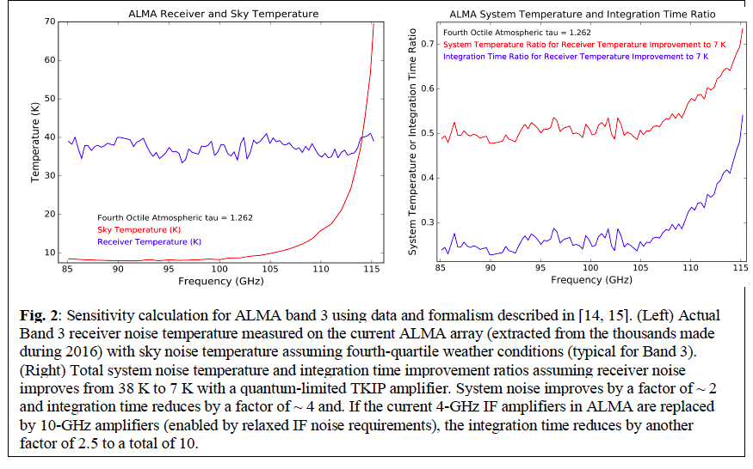
NA Development Study Overview
Cycle 7 Study Overview
Acting on the ALMA2030 vision:
Increasing receiver sensitivity, bandwidth
Technology Development of Quantum-Limited, Ultra-Wideband RF Amplifiers for ALMA: A 65-150 GHz Amplifier Test Case – Hawkins & Noroozian
ALMA Band 6v2 SIS Mixer-Preamp – Kerr & Lichtenberger
ALMA Band 6 Local Oscillator Modifications - Saini & Vaselaar
Expanding ALMA’s processed bandwidth
NRC TALON Frequency Slice Architecture Correlator/Beamformer for ALMA - S. Vrcic
Higher Resolution
ALMA Central LO Article Improvements and Upgrades - Jacques
Improved Archive, data use
Link CASA to the Astropy ecosystem – A. Ginsburg
ALMA Archive Science Mining – P. Teuben
ARCADE: ALMA Reduction in the CANFAR Data Environment- Kirk
TKIP technology could reduce integration times by an order of magnitude
Eight Cycle 7 Studies Commenced FY2020.
Notes:
For B6v2 study, the proposed mixer-preamp subassemblies is increased from the existing 5-10 GHz to 4-12 GHz or 4-16 GHz and the RF coverage is increased from the
present 211-275 GHz to 211-280 GHz while continuing to meet ALMA specifications.

Slide 13
Immediate Future
Projects
NA has one new project, B6v2 upgrade, under way
New Call for Projects forseen depending on funding
Studies
NA: Cycle 7 Call closed 1 May 2019; ~8 new Studies were selected for FY2020.
NA Cycle 8 Call expected 1 December 2019:
Anticipated Funding start: 1 Oct 2020 FY2021

