Slide 1
Radio Astronomy and Comets (TBD)
Things Barely Detectable
Tubers, Booties, and Duckies
Notes:
Passive Single-Dish Observations of Small Bodies
Long-wavelength ground-based observations of asteroids and comets provide an excellent complement to shorter-wavelength observations both from the ground and from space. In addition to the high spectral resolution characteristics of modern radio astronomy instrumentation, single-dish observations provide instantaneous sensitivity for investigation of faint, extended, and time-variable sources such as cometary comae. A single-dish beam can capture the big picture to allow a scientific overview which can also serve to complement higher resolution interferometry. For asteroids, the flexibility and sensitivity of single-dish continuum observations are ideal for surveys to characterize different populations (NEOs, main-belt, centaurs/TNOs) or to enable more intensive time-resolved follow-up for unresolved bodies. I will review example small bodies observations and detection sensitivities for current and future radio instrumentation.

Slide 2
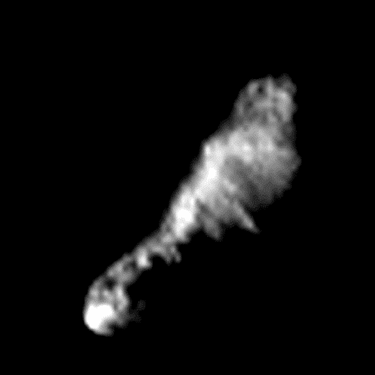
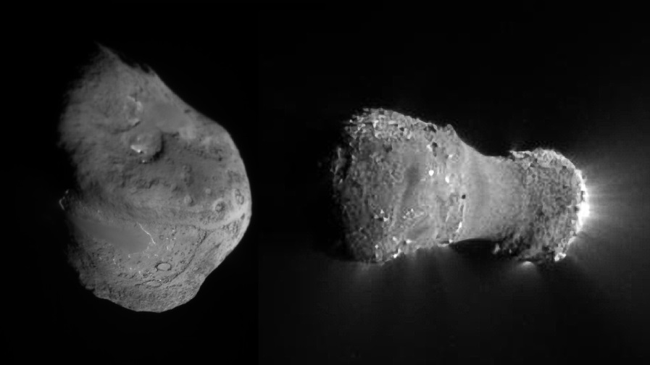
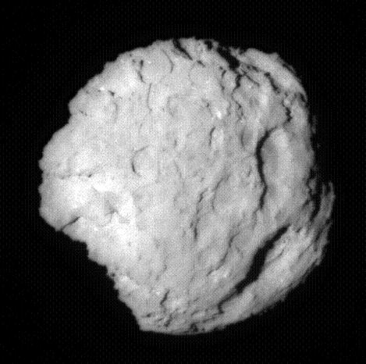
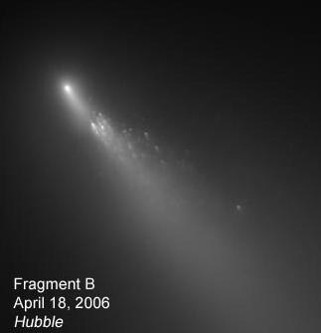
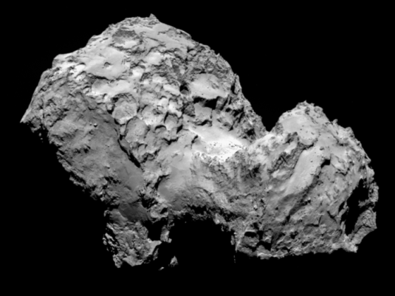
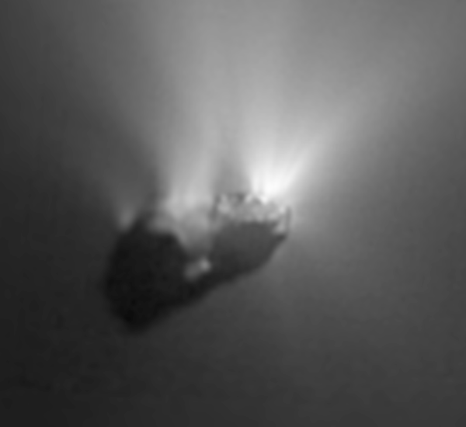
Radio Astronomy and Comets – Tales of Serendipity
Amy Lovell, Agnes Scott College
Notes:
Passive Single-Dish Observations of Small Bodies
Long-wavelength ground-based observations of asteroids and comets provide an excellent complement to shorter-wavelength observations both from the ground and from space. In addition to the high spectral resolution characteristics of modern radio astronomy instrumentation, single-dish observations provide instantaneous sensitivity for investigation of faint, extended, and time-variable sources such as cometary comae. A single-dish beam can capture the big picture to allow a scientific overview which can also serve to complement higher resolution interferometry. For asteroids, the flexibility and sensitivity of single-dish continuum observations are ideal for surveys to characterize different populations (NEOs, main-belt, centaurs/TNOs) or to enable more intensive time-resolved follow-up for unresolved bodies. I will review example small bodies observations and detection sensitivities for current and future radio instrumentation.

Slide 3
Motivation
Science!
How comets fit into the big picture
Where radio astronomy helps

Slide 4
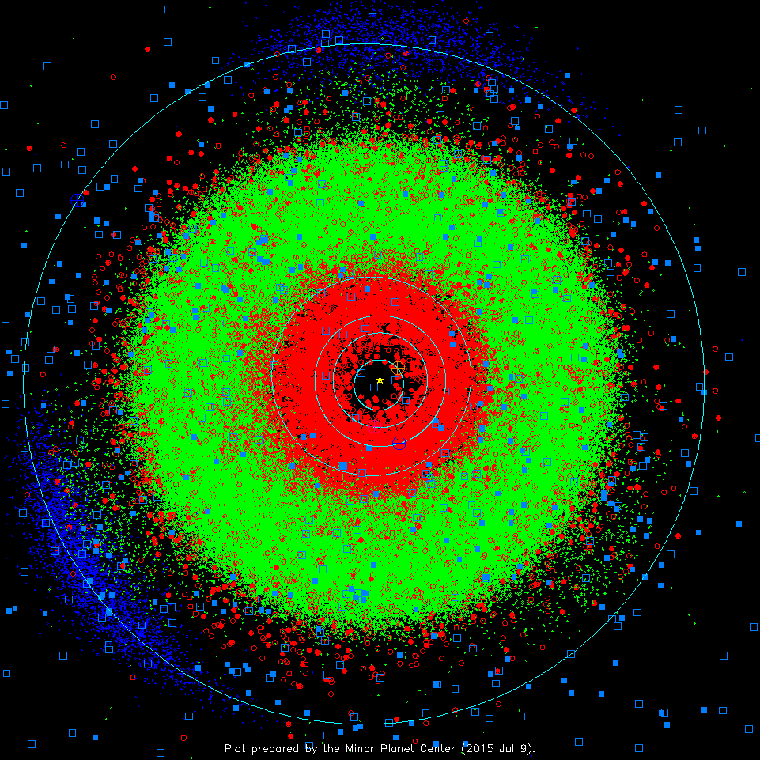
Inner solar system
Red = near-Earth
Blue = comet
green = “asteroid”

Slide 5
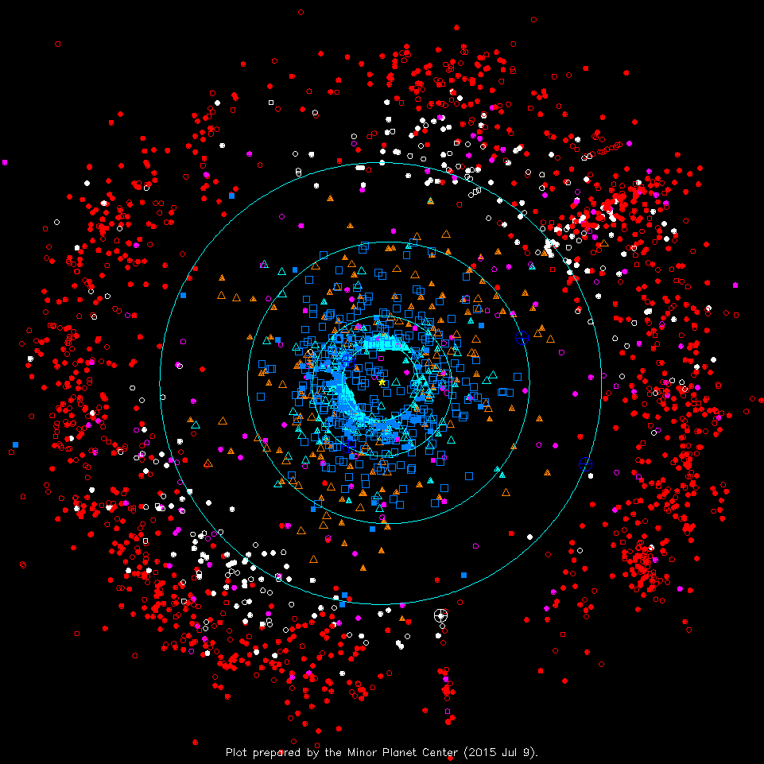
Outer solar system
Red & white = Kuiper Belt (or TNO)
Blue = comet
Orange = Centaur
Notes:
FILLED SQUARES = NUMBERED COMETS (NOW 187)
Orange = “Centaur”

Slide 6
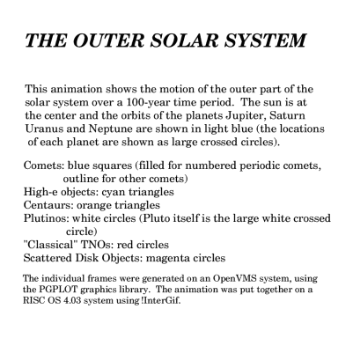
Outer SS Animation
Notes:
FILLED SQUARES = NUMBERED COMETS (NOW 187)
Orange = “Centaur”

Slide 7
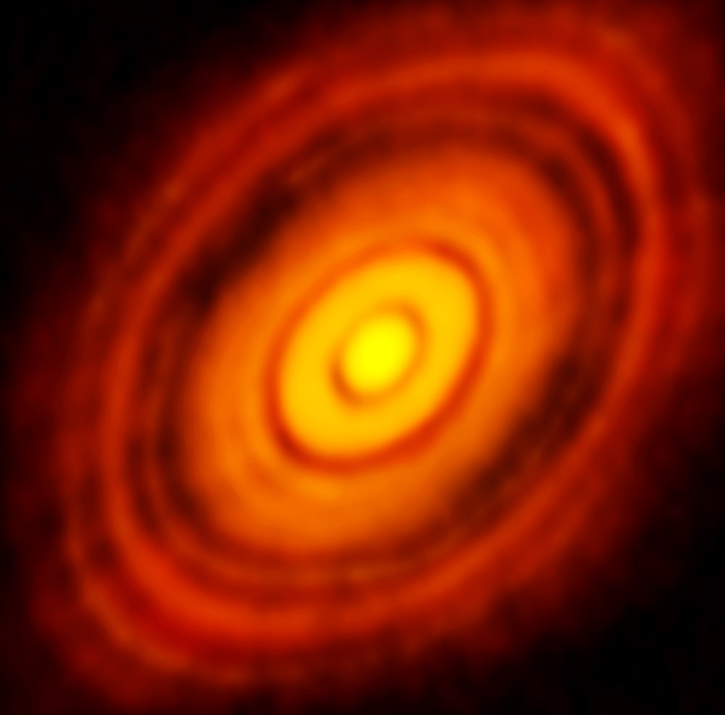
What has our solar system been keeping in the freezer?
“Memory” of the past
Thermal history
Collisions
Mixing **here be dragons
Notes:
Shameless excuse to show HL Tau…

Slide 8
A dynamics interlude
https://www.youtube.com/watch?v=6LzQfR-T5_A
Plane view
Graph view

Slide 9
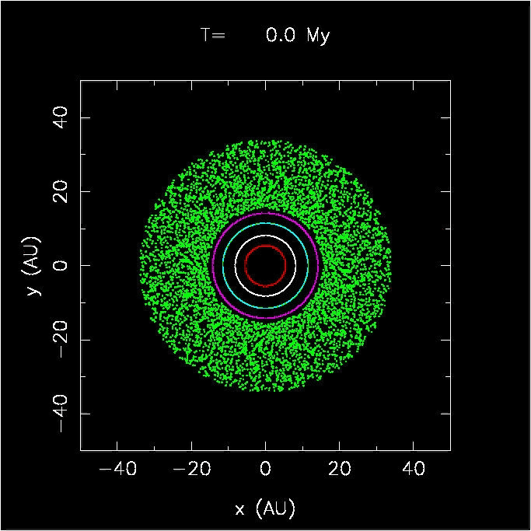
A dynamics interlude

Slide 10
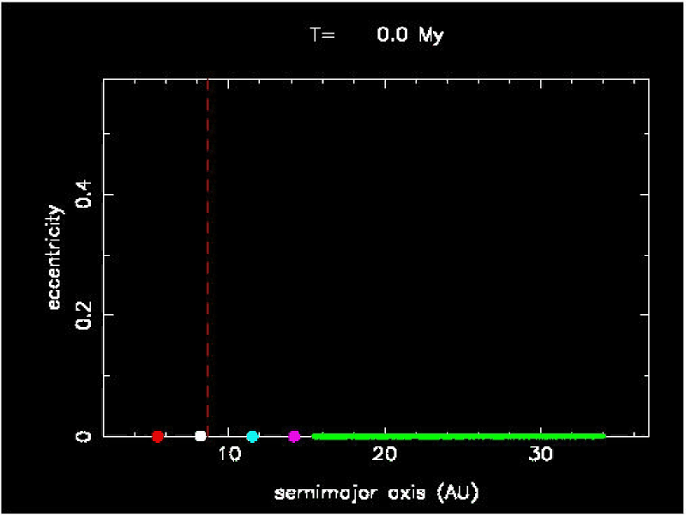
A dynamics interlude

Slide 11
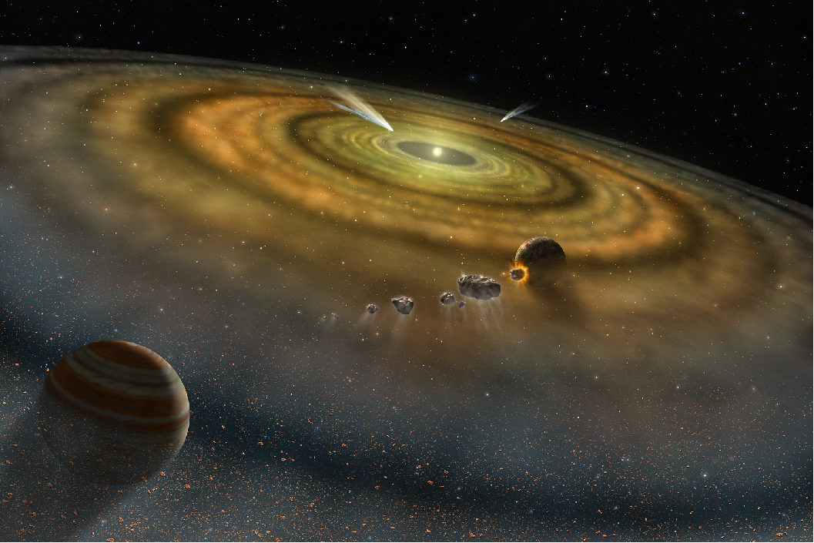
Great idea…. But…

Slide 12
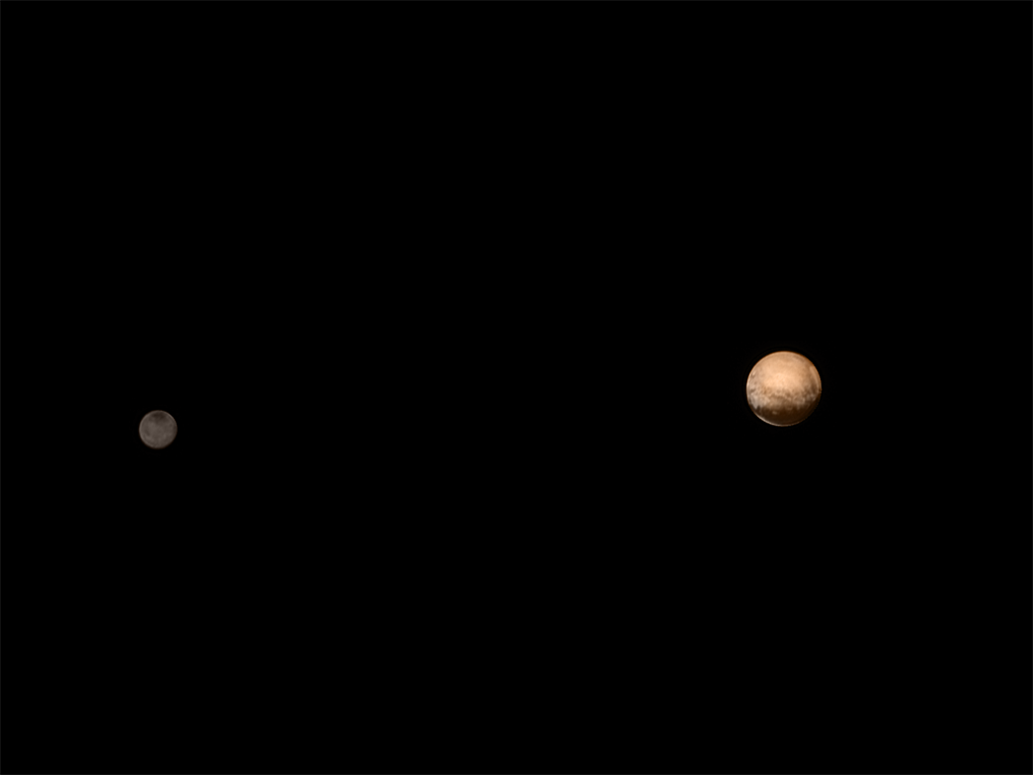

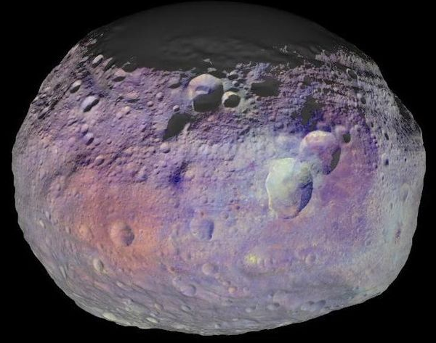

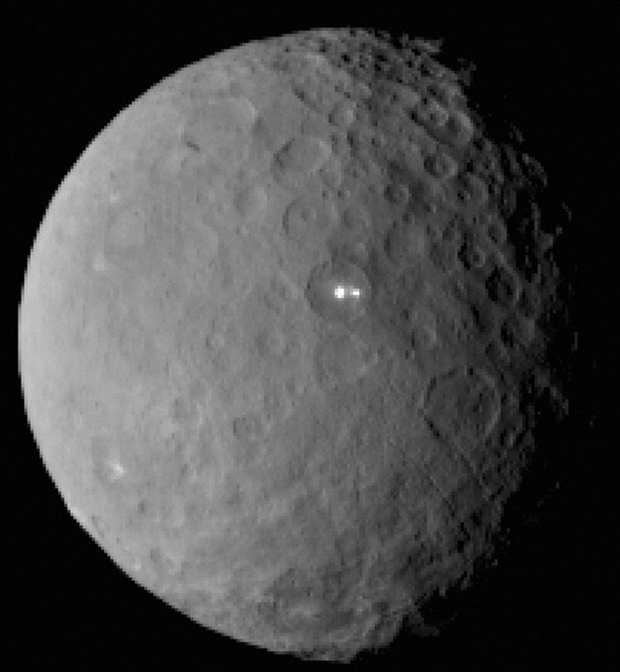

Notes:
How can we link objects to solar system formation when we don’t understand them? They are potatoes, eggplants, bowties, shrunken heads… bright, dark, round, cratered, smooth, concave, convex…

Slide 13
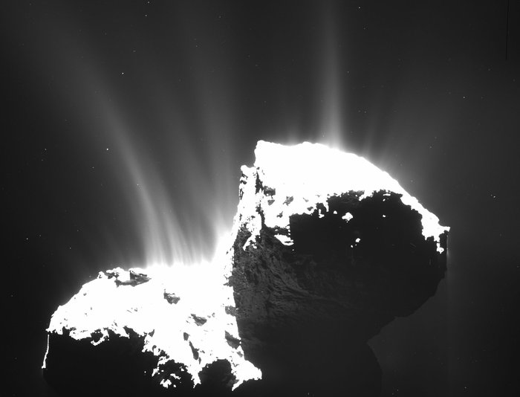
67P/Churyumov-Gerasimenko
Rosetta
Notes:
We discuss these results in comparison to 1P/Halley and suggest that, when possible, observations at heliocentric velocities around -11 and +9 km/s be targeted for future comets.
Spatially-resolved observations at a beam spacing of 4.1 arcminutes were made for 5 of the comets, and may provide constraints on the excitation conditions in the coma. As the coma density increases, the OH population thermalizes and inner-coma OH emission is quenched. We employ a Monte Carlo simulation that includes the cometocentric radius for quenching as a free parameter, and estimate either a best fit radius or an upper limit. These radii and limits are lower than the predictions (Gerard, A&A 230, 489, 1990) based on previous data. We present mapping data with the model fits for quenching and compare to predictions from the literature.

Slide 14
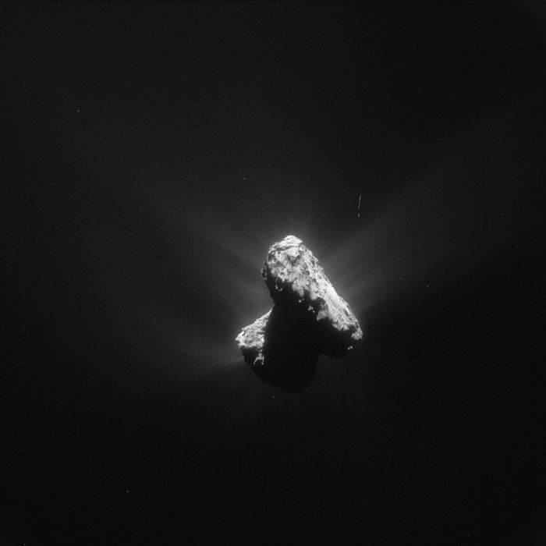
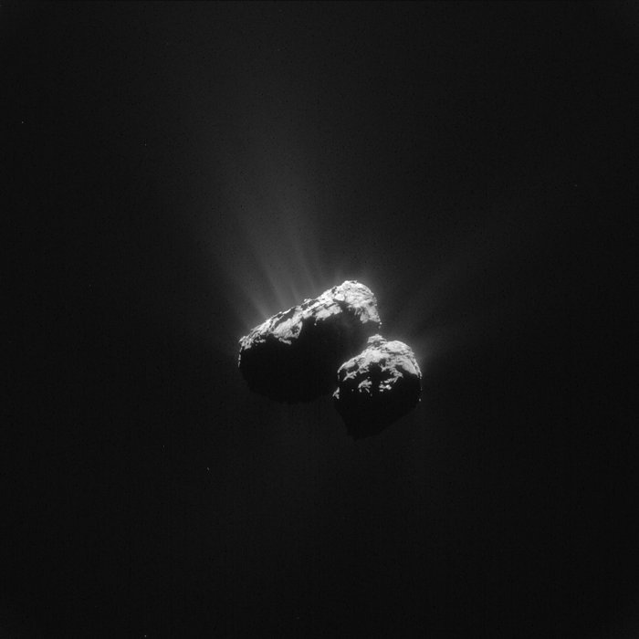

Notes:
We discuss these results in comparison to 1P/Halley and suggest that, when possible, observations at heliocentric velocities around -11 and +9 km/s be targeted for future comets.
Spatially-resolved observations at a beam spacing of 4.1 arcminutes were made for 5 of the comets, and may provide constraints on the excitation conditions in the coma. As the coma density increases, the OH population thermalizes and inner-coma OH emission is quenched. We employ a Monte Carlo simulation that includes the cometocentric radius for quenching as a free parameter, and estimate either a best fit radius or an upper limit. These radii and limits are lower than the predictions (Gerard, A&A 230, 489, 1990) based on previous data. We present mapping data with the model fits for quenching and compare to predictions from the literature.

Slide 15
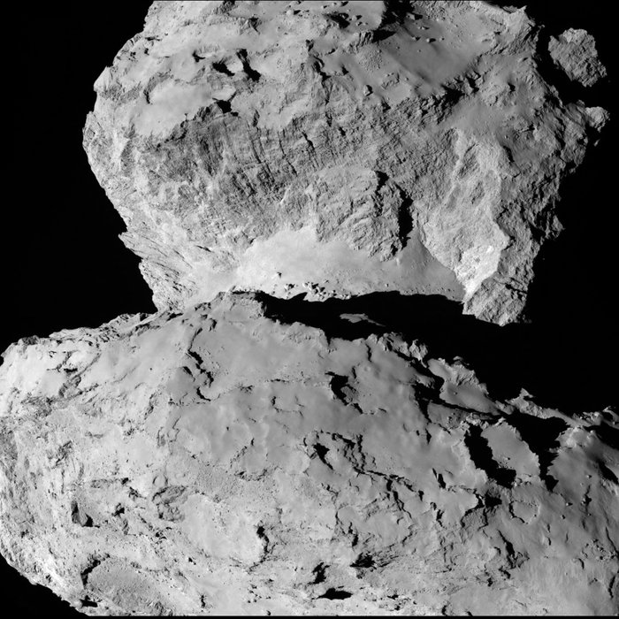
Notes:
From 104km distance – see the “waist”

Slide 16
Comets
Radio Astronomy
*not to scale
Solar System
Astronomy
Spectroscopy

Slide 17
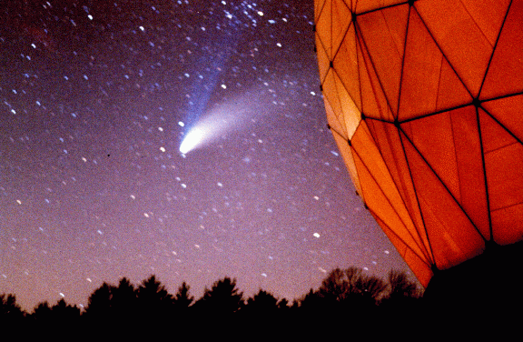
Comet C/1995 O1 Hale-Bopp

Slide 18
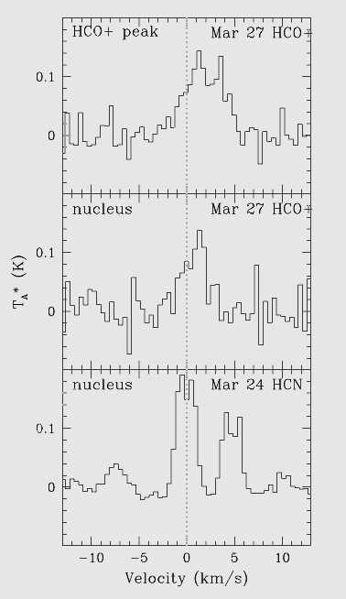
Why Radio?
Long molecule life = large coma
“Parent” molecules from volatiles
High spectral/velocity resolution
Resolved
Even if not
Notes:
Line shape, width, depth

Slide 19
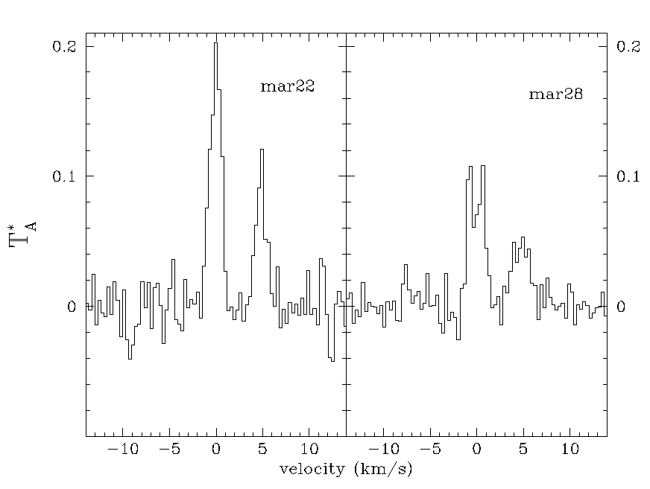
Comparison of gas motions
More redshift
Symmetric motions
Z = ±0.00003

Slide 20
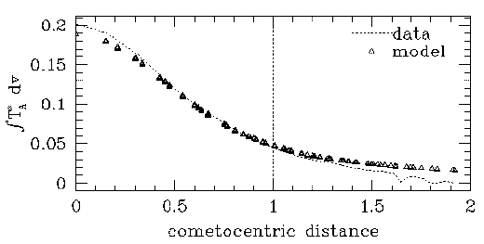
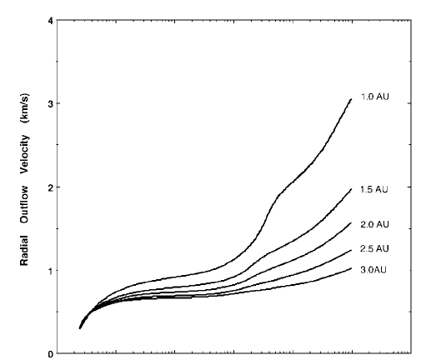
Spatial Profiles

Slide 21
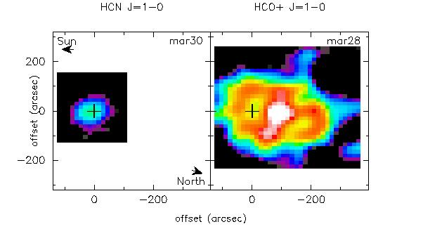

Slide 22
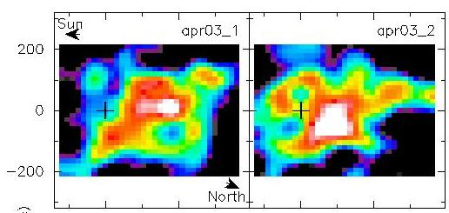

Slide 23
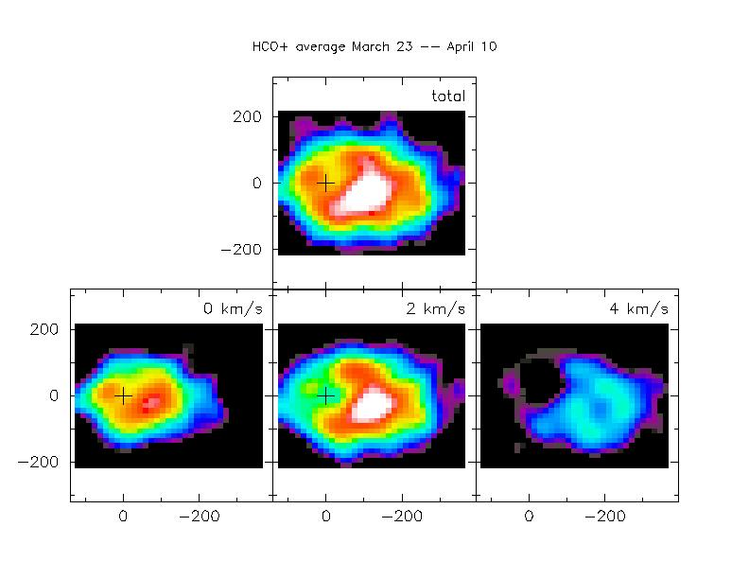
Comet Hale-Bopp HCO+ channel maps

Slide 24
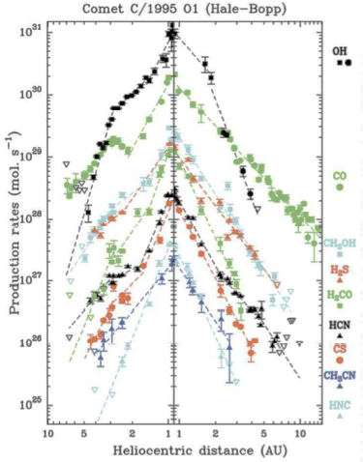
Gas Production (+mm)

Slide 25
Radio Spectra (and Maps)
Volatile production rates
Outflow velocity/acceleration/shift
Asymmetries (spatial/spectral)
Coma density/excitation
Easy with a comet 100x brighter than “normal”
Notes:
Complement & support optical/IR

Slide 26
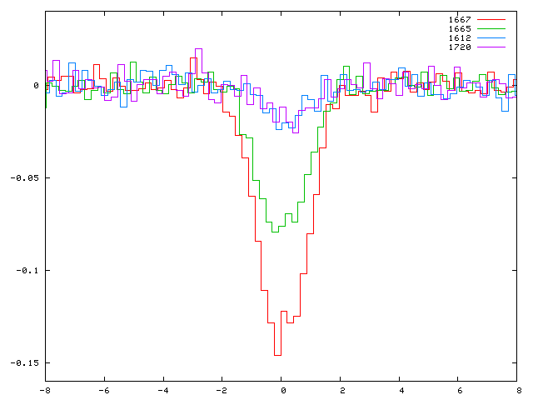
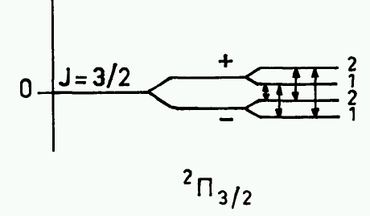
OH Radio Bands
OH 18cm Λ-doublet
1667, 1665 MHz primary
1612, 1720 weaker
Pumped by solar UV
  amplifies or absorbs background
Notes:
Mapping pattern, spectral & spatial resolution

Slide 27
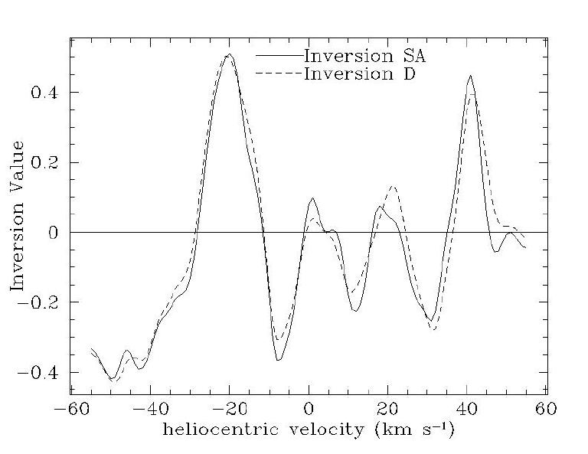
Emission lines
Absorption lines
D=Despois et al. (A&A, 1981); SA=Schleicher & A'Hearn (ApJ, 1988)

Slide 28
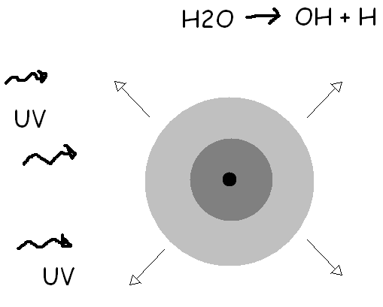
Extent depends on lifetime, outflow
Redshift to sun
Blueshift to sun
Dense inner coma (thermal/collisional) maser quenched

Slide 29
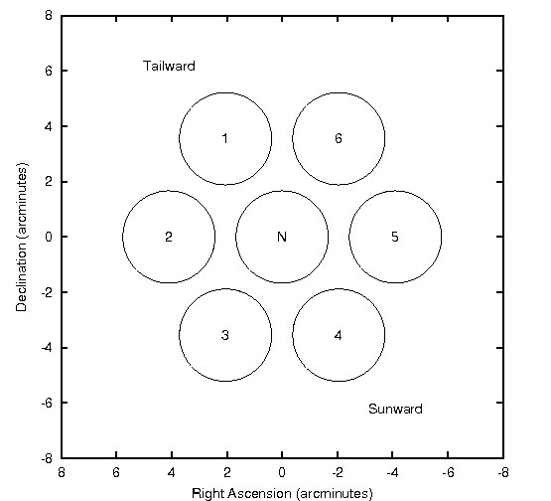
Mapping Layout
OFF
ON
Notes:
May 21, better quenching figure is needed…

Slide 30
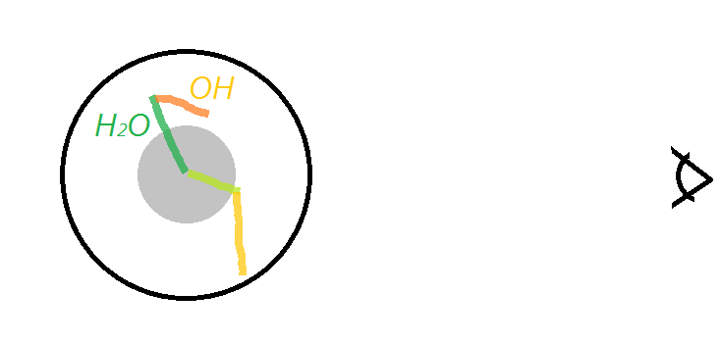
H2O dissociates (statistically) into OH & H
OH flies in a random direction, +1.05 km/s
Binned into a spectrum
Free parameters: outflow velocity, quenching r_{Q}
Lifetime: 82000s (H₂O ~1 day) 150,000s (OH 1.7d)
Notes:
Free parameters: outflow v, quenching r_{Q}
Day/Night independent
Random production/destruction time/angle
Distribution binned to spectrum
χ² minimized for BEST FIT
water/OH lifetimes 8.2 x 10⁴ s (~1 day) 1.5 x 10⁵ s (1.7 days)
OH photodissociation “kick” 1.05 km/s

Slide 31
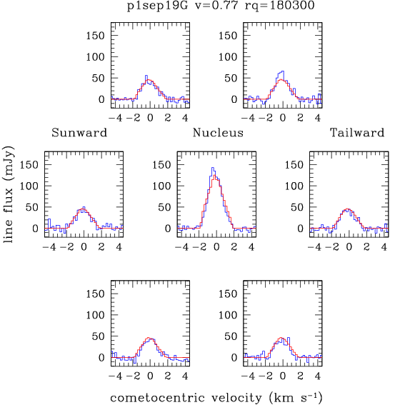
Mapping
19 Sep GBT
Comet Garradd
r_{H} = 2 AU 8’
516,000km
Gas production -> column density, line strength
Line width -> gas velocity
Notes:
Outflow velocity & quenching, possible asymmetry across the coma

Slide 32
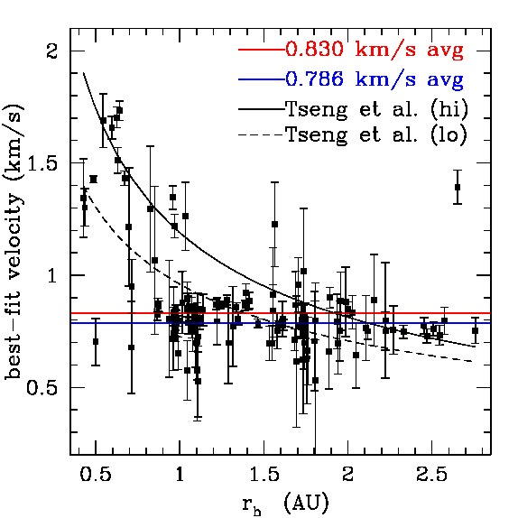
Gas outflow velocity
Notes:
High variability near the sun – levels off at larger distances

Slide 33
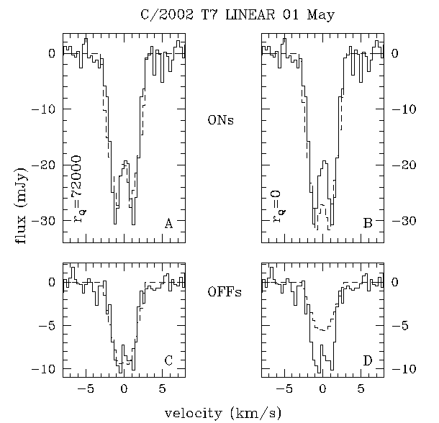
Collisional Quenching ->Density
At high density, OH is thermalized
-negates pumping
-”ons” lower
-”offs” higher
-Production rate
under-estimated
This can be measured!

Slide 34
Extended Emission
Lifetime
Outflow velocity
Excitation/collisions
These influence gas production rate
  # of molecules for observed column density

Slide 35
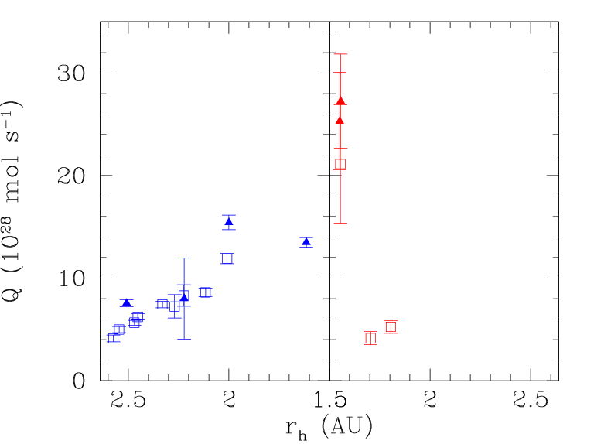
Gas Production variability
pre-perihelion
Q ~ r ^{-2.5}
Post-perihelion
Gas production rates log(Q) are between 28.13 and 28.26 in mid-June and between 28.2 and 28.6 a few weeks later. Late-July gas production rates are lower, between 27.85 and 28.27. Collisional quenching is present at predicted (Gérard et al. 1998) levels, with 11 July appearing above predictions.
Notes:
Garradd

Slide 36
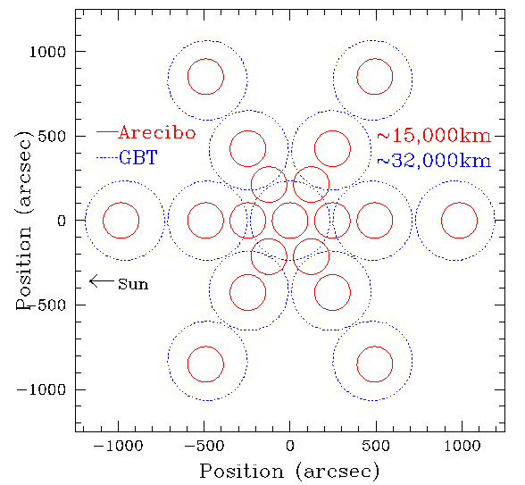
Beam Patterns

Slide 37
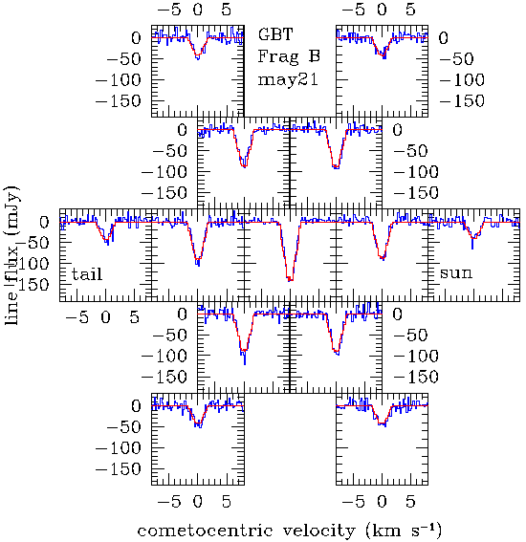
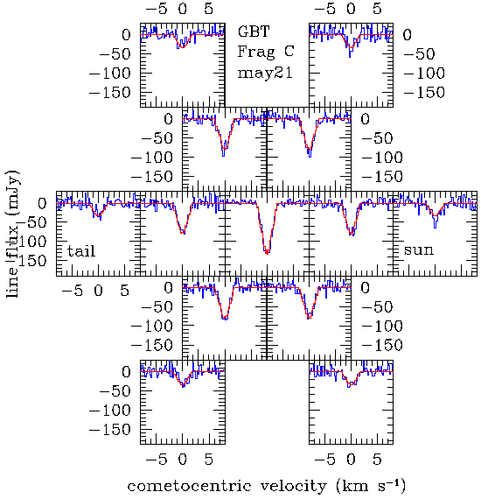
Lines similar, frag B ½ size = more productive

Slide 38
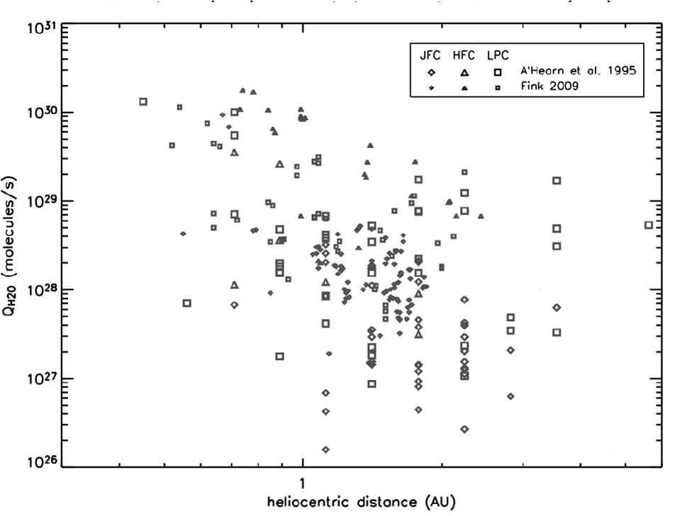
300 kg/s, would fill swimming pool in 4 minutes
Main Belt Comets/ Active Asteroids?

Slide 39
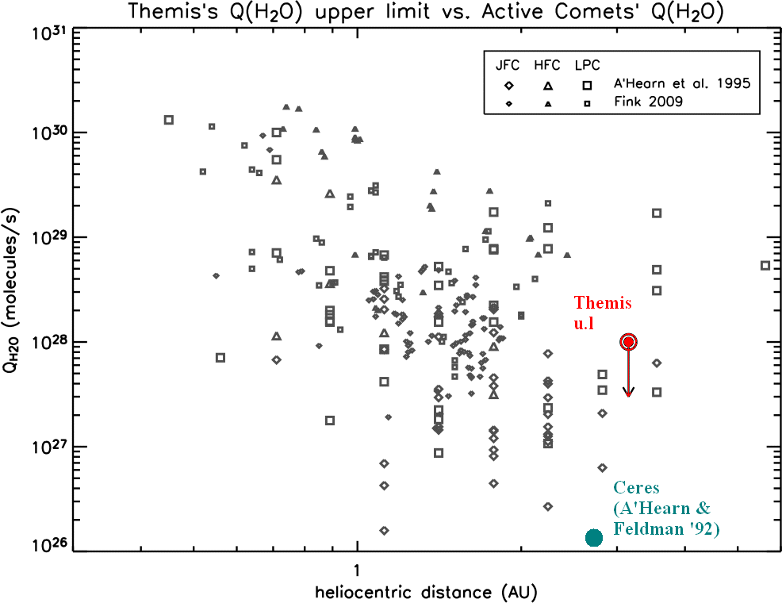

Slide 40
Summary
Radio Astronomy helps us analyze comets
**Even IF it is hard to relate to origins
You should exploit new instruments!
You should talk to people on buses!
What’s your target of opportunity?
Notes:
Complement & support optical/IR

Slide 41
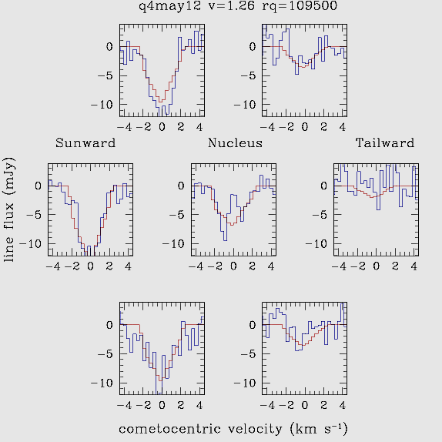
Observational Goals
Radio spectra (and maps) can constrain:
Production rates
Outflow velocities
Asymmetries
Coma density
Notes:
Complement & support optical/IR

Slide 42
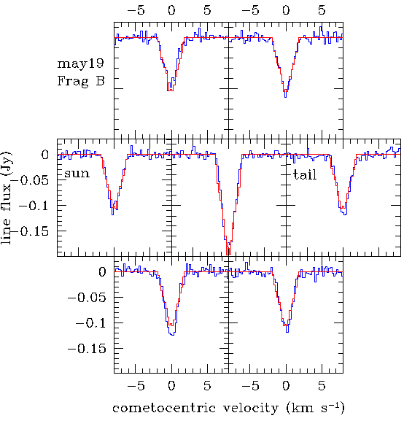
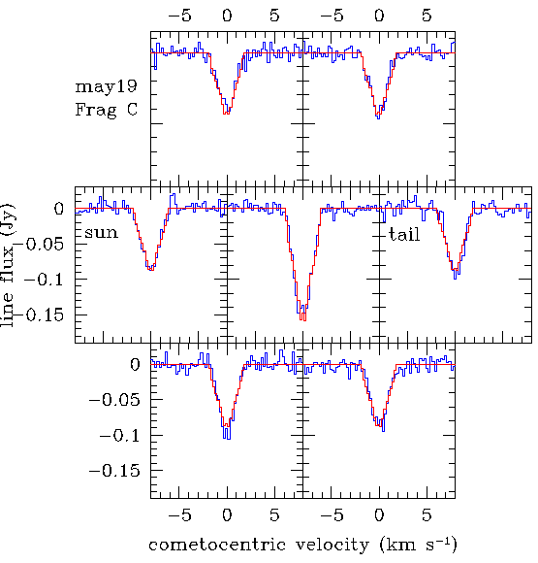
Map comparison
Notes:
Mapping pattern, spectral & spatial resolution – smaller fragment MUCH more active

Slide 43
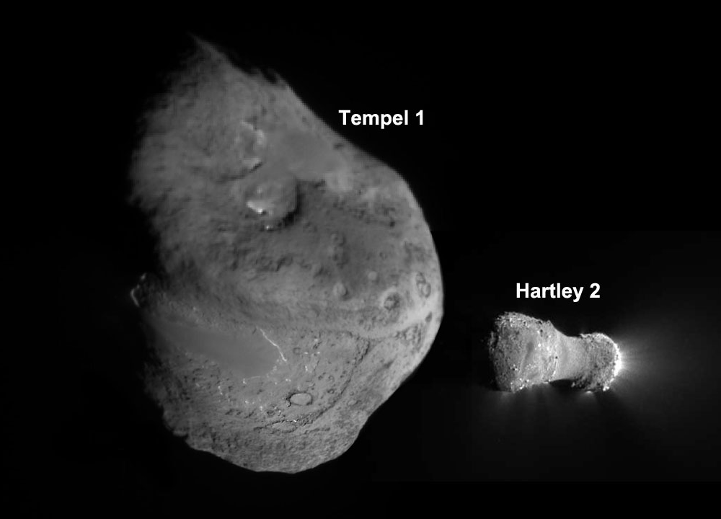
To scale!
Notes:
5x8km vs 2.33 km

Slide 44
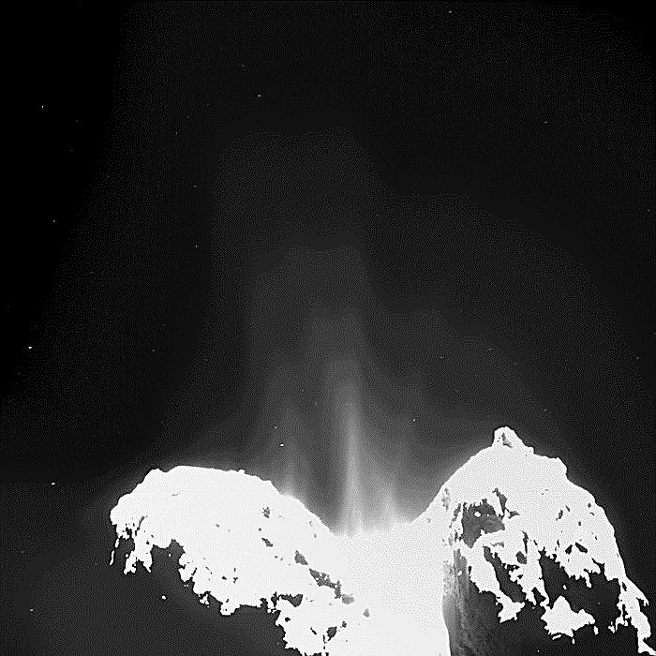

Slide 46
Spatial Profiles

Slide 47
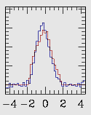

Outflow Velocity & Gas Production
Production rate Q
  # molecules/second from observed column density
Velocities (widths) 0.5–2.5 km/s Low velocity for low-Q or distant
Q<10²⁹ mol s⁻¹ r >1.0 km s⁻¹
Large variations near sun, large Q
Notes:
Flew faster or lived longer

Slide 48

Notes:
May 21, better quenching figure is needed…

Slide 49
Quenching Constraints
Notes:
May 21, better quenching figure is needed…

Slide 50


Slide 51

OH observations
Sample pre-impact OH spectra
Notes:
Sample OH observation (OH is terribly important)

Slide 52
Recent Results

Slide 53

Comet SW3 -- HST

Slide 54

Comet SW3 -- HST

Slide 55

Quenching Constraints
Notes:
May 21, better quenching figure is needed…

