Slide 1
Signal Processing Fundamentals
John Ford, Green Bank Electronics

Slide 2
Signal Processing Fundamentals
Outline
Introduction to Signal Processing
  Definitions
  Introduction
  Complex numbers and number representation
Time and Frequency Domain Processing
Fourier Transforms
Sampling
  Definitions: Baseband, bandlimited signals, Nyquist sampling
Algorithms and Processes

Slide 3
Signal Processing Fundamentals
Introduction to Radio Astronomy Signal Processing
Context: On-line processing as opposed to post-processing
  Must be able to process data as it is collected
  Must be able to store the data on disk as it is collected
Analog vs Digital Signal Processing
  Analog systems used at RF and IF
    Amplification/Attenuation – Change signal levels
    Filtering – Define signals passed downstream
    Frequency Translation – Translate RF signal to another frequency
  Digital systems process the data following initial analog processing
    Sampling
    More filtering
    Conversion to the Frequency Domain

Slide 4
Complex Numbers (Engineering convention)
We define a complex number with the form
Where , are real numbers.
The real part of , written is .
The imaginary part of z, written , is .
Notice that, confusingly, the imaginary part is a real number.
So we may write as
MIT OpenCourseWare
http://ocw.mit.edu

Slide 5
Complex Plane
and
MIT OpenCourseWare
http://ocw.mit.edu

Slide 6
Polar Coordinates
In addition to the Cartesian form, a complex number may also be represented in polar form:
Here, is a real number representing the magnitude of , and represents the angle of in the complex plane.
Multiplication and division of complex numbers is easier in polar form:
Addition and subtraction of complex numbers is easier in Cartesian form.
MIT OpenCourseWare
http://ocw.mit.edu

Slide 7
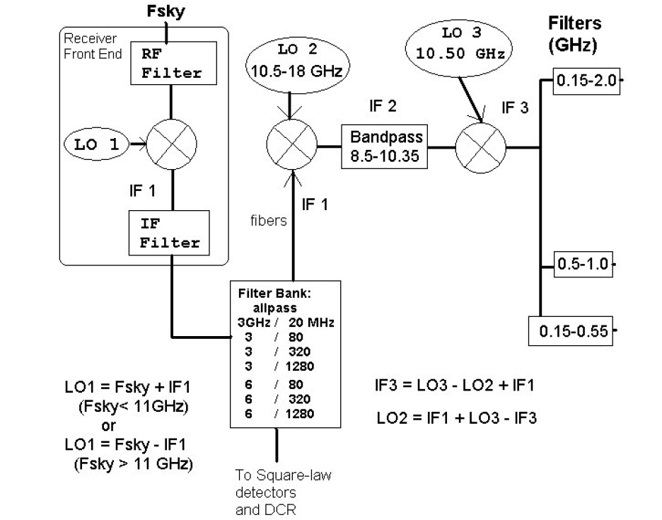

Signal Processing Fundamentals
Analog Processing
Amplification
Filtering
Frequency Translation
FT Modulation Theorem:

Slide 8
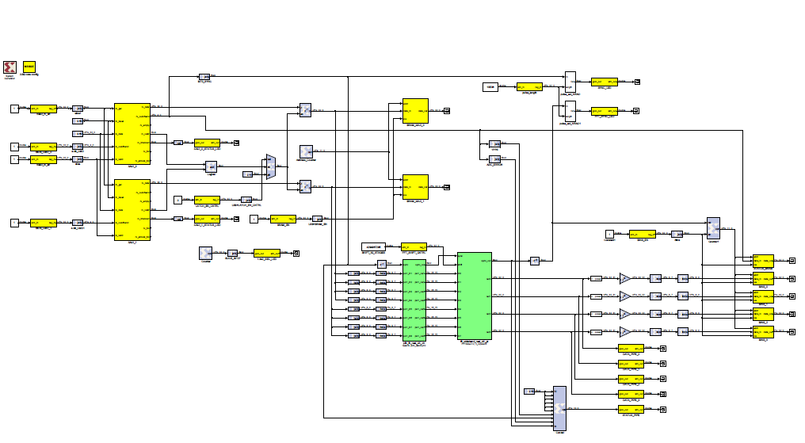
Signal Processing Fundamentals
Digital Signal Processing
Sampling
More filtering
Frequency translation
Time to frequency domain conversion

Slide 9




Signal Processing Fundamentals
Fourier Transforms
Continuous
Discrete
From Essential Radio Astronomy
Condon and Ransom
http://www.cv.nrao.edu/course/astr534/ERA.shtml

Slide 10
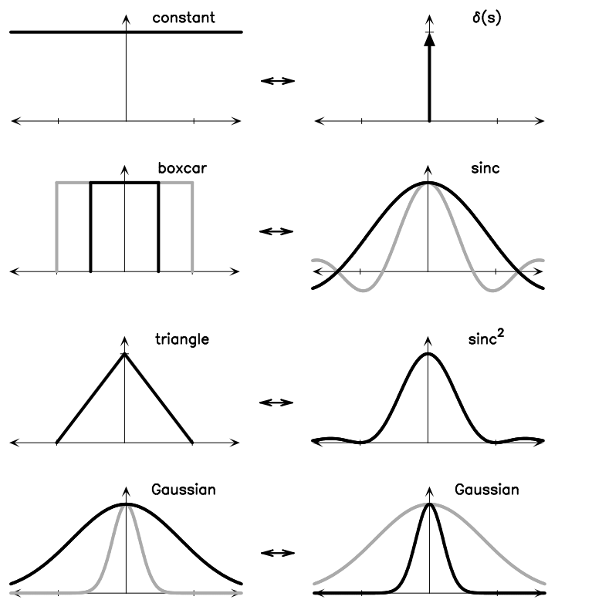
Signal Processing Fundamentals
Common FT Pairs
Recall that the FT is reversible
Similarity Theorem

Slide 11





Signal Processing Fundamentals
FT Properties
Additive
Shifting
Similarity
Modulation
Derivative

Slide 12





Signal Processing Fundamentals
Convolution and Correlation
Convolution
Convolution Theorem
Correlation
Correlation Theorem
Autocorrelation

Slide 13
Signal Processing Fundamentals
Sampling
Convert the analog continuous time signal into a digital representation.
Analog to Digital converters perform this function
Nyquist (Shannon) Theorem (Sampling Theorem)
  To preserve all of the information in the signal, it must be sampled at least twice as fast as the highest frequency present in the signal.
    For 800 MHz bandpass, sample at 1600 MHz
    Note that frequencies present that are outside the band will alias into the signal, corrupting the measurement
  Analog filters ahead of the sampler must bandlimit the signal to less than ½ of the sampling frequency to prevent aliasing

Slide 14
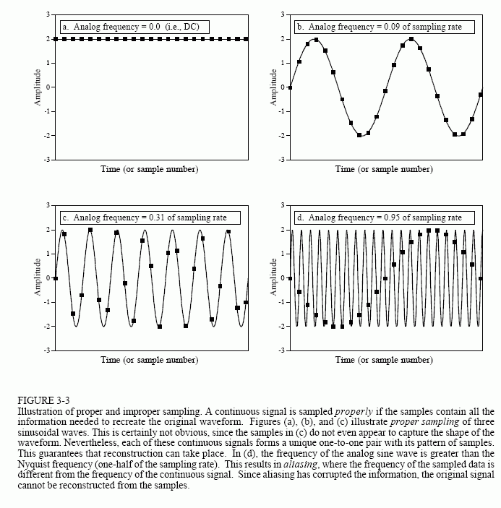
Signal Processing Fundamentals
Sampling
From The Scientist and Engineer's Guide to Digital Signal Processing, copyright ©1997-1998 by Steven W. Smith. For more information visit the book's website at: www.DSPguide.com

Slide 15
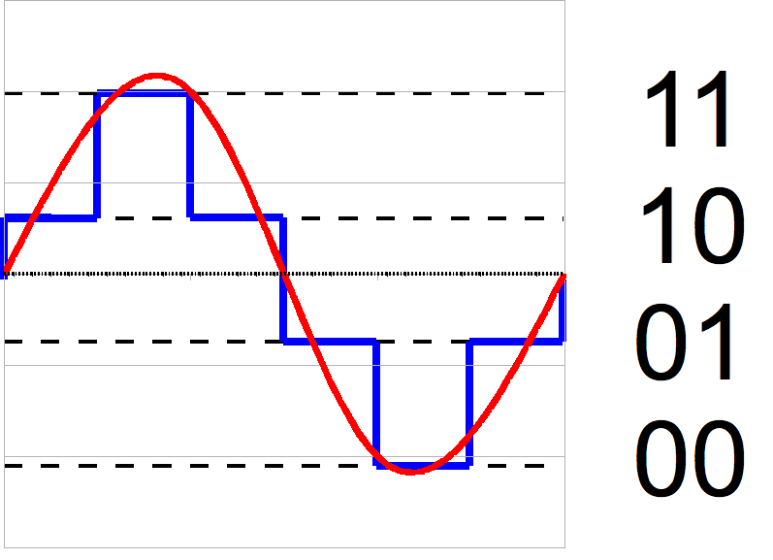
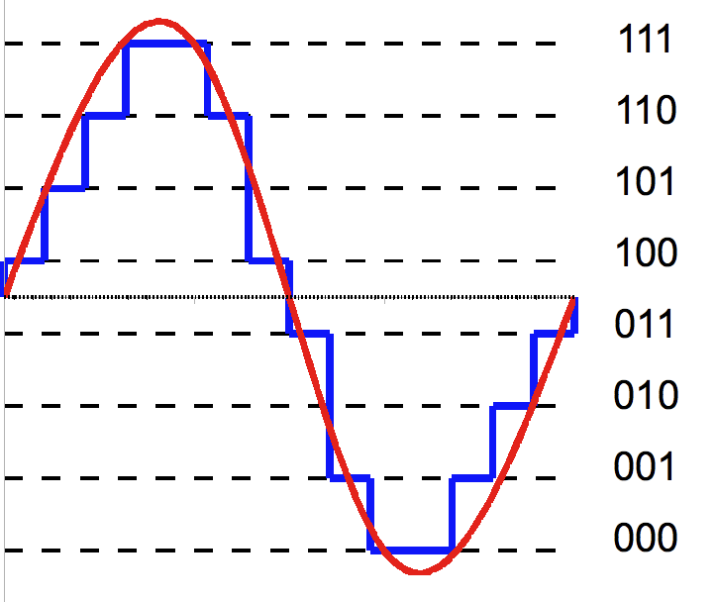
Signal Processing Fundamentals
Sampling
Resolution of the ADC depends on the number of bits in the representation
  From 1 to 12 bits common in RA
    GBT Spectrometer – 2 bits
    VEGAS -- 8 bits
    MeerKAT digitizer – 12 bits
More bits provides more headroom for RFI, and less quantization noise
  VEGAS operates with ~ 4 bits of headroom
"3-bit resolution analog comparison" by Hyacinth - Own work. Licensed under CC BY-SA 3.0 via Wikimedia Commons - https://commons.wikimedia.org/wiki/File:3-bit_resolution_analog_comparison.png#/media/File:3-bit_resolution_analog_comparison.png
"2-bit resolution analog comparison" by Hyacinth - Own work. Licensed under CC BY-SA 3.0 via Wikimedia Commons –
https://commons.wikimedia.org/wiki/File:2-bit_resolution_analog_comparison.png#/media/File:2-bit_resolution_analog_comparison.png

Slide 16
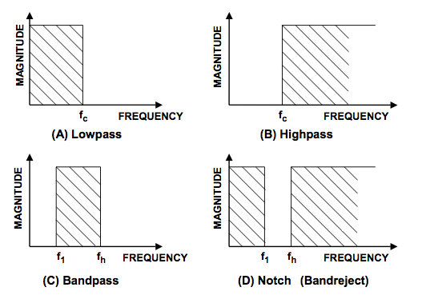
Signal Processing Fundamentals
Filtering
Filtering modifies the frequency content of the signal
  Lowpass
  Highpass
  Bandpass
  Bandstop (Notch)
Non-ideal filters also modify the amplitude of the signal
Filtering is applied in the time domain
http://www.analog.com/library/analogDialogue/archives/43-09/EDCh%208%20filter.pdf

Slide 17
Signal Processing Fundamentals
Digital Filters
Finite Impulse Response (FIR) filter
  Linear phase response
  Needs more taps than an IIR of equal amplitude performance
Cascaded Integrator-Comb (CIC) filter
  Excellent for constrained resource machines (FPGAs)
  Does not use multipliers, just addition
Infinite Impulse Response (IIR) filter
  Recursive
  Poor phase response
Polyphase Filter Bank (Discussed later…)

Slide 18
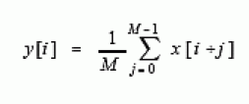

Signal Processing Fundamentals
FIR Filter example: moving average
An FIR filter is a convolution of a filter kernel with the input, i.e. …0,0,1/5,1/5,1/5,1/5,1/5,0,0…, a pulse of width=5 and height=1
The moving average filter is optimal for cleaning up a rectangular pulse in white noise
Note that the filter kernel is of finite length, so the convolution goes to zero eventually, hence the name FIR

Slide 19

Signal Processing Fundamentals
Infinite Impulse Response filters
Uses both input values and previous output values to calculate the current value
This recursive structure results in the IIR moniker
Filter phase is non-linear without using strong magic
Only short filters are stable.

Slide 20
Signal Processing Fundamentals
Cascaded Integrator-Comb filters
CIC filters are an economical structure for large changes in sample rate from the input sample rate to the output rate (R)
No multipliers are needed for the integrators
Width of registers needs consideration
Integrators operate at high speeds
Combs operate at low speeds
Not very sharp edges to the band, aliasing at multiples of the output rate frequency
  Use in combination with a conventional FIR filter once the rate change is complete to reject aliasing, sharpen response

Slide 21
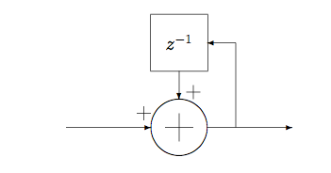

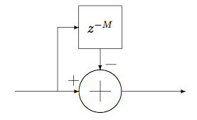

Signal Processing Fundamentals
CIC filters, continued
The integrator is described by the following IIR filter:
The comb section is described by the following FIR filter, where M is the differential delay (Usually 1 or 2)

Slide 22
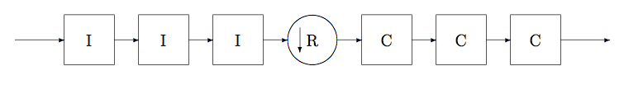

Signal Processing Fundamentals
CIC filters, continued
The CIC filter consists of N cascaded integrator stages running at f_{s}, followed by the rate change, R, which is then followed by N cascaded comb stages running at f_{s}/R as shown below:
The transfer function of the filter :
Further details may be found here:
Hogenauer, E., "An economical class of digital filters for decimation and interpolation," Acoustics, Speech and Signal Processing, IEEE Transactions on , vol.29, no.2, pp.155,162, Apr 1981
doi: 10.1109/TASSP.1981.1163535
URL: http://ieeexplore.ieee.org/stamp/stamp.jsp?tp=&arnumber=1163535&isnumber=26152
Donadio, M. “CIC Filter Introduction”, http://dspguru.com/sites/dspguru/files/cic.pdf

Slide 23
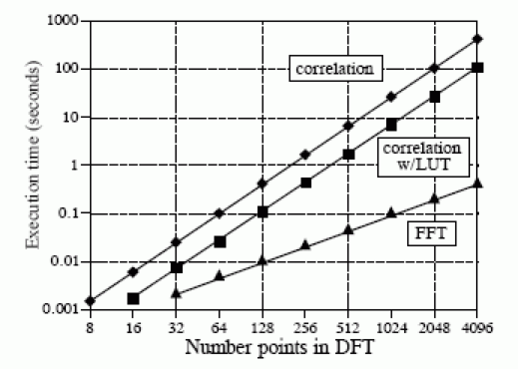
Signal Processing Fundamentals
Fast Fourier Transform
A numerically efficient way to calculate the discrete Fourier transform O(n log₂(n)) vs O(n²)
More accurate than DFT due to less round-off error (fewer calculations)
Many libraries exist for CPU and GPU based systems
Efficient fixed-point FFTs exist for FPGAs
Image by Steve Smith

Slide 24
Signal Processing Fundamentals
FFT applications and problems
Creating a spectrum from time domain samples
  The usual application in radio astronomy
FFT Convolution
  Used in Coherent dedispersion for pulsar timing, and Coherent search modes for searching
  Other filtering and detection algorithms
Problems with FFTs in FPGA implementations
  Numerical overflow in the face of RFI
    Overflow ruins the entire spectrum, not just the channel with the RFI in it (in case of a narrow feature)
  Spectral leakage between bins

Slide 25


Signal Processing Fundamentals
FFT Convolution
Recall that convolution in the time domain is the same as multiplication in the frequency domain
Transform the filter kernel and the input data, multiply, and transform the output data back to the time domain.

Slide 26
Signal Processing Fundamentals
FFT and the Polyphase Filter Bank (PFB)
Problems with FFTs in FPGA implementations
  Overflow in the face of RFI
  Spectral leakage between bins
Some of these problems can be remedied using the Polyphase Filter Bank (PFB)
The PFB is a computationally efficient method to augment the FFT to reduce spectral leakage.
  The PFB does produce some time-domain smearing and does not completely eliminate spectral leakage.
For more on the PFB, see A Mathematical Review of Polyphase Filterbank Implementations for Radio Astronomy, Harris and Haines, Publications of the Astronomical Society of Australia, 2011, 28, 317–322 , http://dx.doi.org/10.1071/AS11032

Slide 27
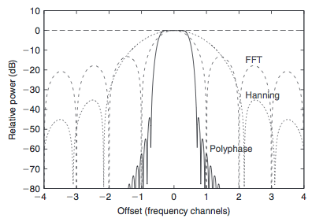
Signal Processing Fundamentals
FFT and the Polyphase Filter Bank (PFB)
Response of the FFT, FFT with Hanning window, and with the PFB
Computational complexity of this structure is O(N(P+Nlog₂(N)))
Response better than longer FFT, still not as numerically intense
N=1024, P =8

Slide 28
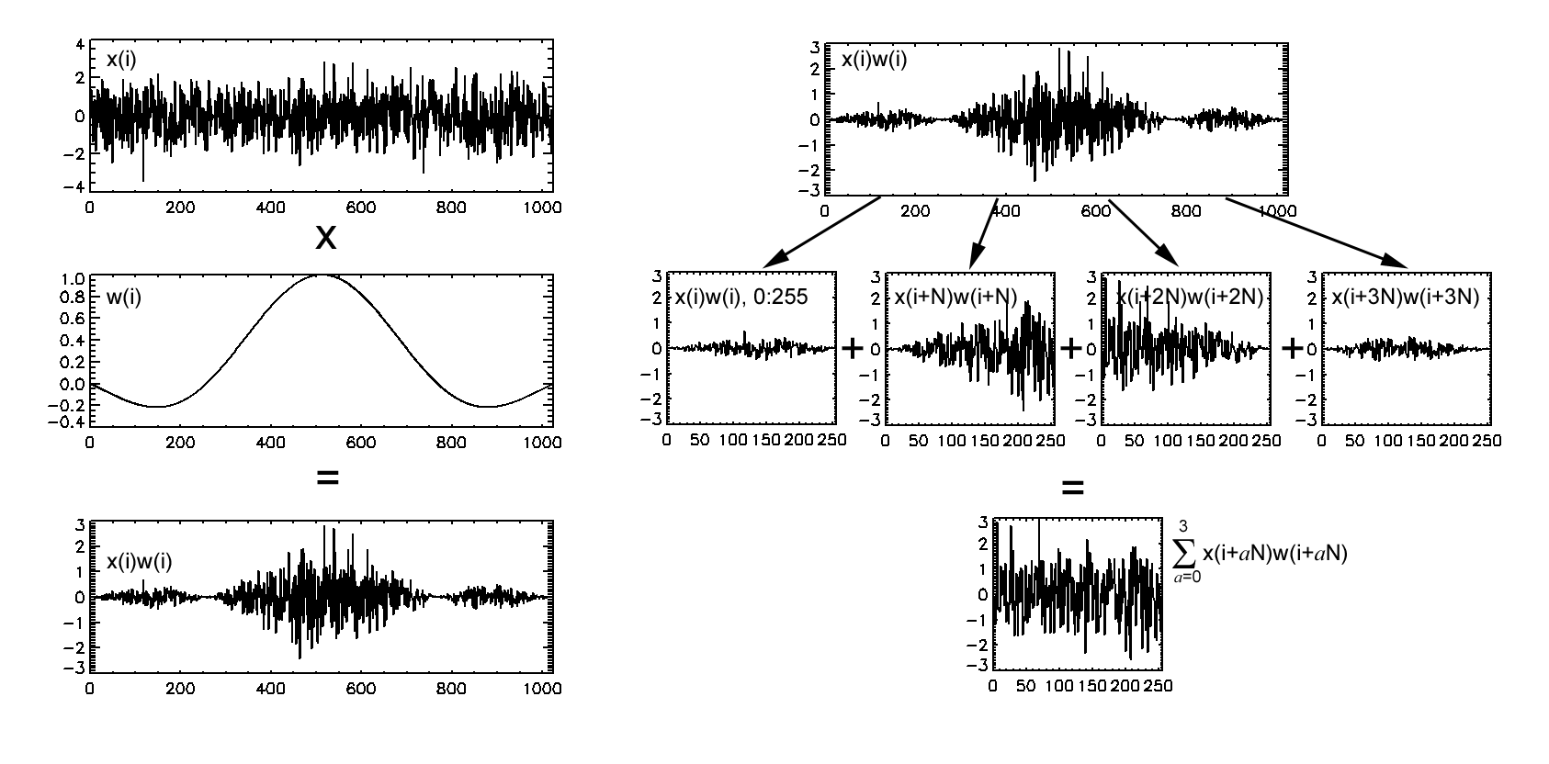
Signal Processing Fundamentals
PFB Mechanization
Image by Dale Gary

Slide 29
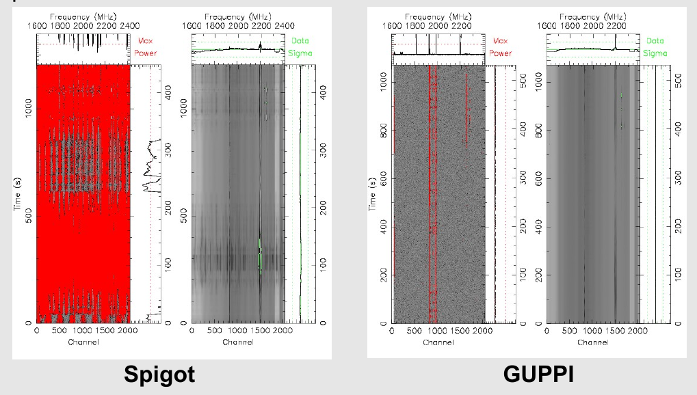
Signal Processing Fundamentals
PFB/FFT contamination reduction
Image by S. Ransom

Slide 30

Signal Processing Fundamentals
Summary: a simple spectrometer
Sketch by Jack Hickish

Slide 31
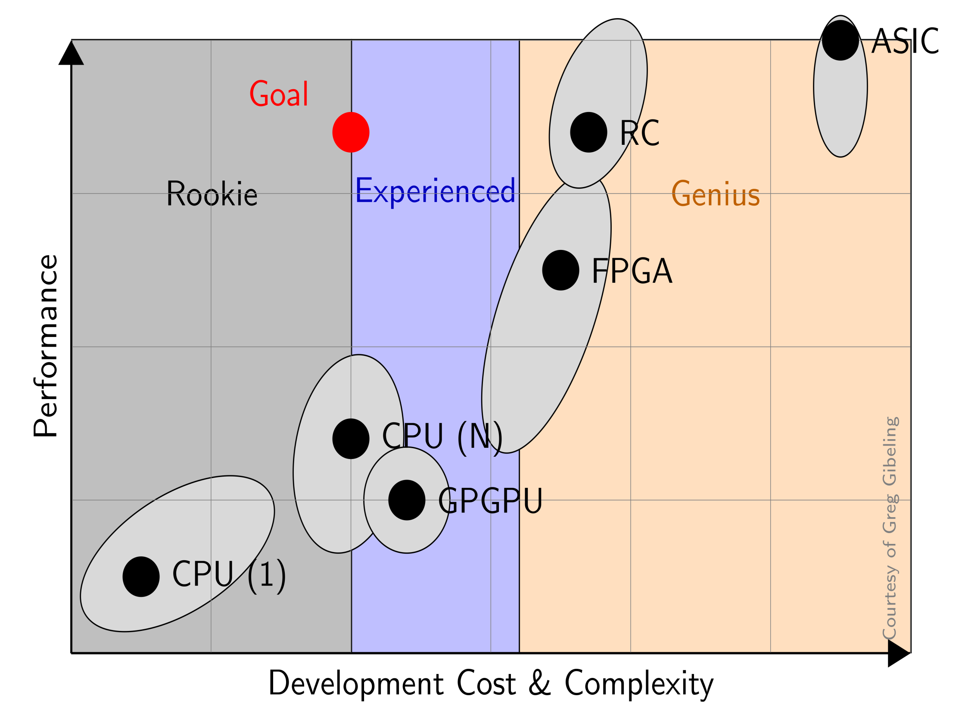
Signal Processing Fundamentals
Casper Architecture
Leverages work of others
Puts more people in the sweet spot
https://casper.berkeley.edu/wiki/images/0/0c/Workshop_casper2010_intro_dan_werthimer.ppt

Slide 32
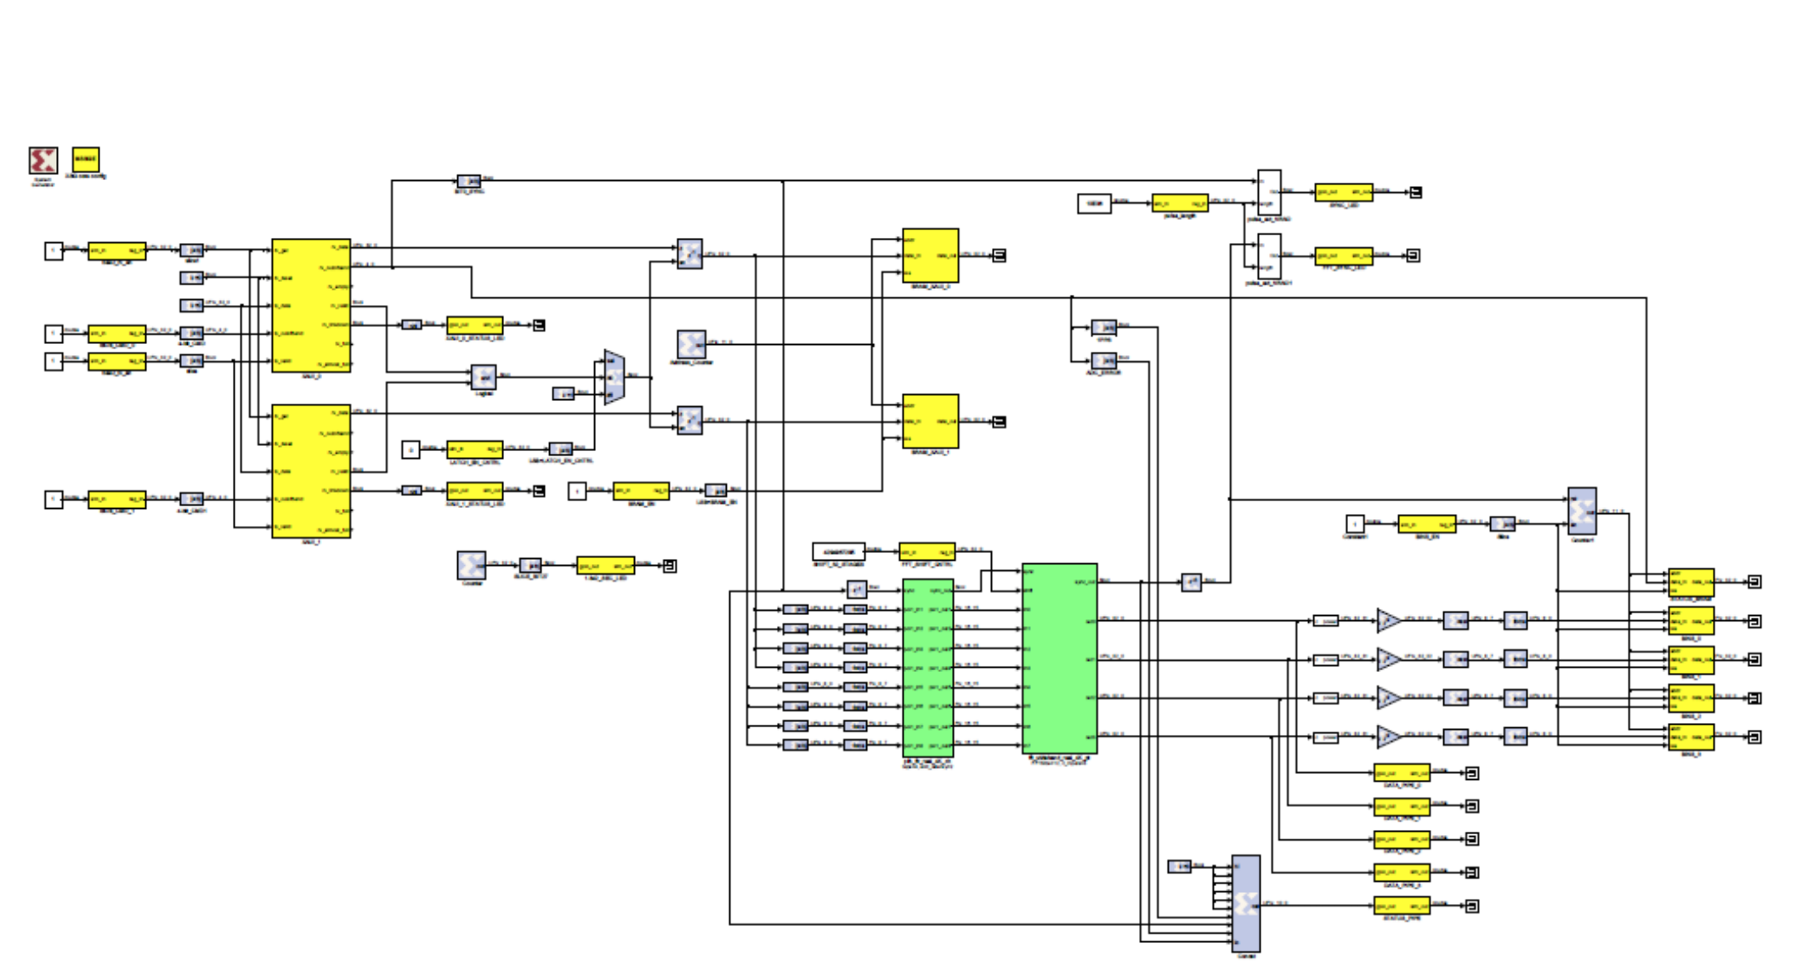
Signal Processing Fundamentals
Software
Build instruments using simulink diagrams
Concentrate on the signal processing instead of the platform quirks

Slide 33
FPGA vs GPU
FGPA = synchronous, GPU = asynchronous
eg: ADC input: FGPA to time stamp, packetize
FPGA: 250 Gbit/sec I/O GPU: 13 Gbit/sec (40?)
GPU’s use more power (3 - 20X FPGA)
GPU’s are easier to program (CUDA)
GPU’s are cheaper
GPU’s are good at floating point

Slide 34
The Problem with the Traditional
Hardware Development Model
Takes 5 to 10 years
Cost Dominated by NRE because of custom Boards, Backplanes, Protocols
Antiquated by the time it’s released.
How to buy the hardware at the last minute?
Each observatory designs from scratch

Slide 35
Solution:
Modular General Purpose Hardware
  Low number of board designs
  Can be upgraded piecemeal or all together
  Reusable
  Standard signal processing model which
  is consistent between upgrades.

Slide 36
CASPER Real-time Signal Processing Instrumentation
Low NRE, shared by the community
Rapid development
Open-source, collaborative
Reusable, platform-independent gateware
Modular, upgradeable hardware
Industry standard communication protocols
Use switches to solve correlator interconnect
Low Cost
Notes:
36

Slide 37
Collaboration
Share Open Source Libraries
Workshops
Video’s and Doc’s on Tool Flow, Libraries
Wiki, Mailing List
Open Source Boards (available from vendors)

Slide 38
Signal Processing Fundamentals
CASPER Complete Instrument

Slide 39
Signal Processing Fundamentals
CASPER Architecture Summary
Single or few FPGAs on a board, connected together with computers to form an instrument
Few varieties of hardware to design
Software portable among platforms
It’s easy to build PI instruments, but still difficult to build common-user instruments, due to all the belts and suspenders and reliability required of a facility instrument

Slide 41
Signal Processing Fundamentals

Slide 42
