Slide 1
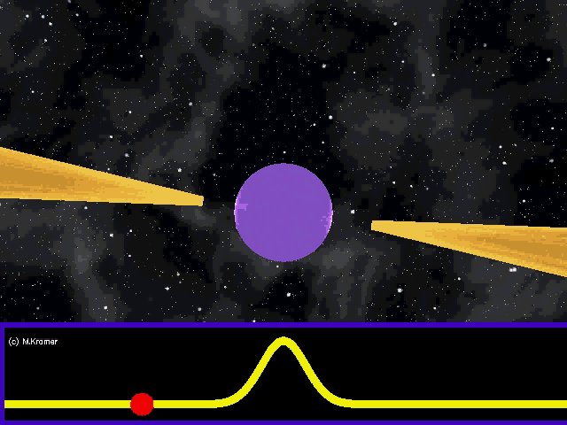
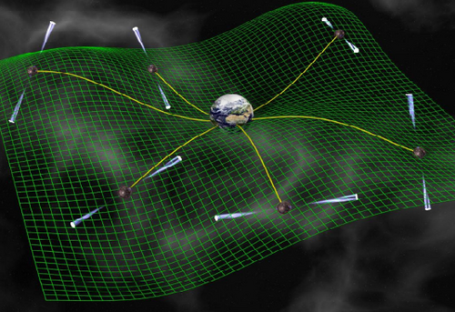


The NANOGrav Science Program
Maura McLaughlin
West Virginia University
July 10 2015
D. Champion
Single Dish Summer School 10 June 2015

Slide 2
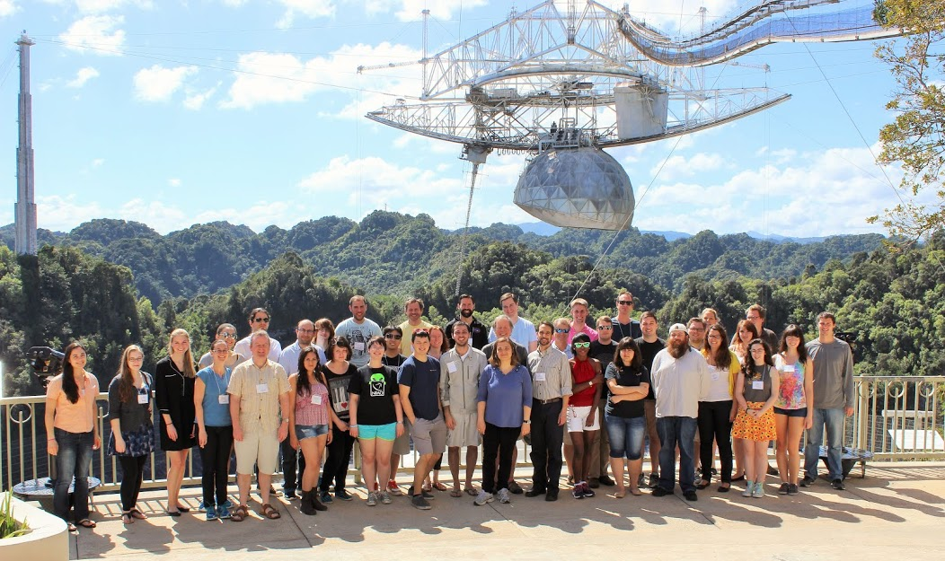
North American Nanohertz Observatory for GWs
About 60 students and scientists in the US and Canada working to characterize the GW universe at low frequencies using pulsar timing.
nanograv.org
Single Dish Summer School 10 June 2015

Slide 3

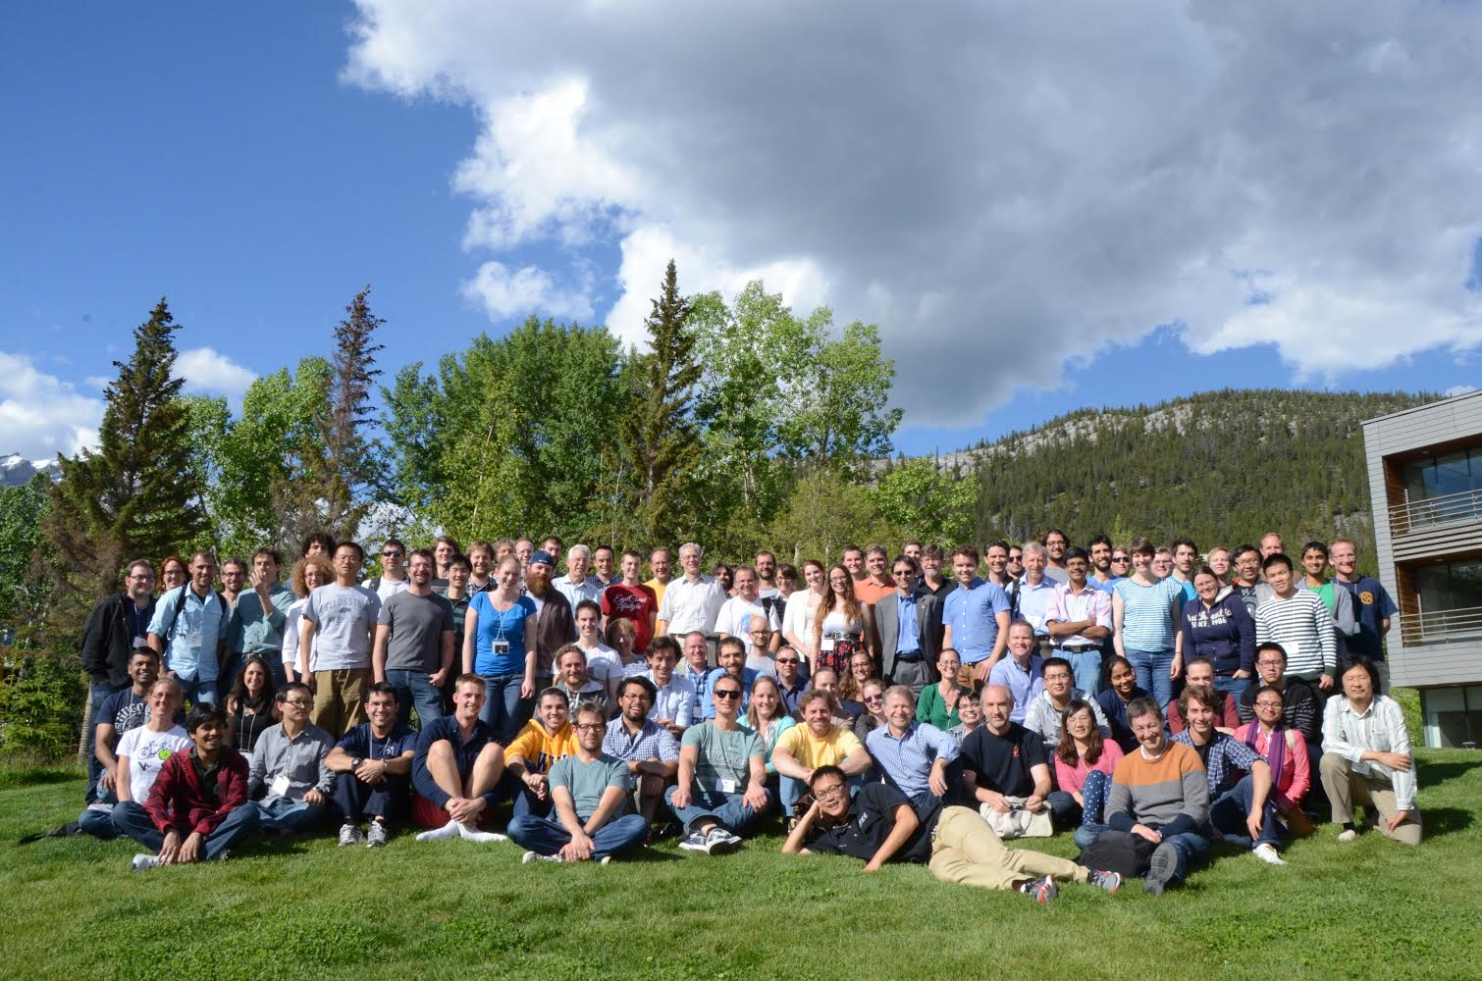
International Pulsar Timing Array (IPTA)
A consortium of consortia: roughly 100 scientists using eight radio telescopes from North America, Europe, and Australia.
Ipta4gw.org
Single Dish Summer School 10 June 2015

Slide 4
The NANOGrav Science Program
What are gravitational waves and why do we want to study them?
What are pulsars and what data do we analyze?
What sources will we detect?
How do we analyze our data?
What have we found so far?
How long to detection and how do we make that time shorter?
Summary and the future
Single Dish Summer School 10 June 2015

Slide 5
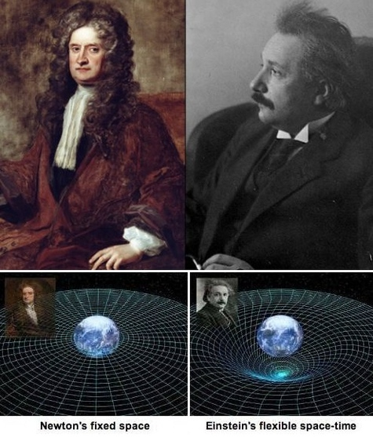
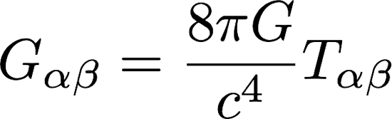
General Relativity
GR published in 1915, and has passed every test so far with flying colors.
Single Dish Summer School 10 June 2015

Slide 6
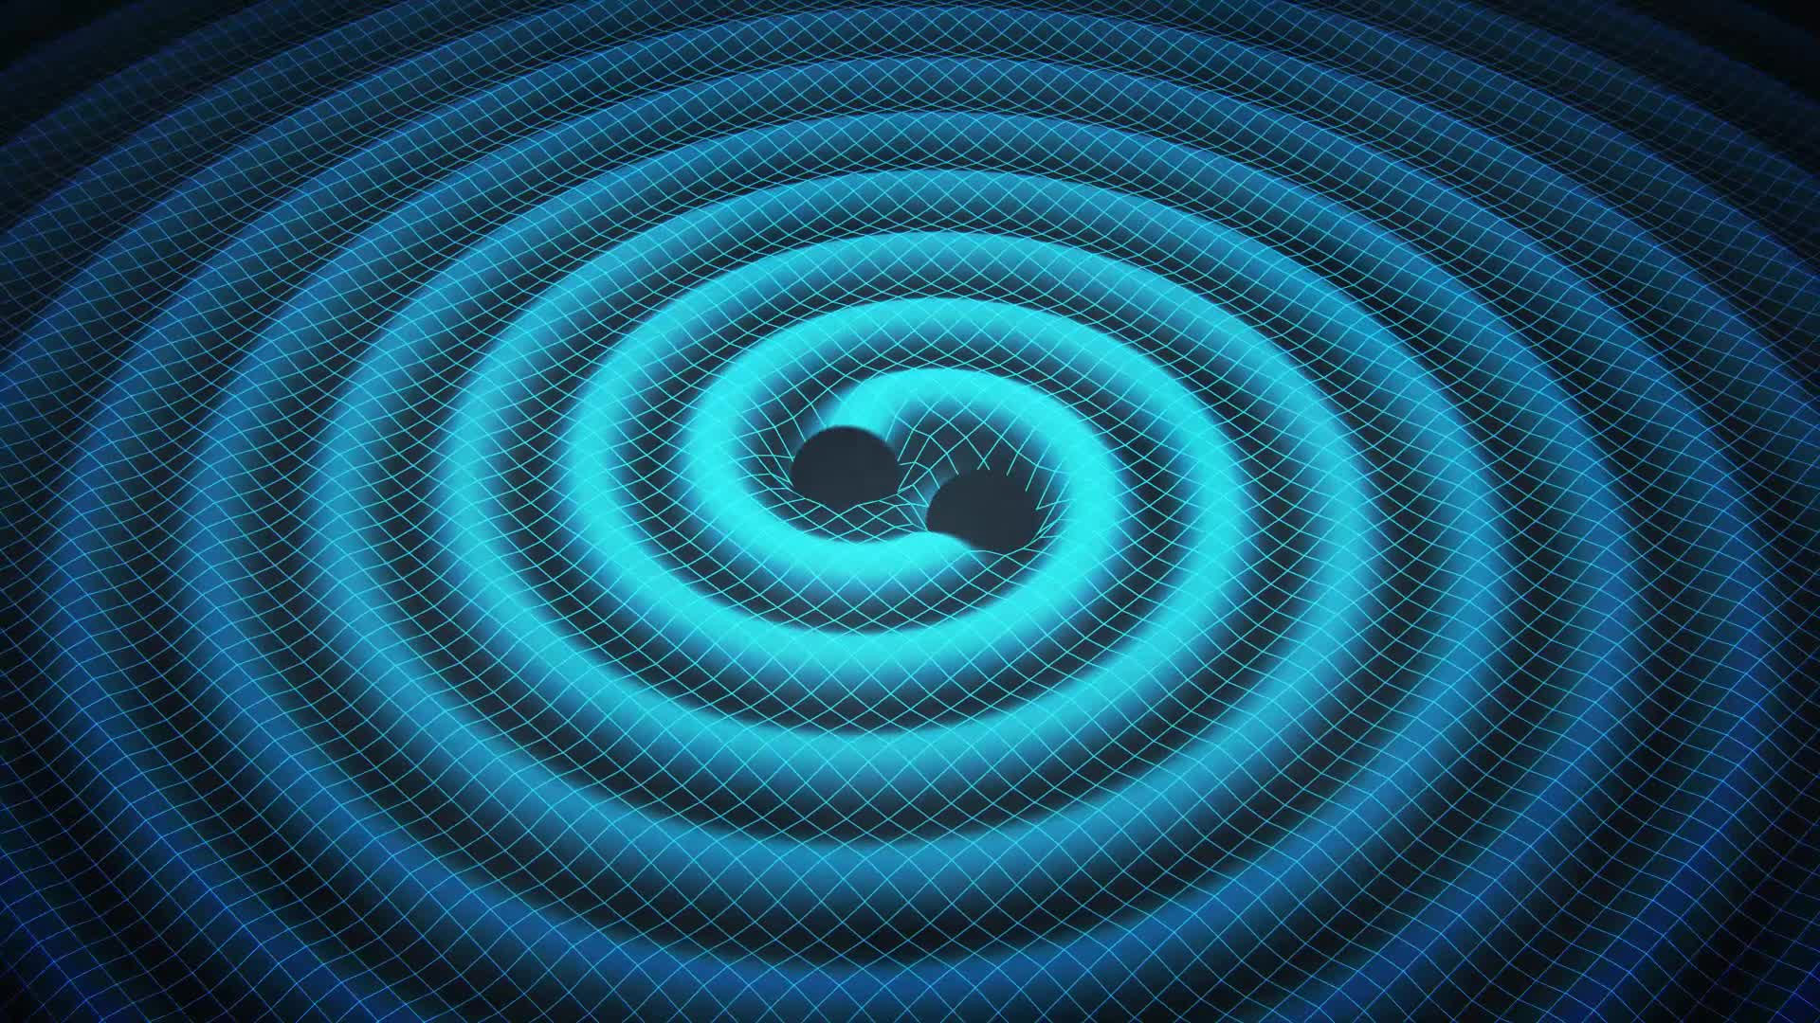
Gravitational Waves
Masses with varying quadrupole moments will emit GWs.
Masses with varying quadrupole moments will emit GWs.
Single Dish Summer School 10 June 2015

Slide 7


The Effect of Gravitational Waves
They change the light travel times between objects.
+
x
h = strain = ΔL/L = 0.5
frequency = 1/(2 seconds) = 0.5 Hz
speed = c
wavelength = 6 x 10⁸ m
Astrophysical strains we aim to detect are 10⁻¹⁵ to 10⁻¹⁶!
Single Dish Summer School 10 June 2015

Slide 8
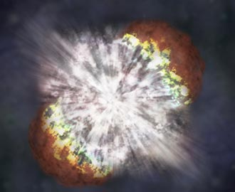
Gravitational Wave Sources
Masses with varying quadrupole moments will emit GWs.
Which of the following are GW sources?
- spinning stars
- pulsing stars
- stars in binary orbits
- supernovae
- stellar mergers
- cosmic strings
- the Big Bang
Single Dish Summer School 10 June 2015

Slide 9
Gravitational Wave Properties
In binary systems, energy is lost to GWs
and orbits will decay
and objects will eventually merge.
Single Dish Summer School 10 June 2015

Slide 10
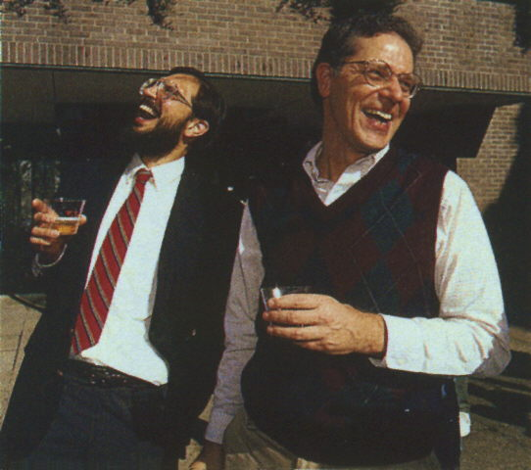

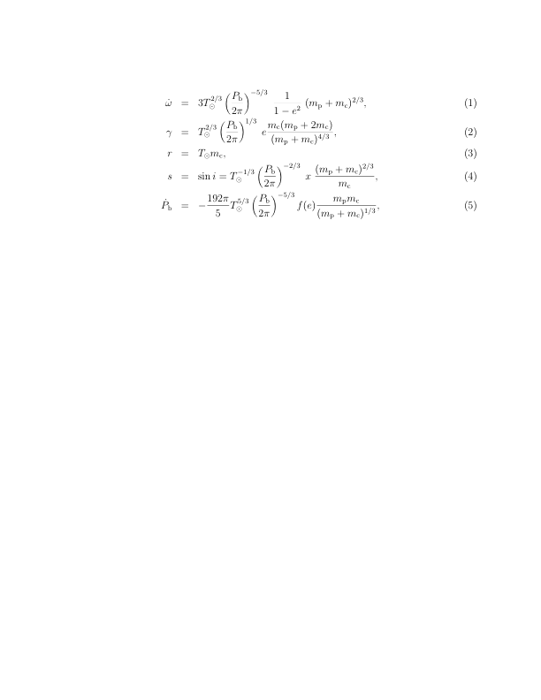
Evidence for Gravitational Waves
Hulse & Taylor, 1975, ApJ, 195, L51
Weisberg, Nice, & Taylor, 2010, ApJ, 722, 1030
Single Dish Summer School 10 June 2015

Slide 11
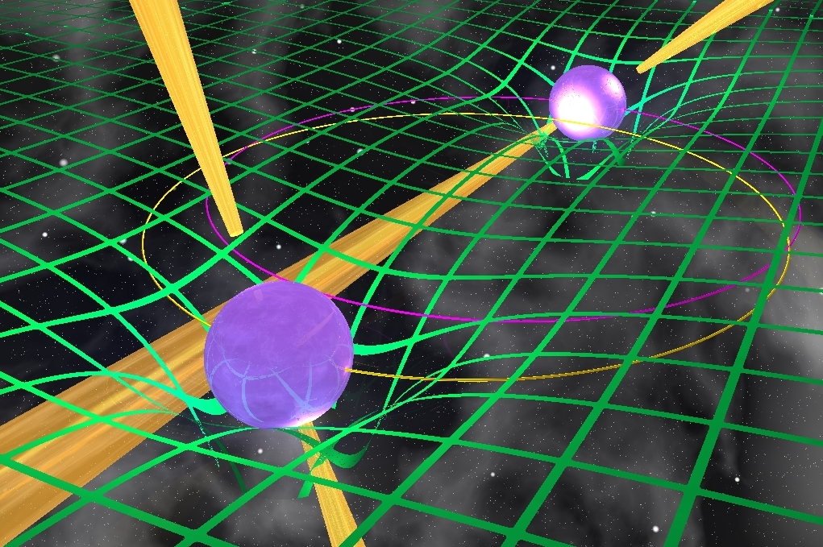
(Even Better!) Evidence for Gravitational Waves
Double Pulsar 7 mm/day orbit shrinkage agrees to 0.1% with GR prediction!
Kramer et al. in preparation
Single Dish Summer School 10 June 2015

Slide 12

Isn’t this good enough?
We want to see the effects of GWs on light travel time between objects with a PTA and then use the PTA as a GW observatory.
Single Dish Summer School 10 June 2015

Slide 13
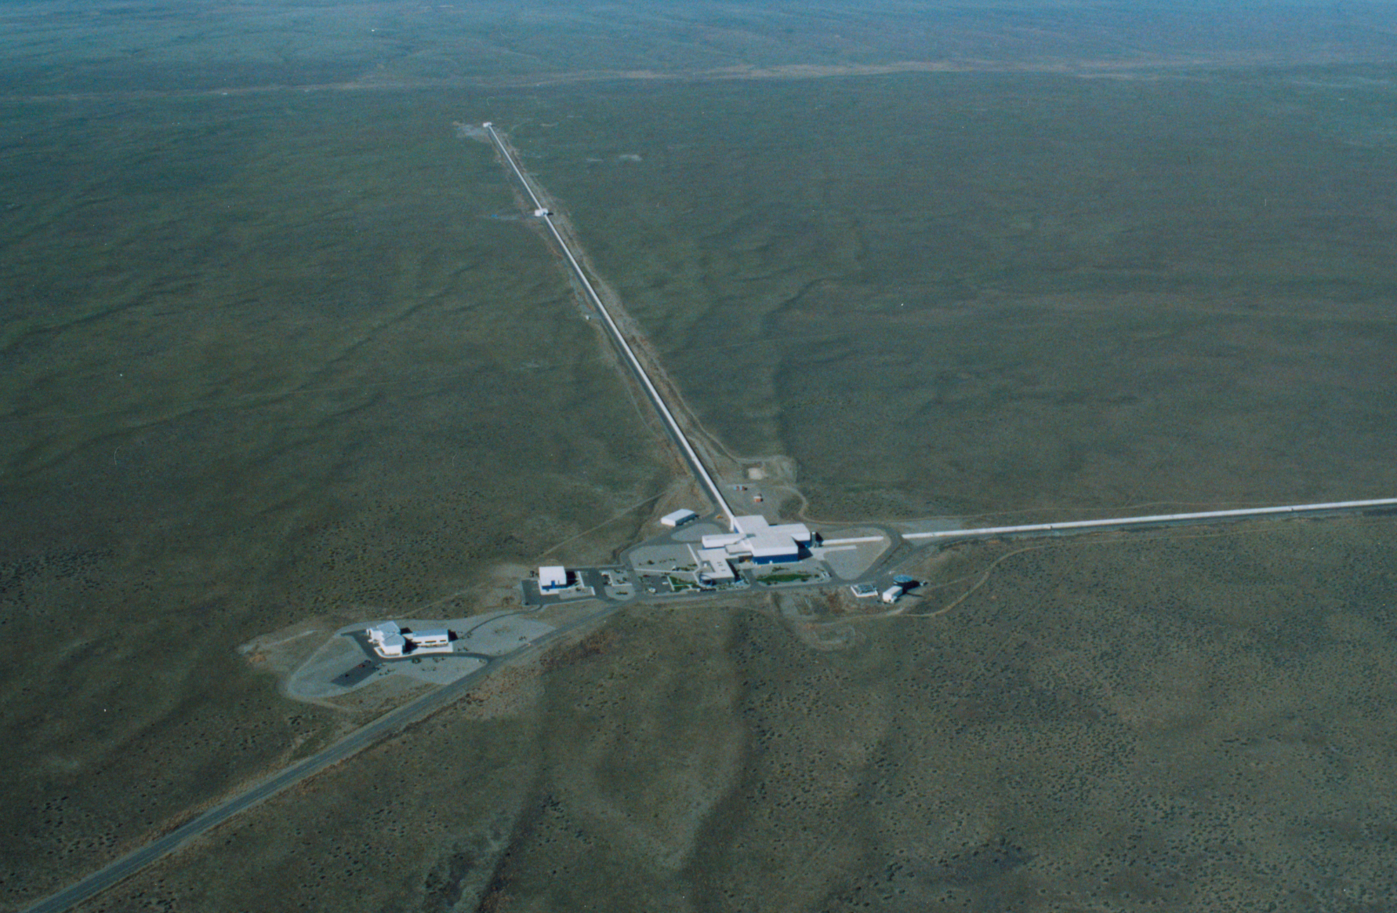
Ground-based approach
LIGO
4 km long arms with 40 kg mirrors at their ends
Sensitive to GWs with timescales of milliseconds
Single Dish Summer School 10 June 2015

Slide 14
Ours is a similar approach but with celestial clocks!
(and a lot cheaper!)
Pulsar Timing Array
Thousands of light years long arms and stars that are more massive than the Sun
Sensitive to GWs with periods of years
Single Dish Summer School 10 June 2015

Slide 15



What is a pulsar?
Single Dish Summer School 10 June 2015

Slide 16
Pulsar Timing Array (PTA)
A network of pulsars that can be used to measure various effects that produce correlations in the arrival times of pulses from the members of the array.
First proposed by Foster and Backer (1990).
Single Dish Summer School 10 June 2015

Slide 17
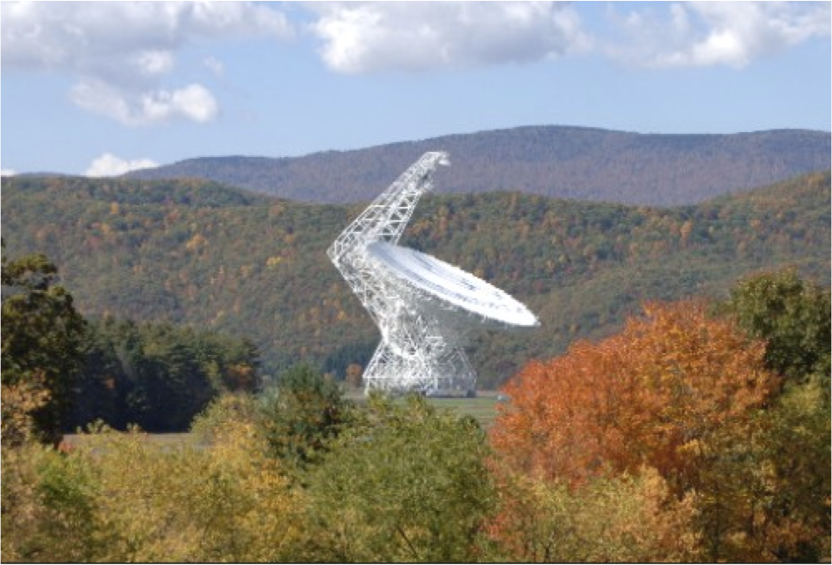
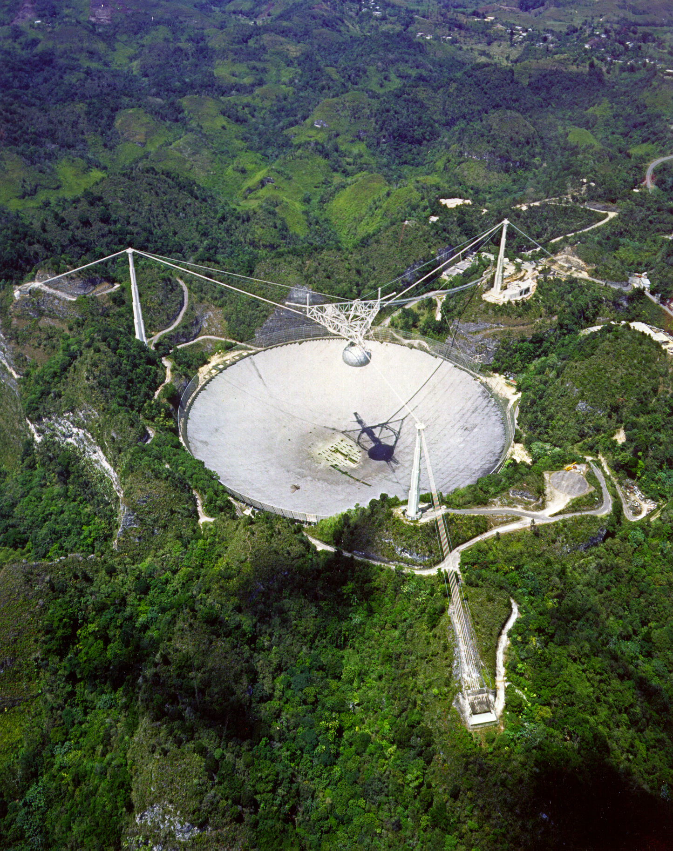
The NANOGrav Experiment
100-m Green Bank Telescope
Green Bank, WV
We use large radio telescopes to observe lots of pulsars and search for tiny (but correlated!) perturbations in times of arrival due to GWs!
300-m Arecibo Observatory
Arecibo, PR
Single Dish Summer School 10 June 2015

Slide 18
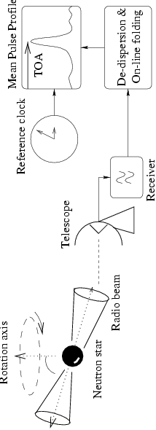
What data does our detector produce? Times-of-Arrival (TOAs)!
Lorimer & Kramer, 2005, “Handbook of Pulsar Astronomy”
On-line folding: adding many pulses together to get stable mean pulse profile
De-dispersion: correcting for frequency-dependent interstellar delays
Single Dish Summer School 10 June 2015

Slide 19
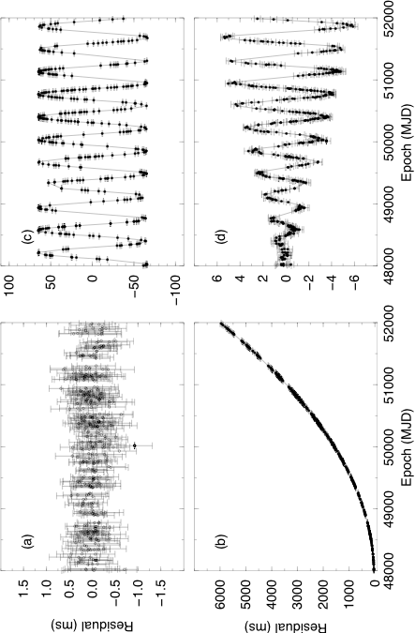
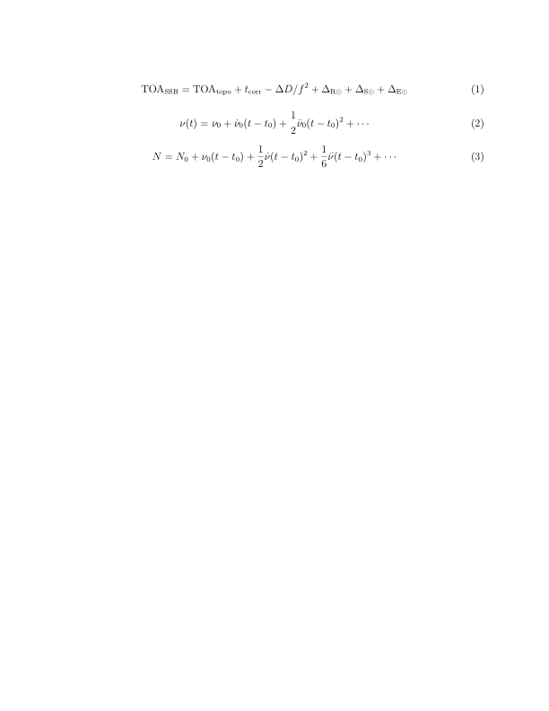
Obtaining a Timing Model and Residuals
Timing Residuals = Model – Measured TOAs
Nice fit.
Wrong position.
We fit for:
period
period derivative
position
dispersion measure
variations in DM
proper motion
parallax
binary parameters
relativistic binary parameters
Wrong spin-down.
No velocity.
Single Dish Summer School 10 June 2015

Slide 20
Typical residuals for a millisecond pulsar
PSR J1713+0747 has a spin period of 4.57 ms. Arrival times are measured to nanosecond levels and the RMS is roughly 70 ns.
This model includes spin-down, astrometric, Keplerian, and post-Keplerian parameters, and a time-variable dispersion measure.
Single Dish Summer School 10 June 2015

Slide 21
Many intrinsic and extrinsic effects….
Spin
Astrometric
Interstellar Medium
Binary
Frequency-dependent profile evolution
Zhu et al. 2015, submitted
Timing parameters estimated using noise models including red noise (intrinsic and due to ISM effects) and pulse jitter.
Single Dish Summer School 10 June 2015

Slide 22
Many intrinsic and extrinsic effects….
Spin
Astrometric
Interstellar Medium
Binary
Frequency-dependent profile evolution
Zhu et al. 2015, submitted
Timing parameters estimated using noise models including red noise (intrinsic and due to ISM effects) and pulse jitter.
Single Dish Summer School 10 June 2015

Slide 23

Pulsars are incredibly stable rotators!
Today at 10:05 am,
the spin period of this pulsar is
4.5701365289250(1) milliseconds.
Single Dish Summer School 10 June 2015

Slide 24
Their periods are predictable to high precision!
Today at 10:05 am,
the spin period of this pulsar is
4.5701365289250(1) milliseconds.
A year from now at the same time,
the spin period will be
4.5701365291940(1) milliseconds.
Single Dish Summer School 10 June 2015

Slide 25

What sources will we detect?
f ~ 1/weeks to 1/years (10⁻⁶ – 10⁻⁹ Hz)
Δt ~ h/f and will have pulsar and Earth terms
h_{min} ~ σ_{rms}/Τ ~ 200 ns/10 years ~ 10⁻¹⁵
λ_{gw} ~ 1-10 lyr; D_{psr} ~ 1000 lyr
First discussed by Detweiler (1979, ApJ, 234,1100) and Sazhin (1978, SA ,22, 36).
Single Dish Summer School 10 June 2015

Slide 26
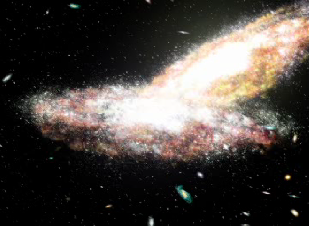
John Rowe Animation
Single Dish Summer School 10 June 2015

Slide 27
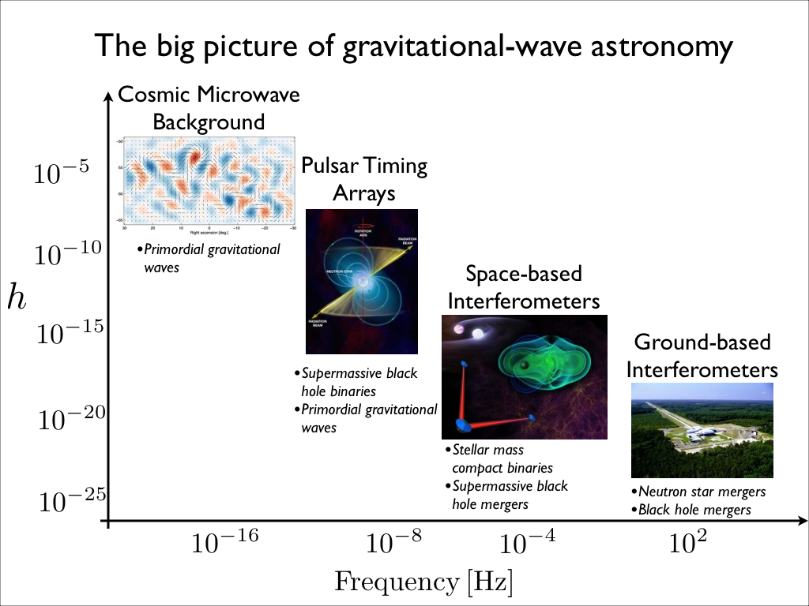
Complementary with other experiments
Single Dish Summer School 10 June 2015

Slide 28
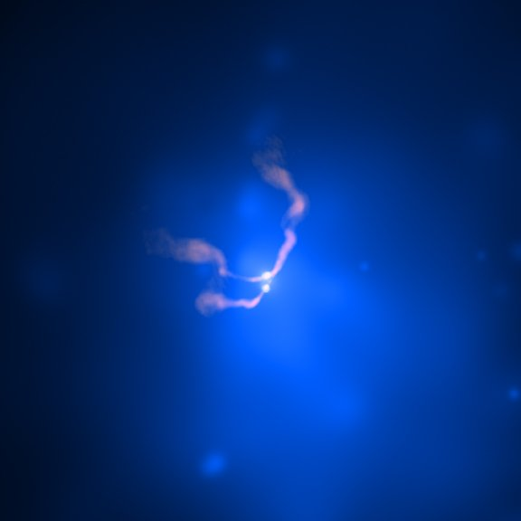
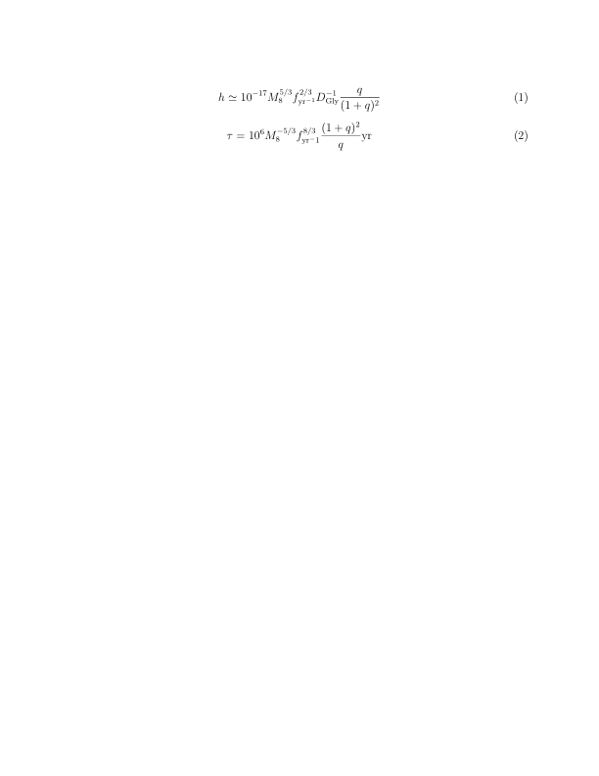
Super-Massive Black Hole Binaries
We expect a large number of super-massive black hole binaries (M ~ 10⁷⁻⁸ solar masses, N ~ Mpc⁻³) in the universe.
(Jaffe & Backer, 2003, ApJ, 583, 616; Sesana et al., 2008, MNRAS, 290,192, Sesana et al. 2013, 433, L1)
NASA CXO
For a SMBH binary,
(Jaffe & Backer 2003, ApJ, 583, 616).
-
Single Dish Summer School 10 June 2015

Slide 29
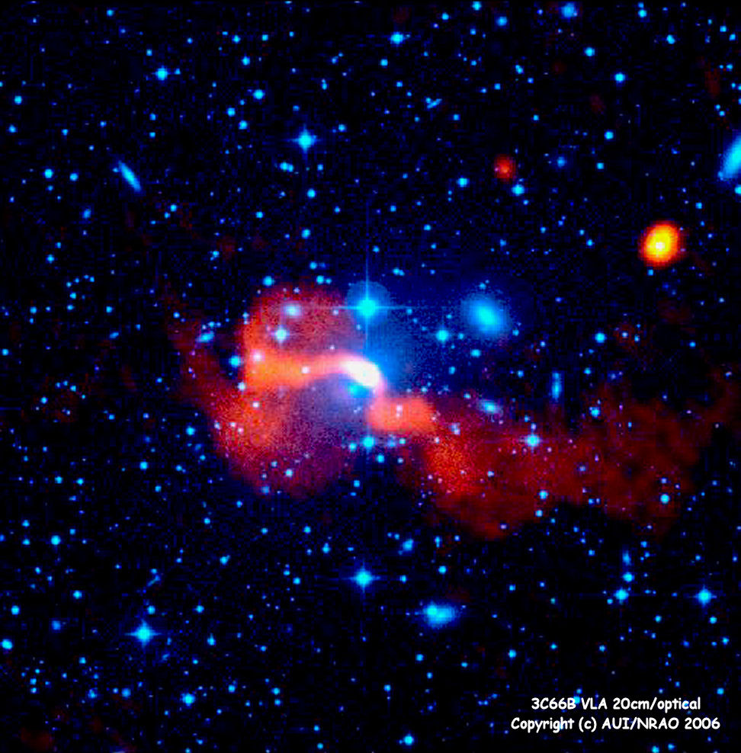
Single Source: 3C66B
Proposed z=0.02 SMBH binary with period 1.05 yr and mass of 5x10¹⁰ solar masses (Sudou et al. 2003).
Pulsar term and Earth term
Jenet et al. 2004
Single Dish Summer School 10 June 2015

Slide 30
Single Source: 3C66B
Proposed z=0.02 SMBH binary with period 1.05 yr and mass of 5x10¹⁰ solar masses (Sudou et al. 2003).
Analysis of the residuals from a single high-precision pulsar shows that this binary cannot exist (Jenet et al. 2004).
Pulsar term and Earth term
Jenet et al. 2004
Single Dish Summer School 10 June 2015

Slide 31
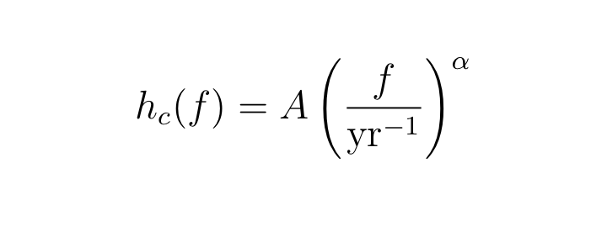
Stochastic Background
For SMBH binaries, h ~ f^{2/3} and lifetimes τ ~ f^{-8/3}. Sum over many systems results in α = -2/3. Amplitudes depend strongly on SMBH masses and galaxy merger rate as a function of redshift, with A α N^{1/2}M.
Model | A | α | References
Supermassive black holes | 10⁻¹⁵ – 10⁻¹⁴ | -2/3 | Jaffe & Backer, 2003, ApJ, 583, 616 Wyithe & Loeb, 2003, ApJ, 590, 691 Enoki et al., 2004, ApJ, 615, 19 Sesana et al., 2008, MNRAS, 290, 192
Relic GWs | 10⁻²⁰ – 10⁻¹⁵ | -1 to -0.8 | Grishchuk, 2005, PU, 48, 1235 Boyle & Buonanno, 2008,PRD,78,043531
Cosmic Strings | 10⁻¹⁶ – 10⁻¹⁴ | -7/6 | Maggiore, 2000, PR, 331, 283
Single Dish Summer School 10 June 2015

Slide 32
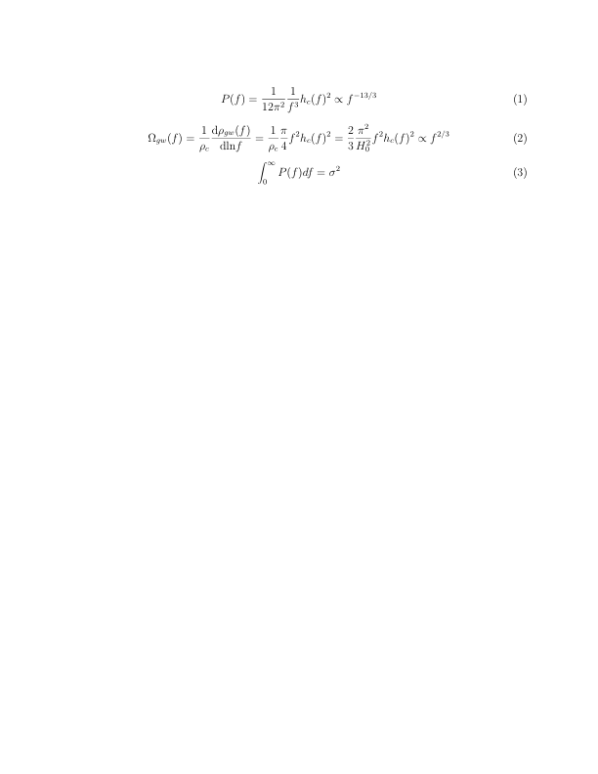
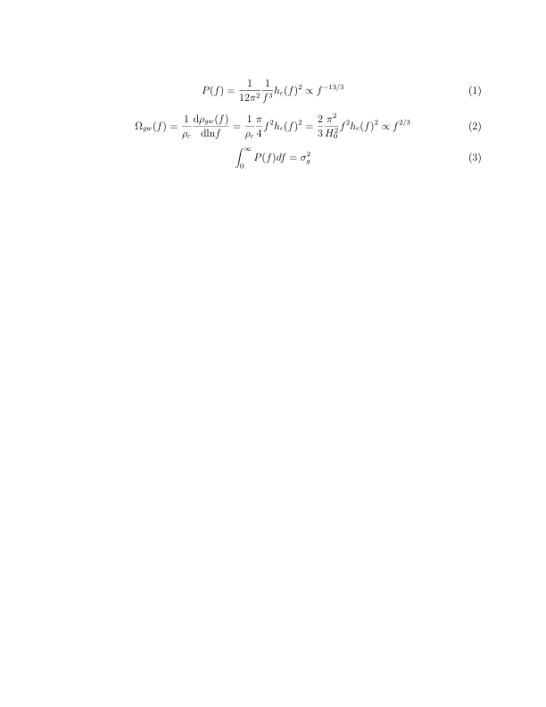
Single Pulsar Limits
h_{c} < 3 x 10⁻¹⁴ (f=1 yr⁻¹)
Kaspi, Taylor, & Ryba, 1994, ApJ, 428, 713
Single Dish Summer School 10 June 2015

Slide 33
Detecting a stochastic background
We cross-correlate the residuals from pairs of pulsars to search for the expected signature predicted by GR. Pulsar terms uncorrelated. Earth terms correlated.
Clock errors monopole. Ephemeris errors dipole. GWs quadrupole.
Hellings & Downs, 1983, ApJ, 265, L39
Single Dish Summer School 10 June 2015

Slide 34
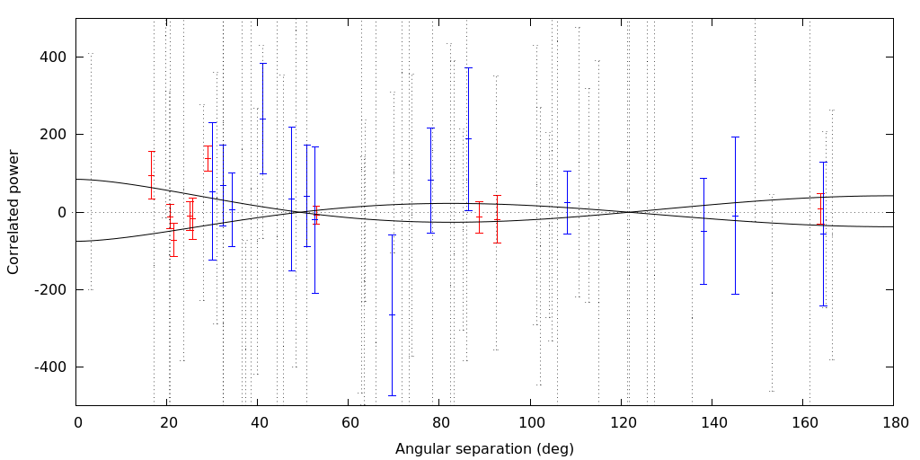
NANOGrav stochastic background limit
h_{c} < 7 x 10⁻¹⁵ (f=1 yr⁻¹)
Based on 17 pulsars timed from 2005 – 2010.
Demorest et al. 2013, ApJ, 762, 94
Single Dish Summer School 10 June 2015

Slide 35
We can also test GR
Lee et al. 2008, ApJ, 685, 1304
Single Dish Summer School 10 June 2015

Slide 36
And some cosmic string models
Demorest et al. 2013, ApJ, 762, 94
Single Dish Summer School 10 June 2015

Slide 37
Can use a PTA for continuous and burst sources too
Anholm et al. 2009, PhRvD, 79, 8
Antenna response for the pulsar-Earth system.
Single Dish Summer School 10 June 2015

Slide 38
NANOGrav continuous wave limit
Arzoumanian et al. 2014, ApJ, 794, 141
Single Dish Summer School 10 June 2015

Slide 39
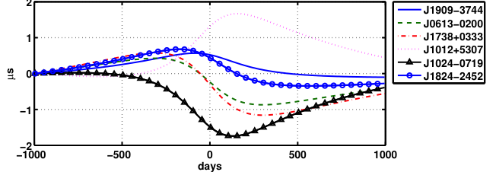
Burst source detection
Finn & Lommen, ApJ, 2000, 718 1400
Signature expected from two billion solar mass black holes separated by 0.02 pc at a distance of 15 Mpc.
Single Dish Summer School 10 June 2015

Slide 40
NANOGrav Current Observing Status
We observe 45 pulsars at the GBT and Arecibo, roughly every three weeks.
Each pulsar is
observed at at least two radio frequencies.
We get roughly 15% of the time on each of the GBT and Arecibo.
D. Nice
AO
GBT
Observed since 2005
Pulsars added ~2009
Pulsars added ~2011
Single Dish Summer School 10 June 2015

Slide 41
Timing Precisions
Nine year data release happening “any day now”. 12 pulsars under 200 ns (4 in last release!)
2-3 times improvement from new GUPPI/PUPPI backends
D. Nice
Single Dish Summer School 10 June 2015

Slide 42
Residuals are continually improving
We see order of magnitude improved SB limit (or detection) due to increased RMS and longer timespan (GW signals are red!)
Single Dish Summer School 10 June 2015

Slide 43
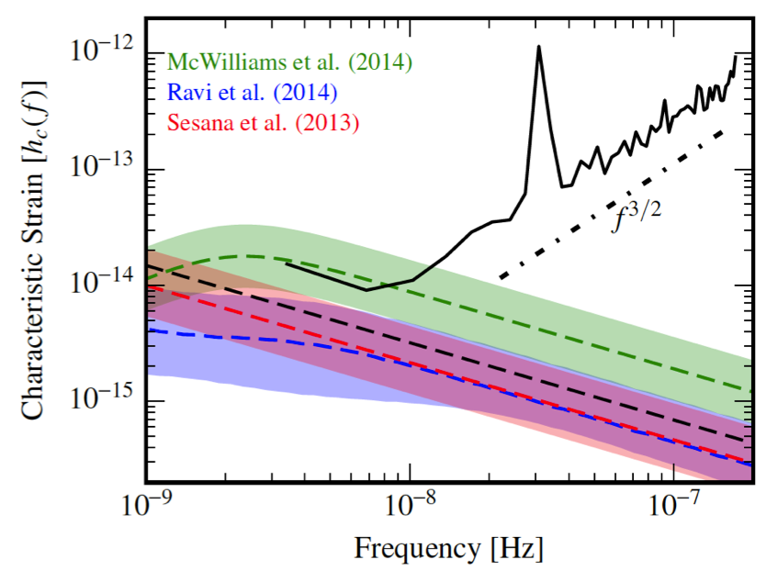
New NANOGrav stochastic background limit
h_{c} < 1.5 x 10⁻¹⁵ (f=1 yr⁻¹)
Based on nine years of data on 37 MSPs.
Single Dish Summer School 10 June 2015

Slide 44
When we will make a detection and how can we get there faster?
?
?
N_{psr} = number of pulsars in the array
c = observation cadence
σ_{rms} = average residual RMS
T = total time span of data
See Siemens et al.
arXiv:1305.3196.
Single Dish Summer School 10 June 2015

Slide 45
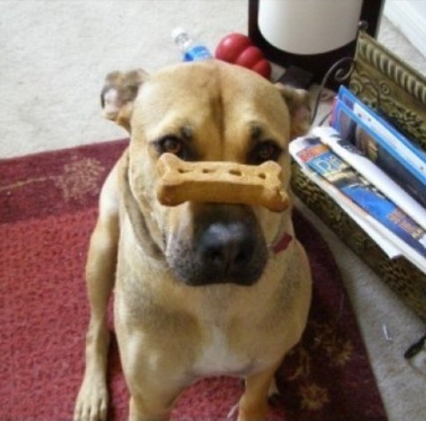
Improvement 1: Time
Patience will pay off! (But pulsar spin noise could be an issue)
Single Dish Summer School 10 June 2015

Slide 46
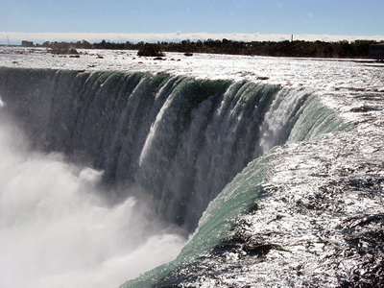
Improvement 2: Cadence
TOA
TOA
TOA
TOA
TOA
TOA
TOA
TOA
TOA
Single Dish Summer School 10 June 2015

Slide 47
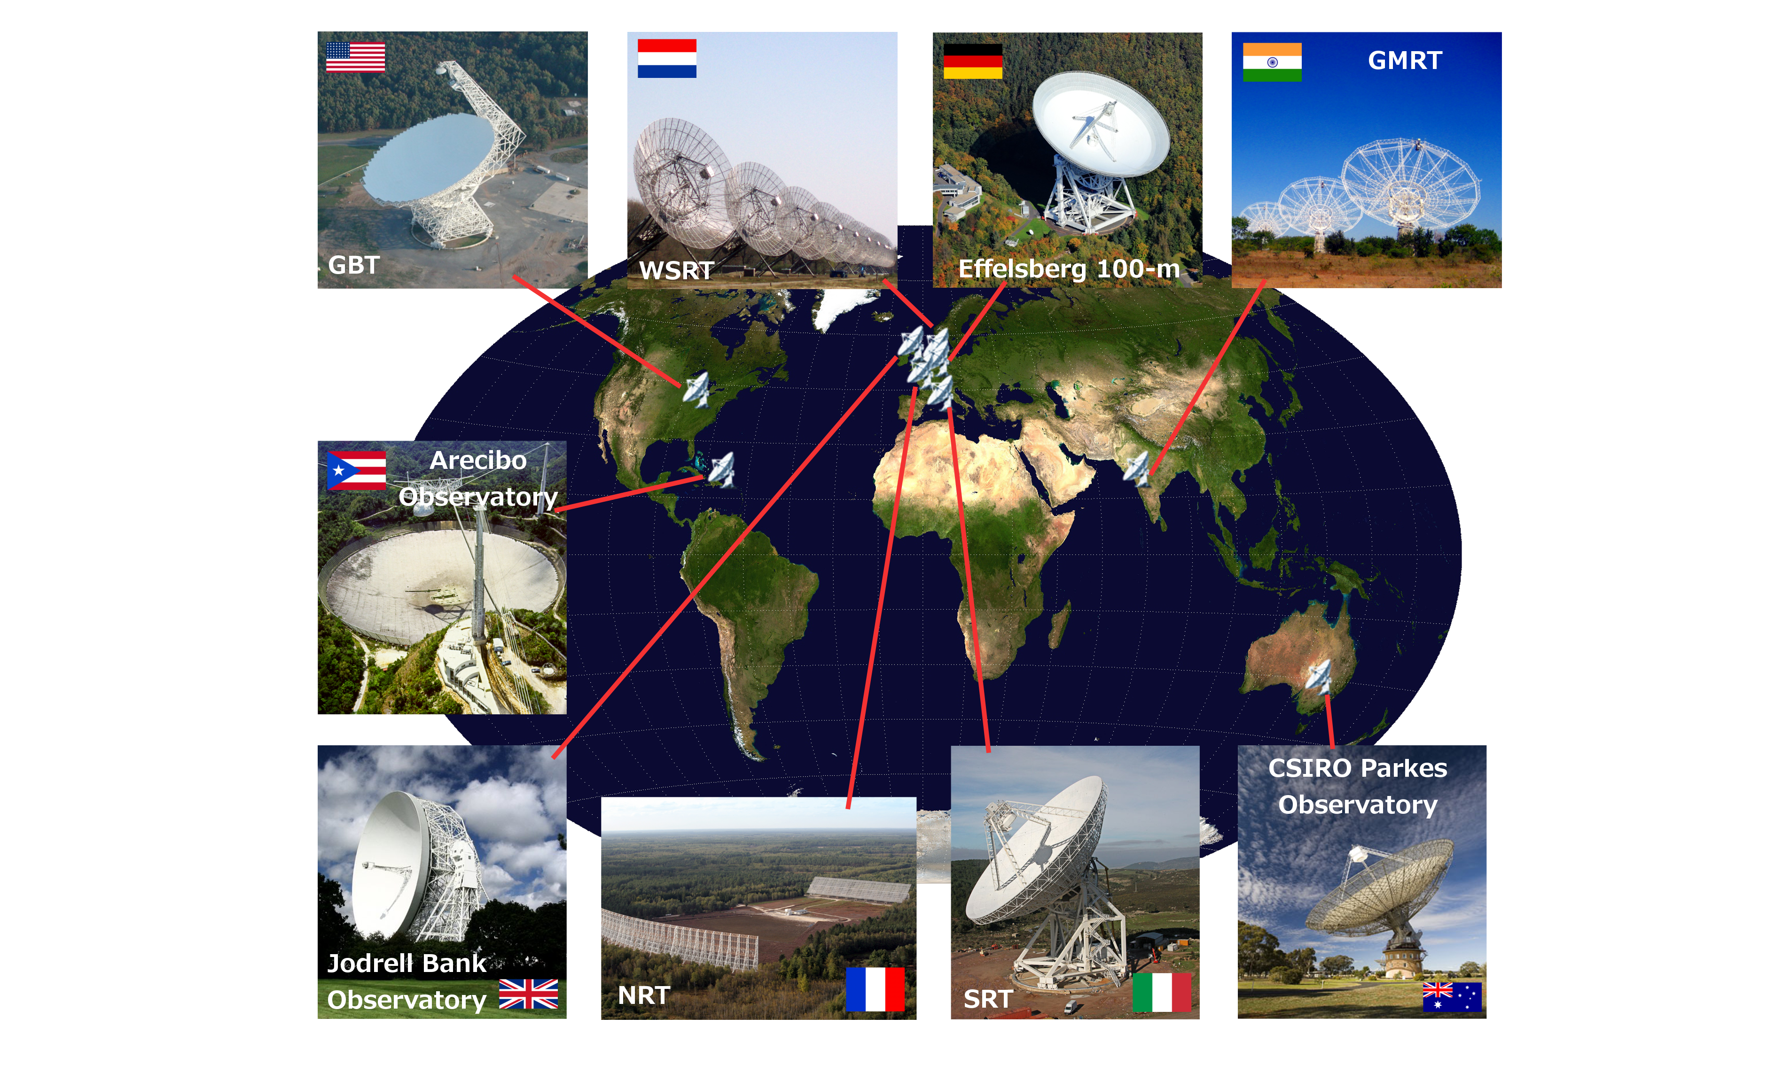
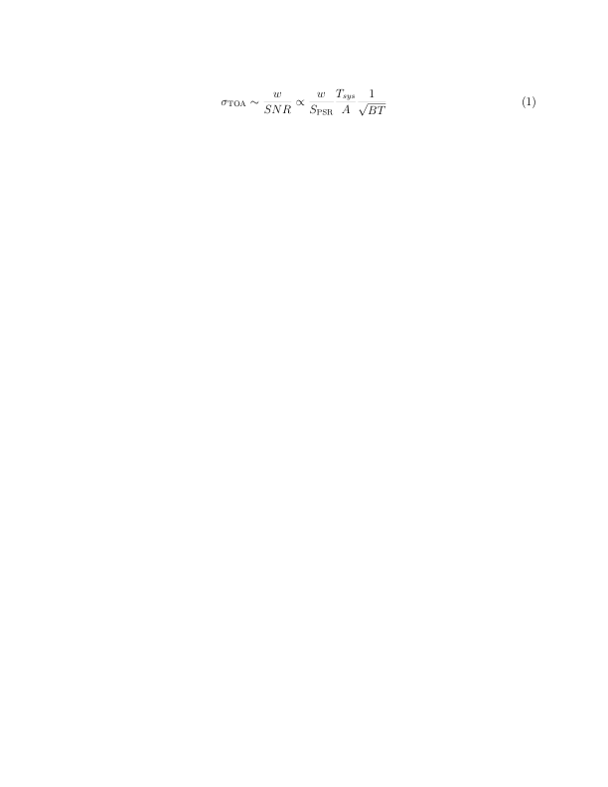
Improvement 3: More precise TOA measurements
We want bright pulsars with narrow pulses observed with sensitive receivers with large telescopes over large bandwidths and with long integration times.
We are using the most sensitive radio telescopes in the world and are steadily increasing our time on them. We are constantly improving instrumentation.
Brian Burt
Single Dish Summer School 10 June 2015

Slide 48
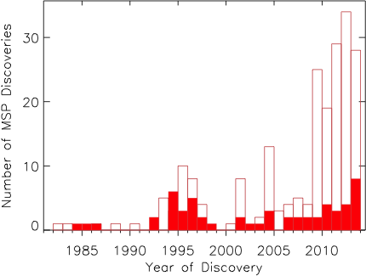
Improvement 4: More MSPs
See http://astro.phys.wvu.edu/GalacticMSPs
Radio searches (aided by Fermi gamma-ray identifications) have more than doubled the Galactic MSP population since 2010. Ongoing searches with the world’s largest telescopes should reveal an additional 100 over the next several years.
Single Dish Summer School 10 June 2015

Slide 49
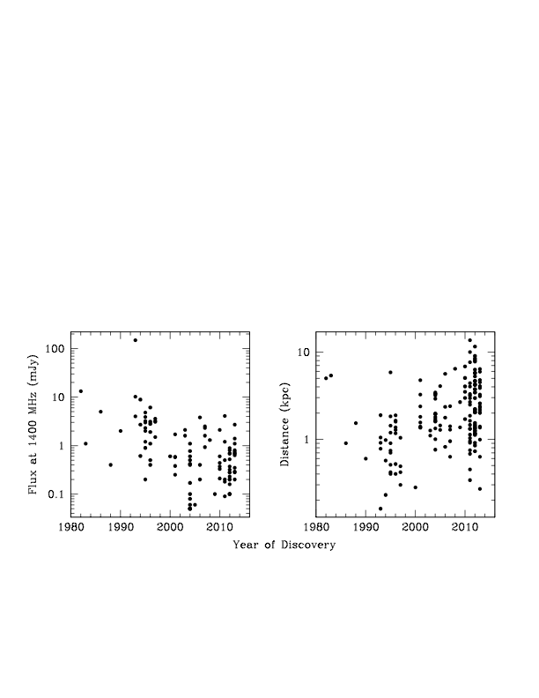
Improvement 4: More MSPs
Many bright and nearby MSPs remain to be found, meaning dramatic increases in our sensitivity are possible.
See http://astro.phys.wvu.edu/GalacticMSPs
Single Dish Summer School 10 June 2015

Slide 50
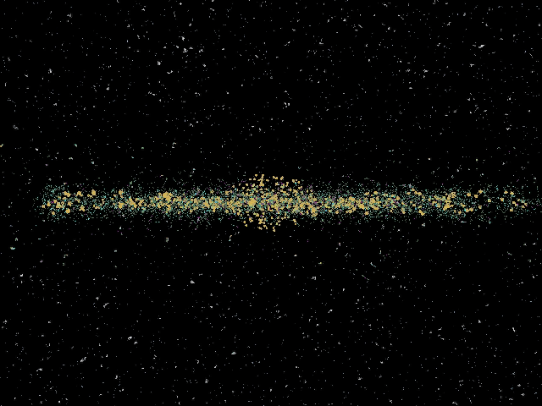
Kramer

Slide 51
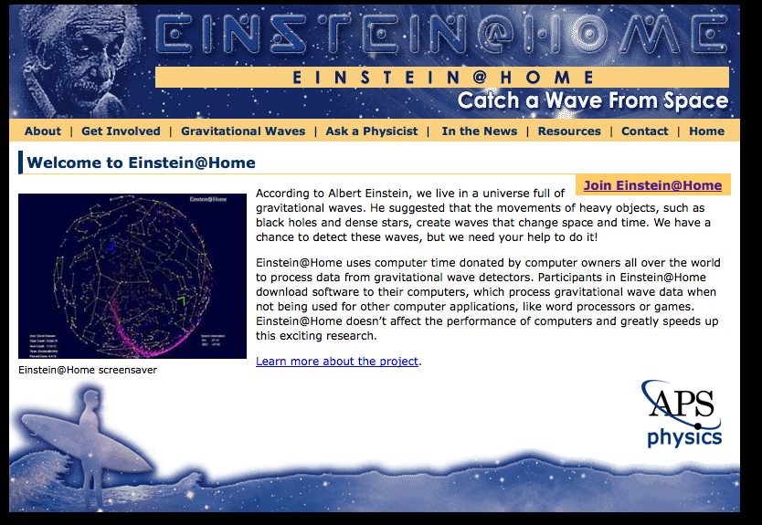
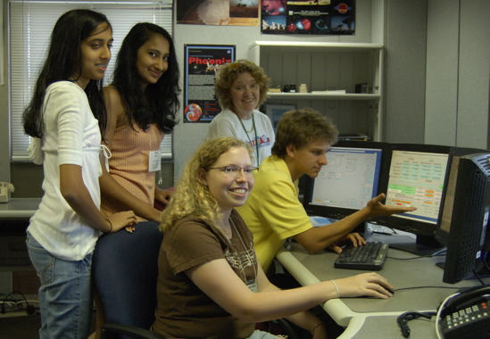
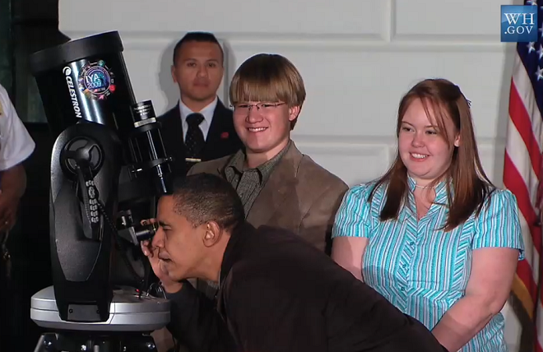

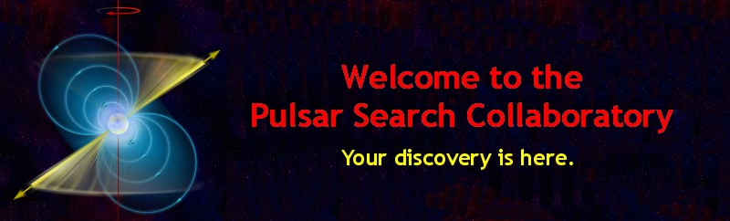
Improvement 4: More MSPs
Arecibo data is analyzed with Einstein@Home!
GBT data analyzed by high-school students
in the NRAO/WVU PSC project.
(See lgmfilm.com to see a trailer of our documentary!)
Both Arecibo and GBT data analyzed by undergraduates in the UWM and UTB ARCC program.
Single Dish Summer School 10 June 2015

Slide 52
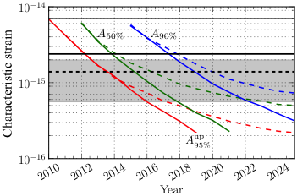
Time to Detection of the Stochastic Background:
Possibly by 2020, very likely by 2025 (with caveats!)
Expected amplitude range given four current models.
The horizontal lines are (from top to bottom): NANOGrav five-year limit, PPTA 11-year limit, NANOGrav nine-year preliminary limit. The IPTA will do even better!
Single Dish Summer School 10 June 2015
1 April 2013

Slide 53
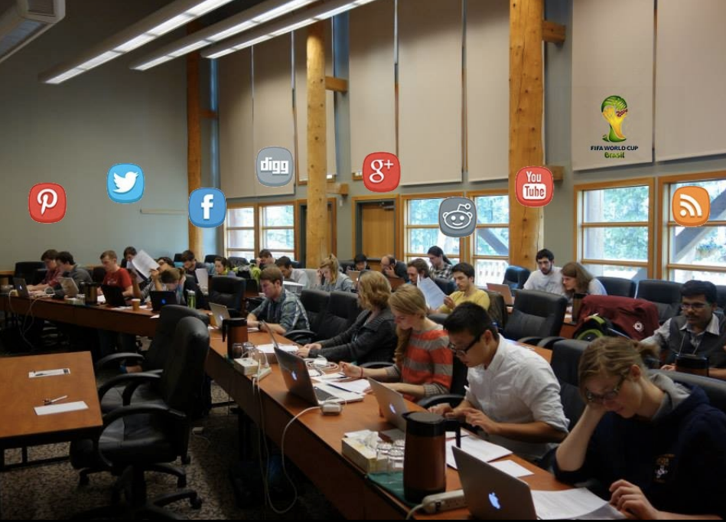
IPTA International Workshops
Our 2016 workshop will be held in South Africa, from June 20-24. Followed by science meeting.
Single Dish Summer School 10 June 2015

Slide 54
Summary
Pulsar timing is a viable method to detect gravitational waves.
The detection and subsequent study of the universe through pulsar timing will allow tests of general relativity and insights into galaxy evolution and cosmology not possible through other means. We are already placing astrophysically interesting constraints (it’s not just one number!)
Pulsar timing arrays are likely to make the first detections within the next decade, and possibly within the next few years.
The most important way we can increase our sensitivity is through pulsar searches. These are also a critical means to bring students into the field.
The Square Kilometer Array (SKA) will result in the discovery of all of the MSPs in the Galaxy, and will allow us to map the GW universe with unprecedented sensitivity. Until then we need the GBT and Arecibo!
Single Dish Summer School 10 June 2015

