Slide 1
NRAO Proposal Tool (PST)
Gustaaf van Moorsel
NRAO Community Day 1/13/2012

Slide 2
Creating an NRAO proposal
Proposal Submission Tool (PST)
EVLA, VLBA, GBT, but …
for ALMA, use ALMA OT
This presentation: EVLA-centric
Accessing the PST
You must be registered at my.nrao.edu
Also allows access to other services (e.g. OPT)
Allows creating and submitting new proposals
Gives access to all proposals you are associated with regardless of your role (PI, co-I, contact author)

Slide 3
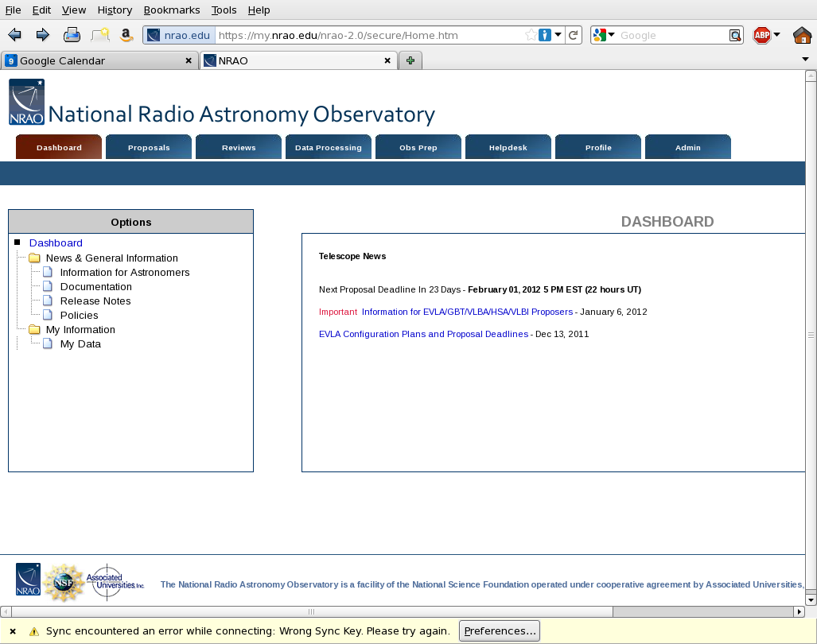
Notes:
Page after logging on to my.nrao.edu

Slide 4
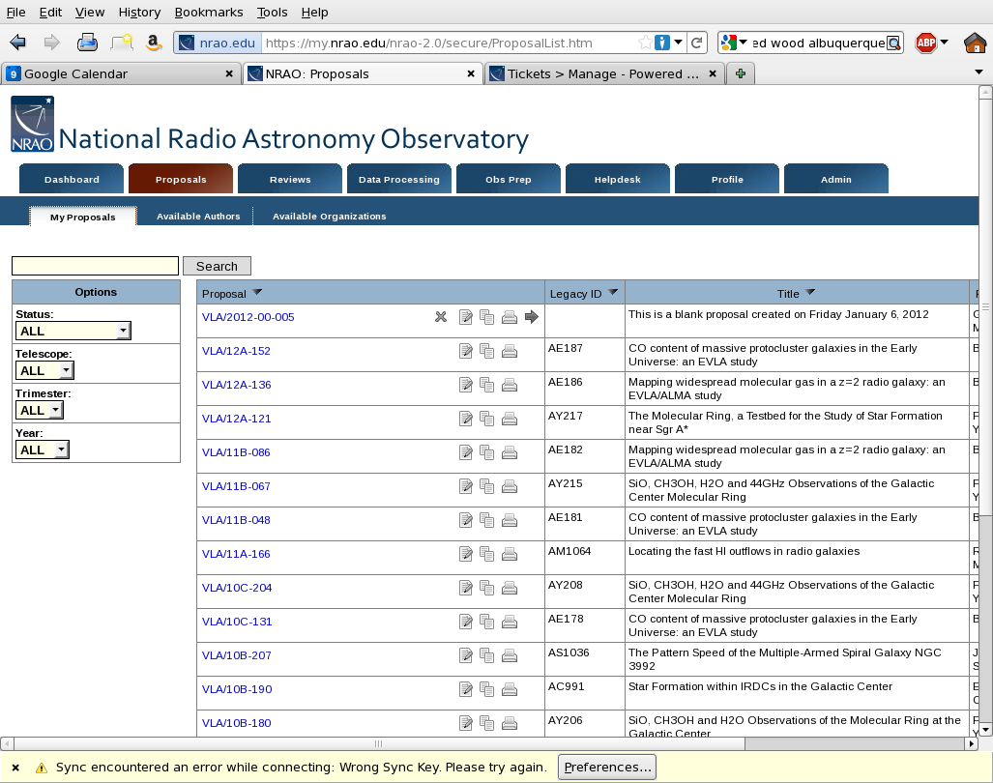
Notes:
After logging on to my.nrao.edu and clicking on Proposals

Slide 5
After submission
Proposal deadlines
2 per year: February 1 and August 1
E.g. this year: 12A and 12B
No longer tied to VLA configurations
After deadline:
All submitted proposals evaluated by Science Review Panel and Time Allocation Committee
Observers will be informed of allocated time (if any) and scientific priority
Basic project information transferred to OPT

Slide 6
Types of proposals
Regular (< 200h) ≤ 4 pages science justification
Large (≥ 200h) ≤ 10 pages science justification; requires data reduction and release plan
Triggered
pre-planned observations of transients whose event times are unknown a priori; well-defined triggering criteria are required
Director’s Discretionary Time
for a Target of Opportunity (unexpected, unpredicted, e.g. supernova in nearby galaxy) or Exploratory Time for high risk/high yield projects.

Slide 7
PST – major elements
General
Authors
Science Justification
Sources – what do you want to observe
Resources – instrumental setup
Sessions – combines Sources and Resources
Student Support

Slide 8
Interactive session. 1: creating a proposal
Log on to my.nrao.edu
Click on Proposals
If you are on any proposals, they will be listed here. Click on New Proposal (upper right)
Choose one telescope (here: EVLA) followed by Create in upper right
It will list the new name at the top (e.g. VLA-2012-00-008). Click on that name.
The tree structure of this new proposal is listed on the left, and the first part, ‘General’ is opened
Click on Edit in the upper right

Slide 9
Interactive session. 2: General
Choose proposal type regular
Scientific category: up to you!
Abstract: type a few words (e.g. will be completed at a later date)
Not a joint proposal
Observing type: spectroscopy
Observer present and staff support: up to you
Click on Save in upper right

Slide 10
Interactive session. 3: Authors
Continue on to Authors in left tree
This should list yourself as sole author
Note that you are also PI and contact author
Add one author (e.g. your neighbor) by clicking Add
Type (part of) his/her name in search field and click Search
In case of multiple hits indicate correct one and click Save and the new author will be listed
Display order can be modified by using up/down
Roles of PI and contact author can be reassigned

Slide 11
Interactive session. 4: Science Justification
Science justification: .pdf or .txt
Uploaded by add, browse, upload sequence
Can skip now; has to be present in order to submit
Max 4 pages (regular), 10 pages (large)
Both for science and technical justification

Slide 12
Interactive session. 5: Sources
Sources can be added in three ways
Manually
Search in NED/SIMBAD
Load from local data file
After sources on left, click on New Source Group in upper right
Give it a name and save
Click search NED/SIMBAD and enter your favorite source (e.g. M31)
Click Save

Slide 13
Interactive session. 6: Resources
After click on Resources in left tree click on Add on the top right
Enter name, configuration, receiver, back-end on top line
Note how choice of back-end affects correlator setup table
Choose a transition from the list
Select one correlator setup
When happy, click on save

Slide 14
Interactive session. 7: Sessions, Validating, and Submitting
After click on Sessions in left tree click on New Session on the top right
Enter session name and other information on top line
Select a source group (here just one) and a resource (here just one)
Enter time and rms you intend to reach (exposure calculator is useful here)
Note Validate, Print and Submit buttons in upper left

