Slide 1
The Karl G Jansky Very Large Array
(formerly known as the EVLA)
Current and future capabilities
Jürgen Ott / Michael Rupen / Gustaaf van Moorsel

Slide 2
What is the EVLA?
The Expanded VLA (EVLA) is a major conversion of the Very Large Array
First light/fringe in 2010, full operation beginning of 2013
5-10 times better continuum sensitivity
Accessibility of entire 1-50 GHz frequency range (8 feeds)
Up to 8 GHz bandwidth per observation and polarization
High dynamic range imaging
Spectral channels up to 16000 - 4x10⁶ channels in up to 64 independent subbands (equivalent to 64 independent correlators)
Correlator supports up to 32 antennas
Dynamical scheduling (based on scientific priority, weather conditions, and scheduling efficiency)
Pipeline-calibrated visibility data plus reference images
New observation preparation software (OPT)
New data reduction software (CASA)

Slide 3
What is the EVLA?
27x25m VLA antennas reconfigurable on baselines 35m to 36km
located in Southern New Mexico at 2100m altitude

Slide 4
What is the EVLA?
27x25m VLA antennas reconfigurable on baselines 35m to 36km
located in Southern New Mexico at 2100m altitude

Slide 5
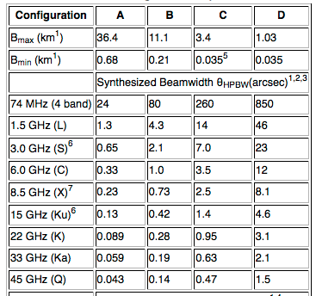
Spatial Resolution
With reconfiguration of the antennas, the EVLA can vary its spatial resolution by a factor of ~50 (depending on largest baseline/telescope separation)
Reconfiguration every 4 months (modifications during commissioning)

Slide 6
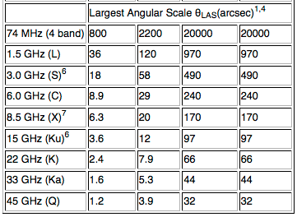
Largest Angular Scale
The shortest baseline sets the largest angular scale that an interferometer is sensitive to
Compact configurations images have less spatial resolution but cover larger angular scales and increase surface brightness sensitivity
Field of view
(depends on
diameter of a
single antenna)
608’
30’
15’
7.5’
5.3’
3’
2’
1.4’
1’

Slide 7
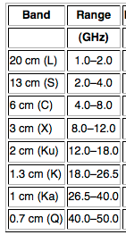
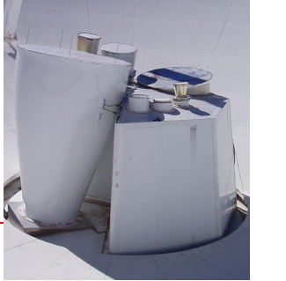
Receivers
8 wideband receivers
Switching receivers can be as fast as 20s

Slide 8
Receivers
Wideband receivers 1 GHz @ L-band to 13.5 GHz @ Ka-band (correlator can go up to 8 GHz)
Better sensitivity (cf. VLA max. bandwidth 50 MHz)
Better image fidelity, higher dynamic range with a goal of 10⁶ (filling in gaps in the uv-coverage/multi-frequency synthesis; better RFI isolation)
Determination of spectral indices in single observations
Multi-line observations at identical weather conditions for accurate line ratios

Slide 9
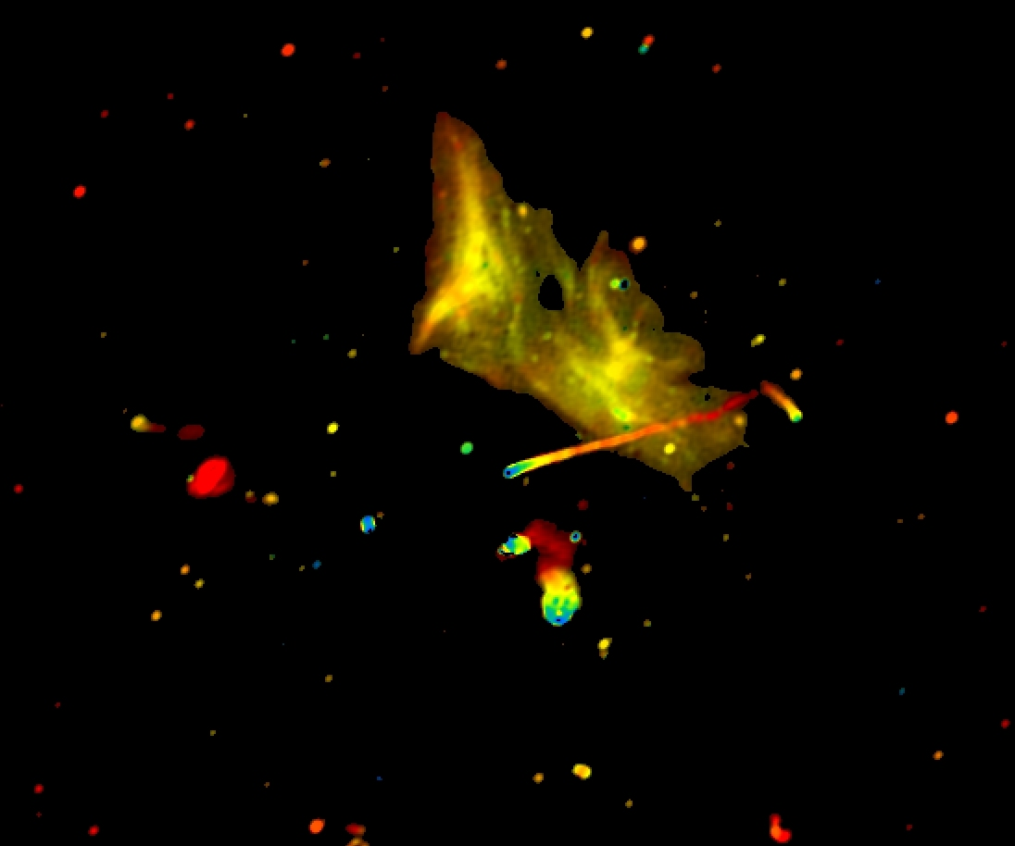
Wideband Imaging
Relics and Jets in Abell 2256
Color: spectral index
Owen, Rudnick, Eilek, Rau, Bhatnagar, Kogan

Slide 10
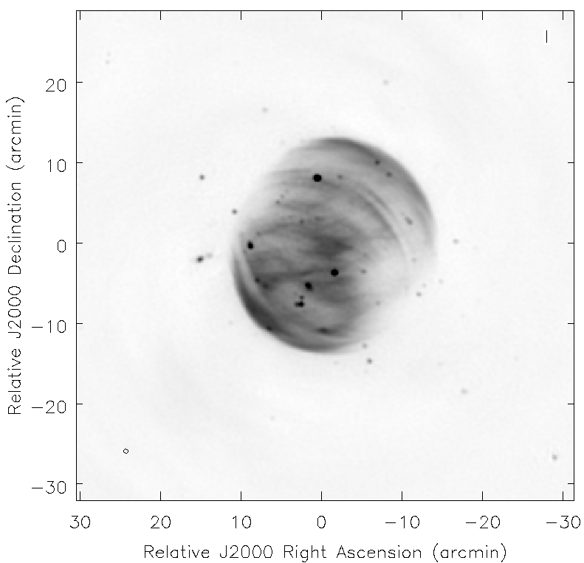
Wideband Imaging
Wide-band, wide-field imaging
Multi-scale cleaning
A-projection for wide-field imaging
G93.3+6.9
fov
Bhatnagar, Green, Rau, Golap, Rupen & Perley

Slide 11
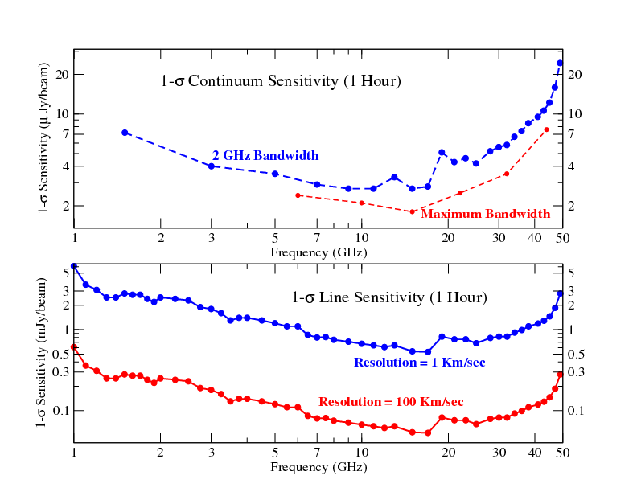
Sensitivity
At 10 GHz: in 1h, a 1σ noise of 2 μJy continuum
0.8 mJy in 1 km s⁻¹ channel
1 GHz
10 GHz
50 GHz
L
S
C
X
Ku
K
Ka
Q

Slide 12
VLA – EVLA Comparison
Parameter | VLA | EVLA
Continuum sensitivity (1s, 9 hr) | 10 μJy | 1 μJy
Maximum bandwidth | 0.1 GHz | 8 GHz
Number of frequency channels at maximum bandwidth | 16 | 16,384
Maximum number of frequency channels | 512 | 4,194,304
Coarsest frequency resolution | 50 MHz | 2 MHz
Finest frequency resolution | 381 Hz | 0.12 Hz
Frequency coverage, 1 - 50 GHz | 22% | 100%
Number of baselines | 351 | 351
Maximum spatial resolution (5GHz) | 0.3” | 0.3”

Slide 13
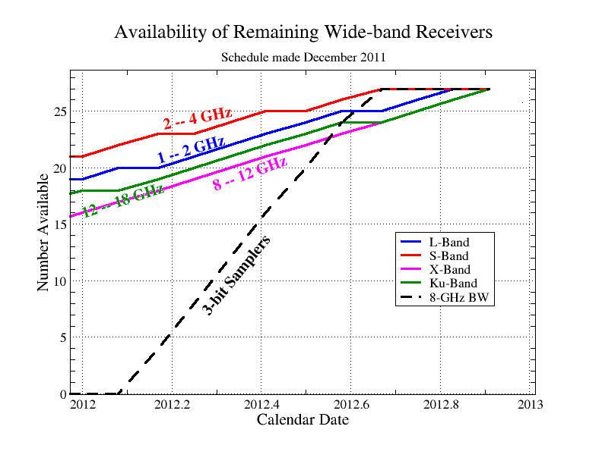
Receiver Availability
Majority of receivers is already installed, a few more remaining, installation of 3-bit samplers (required for 8 GHz bandwidth) will commence soon
Complete:
C: 4-8 GHz
K: 18-26.5 GHz
Ka: 26.5–40GHz
Q: 40-50GHz
8 GHz capability

Slide 14
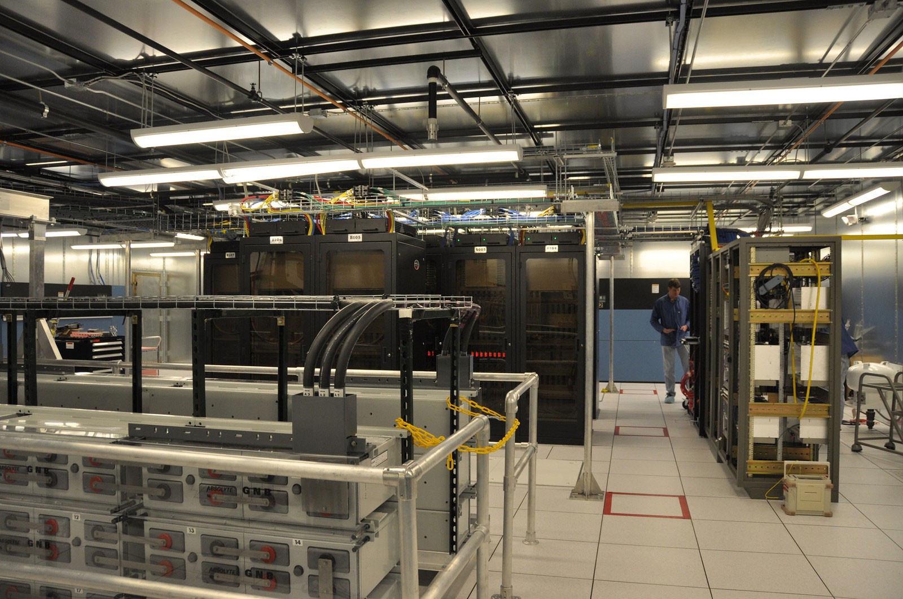
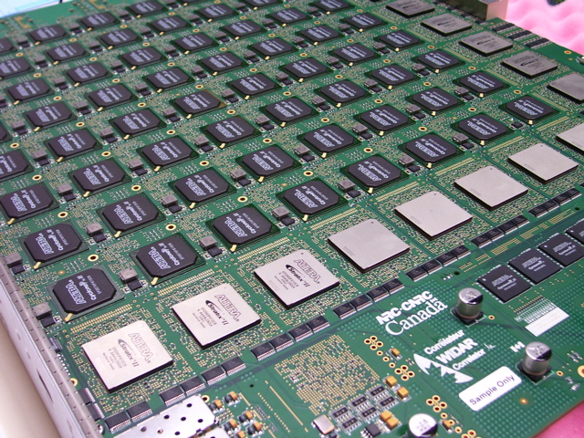


WIDAR Correlator
WIDAR: Wideband Interferometric Digital Architecture
10¹⁶ calculations/s
Fiber bandwidth: 3 Tbits/s = 48 million phone calls
16 GHz per antenna = 2600 TV channels
175 kW = 350 refrigerators electricity usage
160 Gbits/s output
160 baseline boards
120 station boards
NRC-CNRC

Slide 15
WIDAR Correlator
Final specs:
64 independent subbands act like 64 independent correlators
independent in bandwidth, channelization, polarization products
Each subband:
  Up to 4 polarization products
  31 kHz – 128 MHz bandwidth
  Up to 16384 channels
  2 Hz – 2 MHz bandwidth
Baseline board stacking (trading subbands for additional channels)
Recirculation (trading integration time for additional channels)

Slide 16
WIDAR Correlator
Examples:
  Ka-band (1cm): 2x1 GHz imaging (captures tens of important molecular lines) with 3 km/s spectral resolution (dual pol), 1s integration times
  even more channels with recirculation
  L-band (21cm): full stokes continuum at 2 MHz resolution (using 8 subbands) plus sub km/s imaging on HI, OH, radio recombination lines (up to 56 additional subbands!), all simultaneously
  S-band (13cm): 31 Radio recombination lines at once with sub-km/s
  resolution; sensitivity increase by stacking

Slide 17
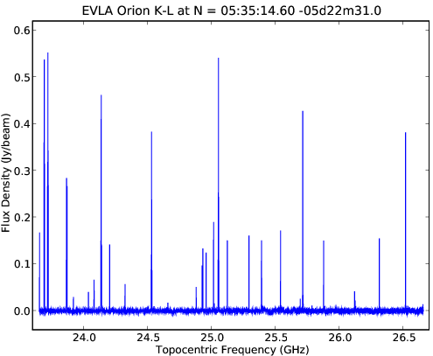
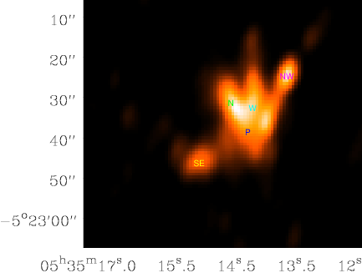
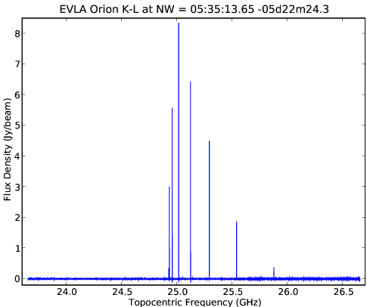
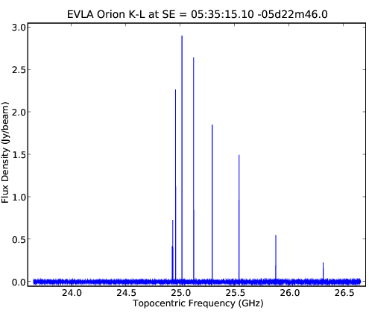
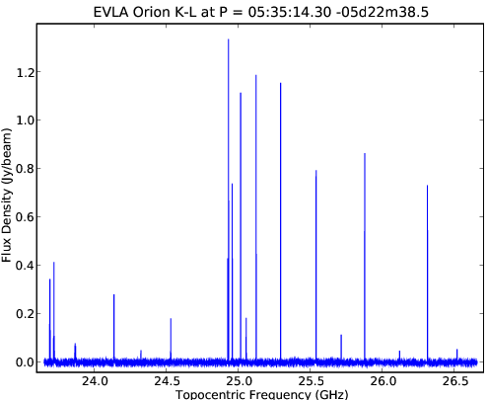
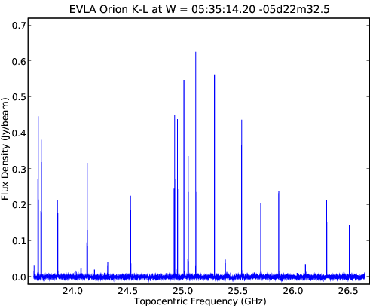
Multi-Line Imaging: Orion KL
Wide-band, wide-field imaging
Multi-scale cleaning
A-projection for wide-field imaging
Moment-0 Image
End to end data processing in CASA
96x96x24012
spectral cube
Bhatnagar, Green, Rau, Golap, Rupen & Perley
17

Slide 18
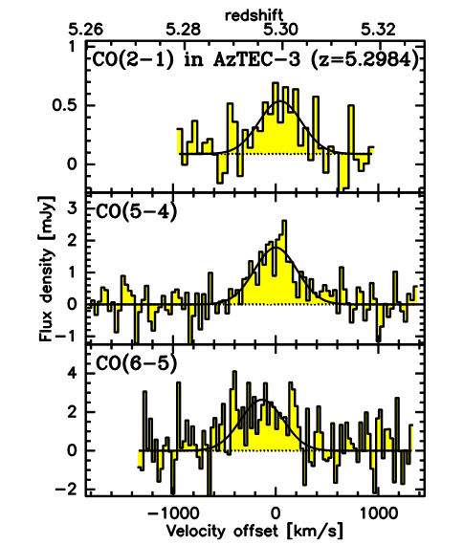
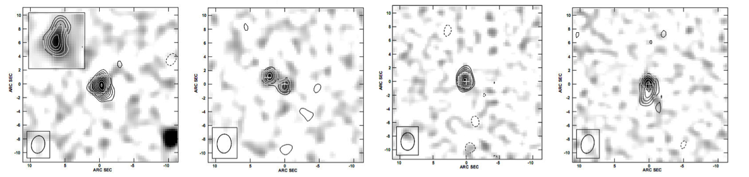
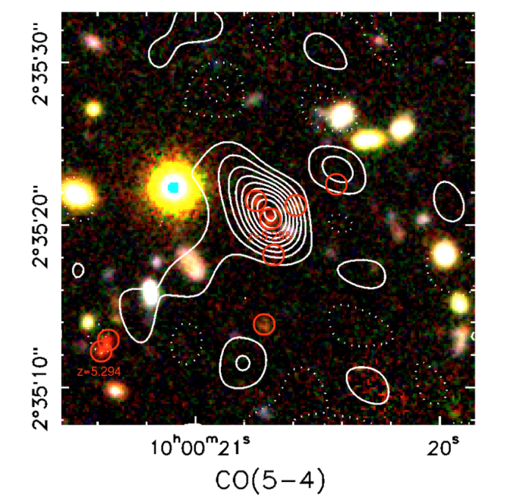
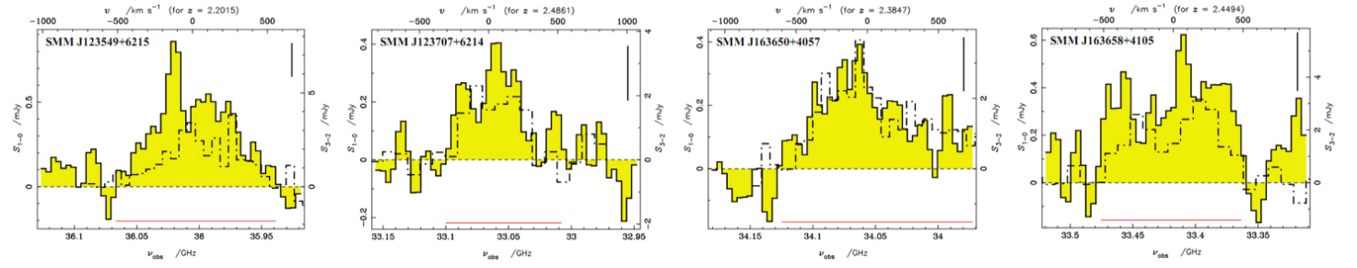
High z spectral surveys
EVLA is giving access to low excitation CO lines at intermediate z and high excitation lines at high z
Wideband enables blind CO surveys
Perfect complement to ALMA and other (sub)mm observatories
EVLA
BURE
Extended, low excitation CO in z~2.3 SMG (Ivison ea)
Extended, low excitation CO in z~2.3 SMG (Ivison ea)
Multitransition CO study of most distance SMG z=5.3 (Riechers, Capak ea)
Courtesy C. Carilli
18

Slide 19
OSRO modes
During commissioning we offer open shared risk (OSRO) observing and resident shared risk observing (RSRO) for those who come to Socorro and help to commission the EVLA for at least 3 months
OSRO capabilities are better tested but more limited than RSRO correlator modes
For the 1 Feb 2012 deadline, we offer the following OSRO capabilities:
2 GHz bandwidth, 1 GHz on each baseband, each up to 8 subbands
Doppler setting
Each subband:
  31kHz – 128 MHz bandwidth with 64 channels, 4 polarization products or
  31kHz – 128 MHz bandwidth with 128 channels, 2 polarization products
  subbands must be contiguous in frequency

Slide 20
RSRO modes
2 or 8 GHz bandwidth (use of 3-bit samplers)
64 subbands
Independently tunable
  Basic subband setting: 31 kHz-128 MHz bandwidth , 64 channels, full pol or
  31 kHz – 128 MHz bandwidth, 128 channels, dual pol
  Baseline board stacking (trading subbands for additional channels)
  Recirculation (trading integration time for additional channels)
Data rates can be very large and some restrictions apply

Slide 21
Advanced Modes for RSRO
Capabilities:
  Multiple sub-arrays
  OTF mosaicing
  Phased EVLA and single-dish VLBI → Amy Mioduszewski’s presentation
  Solar and planetary observing
  Pulsar observing
  Observing with the 3-bit sampler system
  Fast correlator dumps
  Low frequency (<1 GHz) observing
Other commissioning activities:
  Pipeline heuristics, including automated flagging and data quality analysis
  Testing of new full-field, wide-bandwidth imaging algorithms
  Advanced data analysis tools

Slide 22

Data Reduction
OSRO data reduction is possible in CASA and AIPS
RSRO and full EVLA data reduction in CASA only
Data volumes can be very large and parallelization of the software is currently underway
CASA contains new wide-band, wide-field imaging algorithms
On-the-fly Interferometry/Mosaicing
Development of automatic RFI flagging
A computing cluster will be available for users in Socorro
Hardware recommendations are provided on our webpage for those who decide to upgrade their own computing equipment

Slide 23
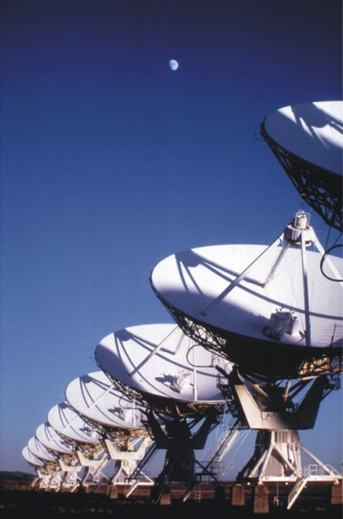
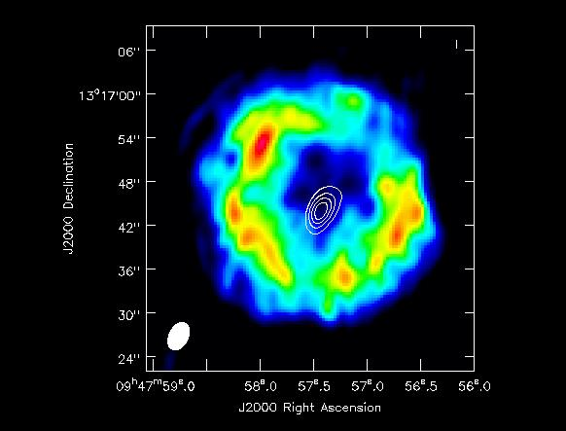
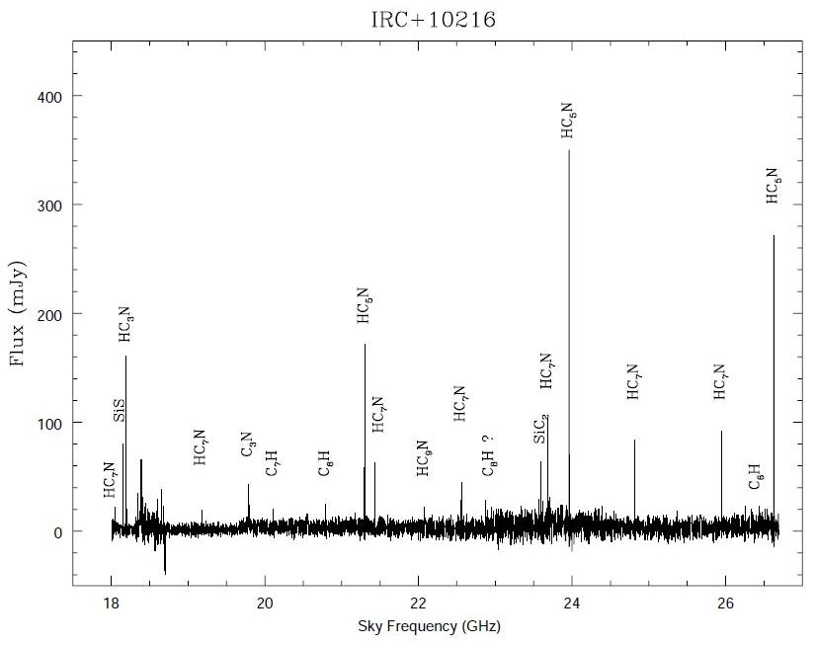
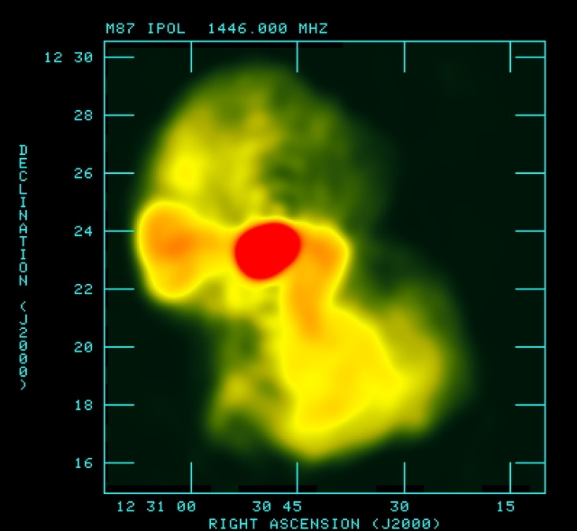
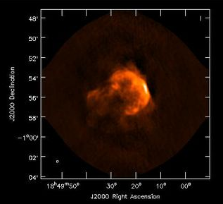
EVLA
Next proposal deadline: 1 Feb 2012
science.nrao.edu
http://science.nrao.edu/evla/earlyscience/demoscience/
23

