Slide 1
The ALMA Observing Preparation Tool
Notes:
This talk will step you through
… using the ALMA Observing Tool
… to prepare a proposal for Early Science
The observing tool is a graphical program
… that is used to design and submit proposals
… and observing scripts
It is similar in many ways to Spitzer’s SPOT
… or Herschel’s HSPOT
… but if you’re not familiar with those programs don’t worry
… it’s very easy to pick up

Slide 2
For a video version of this material:

Slide 3
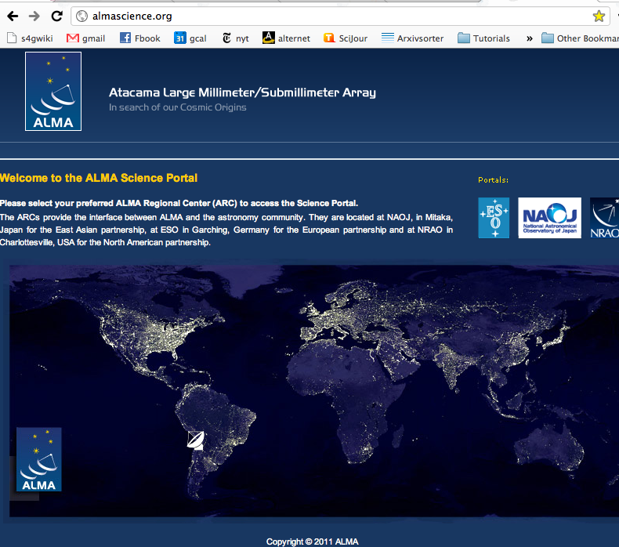
Notes:
Here’s roughly what the user portal will look like
… though there may be cosmetic changes

Slide 4
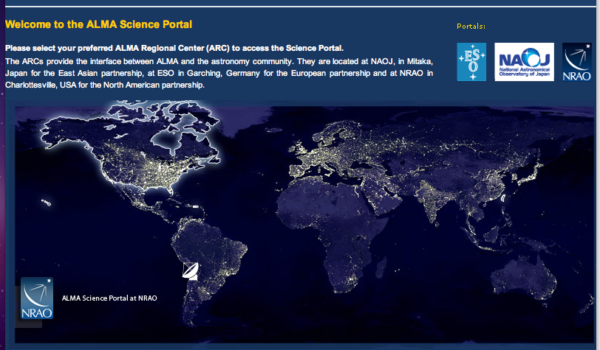
Click here

Slide 5
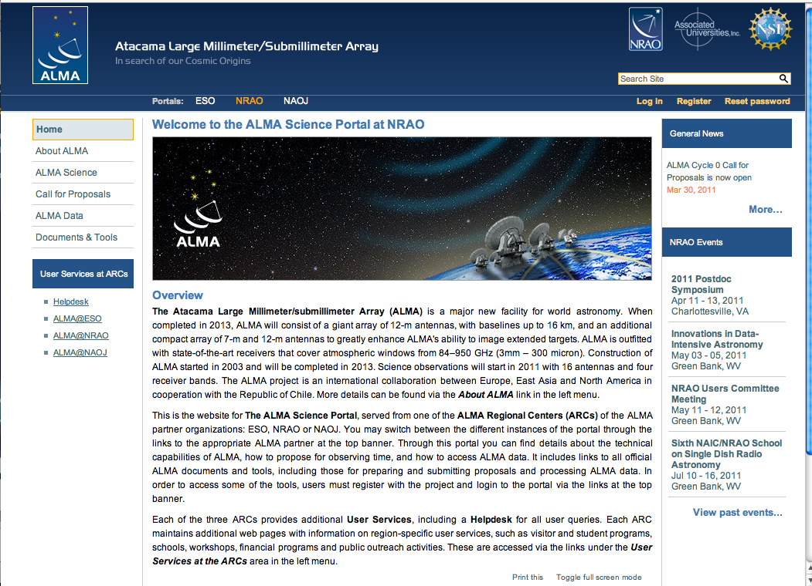

Slide 6
Registering with User Portal
To register for the user portal go to:
http://almascience.org/
Go to the User Portal to access to..
ALMA info and news
Call for Proposals
ALMA tools and documentation
Helpdesk
Project Tracker
ALMA Science Archive
Notes:
So you need to register with the user portal
… you’ll do this over the web
… via a system that will be deployed at the same time as the call for proposals
In addition to registration the User portal has key documentation and tools
… to learn about ALMA, get help, follow your project, and get your data

Slide 7
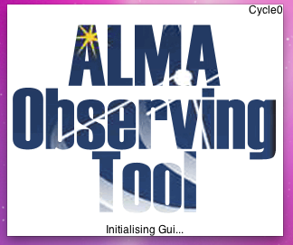
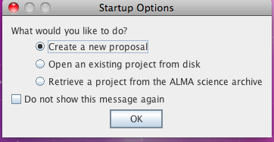
Launch the Application
A couple of dialog boxes will pop up
Notes:
The way we’re going to do this
… is that I will talk you through
… creating a sample proposal
… highlighting important steps
… and showing screen shots along the way
The first step is obviously to start the tool
… when you do so
… a couple of dialog boxes should appear
… we’re going to start from scratch
… so pick the first option here: create a new proposal

Slide 8
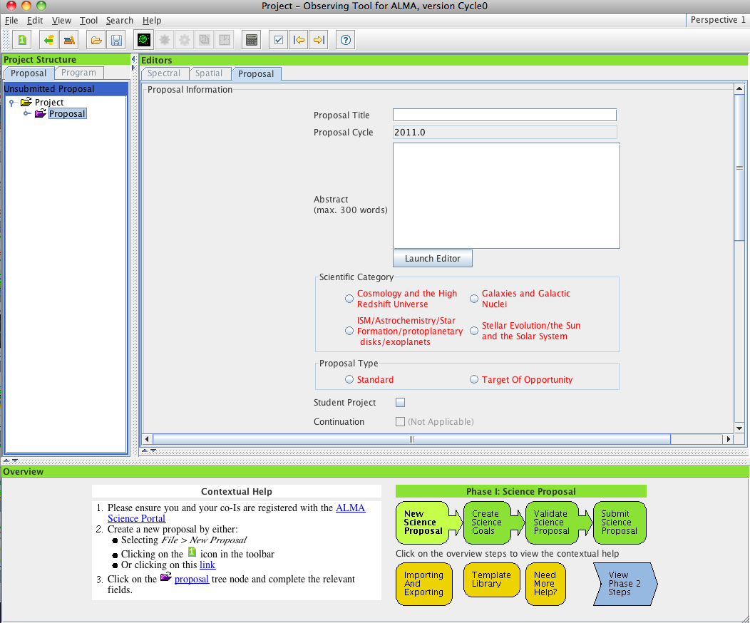
Hover over these icons to get help
New Proposal (Phase I)
Open project from ALMA archive
…
New Phase I Science Goal…
Sensitivity Calculator …
Help!
Contextual help on proposal workflow
Notes:
This should open the OT
… with a blank proposal
Now at this point it’s important for me to note
… that your version of the OT
… and the one that you eventually download
… may look a little different than the examples here
… that’s okay. The key steps are the same.
… the OT is designed to be intuitive and easy to follow
… and for the most part this is the case.
For example, you can get help inside to OT
… by just hovering the mouse over an icon
You also have this zoomed out contextual help here
… that gives you an overview of the proposal process
… with instructions for each step in the OT

Slide 9
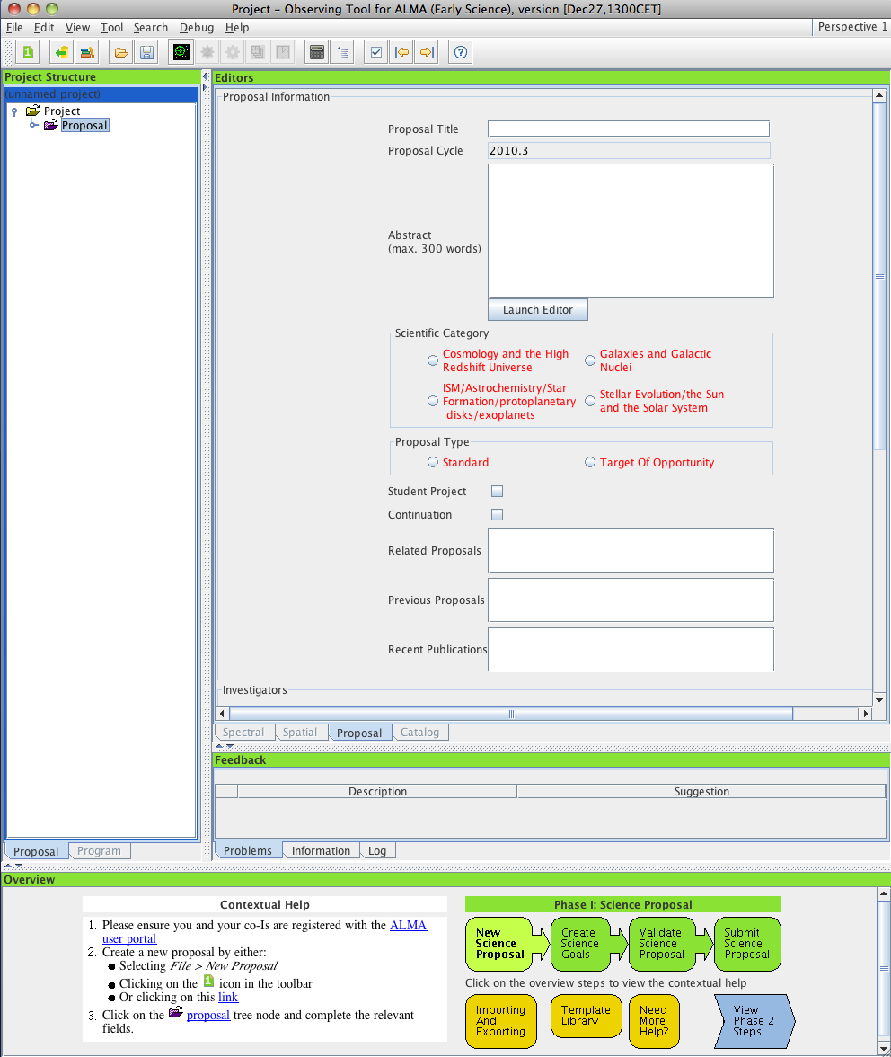
Be alert to the presence of sliders, some information may be off-screen

Slide 10
Stippled edges can be dragged to resize panes

Slide 11
Arrowheads maximize and minimize panes

Slide 12
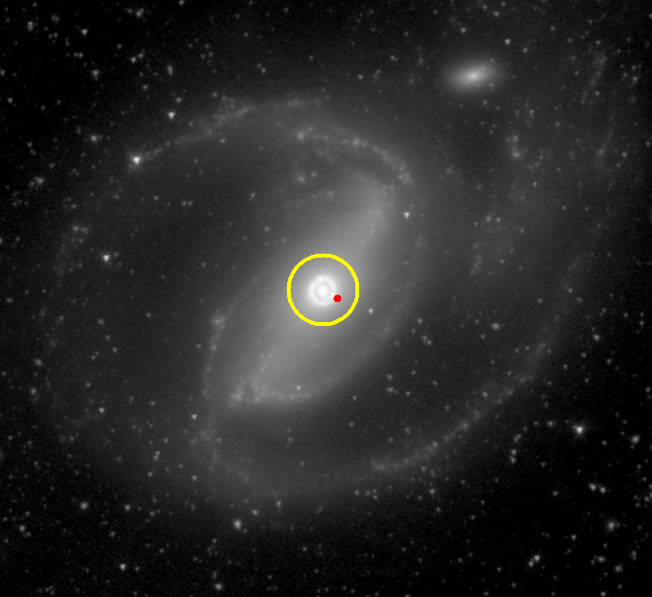
A walk through of a simple example
Observe molecular gas in NGC 1097
Use CO (1-0) emission line
Rest frequency: 115.2712 GHz
Band 3 (2.6 mm)
Size of NGC 1097 is 9’ x 6’
The field of view for a single pointing at 115 GHz is ~ 45”
Single pointing of the nucleus
During ES, up to 50 pointing mosaics are allowed.
Synthesized beam w/400m baseline
NGC 1097 from S⁴G, Sheth et al. 2010
Notes:
So our example will be a very simple observation
… of CO J=1-0 emission
… toward a single field in a nearby galaxy
Here’s our target, NGC 1097
… it’s a big galaxy, so that the primary beam – or field of view - of ALMA
… at the frequency of CO 1-0 covers only a small part of it – that’s the yellow circle
… we’ll focus on the central region here, which hosts a starburst ring
The resolution of ALMA in early science is perfect to resolve this ring
… see the red synthesized beam here, that’s our resolution

Slide 13
Proposal Preparation Workflow – Using the Contextual help
Click through the tabs and follow the instructions on the left.
Notes:
The easiest way to step through
… building a proposal is to use this contextual help window
… just click on each step
… and follow the instructions that appear here
Then move to the next step

Slide 14
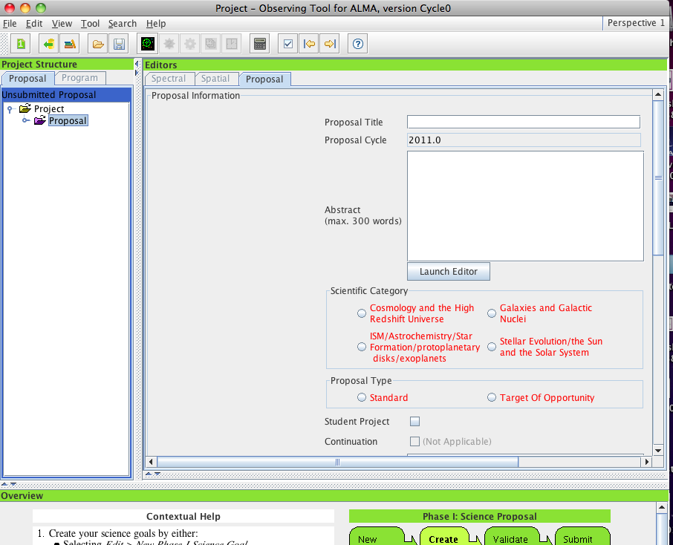
Fill out these relevant fields
Notes:
So the first thing that you’ll want to do
… is the usual administrative stuff
… fill in a title, an abstract
… pick a science category from the available list (which is still in flux)
You can see here in red where the OT is complaining
… because it doesn’t like the (lack of) content
… in a required field

Slide 15
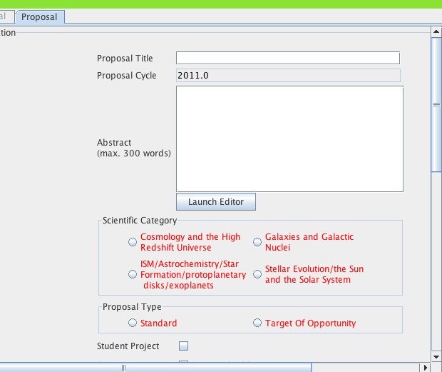
Fill out these relevant fields
Proposal Title
Abstract
Notes:
We’ll fill in our title and abstract
… pick Galaxies and Galactic Nuclei as our Category
… and choose a standard proposal type, the galaxy isn’t going anywhere

Slide 16
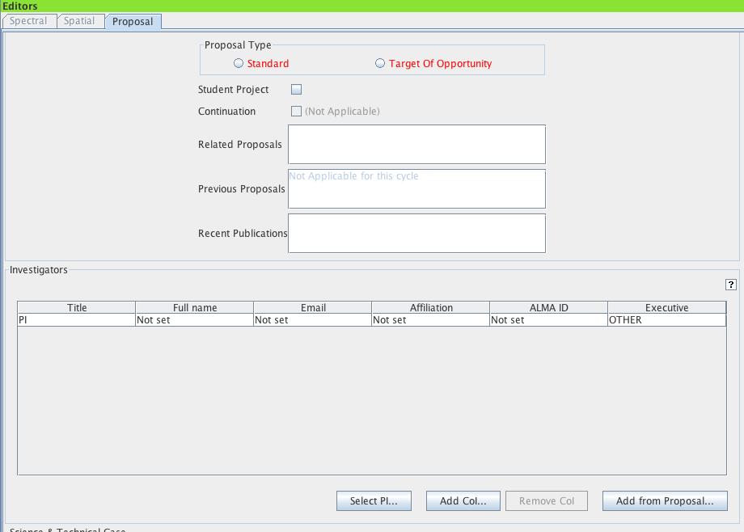
Fill out these relevant fields
{
Click here to set PI and co-Is
Notes:
We’ll then list any related or previous proposals
… and recent publications
Then move on to set the investigators.

Slide 17
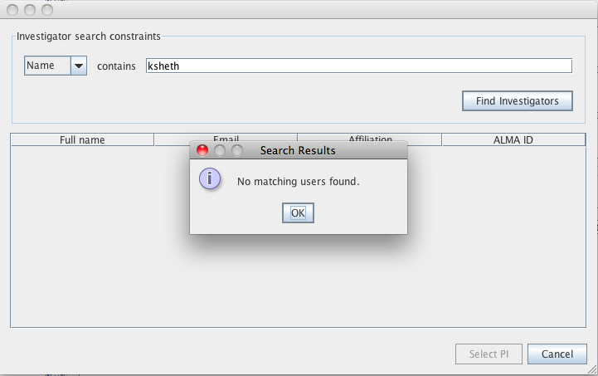
Type in the name
An error may pop up
Notes:
The Pis and CoIs are bookkept through ALMAs database of users
… this means everyone on the proposal needs to register via the ALMA User Portal
... so if you haven’t registered, don’t be surprised if an error pops up the first time you try to do this
… like so
The corollary here is that you really don’t want to be adding coIs
… at the very last minute before you submit, because they may not yet have registered

Slide 18
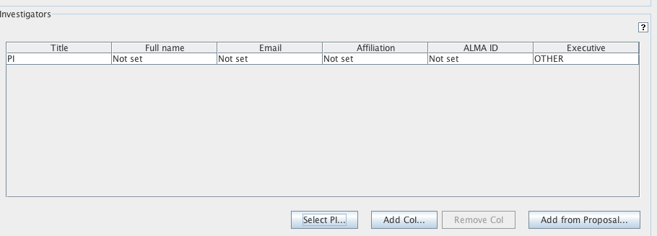
Finding Help
If you get stuck on any step, look for the ? Icon
Click on it to get help.
Notes:
And here, as with any other step
… the OT should have built-in help if you get stuck
… just look for the question mark

Slide 19
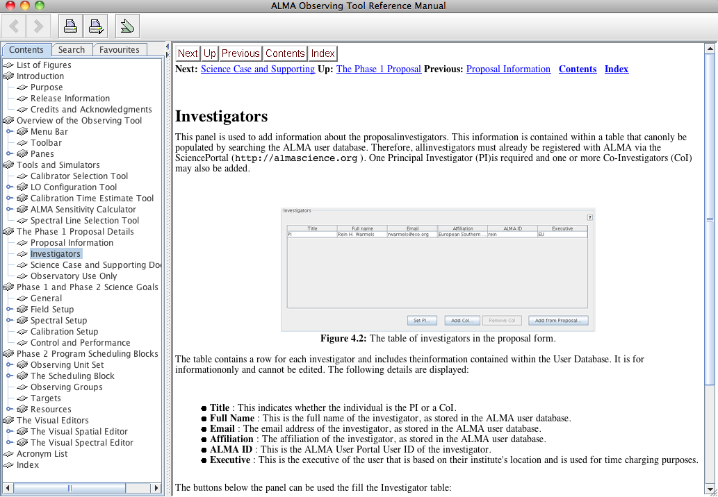
Notes:
For example here’s our help on the issue with PI not found

Slide 20
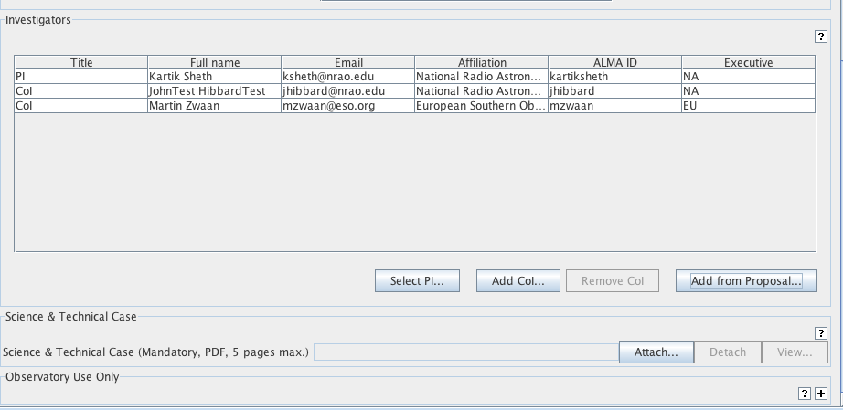
Adding the Sci / Tech Justification
Attach your scientific justification, etc. here as PDF files
Notes:
Okay
… so now we’re all registered
… and our email addresses are showing (which is why we kindly used EU people)
Next we need to attach the science and technical justifications
… that we already generated offline
… in this snapshot it’s four PDFs, most likely it will be a single PDF when you do this

Slide 21
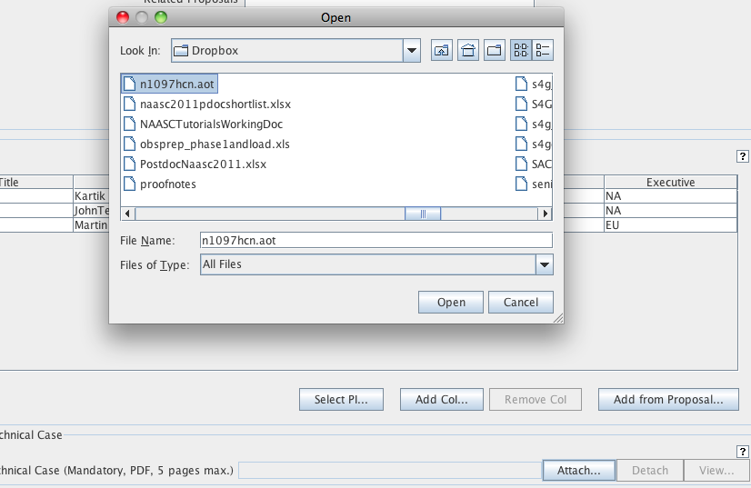
Notes:
Upload via a standard file browser

Slide 22
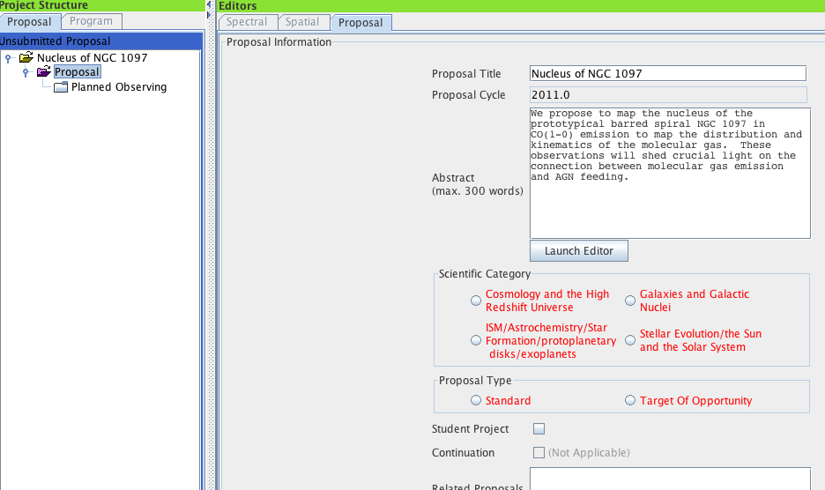
Click on this turnkey to continue
Notes:
So we’re set on the justification now
… we’ve got a title, abstract, coIs, all that good stuff
… and we’re ready to move on to the details
To do that we’ll click on this turnkey
… to drop open the next level of detail
… where we’ll define our observations in concrete terms

Slide 23
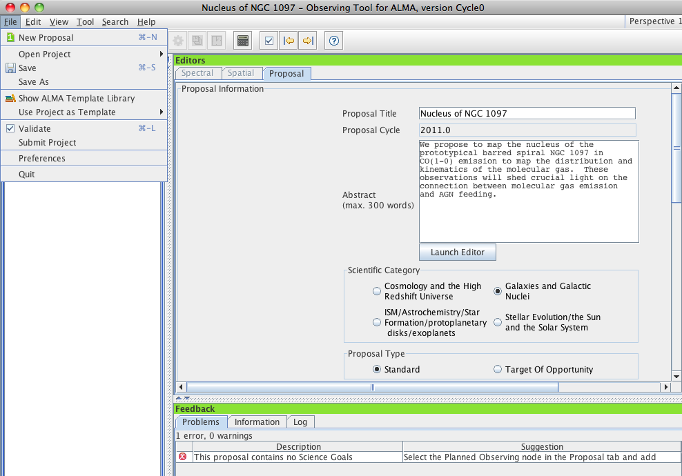
At any point you can check whether your proposal passes validation
Validation required before proposal can be submitted

Slide 24
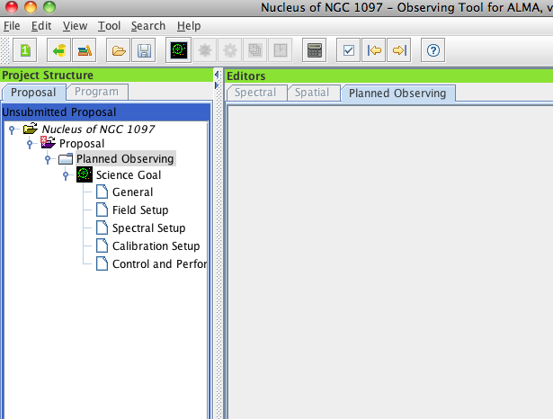
Press on Science Goal tab to create a science goal
Notes:
Specifically what we’re going to do is add
… one or more “Science Goals”
… under this tab Planned Observing

Slide 25
What is a Science Goal in the OT?
A science goal is:
One correlator ./ front end setup in one ALMA band
spectral windows, rest freq, polarization products, line/continuum modes*
Subject to one set of control parameters
spatial resolution, sensitivity, dynamic range
Using one mapping strategy
Mosaic or single-pointing
And one calibration strategy
User or system-defined
Applied to an arbitrary set of sky targets (field centers)
Each with its own LSR velocity
In ES all windows in one science goal must have same bandwidth + channel spacing
Notes:
So what the heck is a Science Goal capital S, capital G?
… basically it’s a discrete observational configuration
… it can target several targets, even with different velocities
… but everything about the observing strategy else has to be fixed
… correlator setup, band, mapping strategy, calibration strategy
And in Early Science there is the additional restriction
… that all correlator windows must have the same bandwidth and channel spacing
So it’s very similar to a Spitzer or Herschel AOR
… except that it can have several different targets

Slide 26
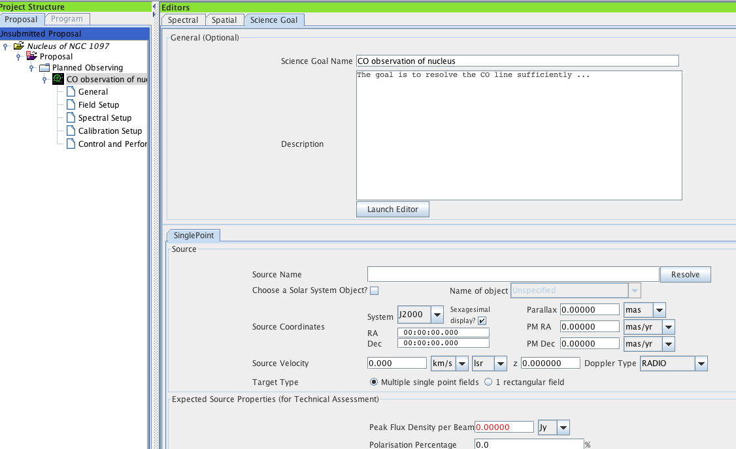
Describe your science goal if you wish – for the technical assessors (not required)
Enter in Source Name and press here

Slide 27
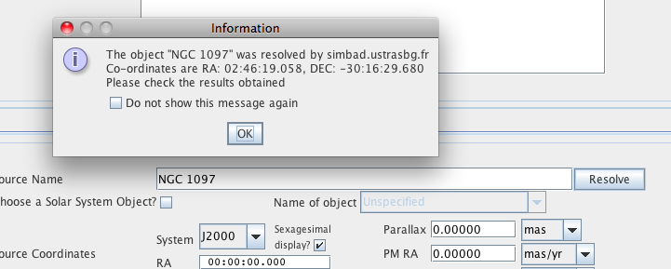
Make sure and double check the coordinates.

Slide 28
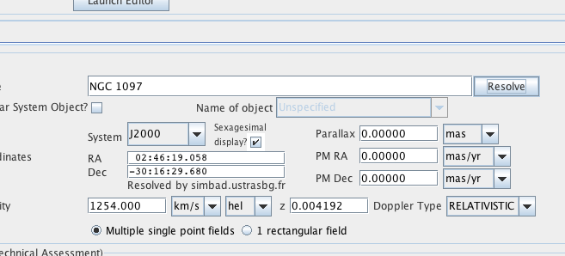
Check the velocity used -> observing frequency.

Slide 29
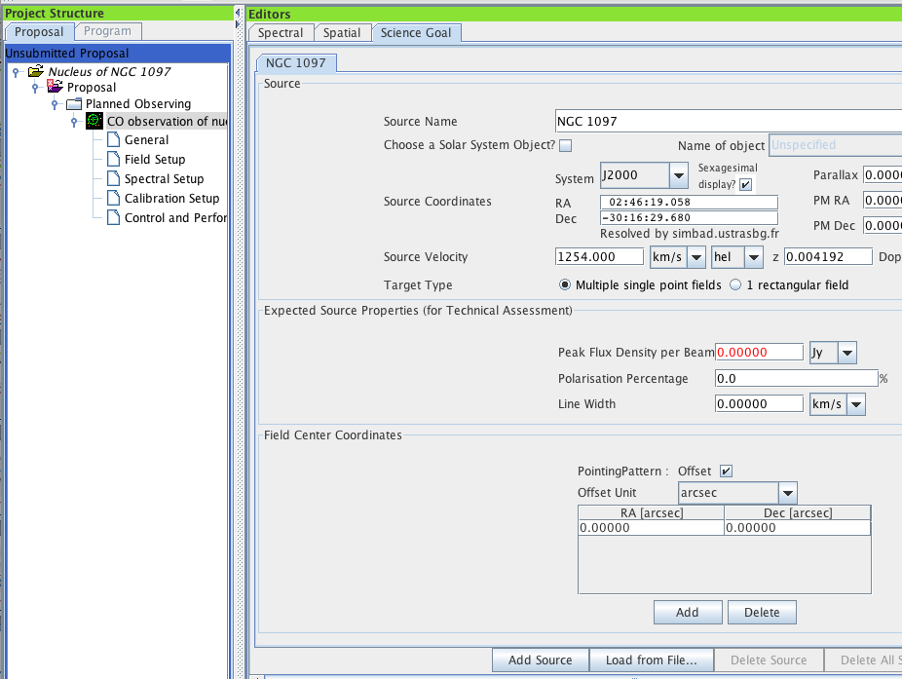
Click on Spatial Tab to visualize observations
Red text indicates incorrect value
Notes:
First we’ll go to the field setup
… and as before notice that the OT
… indicates displeasure via red text
Also notice that you have a few tabs (perhaps not precisely here)
… that let you tab between these parts of the science goal
… we’ll click on the “spatial” tab to visualize our observations

Slide 30
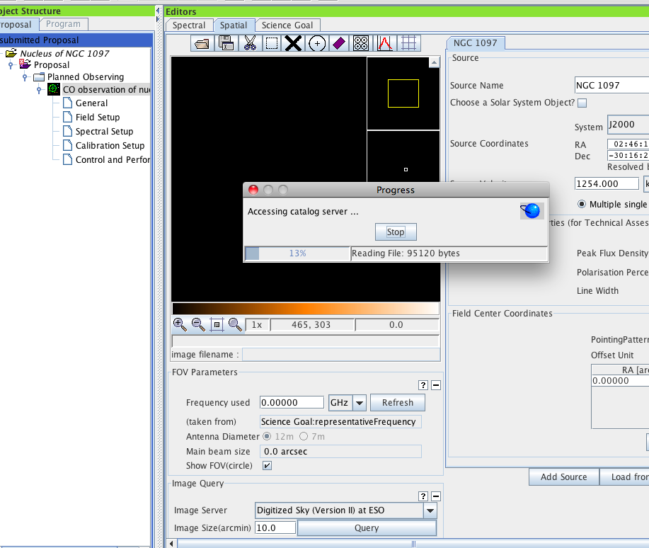
Clicking here opens the visualizer panel
Press Query to get the image from pre-loaded servers
Or
Load your own image* (Galactic coordinates won’t work)

Slide 31
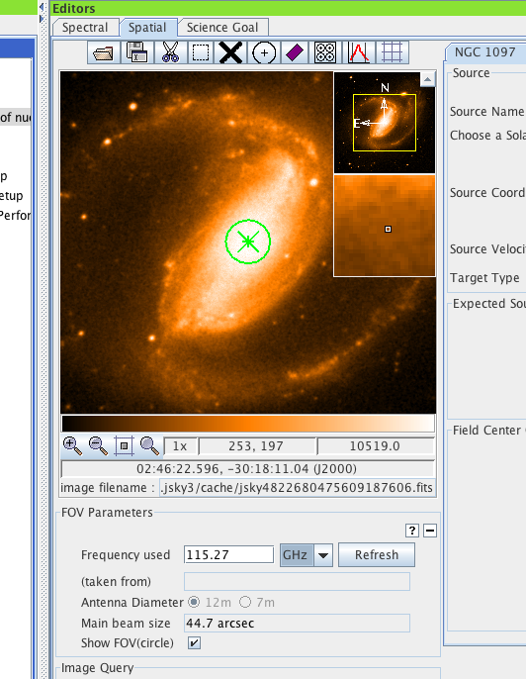
Enter frequency
Notes:
This tab has a lot of functionality
… if you give it the frequency, it will visualize the primary beam
… for our proposed pointings
And it can query online databases to get you a sky image
… here the DSS image is shown
… you can also load in your own if you like

Slide 32
For Calibration Set up – Unless you have a strong reason for using user-defined calibration – leave this as System-defined calibration.
Notes:
In another of these tabs
… you also have the option here to alter the calibration scheme
… in general, you don’t want to do this unless you have a very good reason
… we heavily recommend the default calibration for Early Science
… in which the observatory will select the default calibration scheme
… and strategy

Slide 33
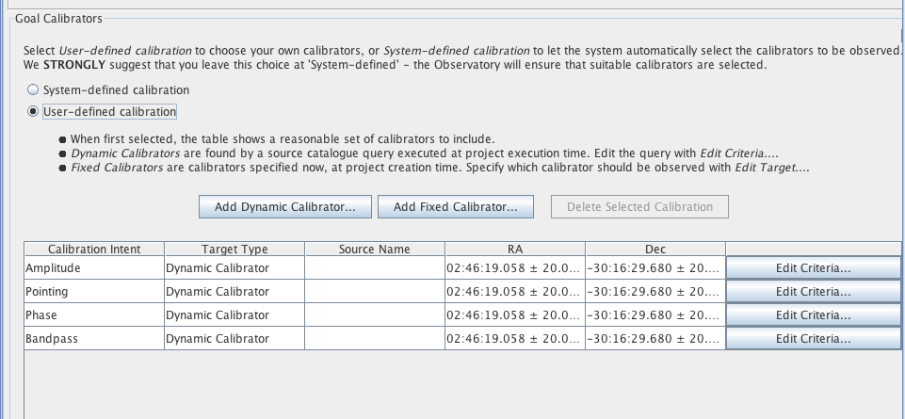
Screen shot of user-defined calibration pane

Slide 34
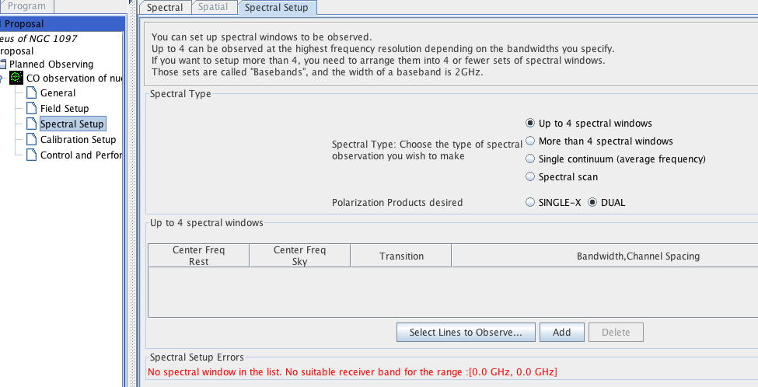
Currently (ES- Cycle 0) supported modes
Press here to add a line

Slide 35
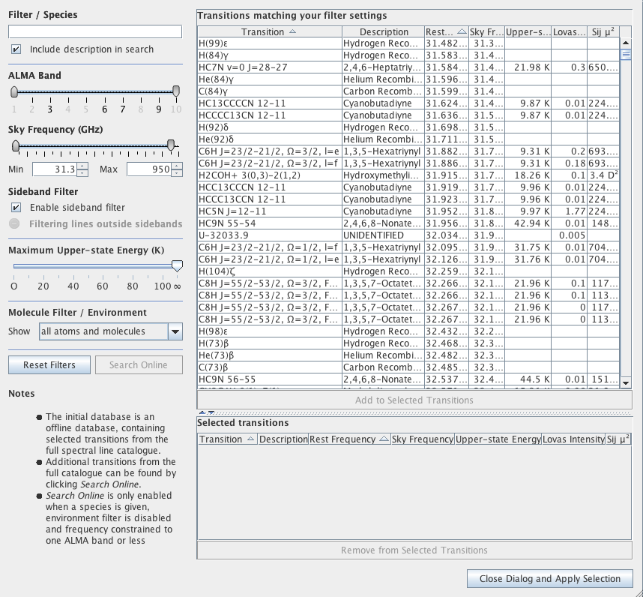
Type in CO
A Splatalogue window will open up.
Notes:
This causes a splatalogue window to open up
… it allows us to specify the species of interest
… we want CO J=1-0
… and so type CO here in this window

Slide 36
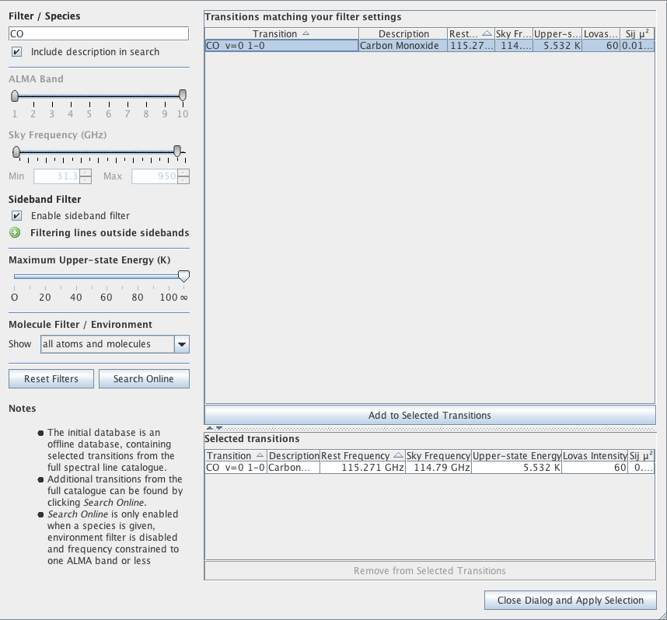
Double click on the transition
Transition moves into this window
Press here to accept selection
Notes:
This brings up a list of CO transitions
… this one here at the top is the one we want
… we double click it and it moves to this lower window
… as one of our selected transitions

Slide 37
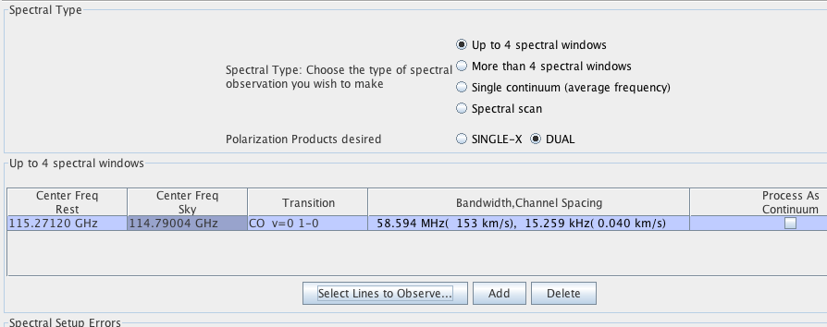
Notes:
We click done and are back to the basic spectral setup window
… and here you see that CO 1-0 is in our list of windows
… the OT has even accounted for the redshift of NGC 1097

Slide 38
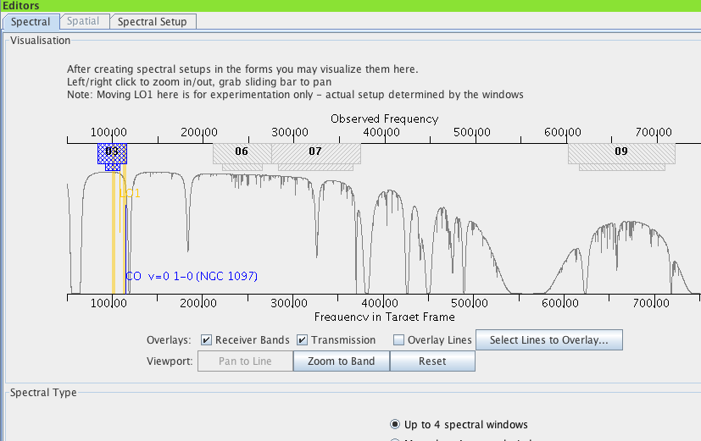
Click on Spectral Tab to visualize observations

Slide 39
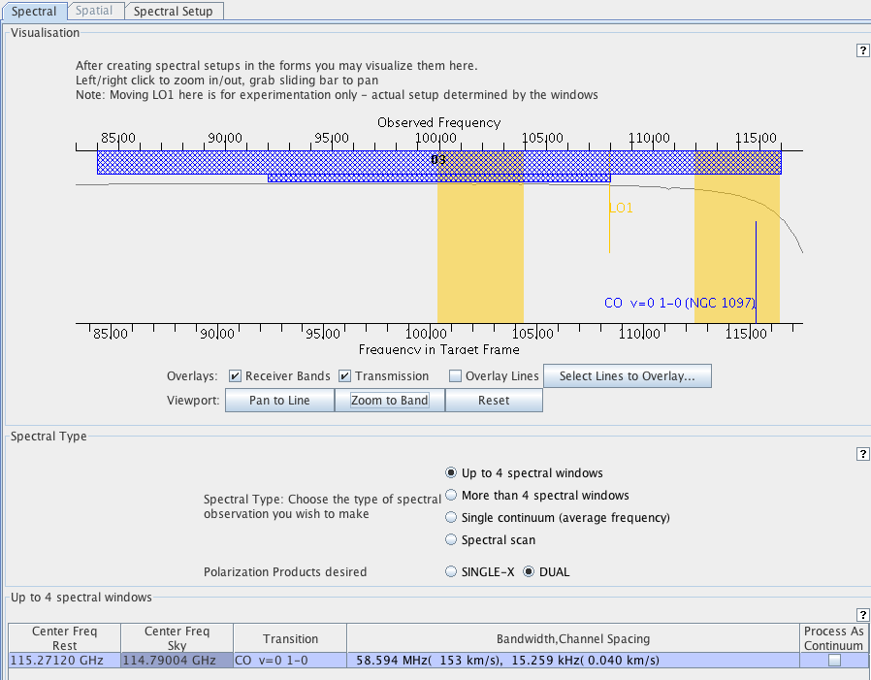
LO
CO
Band 3
LO Range
Sidebands
Press here to change resolution
Notes:
So it’s useful to visualize the spectral setup
… because there can be quite a lot going on here
… this is done inside the spectral part of the Science Goal
… using this graphic here
There’s a bunch of information
… this top bar shows the total frequency coverage of ALMA’s band 3
… (which is our target band)
… the bar underneath it shows where the LO can be tuned
… the two orange bars show the coverage of the current sidebands
… for the LO tuning shown by the orange vertical bar here
You can see that the OT has automatically placed our CO line here
… in the upper sideband
You can also see down here that there is some total bandwidth
… and single channel width associated with our setup

Slide 40
Tradeoff between bandwidth & resolution
Notes:
That bandwidth and channel width (essentially velocity resolution)
… can be changed via a pulldown menu here
… where you can see that there is essentially a tradeoff
… between fine velocity resolution and wide bandwidth
… as a result of finite correlator resources
We’ll pick a wide bandwidth setting with relatively coarse channels
… where coarse means 1.3 km/s
… which is still awesome for extragalactic work

Slide 41
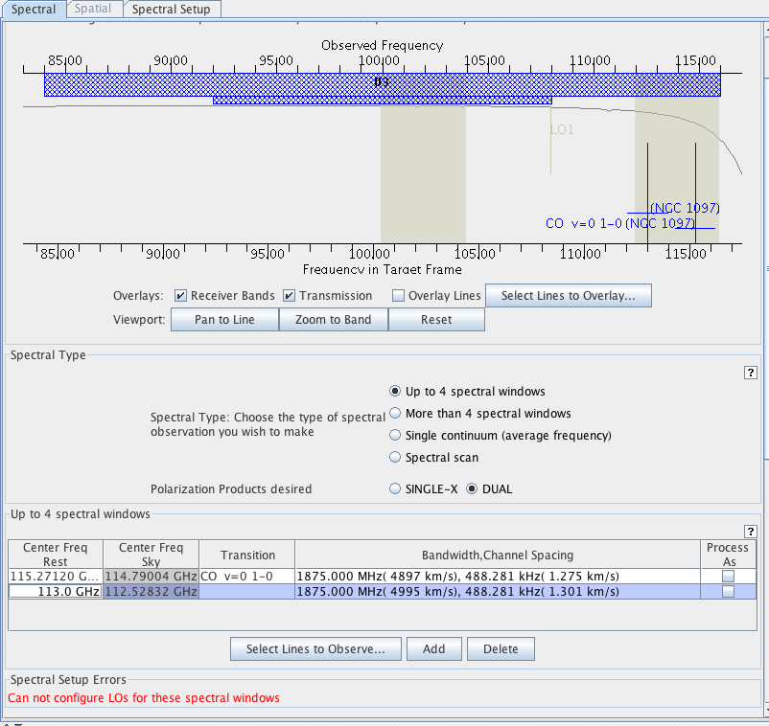
Can add up to 4 spectral windows – must have same resolution/bandwidth for early science
Location of windows is constrained
Notes:
So we have our CO line set up
… but this only uses a fraction of the available power of the ALMA correlator
… even in Early Science we can add up to 4 total spectral windows
… though they must all share the same resolution and wandwidth
… and they must all fit within the sidebands defined by the LO

Slide 42
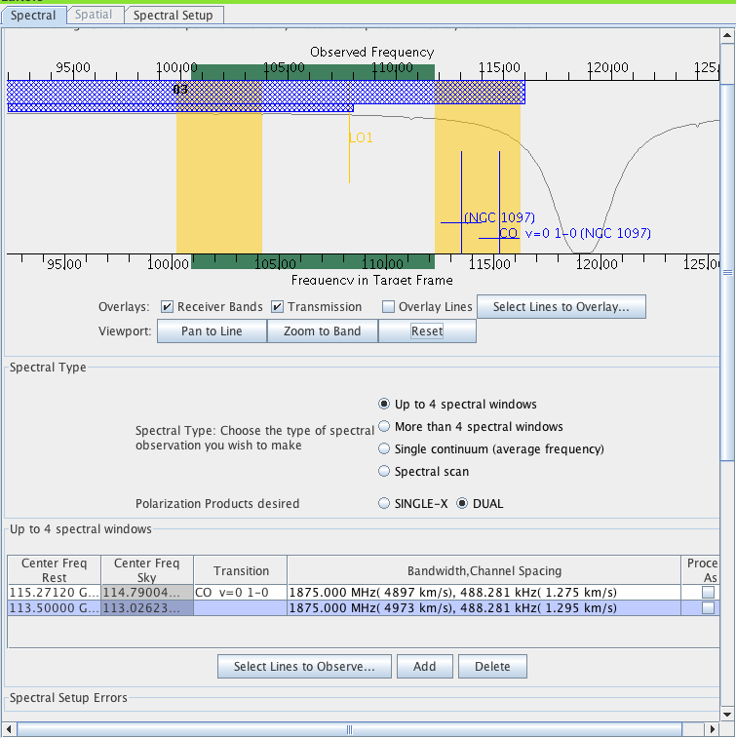
A very versatile tool with lots of options
Notes:
Maybe the most important thing to take away here
… rather than be overwhelmed
… is that the spectral setup part of the observing tool
… like ALMA itself
… is a very versatile tool with lots of options

Slide 43
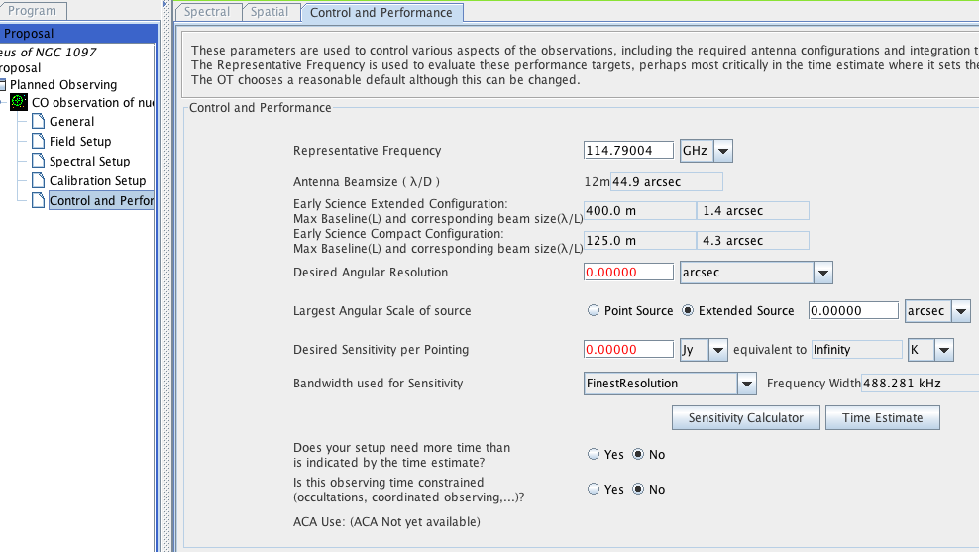
Enter in Max Angular Scale
Request the resolution and sensitivity you need for your science goal
Notes:
Finally we need to specify the requirements for our observations
… the angular resolution
… and sensitivity that you need to do your science
… these should be carefully justified in your technical justification.

Slide 44
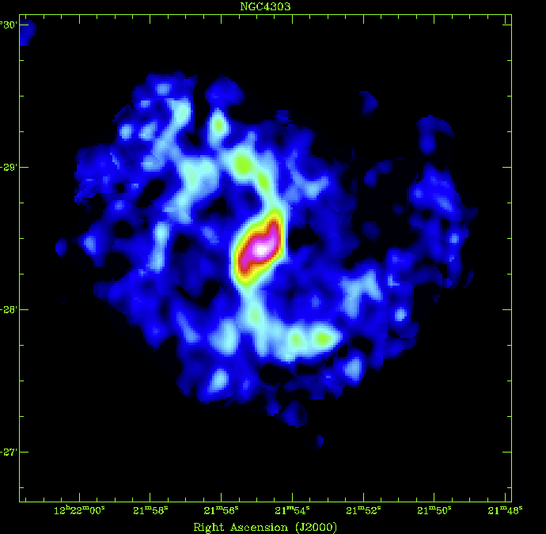
Typical CO Emission in Nearby Galaxies
NGC 4303
Notes:
As we work through our example
… it will be useful to bear in mind a few things about CO emission

Slide 45
Typical CO Emission in Nearby Galaxies
Start thinking in terms of data cubes
We can measure not only the mass and distribution of the molecular gas but also its kinematics
NGC 4303
Notes:
First, it’s a line so that you measure a cube and not an image
… which means we get the kinematics of the gas
... and that the line width will be key to estimate our required sensitivity

Slide 46
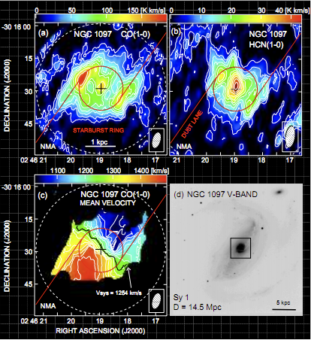
Back to our example of NGC 1097
To get a 10σ detection on the faintest emission in the map requires ~10 mJy/bm in a 10 km/s channel.
The ALMA correlator gives 1.275 km/s channels – we will bin 8 channels to get to 10 km/s.
(So required sensitivity in 1 ALMA correlator channel ~ 10 mJy/bm * sqrt (8) ~ 28 mJy/bm)
Nobeyama maps of NGC 1097 (Kohno et al. 2003)
Notes:
Fortunately NGC 1097 has been studied before
… and we know that targeting 10 millijanskies per beam
… per 10 km/s channel is a reasonable target to recover
… the distribution and kinematics of CO in the inner part
However, note that the ALMA correlator is giving us 1.3 km/s channels
… so we need to account by hand for the binning we plan to do
… in post-processing
… this binning will average about 8 channels, so that we can target a sensitivity
… a factor of sqrt(8) worse than what we needed at 10 km/s resolution
… this is 28 millijanskies per beam

Slide 47
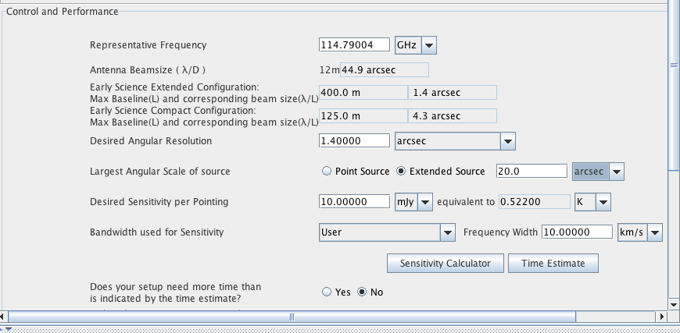
Back to our example of NGC 1097
1.4”~ 110pc
Sufficient to resolve the ring
Press here to get an idea of how long it will take to do this
Notes:
Having worked this out, we can enter
… our desired sensitivity per beam here in the control tab
… and ask the sensitivity calculator how much time this will take

Slide 48
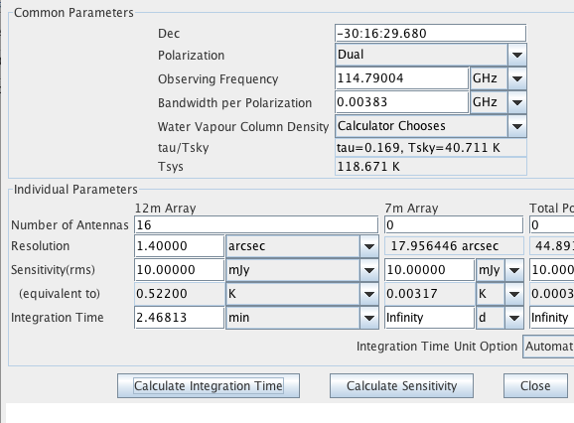
ALMA with 16 x 12m antennas is very fast!
BUT be aware that your UV-coverage may not be ideal – we recommend that you use simdata to check
Notes:
And wow, it only takes about 2 minutes to get to this RMS noise
… this is great
But you need to stop and be a bit careful here
… because for an imaging experiment it’s possible for the sensitivity to outstrip the imaging capabilities
… specifically, with only 16 antennas your coverage of the u-v plane in only two minutes is not very good
Here it will be very important to crosscheck with simdata
… that your science is achievable
… and if necessary you should adjust the requested time to be driver by u-v coverage
How to do this will be the subject of the simdata talk coming up

Slide 49
Back to our example of NGC 1097
Notes:
Now that we’ve done the sensitivity calculation
… we can ask the observing tool to estimate the total time for the project
… we’ll just click on time estimate

Slide 50
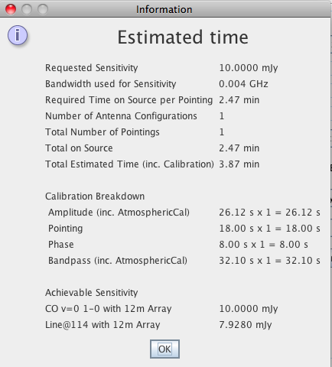
Time allocation for the proposal will be the Total Estimated time.
Notes:
And we see it pop up this box
… the OT calculates overhead from calibrations, pointings
… and comes to a total time estimate

Slide 51
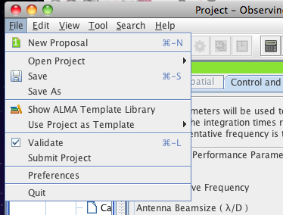
Notes:
Okay, so we think we’re basically done
… we’re now ready to try to submit
… which is done here
... from the file menu
And it’s absolutely critical to point out that
… you can’t submit your project unless it validates
… if you try to submit a proposal that the OT thinks is invalid
… it will come back at you with errors
… and if you try to do this one minute before the deadline
… you will be very very unhappy and we will be unhappy too because we can’t help
… so make sure your project validates
… and don’t submit at the very last minutes

Slide 52
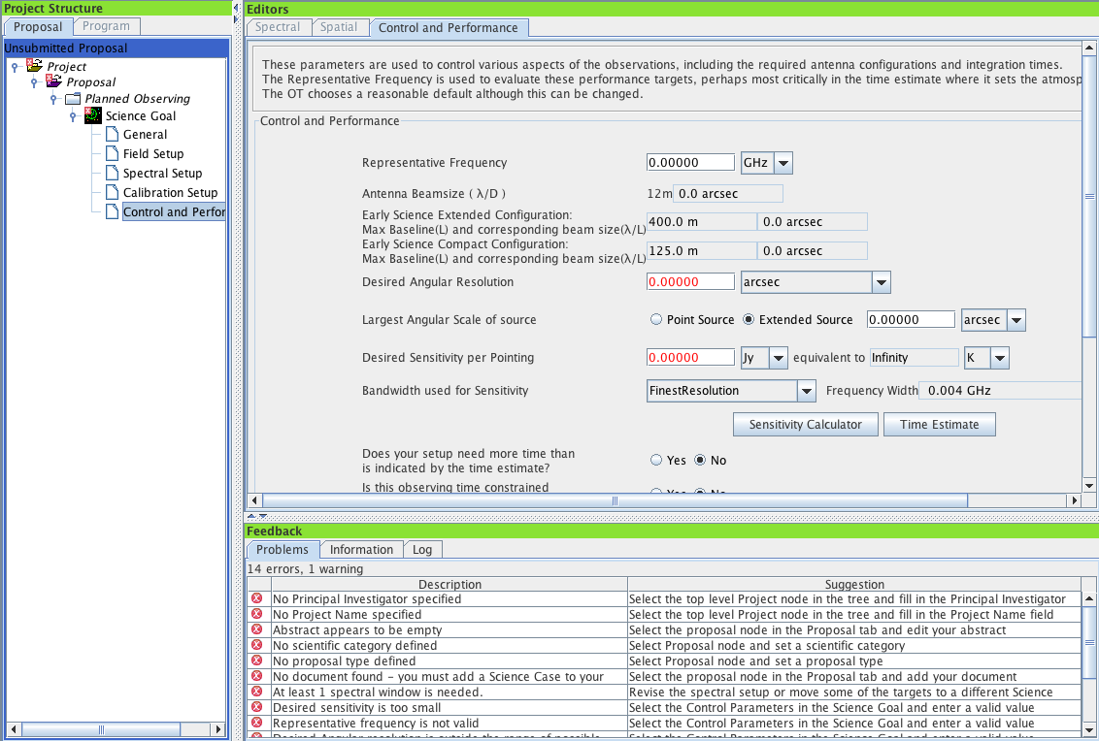
Notes:
As an example here is the OT
… complaining loudly about all sorts of errors in a brand new proposal.

Slide 53
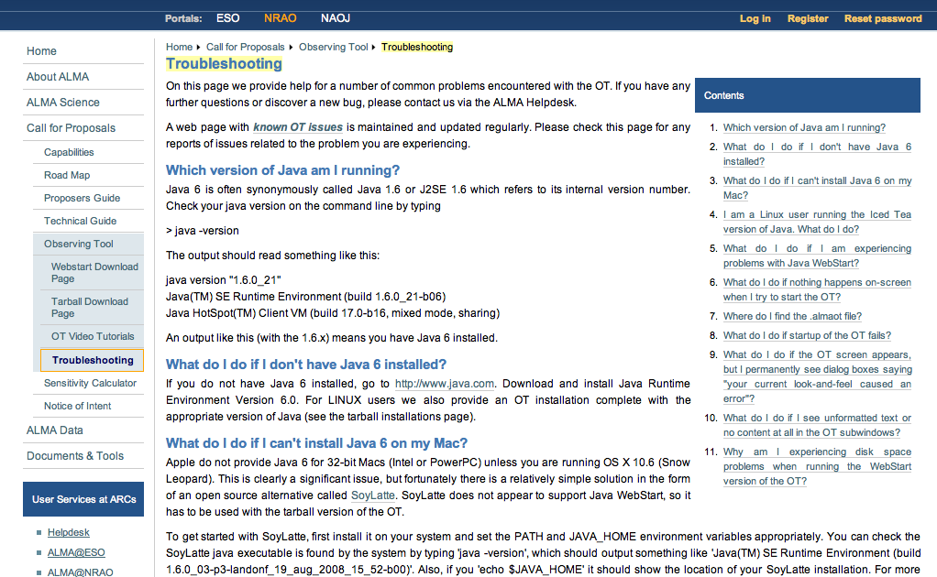
See also known issues:
http://almasw.hq.eso.org/almasw/bin/view/OBSPREP/Cycle0KnownIssues

Slide 54
NAASC Tutorials & Community Events
Jan 18, Victoria, BC
Feb 10-11, Honolulu, HI
Feb 24-25, Charlottesville, VA
Mar 7, Philadelphia, PA
Mar 11, Santa Fe, NM (New Horizons conference)
Mar 15-16, Pasadena, CA
Apr 18, Baltimore, MD
Apr 20, Boston, MA
Apr 26-27, Charlottesville, VA
May 2-3, Gainesville, FL
May 9-10, Iowa City, IOA
May 9-10, Charlottesville, VA
May 22-26, Boston, MA (AAS)
May 27, NYC, NY
Notes:
Okay, thanks for your attention.
Now it’s your turn to start your proposals in the OT
And as you do so, I want to call out the other events being organized
… by the north american alma science center
… in the leadup to early science

Slide 56
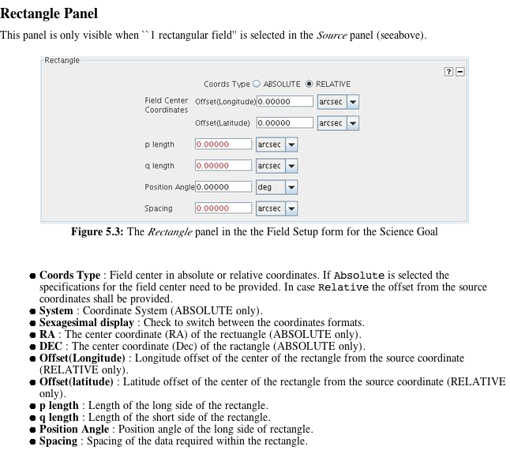

Slide 57
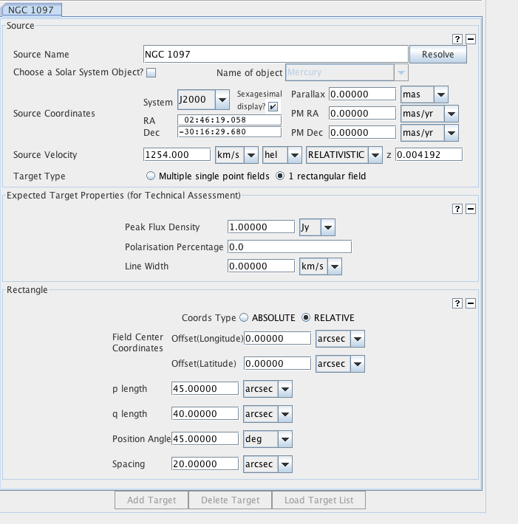

Slide 58
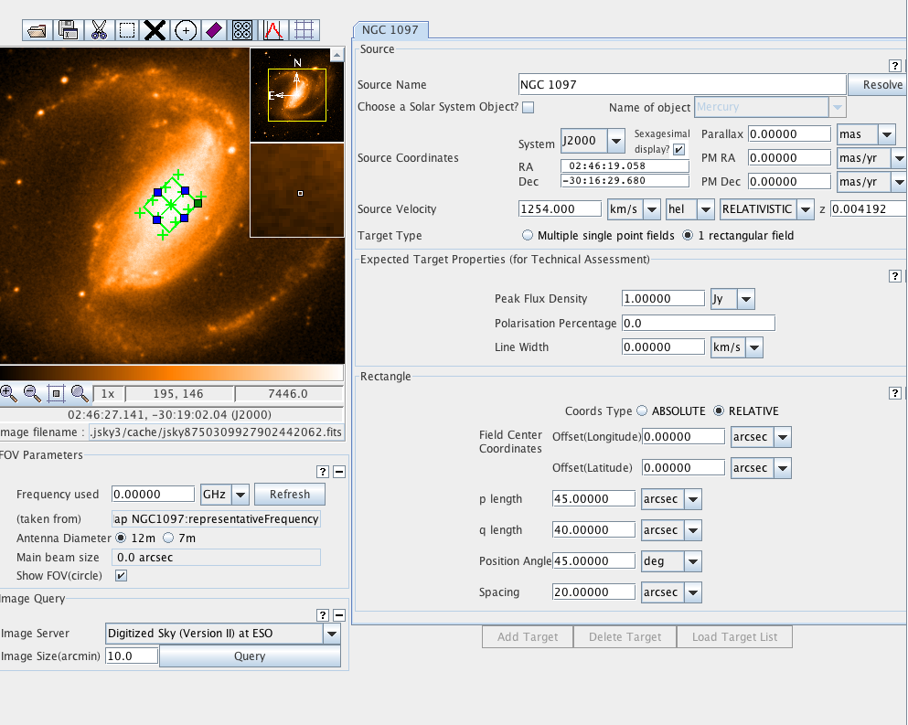

Slide 59
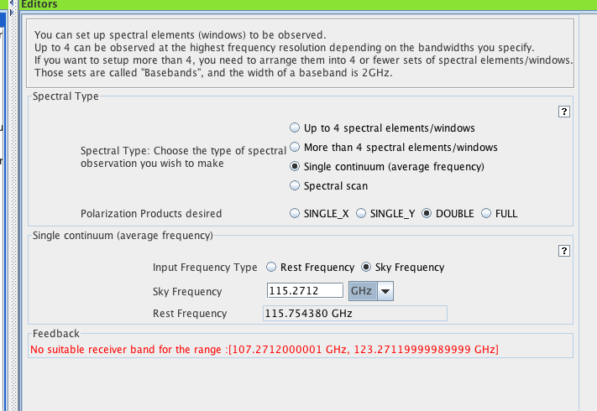

Slide 60
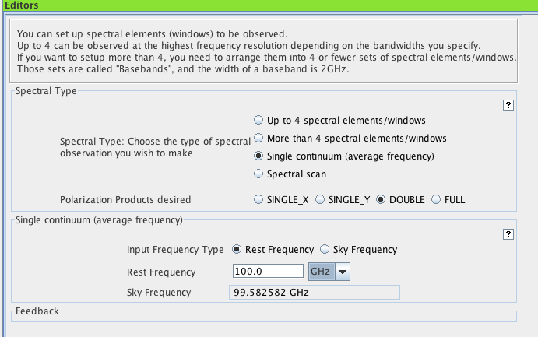

Slide 61
