Slide 1
EVLA Data Reduction Tutorial
Emmanuel Momjian (NRAO)
Notes:
1

Slide 2
Introduction
This tutorial is based on the EVLA high frequency spectral line tutorial targeting the AGB star IRC+10216.
The array was in D-configuration.
There are two spectral windows in this data set. One is centered on the HC3N line and the other on the SiS line.
The full tutorial can be found at:
http://casaguides.nrao.edu
(‘Tutorials’ under ‘EVLA Guides’ of the ‘Data Reduction Guides’).

Slide 3
The data set
You were asked to download several files from
  ftp ftp.aoc.nrao.edu
  login as anonymous, enter your email address for the password.
  cd /staff/gvanmoor/community_day
get the tar files and un-tar them (tar –xvf filename.tar)
  full.tar → day2_TDEM0003_20s_full
  sp.tar → IRC10216_spls.ms
  HC3N.tar → IRC10216_HC3N.image
  SiS.tar → IRC10216_SiS.image

Slide 4
The data set
‘day2_TDEM0003_20s_full’ is a measurement set
This data set is different than the one in the original tutorial:
  Time averaging of 20 seconds have been applied (to make the size of the file more manageable).
  The antenna position corrections have been applied.
  Opacity corrections have been applied.

Slide 5
Initial examination and flagging
List the summary of the data set: listobs
Make a graphical plot of the antenna positions: plotants
Plot the data: plotms
Flag some bad data: flagdata

Slide 6
CASA: listobs
1
List the summary of the data set: listobs
  type default listobs in casa, hit enter
  type inp
  populate the relevant adverbs, e.g.,
vis = 'day2_TDEM0003_20s_full'
verbose = True
listfile = ''
  type go
  Check the casa logger

Slide 7
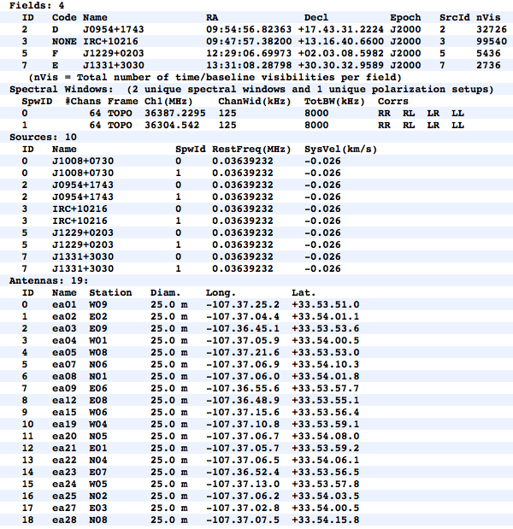
Data set Summary

Slide 8
Summary of Observing Strategy
Gain Calibrator | J0954+1743; field id=2
Bandpass Calibrator | J1229+0203; field id=5
Flux Calibrator | J1331+3030 (3C286); field id=7
Science target | IRC+10216; field id=3
Ka-band spws = 0, 1

Slide 9
CASA: plotants
2
To make a graphical plot of the antenna positions: plotants
  type default plotants in casa, hit enter
  type inp
  populate the relevant adverbs, e.g.,
vis = 'day2_TDEM0003_20s_full'
figfile = ''
  type go

Slide 10
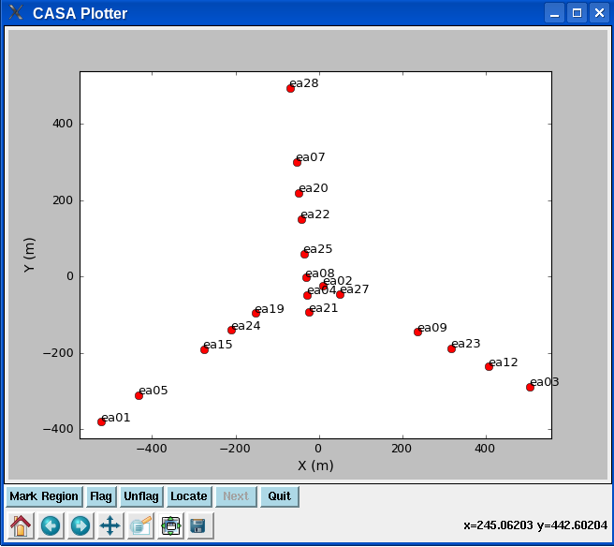
Antenna locations from running plotants
We choose ea02 as the reference antenna

Slide 11
CASA: plotms
3
To plot the data using various types of axes: plotms
  Plot amp vs. time
  type default plotms in casa, then type inp
vis = 'day2_TDEM0003_20s_full'
xaxis = 'time'
yaxis = 'amp'
selectdata = true
spw = '0:4~60'
correlation = 'RR,LL'
averagedata = true
avgchannel = '64'
coloraxis = 'field'
  go

Slide 12
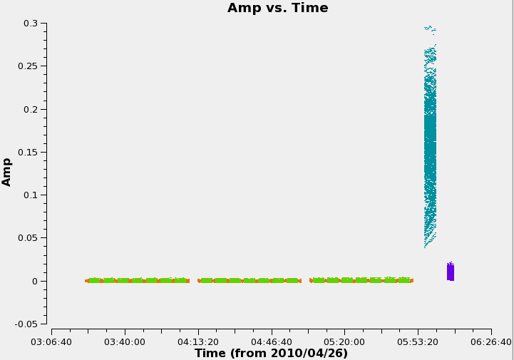
CASA: plotms

Slide 13
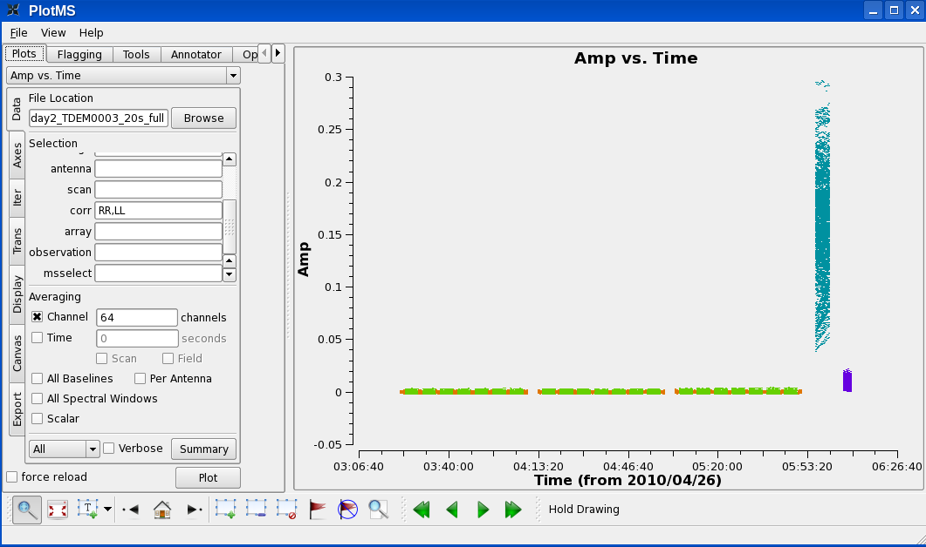
CASA: plotms
In plotms, zoom in on the region very near zero amplitude for sources J0954+1743 and IRC+10216.

Slide 14
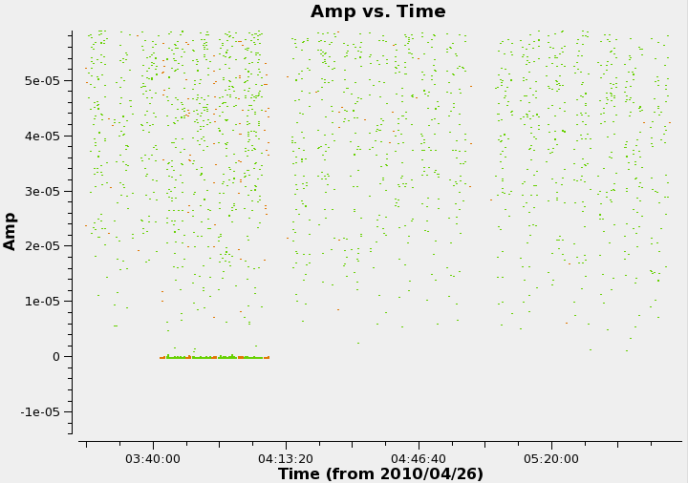
CASA: plotms

Slide 15
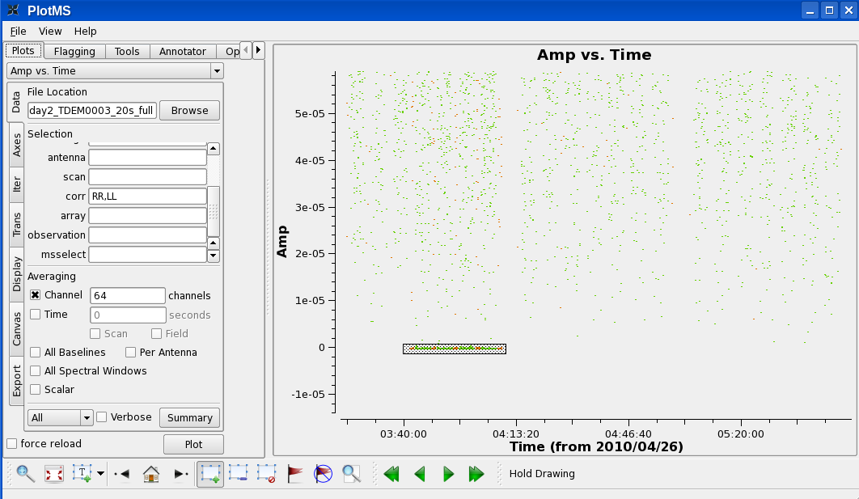
CASA: plotms
Identify the bad points:
2
1
3

Slide 16
CASA: plotms
Check the casa logger.
Notice that all the baselines of these data points include antenna ea12.
Note the time range 03:40:00 to 04:10:00
We could flag interactively/graphically, but we rather flag globally addressing the root cause of the problem.

Slide 17
CASA: plotms
Now check spectral window 1:
  change ‘0:4~60’ to ‘1:4~60’ in the spw window on the side menu of plotms, and hit plot.
  Zoom in again.

Slide 18
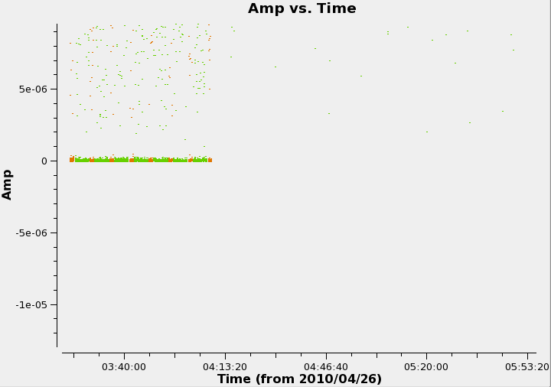
CASA: plotms

Slide 19
CASA: plotms
Identify the bad points:
  Make a region, and locate.

Slide 20
CASA: plotms
The problem in spw 1 is due to ea07.
Time range 03:21:40 to 04:10:00
In the antenna field of plotsms, type !ea07 (this excludes all data points with antenna ea07). Zoom in to note that the bad points are no longer displayed.

Slide 21
CASA: flagdata
4
We have identified two problematic antennas.
To flag, use the task flagdata
default flagdata, then inp
vis = 'day2_TDEM0003_20s_full'
mode = 'manualflag'
spw = ['0', '1']
field = ['2,3', '2,3']
selectdata = True
antenna = ['ea12', 'ea07']
timerange = ['03:41:00~04:10:00','03:21:40~04:10:00']
Type go, and check the casa logger.

Slide 22
Calibration Strategy
Setting the flux density scale: setjy
To properly calibrate the bandpass in high frequency observations:
  Phase only calibration (short solint) on the bandpass calibrator: gaincal
  Bandpass calibration applying (1) : bandpass
The calibration table (1) is ignored in consequent steps. The bandpass table (2) is applied on the fly in consequent steps.

Slide 23
CASA: setjy
5
Flux density calibration using 3C286.
This source requires a model.
Use the task setjy
To find out if a model is available (default setjy)
  vis = 'day2_TDEM0003_20s_full‘
  listmodimages = True
Type go
The list doesn’t yet have the Ka-band model of 3C286. We will use the K-band model instead (3C286_K.im).

Slide 24
CASA: setjy
6
Now set
listmodimages = False
field = '7'
modimage = '3C286_K.im'
Type go
The logger will report:
J1331+3030 (fld ind 7) spw 0 [I=1.7762, Q=0, U=0, V=0] Jy, (Perley-Butler 2010)
J1331+3030 (fld ind 7) spw 1 [I=1.7794, Q=0, U=0, V=0] Jy, (Perley-Butler 2010)

Slide 25
CASA: gaincal
Phase only calibration (short solint) on the bandpass calibrator: gaincal.
This is to correct the phase variations with time before solving for the bandpass to prevent decorrelation.

Slide 26
CASA: gaincal
7
default gaincal, then inp
vis = 'day2_TDEM0003_20s_full'
caltable = 'bpphase.gcal'
field = '5'
spw = '0~1:20~40'
solint = 'int'
refant = 'ea02'
gaintype = 'G'
calmode = 'p'
gaincurve = True
go

Slide 27
CASA: plotcal
8
gaincal made the table bpphase.gcal
Plot the derived solutions: plotcal
default plotcal
  caltable = 'bpphase.gcal'
  xaxis = 'time'
  yaxis = 'phase'
  subplot = 331
  iteration = 'antenna'
  plotrange = [0,0,-180,180]
go

Slide 28
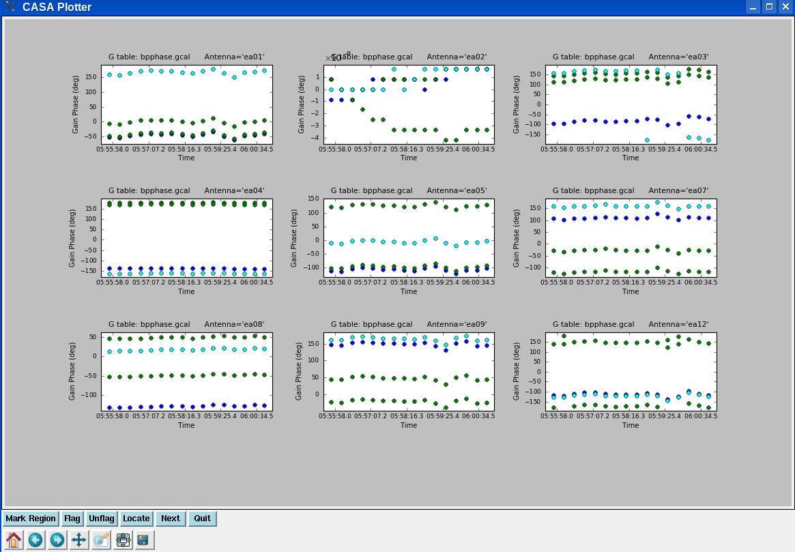
CASA: plotcal

Slide 29
CASA: bandpass
9
Bandpass calibration: bandpass
default bandpass
vis = 'day2_TDEM0003_20s_full'
caltable = 'bandpass.bcal'
field = '5'
solint = 'inf'
refant = 'ea02'
solnorm = True
gaintable = 'bpphase.gcal'
gaincurve = True
go

Slide 30
CASA: plotcal
10
bandpass made the table bandpass.bcal
Plot the derived amplitude solutions: plotcal
default plotcal
  caltable = 'bandpass.bcal'
  xaxis = 'chan'
  yaxis = 'amp'
  subplot = 331
  iteration = 'antenna‘
  go

Slide 31
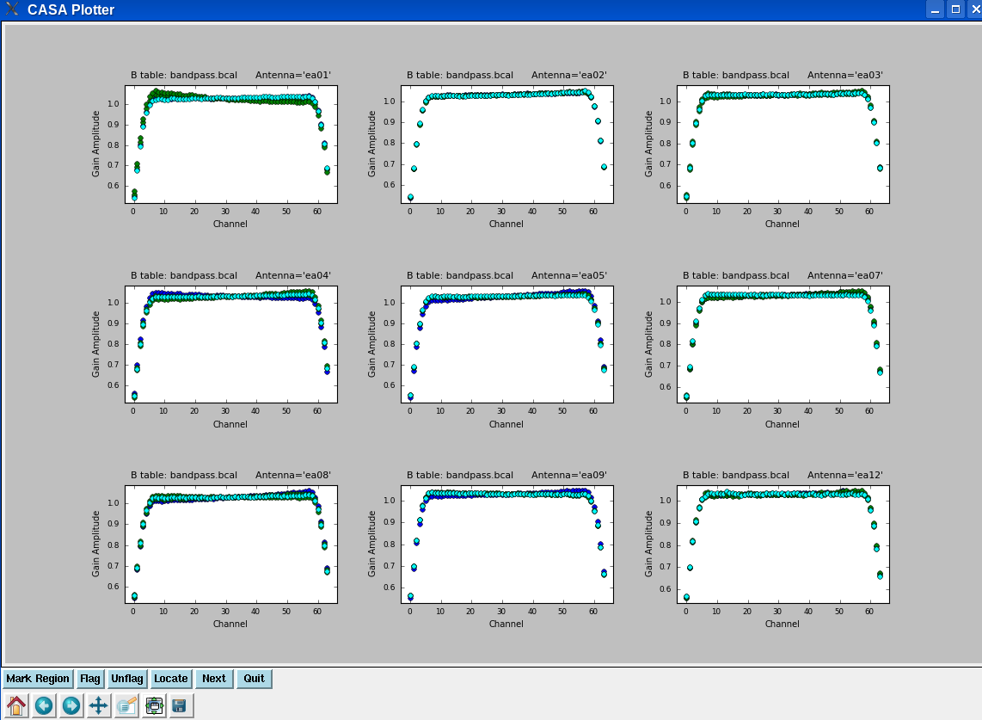
CASA: plotcal

Slide 32
CASA: plotcal
11
Plot the derived phase solutions: plotcal
tget plotcal
  yaxis = ‘phase‘
  go

Slide 33
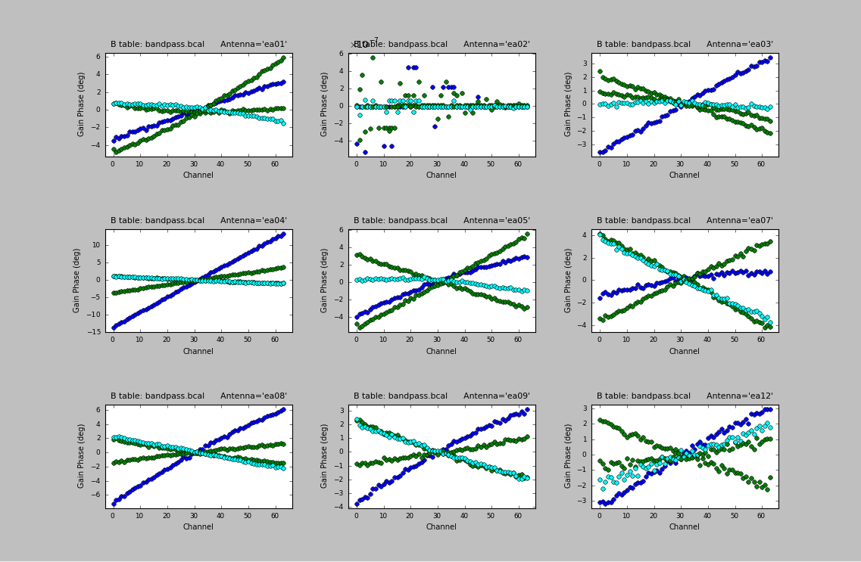
CASA: plotcal

Slide 34
Calibration Strategy
To bootstrap the flux densities of the secondary calibrators:
  Phase only calibration (short solint) on all calibrators: gaincal
  Amplitude only calibration (scan based) on all calibrators: gaincal, apply (a) on the fly
  Derive the flux densities of the secondary calibrators: fluxscale, use (b) as input. This will also correct the amplitude solutions of (b) and write a new table.
To calibrate the target source:
  Phase only calibration (scan based) on the phase calibrator: gaincal
  The amplitude will be calibrated using the table from (c).

Slide 35
Calibration Strategy
Apply the calibration tables on the target
  The task to use is applycal
  The various calibration tables relevant to the target source gets applied on the target. For instance:
    The bandpass table.
    The scan based phase calibration table.
    The amplitude calibration table (written by fluxscale).
  The calibrated data is written in the ‘corrected column’ of the ms.

Slide 36
Calibration Strategy
Examine the calibrated data with plotms.
Identify bad data and/or antennas, flag, and redo all the calibration.
Redo applycal and re-examine.
If all look good, then
  split the target source into a new ms (for convenience).
  Subtract the continuum using uvcontsub
  Doppler correct the data using CVEL (or let clean do the Doppler corrections on the fly).

Slide 37
The spectral line data set
12
The continuum-subtracted spectral-line data set is IRC10216_spls.ms. Plot the lines
default plotms
vis = 'IRC10216_spls.ms'
xaxis = 'channel'
yaxis = 'amp'
averagedata = True
avgtime = '1e8'
avgscan = True
coloraxis = 'spw‘
go

Slide 38
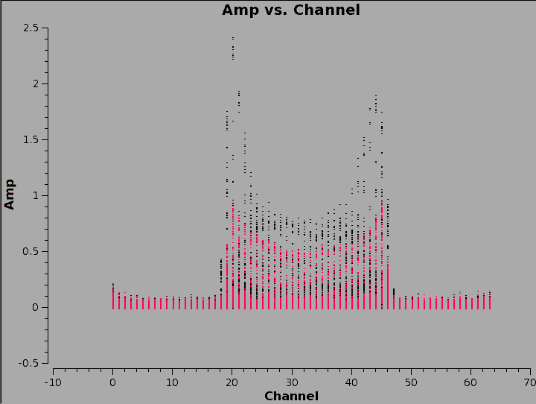

Slide 39
CASA: Clean
13
For illustration: image/clean channel 22 of the SiS line.
default clean
vis = 'IRC10216_spls.ms'
imagename = 'ch22'
spw = '1:22~22'
mode = 'channel'
nchan = 1
start = ''
width = 1
niter = 100000
gain = 0.1
threshold = '3.0mJy'
Don't type go yet

Slide 40
CASA: Clean
14
psfmode = 'clark'
imagermode = 'csclean'
interactive = True
npercycle = 100
imsize = 300
cell = ['0.4arcsec', '0.4arcsec']
stokes = 'I'
weighting = 'briggs'
robust = 0.5
go

Slide 41
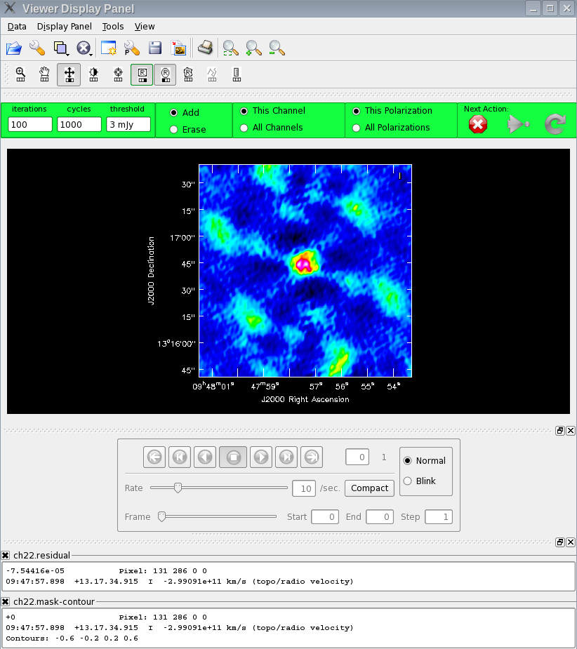
CASA: Clean
Make a region.
Double click inside the region.
Clean (click the green circular arrow).

Slide 42
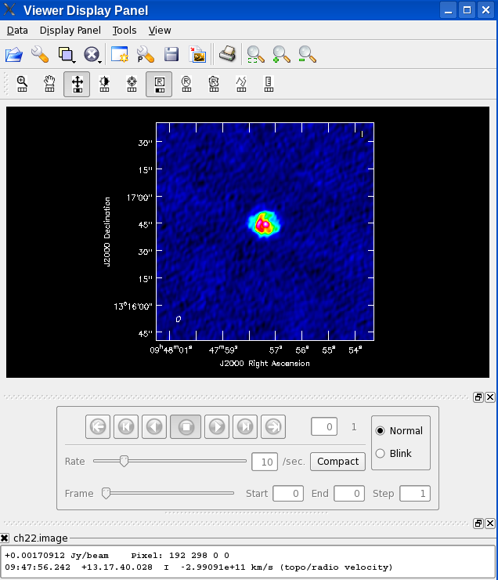
CASA: viewer
Start the viewer (type viewer in CASA).
Choose ch22.image.
Load as ‘raster image’.

Slide 43
CASA: viewer
Make a region off-source, double click in the region to get some statistics (in the CASA terminal).

Slide 44
The Image cubes
From the same ftp area load the image cubes:
  HC3N.tar → IRC10216_HC3N.image
  SiS.tar → IRC10216_SiS.image
Using the viewer, display the image cubes

Slide 45
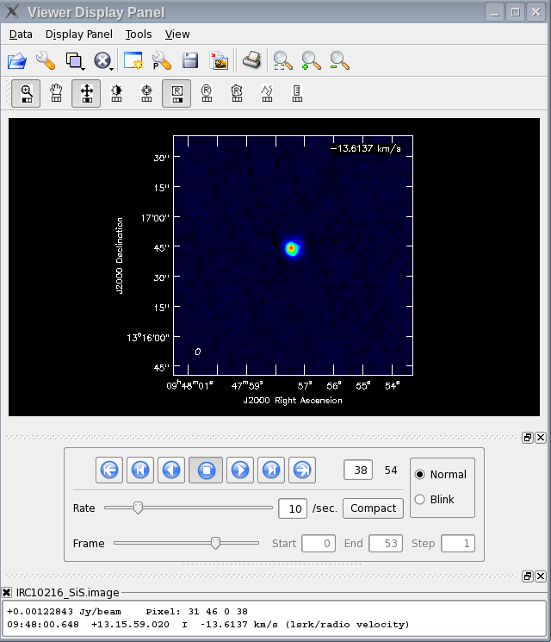
CASA: viewer
Start the viewer
Choose one of the image cubes.
Load as ‘raster image’.
Play the movie.

Slide 46
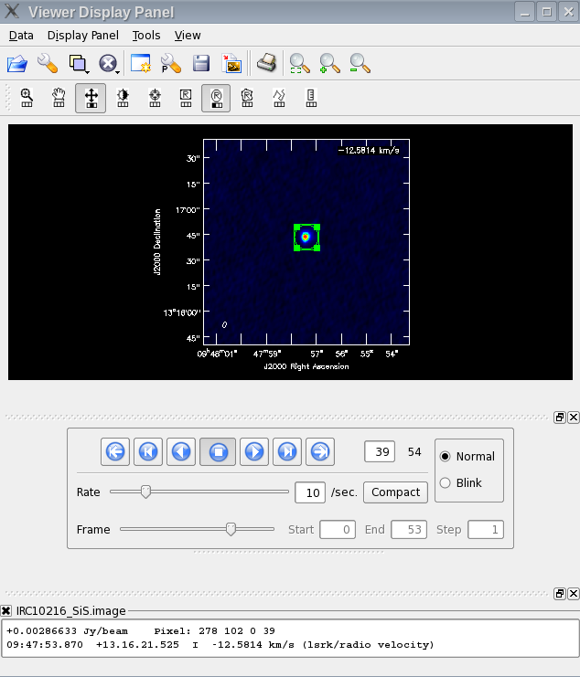
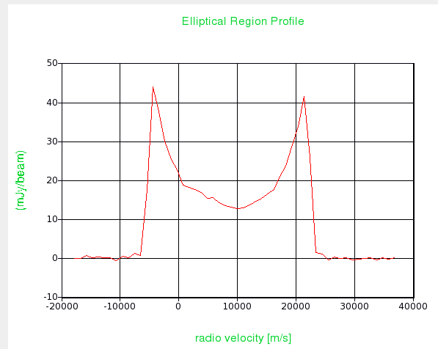
CASA: viewer
Tools → Spectral profile
Make a region to display the spectrum

Slide 47
CASA: immoments
15
Determine the channels with emission in the SiS image cube.
Make moment maps using the task immoments
default immoments
imagename = 'IRC10216_SiS.image'
moments = [0]
axis = 'spectral'
chans = '12~40'
outfile = 'IRC10216_SiS.mom0‘
go
Specify appropriate pixel ranges if necessary (through includepix and/or excludepix parameters).

Slide 48
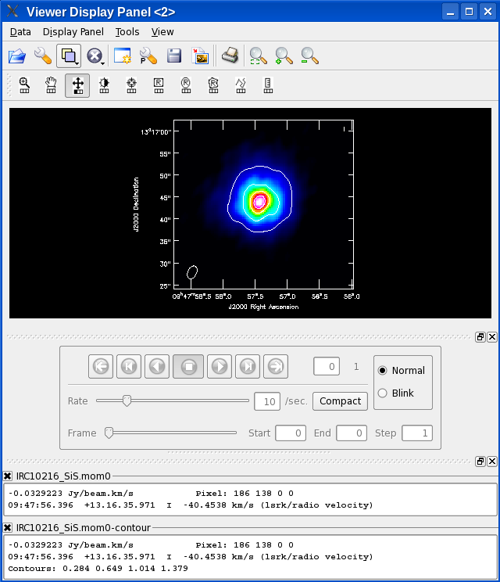
CASA: viewer
Start the viewer
Choose the moment 0 image.
Load as ‘raster image’.
Overlay contours.

Slide 49
Dates to Keep in Mind
2nd EVLA Data Reduction Workshop
  February 22-March 1, 2012, Socorro, NM
Synthesis Imaging Workshop
    May 29-June 5, 2012, Socorro, NM

