Slide 1
The Green Bank Observatory
National Radio Astronomy Observatory
Anthony Remijan (NRAO)
Slides from: Braatz, Frayer, O’Neil, Lockman, Hunter, Langston, and input from other NRAO staff.

Slide 2
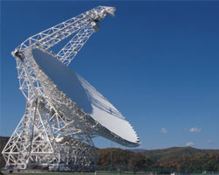
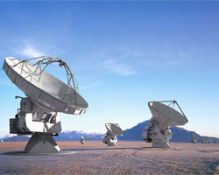
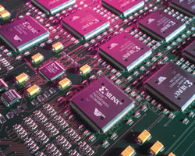
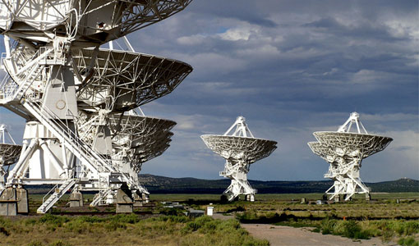
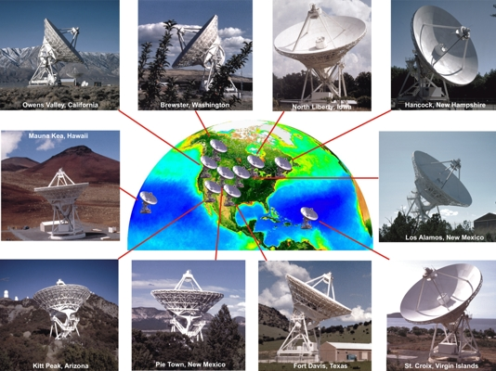
NRAO has complementary suite of telescopes and facilities
New Technology Center
(Charlottesville, Virginia)
ALMA
(Chile)
Green Bank Observatory
Expanded Very Large Array
(Socorro, New Mexico)
Very Long Baseline Array

Slide 3
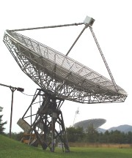
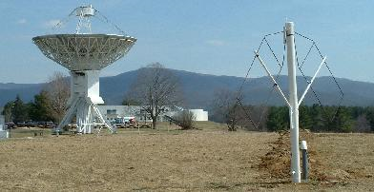
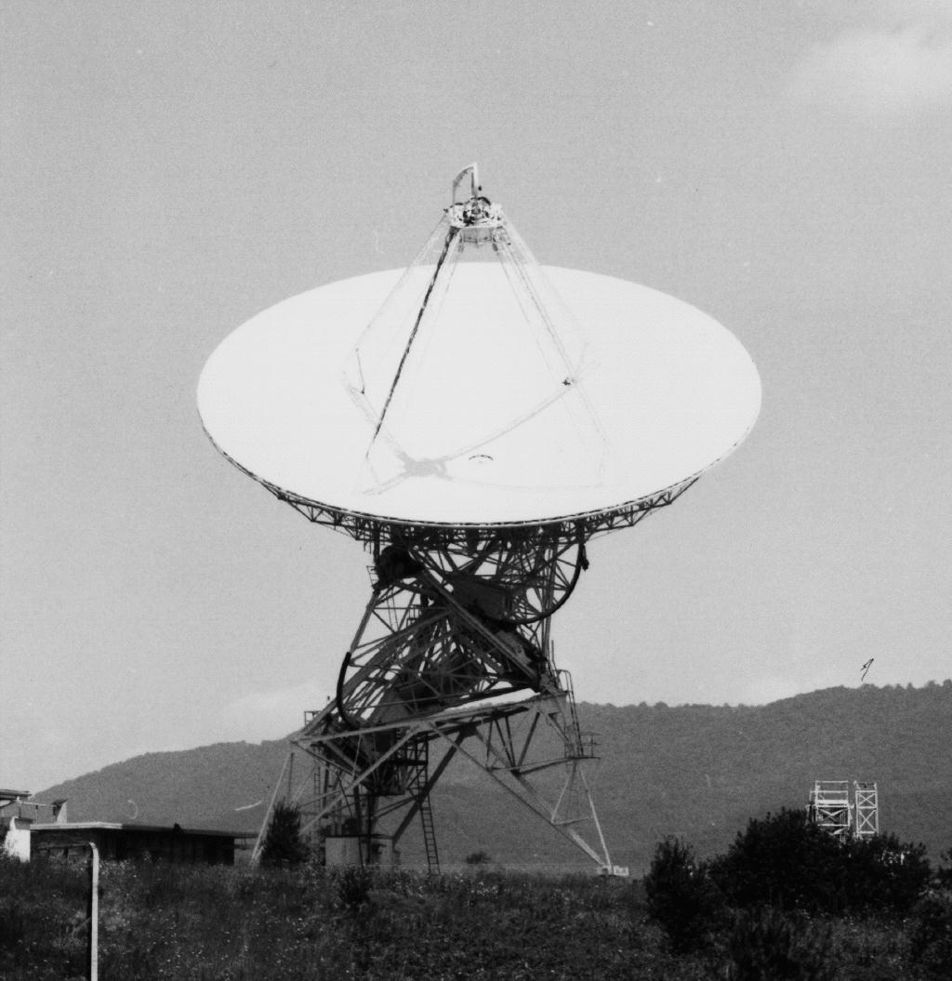
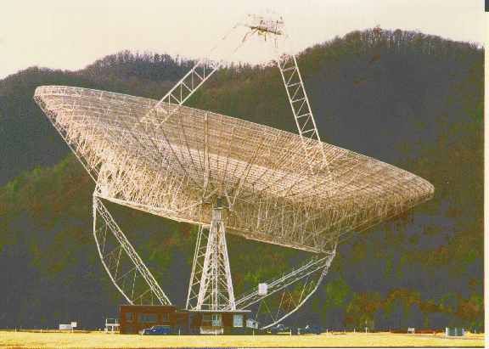
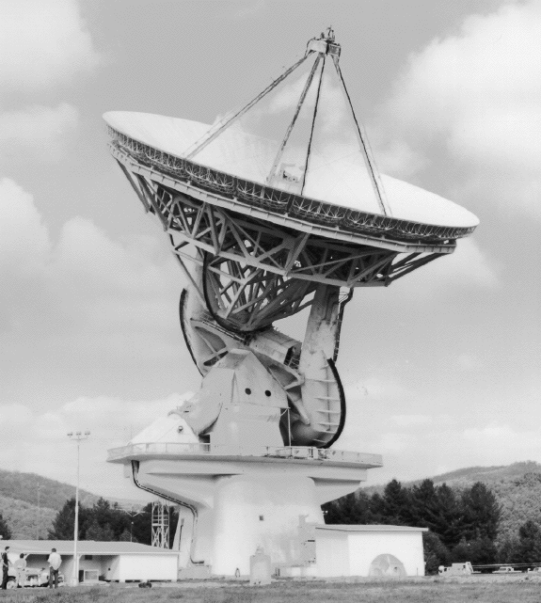
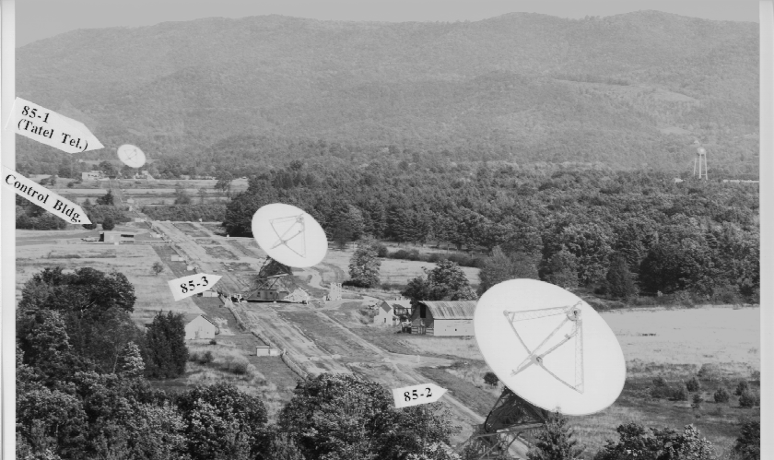
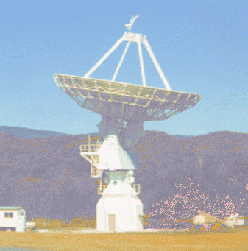
Green Bank is original NRAO site, with world class telescopes for >50 years
Completed 1995
Started 1958
Completed 1959
Completed
1962
Completed 1962
Completed 2000
Completed 1965
Completed 1967
Completed
1994

Slide 4
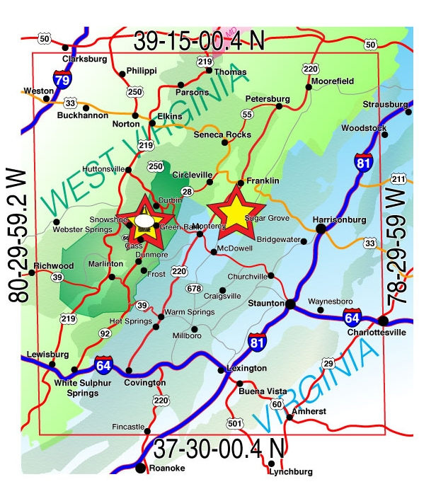
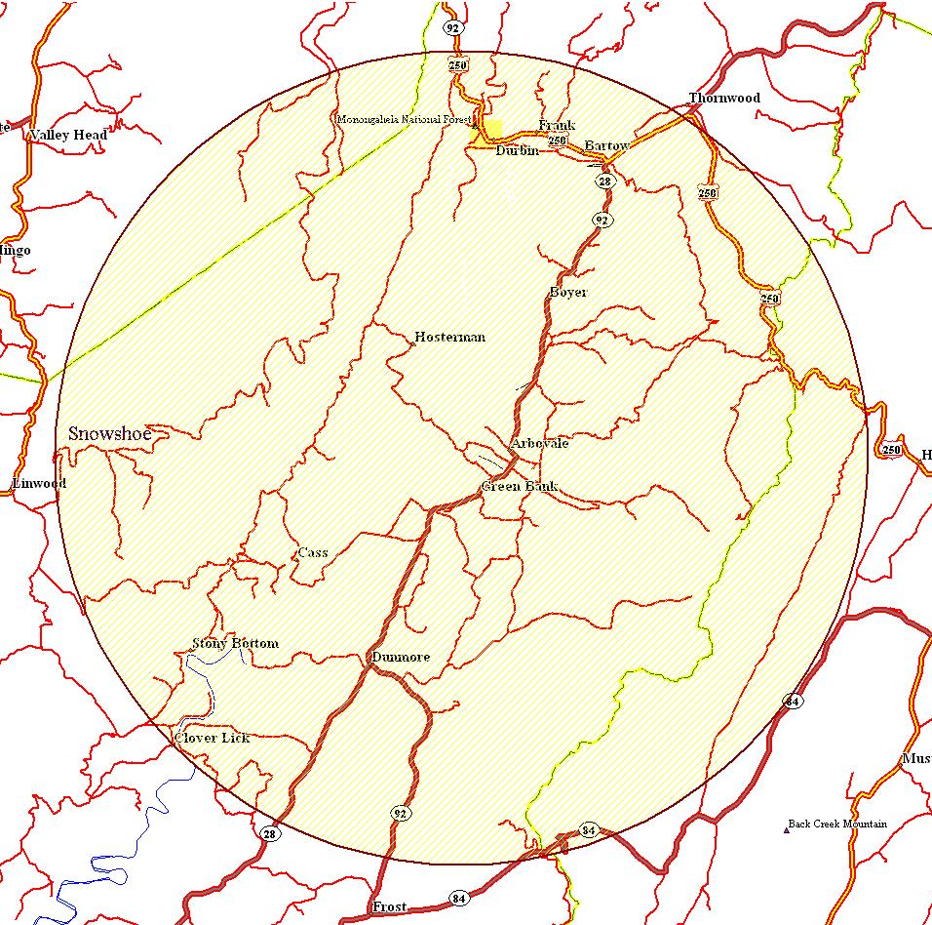
WV Radio Astronomy Zone
Established by the West Virginia Legislature (1956)
Protection within ten miles
of the Observatory
National Radio Quiet Zone
Established by the FCC and NTIA
(1957)
13,000 Square Miles

Slide 5
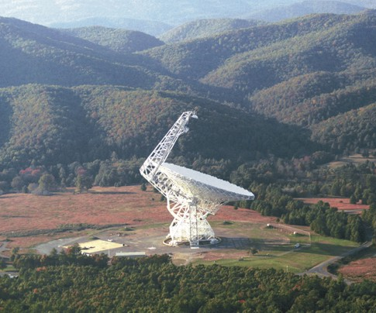

The Green Bank Telescope
100 meter Diameter
Unblocked Aperture
Active Surface
Operates from ~100 MHz to 100 GHz
Fully Steerable
>85% of total sky covered δ≥-46°
Pointing to 1”-2” accuracy
Surface good for 3mm work
Active Instrument Development Program
Site Protected by a 13000 km²
Radio Quiet Zone

Slide 6
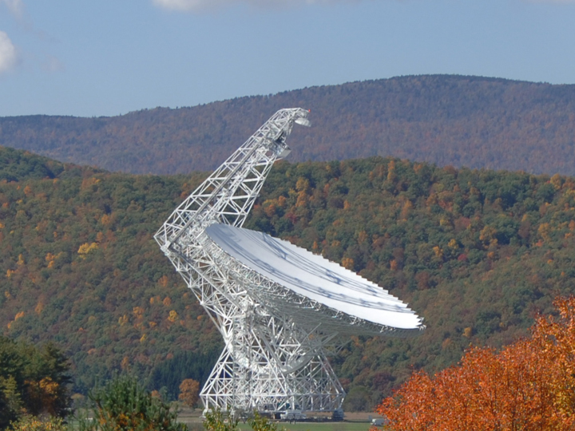

At 100 m, the GBT is the largest fully steerable telescope
and the largest movable structure in the world.
485 ft
2.3 acre collecting area
151 ft

Slide 7
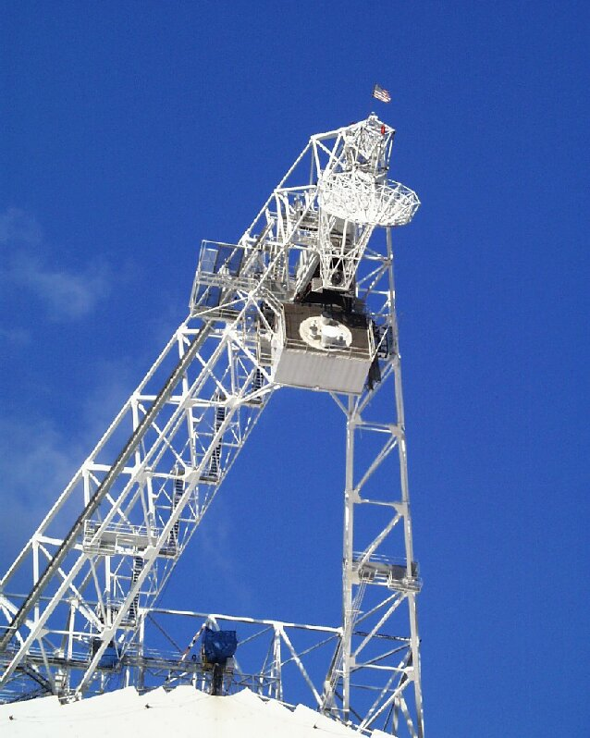
Eight slots in Gregorian receiver turret
Many projects are run each day

Slide 8
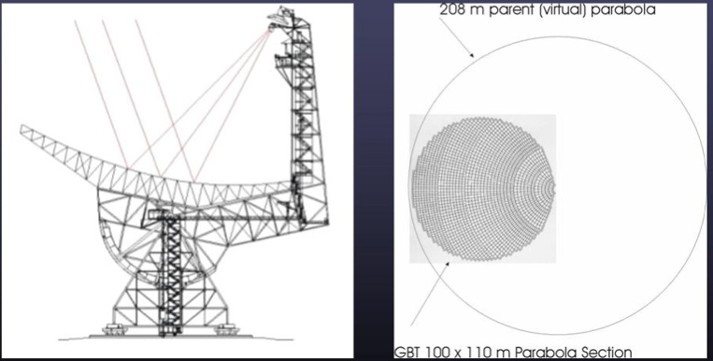
The Offset Paraboloid
8

Slide 9
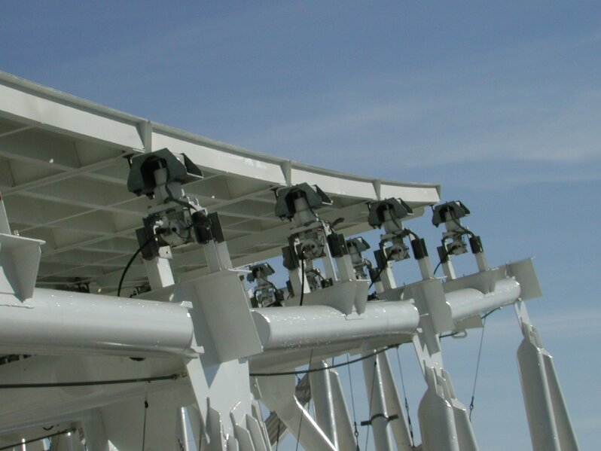
The Active Surface
2209 actuators
Currently rms < 240μm at night, the goal is 210μm
University of Georgia, Sept 2011
9

Slide 10
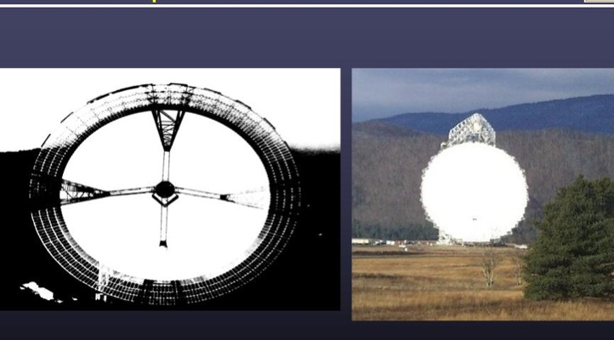
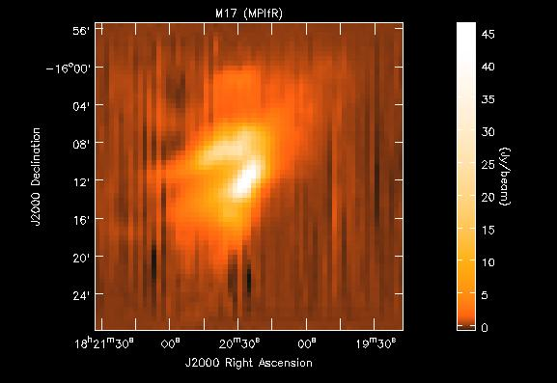
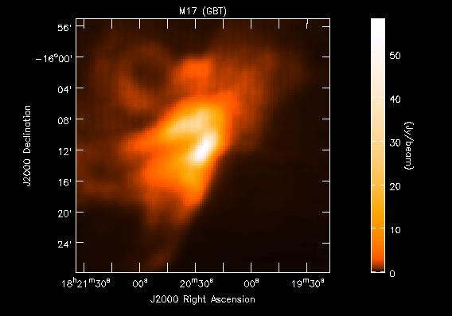
Unblocked Optics for High Dynamic Range
Villanova University, Sept 2011
10

Slide 11
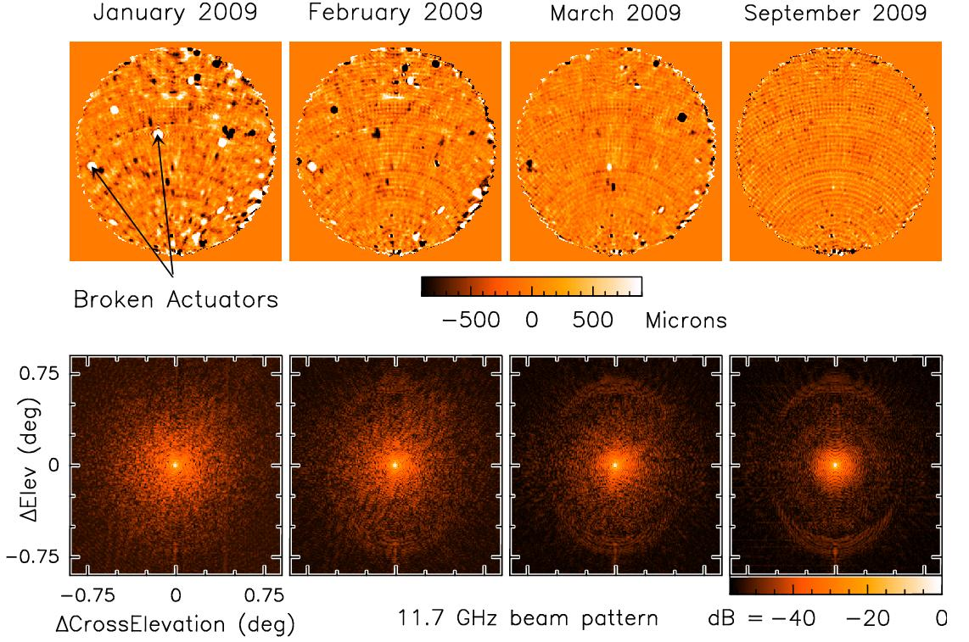
Improvements to Surface Makes 3mm Possible
(From Todd Hunter, PTCS group)

Slide 12
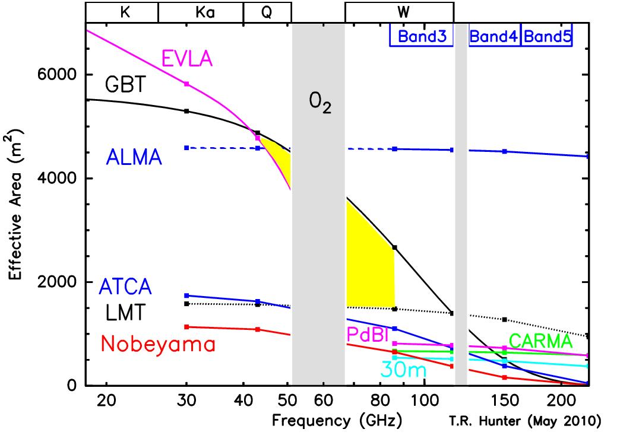
GBT Effective Collecting Area (η_{a} * Area)
Assumes current ~240um rms surface errors➔ 35% at 90 GHz
(still room for more gains)
➔ most sensitive facility at Q and W-low (4mm).

Slide 13
Some Key GBT Science Areas:
Pulsars: Surveys; timing
Neutral Hydrogen (HI): Masses of local galaxies, Kinematics of galaxy and local group/dark matter
High-redshift/Cosmology: Galaxy clusters, CO in the early universe, HI intensity mapping at high-redshift
Interstellar Organic Molecules/Astro-chemisty
Masers: black hole masses, distances to galaxies
Star Formation: NH₃ mapping
Basic Physics: The search for Gravitational Radiation, Limits on Fundamental “constants”
Solar system astronomy
13

Slide 14
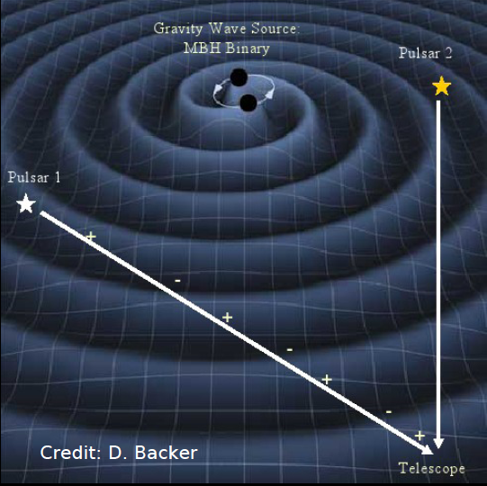
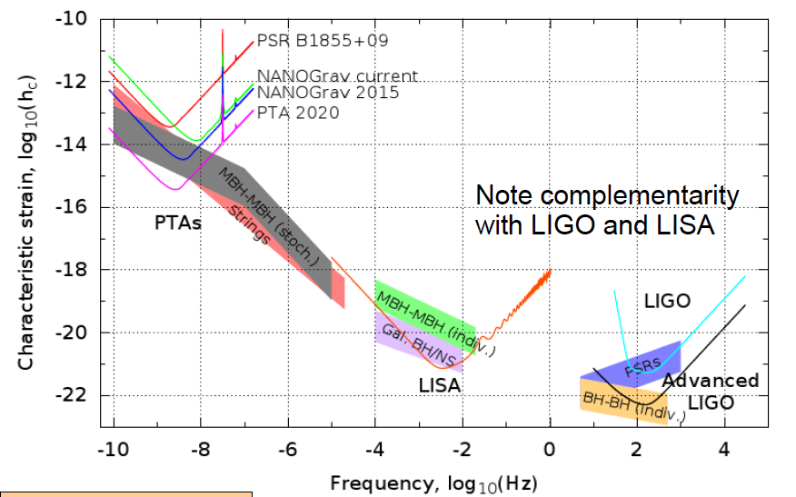
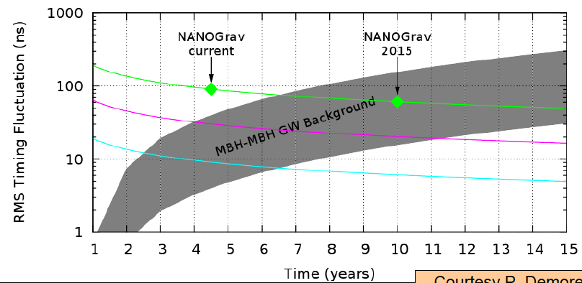

Fundamental physics
The race to detect gravitational waves
NANOgrav
Need 40 pulsars with <100ns timing residuals
Notes:
Cannot be done without GBT within any reasonable timescale; Needs GBT for instantaneous sensitivity, sky coverage
Nanograv status: We are timing 34 pulsars with Arecibo and Green Bank. Two pulsars have RMS residuals less than 100 ns. We require at least ~40 pulsars being timed at this level for GW detection

Slide 15
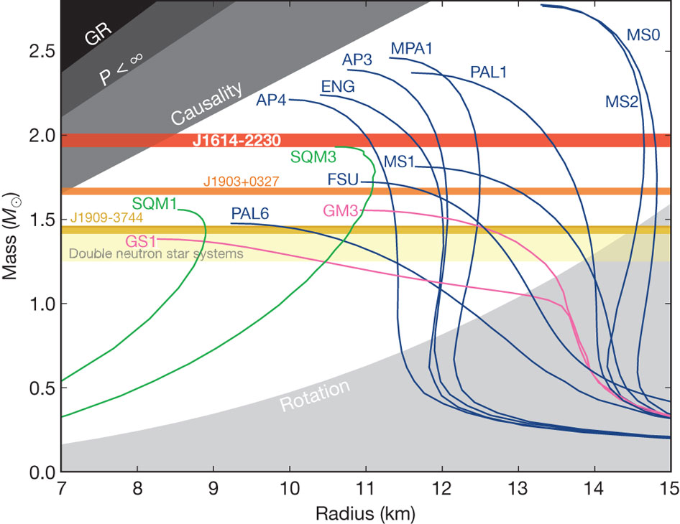
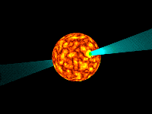
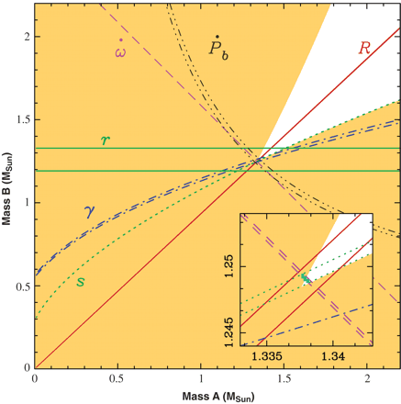
Fundamental physics
Testing matter at extreme densities
Additional pulsar timing results!
Detection of 2M_{sun} neutron star
Rules out many theories of matter at high density
Measuring binary pair eccentricity to test general relativity
Notes:
Needs GBT for instantaneous sensitivity, sky coverage
Image: Enough eccentricity such that we have already measured their orbital precession. The precession is likely
caused by general relativity and provides the total system mass (Mtot).

Slide 16
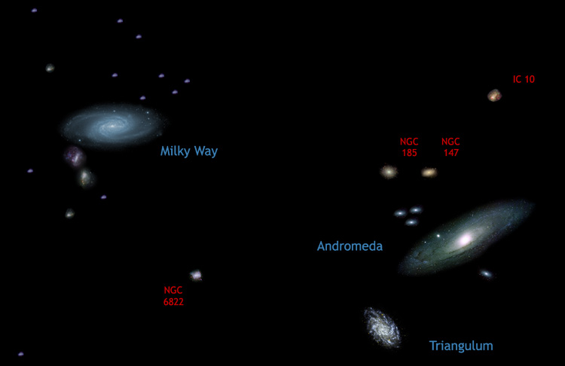
The Dynamics of the “Local Group” of Galaxies
(where is the dark matter?)
1 Mpc
16

Slide 17
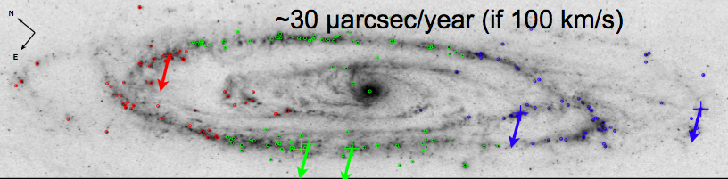
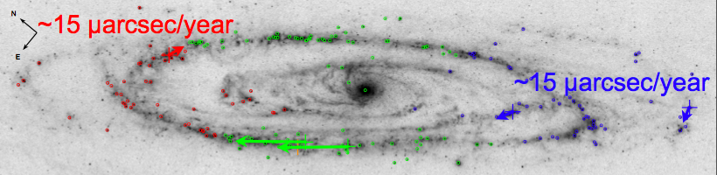
GBT Detection of H2O Masers in M31
J. Darling (2011)
Expect 6σ detection of proper motion in ~3 years
arrows not to scale
~70 μarcsec/year
Proper rotation gives a geometric distance -- expect 10% uncertainty initially

Slide 18
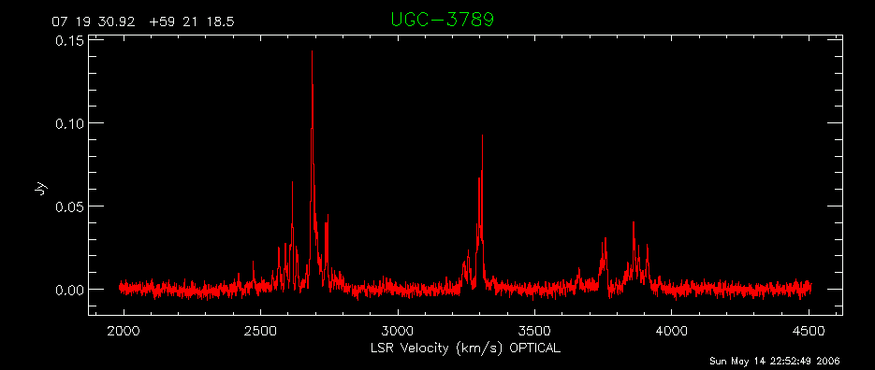
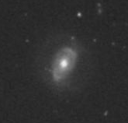
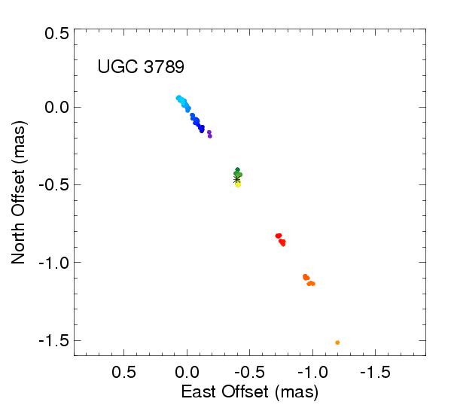
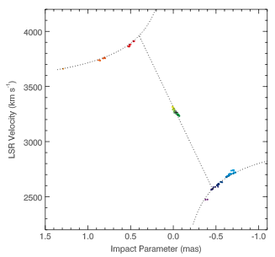
Megamasers provide gold standard M_{bh} and geometric measurement of H₀
Braatz et al. 2010; Reid et al. 2009

Slide 19
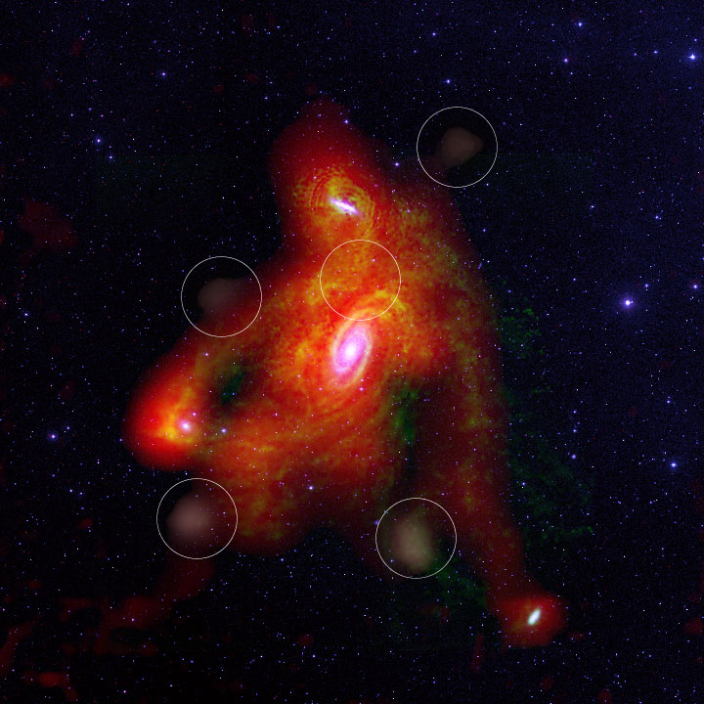
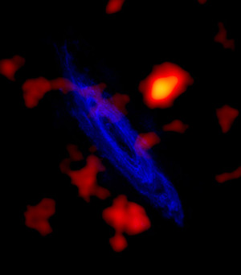
Local Galaxies and dark matter via HI
Chenowyth et al 2008
Westerbork + GBT
Thilker et al 2004 ApJ

Slide 20
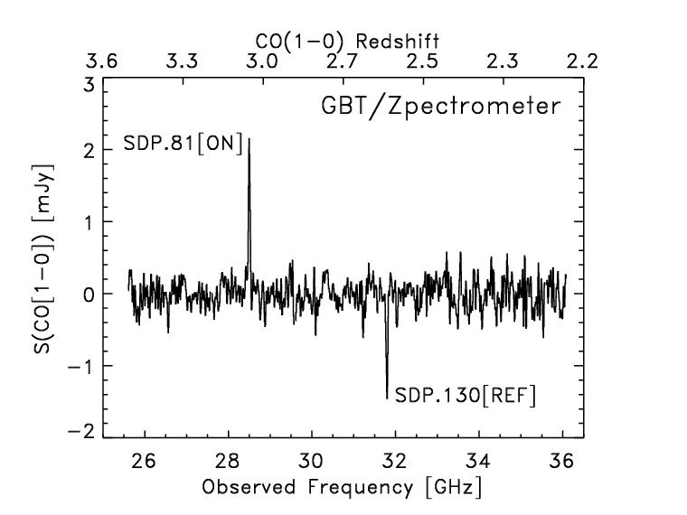
Studying star formation in the early universe via high-redshift CO
Frayer et al. 2011: Molecular gas measurements and redshifts of ultra-luminous infrared galaxies discovered by Herschel with the GBT/Zpectrometer.

Slide 21
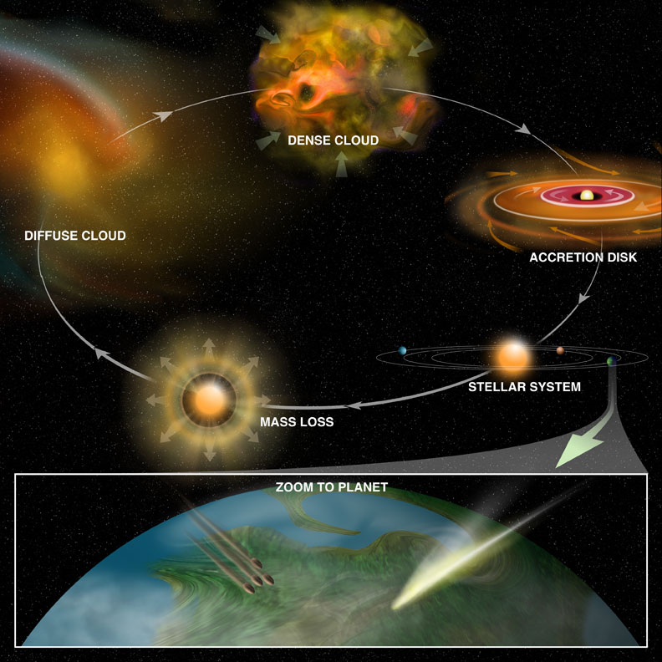
A telescope for interstellar chemistry
Connecting the chemistry of interstellar space with the chemistry of the solar system and the origin of life on earth.
“Like no other science, astrophysics cross-pollinates the expertise of chemists, biologists, geologists and physicists, all to discover the past, present, and future of the cosmos - and our humble place within it.”
- N. deGrasse Tyson
Notes:
We know that complex chemicals exist in interstellar space before stars and planets form. With the new research tools coming in the next few years, we're on the verge of learning how the chemistry of the interstellar clouds, the young stars and their environments, and the disks from which planets are formed is all linked together to provide the chemical basis for life on those planets

Slide 22
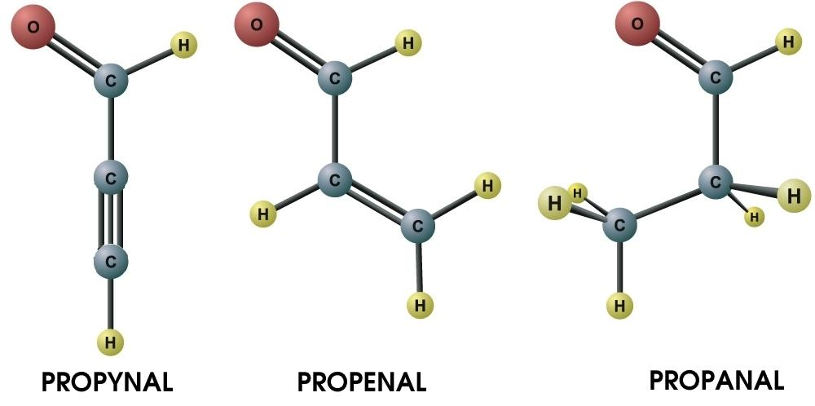
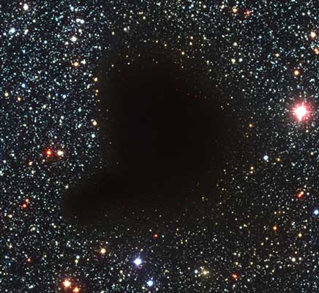
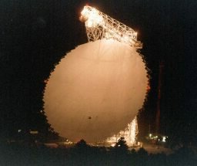
Organic chemistry in interstellar clouds
H2O (water)
H2CO (formaldehyde)
NH3 (ammonia)
CO (Carbon monoxide)
HCOOH (formic acid)
CNCHO (cyanoformaldehyde)
CH3OH (methanol)
CH2CHCN (vinyl cyanide)
HOCH2CH2OH (ethylene glycol)
CH3CO2H (acetic acid)
CH3CH2OH (ethyl alcohol)
CH2OHCHO (glycolaldehyde)
The GBT has detected 14 new interstellar organic molecules
including the first interstellar anions:
C6H⁻ & C8H⁻
(McCarthy et al 2006;
Cordiner et al 2011)
22

Slide 23
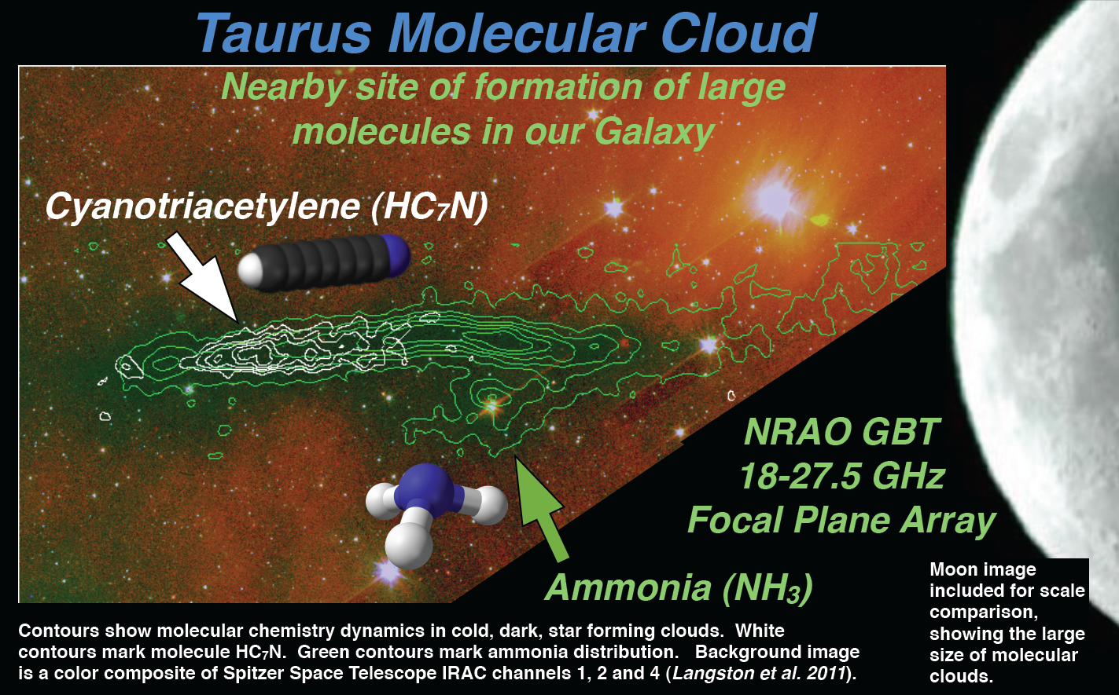
Mapping of Star-Formation Regions with the K-FPA

Slide 24
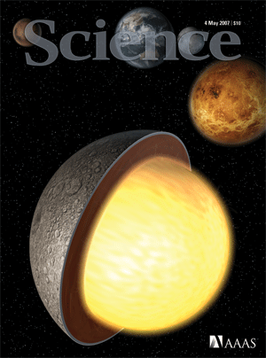
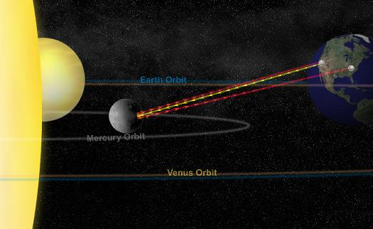
Radar observing to study the solar system
“No Evidence for Thick Deposits of Ice at the Lunar south Pole”
Campbell et al 2006 Nature
“Large Longitude Libration of
Mercury Reveals a Molten Core”
Margot et al. 2007 Science
Campbell & Campbell 2008

Slide 25
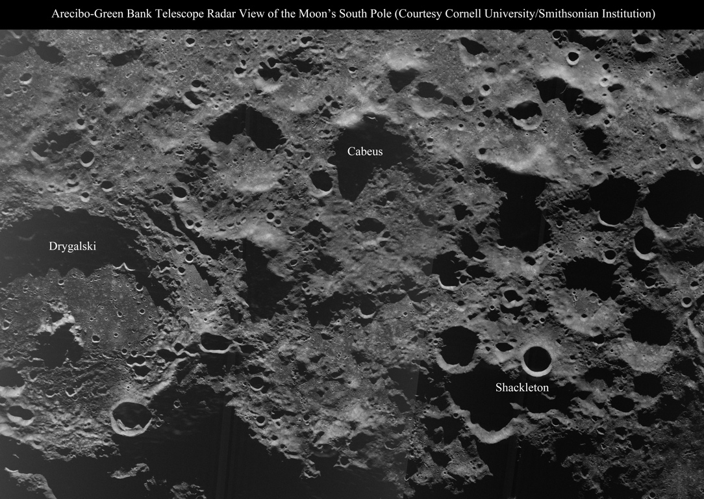
80 m resolution
20 km

Slide 26
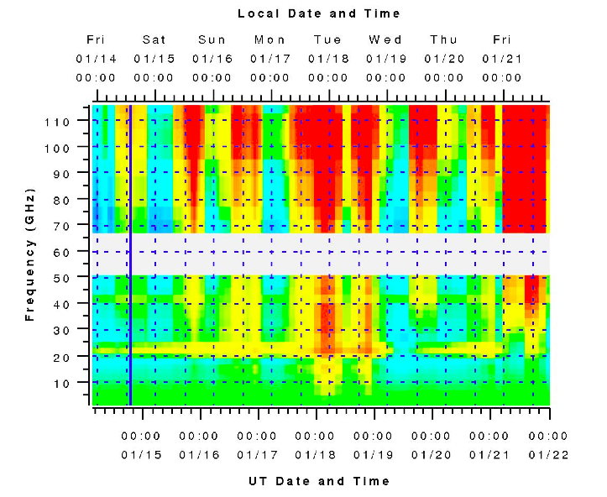
6500 hours a year scheduled
for astronomy
Dynamic Scheduling matches the project to the weather
In 2010 there were 1776 hours used at frequencies above 18 GHz
26

Slide 27
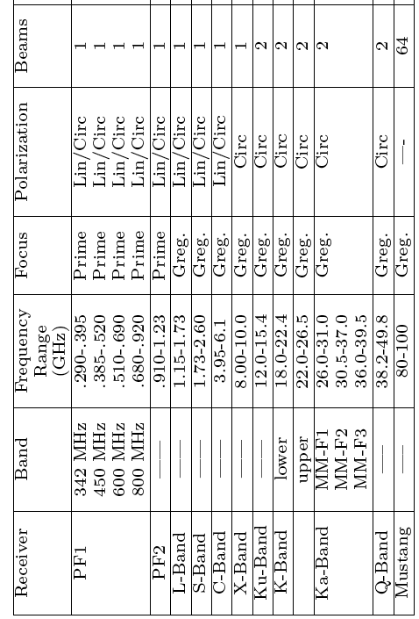
Current Instruments – Front Ends
Example lines:
HI, OH
NH3, HC5N, C2S, H2O
KFPA
-- 7
HCN, HNC, HCO+, HDO, DCN, SiO, SO2, H2CO, N2H+, N2D+, CH3CN, C2H
{W-band (4mm Rx) 67-93.2 Greg. Lin/Circ 2}

Slide 28

Current Instruments – Front Ends-2
--→68%
--→67%
----→65%
----→60%
--→35%

Slide 29
Backends/Spectrometers
Spectrometer with bandwidths: 800, 200, 50, 12.5 MHz. Maximum resolution is 49 Hz with 12.5MHz bandwidth. Minimum integration times 1-2 sec.
Spectral Processor (FFT spectrometer) for high-time resolution data (useful at low freq where RFI is an issue).
Continuum with DCR (digital continuum receiver) for most bands, CCB used for continuum at Ka, and Mustang for continuum at 90GHz.
GUPPI used for Pulsar Observations
VEGAS (VErsitile GBT Astronomical Spectrometer) is the new replacement for the Spectrometer available in 2012 (FPGA based).

Slide 30


VEGAS:
Supports 8 beams, dual polarization (e.g., K-FPA). Up to 16 windows (one beam), 8 windows (two beams).
Maximum continuous bandwidth of 10 GHz, eventually.

Slide 31

GBT Sensitivity Calculator for proposal estimates, also good for verifying available modes.

Slide 32



GBT’s Newest receiver: The 4mm Receiver (67-93.3 GHz). First Light, May 2011: HCN in Orion-KL
Commissioning
2011 Oct, Dec
See http://www.gb.nrao.edu/4mm for more details.

Slide 33
GBT Instrumentation:
Enabling a Wide-Range of Science.
Next Proposal Deadline 2012 Feb 01. Accepting shared-risk proposals for new instruments (see call for details posted on Jan 6, 2012.
67-93.2 GHz spectral line observations
80-90 GHz GBT+VLBI observations
More flexible spectrometer capabilities with VEGAS
New Ku 12-18 GHz Receiver
Expanded C-band coverage for 6-8 GHz (uncertain)

Slide 34




Outreach Opportunities:
Educators:
  Ongoing teacher training workshops
  Science education material for elementary
  through college levels
Students:
  Summer research programs, co-ops, internships
  Pulsar search collaboratory, Governor’s school
  NSF-NRAO REU summer research program
University research groups:
  Contact NRAO to collaborate on any of the planned/ongoing development programs
www.gb.nrao.edu

Slide 35
The End

Slide 36


Pulsars: neutron stars that are remnants of
massive stars that became supernovae
Radio image of the Crab Nebula
With a period ~10⁻³ s
over one year 3x10⁷ s
timing to a part in 10¹¹
36

Slide 37

The most massive known pulsar, J1614-2230
The new mass determination for PSG J1614-2230 makes it the most massive pulsar known, and rules out a number of soft equations of state for nuclear matter including many “exotic” hyperon, kaon models.
(Demorest et al. 2010)
Villanova University, Sept 2011
37

Slide 38

Using pulsars to detect gravitational radiation
Villanova University, Sept 2011
38

Slide 39

The NANOGrav Collaboration
nanograv.org
More pulsars need to be discovered
39

Slide 40


Black Holes in the centers of galaxies and structure of galaxy clusters ➔ constraints on Cosmology
Measurement of black hole masses in centers of galaxies and independent measurements of Ho (age and size scale of the universe) via H20 masers
Measurement clusters of galaxies via 3mm continuum observations
Notes:
Cosmic mileposts;
Measuring Sunyaev-Zel'dovich effect to determine the size and scale of galactic origins

Slide 41
More than just the GBT on site…
Eight Large Telescopes:
  GBT: 100m telescope open to all observers
  43m (140’): Bistatic radar experiments (MIT/Lincoln Labs)
  45’: Solar Radio Bursts monitoring (NSF ATM)
  40’: Education telescope, open to anyone (school/college groups)
  20m: Being recommissioned as part of RadioSkyNet (education!)
  85’: Three telescopes currently not in use
Additional Instruments:
  PAPER: Low frequency array (Berkeley/NRAO/UVa)
  Atmospheric monitoring array (FM signals)
  RFI monitoring station: monitor radio frequency interference
  Geomagnetic sensors (WVU)

