Slide 1
EVLA overview
Current and future capabilities
Michael P. Rupen
Project Scientist for the WIDAR Correlator

Slide 2
What is the EVLA?
A very quick introduction

Slide 3
28x25m antennas, 8 feeds, 0.035-36.4 km

Slide 4
28x25m antennas, 8 feeds, 0.035-36.4 km

Slide 5
28x25m antennas, 8 feeds, 0.035-36.4 km

Slide 6
28x25m antennas, 8 feeds, 0.035-36.4 km

Slide 7
28x25m antennas, 8 feeds, 0.035-36.4 km

Slide 8
28x25m antennas, 8 feeds, 0.035-36.4 km

Slide 9
28x25m antennas, 8 feeds, 0.035-36.4 km

Slide 10
28x25m antennas, 8 feeds, 0.035-36.4 km

Slide 11
Basic scientific capabilities

Slide 12
Sensitivity & frequency coverage
1 GHz
10 GHz
50 GHz
L
S
C
X
Ku
K
Ka
Q
Pull down 2 x 1 GHz (4 GHz) at once, within a given band
~20sec to change bands
Assumes all antennas fully outfitted

Slide 13
Receiver availability
1-4 GHz: new OMTs (better polarization performance)
8-12 GHz: wideband receivers
3-bit samplers: 2 x 8 GHz bandwidth. This has slipped by a few weeks

Slide 14
Angular resolution, largest angular scale, & field-of-view
4 configurations: A → big; D → small
~4 months in each configuration, cycling D C B A
(plus hybrids for southern sources)

Slide 15
WIDAR Overview
 | VLA | WIDAR-now | WIDAR-2013
Quantization | 3-level | 16-level | 16/256-level
# antennas | 27 | 28 | 32
Max. bandwidth | 0.2 GHz | 10 GHz | 16 GHz
# subband pairs | 1 - 2 | 1 – 48 | 1 – 64
# channels (total) | 2-512 | 256 – 32,768 | 256 – 4,194,304
Max./min. δν | 50 MHz / 381 Hz | 2 MHz / 122 Hz | 2 MHz / 0.12 Hz
dt_{min} | 1.7 sec | 0.1 sec | 0.01 sec
Max. data rate | 3.3 x 10³ vis/sec | 6 x 10⁶ vis/sec | 7.5 x 10⁶ vis/sec (1600-16000 x 10⁶ vis/sec)
Extras | Phasing VLBI Subarrays | Phasing Subarrays Auto-correlation | Phasing VLBI Subarrays Pulsar phase bins Burst mode Auto-correlation

Slide 16
Flexibility: truly independent subbands
64 independent Spectral Windows
Ability to make simultaneous continuum & multiple line measurements (e.g., L band, all at once:
continuum
galactic + extragalactic HI imaging & absorption
OH lines
>10 radio recombination lines)

Slide 17
Flexibility: truly independent subbands
64 independent Spectral Windows
Requires each subband be truly independent:
Tuning
Bandwidth (31.25 kHz – 128 MHz)
Number of polarization products (single, dual, full)
Number of channels
Trade time resolution for channels (recirculation)
Trade subbands for channels (hardware stacking)
Dump rates

Slide 18
Computing challenges
The EVLA produces a LOT of data: ~50 MB/s now, ~75 MB/s for this proposal cycle
1 hour= 180 GB @ 50 MB/s
Simply transferring the data is painful → internet or disks
Complete frequency coverage and wide bandwidths
Radio frequency interference (RFI) everywhere
Instruments vary (e.g., field-of-view goes as wavelength)
Sources vary (e.g., freq^2 → factor 4 different in flux over 2:1 bandwidth ratio)
Extremely sensitive → sidelobes and dynamic range issues
LOTS more science: lines, spectral shapes, polarization, mosaics, on-the-fly mapping

Slide 19
Dynamic scheduling
Everything is dynamically scheduled
Can’t tell exactly when your schedule will run, or what will have been observed just before that
Initial slew is uncertain
Scheduling is based on:
TAC priority (A B C, science, etc.) – i.e., competition
Current weather (rms phase, wind – by-band defaults, which you can override) – note we do not yet look at the ionosphere, weather predictions, solar activity, opacity, RFI
Efficiency

Slide 20
Dynamic scheduling
Getting on the telescope:
Get your observing schedules in early
Short blocks are easier…but require more overhead
Can request `filler’ time (short bad weather blocks) – note we are accepting much more Priority C than in the past
Daytime is harder (competes with commissioning, maintenance)
The weather changes during the year

Slide 21
Commissioning while observing
We are still commissioning the EVLA
Shared risk: we do our best, but we do sometimes make mistakes
Commissioning: we’re still putting the system together
Capabilities are not all there
We are still learning the best & most efficient ways to reduce the data
Ten steps forward, two steps back (hey, we’re getting better!)
The staff is very busy these days – be patient with us please!

Slide 22
Commissioning while observing
We take scientific/TAC priorities very seriously
We take Resident Shared Risk Observing very seriously (see next few slides)

Slide 23
Proposing for the EVLA
February 1, 2012 call for proposals

Slide 24
February 1, 2012 deadline
This call only: only BnA and A configurations
Covers 7sep12-7jan13
Regular, Rapid response, Filler proposals (<10 GHz, anytime, 30-60mins)
Key science
Proprietary period normally 12months since last observations
Please note:
Observing time includes overheads (flux, phase, bandpass calibration; slew time; dummy scans)
OSRO has become much more impressive (next slide)
Referees, scientific groupings, and TAC have changed
Joint proposals with Fermi, Chandra
Future calls: Feb 1, Aug 1
Exploratory/DDT proposals anytime (<=6 mos. proprietary period)

Slide 25
Open Shared Risk Observing (1feb12)
2 basebands
8 contiguous subbands per baseband (8x128-8x0.03125 MHz)
Full, dual, single pol’n products
Within a baseband all subbands have same BW, number of channels, pol’n products
Lower sensitivity at subband edges
No Doppler tracking

Slide 26
Resident Shared Risk Observing (1feb12)
Up to 25% of observing time
Full access to EVLA capabilities at the time of observing…
In exchange for helping us out with commissioning
Come to Socorro for at least 3 months (1 mo./10 hrs of obs time)
Work in commissioning group
Proposal includes a technical justification of your proposed commissioning work
Commissioning part of proposal is separately reviewed, after passing the scientific TAC
Possible areas: fast dumps, pulsars, VLBI, planetary observing, OTF mosaicking, automatic flagging, solar observing, advanced imaging algorithms and data analysis tools, pipeline, …

Slide 27
Resident Shared Risk Obs.
1feb12
deadline ➔
31dec12 Formal end of construction project

Slide 28
Resident Shared Risk Observing (1feb12)

Slide 29
What NRAO can do for you
After the proposal

Slide 30
Documentation on the Web
Go to www.nrao.edu, click on astronomer, then EVLA:
Observational Status Summary: basic introductory guide with (almost) everything in this talk, and more!
EVLA Exposure Calculator: how long does it take to get to 1microJy/beam?
FAQs: how much overhead do I need?
eNews: late-breaking news for our observing community
Data archive: all VLA, VLBA, EVLA data are accessible through the NRAO archive
Plus information on proposal submission, observing scripts, memo series, RFI plots and lists, data reduction…

Slide 31
Training
Community days
Berkeley, CA Jan 13, 2012
AAS splinter sessions & NRAO booth
Data reduction workshops
Caltech, CA Jan 19-20, 2012
Socorro, NM Feb 22-Mar 1, 2012
Synthesis Imaging Workshop (and books) every two years
Socorro, NM May 29- Jun 5, 2012
Single dish workshops in Green Bank, WV every other year
Lectures are on the Web
Visit NRAO
Observing & data reduction trips

Slide 32
Support
Travel support
Preprint and page charges
Large proposal/key science support
Students (undergraduate and graduate)
Summer students
Student observing support (also class observations in some cases)
Co-op program (undergraduates)
Graduate student internships
Graduate fellowships
Postdoctoral fellowships (Jansky and others)
Short- or long-term visits
PhD astronomers or radio engineers, preferably junior

Slide 33
NRAO staff
Helpdesk
E-mail, telephone
Wide variety of radio expertise
Data analysts
Software engineers
Hardware gurus
Scientific staff
Friendly (mostly), helpful (usually)
We really do like working in a national observatory
You can’t possibly have crazier ideas than we do

Slide 34
Some recent results (just for fun)
Recent demo/science results from the EVLA

Slide 35
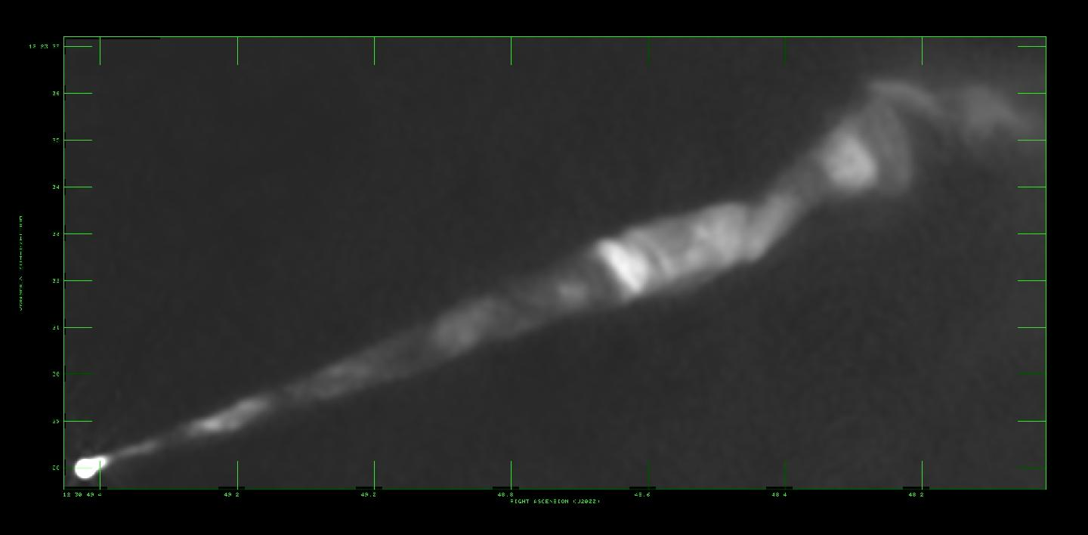
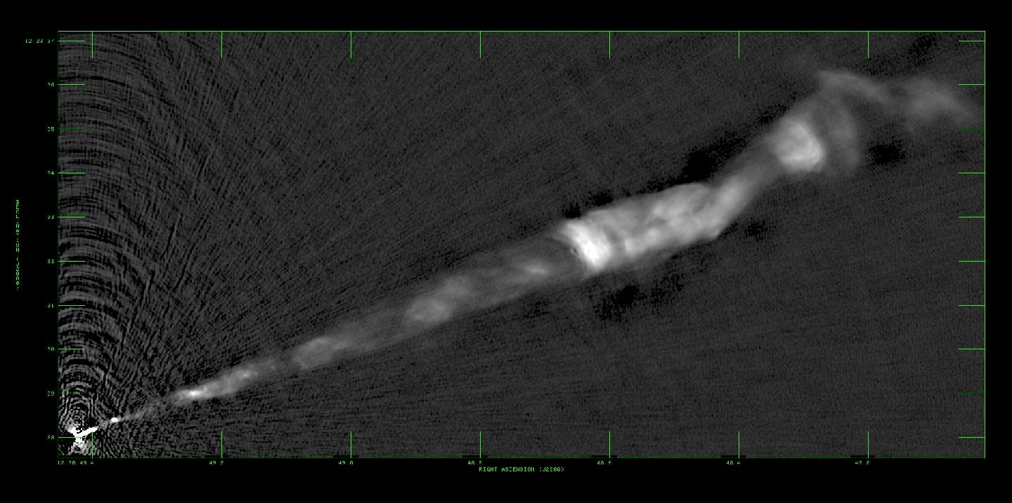
The jet of M87, then and now
VLA, 15 GHz, θ=0.15″
EVLA demo science: F. Owen
EVLA, 33 GHz, θ=0.05″

Slide 36
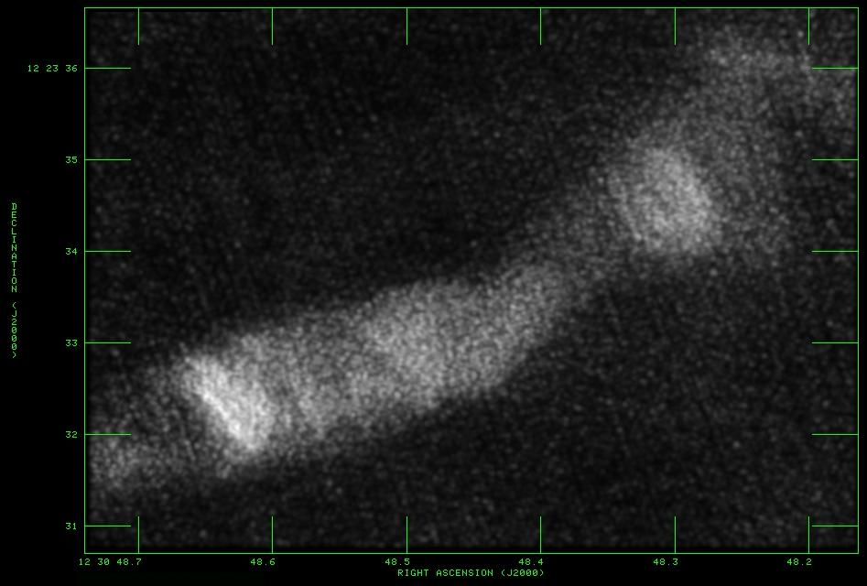
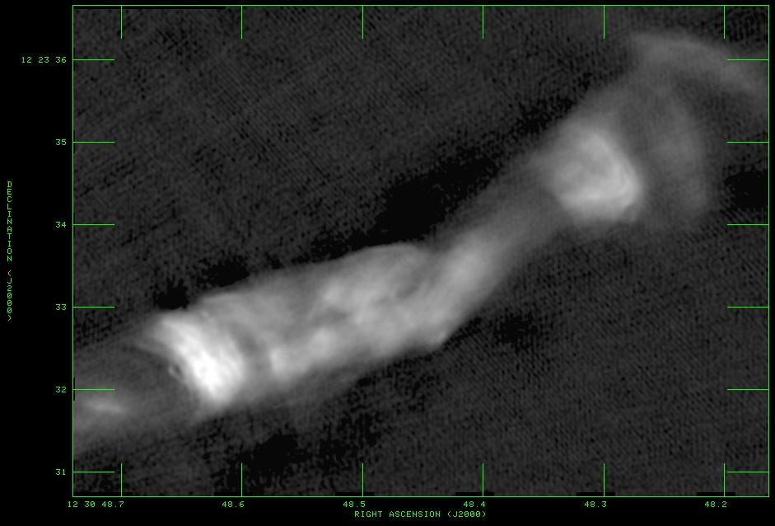
The jet of M87, then and now
VLA,
44 GHz
EVLA, 33 GHz
EVLA demo science: F. Owen

Slide 37
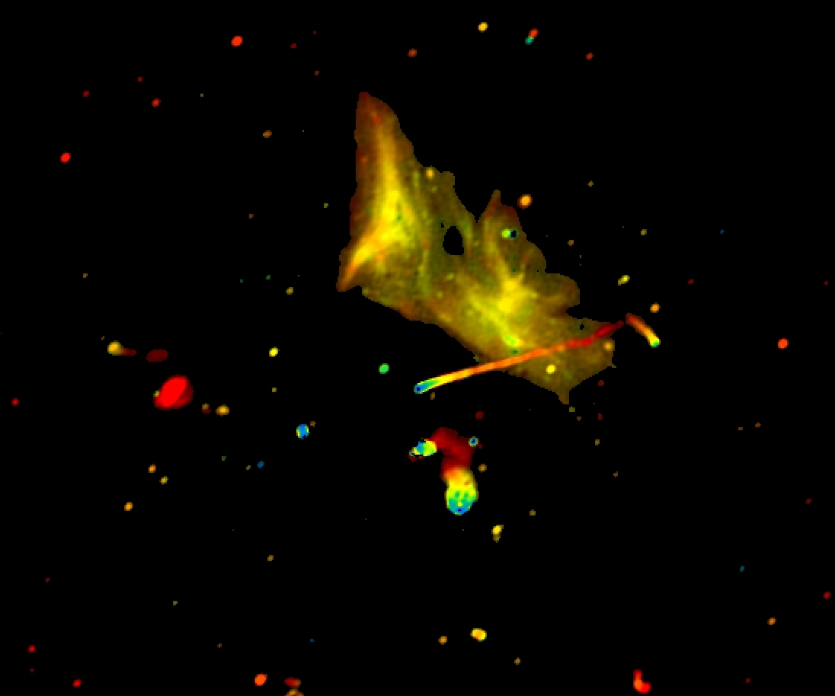
Relics and jets in Abell 2256
1–2 GHz, 20-arcmin on a side; color corresponds to spectral index (Owen, Rudnick, Eilek, Rau, Bhatnagar, Kogan)

Slide 38
SS433 @ 26 GHz: 12 ~weekly snapshots
Miller-Jones et al./demo science

Slide 39
IC10 (dwarf galaxy) at 6cm
Heesen et al.

Slide 40
Backup slides
Low frequencies
A few more pics

Slide 41
Below 1 GHz at the EVLA: receivers
Lowband: 58-84, 230-430 MHz
First receiver set in the lab being tested; 2nd in final stages of construction
An optimistic schedule of getting them on the array:
Jan 2012: 2
Mar 2012: 6
End 2012: 28
RSRO would really help, in the second half of 2012
Probably could get a bit of ToO time (<10hrs per project) on that timescale
Optimistically might hope for “regular” RSRO call in Aug 2012 (for 2013)
Pretty pics: http://www.aoc.nrao.edu/~pharden/LBR/lbr.htm

Slide 42
Below 1 GHz at the EVLA: feeds
Initially use the old 4, P band dipoles
Means special campaigns for lower band – upper should be available all the time
New feed based on Harun & Ellingson (Va Tech) is in the early stages of design
74 MHz dipoles:
http://www.aoc.nrao.edu/~pharden/LBR/PIX/pix.htm#74dipole

Slide 43
Below 1 GHz at the EVLA: pretty pics

