Slide 1
Project Summary
Eric J. Murphy, ngVLA Project Scientist

Slide 2
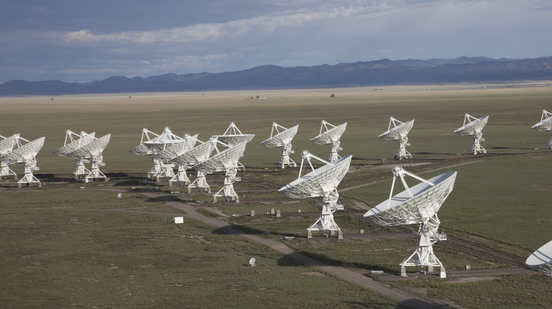
The Jansky Very Large Array
1972 – Approved by Congress
1975 – First Antenna in place
1980 – Full science operations
2001 – Complete electronics upgrade approved by NSF
2011 – Jansky VLA full science ops
Notes:
~12,000 refereed papers with ~500,000 citations
~500 PhD theses
The VLA has been among the most productive telescopes ever!
Major recent science:
FRB localization of completely unknown phenomena
distance record for atomic H in emission
Investigations of solar weather.

Slide 3
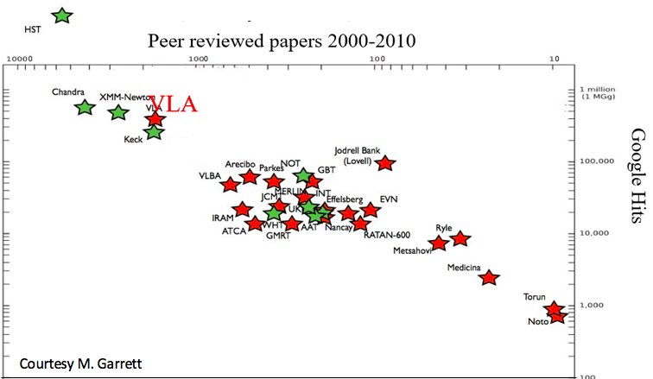
Radio Astronomy Powerhouse from 1980 to Present
~12,000 refereed papers with ~500,000 citations
~500 PhD theses
The VLA has been among the most productive telescopes ever!

Slide 4
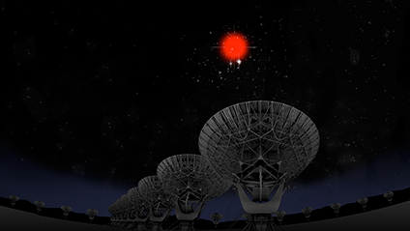
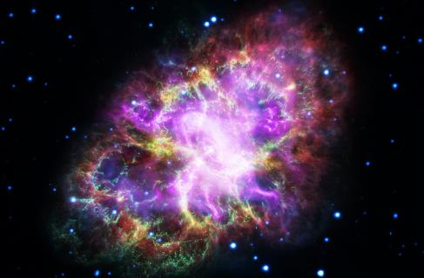
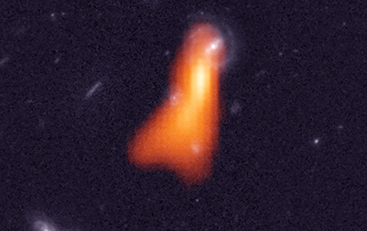
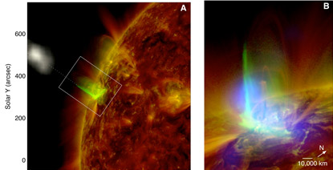
Still a Radio Astronomy Powerhouse: VLA Recent Discoveries
Precise Location of Fast Radio Bursts
A New View of the Crab Nebula
Distance Record (5 billion ly) for Hydrogen
Solar Flares as Particle Accelerators
Notes:
New view of Crab Nebula (VLA/Chandra/HST) to look at interactions between fast-moving particles and magnetic fields similar to structures seen on the Sun
FRB localization of completely unknown phenomena
distance record for atomic H, most abundant element in Universe
Radio telescopes can directly observe the sun -- how solar flares accelerate particles to learn about basic physical processes in extreme environments by Earth standards.

Slide 5
A next generation VLA
Scientific Frontier: Thermal imaging at milli-arcsecond scale resolution
Core Design Requirements
  10x effective collecting area of JVLA and ALMA
  10x resolution of JVLA and ALMA
  Frequency range: 1.2 –116 GHz
Located in Southwest U.S. (NM+TX) & Mexico, building from JVLA site
Baseline design remains under continuous development
Low technical risk (reasonable step beyond current state of the art)
https://science.nrao.edu/futures/ngvla
Notes:
Where we started… goals for the array.
Really was EVLA phase 2 (New Mexico Array)

Slide 6
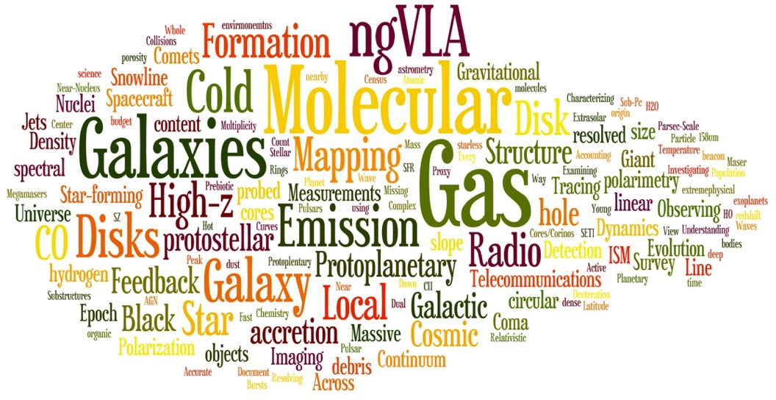
Developing the ngVLA Science Case
Community-Driven, Growing, and Evolving
Numerous Science and Technical meetings, starting from Jan 2015 AAS
Initial Science Working Group reports covering 4 broad areas, Nov .2015 (http://library.nrao.edu/ngvla.shtml)
  Cradle of Life: CoL (Isella et al): Terrestrial-zone planet formation, Massive Stars, etc.
  Galaxy Ecosystems: GEco (Leroy et al): wide field, high resolution/sensitive imaging
  Galaxy Formation: GFor (Casey et al): Dense gas history of the Universe
  Time domain, Cosmology, and Physics: TdCP (Bower et al): Plasma physics, Exo-space weather, Strong Lensing
26 Community Design Studies in progress, partially funded by NRAO (https://science.nrao.edu/futures/ngvla/ngvla-community-studies-approved-programs)
75 Community-Led Science Use Cases Submitted for ‘Reqs to Specs’ process (ngVLA memo # 18)
All gathered to report out and build toward a consensus vision last week of June in Socorro
Notes:
Went out to the community and asked them to investigate if there was a major science case for such a facility…
Major community effort.

Slide 7
Community-Led Advisory Councils
ngVLA Science Advisory Council
ngVLA Technical Advisory Council
Interface between the science community & NRAO
Recent/Current Activities:
  Science working groups: science use cases → telescope requirements
  SOC for science meeting in June 2017/2018
  Winter 2018 AAS Special Session
  Lead Science case development → ‘science book’ & DS2020 White Papers
Interface between the engineering & computing community and NRAO
Membership covers a broad range of expertise in relevant technical areas including:
  Antennas, low-noise receiver systems, cryogenics, data transmission, correlators, and data processing
Alberto Bolatto (University of Maryland: co-Chair)
Andrea Isella (Rice University : co-Chair)
Brenda Matthews (NRC-Victoria: SWG1 Chair)
Danny Dale (University of Wyoming: SWG2 Chair)
Dominik Riechers (Cornell: SWG3 Chair)
Joseph Lazio (JPL: SWG4 Chair)
James Lamb (Caltech : co-Chair)
Melissa Soriano (JPL : co-Chair)

Slide 8

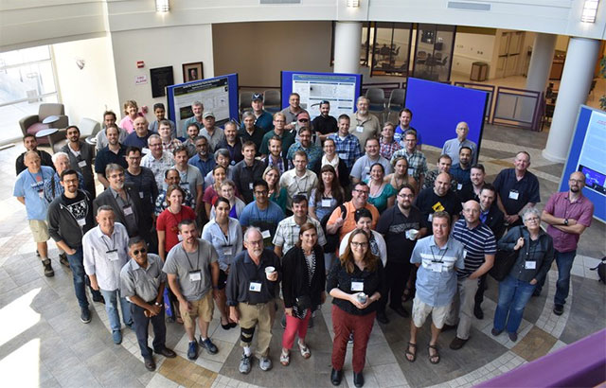
~ 150 attendees (capped with waitlist)
24 talks on innovative science allowed by the ngVLA
Followed by SAC face-to-face meeting
Main outcomes:
ngVLA preliminary telescope design
Definition of the Key Science Goals for the ngVLA
8

Slide 9
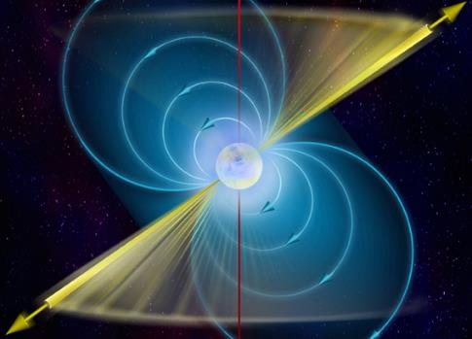
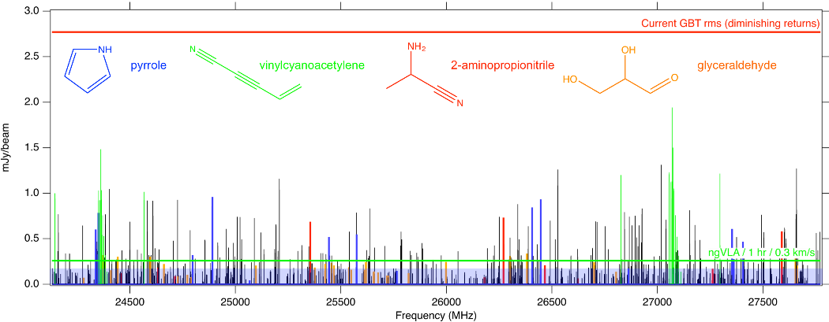
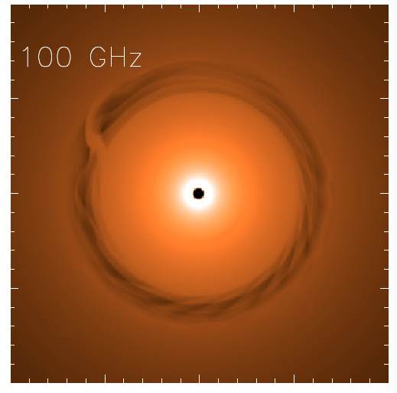
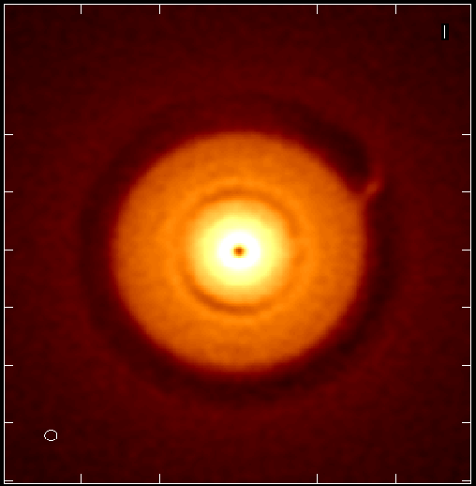
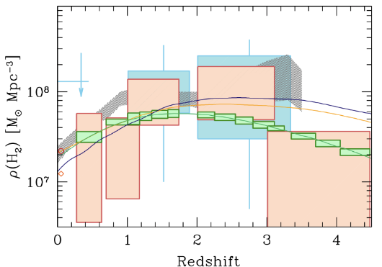
ngVLA Key Science Mission
(ngVLA memo #19)
Unveiling the Formation of Solar System Analogues
Probing the Initial Conditions for Planetary Systems and Life with Astrochemistry
Charting the Assembly, Structure, and Evolution of Galaxies Over Cosmic Time
Using Pulsars in the Galactic Center as Fundamental Tests of Gravity
Understanding the Formation and Evolution of Stellar and Supermassive
BH’s in the Era of Multi-Messenger Astronomy
Highly synergistic with next-generation ground-based OIR and NASA missions.
Jupiter @13AU
Saturn @6AU
ngVLA 100hr 25GHz 10mas
Gas
NGVLA
ALMA
Decarli+2016
0.1” = 13AU
Isella Dust Model
rms = 90nJy/bm = 1K
HI + CO(1-0)
CO(2-1)

Slide 10
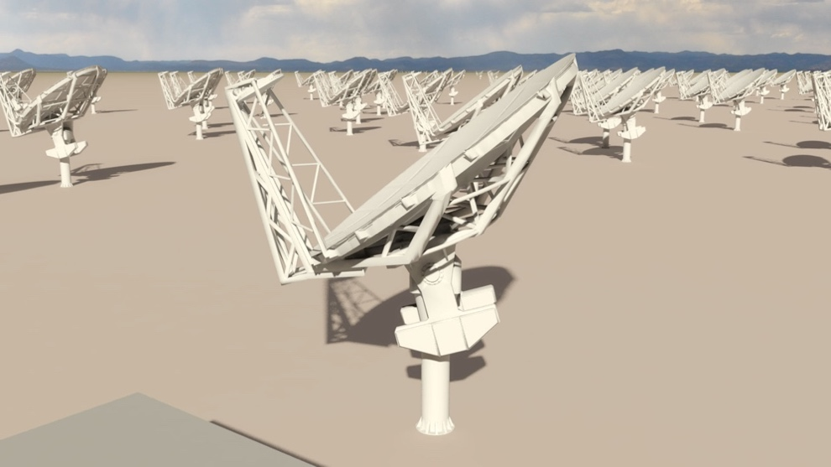
Current Reference Design Specifications
(ngVLA Memo #17)
214 18m offset Gregorian (feed-low) Antennas
  Supported by internal cost-performance analysis
Fixed antenna locations across NM, TX, MX
  ~1000 km baselines being explored
1.2 – 50.5 GHz; 70 – 116 GHz
  Single-pixel feeds
  6 feeds / 2 dewar package
Short-spacing/total power array under consideration
Receiver Configuration
Band # | Dewar | f_{L} GHz | f_{M} GHz | f_{H} GHz | f_{H}: f_{L} | BW GHz
1 | A | 1.2 | 2.55 | 3.9 | 3.25 | 2.7
2 | B | 3.9 | 8.25 | 12.6 | 3.23 | 8.7
3 | B | 12.6 | 16.8 | 21.0 | 1.67 | 8.4
4 | B | 21.0 | 28.0 | 35.0 | 1.67 | 14.0
5 | B | 30.5 | 40.5 | 50.5 | 1.66 | 20.0
6 | B | 70.0 | 93.0 | 116 | 1.66 | 46.0
Continuum Sensitivity: ~0.1uJy/bm @ 1cm, 10mas, 10hr => T_{B} ~ 1.75K
Line sensitivity: ~14uJy @ 1cm/bm, 10 km/s, 1” => T_{B} ~ 215K
Notes:
- Where we ended up based on a very successful meeting in June in Socorro.
- Registration was a oversubscribed.
- Included breakout sessions of SWGs.
- Settled on a reference design to focus on for DS2020.

Slide 11
ngVLA Memo #17
Next Generation VLA Key Performance Metrics
Parameter [units] | 3 GHz | 8 GHz | 17 GHz | 28 GHz | 41 GHz | 93 GHz
Field of View FWHM [arcmin] | 19.5 | 7.3 | 3.4 | 2.1 | 1.4 | 0.6
Aperture Efficiency [%] | 0.75 | 0.75 | 0.77 | 0.75 | 0.72 | 0.53
Effective Area, A_{eff,} x 10³ [m²] | 40.8 | 40.8 | 41.9 | 40.8 | 39.2 | 28.9
System Temp, T_{sys} [K] | 18 K | 22 K | 21 K | 31 K | 48 K | 87 K
Max Inst. Bandwidth [GHz] | 2.7 GHz | 8.7 GHz | 8.4 GHz | 14.0 GHz | 20.0 GHz | 20.0 GHz
Resolution of Max. Baseline [mas] | 69 | 26 | 12 | 7 | 5 | 2
Resolution FWHM @ Natural Weighting [mas] | 130 | 49 | 23 | 14 | 10 | 4
Continuum rms, 1 hr [μJy/beam] | 0.30 | 0.21 | 0.20 | 0.23 | 0.31 | 0.76
Line Width, 10 km/s [kHz] | 100.00 | 266.67 | 566.67 | 933.33 | 1366.67 | 3100.00
Line rms, 1 hr, 10 km/s [μJy/beam] | 49.9 | 37.3 | 23.8 | 28.1 | 37.5 | 61.3
Resolution [mas] | 1000
Continuum rms, 1 hr, Robust [μJy/beam] | 0.61 | 0.45 | 0.45 | 0.56 | 0.77 | 2.01
Line rms 1 hr, 10 km/s Robust [μJy/beam] | 100.1 | 81.7 | 55.4 | 68.0 | 93.2 | 161.6
Brightness Temp (T_{B}), RMS Cont., 1 hr, Robust [K] | 0.0823 | 0.0086 | 0.002 | 0.0009 | 0.0006 | 0.0003
T_{B} rms line, 1 hr, 10 km/s, Robust [K] | 13.53 | 1.55 | 0.23 | 0.11 | 0.07 | 0.02
11
Notes:
12.6xVLA @ 3 GHz, NA Weights (point source sensitivity)
22.0xVLA @ 41 GHz, NA Weights
6x-9x more sensitive than VLA at 1 arc sec. (Imaging sensitivity)

Slide 12
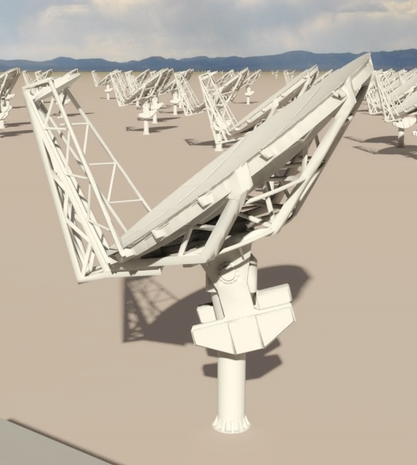
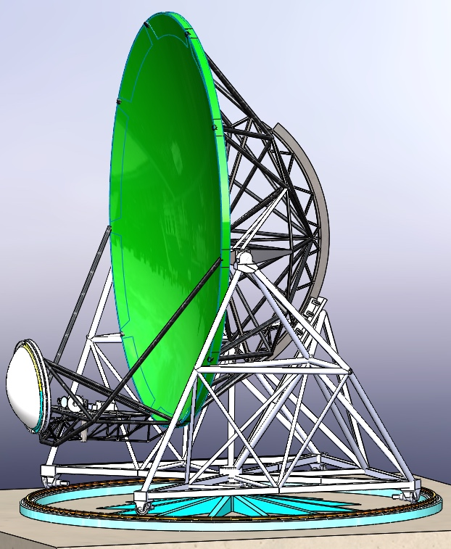
0
Antenna Concept
18m Aperture: Based on cost and performance modeling.
Offset Gregorian: Off-axis geometry minimizes scattering, spillover, and sidelobe pickup
Feed Low: Performance and maintenance requirements favor a receiver feed arm on the low side of the reflector
Mount concept: TBD.
  Evaluating pedestal mount vs wheel and track.
  Pointing specification is a design driver.
Pursuing antenna reference design this fall.

Slide 13
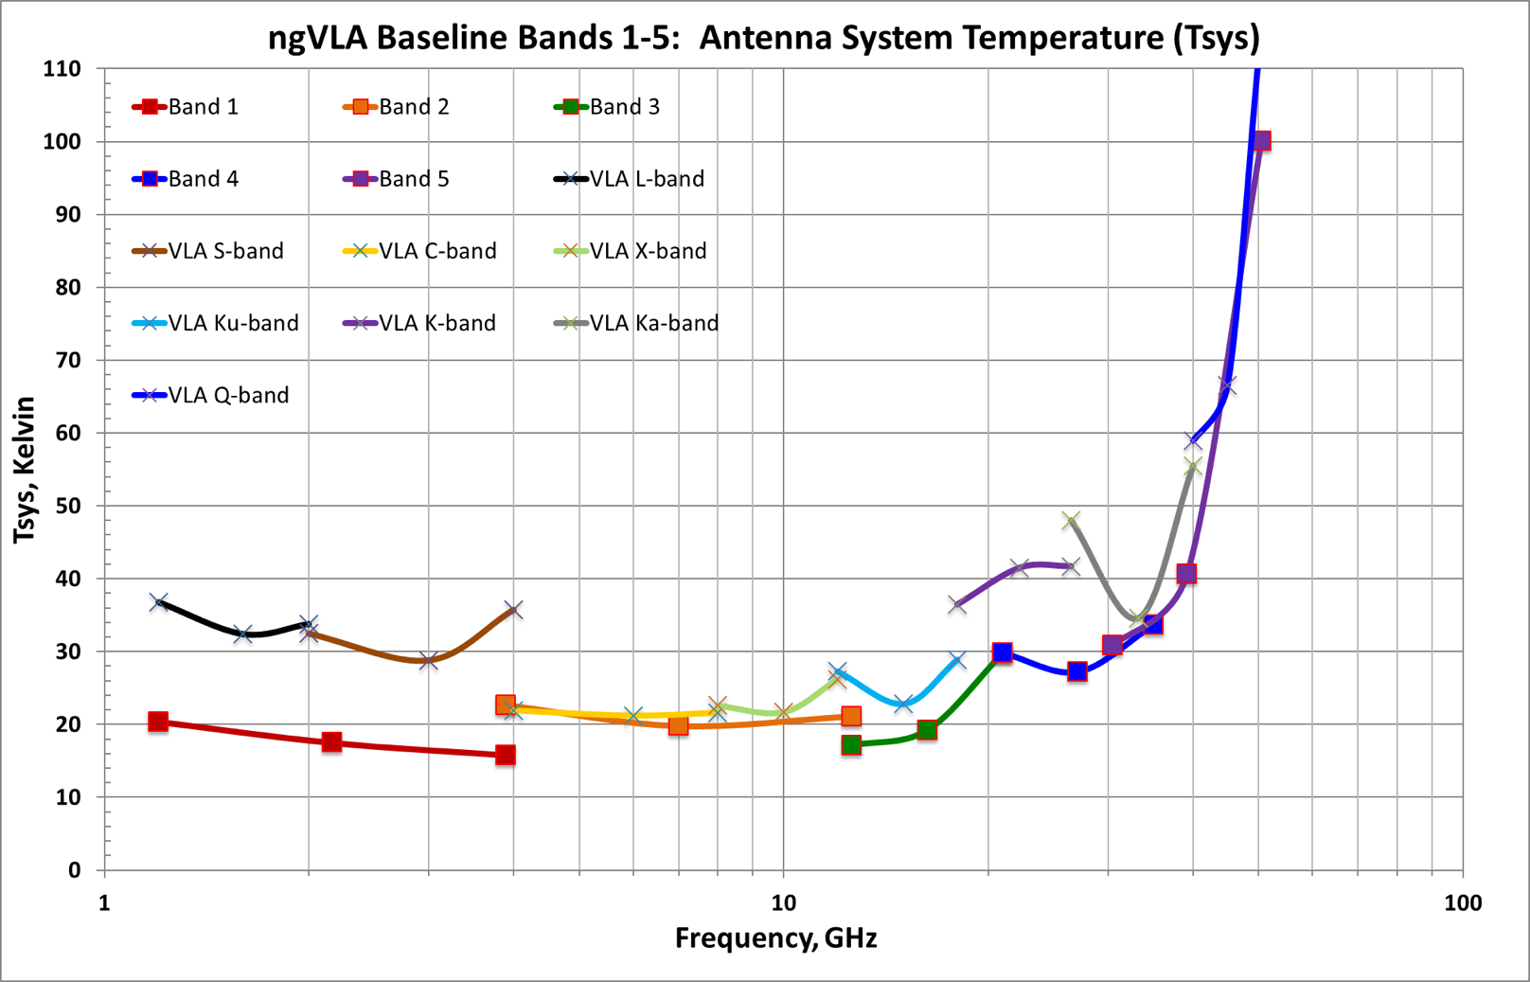
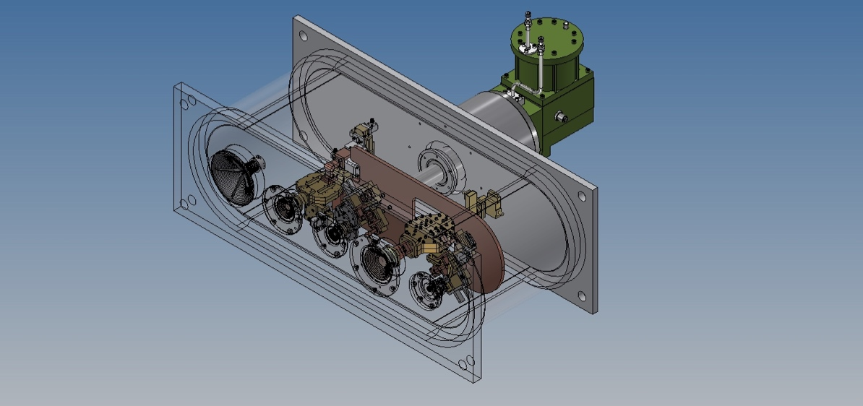
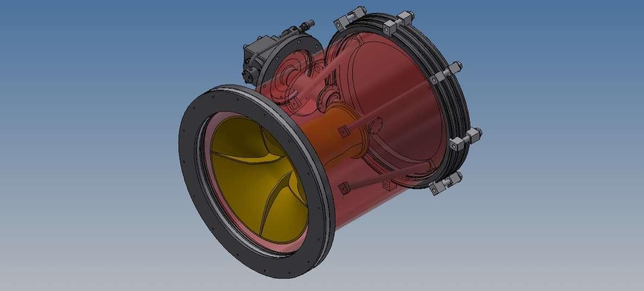
Receiver/Feed Configuration Concept
6 Bands in 2 Cryogenic Dewars
1.2-3.9 GHz and 3.9-12.6 GHz Quad-Ridge Horns, 3.25:1 bandwidth, coaxial LNAs.
12.6-50.5 GHz using three 1.67:1 BW corrugated horns and waveguide LNAs.
70-116 GHz 1.67:1 BW corrugated horn and waveguide LNAs with block down conversion.
Single stage down-conversion to baseband for 5 bands. Direct SSB or IQ sampling using modular devices @ FE.

Slide 14
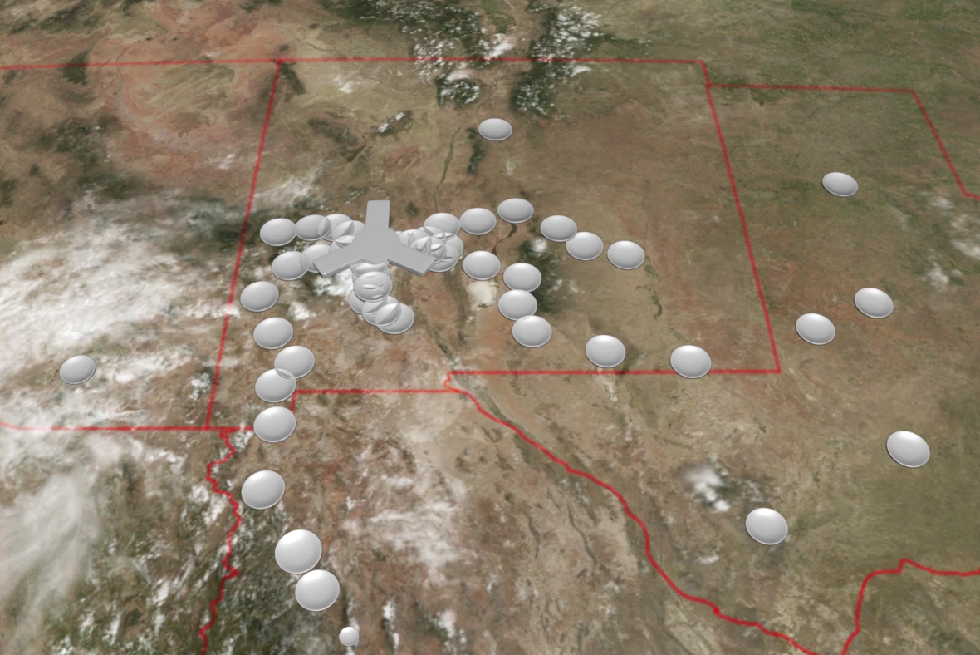
The ‘Southwest Array’
Location: U.S. Southwest, Mexico
Homogeneous array 214 x 18m, off-axis antennas
50% to core: b < 3 km => 1” at 30GHz
80% to mid: b < 30 km => 0.1”
100% to long: b < 1000 km => 0.003”
550 km
Nominal 18m homogeneous array
Consensus design
Challenge of tri-scale-array: Sensitivity vs. resolution
Options
Long baselines: continental VLBI
Short baselines: 16 x 6m array + 18m total power
350 miles

Slide 15

Computing Considerations
?
SCIENCE!
Analysis shows that for most use cases storing the raw visibilities will be tractable when ngVLA goes into operations.
  High time resolution science may not be able to save all visibilities.
  Depends upon continuation of the historic trend in cost of storage.
Computing problem is tractable for most cases, but not simple.
  Computing size requirements are set by lowest frequency band
    Low-frequency, full-beam, will require substantial computing resources – currently omitted from baseline design in order to constrain the cost/complexity of the system.
Current paradigm of reduction at home institution is unsupportable
  Data volumes prohibit multiple copies, moving data frequently.
  Computing resources required for most projects are greater than a single workstation / small cluster.
NRAO’s Science Ready Data Products project on ALMA and the VLA is a pathfinder for the techniques and technology needed to support the ngVLA as a Science Ready Data Product facility.

Slide 16
Project Office Status
Lean and Mean:
  Mark McKinnon (Project Director)
  Eric Murphy (Project Scientist)
  Rob Selina (Project Engineer)
  Full time project management support
  Ad hoc support from entire (~380 members) of NRAO
$11M in Development Funding for 2 yrs to take us to DS2020
  Contracting Antenna Design
  Level 0 Science Requirements Drafted
  Level 1 System Requirements Drafted
  Level 2 Antenna Specifications Drafted
Branding and new website late late Fall 2017

Slide 17
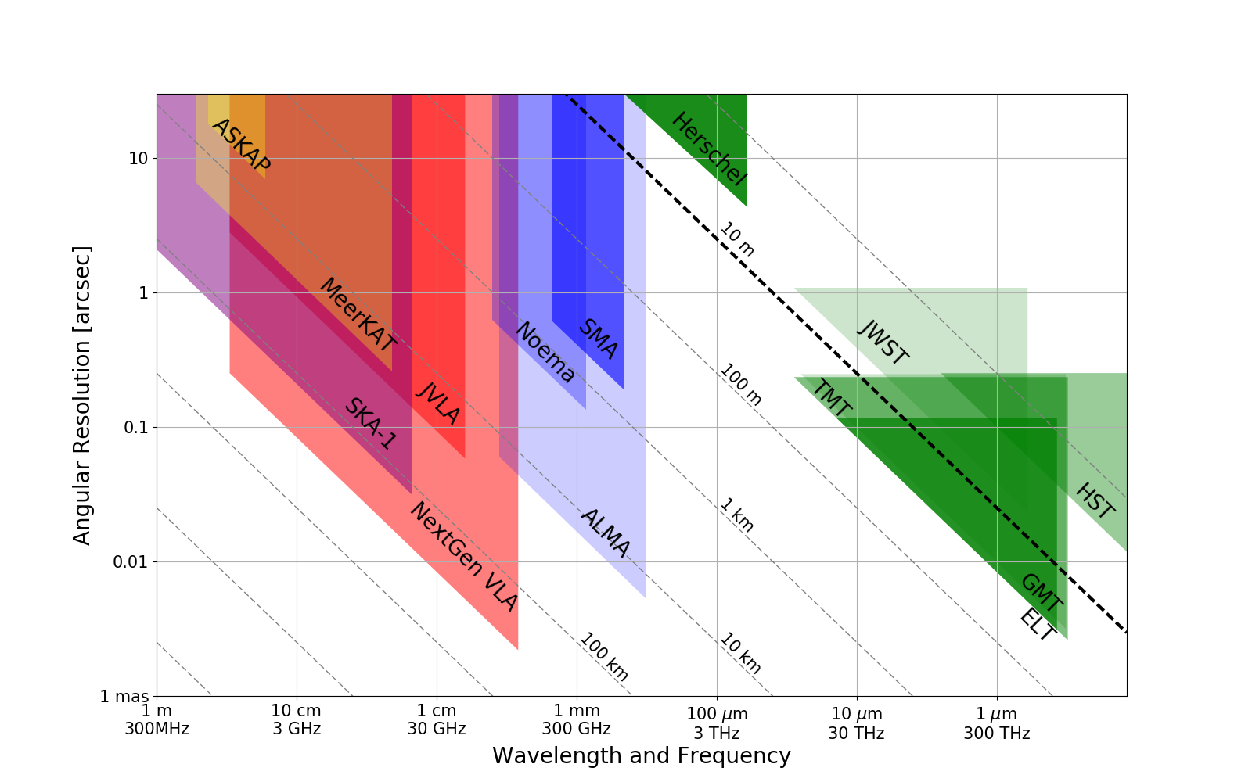
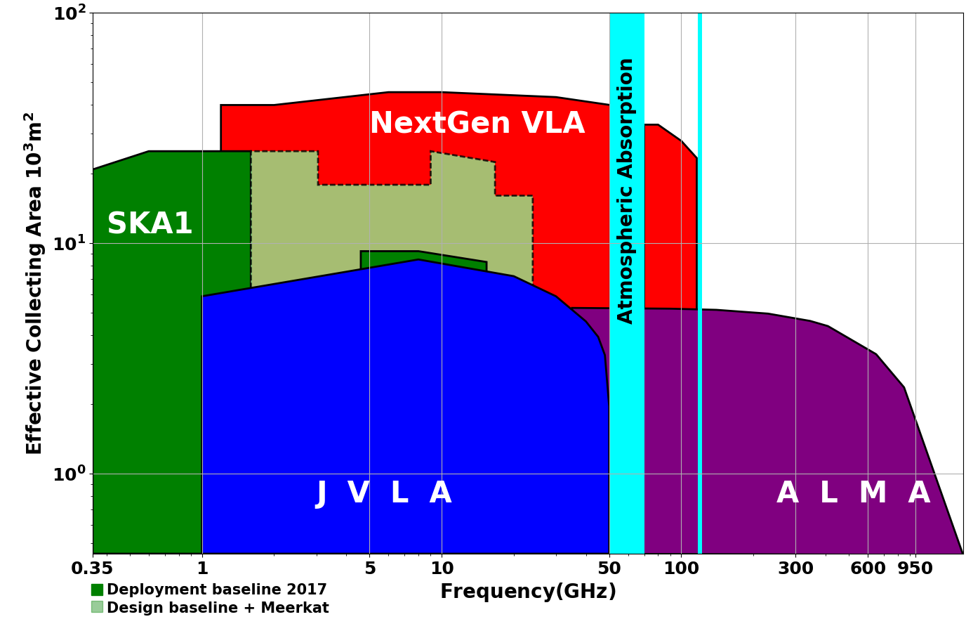
Bridging SKA & ALMA Scientifically
Thermal Imaging on mas Scales at λ ~ 0.3cm to 3cm
ngVLA Key Science Cases
Terrestrial zone planet formation: 1AU @ 140pc
Complementary suite from cm to submm arrays for the mid-21st century
< 0.3cm: ALMA 2030 superb for chemistry, dust, fine structure lines
  0.3 to 3cm: ngVLA ngVLA superb for terrestrial planet formation, dense gas history, baryon cycling
  > 3cm: SKA superb for pulsars, reionization, HI + continuum surveys
Notes:
Snapshot comparison of effective collecting area for dish-arrays expected in the 2030’s.
Assumes SKA deployment baseline (July 2017)
SKA 1
- 130 antennas, SKA bands 1, 2
- 67 antennas, SKA Band 5 a/b
MeerKAT:
- 64 antennas, bands 1, 2, 3
MeerKAT has receiver indexer with 4 slots

Slide 18
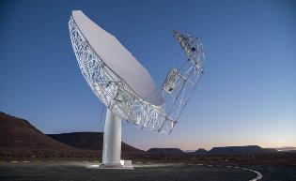
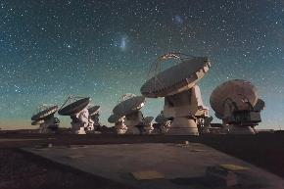
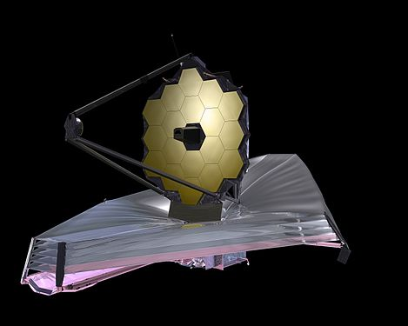
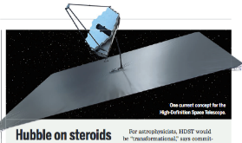
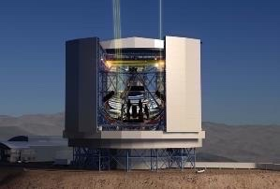
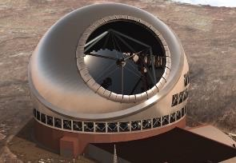
Highly Synergistic with Other Facilities on Similar Timescales
SKA
  Atomic/non-thermal
  Molecular/thermal
ALMA
  Warm/star-forming
  Cold/dense fuel for SF
LUVOIR/HabEx
  Image earth-like planets
  Image terrestrial-zone planets forming
OST (FIR surveyor)
  C/WNM & WIM
  Cold Molecular Medium
TMT/GMT
  Stellar Mass and Unobscured SF
  Dense Gas and Obscured SF
JWST
  Continuing its legacy in many areas of astrophysics

Slide 19
Five Key Science Goals for the ngVLA
http://library.nrao.edu/public/memos/ngvla/NGVLA_19.pdf
Unveiling the Formation of Solar System Analogues
Probing the Initial Conditions for Planetary Systems and Life with Astrochemistry
Charting the Assembly, Structure, and Evolution of Galaxies from the First Billions Years to the Present
Using Pulsars in the Galactic Center as Fundamental Tests of Gravity
Understanding the Formation and Evolution of Stellar and Supermassive Black Holes in the Era of Multi-Messenger Astronomy
19

Slide 20

Unveiling the Formation of Solar System Analogues
20

Slide 21
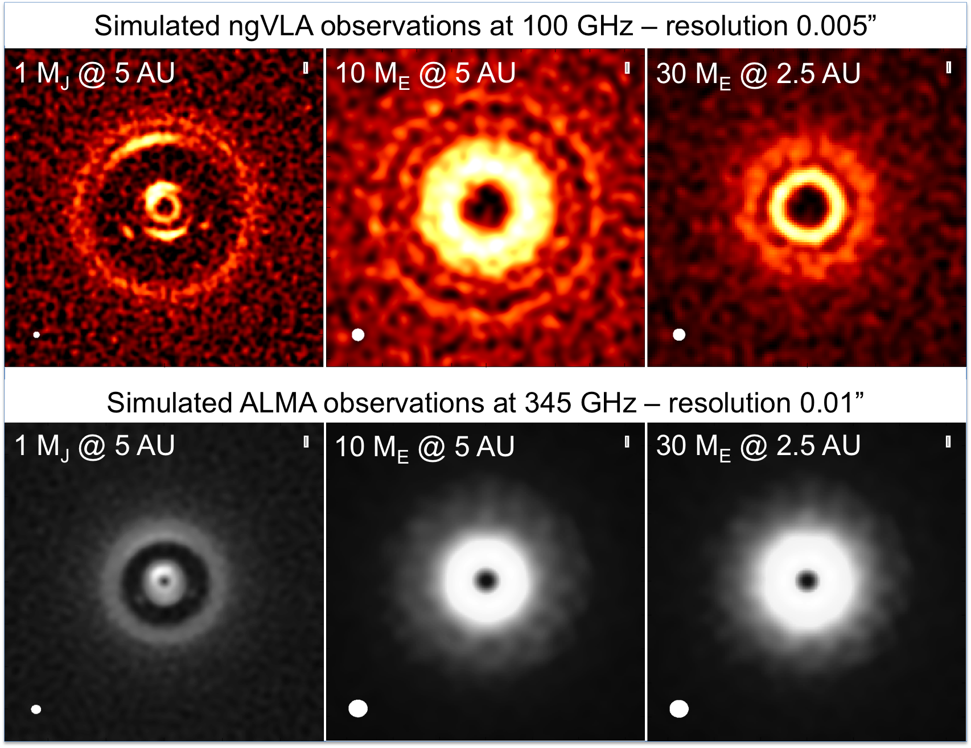
Unveiling the Formation of Solar System Analogues
  The ngVLA will measure the planet initial mass function down to a mass of 5-10 Earth masses and unveil the formation of planetary systems similar to our own Solar System.
  The ngVLA will reveal circumplanetary disks and sub-structures in the distribution of mm-size particles created by close-in planets. and will measure the orbital motion of these features on monthly timescales.
Luca Ricci et al. (in preparation)
21

Slide 22
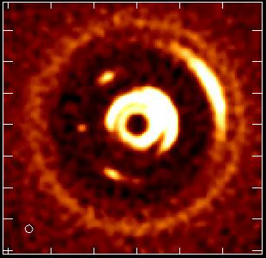
Unveiling the Formation of Solar System Analogues
  The ngVLA will measure the orbital motion of planets and related features on monthly timescales.
Simulated 100 GHz ngVLA observations of a newborn planetary system comprising a Jupiter analogue orbiting at 5 AU from a Solar type star.
Luca Ricci et al. (in preparation)
22

Slide 23
Probing the Initial Conditions for Planetary Systems and Life with Astrochemistry
  The ngVLA can detect complex pre-biotic molecules and provide the chemical initial conditions in forming solar systems and individual planets
Credit: Brett McGuire (NRAO)
23
Notes:
This is a simulation of ~30 complex organic molecules, not currently detected in the ISM, but which are good candidates for detection. I have highlighted in colors example of these molecules which are important for understanding chemical evolution (e.g., increasingly complex carbon-nitrogen chains), probing chirality (e.g., glyceraldehyde), are part of largely unknown cyclic/aromatic chemistry (e.g. pyrrole), or are excellent candidates for being direct precursors to amino acids and other biogenic species (e.g. aminopropionitrile).
The simulation assumes that the emission is coming from a compact, 1" hot core in Sgr B2(N), from molecules with column densities of 10^12 - 10^14 cm-2, at T = 200 K, and with a linewidth of 3 km/s.
The simulation does *not* contain any currently-detected species, meaning that a real spectrum in this frequency range would have many, many bright lines off the scale of this graph.
The red horizontal line is the ~rms of the current GBT PRIMOS observations. These suffer greatly from beam dilution, as the 1" source is diluted in a 30" GBT beam. This rms is about what we can reasonably get with reasonable integration times at the GBT. Drilling deeper will take far longer than is feasible for a survey.
The green line is taken from the ngVLA tech specs page for line sensitivity at 10 km/s in 1 hr, degraded for 0.3 km/s channels.
The blue shaded region is the area in which I project, from a statistical analysis of the PRIMOS observations, we will hit line-confusion in this frequency range. There is little point in integrating more than 3 sigma deeper than this.
So what are the take-away messages here?
1) the ngVLA will almost certainly provide access to a wealth of new molecular detections of molecules similar to the representative species shown here
2) the ngVLA in reasonable integration times (say 4-20 hours) should hit line confusion in this most molecularly-rich galactic source at the 3 sigma level, something that the GBT and (J/E)VLA cannot hope to accomplish.

Slide 24
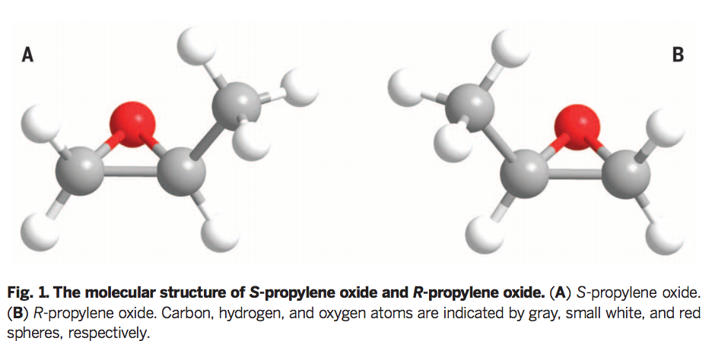
Probing the Initial Conditions for Planetary Systems and Life with Astrochemistry
Discovery of the interstellar chiral molecule propylene oxide
(CH3CHCH2O)
Chyrality
McGuire et al. (2016, Science)
24

Slide 25
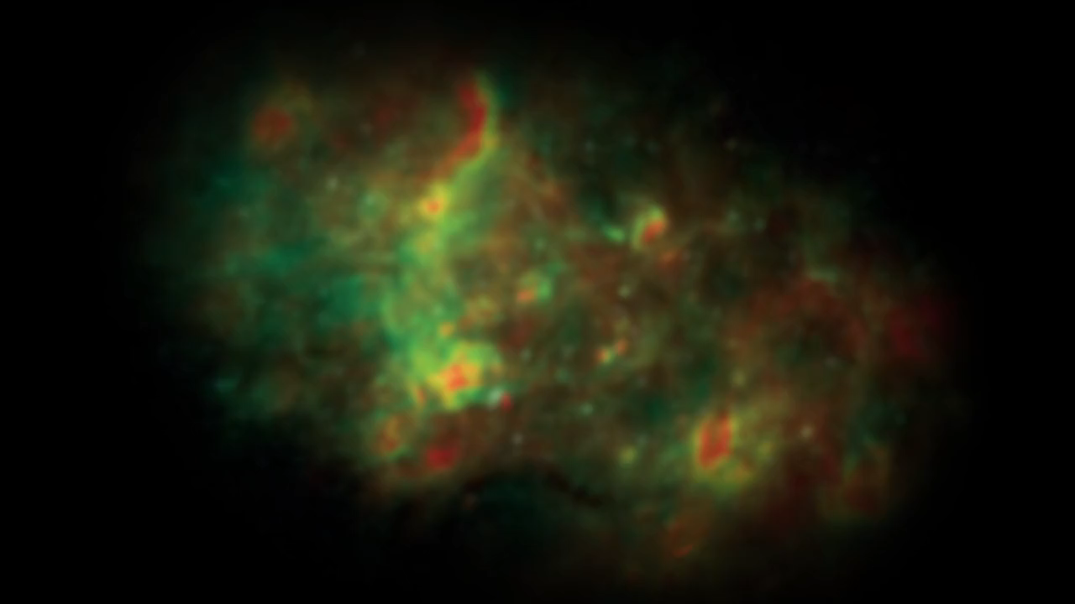
Charting the Assembly, Structure, and Evolution of Galaxies from the First Billions Years to the Present
25

Slide 26
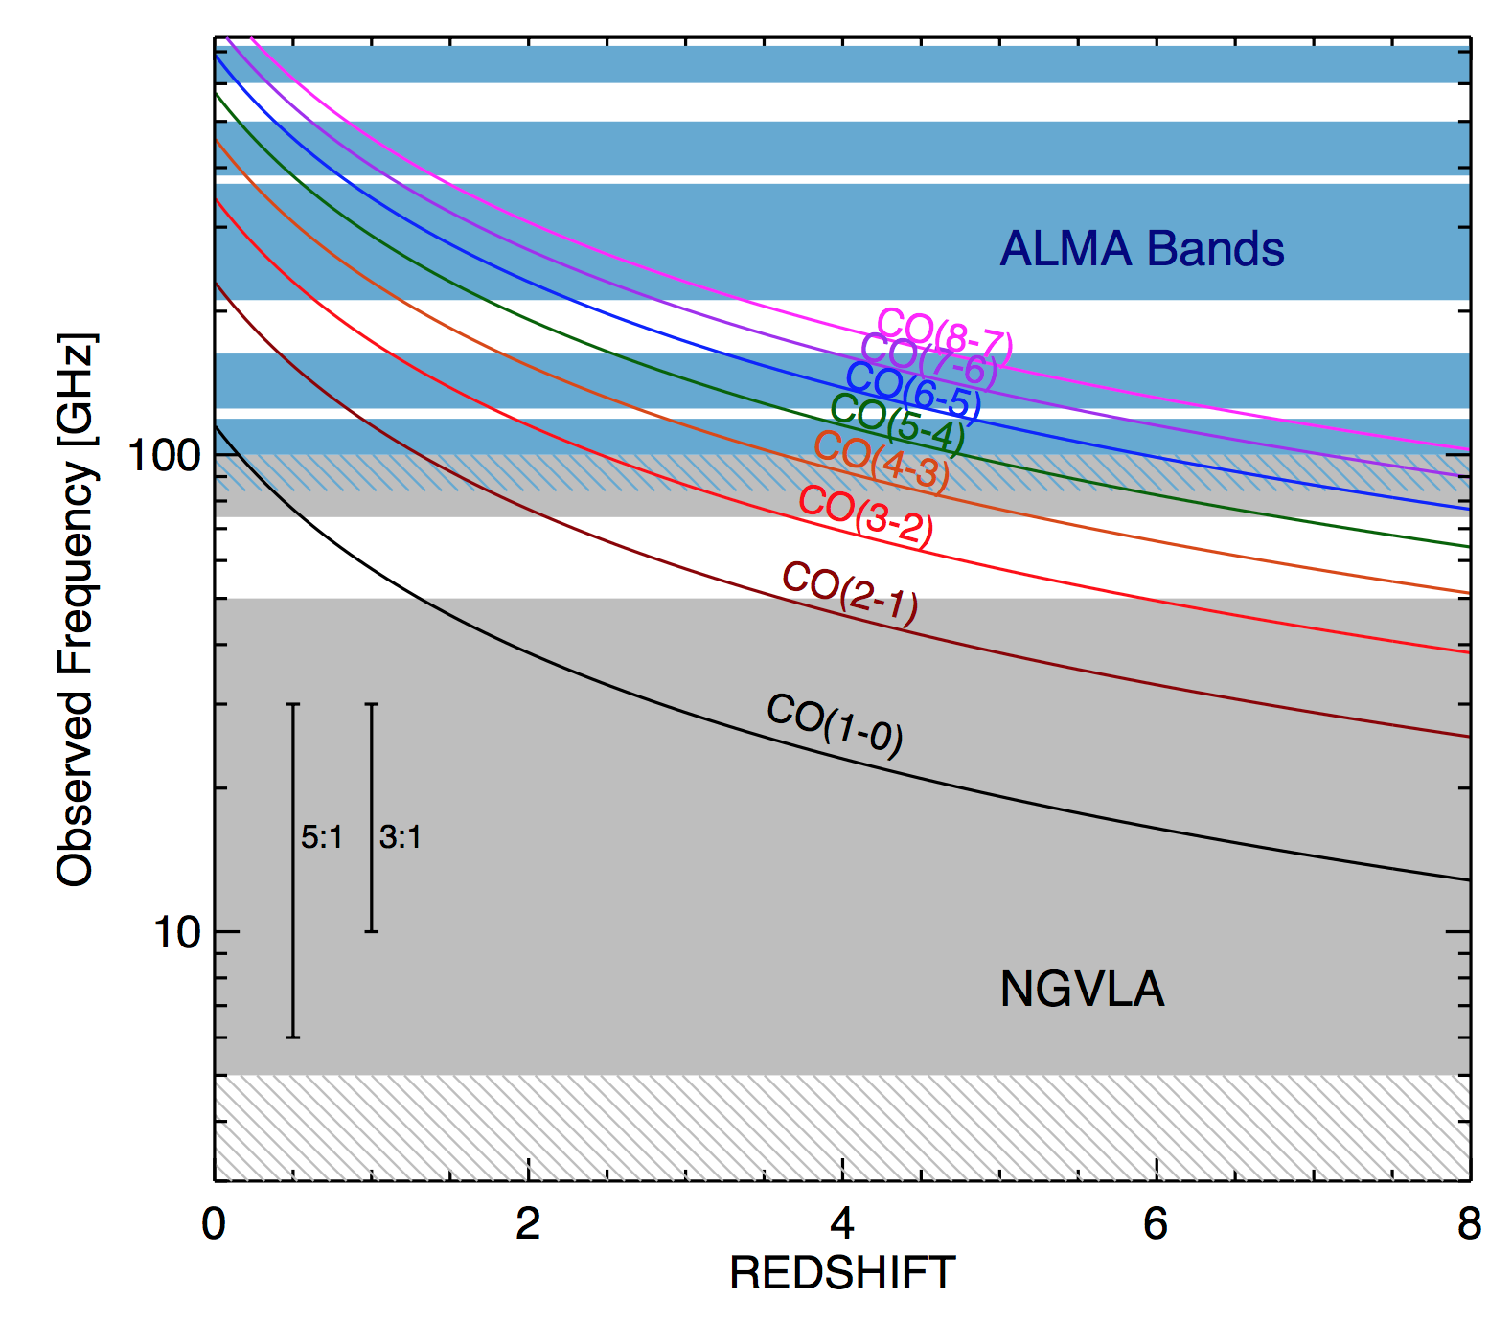
Charting the Assembly, Structure, and Evolution of Galaxies from the First Billions Years to the Present
  Order-of-magnitude improvement in depth and area for surveys of cold gas in high-z galaxies
  Routine sub-kpc imaging of the structure of protogalactic disks at any redshift where CO exists
26

Slide 27
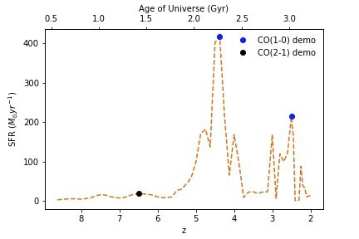
Charting the Assembly, Structure, and Evolution of Galaxies from the First Billions Years to the Present
  Order-of-magnitude improvement in depth and area for surveys of cold gas in high-z galaxies
  Routine sub-kpc imaging of the structure of protogalactic disks at any redshift where CO exists
MUFASA cosmological simulation (Davé et al.)
27

Slide 28
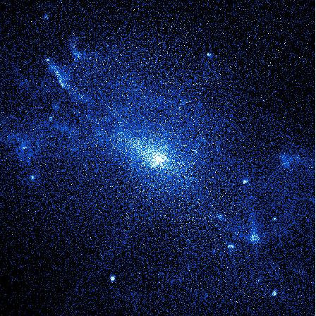
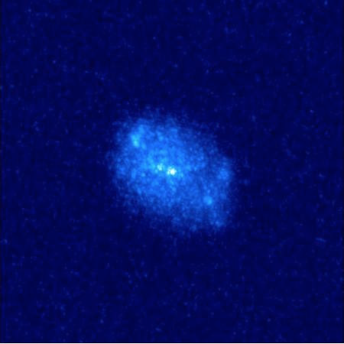
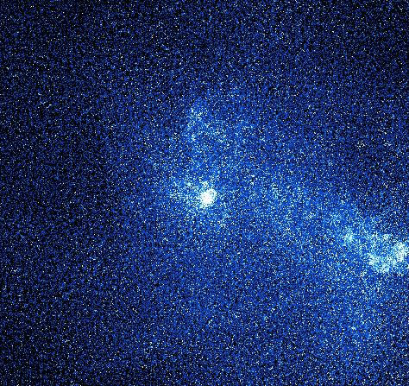
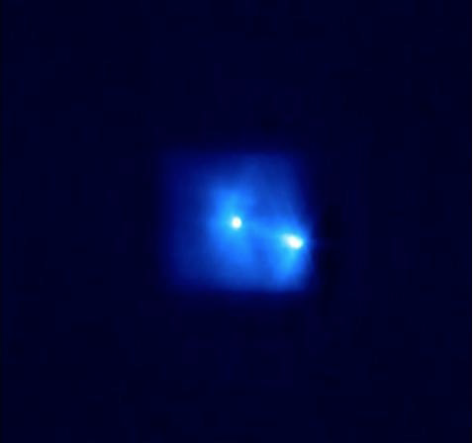
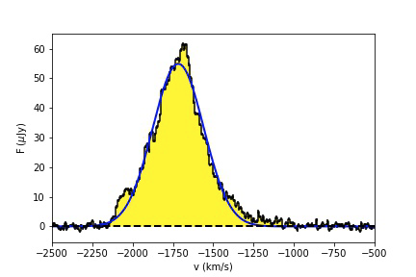
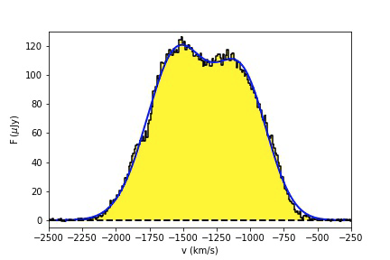
Charting the Assembly, Structure, and Evolution of Galaxies from the First Billions Years to the Present
Z=4.4
2”
Z=2.5
Model
ngVLA observations
Model
ngVLA observations
CO (1-0)
Credit: Caitlin Casey (UT Austin)
28

Slide 29
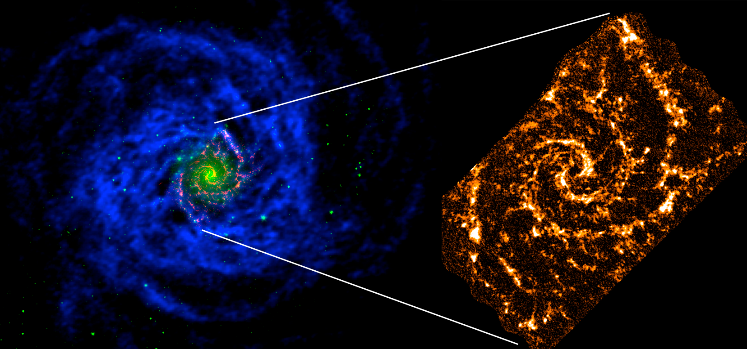
Charting the Assembly, Structure, and Evolution of Galaxies from the First Billions Years to the Present
Understanding How Galaxies Produce New Generations of Stars
  The ngVLA can study extended atomic reservoirs and large samples of GMC populations
  Unique windows into the physical and chemical properties of accretion, transport, phase change, and expulsion processes
NGC 628: THINGS HI (12”, blue), PHANGS ALMA CO (1”, red), IRAC 4.5 um (green)
29

Slide 30
Using Pulsars in the Galactic Center as Fundamental Tests of Gravity
  The ngVLA sensitivity and frequency coverage will probe deeper than currently possible into the GC area looking for pulsars, which are moving clocks in the space-time potential of Sgr A*
  New tests of theories of gravity, constraints on exotic binaries, SF history, stellar dynamics and evolution, and ISM at the GC
  Estimates are as high as 1,000 PSRs. Only known example is PSR J1745-2900 magnetar, which are extremely rare (<1%)
30

Slide 31
Using Pulsars in the Galactic Center as Fundamental Tests of Gravity
  The ngVLA sensitivity and frequency coverage will probe deeper than currently possible into the GC area looking for pulsars, which are moving clocks in the space-time potential of Sgr A*
  New tests of theories of gravity, constraints on exotic binaries, SF history, stellar dynamics and evolution, and ISM at the GC
  Estimates are as high as 1,000 PSRs. Only known example is PSR J1745-2900 magnetar, which are extremely rare (<1%)
Credit: R. Wharton
31
Notes:
Shown is the current distribution of known pulsars in the GC.

Slide 32
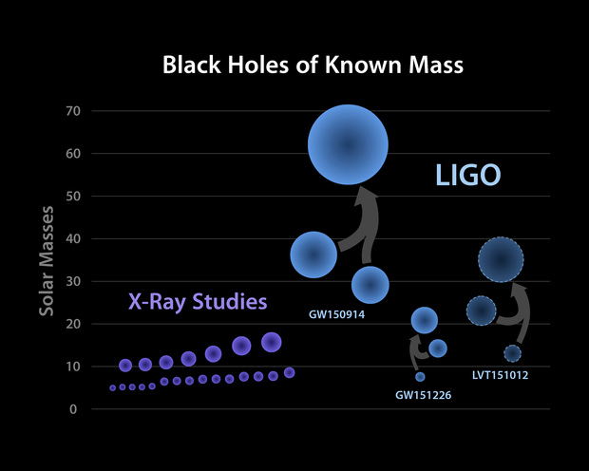
Understanding the Formation and Evolution of Stellar and Supermassive Black Holes in the Era of Multi-Messenger Astronomy
Unaffected by dust obscuration and with the angular resolution to separate Galactic sources from background objects using proper motions, the ngVLA will enable a search for accreting black holes across the entire Galaxy.
Key to understanding GW discoveries
32

Slide 33
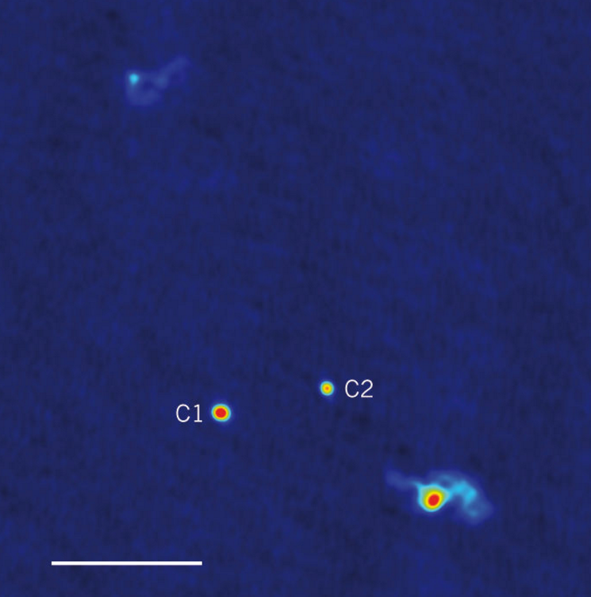
Understanding the Formation and Evolution of Stellar and Supermassive Black Holes in the Era of Multi-Messanger Astronomy
22 GHz VLBA image of binary SMBH
Z = 0.06
The ngVLA, with its deep high resolution imaging capabilities, will enable discovery of many binary supermassive black holes.
Synergies to LISA and Pulsar Timing Arrays.
10 pc
VLBA Image Courtesy of NRAO/AUI/NSF, from Taylor 2014
33

Slide 34
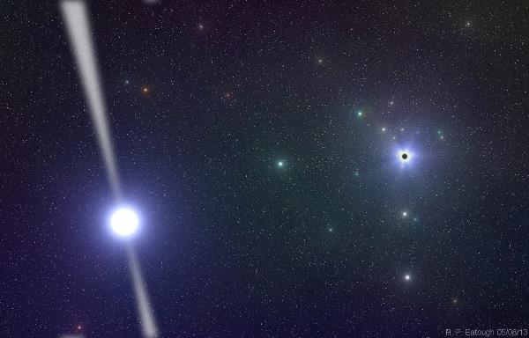

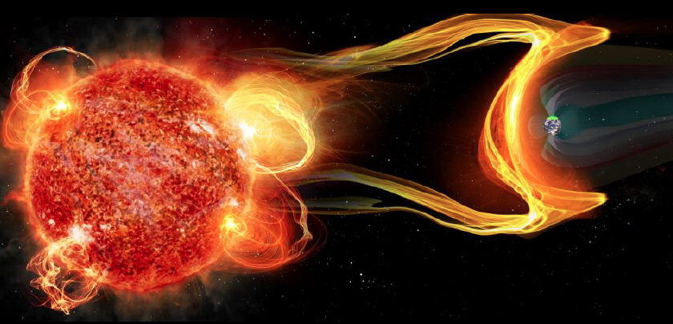
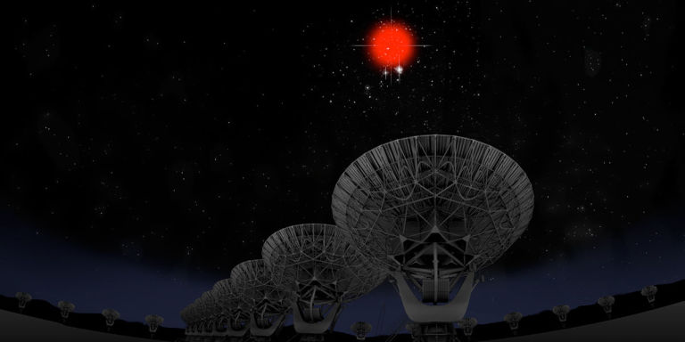
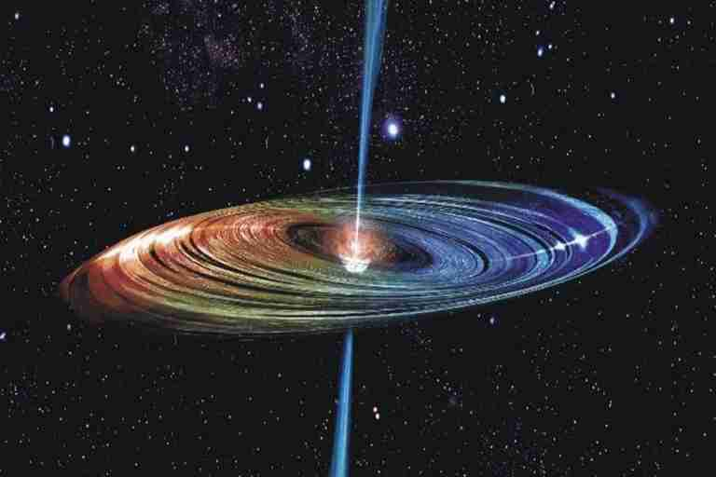
Versatility: Remarkable breadth of Science Enabled by the ngVLA
Galactic Center pulsars: testing GR
Gravitational Wave EM Follow-up
Extrasolar Space Weather
Bursting universe (FRB, GRB, TDE…)
Low surface brightness HI, CO
Obscured Black Hole Growth and AGN Physics
Quasar-Mode Feedback and the SZ Effect
Black hole masses and H_{o} with Mega-Masers
μas Astrometry: ICRF, Galactic structure…
Solar system remote sensing: passive and active radar
Spacecraft telemetry, tracking: movies from Mars

Slide 35
Estimated Price Tag
(Internal Preliminary Costing Exercise)
Target construction baseline budget ~ (2016) $1.5B
Target operations budget of < (2016) $75M (< 3x current VLA)
  Operations, maintenance, computing, archiving, etc.: optimize as part of design
Partnerships:
  Possible U.S. Multiagency Interest [including VLBI option]
    ICRF – DOD/Navy, Air Force
    Spacecraft tracking/imaging, `burst-telemetry’ (mission-critical events) – NASA, DOD
    Space situational awareness – DOD
  Strong International Partnership critical for success:
    Current International Involvement in SAC/TAC/Community Studies:
    Canada, Mexico, Japan, Germany, Netherlands, Taiwan
  Current Industrial Involvement through Community Studies:
    REhnu Inc., Minex Engineering Corp, LaserLaB, Quantum Design
Notes:
Anticipating “Open Skies” policy
Is this SKA-High? Scientifically, the same direction.

Slide 36
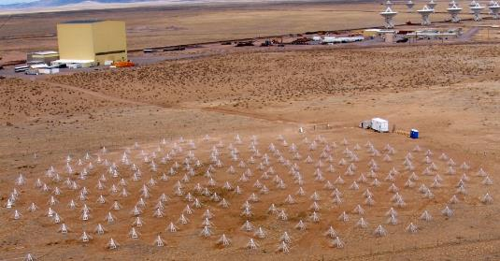
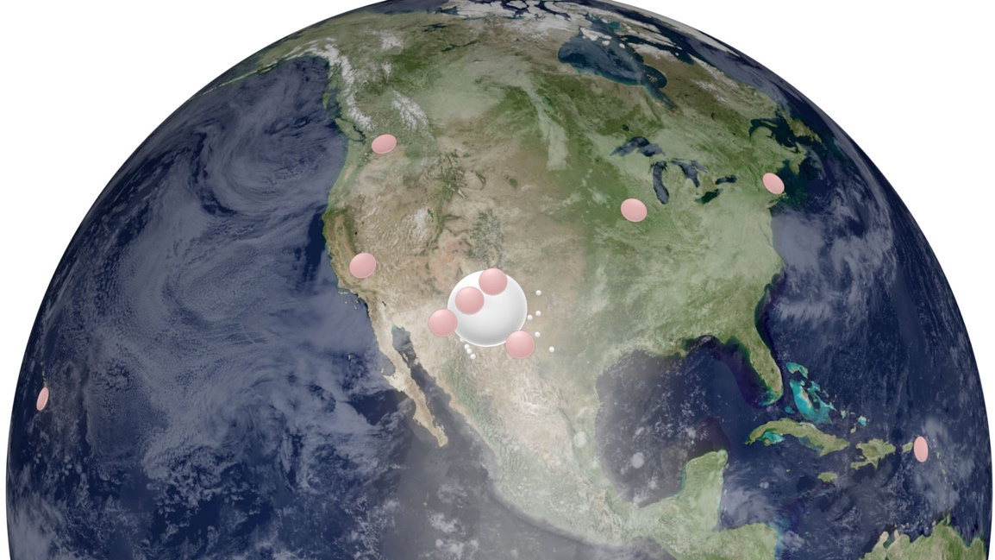
Science Options
Commensal Low Frequency Science
  Leverage ngVLA infrastructure (land/fiber/power) for commensal LF capabilities (ngLOBO)
    5 – 150 MHz: multi-beam dipole arrays alongside ngVLA long-baseline stations (e.g., LWA style).
    150 – 800 MHz commensal prime focus feeds on ngVLA antennas (e.g., VLITE style)
U.S. VLBI Expansion of Capabilities
  Replace existing VLBA antennas/infrastructure with ngVLA technology
  Introduce new >~1000 km baseline stations to bridge gap between ngVLA & existing VLBA baselines
  Cross correlate VLBI antennas with phased ngVLA core
LWA: all sky w/ multiple beams
36

Slide 37
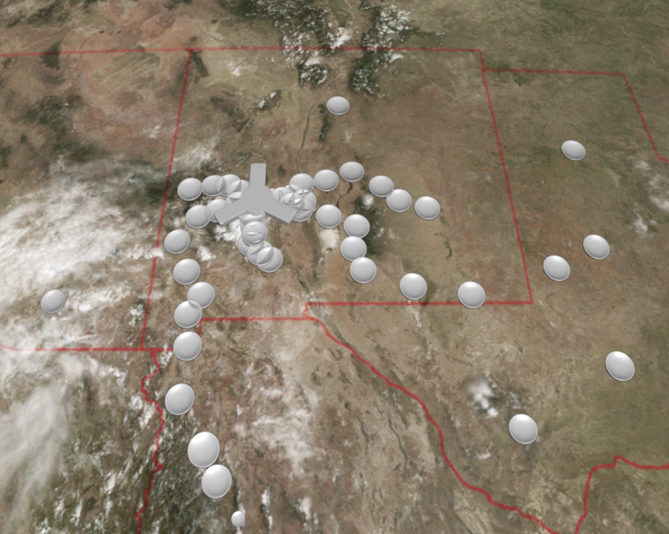
Key Open Questions
Phase calibration
  Paired antennas, dedicated reference array, water vapor radiometers, fast switching, self-calibration
Array configuration
  Surface brightness sensitivity: % in core, intermediate, long
  VLBI option
  Low Frequency (<1 GHz) options
Short Spacings
  Is 30 – 40m minimum spacing good enough?
    Array of small dishes (e.g., <~6m x 16) + 18 Total Power Mode?

Slide 38
Most Recent Milestones and Community Engagement
Milestone | Date | Comment
Consensus on Reference Design | July 18, 2017 | ngVLA Memo #17
ngVLA Key Science Goals Drafted | August 2, 2017 | ngVLA Memo #19
ngVLA Project Funded for Development | Sept. 15, 2017 | $11 M over two years
Call for 2nd round of Science Community Studies | Sept. 25, 2017 | Proposals due Oct. 23, 2017; up to $30,000K per study.
ngVLA Science Book | Oct. 1 – present | Ongoing SAC & SWG activity
AAS Special Session | Jan. 11, 2018 | VLA Today and Tomorrow
Astrophysical Frontiers Meeting | June 26-29 in Boulder | Pre-Registration open

Slide 39


The Road to Astro 2020
Goal: NRAO CoDR-level ‘proposal’ to 2020 Decade Survey
Compelling science program & defensibly costed design of all major elements
2017
Today
2018
2019
Start
Wed 9/14/16
Nov '16
Jan '17
Mar '17
May '17
Jul '17
Sep '17
Nov '17
Jan '18
Mar '18
May '18
Jul '18
Sep '18
Nov '18
Jan '19
Mar '19
May '19
Finish
Mon 7/1/19
Sci Case Capture
Mon 10/31/16 - Wed 5/30/17
Sci Book First Draft
Thu 6/1/17 - Fri 12/1/17
Sci Book Second Draft
Mon 12/4/17 - Fri 6/15/18
Sci Book Final Draft
Mon 6/18/18 - Fri 12/14/18
ngVLA Astro2020 Proposal
Sat 12/15/18 - Mon 7/1/19
Ref. Design First Draft
Mon 10/31/16 - Fri 4/28/17
Rev 1 Design Docs Published (TRL1)
Fri 5/12/17
Ref. Design 1.5 Draft
Mon 5/15/17 - Fri 11/24/17
Reference Design Second Draft
Mon 11/27/17 - Tue 7/31/18
Final Draft
Tue 10/23/18
Community Study Development
Mon 10/31/16 - Tue 8/15/17
Rev 1.5 Design Docs Published (TRL1)
Release 2nd Draft of Sci Book
Fri 6/15/18
Publish Final Draft of Sci Book
Fri 12/14/18
Submit RFIR1
Mon 4/1/19
2020
2023
Design Docs Rev2 Released for Review (TRL2)
Tue 7/31/18
Submit RFIR2
Mon 7/1/19
Release 1st Draft of Sci Book
Fri 12/1/17
Submit NOI
Fri 1/11/19
Final Design Docs Published
Tue 10/23/18
Submit SWPs
Fri 2/15/19
Pre-Proposal Review #1 Complete
US Radio Futures Conference #3
Community Study Final Reports Due
Tue 8/15/17
Pre-Proposal Review #2 Complete
Fri 9/28/18
2025
2034

Slide 40




Astrophysical Frontiers in the Next Decade:
Planets, Galaxies, Black Holes, & the Transient Universe
Workshop Boulder, CO USA June 26-29, 2018
Pre-Registration open: http://go.nrao.edu/ngVLA18
New research facilities and the scientific vision outlined by New Worlds, New Horizons have motivated the exploration of vast new discovery space, and astrophysics has seen extraordinary progress in the past decade, opening new frontiers across many fields. Sponsored by the National Radio Astronomy Observatory, this conference will bring together a substantial cross-section of the astronomical community to discuss how to effectively address the highest priority astrophysical questions of our time. Plenary sessions will feature invited speakers, and three parallel sessions of contributed presentations will address (1) Exoplanet and Protoplanetary Disk Origins, (2) Galaxy Evolution Mechanisms, and (3) Black Holes & Transient Phenomena. Each session will canvas recent observational and theoretical progress, address key unanswered questions, and motivate future research directions in the context of next-generation facilities that would span the electromagnetic spectrum, including a Next Generation Very Large Array, the Large Synoptic Survey Telescope, 30m-class optical-infrared telescopes, the Advanced Laser Interferometer Gravitational-Wave Observatory, and the Square Kilometre Array.
SOC co-Chairs
Brenda Matthews (NRC – Cradle of Life)
Caitlin Casey (UT – Galaxy Evolution)
Laura Chomiuk (MSU – BHs and Transients)
ngVLA
The Next Generation Very Large Array
Notes:
Also, there will be a very important announcement regarding future planning for the ngVLA on Sept. 15.

Slide 41
Summary
The ngVLA is being designed to tap into the astronomical community’s intellectual curiosity and enable a broad range of scientific discovery (e.g., planet formation, signatures of pre-biotic molecules, cosmic cycling of cool gas in galaxies, massive star formation in the Galaxy etc.)
Based on community input to date, the ngVLA is the obvious next step to build on the VLA’s legacy and continue the U.S.’s place as a world leader in radio astronomy.
Major Challenges: No major technological risks identified, but continually looking to take advantage of major engineering advancements seeking performance and operations optimizations.
Next Steps: Continue to refine the ngVLA science mission and instrument specifications/performance through detailed science book and reference design study.

Slide 42
Many Thanks to:
The ngVLA Science and Technical Advisory committees
All ngVLA Science Working Group Participants
Initial ngVLA Science White Paper Authors
ngVLA Community Studies Participants

Slide 43


