Slide 2
NRAO: Enabling Forefront Research
Fred K. Y. Lo
Director

Slide 3
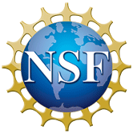
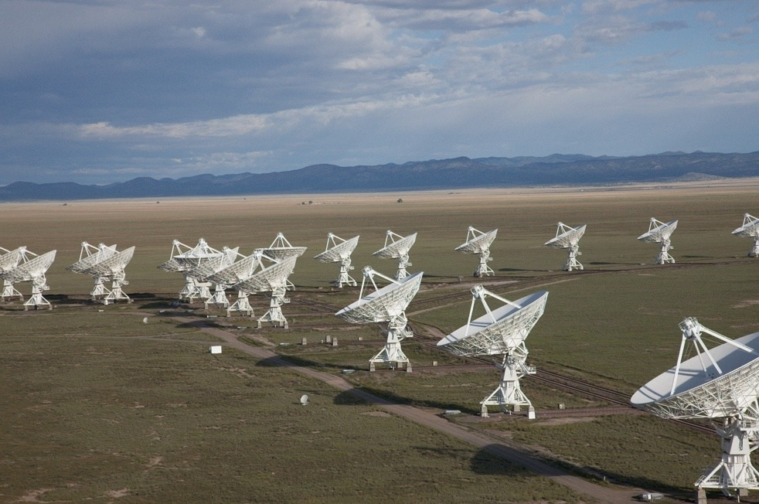
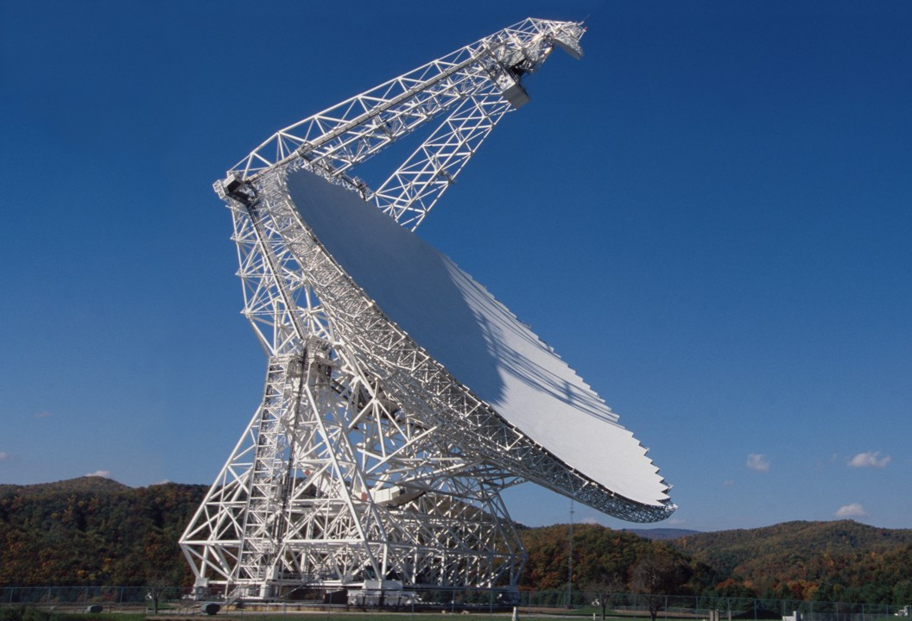
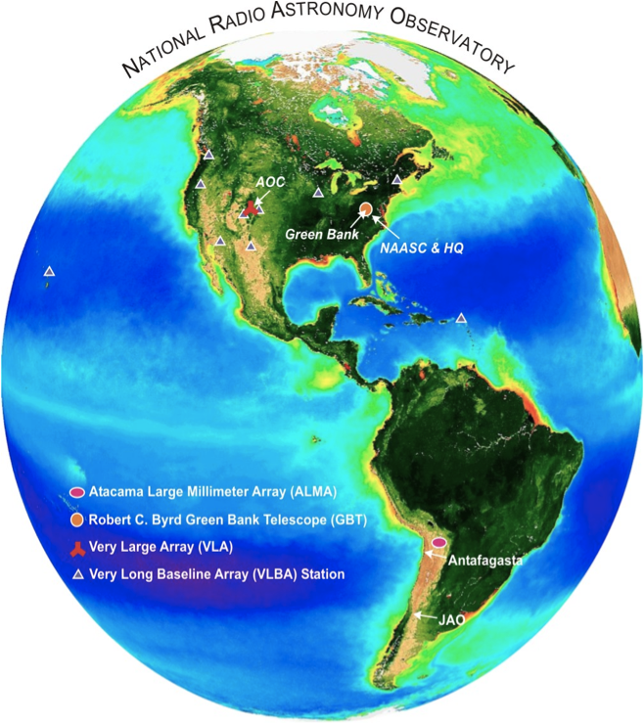
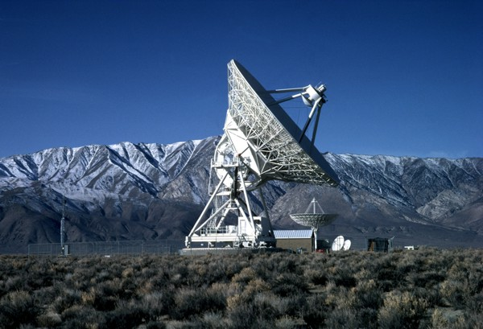
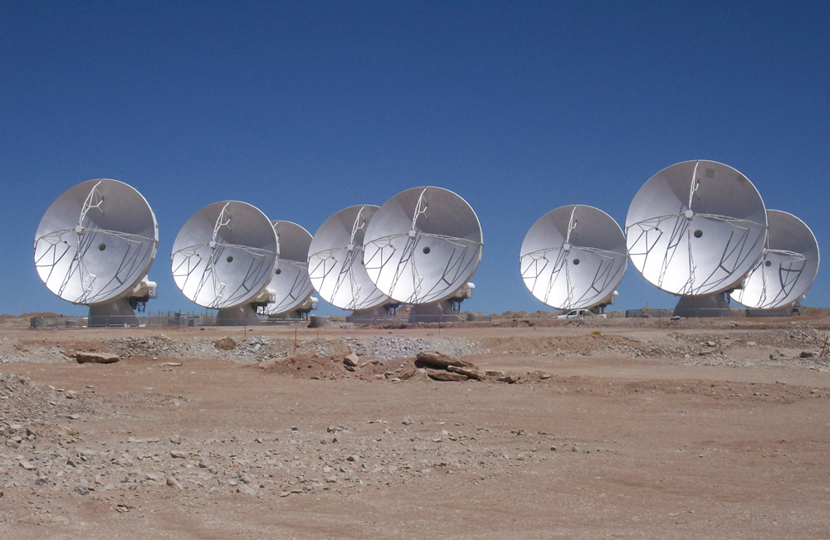
NRAO in 2013
4 Forefront Facilities, under Open Skies policy
Complement HST, Chandra, Herschel, SOFIA, Gaia, LSST, JWST, GSMT, LIGO,…
EVLA
GBT
VLBA
ALMA
3
Notes:
The complementary suite of 4 forefront facilities enables forefront research by the community to address many of the
Scientific questions highlighted by the NWNH decadal survey,
The radio observations of NRAO telescopes will be essential complements to other major observatories and space missions in other wavelength bands.

Slide 4
Implementing NWNH goals
Indispensable for addressing many key science questions
  Enhanced user support for ALMA, EVLA, VLBA and GBT
    NA ALMA Science Center in CV
    Array Science Center in SO
    GB Science Ops in GB
Towards the future
  Help realize NWNH highly ranked mid-scale projects
    NANOGrav, PAPER/HERA, FASR
  Develop current facilities to maintain best performance
  CDL: long term R+D for next generation facilities
    e.g. Digital backend; Signal Processing; design towards manufacturing…

Slide 5
Highlights
EVLA Early Science started 30 September 2010
  ApJL Special Issue published September 2011
ALMA Early Science started 30 September 2011
  First datasets just delivered
GBT: 2nd generation instrumentation
  λ3.5mm receiver, λ1cm FPA, λ3mm MUSTANG
  GUPPI and VEGAS
VLBA:
  Software correlator
  Increased BW to 2 Gbps: higher sensitivity
  New 4-8 GHz receivers

Slide 6
Science with NRAO Telescopes
Star Formation
Crystal Brogan
Galaxy Evolution
Adam Leroy
3 Observing with NRAO Telescopes
Dale Frail

Slide 7
New name to recognize the dramatic new capabilities of the transformed VLA
Public call for nominations for new name
  mid-October to 1 December 2011
Extensive world wide news coverage
23,331 suggestions submitted by 17,023 people from more than 65 countries;
  The number of unique names submitted was 16,223
Personal favorite is the suggestion by Roger Blandford:
Fabulous Radio Extragalactic Device (FRED)
New name that becomes official at dedication ceremony on 31 March 2012
Karl G. Jansky Very Large Array (Jansky VLA)

Slide 8
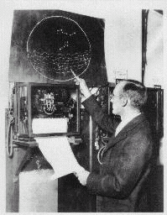
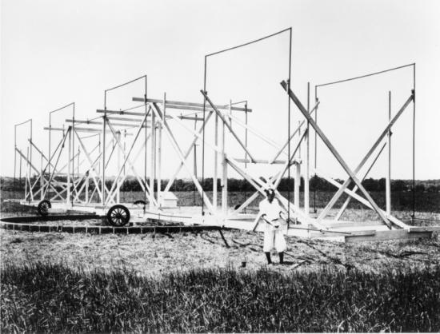
1932: Beginning of Radio Astronomy
Karl Jansky, studying static from thunderstorms at Bell Labs,
discovered radio waves from the center of Milky Way

