Slide 1
NRAO Instruments Provide Unique Windows On Star Formation
Crystal Brogan
North American ALMA Science Center

Slide 2
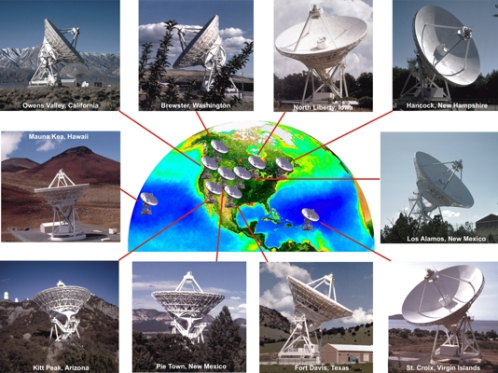
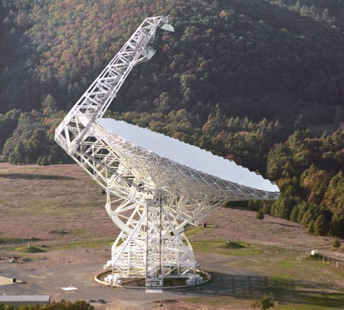
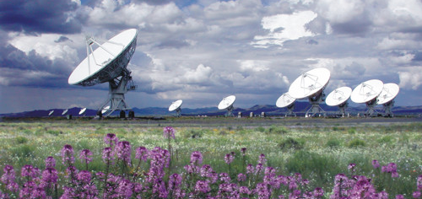
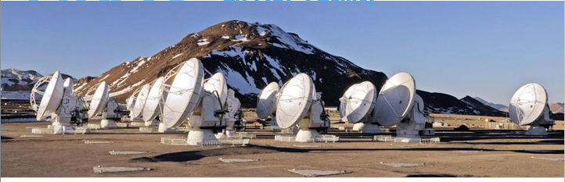
Unique Windows on Star Formation:
GBT: Sensitivity to large scale structures and fast mapping
VLBA: Exquisite astrometry
ALMA: Revealing the dust and gas within the obscured heart of star forming regions
EVLA: Probe optically thin dust, as well as molecular and ionized gas
…critical to answer key NWNH questions on star formation

Slide 3
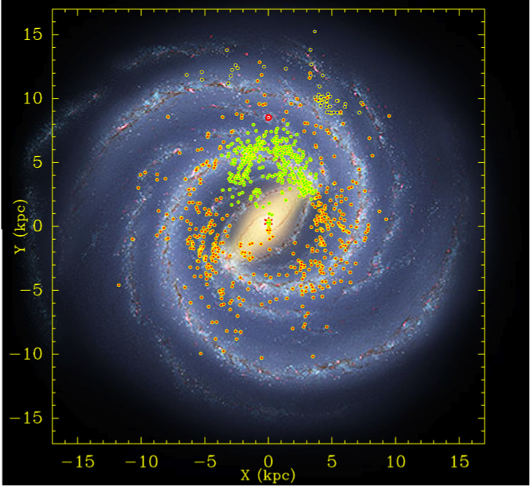
Key Science: Bar and Spiral Structure Legacy (BeSSeL) Survey
Goal: Determine trigonometric parallax and proper motions for up to 400 massive star forming regions in the Milky Way via strong methanol and water masers
Accurate measurements of:
Distance to the Galactic center (Ro)
Milky Way rotation velocity (Θo)
Milky Way rotation curve
Spiral structure
Results so far suggest:
Milky Way 2x heavier
Ro=8.3 kpc (vs 8.5 kpc)
Θ_{O}=239 km/s (vs. 220 km/s)
Previous values can yield kinematic distances in error by factor of 2
Probes deeply OBSCURED REGIONS in the disk --complementary to GAIA
http://www.mpifr-bonn.mpg.de/staff/abrunthaler/BeSSeL
(Brunthaler et al. 2011)
Notes:
6 GHz RECEIVER for 6.7 GHZ METHANOL MASER IMPORTANT
The BeSSeL Survey (Bar and Spiral Structure Legacy Survey) is a VLBA Key Science project. The survey is named in honor of Friedrich Willhelm Bessel who measured the first stellar parallax in 1838. The goal of the survey is to study the spiral structure and kinematics of the Milky Way.

Slide 4
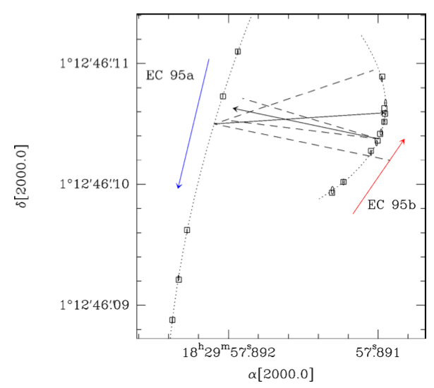
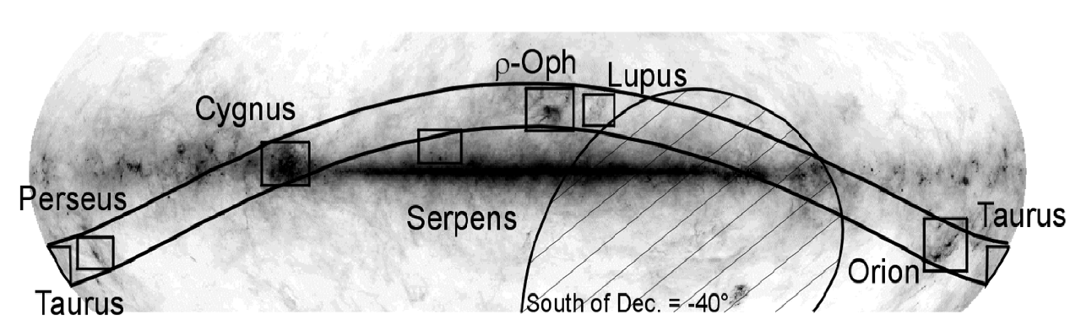
Key Science: Gould’s Belt Distance Survey
Goal: Determine trigonometric parallax and proper motions for ~200 young magnetically active low mass stars in Gould’s Belt star forming regions (d< 500pc) via gyrosynchrotron continuum emission to few percent accuracy
Example: “EC 95” in Serpens:
Parallax Distance = 429 +/- 2 pc (0.5%!)
  Previous extinction estimate d~ 260pc
  Luminosities in error by factor 2.7!
A tight binary with EC 95a = intermediate mass protostar and EC 95b = low mass T Tauri star
Distance to Serpens Molecular cloud likely 429 +/- 20 pc.
(Dzib et al. 2010, 2011; Loinard et al. 2011)
Notes:
IMPROVED CONTINUUM BANDWIDTH AND HENCE SENSITIVITY CRUCIAL
Ophiuchus, Taurus, Perseus, Serpens, and Orion
4-year project to expand number within each region and get parallaxes for all strong enough underway

Slide 5
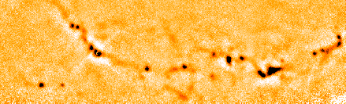
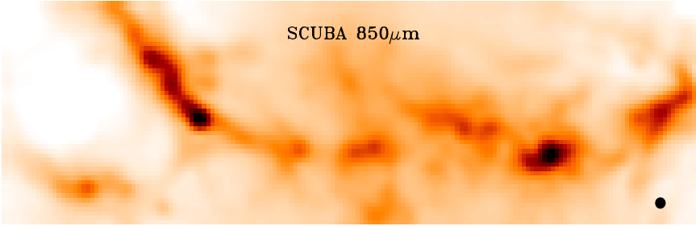
MUSTANG - Orion Molecular Cloud
Goal: Multi-wavelength study of the dust properties and core masses of OMC2/3 from 70μm to 3mm. The greatest uncertainty in measuring dust masses is in the dust emissivity (κ=κ_{o}[ν/ν_{o}]^{β}); adding long wavelength data (3mm) to the SED is essential to add the long lever arm necessary to accurately constrain β.
MUSTANG 3 mm
0.26 pc
2 arcmin
16’ x 5’ map made in just 10 hours
N
E
MUSTANG resolution is 9” -- 3-4x better in beam area than JCMT or APEX
Schnee, Di Francesco, Friesen, Mason & Sadavoy in prep
SCUBA Legacy Catalogue data (Di Francesco et al. 2008)
5
Notes:
64 pixels and 20 GHz BW
Top – The Orion molecular cloud, (OMC2 and OMC3), as seen in the 3mm 9” MUSTANG map. The 3mm emission is generally dominated by thermal emission from cold dust, but some of the emission may be free-free from protostellar jets

Slide 6
K-Band Focal Plane Array: NH₃ in the Serpens South Cluster
Goal: Map the detailed temperature, density, and kinematics of clustered star formation using ammonia
GBT NH₃ (1,1)
Spitzer 3.6, 4.5, 8.0μm
30’ =
32 pc
(Gutermuth et al. 2008)
32” resolution = 0.6 pc
~ 30 hrs observing time
Friesen, Di Francesco, Myers, Bourke & Gutermuth, in prep.
Notes:
Notes: 7-beam 18-27 GHz
These images are sized by hand so that they overlap. The white circle is approximately the GBT beam FWHM at 23.7 GHz (~32”, or 0.6 pc at d=400 pc).
The Serpens South Cluster was discovered through Spitzer observations by the Spitzer Gould Belt Legacy Survey (Gutermuth et al. 2008). It has a high stellar density and unusually large fraction of Class I protostars among embedded YSOs (77%), suggesting star formation began very recently, ~2 +/- 1 Myr. The very high star formation rate implies many more stars will be formed before the dense gas is dispersed. (The stars forming here are low mass)

Slide 7
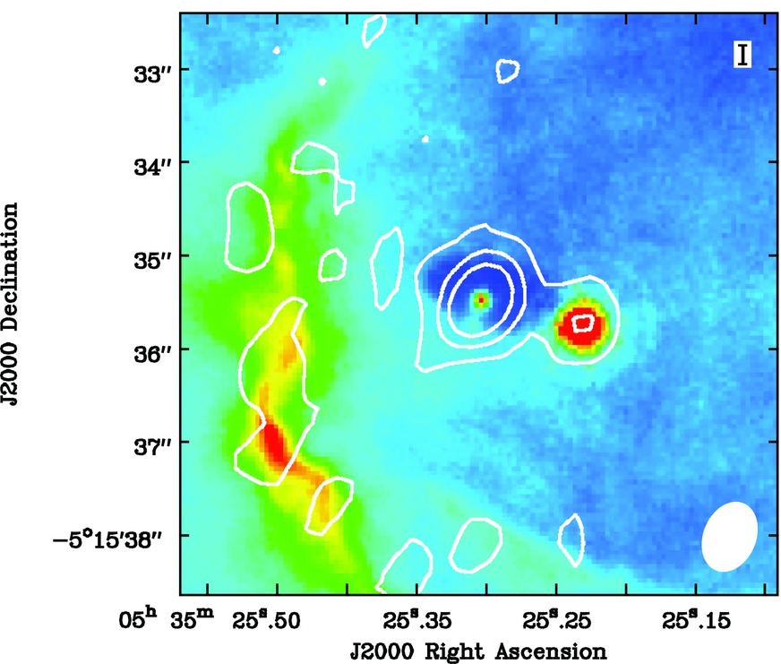
Deep Continuum Observation Reveals the Obscured Heart of Star Formation
Goal: Study the dust emission in the optically obscured 253-1536 binary disk system in Orion to test theories of dust evolution and grain growth
The dust SED suggests disk A has larger grains despite its apparent lower density.
  Could be due to viscosity variations or radial motions not included in the model
Higher angular resolution data will help to understand this unexpected result
A
B
460 AU
C-configuration; ~0.6” resolution
  Resolution could be 10x higher
256 MHz Bandwidth; 6 hour observation
  8 GHz soon or factor of ~6x more sensitive
7mm EVLA (white contours)
Hα HST (colorscale)
Ricci et al. 2011
Notes:
1 pc North of theta1C
Disk mass about 0.07 Msun, most massive in Orion Nebula Cluster
Star masses are about 2 and 0.3 Msun
Variations in viscosity or radial motions

Slide 8
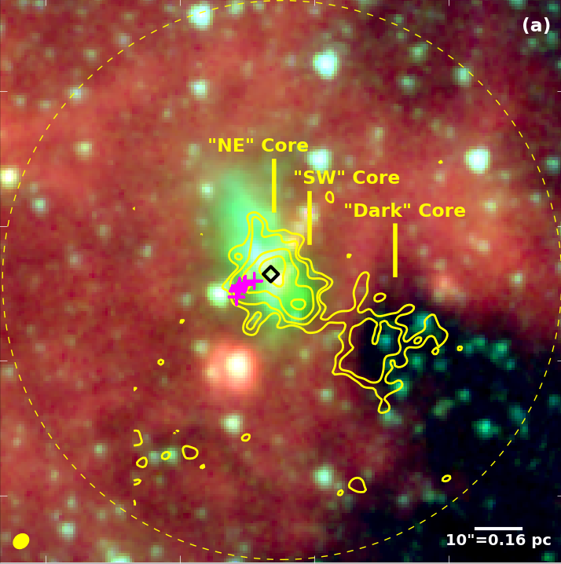
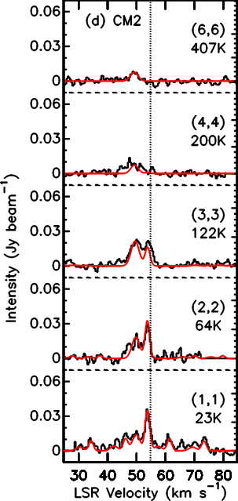
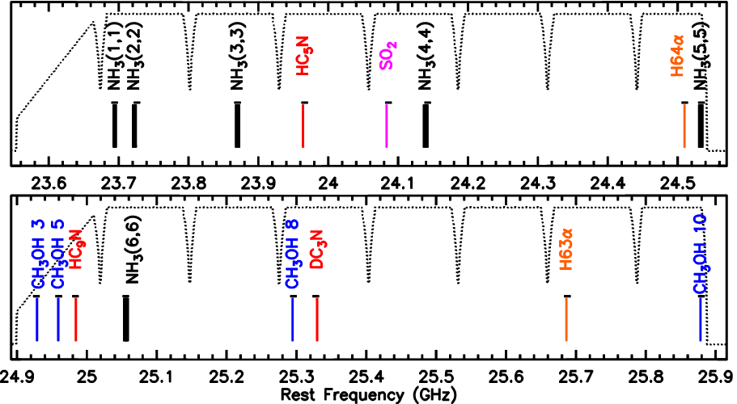
EVLA WIDAR: Many Diagnostic Tracers Simultaneously!
Goal: Derive the temperature, density, and kinematics for a sample of 20 massive protostars in order to develop an observationally based evolutionary sequence
T_{k} ~ 30, 35, 220 K
16 x 8 MHz subbands with 0.4 km/s channels
NH₃ 1,1 to 6,6 (Temperature, density, and kinematics)
4 CH₃OH (Masers and hot core tracer)
SO₂, HC₅N, DC₃N (Trace formation history of gas)
2 Radio Recombination Lines (Kinematics of ionized gas)
Decent continuum bandwidth from line-free regions (Ionized gas)
3.6 μm 4.5 μm 8.0 μm
6.7 GHz ✚ 44 GHz
NH₃ (1,1)
( Cyganowski et al. 2009; Brogan et al. 2011)

Slide 9
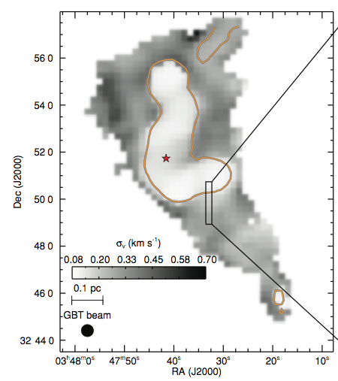
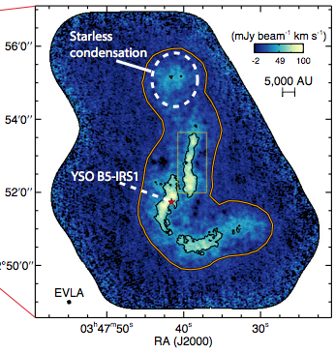
Embedded Filaments in the Perseus B5 Core
EVLA+
Goal: Study the kinematics and morphology of “coherent gas” (i.e. low turbulence) using ammonia at high angular resolution
Area with subsonic non-thermal line widths,
< 0.2 km/s
GBT NH₃ (1,1) Velocity Dispersion
EVLA + GBT NH₃ (1,1) Integrated Intensity
Newly discovered filament best fit with isothermal hydrostatic equilibrium model in contrast to recent Herschel results for lower density regions
Pineda et al. (2010; 2011)
Notes:
THE COMBINATION OF SENSITIVITY TO LARGE RANGE OF SPATAIL SCALES WITH HIGH ANGULAR RESOLUTION ESSENTIAL
P exponent for Hershel is about 1.5 to 2.5 compared to 4 for NH3.

Slide 10
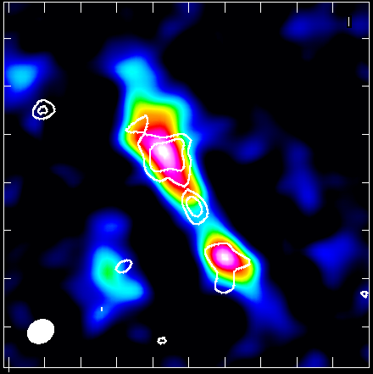
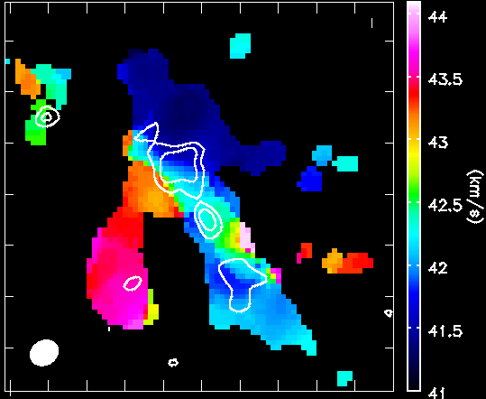
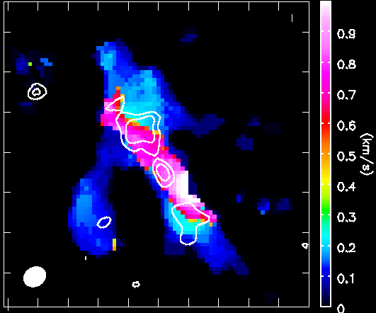
Earliest Stages of Massive Star Formation
Goal: Cycle 0 project (236) to determine the dynamical state of 4 massive starless cores using several chemical tracers in order to distinguish between different theories of massive star formation. (Tan, Butler, Caselli, Fontani)
DCO+ (3-2)
Integrated Intensity
Reference Images for target “G2”
40min(!) compact config; ~2.2” resolution
White contours show 1.3mm continuum
Velocity resolution ~0.16 km/s
30”
Velocity Field
Velocity Dispersion
Notes:
FACTOR OF 3x SPECTRAL SENSITIVITY IN FULL SCIENCE
CYCLE 1: CONTINUUM 2x if one wideband spw used

Slide 11
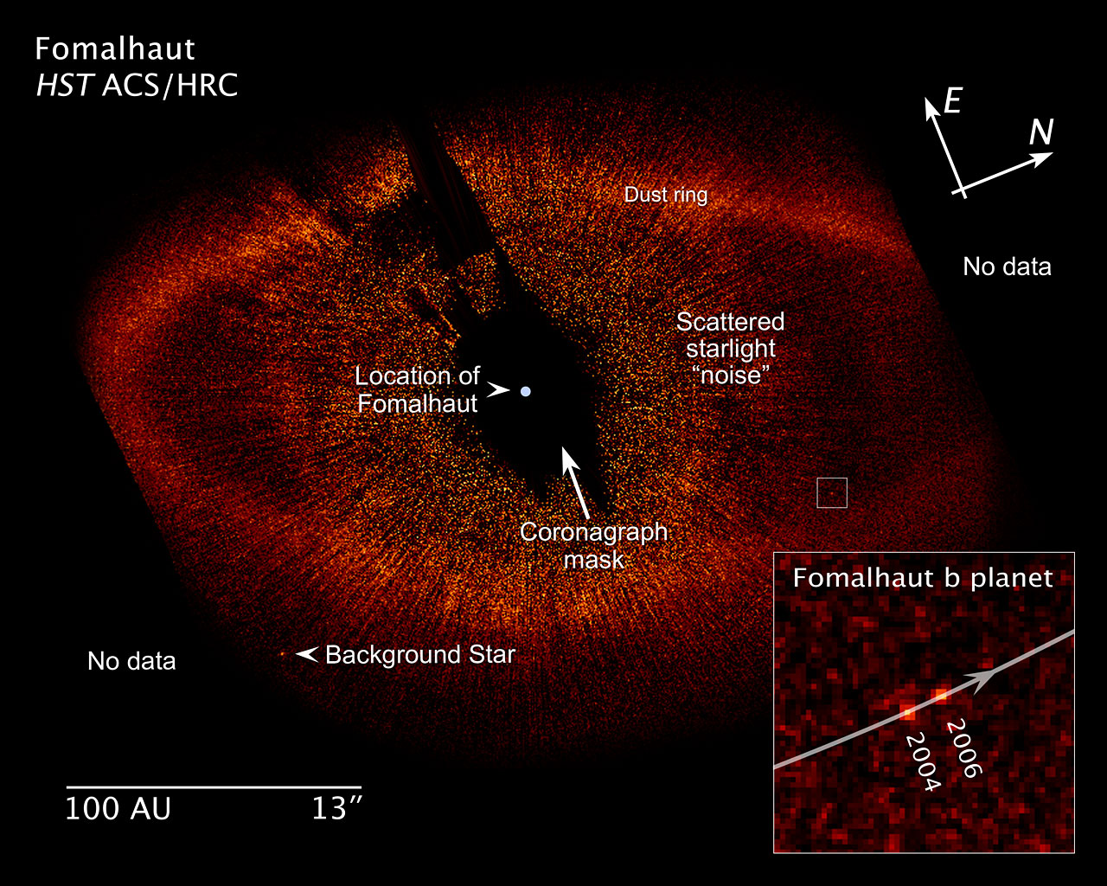
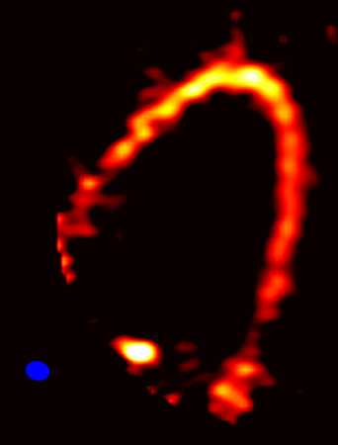
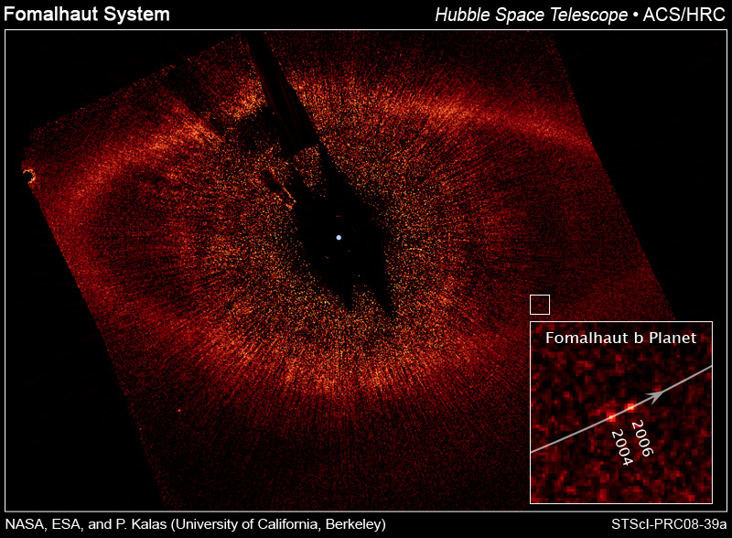
The Formation of Planetary Systems: Fomalhaut
ALMA Cycle 0 Reference Image
Band 7 (870 μm)
Dust Continuum
No data
Dust ring
Goal: Cycle 0 project (191) to measure emission from known circumstellar material and potentially circumplanetary dust near the planet Fomalhaut b using the compact (3hrs) and extended configurations (Boley, Payne, Corder, Dent, Ford, Shabram)
Location of
Fomalhaut
Coronagraph
mask
Scattered
starlight
1.5” x 1.2”
No data
Boley et al. in prep.
20 arcseconds ~ 150 AU
Notes:
FULL SCIENCE 100X better angular resolution and at least 4x better sensitivity.
Rms noise ~0.1 mJy/beam with a peak in the dust ring of about 1.5 mJy/beam (fomalhaut is 2.1 mJy close to expectation).
About 3 hours on source.
Science Goal: “measure emission from potential circumplanetary dust and from known circumstellar material near Fomalhaut b. These observations will allow us to place strong constraints on the planet formation process by testing mechanisms for forming wide-orbit gas giant planets.”
Position of Fomalhaut: 22h57m38s, -29:37:20; spectral type A3

