Slide 1
Galaxy Evolution Highlights
Recent results from the NRAO Telescopes
Adam Leroy
North American ALMA Science Center
Notes:
Thanks…
… so I’m going to tell you a bit
… about about science related to galaxy evolution
… carried out by the NRAO telescopes
… in the last year

Slide 2
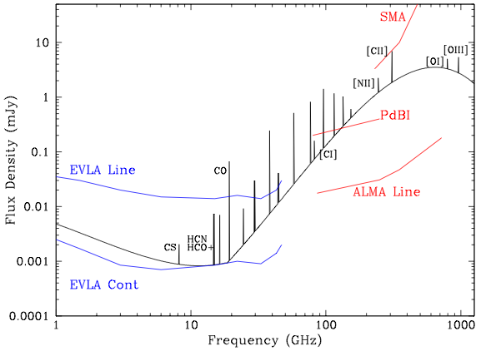
The “Radio Era” to Study Galaxy Evolution
Stars and star formation studied to z ~ 8, c. 500 Myr after Big Bang
Major unknown is the distribution and evolution of the cold gas reservoir
EVLA and ALMA are poised to unveil the fuel for galaxy assembly…
SED of galaxy forming 100 M_{sun} yr⁻¹ at z=5
EVLA + GBT Line
ALMA Cont.
Notes:
So this is an especially exciting time
… to be doing this because we’re really at the beginning
… a “radio era” for studying galaxy evolution
What I mean by that is that in the past couple of decades
… optical and IR telescopes have studied stars and star formation
… out to redshift of about 8
… or around 500 mega years after the big bang
As a result we know a lot about the evolution
… of the stellar component of galaxies
What remains is to learn about the material that fuels this evolution
… so to study the evolution of the cold gas reservoir
… the fuel for star formation
… across cosmic time
Studying the evolution of this “other half” of galaxy evolution
… is a unique strength of radio telescopes like the NRAO facilities
... and this sketch shows why

Slide 3
The “Radio Era” to Study Galaxy Evolution
SED of galaxy forming 100 M_{sun} yr⁻¹ at z=5
Low-J molecular lines
Total H2
Dense gas
Dynamics
EVLA + GBT Line
EVLA + GBT Line
ALMA Cont.
Notes:
You are looking at the spectral energy distribution
… of a galaxy forming stars at about a hundred solar masses a year
… at redshift 5, about a billion years after the big bang
You see the continuum and line emission
… and lines indicating the sensitivity of various telescopes
… EVLA, GBT and ALMA looking at spectral lines and continuum
What you see is that EVLA and the GBT have sensitivity
… to observe low-J molecular lines in these systems
These are your most robust and important tracers
… of the total molecular gas reservoir

Slide 4
The “Radio Era” to Study Galaxy Evolution
SED of galaxy forming 100 M_{sun} yr⁻¹ at z=5
Atomic lines
ISM coolants
Distribution
Conditions
SFR
EVLA + GBT Line
ALMA Cont.
Notes:
Meanwhile ALMA has phenomenal sensitivity
… to the atomic fine structure lines in the same systems
These lines are the most important ISM coolants
… and key diagnostics

Slide 5
The “Radio Era” to Study Galaxy Evolution
SED of galaxy forming 100 M_{sun} yr⁻¹ at z=5
EVLA + GBT Line
ALMA Cont.
Continuum (dust, free-free, synchrotron)
SFR, ISM distribution, dust abundance
Notes:
And continuum emission observed by both telescopes
… gives you another way to trace
… the distributions of the ISM
… and embedded star formation
So the point here is that the NRAO telescopes
… offer the tools needed to probe the “unknown” half of galaxy evolution
… meaning the fuel for galaxy assembly and star formation
By tracing embedded star formation, gas, and physical conditions
… back to the earliest epochs of galaxy formation

Slide 6
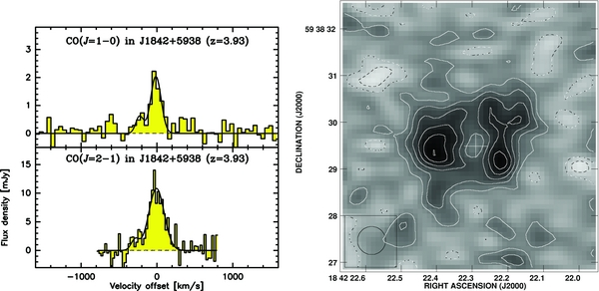
EVLA Images Molecular Gas at High-z
EVLA: a powerful tool to image low CO emission from galaxies at high z.
Exploring the formation of massive galaxies, clusters, and the evolution of cold gas reservoirs and the molecular gas fraction.
CO 2-1 Image
Molecular Einstein Ring Toward SMG MM18423+5938 (z=3.93)
Lestrade et al. (2011)
Notes:
And if you take one thing away from this talk
... I hope it’s that the EVLA is doing this stuff *right now*
Thanks to its wide frequency coverage – 1 to 50 GHz
… excellent bandwidth and good sensitivity
… the EVLA can measure redshifted low-J CO emission
… from galaxies at intermediate to high redshift
… mapping out the fuel for star formation
… during the epoch of galaxy assembly
As a very neat example from this year’s EVLA special issue
… the image here shows a complete molecular Einstein ring
… toward a lensed submillimeter galaxy at z of 4
So this is redshifted CO 2-1 emission
… from about 1.5 billion years after the big bang
… and the powerful lens offers the chance to study it
… at phenomenal resolution

Slide 7
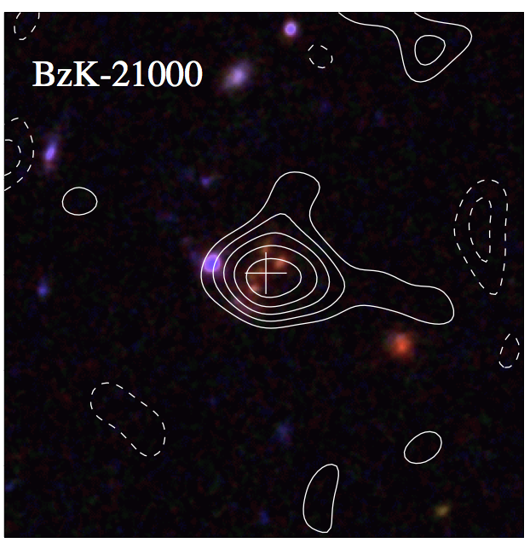
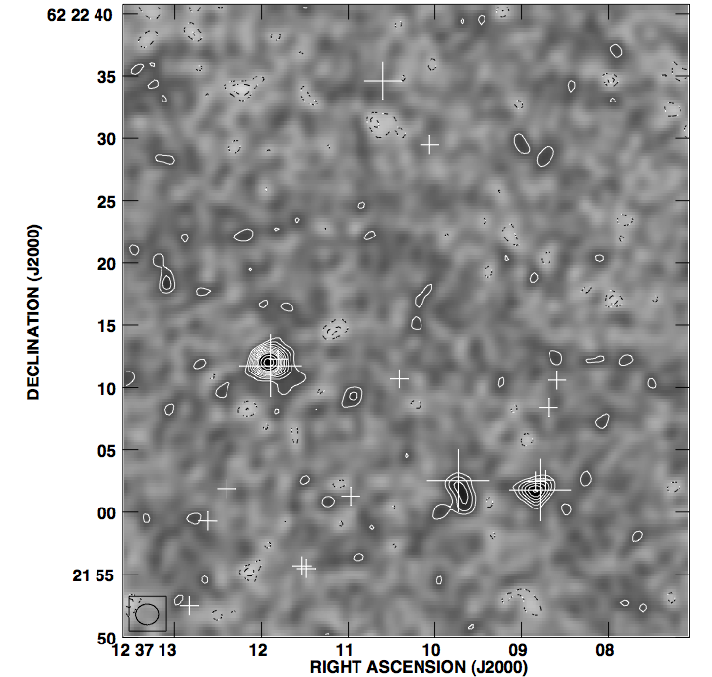
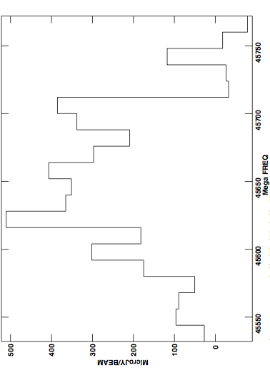
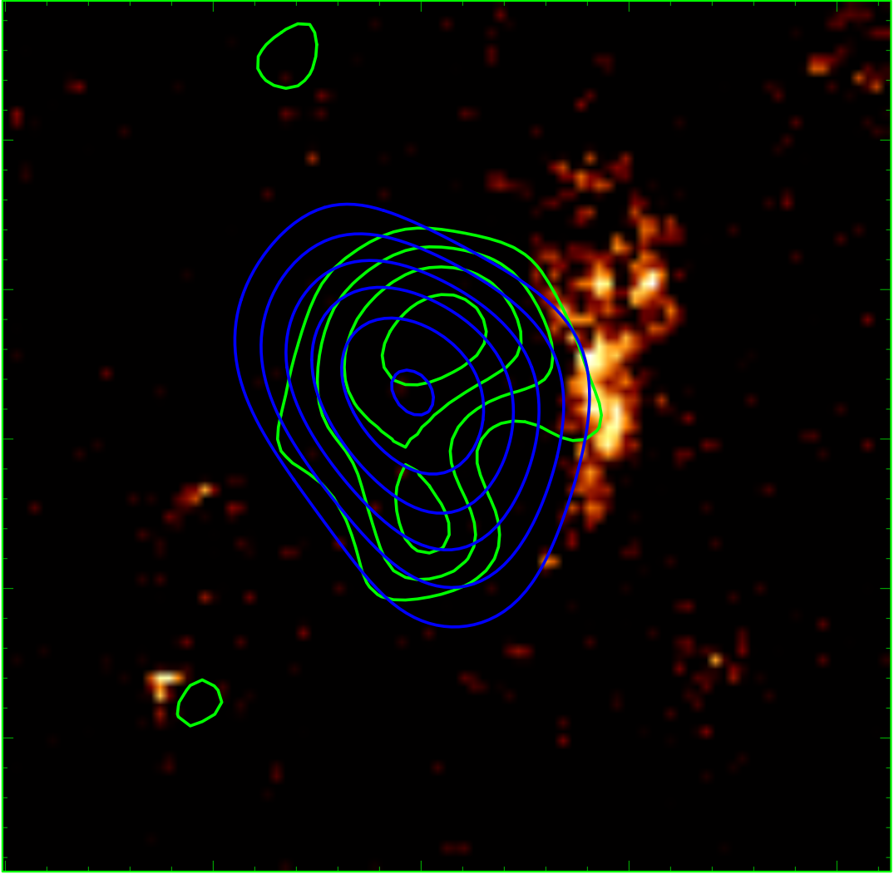
A Molecule-Rich Protocluster
Foreground sBzK galaxy
CO 1-0
46 GHz Observations of GN20
z=1.5
CO 2-1 Spectroscopy
z=4.055
Imaging CO 2-1
CO 2-1, HST, sub-mm
z=4.051
48,550
48,750
48,650
Frequency [MHz]
z=4.056
Carilli et al. (2011)
Notes:
These NRAO “Key Science” results on the GN20 protocluster
… demonstrate the power of the EVLA even more clearly
These are EVLA 46 GHz spectral line observations
… of a proto-cluster forming at z of about 4
... in this arcminute field you see redshifted CO 2-1 emission
… from three forming massive galaxies
In its more extended configurations, the EVLA can resolve this emission
… letting you study the distribution of cold gas
… relative to stars and star formation
Maybe the most impressive thing in this image
… is what’s here by accident.
… here you see CO 1-0 emission
… from a redshfit 1.5 “normal” star forming galaxy
These observations picked up this galaxy serendipitously
… even though this image was taken using only 256 MHz of bandwidth
… one sixteenth of the final instantaneous EVLA bandwidth
Once you get the full 8 GHz bandwidth, it will be difficult *not* to observe
… redshifted CO emission from forming galaxies
… in any long, wide-band, high-frequency integration

Slide 8
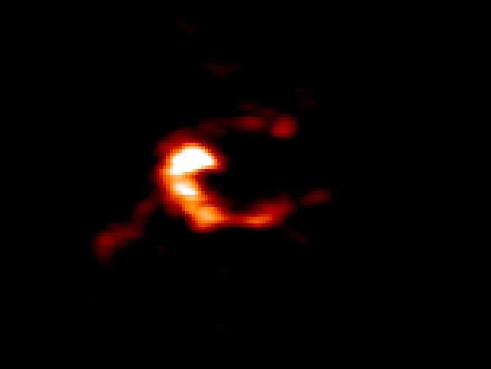
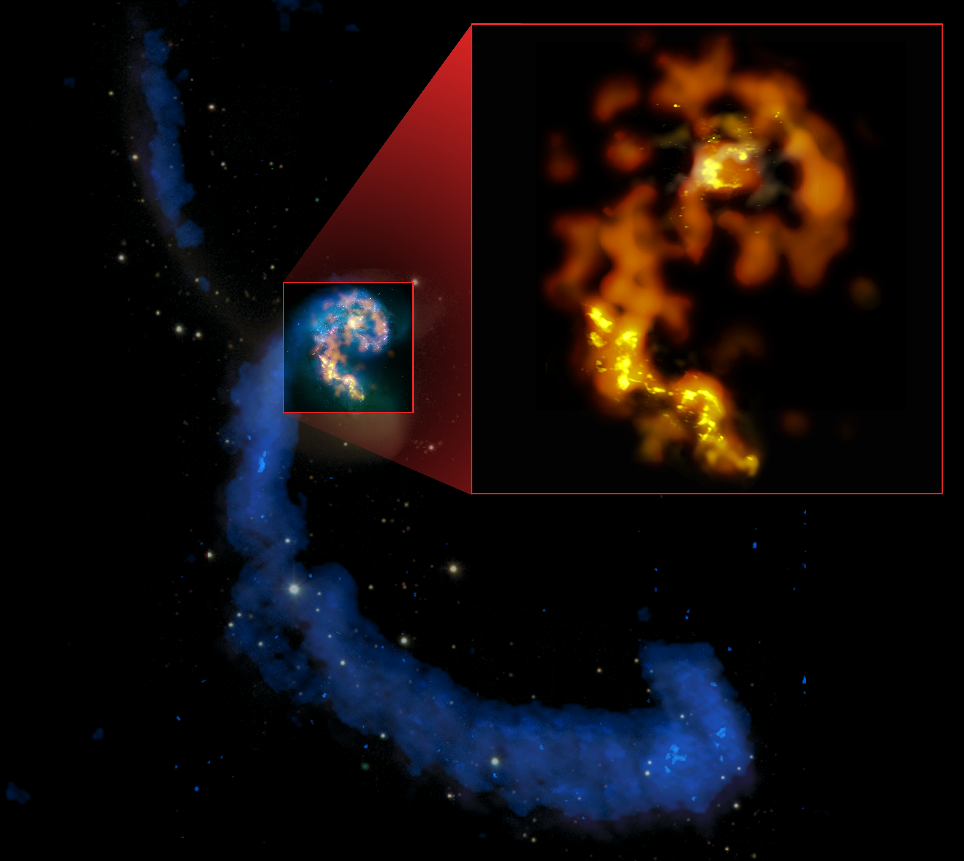
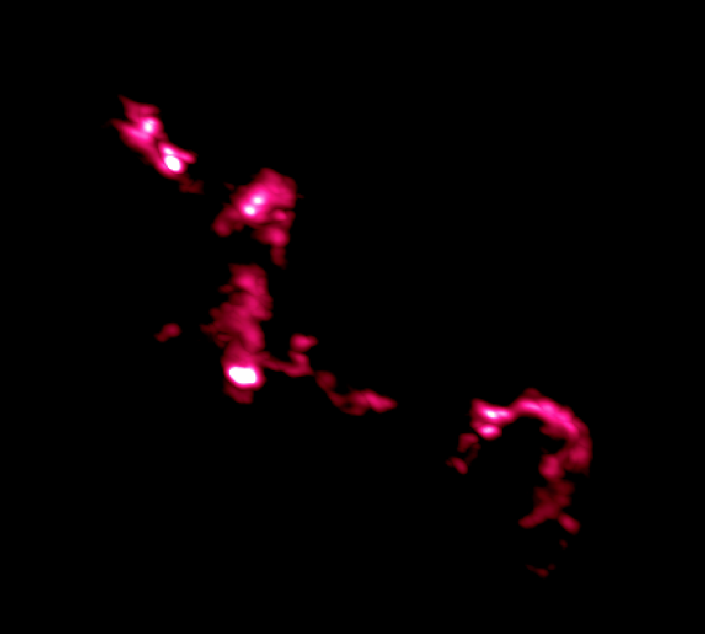
ALMA Images Nearby Galaxies
Science verification imaging of the Antennae Galaxies
CO 2-1
CO 3-2
HI, CO 3-2, CO 1-0
Notes:
If you take away a second thing from this talk
… I’d like it to be that ALMA is working
… and has demonstrated the power to image galaxies in exquisite detail
… though if Crystal’s talk didn’t convince you of that you’re not awake
I’m showing you here imaging of the Antennae Galaxies
… obtained and publicly released as part of ALMA’s science verification program
In a limited, roughly 11 telescope, configuration
… ALMA imaged low-J CO emission in three transitions
… across the body of these nearest colliding galaxies
That shows up in gold over here
… and then in more detail over here
… the resolution and sensitivity even in this limited form
… are sufficient to pick out individual star-forming clouds and complexes

Slide 9
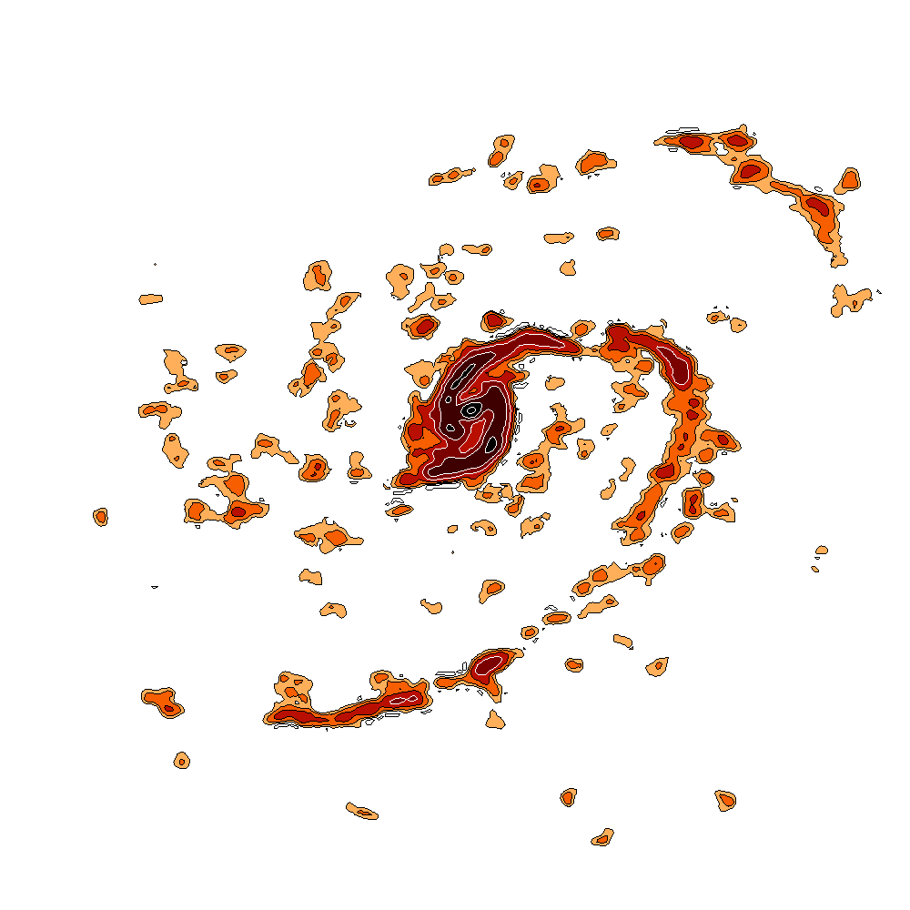
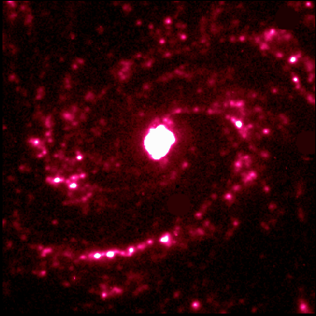
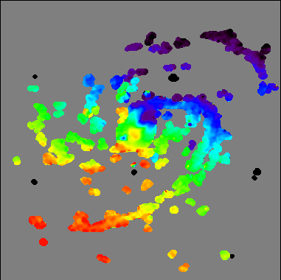
ALMA Images Nearby Galaxies
Science verification imaging of M100
Hα
CO 1-0
47-pt mosaic
Velocity
Notes:
You can see the same power at work in these just-released data
… on M100, a bright Virgo cluster spiral galaxy
This is a big, 50-point mosaic
… obtained in about 6 hours using 13 antennas
… so spending a total of around 7 minutes per point
Again, you see the distribution of star forming gas in detail
… including individual star-forming knots
… along sharp, well-defined spiral arms

Slide 10
ALMA Cycle 0 Underway
Observations of fine structure lines at high redshift. Resolve and detect [CII] out to z > 6, contrast with [NII], reach 300 pc resolution
Detailed physical conditions at high resolution in local galaxies.
Physics of Star Formation, Active Galactic Nuclei
Exploring new populations. SPT Sources, WISE QSOs, Blind Survey behind a Lensed Cluster, Localizing SMGs
Emphasis on physical conditions, extreme systems, and unknown populations.
See C. Lonsdale talk + Press Release at ALMA Special Session
Notes:
These two science verification examples show that ALMA is working
… and already capable of exquisite imaging of extragalactic systems
The real story, though, is that ALMA’s first PI-driven science campaign
… is now underway
The extragalactic component of this “Cycle 0” is pretty diverse
… but if you want distill out a few themes these would be
The use of atomic fine structure lines to study high redshift systems
… detailed studies of the physical processes
… governing star formation and galactic nuclei in local galaxies
… and exploring new populations: for example south pole telescope or WISE sources
The first Cycle 0 extragalactic data set has just been delivered to the community
… let me advertise that at tomorrow’s ALMA special session
… Carol Lonsdale will present results using ALMA to diagnose
… the evolutionary state of the most luminous embedded quasars in the universe

Slide 11
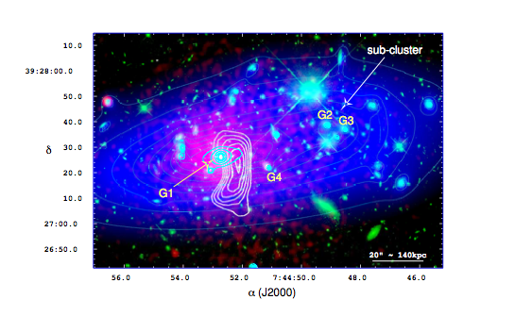
Imaging Massive Clusters via the SZE
MUSTANG (GBT 4mm)
Chandra
MUSTANG (contour)
Chandra
HST
Mass Model
Korngut et al. (2011)
Notes:
I’ve emphasized using ALMA and the EVLA to study star-forming gas at high redshift
… just as important is how large-scale structures form and evolve
… and the Green Bank Telescope is a phenomenal tool to address this
For instance I’m showing here
… results from the MUSTANG 4mm bolometer array
… observing the Sunyaev Zeldovich effect in a cluster at redshift 0.7
Thanks to GBT’s large diameter MUSTANG images the SZ effect at high resolution
… allowing the authors to pick out an overpressured region here
… consistent with a weak shock moving through the cluster.
… this study found three of four clusters to show important substructure.
These sorts of high resolution SZ observations …
… give you a tool understand detailed cluster physics
… help understand scatter among different methods of estimating cluster masses
… and help quantify the uncertainties in using the SZ effect for cosmology

Slide 12
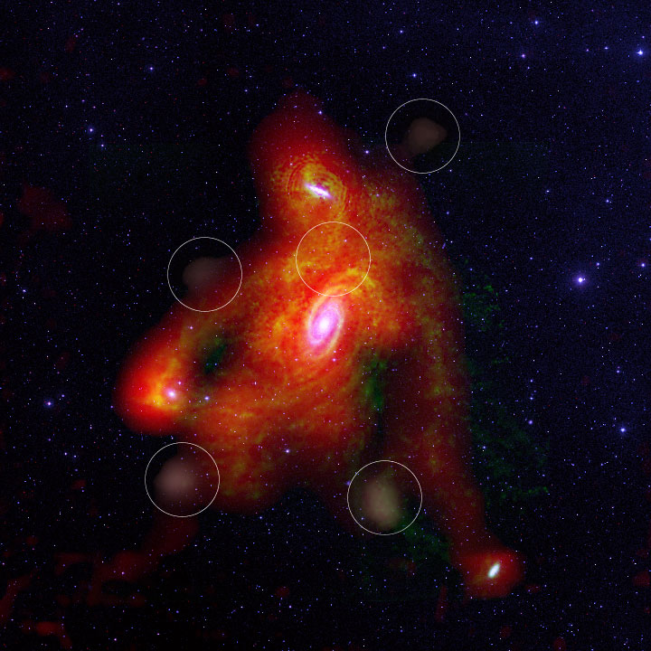
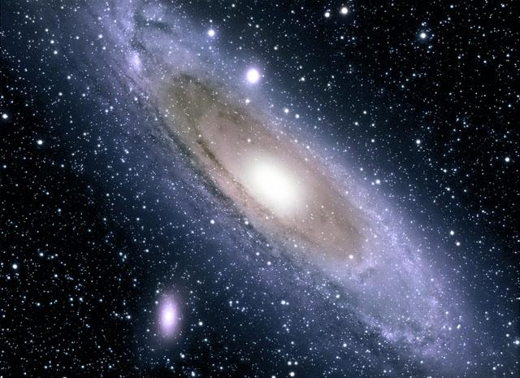
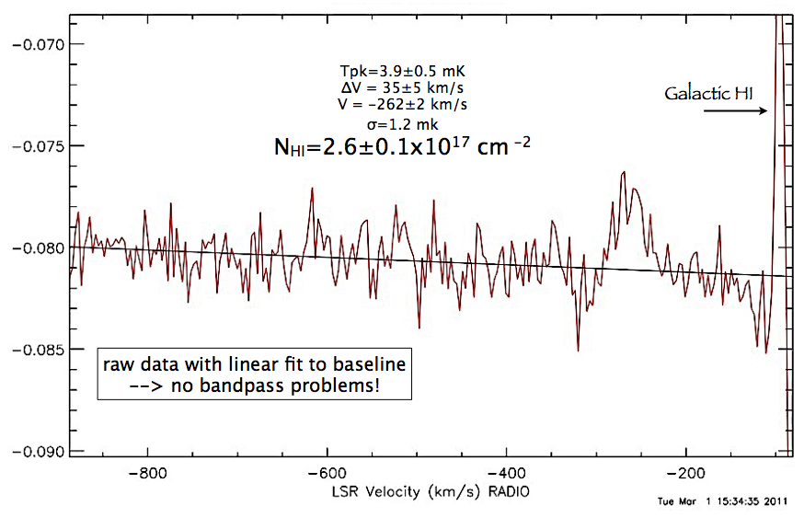
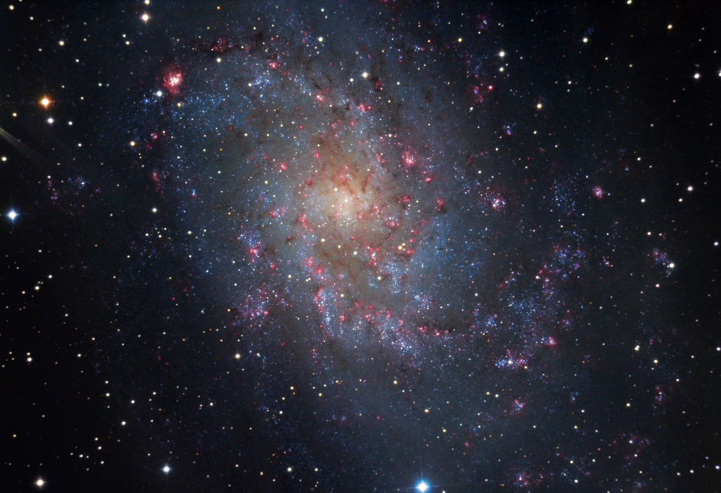
HI Superstructure in Local Galaxies
Low column superstructure in nearby galaxy groups.
M31
M33
Chynoweth et al. (2008, 2011)
Not to scale!
Lockman et al. (Wed. poster) : GBT detects M31-M33 Stream
N(HI) ~ 2.6 ± 0.1 10¹⁷ cm⁻²
Pushing towards the cosmic web!
Notes:
The GBT is also a powerful tool look for other types of cosmic superstructure
… especially faint HI filaments tracing
… merger remnants or interactions
… and eventually the cosmic web of infalling filaments
… that feed galaxy formation
GBT has already demonstrated impressive results imaging huge HI structures
… for example these studies of the M81 group
… and this continues to be an active discovery area
The result that I want to call out here is this poster by Jay Lockman
… he and his collaborators have taken deep, 6 hour spectra, of
… the region between the Local Group galaxies M31 and M33
They detect HI emission with a column density of a couple times 10 to the 17th
… with significance of more than 20 sigma, helping confirm
… the existence of a faint stream linking these two galaxies
This is the raw spectrum, see how well behaved the baseline is!
… reaching this very low column with such a well-behaved spectra
… highlights the strength of the clean GBT system, including the off-axis parabaloid
This is an interesting result and a fantastic sign
… of GBTs promise to explore large, faint cosmic structures

Slide 13
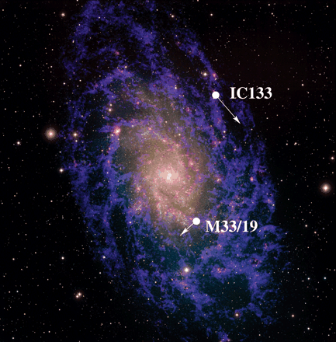
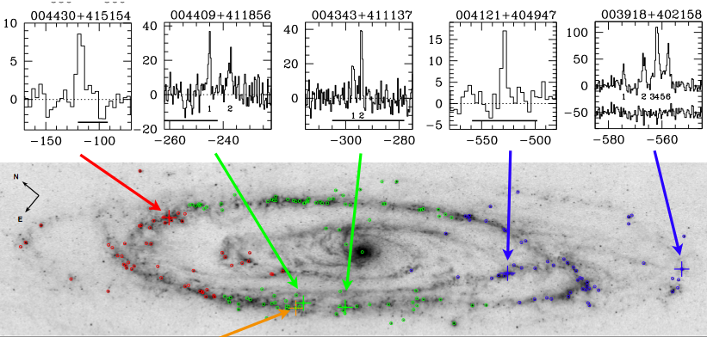
Local Group Dynamics & H₂O Masers
VBLA astrometry of masers in nearest galaxies yields 3-d proper motions
Model the distribution of dark matter, boundedness
Derive geometric distances from rotation
5 new H₂O masers in Andromeda, 6σ proper motion detection in ~3 yr?
Builds on ongoing M33 work. Unique application of VLBA
Motion in nearby
galaxies
Darling, 2011, ApJL, 732, 2
Brunthaler et al. 2005
Notes:
Finally, the detailed astrometric precision offered by the VLBA
… is allowing folks to push the frontiers of galaxy evolution in other directions
… So I’ll call out two quick examples
First, proper motions of water masers associated with star-forming regions
… in the nearest galaxies
… give the ability to derive true 3-dimensional velocities
… both within and among Local Group galaxies
... meaning you see both the rotation and bulk motion on the sky
Knowing full 3-d velocities
… give you geometric distance measurements to local galaxies
… but even more important it gives you key constraints
... on the true mass distribution and boundedness of the local group
Brunthaler and collaborators have done this kind of work with VLBA on M33
… this year, Darling used the GBT to identify five new water masers in Andromeda
… appropriate for VLBA followup
Under reasonable assumptions, VLBA could detect significant proper motions
… from these Andromeda masers in only a few years
… allowing work on M31 similar to what’s being done
… in M33 by Brunthaler and collaborators

Slide 14
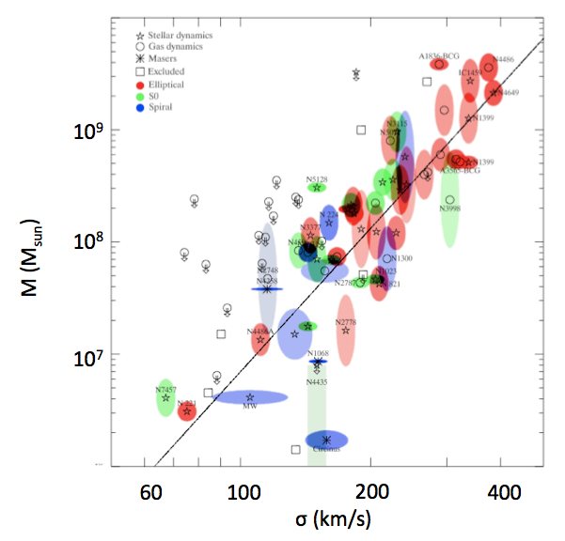
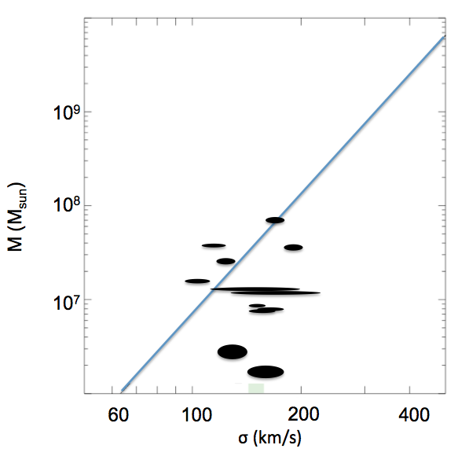
H₂O Megamasers, H₀, and SMBHs
Key science project to find and monitor H₂O megamasers around SMBHs
Megamasers trace rotation within sphere of influence of the SMBH
So far 18 systems with directly measured masses (low mass ~ 10⁷ M_{sun})
These systems seem to deviate systematically below M-σ relation
Current H₀ constraints 67 ± 6 km s⁻¹ Mpc⁻¹
M-σ Relation
M-σ Relation (Maser masses only)
Gultekin et al. (2010)
Greene et al. (2010)
Kuo et al. (2011)
Notes:
Of course another key contribution of precision astrometry
… to understanding galaxy evolution
… is direct measurements of the motions in accretion disks
… around nearby supermassive black holes
This is another ongoing key science program
… and as with the Local Group masers you get
… both a geometric distance
… which can be used to constrain the Hubble constant
… and a probe of the physics of these systems
Notably, you get a very high precision, very direct
… measurement of the mass of the black hole
… which is letting this team put relatively low-mass local galaxies
… on the black hole-mass bulge relation
The key scaling relation that’s at the core of what we know about
… the co-evolution of galaxies and their supermassive black holes
You can see that the H20 megamaser black holes here
… so far lie mostly below the M-sigma relation found for more massive systems.
… this suggests a non-universal M-sigma relation, even at redshift zero
… an important constraint on how black holes and their host galaxies couple

Slide 15
The “Radio Decade” for Galaxy Evolution
EVLA, ALMA, GBT: Gas reservoirs of forming galaxies. f(H₂), Ω(H₂) vs. z.
How did the first stars and galaxies form? How do galaxies assemble and evolve with cosmic time?
GBT, VLBA: Detailed dynamical models of the Local Group, SMBHs.
The link between luminous and dark matter.
Co-evolution of black holes and host galaxies.
GBT: Superstructure of the Milky Way, Nearby Galaxies, Galaxy Clusters.
How do cosmic structures form and evolve?
EVLA, ALMA: Linking star formation and environment at low and high-z.
How does star formation depend on external conditions?
Notes:
Okay, so that’s my very brief survey of ongoing contributions
… of the NRAO telescopes to galaxy evolution
I’d like to close with this summary
… Which links the ongoing projects that I just mentioned
… to key questions called out in last year’s
… “New Worlds, New Horizons” decadal report
All four NRAO telescopes have indispensible contributions
… to make to each of these discovery areas
… and I hope you’re as excited as we are about what we’ll find
… in the next years
Thank you!

