Slide 1
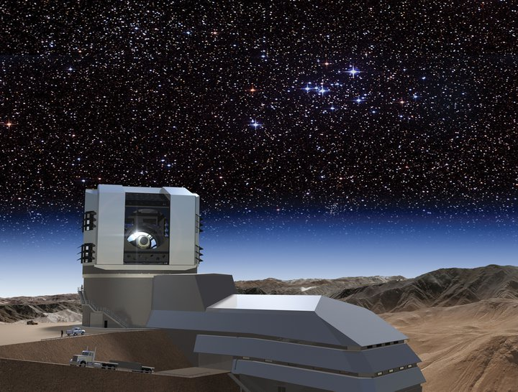
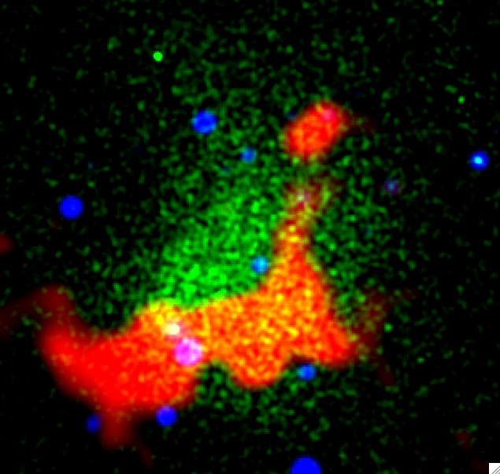
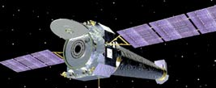
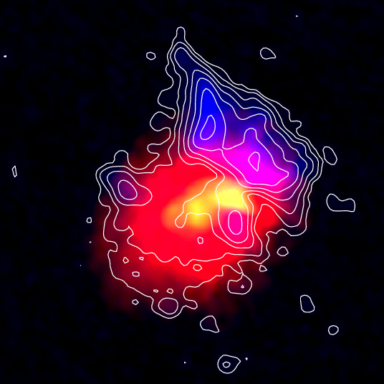
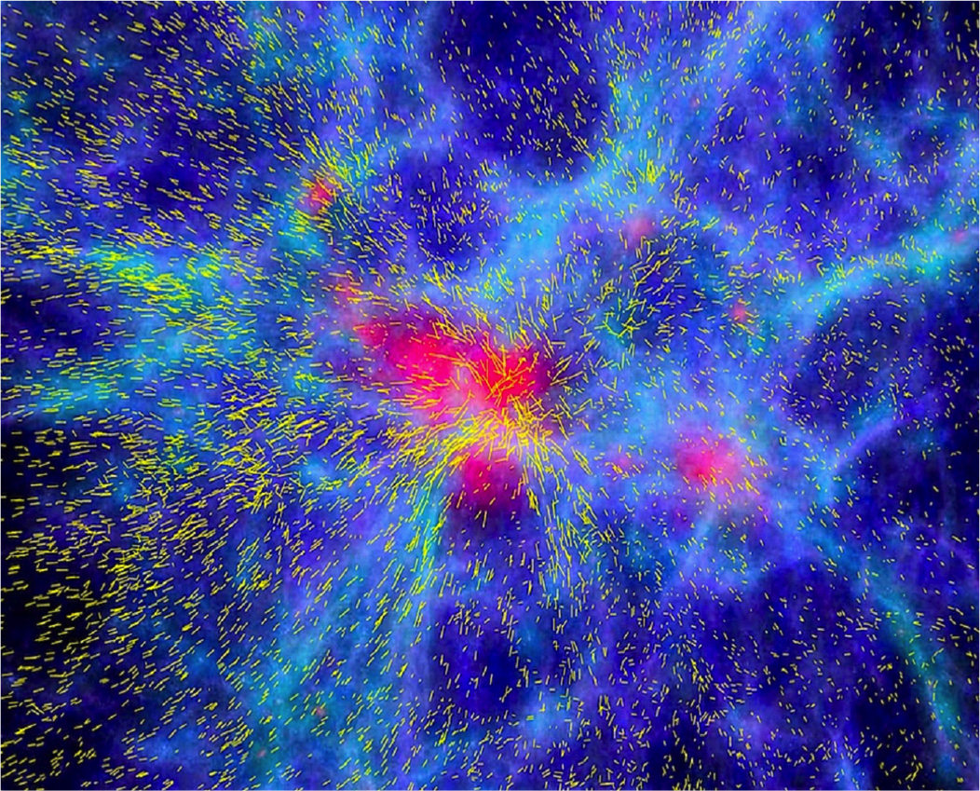
Cosmic Magnetism in Galaxy Clusters and Large Scale Structure
Tracy Clarke
Naval Research Laboratory

Slide 2
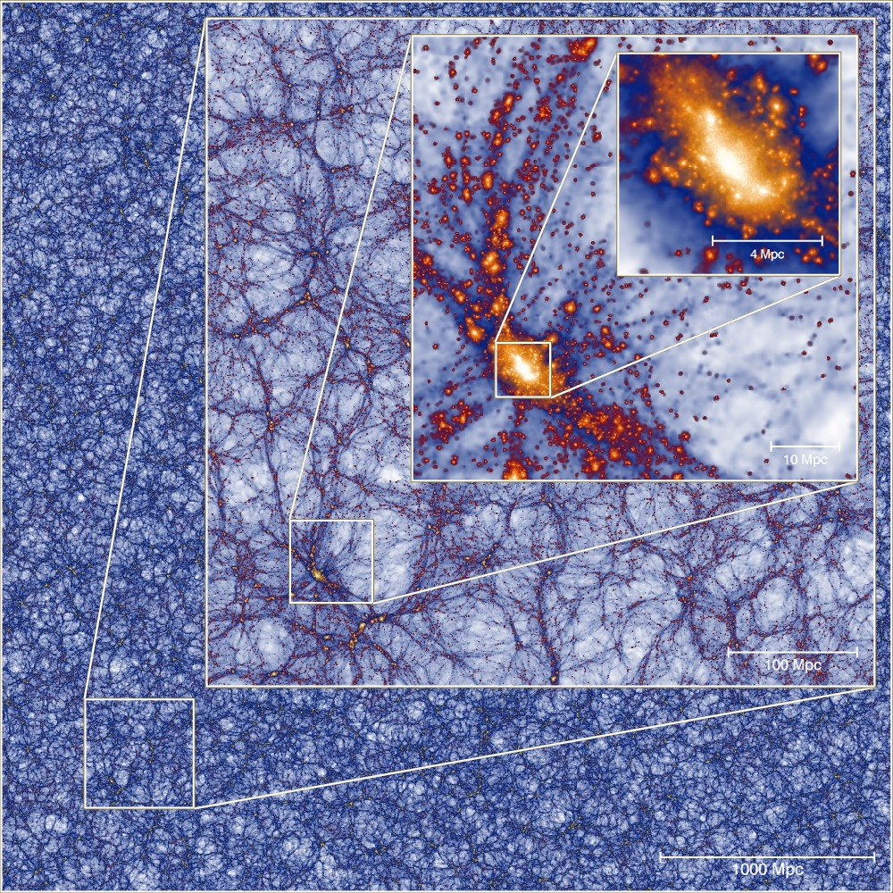
Formation of a Massive Galaxy Cluster
4 Mpc
10 Mpc
100 Mpc
1000 Mpc
Millennium XXL (2010)

Slide 3
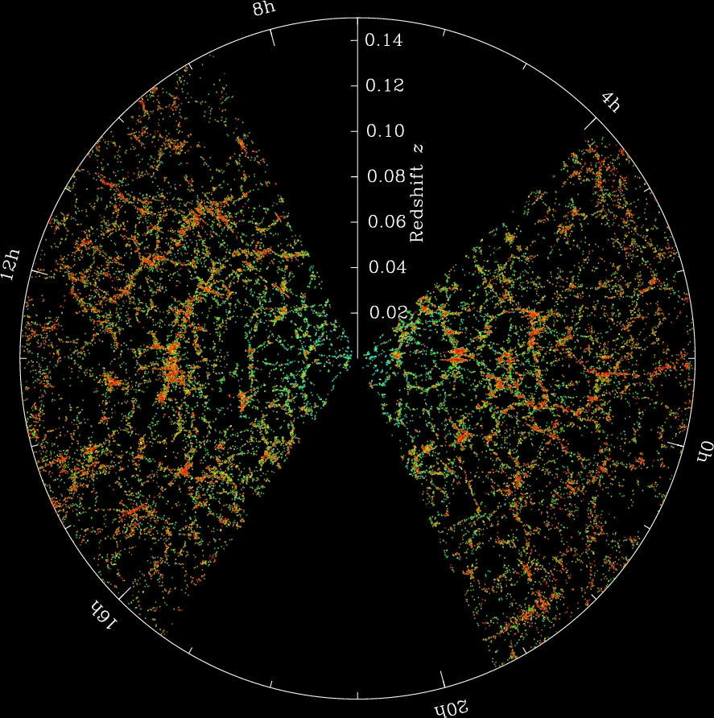
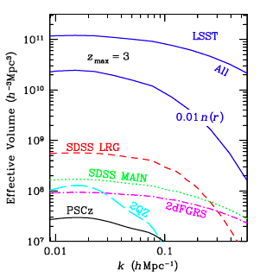
Tracing Structure with Redshifts
Redshift surveys: galaxy redshifts map out the 3D large scale structure of the Universe (bubbles, voids, sheets, filaments)
LSST: photometric redshift survey will target a much larger volume, ID sources for spectroscopic follow-up as needed
~150 000 galaxies
LSST Science Book
SDSS
Notes:
LSST cluster photometric redshifts are good to z~1! Clustering studies are likely OK with photoz’s

Slide 4
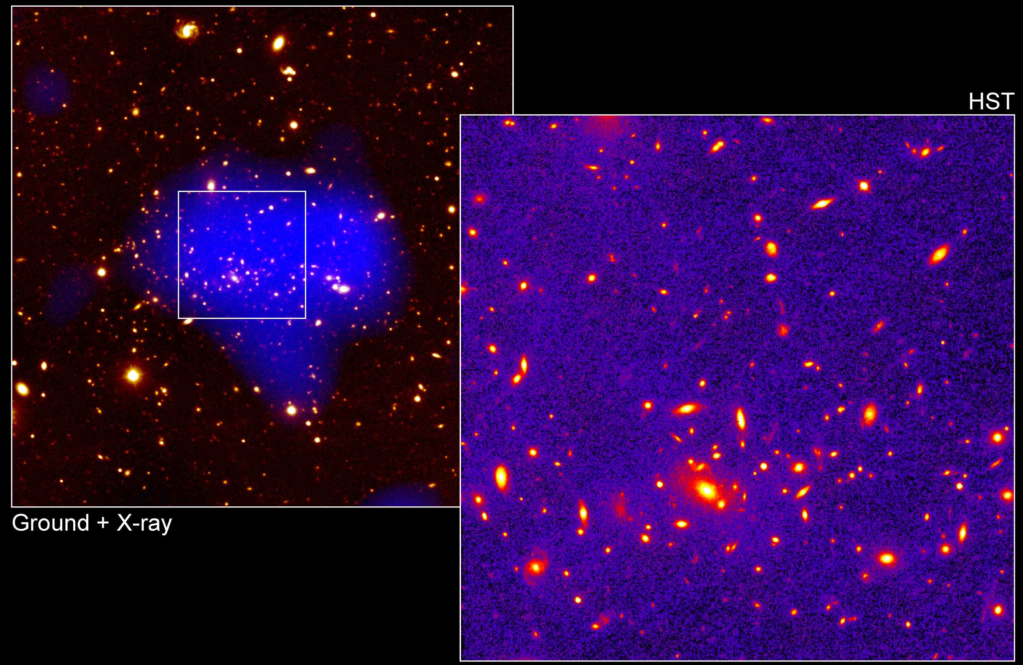
Content of Clusters and LSS
Clusters:
- Optical: 10² – 10³ galaxies (~5% of the mass)
- X-ray: 10⁷-10⁸ K gas
(~20% mass)
- 75% of mass is Dark Matter
- Radio: 10<γ<10⁴ relativistic electrons & 0.4<B<40 μG magnetic fields
Filaments:
- Majority of baryons are in the WHIM
- 10⁵ – 10⁷ K gas
- 0.01<B<0.1 μG fields
- Σ_{WHIM} ~10⁻³ – 10⁻⁵ x Σ_{ICM}
Clarke & Ensslin (2006)

Slide 5
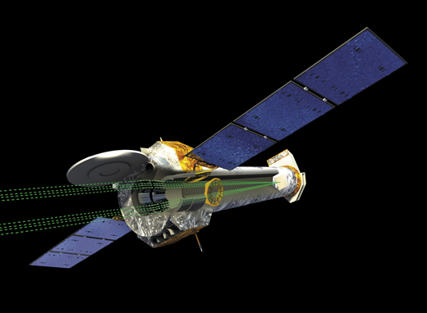
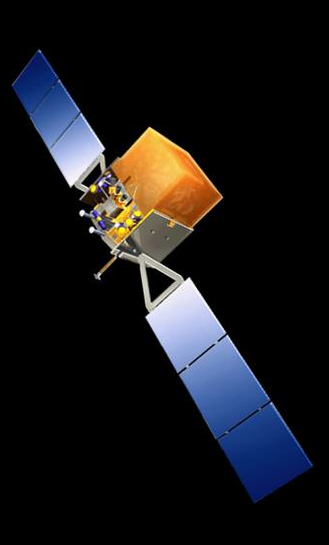
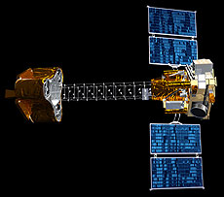
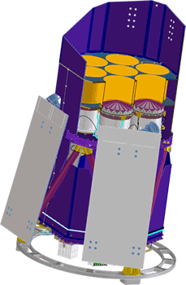
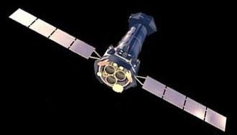
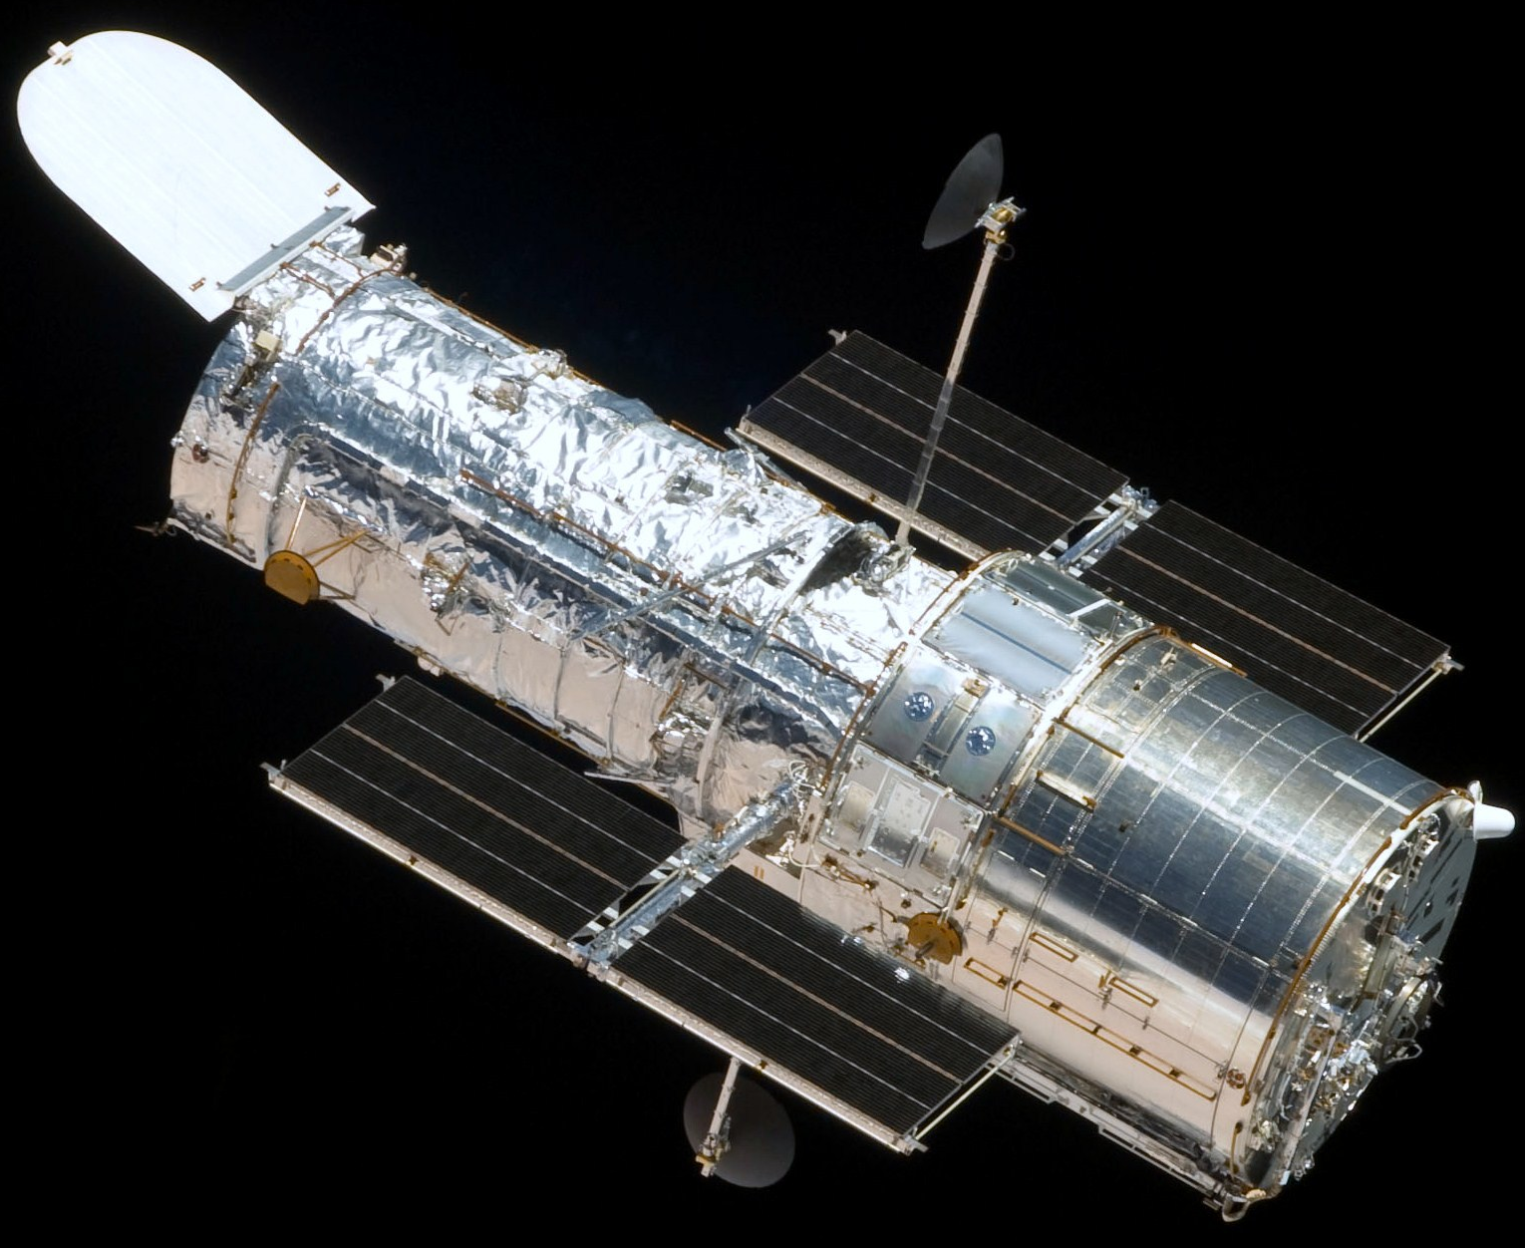
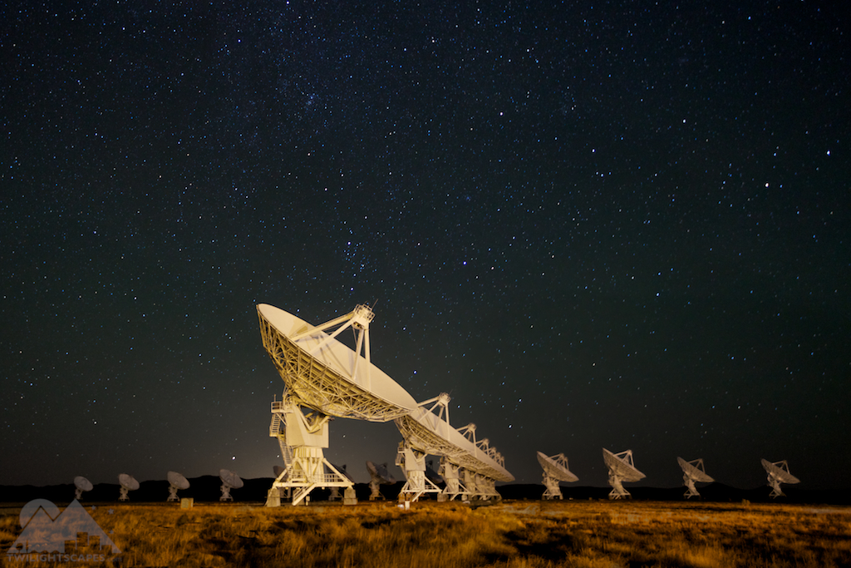
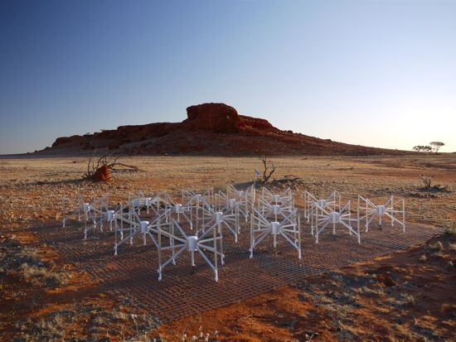
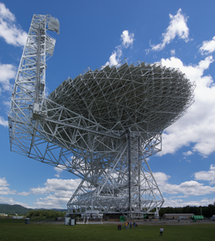
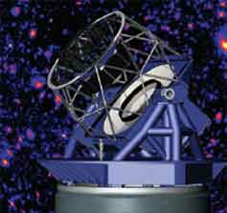
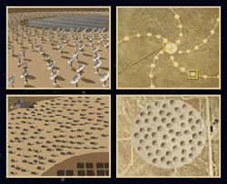
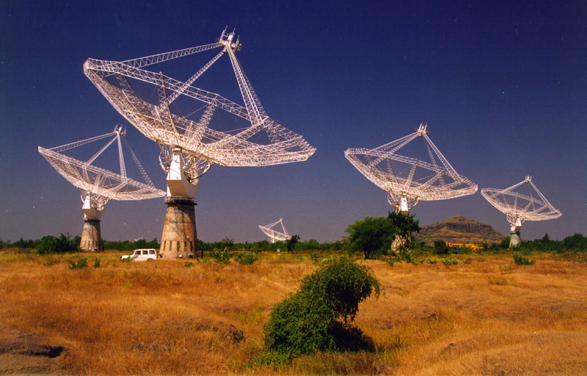
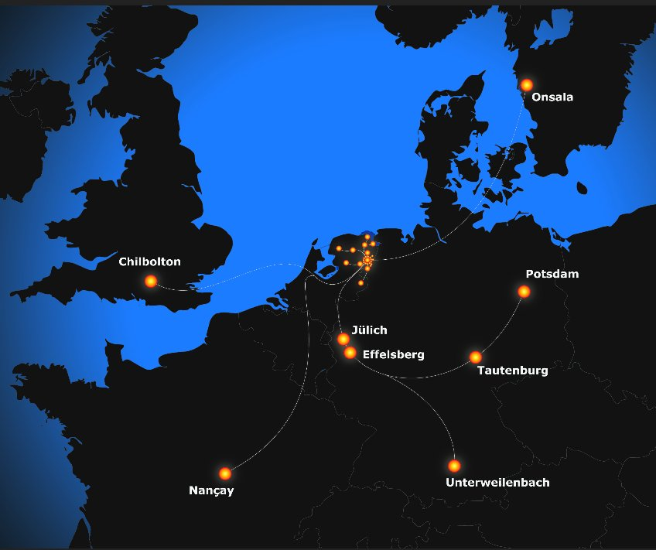
Multi-Wavelength Telescope Toolkit
Chandra
eROSITA
Fermi
NuSTAR
XMM
HST
MWA
GBT
JVLA
GMRT
LOFAR
SKA
LSST

Slide 6
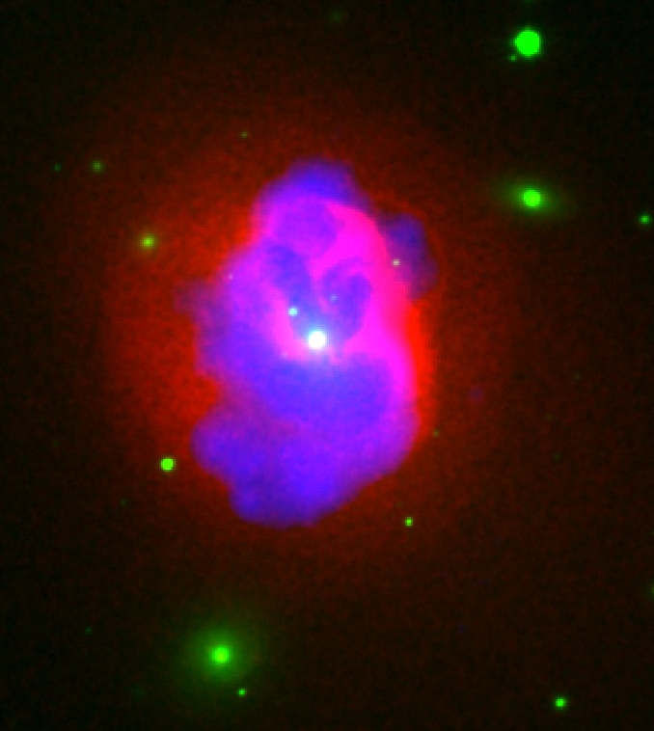
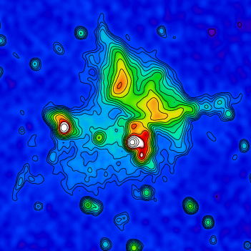
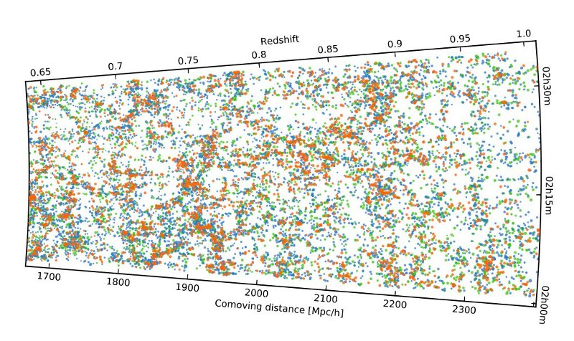

Astrophysics & Cosmology with Clusters
AGN Feedback
Particle Acceleration
Blanton et al. (2011)
Clarke et al. (2011)
Dark Matter
Dark Energy (Cluster Counting)
Clowe et al. (2004)
Guzzo et al. (2013)

Slide 7

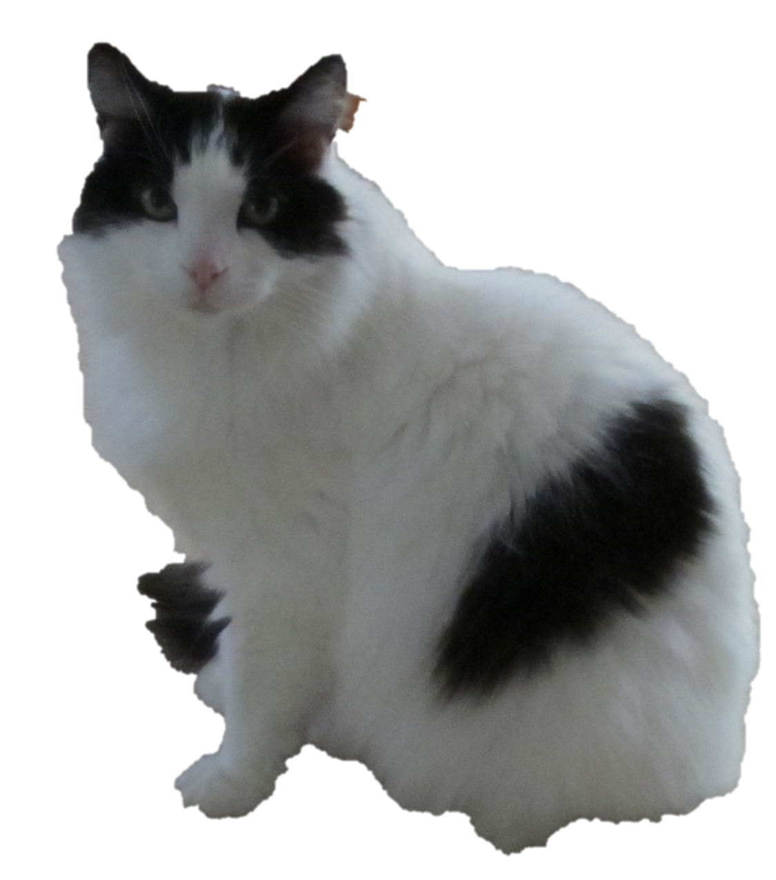
Cosmic Magnetism: The Next Frontier

Slide 8
Intracluster Magnetic Fields: Synchrotron Emission
Some clusters contain Mpc scale regions of diffuse synchrotron emission
Indicate presence of magnetic fields and relativistic electrons throughout the ICM
Roughly 50 systems known to host this emission
Halos are centrally located, diffuse and unpolarized
Relics are peripheral, often filamented and highly polarized
Relic
Halo
500 kpc
Clarke & Ensslin (2006)
All clusters which contain diffuse synchrotron emission show merger evidence but the connection to the merger energy is still uncertain. Need detailed understanding of cluster mass and dynamical state.

Slide 9
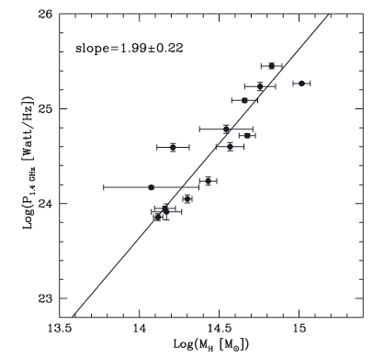
Halo Power – Mass Scaling Relations
Radio power is correlated with cluster mass
Hydrostatic equilibrium masses may be off by 40%
Accurate masses are important:
- constrains theories
- determination of magnetic field scaling with mass
- constrains ε_{rel}/ε_{th}
- limits on the fraction of PdV work that goes into ICM turbulence
Log P_{1.4}
Log M
Cassano et al. (2007)

Slide 10
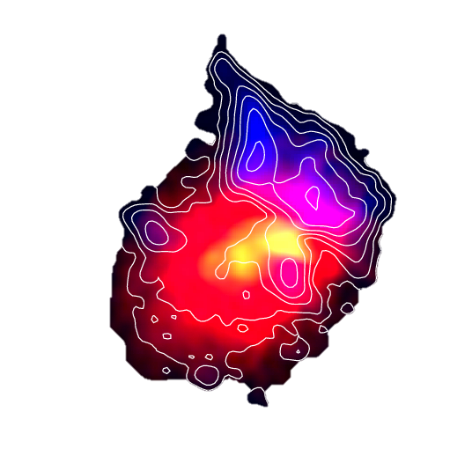
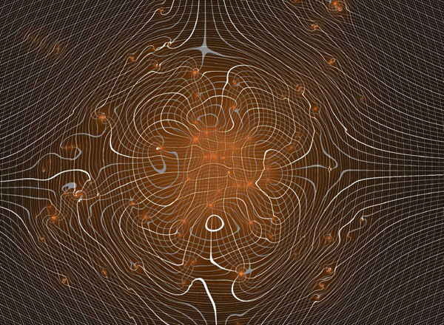
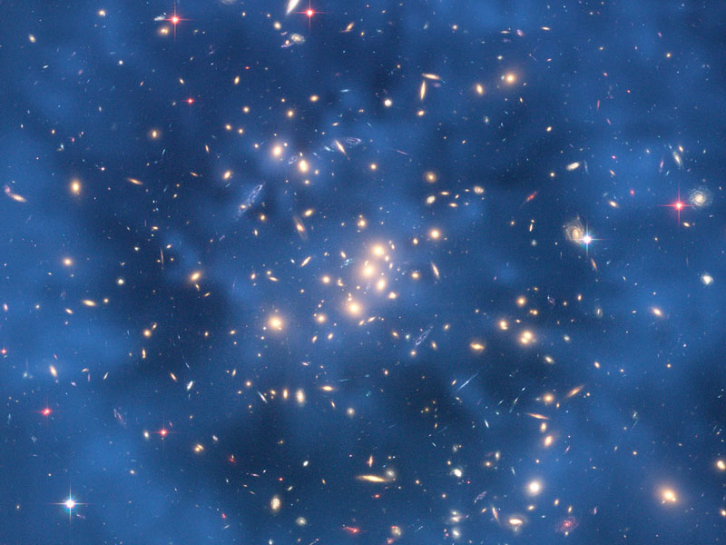
Looking Deeper at Clusters in the LSST Era
“Weak lensing … can measure total cluster mass without regard to baryon content, star formation history, or dynamical state.”
“… lensing is crucial for calibrating the mass-observable relation.”
CL0024: Image Credit LSST
CL0024: Image Credit NASA (HST)

Slide 11


1) Intracluster Magnetic Fields: Halos
Halo emission implies fields and particles distributed over Mpc scale
Origin is uncertain, primary or hadronic secondary
Emission is unpolarized, use minimum energy assumptions to estimate field strength:
Govoni & Feretti (2004)
Nominal halo numbers:
Σ_{syn} ~ 10⁻⁶ Jy/arcsec² @ 1.4 GHz, α < 1
B_{eq} ~ 0.1 – 1.0 μG
(assumes homogeneous field)
500 kpc

Slide 12
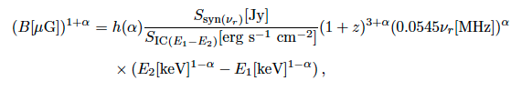
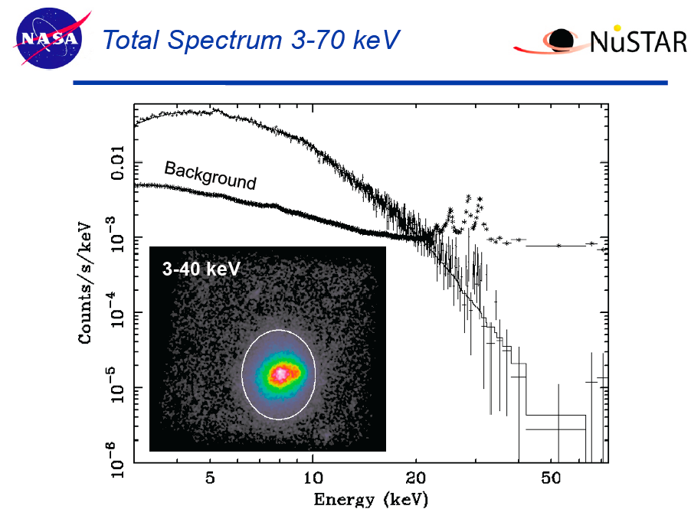
1) Intracluster Magnetic Fields: Halos
Relativistic electrons that produce synchrotron are also expected to inverse Compton scatter CMB to hard X-rays
Govoni & Feretti (2004)
IC halo limits from NuSTAR:
NuSTAR upper limit on IC emission from the Bullet cluster gives a lower limit of B_{IC} > 0.2 μG
Bullet Cluster
Wik et al. (2013)

Slide 13
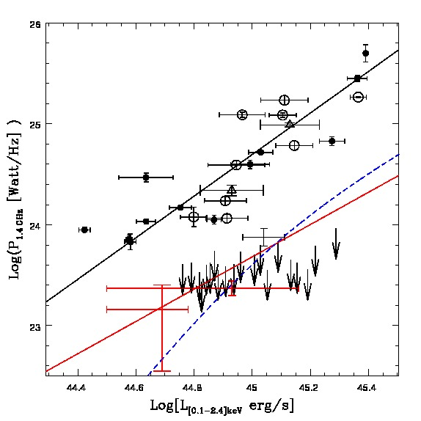
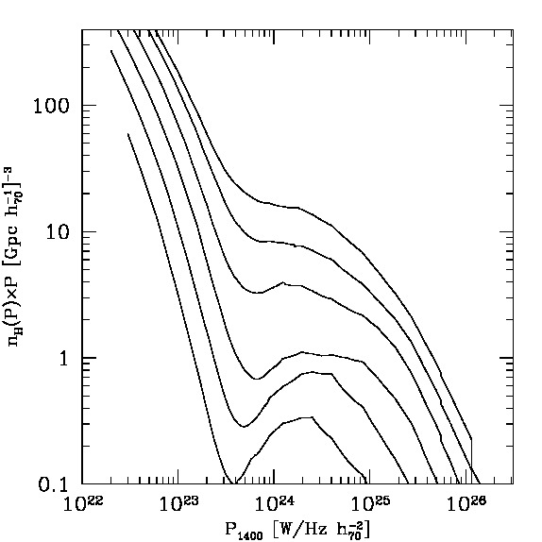
1) Halos: Near Future
ASKAP: EMU + WSRT: WODAN (LSST & Pan-STARRS complements)
Low frequency survey by LOFAR
Optical: accurate mass estimates and dynamical state information
Radio halos generated via turbulent re-acceleration
“Off-state’’ halos generated by hadronic secondaries in more relaxed clusters
EMU+WODAN (θ_{b}≈25 arcsec)
“off-state” halos
“off-state”
0.0-0.1
0.1-0.2
“turbulent” halos
Cassano et al. (2012)
0.2-0.3
Off-state clusters dominate at low L_{R}
Predict 200 new halos at z<0.6
Turbulent re-acceleration model predicts much larger number of USS halos will be seen by LOFAR
z
0.3-0.4
0.4-0.5
0.5-0.6
Halo Power
Notes:
EMU: Evolutionary Map of the Universe

Slide 14
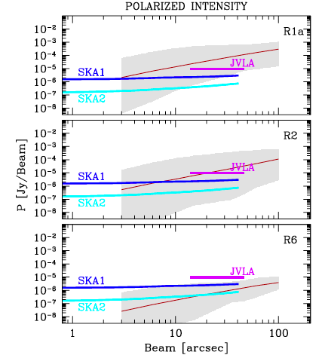
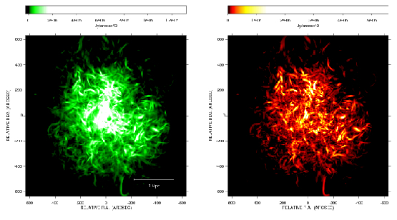
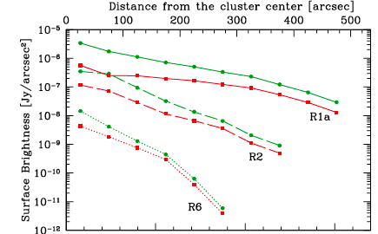
1) On-State Halos: Path Forward
JVLA should detect the first polarization signature in the brightest halos
SKA will see intermediate & faint halos to measure the polz. signature
Need deep optical data to probe dynamical state, cluster mass and target background RM probes
Fractional polz. is a robust indicator of ICM magnetic power spectrum
Bright
I
P
Intermediate
Faint
μJy/☐”
Bright
nJy/☐”
Intermediate
Faint
Govoni et al. (2013)

Slide 15

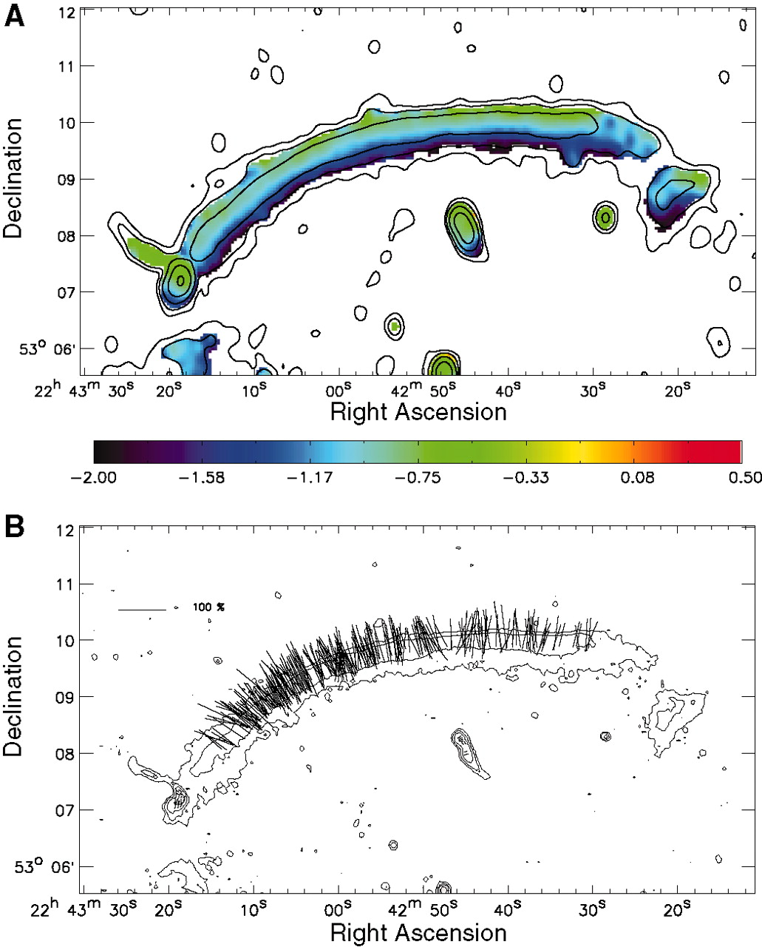
2) Intracluster Magnetic Fields: Relics
Relic emission projected at >1.5 Mpc from cluster core in some cases
Emission is highly polarized, fractional polarization gives angle between shock plane and line-of-sight
Use narrow width + spectral aging to estimate field strength in relic:
2 Mpc
55
kpc
Nominal relic numbers:
Polarized 10% - 50% level
B_{l} ~ 5 – 7 μG (compressed field strength)
~ 1.7 – 2.3 μG (pre-compression)
B_{eq} ~ 0.5 – 2 μG
B_{FRM} ~ 3 – 5 μG (A3667 relic)
B_{IC} ~ > 1.6 μG (Suzaku limits)
50% - 60% polarization
van Weeren et al. (2010)

Slide 16
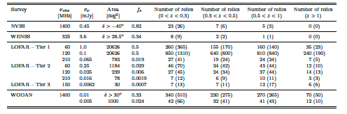
2) Relics: Near(ish) Future
Nuza et al. use MARENOSTRUM UNIVERSE simulation to determine relic power scaling with cluster mass and redshift
Predict relic counts(z) for upcoming WODAN and LOFAR surveys, need accurate optical mass reconstructions from Pan-STARRS & LSST
Nuza et al. (2012)
WODAN: Westerbork Observations of the Deep APERATIF Northern-Sky
LOFAR – Tier 1: Large area survey
LOFAR – Tier 2: Deep area survey
LOFAR – Tier 3: Ultra-deep area survey

Slide 17
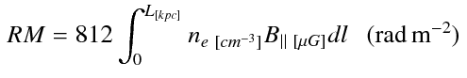
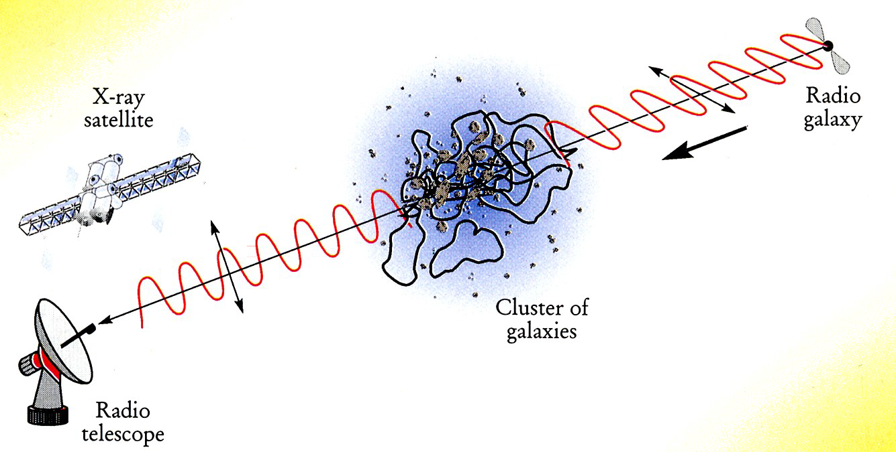
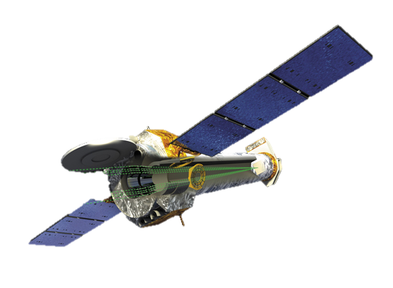
3) Intracluster Magnetic Fields: Faraday Rotation
n_{e}, B
Image Credit:
Govoni (2011)

Slide 18
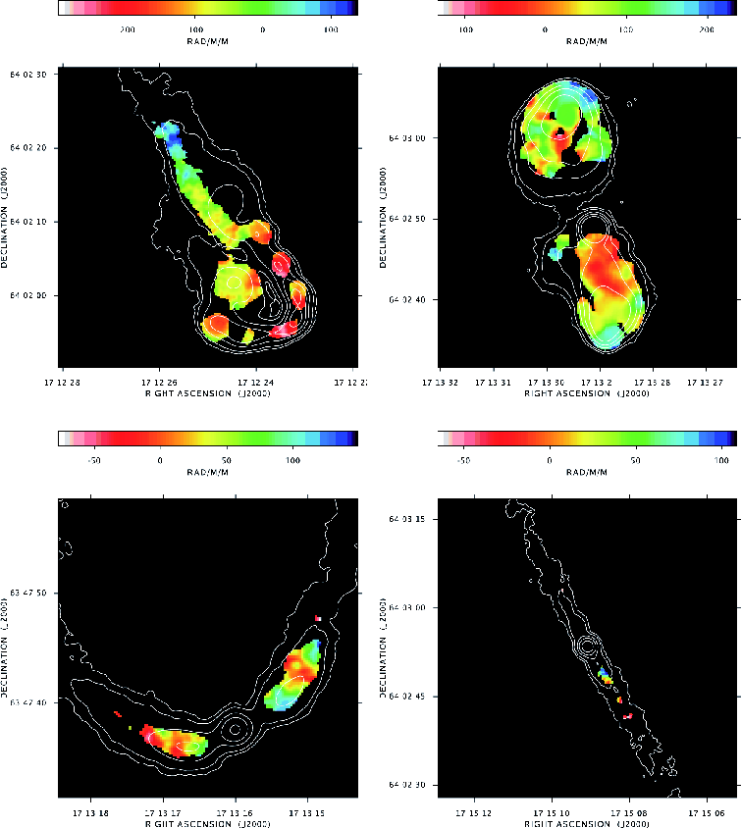
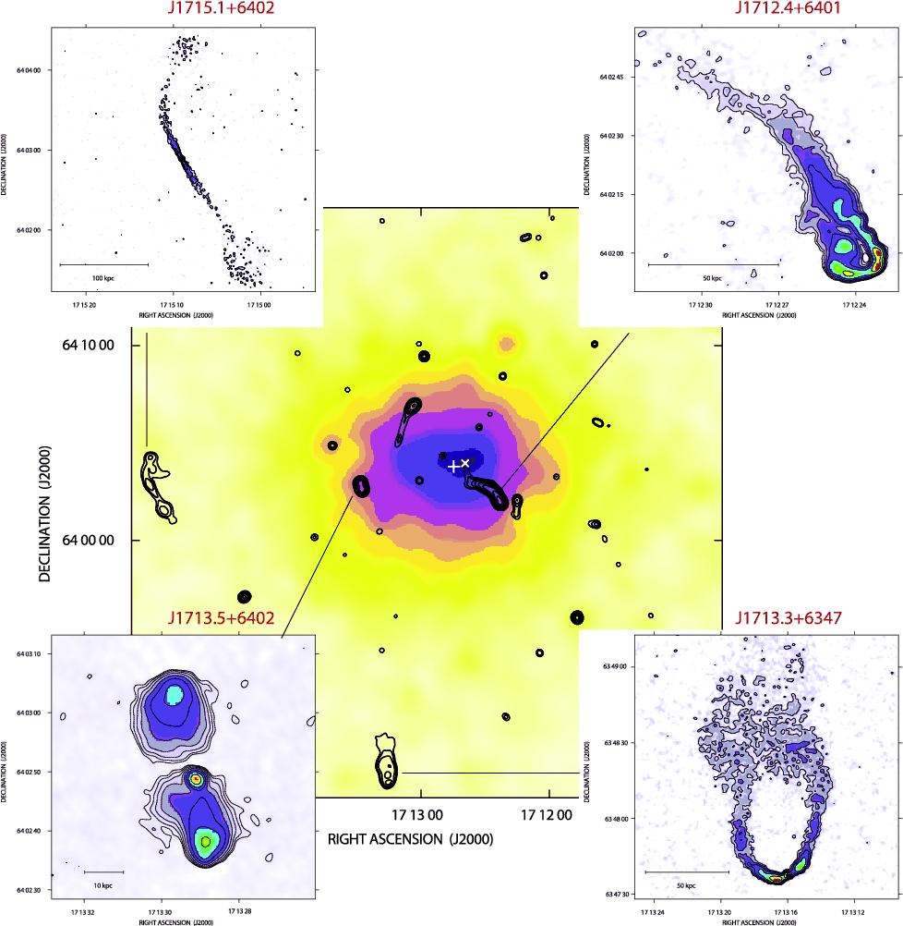
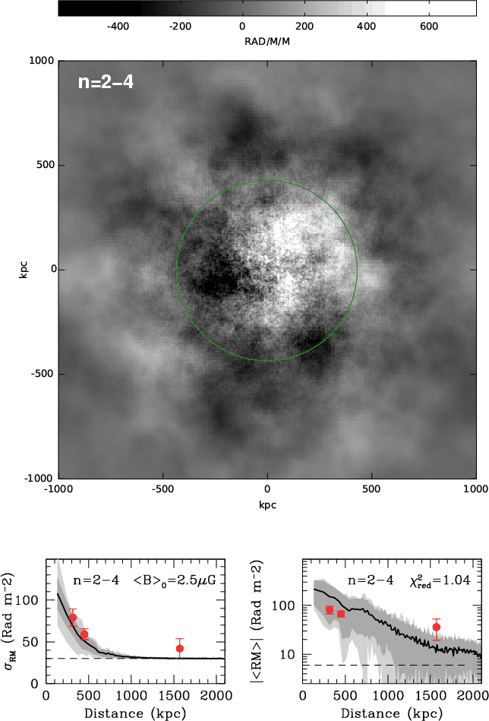
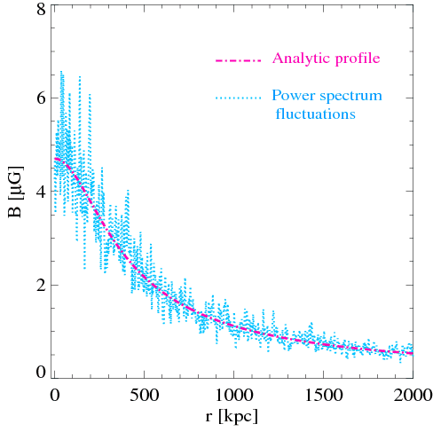
3) Faraday Rotation: Individual Clusters
3 sources
<B>_{c} ~ 2.5 μG
<B>_{o} ~ 1.2 μG
n=3
Abell 2255
7 sources
<B>_{c} ~ 4.7 μG
<B>_{o} ~ 0.1 μG
n=2.4-2.7
Coma
Govoni et al. (2006)
Bonafede et al. (2010)

Slide 19
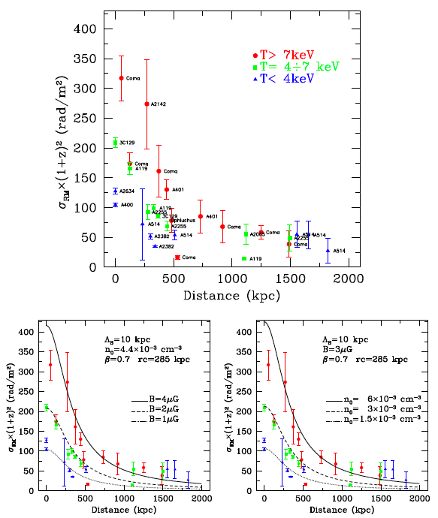
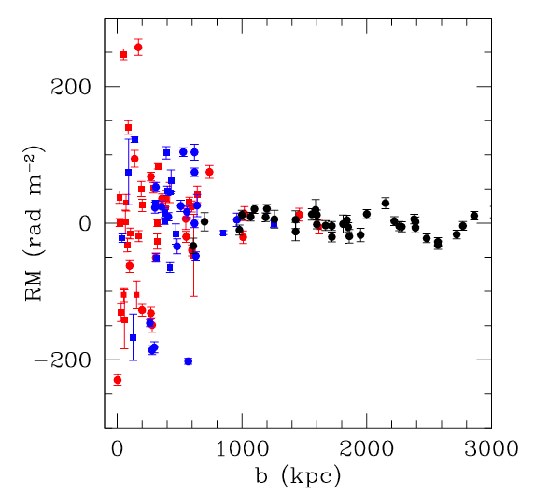
3) Faraday Rotation: Statistical Approach
Cluster RM signal to ~500 kpc
RM dispersion depends on ICM properties
Similar signals for embedded and background sources but need larger samples
Embedded
Background
Govoni et al. (2010)
Clarke (2004)

Slide 20
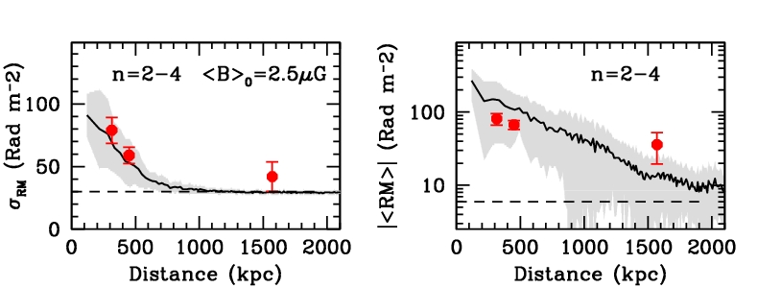
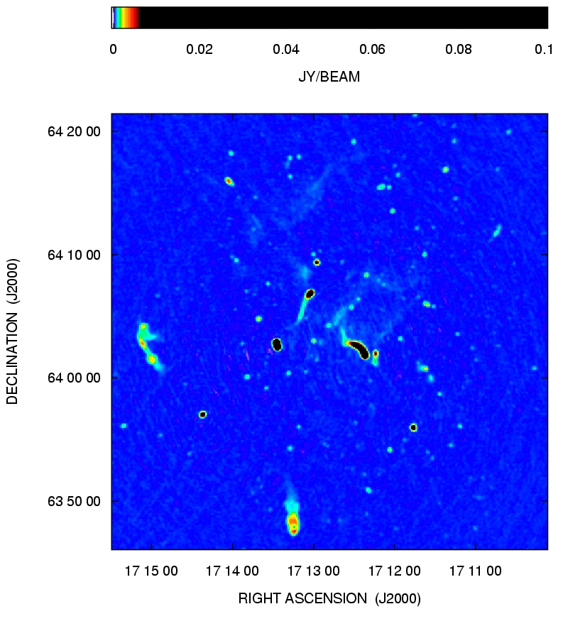




3) Faraday Rotation: Path Forward
POSSUM 1.4 GHz survey predicted 100 RMs/degree²
SKA will map Milky-Way type galaxies to z<1 and their
polarization emission to z<0.5.
Govoni (2013)
Notes:
POSSUM: Polarization sky survey of the Universe’s Magnetism

Slide 21

Caution: New Regime
Polarized Radio Probe Population
Deep JVLA 1.4 GHz fields, Rudnick & Owen (in prep.) now probe the faint end of the polarized source population that can be used for RM studies
They find a break in the cumulative count slope below 1 mJy
POSSUM
~1/3
Rudnick and Owen (in prep.)

Slide 22




4) Cosmic Web: Current Status
Some evidence of faint synchrotron bridges or possible LSS (Bagchi filament field B~0.3 – 0.5 μG)
Cross-correlation of 2MASS and 1.4 GHz Bonn survey placed limits limits around 0.2 μG on fields (Brown et al. 2011)
Predictions for μJy/☐’ radio surface brightness at 1.4 GHz
Brown et al. (2011)
A399 & A401
2.2 Mpc
Murgia et al. (2009)
Giovannini et al. (2013)
Planck collaboration (2013)

Slide 23


4) Cosmic Web: Path Forward
Pan-STARRS & LSST map cosmic web: cross correlation & stacking
Faraday rotation and diffuse synchrotron are used to map the magnetic field strength in the filaments as a function of redshift
Characterizing LSS field may discriminate field origin (Donnert et al. 2009)
Ryu et al. (2008)
Di Matteo (2008)

Slide 24

4) Cosmic Web: Path Forward
Brown (2010)

Slide 25
Summary: Radio/Optical Synergies
Magnetic fields traced through the diffuse synchrotron emission, physics details depend on accurate mass and dynamical state information
FRM probes cluster field magnetic power spectrum: redshift powerful tool for interpreting Faraday depth
Photometric redshift mapping of LSS combined with radio synchrotron can give first field measurements of Cosmic Web
Weak & strong lensing reconstruction of mass and dynamics for scaling relations
Radio Requirements
Deeper: high resolution on individual systems for direct detection
Wider: statistical cross-correlation and stacking studies
Lower: steep spectrum combined with high resolution needed
Higher: use polarization to trace cosmic shocks
Cluster studies need I~μJy/arcsec² & P~0.05 μJy/arcsec² at 1.4 GHz
Cosmic Web synchrotron studies need to reach μJy/arcmin² level
RM studies of the cosmic web need to be sensitive to RM~1 rad/m²

