Slide 1
Extragalactic Source Populations
Radio Astronomy in the LSST Era May 7, 2013
Jim Condon
Notes:
The LSST era means, there will be a multi-epoch and very sensitive 6-color optical survey covering the southern hemisphere. Radio astronomers can work with LSST by making their own surveys and finding their own transients, and by directed follow-up observations.

Slide 2
Questions:
What is already known about extragalactic source populations?
What should we try to learn before the LSST era?
How should future radio telescopes and observations be designed to match radio source properties?
How should future radio observations be designed to match the LSST?

Slide 3
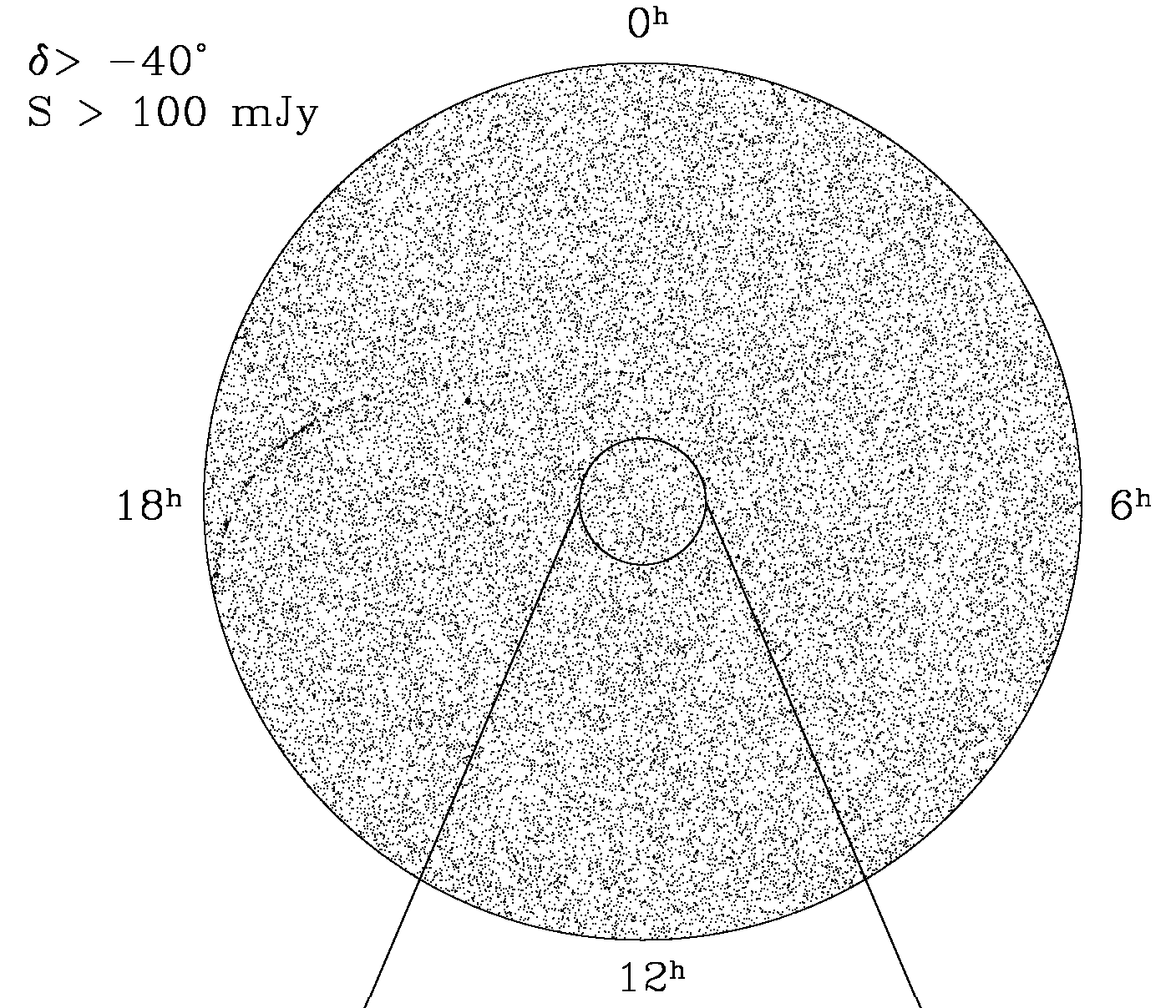
Nearly all radio sources are extragalactic
Notes:
Equal-area projection. Each point represents one discrete source at NVSS resolution (45”) stronger than 100 mJy at 1.4 GHz over 82% of the sky. The brightest radio sources are more isotropic than the optically brightest galaxies because they are much more distant, <z> ~ 1. The Galaxy is visible only within about 30 deg of the center, mostly too smooth.

Slide 4
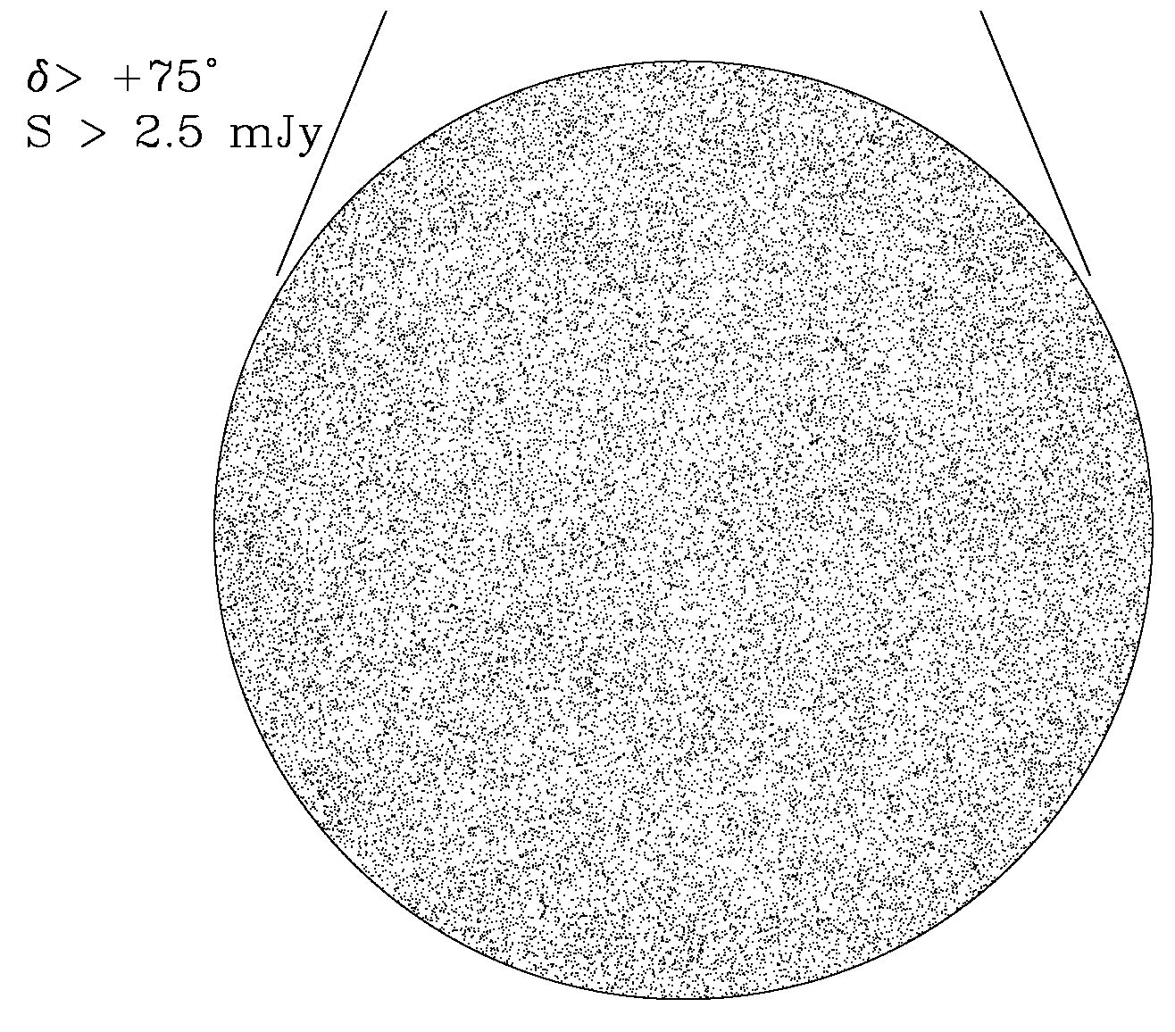
… very extragalactic: <z> ~ 0.8
Small Ω gives a fair sample
Notes:
The fainter sources (S > 2.5 mJy at 1.4 GHz) in the sky north of +75 deg, well away from the Galactic plane, are also very isotropic and hence cosmologically distant. Consequences of the isotropy: (1) Representative samples of radio sources can be selected from almost any small area of sky. (2) Large samples selected from “all sky” surveys can be used for cosmology; e.g., the integrated late Sachs-Wolfe effect and the Earth’s motion wrt the frame of radio galaxies have been measured from NVSS source counts. This requires good radio survey uniformity (sensitivity, angular resolution, photometry…). Quantity is useless without quality, or systematic errors will dominate statistical errors. EMU will find 500,000 sources > 50 microJy in the LSST 300 sq deg of deep drilling fields. Large area for nearby galaxies.

Slide 5
Few radio sources are nearby:
< 1% of 1.4 GHz radio sources can be identified with the ~ 10⁴ nearby (z < 0.05) UGC galaxies.
Often “all sky” radio surveys are faster than targeted observations for studying large samples of nearby galaxies; e.g.,
55000 2MASS galaxies with k < 12.25 mag can be found faster with NVSS (2500h) than with targeted scans. EMU
(~50 million sources > 50 μJy)
Notes:
Consequence: To study the radio emission from a large sample of nearby bright galaxies requires a radio survey covering a large fraction of the sky or many targeted observations of individual galaxies. For example, there are about 55000 2mass galaxies brighter than k20fe = 12.25 mag in dec > -40 deg and |b| > 20 deg. Making targeted VLA snapshots of all of them would take as long as making the NVSS survey (~2500 h). This argues for making NVSS successor surveys covering the southern hemisphere, such as the ASKAP EMU survey (50 microJy/beam detection limit, 10 arcsec FWHM resolution at 1.4 GHz), to make the best use of LSST.

Slide 6
Radio power sources:
Star formation AGN
1.4 GHz local luminosity functions of star-forming galaxies and AGNs
Notes:
“Star formation” means stars more massive than 8 solar masses, which ionize HII regions and make free-free emission, and whose supernovae within 30 Myr accelerate the cosmic rays that make the synchrotron radiation that dominates at wavelengths longer than ~ 1 cm. Stars significantly older than 30 Myr make most of the visible light but almost none of the radio emission from galaxies. Our Galaxy log L ~ 21.4, M82 ~22.1, Arp 220 ~ 23.4.

Slide 7
Locating SMBHs in AGNs
Notes:
N > 300 VLBA detections so far, > 50% detection rate. 2mass absolute astrometry sigma_alpha ~ sigma_delta ~ 0.1 arcsec. 2mass frame offset from ICRF < 10 mas, individual radial offsets Rayleigh distributed as expected from Gaussian noise, with sigma = 114 mas so genuine offsets > 0.424 arcsec (outside the circle) are 99.9% significant. Future improved OIR astrometry with LSST. ( LSST rms per coord ~ 10 mas for stars brighter than 21 mag, good match to VLBA). So far one good candidate galaxy. LSST astrometry of galaxy bulges?
ESO 443 -G 007 ( ~ 1 arcmin opt diam, v = 17194 km/s, in Abell 3528A cluster), peak shown 2MASS Ks grey scale with VLBA position cross offset ~ 3 arcsec to the east. Also, one 7 pc binary AGN in this sample.

Slide 8
FIR/radio correlation
Radio luminosity is an extinction-free measure of star-formation rate
Radio and FIR flux-limited populations of star-forming galaxies are nearly identical
Notes:
The FIR/radio correlation makes radio flux densities useful extinction-free star-formation indicators, even though the radio emission is energetically unimportant. The radio sources powered by star formation are roughly coextensive with the FIR dust emission and star formation. Radio images can resolve even the most compact star-forming galaxies, unlike FIR images, using aperture synthesis interferometry.

Slide 9
Evolving populations of radio sources
: 2012, ApJ, 758, 23
Notes:
Flattening 10-1000 microJy from star-forming galaxies, dropoff below 10 microJy = “knee” of their luminosity function.
<z> is nearly independent of flux density because of (1) strong evolution up to z ~ 1 and (2) steep radio spectra (alpha ~ -0.7) give large K correction to suppress z >> 1 sources.
Consequently, flux density correlates better with luminosity than distance; see upper abscissa. 1 microJy ~ our Galaxy (unevolved logL = 21.4) at z = 0.8. Why even moderately bright radio sources have optically faint galaxy IDs.
y
Sensitive radio surveys are not “deep” radio surveys; they just sample less-luminous sources. Similar to submm surveys, but for a different reason and at lower z.

Slide 10
Star formation vs AGN sources:
1000 × luminosity difference but comparable energy densities
u_{m} ∝ L ρ_{m}(L)
Notes:
Remember the shape of these curves; they show contributions to the sky background as a function of log flux density.

Slide 11
Resolving the radio source background
Notes:
Consequently, AGNs dominate the radio source background above a few tenths of a mJy, star-forming galaxies below this. AGN:star-forming contributions ~ 63%/37% to total.

Slide 12
FIR/radio correlation and the μJy radio source count
Data points and P(D) box: Herschel λ = 160 μm counts (Berta et al. 2011, A&A, 532 A49) converted to 1.4 GHz by FIR/radio correlation
Notes:
Berta et al. 2011, A&A, 532, A49 Herschel P(D) counts at 160 microns ~ 80 microns in source frame at z ~ 1. Good match to radio microJy source count.
Rapid convergence of counts implies confusion is not a problem, dynamic range is. See Condon, J. 2009, SKA Memo 114. FIR/radio correlation consistent
with microJy radio sources being mostly powered by star formation.

Slide 13
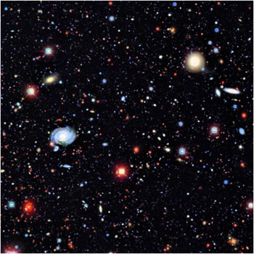
Optical IDs
~ 10¹⁰ galaxies
with r < 27.7
in 2×10⁴ deg² →
1 galaxy / 25 arcsec²
σ ~ 0.2 arcsec astrometry to ID?
~ 100% ID rate?
(Willner et al. 2012, ApJ, 756, 72)
Notes:
LSST simulated image 4arcmin X 4 arcmin. See NVSS paper Condon et al. 1998 AJ 115 1693 for astrometry calculation. 5e5 galaxies/deg^2 ~ 1.6e9 galaxies/sr. From 1.40G.CNT, there are about 1.6e9 sources/sr stronger than 0.01 microJy at 1.4 GHz. LSST sky density ~1.0e4 X NVSS sky density above 2.4 mJy at 1.4 GHz, ~100 X EMU sky density above 50 microJy at 1.4 GHz, and ~10 X JVLA deep fields (~ 4 microJy at 1.4 GHz). 0.2 arcsec
rms errors in RA or DEC at SNR ~ 5 require a beam size < 2.0 arcsec, not too small for median size < 1 arcsec of distant starburst galaxies. Note radio confusion melts away; at 2 arcsec FWHM, there are 1.e10 beam solid angles per sr and 25 beam solid angles per source stronger than ~0.3 microJy at 1.4 GHz.

Slide 14
Matching observations to sources - 1
Brightness temperature detection limit for “normal” galaxies:
T_{b}= 2 ln(2) c² S / (π k θ² ν²) = 1.22 S(μJy) × [θ(arcsec) ν(GHz)]⁻² (K) ≤ 1 K at 1.4 GHz to detect “normal” star-forming galaxies.
Ex: EMU S = 50 μJy, θ = 10 arcsec, ν = 1.4 GHz yields T_{b} = 0.3 K
Astrometric accuracy for optical identifications with faint LSST galaxies:
σ= θ / (2 × SNR) ~ θ / 10 for SNR = 5
Ex: EMU σ ~ 1 arcsec is not good enough for reliable position-coincidence identifications of faint radio sources with the faintest LSST galaxies.
Notes:
Larger arrays have a lower filling factor, can’t see low-brightness sources.

Slide 15
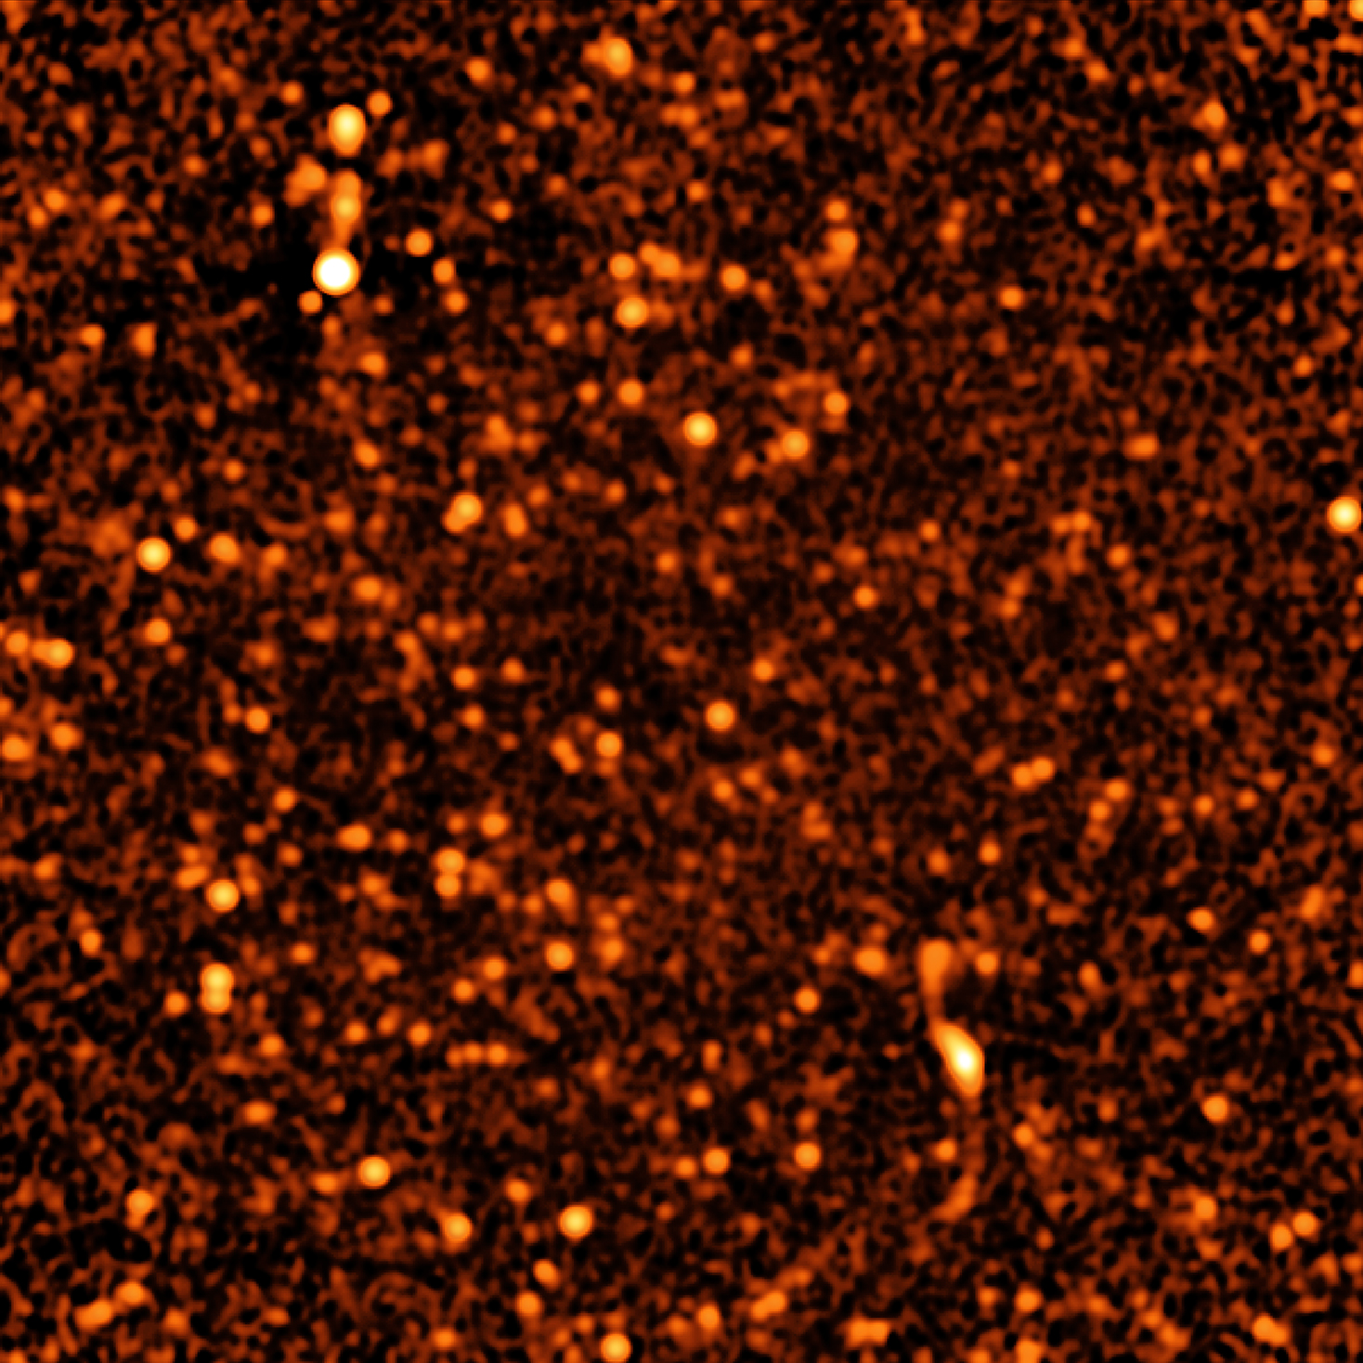
Confusion
Instrumental
Natural
12 arcmin × 12 arcmin ν= 3 GHz
θ = 8 arcsec σ_{c} = 1 μJy/beam
(2012, ApJ, 758, 23)
Confusion “melts away” in smaller beams

Slide 16
Matching observations to sources - 2
Instrumental confusion “melts away” for FWHM θ ≤ 10 arcscec .
Ex: EMU θ = 10 arcscec, ν = 1.4 GHz, σ_{c} ~ 3 μJy/beam
Natural confusion will not be a problem even at nanoJy levels if faint source size <Φ> ~ 0.5 arcsec FWHM, the median angular size of faint star-forming galaxies (Nelson et al. 2013, ApJ, 763L, 16).
Notes:
Median angular size of faint galaxies ~ 0.5 arcsec estimated from 2 kpc radius at z ~ 0.8 from HST H-alpha spectra, needs EVLA confirmation.

Slide 17
Matching observations to sources - 3
Dynamic range:
A problem at low frequencies; see SKA Memo 114
Choose “deep drilling” fields to avoid strong radio sources.
Ex: EMU primary Ω ~ 1 deg2, <S_{eff}> ≤ 1 Jy over 90% of the sky, and
σ_{n} = 10 μJy/beam requires DR ~ 100,000:1
Ex: EVLA S-band (3 GHz) B-array θ ~ 2.5 arcsec > 0.5 arcsec deep integrations reaching 5σ ~ 5 μJy can do it all, in small selected areas.
Spectral indices: σ_{α} ~ 1 / | ln(ν₁/ν₂) | so surveys to complement 1.4 GHz should be at > 5 GHz or < 0.4 GHz.
Notes:
Median angular size of faint galaxies ~ 0.5 arcsec estimated from 2 kpc radius at z ~ 0.8 from HST H-alpha spectra, needs EVLA confirmation.

Slide 18
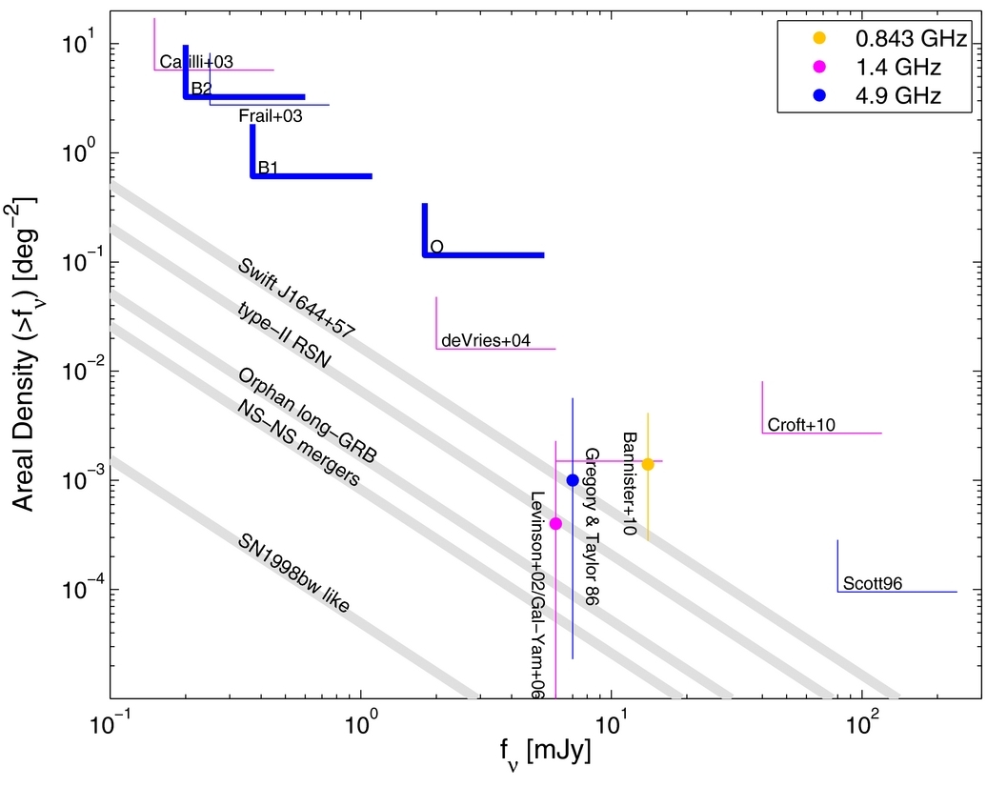
Transient extragalactic radio sources
Core-collapse SNe
Orphan GRBs
TDEs
Microquasars
“Lorimer bursts”
Follow-up vs blind survey
Coherent vs incoherent
VAST 1.4 GHz
VLA 74 and 330 MHz
GMRT 150 MHz, LOFAR
VLA 6 GHz sky survey?
Frail et al. 2012, ApJ, 747, 20
Notes:
Frail et al. “conclude that the dynamic radio sky remains a rich area for further exploration.” Meaning, we don’t know much about it, and many reported transients aren’t real.
Most radio transients are follow-ups of optical, x-ray, or gamma-ray transients.
1.4 GHz “intermediate frequency gap” between known extragalactic variables and “false” variability from ISS.
VAST: An ASKAP [blind] survey for variables and slow transients, Murphy et al. 2013, PASA, 30, 6 will cover 10000 deg^2/day with rms 0.5 mJy/beam.

Slide 19
Summary:
What is already known about extragalactic source populations?
The nonvariable population is well constrained near 1.4 GHz.
What should we try to learn before the LSST era?
Transient sources, steady sources at lowest and highest frequencies.
How should future radio telescopes and observations be designed to match source properties?
T_{b} ≤ 1 K detection limit at 1.4 GHz, high dynamic range at low frequencies.
High data quality, calibration errors < 1 / √N
Multifrequency follow-up capability (e.g., EVLA, ALMA).
How should future radio observations be designed to match the LSST?
σ ≤ 0.2 arcsec for identifications, high fidelity for transient surveys,
θ > 0.5 arcsec FHWM beam for completeness.
Low frequency surveys for coherent transient sources
High frequency (e.g., 6 GHz) EVLA sky survey for spectra, variables.

Slide 21
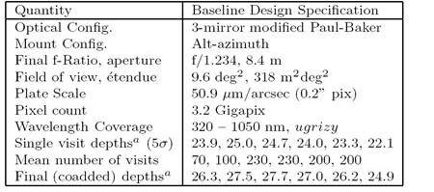
LSST telescope and main survey specifications
Main survey sky coverage 20000 deg2
30 s “visit” time
Relative astrometry within one 4k x 4k CCD:
~10 mas per visit, 0.2 mas/yr proper motion after 10 years
Notes:
90% of LSST time goes to main survey. FoV limited by telescope optics, not detector. 0.2 arcsec pixels Nyquist sample in best of seeing; avg FHWM = 0.7 arcsec limited by atmosphere at Cerro Pachon, northern Chile, latitude = -30 deg. 6.5 m effective aperture. Compare SDSS etendue ~ 6 m^2 deg^2. Array of 189 4 k X 4k CCD detectors, each ~ 0.23 deg on a side.

Slide 22
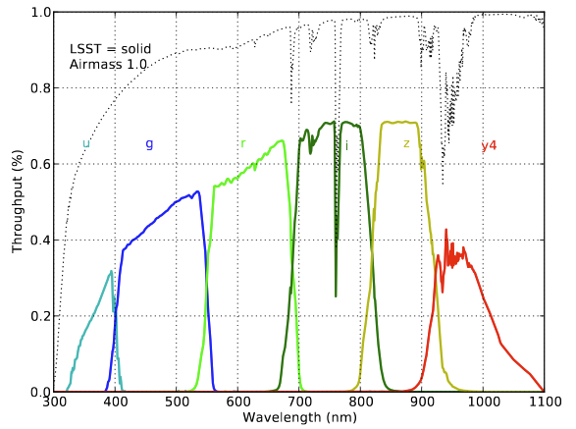
LSST ugrizy filters cover 0.32−1.05μm

Slide 23
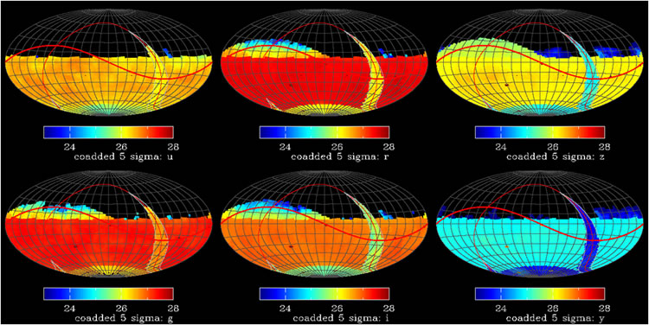
Sky coverage of 20000 deg² main survey
Notes:
Deepest survey is r = 27.7 (5 sigma) after 10 years. Sky coverage ~ 20000 deg^2, mostly in southern hemisphere and north ecliptic plane (for solar-system objects).

Slide 24
Complementary radio telescopes, surveys, and directed observations
Coordinated transient searches, especially with multibeam interferometers like ASKAP (1.4 GHz FOV ~ 30 deg² with 10 arscec resolution ~ 10⁷ “pixels”)
Coordinated deep surveys (EMU survey will cover 30000 deg² and detect up to 7 X 10⁷ galaxies, but ~1 arcsec positions may not be good enough for position-coincidence identifications with faint LSST galaxies
Directed radio follow-ups of optical transients having intrinsically long- lived radio afterglows with high angular resolution, absolute position accuracy, and sensitivity (EVLA, VLBA, ALMA, …). E.g., gamma-ray bursts, periodic radio emission from brown dwarf stars;…
Directed radio follow-ups of non-transient LSST sources (QSOs selected by low proper motion or optical variability, location of AGNs in host galaxies by accurate astrometry, optical identifications of faint clusters of galaxies…)
Notes:
Notes: interferometer images of primary beam ~ megapixels. Radio good to follow up optical transients because
High-energy phenomena frequently produce low-energy photons (e.g., synchrotron radiation) and
(2) Radio gives intrinsically long-lived afterglows easier to follow up.

Slide 25
RMS community involvement with LSST
LSST working group discussion at the March 2011 Santa Fe "Building on 'New Worlds, New Horizons’” workshop group lead Amy Kimball akimball@nrao.edu group mailing list rms-lsst-group@nrao.edu
  Coordinating follow-up observations of LSST transient sources
  Contributing to (and learning from) designs of LSST surveys and data products
  Contact Amy to join
NRAO institutional membership in LSSTC (LSST Corporation)? Major commitment: $75k to join + $25k/year dues Major opportunity as voice for RMS community
Notes:
LSST will develop a lot of software for real-time data processing, imaging, etc., which the NRAO might learn from.

