Slide 1
Virtual Astronomy in the Era of LSST
Robert Hanisch
Virtual Astronomical Observatory and
Space Telescope Science Institute
G.B. Berriman (IPAC/Caltech/VAO), T.J.W.Lazio (JPL/VAO), D. Tody (NRAO/VAO), M.J.Graham (Caltech/VAO), A. Rots (SAO/VAO)

Slide 2
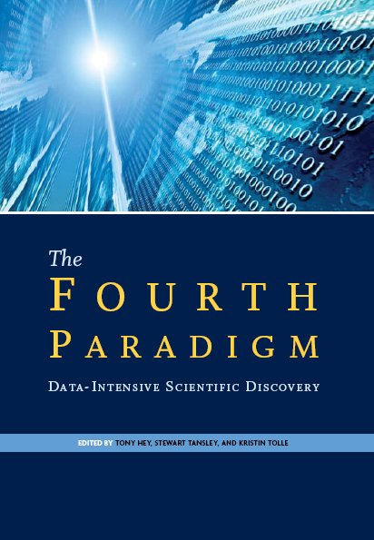
“Virtual Astronomy”
… is the utilization of diverse, distributed, multi-wavelength data resources and distributed storage and computational services to enable both novel and more efficient research in astronomy
Re-use and re-purpose data; broaden impact of data taken at significant expense
Support research in the world of TB→ PB scale data collections
“data enabled discovery – the database is the new laboratory” (T. Tyson)
Enabling virtual astronomy:
the Virtual Observatory
Observation
Theory
Simulation
Data

Slide 3
Radio/LSST Implied Requirements
Data exchange / interoperability / multi-λ (co-observing)
Query and cross-match across distributed databases
Remote (but managed) access to centralized computing and data storage resources
Transient event notification, scalable to 10⁵ – 10⁶ messages/night
Data mining, characterization, classification, statistical analysis

Slide 4
Radio/LSST Implied Requirements
Data exchange / interoperability / multi-λ (co-observing)
Data Access Layer (SIAP, SSAP / time series)
Query and cross-match across distributed databases
Cone Search, Table Access Protocol
Remote (but managed) access to centralized computing and data storage resources
VOSpace, single-sign-on, VOBox
Transient event notification, scalable to 10⁵ – 10⁶ messages/night
VOEvent
Data mining, characterization, classification, statistical analysis
VOStat, Data Mining and Exploration (DAME) toolkit

Slide 5
The Virtual Observatory
5
The VO is a data discovery, access, and integration facility
Images, spectra, time series
Catalogs, databases
Transient event notices
Software and services
Application inter-communication
Distributed computing
  authentication, authorization, process management
International coordination and collaboration

Slide 6
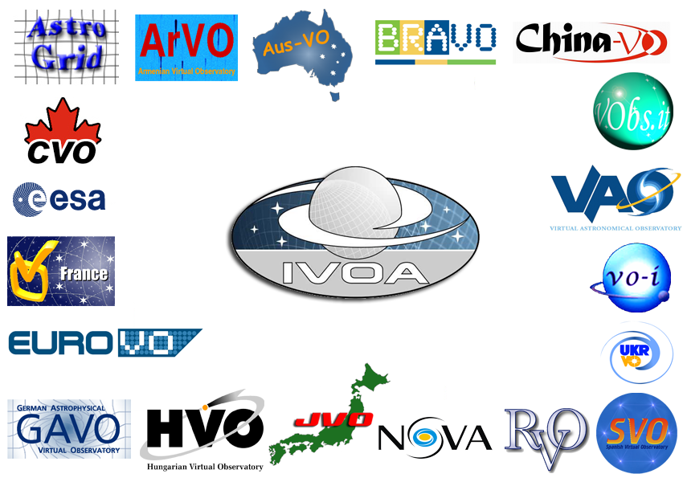
The International Virtual Observatory
6
International collaboration on metadata standards, data models, and protocols
  Image, spectrum, time series data
  Catalogs, databases
  Transient event notices
  Software and services
  Distributed computing (authentication, authorization, process management)
  Application inter-communication
International Virtual Observatory Alliance established in 2001, patterned on WorldWideWeb Consortium (W3C) http://www.ivoa.net/

Slide 7
Virtual Observatory Architecture

Slide 8
Virtual Observatory Architecture

Slide 9
Virtual Observatory Architecture

Slide 10
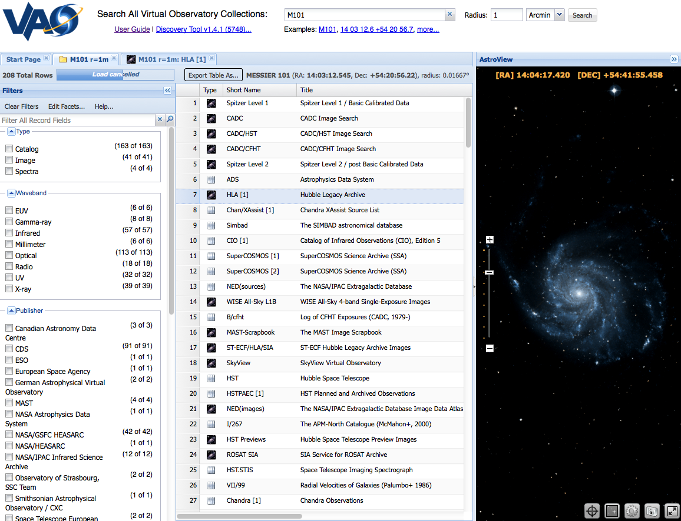
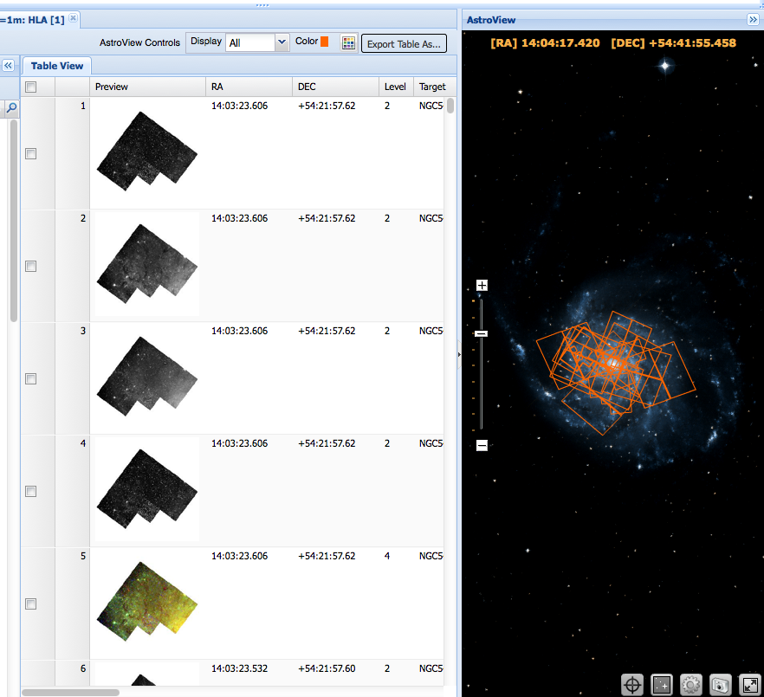
Data Discovery

Slide 11
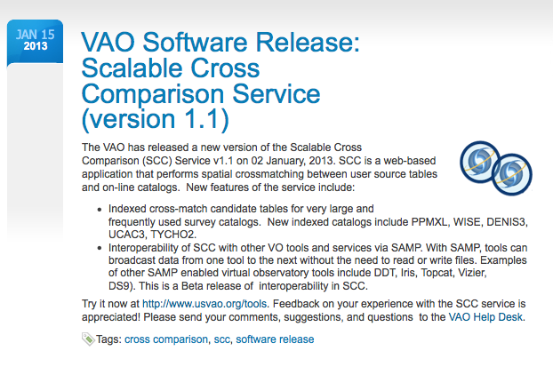
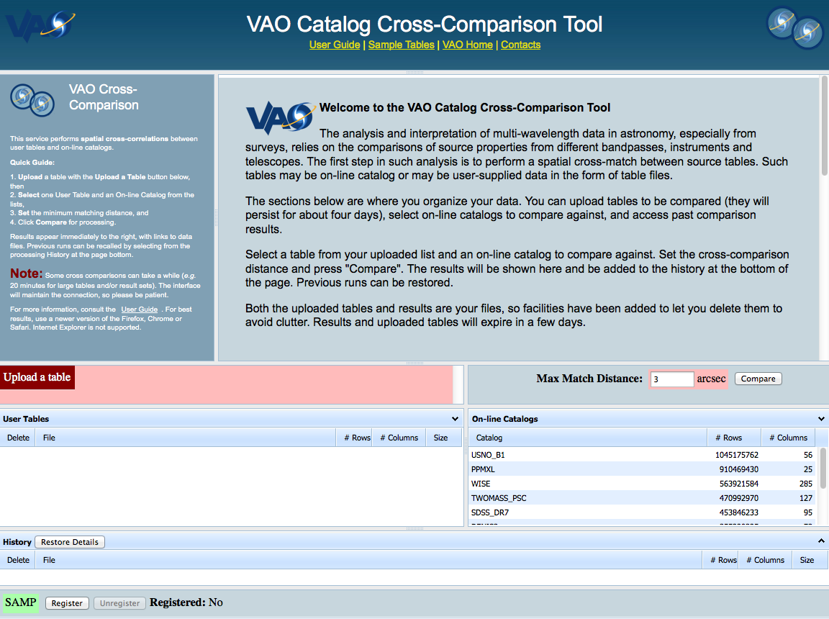
Cross-Comparison

Slide 12
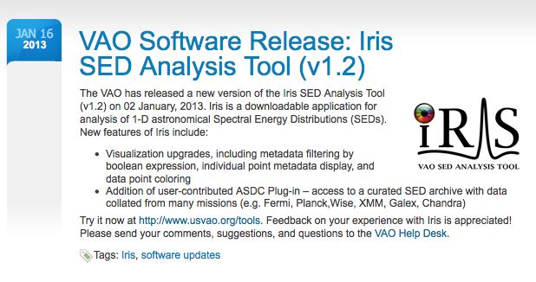
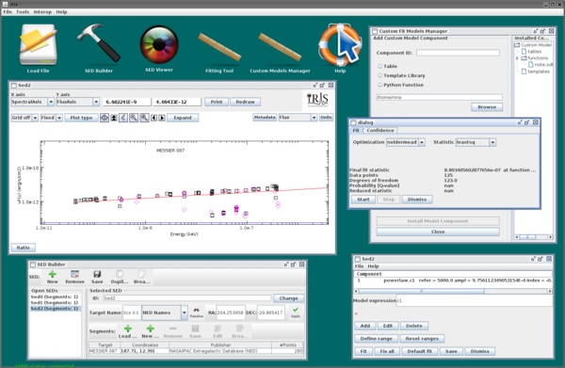
Spectral Energy Distributions

Slide 13
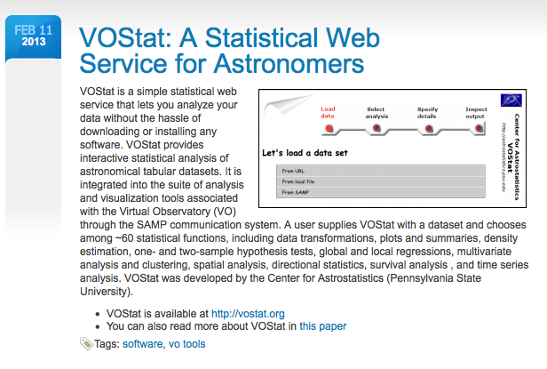
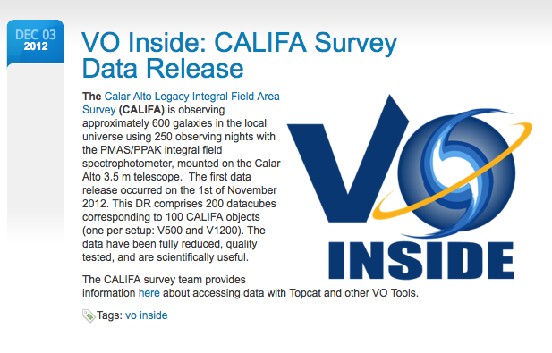
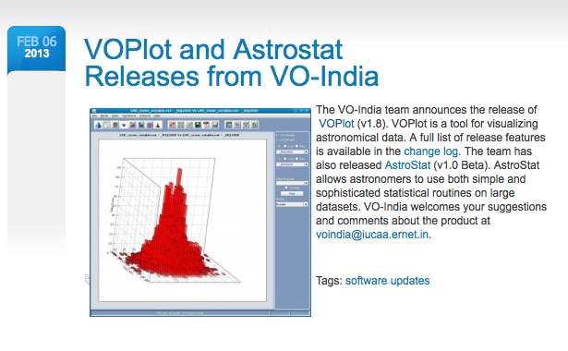
Statistics, Data Publication
News items are
announced on website,
Facebook, twitter, via
RSS feed, and e-mail

Slide 14
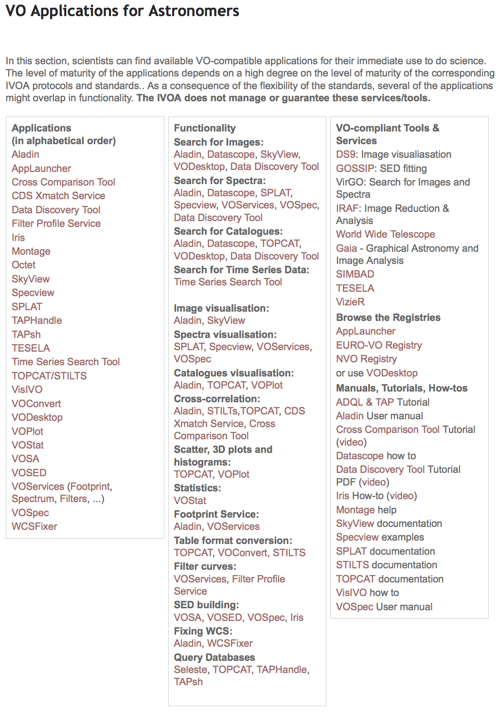
VO Apps
http://www.ivoa.net/
astronomers/applications.html

Slide 15
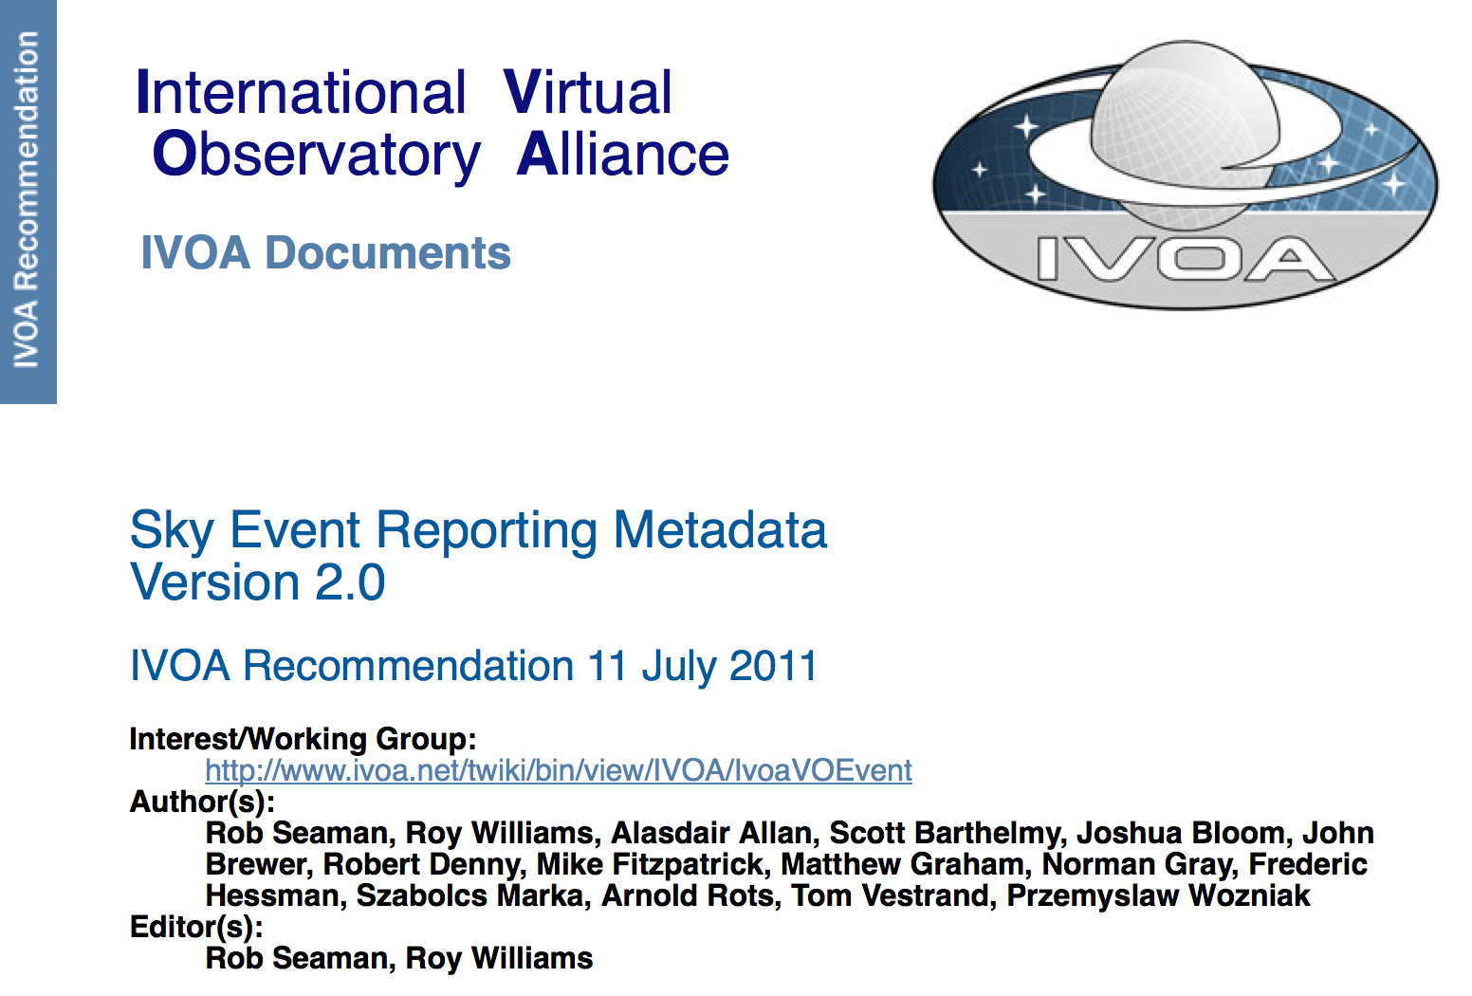
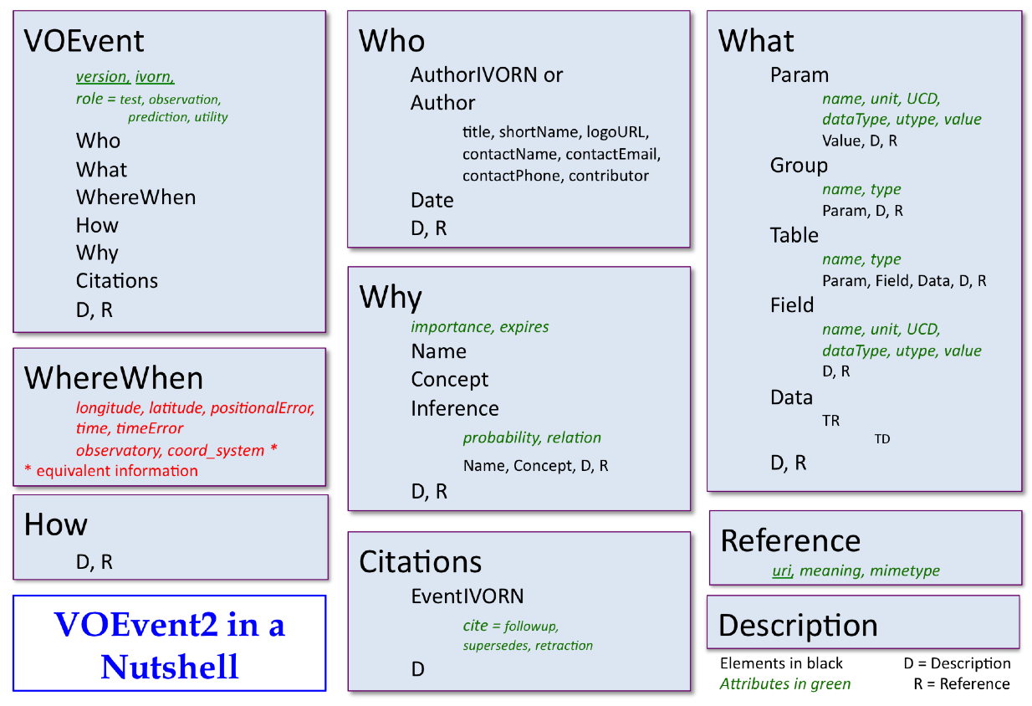
VOEvent

Slide 16
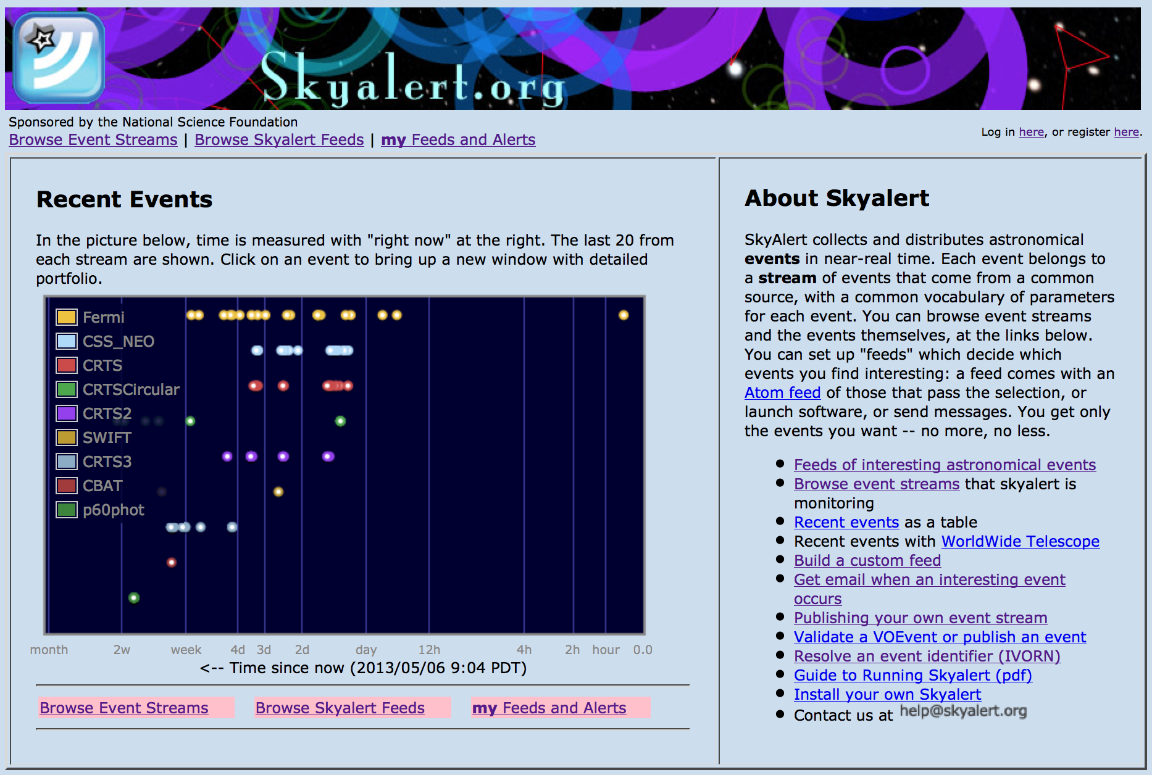
Skyalert (VOEventNet)

Slide 17
VOEventNet
GCN
NASA/GSFC
OGLE III
Poland
Liverpool Telescope
La Palma
SDSS SNe
U Washington/Stanford
Faulkes
Hawaii/Australia
Palomar-Quest
Caltech
Exeter
Caltech
LANL
Microlensing Survey
Exeter
UKIRT
Hawaii
NOAO
Palomar P60
Caltech
Raptor
LANL
Author
Publisher
Repository
Relay
Subscriber
Pairitel
Berkeley
CTIO/KPNO
surveys

Slide 18
VO Impact and Penetration
Astronomers use VO every day without realizing it
A few examples
  Major archives and data centers are VO compliant
  Hubble Legacy Archive is built with “VO Inside”
  HEASARC Xamin facility
  Dark Energy Survey pipeline and archive
  WIYN One-Degree Imager pipeline and archive
  PanSTARRS
  LSST development
~500k VO-compliant service requests every week at VAO organizations

Slide 19
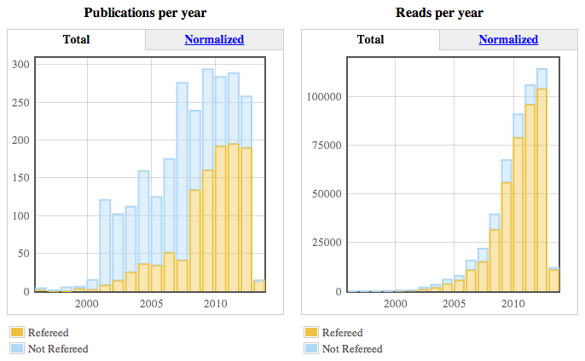
VO-Enabled Science
Citation analysis done by M. Kurtz (ADS) finds nearly 2,500 VO-related papers

Slide 20
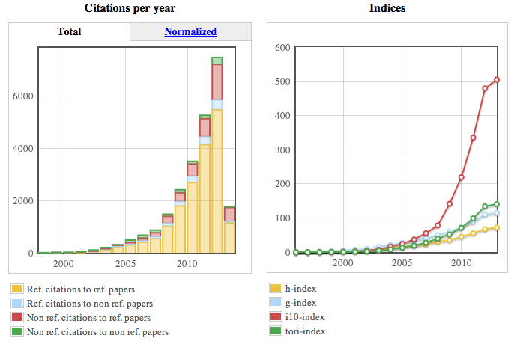
VO-Enabled Science
Citation analysis done by M. Kurtz (ADS) finds nearly 2,500 VO-related papers

Slide 21
VO-Enabled Science
Citation analysis done by M. Kurtz (ADS) finds nearly 2,500 VO-related papers
  Certainly some “contamination” in this sample, and it would take significant manual effort to clean the list
Recent VO-enabled research papers
  “The Chandra Multi-wavelength Project: Optical Spectroscopy and the Broadband Spectral Energy Distributions of X-ray Selected AGNs,” M. Trichas et al., ApJS 200, 2, 17 (2012)
  “The Halo Masses and Galaxy Environments of Hyperluminous QSOs at z~=2.7 in the Keck Baryonic Structure Survey,” R. Trainor and C. Steidel, ApJ 752, 1, 39 (2012)
  “New Ultracool Subdwarfs Identified in Large-Scale Surveys Using Virtual Observatory Tools. I. UKIDDS LAS DR5 vs. SDSS DR7,” N. Lodieu et al., A&A 542, A105 (2012)

Slide 22
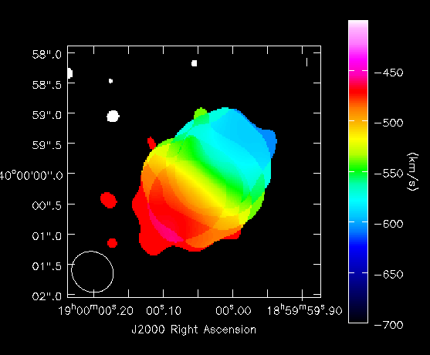
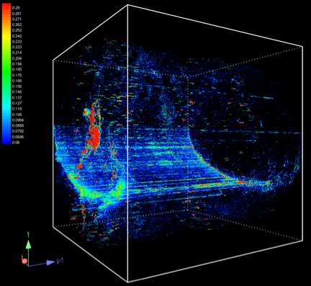
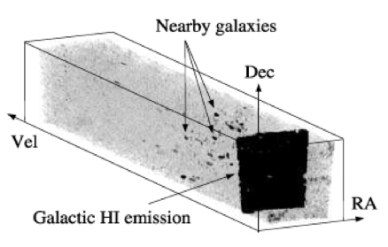
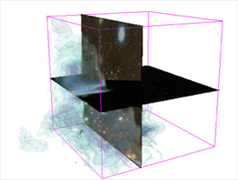
Data Cubes
Discovery and access of data-cubes / hyper-cubes (aka SIAP V2) for radio, O/IR IFU spectroscopy, time series, and high energy (sparsely sampled) data
  ALMA, JVLA, LOFAR, …
  JWST
  Keck OSIRIS
  Gemini GMOS and GNIRS
  Magellan IMACS
  PanSTARRS and LSST image time-series
  Chandra
Extensive use cases
International priority

Slide 23

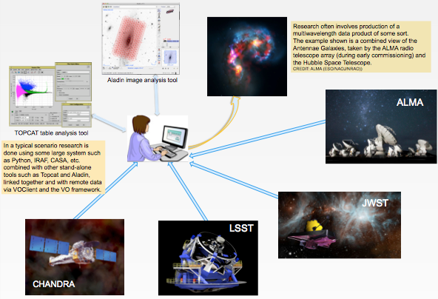
Scripting
The programmable / scriptable VO through and other programming environments
# Sample Python script to find and display
# an X-ray image of NGC 3393.
import voclient as vo
# Find image services returning X-ray data.
reg = vo.RegistrySearch.connect()
res = reg.Search(bandpass=‘xray’, type=‘SIA’)
# Get the first such service.
url = res.getAttribute('ServiceURL’, 0)
# Search for X-ray images of NGC 3393.
obj = vo.lookup('NGC 3393')
cur = vo.sia(url, pos=(obj.ra, obj.dec))
# Get the first such image found.
acref = cur.getField('acref')
# Broadcast SAMP message to display image.
samp.loadImage(acref)

Slide 24
Programmatic Matters
NVO: 2001-2008, NSF funded with some NASA in-kind support
VAO: 2010-2014, NSF (~2/3) and NASA (~1/3) funded; established VAO, LLC with 50-50 interest from AUI and AURA
October 2012: NSF/NASA asked VAO to finish work by end of September 2014
  “VAO and its NVO predecessor have provided an essential foundation on which a future virtual observatory can be maintained…the successful protocols and standards that will be an important resource for our scientific community”
  “document and package all existing products, middleware, protocols, tools, and other results, so as to be of the greatest use to any successor activity”

Slide 25
VAO Project Summary
Infrastructure activities are well underway and within scope for the remaining funding
Data-cube initiative has international support
Maintain operations support
Applications will be packaged and made publicly available for re-use and adaptation by others, as will all infrastructure components
Successor organization TBD

Slide 26
Looking Ahead
Virtual astronomy is part of the research environment of today and the future
VAO/IVOA infrastructure is the backbone for data discovery, access, and interoperability
Maintain through community / data center take-up
  Major observatories and data centers, large projects, scholarly publications
  Use of standards and sharing of software, experience, and best practices improves the research environment and reduces development costs
  http://usvao.org/

