Slide 1
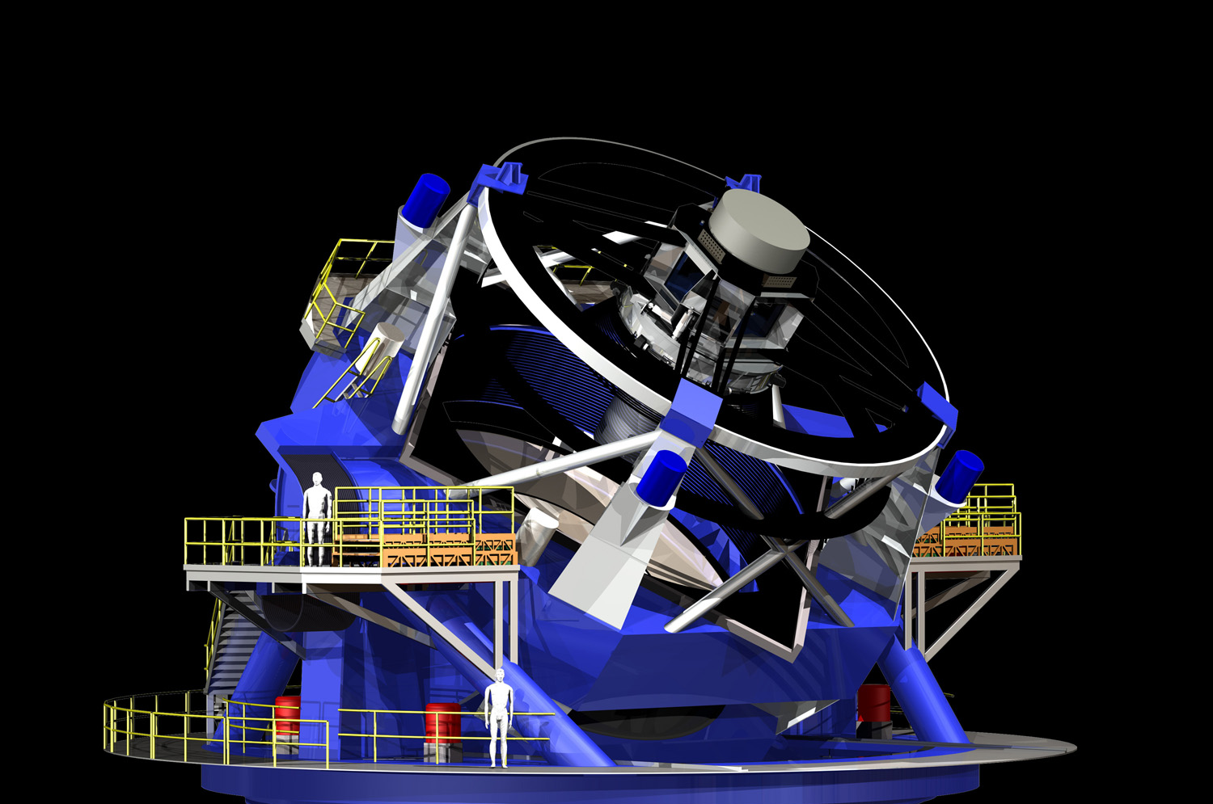
LSST & the Radio Sky
Tony Tyson
University of California, Davis

Slide 2
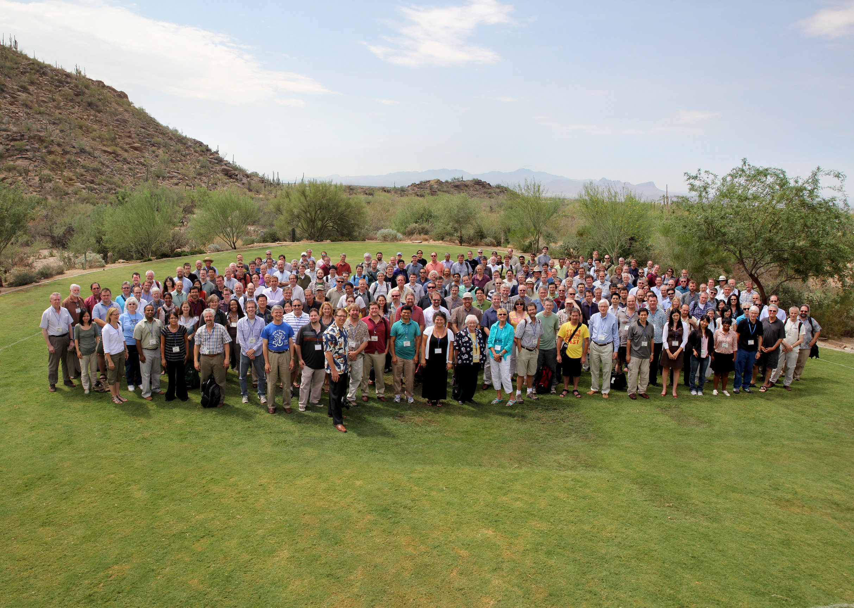

Slide 3
37 Institutional Members of LSST Corp.
Adler Planetarium
Argonne National Lab
Brookhaven National Laboratory
California Institute of Technology
Carnegie Mellon University
Chile
Cornell University
Drexel University
Fermilab
George Mason University
Google Inc.
Harvard-Smithsonian Center for Astrophysics
IN2P3 Labs France
Johns Hopkins University
Kavli Institute for Particle Astrophysics and Cosmology at Stanford University
Las Cumbres Observatory Global Telescope Network, Inc.
Lawrence Livermore National Laboratory
Los Alamos National Laboratory
National Optical Astronomy Observatory
National Radio Astronomy Observatory
Princeton University
Purdue University
Research Corporation for Science Advancement
Rutgers University
Space Telescope Science Institute
SLAC National Accelerator Laboratory
Texas A&M University
The Pennsylvania State University
The University of Arizona
University of California, Davis
University of California, Irvine
University of Illinois at Urbana-Champaign
University of Michigan
University of Pennsylvania
University of Pittsburgh
University of Washington
Vanderbilt & Fisk Universities
Notes:
3

Slide 4
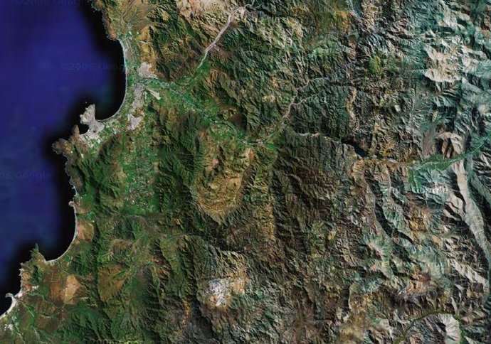
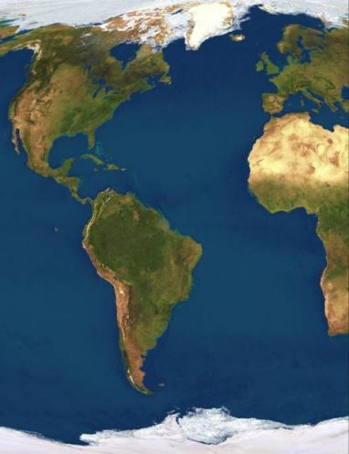
Site selection based on weather and seeing conditions, as well as infrastructure considerations
Cerro Pachón chosen in 2006 after 2 year global evaluation by international committee.
La Serena
La Serena airport
port
50 km paved highway
LSST
Base Facility
Coquimbo
Vicuña
CTIO
Pan-American Highway
40km dirt road
Gemini & SOAR
N
0
10
20 km
LSST SITE

Slide 5
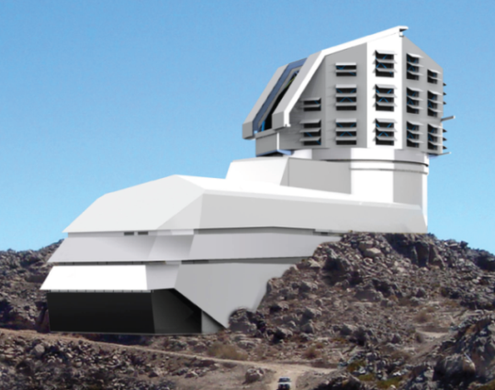
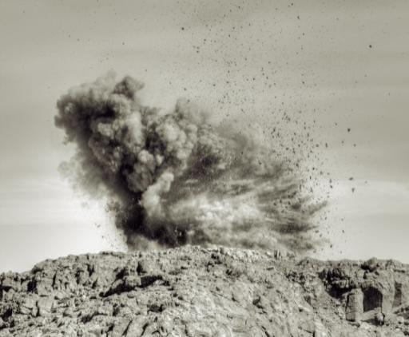
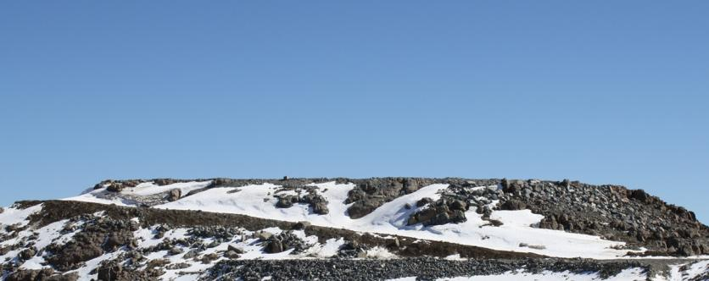
Site and facility development
Facility design
Early Site Leveling
After ~4,000 kg of explosives and ~12,500 m³ of rock removal, Stage I of the El Peñón summit leveling is completed.

Slide 6
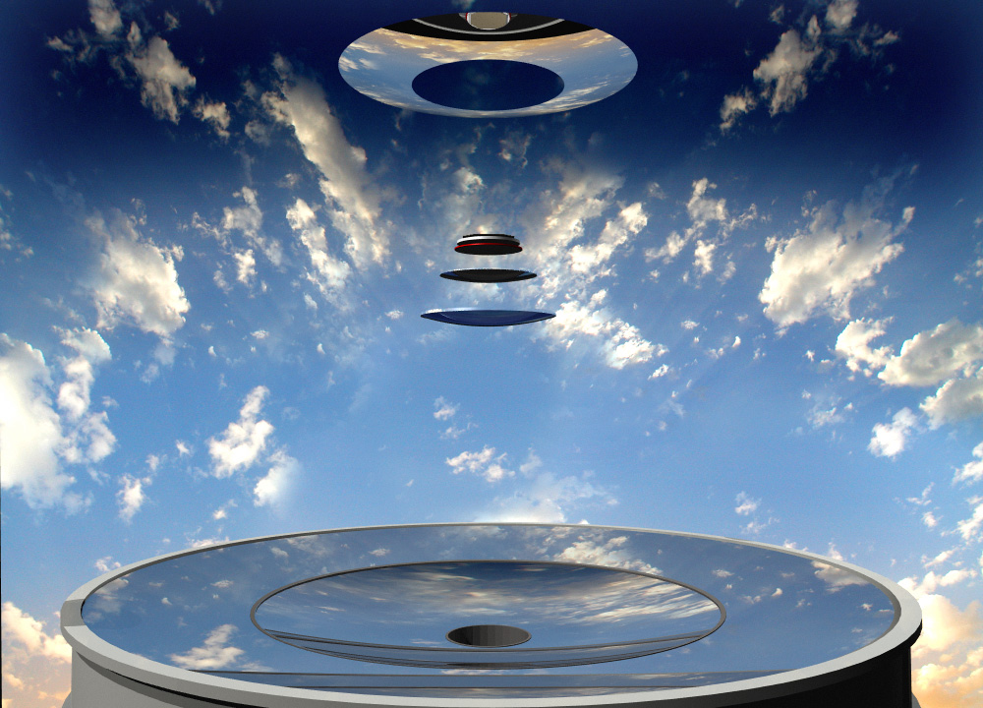

Slide 7
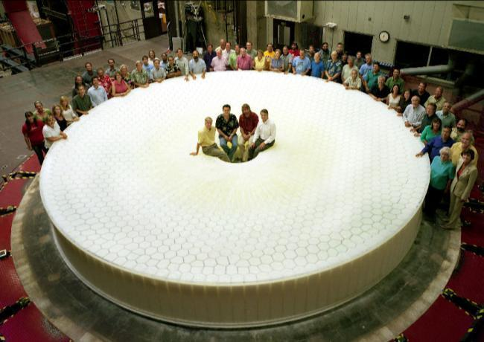
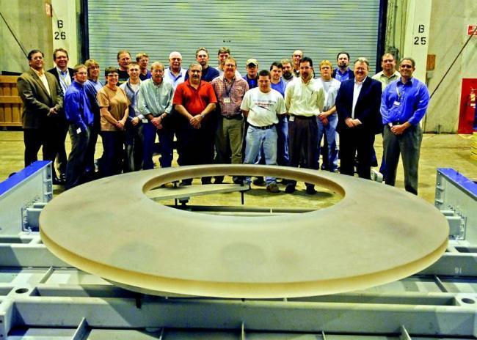
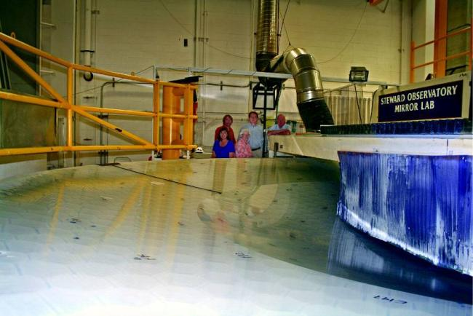
Mirror fabrication is advanced - Private funding enabled early start of both reflective optics
Primary-Tertiary was cast in 2008
Fabrication completed in 2013
Secondary substrate fabricated by Corning in 2009.

Slide 8
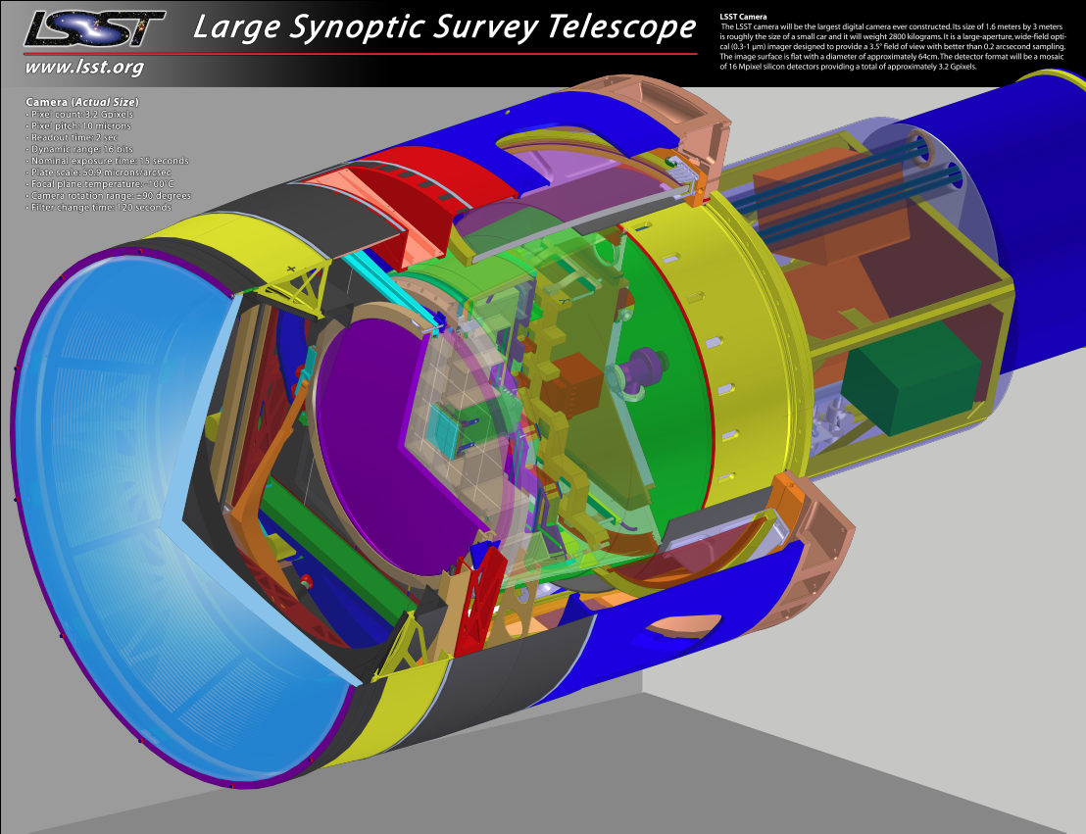
3200 megapixel camera

Slide 9
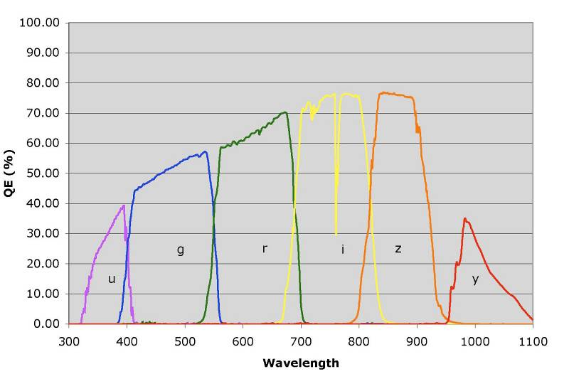
LSST six color system
Includes sensor QE, atmospheric
attenuation, optical transmission functions
Relative system throughput (%)
Wavelength (nm)

Slide 10
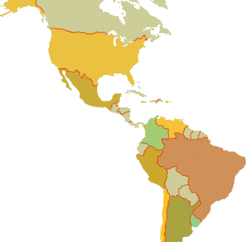
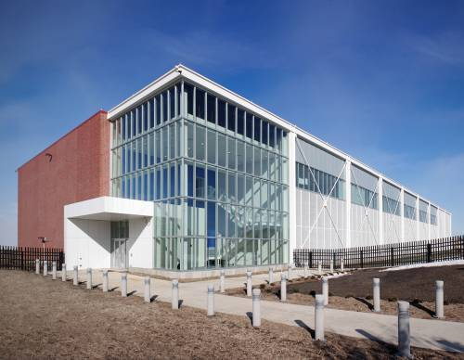
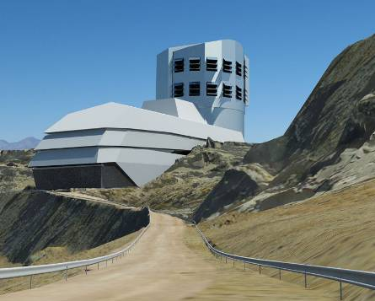
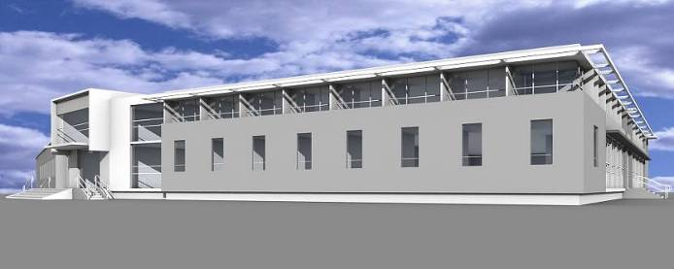
One System, Two Continents, Four Sites
Archive Site
Archive Center
  Alert Production
  Data Release Production
  Long-term Storage (copy 2)
Data Access Center
  Data Access and User Services
Additional Processing Site(s)
  Data Release Production
Headquarters Site
  Headquarters Facility
  Observatory Management
  Science Operations
  Education and Public Outreach
Summit Site
Summit Facility
Telescope and Camera
Data Acquisition
Crosstalk Correction
Base Site
Base Facility
  Long-term storage (copy 1)
Data Access Center
  Data Access and User Services

Slide 11
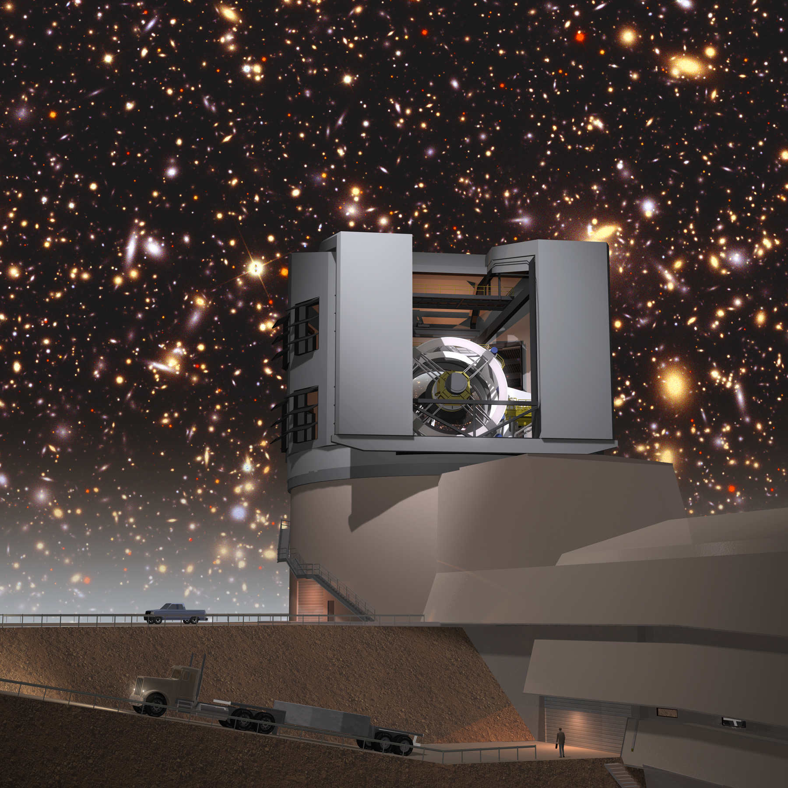


LSST will open new windows onto our universe

Slide 12
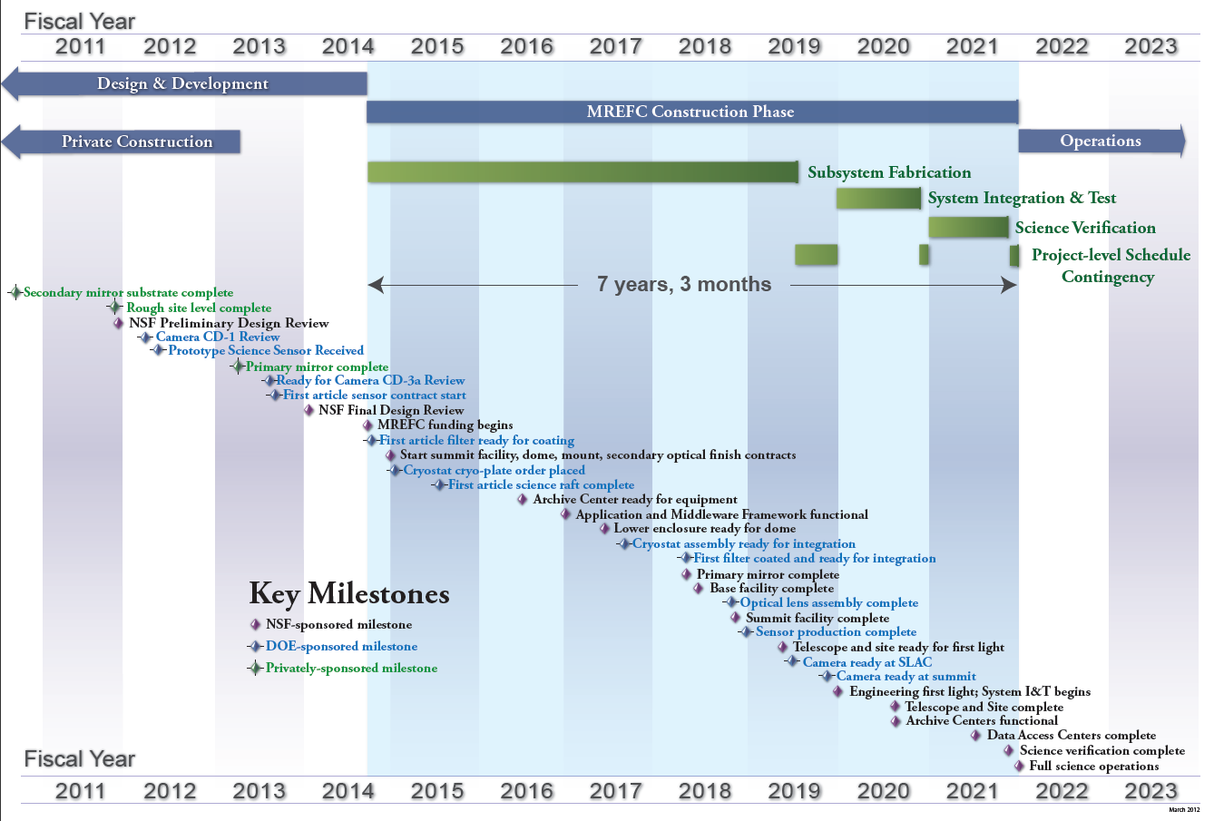
Integrated Project Schedule with Key Milestones
In FY14 request
NSB APPROVAL

Slide 13
An LSST Observing Cadence
Pairs of 15 second exposures (to 24.5 mag) per visit to a given position in the sky.
Visit the same position again within the hour with another pair of exposures.
Number of 9.6 sq.deg field-of-view visits per night: 850
Detection of transients announced within 60 seconds.
Expect 1-2 million alerts per night!

Slide 14
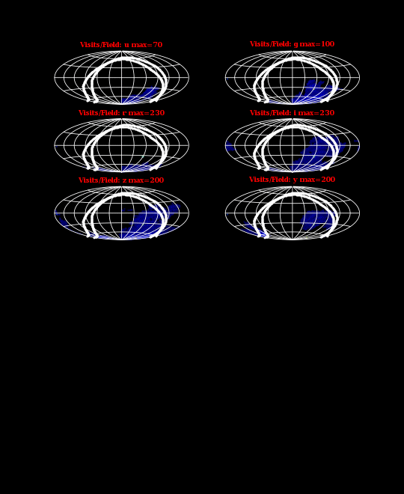
Celestial Cinematography

Slide 15
Two planned LSST surveys
MAIN SURVEY
Deep Wide Survey:
18,000 square degrees to a uniform depth of
u: 26.1 g: 27.4 r: 27.5 i: 26.8 z: 26.1 y: 24.9 AB mag
27.5 r mag ~ 36 nJy
DEEP DRILLING SURVEY
10% of time: ~30 selected fields. 300 square degrees
Continuous 15 sec exposures. 1hour/night

Slide 16
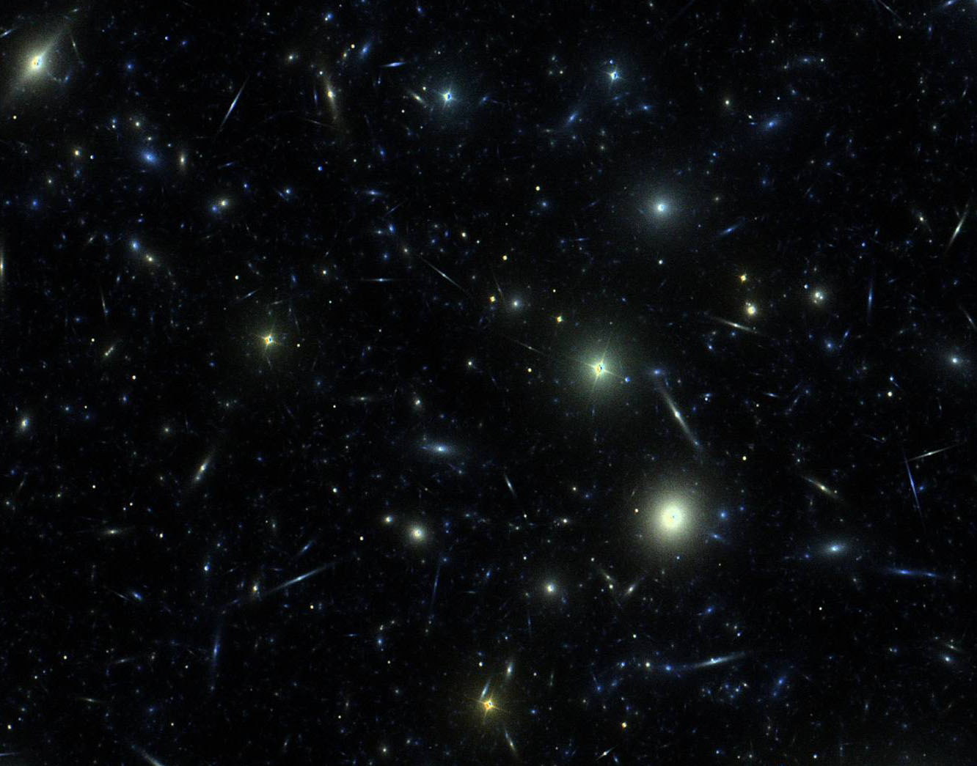
LSST Wide-Fast-Deep survey
32 trillion photometric measurements of 38 billion objects
Immediate transient alerts

Slide 17
LSST Wide-Fast-Deep survey
4 billion galaxies with redshifts
14 billion stars
Time domain:
1 million supernovae
1 million galaxy lenses
1-2 million alerts per night
new phenomena

Slide 18
IMAGE SIMULATIONS
All Sky Database
Extended Sources
Milkyway
Transients
Defects
Base Catalog
Solar System
Cosmology
Generate the seed catalog as required for simulation. Includes:
Instance Catalog
Generation
Operation Simulation
Metadata Size Position
Color Brightness Proper motion
Type Variability
DM Data base load simulation
Source Image Generation
Introduce shear parameter from cosmology metadata
Generate per FOV
Atmosphere
Photon Propagation
Operation Simulation
Telescope
Camera
Defects
Formatting
Generate per Sensor
DM Pipelines
Calibration Simulation
LSST Sample Images and Catalogs

Slide 19
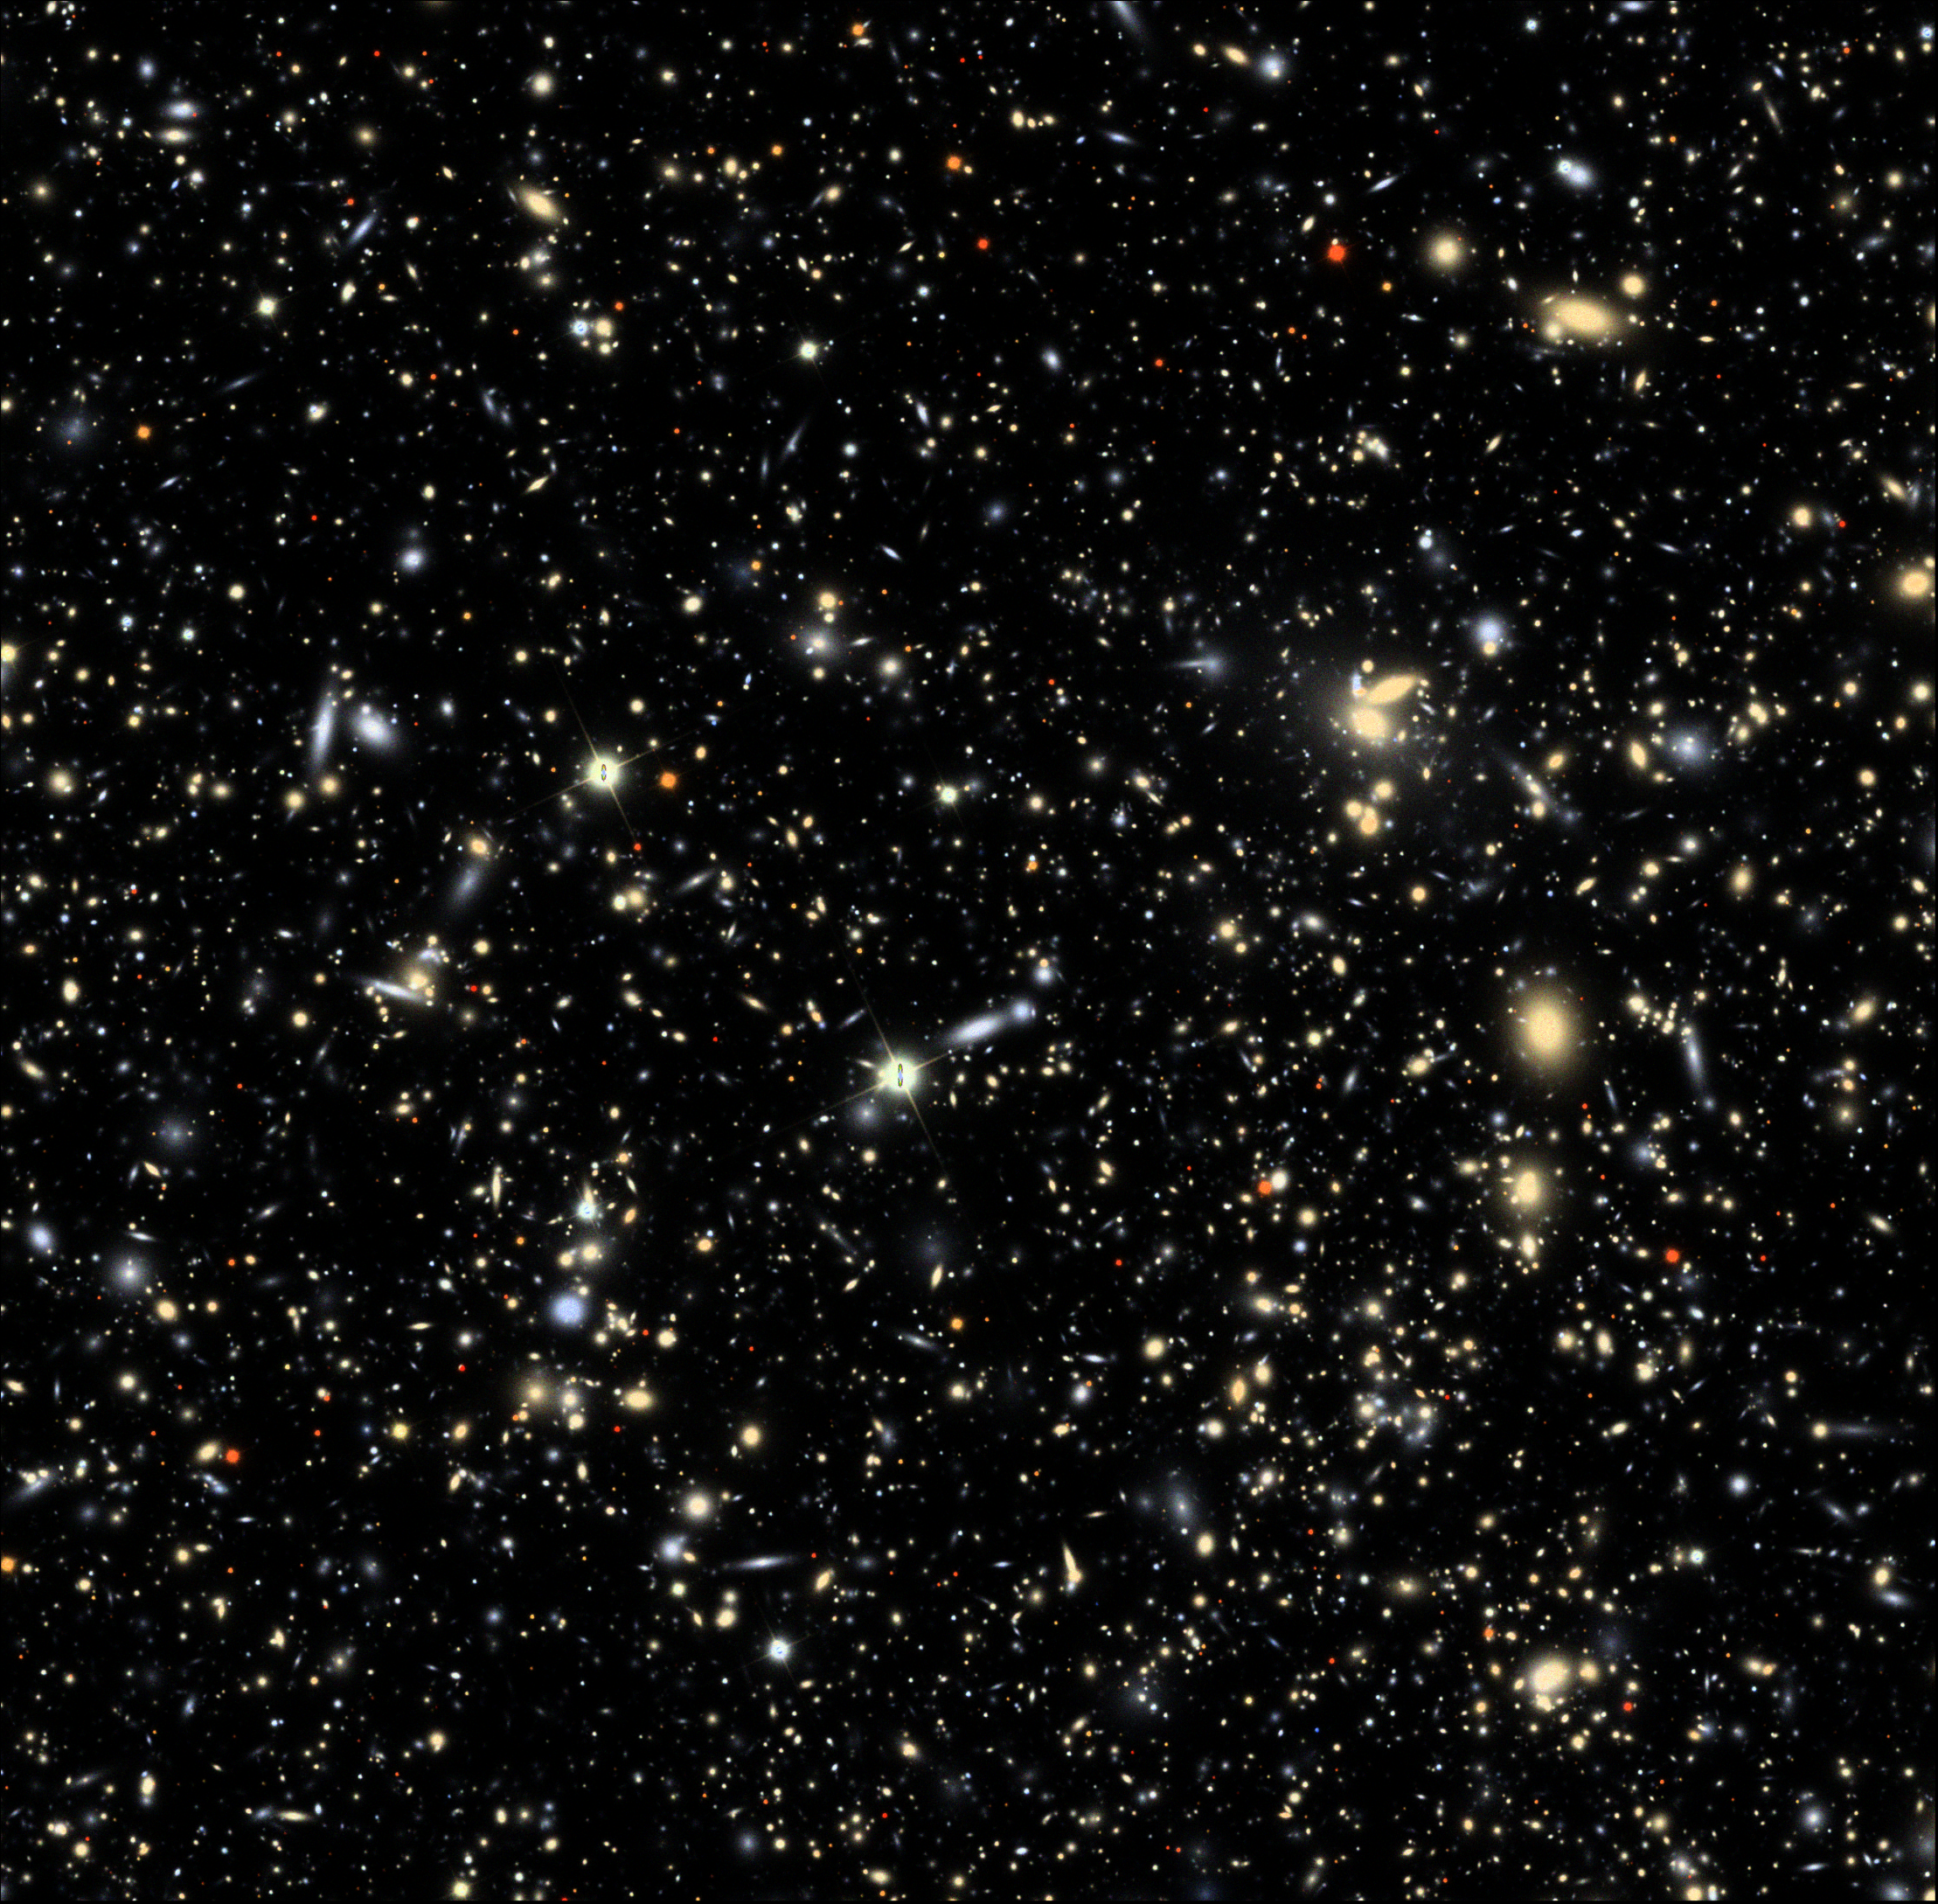
Full end-to-end simulations
Notes:
1.7ppm of full survey

Slide 20
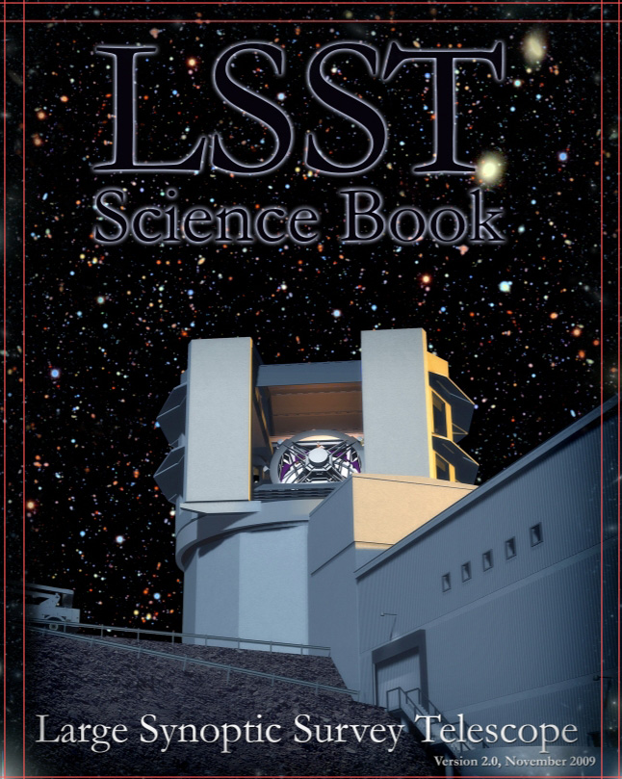
LSST Science Book v2.0 written by LSST Collaboration
245 authors
598 pages
Living document
(on lsst.org)
http://www.lsst.org/lsst/scibook
11 Science Collaborations.
Science by community, not the LSST project.

Slide 21
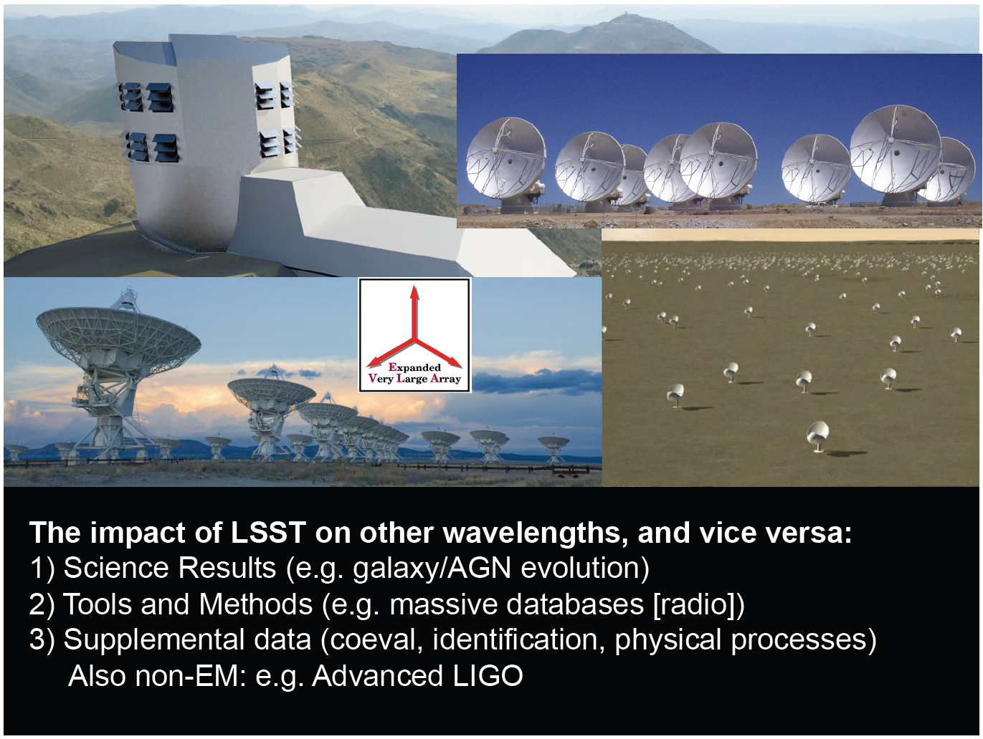

Slide 22
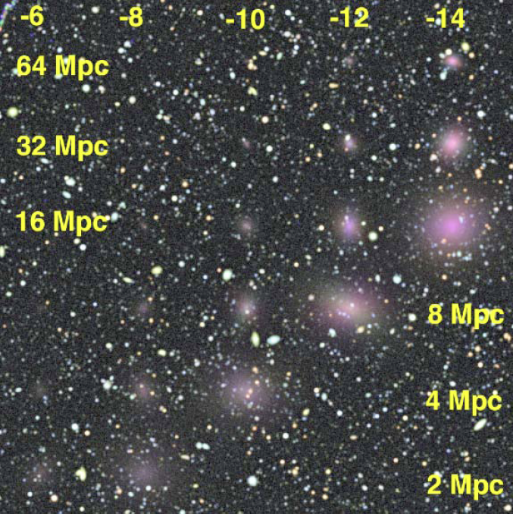
Discover Nearby Dwarf Galaxies

Slide 23
Two radio-optical 3D spaces
Nature
Flux distribution
Number density
Timescale
Observing
Flux limit
Survey area
Time sampling

Slide 24
Optical Radio Modes
Transient discovery via co-observing
>30 sec timescales
Follow-up research
longer timescale multi-wavelength investigations of new phenomena

Slide 25
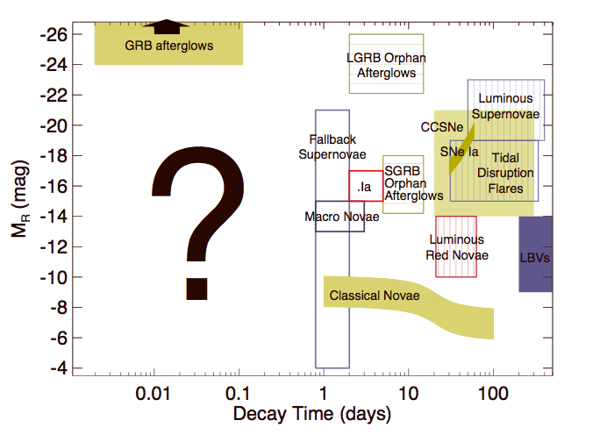
unexplored
Rau et. al. 2009

Slide 26
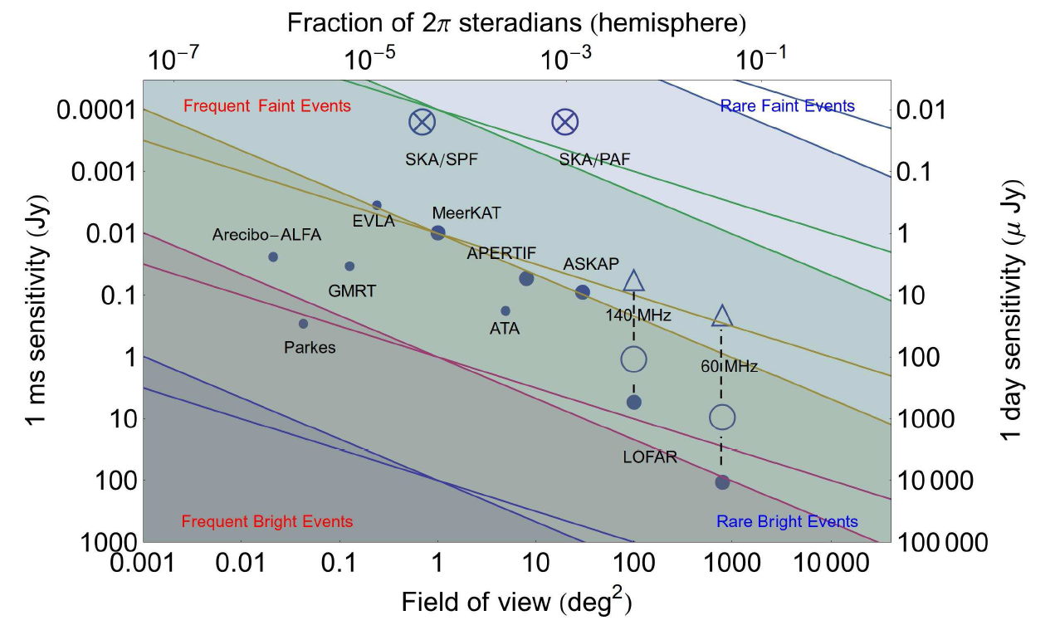
Transient Radio – Optical Sky
LSST optical 0.4 μJy / day
Fender & Bell 2011

Slide 27
Automated discovery
Data exploration
Discovering
The unexpected
This is required also for
automated Data Quality Assessment

Slide 28
Alert Rate
In ten minutes time the LSST transient pipeline is likely to issue 2,000 (av) -10,000 alerts at 5σ.
While most of these will be moving objects, perhaps several thousand will be flaring objects or bursts. Possibly new kinds of objects!
Radio-Optical co-observing!
What is needed then is highly trusted event classification. FAST

Slide 29
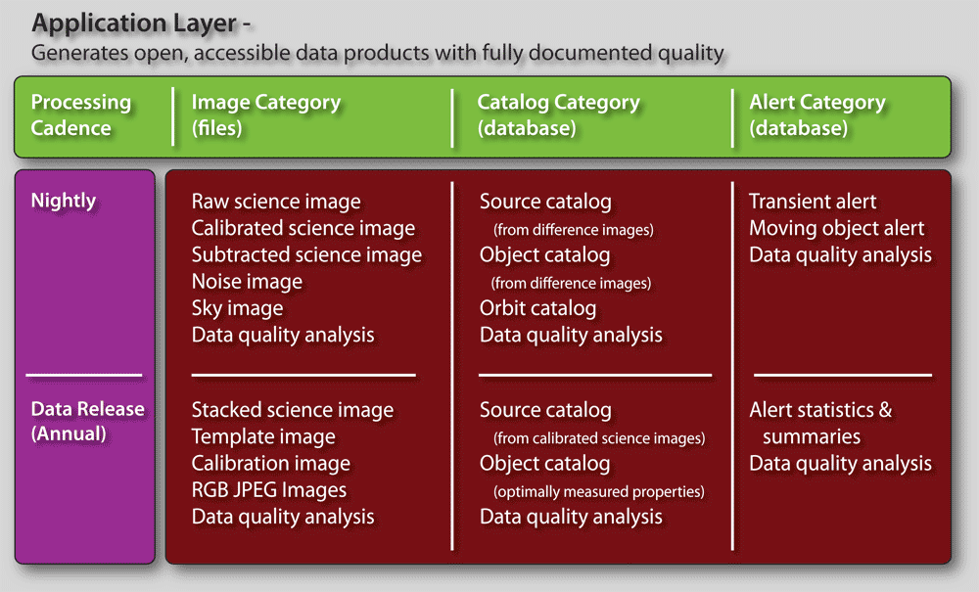
DATA PRODUCTS
CLASSIFICATION

Slide 30
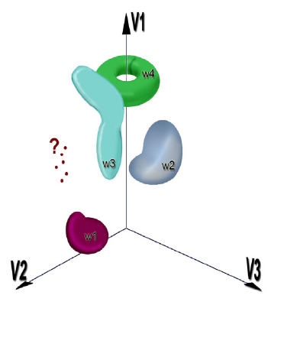
Assuring accurate classification
Characterize the known clustering)
Assign the new classification
Discover the unknown outlier detection
Tom Vestrand
Benefits of very large data sets:
    best statistical analysis of “typical” events
    automated search for “rare” events
Notes:
30

Slide 31
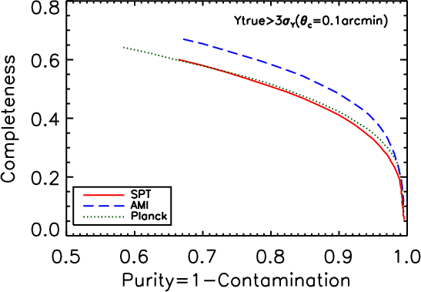
completeness-purity trade
Rare events should be reliable events
Radio-optical correlations
Sensitive to tails of distributions
Radio trigger
Optical trigger
Statistical cross correlations
Notes:
31

Slide 32
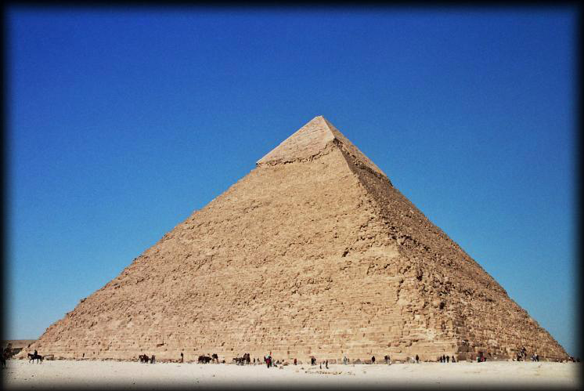
Old Paradigm
Astronomer+
pencil+paper
INSTRUMENT
TELESCOPE

Slide 33
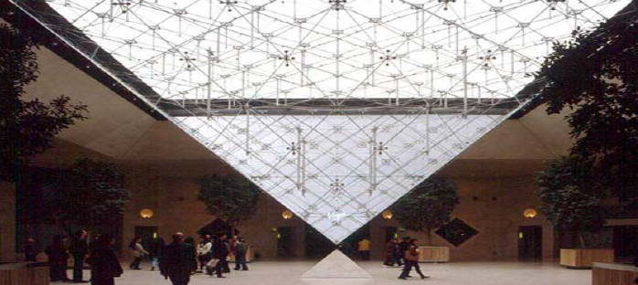
New Paradigm
DATA ENABLED
DISCOVERY
INSTRUMENT
TELESCOPE

Slide 34
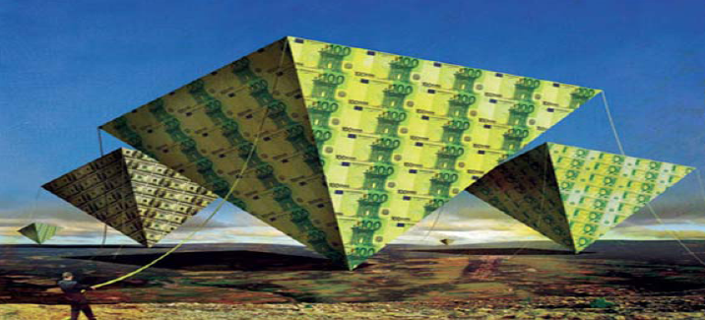
Harnessing Survey Data at Exascale
Number of scientists does not scale with the data!
Database is the
new Lab, the new
Experiment
Sparse matrix
of databases:
Radio & optical
observations, and
simulations of
observations

Slide 35
LSST DATA
LSST data, including images and catalogs, will be available with no proprietary period to the astronomical community of the United States, Chile, and International Partners
Transient alerts will be available world-wide within 60 seconds, using standard VO protocols
LSST data processing stack is free software (licensed under the GPL, v3 or later)

