Slide 1
Radar Speckles and Near-Earth Asteroids
Michael Busch
(with thanks to Jean-Luc Margot, Lance Benner,
Walter Brisken, and Adam Deller)

Slide 2
Radar Speckle Patterns
Target
d
Separation
Baseline (B)
D_{target}
L_{Speckle} = D_{target}λ/d
Earth and
Antennas

Slide 3
Radar Speckle Patterns
Antenna 1
Speckle Motion
Antenna 1
B
Antenna 2
Antenna 2
Echo Power
Projected
spin vector
Time
L_{Speckle}
Bcos(α) << L_{Speckle}
Kholin 1988, Margot et al. 2007
Notes:
Mercury and Venus: Green Bank – Goldstone s“Magic moments” Next project: Europa
Asteroids require shorter baselines at a variety of angles – Southwestern VLBA best option.

Slide 4
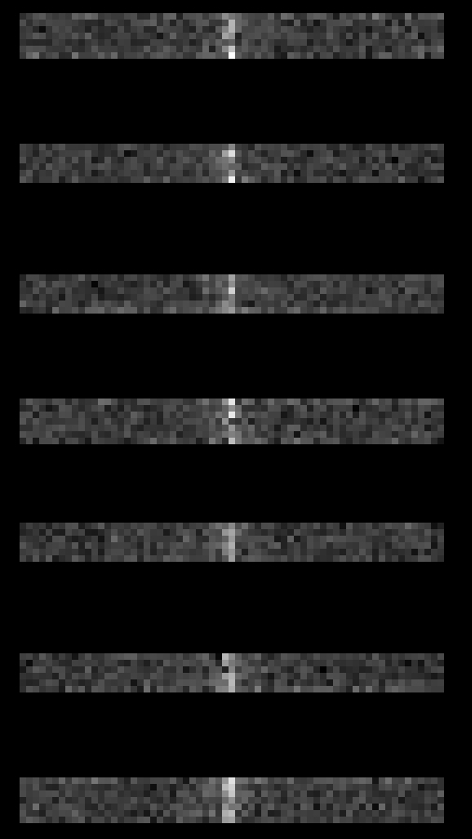
Software Correlation
2008 EV5 GBT Autocorrelation
DiFX with 12 Hz Frequency Resolution

Slide 5
2008 EV5
Discovered in 2008 by the Mt. Lemmon Survey.
Spectral Type C (Hicks) or X (Reddy).
Arecibo, Goldstone, and VLBA observations during December 2008.
EV5 is being considered as a possible target for a human asteroid mission (Landau et al. 2010)

Slide 6
Kitt Peak - Pie Town baseline was ~10º from the projected pole direction, Los Alamos - Fort Davis was too long.

Slide 7
EV5’s Shape
Notes:
EV5 as mission target, asteroid target frequency

Slide 8
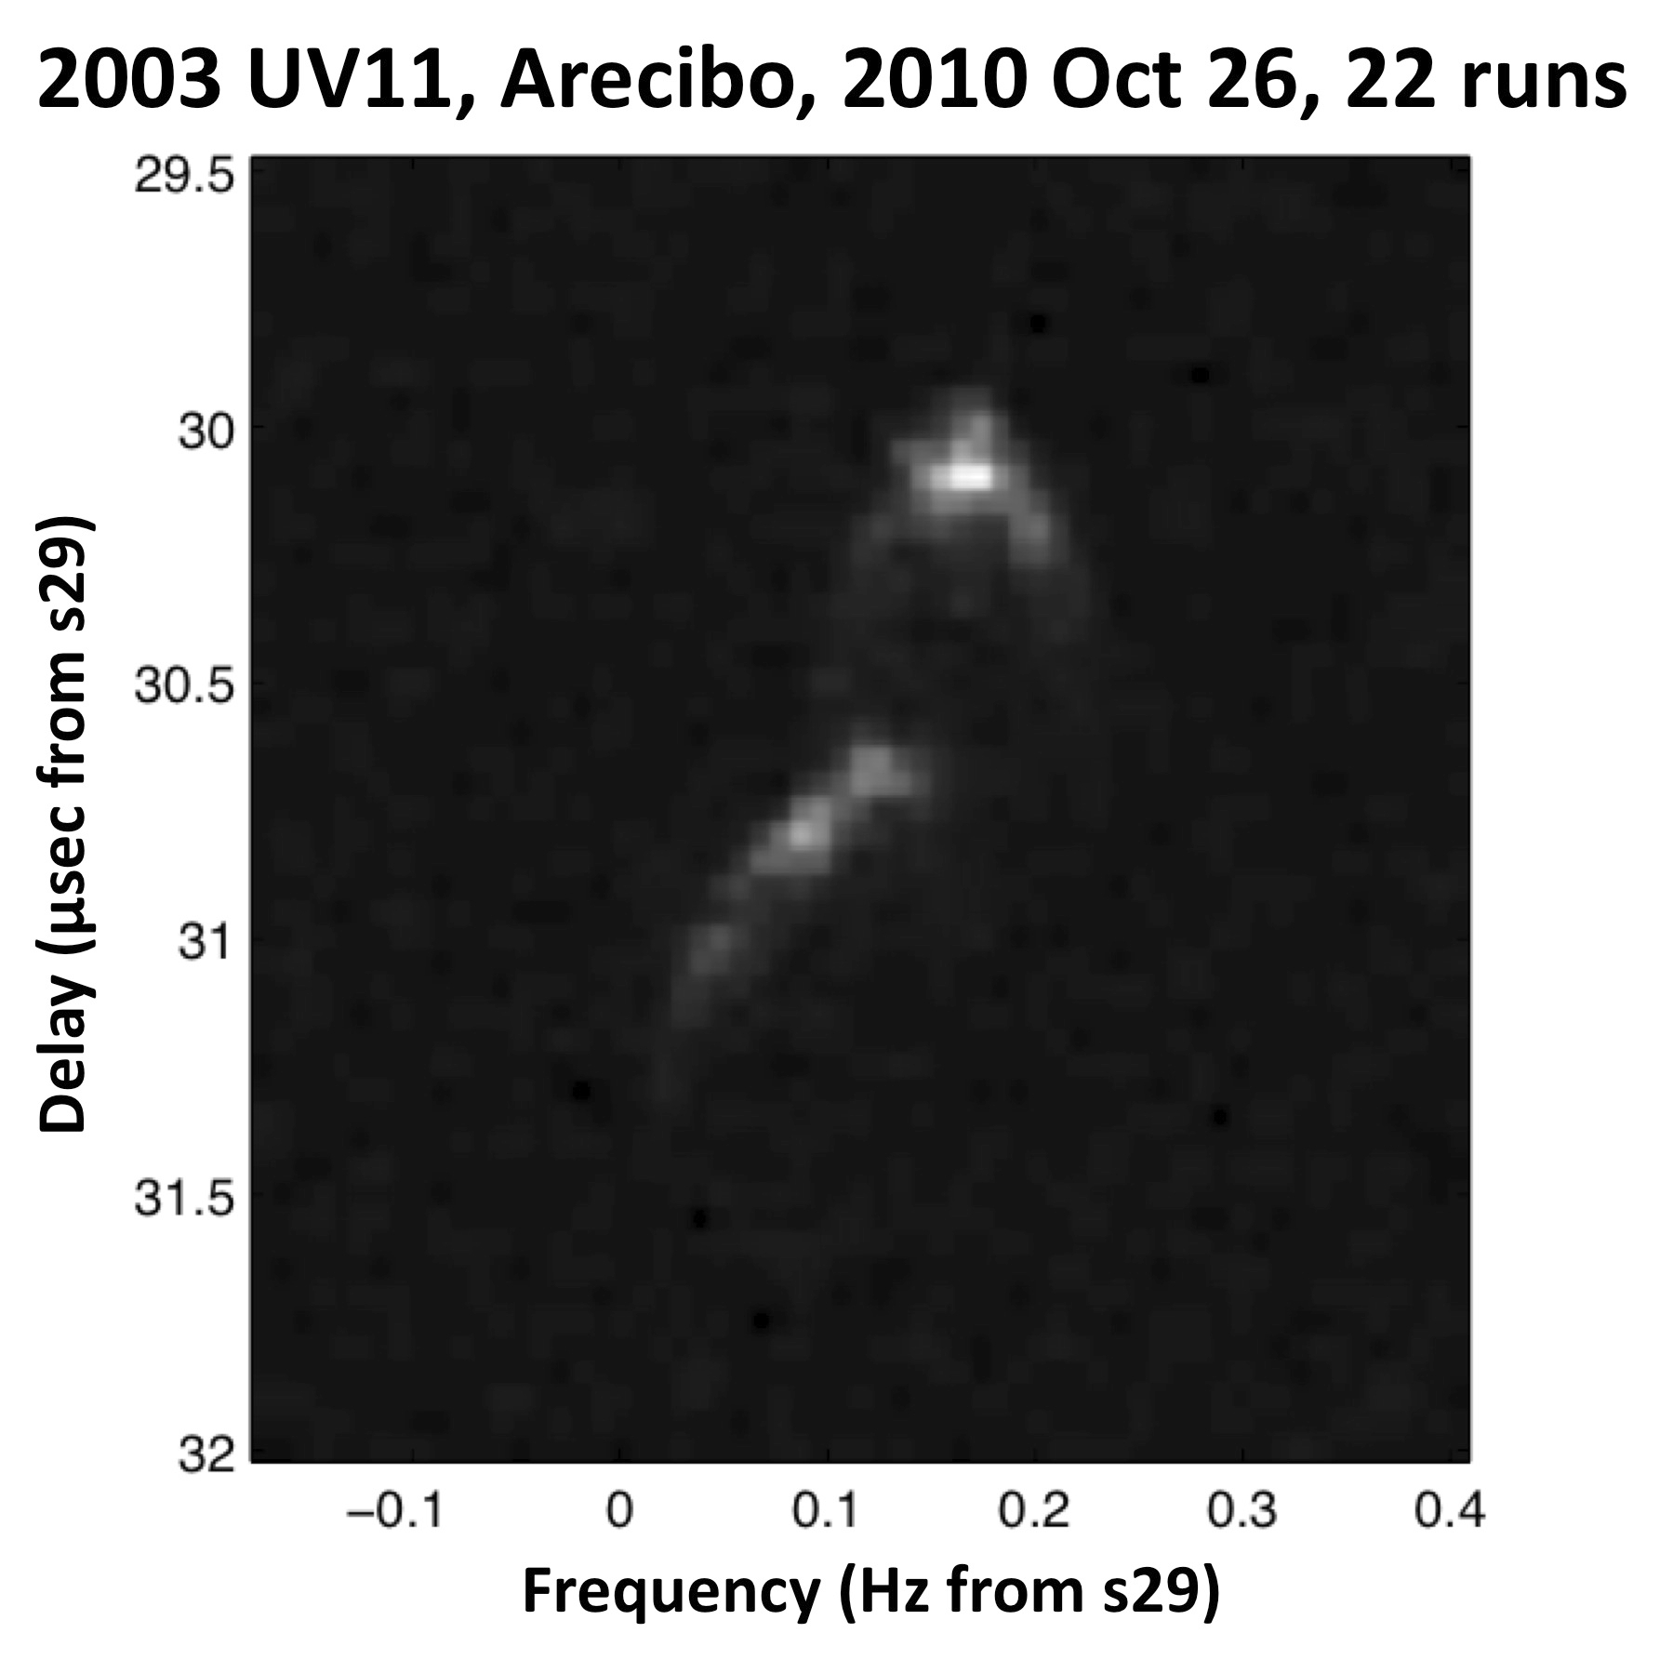
Project Status
2003 UV11 in late October 2010.
Upcoming Targets:
2005 YU55
Toutatis
New Discoveries

