Slide 1
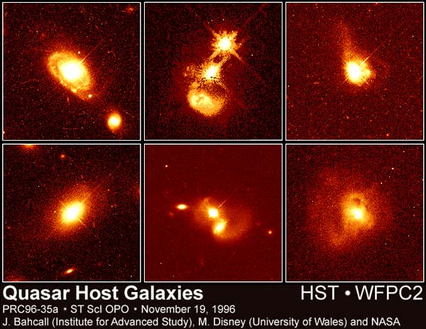
The Most Luminous Quasars
Amy Kimball
NRAO Charlottesville (NAASC)
Notes:
“pretty pictures” are actually of the host galaxies

Slide 2
What I hope you will learn from this talk
Why is quasar “feedback” important for galaxy formation (and what are the two feedback modes)?
How to identify candidate “most extreme feedback” objects
How luminous are the most luminous quasars?

Slide 3
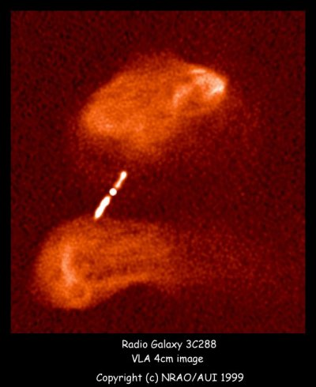
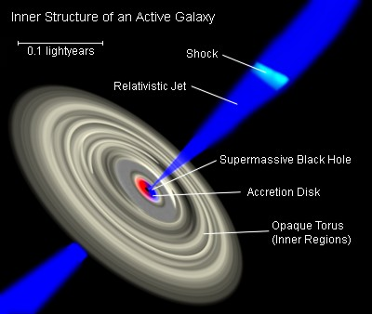
Quasar structure: an artist’s conception
Mr. Brak / Wikimedia Commons / CC-BY-SA-3.0 / GFDL
Notes:
- super-massive black hole at center of a galaxy
- accretion disk: makes it ACTIVE
- most GROWTH during ACCRETION PHASE
Zoom out: not all are RADIO QUASARS but many are.
- JETS that are initially CONFINED to the galaxy
- Over time they grow, PUNCH OUT OF THE GALAXY, and expand in beautiful extended emission
Image is from http://en.wikipedia.org/wiki/File:Galaxies_AGN_Inner-Structure-of.jpg (publishing permissions dubious)

Slide 4
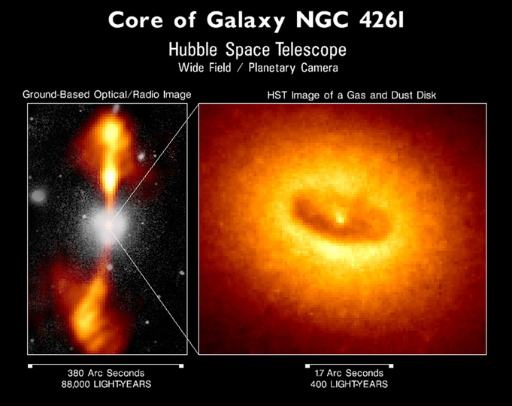
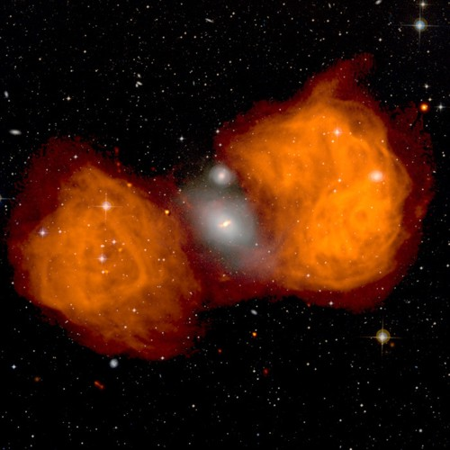
Radio quasar habitat: elliptical galaxies
Radio galaxy Fornax A / NGC 1316
Image credit: NRAO/CIT/NASA/HST/WFPC2
Image courtesy of NRAO/AUI and J. M. Uson
Notes:
Left: optical/radio composite image; HST image of galaxy center.
Right: radio from VLA, optical from STSci/POSS-II (second Palomar Observatory Sky Survey; 48 in Oschin Schmidt Telescope)

Slide 5
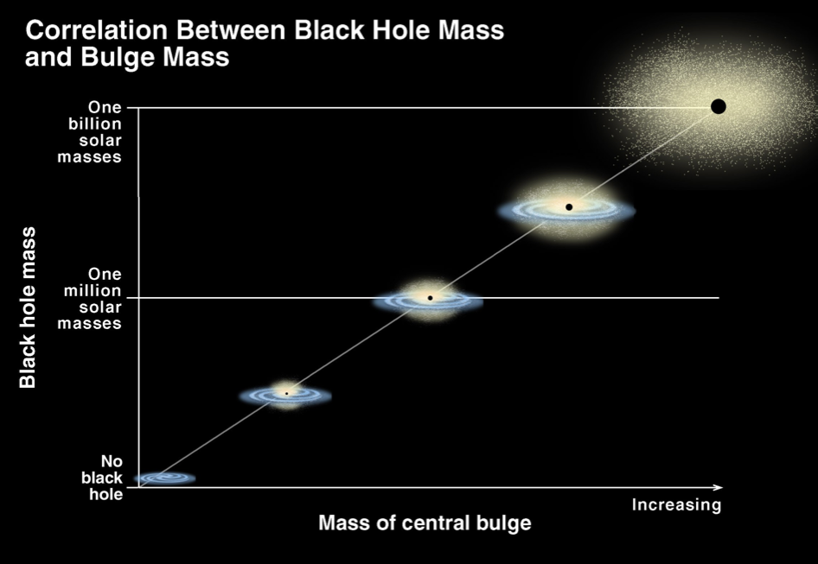
(300 km/s)
Image credit: K. Cordes, S. Brown (STSci)
Notes:
Suggests that the SAME PROCESS may be responsible for and regulate the growth of both of these.
Also note that these have HIGH MASS
Image: http://www.spacetelescope.org/images/opo0022b/

Slide 6
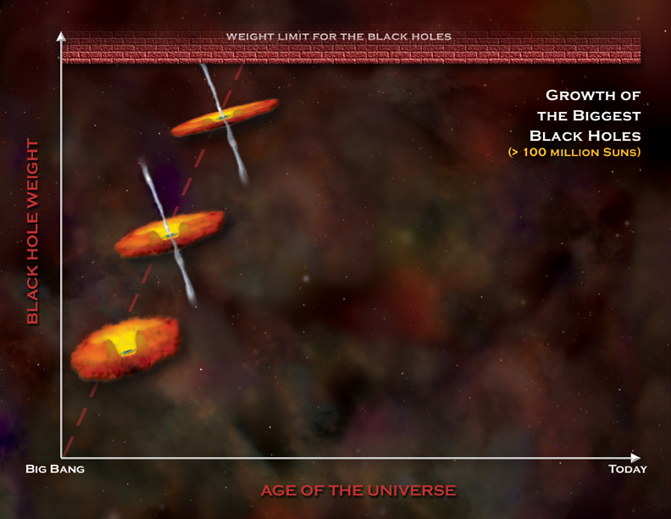
one billion years
Image: NASA/CXC/M. Weiss
Notes:
- LARGE BLACK HOLES in place already by redshift 6
10^9 Msun within ONE BILLION YEARS
deliver GALAXY OF GAS in short TIME SCALE

Slide 7
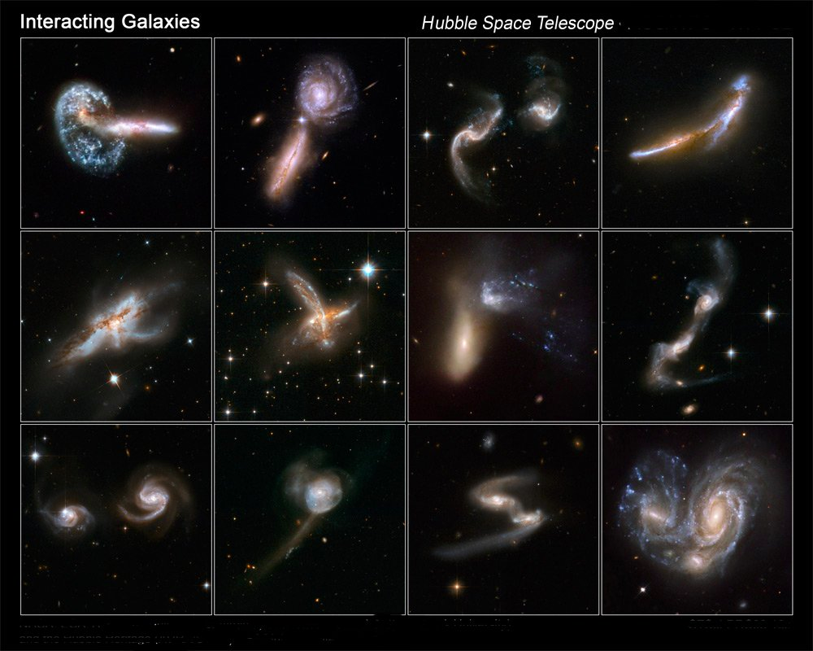
Credit: NASA, ESA, the Hubble Heritage (STScI/AURA)-ESA/Hubble Collaboration, and A. Evans (University of Virginia, Charlottesville/NRAO/Stony Brook University)
Notes:
Answer: MERGERS
CHURN up gas, send it to black hole
not necessarily the answer… but one way that we think the brightest quasars turn on

Slide 8
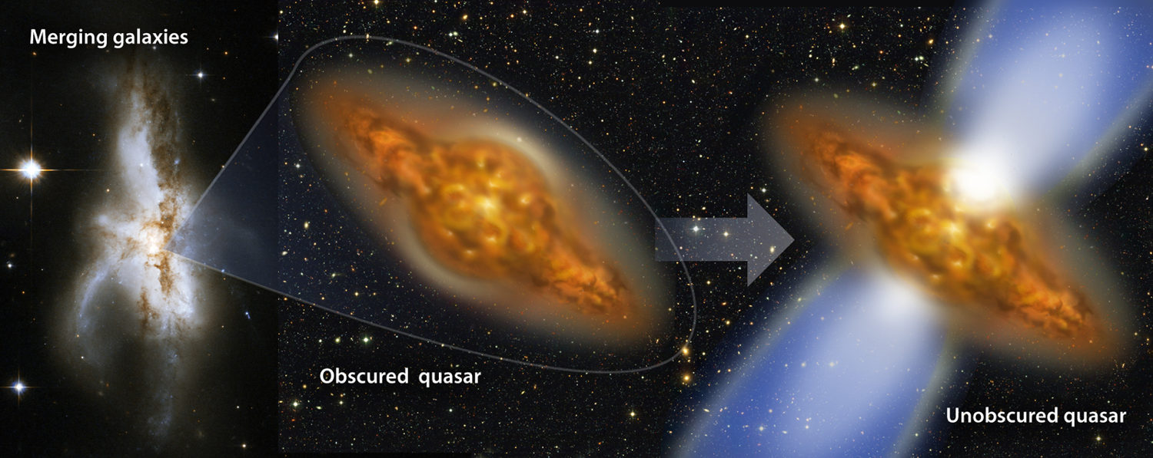
Galaxy merger model for quasar evolution (Sanders et al. 1988)

Slide 9
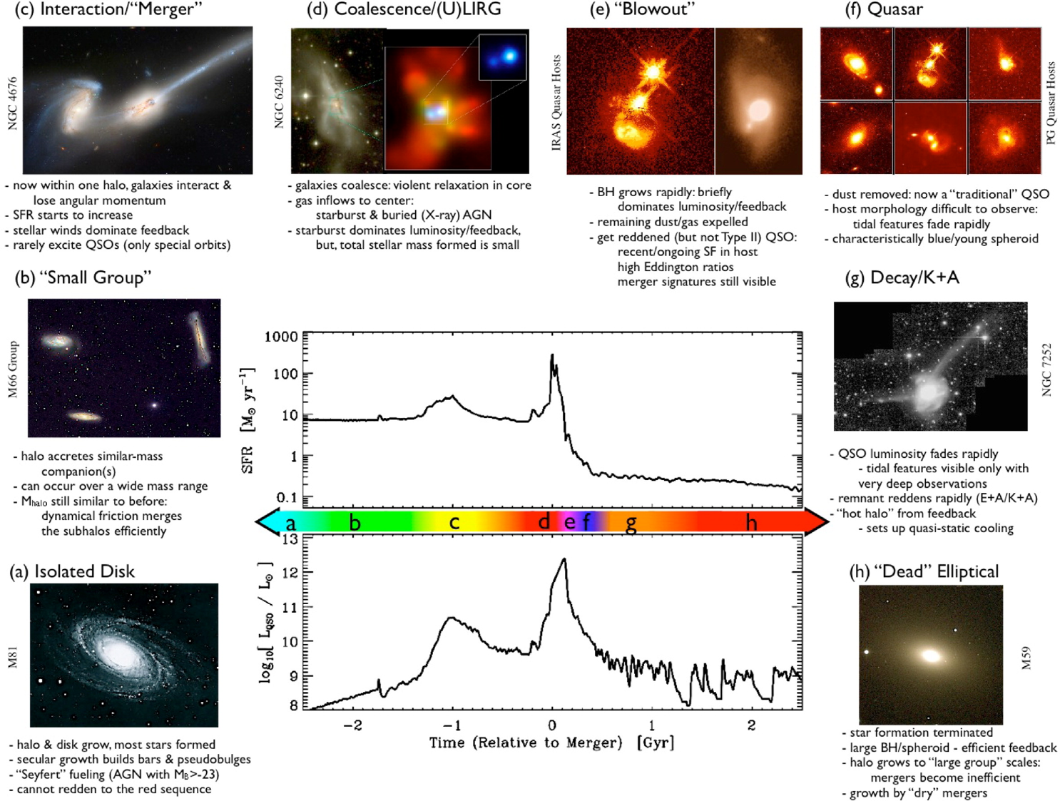
The Most Luminous Broad-line QSOs
It’s only with the WISE all-sky data that we can make a concerted effort to find the *truly* most luminous QSOs… now that we have mid-infrared!
SFR
L_{bol}
Hopkins et al. 2008, ApJS, 175, 356
Notes:
PEAK LUMINOSITY: JUST BEFORE OR AFTER peak accretion and obscuration
BLOWOUT = FEEDBACK. this is a BUZZWORD
does peak luminosity lead or lag peak SFR? when does feedback become most important

Slide 10
Black Hole Accretion
As gas falls into a black hole, it accelerates and emits high energy radiation (ultraviolet, X-ray, and gamma-rays)
This radiation has an effect on the gas near the black hole (“feedback”)
Slide credit: Jillian Bellovary
Notes:
DEFINE ACCRETION

Slide 11
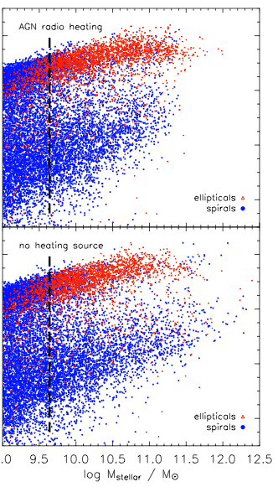
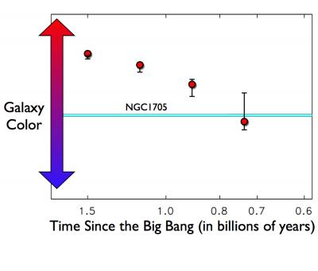
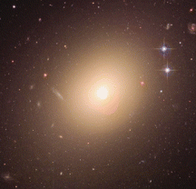
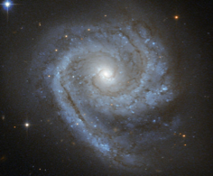
Today’s most luminous and massive galaxies are “red and dead” ellipticals
w/ quasar radio heating
Elliptical
Spiral
Galaxy color
Time
no heating source
Galaxy mass
S. Finkelstein / CANDELS collaboration
NASA / ESA / Hubble Heritage Team (STScI/AURA)
Croton et al. 2006
Notes:
MOTIVATION FOR BLOWOUT PHASE
elliptical galaxy ESO 325-G004
spiral galaxy ESO 498-G5

Slide 12
“Quasar-mode” feedback in galaxies
Feedback radiation heats or disrupts surrounding gas/dust, which otherwise would have formed stars
The gas may even get blown out of the galaxy!
Notes:
- No radio feedback on galaxy scale?
Wagner and Bicknell:
need high resolution simulations
need clumpy dust

Slide 13
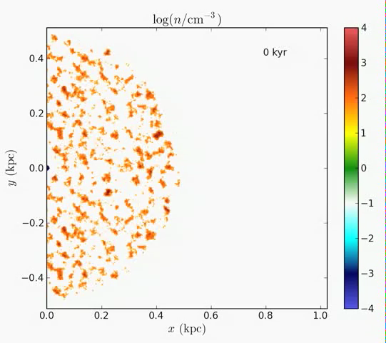
“Radio-mode feedback”: inner kpc

Slide 14
Goal: Identify and study the most luminous obscured and unobscured quasars and their host galaxies
Project 1: Luminous obscured quasars that are likely to be in the process of radio-jet feedback (Lonsdale+ in prep)
Project 2: The most luminous unobscured quasars that are likely to be in the process of quasar-mode feedback (Kimball+ in prep)
Jim Condon, Carol Lonsdale, Mark Lacy, Minjin Kim (NRAO) Peter Eisenhardt, Dan Stern (JPL) • Tom Jarrett, Chao-Wei Tsai (IPAC) Andrew Blain (Leicester) • Colin Lonsdale (MIT/Haystack) Robyn Smith (Drexel) • Dominic Benford (Goddard)
Notes:
find objects in RARE, BRIEF PHASE
RECENT sky survey allows this
goal 2: target individual sources
collaborators: ROBYN UNDERGRAD FIRST-AUTHOR

Slide 15

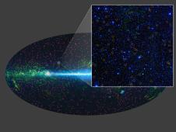
Luminous infrared sources:
Wide-field Infrared Survey Explorer
From 2009 – 2011,
500 million objects observed in four infrared bands:
3.4μm, 4.6μm, 12μm, 22μm
Notes:
- feedback sources are obscured by dust so INFRARED LUMINOUS
RARE need LARGE SURVEY
survey came out EARLIER THIS YEAR

Slide 16
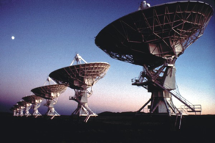
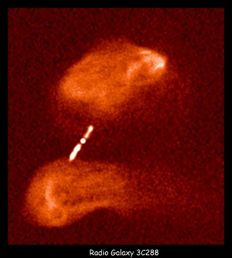
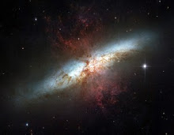

Radio “loudness” determined with the NRAO-VLA Sky Survey (NVSS)
Image courtesy of NRAO/AUI
Radio quiet
Radio intermediate
Radio loud
Young radio quasar? (early feedback stage)
Radio-loud quasar (post-feedback)
M82: starburst (not a quasar)
NRAO/AUI
NASA / ESA / Hubble Heritage Team (STScI/AURA)

Slide 17
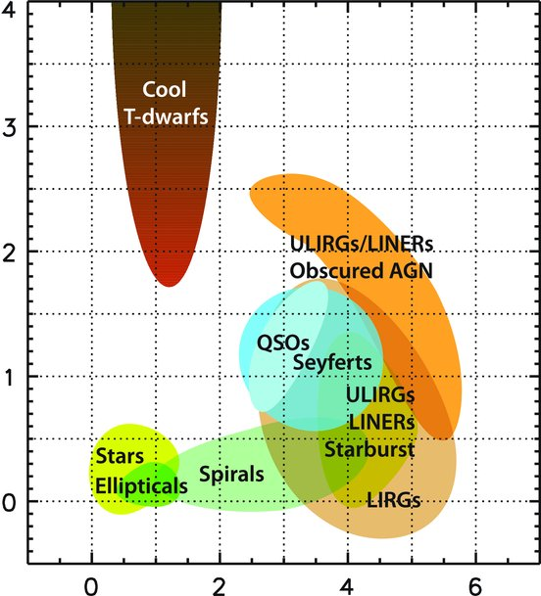
Obscured (dusty) quasars are red in WISE
3.4μm to 4.6μm color
4.6μm to 12μm color
Wright et al. 2010
Notes:
OBSCURED sources and MERGERS will appear RED

Slide 18



Luminous obscured quasars: selection summary: 600 candidates
Reliable detection at 12μm or 22μm
(SNR > 7)
Compact at 1.4 GHz
Intermediate radio-loudness
Very red in mid-IR

Slide 19
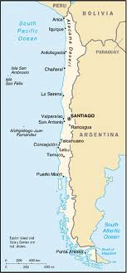
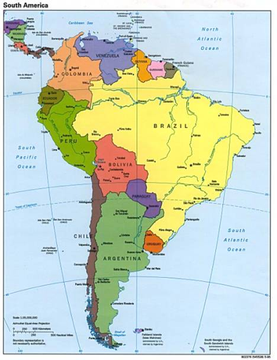
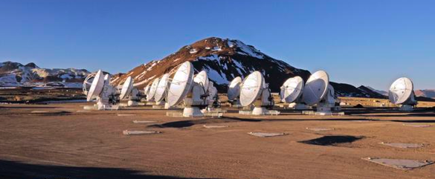
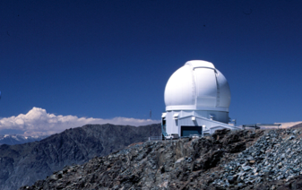
Targeted observations (southern)
SOAR (optical) telescope on Cerro Pachon in Chile
ALMA (sub-millimeter) Cycle 0 observations (49 sources)
almaobservatory.org
soartelescope.org
Notes:
my first observing run!

Slide 20
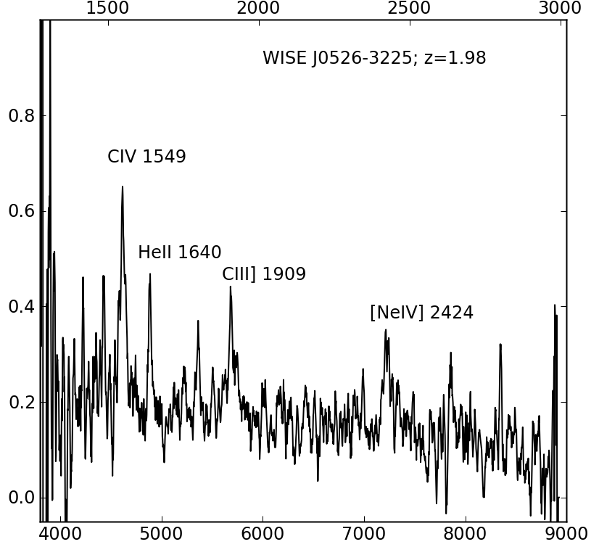
Targeted observations: optical spectra
Emitted wavelength [Angstroms]
spectra obtained for 28 sources
Broad molecular emission lines confirm classification as quasar
Example here: luminosity ~10¹⁴ L☀
Observed wavelength [Angstroms]
Notes:
sources are OPTICALLY FAINT
observed 1 HOUR
I guess if J0526 has z=1.98, Universe was approximately 1/3 of its current age/size when J0526 light was emitted. That would make it, I guess, about 9 billion light years away.

Slide 21
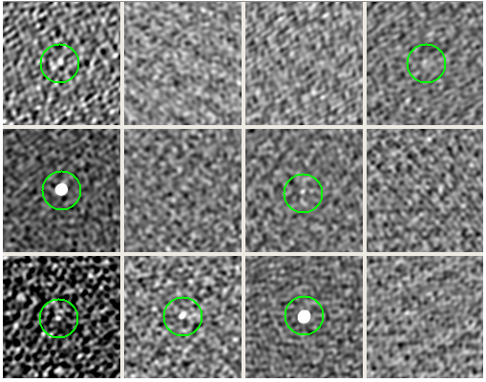
Targeted observations: ALMA (Cycle 0)
ALMA: dust in host galaxy and in quasar torus
49 targets (southern hemisphere)
~1.5 min each
27 detections
Notes:
alma observes COOL SF DUST
and also HOT quasar TORUS dust
data DELIVERED YESTERDAY

Slide 22
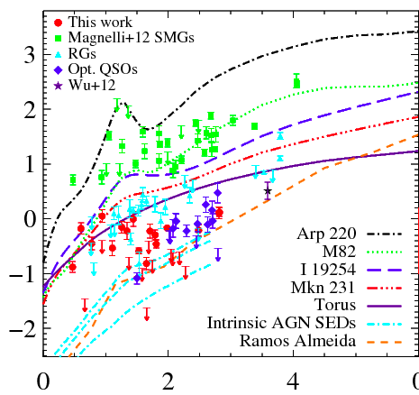
Initial results: ALMA continuum + redshifts
Starburst and quasar templates/observations
Limited star formation in host galaxy?
(Not your typical infrared-luminous source)
Log (submm/farIR ratio)
6
Redshift
Notes:
template: evolution with redshift
CONSISTENT with torus models
LIMITED SF in host

Slide 23

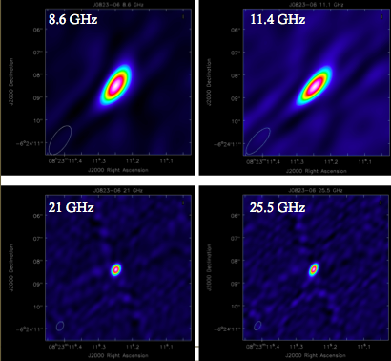
VLA: higher resolution radio imaging and radio spectra
~150 targets
J0823-06
Notes:
physical size of jets: COMPACT
size of NVSS BEAM
steep spectra confirm jet emission, not beamed
YOUNG JET AGE
css and gps: 10^4-10^6 years; extended radio emission 10^7-10^8 years
These sources are all *compact* in radio. Sizes less than several kpc? Not beamed: spectra are steep not flat.
Bump in J0526 could be a flattening due to synchrotron self-absorption, but need to verify the data reduction because the X-band frequencies were a lot noisier.
Break in spectral index allows an estimate of age, with measurement of source size (and assumption of equi-partition of magnetic field)
Literature ages:
extended radio galaxies 10^7-10^8 yrs
GPS/CSS sources <10^5 years old

Slide 24
What’s next?
Constrain host galaxy dust/gas properties (mass, kinematics, morphology)
  high-resolution ALMA follow-up: observe CO lines
High-resolution mapping of the radio jets (inner part of galaxy)
  Very Large Array (VLA) and Very Long Baseline Array (VLBA) imaging
Observe broader range of quasars: track properties through jet growth and different feedback stages
Identify the most luminous unobscured quasars!
Notes:
other observing proposals
ALMA: host galaxy dust properties, mapping of dust
VLBA: jet imaging, mapping and compare to dust

Slide 25

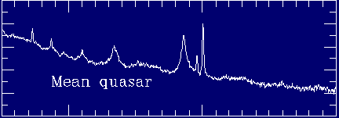
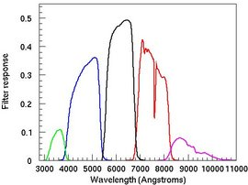
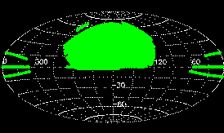
Optical QSO identification:
Sloan Digital Sky Survey
SDSS Data Release 7 QSO catalog:
Broad-line QSO spectrum
  Over 100,000 QSOs in Ω~ 10,000 deg²
5 filters:
u, g, r, i, z
Bill Keel: www.astr.ua.edu/keel/agn
Notes:
Optical surveys: SDSS- photometric and spectroscopic surveys- get identities for r to 21.5 (third of sample; LSST will improve this)- color space- spectroscopy for many sources

Slide 26
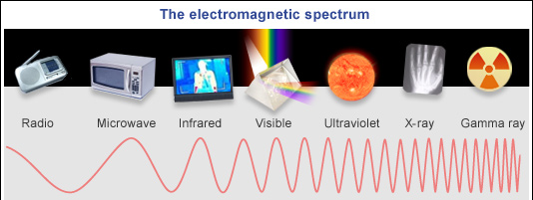

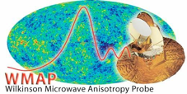





Compilation of multi-wavelength sky surveys
NVSS/FIRST
Notes:
Multi-wavelength data from radio to X-ray. Covers a quarter of the sky (limited by SDSS).
Everything else is all-sky (2MASS vs UKIDSS)
X-ray: grab from NED

Slide 27
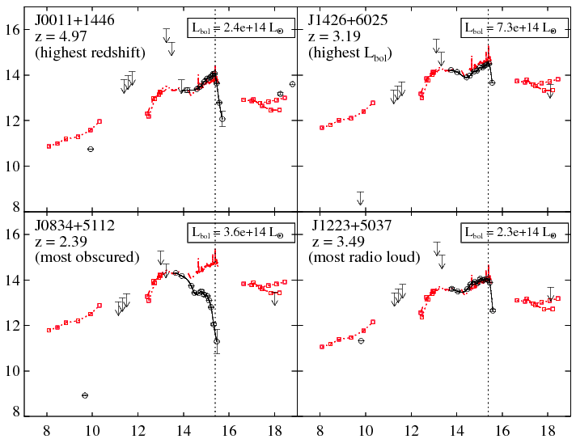
Empirical luminosity determination
Luminosity [L] per frequency decade
Shang et al. 2011
Rest frequency [log Hz]
Notes:
Example of four SEDs: highest redshift, highest luminosity, most obscured, most radio loud.
Say how we estimate bolometric luminosity (only a factor of 3-ish above empirical luminosity)
- Most are not obscured!! Only a small handful are.

Slide 28
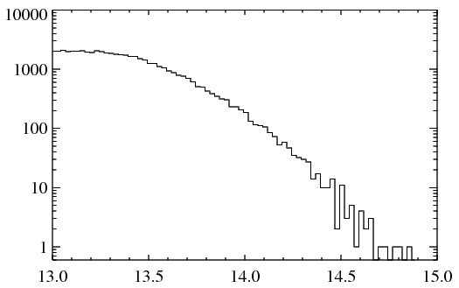
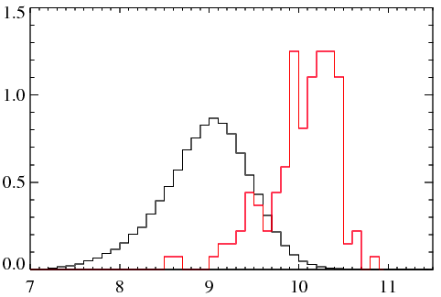
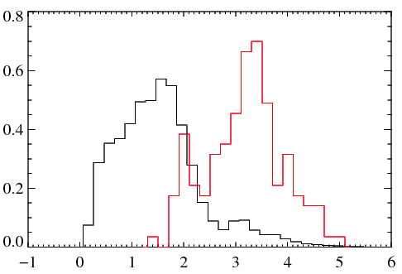
Sample of most luminous optical QSOs
BH mass from Shen et al. 2011
max(L_{bol}) = 7.3x10¹⁴ M
max(M_{BH}) = 6.3x10¹⁰ M
max(redshift) = 4.97
Luminous QSOs (143)
Luminous QSOs
Luminous QSOs
Full sample
Full sample
(~102,000)
#
# (normalized)
# (normalized)
Full sample
Luminosity: log [L]
Black hole mass: log [M]
redshift
<log M_{BH}>
<log λ_{Edd}>
All SDSS QSOs:
Luminous subset:
9.0 ± 0.5 (log M)
10.2 ± 0.3 (log M)
-0.52 ± 0.39
-0.23 ± 0.34
Notes:
Luminosity distribution: We sort of arbitrarily put a limit at 2x10^14 Lsun. There are 143. Clearly skewed to higher masses and Eddington ratios, as you might expect.

Slide 29
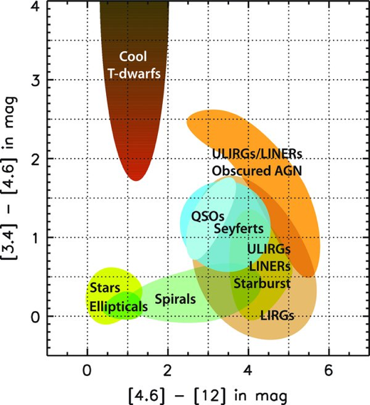
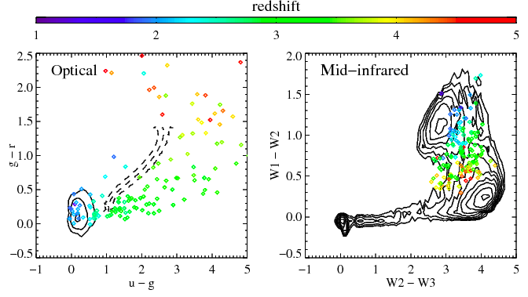
Optical and mid-infrared colors

Slide 30
Exploration of the host galaxies of the most luminous QSOs
Science goal: determine relative epoch of BH/spheroid growth in massive obscured/unobscured systems
ALMA Cycle 1 submm continuum (14 sources) and [CII]158μm line (4 sources):
estimate total far-IR luminosity, SFR, bulge mass
HST Cycle 21 imaging and spectroscopy (3 sources, z~2):
characterize host galaxies, independent bulge mass estimate, age of stellar population, outflowing gas
Jansky VLA radio imaging (21 sources):
radio loudness, spectral index, CO mapping
Notes:
For science goal: can compare with other samples: completely obscured quasars from Lonsdale; radio galaxy samples from Stern, Ivison.
Can we trace evolution of the most massive systems?

Slide 31
Summary
Feedback from super-massive black holes is a critical stage in major-merger theory of galaxy/quasar evolution
We identified sample of rare, extremely luminous obscured quasars in early stages of jet formation and radio feedback using optical/infrared/radio.
We identified most luminous broad-line QSOs from optical/MIR sky surveys… L ~ several times 10¹⁴ L!
Continuing investigations:
  Are we observing just before/after peak starburst activity?
  What are host galaxy properties in the complementary quasar samples?

