Slide 1
Finding Tiny Gas Rich Galaxies in the GALFA-HI Survey
Jennifer Donovan Meyer
NAASC Postdoc – NRAO, Charlottesville
Notes:
New nrao postdoc in CV,
If you look in the program, it appears that there’s a very interesting project I’m meant to discuss with you… finding gas rich galaxies in the GALFA HI survey
unfortunately

Slide 2
Finding Tiny Gas Rich Galaxies in the GALFA-HI Survey
Jennifer Donovan Meyer
NAASC Postdoc – NRAO, Charlottesville
Notes:
It would appear this was a bit of an optimistic typo… and what I meant to have promised to discuss is the culmination of a lot of work by a large team of people at my last postdoc,

Slide 3
Finding Tiny Gas Rich Galaxies in the GALFA-HI Survey insights from the canon CO (1-0) survey
Jennifer Donovan Meyer
NAASC Postdoc – NRAO, Charlottesville
Notes:
Don’t worry, I’m still in the right session… if you’ve been holding your breath all day waiting for the “gas in star forming galaxies” talks, you can still finally breathe for this one.

Slide 4
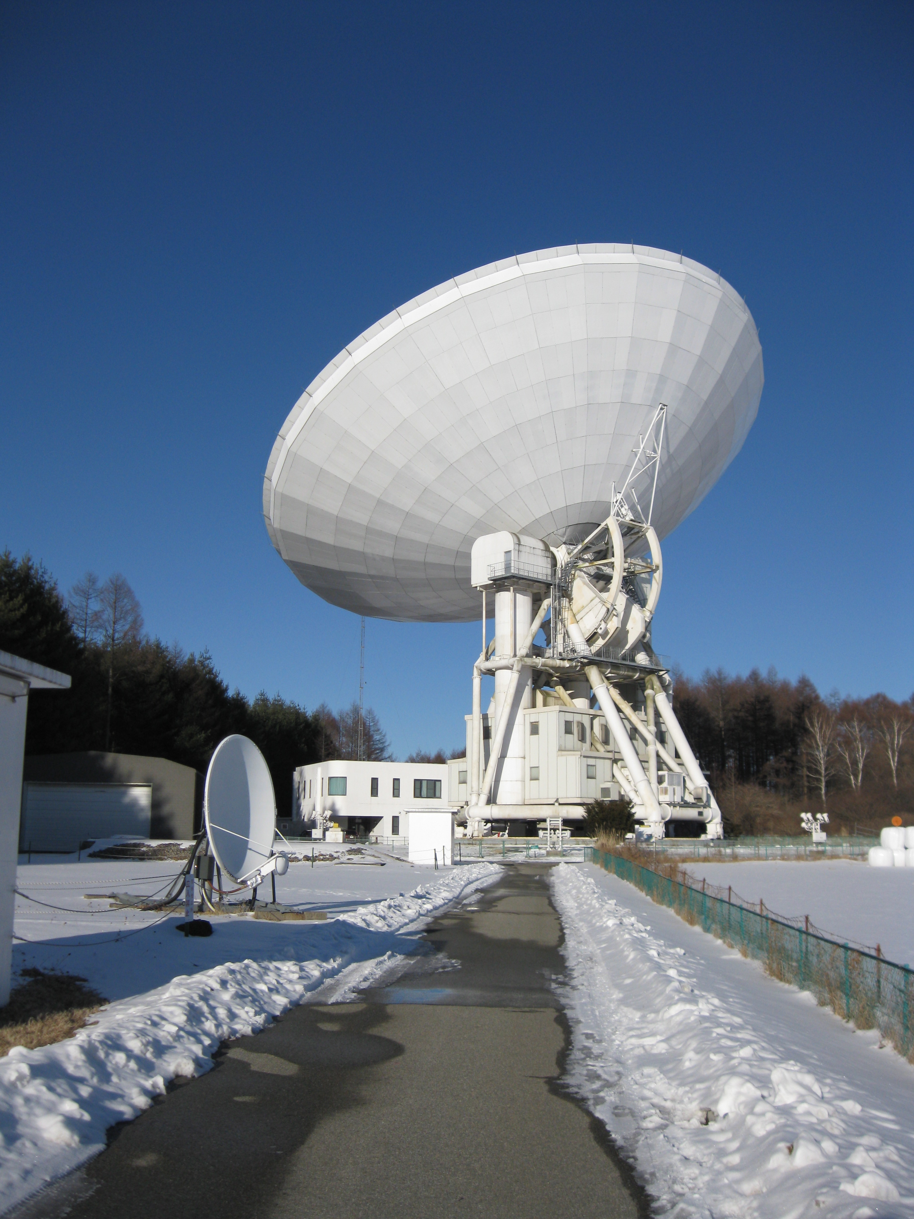
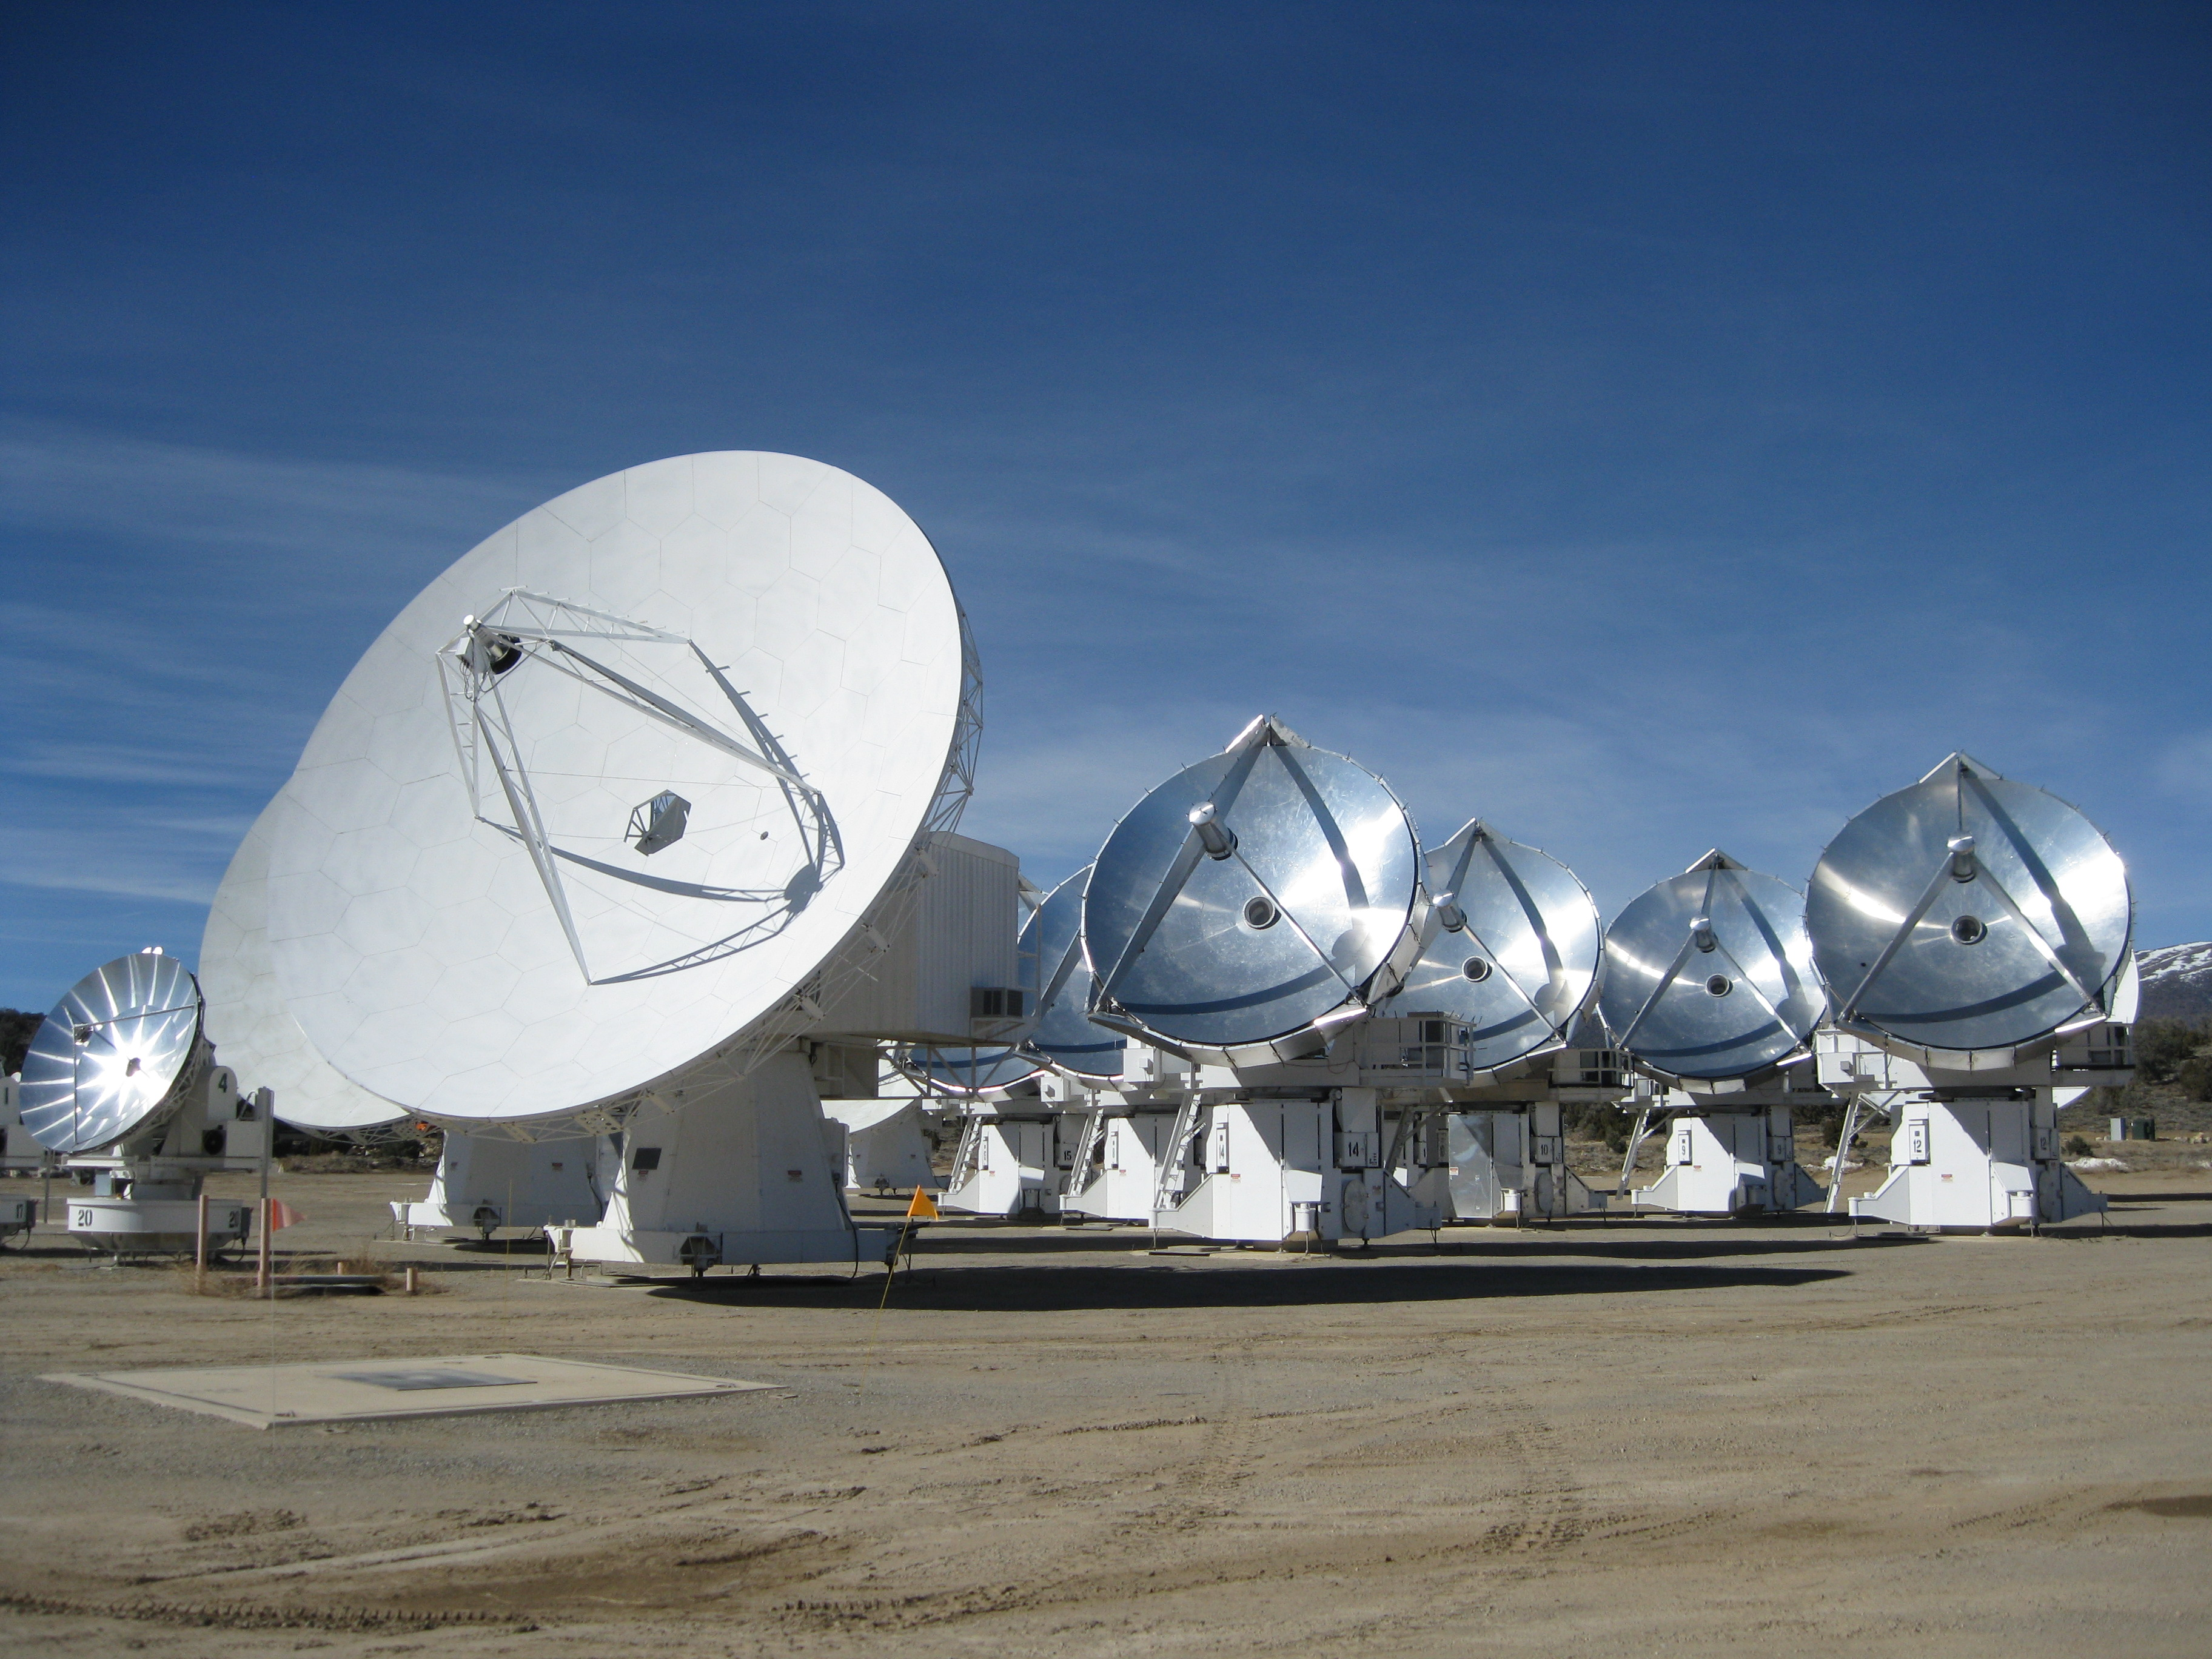
CARMA and NObeyama Nearby Galaxies CO (1-0) Survey (CANON)
Jin Koda (PI) – Stony Brook University
Tony Wong (co-PI) -- UIUC
Daniela Calzetti -- UMASS
Jennifer Donovan Meyer -- NRAO
Fumi Egusa – JAXA
Rob Kennicutt -- Cambridge Univ.
Nario Kuno -- Nobeyama Radio Observatory
Melissa Louie -- Stony Brook Univ
Rieko Momose -- Tokyo Univ.
David Rebolledo -- UIUC
Nick Scoville -- Caltech
Kazuo Sorai -- Hokkaido Univ.
Michiko Umei -- Hokkaido Univ.
+ a few more students in Japan
Nobeyama 45-meter
CARMA
Notes:
So I mentioned this is a big project with lots of people involved…
Obligatory collaborators slide,

Slide 5
Why study molecular gas?
Notes:
This is likely a point that is emphasized every time you hear an ALMA talk, but…
Dominant component of the ISM of spiral galaxies. Studying the properties of and understanding/modeling them gives us insight into the evolution of these galaxies – describing their evolution would be impossible without a proper description of this gas.
In fact, lots of recent work with molecular gas is reshaping our picture of galaxy evolution.

Slide 6
Why study molecular gas?
Traces (evolution of) the interstellar medium
Notes:
Classical picture of the ISM involves molecular gas on spiral arms – dissociates into HI in interarm regions, shocked back into molecules in arms
Early obs: no CO in interarm regions, stellar ages in local GMCs < 10 Myr
This forces the timescale to be short for GMCs – a few Myr

Slide 7
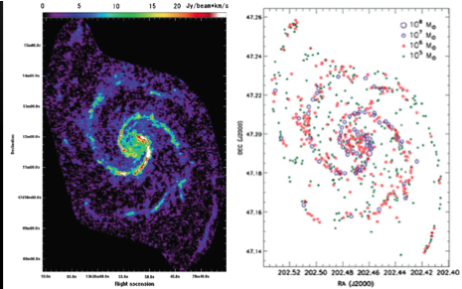
M51
GMCs exist in interarm regions
Molecular gas fraction 70-80% in arms and interarm regions
Koda et al. (2009)
Notes:
Molecular cloud distribution -- GMAs only in arms , GMCs in arm & interarm regions

Slide 8
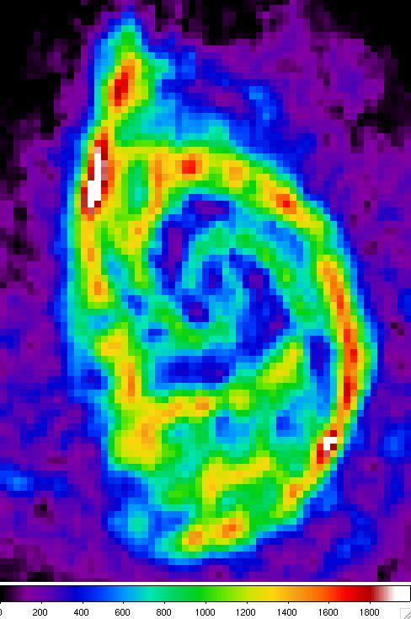
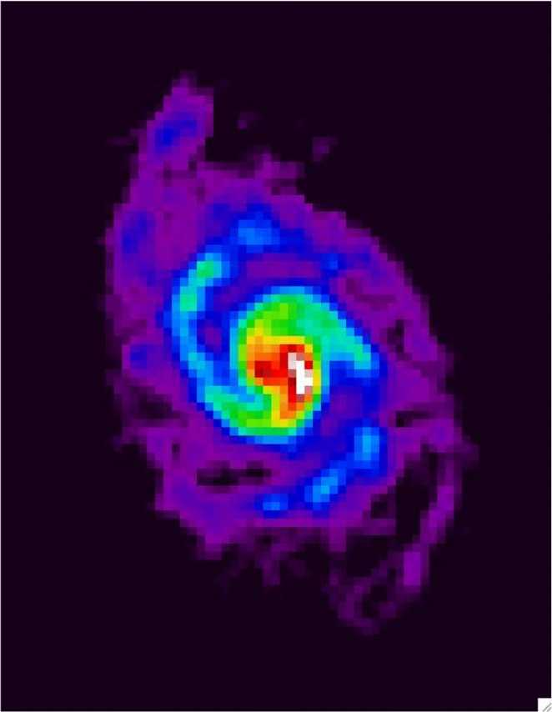
Molecular Gas Fraction in 2D
Molecular fraction
HI 21 cm
CO(1-0)
Westerbork -- Braun et al. 2007
Koda et al. 2011
Notes:
Molecular gas fraction -- 70%~80% in arms and interarms
Evolution scenario -- GMCs→GMAs→SF→GMCs -- little molecular gas ionized/dissociated after star formation

Slide 9
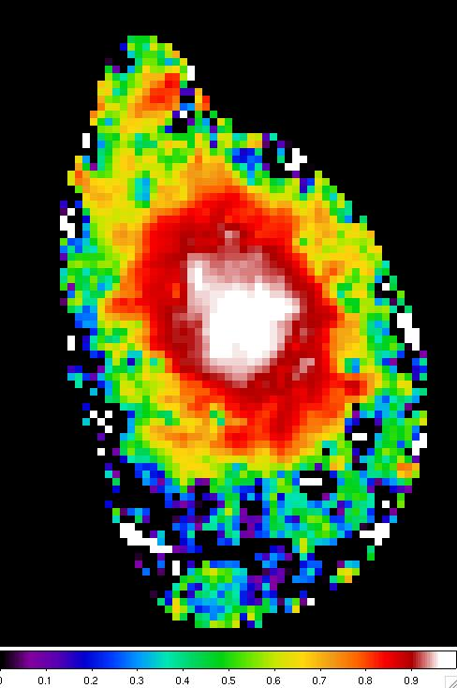
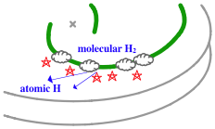
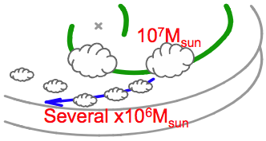
High Molecular Gas Fraction
Molecular fraction
Molecular fraction
> 70-80%
Little/No azimuthal change
10kpc
Notes:
Molecular gas fraction -- 70%~80% in arms and interarms
Evolution scenario -- GMCs→GMAs→SF→GMCs -- little molecular gas ionized/dissociated after star formation

Slide 10
Why study molecular gas?
Traces (evolution of) the interstellar medium
Necessary for star formation

Slide 11
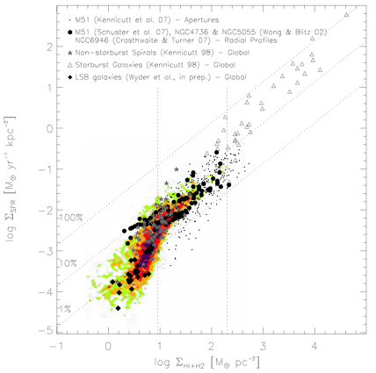
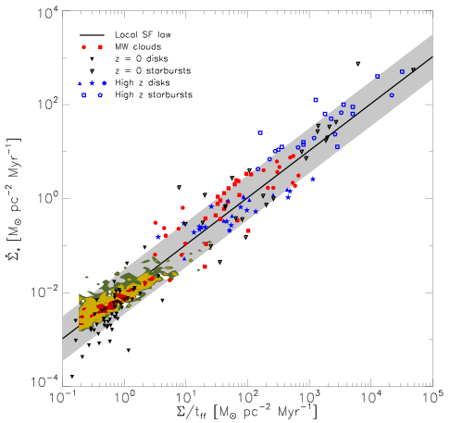
Schmidt-Kennicutt relation
Surface density of star formation
Surface density of star formation
Gas surface density
Gas “volume” density
Bigiel+ (2008)
Krumholz+ (2011)
Notes:
Diagonals: lines of constant SFE indicating sigma(SFR) needed to consume 1/10/100% of gas within 10^8 years
Recent debate – over slope and whether the SF law varies with environment – from obs of high redshift starburst galaxies and in regions of low gas surface density
Obs compiled in the left panel (three different regions observed) – promotes idea of SF thresholds
recent results from Mark Krumholz on right suggest SF law may be volumetric – dividing gas surface density by the local free fall time yields a single SF law, 1% of gas turns into stars per local ff time –
MW-esque star forming GMCs collapse from general ISM and yield a different depletion time than starbursts, where SF regions are not that much denser than ISM and free fall time of entire region is the important quantity

Slide 12
Why study molecular gas?
Traces (evolution of) the interstellar medium
Necessary for star formation
To calibrate high redshift observations
of galaxies

Slide 13
Molecular gas out to high redshift
- Universal star formation law?
Evolution of gas fraction - ~0.1 locally, >1 past z~2?
Galaxy dynamics – disks? Accretion? Major mergers?
Black hole/bulge mass relation
ISM physics and chemistry
HUDF
Notes:
Observations of entire galaxies, mostly unresolved, which we can understand in the context of galaxies which we understand locally
In a few cases, resolved observations – indicate that Xco is similar to the Galaxy, about a factor of 5 higher than in local ULIRGs
So understanding molecular gas is crucial to understanding galaxies – how is it configured? GMCs

Slide 14
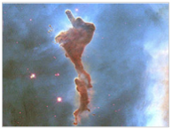
Giant Molecular (H₂ + He) Clouds
GMCs: 10⁴ – 10⁶ solar masses
10-100 pc in size
T~10-20 K
Average surface density ~ 170 M_{sun}/pc²
Self-gravitating (not confined by external pressure)
  Turbulent linewidths (of CO) ~ few km/s, compared to 0.1 km/s sound speed of gas
Substructure: cores
Located in spiral galaxy disks,
coincident with spiral
arms (AND interarm regions)
Cloud associated with
Carina Nebula
Notes:
Gmcs – about half of the mass interior to sun’s orbit,( but only about 1% of the volume of the ISM?)
Lie in the midplane of the disk, so within scale heights of 50-75 pc (thinner than the warm atomic and warm ionized parts of the ISM, which extend up to 1000 pc)
Substructure – clumps, sheets, bubbles, filaments -- densest parts are called cores, where SF can occur because it’s dense and cold enough there
Self gravitating – not confined by external pressure – supersonic turbulent linewidths of CO are a few km/s, as compared to the 0.1 km/s (thermal) sound speed of gas at this temperature (less than ~30 K)

Slide 15
H₂ proxy: CO (1-0)
J=1-0 transition at 115.2712 GHz, hν/k = 5.5 K
Critical density given by n_{H2}=A₁₋₀/σv ~ 3000 cm⁻³
  But CO (1-0) is optically thick, so n_{crit} reduced by τ
  τ_{CO} ≥ ~10 in most GMCs, so critical density for CO (1-0) ≤ 300 cm⁻³
Required: well-calibrated CO-to-H2 conversion factor (X_{CO} or α_{CO} in the literature)
Notes:
Problem with observing H2 directly -- H2 lacks a dipole moment -- molecular gas too cold for quadrupole emission -- high opacity of molecular clouds prevents UV absorption studies from probing the bulk of the gas – use CO as a proxy for H2
Critical density: Einstein’s coefficient for spontaneous emission over collisional cross section * velocity of H2
But CO (1-0) is optically thick (from obs of 13CO) – must also include induced radiative processes. We end up correcting critical density for excitation by a factor of tau in optically thick regime
So we want to observe GMCs in CO – what do they look like in the MW?

Slide 16
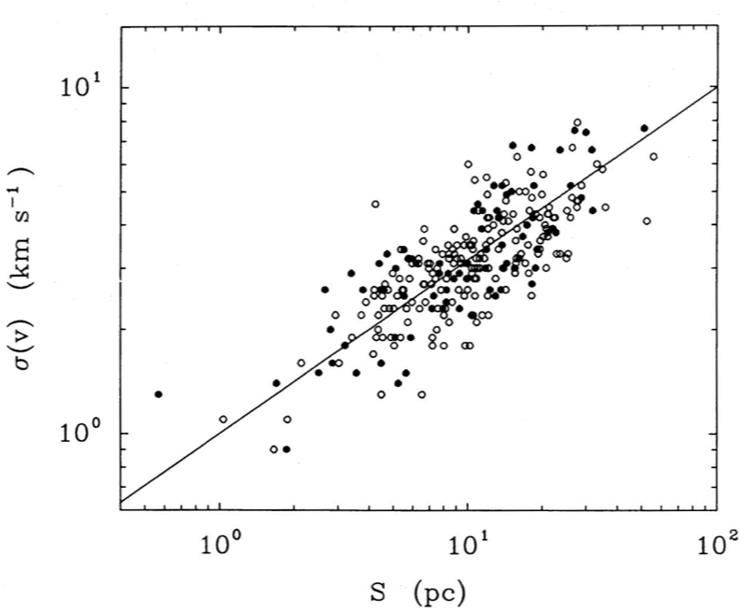
Milky Way GMC population
Solomon et al. (1987)
Notes:
Not immediately obvious that GMCs should obey any physical trend – but 25 years ago (at Stony Brook!) it was discovered it turns out they do, suggesting that they are governed by the same physics
Are extragalactic GMCs governed by this physics too? Resolving individual GMCs outside of the Milky Way is not particularly easy, and until recently we’ve been limited to clouds mostly in dwarfs…

Slide 17
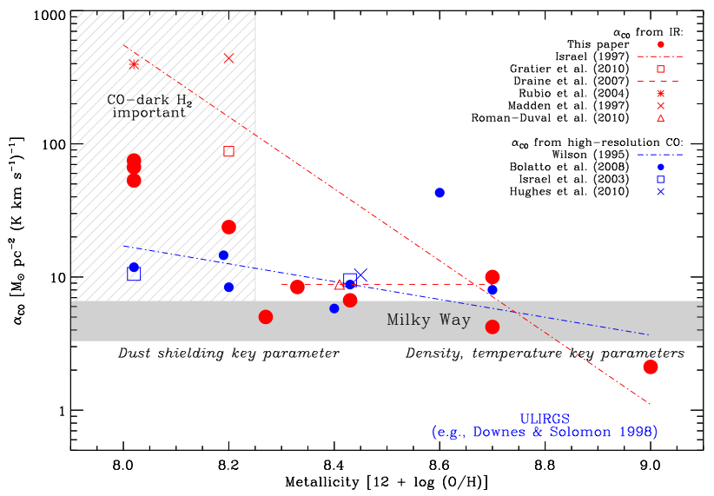
Extragalactic GMC populations
Leroy+ (2011)
Notes:
But there are metallicity effects driving trends in those nearby clouds
Goes in direction one would expect – higher Xco in lower metallicity environments / lower dust environments – poorer self-shielding lets CO get dissociated and CO-emitting cores shrink, so Xco goes up

Slide 18
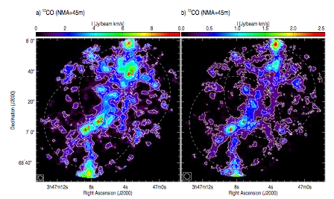
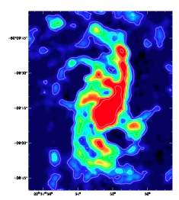
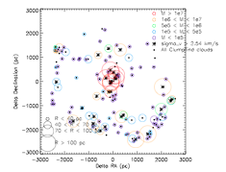
Extragalactic GMC populations
IC 342,
Hirota+ (2011)
Low metallicity GMCs dominate resolvable observations → X_{CO} measurements of Galactic GMCs are our best guess for everything else
How similar are Milky Way GMCs to other galaxies’ GMCs?
GMCs in larger spirals are starting to appear…
But recent BIMA-SONG survey of nearby spirals has resolution 300-400 pc, not enough to resolve typical (or large) Milky Way GMCs
NGC 6946, DM+ (2012)
Notes:
Starting to be able to get GMCs in nearby galaxies (NGC 6946 – Rebolledo in prep, DM12 and IC342 – Hirota2011)

Slide 19
Needed:
  High resolution CO maps of a representative sample of nearby spiral galaxies, with plenty of available multi-wavelength ancillary data, to quantify:
    Conversion factor for CO luminosity → H₂ mass (X_{CO})
    Resolved Kennicutt-Schmidt laws (relating gas to SF)
    ISM evolution
    Star formation efficiencies
    Gas/dust ratios (with the KINGFISH team)
Notes:
Xco
Resolved comparisons of star formation tracers and gas surface density – does the KS law survive on scales smaller than 500 or 1000 pc?
ISM evolution via GMA/GMC distributions and kinematics
SF efficiencies on spiral arms and in interarm regions, density wave studies via offsets between CO peaks and Halpha emission
Gas/dust ratios in collaboration with the Herschel legacy KINGFISH project
All with the help of ancillary data – HI (VLA, WSRT), UV (GALEX), IR (Spitzer, Herschel) for gas phase and star formation studies

Slide 20
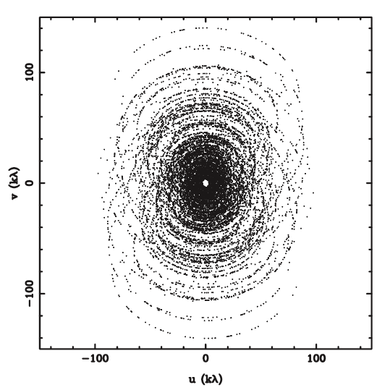
Central Hole
(Difference between mm and cm astronomy)
Size of central hole in Fourier space
= dish diameter/wavelength
= D/λ
Jansky VLA (aka EVLA)
  D = 25m, lambda=21cm
  Hole size ~ 120 (~28’)
CARMA or ALMA
  D ~10m, lambda~2.6mm
  Hole size ~ 3800 (~0.9’)

Slide 21
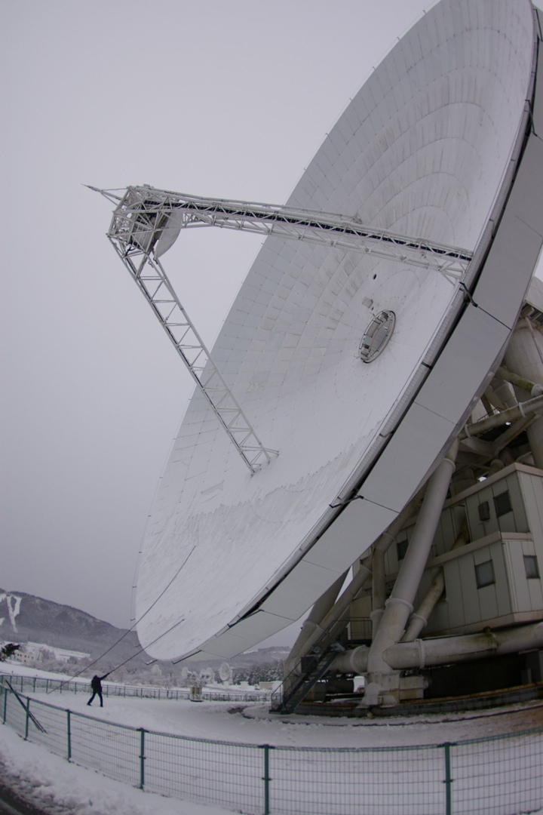
Snow Sweep at
Nobeyama
Need single-dish, even though it’s tough!

Slide 22
The Survey
29 nearby galaxies
  Chosen from SINGS
  Full range of spiral morphologies
  Dec > 0°, d > 4’, SB > 0.5 mJy/sq ‘’ at 160 μm
Observations
  Combine NRO 45m and CARMA observations for high image fidelity
  NRO 45m: OTF mapping of full disks (at 24μm) with 25-beam BEARS (now new FOREST) receivers
  CARMA: 4 tracks (2C, 2D) in a 19-point mosaic mapping of the central ~6 kpc (2.3’) of each galaxy
Notes:
BEARS MULTI-BEAM RECEIVER ON NRO45
full range of galactic structures and dynamical environments (strong/weak spiral arms and bar potentials) -- from early-type (Sa-Sab) to late-type spiral galaxies (Sb-Sbc) -- from barred (SAB, SB) to non-barred galaxies (SA) -- from flocculent galaxies (Arm Class 1-4: weak spiral arms) to grand-design spiral galaxies (9-12: strong spiral arms).
Missing zero spacing problem – sensitivity to structure on all scales

Slide 23
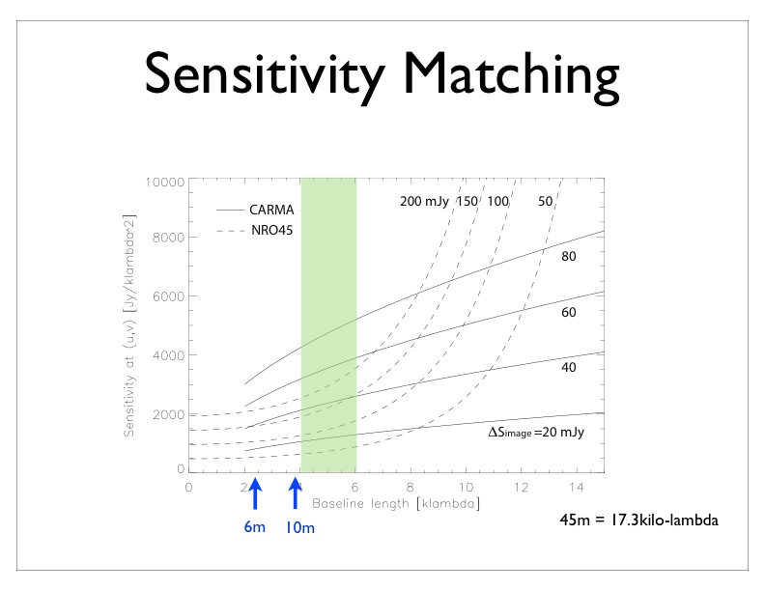
Koda et al. (2011)
Notes:
The weight of the NRO45 visibilities, with respect to CARMA, are determined based on the RMS noise of the NRO45 cube.
pixel sensitivities ∆Sp of CARMA and NRO45 as function of baseline length b for fixed image sensitivities ∆Si. The CARMA and NRO45 uv coverages overlap significantly between 4 and 10 kλ. The NRO45 noise (sensitivity) increases rapidly beyond the baseline length of about half the diameter (∼ 8kλ), and CARMA can complement the uv range beyond that.
The imaging sensitivities of our CARMA and NRO45 observations are 27 and 155 mJy in the velocity width of 10 km s−1, respectively. Their sensitivities match around b ∼ 4-6kλ, within the range where the uv coverages overlap.

Slide 24
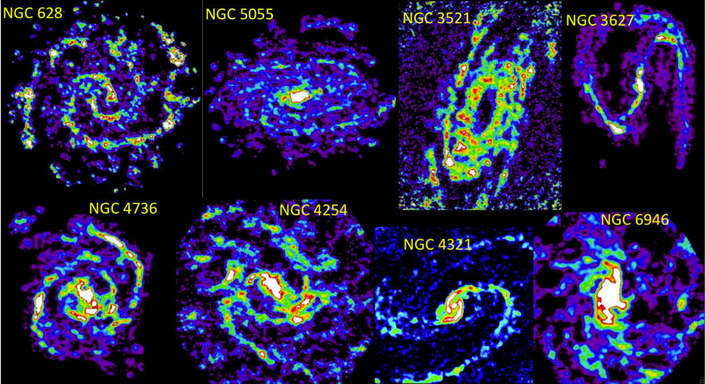
CARMA and NObeyama Nearby-galaxies (CANON) CO (1-0) Survey
(finding GMCs in nearby galaxies)
Three times higher sensitivity & resolution (2-3”) compared to BIMA-SONG
Notes:
Typical resolution of the BIMA-SONG survey of several years ago (BIMA survey of nearby galaxies) is 6’’ or a few 100 pc – we have factors of 2-3 better resolution and in most cases a factor of 2-3 better sensitivity
Obs time: of order 20-30 hours per galaxy at each telescope

Slide 25
Some survey insights into extragalactic GMCs…

Slide 26
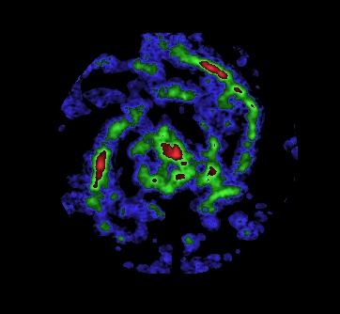
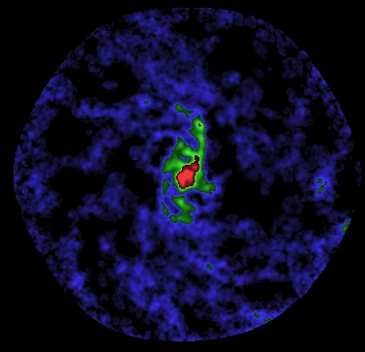
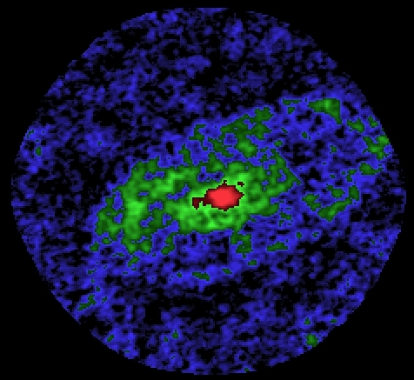
Best resolved nearby galaxies
NGC 4736
NGC 6946
NGC 4826
Notes:
resolution less than 80 pc

Slide 27
Notes:
8um image of NGC 6946 and positions of detected GMCs

Slide 28
GMCs in nearby galaxies
JDM+12, JDM+13 (submitted)
Notes:
Individual GMCs in nearby galaxies show similar properties to those in the MW disk – resolution less than 80 pc

Slide 29
CO-to-H₂ conversion factors
JDM+12, JDM+13 (submitted)
Notes:
Yielding a similar conversion factor in individual clouds with typical factor of 2 scatter and no radial trend

Slide 30
Metallicity
JDM+13 (submitted)
Notes:
Conversion factors from Virial measurements compared to metallicity (which is a big source of error) and various predictions based on observations of resolved GMCs in lower-z systems
Wilson metallicity-conversion factor relation for 2x10^20
Shows our narrow range of probed metallicity
Very dependent upon the metallicity formalism that you choose – these are the theoretically calibrated Kobulnicky & Kewley 2004 values (same with B08), but the empirically calibrated changes by 0.6 dex
Metallicity gradients published for two of the four galaxies – not very steep, mets change by less than 0.2 dex at r=2 kpc, which is almost the edge of our field of view

Slide 31
Leroy+ (2011)
Notes:
Using dust to gas measurements, Leroy et al show that Xco should become a strong function of metallicity just below these values

Slide 32
Radial “profiles”
JDM+13 (submitted)

Slide 33
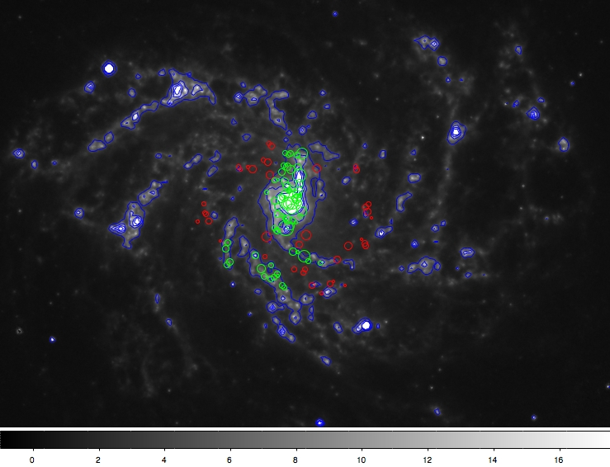
Radial “profiles”
Notes:
If time:
Constant radial profile is in apparent contrast with sandstrom+2012

Slide 34
Dust to gas ratio (DGR) and Xco
Sandstrom+12
Notes:
Sandstrom+ 12 -- simultaneously solved for αCO and DGR by assuming that on kpc scales, the DGR is approximately constant. With this assumption, we can use maps of dust mass surface density, CO integrated intensity and H I column density to solve for both constants with no assumptions about their value or dependence on metallicity or other parameters. --- USING CO (2-1)

Slide 35
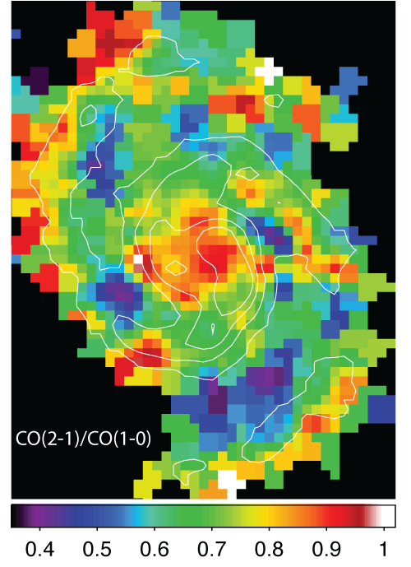
Dust to gas ratio (DGR) and Xco
Spiral arms
  High ratio ~ 0.8-1.0
Interarm regions
  Low ratio ~ 0.4-0.6
Central 2.5kpc
  High ratio ~ 0.8-1.0
Koda+12
Notes:
Sandstrom+ 12 -- simultaneously solved for αCO and DGR by assuming that on kpc scales, the DGR is approximately constant. With this assumption, we can use maps of dust mass surface density, CO integrated intensity and H I column density to solve for both constants with no assumptions about their value or dependence on metallicity or other parameters. --- USING CO (2-1)

Slide 36
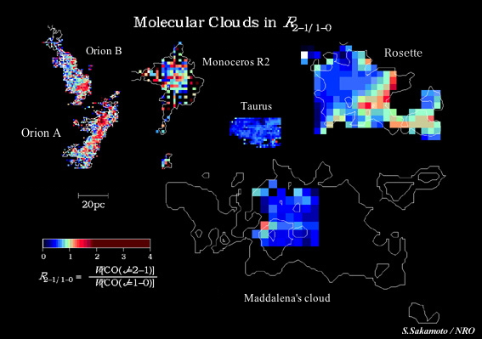
R_{2-1/1-0}
Interarm -- dormant, less star forming GMCs
Spiral arms – actively star forming GMCs.
Koda+12

Slide 37
DGR/Xco minimization using CO (1-0)

Slide 38
Summary
Our CARMA+NRO survey of nearby galaxies is enabling resolved measurements of GMCs out to the largest distances currently possible (to be superseded by ALMA)
These are the best resolved GMCs in galaxies outside of the Local Group and are remarkably similar between galaxies, but average CO-to-H₂ ratios vary systematically – though still within a factor of 2 of the MW value
The metallicity range is narrow, but variance in Xco is consistent with predictions; no dependence on environment is observed, consistent with CO (2-1) observations that Xco(2-1) may drop in the center of NGC 6946

