Slide 1
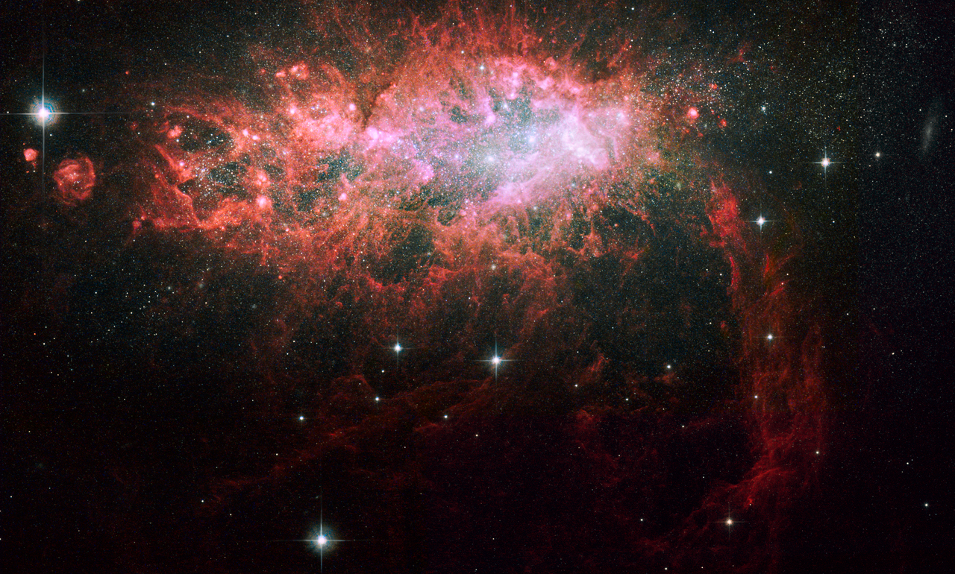


Neighborhood HI Watch: Mapping the HI Neighborhood Around Starburst Dwarf Galaxies
Megan Johnson
NRAO, Green Bank
Post-doc Symposium, April 2013

Slide 2
Outline
Motivation
Introduction
NGC 1569
  HI from VLA
  9° x 2° GBT map
NGC 4163/NGC 4214
  GBT map
Summary and Future Plans
Notes:
2
This is the direction that my talk will take starting with an introduction and then a detailed look at NGC 1569, which shows how the HI mapping with the GBT was prompted. Then, I’ll present some new data taken with the GBT around NGC 4163 and 4214. I’ll conclude with a brief summary.

Slide 3
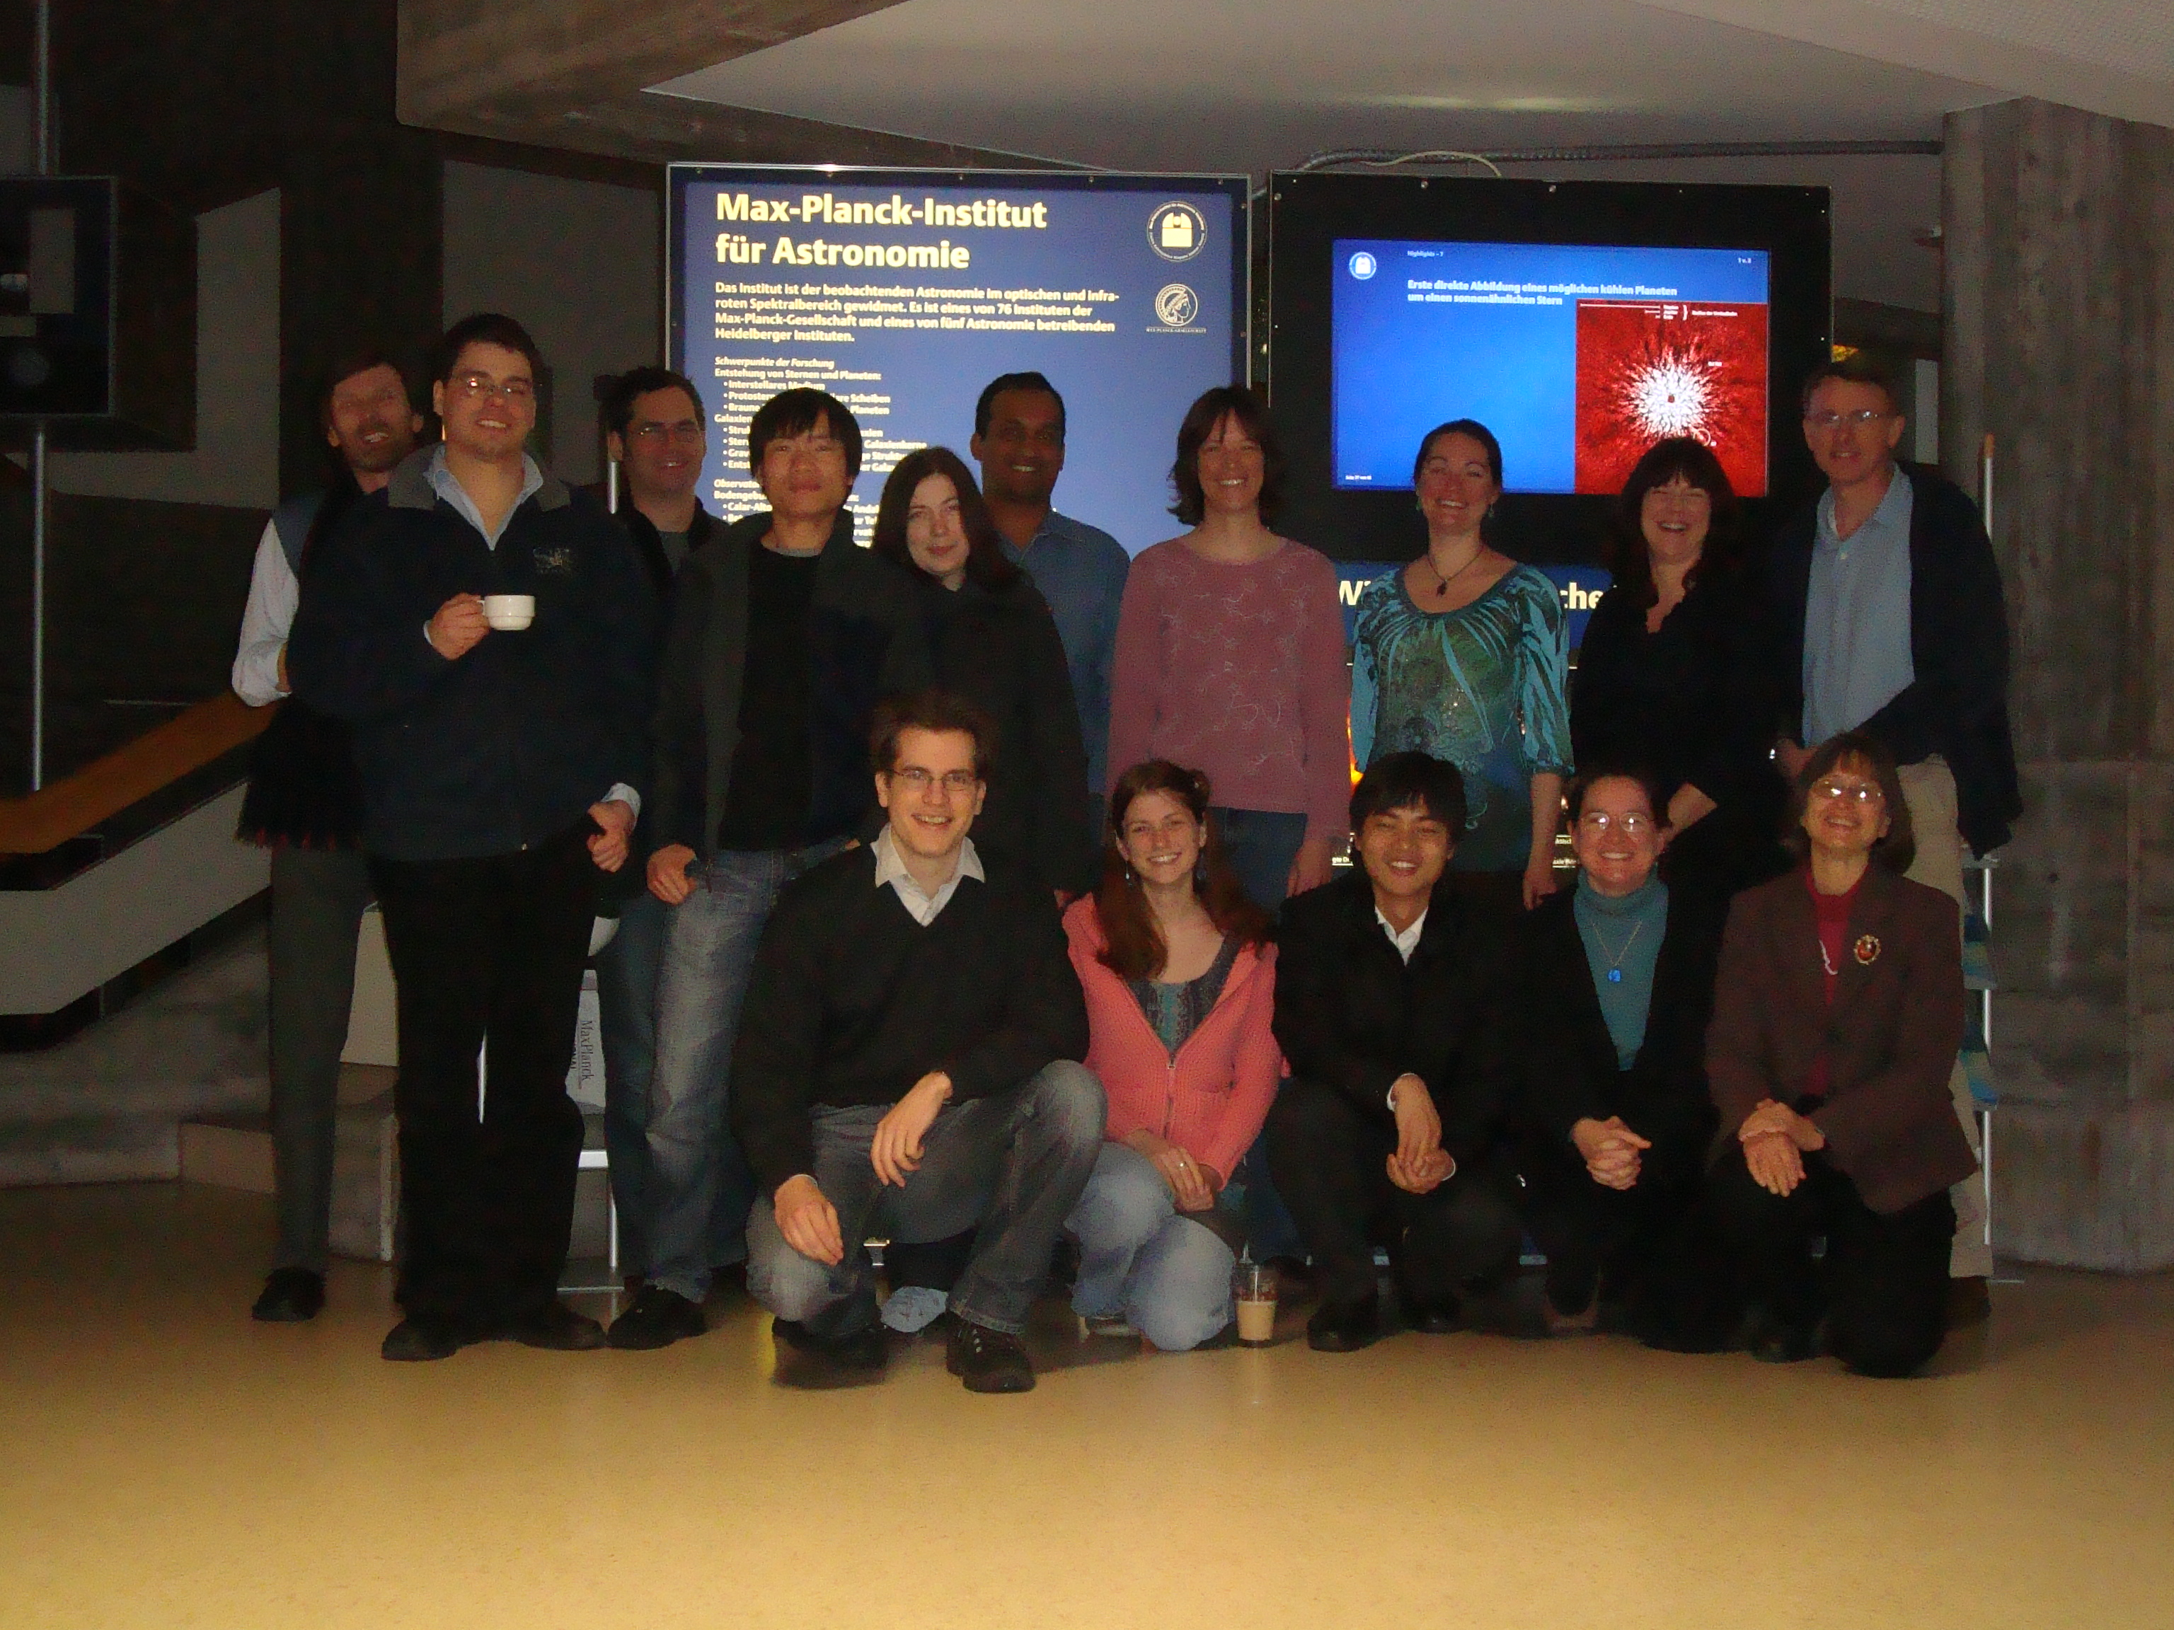
LITTLE THINGS Team
Elias Brinks Fabian Walter Dana Ficut-Vicus Me Bruce Elmegreen
Volker Heesen Hong-Xin Zhang Lisa Young Caroline Simpson
Andreas Schruba Se-Heon Oh Deidre Hunter
Trisha Ashley Kim Herrmann
Notes:
3
Collaborators

Slide 4
Collaborators
Kristy McQuinn – University of Minnesota
Baerbel Koribalski – CSIRO, Sydney
Jeremy Bailin – University of Alabama
Alyson Ford – NRAO, Green Bank
[Gurtina Besla – Colombia University]
Notes:
4
Collaborators

Slide 5
Motivation
What is the role of interactions/mergers between dwarf galaxies in the local universe?
Notes:
5
According to Lambda CDM, dwarf galaxies are the building blocks of larger galaxies, yet the role of present day dwarf-dwarf galaxy interactions and mergers is not well known.

Slide 6
Introduction
LITTLE THINGS = Local Irregulars That Trace Luminosity Extremes, The HI Nearby Galaxy Survey
GOAL: understand how stars form in dIrr galaxies – 41 dIrr galaxies in sample chosen to be “isolated”
multi-wavelength dataset including Galex FUV & NUV, UBVJHK & Hα photometry, Spitzer 3.6μm, and VLA B-, C-, and D-array HI emission data.
for more information see Hunter+ 2012 and: https://science.nrao.edu/science/surveys/littlethings/
Dr. Deidre Hunter Colloquium – this Wednesday, 2 pm!!
Notes:
6
This research grew out of the LITTLE THINGS survey, which is a multi-wavelength data collection with the star being high resolution HI VLA data. The goal of the project is to understand how stars form in gas rich dwarf galaxies. Be sure to catch Deidre’s colloquium Wed. at 2 pm.

Slide 7
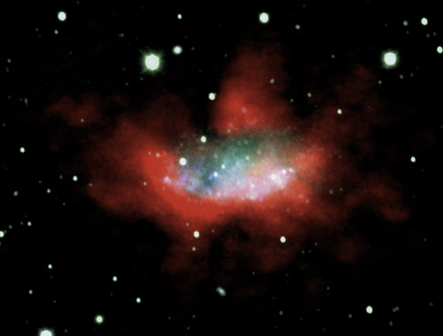
Introduction
DDO 165 – Member of
M81/M82 Group
Notes:
7
This is the direction that my talk will take starting with a brief introduction and then a detailed look at NGC 1569, which I studied for my dissertation. Then, present some new data taken with the GBT around NGC 4163 and 4214. I’ll conclude with some future work and a brief summary.

Slide 8
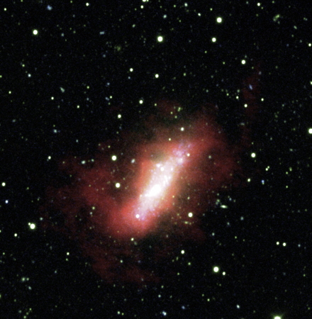
Introduction
DDO 168 – Member of Canes
Venatici Cloud
Notes:
8
This is the direction that my talk will take starting with a brief introduction and then a detailed look at NGC 1569, which I studied for my dissertation. Then, present some new data taken with the GBT around NGC 4163 and 4214. I’ll conclude with some future work and a brief summary.

Slide 9
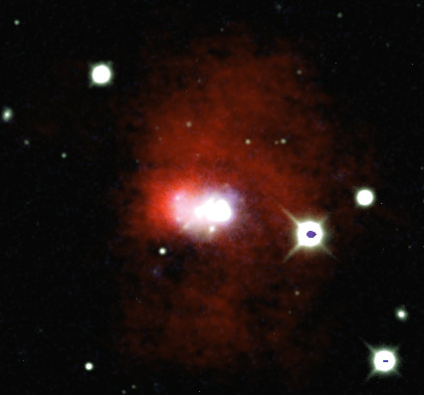
Introduction
Haro 29 – No Known
Group
Notes:
9
This is the direction that my talk will take starting with a brief introduction and then a detailed look at NGC 1569, which I studied for my dissertation. Then, present some new data taken with the GBT around NGC 4163 and 4214. I’ll conclude with some future work and a brief summary.

Slide 10
Introduction
Using GBT to map 2° x 2° regions around all 41 LITTLE THINGS dwarf galaxies
GOAL: To determine if faint HI in the outskirts of dIrr galaxies can provide information about the process(es) that create “unsettled” HI morphologies
→ Are interactions/mergers responsible?
Notes:
10

Slide 11
Introduction
Starburst Dwarf Galaxies
  Logical place to look for interactions/mergers, assuming they follow the more massive spiral galaxies (Kravtsov, Gnedin, & Klypin 2004)
  HI often most massive component in interaction/merger (Besla + 2012)
Notes:
11

Slide 12
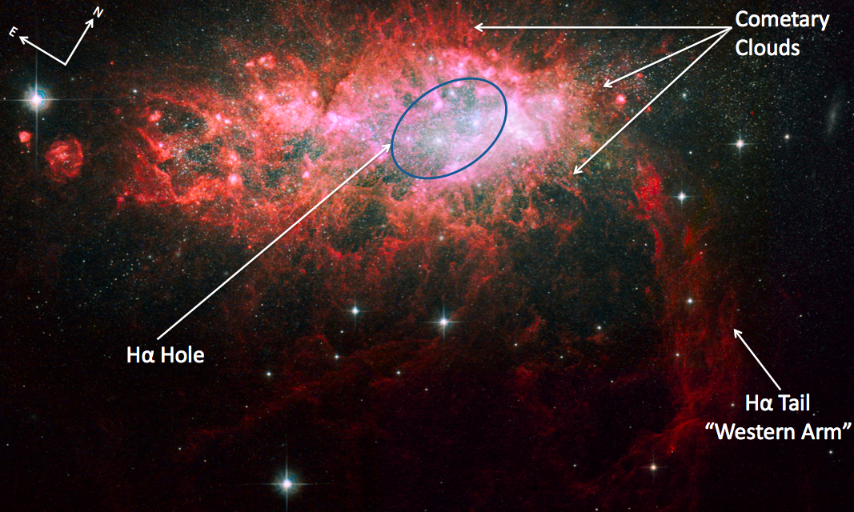
NGC 1569
A
B
Member of IC 342 Galaxy Group
D = 2.96 Mpc (Grocholski + 2013)
M_{V} = -17.57
SFR = 0.24 M/yr
HI mass = 2.5 x 10⁸ M
Stellar mass = 2.8 x 10⁸ M
Notes:
12
This work was prompted by my thesis, which was on the stellar and gas kinematics of NGC 1569. I was trying to determine the 3-dimensional shape of dwarf irregular galaxies using the kinematic measure V/sigma. NGC 1569 is a nearby post-starburst dwarf irregular galaxy in the IC 342 Galaxy Group. In this beautiful HST image, we see an H-alpha cat-like tail extending to the southwest known as the Western Arm.. It is home to 3 SSCs, A1, A2, and B. There are cometary structures extending out in all directions from the SSCs. The black rectangle outlines the placement and size of the region over which we determined stellar kinematics for the major axis of NGC 1569.

Slide 13
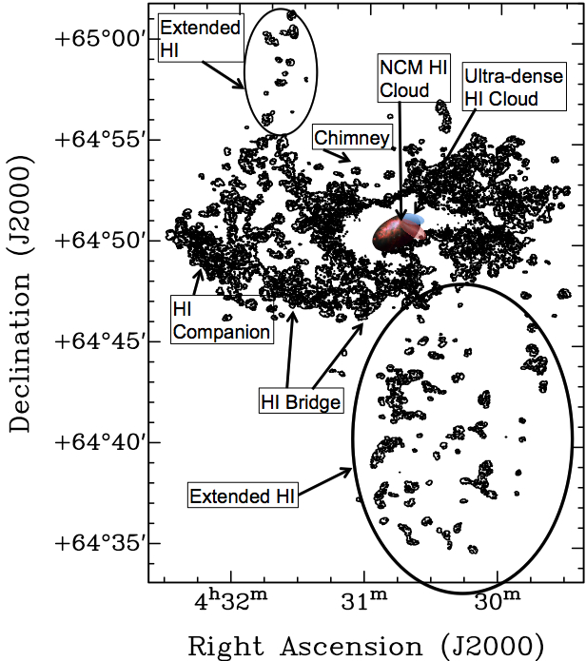
Previous Work:
“HI Companion,” “HI Bridge,” Stil & Israel (1998) and “NCM HI Cloud” – Stil & Israel (2002) - HV3
“Chimney” - Hunter et al. (1993); Mühle et al. (2005); Westmoquette et al. (2008)
Johnson+ 2012
Notes:
If we zoom out, we can see the neutral hydrogen gas disk where several HI features that have already been studied in previous works. Here, we have imaged tenuous, extended emission to the south and northeast of the disk using a new multi-scale cleaning algorithm implemented by LITTLE THINGS.

Slide 14
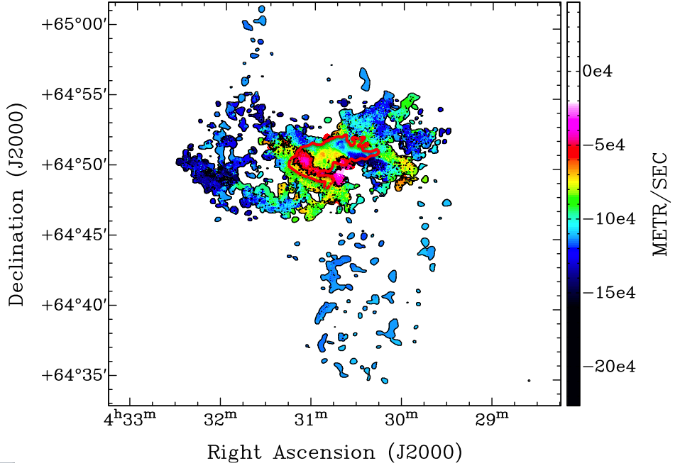
VLA HI Intensity-weighted Velocity Field
Johnson+
2012
Notes:
In order to derive Vmax, we have to determine the HI rotation curve. However, because the intensity-weighted HI velocity field has high velocity gas strewn all across the disk, we needed another method for deriving the rotation curve.

Slide 15
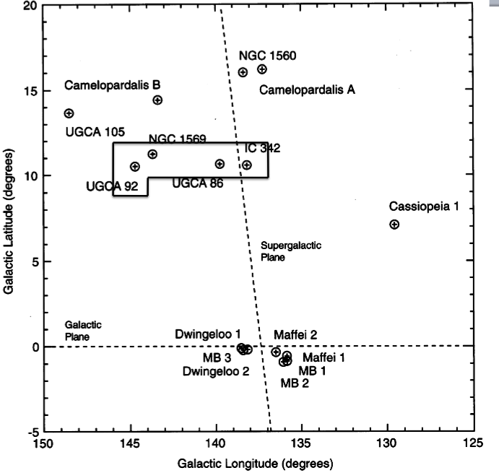
NGC 1569 with the GBT
Notes:
15
Why study starburst dwarf galaxies? Well, if this is the definition of a starburst and this is a definition of a dwarf galaxy, then, are starburst dwarf galaxies building blocks in action? What is the role of interactions and mergers between dwarf galaxies?

Slide 16
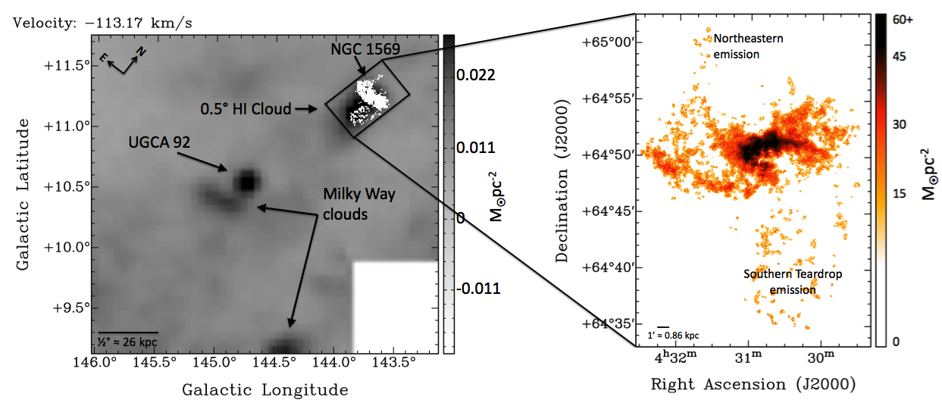
GBT Map around NGC 1569
Johnson 2013
Notes:
contours are VLA ;
make connection that VLA contours are confirmed with GBT, not noise;
call cloud – southern extension

Slide 17
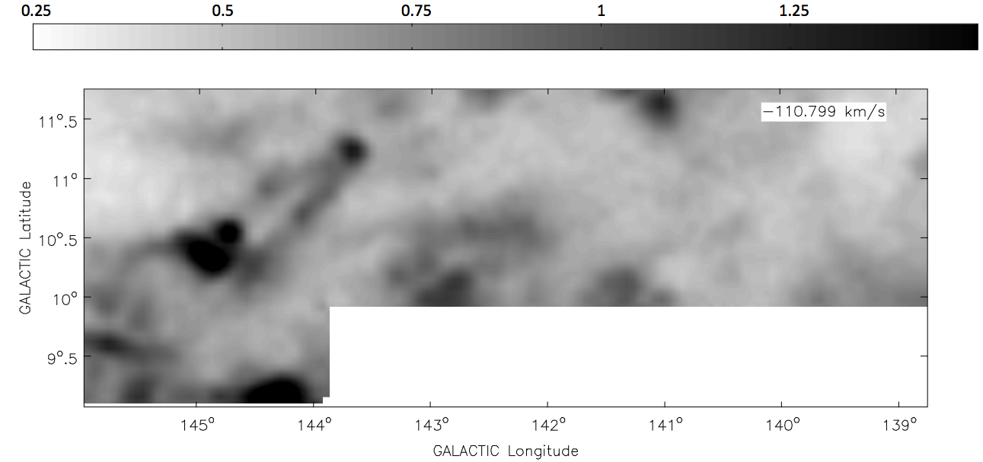
GBT Map around NGC 1569
NGC 1569
Intergalactic Filaments
UGCA 92
MW Cloud
Johnson 2013
Notes:
intergalactic filament structures
Other emission in map is from Milky Way

Slide 18
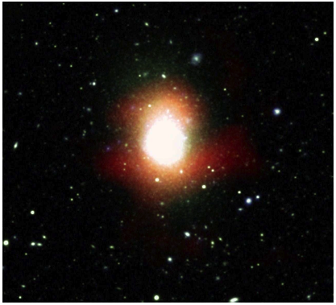
NGC 4163
Member of Canes Venatici Cloud
D = 2.8 Mpc
M_{V} = -14.37
SFR = 9.1 x 10⁻⁴ M/yr
HI mass = 1.4 x 10⁷ M
Stellar mass = 2.7 x 10⁷ M
Notes:
18

Slide 19
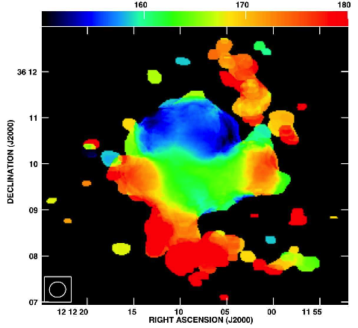
NGC 4163 – IWM Velocity Field
Notes:
19

Slide 20
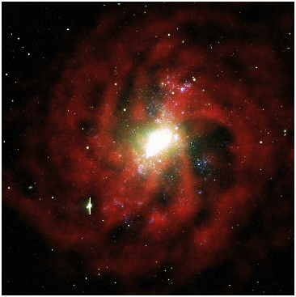
NGC 4214
D = 2.9 Mpc
M_{V} = -17.56
SFR = 0.13 M/yr
HI mass = 5.8 x 10⁸ M
Stellar mass = 4.8 x 10⁸ M
Member of Canes Venatici Cloud
Notes:
20

Slide 21
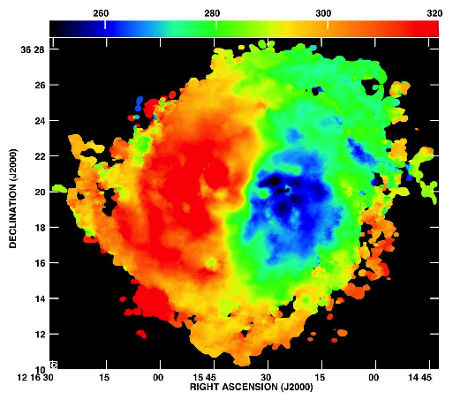
NGC 4214 – IWM Velocity Field
Notes:
21

Slide 22
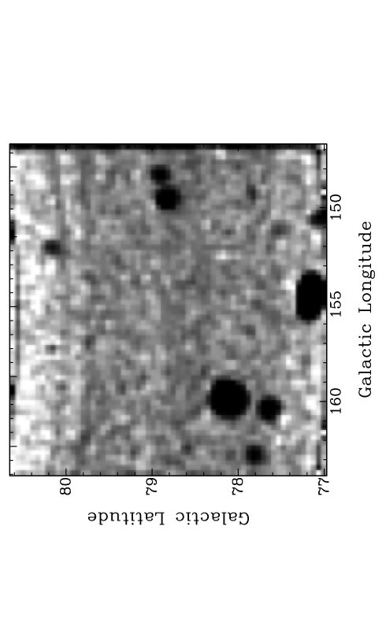
Integrated HI GBT Map
UGCA 7605
RMS = 23 mK, (at 1σ
in a 1 km/s channel)
UGCA 7559
UGCA 7599
UGC 7257
NGC 4214
NGC 4163
NGC 4190
KDG 105
BTS 133
NGC 4244
KUG 1218+387
Notes:
summed over 270 channels for total velocity of 261 km/s

Slide 23
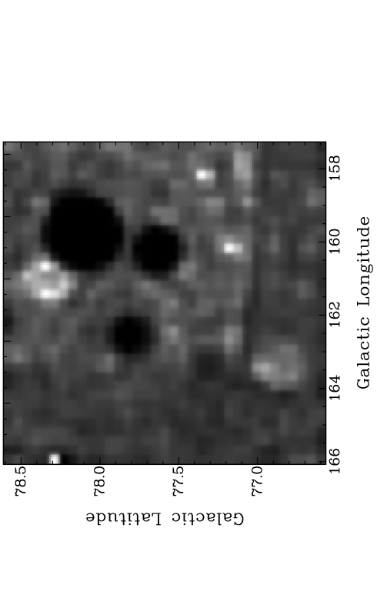
Integrated HI GBT Map
NGC 4214
RMS = 13 mK, (at 1σ
in a 1 km/s channel)
NGC 4190
UGC 7257
NGC 4163
KUG 1207+367
UGC 7125
UGC 7207
Notes:
summed over 270 channels for total velocity of 261 km/s

Slide 24
Summary
NGC 1569
  Extended HI emission to south and northeast in VLA map stretching in the direction of UGCA 92 and confirmed with GBT
  GBT data show v-shaped filamentary structures and a 0.5° HI cloud stretching out from NGC 1569 in the direction of UGCA 92
NGC 4163/4214
  “Unsettled” HI in VLA maps
  Possible extended emission around NGC 4214 detected in GBT map
  Need “position switched” data reductions to obtain better baseline fits
Notes:
24

Slide 25
Future Work
Form complete statistical sample of HI environments around starburst and quiescent dIrr galaxies
  Deep GBT maps of 7 starburst dwarf galaxies next semester
  Deep Parkes Telescope observations of starburst and quiescent dwarf galaxies to be obtained September 2013
Compare observations to hydrodynamic simulations
Notes:
25

Slide 26
Notes:
26

Slide 27
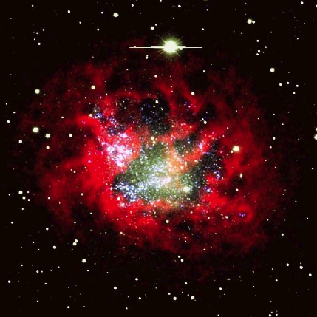
IC 1613 – Local Group Member
Notes:
27

Slide 28

DDO 165 – M81 Group Member
Notes:
28

Slide 29
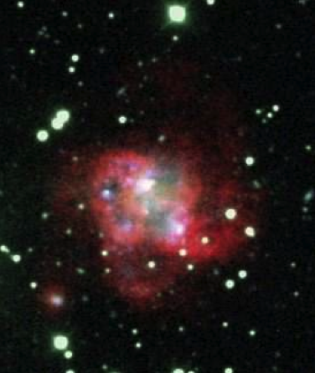
DDO 46 – No Known Group
Notes:
29

Slide 30
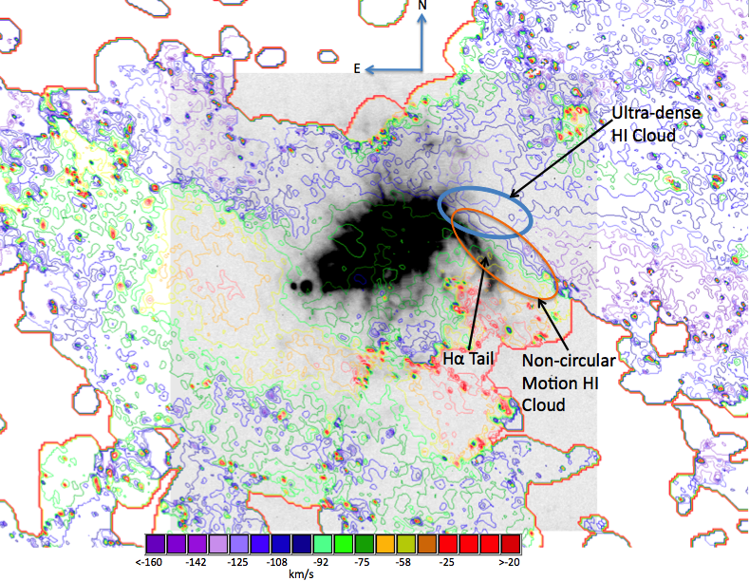
Ultra-dense HI Cloud (UDHIC)
Hα tail – Velocity ~ -90 km/s (Tomita et al. 1994)

Slide 31
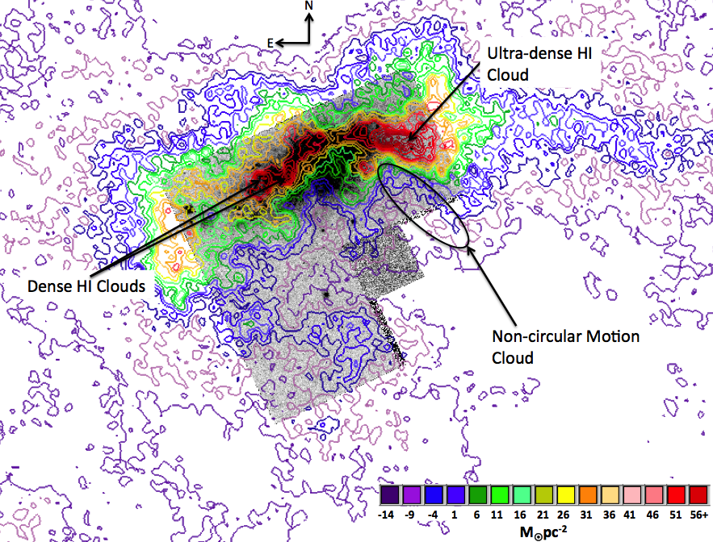
Integrated HI Intensity Contour Map

Slide 32
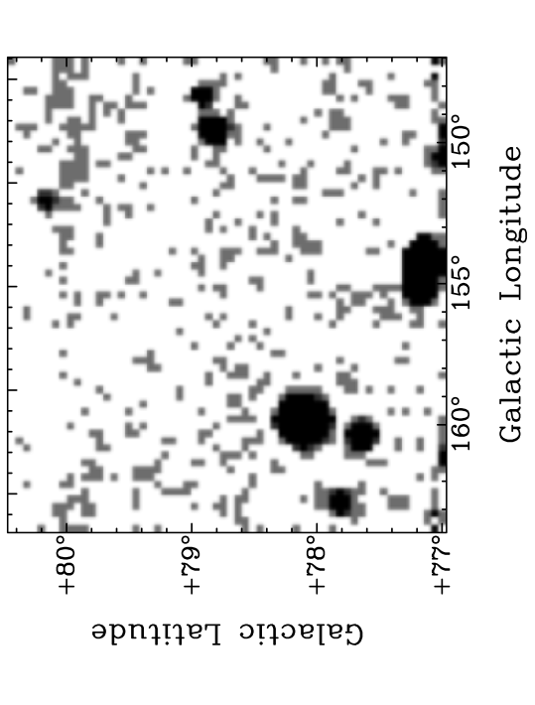
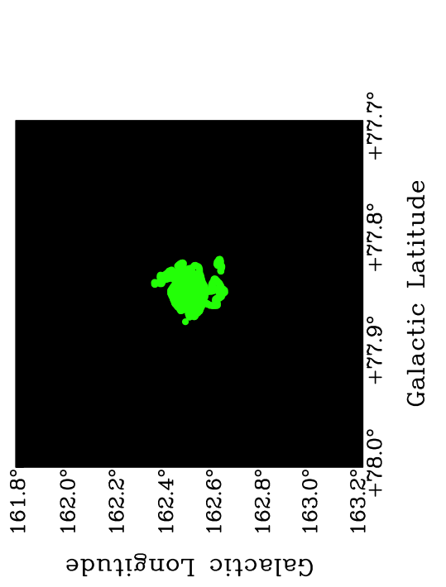

Slide 33
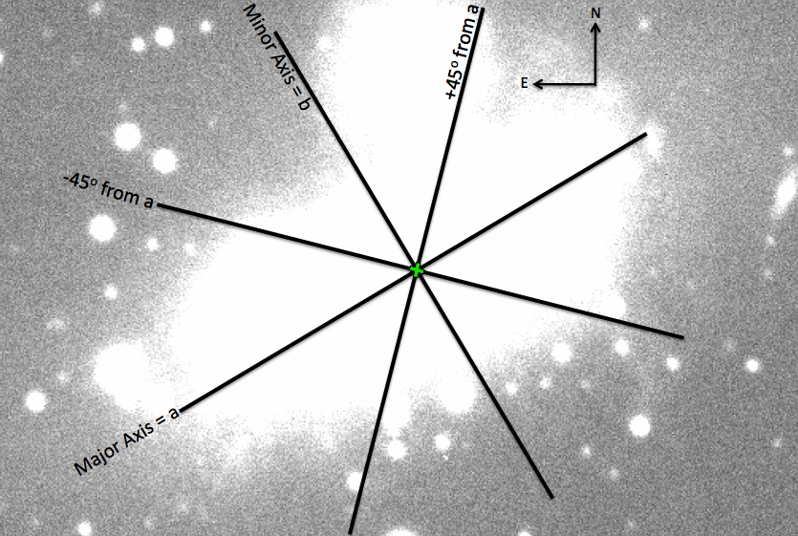
Stellar Kinematics
Notes:
We obtained stellar velocities and velocity dispersions along 4 PAs with the Kitt Peak National Observatory’s 4-meter telescope with the Echelle spectrograph.

Slide 34
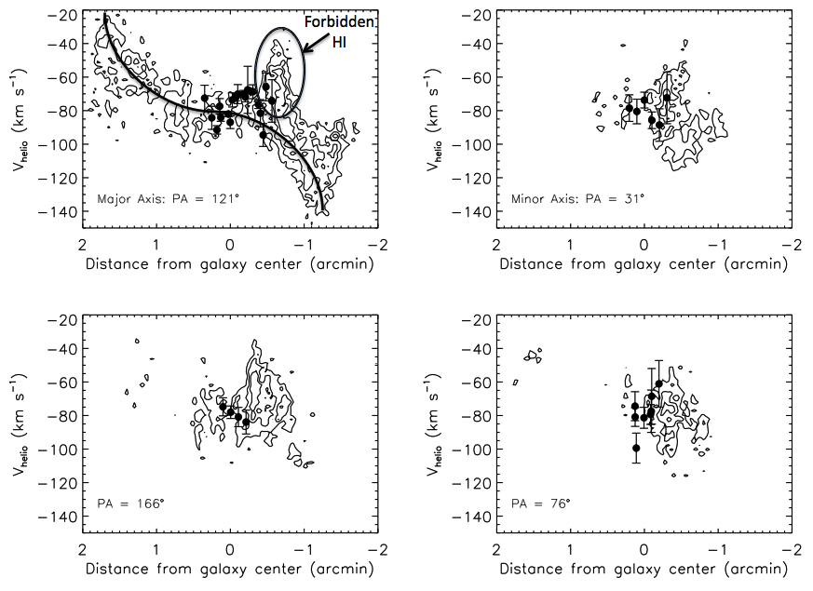
Position-Velocity Diagrams:
Stars and Gas
Notes:
34
Here are the stellar velocities from the 4 position angles plotted ontop of HI velocity contours derived from slicing the HI data cube along the same 4 PAs. We see that the stars and gas kinematically follow each other.

Slide 35
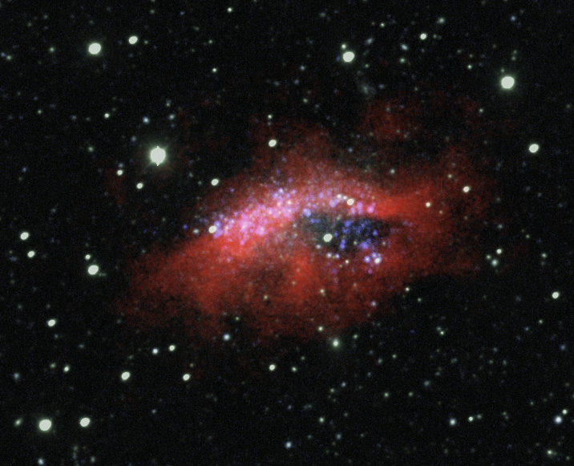
Introduction
DDO 69 – Member of
Local Group
Notes:
35
This is the direction that my talk will take starting with a brief introduction and then a detailed look at NGC 1569, which I studied for my dissertation. Then, present some new data taken with the GBT around NGC 4163 and 4214. I’ll conclude with some future work and a brief summary.

Slide 36
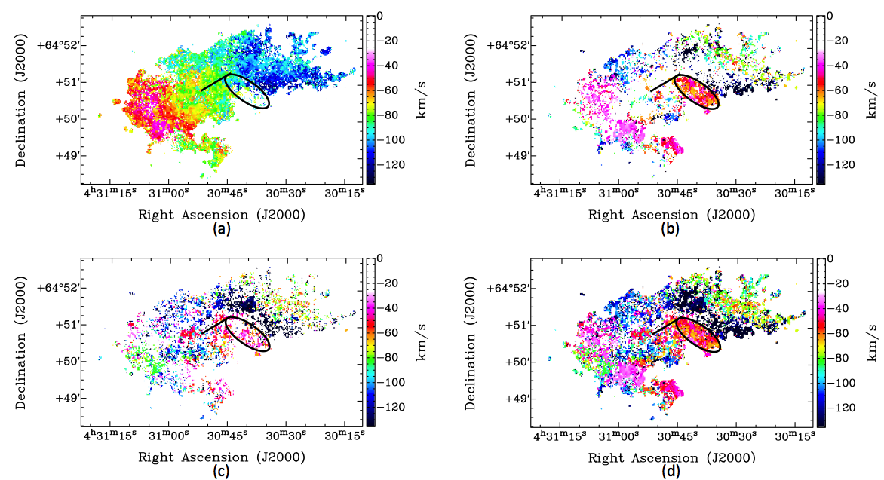
Bulk Motion Extraction
Strong
NCM
Bulk VF
V_{max} = 50 ± 10 km/s
Weak
NCM
Strong
+ Weak
Notes:
Double Gaussian decomposition procedure – If 2 Gaussian profiles are detected at a single position in the HI data cube, then the corresponding velocities are compared to a model velocity field. The velocity that most closely resembles the model field

