Slide 1
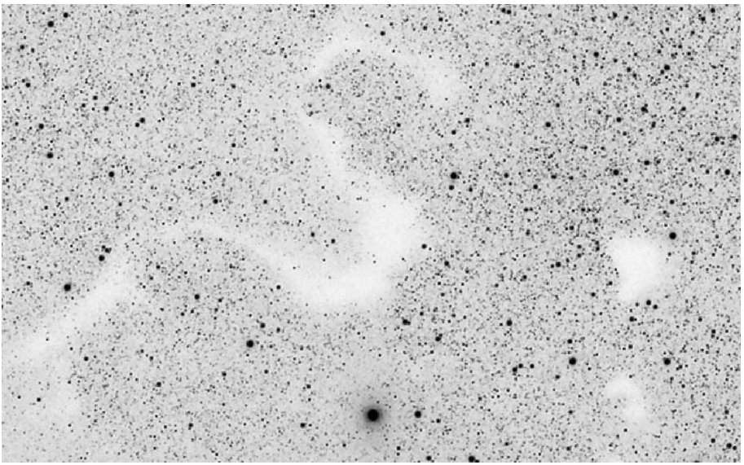

Molecular Line Surveys of Dark Clouds
Discovery of CH₃O
Nuria Marcelino
(NRAO-CV)

Slide 2
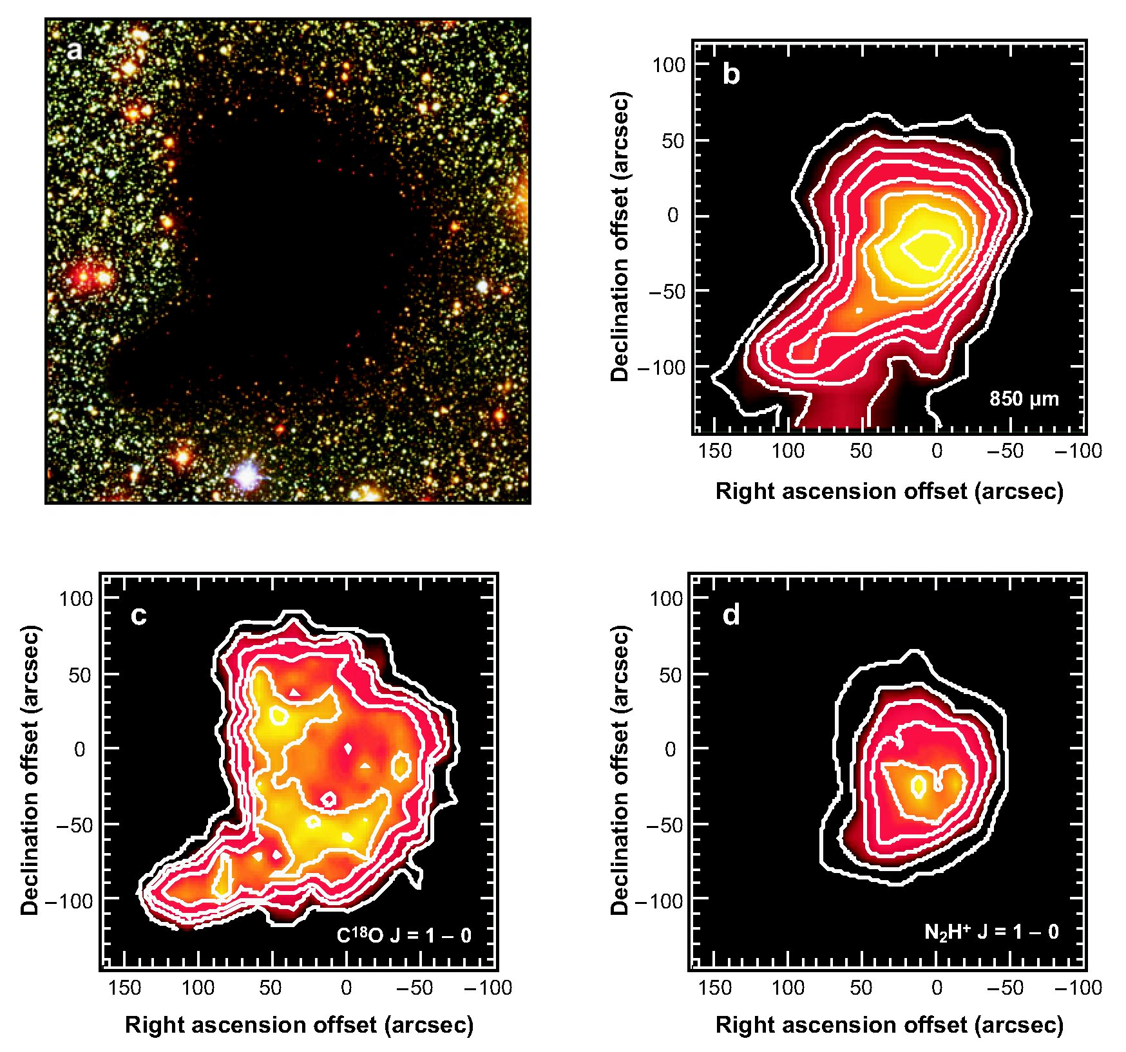
Dark clouds
Dense (≥10⁴ cm⁻³), cold (~10 K) cores
Sites of low-mass star formation
Simple to model (lack of a heating source, outflows,..)
But they are more chemically rich and complex than previously thought…
Bergin & Tafalla (2007)

Slide 3
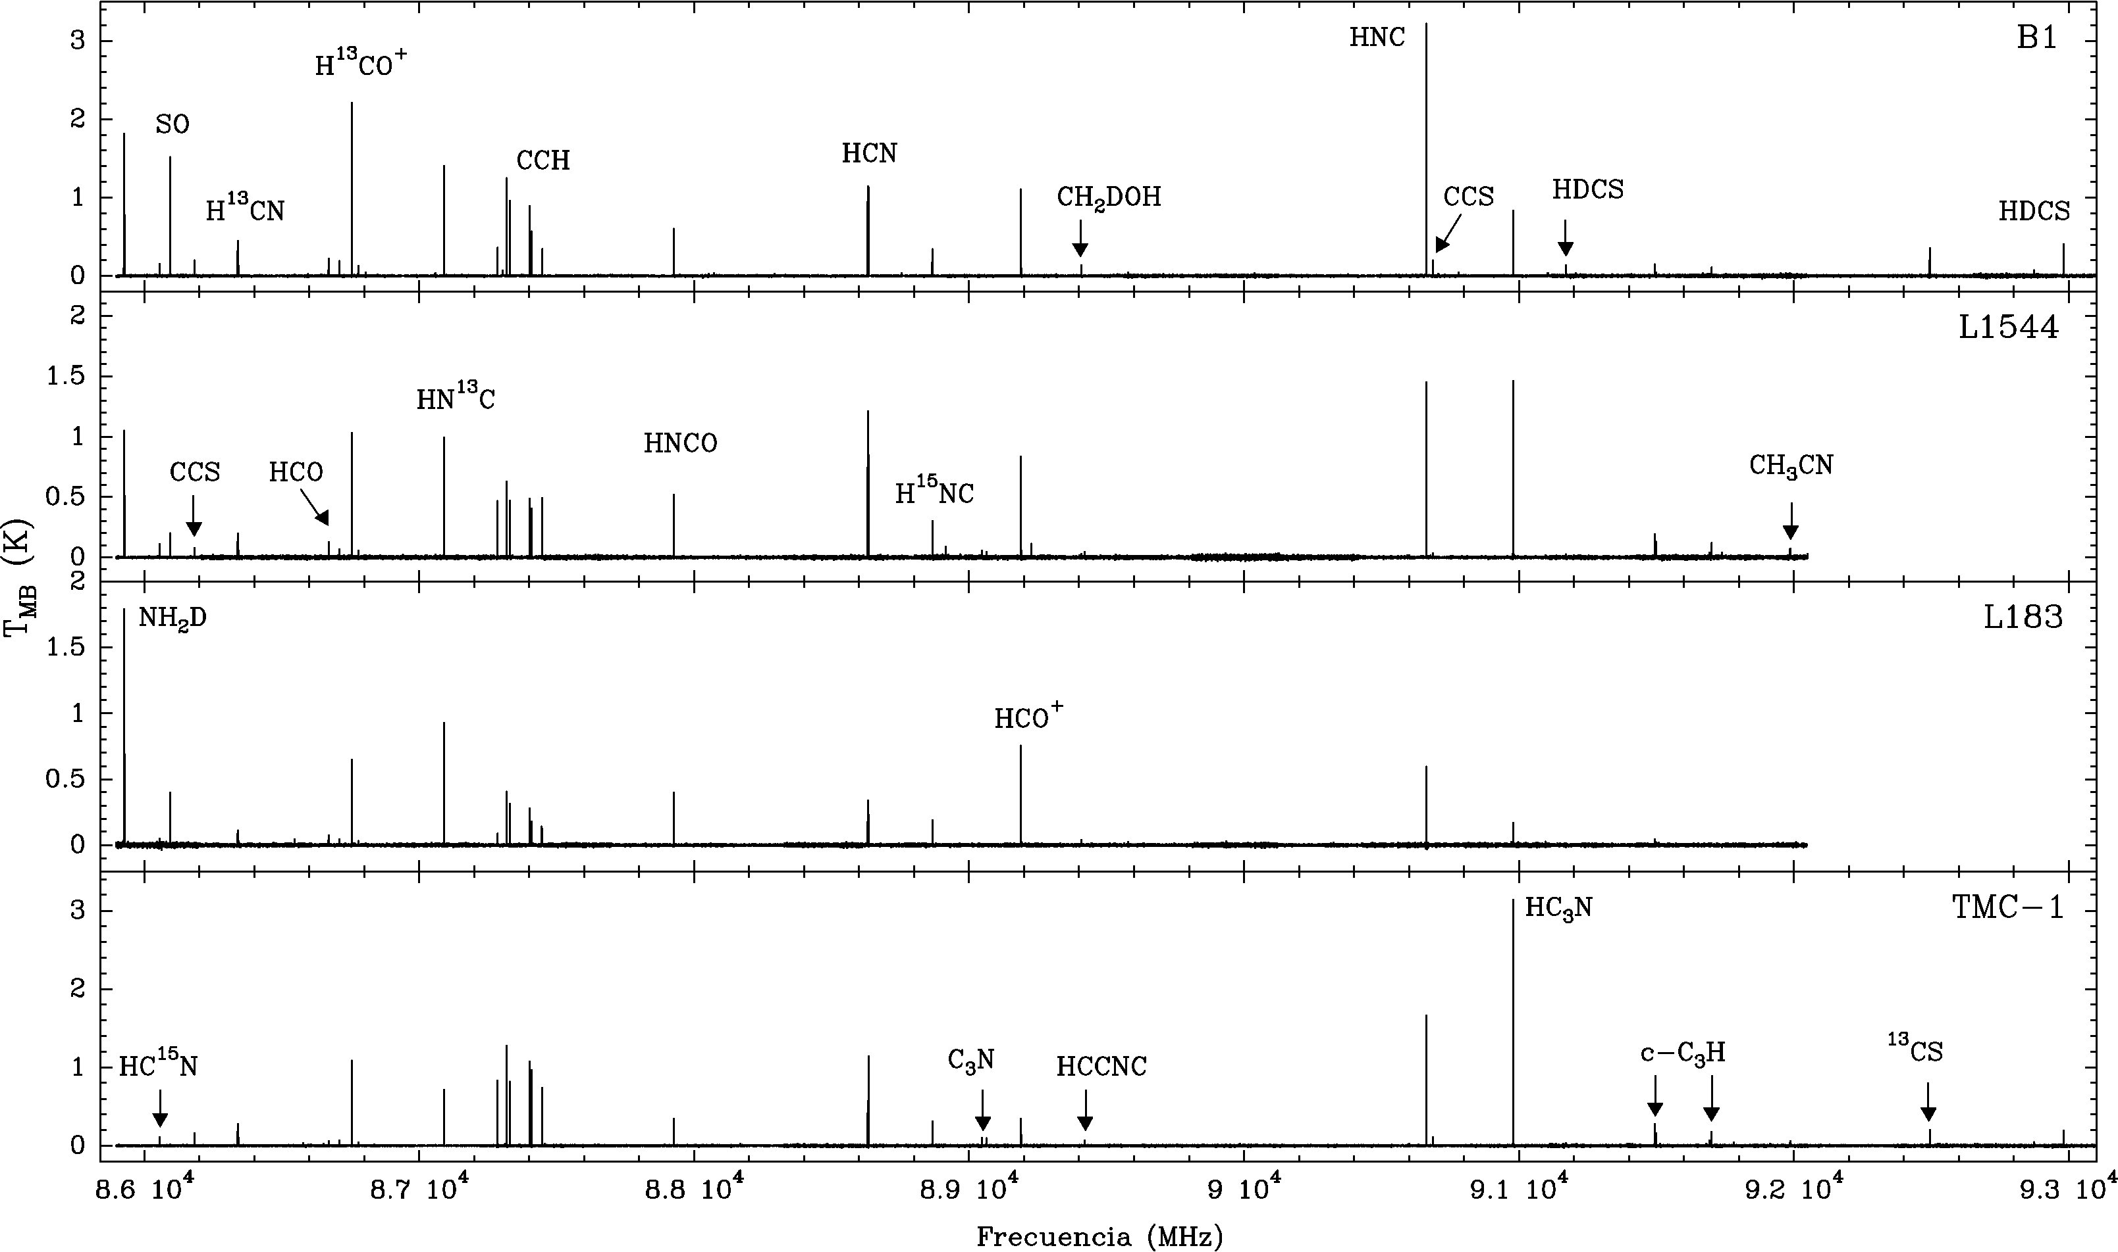
Marcelino (2007)

Slide 4
86-93 GHz Scan
First spectral survey at 3mm
Four sources at different stages of star formation
In only 7 GHz: ~70 lines from 28 molecular species and 14 isotopologues. ~30 lines remain unidentified
Detection of CS, HCN, HNC, HC₃N, HCO⁺… HCO, HNCO, SO, HCOOH, CH₃OCOH…
And new species: D₂CS, CH₂CHCH₃, HCNO and HOCN

Slide 5
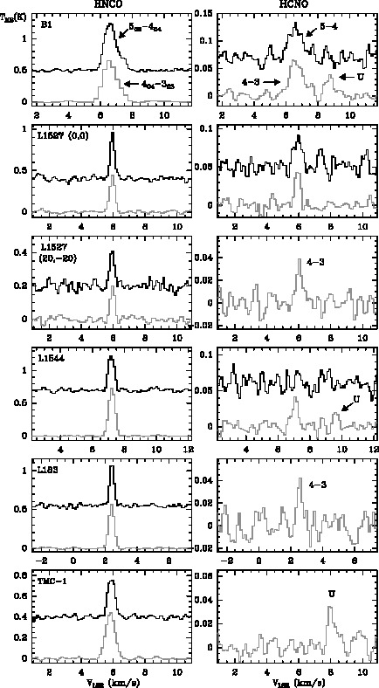
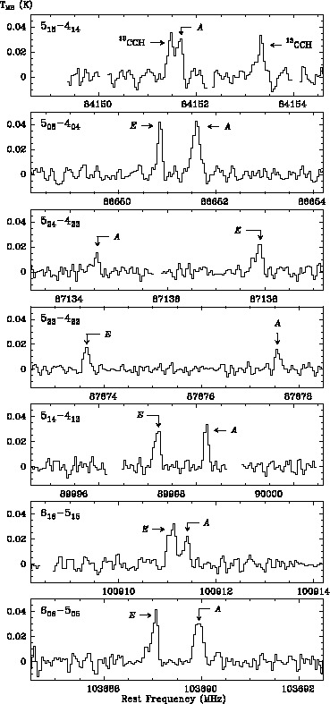
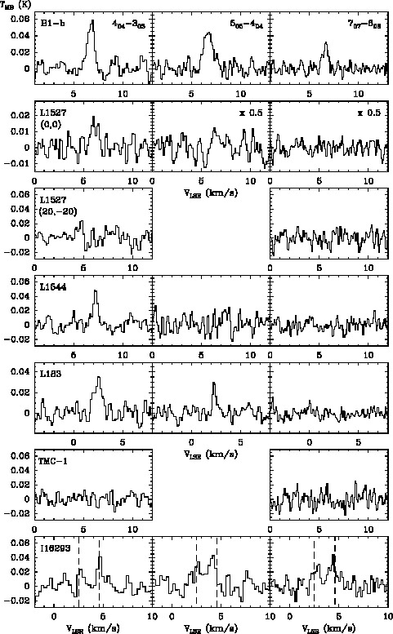
CH₂CHCH₃
HCNO
HOCN
Marcelino ea (2007)
Marcelino ea (2009)
Marcelino ea (2010)

Slide 6
Chemistry in dark clouds
Rich and complex chemistry Important laboratories for astrochemistry
Gas-phase chemistry: exothermic reactions neutral-neutral and ion-molecule
Production on grain mantles… return to gas-phase: - thermal evaporation not effective at T_{d} = 10 K - non-thermal evaporation mechanisms (cosmic rays, secondary photons, etc.)

Slide 7
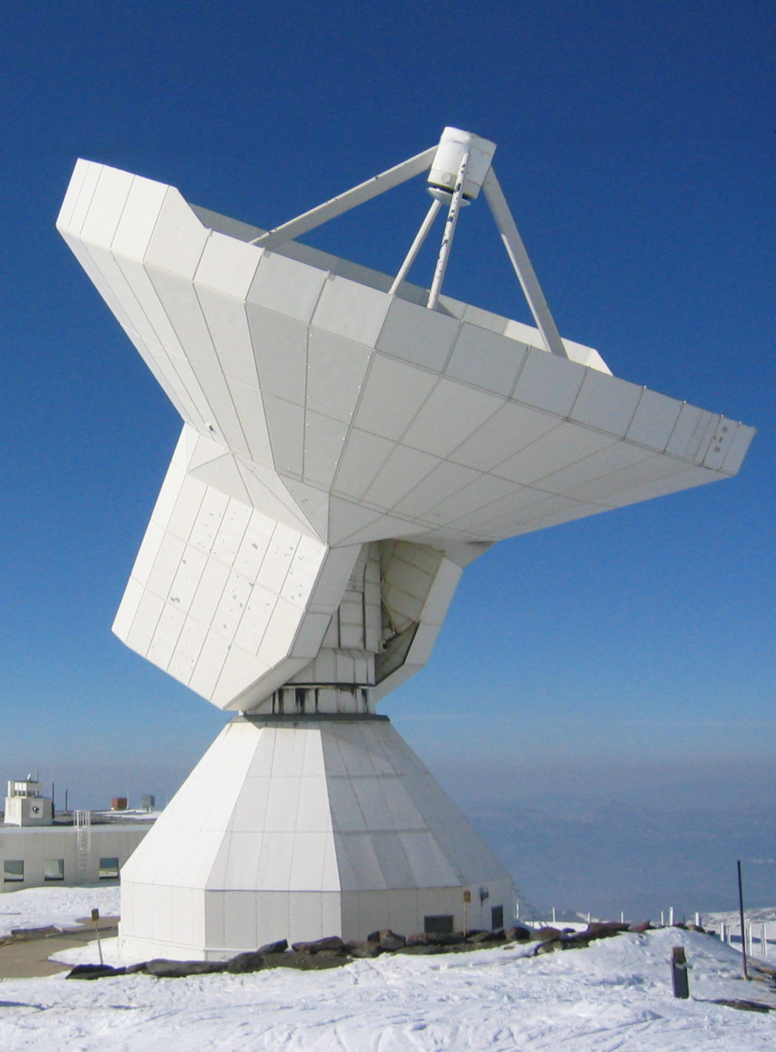
Observations
SIS receivers at 3mm (81-115 GHz; 500 MHz of bandwidth)
Autocorrelator with 16000 channels
- resolution = 40 kHz (~0.12 km/s)
- bandwidth = 315 MHz
85.9 – 93.1 GHz (7 GHz)
rms ~ 8-10 mK in 2 hours per setting = 50 hours (per source)

Slide 8
New Observations
EMIR receivers at 3mm (83-117 GHz; 2x4 GHz of bandwidth, dual sideband)
Autocorrelator with 16000 channels
- resolution = 40 kHz (~0.12 km/s)
- bandwidth = 315 MHz
85.9 – 93.1 GHz (7 GHz)
rms ~ 8-10 mK in 2 hours per setting = 50 hours (per source)

Slide 9
New Observations
EMIR receivers at 3mm (83-117 GHz; 2x4 GHz of bandwidth, dual sideband)
24 FFT Spectrometers
- resolution = 50 kHz (0.13-0.17 km/s)
- bandwidth = 7.2 GHz (4x1.8 GHz)
85.9 – 93.1 GHz (7 GHz)
rms ~ 8-10 mK in 2 hours per setting = 50 hours (per source)

Slide 10
New Observations
EMIR receivers at 3mm (83-117 GHz; 2x4 GHz of bandwidth, dual sideband)
24 FFT Spectrometers
- resolution = 50 kHz (0.13-0.17 km/s)
- bandwidth = 7.2 GHz (4x1.8 GHz)
82.5 – 117.5 GHz (35 GHz)
rms ~ 8-10 mK in 2 hours per setting = 50 hours (per source)

Slide 11
New Observations
EMIR receivers at 3mm (83-117 GHz; 2x4 GHz of bandwidth, dual sideband)
24 FFT Spectrometers
- resolution = 50 kHz (0.13-0.17 km/s)
- bandwidth = 7.2 GHz (4x1.8 GHz)
82.5 – 117.5 GHz (35 GHz)
rms ~ 4-6 mK in 2 hours per setting = 15 hours (per source)

Slide 12
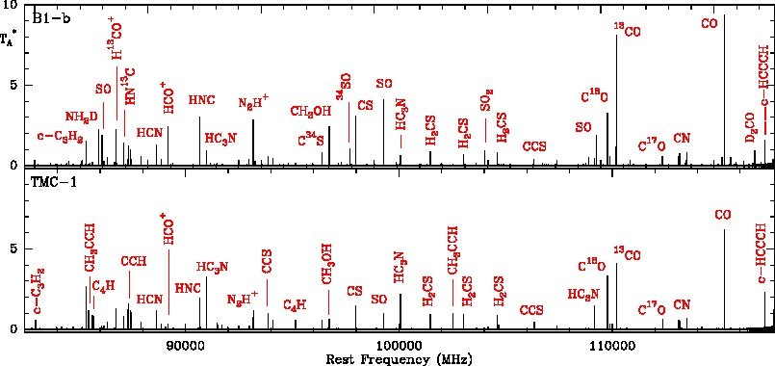
82.5-117.5 GHz Scan
Marcelino ea (in prep)

Slide 13
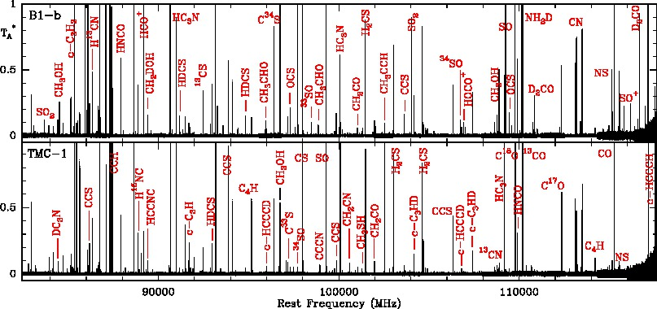
82.5-117.5 GHz Scan
Marcelino ea (in prep)

Slide 14
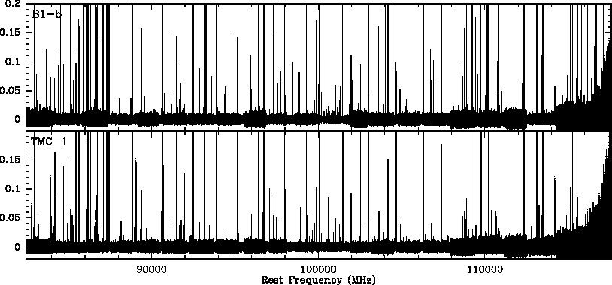
82.5-117.5 GHz Scan
Marcelino ea (in prep)

Slide 15
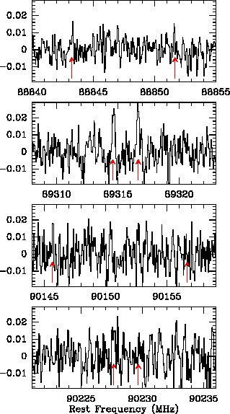
CH₃OCOH in B1-b

Slide 16
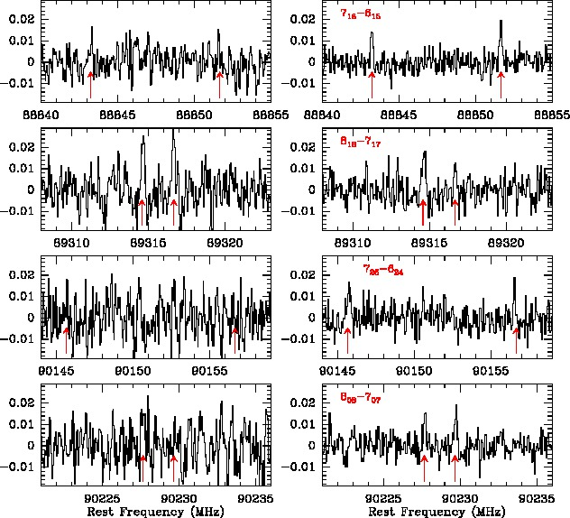
CH₃OCOH in B1-b

Slide 17
COMs in dark clouds
Complex Organic Molecules typically observed in hot cores and hot corinos (T_{kin}>100 K) grain mantle desorption followed by warm gas-phase reactions
New gas-grain chemistry models (E. Herbst and coworkers) suggest formation on grains during warm-up, followed by (thermal and non-thermal) evaporation
Recent detection of COMs in cold prestellar cores (Öberg ea 2010, Bacmann ea 2012)
However grain surface reactions are not well known… Laboratory experiments are necessary !

Slide 18
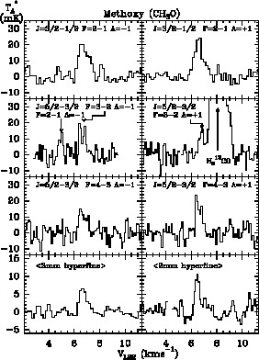
CH₃O and COMs in B1-b
Discovery of CH₃O in space, and first detection of other COMs in cold clouds
Methoxy radical is the precursor of COMs, such as CH₃OH, CH₃OCOH and CH₃OCH₃
Cernicharo, Marcelino ea (2012)

Slide 19
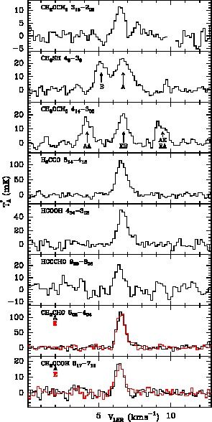
CH₃O and COMs in B1-b
Discovery of CH₃O in space, and first detection of other COMs in cold clouds
Methoxy radical is the precursor of COMs, such as CH₃OH, CH₃OCOH and CH₃OCH₃
First detection of CH₃SH outside the GC. Only 3 of these species detected in TMC-1
Observed abundances ~ 10⁻¹¹
common origin ?
Cernicharo, Marcelino ea (2012)

Slide 20
CH₃O and COMs in B1-b
UV/ion irradiation experiments on ices support the formation of most observed COMs
CH₃O ice production could not be confirmed… It either isomerizes in CH₂OH or produces CH₃OH

Slide 21
CH₃O and COMs in B1-b
UV/ion irradiation experiments on ices support the formation of most observed COMs
CH₃O ice production could not be confirmed… It either isomerizes in CH₂OH or produces CH₃OH
CH₃O gas-phase production from methanol is possible through UV dissociation or CH₃OH + OH (?)
B1-b harbors very early star-formation activity, however T_{kin}~12-15 K… compact warmer sources ?

Slide 22
CH₃O and COMs in B1-b
UV/ion irradiation experiments on ices support the formation of most observed COMs
CH₃O ice production could not be confirmed… It either isomerizes in CH₂OH or produces CH₃OH
CH₃O gas-phase production from methanol is possible through UV dissociation or CH₃OH + OH (?)
B1-b harbors very early star-formation activity, however T_{kin}~12-15 K… compact warmer sources ?
Gas-phase chemistry following desorption must be studied at the low temperatures of prestellar cores

Slide 23
Summary ~ Future prospects
First complete 3mm spectral line survey toward 2 dark clouds (different chemistry and star formation activity)
Discovery of CH₃O, and other COMs, in cold prestellar cores. Many lines remain unidentified in the 35 GHz covered
Spectral surveys are the best tool to obtain the molecular inventory of prestellar cores. New detections provide new diagnostics and probe chemical models
New sensitive and large bandwidth receivers make these studies much more efficient (35 GHz observed in 15 hrs!)
Extend to other frequencies: e.g. W-Band at GBT
Extend to other sources: probe all stages in low-mass star formation (starless, protostellar, hot corinos and outflows)

Slide 25
Sources
TMC-1. Quiescent cloud. Rich in C. d=140 pc, n(H₂)~6x10⁴ cm⁻³, T_{kin}~10 K
L183. Quiescent cloud. Rich in O and D. d=160 pc, n(H₂)~3x10⁴ cm⁻³, T_{kin}~12 K
L1544. Starless core. Primordial phases of gravitational collapse. d=140 pc, n(H₂)~10⁶ cm⁻³, T_{kin}~10 K
B1. Star formation activity nearby. d=200 pc, n(H₂)~10⁶ cm⁻³, T_{kin}~12 K

Slide 26
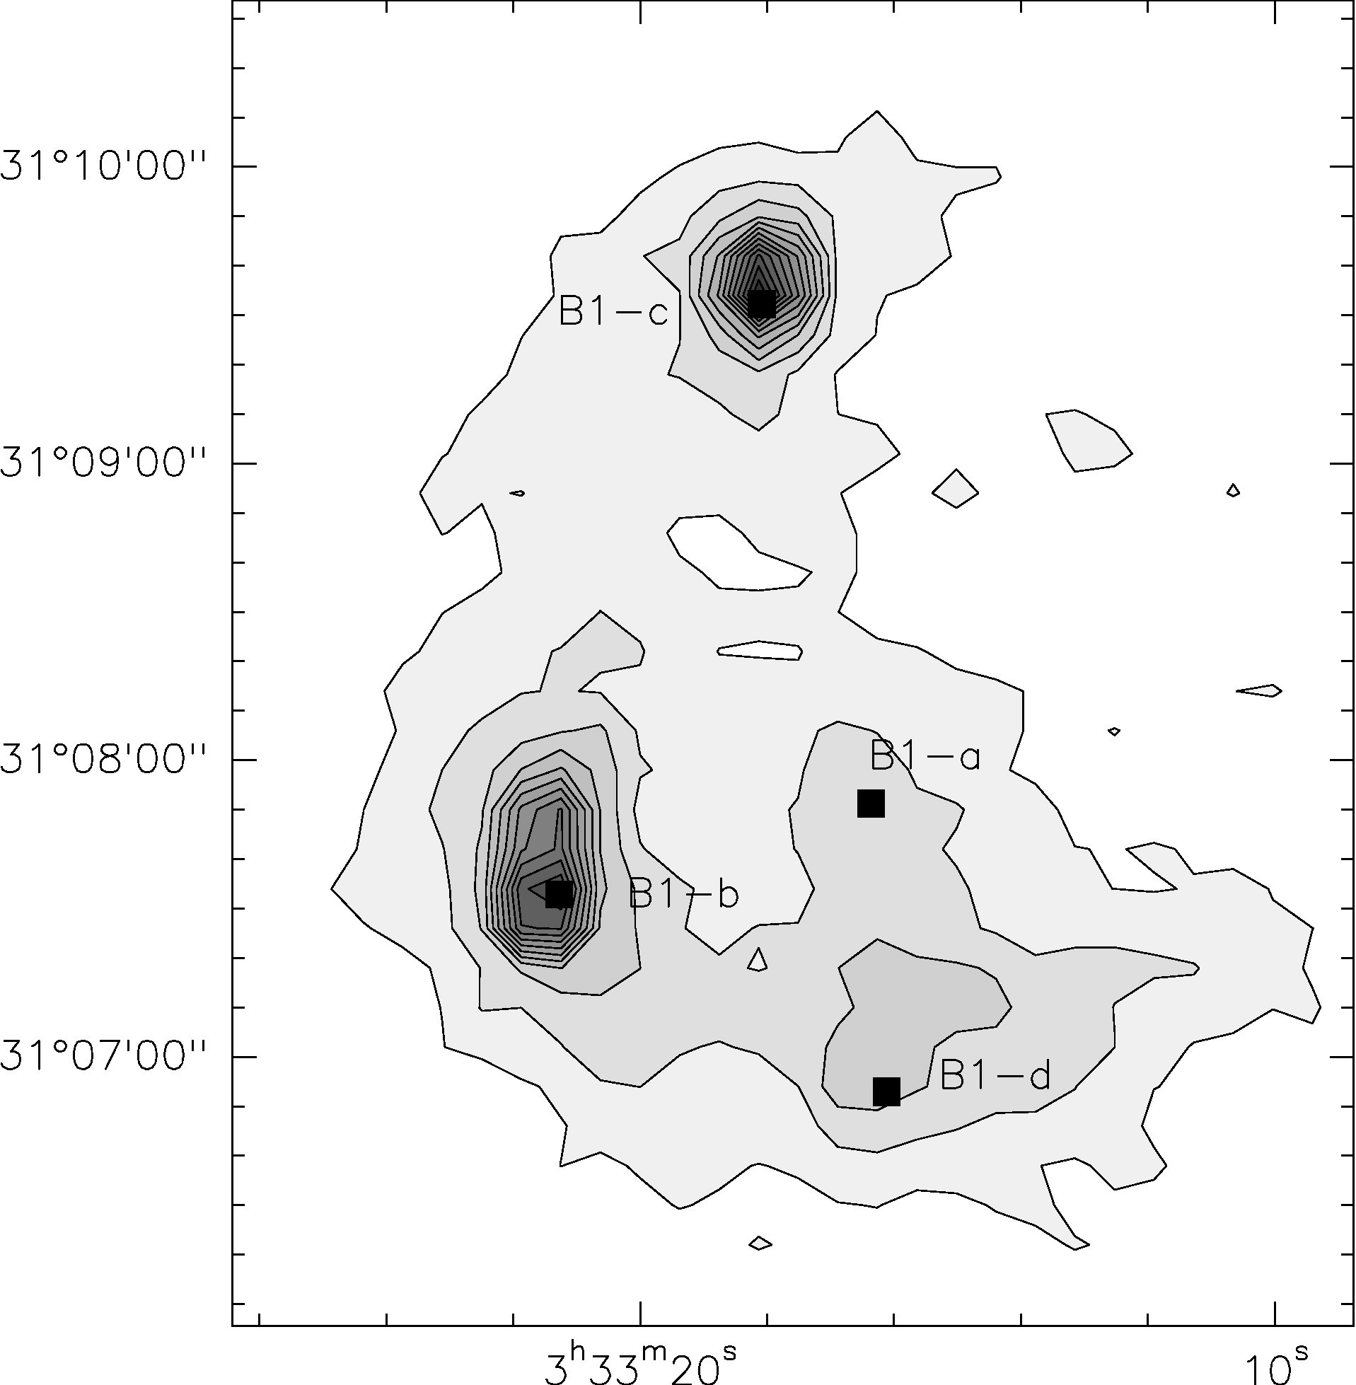
Sources: B1-b
High column density
Star formation activity: protostellar objects (FHSC), outflows and HH objects nearby
Rich in O-bearing species
n(H₂)~10⁶ cm⁻³, T_{kin}~12-15 K

Slide 27
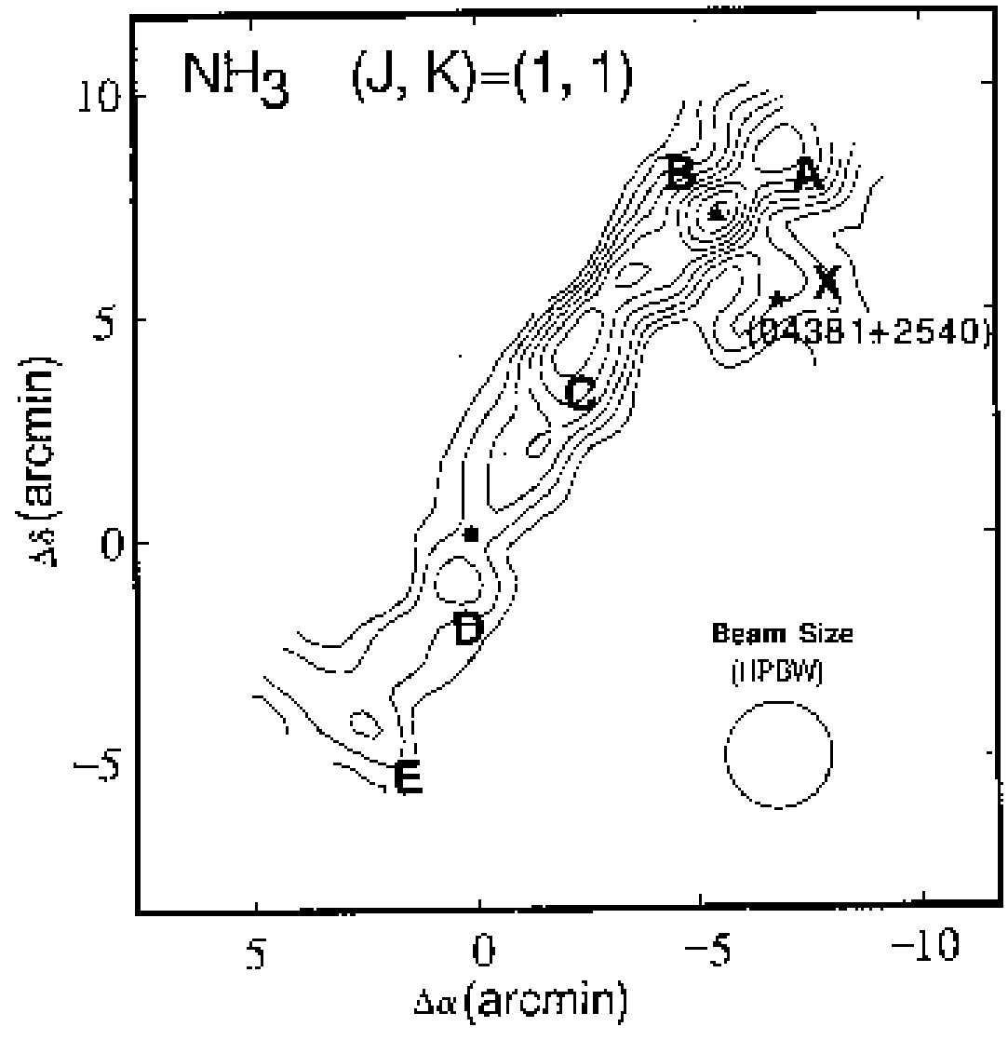
Sources: TMC-1 (CP)
Starless
Used to test chemical models
Rich in C-bearing species and carbon chains
n(H₂)~6x10⁴ cm⁻³, T_{kin}~10 K
Hirahara et al. (1992)

