Slide 1
The Quest to Understand Why Some Novae Emit Gamma-Rays
Laura Chomiuk, Michigan State University

Slide 2
In Collaboration with:
Tommy Nelson (Minnesota)
Mike Bode (Liverpool John Moores)
Stewart Eyres (Lancashire)
Miriam Krauss (NRAO)
Amy Mioduszewski (NRAO)
Koji Mukai (UMBC/Goddard)
Ulisse Munari (Padova)
Tim O’Brien (Jodrell Bank)
Valerio Ribeiro (U Cape Town)
Nirupam Roy (NRAO)
Michael Rupen (NRAO)
Jeno Sokoloski (Columbia)
Jennifer Weston (Columbia)
Bob Williams (STScI)

Slide 4
Outline
An Introduction to Novae and their Radio Emission
V407 Cyg: The first gamma-ray nova (2010)
Sco 2012 & Mon 2012: The perplexing cast of characters from last summer

Slide 5
An Introduction to Novae

Slide 6
Why novae?
Nearby, common, bright
Wonderful laboratories for accretion, thermonuclear, and mass ejection processes
Potential progenitors of Type Ia supernovae
Notes:
a TNR on a WD

Slide 7
Accreting White Dwarf:
White Dwarf
(He, CO, or ONe)
H-rich material transferred
Companion Star
(main-sequence, sub-giant, or giant)
H-rich “skin”

Slide 8
Occasional Nova Explosions:
Nuclear-burning “skin”
White Dwarf
(He, CO, or ONe)
Companion Star
(main-sequence, sub-giant, or giant)
Puffed-up and Expanding H-rich envelope

Slide 9
Occasional Nova Explosions:
Nuclear-burning “skin”
Some Nova Facts:
10⁻⁷-10⁻³ M ejected
At 400-5,000 km/s
10⁴⁴-10⁴⁶ erg
~35 novae/yr in Milky Way
White Dwarf
(He, CO, or ONe)
Puffed-up and Expanding H-rich envelope

Slide 10
After a nova, H-rich skin gradually re-accretes:
White Dwarf
(He, CO, or ONe)
H-rich material transferred
Nova recurrence times span ~10-10⁸ years.
Governed by M_{WD} and accretion rate.
H-rich “skin”

Slide 11
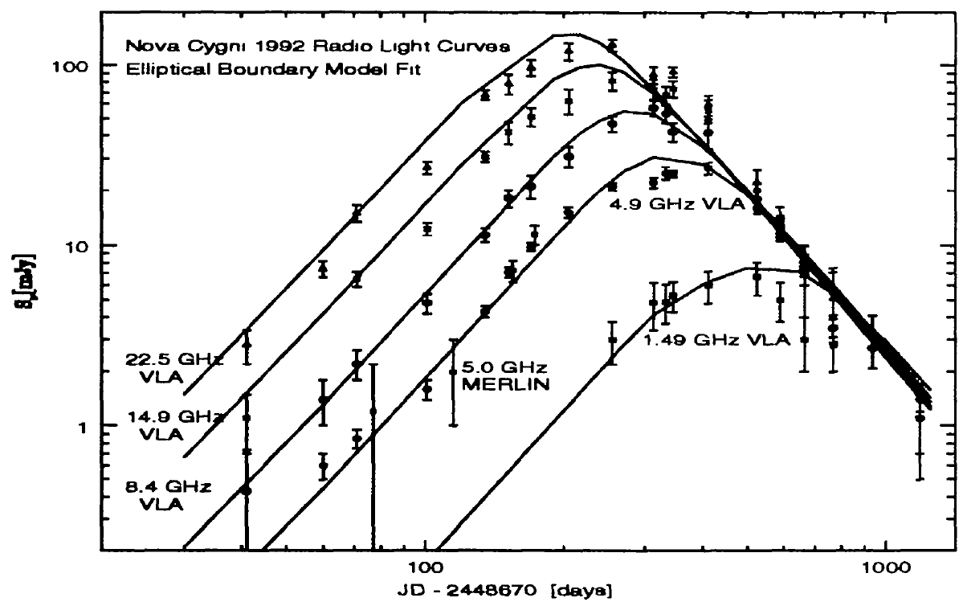
A Nova Light Curve...in the Radio
V1974 Cyg
S_{ν} (mJy)
Hjellming 1996
Time Since Outburst (Days)

Slide 12
A Simple Picture for Radio Emission from Novae
- thermal free-free emission
ρ ~ r⁻²
homologous expansion
spherical
- T_{e} constant

Slide 13
Phase 1: Optically Thick
Photosphere at
5 GHz and 25 GHz
S_{ν} (mJy)
Time Since Outburst

Slide 14
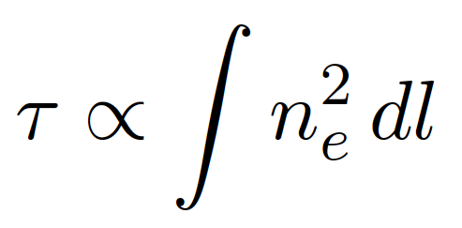
Radio light curves give radial density profiles of ejecta
optical depth
emission measure

Slide 15
Phase 2: Receding Photospheres
Photosphere at
5 GHz
25 GHz
S_{ν} (mJy)
Time Since Outburst

Slide 16
Phase 3: Optically Thin
No Photospheres
S_{ν} (mJy)
Time Since Outburst

Slide 17
Radio light curves give radial density profiles of ejecta
n_{e}²(r)
Integrate n_{e}(r) to give total M_{ej}

Slide 18
V407 Cyg:
The first gamma-ray nova

Slide 19
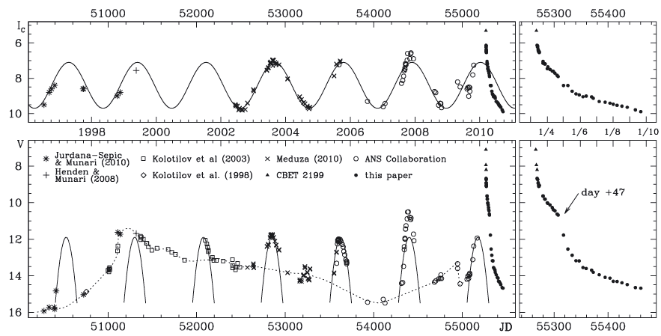
V407 Cyg: A WD + Mira Giant Symbiotic Binary
Munari et al. (2011)

Slide 20
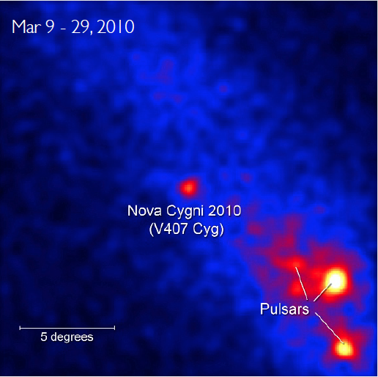
V407 Cyg’s 2010 Nova Outburst
Thermonuclear runaway on white dwarf expels material at ~3,000 km/s
First nova ever detected in gamma rays!
Fermi LAT
NASA/DOE/Fermi LAT collaboration

Slide 21
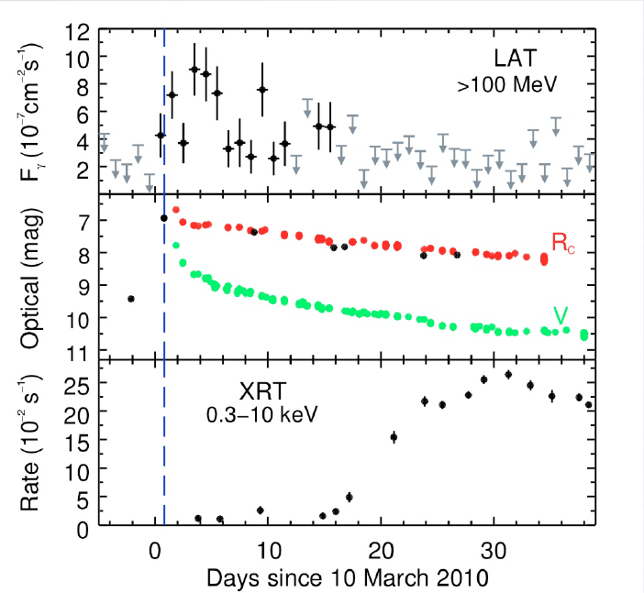
Interaction between nova and circumbinary material seen on all scales, at all wavelengths.
Gamma Ray:
10¹³-10¹⁴ cm
X-ray:
10¹⁴-10¹⁵ cm
Abdo et al. (2010)
Radio:
10¹⁵-10¹⁶ cm
Particle acceleration at early times produces gamma-ray emission.

Slide 22
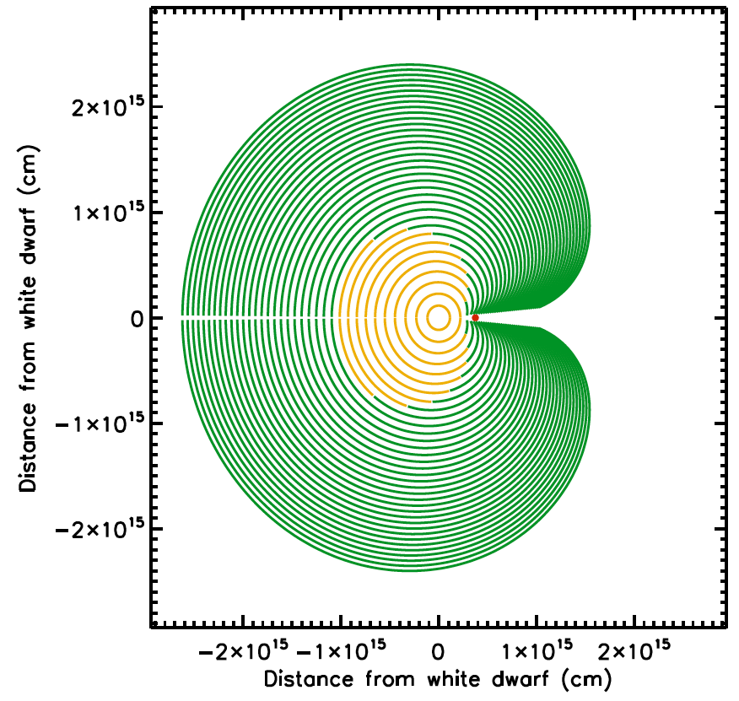
Interaction between nova and circumbinary material seen on all scales, at all wavelengths.
Gamma Ray:
10¹³-10¹⁴ cm
.
γ
X-ray:
10¹⁴-10¹⁵ cm
Radio:
10¹⁵-10¹⁶ cm
Nelson, Donato, Mukai, Sokoloski, & Chomiuk (2012)

Slide 23
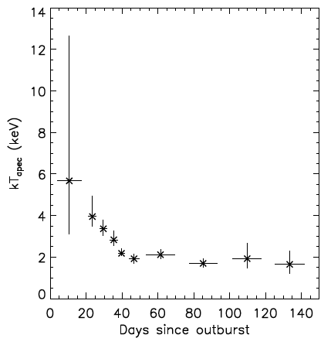
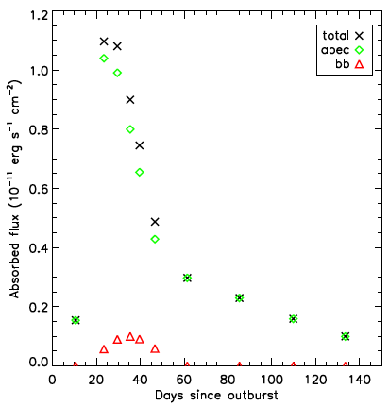
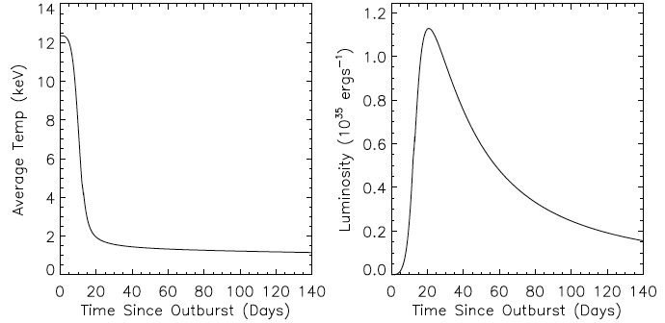
Interaction between nova and circumbinary material seen on all scales, at all wavelengths.
Gamma Ray:
10¹³-10¹⁴ cm
Swift
X-ray Data
X-ray:
10¹⁴-10¹⁵ cm
Luminosity
Temperature (keV)
A Model for the Forward Shock
Radio:
10¹⁵-10¹⁶ cm
Nelson, Donato, Mukai, Sokoloski, & Chomiuk (2012)

Slide 24
Interaction between nova and circumbinary material seen on all scales, at all wavelengths.
Gamma Ray:
10¹³-10¹⁴ cm
X-ray
.
γ
X-ray:
10¹⁴-10¹⁵ cm
X-ray
Radio:
10¹⁵-10¹⁶ cm

Slide 25
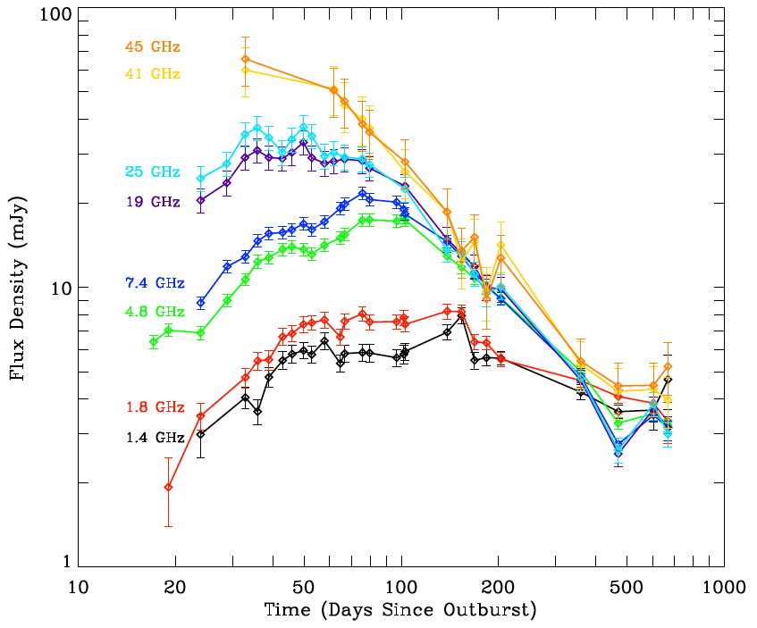
Interaction between nova and circumbinary material seen on all scales, at all wavelengths.
Interaction between nova and circumbinary material seen on all scales, at all wavelengths.
Gamma Ray:
10¹³-10¹⁴ cm
VLA Light Curves
Gamma Ray:
10¹³-10¹⁴ cm
X-ray
.
γ
X-ray:
10¹⁴-10¹⁵ cm
X-ray:
10¹⁴-10¹⁵ cm
X-ray
Mira wind becoming more ionized
Wind eaten away by nova blast
Radio:
10¹⁵-10¹⁶ cm
Radio:
10¹⁵-10¹⁶ cm
Chomiuk et al. 2012

Slide 26
Interaction between nova and circumbinary material seen on all scales, at all wavelengths.
Gamma Ray:
10¹³-10¹⁴ cm
Radio
X-ray
.
γ
X-ray:
10¹⁴-10¹⁵ cm
X-ray
Radio
Radio:
10¹⁵-10¹⁶ cm

Slide 27
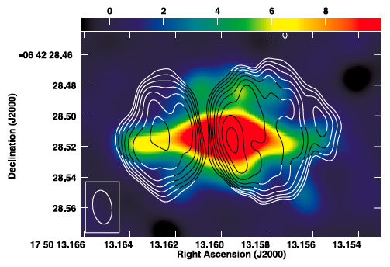
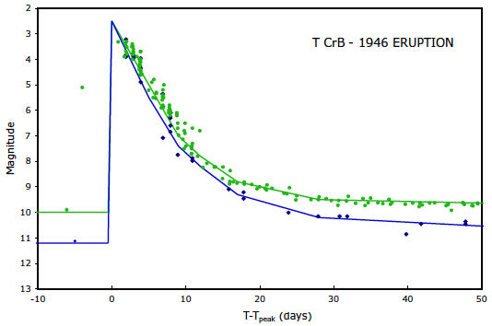
Novae with giant companions are rare.
RS Oph 2006

Slide 28
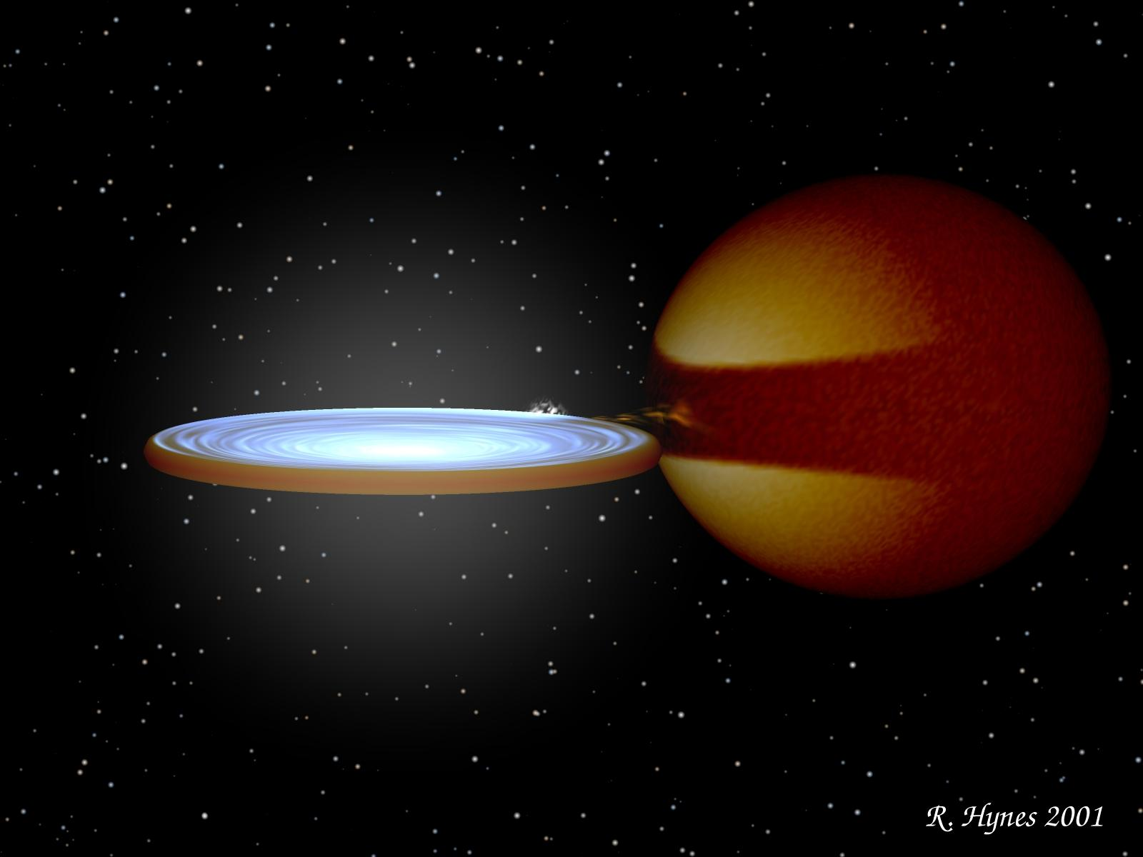
Most novae have very low density surroundings

Slide 29
Sco 2012 & Mon 2012
The second and third gamma-ray novae

Slide 30
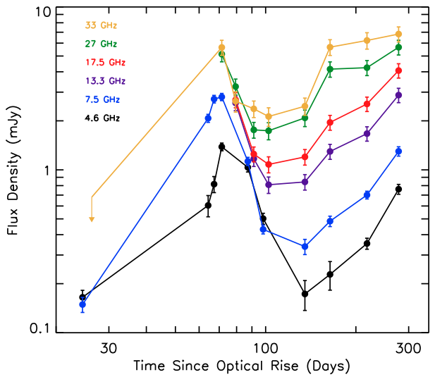
Gamma Ray Nova #2: Sco 2012
A “normal” classical nova

Slide 31
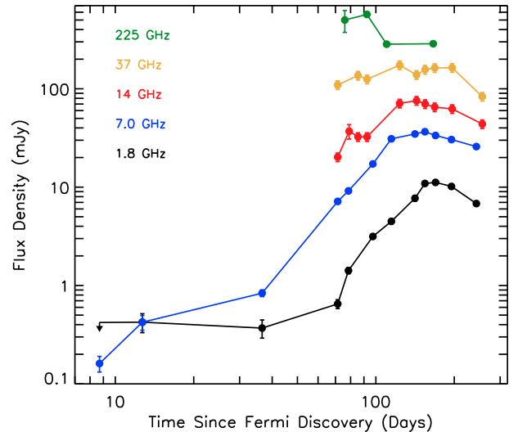
Gamma Ray Nova #3: Mon 2012
Another “normal” classical nova
First nova discovered with gamma rays!
Only gamma-ray and radio data for the first ~2 months!

Slide 32
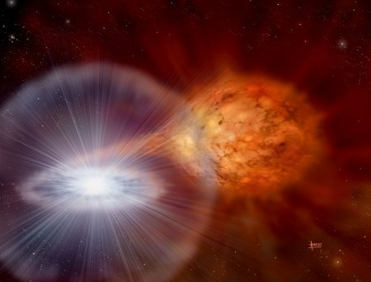
Why did Sco 2012 and Mon 2012 show gamma-rays while dozens of other novae have not?
Evolved companion? (a la V407 Cyg)
Progenitors detected for both systems, consistent with main sequence companions.

Slide 33
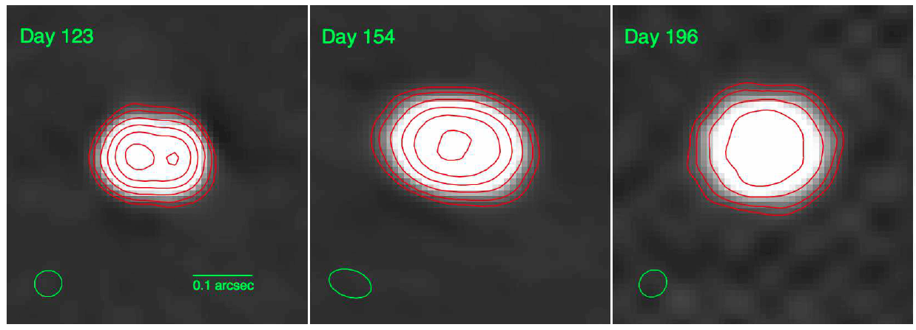
Why did Sco 2012 and Mon 2012 show gamma-rays while dozens of other novae have not?
Evolved companion?
Proximity?
Expansion of Mon 2012 resolved with VLA, expansion parallax implies D ~ 3.6 kpc

Slide 34
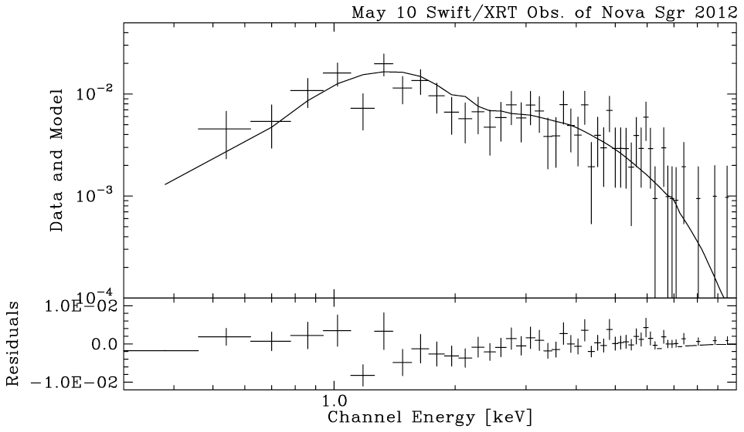
Why did Sco 2012 and Mon 2012 show gamma-rays while dozens of other novae have not?
Evolved companion?
Proximity?
Internal Shocks?
Other novae show faster shocks, like Sgr 2012 #1. X-rays imply >30 keV plasma, or >5,000 km/s shock.

Slide 35
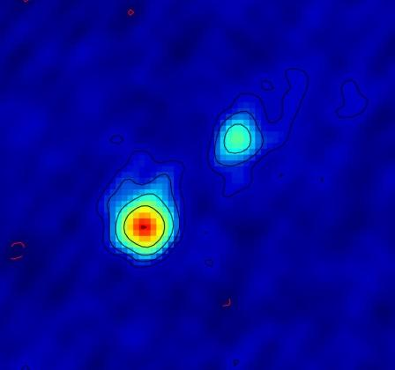
Why did Sco 2012 and Mon 2012 show gamma-rays while dozens of other novae have not?
Evolved companion?
Proximity?
Internal Shocks?
Jets?
35 +/- 1 mas
50 mas
EVN imaging of Mon 2012 at 5 GHz

Slide 36
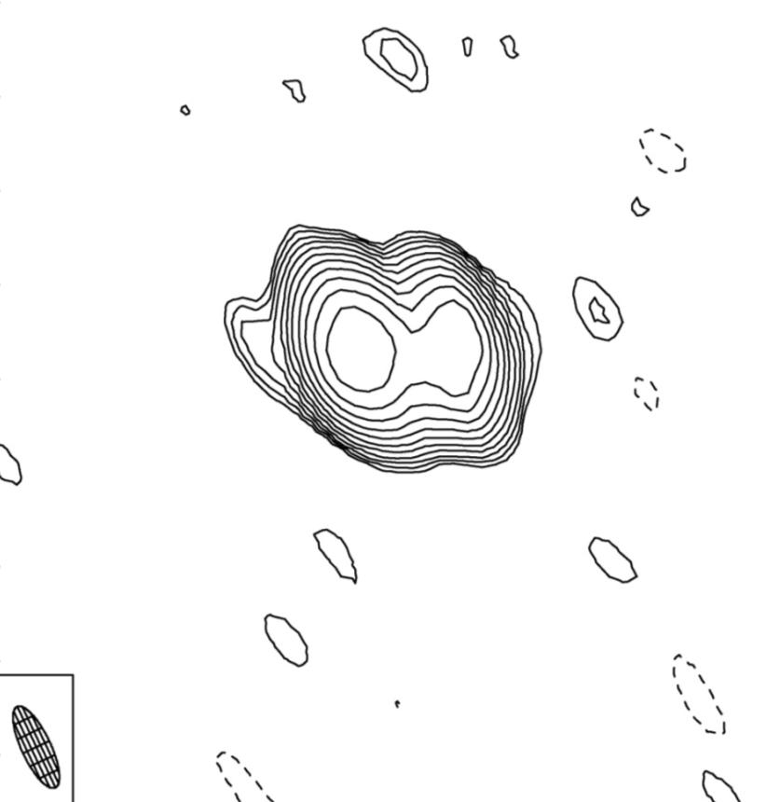
Why did Sco 2012 and Mon 2012 show gamma-rays while dozens of other novae have not?
Evolved companion?
Proximity?
Internal Shocks?
Jets?
e-MERLIN – 5.7 GHz
200 mas

Slide 37
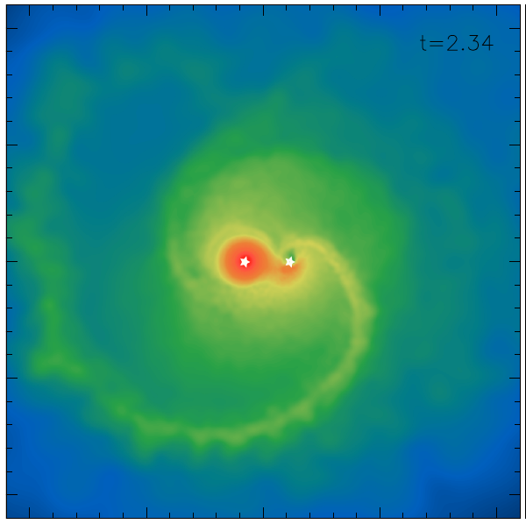
Why did Sco 2012 and Mon 2012 show gamma-rays while dozens of other novae have not?
Evolved companion?
Proximity?
Internal Shocks?
Jets?
Non-conservative mass transfer?
Mohamed & Podsiadlowski (2010)

Slide 38
How is mass ejected from novae?
Common Envelope
Residual burning on WD
Irradiated companion
Impulsive Ejection

Slide 39
In Conclusion
Novae interacting with dense circumbinary material can produce gamma rays. This makes sense.
But novae surrounded by low density material can also (sometimes) make gamma rays.
This has us all stumped. Still (9 months after Sco 2012/Mon 2012).

Slide 40
In Conclusion

