Slide 1
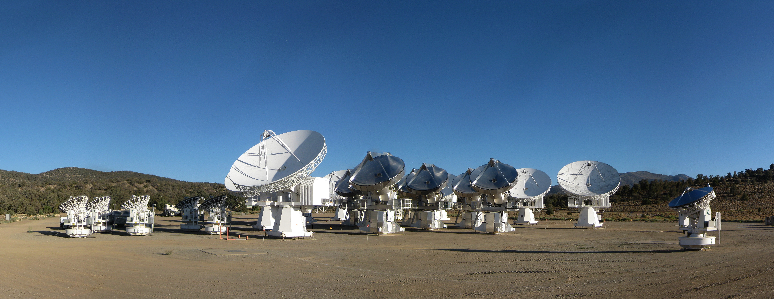
CARMA observations of magnetic fields in star-forming filaments
Photo: Chat Hull (Harvard/NRAO)
Chat Hull
Jansky Fellow —
Harvard-Smithsonian Center for Astrophysics
National Radio Astronomy Observatory
10 October 2014
Filaments 2014
NRAO
Charlottesville, VA

Slide 2
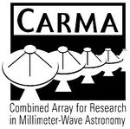














TADPOL collaboration
UC Berkeley
  Chat Hull (PI), Dick Plambeck, Mel Wright, Carl Heiles
University of Maryland
  Marc Pound, Alberto Bolatto, Katherine Jameson,
  Lee Mundy
Caltech
  John Carpenter, James Lamb, Nikolaus Volgenau
University of Illinois, Urbana-Champagne
  Leslie Looney, Dick Crutcher, Nick Hakobian
Other
  Geoff Bower (ASIAA), Thushara Pillai (Bonn), Dan Marrone (Arizona), Meredith Hughes (Wesleyan), John Vaillancourt & Göran Sandell (USRA-SOFIA), John Tobin (NRAO), Ian Stephens (BU), Jason Fiege & Erica Franzmann (Manitoba), Martin Houde (UWO, Caltech), Brenda Matthews (NRC-CNRC), Woojin Kwon (SRON)

Slide 3
Outline
Brief filamentary introduction
Magnetized filaments
  High-mass: NGC 7538
  Low-mass: Ser-emb 8, 8(N)
Simulations

Slide 4
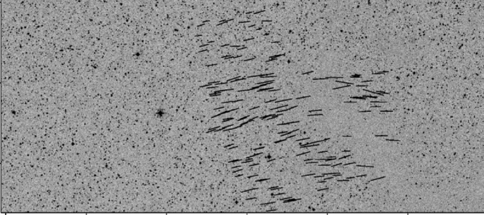
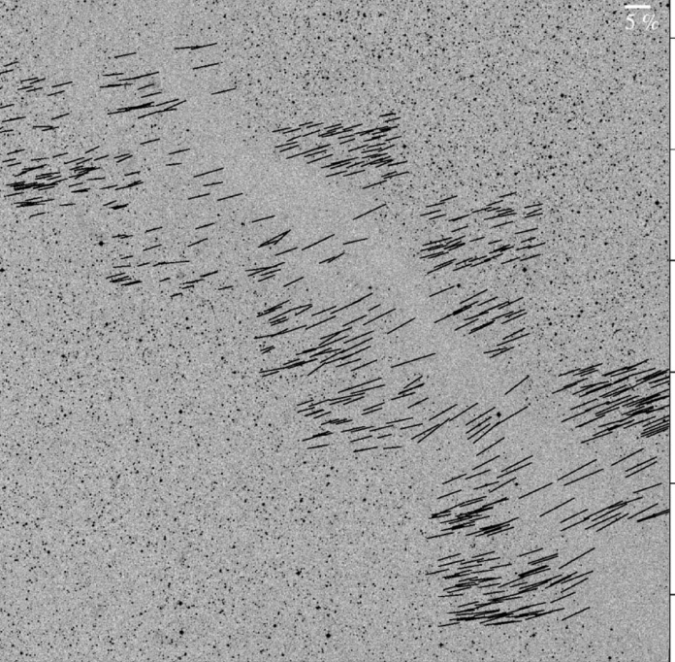
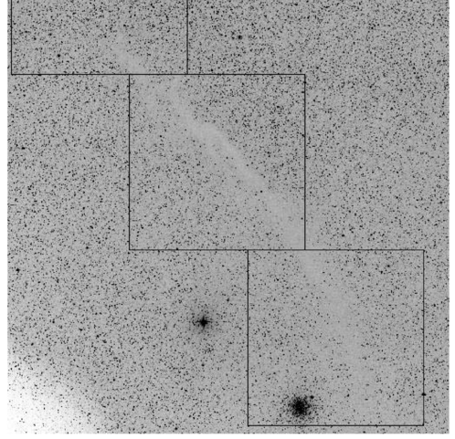
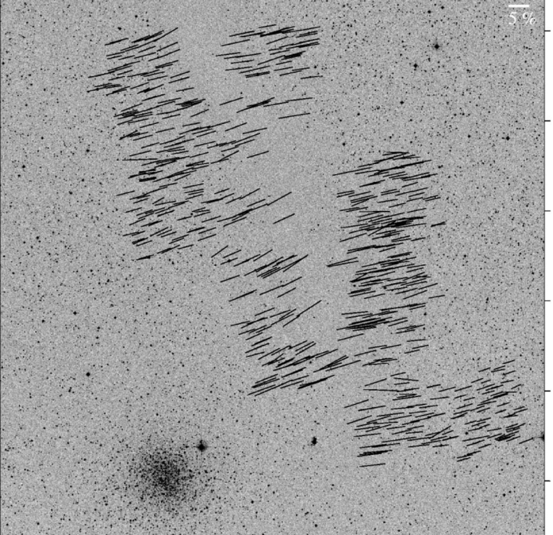
B-fields in large-scale filaments
Musca dark cloud
10 pc
E,B
Pereyra & Magalhães 2004

Slide 5


What is the role of magnetic fields in star formation?
Incidental?
Fundamental?

Slide 6
How do different kinds of filaments form?
Specifically: in low- vs. high-mass objects

Slide 7
High-mass star-forming region
NGC 7538

Slide 8
NGC 7538
10 pc
Fallscheer+2013
Notes:
Herschel

Slide 9
NGC 7538
0.1 pc
Wright, Hull+2014, ApJ, submitted
Notes:
-Herschel SPIRE and PACS data
-Filamentary!

Slide 10
NGC 7538
0.1 pc
Frau+2014

Slide 11
NGC 7538
1 pc
B
Matthews+2009

Slide 12
NGC 7538
0.1 pc
0.1 pc
Hull+2014, ApJS, 213, 13
Small-scale B-field in filament doesn’t reflect original field
Notes:
-Herschel SPIRE and PACS data
-Filamentary!

Slide 13
NGC 7538
0.1 pc
0.1 pc
Frau+2014
Wright, Hull+2014, ApJ, submitted
Magnetized filament is shaped by a combination of infall and outflow

Slide 14
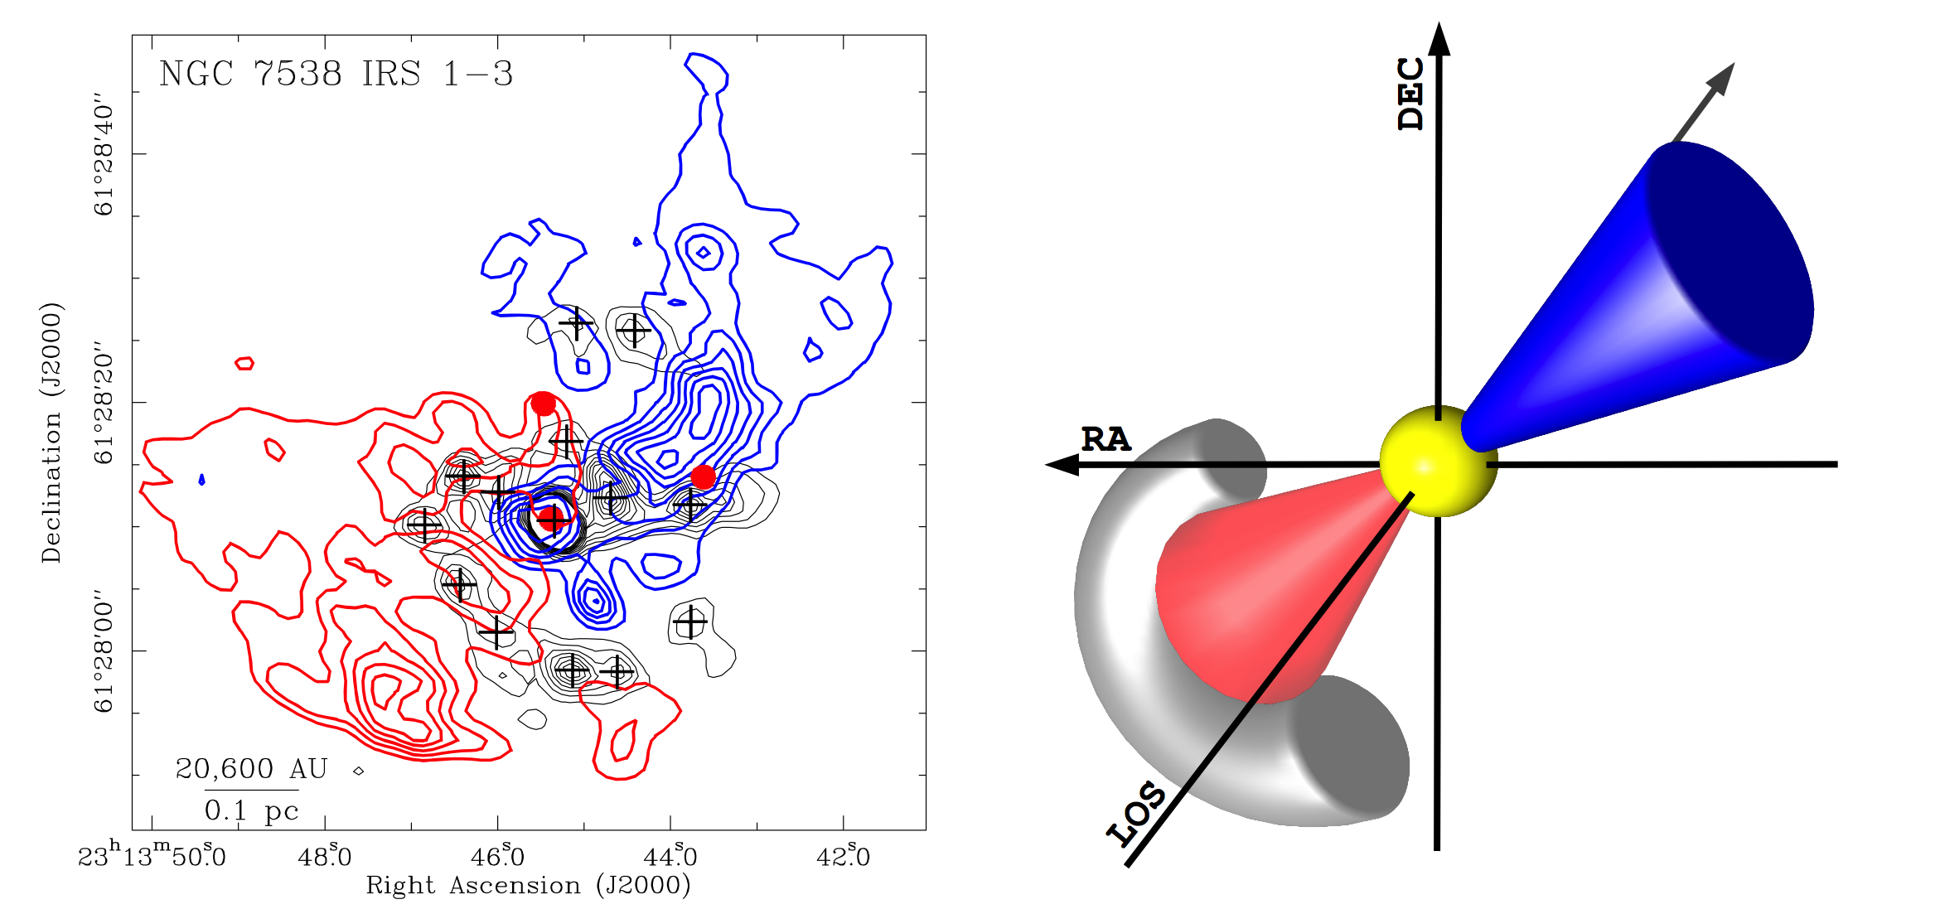
NGC 7538
0.1 pc
Frau+2014

Slide 15
Low-mass star-forming cores
Ser-emb 8, 8(N)

Slide 16
Ser-emb 8, 8(N)
0.01 pc
This filament is small!
(d ~ 0.01 pc)
How did this filament form?
What does the B-field look like between the cores?
Hull+2014, ApJS, 213, 13

Slide 17
Simulations
1 pc
1 pc
Chen & Ostriker 2014
Soler+2013

Slide 18
Summary (1/2)
1 pc

Slide 19
Summary (2/2)
Comparison of new dust polarization data with multi-scale, observable MHD simulations will show which processes dominate at small scales
High-mass: filaments may not reflect original configuration, and can be created by outflows, infall, etc.
Low-mass: numerous formation scenarios. But what about the smallest scales?
Even higher resolution ALMA observations will clear up (or further complicate?!) the situation
NGC 7538 filament
arXiv:1410.2269
TADPOL data release
2014 ApJS, 213, 153
TADPOL outflows/B-fields:
ApJ, 768, 159

Slide 20
Fin

