Slide 1





Asteroid Radar Astronomy and Spacecraft Missions
Michael Busch

Slide 2
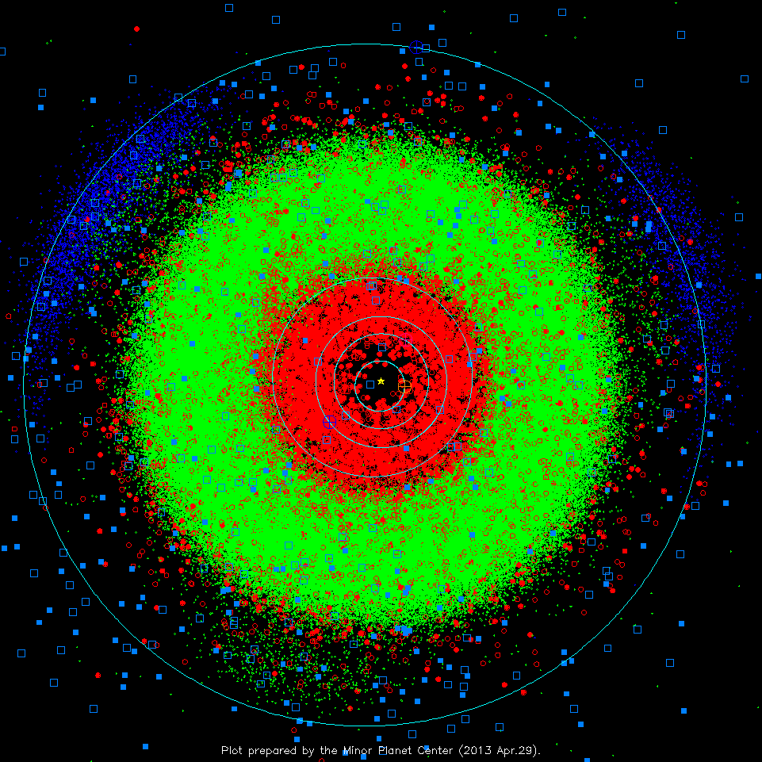
Here Be Asteroids

Slide 3
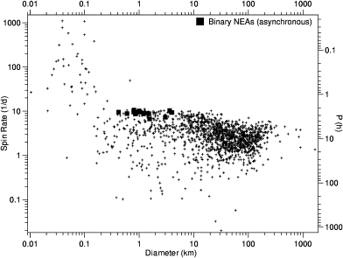
Sizes and Spin Rates
Figure from Pravec et al. 2006

Slide 4
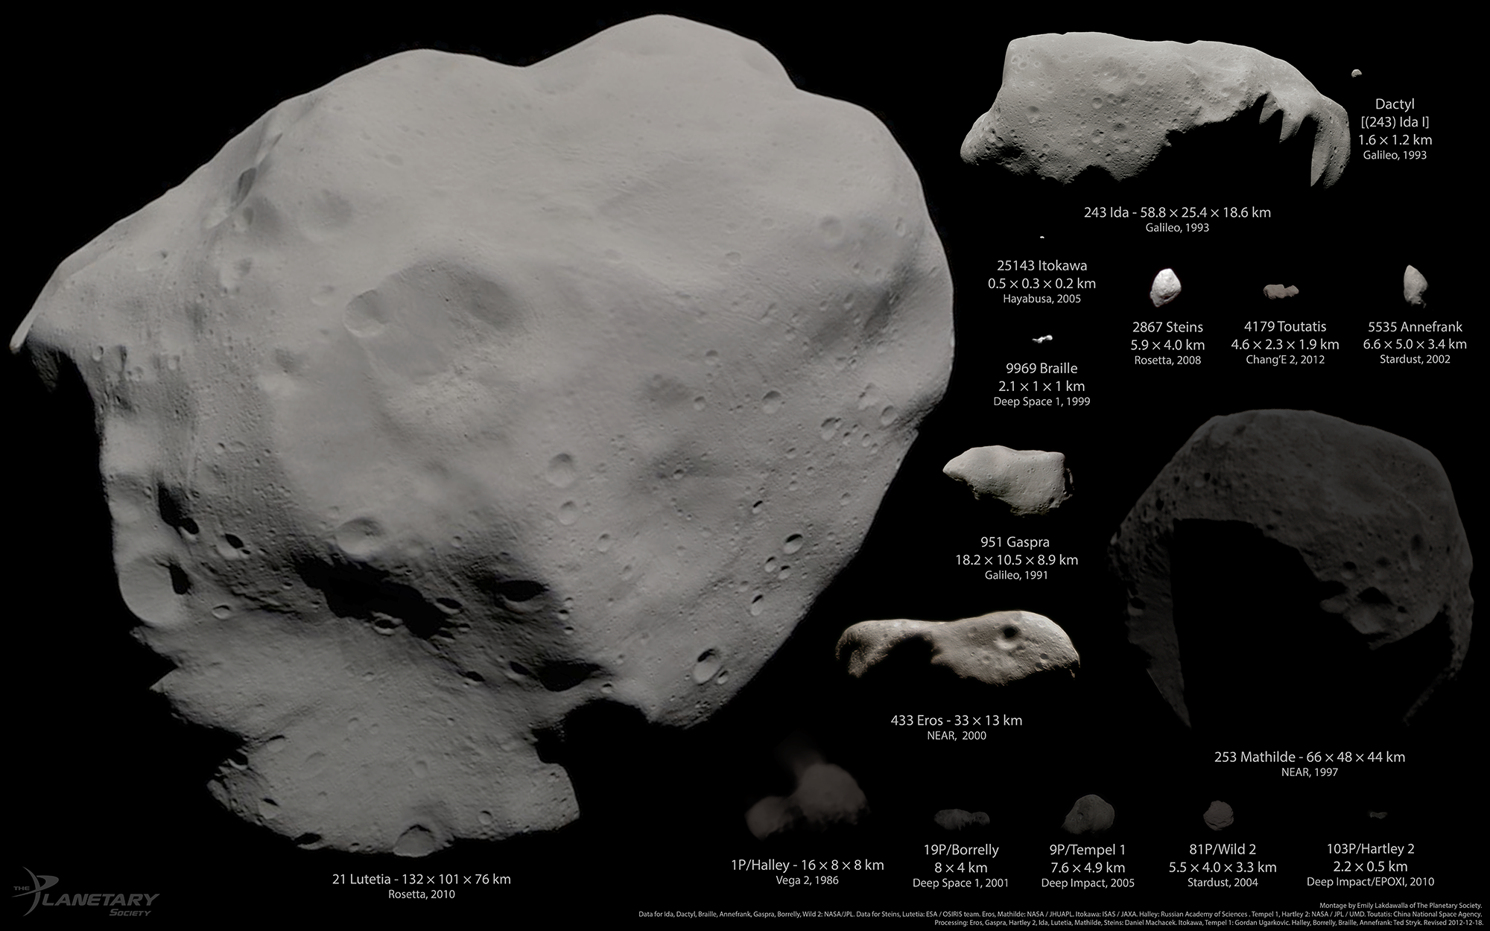
Asteroid Shapes
Collage by Emily Lakdawalla, Planetary Society, http://www.planetary.org/blogs/emily-lakdawalla/

Slide 5
Asteroid Shapes
Collage by Emily Lakdawalla, Planetary Society, http://www.planetary.org/blogs/emily-lakdawalla/

Slide 6
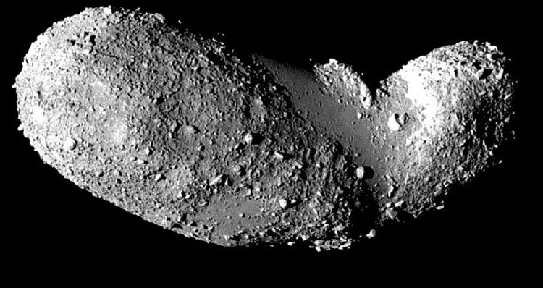
Rubble Pile Structure
25143 Itokawa, observed by the Hayabusa spacecraft. 540 m long

Slide 7
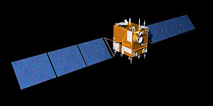
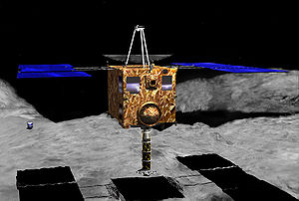
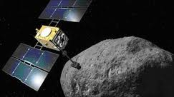
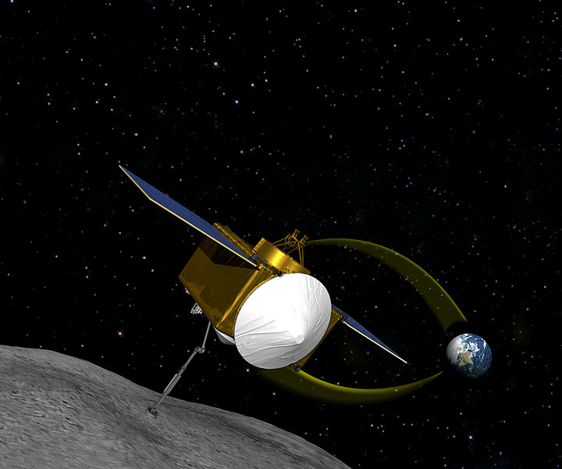
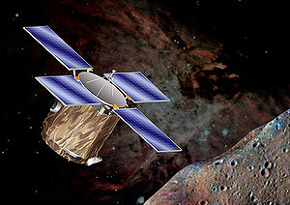
NEA Spacecraft Missions
Chang’e 2, 2010-2012 - CNSA
Hayabusa, 2003-2010 – JAXA
Hayabusa 2, 2014-2020
Marco Polo – R, 2023 - ESA
NEAR, 1996-2001 - NASA
OSIRIS-Rex, 2016-2023 - NASA

Slide 8
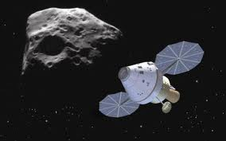
Human Missions
Obama Administration: “NASA should do a human asteroid mission by 2025”.
A caveat: low NASA budget as compared to during Apollo.

Slide 9
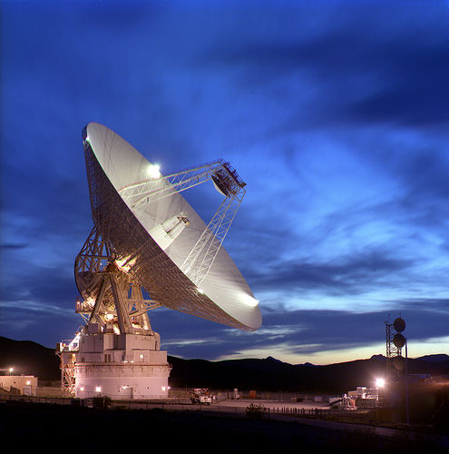
Radar – Characterizing Many NEAs

Slide 10
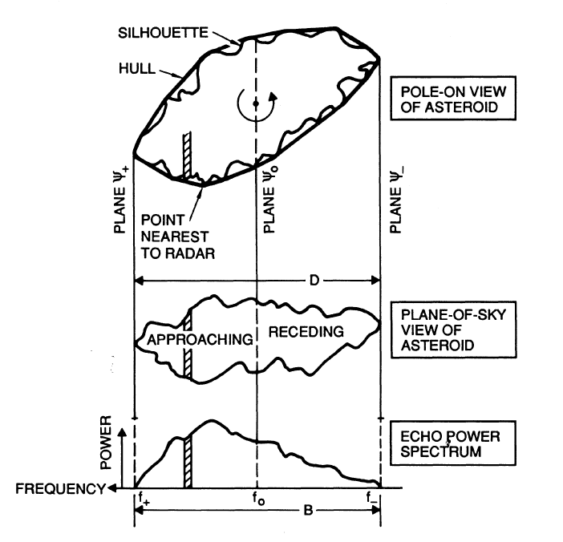
Delay-Doppler Imaging

Slide 11
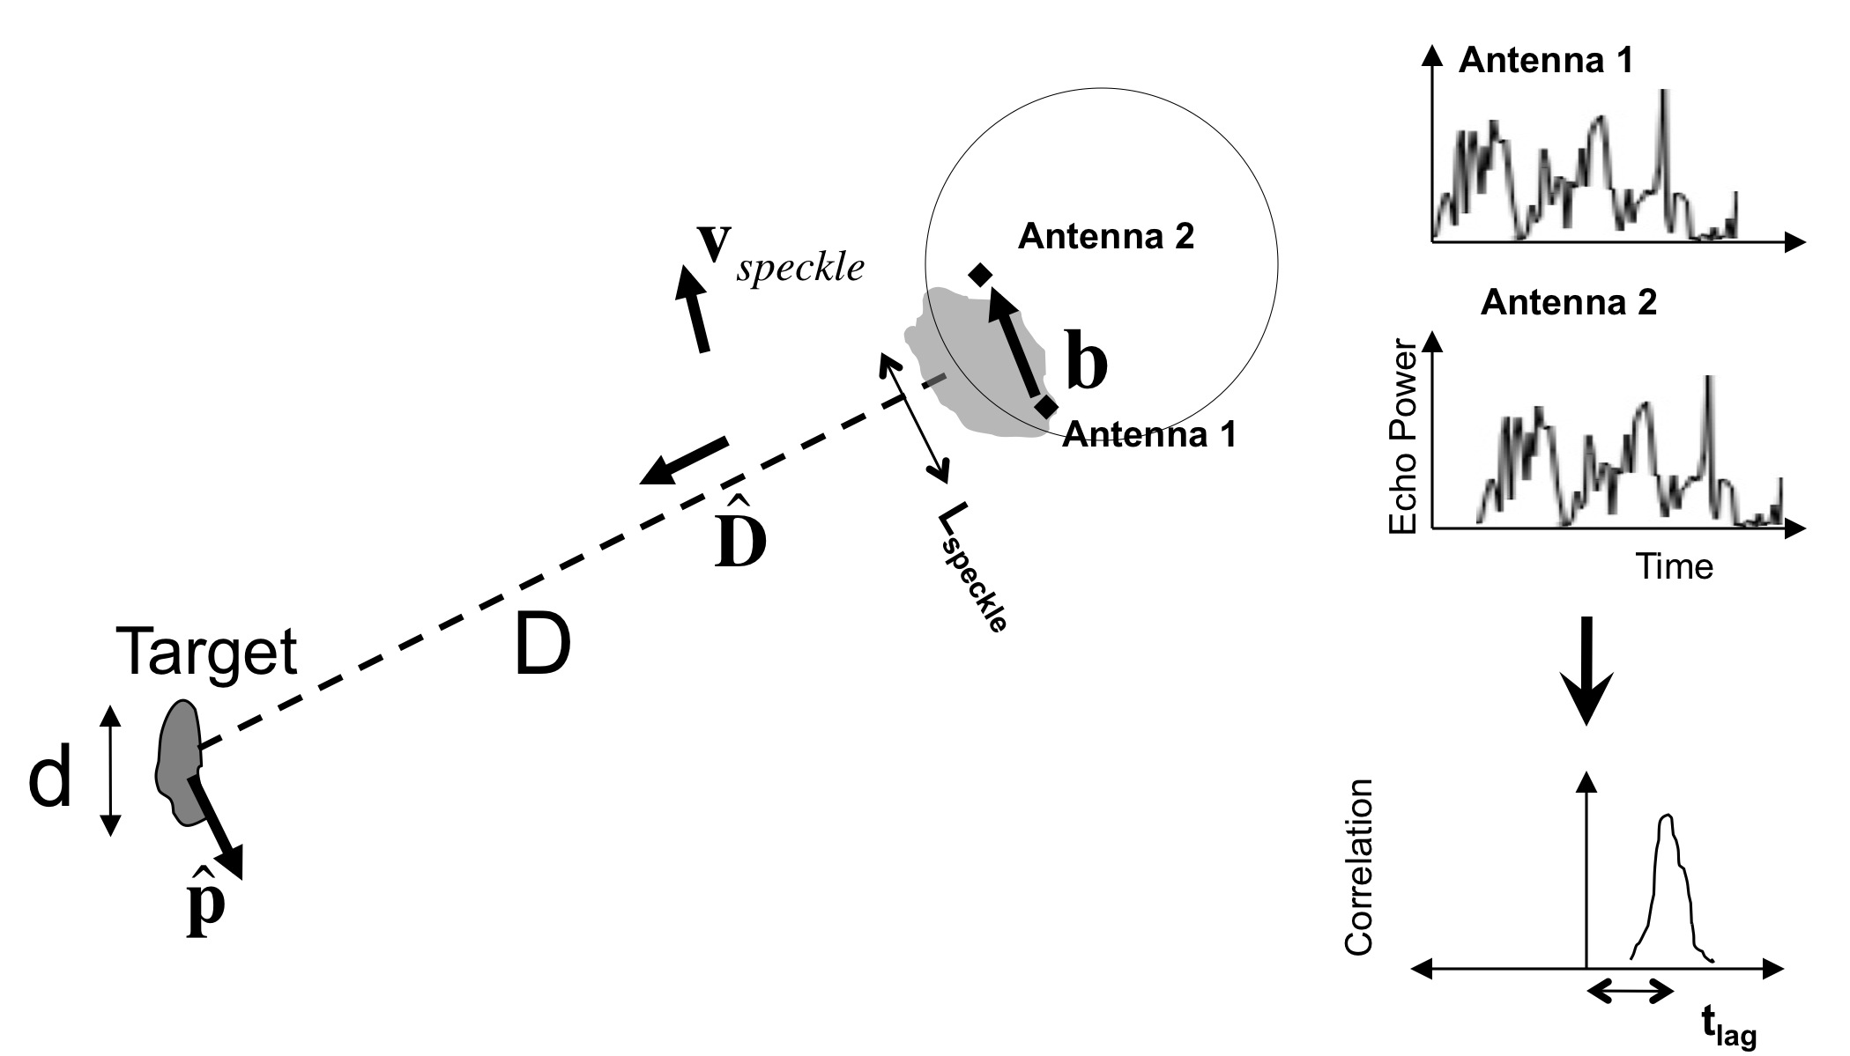
Radar Speckle Tracking
Schematic of radar speckle tracking. As the speckle pattern moves across the Earth, speckles are received at different times at different antennas. Time lag exaggerated for clarity.

Slide 12
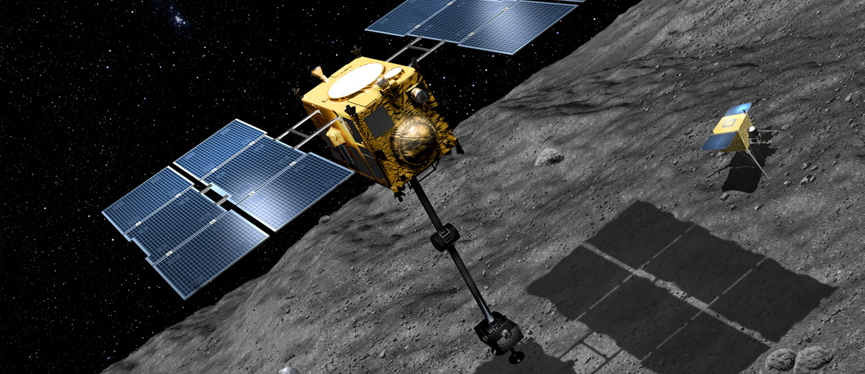
Marco Polo R
Orbiter, carrying lander and sample-return capsule.
Proposed launch 2023, 4.5 years to 2008 EV5 and back.
Final down-selection by ESA in late 2013.

Slide 13
2008 EV5 Radar Data
Arecibo delay-Doppler images of EV5
Goldstone images: 18.75 m/pixel range resolution
Arecibo images: 7.5 m/pixel range resolution

Slide 14
Equator-Aligned Ridge

Slide 15
EV5’s Size And Shape
Best-Fit Shape: ~400 m spheroid. The ridge is on the equator, and the concavity breaks the ridgeline.
Caveat: The poles, particular the north pole, were not seen or were seen only at grazing incidence.

Slide 16
EV5 Model Properties
Pole direction:
Ecliptic: (180º,-84º) ± 10º
RA & Dec: (7h, -66º) ± 10º
Principal-axis dimensions: (420 x 410 x 390) ± 50 m
DEEVE dimensions: (415 x 410 x 385) ± 50 m
Equivalent diameter: 400 ± 50 m
Volume: 0.035 km³ ± 40%
Rotation period: 3.725 ± 0.001 h (lightcurves)
SC/OC: 0.40 ± 0.07 S-Band
0.38 ± 0.02 X-Band
OC radar albedo: 0.29 ± 0.09
Near-surface bulk density: 3* ± 1.5 g/cm³
Optical albedo: 0.12 ± 0.04
Spectral class: CI/X (V. Reddy et al.)

Slide 17
Surface Environment
Geopotential (l) and facet-scale gravitational slopes (r) mapped over EV5’s surface, for a uniform density of 3 g/cm³.
The concavity and the temperate regions are the lowest-lying regions of the surface. Max gravitational slope at facet scale ~35º, mean ~13º.

Slide 18
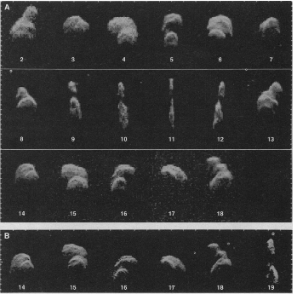
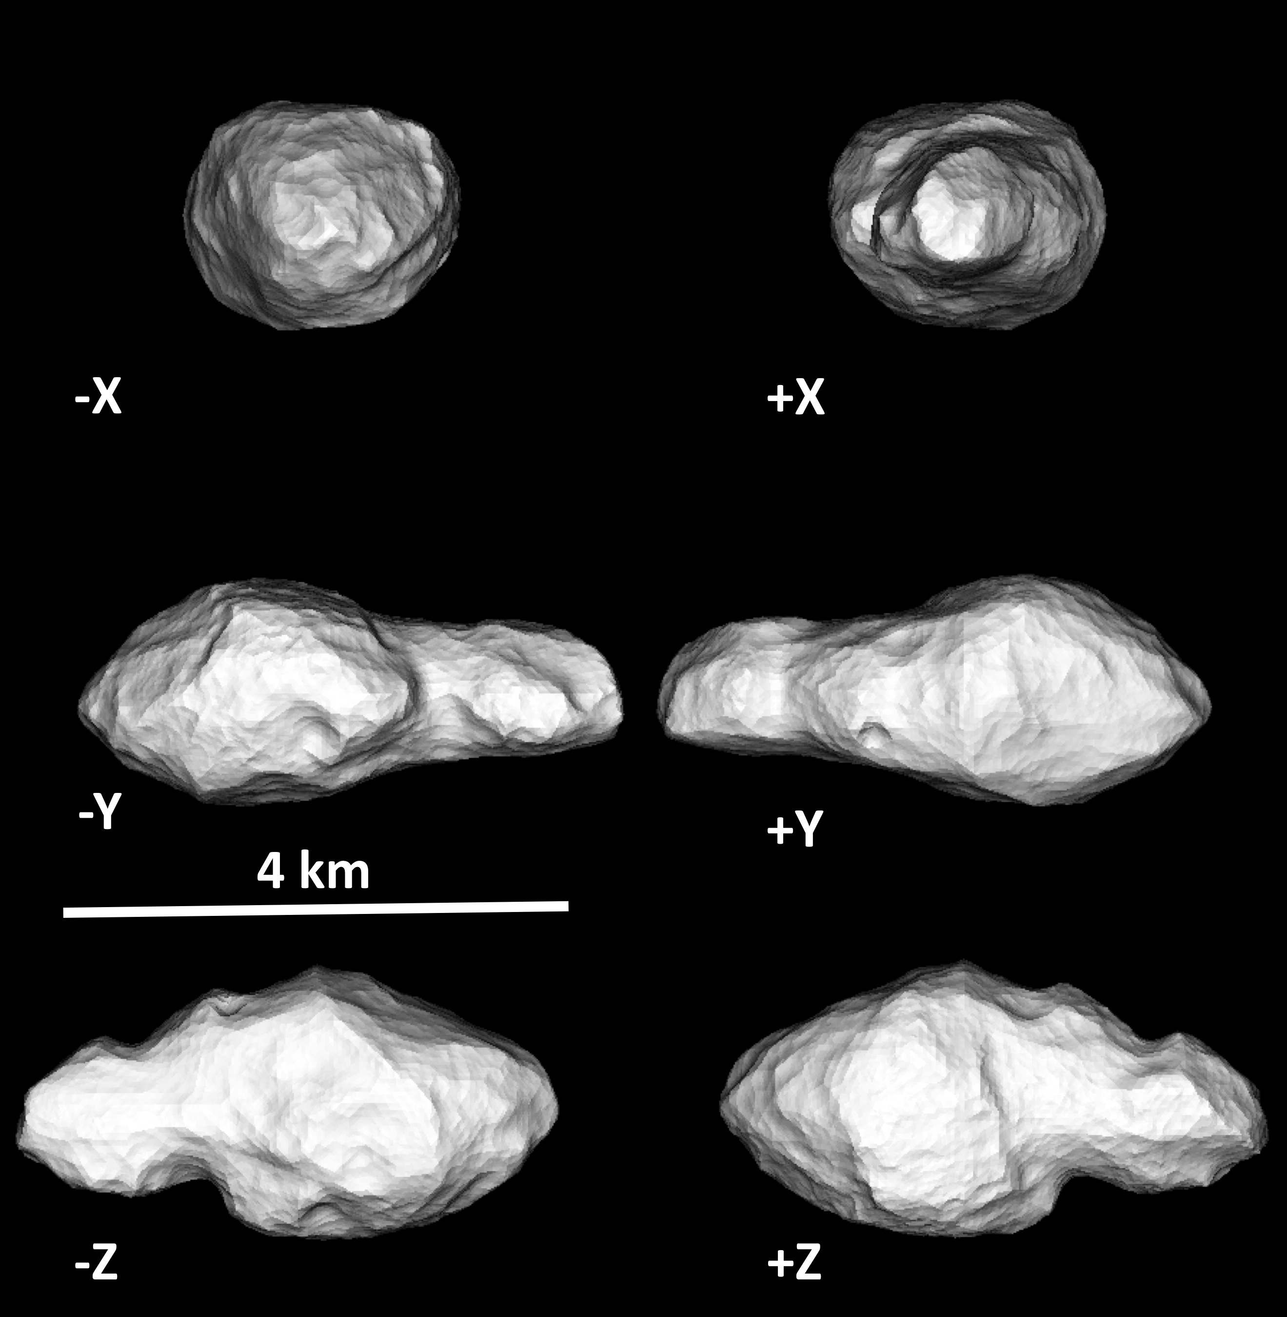
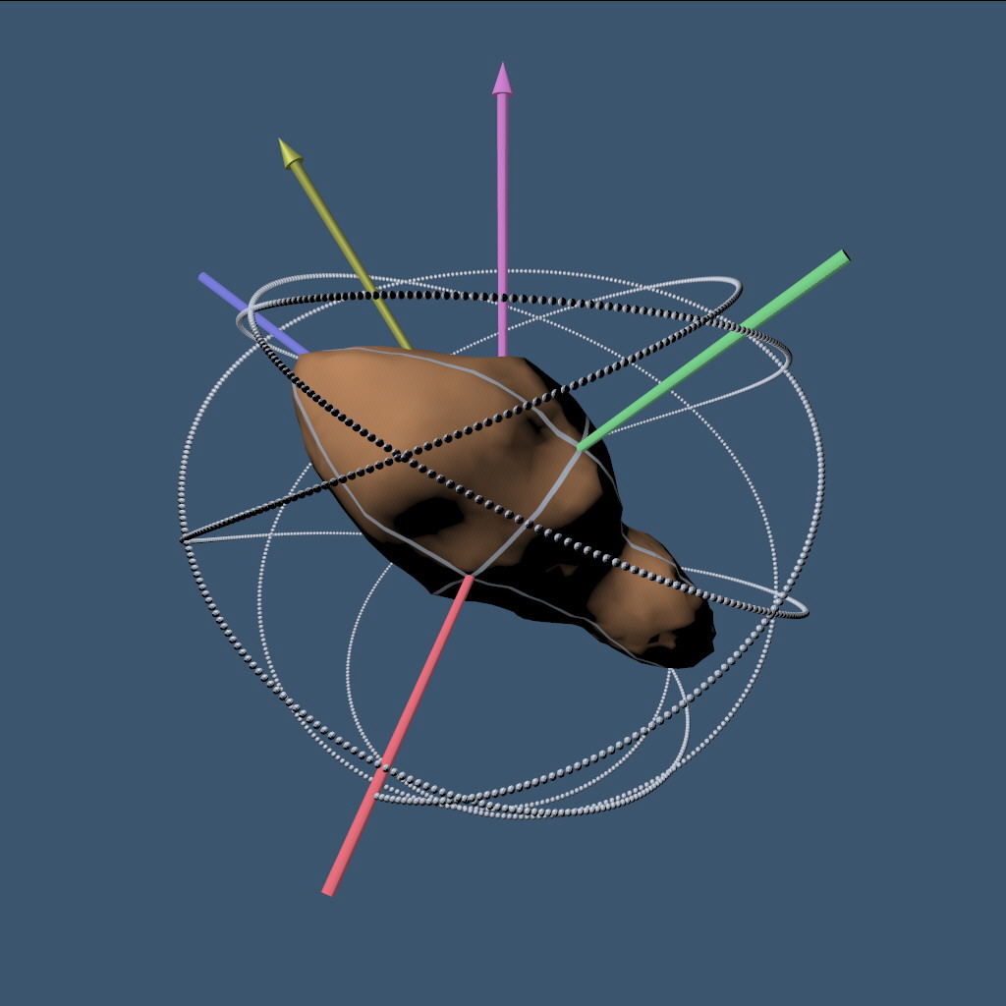
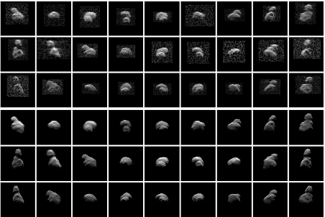
Toutatis: 1992-1996
Observations led by Steve Ostro, shape and spin state models led by Scott Hudson.
1992 Arecibo & Goldstone Radar Images
Toutatis is bilobate, ~4.5 km long.
It has an aperiodic NPA spin state.
NPA spin depends on Toutatis’ moments of intertia.
1996 Arecibo & Goldstone Radar Images

Slide 19
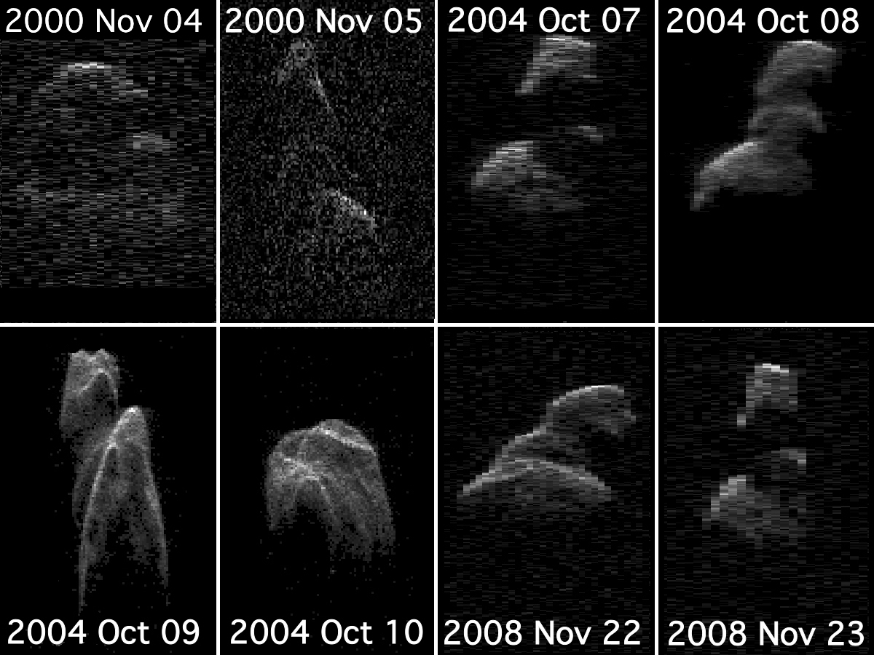
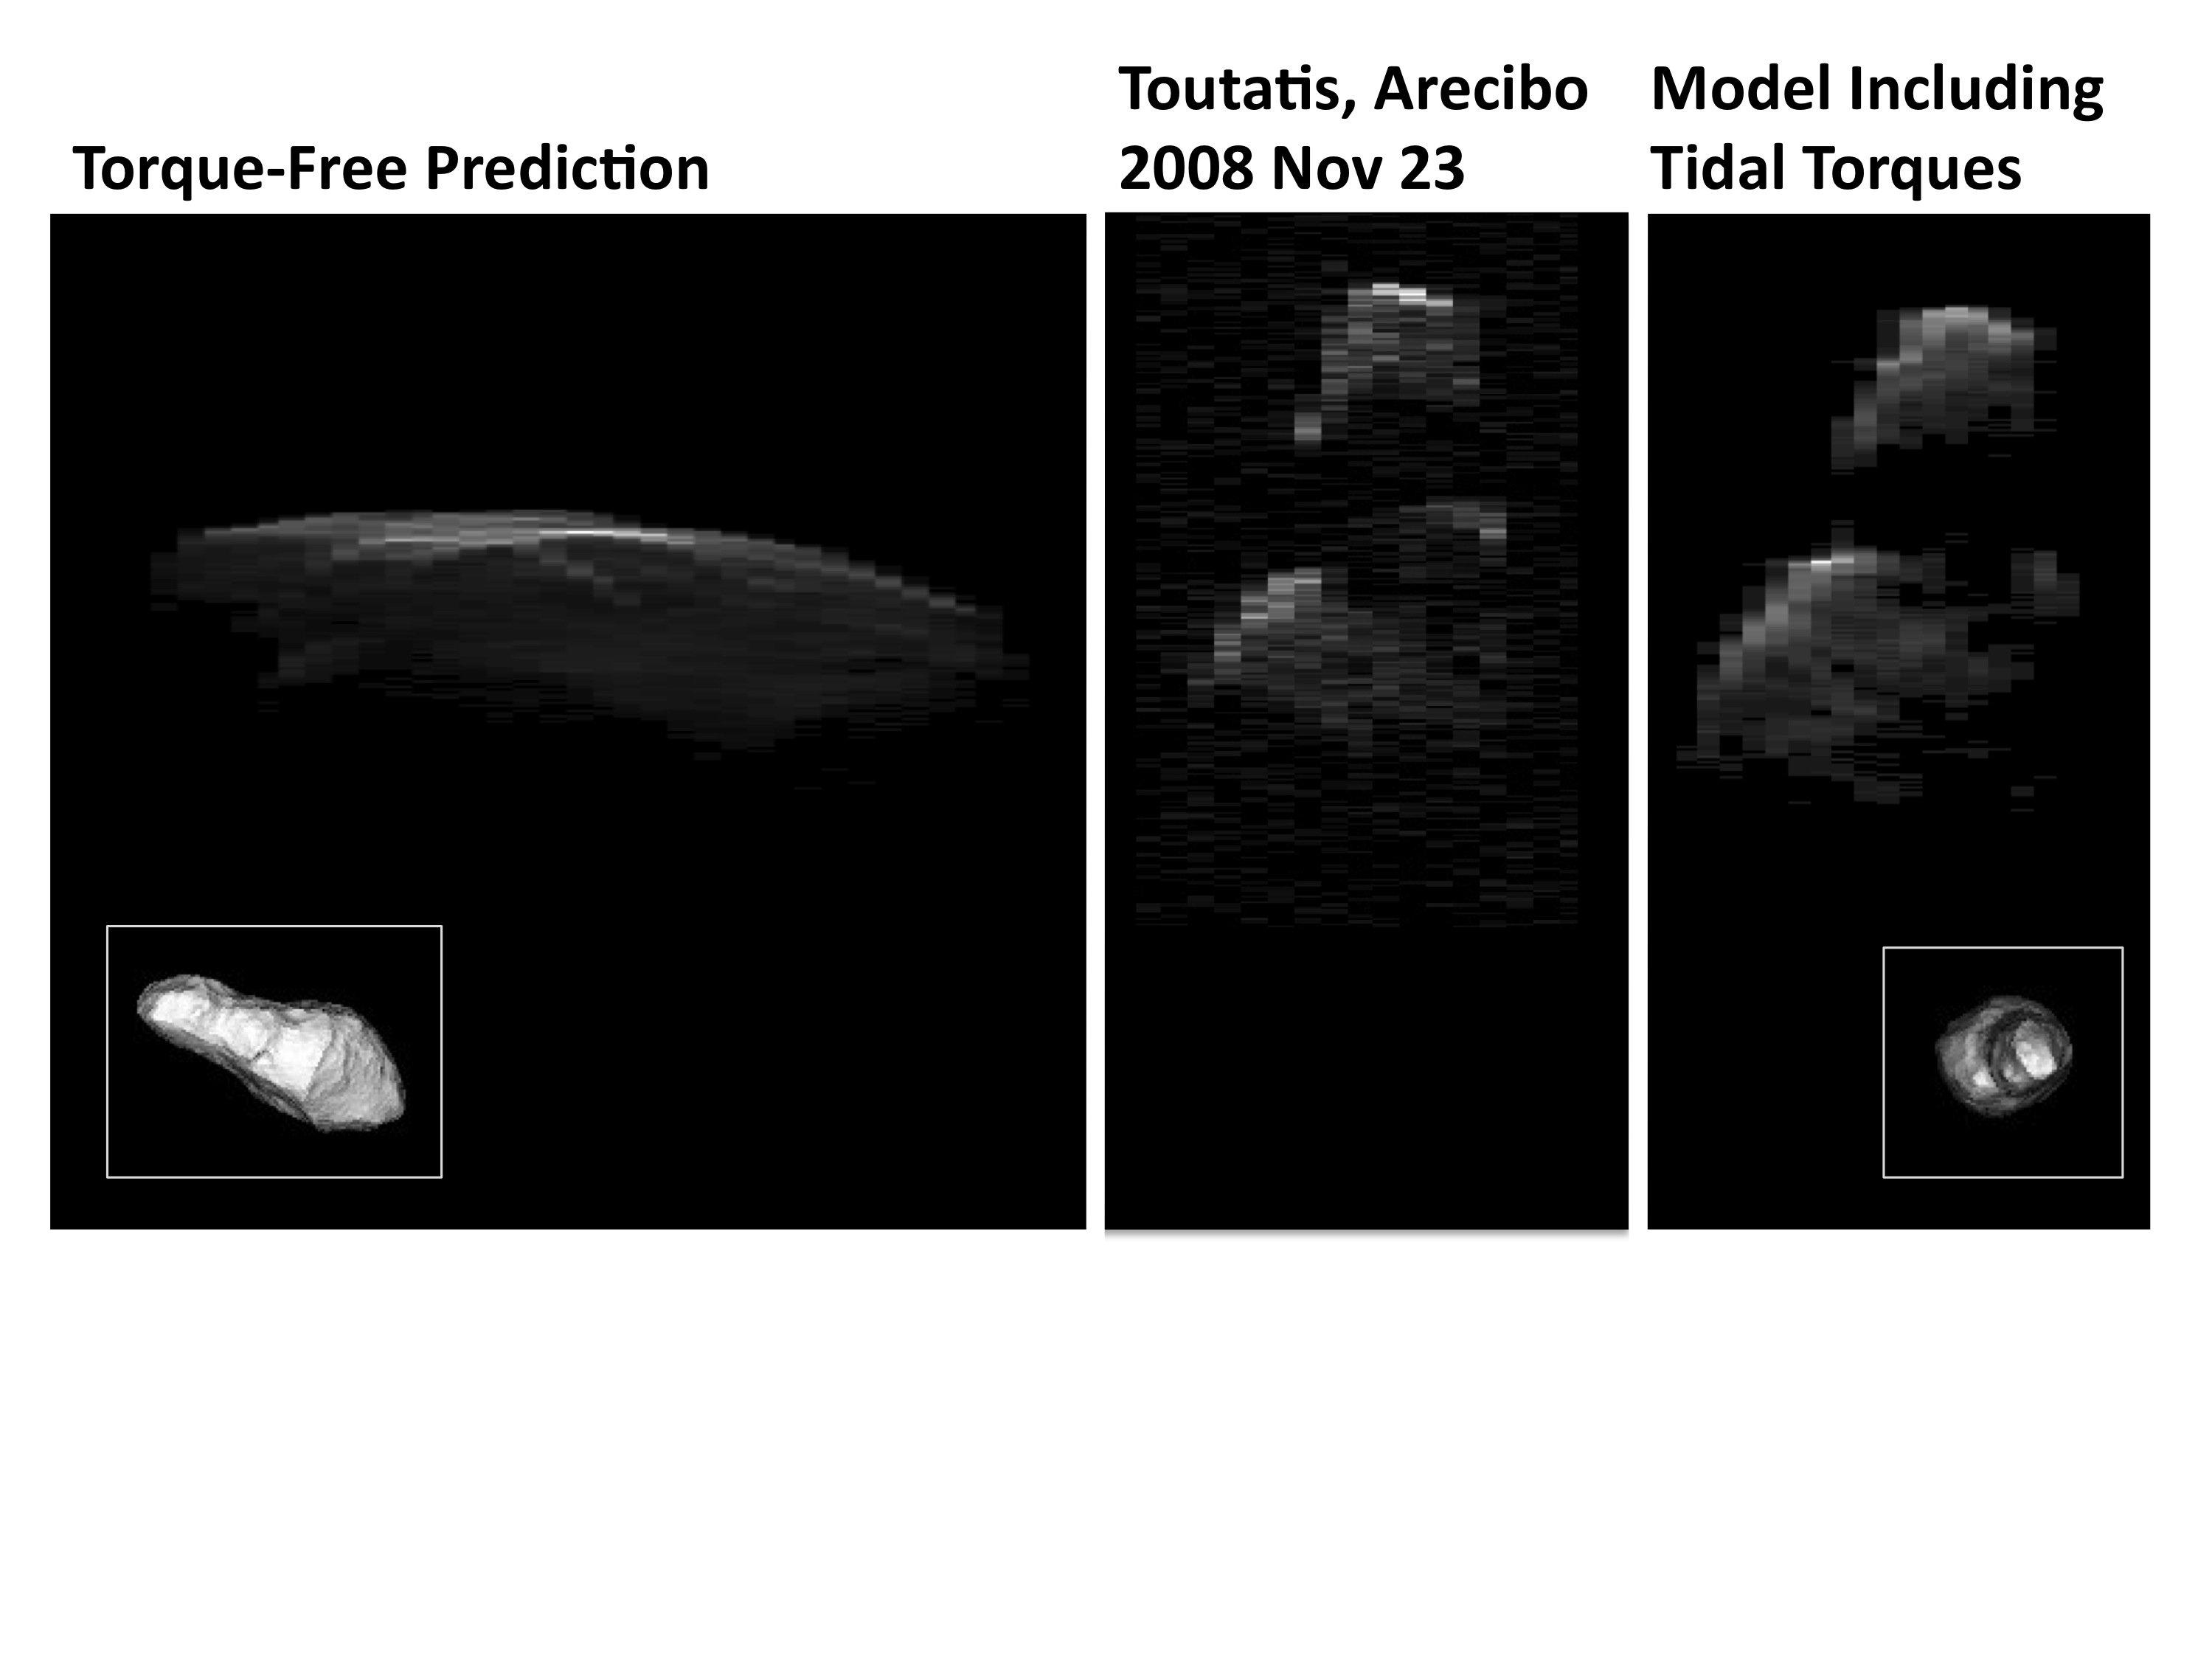
Toutatis: 2000-2008
Radar images: Goldstone ‘00, Arecibo ‘04 & ‘08.
Mismatch between ‘92-‘96 spin state fit and later images.

Slide 20
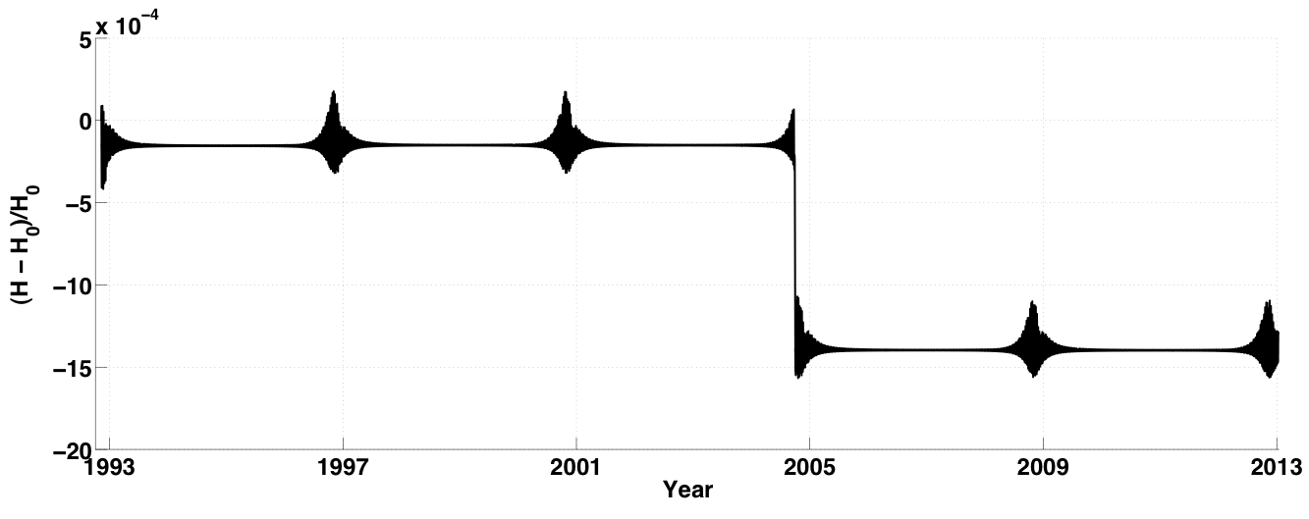
Toutatis’ Changing Spin State
Changes in Toutatis’ angular momentum from Dec 1992 to Dec 2012.
Chart and fit from Yu Takahashi.
Toutatis is torqued by tides from the Sun and Earth. The largest spin state change since 1992 was during the ‘04 flyby.
Moment of inertia ratios from ’92-’08 spin state fit: I_{s}/I_{l} = 3.23 ± 0.01 and I_{i}/I_{l} = 3.087 ± 0.005

Slide 21
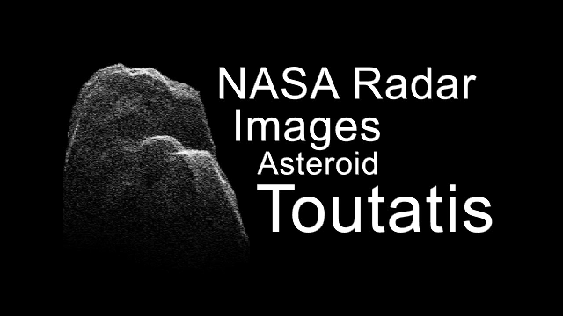
Images from 2012 Dec 12 & 13 UT

Slide 22
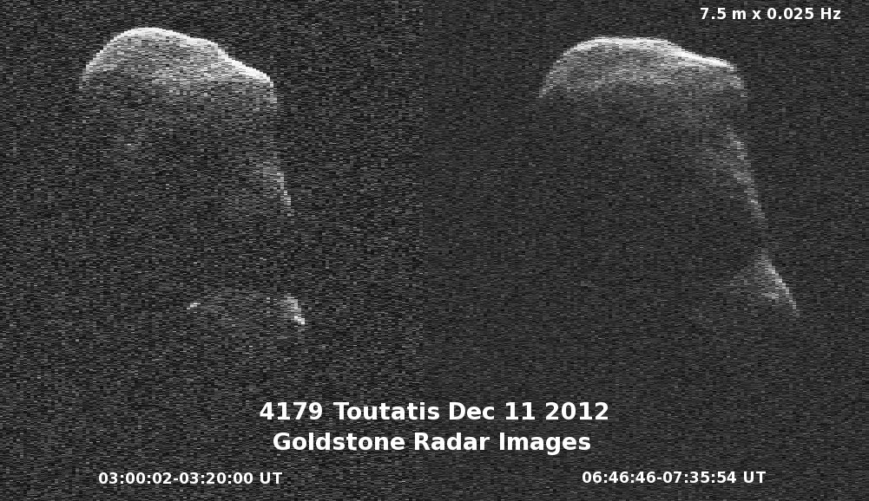
7.5 m/pixel and 3.75 m/pixel images of Toutatis show some 10-m-scale bright features. Boulders?

Slide 23
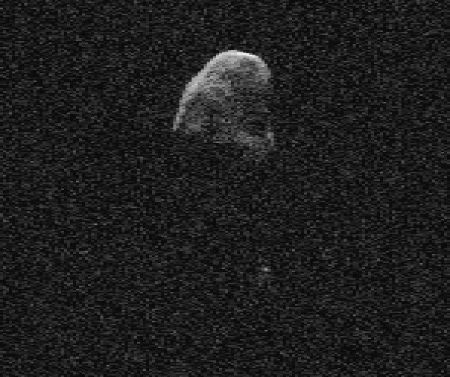
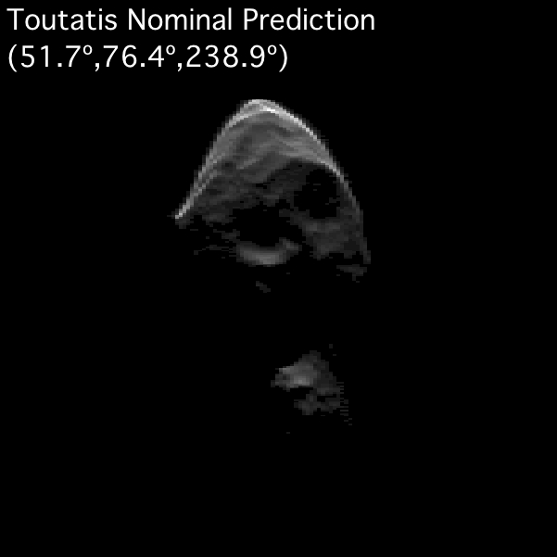
How Good Was The Shape Model?
Toutatis Image, 2012 Dec 4, 03:30 UT
Spin state predictions were quite good.
Radar and Chang’e 2 images imply errors in the shape model of perhaps 3% by volume.
Limitations of SHAPE software: initial ellipsoid model of the big end was preserved throughout later shape fits.

Slide 24
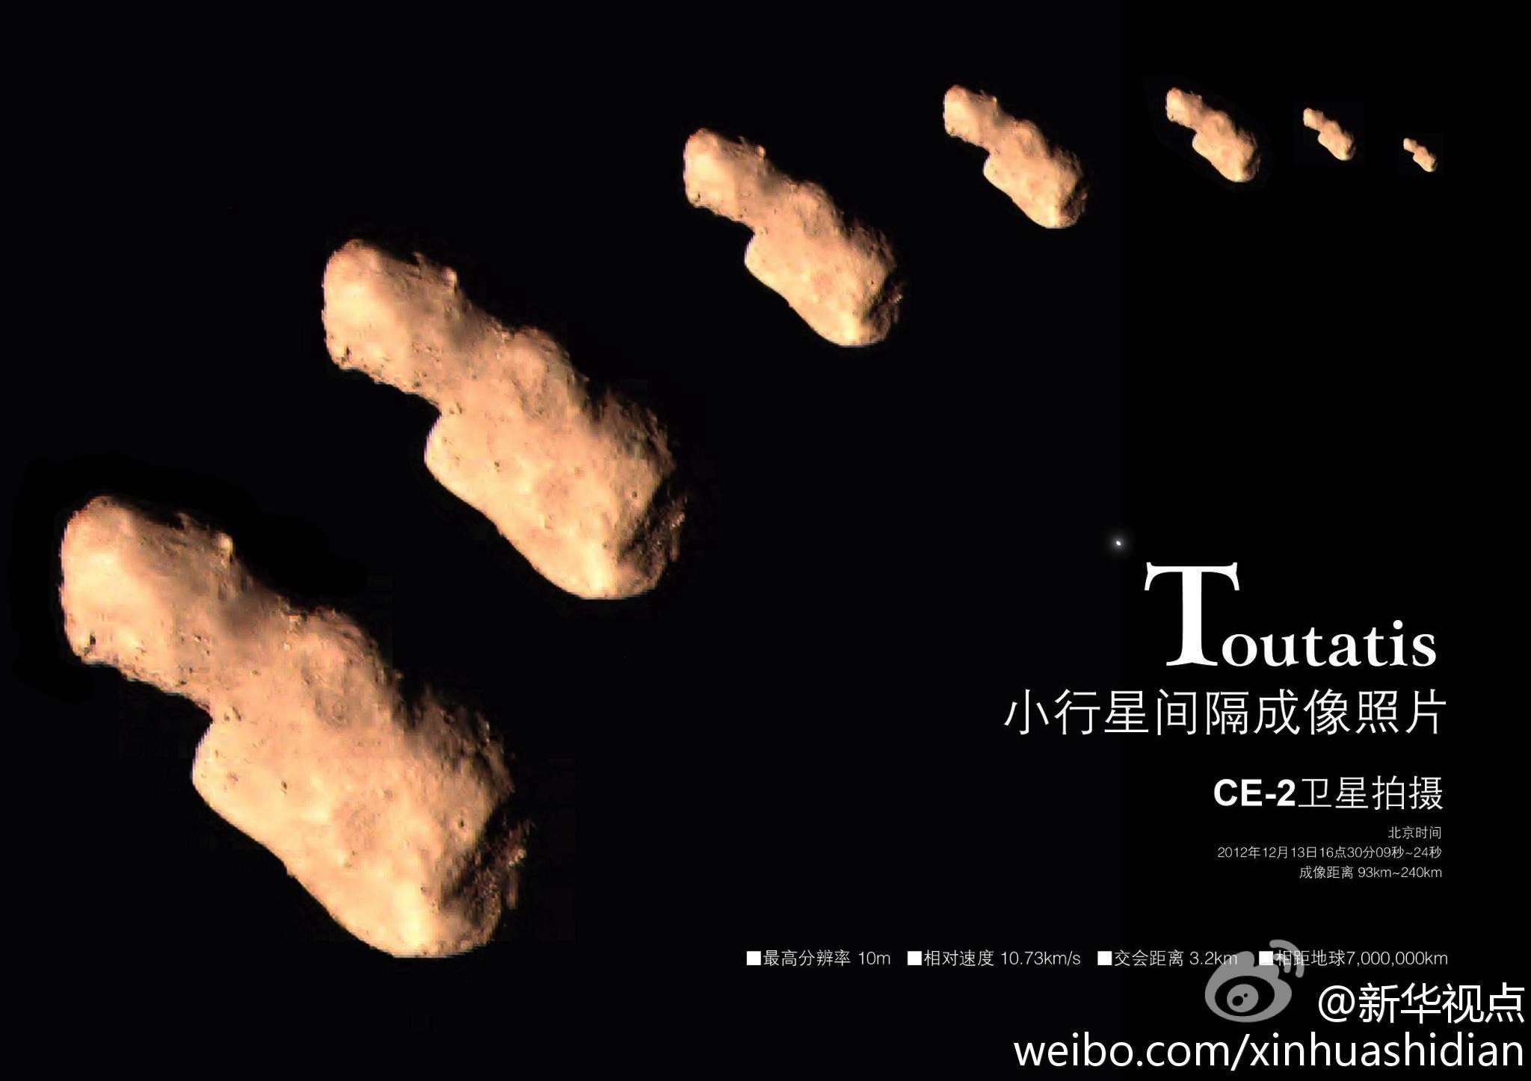
Toutatis & Chang’e 2
Optical images from Chang’e 2, 2012 Dec 13
(false-color – the asteroid is really a slightly reddish grey)

Slide 25

What Happens Next?
Improve the spin state model with both radar imaging and speckle tracking data.
Correct the shape model:
Radar images from this year allow both higher resolution and correction of errors on the big end.
Eventually, combine CE2 and radar data (stereo mesh from CE2 + radar over rest of the surface)
Consider implications for internal structure.
Silhouette of Toutatis shape model from –z direction, with largest errors highlighted.

Slide 26
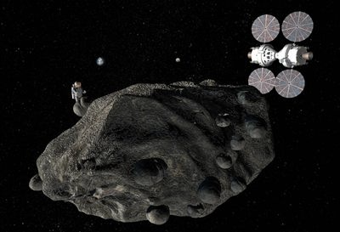
Bringing Humans to NEAs
Advantages:
Less fuel needed to get to many of them than the Moon.
Easier in every way than going to Mars.
Disadvantages:
Longer travel time than going to the Moon.
Radiation (a problem for everything beyond low Earth orbit).
Interacting with rubble in microgravity – dock, not land.
Concept mission art. Note the size of the asteroid as compared to the astronaut.

Slide 27
Bringing Humans to NEAs
Example: 2008 EV5
Launch 2024 June 22
370 days round trip
64 days at EV5
6.3 km/s velocity change
(just about equal to the Moon)
At the extreme limit of accessibility for humans right now.
Shape model from radar data (Busch et al. 2011)
See http://neo.jpl.nasa.gov/nhats/

Slide 28
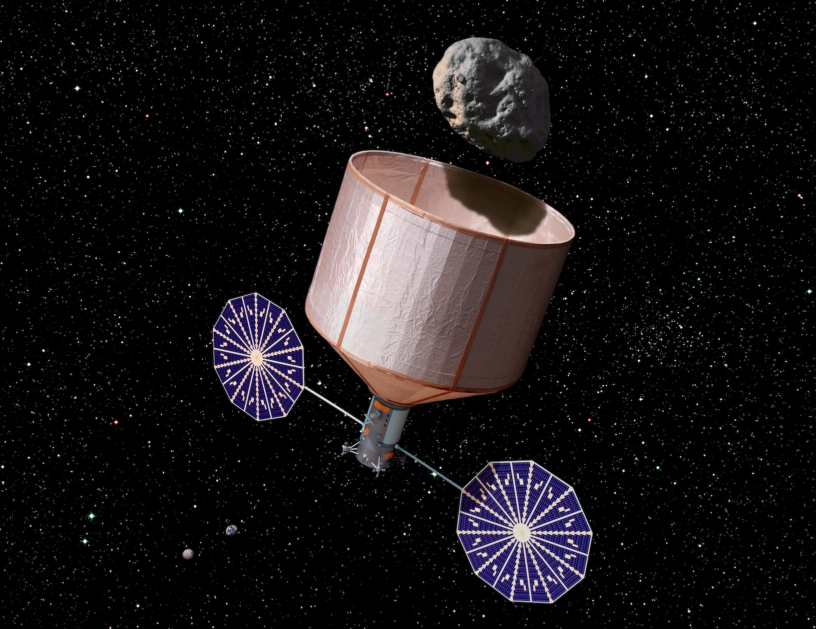
Bringing NEAs to Humans
Advantages:
Lower cost.
Shorter travel times for humans
Disadvantage:
Target is no longer pristine.
Where do you bring the asteroid to?
Still need to find more suitable targets.
Asteroid Retrieval Mission concept,
Caltech Keck Institute for Space Studies

Slide 29
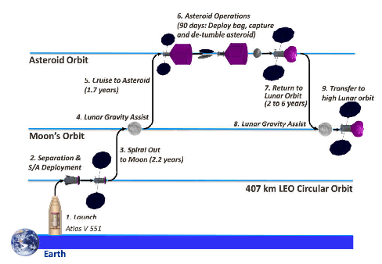
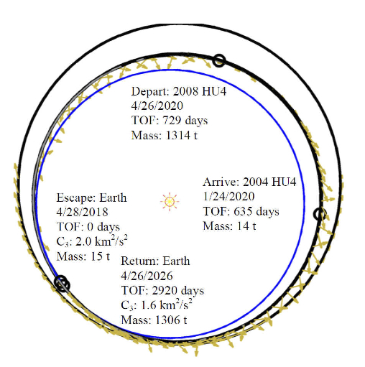
Moving Rubble Piles Around
Test Case: 2008 HU4. With launch in 2016, this is not likely to be a real target. But there are many other similar objects.
Launch robotic spacecraft to object.
Capture and return to Earth-Moon space.
Send humans out to returned object.
Need to find the targets.

Slide 30
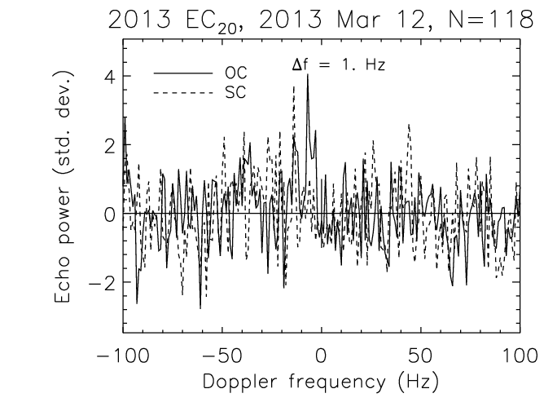
Observing Very Small NEAs
Need to be followed-up within ~1 week of discovery.
Lightcurves -> spin.
IR spectra -> composition.
Radar -> trajectory and size
2013 EC20. 2-3 m diameter, 10-30 ton mass.
(red bars are 3σ errors in optical-only trajectory)

Slide 31
Questions?

Slide 32
Space Resources
Spacecraft are expensive.
Launching spacecraft is expensive.
Anything that can be found in space and brought back to Earth orbit cheaply is a potentially useful resource.
Retrieval mission: cost per kilogram at high lunar orbit is 1-10% of bringing that up from Earth.

Slide 33
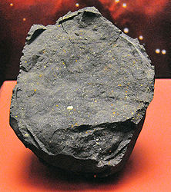

Products
Sandbags
Water
Fuel
Life Support
Carbon compounds
Structural metal
Murchison Meteorite – 12% water
Recent Private Interest:

