Slide 1
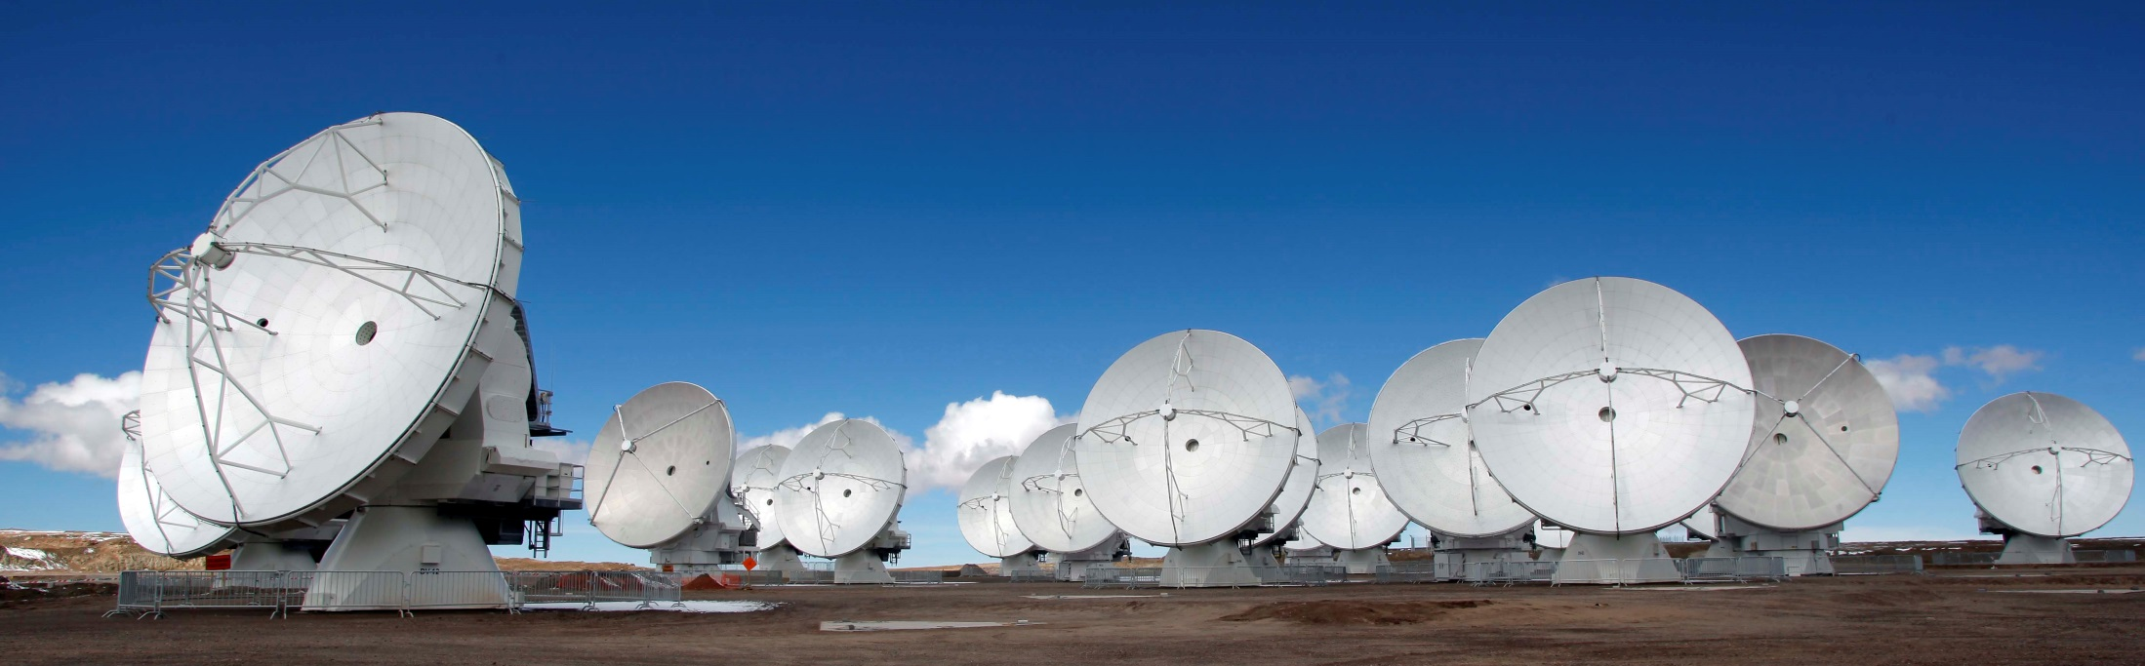
ALMA Correlator System Overview
rescoffi@nrao.edu,

Slide 2
ALMA Correlator Specifications
64 Antennas
8 Base Band outputs per antenna
4 spectral windows + 2 polarizations
Maximum bandwidth per antenna 16 GHz
3-bit samples, 2-bits correlated (3-bit and 4-bit correlated modes as well as twice Nyquist are possible)
1024 leads and 1024 lags per baseline (256 per quadrant) at 2 GHz BW for time division modes
32K leads and 32K lags per baseline for frequency division modes
1 millisecond delay adjustment range, 250 picosecond delay resolution
Full polarization capability (HH HV VH VV) plus autocorrelations
Digital filter for bandwidth selection below 2 GHz
Minimum accumulation time, 16 millisecond cross, 1 auto
1 Gbyte/sec total output data rate capacity
Up to 6 sub-arrays
Binning capability for side-band separation
Multi-resolution modes possible
Phased array outputs

Slide 3
SYSTEM BLOCK DIAGRAM

Slide 4
Station Electronics

Slide 5
Time Division Mode

Slide 6
Frequency Division Mode

Slide 7
FDM Frequency, Resolution Agility

Slide 8
Filter Programmability
Tunable Filters
  2 GHz bandwidth, All 32 active
  1 GHz bandwidth, 16 active
  500 MHz bandwidth, 8 active
  250 MHz bandwidth, 4 active
  125 MHz bandwidth, 2 active
  62.5 MHz bandwidth, 1 active
  31.25 MHz bandwidth, 1 active
Programmable parameters
  Center frequency of each filter (once per scan)
  Output quantization (once per scan)
  Coarse delay (update during scan)
  Fine LO setting (update during scan)
Monitor parameters
  Sample statistics (before scan)
  Output total power (at filter set-up)
More on Rich’s presentation

Slide 9
Station Card Programmability
Bulk delay (once per scan)
Mode (once per scan)
  TDM or FDM
    For TDM; one band, 2 band, 4 band
    For FDM; number of active filters, 1, 2, 4 bands
For sub-arrays (once per scan)
  Mode for station cards assigned to sub-array 1
  Mode for station cards assigned to sub-array 2
  Mode for station cards assigned to sub-array 3?
  Mode for station cards assigned to sub-array 4?
More on Rich’s presentation

Slide 10
Baseline Electronics

Slide 11
Correlator Plane

Slide 12
Sub-Arrays

Slide 13
Sub-Arrays (how the real world works, of course)

Slide 14
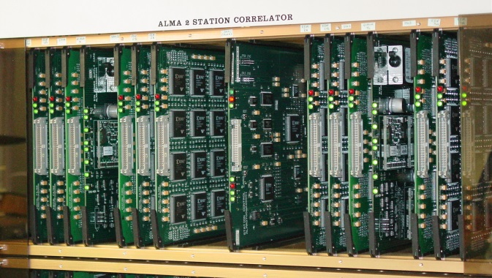
Station Bin

Slide 15
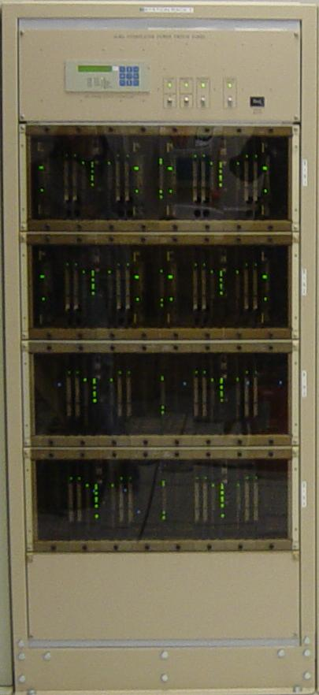
Station Rack

Slide 16
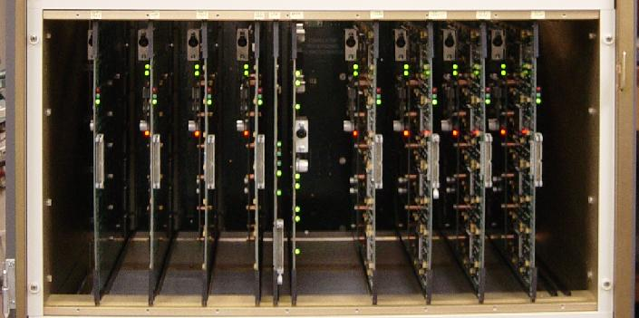
Correlator Bin

Slide 17
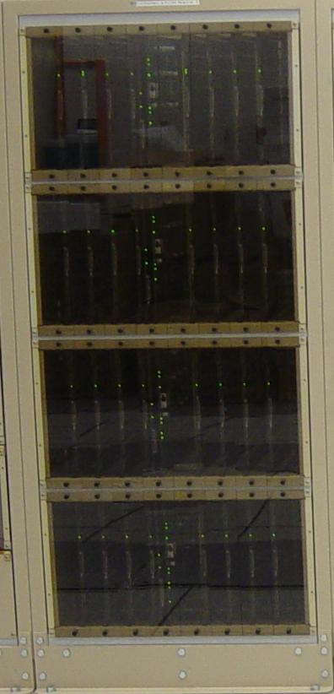
Correlator Rack

Slide 18
One Quadrant

Slide 19
Control Cards
Station Control Card (SCC)
  Programs TFB and Station cards
Correlator Control Card (CCC) (also functions as LTA)
  Programs Correlator cards
Final Adder (FA)
  Not a control card but has microprocessor and CAN bus interface
  Resides (two per quadrant) in a correlator bin
Quadrant Control Card (QCC) (has separate CAN bus)
  Monitors quadrant voltage, current, and temperatures, powers down quadrant if danger is found
  Provide the path for turning on and off the Correlator.
  distribution point for the RS232 busses from the PC and VME computers.
  Provide a global Boot and Reset capability to the control cards on the multidrop bus.
  Resides in a correlator bin
Power Control Card (PCC)
  Various power control functions
  Resides in a correlator bin

Slide 20
Self Test Capability

Slide 21
DTS Simulator Card
Versatile test fixture for system testing
A circuit card that replaced a DRX card in the system for off-line hardware or software testing
Simulates realistic antenna signals with precisely controllable spectral features
Simulates antenna signals with realistic polarization properties
Controllable correlation coefficients between two DTS Simulator cards

Slide 22
Engineering Port
Separate SR-485 bus that parallels the CAN bus
Provides most of the control afforded by the CAN bus
Firmware in place to conduct many types of tests
Formatter CRT screens for easy interpretation of test results
Engineering port software in place to duplicate many CCC operations
Can extract correlation function from several points in the system
  instrumental for validating many correlator features while the software was not ready
Very useful for engineering testing and trouble shooting
Easily changeable/expandable firmware

