Slide 1
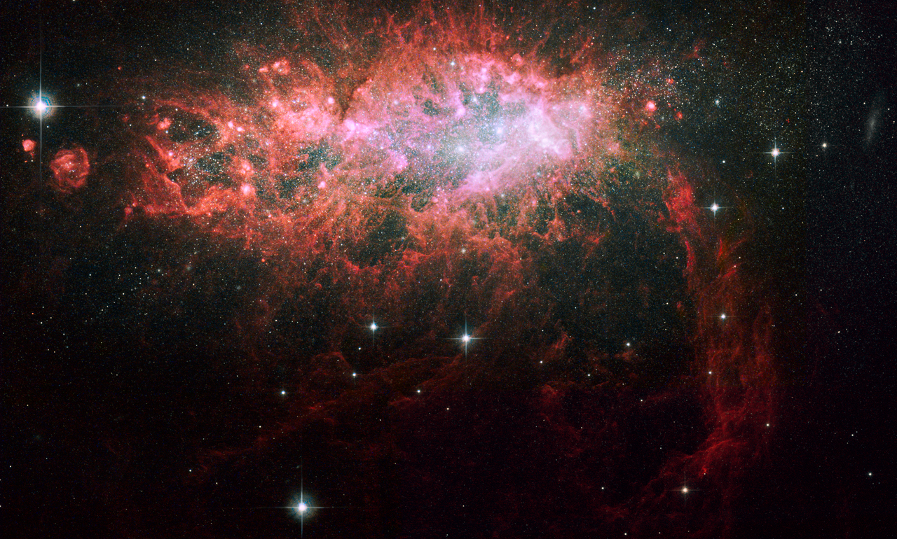
Constraining the Physics of Star Formation in Galaxies Using the JVLA and GBT
Amanda Kepley
NRAO - GB

Slide 3
Molecular gas clouds collapse to form stars, but detailed physics is complicated.
Molecular
Gas
Physics
Stars
Angular Momentum?
How are molecular
clouds formed?
Magnetic Fields?
What are the properties of young massive stars?
Turbulence?
What are their properties?
Radiative Feedback?

Slide 4
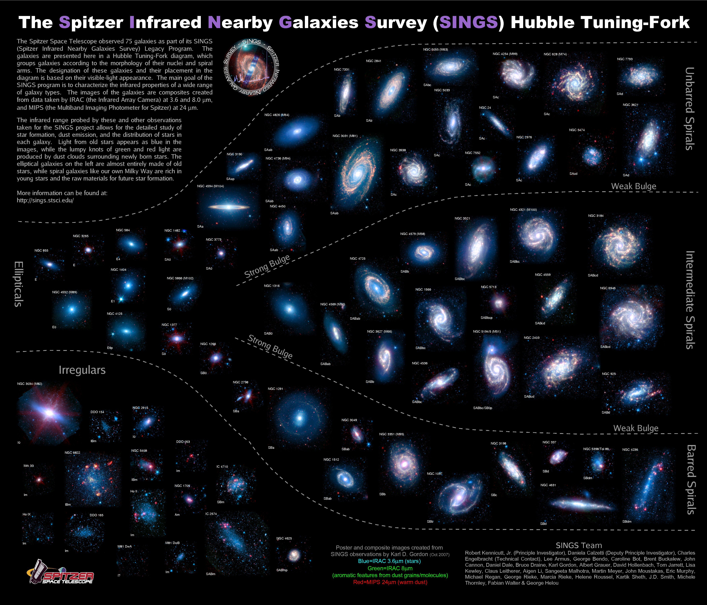
Different physical processes may dominate star formation in different galaxies.

Slide 5
Molecular
Gas
Physics
Stars
Dana Balser, Laura Chomiuk,
Miller Goss, Kelsey Johnson,
David Meier, D.J. Pisano

Slide 6
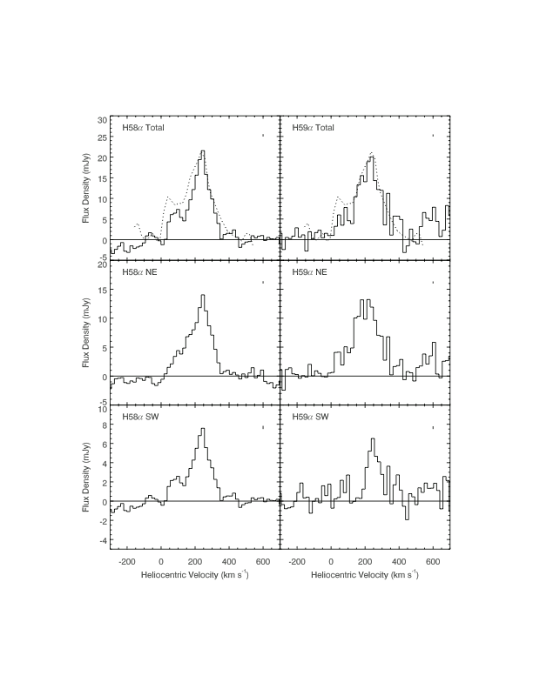
Young massive stars ionize the ISM, which emits radio recombination lines.
Kepley+ 2011
Notes:
.

Slide 7
Radio recombination lines are transitions
between the outer levels of an atom.
n = 58
γ
n = 57
Found throughout radio/submm band (~1 GHz to 1000 GHz)

Slide 8
RRLs give densities, sizes, and kinematics of HII regions.
Densities
Sizes
Kinematics
Mass of ionized gas
Number of ionizing photons
Star formation rates
Notes:
Add something about better than just continuum…….know whether optically thin or thick
RRLs act like density filters – higher frequency lines tracer higher densities.

Slide 9
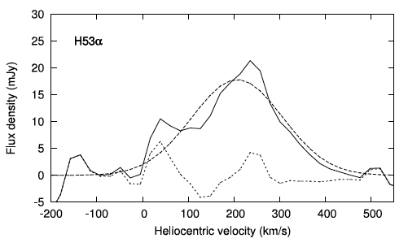
Extragalactic RRLs were very hard to detect.
~20 mJy
Faint
Broad
230 km/s
Rodriguez-Rico et al. 2006
Brighter at higher frequencies
Notes:
How bright is continuum in center of NGC 253?

Slide 10
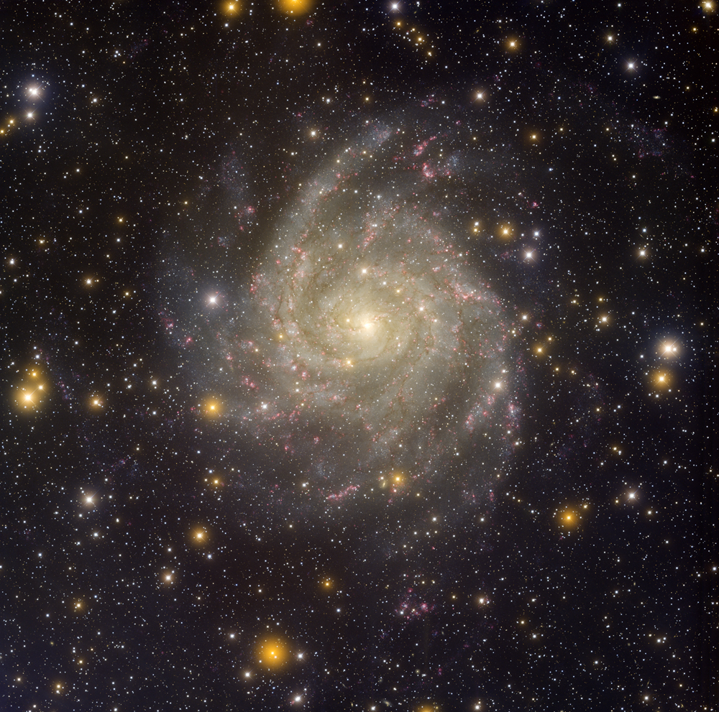
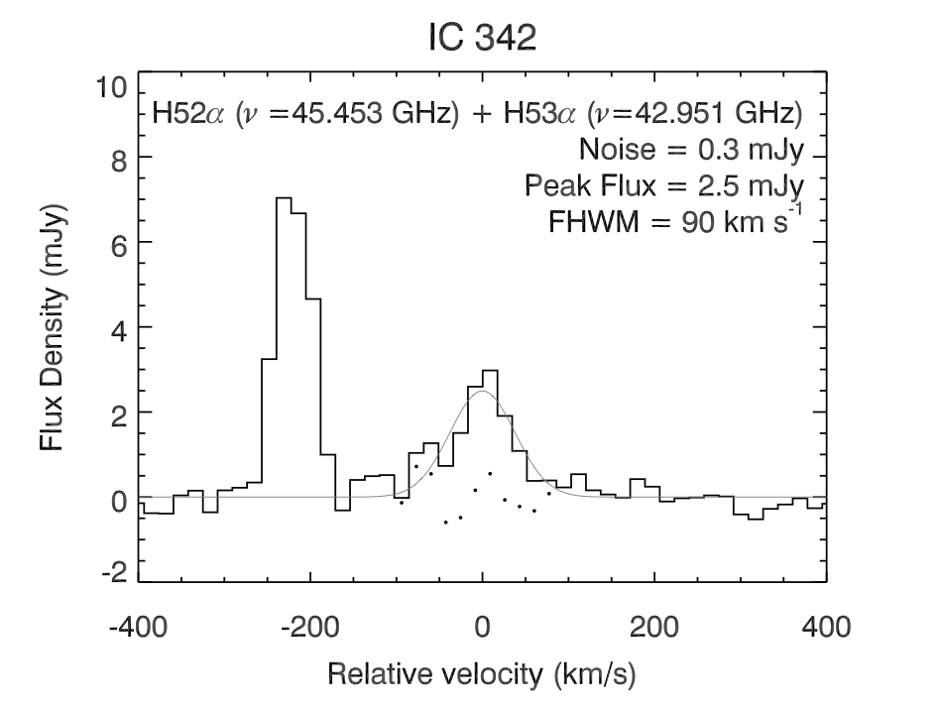
The sensitivity of the GBT allows us to detect fainter RRL sources.
IC 342
HC₃N
RRL
Credit & Copyright: T. Rector (U. Alaska Anchorage), H. Schweiker, WIYN, NOAO, AURA, NSF
Kepley et al. 2013 (in prep)

Slide 11
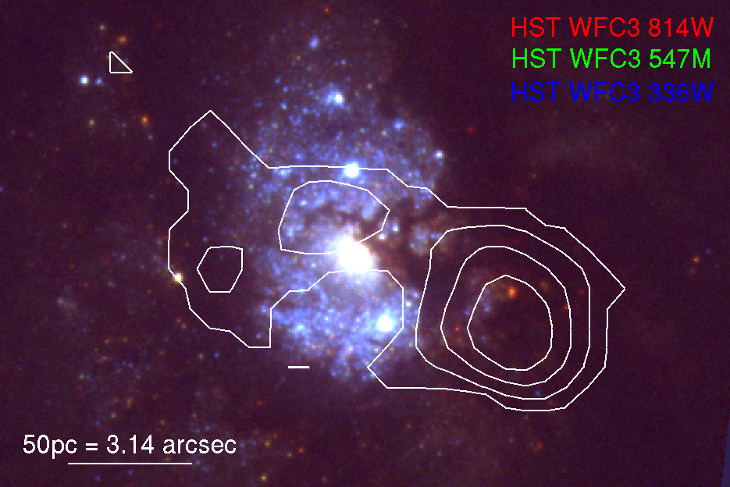
We followed up the GBT detection with higher resolution VLA observations.
Kepley et al. 2013 (in prep)

Slide 12
RRL models need non-LTE physics and radiative transfer.
Non-LTE Physics
Radiative Transfer
Line Flux
Free-free Flux Density
n_{e}
T_{e}
l
Compare to Line and Free-free Measurements
Notes:
Add something about better than just continuum…….know whether optically thin or thick
Need full radiative transfer equation – simulated emission (both internal and external to the region), spontaneous emission.
RRLs act like density filters – higher frequency lines tracer higher densities.

Slide 13
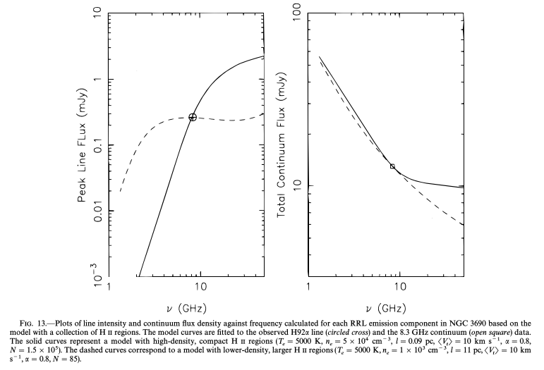
RRL observations at multiple frequencies are needed to derive the density and sizes.
Zhao+ 1997

Slide 14
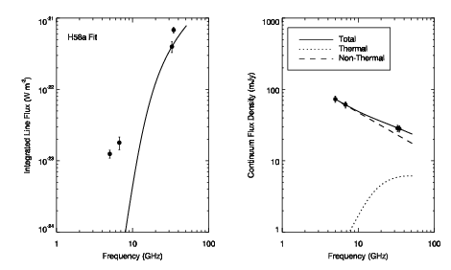
High frequency lines in IC 342 are best fit by small, high density HII regions.
T_{e} = 7500 K
N_{e} = 10⁵ cm⁻³
l = 0.1 pc
Kepley et al. 2013 (in prep)

Slide 15
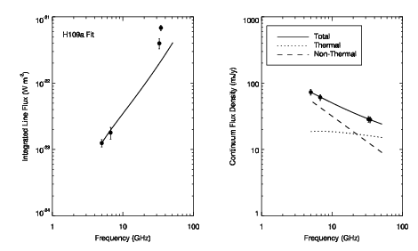
Low frequency lines in IC 342 are best fit by larger, lower density HII regions.
T_{e} = 7500 K
N_{e} = 3000 cm⁻³
l = 2 pc
Kepley et al. 2013 (in prep)

Slide 16
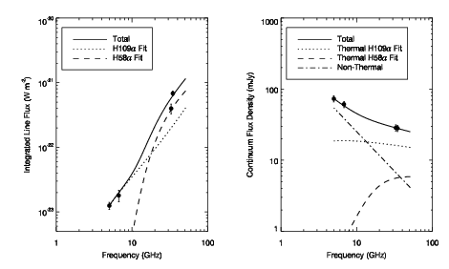
RRL emission from IC 342 is best fit by multiple density components.
T_{e} = 7500 K
N_{e} = 10⁵ cm⁻³
l = 0.13 pc
T_{e} = 7500 K
N_{e} = 3000 cm⁻³
l = 2 pc
Kepley et al. 2013 (in prep)

Slide 17
Molecular
Gas
Physics
Stars
David Frayer, Adam Leroy,
Josh Marvil, Antonio Usero

Slide 18
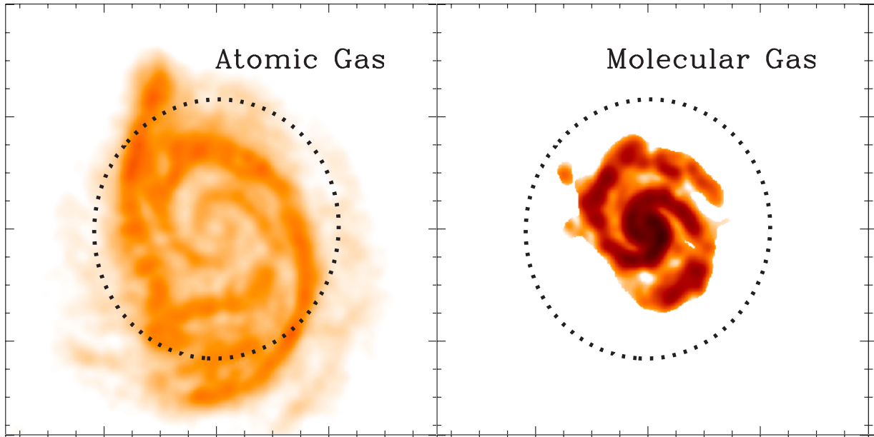
Most studies of star formation to date have used CO to trace the molecular gas.
Leroy+ 2008

Slide 19
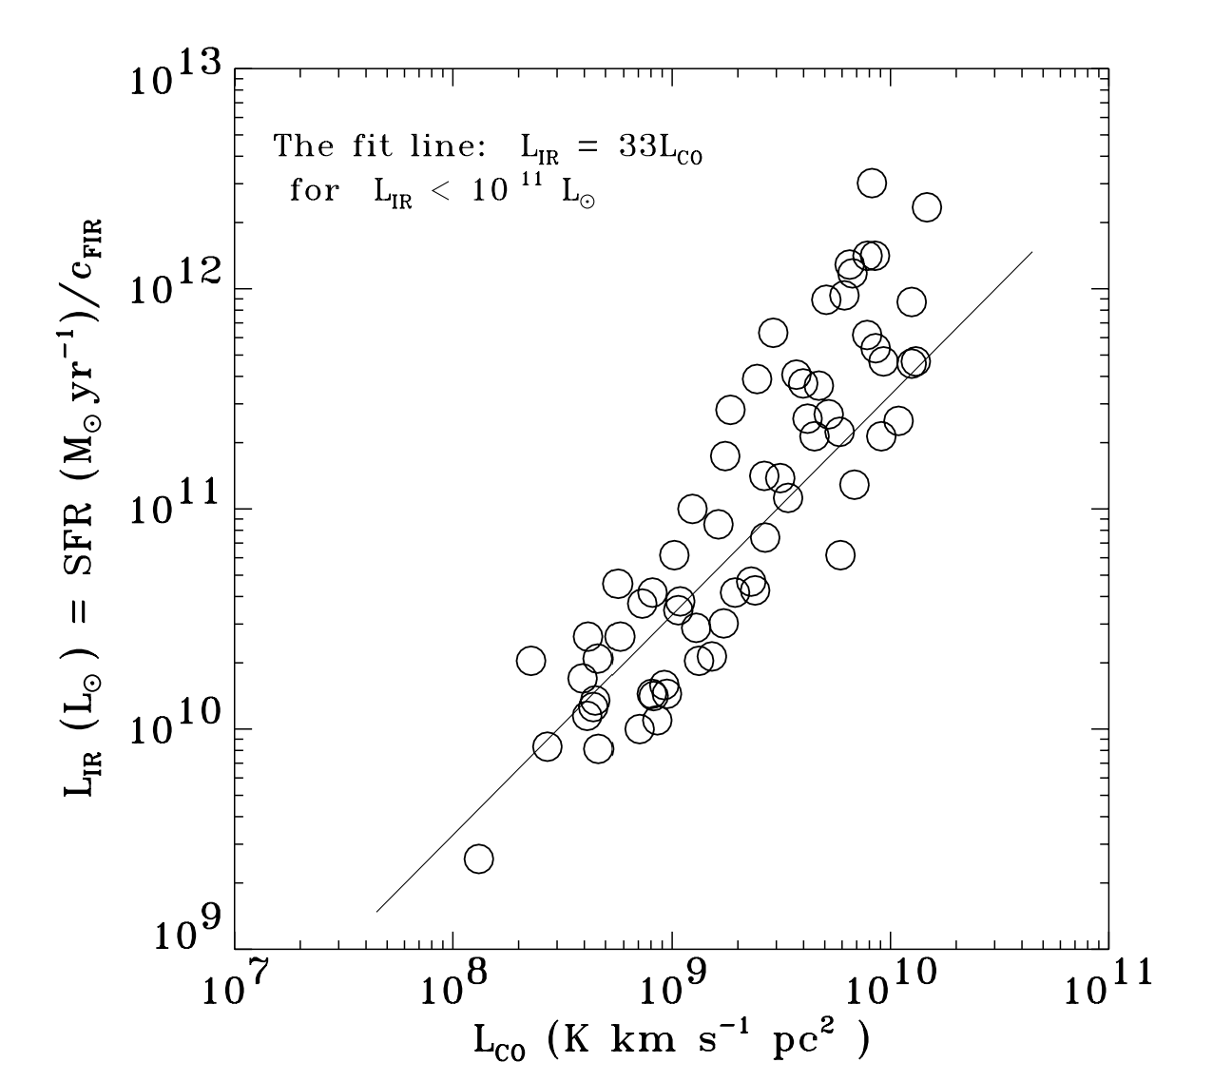
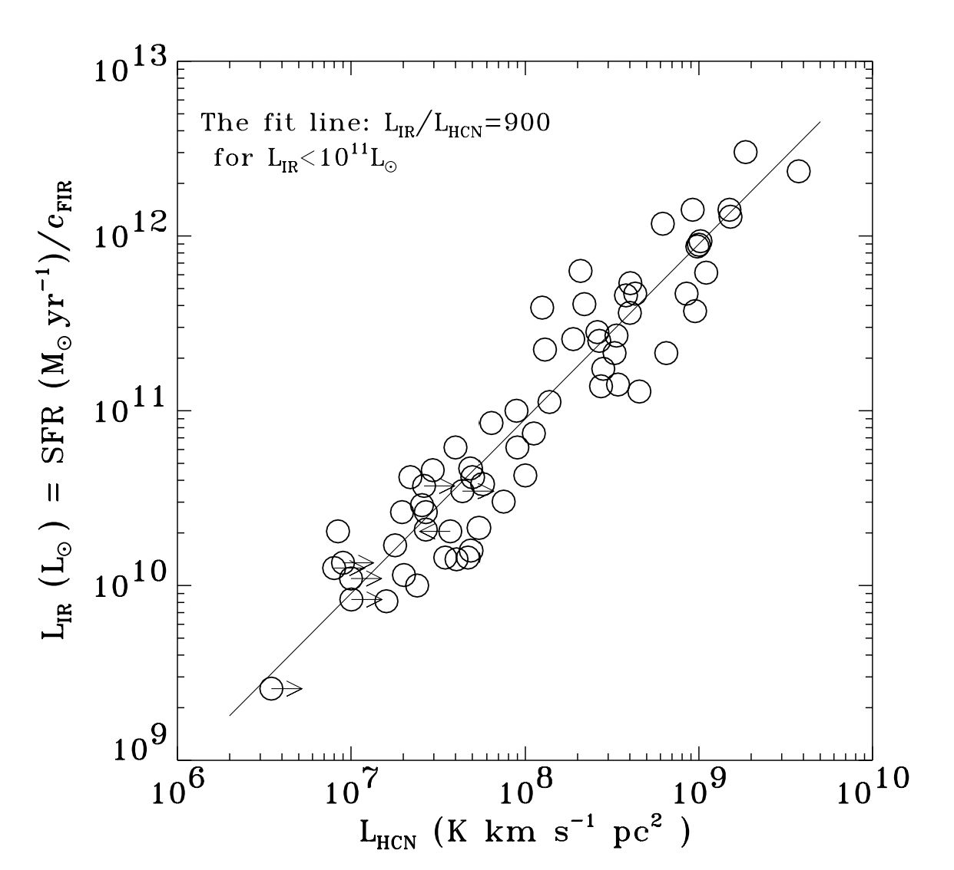
HCN may be better tracers of the dense molecular gas that forms stars.
Gao & Solomon (2004)
Gao & Solomon (2004)

Slide 20
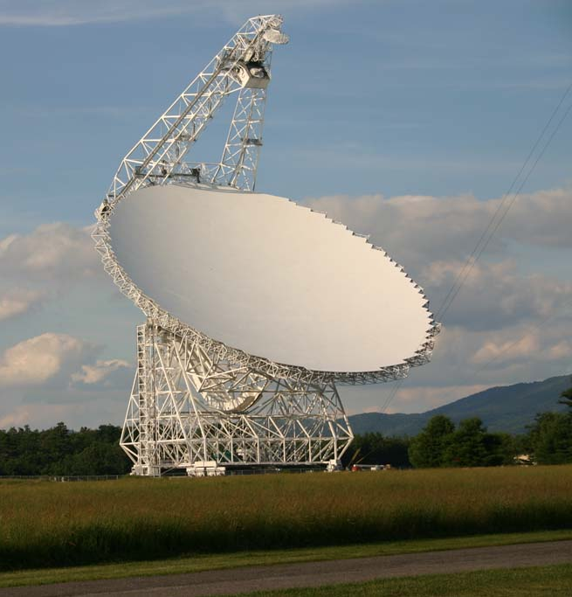
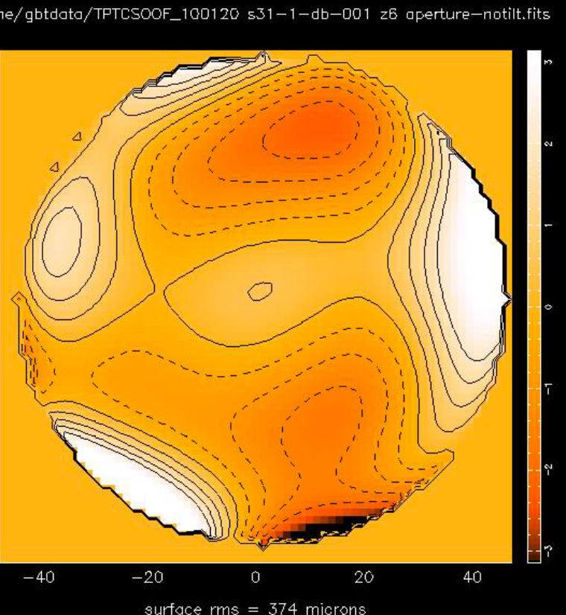
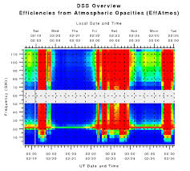
The GBT is an excellent 4mm telescope.
Notes:
100m is a lot of area
AUTOOOF
DSS

Slide 21
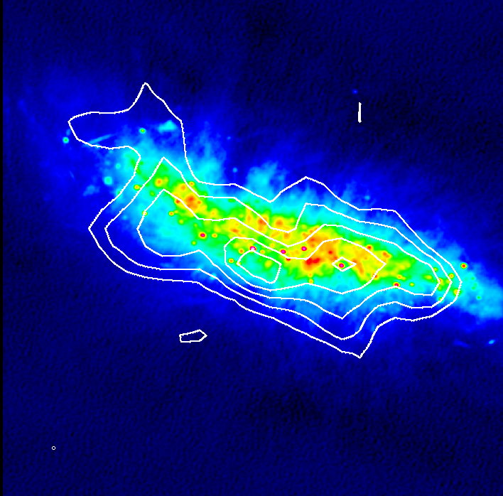
Initial observations show that GBT can produce excellent HCN maps of galaxies.
Color image: 6GHz radio continuum (Marvil+ 2013, in prep)
Kepley+ (2013, in prep)

Slide 22
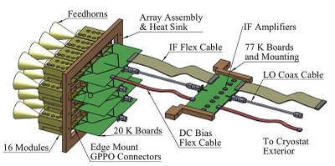
ARGUS (late 2014) will significantly increase the mapping speed of the GBT.
Argus is a collaboration between Stanford (PI Sarah Church), Caltech, JPL, Univ. Maryland, Univ. Miami, and NRAO.

Slide 23
Molecular
Gas
Physics
Stars

Slide 24
Lastest generation of radio telescope are driving studies of star formation in extreme galactic environments.
The ionized gas in the center of IC 342 has multiple density components including a significant component with a density comparable to ultracompact HII regions.
The capabilities of the GBT make resolved studies of the very dense, star-forming gas in galaxies possible.

Slide 25
akepley@nrao.edu

Slide 27
Radio recombination lines are more powerful than free-free emission.
 | Free-free | Radio Recombination Lines
Number of ionizing photons | ✔ | ✔
Density | RMS density through the emission measure | ✔
Filling Factor | ✗ | ✔
Kinematics | ✗ | ✔

Slide 28
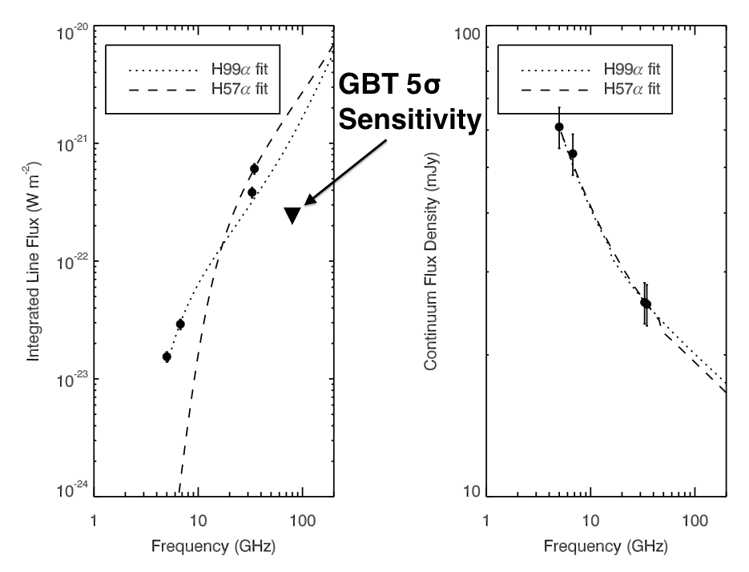
Initial models of the center of IC 342 suggest that multiple density components are present.
Kepley+ 2013 ( in prep)

