Slide 1
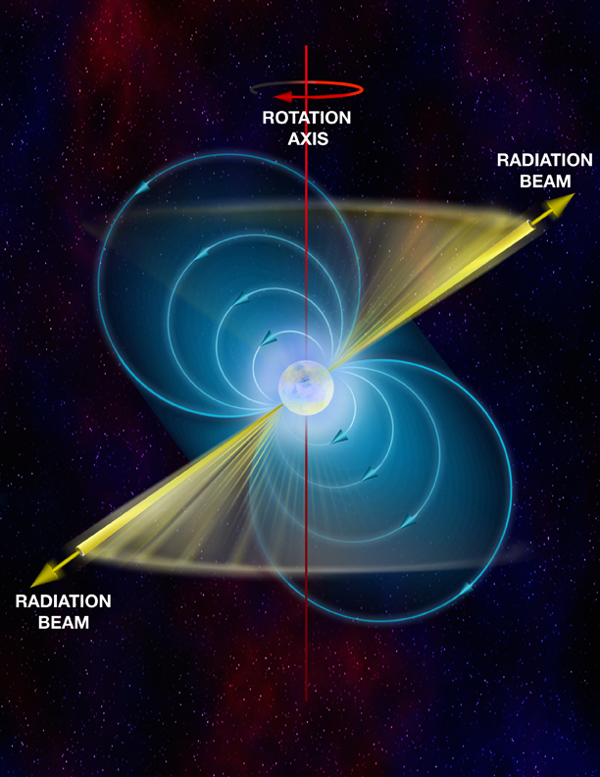
PulsaR Exploration and Search TOolkit
@GPU
Jintao Luo
NRAO-CV
CREDIT: Bill Saxton, NRAO/AUI/NSF

Slide 2
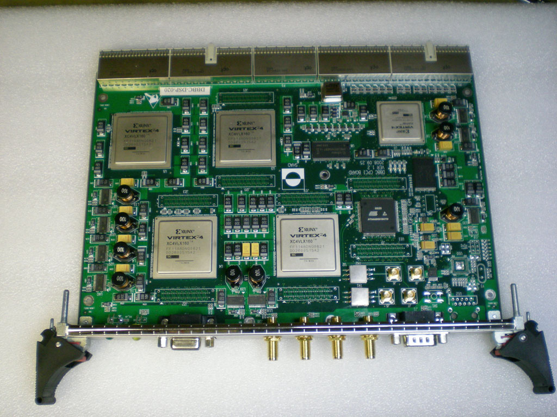
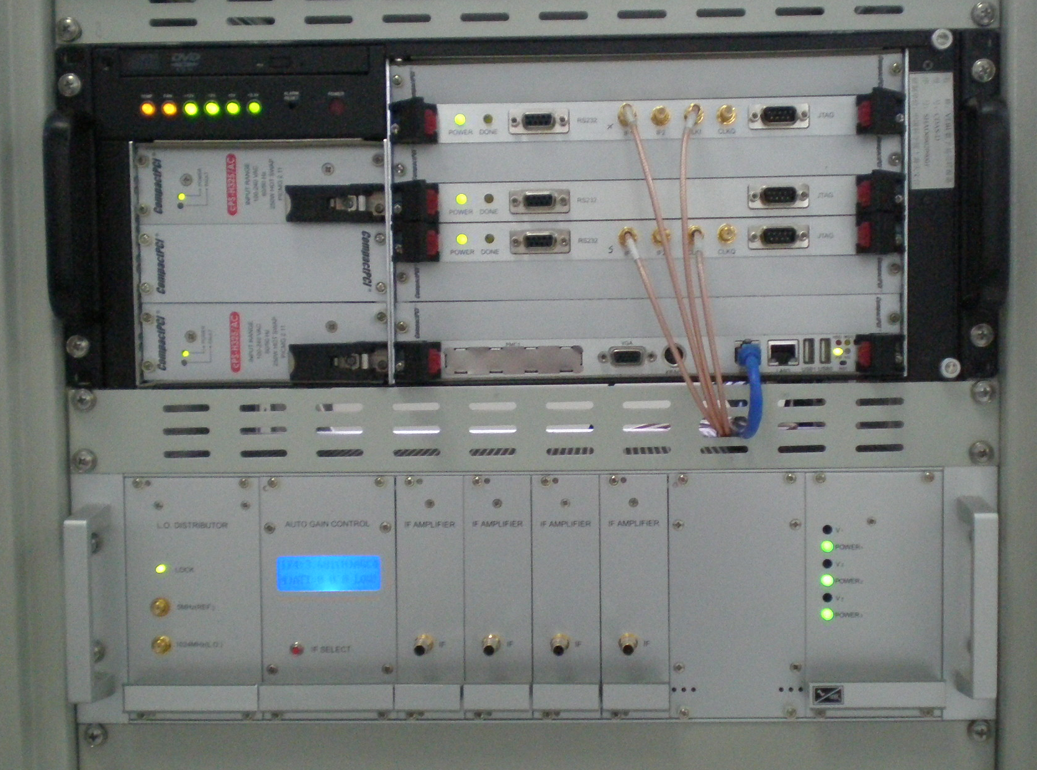
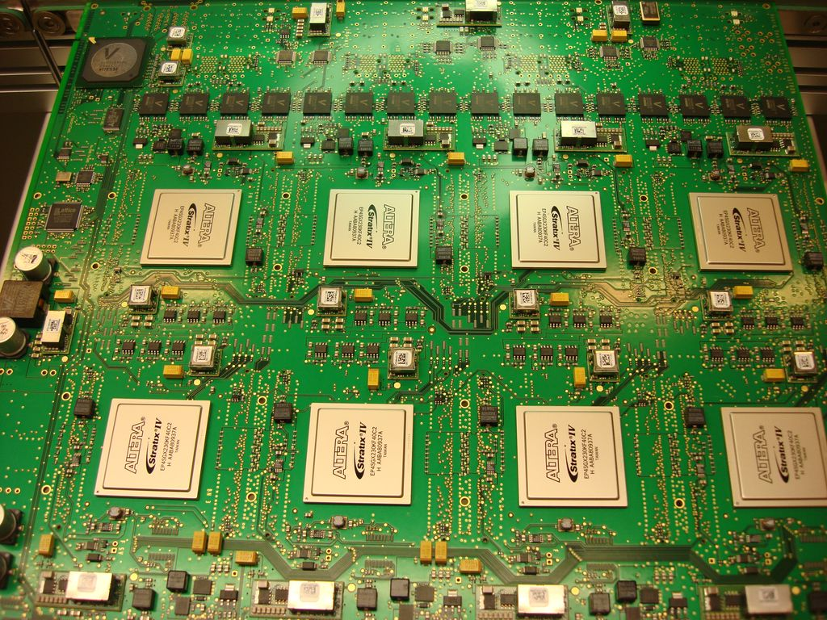
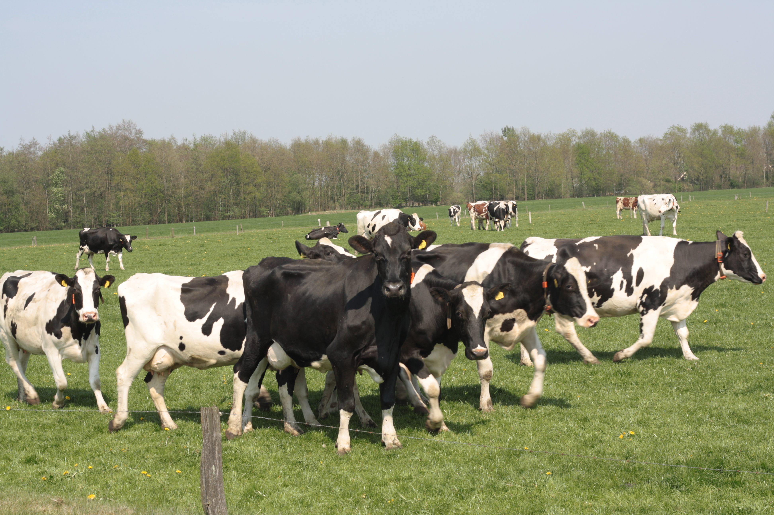
A newbie
NRAO: NANOGrav, mainly on pulsar instrument
SHAO(Shanghai Astronomical Observatory), China: VLBI backend, correlator, observations, Pulsar instrument
JIVE(Joint Institute for VLBI in Europe), Netherlands: VLBI correlator, Pulsar instrument

Slide 3
Outline
Pulsar
PRESTO
GPU
PRESTO@GPU
Future Work

Slide 4
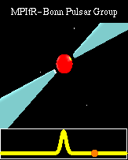
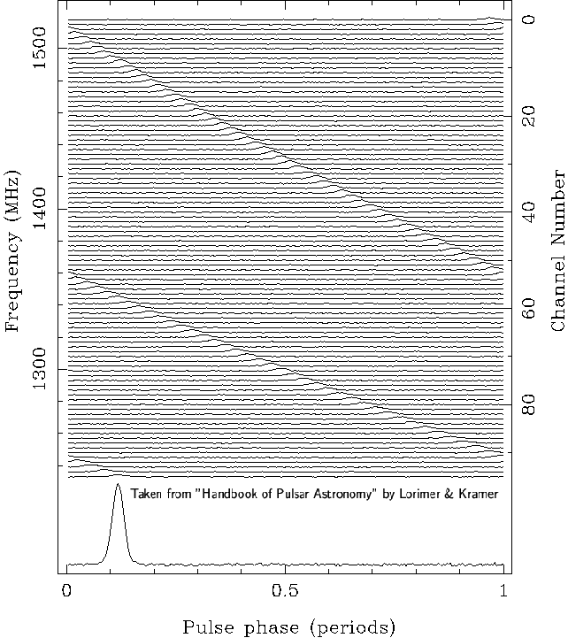
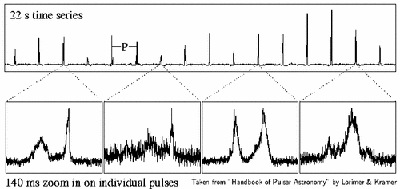
Pulsar
Spinning neutron star
Precise period
Dispersion
Stable integrated profile
Weak signals
Time keeping, navigation, measure gravitational wave(NANOGrav)

Slide 5
PRESTO
PulsaR Exploration and Search TOolkit
Developed by Scott Ransom
A large suite of pulsar search and analysis software
One of the best pulsar searching software in the world
http://www.cv.nrao.edu/~sransom/presto/
200+ pulsars found with PRESTO
Including the fastest pulsar ever found, PSR J1748-2446ad, 716-Hz spin frequency

Slide 6
(From PRESTO_search_tutorial)

Slide 7
Data preparation
Interference detection and removal, de-dispersion, barycentering
Searching
Fourier-domain acceleration, single-pulse, and phase-modulation or sideband searches
Folding
Candidate optimization, Time-of-Arrival generation
Misc
Data exploration, de-dispersion palnning, data conversion…
My work is to speep up the Fourier-Domain acceleration search: accelsearch with GPU
And, why GPU?
GPU is powerful!

Slide 8
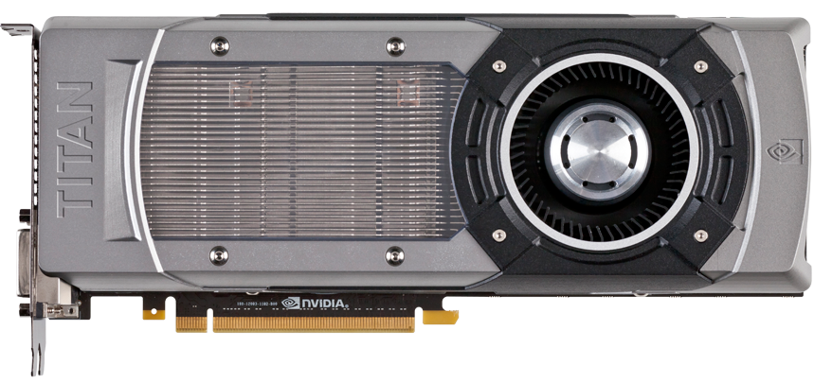
GPU
Graphics Processing Unit
chip in computer video cards, PlayStation3, Xbox, etc.
Two major vendors: NVIDIA, ATI(now AMD)
GPUs are massively multithreaded many core chips
(From www.geforce.com)

Slide 9
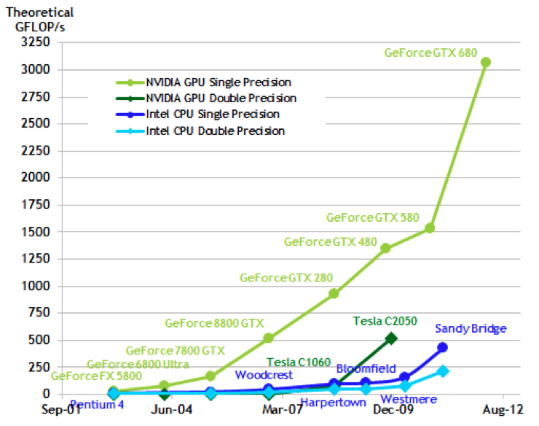
(From NVIDIA CUDA_C_Programmig_Guide)

Slide 10
GPU Capabilities
(From NVIDIA CUDA_C_Programmig_Guide)
GPU is specialized for compute-intensive, highly parallel computation
GPU devotes more transistors to data processing

Slide 11
PRESTO@GPU
Core computation: FFT_MUL_IFFT
Data
FFT
IFFT
Kernel_0
Kernel_1
FFT
Kernel_n-1

Slide 12
Diagram of the realization
Data & Kernel preparation
(On CPU)
Copy to GPU Mem
Mem copy operations are time consuming
Run FFT_Mul_IFFT
Combination
(On GPU)
Copy to CPU Mem
Following process
(On CPU, plan to partly on GPU)

Slide 13
Testbench: GPU vs CPU(without mem copy)
~100X
CPU runtime
GPU runtime

Slide 14
Accel_search: GPU vs CPU(whole program with mem copy)
With almost the heaviest duty in practical use
GPU version run time: 18.15sec
CPU version run time: 60.18sec
Just 3 times faster
We want ~20X
How to?

Slide 15
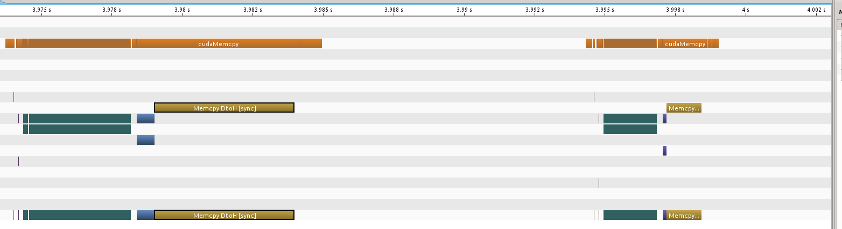
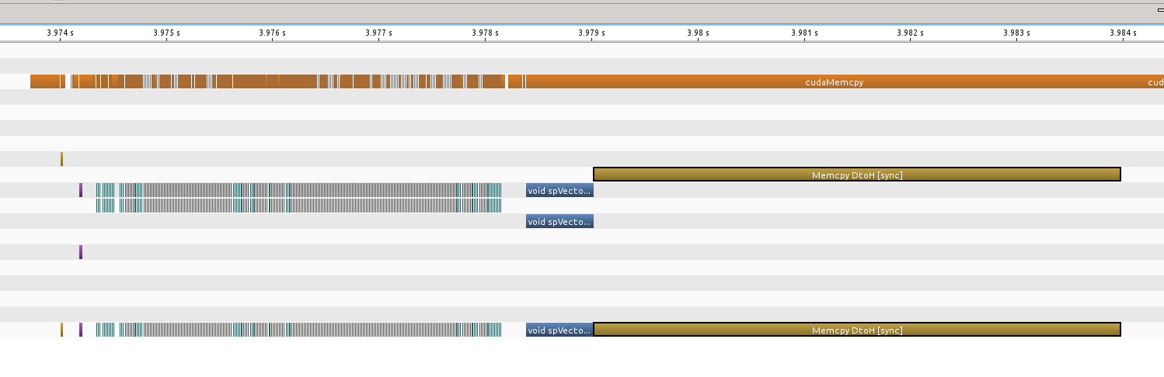
There are possibilities!
1. Mem copy
2. Following process on CPU
3. Loops of Mul on GPU

Slide 16
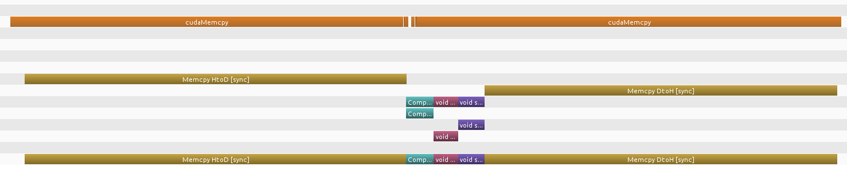
An improvement
Mul
IFFT
Run time of Mul has been reduced, via using no loop
The same level of FFT run time

Slide 17
Future work: faster
Mem copy
Reduce number of mem copy operations
Following processes
Move more processes to GPU
Mul loops
Use only one loop
Using texture mem of GPU, etc

Slide 18
Summary
PRESTO has been made faster @GPU, not fast enough
Could be even faster, ~20X
Using FPGA, RoachBoard for example?...

