Slide 1
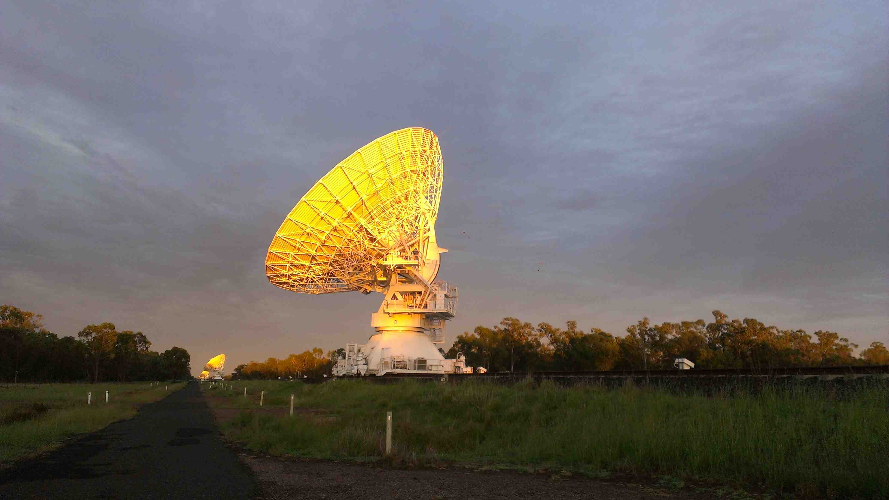
Star-formation in a Transitioning Radio Source
Minnie Y. Mao (NRAO)
Ray Norris (ATNF)
Rob Sharp (AAO)
Bjorn Emonts (ATNF)
Jamie Stevens (ATNF)
Juergen Ott (NRAO)

Slide 2
F00183-7111 is a Ultra-Luminous Infrared Galaxy that has a big AGN in its core that appears to be dominating the total infrared luminosity, which is surprising as ULIRGs are classically thought to be dominated by star-formation …
Minnie Y. Mao (NRAO)
Ray Norris (ATNF)
Rob Sharp (AAO)
Bjorn Emonts (ATNF)
Jamie Stevens (ATNF)
Juergen Ott (NRAO)

Slide 3
F00183-7111 is so awesome!
Minnie Y. Mao (NRAO)
Ray Norris (ATNF)
Rob Sharp (AAO)
Bjorn Emonts (ATNF)
Jamie Stevens (ATNF)
Juergen Ott (NRAO)

Slide 4
Why this is interesting
IRAS F00183-7111 is one of the most extreme Ultra Luminous Luminous Infrared Galaxies (ULIRGs) known
ULIRGs are believed to represent a transitional stage towards the formation of dusty quasars (e.g. Armus, Heckman & Miley 1987)
Understanding the nature of ULIRGs is thus critical to understanding the evolution of galaxies
Especially when they’re relatively close like F00183… (z = 0.3276)
F00183 appears to have been caught just as it’s transitioning to quasar-mode (Norris et al. 2012)
Debates have raged over whether ULIRGs are predominately powered by star-formation (e.g. Genzel et al. 1998) or AGN (e.g. Sanders 1999)
Let’s find out…

Slide 5
It helped that the source is dec = -71 degrees so I had to go home for the observations…

Slide 6
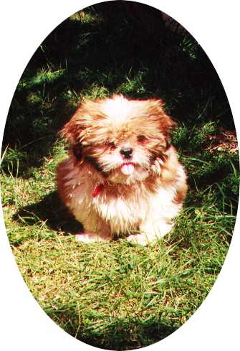
… I got to see my dog, a snake and my favourite telescope…

Slide 7
ULIRG: What’s in a name? A nose by any other name would still smell… – Reduced Shakespeare Company
Ultra → Very; extremely
Luminous → Full of or shedding light; bright or shining, esp. in the dark
Infrared → Having a wavelength just greater than that of the red end of the visible light spectrum but less than that of microwaves. Infrared radiation has a wavelength from about 800 nm to 1 mm, and is emitted particularly by heated objects
Galaxy → A system of millions or billions of stars, together with gas and dust, held together by gravitational attraction

Slide 8

ULIRG: What’s in a name? A nose by any other name would still smell… – Reduced Shakespeare Company
A system of millions or billions of stars, together with gas and dust, held together by gravitational attraction that is extremely full of or shedding light that has a wavelength just greater than that of the red end of the visible light spectrum but less than that of microwaves…
IR emission → dusty! – hot dust may be attributed to the UV emission from young hot OB stars, which is being absorbed by the dust and reradiated…
ULIRGs are galaxies that are extremely star-bursty?

Slide 9
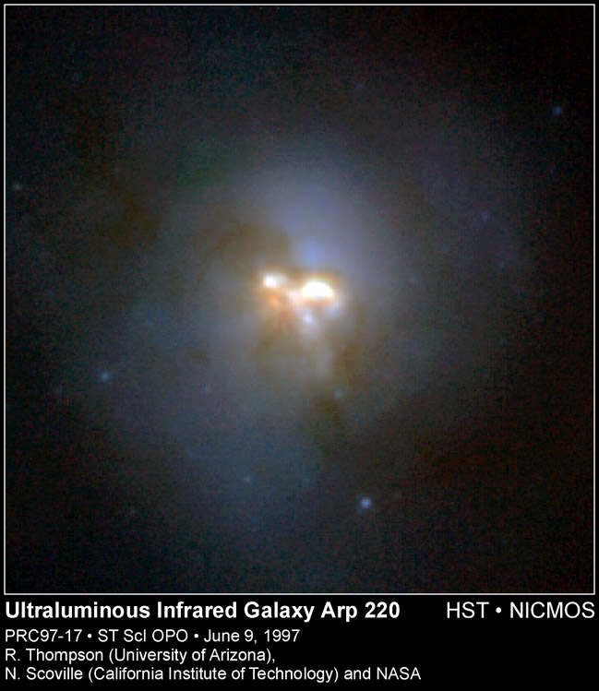
ULIRGs
Ultra Luminous InfraRed Galaxies
Extremely Luminous FIR sources (ELFs)
Classically defined as L_{IR} > 10¹²L
ULIRGs were first discovered by IRAS almost 30 years ago (Aaronson & Olszewski 1984)
ULIRGs are believed to be predominately powered by star-formation, but may have a significant contribution by AGN (e.g. Lonsdale 2006)
The closest ULIRG to us is Arp 220 (z = 0.018)

Slide 10
ULIRGs
Current observations suggest that ULIRGs are formed as a result of the merger of two gas-rich spirals (Sanders et al. 1988)
The merger scenario for ULIRGs triggers “cold-mode” accretion onto the central black hole
The dusty, gas-rich spiral galaxies feed the black hole resulting in its rapid growth
This leads to powerful quasar winds that quench star-formation (e.g. Hopkins et al. 2008), which drives the black hole’s fuel away thus starving both the AGN and the star-formation
The AGN now accretes hot gas inefficiently resulting in “hot-mode” accretion

Slide 11
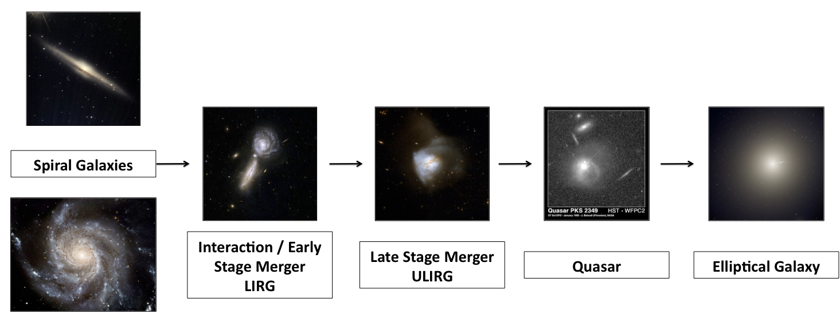
ULIRGs
Image credit: CANDELS
ULIRGs are believed to be an evolutionary stage of the classic double-lobed radio galaxies we see in the local Universe!

Slide 12
IRAS F00183-7111
F00183 is one of the most luminous sources discovered by IRAS!
z = 0.3276 (Roy & Norris 1997)
S_{70μm} = 1.5 Jy
L_{8-1000μm} = 9 x 10¹² L (Spoon et al. 2009)
L_{4.8GHz} = 3 x 10²⁵ W/Hz (Roy & Norris 1997)
Radio-loud ULIRG!

Slide 13
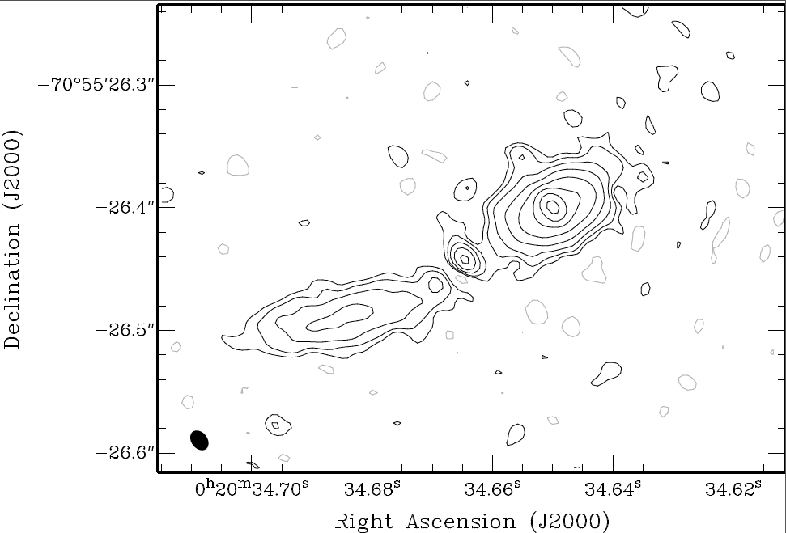
IRAS F00183-7111
One of the best ways of distinguishing between star-formation and AGN is the use of VLBI.
Recently, Norris et al (2012) detected F00183 at 2.3 GHz using the LBA
The LBA image displays a classical core-jet morphology
The morphology and spectral index are both consistent with Compact Steep Spectrum (CSS) sources (O’Dea 1998)
CSS sources are widely thought to represent an early stage of evolution of radio galaxies (e.g. Randall et al. 2011)
Image: Figure 1 from Norris et al. 2012. Naturally weighted 2.3 GHz LBA image of F00183. The peak flux is 45 mJy/beam and the source has a total integrated flux of 178 mJy.

Slide 14
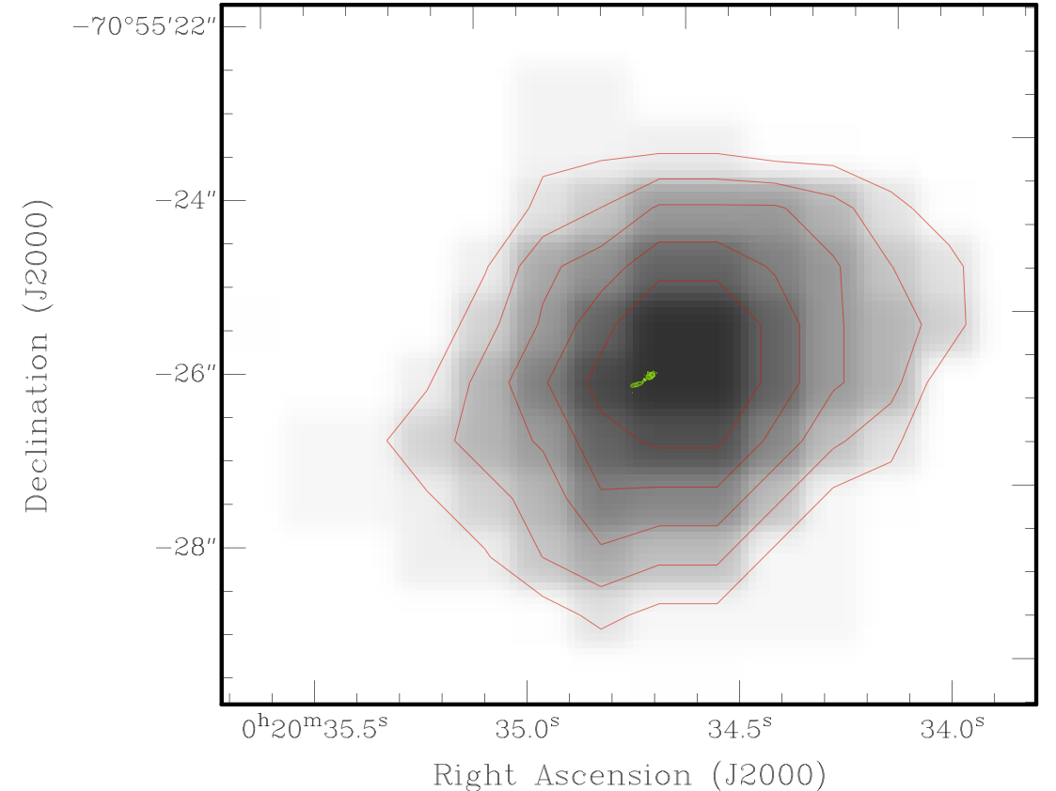
IRAS F00183-7111
F00183 is believed to have been caught in the brief transition period between merging starburst and radio-loud “quasar-mode” accretion (Norris et al. 2012)
Image: Figure 3 from Norris et al. 2012. UKST R-band image of F00183. The green contours show the location of the LBA detection

Slide 15
A quasar has turned on! But it’s a ULIRG so let’s look for the star-formation…

Slide 16
CO(1-0)
Molecular hydrogen (H2) is a key ingredient to forming stars
However, unless shocked or heated to very high temperatures, H₂ is very difficult to see due to its strongly forbidden rotational transitions
H₂ may be traced by carbon monoxide (CO), which emits strong rotational transition lines that occur primarily through collisions with H₂.
CO traces the star-formation and is NOT contaminated by the presence of AGN
At z = 0.3276, CO(1-0) is redshifted into the 3mm observing band on the Australia Telescope Compact Array.

Slide 17
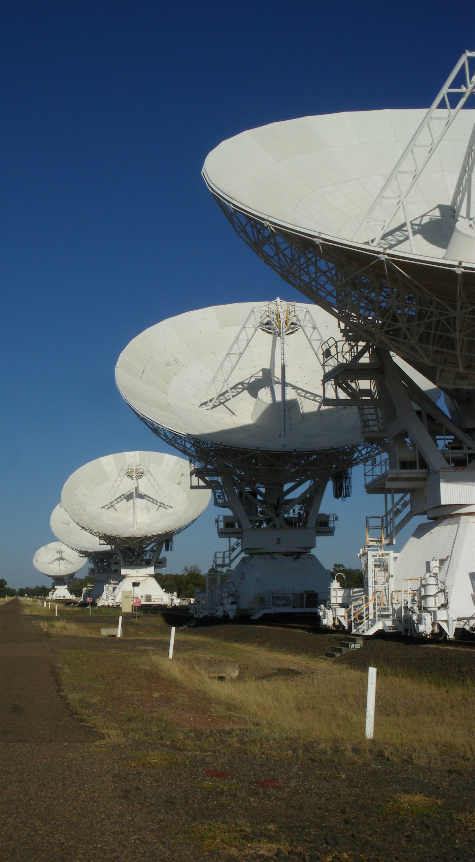
ATCA
Australia Telescope Compact Array
Located in Narrabri, NSW (~6h drive from Sydney)
6 x 22m antennas
6km maximum baseline
Operates from 1GHz to 106GHz in 5 discrete bands (~3mm – 30cm)
In 2009, ATCA was upgraded with the Compact Array Broadband Backend (CABB)
Operated by the CSIRO Astronomy and Space Science (CASS) division and is part of the Australia Telescope National Facility (ATNF)

Slide 18
CABB
Compact Array Broadband Backend
Wilson et al. (2011)
Pre-CABB instantaneous bandwidth: 2 x 128MHz
CABB instantaneous bandwidth: 2 x 2GHz (full Stokes)
16-fold increased in bandwidth! → 4-fold increase in continuum sensitivity
CABB’s increased sensitivity has substantially advanced the science capabilities of the ATCA!

Slide 19
CO(1-0) in F00183
Measuring the reservoir of molecular gas in F00183 will enable us to estimate the contribution by star-formation of the overall energy budget without contamination of AGN
If all the IR luminosity were due to star-formation we would expect an extremely strong CO(1-0) detection…

Slide 20
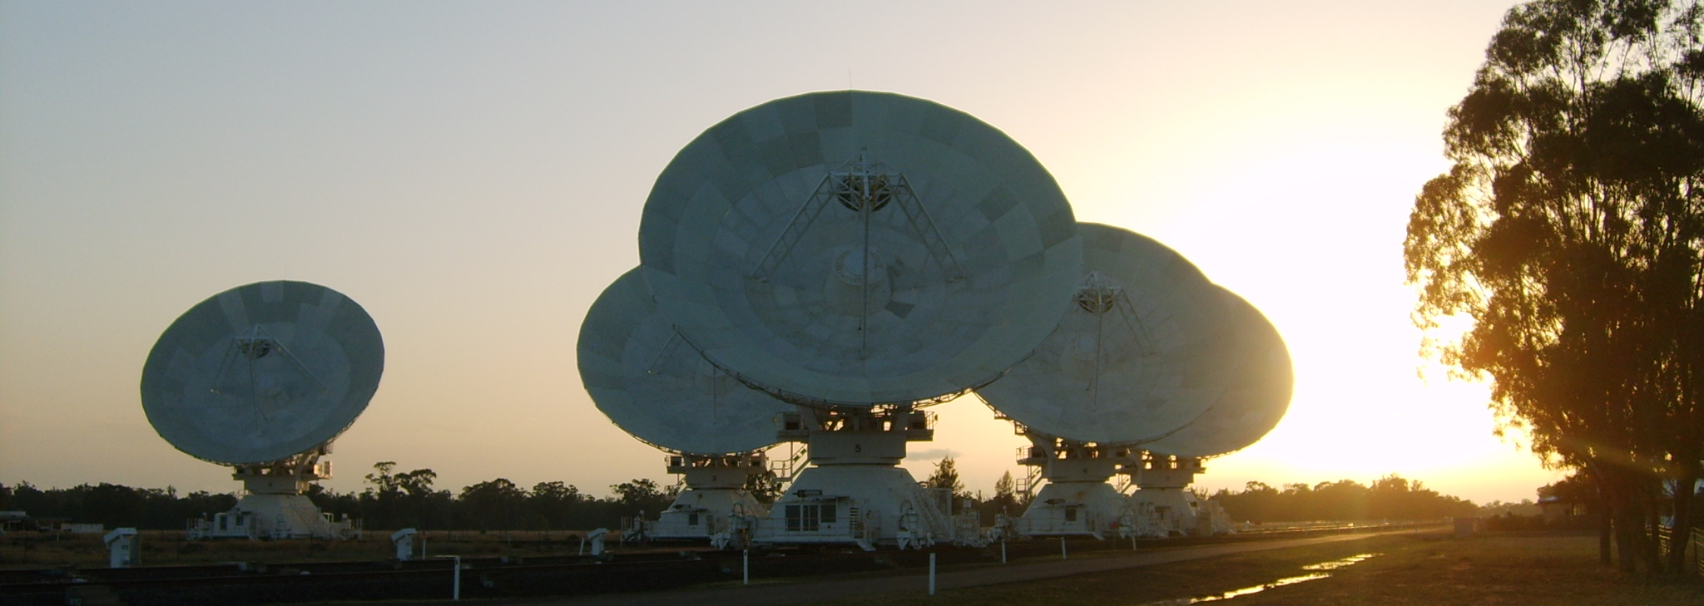
CO(1-0) in F00183
4 x 12h in H75 (PI: Norris)
October 2011
7.4 arcsec spatial res
2 x 2 GHz, 1 MHz resolution → ~3.5km/s
Observing frequency: 115.271/(1+z) = 86.8 GHz
Effective on source time ~25h

Slide 21
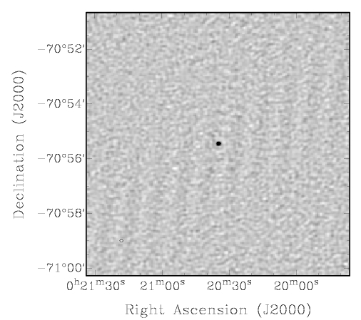
CO(1-0) in F00183

Slide 22
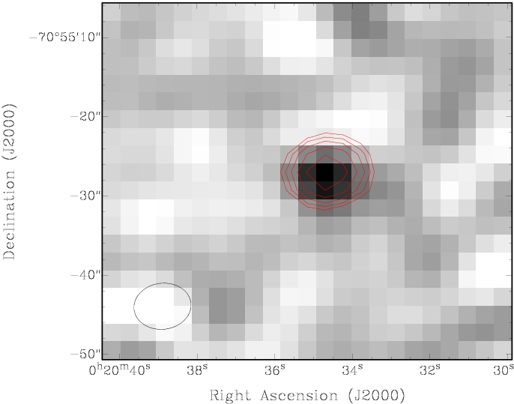
CO(1-0) in F00183

Slide 23
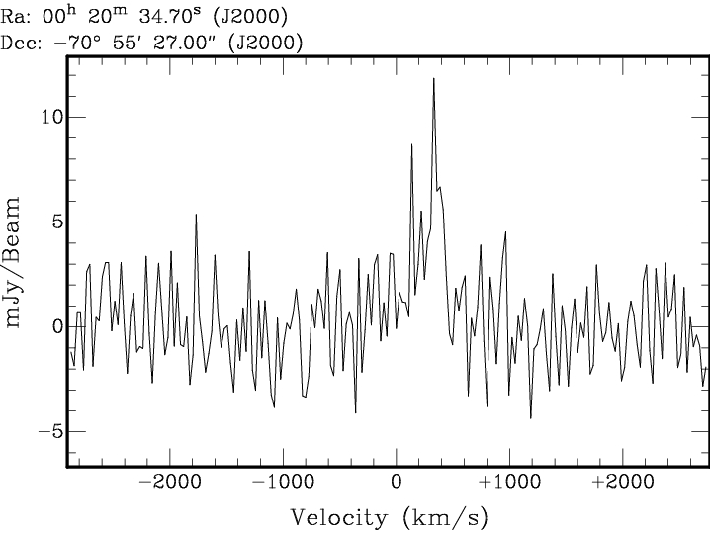
CO(1-0) in F00183

Slide 24
Let’s fit a Gaussian!

Slide 25
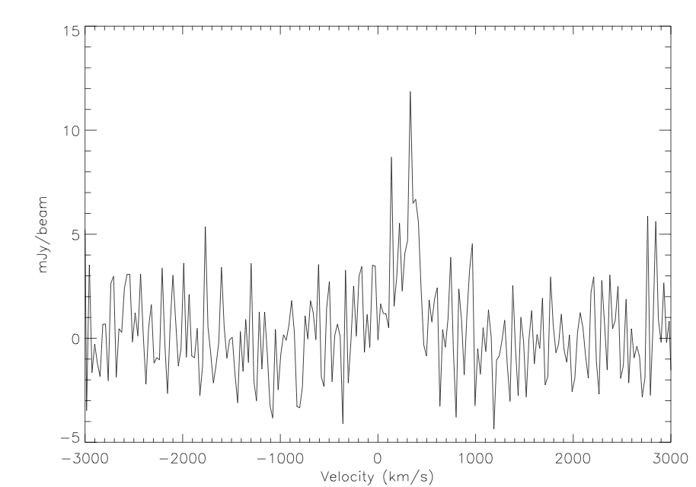
CO(1-0) in F00183

Slide 26
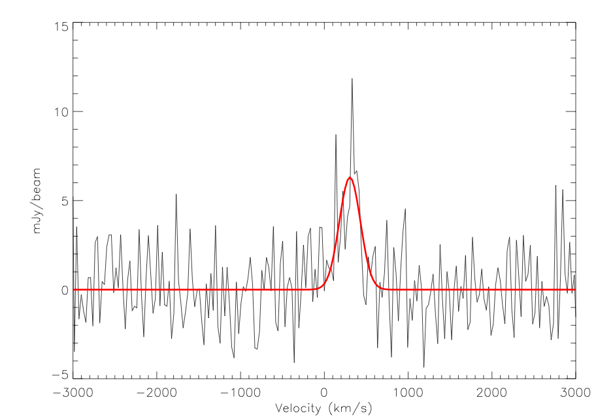
CO(1-0) in F00183

Slide 27
CO(1-0) in F00183
Peak: 6.3 mJy / beam
Velocity shift: 305 km/s
FWHM: 297 km/s

Slide 28
CO(1-0) in F00183
Spatially unresolved
L’_{CO} = 1.25 x 10¹⁰ K km/s pc²
M_{H2} = 1 x 10¹⁰ M (α_{X} = 0.8 M, Downes & Solomon 1998)
Implies SFR ~220 M/year (e.g. Carilli & Walter 2013)
Notes:
Conversion factor for ULIRGs

Slide 29
Huge-normous star-formation?
L_{8-1000μm} = 9 x 10¹² L (Spoon et al. 2009)
If powered solely by star-formation this would imply a SFR of ~1600 M/year!
L_{2-10keV} ~ 2 x 10⁴⁴ erg/s (Nandra & Iwasawa 2007)
If powered solely by star-formation this would imply a SFR of >12000 M/year!

Slide 30
But there’s a whopping great AGN…
Norris et al. (2012) find a 10²⁵ W/Hz AGN core
Nandra & Iwasawa (2007) calculate that the AGN contributes >80% of the total IR luminosity
Ranalli et al. (2003) infer the SFR from the soft X-ray luminosity to be 310 M/year
Spoon et al. (2004) find that star-formation contributes only up to 30% of the total IR luminosity…

Slide 31
Consistent-ish SFRs
Despite the extremely high infrared luminosity, near and mid-IR diagnostics suggest that no more than 30% is due to star-formation
<30% of 9 x 10¹² L =~<3 x 10¹² L → SFR ~<540 M/year
Recall that this is an upper limit
X-ray diagnostics suggest the SFR is ~310 M/year
The CO luminosity we derive from our ATCA observations suggest the SFR is 220 M/year
F00183 is still very star-bursty but no longer super insanely so…

Slide 32
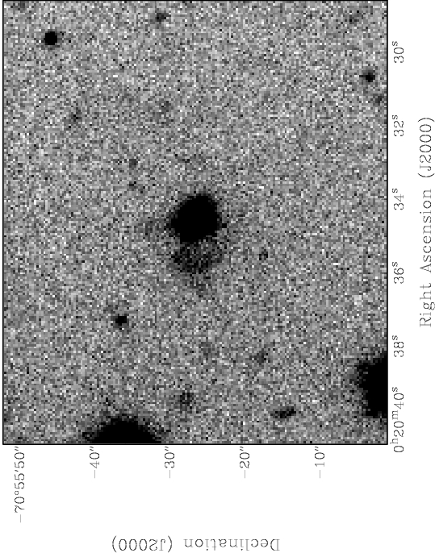
Meanwhile, we got a better optical image

Slide 33
Meanwhile, we got a better optical image
What is this?

Slide 34
Meanwhile, we got a better optical image
Is there star-formation here?

Slide 35
Radio Continuum from Star-Formation
We know that the radio emission from the AGN will be unresolved with the 6km ATCA
Thus any detection of resolved structure will be tracing star-formation

Slide 36
Radio Continuum from Star-Formation
If we assume ~30% of the IR luminosity is due to star-formation, then using the FIR/radio correlation we can guesstimate the amount of star-formation we would expect to see in the radio
S_{70μm} = 1.5 Jy → ~0.5Jy from star-formation
Using q70 = 2.15 (Appleton et al. 2004), we would then expect to detect 3.5mJy at 1.4GHz
α = -0.97 between 1.4 and 8.6GHz (Drake et al. 2004)
Expect to detect ~600uJy at 9GHz due to star-formation

Slide 37
Radio Continuum from Star-Formation
3 x 12h in 6A
2 x 2 GHz centred at 6 and 9.5GHz
~1 arcsec resolution
~10 beams across the source
Requires sensitive, high dynamic range imaging to combat the bright AGN core!

Slide 38
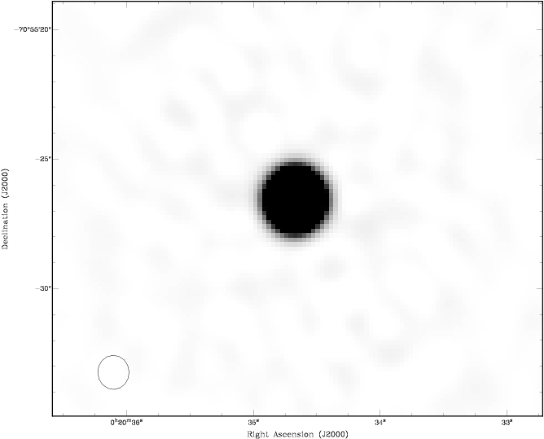
6GHz

Slide 39

9.5GHz

Slide 40
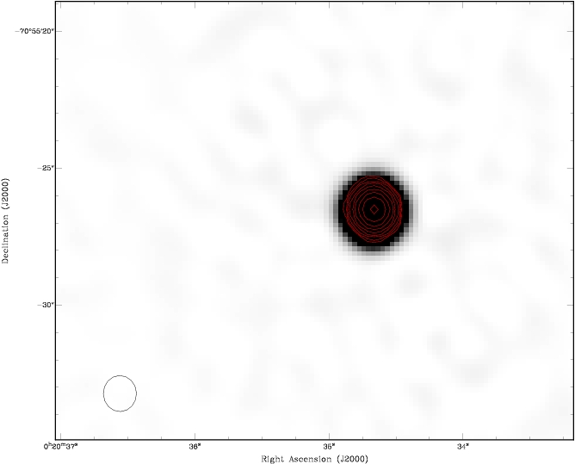
6GHz overlaid with 9.5GHz contours

Slide 41
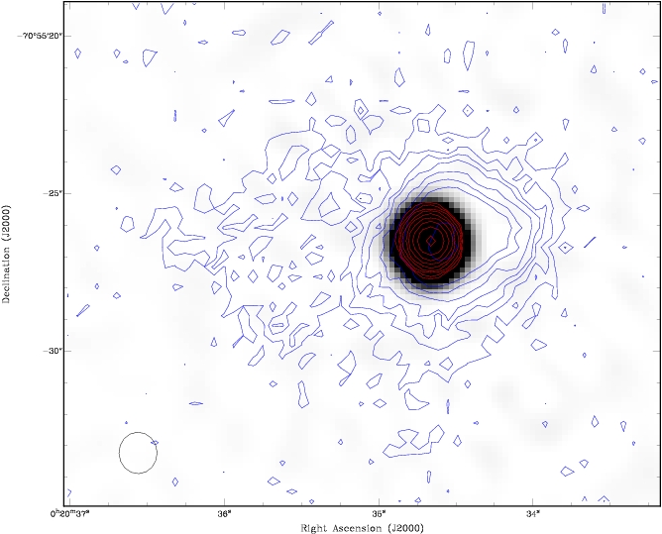
6GHz overlaid with 9.5GHz and optical contours

Slide 42
6GHz overlaid with 9.5GHz and optical contours

Slide 43
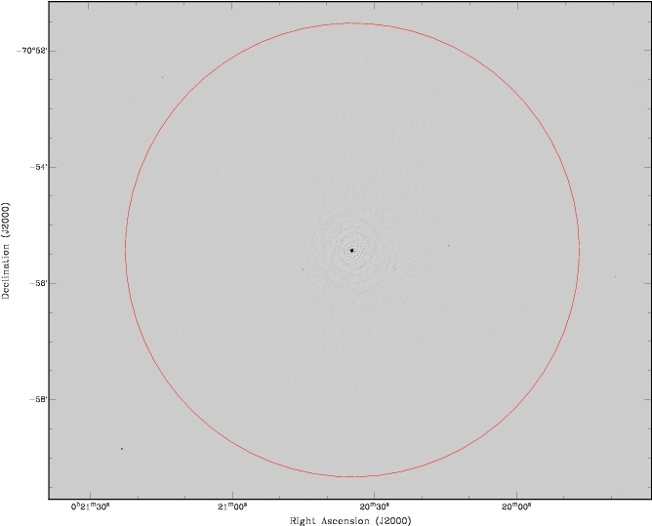
6GHz

Slide 44
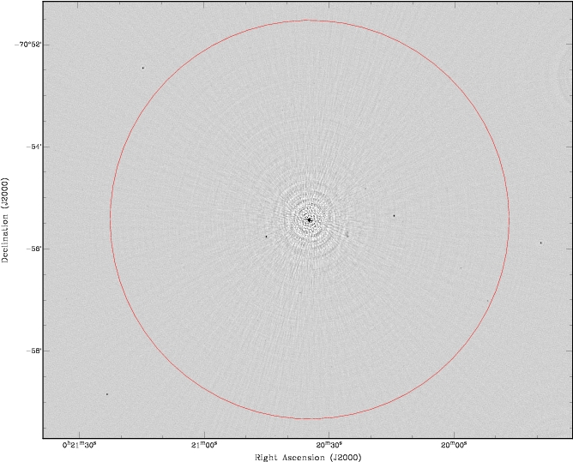
6GHz

Slide 45
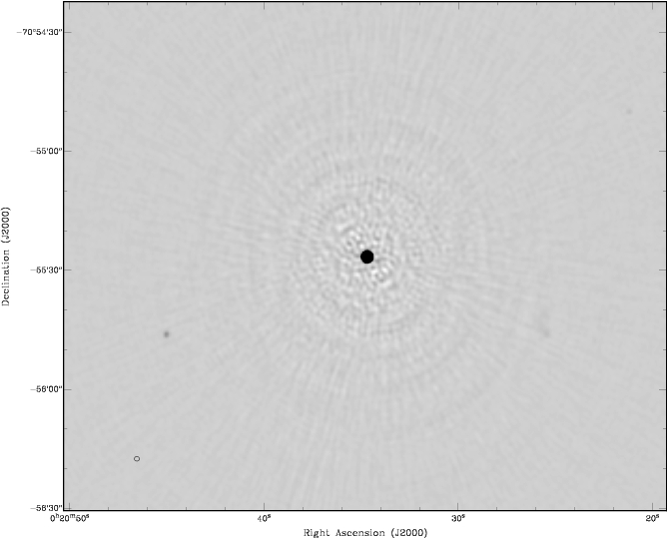
6GHz

Slide 46
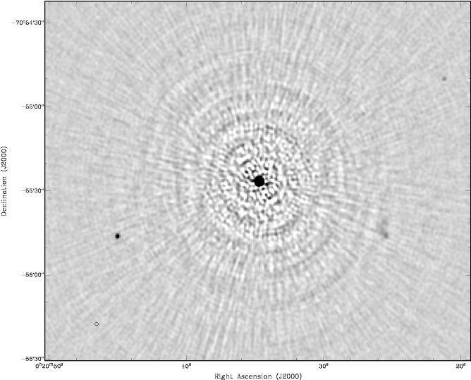
6GHz

Slide 47
The final 6GHz image had a dynamic range of ~17000, but there are still artefacts around the central source!

Slide 48
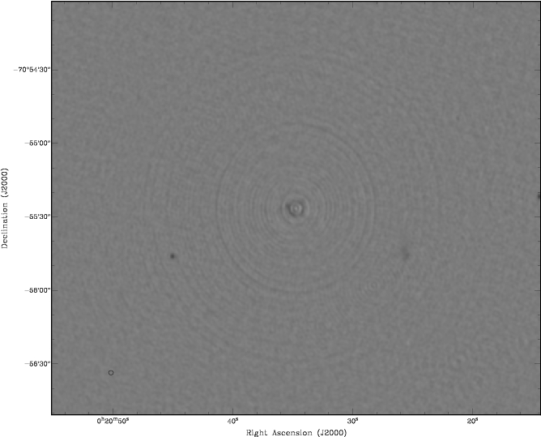
Focus issues and high dynamic range
After much angst and expert advice, the current prognosis by ATCA staff is that this is due to the 4cm receiver positions not being well known and hence the radio images are ‘out of focus’
This project was the first project to use the full array with the 4cm system – since then the focus positions have been refined

Slide 50
Radio Continuum from Star-Formation
We do not detect any evidence for star-formation in the extension seen in the optical image
Radio flux density < 0.1mJy/beam
SFR < ~30 M/year
Not terribly exciting…
The unresolved radio detection suggests that the star-formation that we expect to see is likely nuclear
Lack of extended radio emission rules out vast amounts of star-formation occurring outside of the nucleus…

Slide 51
What we do know
There’s a powerful AGN in the core of F00183 that is contributing most (>70%) of the total IR luminosity
There is on-going star-formation, as evidenced by the CO detection, but there is no evidence this star-formation is spread over the galaxy, that is, the star-formation appears nuclear
The radio results appear consistent with previous IR and X-ray studies

Slide 52
What this means and what next?
F00183 harbours both a powerful AGN and large amounts of star-formation
If the evolutionary scenario is believed, this suggests that F00183 is at a late stage in its merger and the star-formation is ramping down as the AGN ramps up
That is, all evidence is consistent with the AGN in F00183 transitioning between quasar-mode and radio-mode

Slide 53
F00183-7111
Image credit: CANDELS
F00183 may represent objects that are at the end of their “ULIRG” period…

Slide 54
F00183-7111
Image credit: CANDELS
F00183 may represent objects that are at the end of their “ULIRG” period…

Slide 55
What this means and what next?
The majority of ULIRGs studied to date are star-formation dominated
The contribution to the total energy budget by AGNs discovered in ULIRGs appears to vary greatly
Lonsdale et al. 1995 find a relation between core radio power and bolometric luminosity for radio-quiet QSOs
What is the incidence of radio-loud sources in ULIRGs?
Hypothesis: ULIRGs harbouring radio-loud sources in their cores should have a smaller contribution from star-formation to their total infrared luminosity.

Slide 56
What this means and what next?
Hypothesis: ULIRGs harbouring radio-loud sources in their cores should have a smaller contribution from star-formation to their total infrared luminosity.
How can we test this in the radio regime? CO traces star-formation while (at high enough redshifts) a VLBI continuum detection is almost certainly due to the presence of an AGN. Using these two diagnostics with a sample of ULIRGS should enable us to determine the contribution of each to the total energy budget…

Slide 57
Summary/Conclusions
We have detected CO(1-0) in F00183 and the CO luminosity we derive suggest the SFR is 220 M/year
This is consistent with IR and X-ray studies of this object
We do not see any extended star-formation
We find this ULIRG to be AGN dominated and suggest this source is nearing the end of its “ULIRG” phase and thus star-formation may be ramping down
The relative scarcity of AGN dominated ULIRGs may attest to how short-lived this period may be…

