Slide 1
The Very Large Array: Pioneering New Directions in Radio Astronomy
Mark McKinnon
NRAO-NM
January 11, 2018

Slide 2
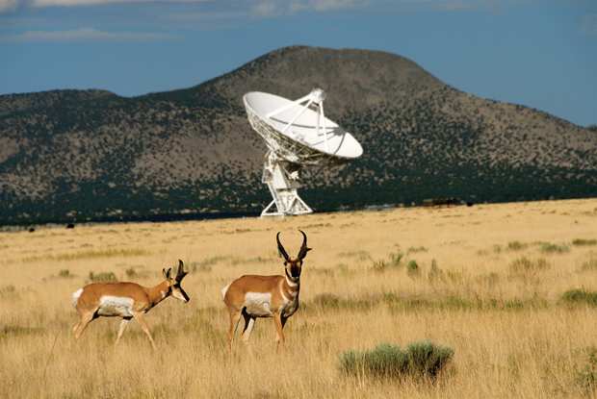
Purpose and Outline
Purpose: Introduction to this AAS Special Session on The Very Large Array Today and Tomorrow
Outline
  Brief historical overview of the VLA
  Some recent VLA results as a prelude to science talks to follow
  Description of new, major VLA initiatives and their synergies
    Details of initiatives in talks to follow

Slide 3
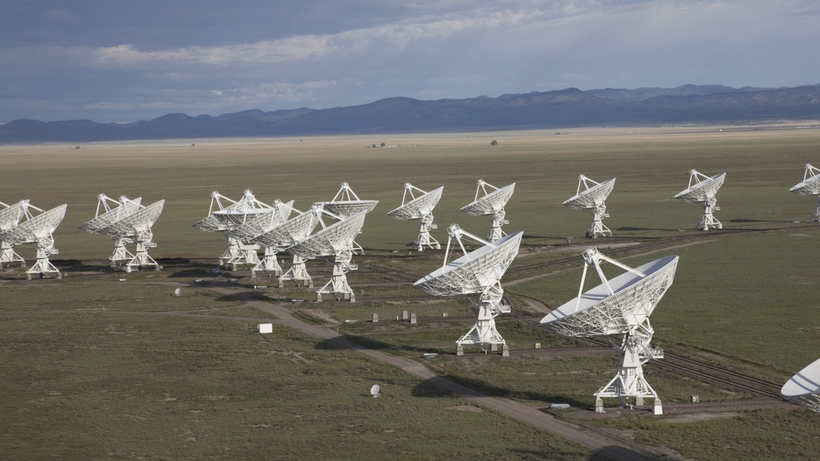
The Jansky Very Large Array
~7,200 refereed papers with ~300,000 citations
~500 PhD theses
Among the most productive telescopes ever
1972 – Approved by US Congress
1975 – First antenna in place
1980 – Full science operations
2001 – Complete electronics upgrade approved by NSF (EVLA)
2011 – Jansky VLA full science ops

Slide 4
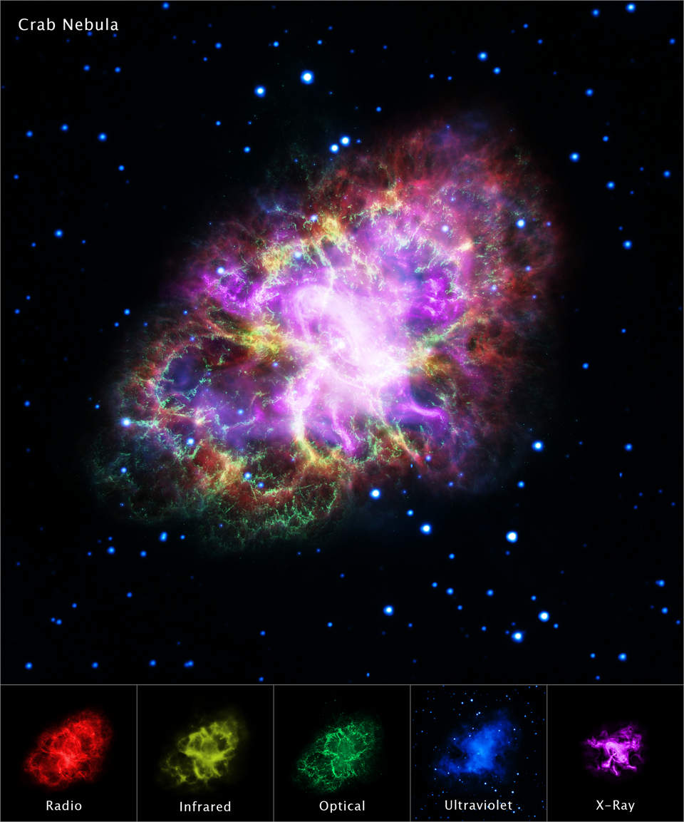
Crab Nebula
Composite image of Crab Nebula
  VLA (radio)
  Hubble (optical)
  Chandra (X-ray)
  Spitzer (IR)
  XMM-Newton (UV)
SN in 1054 AD; 33ms PSR
Shows interaction of PSR, SN ejecta, magnetic field, wind of particles, jets
Dubner et al., 2017

Slide 5
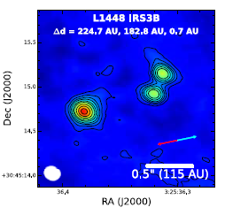
Multiplicity Study of Protostars in Perseus MC
Multiplicity study of protostars (94) in the Perseus molecular cloud
  More than half in multiple systems
  Star formation tends to produce multiples rather than single stars
Different formation mechanisms depending upon companion separation
Tobin et al., 2016
L1448 IRS3B = triple system
Notes:
Claire Chandler and Laura Perez are co-authors
VANDAM survey (VLA Nascent Disk and Multiplicity Survey) – 264 hours
JVLA, Ka-band

Slide 6
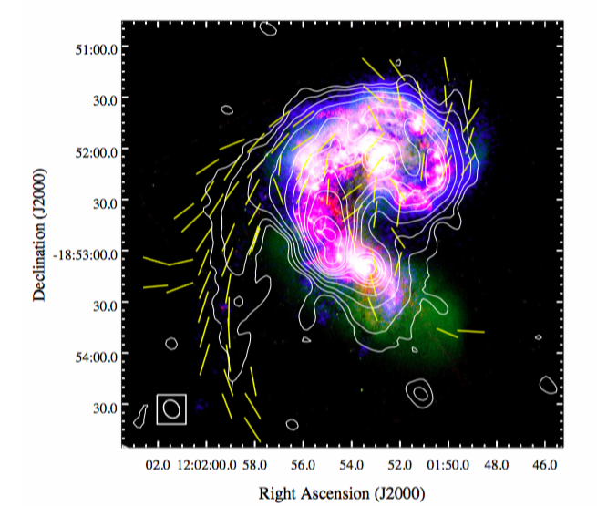
Largescale Magnetic Field in the Antennae
VLA image of B-field in Antennae merging galaxies
Tail highly polarized with B-field aligned with tail
Largest detected regular field structure on galactic scales (20kpc)
B-fields within merging bodies usually dominated by strong turbulent fields
  Study shows tidal effects can produce large-scale regular field structure in the outskirts.
Antennae with GALEX, HST, JVLA (3GHz contours), plus the Faraday rotation-corrected B-field orientations (Basu et al., 2016)
Notes:
Galaxy Evolution Explorer (GALEX) – UV all-sky survey; run by CalTech
Ro = 8.5kpc

Slide 7
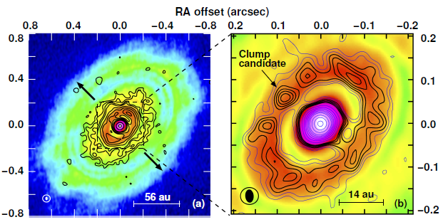
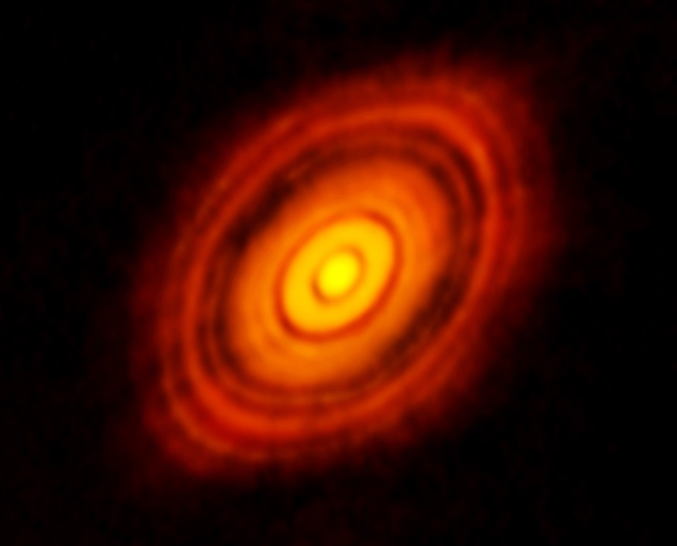
VLA Image of HL Tau
HL Tau with VLA at 7mm
Where are the planets? System too young for planets to form?
Inner bright ring is clumpy, dense, massive, gravitationally unstable
  (Protoplanetary?) clump with thermal spectrum found in inner ring
Interpretation: proto-planets only just beginning to form in ring via Rossby Wave Instabilities
Carrasco-Gonzalez et al., 2016
Brogan et al., 2014
Notes:
System optically thin at JVLA wavelengths. Indicator of what kind of science can be done with ngVLA

Slide 8
First Localization of an FRB
Chatterjee et al., 2017
VLA makes first localization of fast radio burst (FRB 121102)
  VLA appears on cover of Nature for first time
Increasing interest in time domain astronomy
Lorimer
et al., 2007

Slide 9
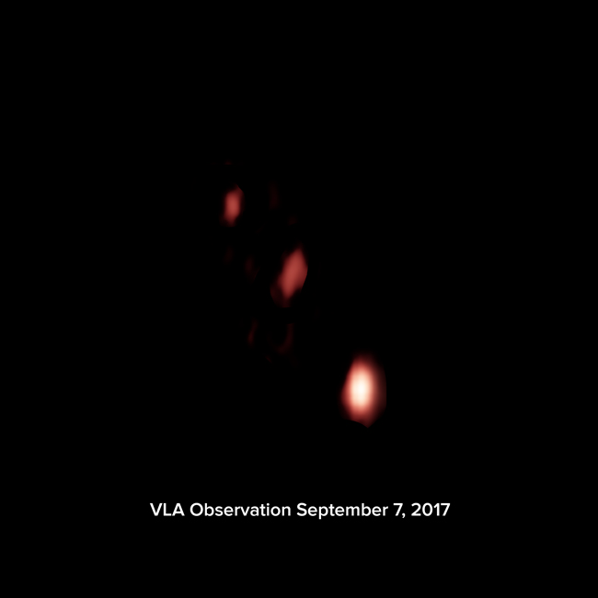

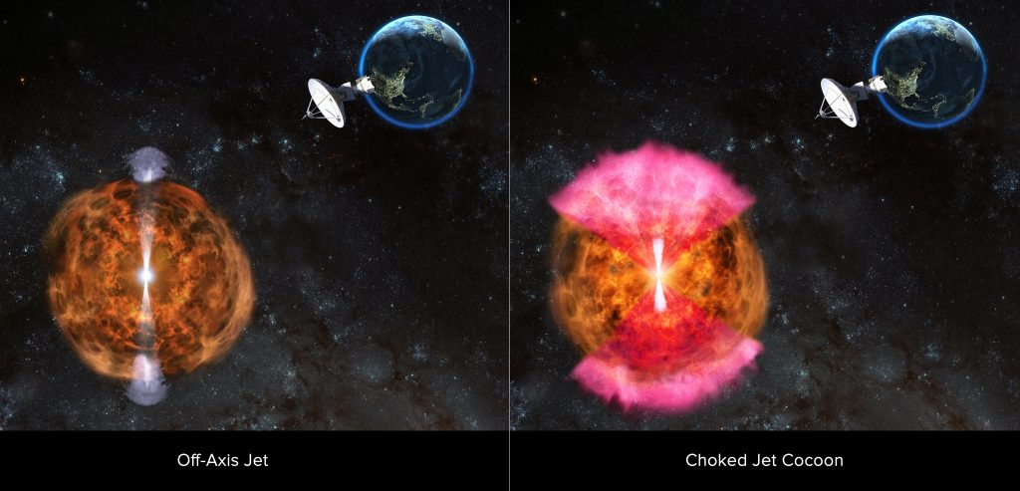
Radio Afterglow of GW170817
Radio afterglow of neutron star-neutron star merger detected with VLA
VLA at the vanguard of multi-messenger astronomy
Alexander et al., 2017
Hallinan et al., 2017
Mooley et al., 2018

Slide 10
New NRAO Initiatives
New cooperative agreement between NSF and AUI to manage NRAO (effective October 1, 2016)
  Agreement provides for a number of major initiatives across NRAO
Four initiatives are directed towards or related to the VLA
  Science Ready Data Products [SRDP, Kern (342.13)]
    Needed by user community for VLA, ALMA & ngVLA data analysis
  VLA Sky Survey (VLASS)*
    Exploits new capabilities provided by EVLA. Excellent SRDP application
  VLA Infrastructure Improvement Program*
    Sustains VLA operations (and VLASS). Possibly reused by ngVLA
  Next Generation VLA (ngVLA)*
    Relies and builds upon initiatives above
* Led by NRAO-NM

Slide 11
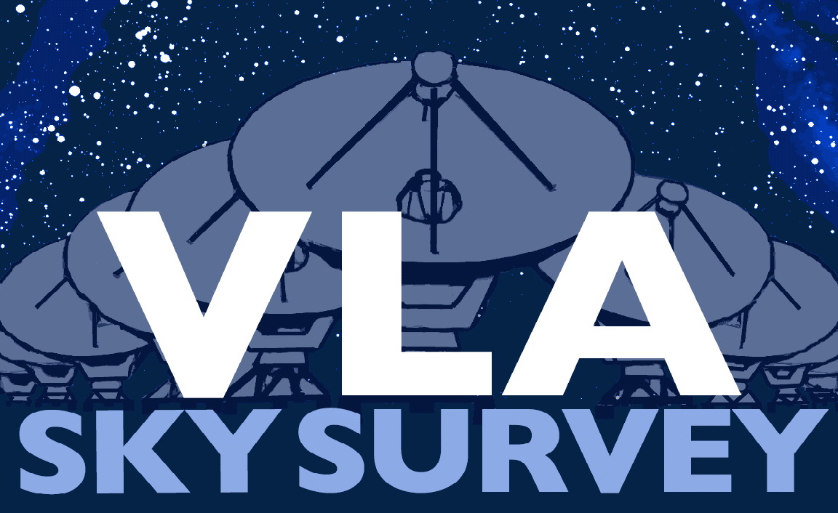
VLA Sky Survey (VLASS) - I
Highest spatial resolution, all-sky radio survey ever undertaken
  All-sky (33,885 deg² above declination –40°)
  Frequency: 3 GHz (2-4 GHz, less RFI affected regions)
  Angular resolution: 2.5’’ (VLA B-configuration)
  Cadence: 3 epochs separated by 32 months
  Observing time requested: 920 hours per configuration cycle, 5520 hours over ~7 years
Launched Sep 2017
Progress and status
  See Lacy et al. (321.02)
Notes:
(<13% science time)

Slide 12
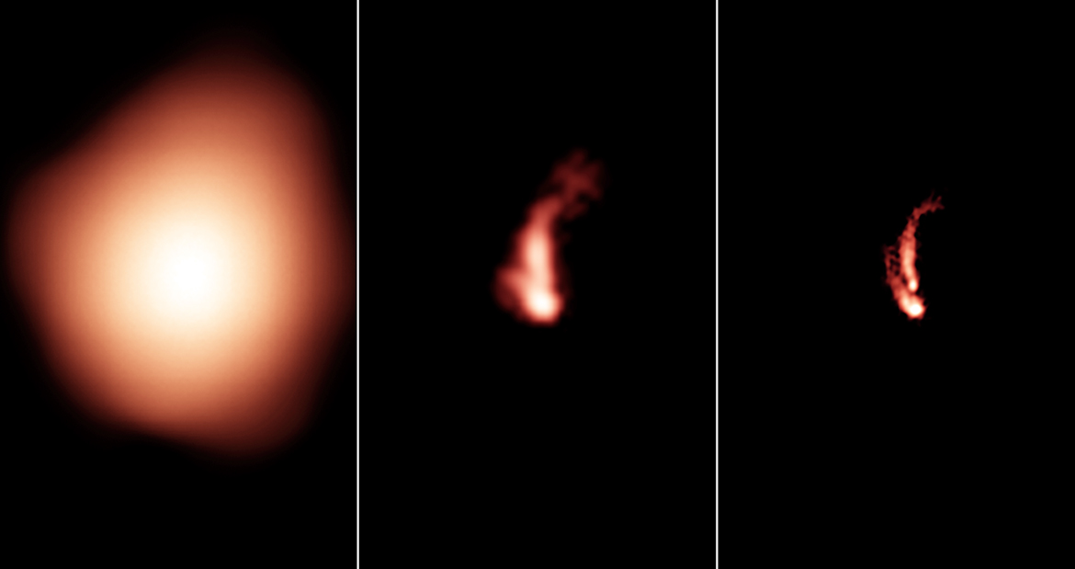
VLA Sky Survey - II
Resolution comparison of NVSS, FIRST, and VLASS surveys
NVSS FIRST VLASS

Slide 13
VLA Infrastructure Improvement Program - I
Maintaining VLA capabilities with infrastructure renewal is a major initiative in AUI’s cooperative agreement with NSF
Aims to replace critical infrastructure after four decades of continuous operation
Most urgent needs: site electrical system, antennas, and rails
Status
  All items scheduled for FY17 completed within allotted budget
  Replaced overhead crane in antenna assembly building (AAB)
    Needed for antenna overhauls & azimuth bearing replacements
  Technical plan developed for upgrade of electrical infrastructure
    Upgrade during shutdown/array reconfiguration June 11-29, 2018

Slide 14
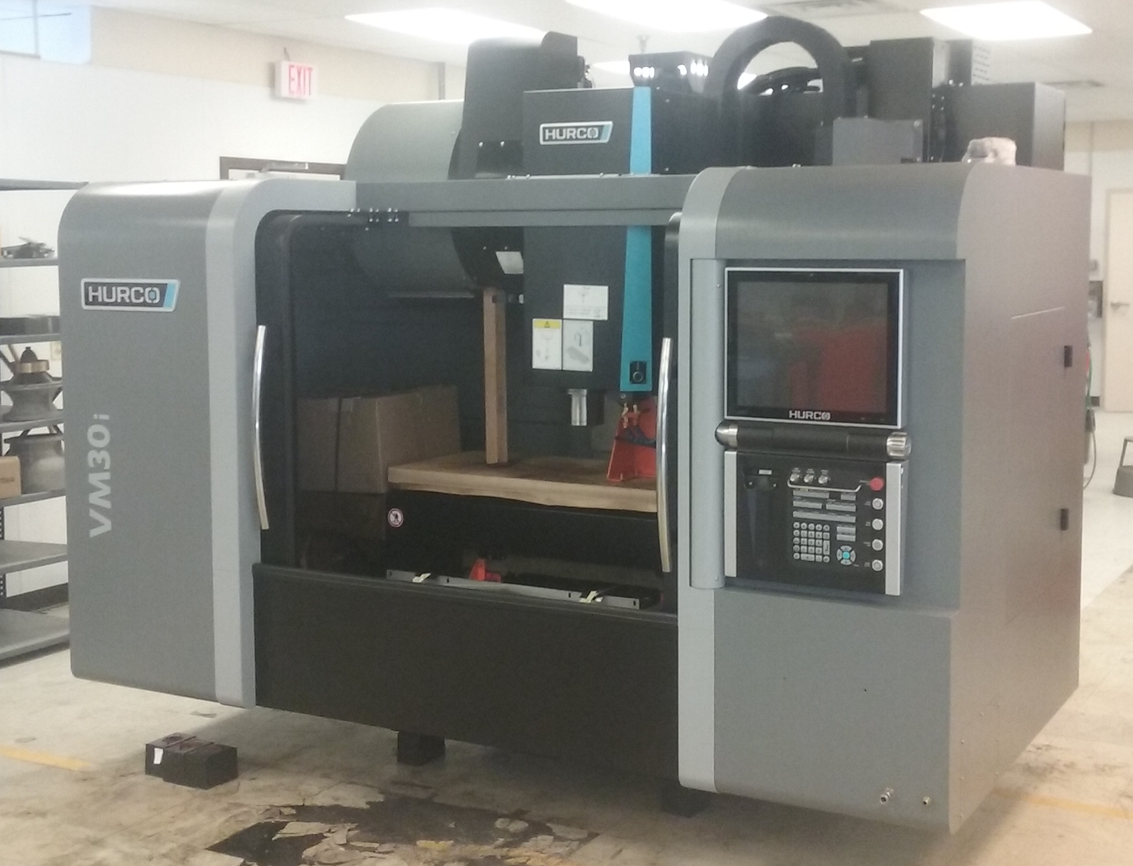
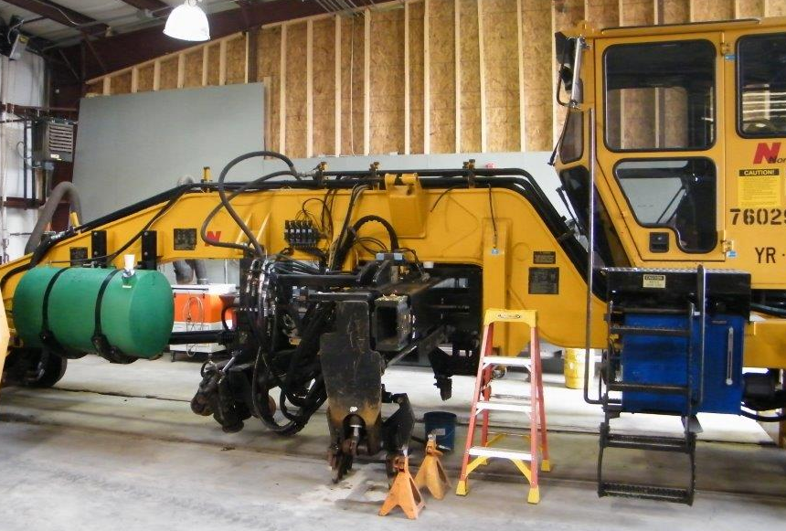
VLA Infrastructure Improvement Program – 1I
AAB overhead crane
CNC Mill
Boom Truck
Rail ties
Tie inserter
Rail vehicle
Notes:
6500 ties at $281K; $240K for ballast

Slide 15
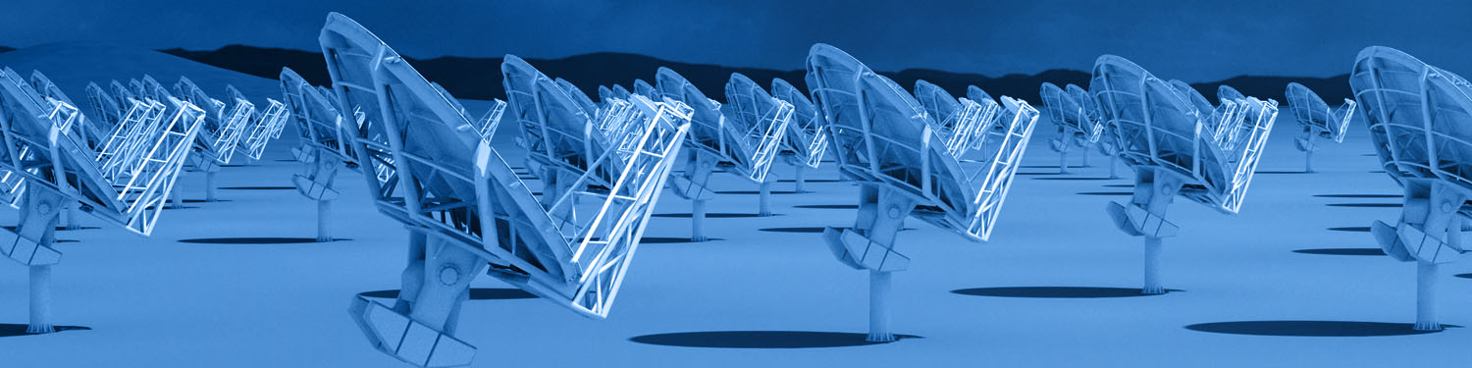
Next Generation VLA (ngVLA) - I
Scientific Frontier: thermal imaging at milli-arcsecond resolution
Core design requirements
  10x sensitivity of VLA and ALMA
  10x better spatial resolution
  Frequency range: 1.2-116GHz
Locate in southwest US (NM+TX) and MX, centered on VLA
Baseline design under development
Low technical risk
Present ngVLA concept to Astro2020 Decadal Survey

Slide 16

ngVLA Key Science
Unveiling the Formation of Solar System Analogues
Probing the Initial Conditions for Planetary Systems and Life with Astrochemistry
Using Galactic Center Pulsars as Fundamental Tests of Gravity
Understanding the Formation and Evolution of Stellar and Supermassive BH’s in the Era of Multi-Messenger Astronomy
Charting the Assembly, Structure, and Evolution of Galaxies Over Cosmic Time
See talk by Murphy et al. (321.03)

Slide 17
Summary
VLA continues to deliver spectacular science results
  Increasing interest in time domain astronomy
NRAO-NM started major VLA initiatives in 2017
  VLASS launched in September 2017
  Major improvements in VLA infrastructure underway
  ngVLA concept being developed in earnest with the astronomy community

Slide 19
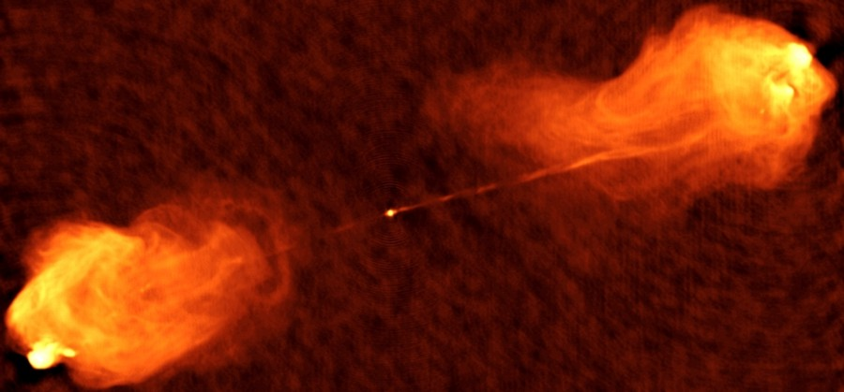
Radio Transient in Cygnus A
Radio transient in Cygnus A
  Object did not appear in observations in 1980s &1996
  Appears with post-EVLA observation in 2015
Possibilities:
  Foreground/background object:
    Probability too low
  Supernova
    Too bright for too long
  Second SMBH in the galaxy
    Caused by rapid increase in accretion rate on an AGN
VLA: 8.5 GHz
Perley, D. A. et al., 2017
Notes:
Appears at same location at multiple frequencies
VLA & VLBA observations
A-2 also detected with Keck (NIRC2) in May 2002 (Canalizo et al. 2003)
SED is non-thermal over all bands observed
A-2 is clearly separate from the nucleus that powers Cyg-A jets
Could be an AGN TDE, but TDE rate per galaxy is very low and probability to catch by chance is low.

