Slide 1
Mark Lacy, VLASS Project Scientist.
On behalf of the VLASS Project and Survey Science Group

Slide 2
What is the VLA Sky Survey?
All the sky the VLA can see (Dec >-40).
Three epochs, each epoch separated by 32 months.
S-band (2-4GHz), IQU polarization.
Depth 120μJy per epoch, 70μJy combined.
2.5” resolution – better than any previous large area radio survey.
Pilot survey observations were executed in the Summer of 2016.
Observations of the full survey started in September 2017.
Observation of the 3rd epoch will be completed in 2024, completing ~5520hr of observing.

Slide 3
Science Goals
Imaging galaxies through time and space
Hidden explosions (transient events: SNe, tidal disruption events, GRBs..)
Faraday tomography of the magnetic sky
The Milky Way
Missing Physics
Serendipitous discoveries that come from opening up new parts of observational parameter space.

Slide 4
Why do VLASS?
VLASS is not optimized for radio source detection.
SKA precursors such as ASKAP and MeerKAT will do a much better job.
Instead, the emphasis is on high angular resolution at high frequency, and transients
Allows study of the physics of the radio sources
Morphological classification
Reliable multiwavelength identification e.g. in deep optical/NIR surveys
Low depolarization, due both to high frequency and (for extended sources) small beam.
Three epoch strategy to find transients.
The VLASS will form a high angular resolution reference survey to compare to optical/near-IR surveys with similar resolution.

Slide 5
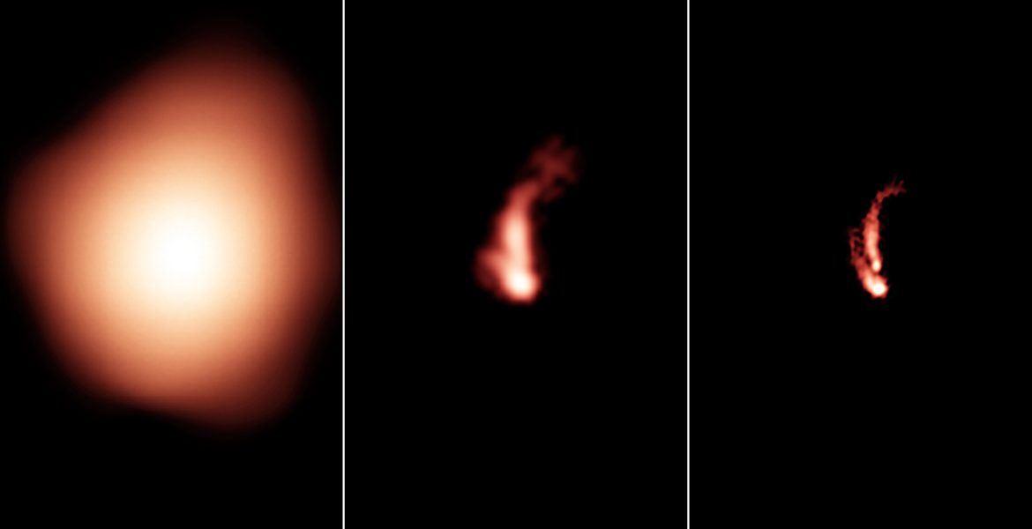
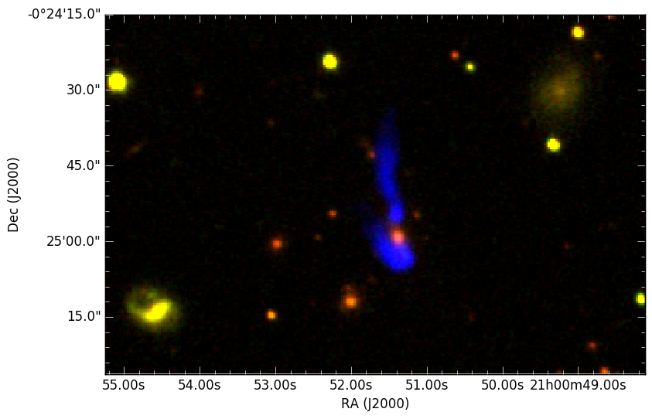
NVSS
FIRST
VLASS
VLASS+SDSS

Slide 6
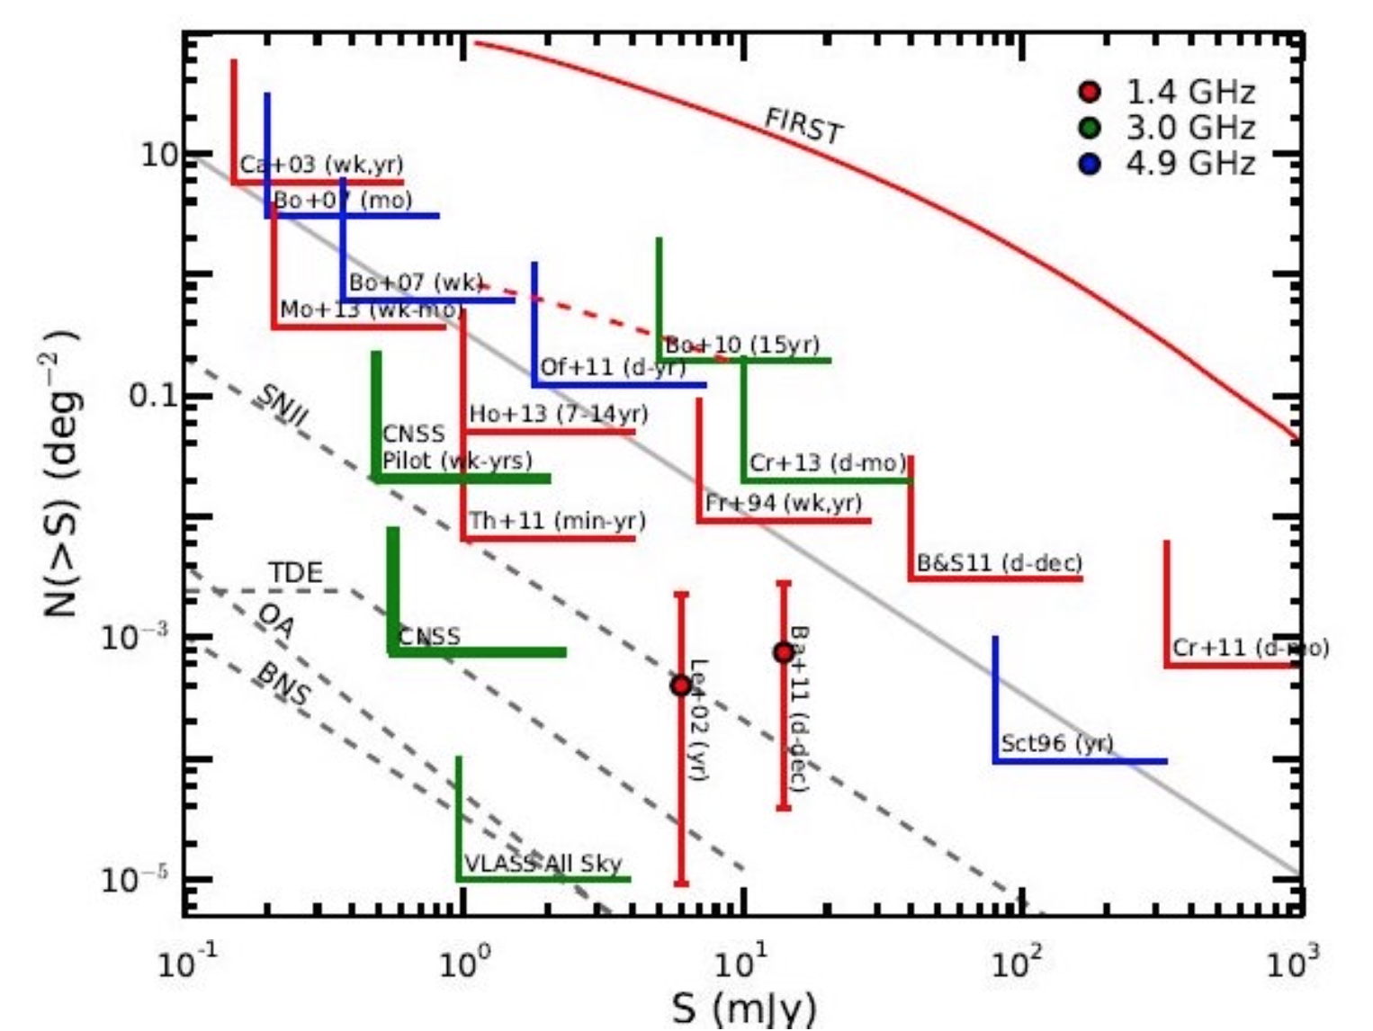
Transients

Slide 7
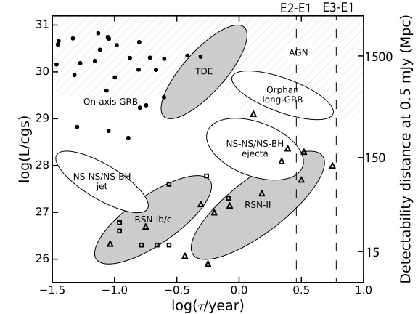
32 month cadence
Detectable by VLASS
Log[Rise time (yr)]

Slide 8
Survey Strategy
“On the Fly” mosaiking is used
the antennas scan continuously in a raster pattern in RA and Dec in large (40-80 deg²) “tiles”.
Data are sampled every 0.45s, ~10 samples across the beam.
The sky is divided into 40deg² tiles
typically tiles are paired in Scheduling Blocks to give blocks of 4hr duration, enough time for the polarization leakage calibrator to cover 90 deg in parallactic angle.
The 4hr SBs are short enough to work into the dynamic schedule, and thus minimize the impact on PI science.

Slide 9
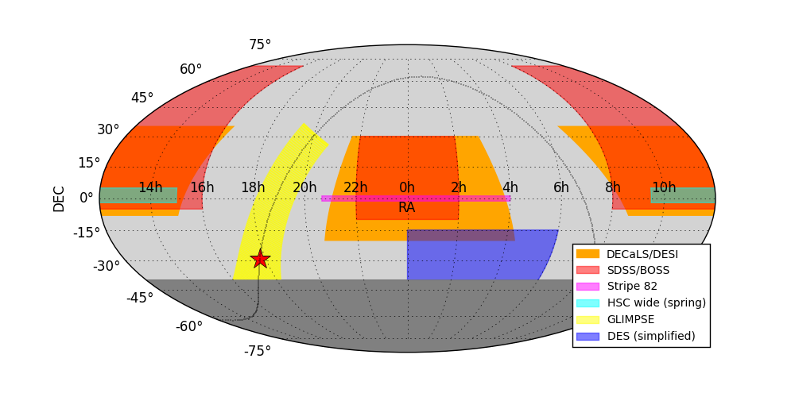
Synergy with surveys at other wavelengths
(Pan-STARRS overlaps at Dec >-30, WISE overlaps the whole survey area)
Galactic Center

Slide 10
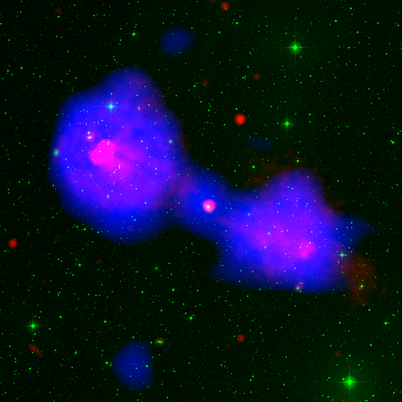
Commensal surveys
Two survey programs will run in parallel with VLASS:
Realfast (PI C. Law) is a fast transient survey that uses a fast-sampled data stream from the VLA correlator to search for fast transients in real time.
VLITE (PI T. Clarke) uses the VLA low-band receivers (at prime focus) to observe commensally at 320-384MHz with the high frequency Cass feeds that are used for the main survey.
Both these systems run at the VLA in any case, but the VLASS observations are perfect for increasing their programs to all-sky coverage.

Slide 11
VLASS progress
VLASS will be taken in three epochs, observing half the sky in each B-array configuration over a seven year period (ending in 2024).
Additionally, a pilot survey was carried out during the Summer of 2016.
The first half of the first epoch of the full survey will be completed in February 2018.

Slide 12
The VLASS Pilot Survey
~200hr survey conducted 2016 June-September.
Covered well-studied galactic and extragalactic fields.
Depth varied from single passes to 3-repeat
COSMOS and SDSS Stripe-82 were observed in 3 epochs separated by a few weeks.
Raw data available from the NRAO archive.

Slide 13
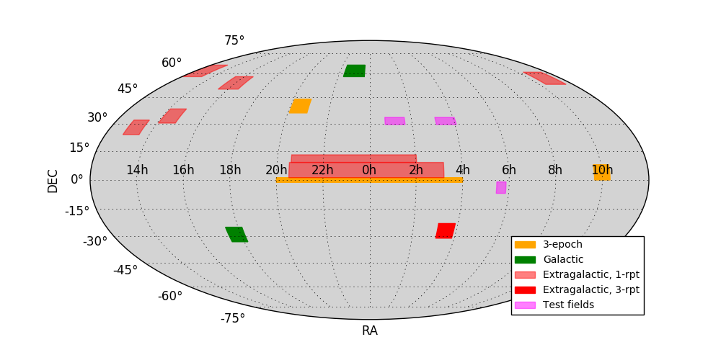
Pilot Survey Coverage

Slide 14
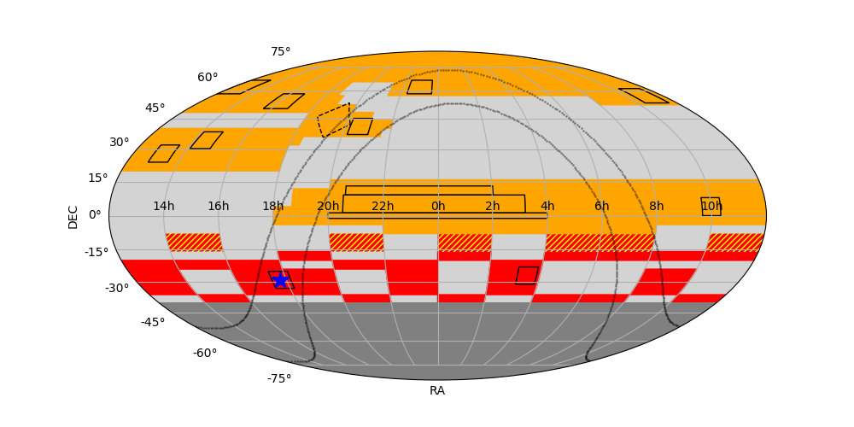
VLASS Epoch 1, pass 1 (VLASS1.1)
Ongoing now.
Observing half the sky, including pilot areas.
B-array observations started in September 2017.
Moving to hybrid BnA in January 2018 to observe southern sky.

Slide 15
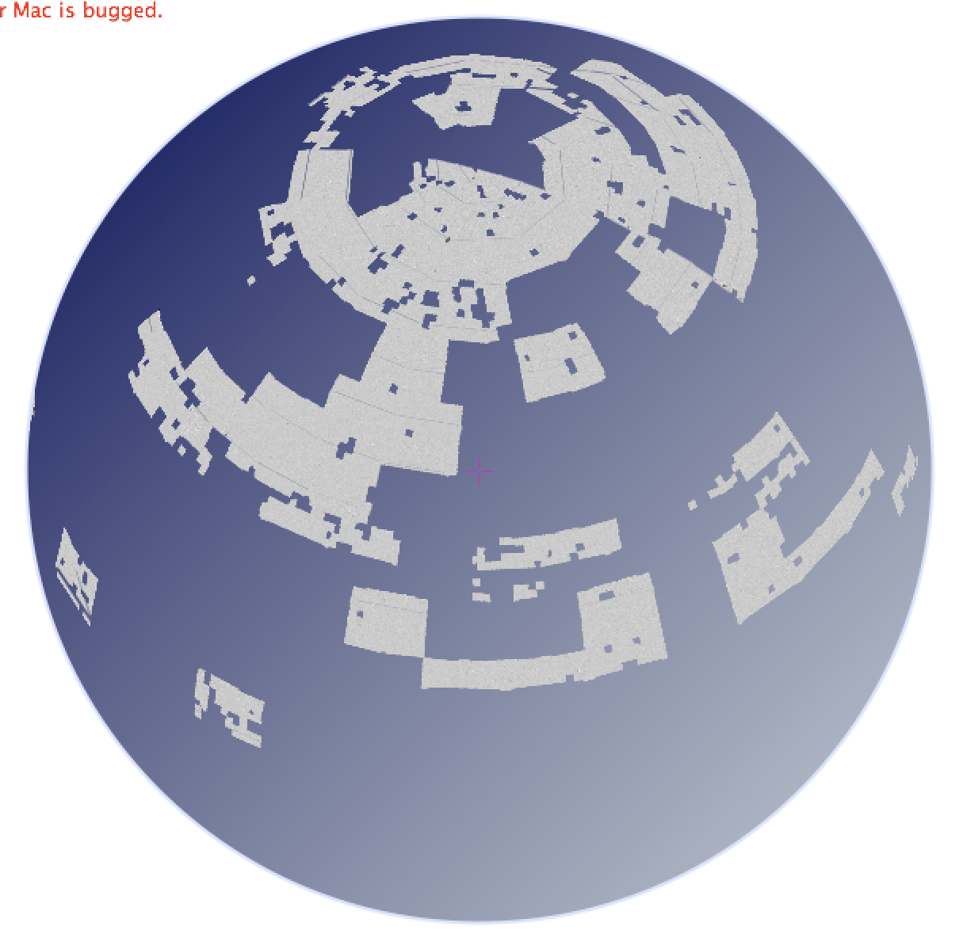
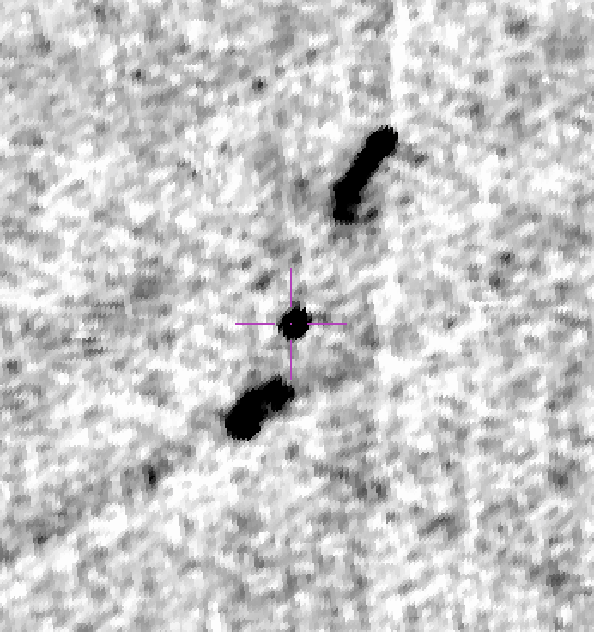
VLASS data
Images from https://archive-new.nrao.edu/vlass/quicklook/
See also (unofficial) Aladin-Lite viewer:
http://www.aoc.nrao.edu/~smyers/vlass/VLASS1.1/pubimages/ALLPNG/

Slide 16
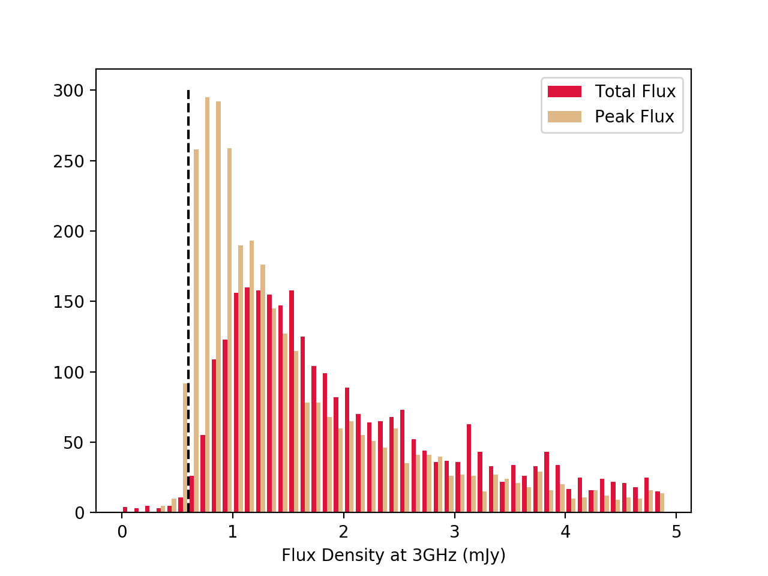
Source counts
Most sources are resolved in the 2.5” beam

Slide 17
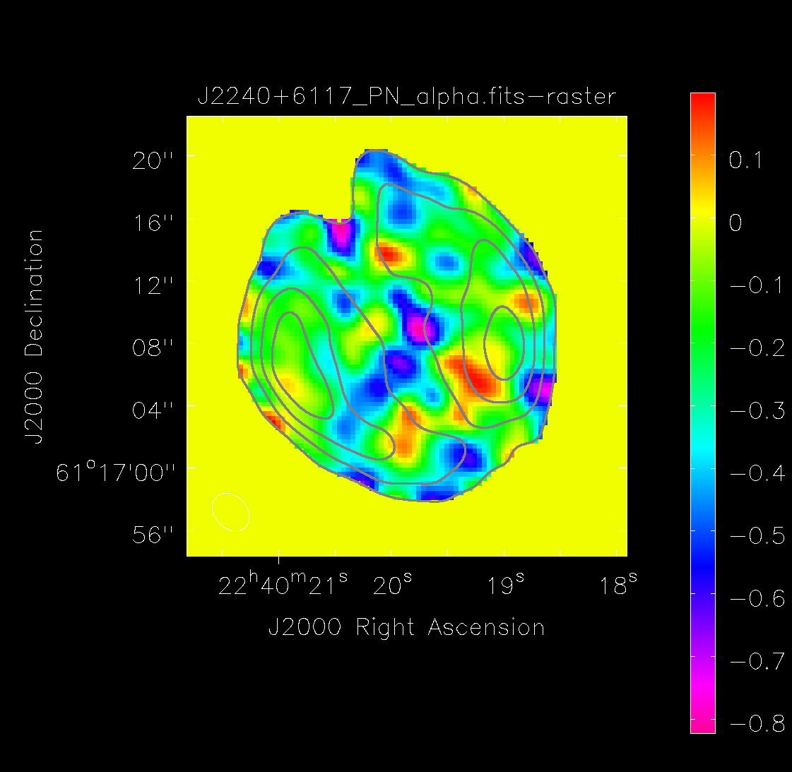
Spectral indices
The octave-wide bandwidth allows spectral index estimates either from cubes or from the ratio of the 1st and 0th Taylor-term images.
Works well at high S:N.

Slide 18
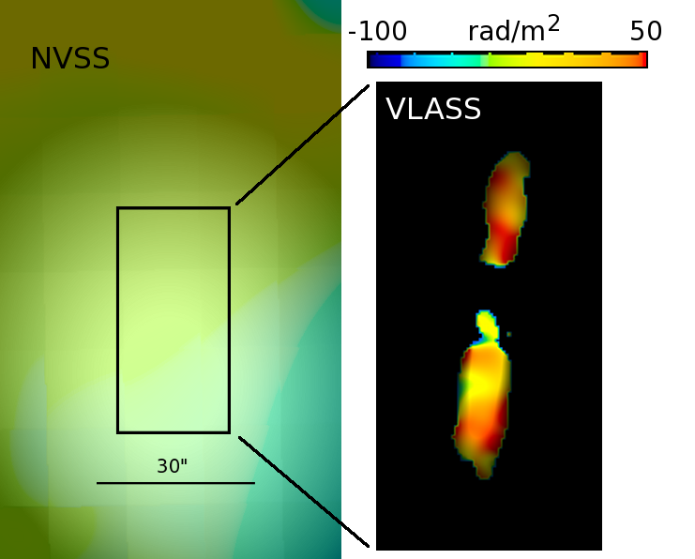
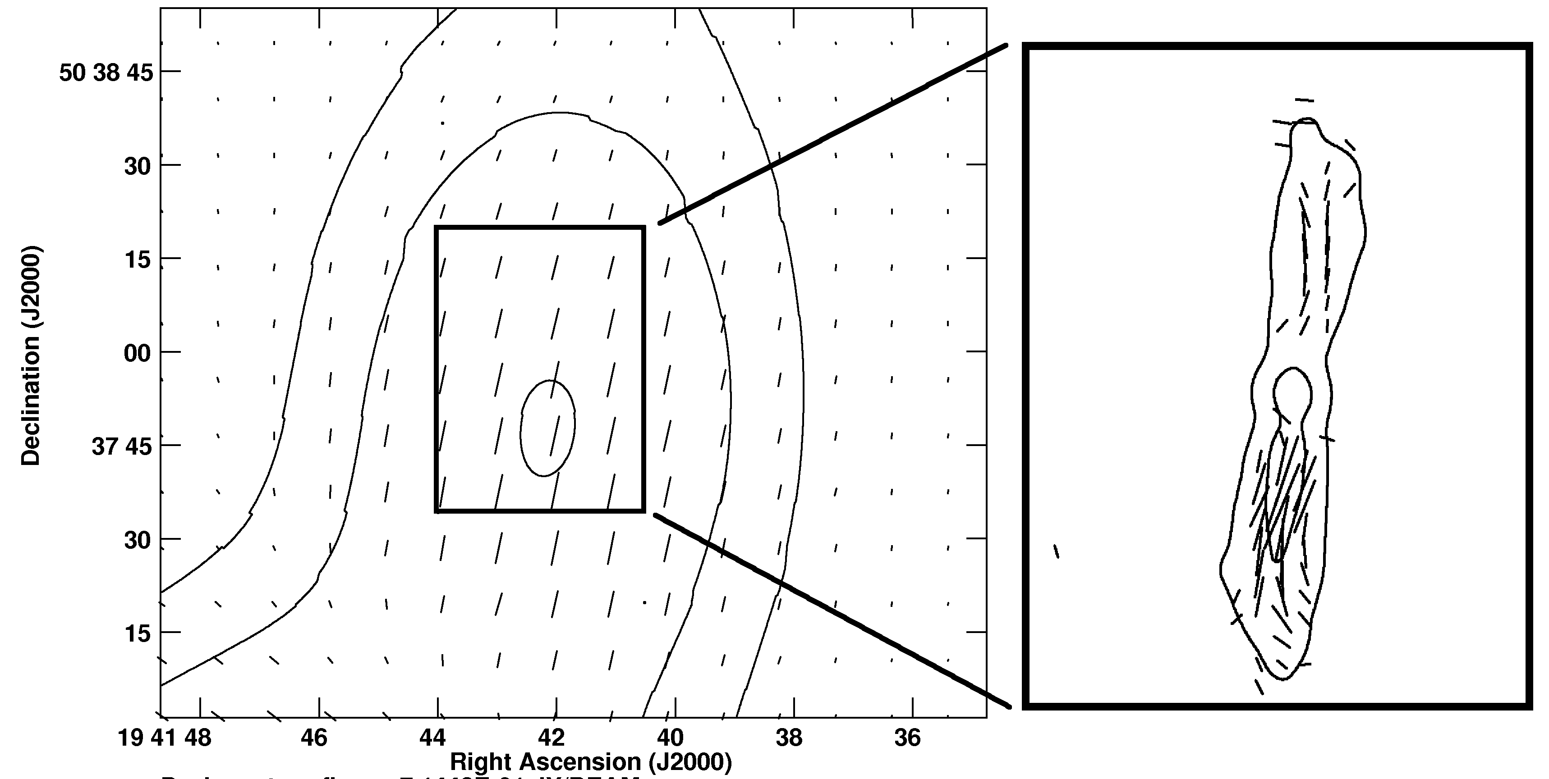
Polarimetry
Comparing to NVSS, mean polarization similar.
See a lot more structure in the RM that is washed out in the low resolution NVSS data.
Images courtesy of L. Rudnick

Slide 19
Lessons learned from the pilot and first pass
Inevitably, we learned a lot….
Data compression due to high levels of RFI
Have a solution for the less severe cases.
Scheduling
is very difficult, particularly with queue scheduling combined with the need for parallactic angle coverage for polarization calibration and constraints from geostationary satellites near the equator.

Slide 20
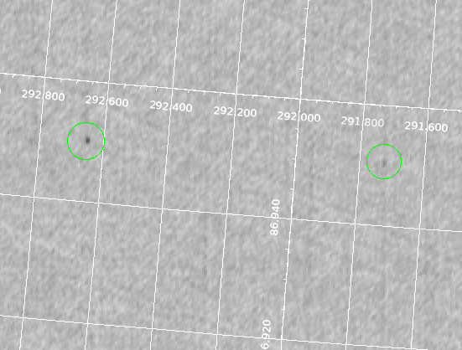
Lessons learned -2
Ghost images
If data is assigned by the software to the wrong scan, it can lead to ghost images in the OTF mapping. Luckily easy to identify as they are almost exactly 3’ in RA from the original. Also very rare (~0.03% of sources).
Working on flagging these in the UV data.
180 arcsec

Slide 21
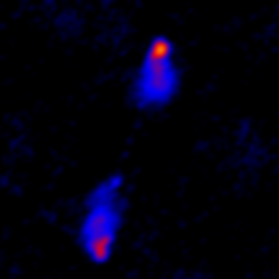
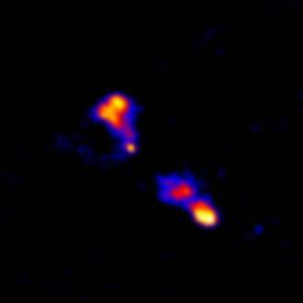
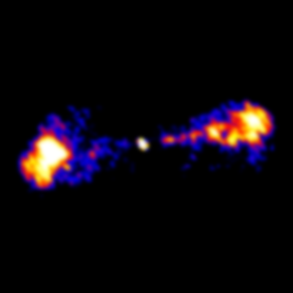
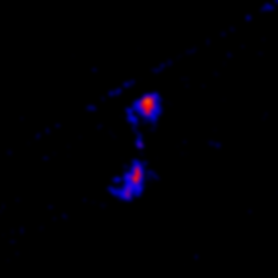
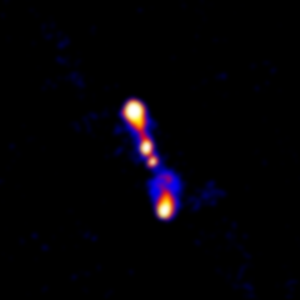
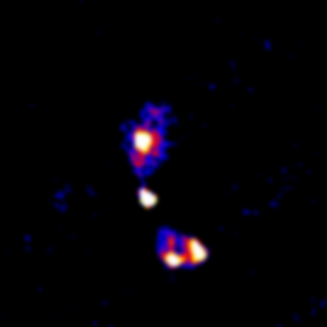
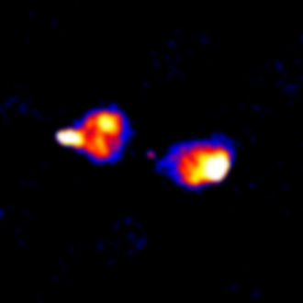
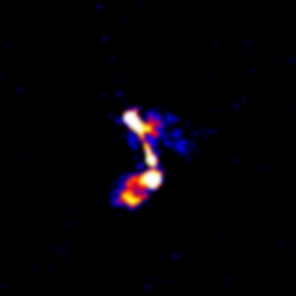
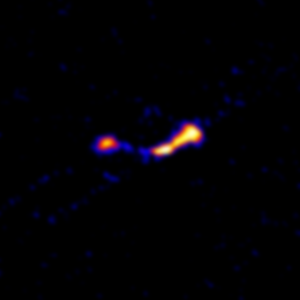
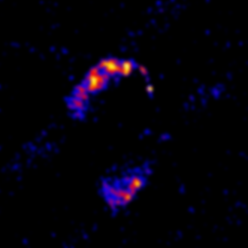
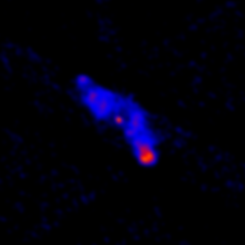
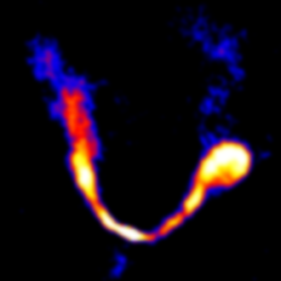
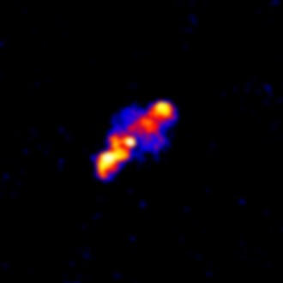
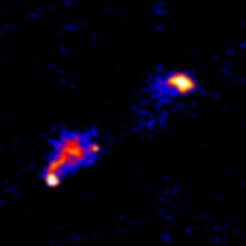
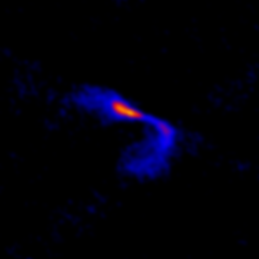
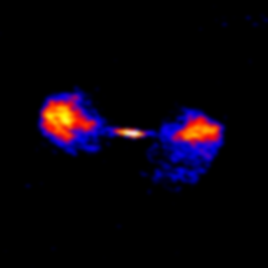
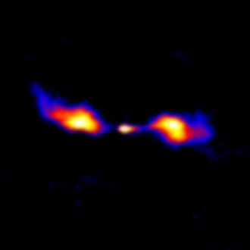
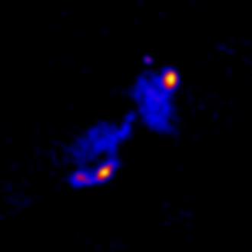
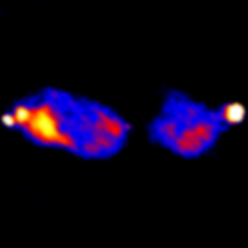
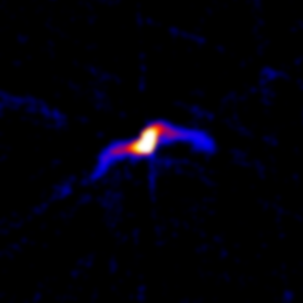
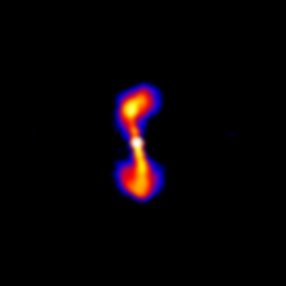
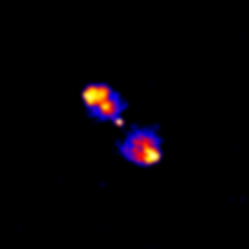
All images are 2 arcminutes, produced with the VLA quick look imaging pipeline.
B. Kent and the VLASS team
All images are 2 arcminutes

Slide 22
Next steps
Single epoch imaging
“Quicklook” images produced so far are in Stokes I only and coarsely sampled
Over the next year, we will make “Single Epoch” images, which will be better sampled, and utilize improved imaging algorithms.
Full Stokes cubes with 128MHz channels will be produced, and about 10% of the sky around bright sources (all we can afford to store), will be archived at NRAO.
Cubes will be stored as planes, users will download the planes for a given cube and use a CASA script to assemble into a cube.
Means we can easily deal with varying beams as a function of frequency

Slide 23
Cumulative imaging.
Once more than one epoch is complete over the whole sky we will coadd the epochs.
Cumulative products will be similar to the Single Epoch ones, but deeper.
Will also include “fine” cubes around very bright sources (16MHz channels) and spectral curvature images.
If developed in time, algorithms to deal correctly with sources that vary between epochs (breaking the “stationary sky” assumption of imaging) will be implemented.

Slide 24
Data management
VLASS will produce a large amount of data:
0.5PB of raw data
99TB of continuum images
234TB of image cubes (for 10% of the sky, too expensive to store the whole sky).
Most processing will be done using the in-house cluster, though we may use cloud services e.g. AWS for some.

Slide 25
Enhanced Data Products
NRAO does not have the resources to fully exploit the VLASS dataset
We are therefore collaborating with external groups to produce enhanced data products.
These are likely to include:
Transient Object Catalogs and Alerts
Rotation measure images and catalogs
Full spectral resolution image cubes
Light curves for variable sources
Improved catalogs, with multiwavelength associations.
Collaborators include the Canadian CIRADA program (funded through CFI) and the South African IDIA program.

Slide 26
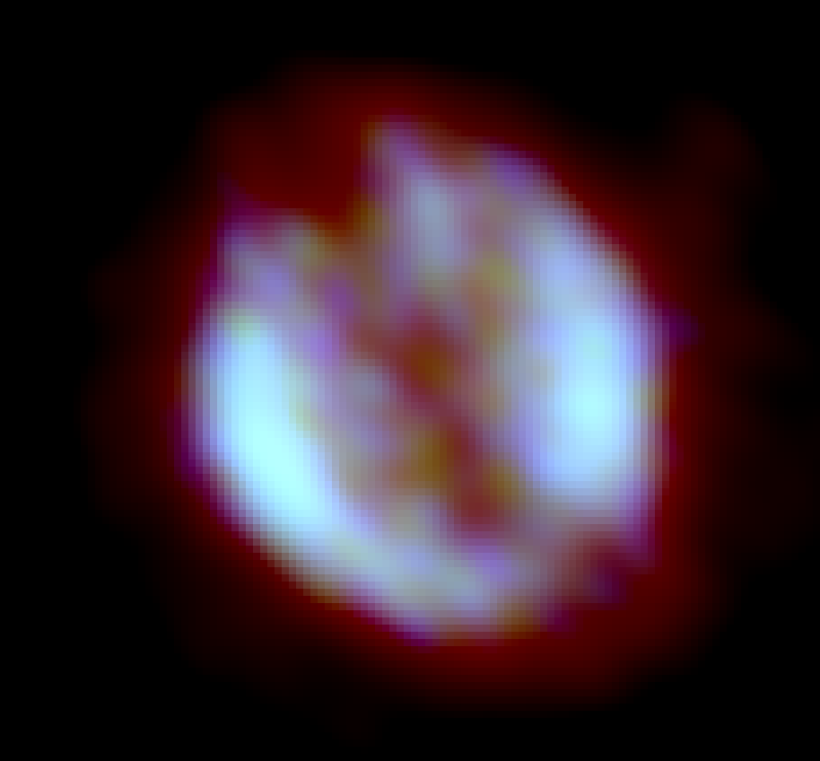
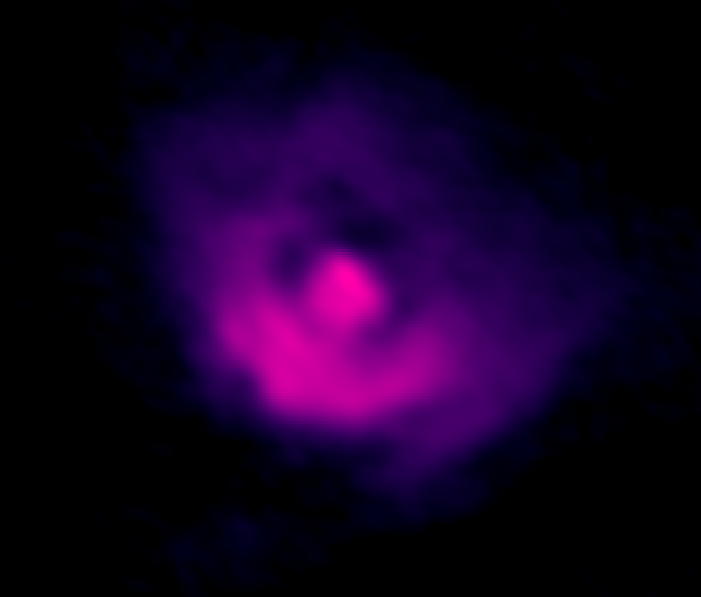
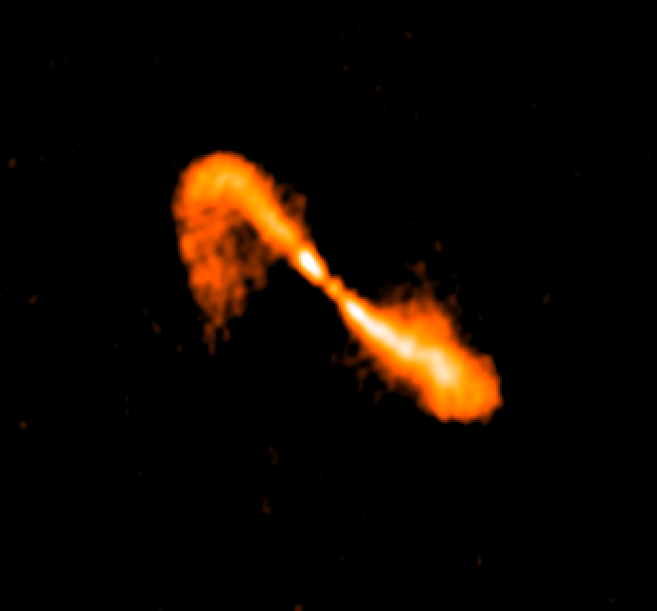
How to get involved:
VLASS has been community led from the start – this is your survey!
If you are interested in getting involved, the Science Working Groups are always open to new members, follow the link to the Google Group on https://science.nrao.edu/science/surveys/vlass

Slide 27
VLASS related presentations at AAS 231
Oral: 231.02 Radio Transients in 1333 deg² of the VLA Sky Survey Pilot Dillon Dong; Gregg Hallinan; Steven T. Myers; Kunal Mooley
Oral: 231.08. The VLA Sky Survey (VLASS): Overview and First Results Steven T. Myers
Poster: 342.14. The Very Large Array Data Processing Pipeline Brian R. Kent; Joseph S. Masters; Claire J. Chandler; Lindsey E. Davis; Jeffrey S. Kern; Juergen Ott; Frank K. Schinzel; Drew Medlin; Dirk Muders; Stewart Williams; Vincent C. Geers; Emmanuel Momjian; Bryan J. Butler; Takeshi Nakazato; Kanako Sugimoto
Poster: 342.30. VLITE Surveys the Sky: A 340 MHz Companion to the VLA Sky Survey (VLASS) Wendy Peters; Tracy Clarke; Walter Brisken; William Cotton; Emily E. Richards; Simona Giacintucci; Namir Kassim

