Slide 1
Project Summary
Eric J. Murphy, ngVLA Project Scientist

Slide 2
A next generation VLA
Scientific Frontier: Thermal imaging at milli-arcsecond scale resolution
Core Design Requirements
  10x effective collecting area of JVLA and ALMA
  10x resolution of JVLA and ALMA
  Frequency range: 1.2 –116 GHz
Located in Southwest U.S. (NM+TX) & Mexico, building from JVLA site
Baseline design remains under continuous development
Low technical risk (reasonable step beyond current state of the art)
https://ngvla.nrao.edu
Notes:
Where we started… goals for the array.
Really was EVLA phase 2 (New Mexico Array) then North America Array

Slide 3
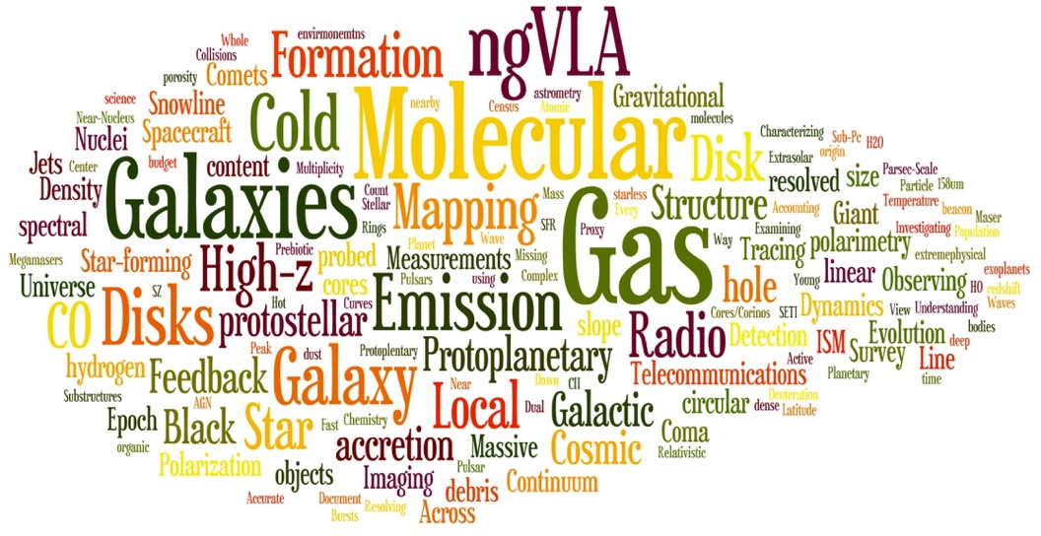
Developing the ngVLA Science Case
Community-Driven, Growing, and Evolving
Numerous Science and Technical meetings, starting from Jan 2015 AAS
Initial Science Working Group reports covering 4 broad areas, Nov .2015 (http://library.nrao.edu/ngvla.shtml)
  Cradle of Life: CoL (Isella et al): Terrestrial-zone planet formation, Massive Stars, etc.
  Galaxy Ecosystems: GEco (Leroy et al): wide field, high resolution/sensitive imaging
  Galaxy Formation: GFor (Casey et al): Dense gas history of the Universe
  Time domain, Cosmology, and Physics: TdCP (Bower et al): Plasma physics, Exo-space weather, Strong Lensing
Community Studies Program: 38 studies approved over 2 Rounds, financially supported by NRAO (https://science.nrao.edu/futures/ngvla/ngvla-community-studies)
Community-Led Science Use Cases: 80 submitted for ‘Reqs to Specs’ process (ngVLA memo # 18)
All gathered to report out and build toward a consensus vision last week of June in Socorro
Notes:
Went out to the community and asked them to investigate if there was a major science case for such a facility…
Major community effort.

Slide 4

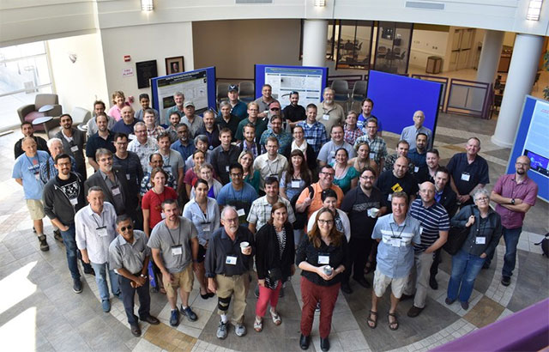
~ 150 attendees (capped with waitlist)
24 talks on innovative science allowed by the ngVLA
Followed by SAC face-to-face meeting
Main outcomes:
ngVLA preliminary telescope design
Definition of the Key Science Goals for the ngVLA
Notes:
- Registration was a oversubscribed.
- Included breakout sessions of SWGs.
- Settled on a reference design to focus on for DS2020.

Slide 5
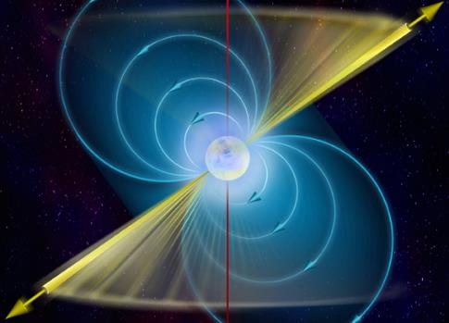
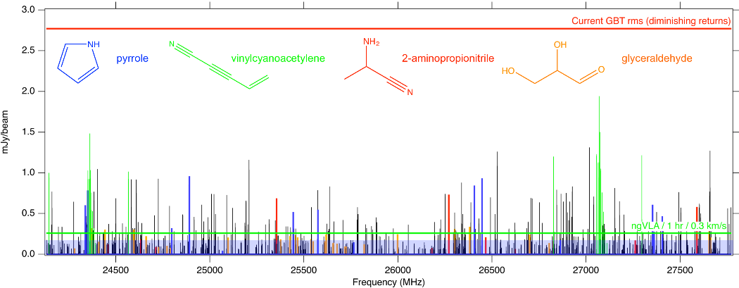
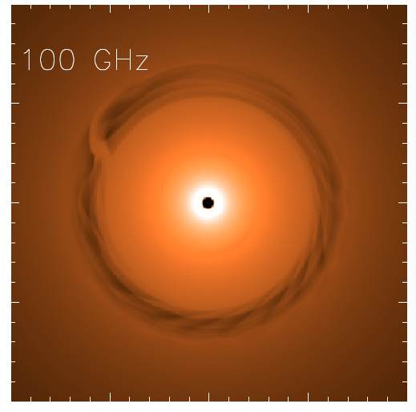
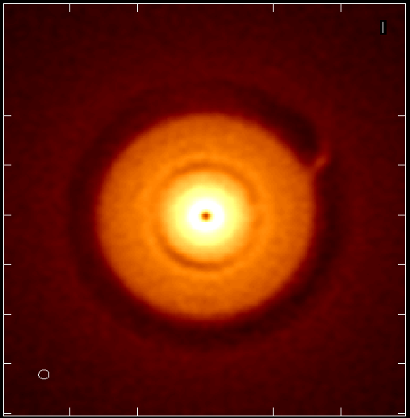
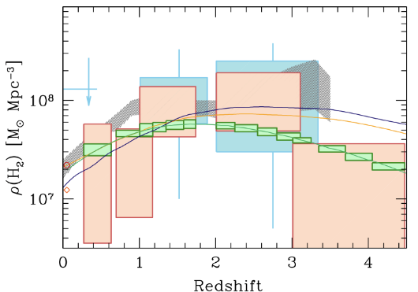
ngVLA Key Science Missions
(ngVLA memo #19)
Unveiling the Formation of Solar System Analogues
Probing the Initial Conditions for Planetary Systems and Life with Astrochemistry
Charting the Assembly, Structure, and Evolution of Galaxies Over Cosmic Time
Using Pulsars in the Galactic Center as Fundamental Tests of Gravity
Understanding the Formation and Evolution of Stellar and Supermassive
BH’s in the Era of Multi-Messenger Astronomy
Highly synergistic with next-generation ground-based OIR and NASA missions.
Jupiter @13AU
Saturn @6AU
ngVLA 100hr 25GHz 10mas
Gas
NGVLA
ALMA
Decarli+2016
0.1” = 13AU
Isella Dust Model
rms = 90nJy/bm = 1K
HI + CO(1-0)
CO(2-1)

Slide 6
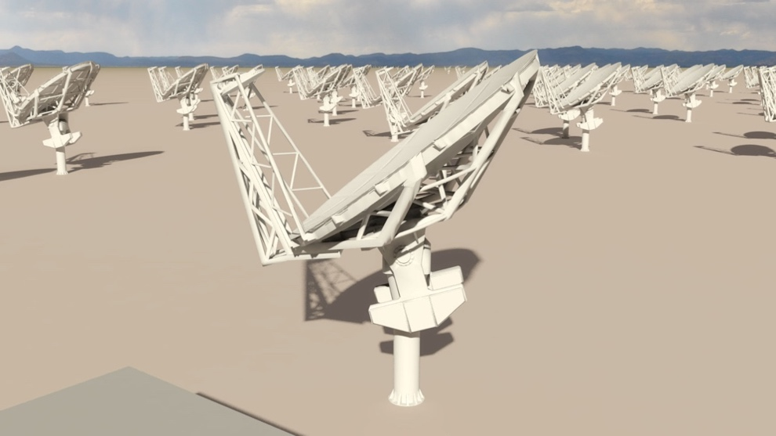
Current Reference Design Specifications
(ngVLA Memo #17)
214 18m offset Gregorian (feed-low) Antennas
  Supported by internal cost-performance analysis
Fixed antenna locations across NM, TX, MX
  ~1000 km baselines being explored
1.2 – 50.5 GHz; 70 – 116 GHz
  Single-pixel feeds
  6 feeds / 2 dewar package
16 6m short spacing array + 4 18m in TP mode to fill in (u, v) hole.
Receiver Configuration
Band # | Dewar | f_{L} GHz | f_{M} GHz | f_{H} GHz | f_{H}: f_{L} | BW GHz
1 | A | 1.2 | 2.35 | 3.5 | 2.91 | 2.3
2 | B | 3.5 | 7.90 | 12.3 | 3.51 | 8.8
3 | B | 12.3 | 16.4 | 20.5 | 1.67 | 8.2
4 | B | 20.5 | 27.3 | 34.0 | 1.66 | 13.5
5 | B | 30.5 | 40.5 | 50.5 | 1.66 | 20.0
6 | B | 70.0 | 93.0 | 116 | 1.66 | 46.0
Continuum Sensitivity: ~0.1uJy/bm @ 1cm, 10mas, 10hr => T_{B} ~ 1.75K
Line sensitivity: ~21.5uJy/bm @ 1cm, 10 km/s, 1”, 10hr => T_{B} ~ 35mK
Notes:
Where we ended up based on a very successful meeting in June in Socorro.
MAIN GOAL OF ARRAY
To be flexible enough to support the breadth of scientific investigations that will be proposed by its creative scientist-users over the decades-long lifetime of the instrument.
Much different style of instrument than SKA and LSST, which is really focused on surveys.

Slide 7
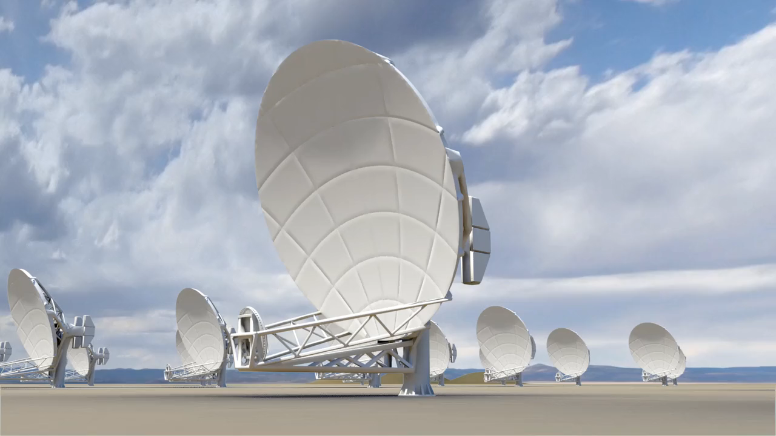
Notes:
Location: U.S. Southwest, Mexico
Homogeneous array 214 x 18m, off-axis antennas
50% to core: b < 3 km => 1” at 30GHz
80% to mid: b < 30 km => 0.1”
100% to long: b < 1000 km => 0.003”
Nominal 18m homogeneous array
Consensus design
Challenge of tri-scale-array: Sensitivity vs. resolution
Options
Long baselines: continental VLBI
Short baselines: 16 x 6m array + 18m total power

Slide 8
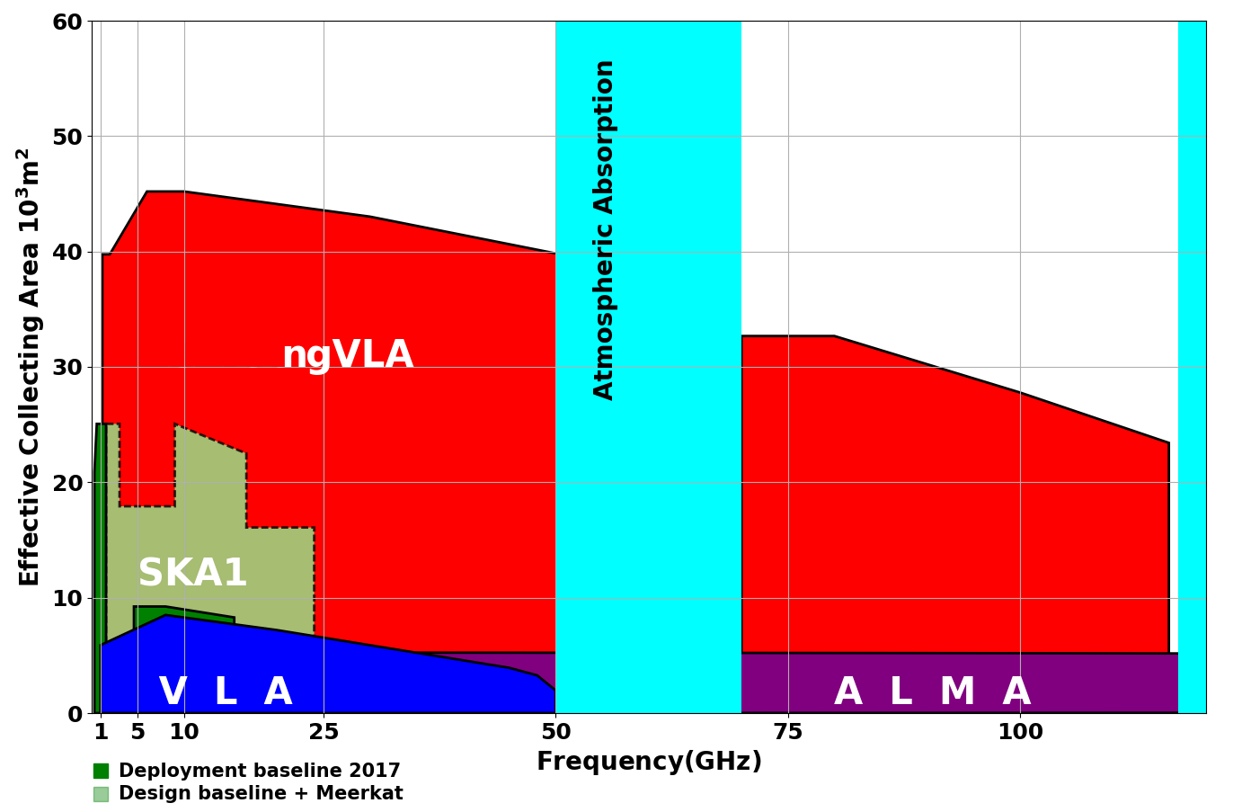
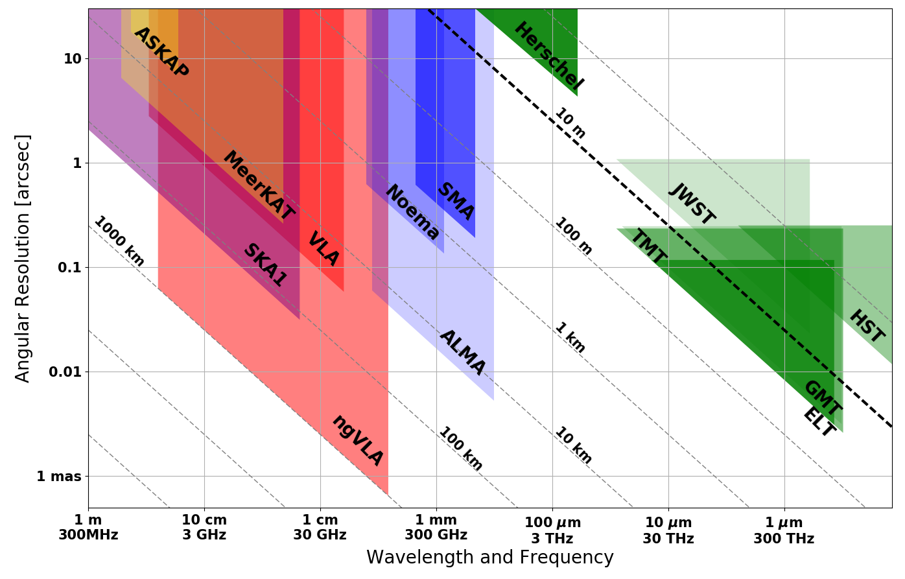
Bridging SKA & ALMA Scientifically
Thermal Imaging on mas Scales at λ ~ 0.3cm to 3cm
ngVLA Key Science Cases
Terrestrial zone planet formation: 1AU @ 140pc
Complementary suite from cm to submm arrays for the mid-21st century
< 0.3cm: ALMA 2030 superb for chemistry, dust, fine structure lines
  0.3 to 3cm: ngVLA ngVLA superb for terrestrial planet formation, dense gas history, baryon cycling
  > 3cm: SKA superb for pulsars, reionization, HI + continuum surveys
Notes:
Snapshot comparison of effective collecting area for dish-arrays expected in the 2030’s.
Assumes SKA deployment baseline (July 2017)
SKA 1
- 130 antennas, SKA bands 1, 2
- 67 antennas, SKA Band 5 a/b
MeerKAT:
- 64 antennas, bands 1, 2, 3
MeerKAT has receiver indexer with 4 slots

Slide 9
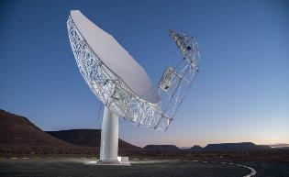
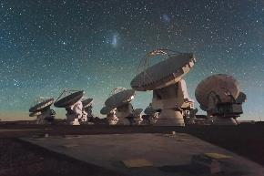
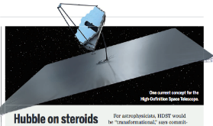
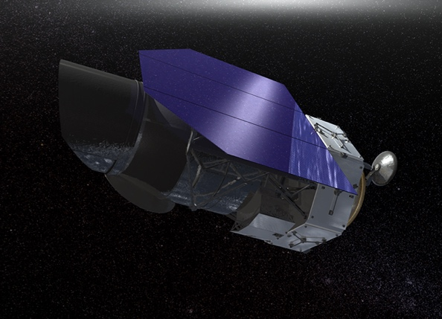
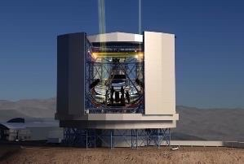
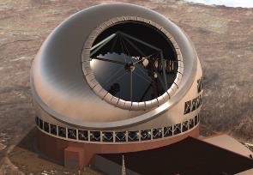
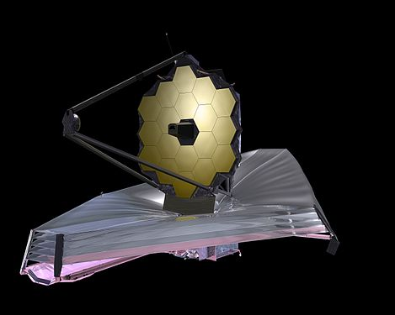
Highly Synergistic with Other Facilities on Similar Timescales
SKA/Lynx
  Atomic/non-thermal
  Molecular/thermal
ALMA
  Warm/star-forming
  Cold/dense fuel for SF
LUVOIR/HabEx
  Image earth-like planets
  Image terrestrial-zone planets forming
OST (FIR surveyor)
  C/WNM & WIM
  Cold Molecular Medium
TMT/GMT
  Stellar Mass and Unobscured SF
  Dense Gas and Obscured SF
JWST/WFIRST
  Continuing its legacy in many areas of astrophysics
Notes:
No matter which of these facilities materialize, their user-base will be ngVLA users as well.

Slide 10
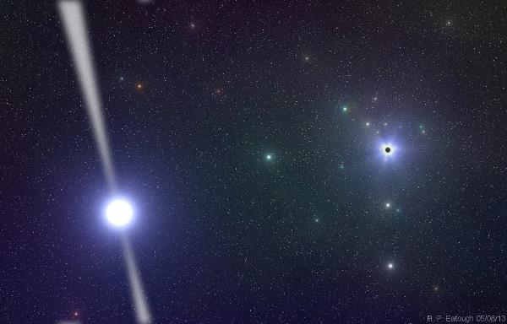
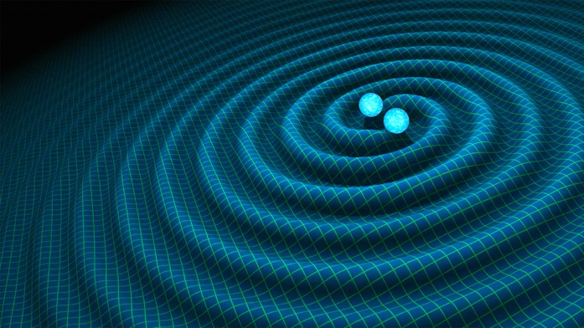
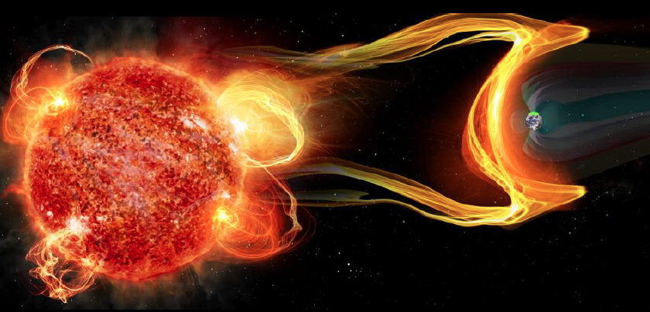
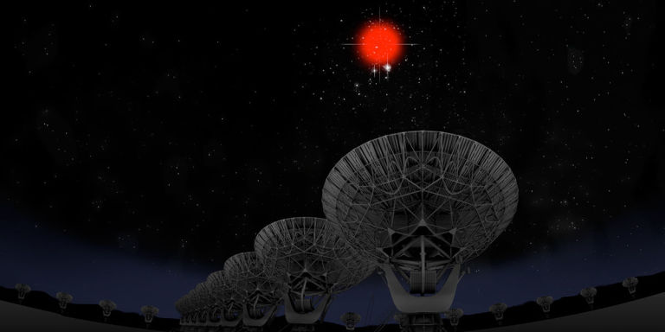
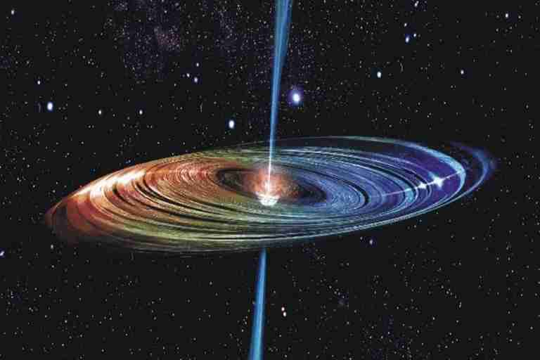
Versatility: Remarkable breadth of Science Enabled by the ngVLA
Galactic Center pulsars: testing GR
Gravitational Wave EM Follow-up
Extrasolar Space Weather
Bursting universe (FRB, GRB, TDE…)
Low surface brightness HI, CO
Obscured Black Hole Growth and AGN Physics
Quasar-Mode Feedback and the SZ Effect
Black hole masses and H_{o} with Mega-Masers
μas Astrometry: ICRF, Galactic structure…
Solar system remote sensing: passive and active radar
Spacecraft telemetry, tracking: movies from Mars

Slide 11
Many Thanks to:
The ngVLA Science and Technical Advisory committees
All ngVLA Science Working Group Participants
Initial ngVLA Science White Paper Authors
ngVLA Community Studies Participants

