Slide 1
The Bursting Universe: New Tools for Cosmology and Physics
Rachel Osten (STScI, JHU)
Also thanksk to Gregg Hallinan (CalTech), Laura Chomiuk (MSU), Shami Chatterjee (Cornell), Joe Lazio (JPL), Tom Maccarone (TTU)

Slide 2
Outline
Fundamental role of radio observations in transient follow-up; recent JVLA results, motivation for future Brave New Transient World
ngVLA Key Science: Using Pulsars in the Galactic Center as Fundamental Tests of Gravity
ngVLA Key Science: Understanding the Formation and Evolution of Stellar and Supermassive Black Holes in the Era of Multi-Messenger Astronomy
}
Posters!

Slide 3
The JVLA as a Transient Response Machine
Fundamental role of radio observations in transient follow-up; recent JVLA results, motivation for future Brave New Transient World
Gravitational wave events & multi-messenger follow-up
Fast Radio Bursts
Gamma Ray Bursts
Tidal Disruption Events
Compact objects (thermal & nonthermal)
Magnetic reconnection from normal stars
Why radio observations are important
Radio response probes energetics of event, often provides unbiased rates, constrains characteristics of surrounding media
Localization key to identification, follow-up

Slide 4
Gravitational wave events, multi-messenger follow-up
Binary neutron star merger event
Breakthrough science

Slide 5
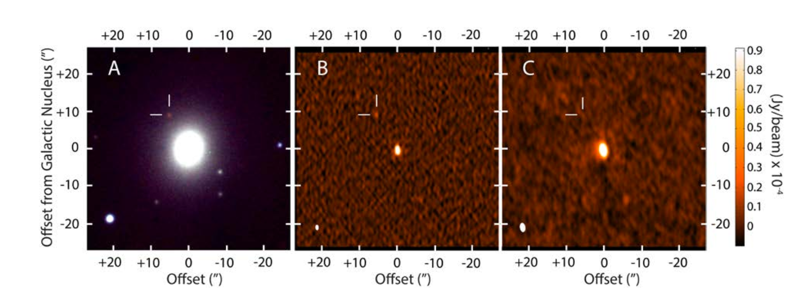
Gravitational wave events, multi-messenger follow-up
Hallinan & Corsi et al. (2017)
Aug. 17
Sept. 9
Aug. 22-Sept. 1

Slide 6
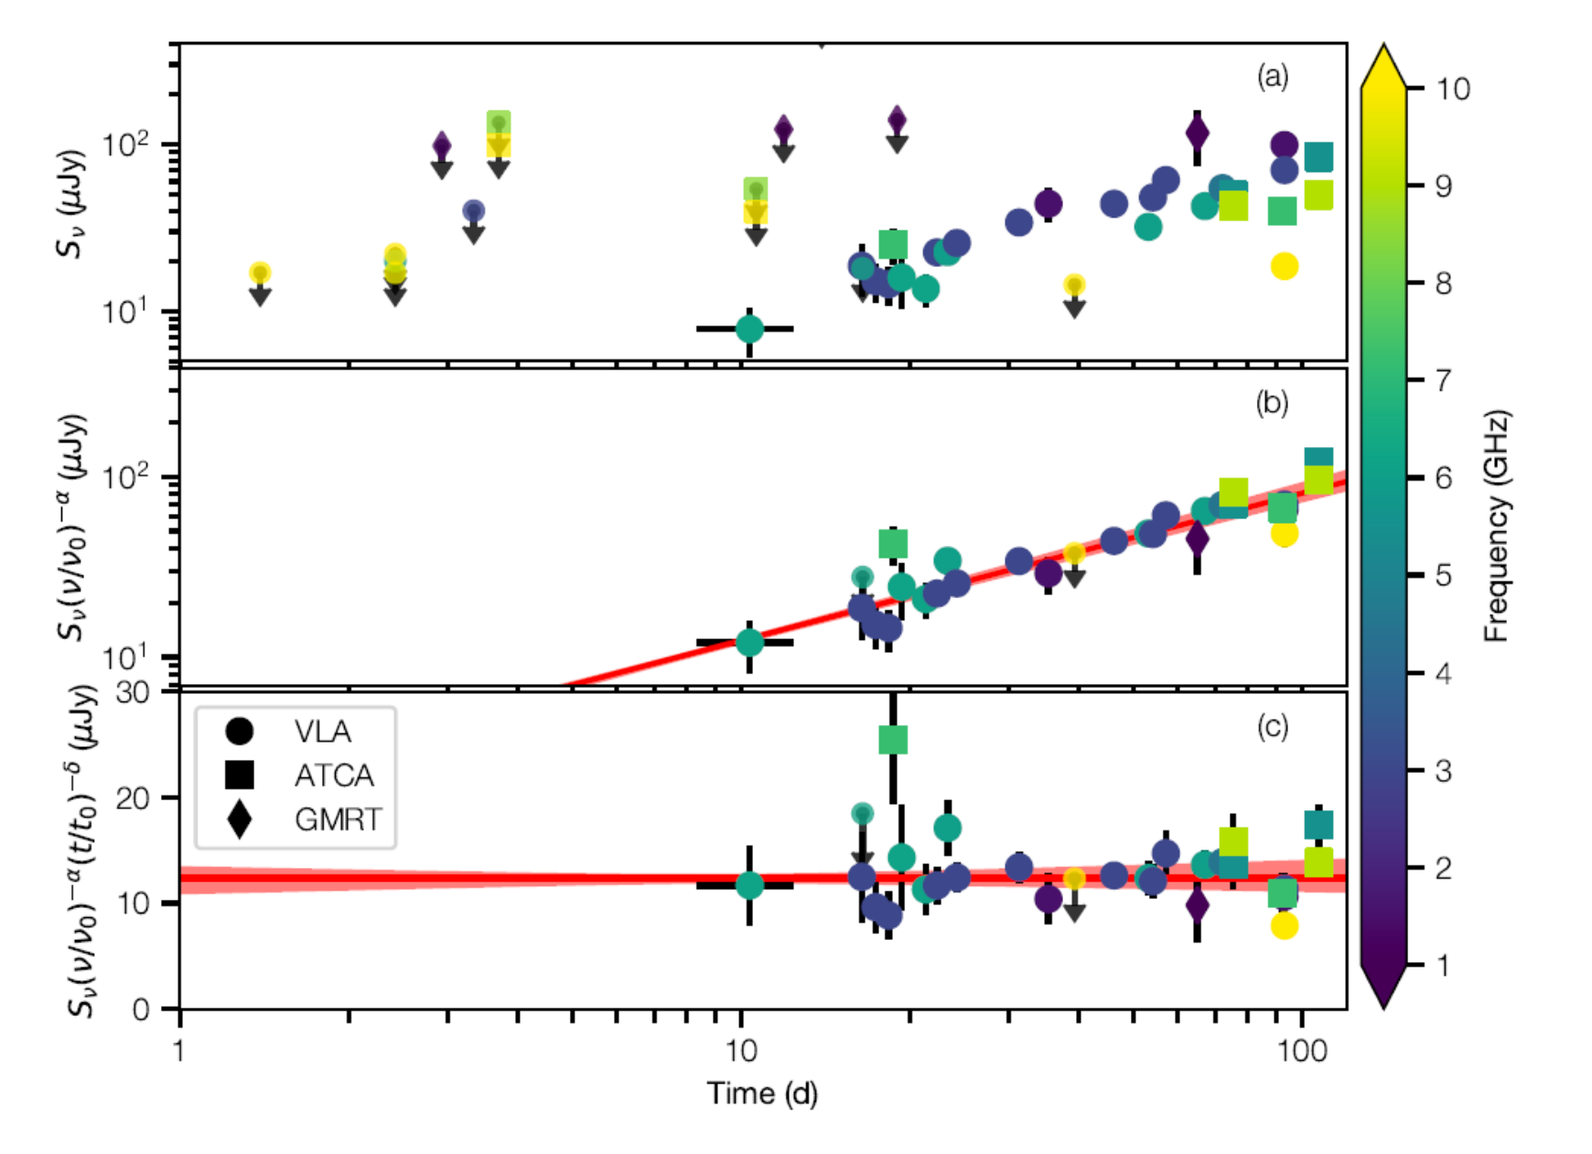
Gravitational wave events, multi-messenger follow-up
Lack of early radio detection → not viewing jet on-axis Time evolution currently consistent with either “structured jet” or wide-angle relativistic outflow (“cocoon”) Continued radio monitoring will be able to distinguish these possibilities.
Mooley et al. (2017)
Hallinan & Corsi et al. 2017

Slide 7
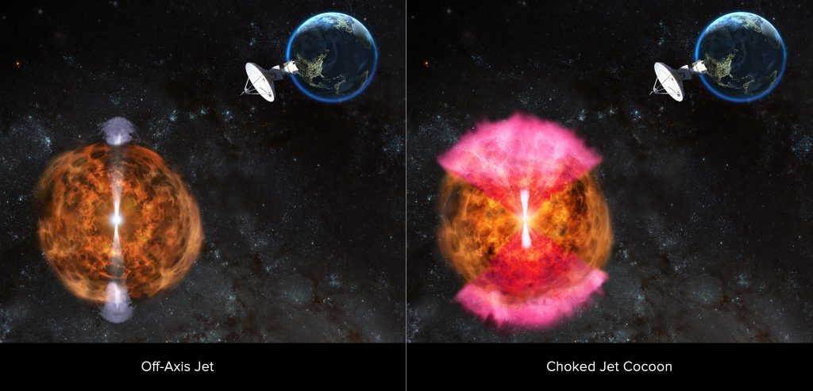
Gravitational wave events, multi-messenger follow-up
Radio emission isotropic, constrains total energy of ejected matter, velocity, density of surrounding medium
Requires ability to survey large areas of sky quickly & sensitively
ngVLA combination of high resolution and sensitivity can provide identification of progenitor systems.
Image credit: NRAO/AUI/NSF/D. Berry

Slide 8
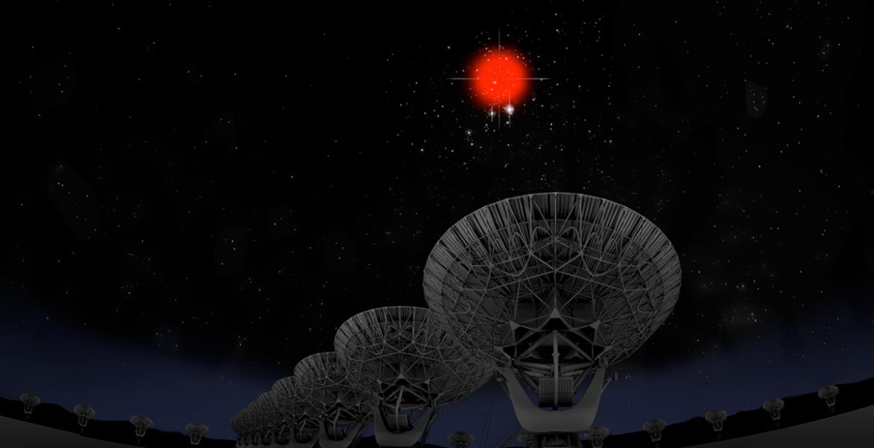
Fast radio burst localization, characterization
Credit: B. Saxton

Slide 9
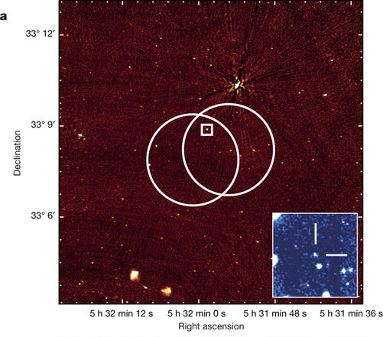
Fast radio burst localization, characterization
Localization of repeating FRB enables identification of host galaxy
Unclear if this is typical behavior as it is the only repeating FRB
Chatterjee et al. (2017)

Slide 10
Gamma ray bursts
Roughly 31% of long and short GRBs have radio afterglows (Chandra & Frail 2012) ➜ intrinsically dim or sensitivity limited?
Collimated events; only detect γ-ray emission from objects pointing at us. “Orphan” afterglows inform the true rate of GRBs, indirect limits on jet structure
Radio afterglow: burst physics (energy in explosion, jet structure, nature of ambient medium, physics of relativistic shocks)
Credit: NAOJ

Slide 11
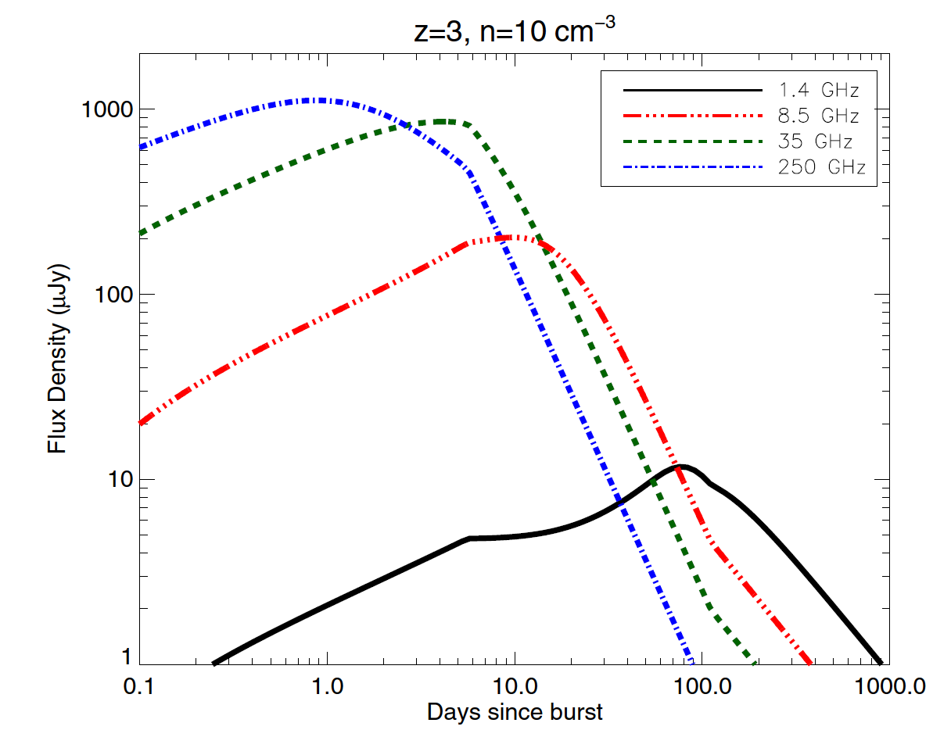
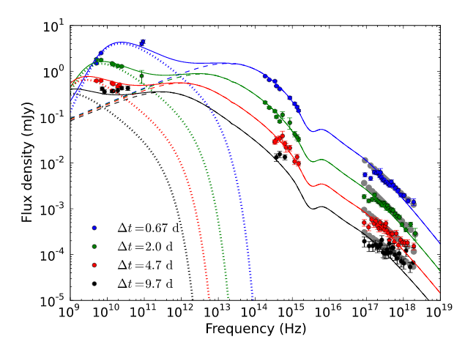
Gamma ray bursts
Chandra & Frail (2012) showing the higher frequencies of long GRBs peak earlier
Laskar et al. (2013) evidence of a reverse shock in a long GRB
Constrains initial bulk Lorentz factor, ejecta composition
Peaks at early times at higher frequencies

Slide 12
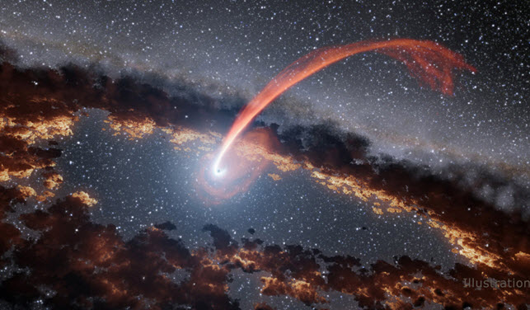
Tidal disruption events
Radio observations detail interaction between TDE jet and dense gas surrounding SMBH
Opportunity to witness the waking up of an AGN
Physics of jet production across a wide range of mass feeding rates, physics of relativistic jet formation, super-Eddington accretion, distribution of accreting or outflowing gas in a quiescent galactic nuclei

Slide 13
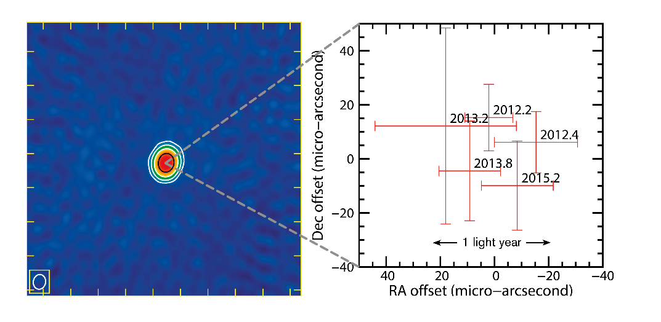
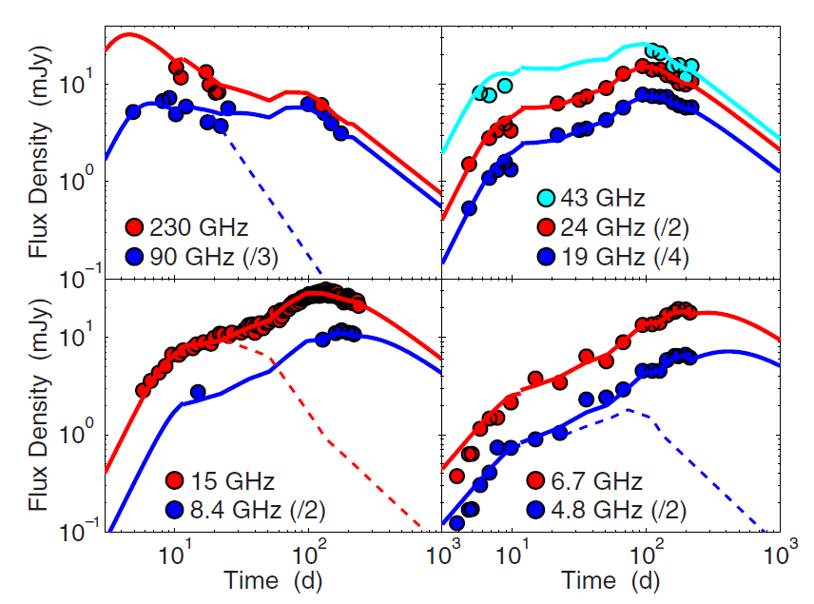
Tidal disruption events
High frequency late-time re-brightening implies more complex temporal or angular structure to jet
No apparent superluminal motion
Yang et al. (2016)
Zauderer et al. (2013)

Slide 14
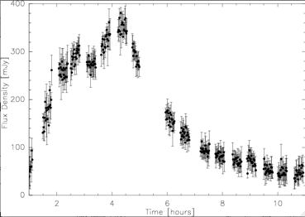
Magnetic reconnection events from normal stars
Bower et al. (2003)
Massi et al. (2006) 90 GHz flare on V773 Tau

Slide 15
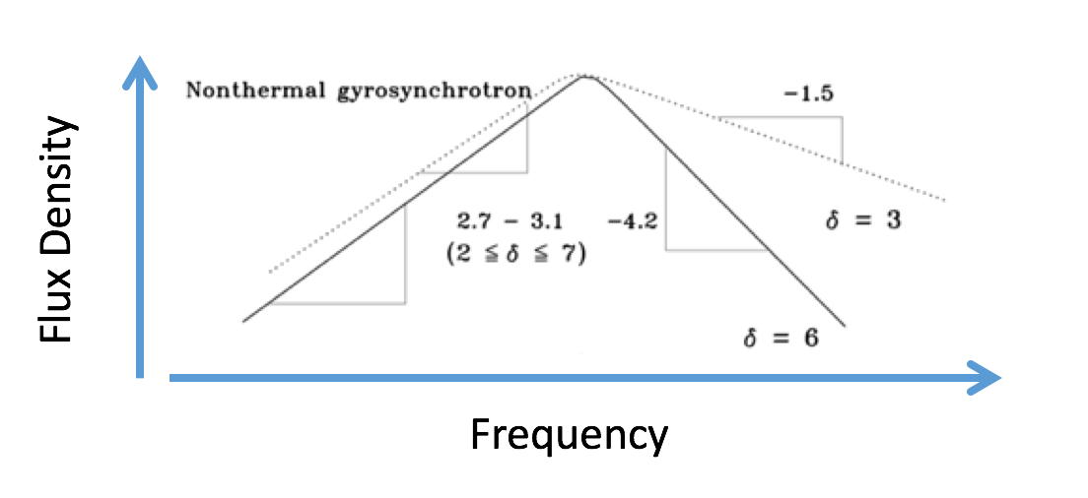
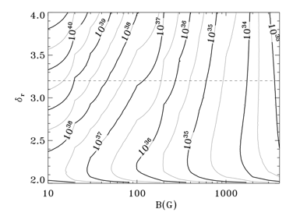
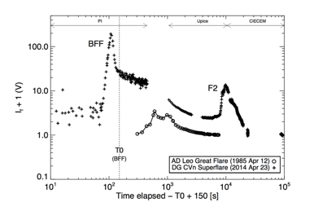
Magnetic reconnection events from normal stars
Osten et al. (2016)
Higher radio frequencies (ν>10 GHz) probe optically thin conditions.
Currently the only way to constrain particles and fields in flaring plasma.
See Osten poster 342.18 for much more detail about this topic!

Slide 16
JVLA ➜ ngVLA rapid follow-up
Higher frequencies peak earlier for many types of astrophysical transients, motivating a sensitive radio telescope capable of operating in the 1-100 GHz range with resolution to provide identification of progenitor systems
With a much enhanced sensitivity, the ngVLA can monitor e.g. TDE jets for decades & resolve the jets, providing jet angular structure, jet precession due to BH spin

Slide 17
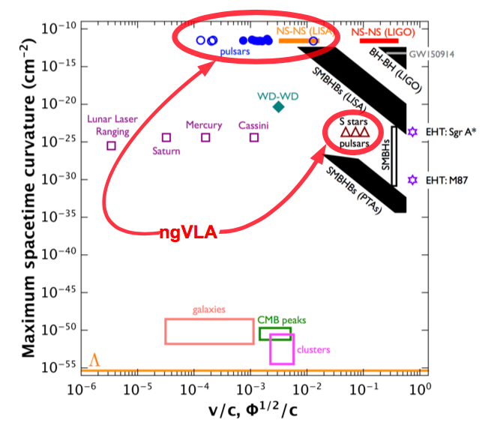
ngVLA Key Science: Pulsars in the Galactic Center
Credit: B. Saxton
Figure credit: M. Kramer
Notes:
Getting to the upper right corner of the plot on the right provides the most constraints on general relativity

Slide 18
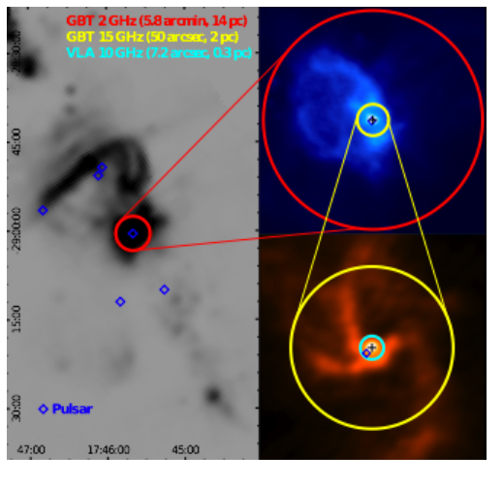
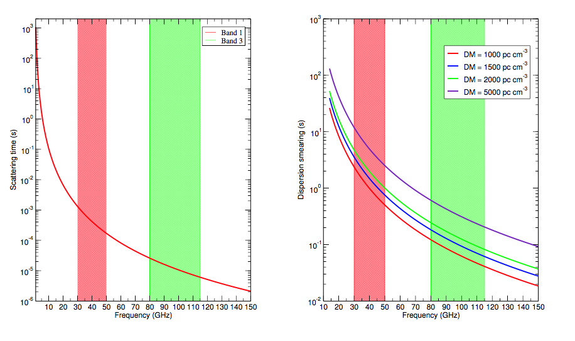
ngVLA Key Science: Pulsars in the Galactic Center
Credit: R. Wharton
Expect up to ~10³ pulsars in GC region; only see handful
Pulsar searches at high frequency take advance of decreasing scattering time and dispersion smearing, need sensitivity to overcome decreasing flux density

Slide 19
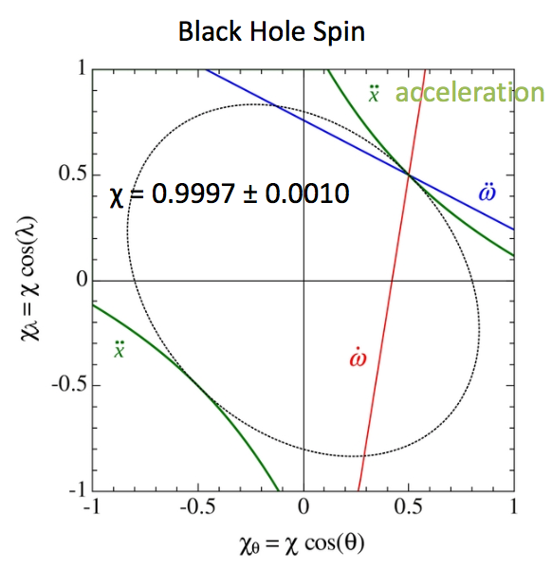
ngVLA Key Science: Pulsars in the Galactic Center
Liu et al. (2012)

Slide 20
ngVLA Key Science: Pulsars in the Galactic Center
Measure mass of Sgr A* to precision of 1 M⊙
Age distribution of pulsars ➜ star formation history at Galactic center
Measure local gravitational potential via ms pulsars
Dispersion & scattering (and their variability) ➜ distribution and clumpiness of ISM
Pulsar timing + astrometry of stellar orbits ➜ distance to Galactic center R₀
See Bower poster 342.31 for much more detail about this topic!

Slide 21
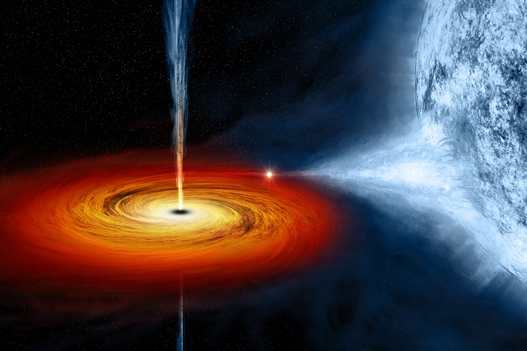
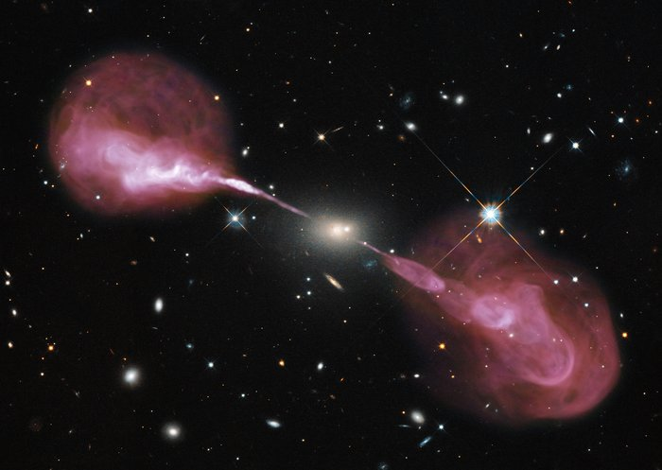
ngVLA Key Science: Formation and Evolution of Stellar, Supermassive Black Holes
M.Weiss/NASA/CXC
NASA, ESA, S. Baum & C. O’Dea (RIT), R. Perley & W. Cotton (NRAO/AUI/NSF), and the Hubble Heritage Team (STScI/AURA)

Slide 22
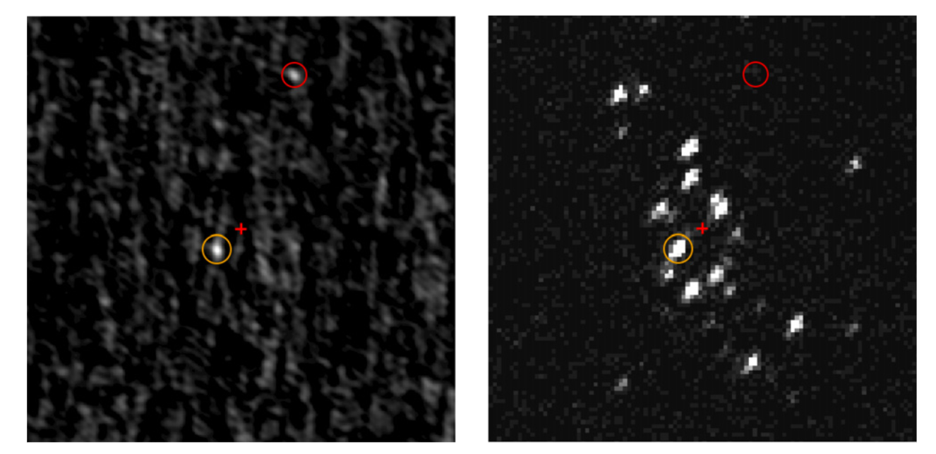
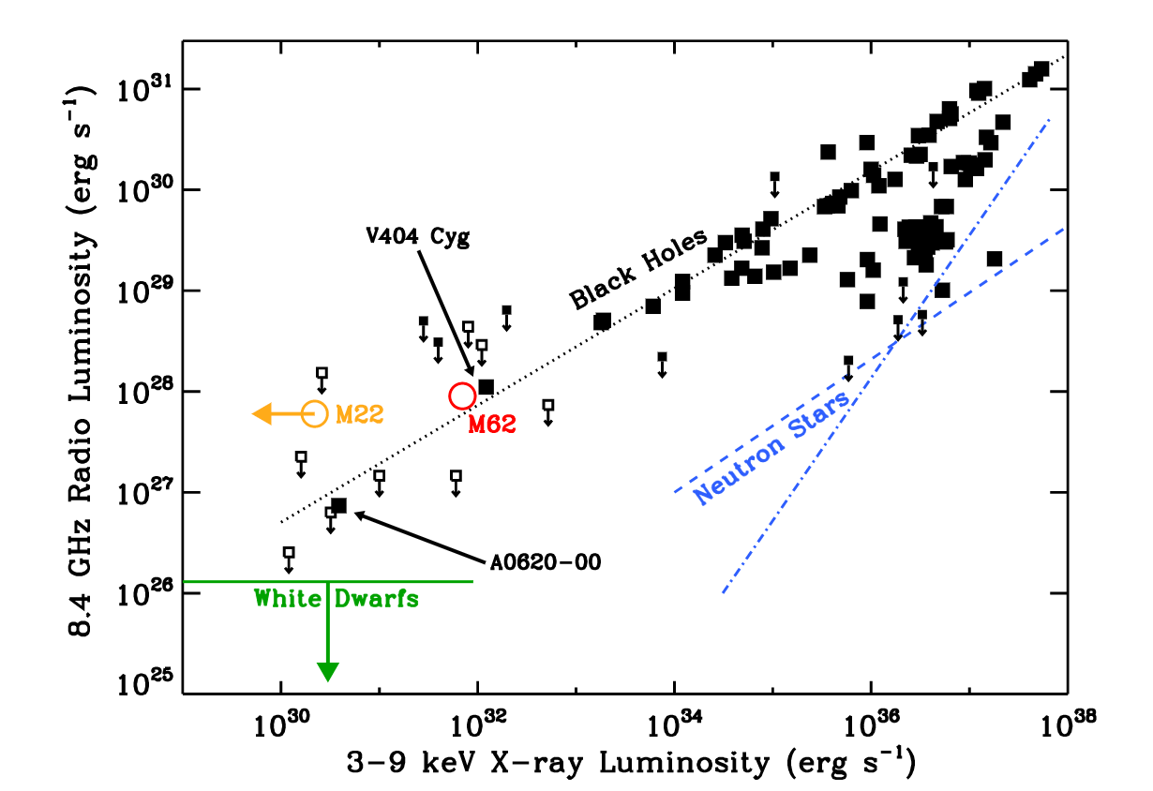
ngVLA Key Science: Formation and Evolution of Stellar, Supermassive Black Holes
VLA
Chandra
Chomiuk et al. (2013) black hole candidate in M62
10 pc
# of X-ray binaries in the Milky Way estimated between 100 and 10⁸ (Tetarenko et al. 2016)
Proper motion + distance ➜ kick speeds (& constraints on BH spin alignment)

Slide 23
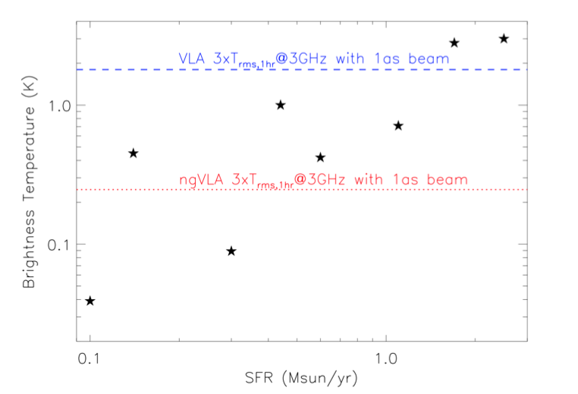
ngVLA Key Science: Formation and Evolution of Stellar, Supermassive Black Holes
Taylor et al. (2014), binary system of SMBH at z=0.06
Pulsar timing array, high resolution imaging will survey SMBH population
Measure rate of SMBH mergers through contribution to stochastic gravitational wave background
Image evolution of binary SMBHs in lead up to merger
Proper motions of double AGN
Corsi et al. (2017) ngVLA memo #28
Most hosts of NS-NS and NS-BH binary mergers at z<0.1 will be resolved.
10 pc

Slide 24
ngVLA Key Science: Formation and Evolution of Stellar, Supermassive Black Holes
“the ultimate black hole finding machine”
Formation and growth of black holes of all sizes
Radio counterparts to transient sources detected by gravitational wave, neutrino, optical observatories
High resolution, fast mapping ideal for pinpointing transients associated with SMBH mergers, blast waves
Unaffected by dust obscuration
Angular resolution to separate Galactic sources from background objects using proper motions
10 pc
See Lazio poster 342.32 for much more detail on this topic!

Slide 25
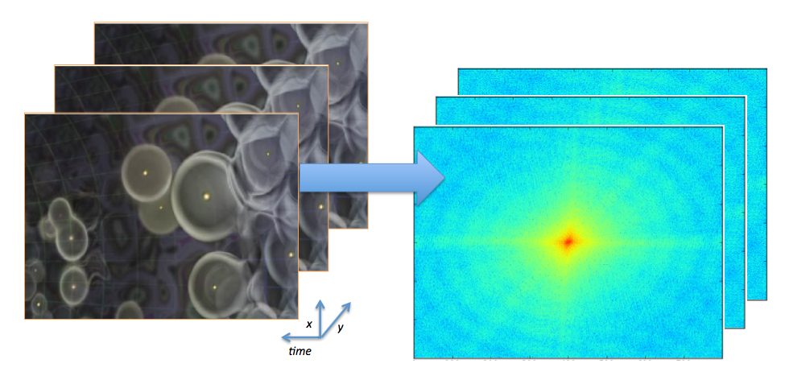
Other Fundamental Physics
Cosmology: Megamasers
Cosmology: Intensity Mapping
H₀ to 1%, Keplerian rotation curve only tenths of a pc from the galactic nucleus, within the SMBH sphere of influence
Detect many objects at once through integrated emission rather than direct detection of individual objects

Slide 26
Other Fundamental Physics
Cosmology: Changing Fundamental Constants
Current radio studies limited to z<1
Changes in fine structure constant α, proton-electron mass ratio μ
Current capabilities at radio wavelengths: Δμ/μ∼few x 10⁻⁸, Δα/α∼few x 10⁻⁷
ngVLA advances:
10x towards currently studied systems
Expand redshift coverage to z>1 with CH₃OH, NH₃ lines
Combine transitions to get Δμ/μ ∼few x 10⁻¹⁰ for currently studied systems, and few x 10⁻⁹ at z>1 using multiple absorbers
Need raw telescope sensitivity + wide frequency coverage, 3-50 GHz crucial, 1-100 GHz expands redshift coverage, transitions

Slide 27
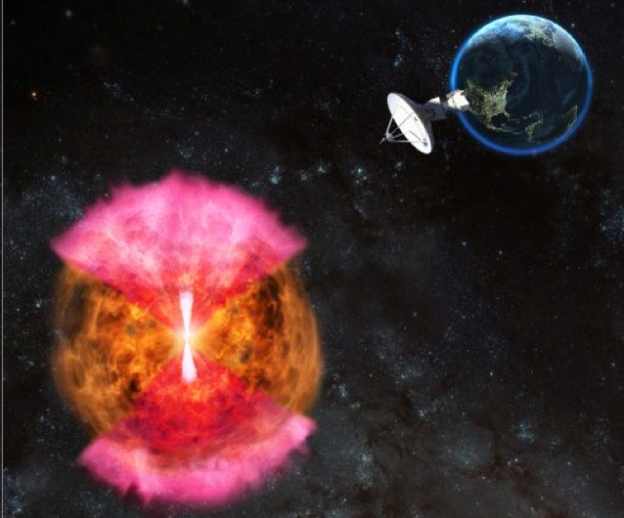
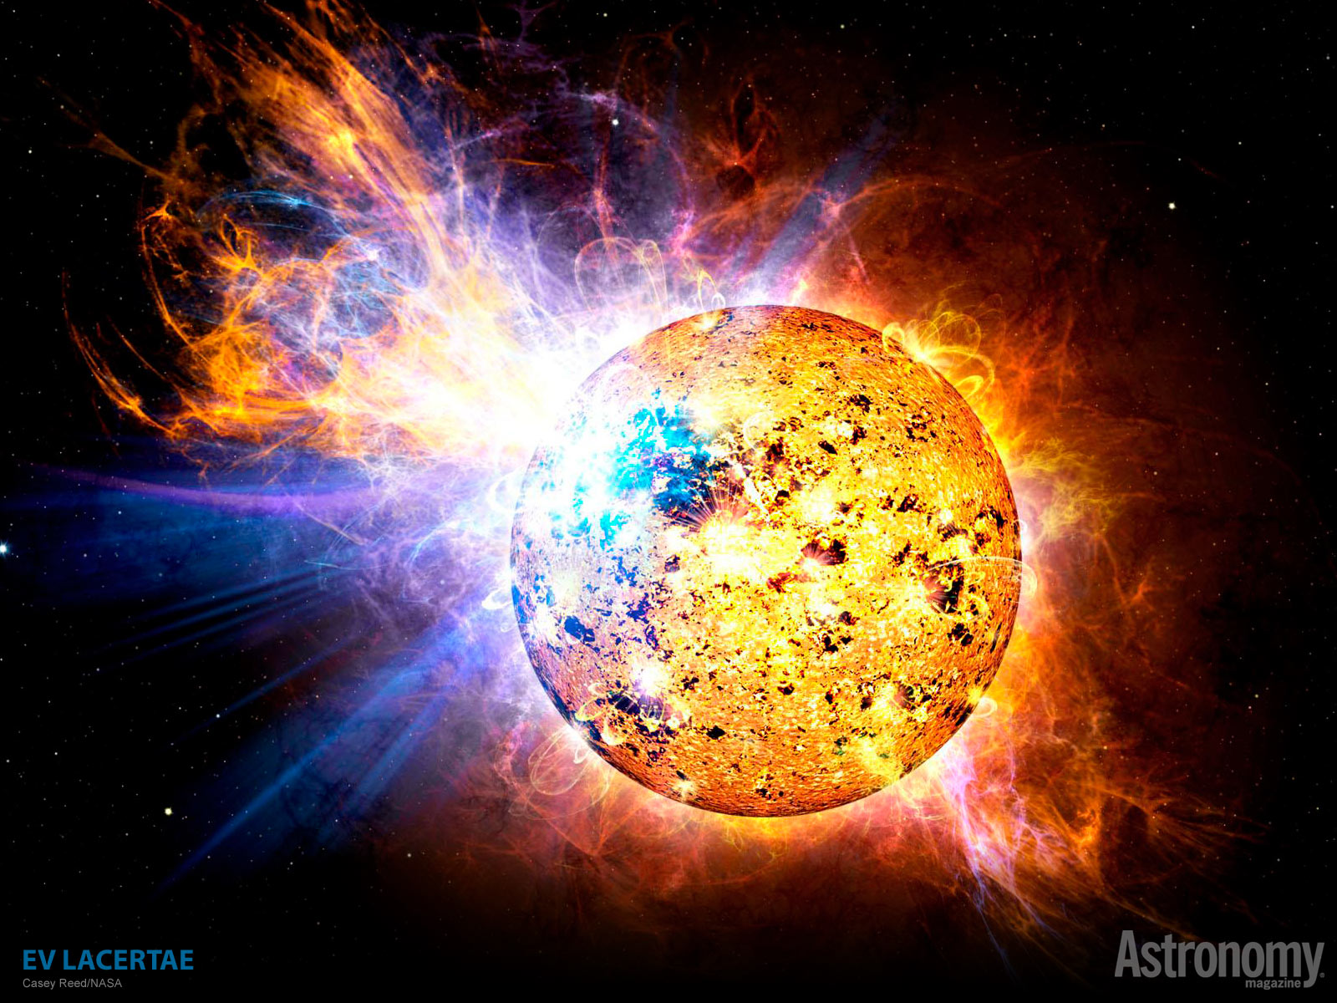
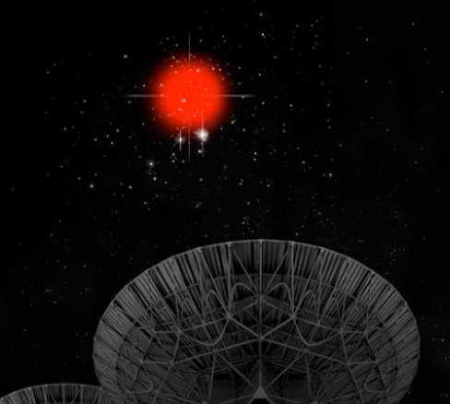
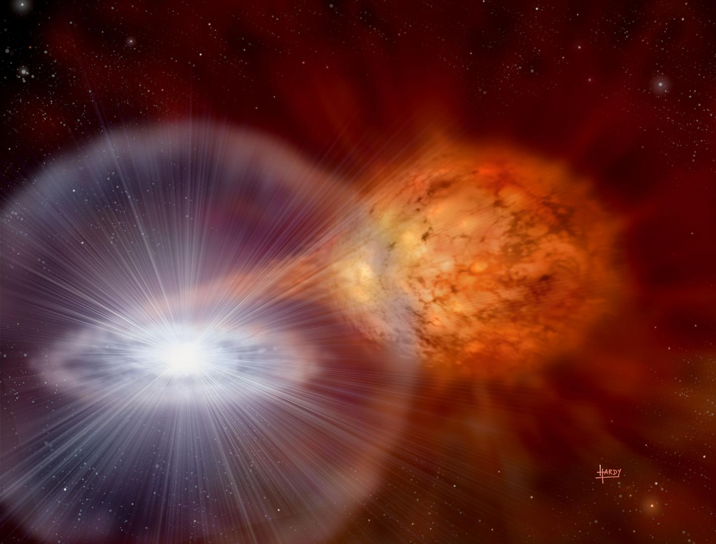
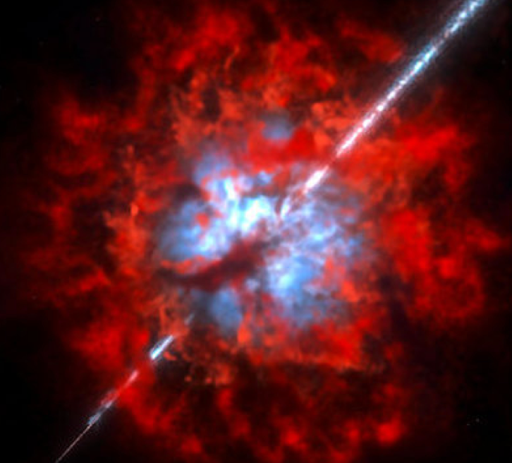
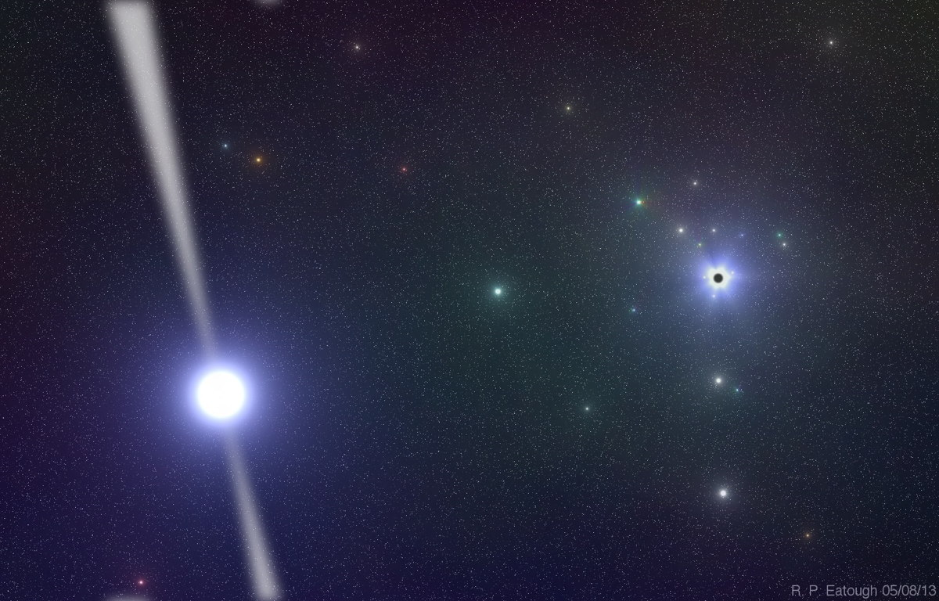
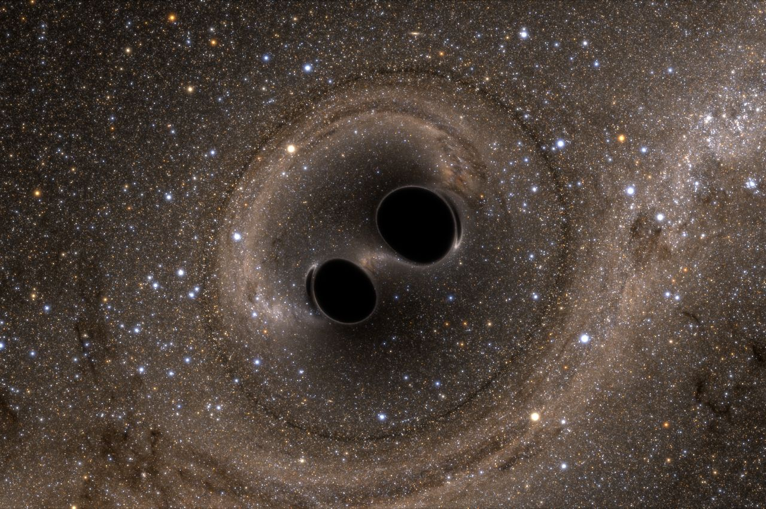
The Universe is out there for the ngVLA to study!
Radio advantage of localization, energetics, probe of environment are necessary to advance understanding of transient phenomena, fundamental physics
What is needed: (1) frequency range (1-100 GHz)
(2) high sensitivity (10x JVLA)
(3) good angular resolution (several mas)

Slide 28
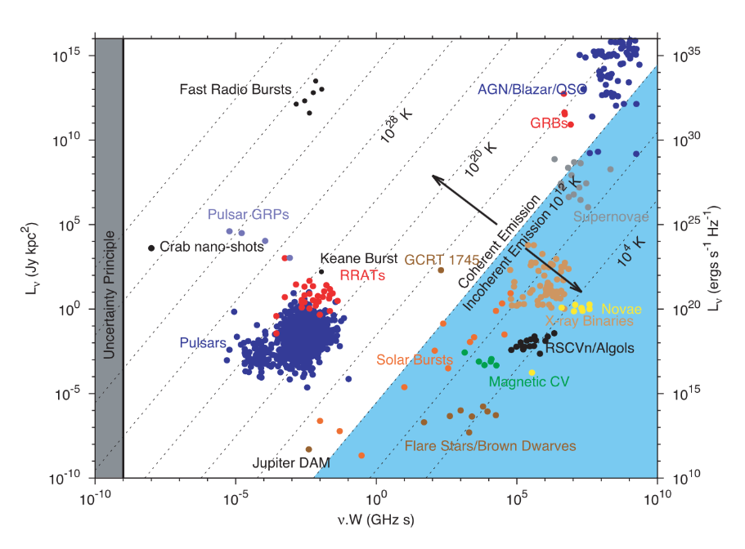
Radio Transient Parameter Space
Pietka et al. (2015)

Slide 29
Gravitational wave events, multi-messenger follow-up
Radio emission isotropic, constrains total energy of
ejected matter, velocity, density of surrounding medium
Requires ability to survey large areas of sky quickly & sensitively
ngVLA combination of high resolution and sensitivity can provide identification of progenitor systems.

Slide 30
megamasers
Megamasers into the Hubble flow at 5—20 Mpc
Megamaser cosmology project aims to get to measurement of H0 to 4% uncertainty
Kepleriat rotation curve only tenths of a pc from the galactic nucleus, within the SMBH sphere of influence
To get 1% uncertainty, need 10% distances to 100 megamaser galaxies

Slide 31
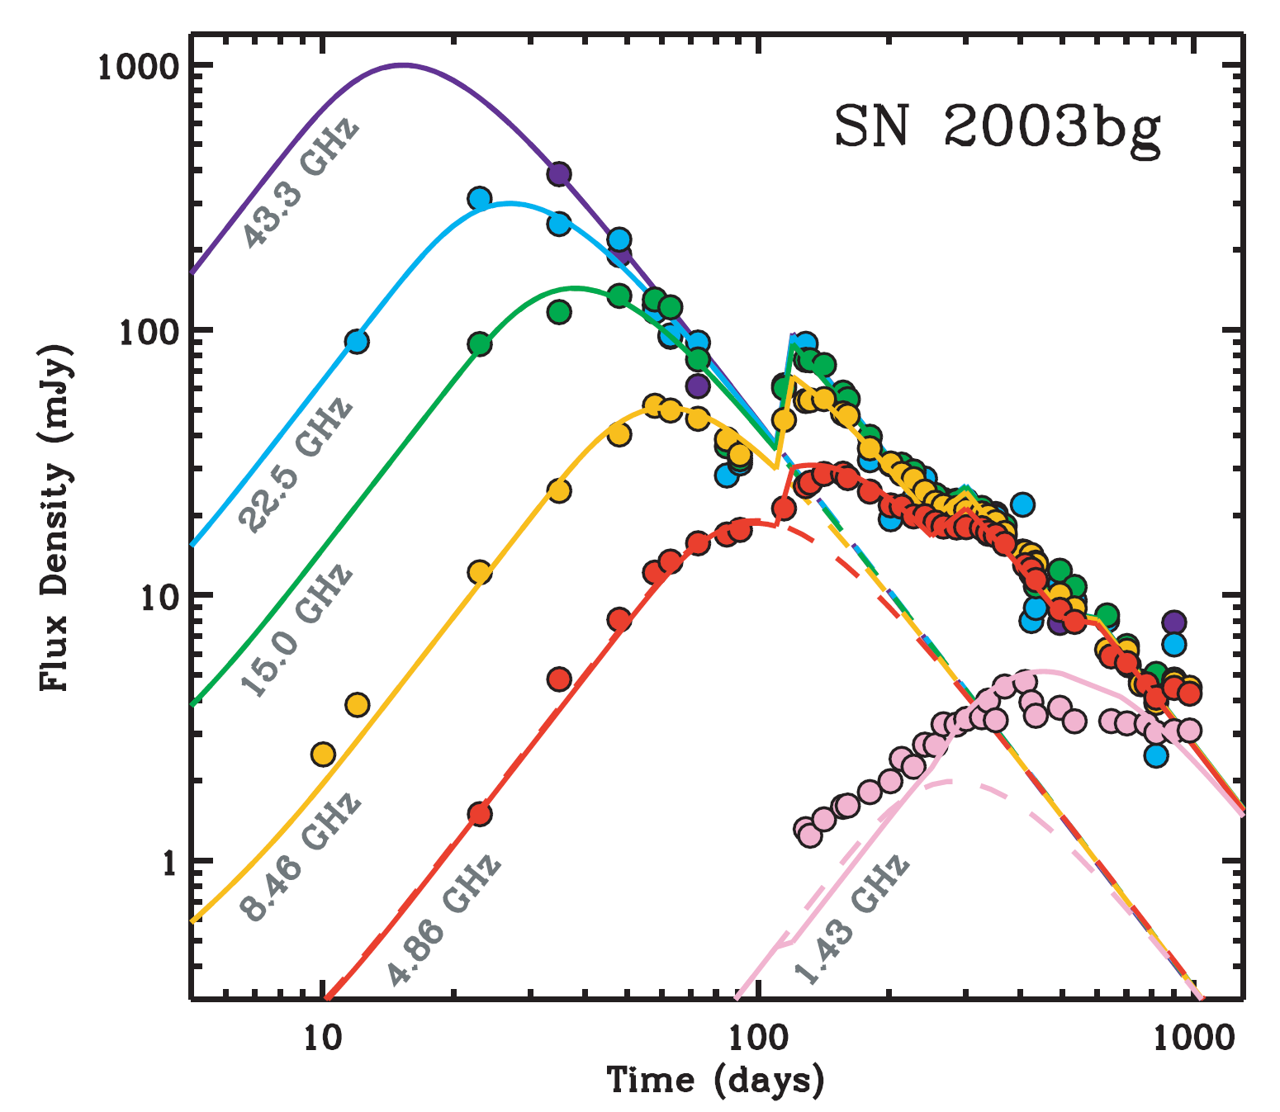
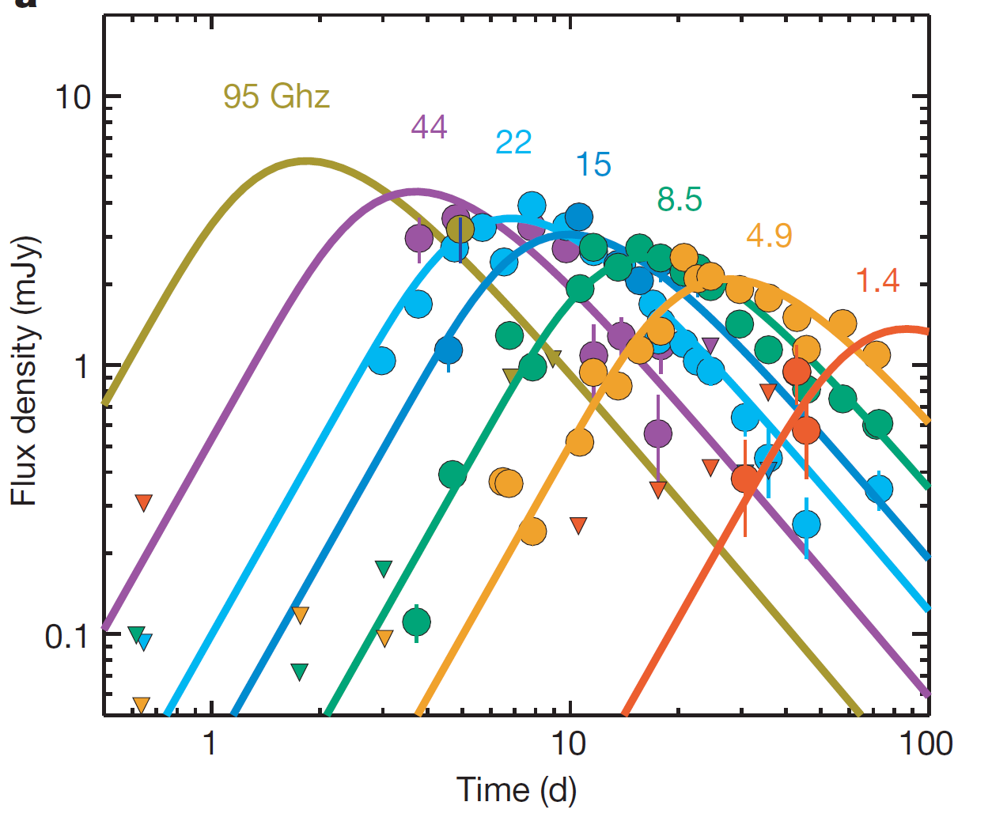
Supernovae
←Soderberg et al. (2006)
Soderberg et al. (2008)→
Synchrotron emission: interaction of explosion shock with CSM
Higher frequencies peak earlier

Slide 32
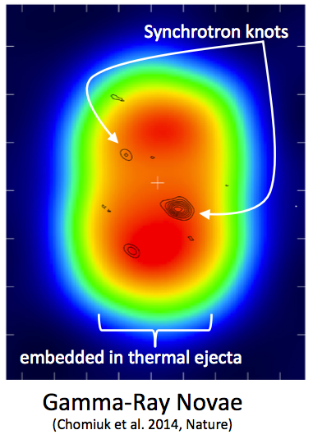
Novae
Thermal bremsstrahlung emission from warm ejecta produces transient radio signature
Radio emission lasts ∼years, compared to ∼months for optical
Constrain the mass of the ejecta from nova evolution
Interaction of ejecta with environment gives rise to shock, which can produce NT synchrotron emission component

Slide 33
Conclusions
The JVLA has been enormously successful in studying the transient universe; ngVLA will do even better
ngVLA will make much-needed advances in fundamental physics through studies of the Galactic Center region, black holes of all sizes, and transients

