Slide 1
An Overview of
Quadruple-ridged Flared Horns for Radio Astronomy
Ahmed H. Akgiray
Ozyegin University
ngVLA Workshop @ Caltech
19-20 June 2018

Slide 2
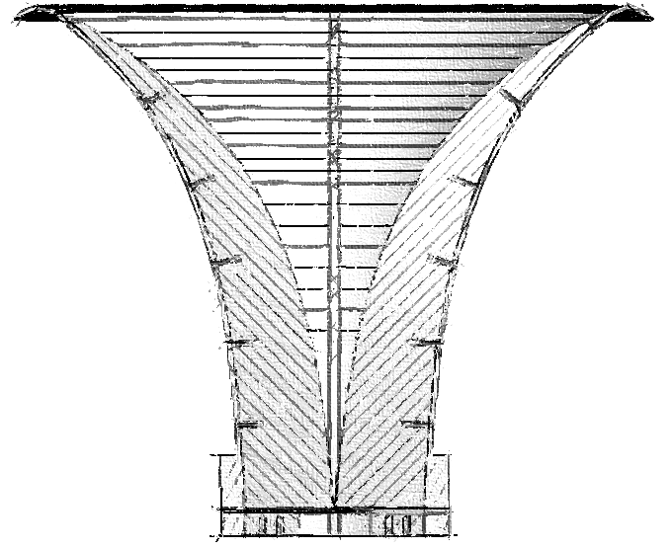
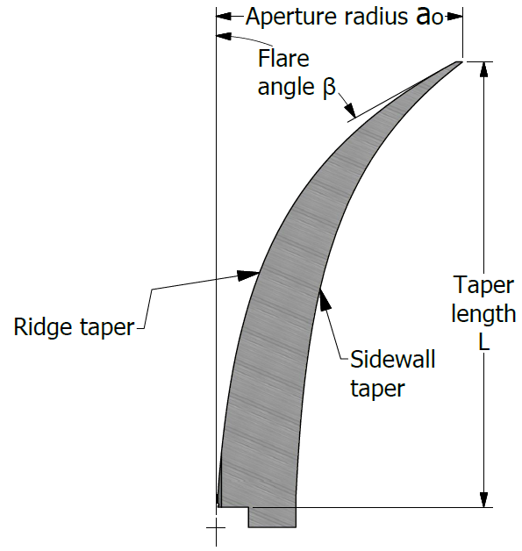
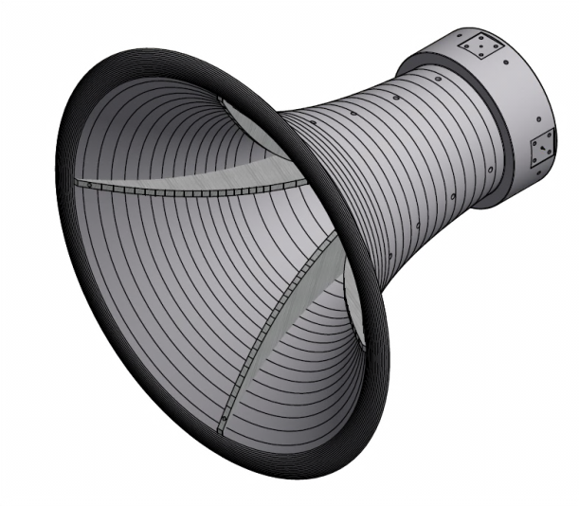
CIT Quadruple-Ridged Flared Horn
Several ideas coming together:
Notes:
All the ideas that go into the QRFH have been around, we’re the first to put them together to design a constant-gain horn
Talk about flare angle

Slide 3
Prior State of the Art
Corrugated horns satisfy all except bandwidth
Type | Radiation pattern features | Typical aperture efficiency | Input Impedance | BW | Cost Estimate
Corrugated horn | Almost Gaussian beam, constant with freq; low sidelobes, excellent x-pol; const phase ctr; can be designed for different beamwidths | 75-85% | 50 Ohm single-ended | 2:1 | Low to medium
Eleven feed | Const beamwidth w/ reasonably circular beam; mediocre x-pol; const phase ctr; tough to change beamwidth | 60-65% | 200 Ohm differential | 7:1 | High
ATA feed | Const beamwidth w/ reasonably circular beam; mediocre to poor x-pol; large phase ctr variation; tough to change beamwidth | 50% | 200 Ohm differential | 10:1 | Medium to high
QSC feed | Const beamwidth w/ reasonably circular beam; mediocre to poor x-pol; ??? phase ctr variation; tough to change beamwidth | 60% | 200 Ohm differential | 10:1 | ???
Sinuous feed | Mediocre beamwidth stability w/ elliptical beam; mediocre x-pol; const phase ctr; tough to change beamwidth | 60%??? | 260 Ohm differential | 4:1 | Medium

Slide 4
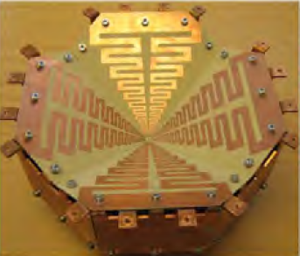
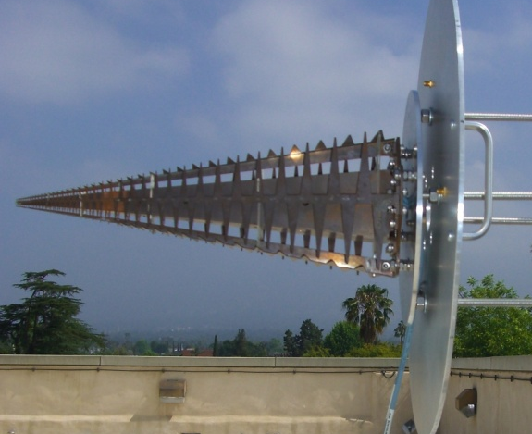
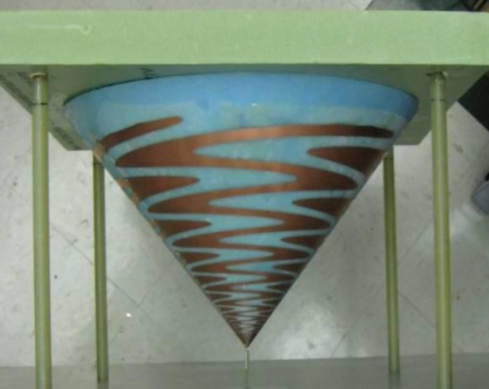
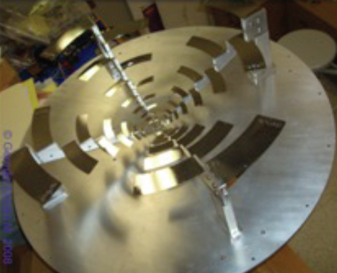
Prior State of the Art
Corrugated horns satisfy all except bandwidth
Type | Radiation pattern features | Typical aperture efficiency | Input Impedance | BW | Cost Estimate
Corrugated horn | Almost Gaussian beam, constant with freq; low sidelobes, excellent x-pol; const phase ctr; can be designed for different beamwidths | 75-85% | 50 Ohm single-ended | 2:1 | Low to medium
Eleven feed | Const beamwidth w/ reasonably circular beam; mediocre x-pol; const phase ctr; tough to change beamwidth | 60-65% | 200 Ohm differential | 7:1 | High
ATA feed | Const beamwidth w/ reasonably circular beam; mediocre to poor x-pol; large phase ctr variation; tough to change beamwidth | 50% | 200 Ohm differential | 10:1 | Medium to high
QSC feed | Const beamwidth w/ reasonably circular beam; mediocre to poor x-pol; ??? phase ctr variation; tough to change beamwidth | 60% | 200 Ohm differential | 10:1 | ???
Sinuous feed | Mediocre beamwidth stability w/ elliptical beam; mediocre x-pol; const phase ctr; tough to change beamwidth | 60%??? | 260 Ohm differential | 4:1 | Medium
Eleven Feed (Chalmers)
ATA Feed (UCB)
Sinuous Feed (UVa)
QSC Feed (Cornell)
Notes:
There is a tight competition between five different wideband single-pixel feeds in consideration for the DVA-1 antenna. This list is certainly not exhaustive but this is the group we’re focusing on right now. Shown here are: ….
But the CIT QRFH has some unique features.
First, we can design the feed to have a constant beamwidth over 6:1 bandwidth (within +/- 10%) for nominal 10-dB beamwidths between 60-130 degrees.
Furthermore, the feed input impedance could be designed to be any desired value between 50-100 ohm (and in fact higher than 100 ohm). While 50 ohm is convenient for testing in the lab and integration with other components, 100 Ohm tends to yield slightly better performance.
Unlike the other feeds shown on this slide, our horn only requires two single-ended LNAs. The others require 4 or 8 such LNAs.
For consideration in large-N telescopes, these feeds should be easy to manufacture and maintain. And this horn is. It took our machinist 8 working days to build it which is quite fast considering it’s the first time we’ve built one (and as such he had to make two different spindles as big as the feed).

Slide 5
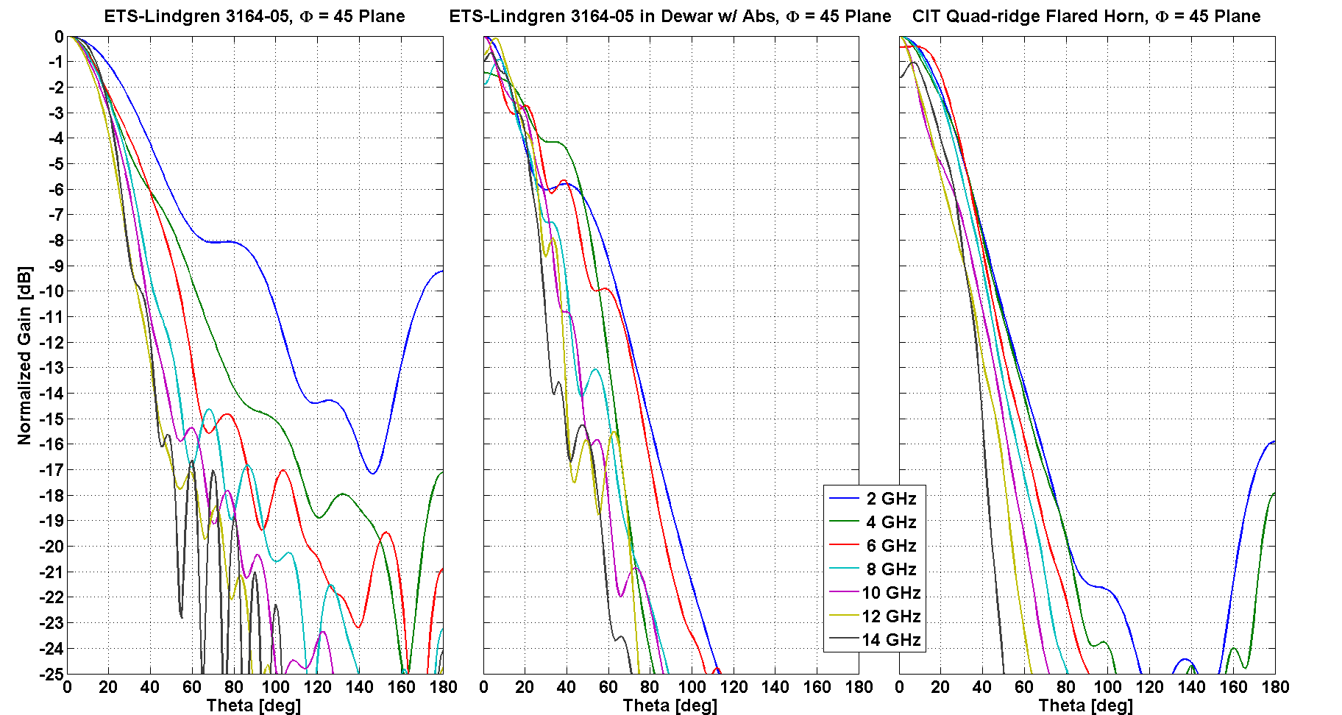
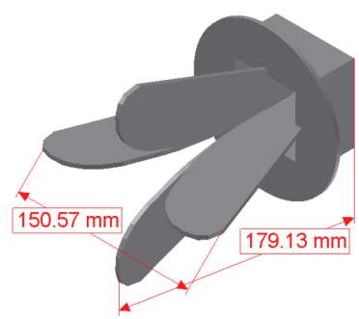
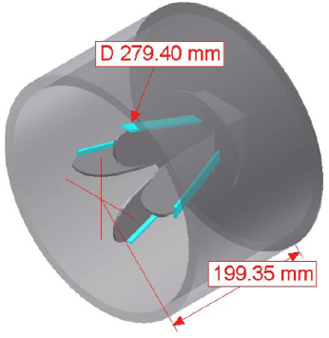
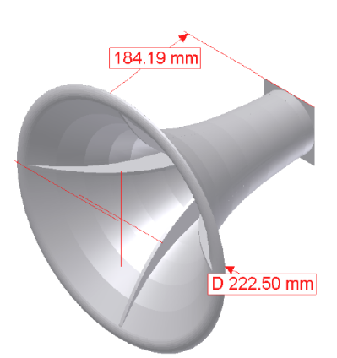
A more quantitative look:
ETS-Lindgren vs. an early QRFH design
Notes:
Emphasize early design, take note of the backlobe

Slide 6
Why quad-ridge horn?
6:1 bandwidth typical
Low loss
High return loss
Single-ended ports
Easy to fabricate
Flexible design (infinitely many profiles)
H-plane beam narrows vs frequency
Cross-polarization needs improvement
Designs for small f/D more challenging
Lacks a design procedure like corrugated horns => brute force optimization

Slide 7
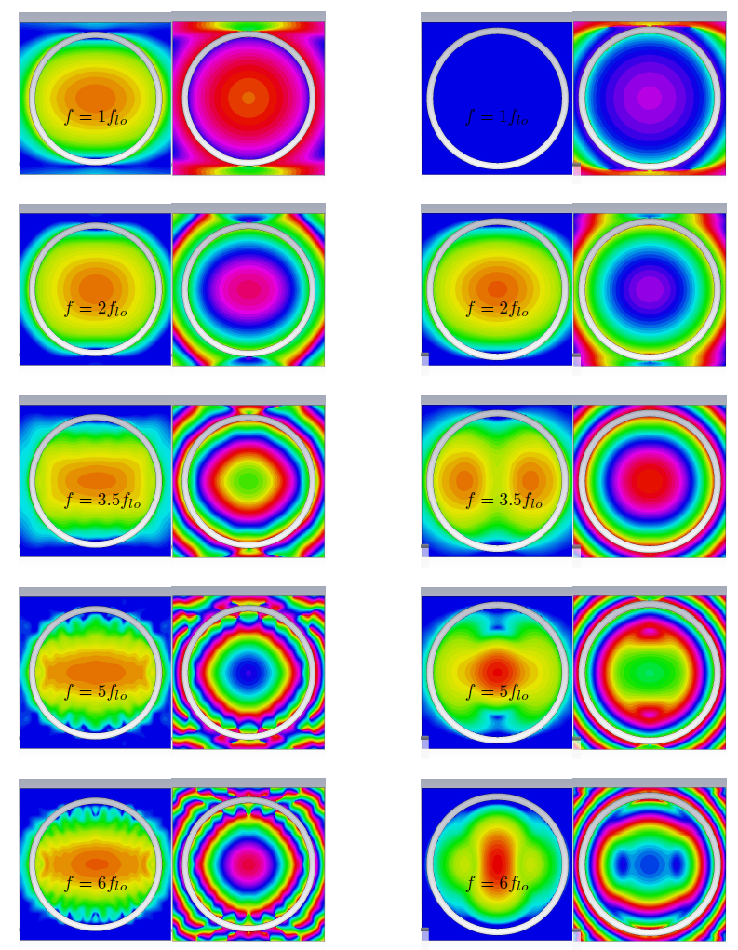
Impact of ridges
A qualitative perspective
With ridges
Amp & Phase
Without ridges
Amp & Phase
Ideally one needs the fractional aperture area with uniform phase and amplitude to reduce with frequency to achieve constant beamwidth.
In the QRFH:
area with uniform amplitude is fairly constant in the plane of the excited polarization
It’s the area with uniform phase that shrinks considerably
This suggests that the QRFH is a flare-angle limited horn…
only x-directed aperture fields plotted

Slide 8
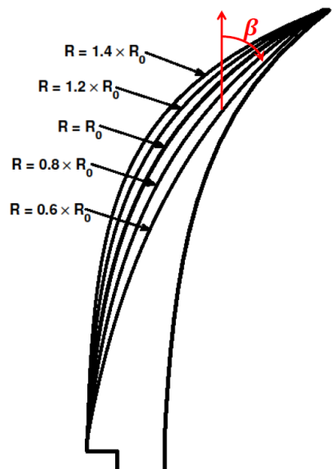
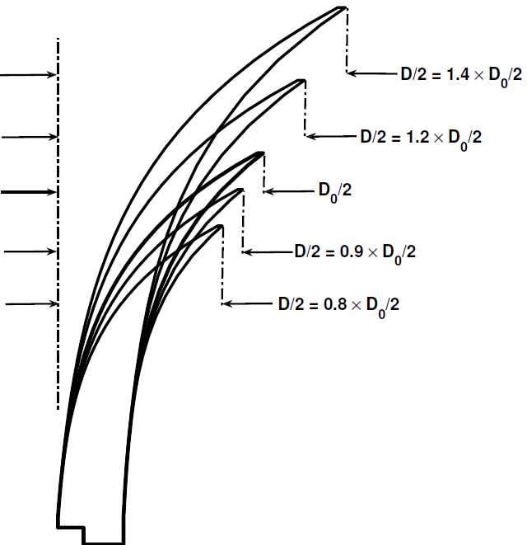
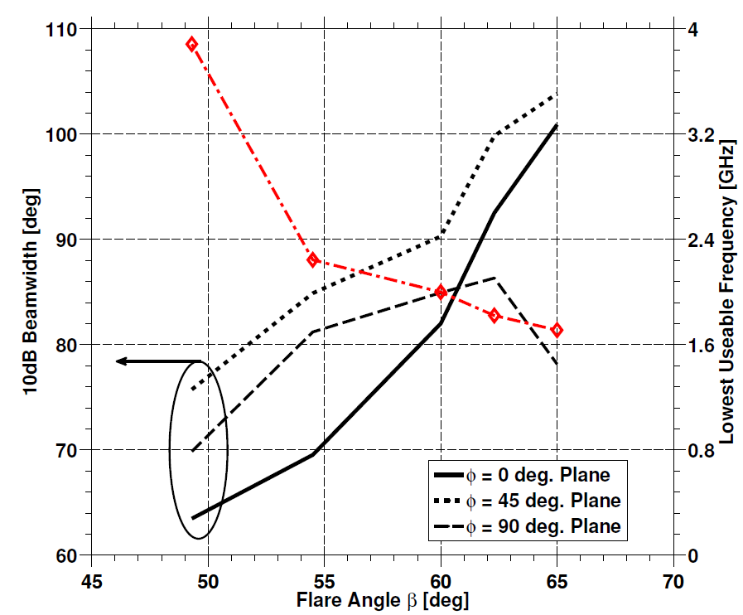
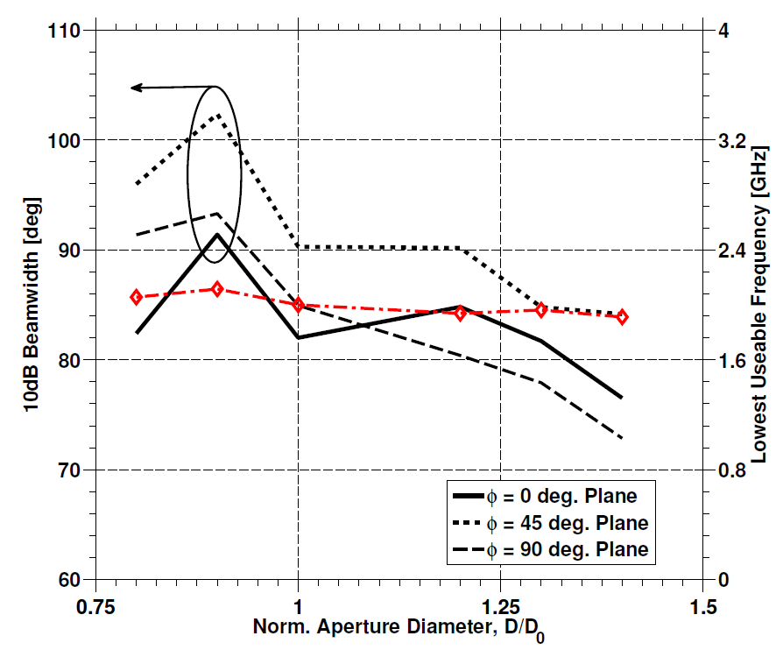
Ridge Profile Opening Rate vs. Aperture Diameter
QRFH: a flare-angle limited horn
Freq = 5GHz
R₀ and D₀ are nominal ridge opening rate and aperture diameter, respectively, namely those of the first QRFH built
Notes:
Return loss cutoff frequency = lowest useable frequency
Emphasize flare angle

Slide 9
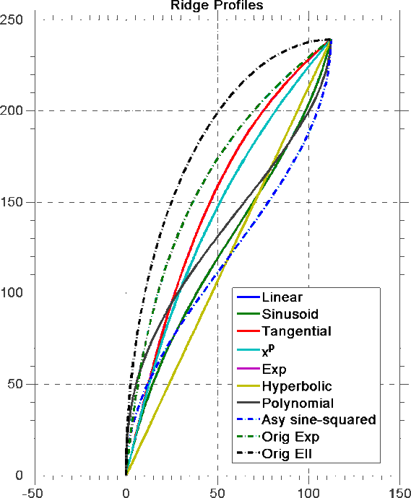
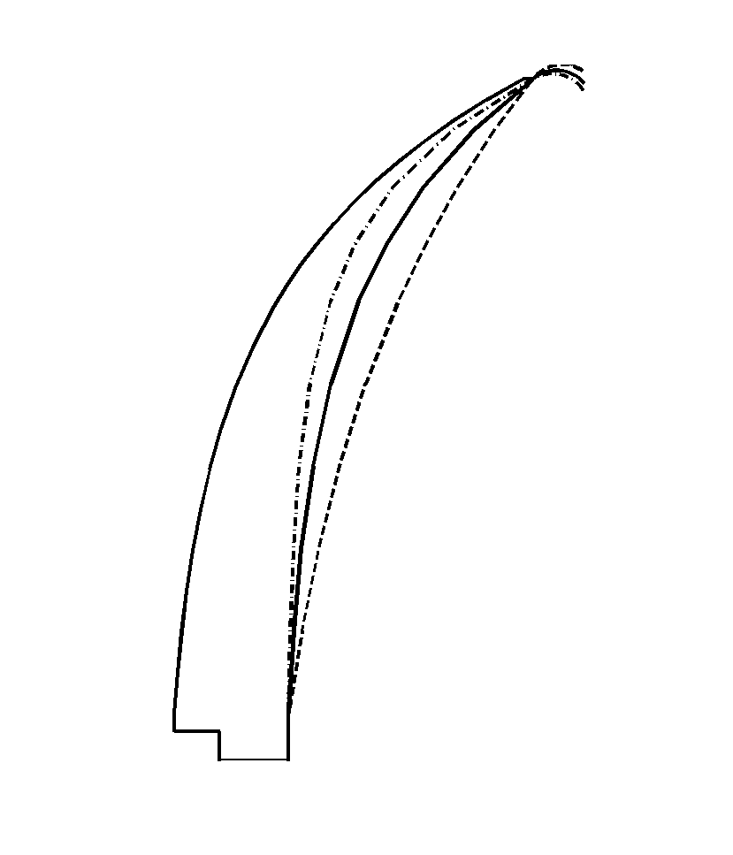
Sidewall and Ridge Profiles
Critical for desired performance
Ridge and sidewall profiles determine:
Bandwidth:
Four-fold reduction in dominant mode cutoff freq
Beamwidth:
  Large exit angle → smaller aperture area with “uniform” amplitude & quadratic phase → wider beamwidth
Return loss:
Strong function of the “opening rate”; smooth profile variation generally => high return loss
Infinitely many possibilities in choice of profile shape (derived from profiled horn literature):
Larger opening rate
Smaller opening rate
Nominal opening rate
Notes:
Take time to describe the plots.
Refer to corrugated horn literature where some of these profiles can be found. Talk about exponential being the one we spent the most time on followed by elliptical
return loss low-freq cutoff depends very much on opening rate of the ridge vs that of the sidewall

Slide 10
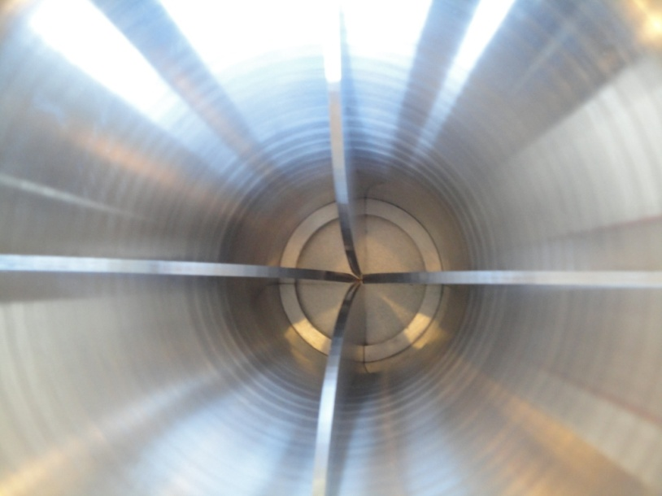
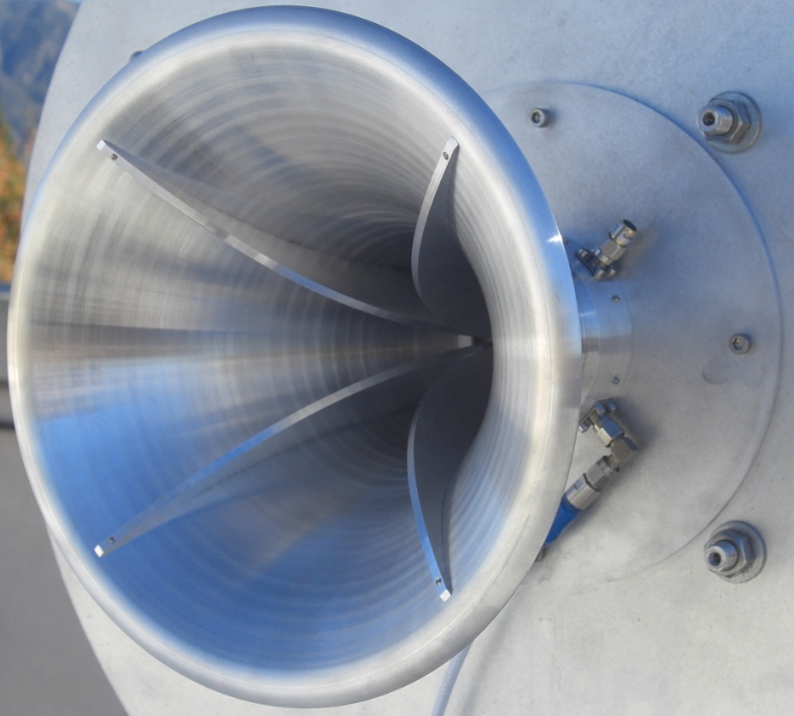
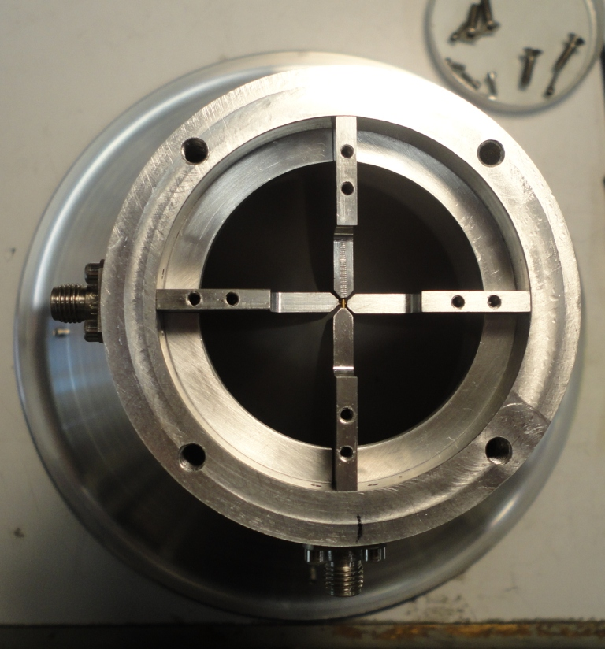
The First QRFH
Application:
Secondary focus operation on 12m Patriot/Cobham symmetric, shaped, dual reflector antennas of geodetic VLBI community
Target 10 dB beamwidth = ~ 85-90 deg
Target bandwidth = 2 – 12 GHz
Size = 18cm x 18cm x 17cm

Slide 11
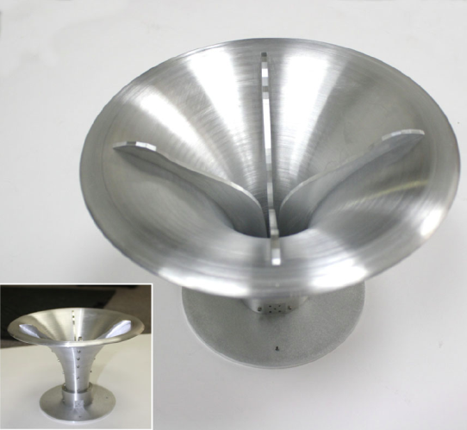
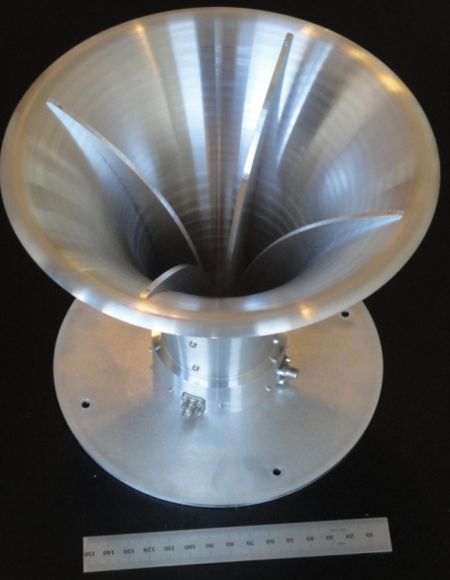
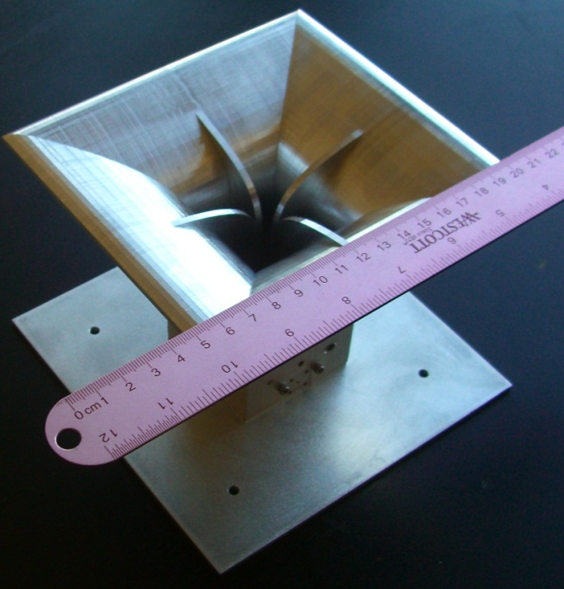
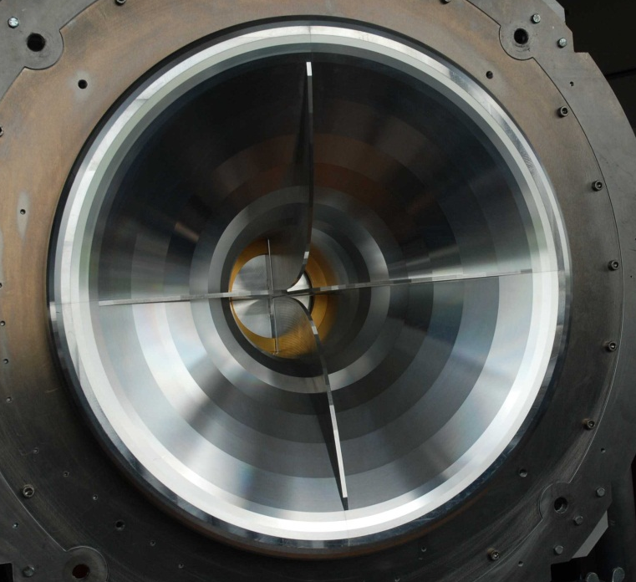
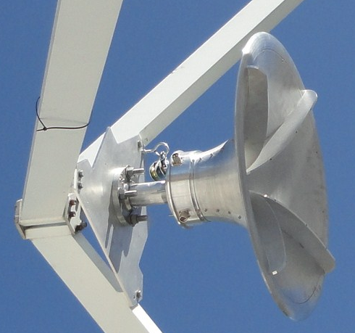
Timeline of QRFH development
Flexible design enables multitude of applications
MIT Haystack Observatory
2-12 GHz, ~90deg 10dB beamwidth
MIT Haystack Observatory, Shanghai Astronomical Observatory,
Geospatial Information Authority of Japan
2.3-14 GHz, ~120deg 10dB beamwidth
VLBI
Max Planck Institute for Radio Astronomy
0.6-2.5 GHz, ~150deg 10dB beamwidth
VLBI
MIT Haystack Observatory
2.3-14 GHz, ~150deg 10dB beamwidth
Pulsar timing
Caltech 6m
0.6-3 GHz, ~150deg 10dB
beamwidth
Astronomy class
VLBI

Slide 12
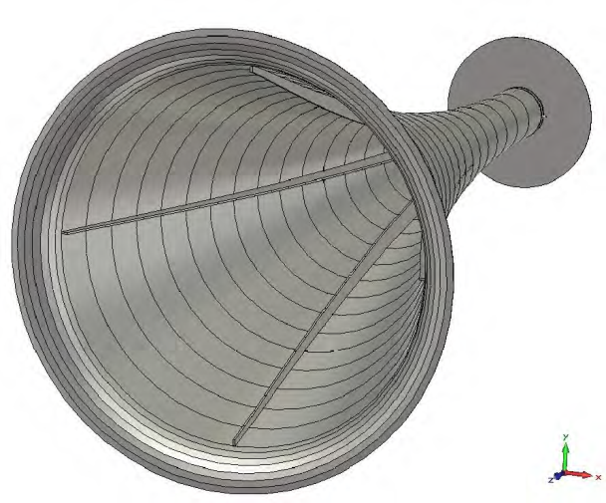
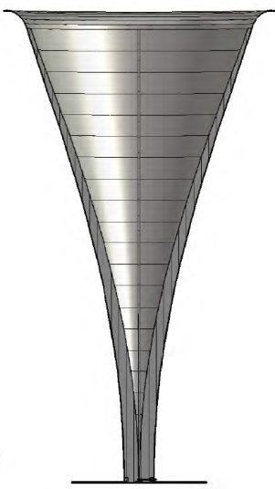
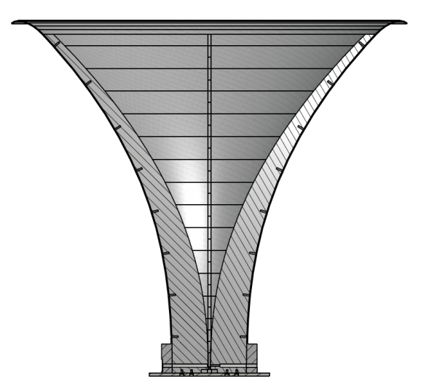
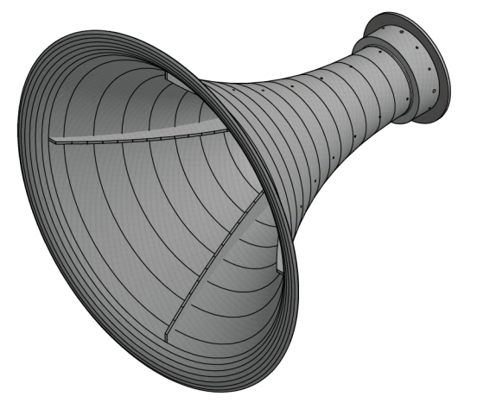
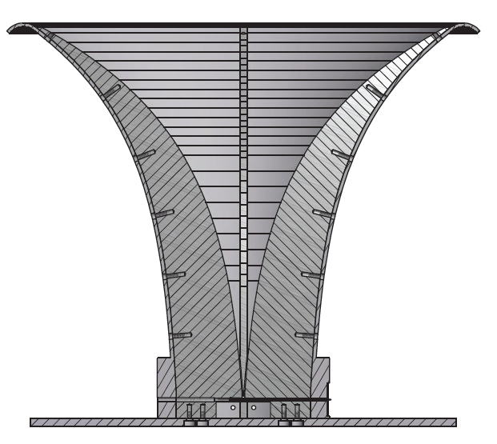
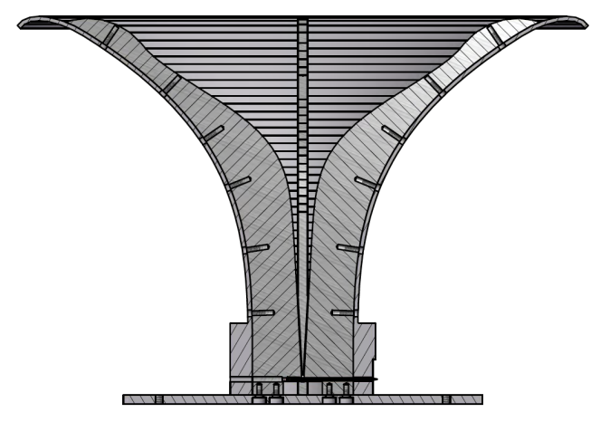
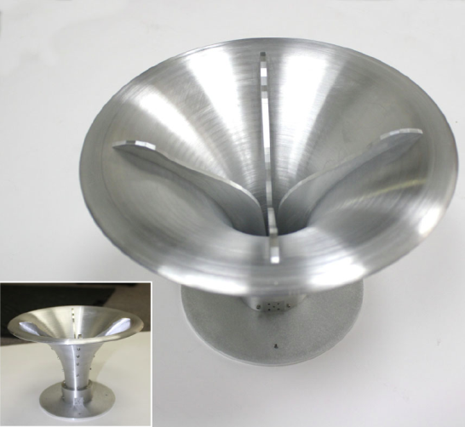
Geometries of Four QRFH Designs
Very high gain QRFH
32 deg beamwidth
High-gain QRFH
65 deg beamwidth
i
i
Medium-gain QRFH
90 deg beamwidth
i
i
Low-gain QRFH
120 deg beamwidth
Drawings are on different scales

Slide 13
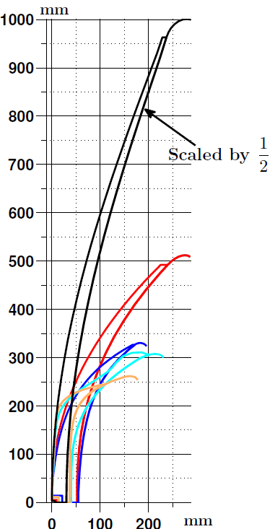
Geometries of Four QRFH Designs
Ridge Profiles
All horns are scaled such that their lowest frequency of operation is 1 GHz
Note the enormous size of the very-high gain QRFH
These plots further underline importance of the flare angle
Legend: Very-high (black), high (red), medium (blue), low (turquoise), very-low (orange) gain QRFH profiles

Slide 14
Other QRFH designs
Flexibility and ease of fabrication of the QRFH has proved to be very appealing
Many different groups around the world coming up with improved versions:
  Caltech: 8-50 GHz QRFH
  Chalmers: differential feeding, spline profiles, different backshort cavities
  National Astronomical Observatories, China: differential feeding, spline profiles
  U of Pretoria, South Africa: 12:1 impedance bandwidth design, elliptical profile
  CSIRO: dielectrically loaded QRFH

Slide 15
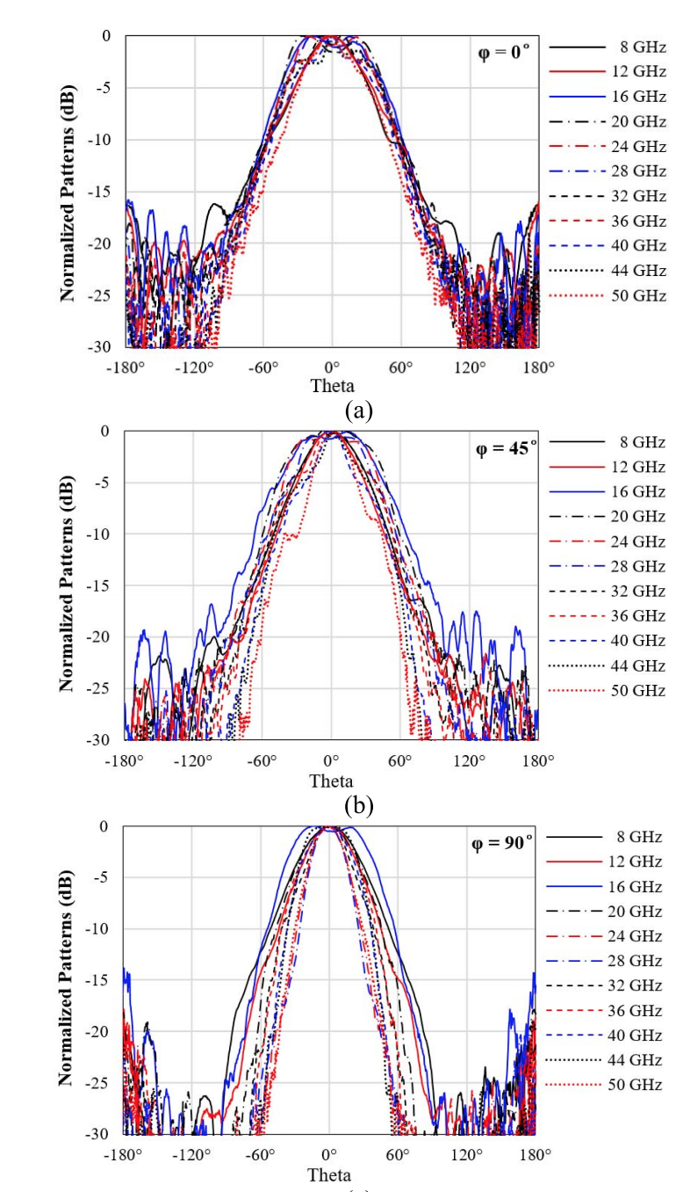
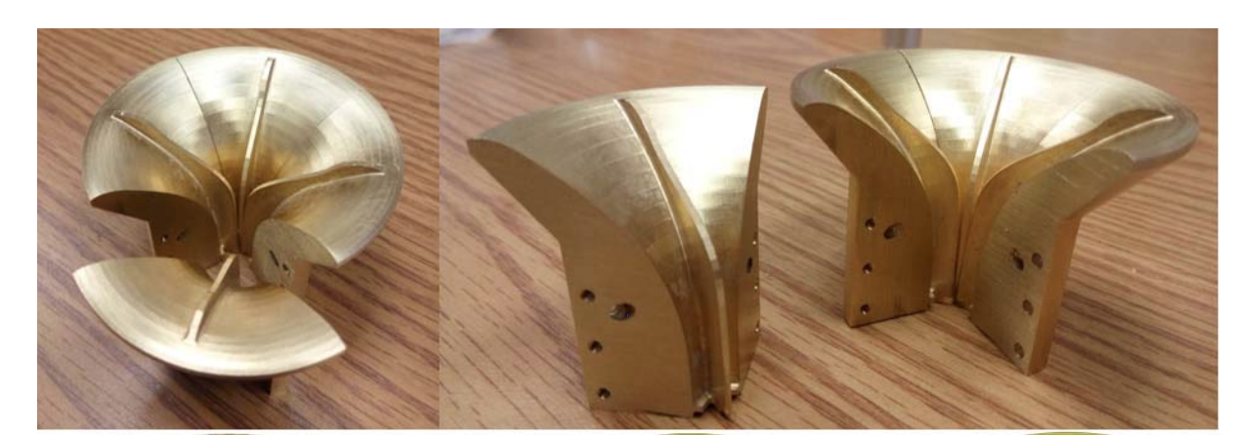
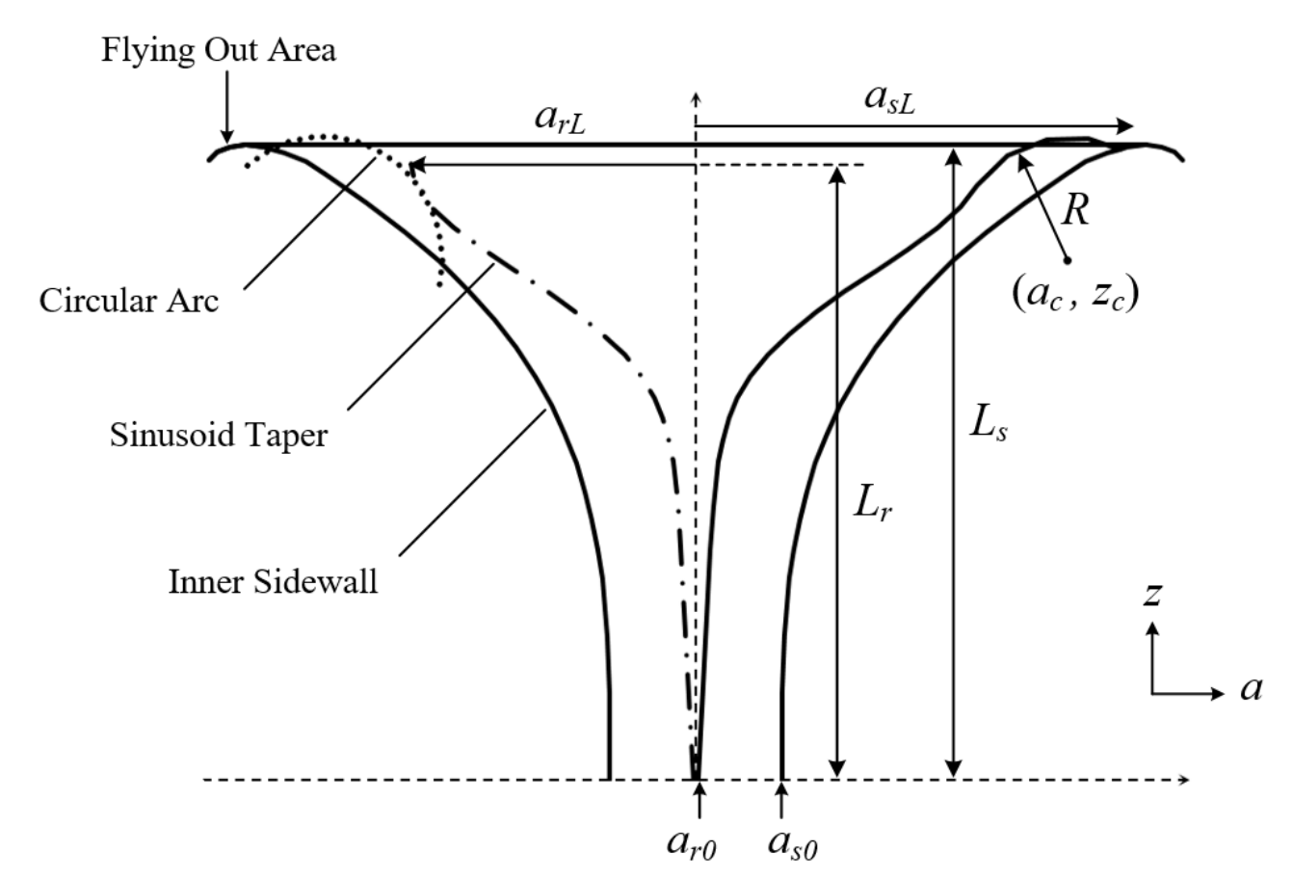
Caltech: 8-50 GHz
“Quadruple-Ridged Flared Horn Operating From 8 to 50 GHz,” IEEE TRANSACTIONS ON ANTENNAS AND PROPAGATION

Slide 16
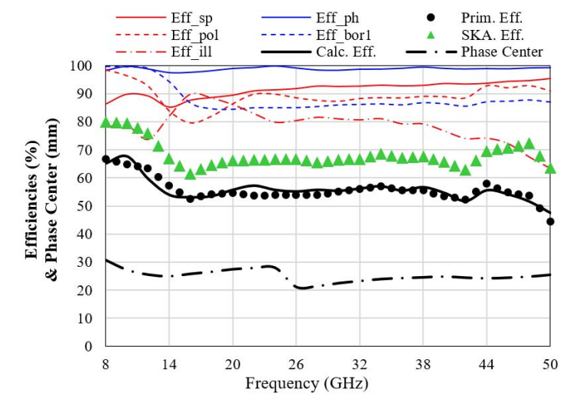
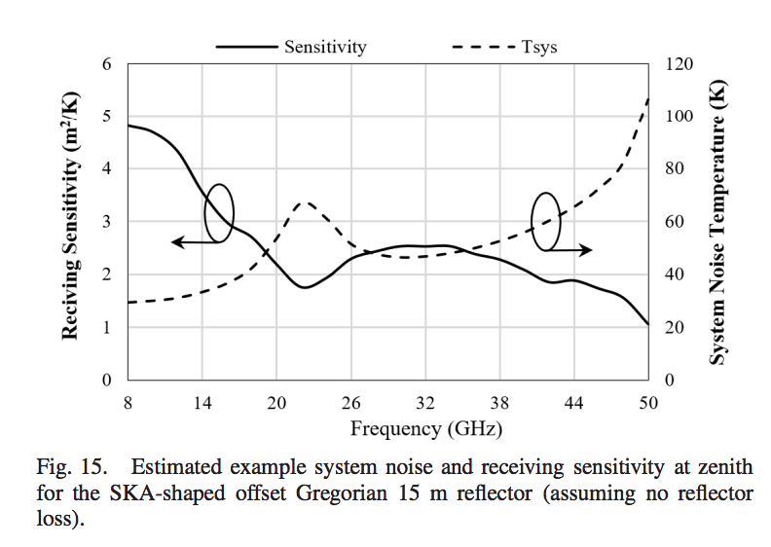
Caltech: 8-50 GHz
“Quadruple-Ridged Flared Horn Operating From 8 to 50 GHz,” IEEE TRANSACTIONS ON ANTENNAS AND PROPAGATION

Slide 17
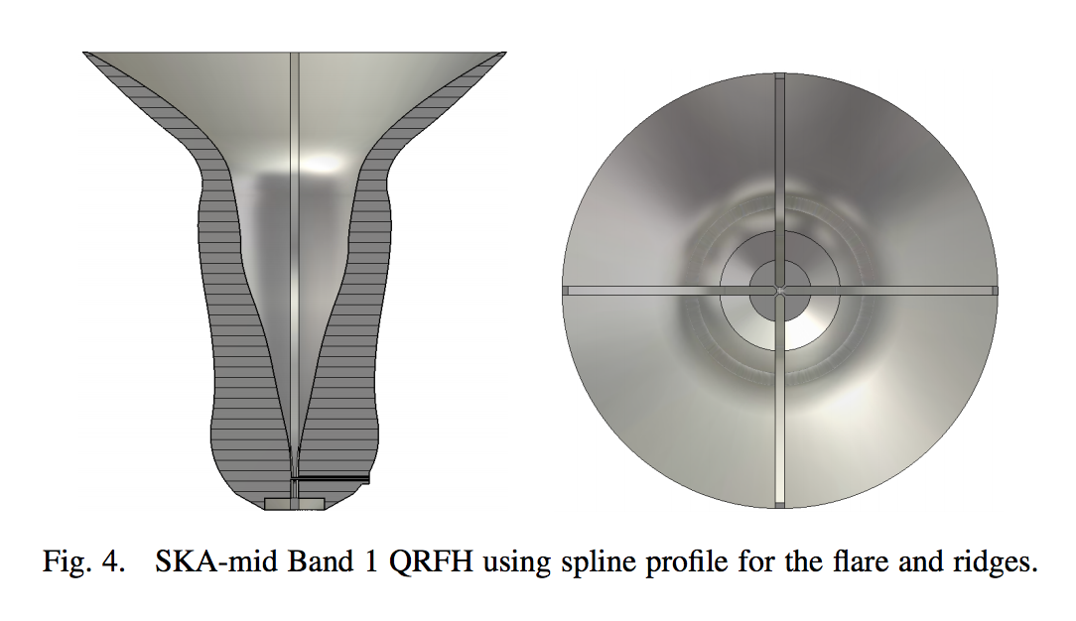
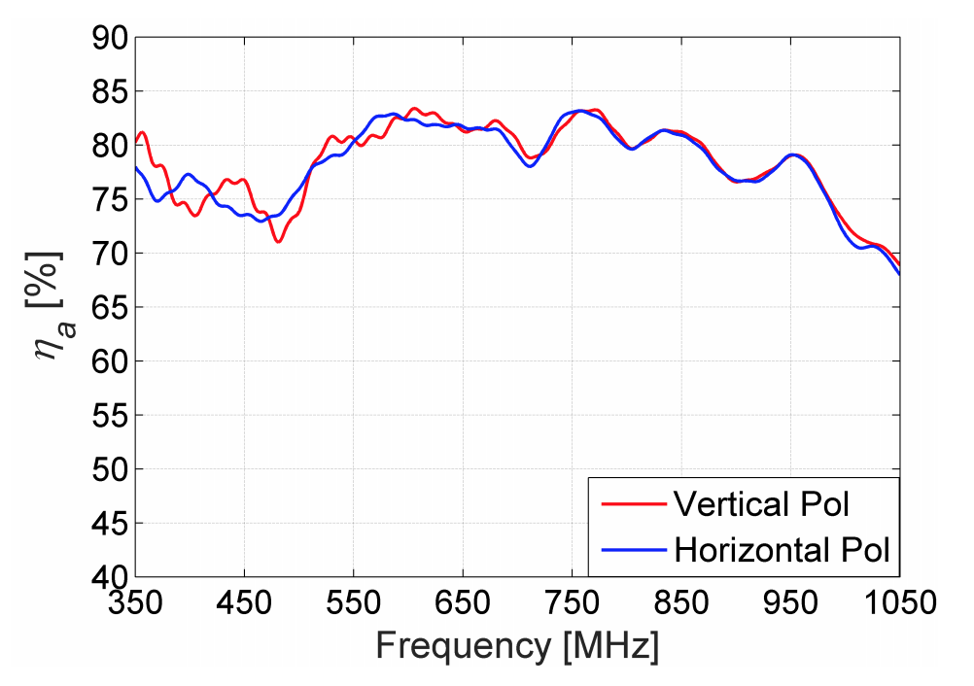
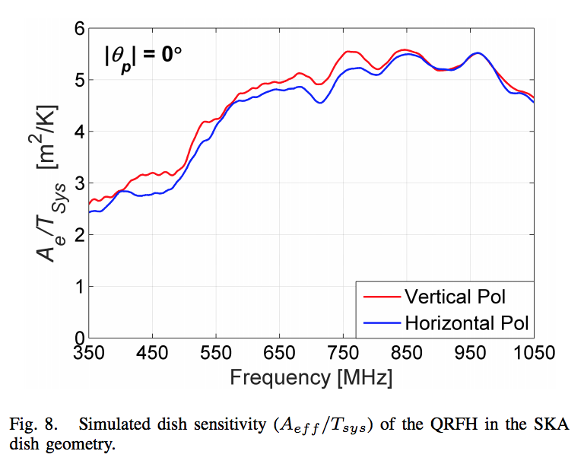
Chalmers + China: Spline-profiled QRFHs
“A wide-band feed system for SKA band 1 covering frequencies from 350 – 1050 MHz,” 2016 10th European Conference on Antennas and Propagation (EuCAP)
Single-ended feed design
SKA dual reflector

Slide 18
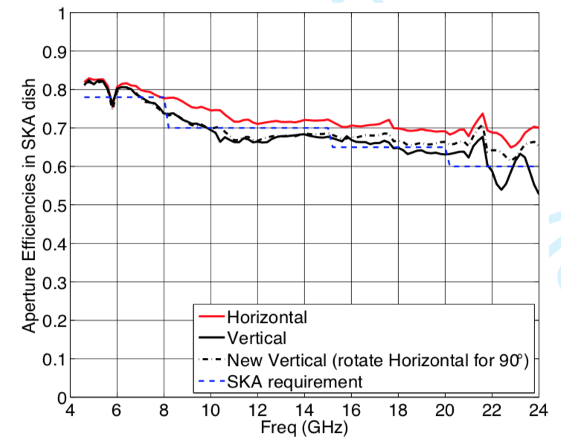
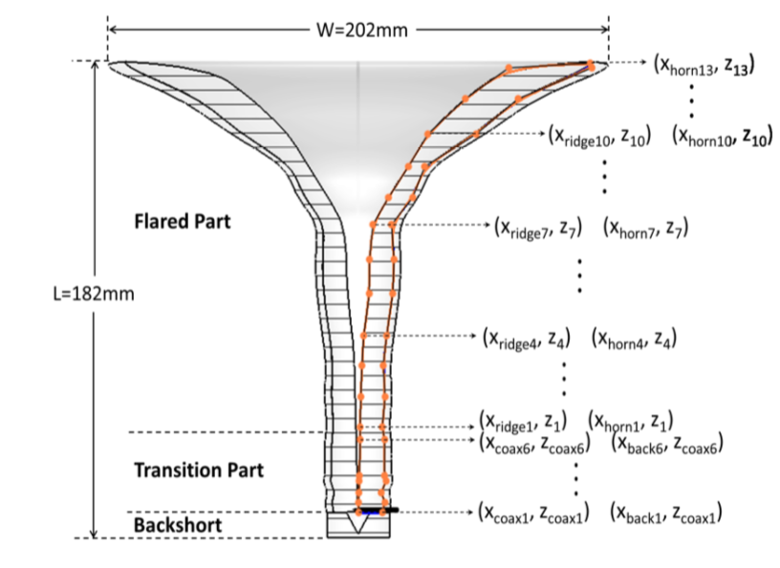
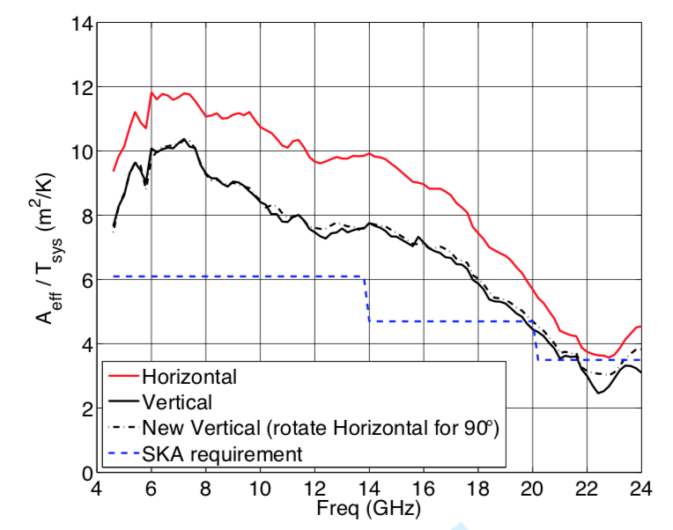
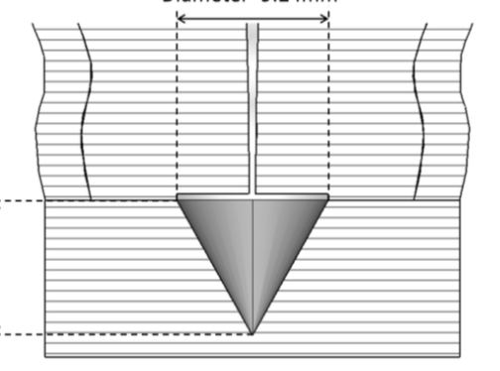
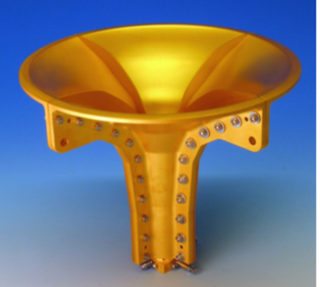
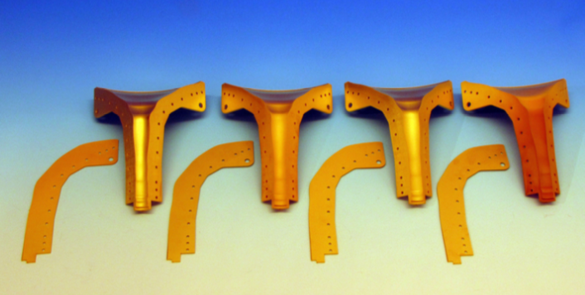
Chalmers + China: Spline profiles

Slide 19
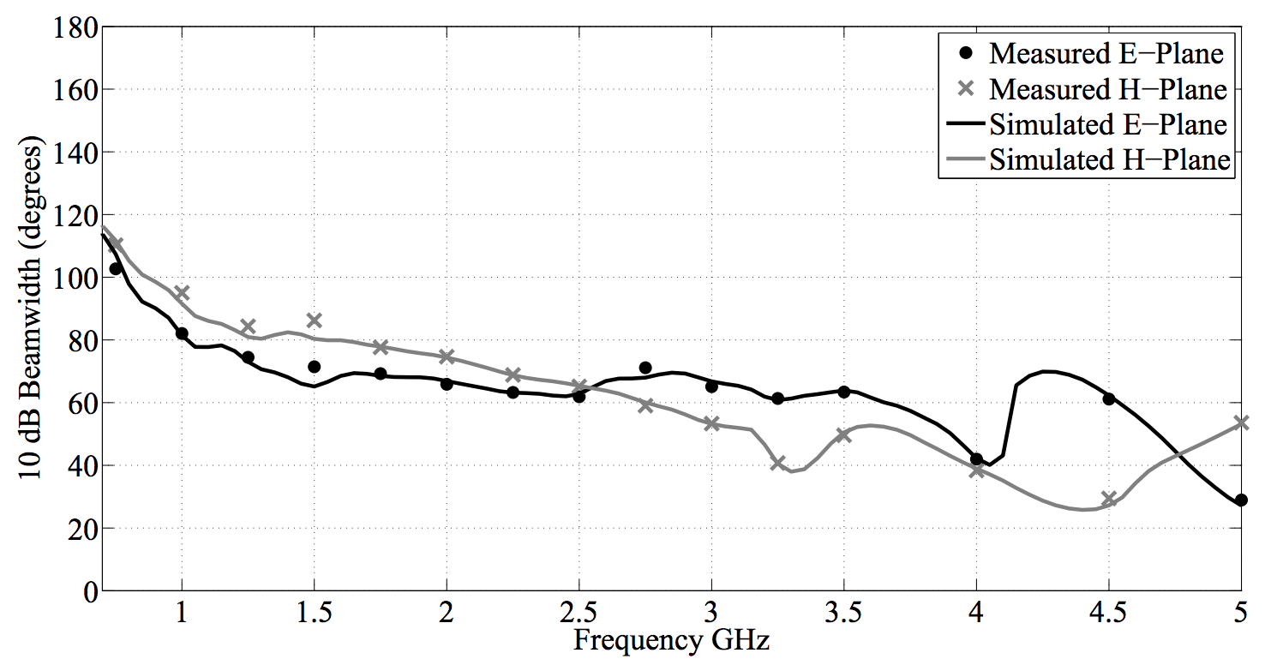
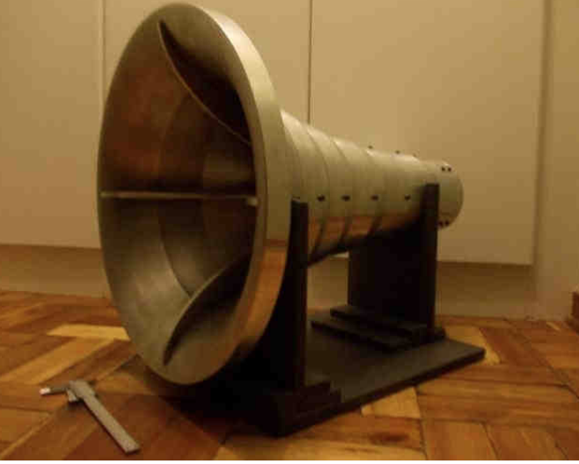


Pretoria: Elliptical profiles
O. Jacobs, M.S. Thesis, U of Pretoria

Slide 20

CSIRO: Dielectrically loaded QRFH
Credit: Alex Dunning
Fused Quartz
Aluminium
PTFE
0.7GHz
4.2GHz
Differential feed
“An Ultra-Wideband Dielectrically Loaded Quad-Ridged Feed Horn for Radio Astronomy,” 2015 IEEE-APS Topical Conference on Antennas and Propagation in Wireless Communications (APWC)
Notes:
Solution: Dielectric loaded feed

Slide 21





CSIRO: Dielectrically loaded QRFH
Credit: Alex Dunning
0.7GHz
1.4GHz
Er=1
Er=1.4
Er=2.1
Er=3.8
2.5GHz
4.2GHz
0.06 dB loss @ 4.2 GHz due to dielectric spear quoted by Dunning et al.
“An Ultra-Wideband Dielectrically Loaded Quad-Ridged Feed Horn for Radio Astronomy,” 2015 IEEE-APS Topical Conference on Antennas and Propagation in Wireless Communications (APWC)
Notes:
Solution: Dielectric loaded feed

Slide 22
CSIRO: Dielectrically loaded QRFH
Credit: Alex Dunning
X-pol improved and H-plane beamwidth is much more stable
Notes:
Feed Patterns

Slide 23


CSIRO: Dielectrically loaded QRFH
Credit: Alex Dunning
Notes:
Feed Patterns

Slide 24
Future work for ngVLA
Re-optimize 1.2-4.2 GHz feed for -16 dB edge taper at 55 degree half angle
Infinitely many profiles -> optimization ongoing in various parts of the world
  Elliptical is really nice in my experience, but too restricted?
  Exponential works well if f/D is not too small
Dielectric loading, dielectric lens? Loss prohibitive?
Concentration on equalization of E- and H-plane beamwidths is probably the most worthwhile in terms of efficiency improvement
  necessarily implies x-pol improvement
  Perhaps an approach similar to Dunning in dividing the frequency range into different regimes of operation?
Some sort of (preliminary) numerical/theoretical framework would be useful in synthesis and also understanding what is achievable in terms of efficiency, bandwidth, x-pol
Many efficiency curves floating around for many different QRFH designs on many reflector configurations. Need to be careful in evaluating performance

