Slide 1
Advanced Cryocoolers For ngVLA
Larry D’Addario, Caltech
ngVLA Optics Workshop, Pasadena, 2018 June 20

Slide 2
Outline
History of cryocoolers in radio astronomy
Existing radio telescope cryocoolers
How cold do we need to get?
[Tutorial on cryocoolers]
Cyrocooler industry: suppliers and customers
Survey of available cryocoolers
Recommendations for ngVLA
Main take-away: Current thinking is stuck on making small tweaks to 50-year-old technology. We can do better.

Slide 3
History
“Those who cannot remember the past are condemned to repeat it.” George Santayana, 1907.
1950s: First use of cyrogenic receivers in radio astronomy (liquid cryogens)
  paramps and masers cooled with LN2 and LHe.
1960s: First use of closed-cycle He refrigerators (GM cycle invented 1960)
  1970: 2-stage GM refrigerator commercialized as CTI Model 1020 (still in production!)
1975: Closed-cycle cooler for 4K developed for DSN masers
  Custom-built Joule-Thompson stage added to COTS 2-stage GM
  Later adopted by NRAO and CSIRO, which had in-house cryo development labs
1980s: Masers supplanted by HEMT amplifiers at cm wavelengths. SIS mixers developed for mm wavelengths.
  20K sufficient for HEMTs, but 4K needed for SIS, so custom JT stages still needed.
1990: Rare-earth regenerators allow 2-stage GM coolers to reach 4K (not adopted in RA)
1997: 4K GM coolers commercialized by Sumitomo, adopted for ALMA.
late 1990s: NRAO and CSIRO abandon in-house cryo development labs.
  Radio astronomy-specific development stagnates and has not recovered.
1970s through today: extensive cryocooler development for space and military apps.
2010 through today: radio astronomy starts to need large numbers of cryocoolers.

Slide 4
Cryocoolers in Existing Radio Telescopes
Almost all are two-stage GM types, reaching 15-25K depending on heat load.
Many telescopes use cryocooler designs that are 30-40 years old.
GM cryocooler invented in 1960
  Two-stage versions commercialized ~1970 with CTI model 1020 (still in production!).
Superconducting receivers (SIS mixers, some bolometers) [not for ngVLA]
  Require cooling to ~4K
  Until ~15 years ago, relied on open-cycle cooling with liquid He or adding a Joule-Thompson 3rd stage to a 2-stage GM.
    Very inefficient
  Now 2-stage GM coolers reaching <4K are available due to exotic regenerator materials (Er₃Ni, HoCu).

Slide 5
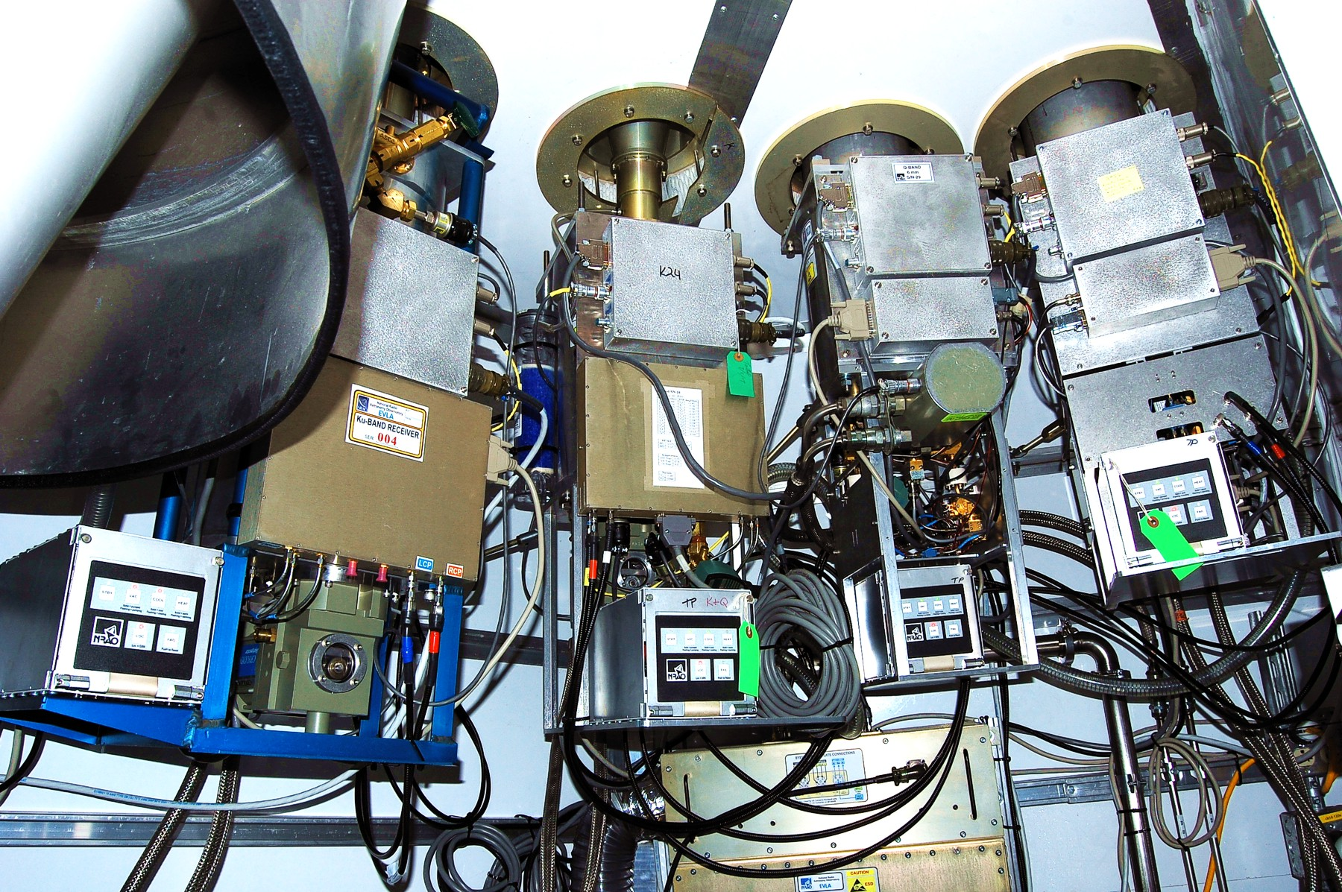
VLA Antenna Receiver Cabin
8 front ends (4 shown), each in a separate vacuum chamber with its own cryocooler.
1 ea. CTI 1050 (L)
6 ea. CTI 350 (S, C, X, Ku, K, Ka)
1 ea. CTI 22 (Q)
3 compressors, 18 kW total

Slide 6
19-Element Phased Array Feed Receiver (for GBT)
70 cm diameter
CTI 1050 cryocooler
(3W at 15K, 60W at 70K; ~5500W input)
G. Cortes-Medellin et al., "A Fully Cryogenic Phased Array Camera for Radio Astronomy," IEEE Trans on AP, 63:2471-2481, June 2015.

Slide 7
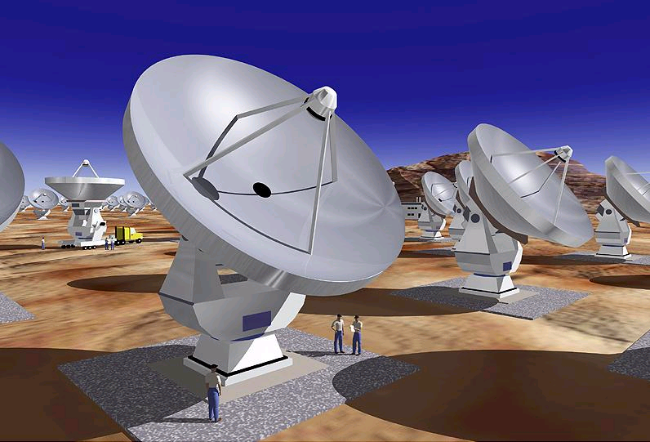
ALMA
Uses a “special” three stage GM cryocooler ordered from Sumitomo
1st stage 33W @ 68K
2nd Stage 8W @ 13.7K
3rd Stage 1W @ 4.2K
Covers 30-950 GHz with 10 receivers in a single large cryostat.
Cryocooler is shown in red

Slide 8
How Cold is Cold Enough?
I will show some plots based on the following model, covering physical temperatures of 0-80K and frequencies 1-50 GHz
LNA based on InP HEMT transistors from “cryo3” wafer (well modeled)
Input transistor operated at optimum input impedance (for each temperature and frequency)
Transistors subject to self-heating of up to 18K [1].
Feed is cooled to the same temperature as LNA and has 1% loss
Dewar window is at 300K and has 1% loss
Antenna is pointed at 45º elevation
  Sky noise from the Bryan Butler model for VLA site with 6 mm PWV
Spillover noise is 3K, independent of frequency
[1] J. Schleeh et al., “Phonon black-body radiation limit for heat dissipation in electronics.” Nature Materials, 10 Nov 2014 (on line).

Slide 9
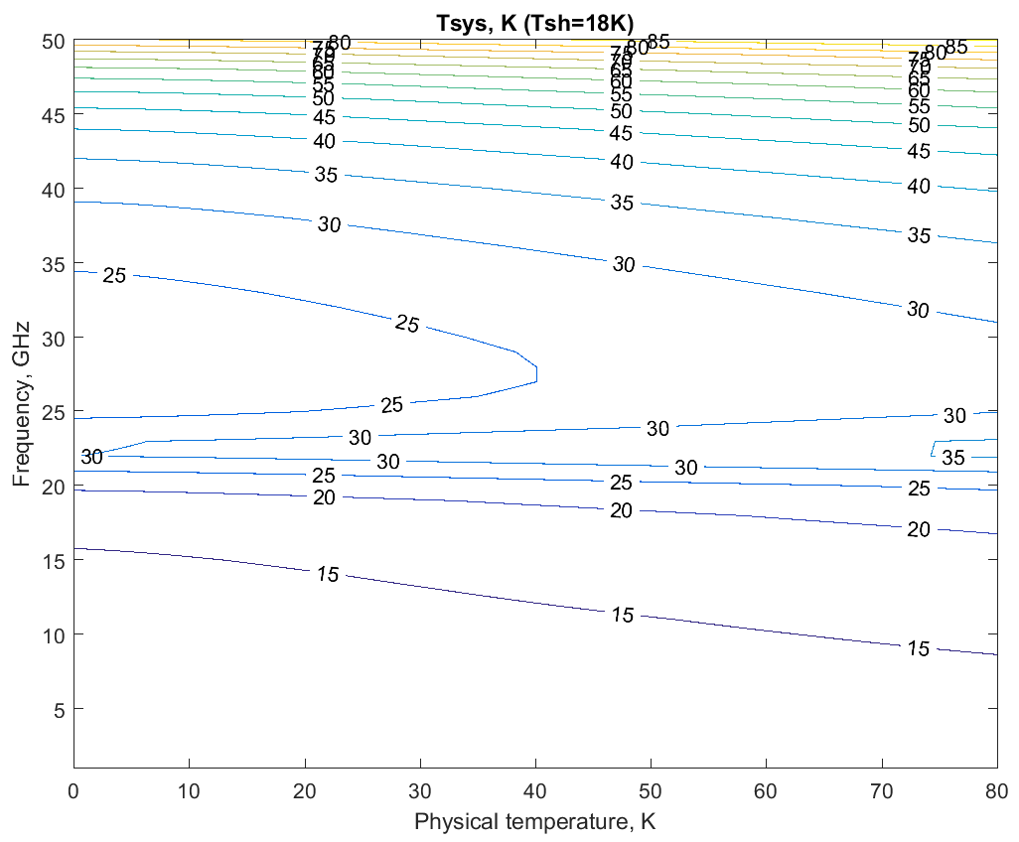
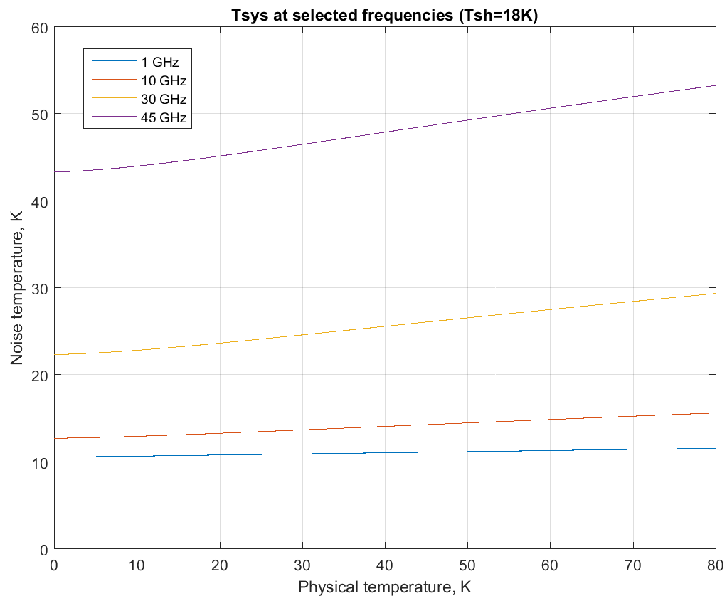
T_{sys} vs. Frequency and T_{phys}

Slide 10
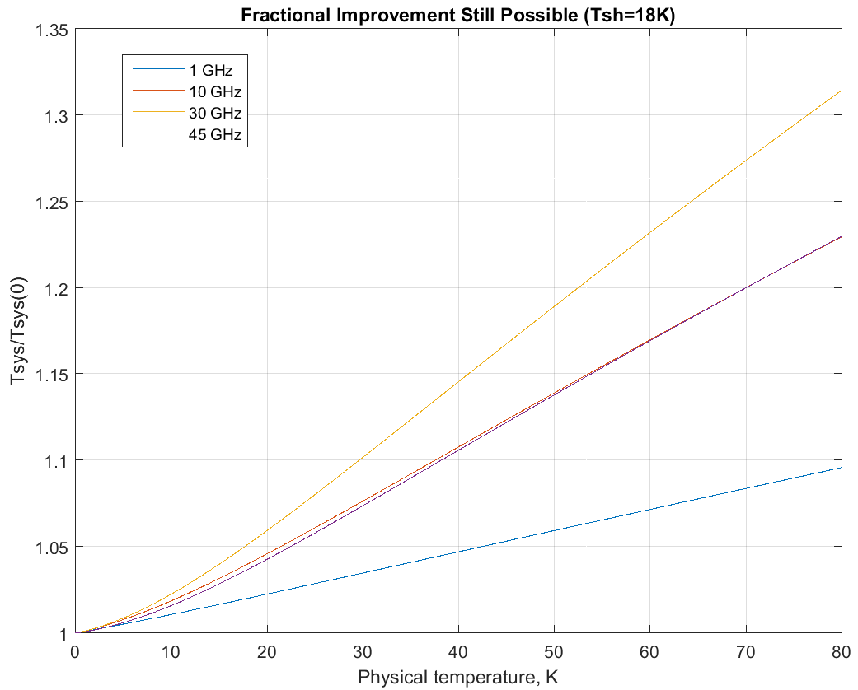
Diminishing Returns

Slide 11
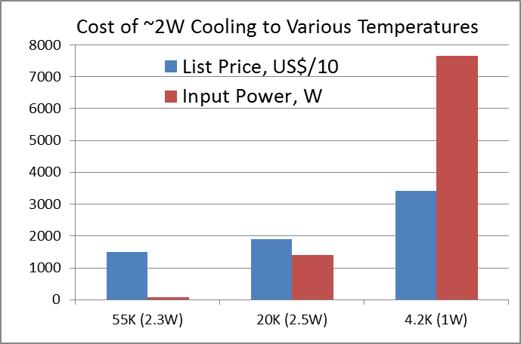
Cost of Getting Colder
SunPower MT
SHI RDK101D/CNA11C
SHI RDK408D2/CSA71A

Slide 12
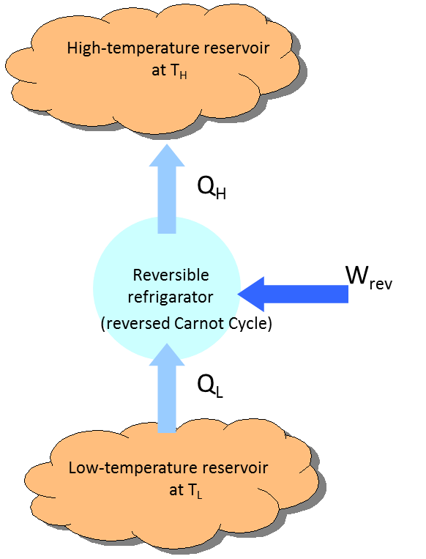
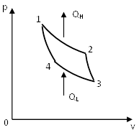
Cryocooler Thermodynamics – Ideal
Carnot cycle
T_{H}
T_{L}
Efficiency = Q_{L}/W = COP
(ideally) = T_{L}/(T_{H} - T_{L}) [Carnot]
300K to 20K: η_{c} = 20/280 = 7.1%

Slide 13
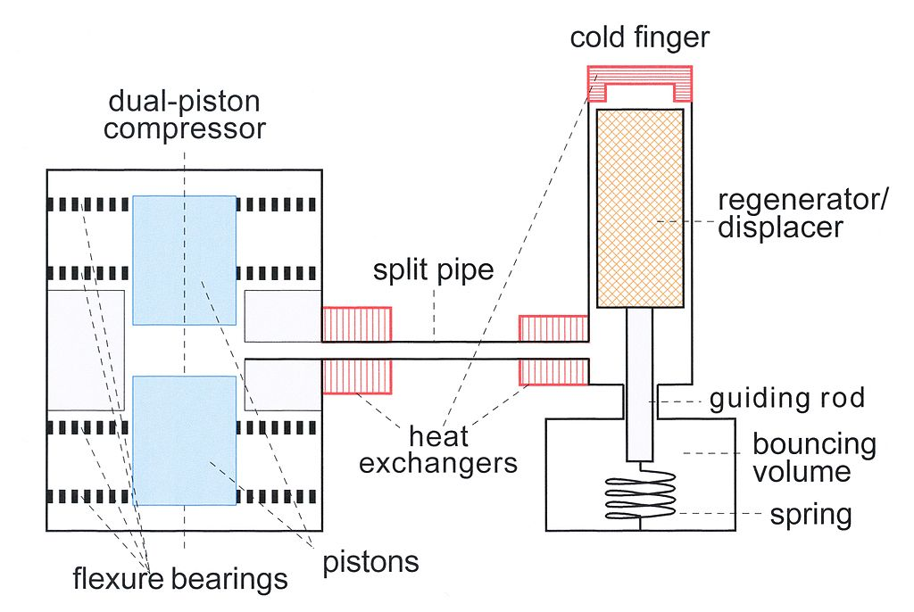
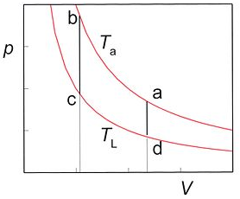
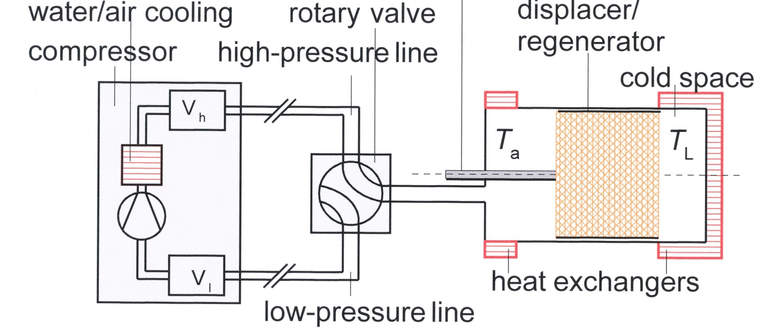
Cryocooler Thermodynamics – Practical
Sterling (reverse)
Gifford-
McMahon

Slide 14
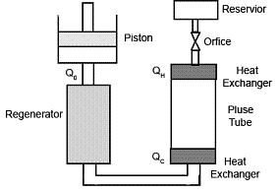
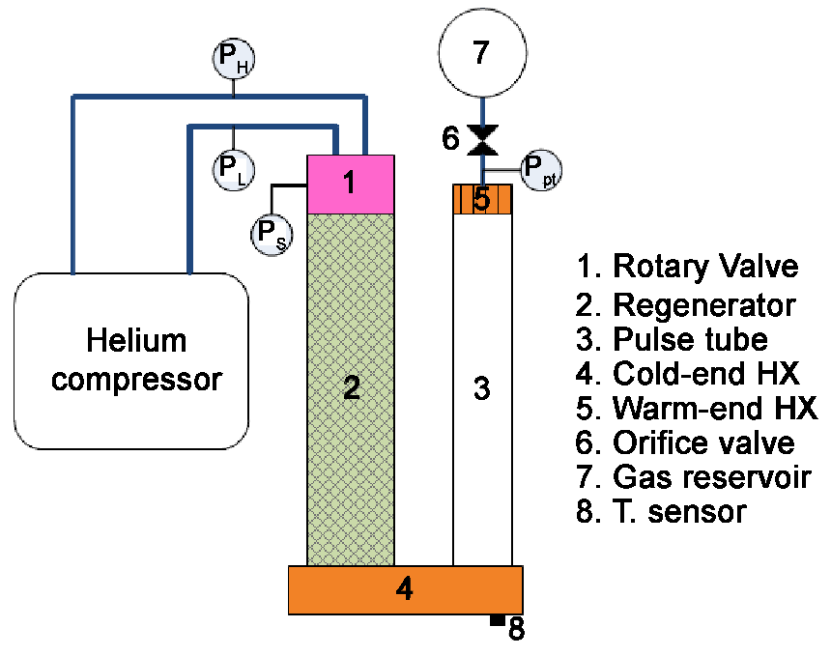
Pulse Tube Refrigerators
Sterling Type
GM Type
No moving parts in the cold region -> low maintenance, low vibration
Generally less efficient than parent type

Slide 15
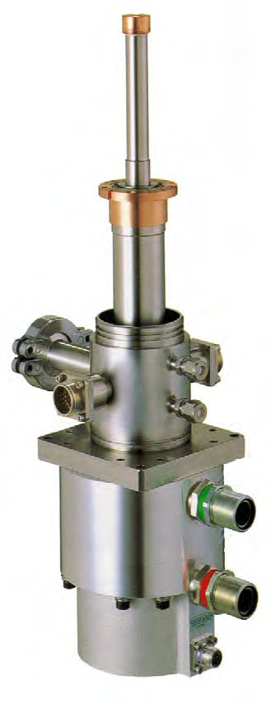
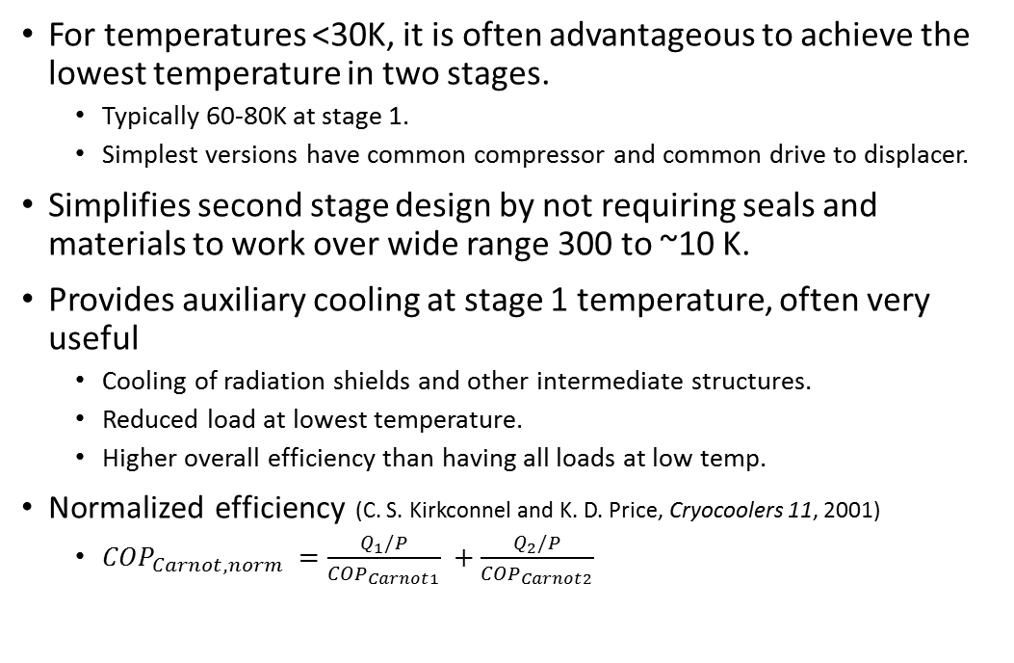
Multi-Stage Cryocoolers
For temperatures <30K, it is often advantageous to achieve the lowest temperature in two stages.
  Typically 60-80K at stage 1.
  Simplest versions have common compressor and common drive to displacer.
Simplifies second stage design by not requiring seals and materials to work over wide range 300 to ~10 K.
Provides auxiliary cooling at stage 1 temperature, often very useful
  Cooling of radiation shields and other intermediate structures.
  Reduced load at lowest temperature.
  Higher overall efficiency than having all loads at low temp.
Normalized efficiency (C. S. Kirkconnel and K. D. Price, Cryocoolers 11, 2001)
  ${COP}_{Carnot,norm} =\frac{Q_{1}/P}{{COP}_{Carnot1}} +\frac{Q_{2}/P}{{COP}_{Carnot2}}$
Two-stage GM cryocooler (SHI)
Stage 2 cold station
Stage 1 cold station

Slide 16
Cryocooler Industry
Magnetic resonance imaging: superconducting magnets
  1W cooling at 4K
  >40,000 4K GM cryocoolers sold since 1995.
Infrared sensors
  Primarily military applications (night vision, weapon guidance)
  0.3 to 1.75W cooling at 65 to 120K
  ~180,000 coolers since 1970s
High vacuum: cyropumping, primarily for semiconductor processing
  a few watts at 15K
  ~20,000 per year at peak of semiconductor business
Space: IR and X-ray detectors, other specialized applications
  mission-specific
  low power, low mass
  small quantities, very expensive

Slide 17
Cryocooler Manufacturers
Commercial
  CTI -> Helix Technologies -> Brooks Automation (one- and two-stage GM)
  SHI Cryogenics [Sumitomo] (one- and two-stage GM and GM-type PT)
  Cryomech (single-stage GM)
  Oxford Cryosystems (one- and two-stage GM)
  Sterling Cryogenics (large one- and two-stage Sterling)
  Qdrive (large single-stage Sterling)
  Sunpower (small single-stage Sterling)
Aerospace/Military
  Ball Aerospace
  Raytheon
  Northrop Grumman
  Honeywell Aerospace

Slide 18
Special Considerations for Radio Astronomy
Variable orientation with respect to gravity
Need to cool substantial mass (feed, waveguides, mechanical structures)
  Cooldown time can be very long
  Cu, 300K to 77K: 73 kJ/kg -> 20.3h/kg/W.
  Would like high capacity during cooldown, but less in equilibrium.
  Cryocooler is often oversized to achieve cooldown.
With good design, cooling load is dominated by connections to the outside rather than dissipation inside
  Radiation through input window: 20 cm diameter admits 14.4W of 300K radiation.
  Conduction through waveguides, coax cables and wires.

Slide 19
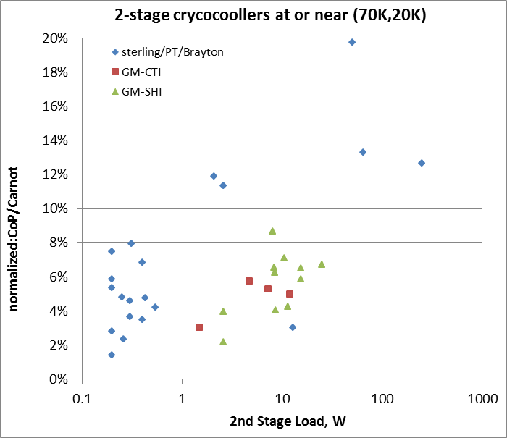
Survey of available two-stage cryocoolers
Includes:
COTS machines
Published laboratory demos
Space applications (small quantity)
COTS: Sterling Cryogenics
Raytheon: RSP2 hybrid

Slide 20
Sterling vs. GM (including PT)
Sterling (and Sterling-type PT) | Gifford-McMahon (and GM-type PT)
Carnot efficiency ~10% | Carnot efficiency ~3%
Compressor adjacent to cold head | Compressor can be remote
Little to no maintenance for >>10 years | Replacement of seals every 12-24 months
Vary power input / capacity by amplitude or frequency | Vary power input / capacity by frequency
Can shift capacity between stages by phase adjustment | Capacity ratio of stages fixed
PT version may have slight orientation dependence | PT version may have large orientation dependence

Slide 21
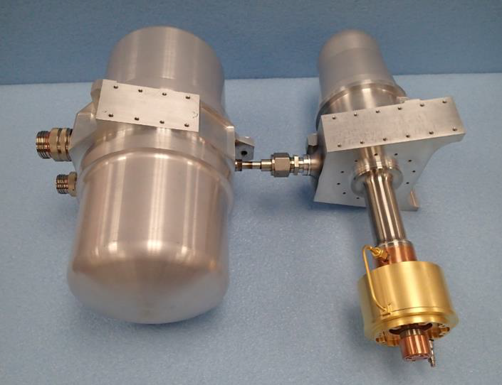
Raytheon RSP2: Sterling-PT Hybrid
Sterling 1st stage and pulse tube 2nd stage. No moving parts at low temp.
Designed for space applications, evolved over 15 years of development
  Prototype built in 2000 2.2W at 80K 0.5W at 35K
  Published in 2009 16.2W at 80K 2.6W at 35K 513W input 11.35%
  Published in 2014 (LT-RSP2) 6W at 55K 0.31W at 10K 450W input 7.94%
  Analysis for ngVLA (LT-RSP2) 6W at 60K 2.1W at 20K 450W input 11.87%
Comparable cooling: SHI SDK-101D with
CNA-11C compressor at 3x power input:
  2.5W at 20K, 4.5W at 60K, 1400W input
  Normalized Carnot efficiency 3.8%
Sterling compressor
PT compressor
Stage 1
Photo curtesy of Ted Conrad, Raytheon Company
Intertance tube and reservoir
Stage 2

Slide 22
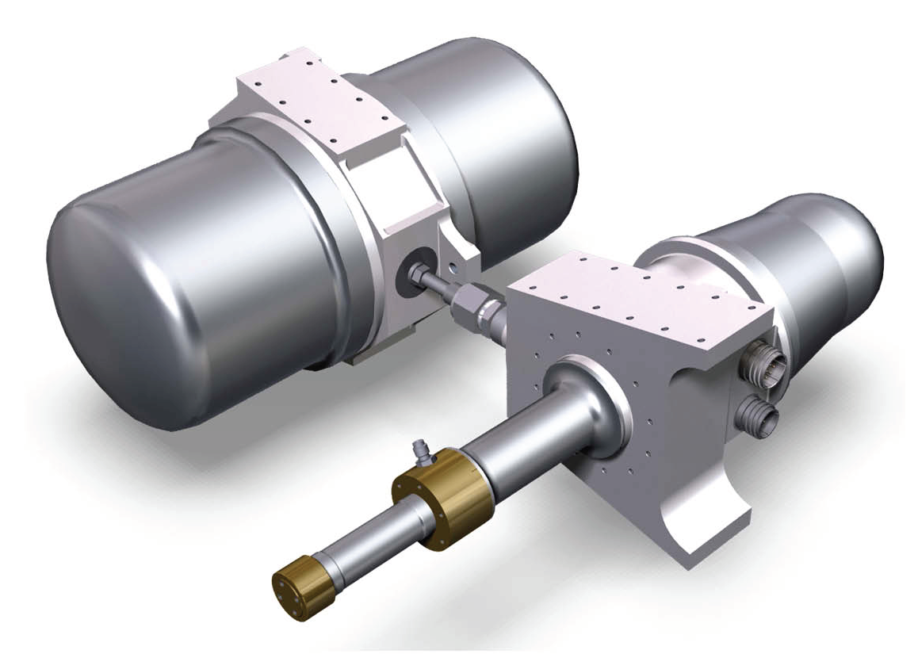
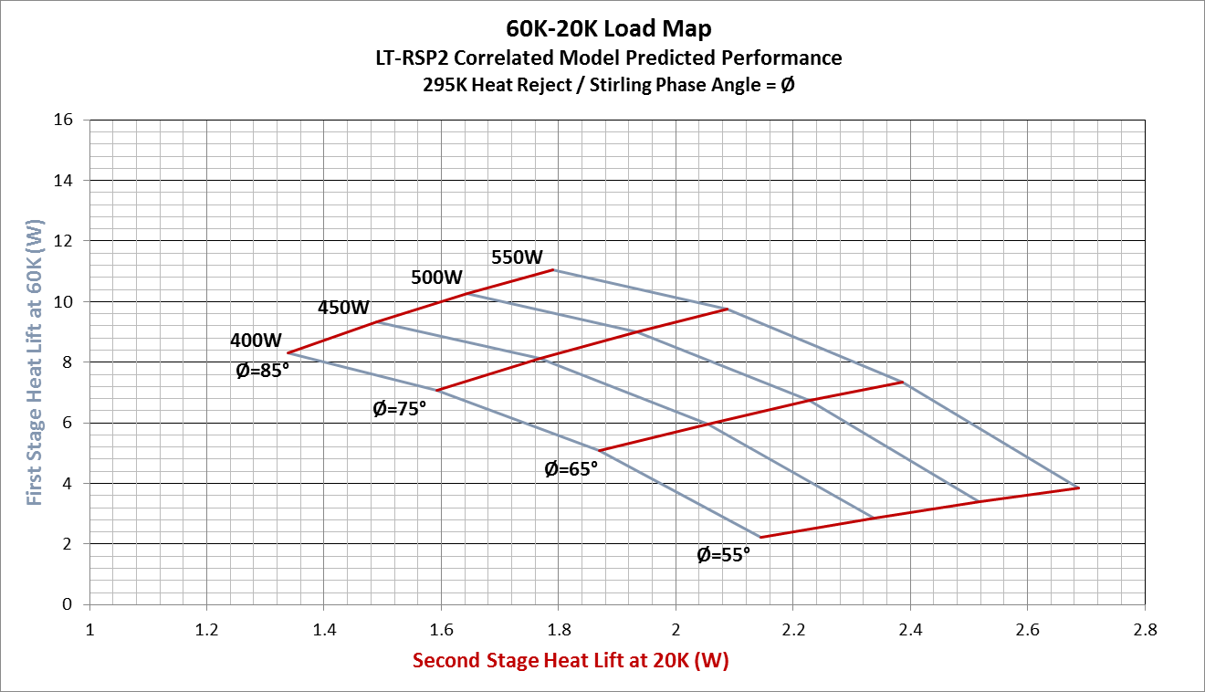
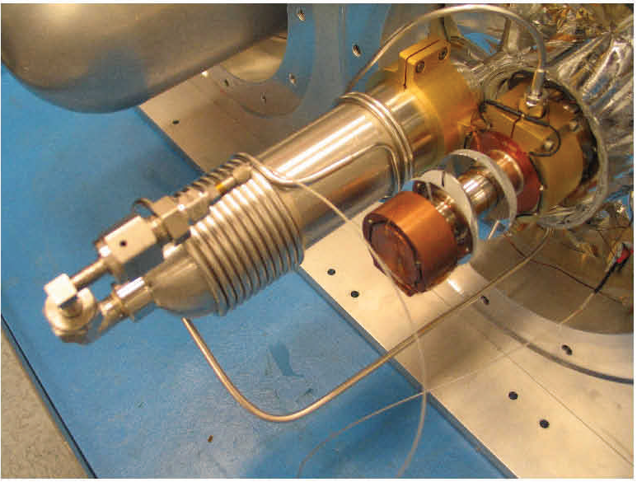
Raytheon LT-RSP2
Simulation for ngVLA by Ted Conway, Raytheon Company
Images from Schaefer 2014, Cryocoolers 18.
Optimizations for 20K operation:
–InertanceTube Length
–Reservoir Volume
–Fill Pressure
–Operating Frequency

Slide 23
Recommendations for ngVLA
Don’t try to achieve very low temperatures, especially at 1.2-3 GHz
Allocate funds for NRE
  Develop hardware matched to our specific needs
  Don’t count on off-the-shelf procurement; it leads to oversizing
Engage with the aerospace industry
  International Cryocooler Conference NOW (Burlington, VT)
Hire an in-house expert
  Head an in-house development team and laboratory
  If development is done by contracting, in-house expert is still needed for proper oversight
Consider spending more on construction and NRE to save on operations
  Pay-back time for power savings is easy to calculate
    Saving 2 kW per antenna for 220 antennas is about 4 M$/year -> worth ~10 M$ investment.
  Maintenance saving is likely to be significant too

Slide 24
Backup
Backup slides follow

Slide 25
Important Parameters
Net refrigeration power: dQ/dt
Power input, P: P = dW/dt
Actual Coefficient of Performance, COP : COP = (dQ/dt) / P
Ideal (Carnot) COP_{Carnot} : COP_{Carnot} = T_{c} /(T_{h}-T_{c})
Efficiency, η: η = COP / COP_{Carnot}
Specific Power 1/COP

Slide 26
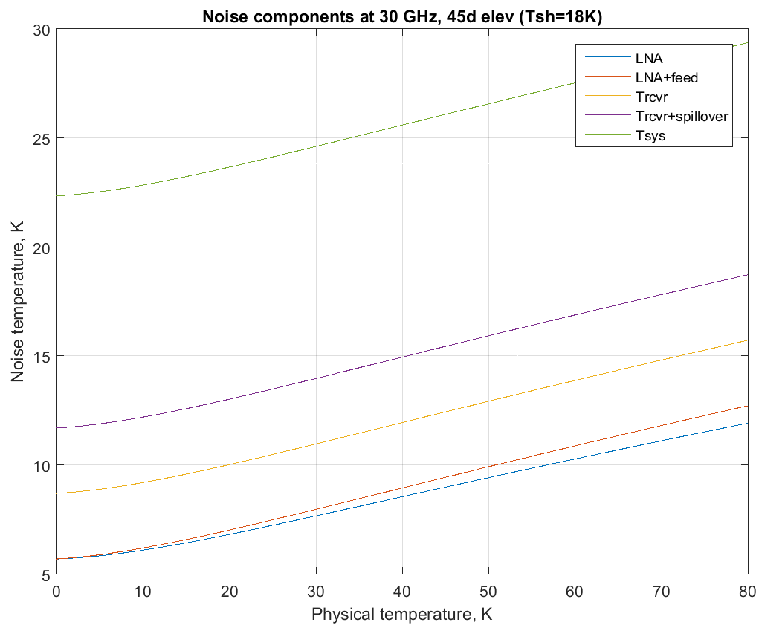
Components of System Noise at 30 GHz

Slide 27
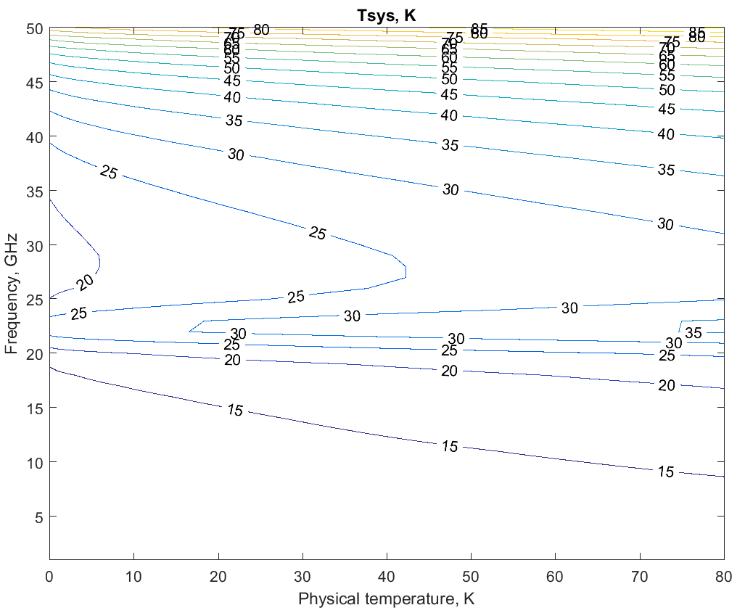
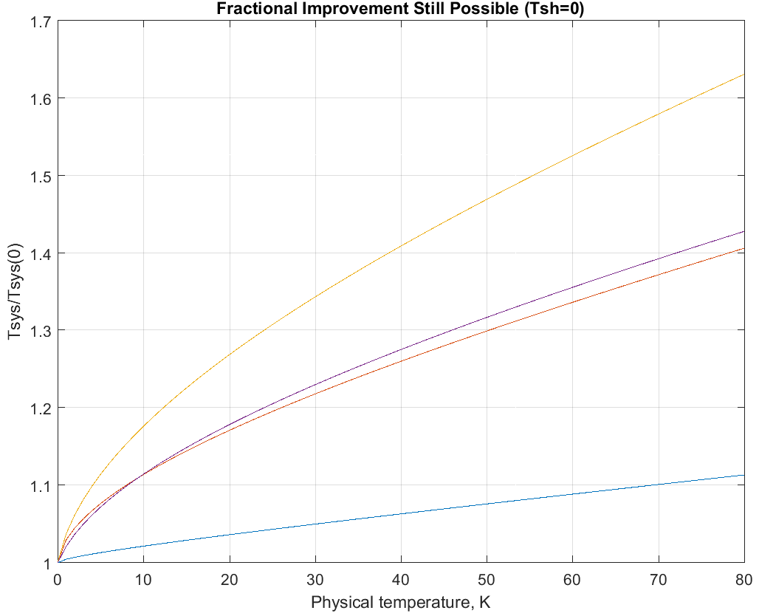
System Noise Model with No Self Heating

