Slide 1
SKA Band 3/4/5 feed package
(and other related receiver work at Oxford)
Mike Jones
Jamie Leech, Angela Taylor, Bob Watkins, Amin Aminaei, Tommaso Ghigna, Alex Pollak, Jaz Hill-Valler, Lei Liu, John Saunders
University of Oxford
Andy Born
UKATC, Edinburgh
Wu Yang, Du Baio
JLRAT / CETC54, China

Slide 2
SKA Mid feed packages
Band 1: 350 - 1050 MHz: Uncooled, QRFH (Chalmers – Miroslav Pantaleev et al)
Band 2: 950 – 1750 MHz: Cooled, ‘Corrugated’ (choked flange) 1.85:1 feed, 4-probe OMT (EMSS – Isak Theron et al)
Band 3/4/5(6) 1.65 – 24 GHz
Band 5a/b 4.6 – 15.4 (initially), Cooled single cryostat, up to five corrugated feeds.

Slide 3
SKA Band 345 design brief
Band 5 at first light (4.6 – 13.8 GHz, originally 3:1 QRFH)
Bands 3, 4 (1.65 – 3.05, 2.8 – 5.2) to be retro-fittable
Option for a possible Band 6 (~15 – 24 GHz)
Shared vacuum manifold and He compressor with Band 2
Total cryogenics power budget for all bands < 5 kW
Concept: Single cryostat, single coldhead, multi-feeds

Slide 4
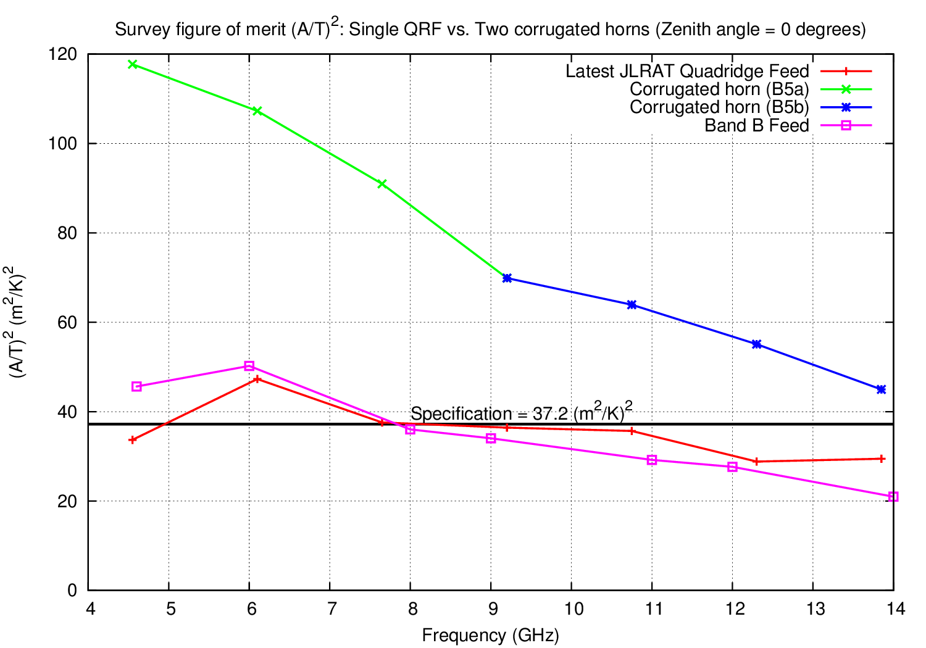
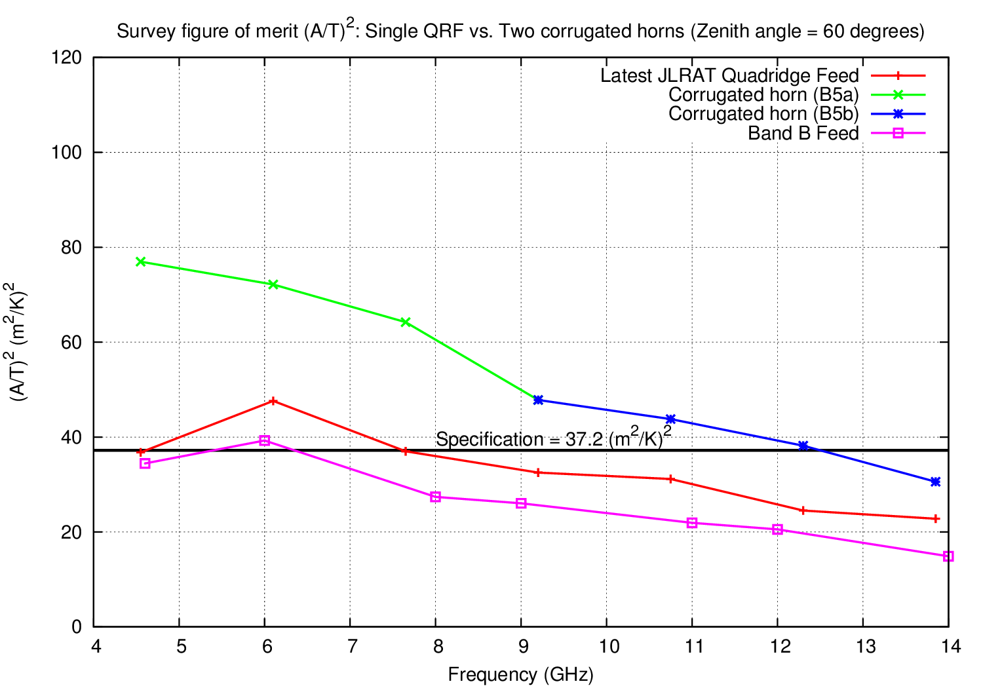
Band 5 : QRFH vs dual CH
JLRAT QRFH and scaled EMSS Band 2 feeds: insert beam model in to GRASP SKA antenna model, integrate over 4π SKA sky/ground brightness model
Calculate FOM: (Aeff/Tsys)²
Decision: Dual feeds!
Band 5a: 4.6 – 8.5 GHz
Band 5b: 8.3 – 15.4 GHz (improved upper freq limit helps planet formation KSP)

Slide 5
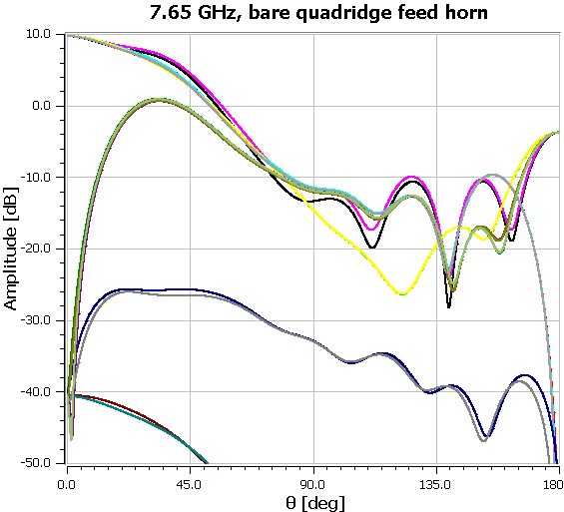
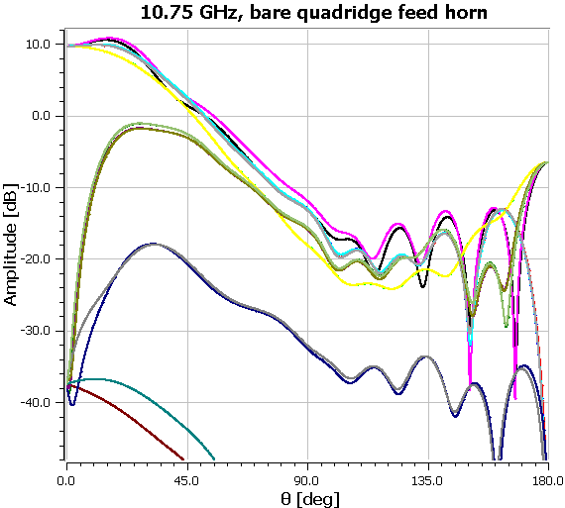
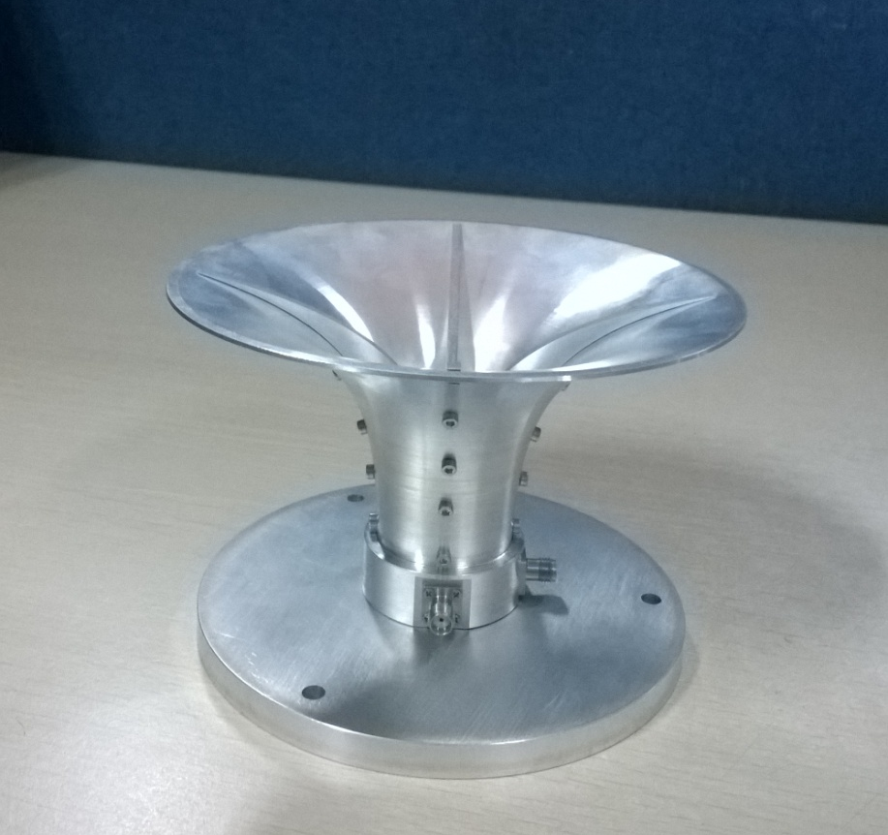
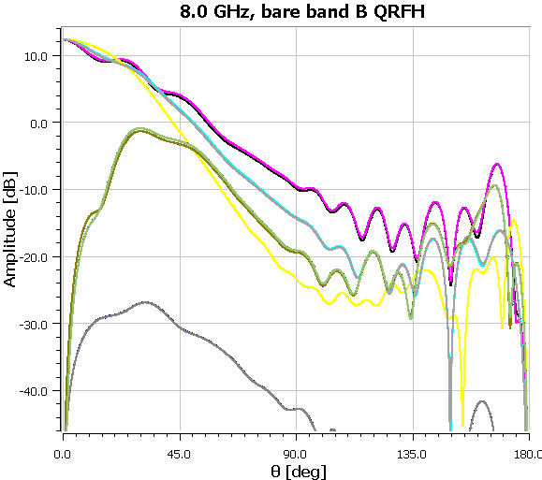
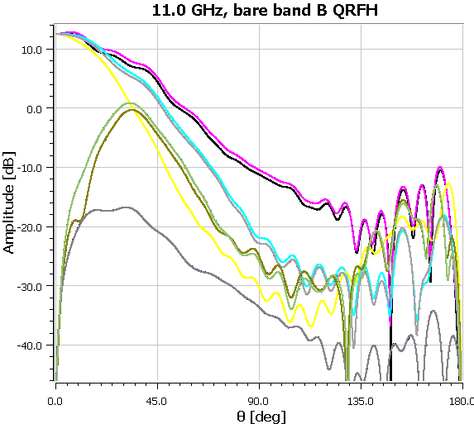
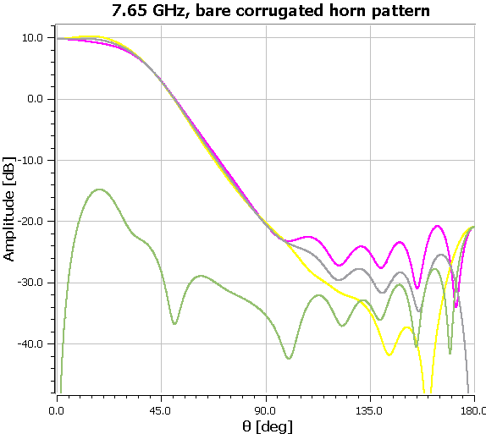
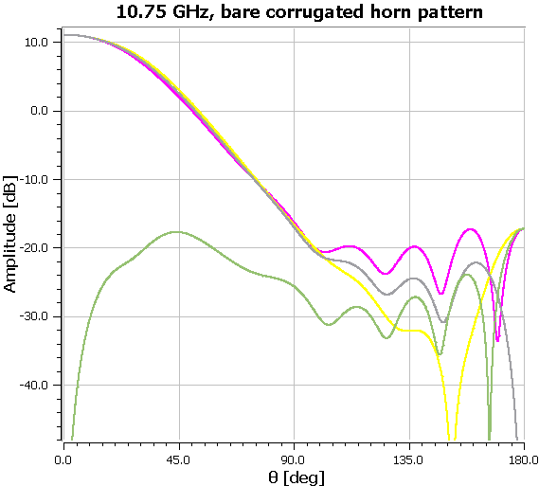
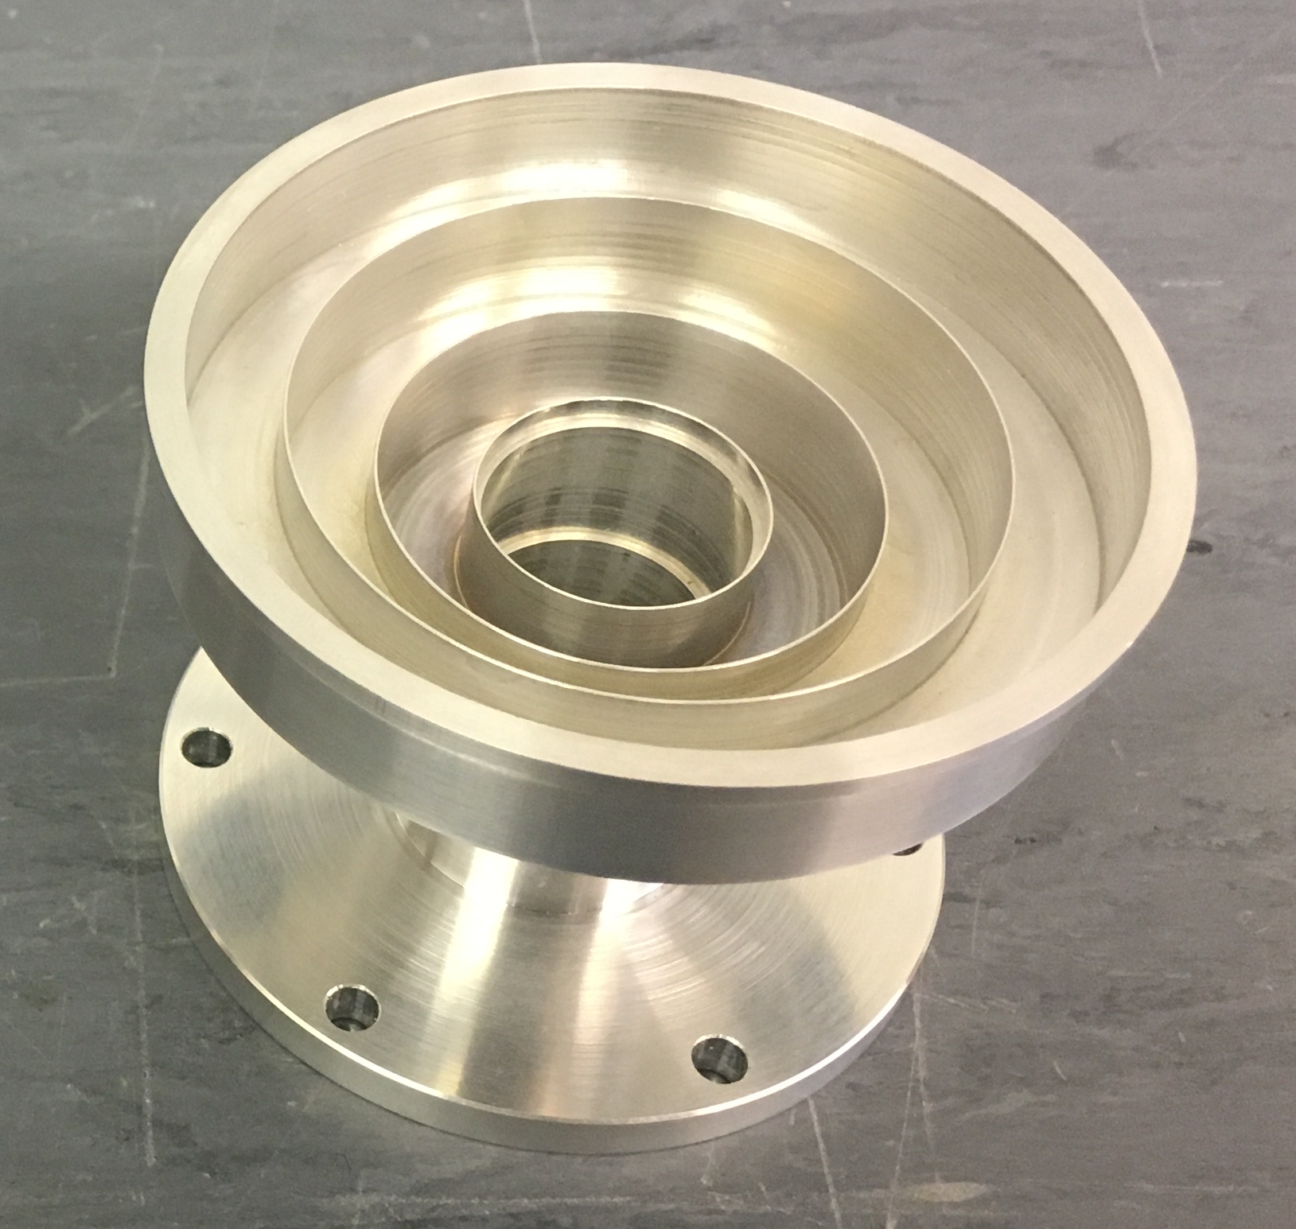
Bare horn pattern comparison
JLRAT QRFH
Chalmers Band B QRFH
Scaled EMSS corrugated horns:
Note: much higher beam circularity
Lower sidelobes
Much lower Cross-pol
Notes:
SKA is in design phase – completing detailed design by 2017. 4 areas in Oxford: Software; SKA-LOW Digital signal processing and architecture; Dish receivers; Non-imaging processing (pulsars).
Software – at OERC. Areas as listed
Dishes – picture is a Gifford McMahon cold head! Aim is to reduce power consumption by a factor of a few for SKA1, order of magnitude for SKA2

Slide 6
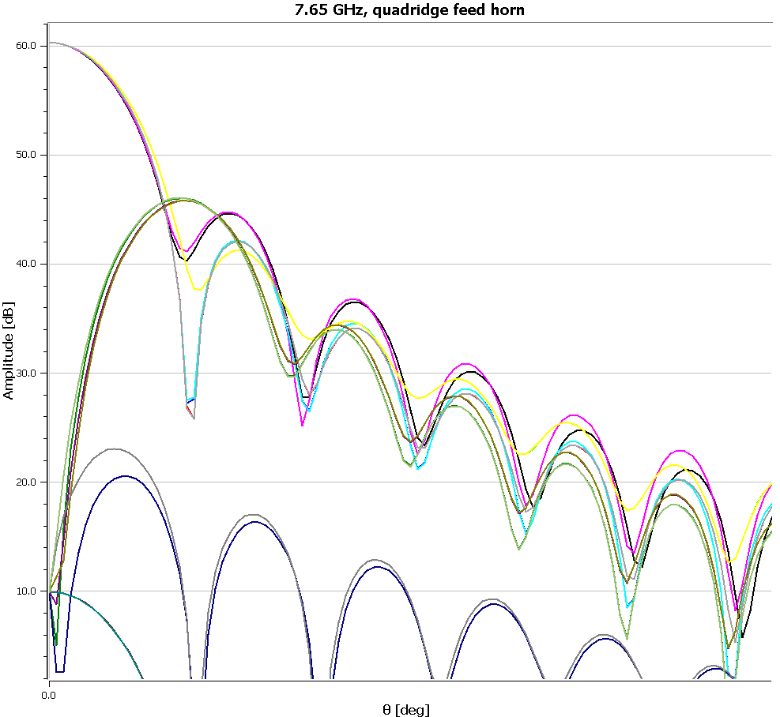
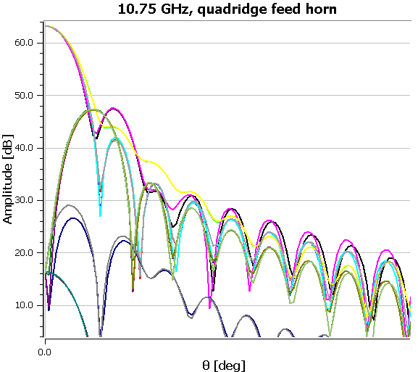
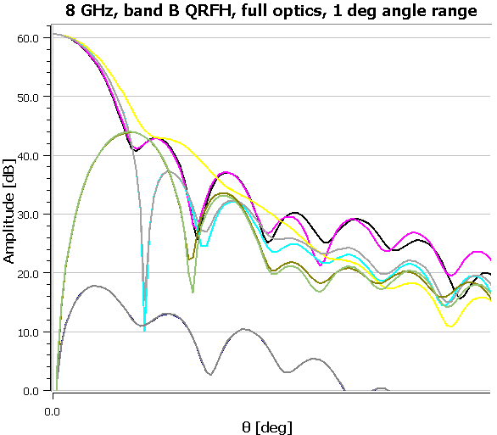
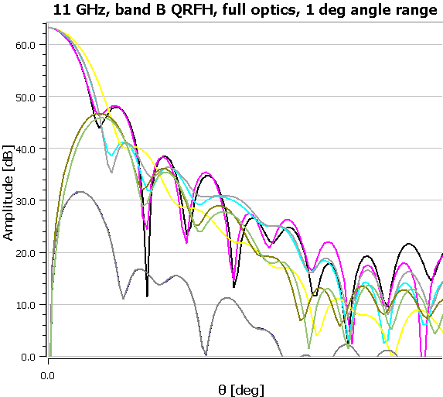
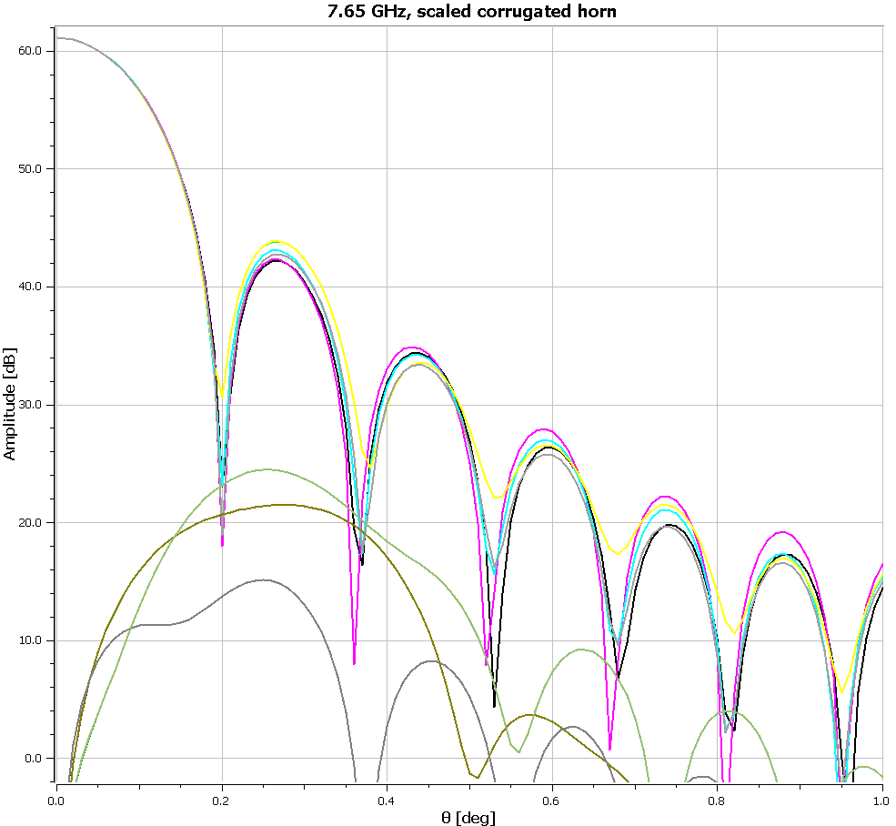
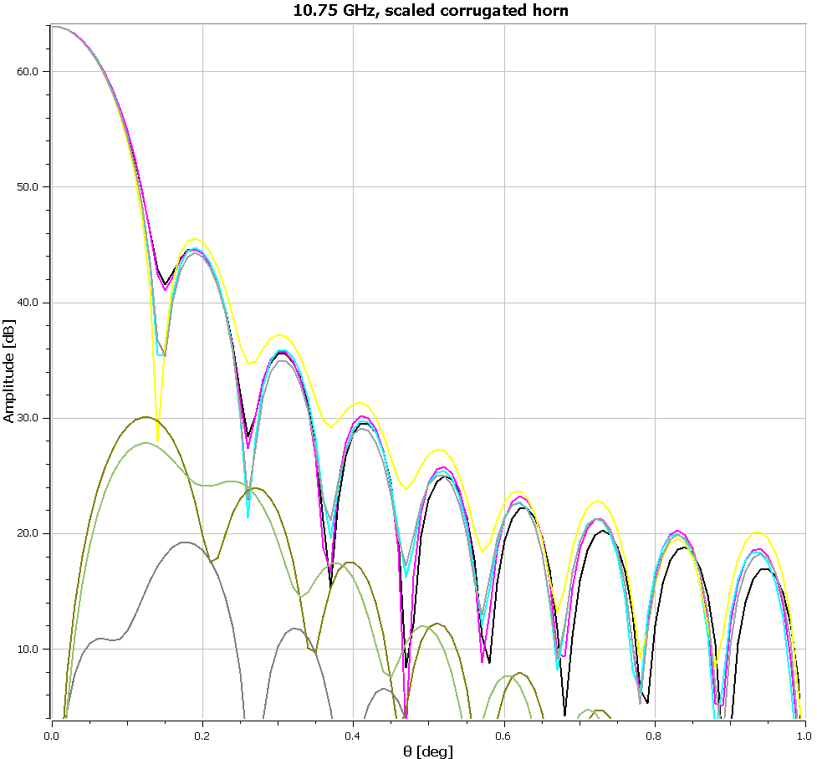
Full optics beam comparison
JLRAT QRFH
Chalmers Band
B QRFH
Scaled EMSS corrugated horns:
Note: Much lower Cross-pol
Notes:
SKA is in design phase – completing detailed design by 2017. 4 areas in Oxford: Software; SKA-LOW Digital signal processing and architecture; Dish receivers; Non-imaging processing (pulsars).
Software – at OERC. Areas as listed
Dishes – picture is a Gifford McMahon cold head! Aim is to reduce power consumption by a factor of a few for SKA1, order of magnitude for SKA2

Slide 7
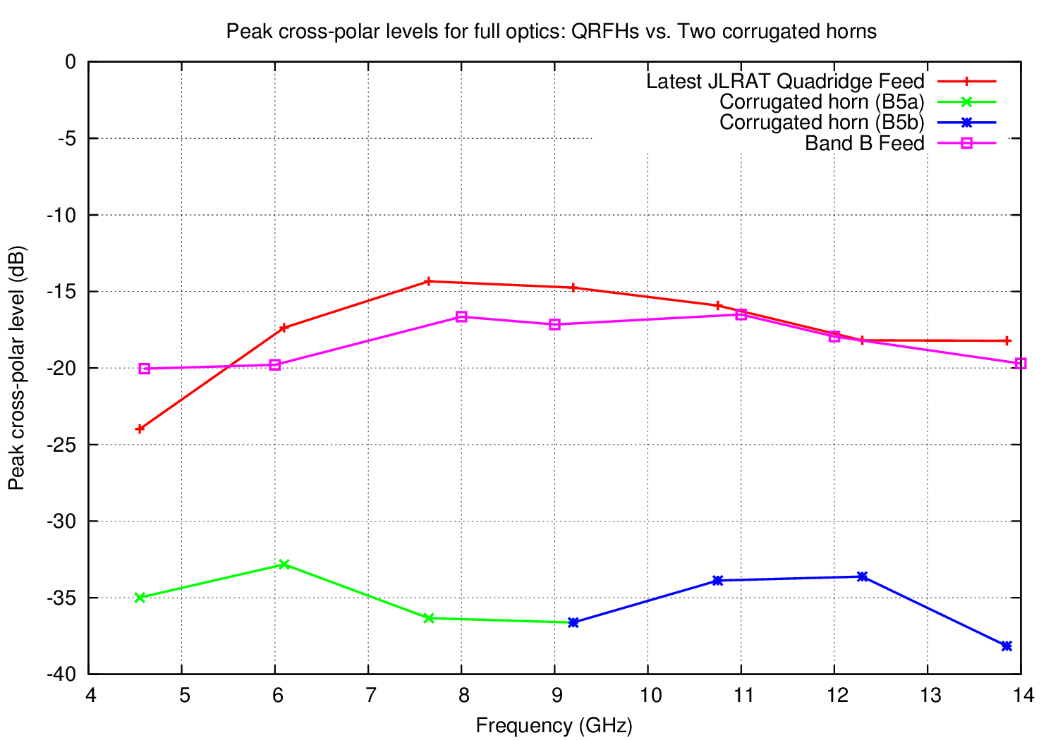
Band 5 – Cross-polarization
Notes:
SKA is in design phase – completing detailed design by 2017. 4 areas in Oxford: Software; SKA-LOW Digital signal processing and architecture; Dish receivers; Non-imaging processing (pulsars).
Software – at OERC. Areas as listed
Dishes – picture is a Gifford McMahon cold head! Aim is to reduce power consumption by a factor of a few for SKA1, order of magnitude for SKA2

Slide 8
Aperture efficiency
Notes:
SKA is in design phase – completing detailed design by 2017. 4 areas in Oxford: Software; SKA-LOW Digital signal processing and architecture; Dish receivers; Non-imaging processing (pulsars).
Software – at OERC. Areas as listed
Dishes – picture is a Gifford McMahon cold head! Aim is to reduce power consumption by a factor of a few for SKA1, order of magnitude for SKA2

Slide 9
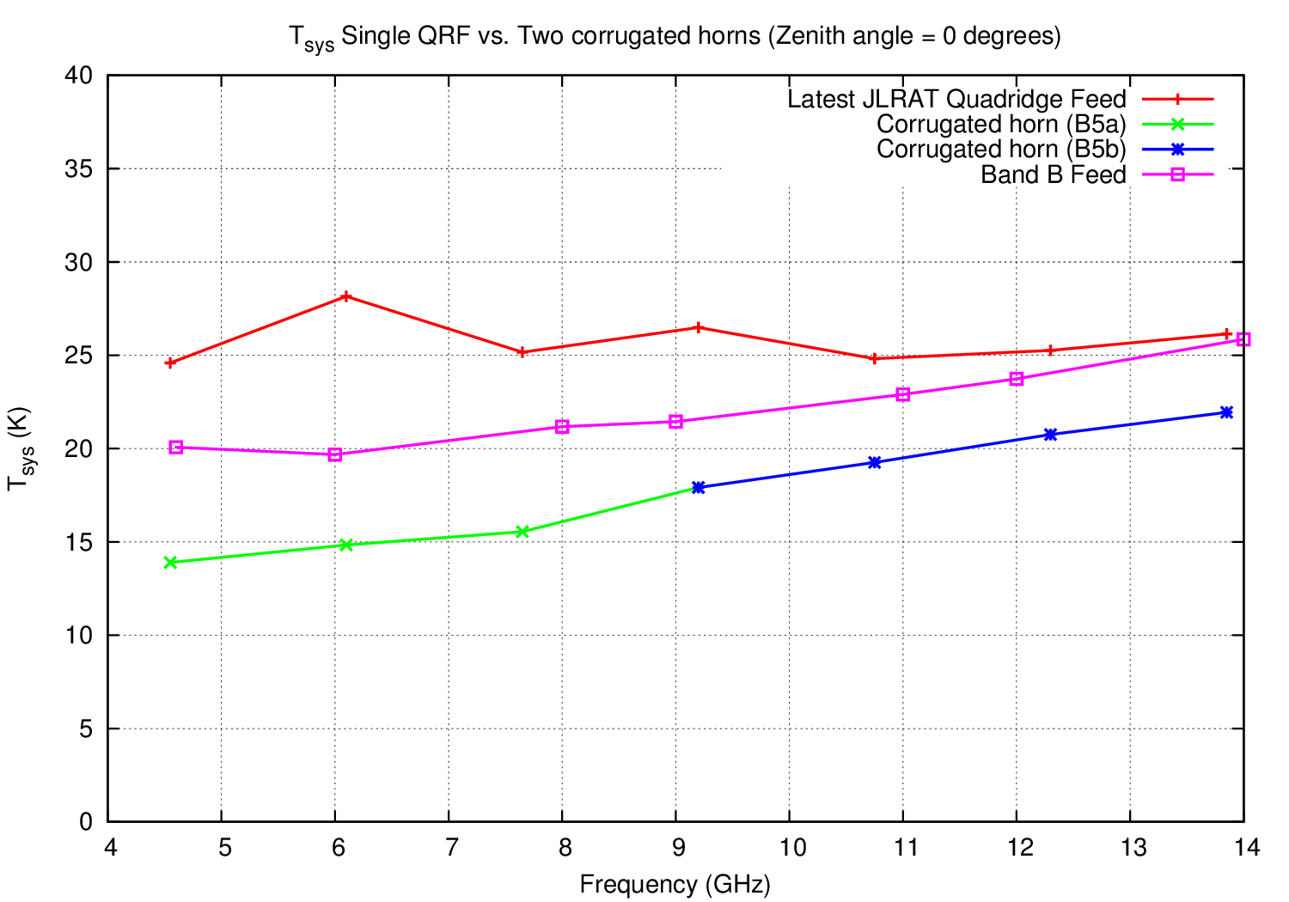
Tsys - Zenith
Notes:
SKA is in design phase – completing detailed design by 2017. 4 areas in Oxford: Software; SKA-LOW Digital signal processing and architecture; Dish receivers; Non-imaging processing (pulsars).
Software – at OERC. Areas as listed
Dishes – picture is a Gifford McMahon cold head! Aim is to reduce power consumption by a factor of a few for SKA1, order of magnitude for SKA2

Slide 10
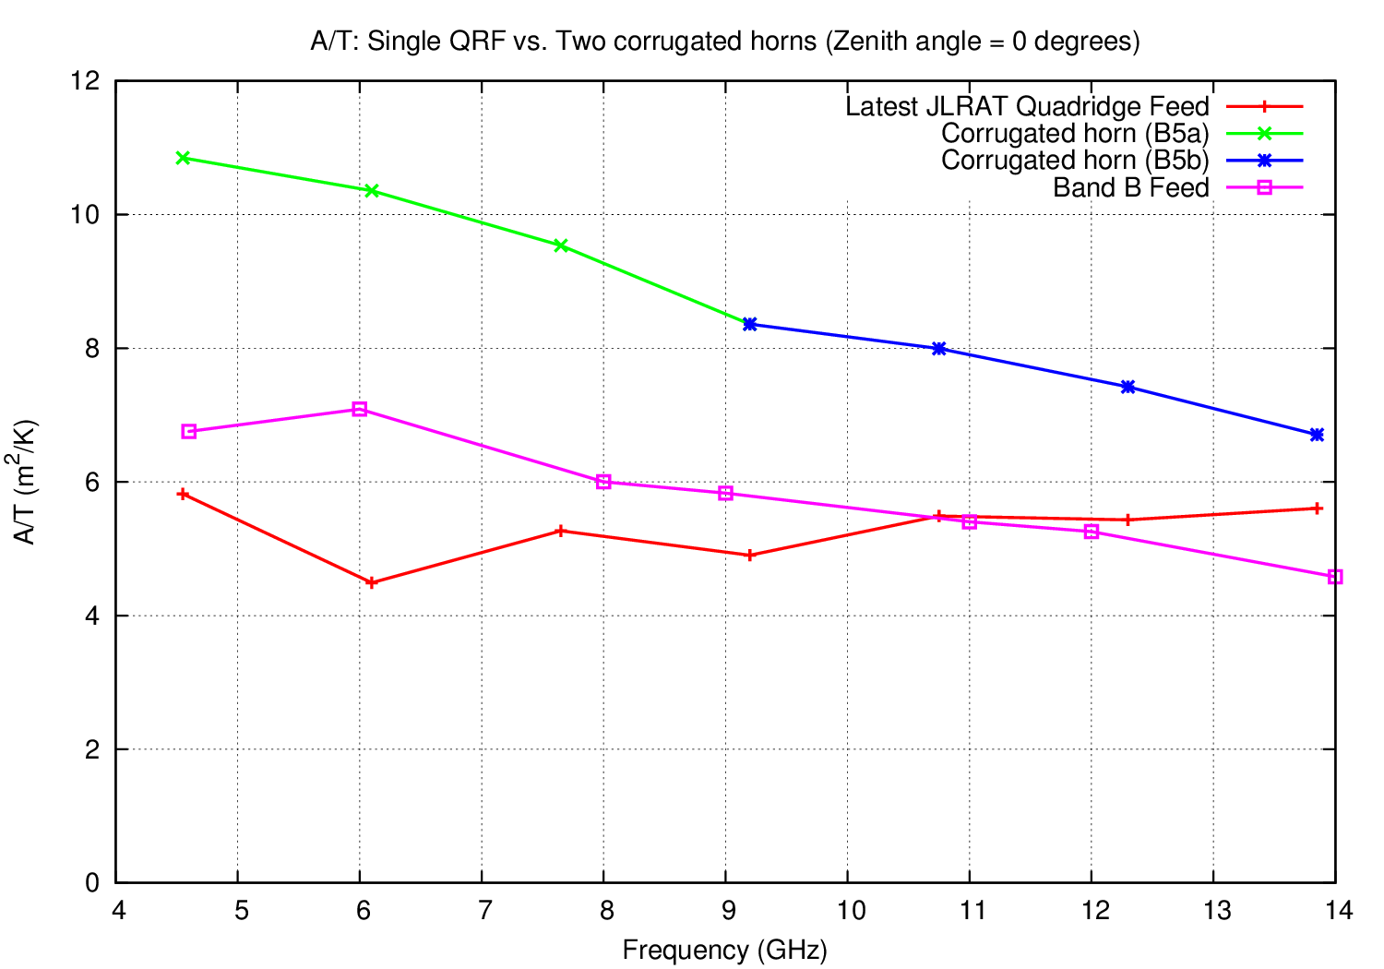
A/T - Zenith
Notes:
SKA is in design phase – completing detailed design by 2017. 4 areas in Oxford: Software; SKA-LOW Digital signal processing and architecture; Dish receivers; Non-imaging processing (pulsars).
Software – at OERC. Areas as listed
Dishes – picture is a Gifford McMahon cold head! Aim is to reduce power consumption by a factor of a few for SKA1, order of magnitude for SKA2

Slide 11
Mapping Speed - Zenith
Notes:
SKA is in design phase – completing detailed design by 2017. 4 areas in Oxford: Software; SKA-LOW Digital signal processing and architecture; Dish receivers; Non-imaging processing (pulsars).
Software – at OERC. Areas as listed
Dishes – picture is a Gifford McMahon cold head! Aim is to reduce power consumption by a factor of a few for SKA1, order of magnitude for SKA2

Slide 12
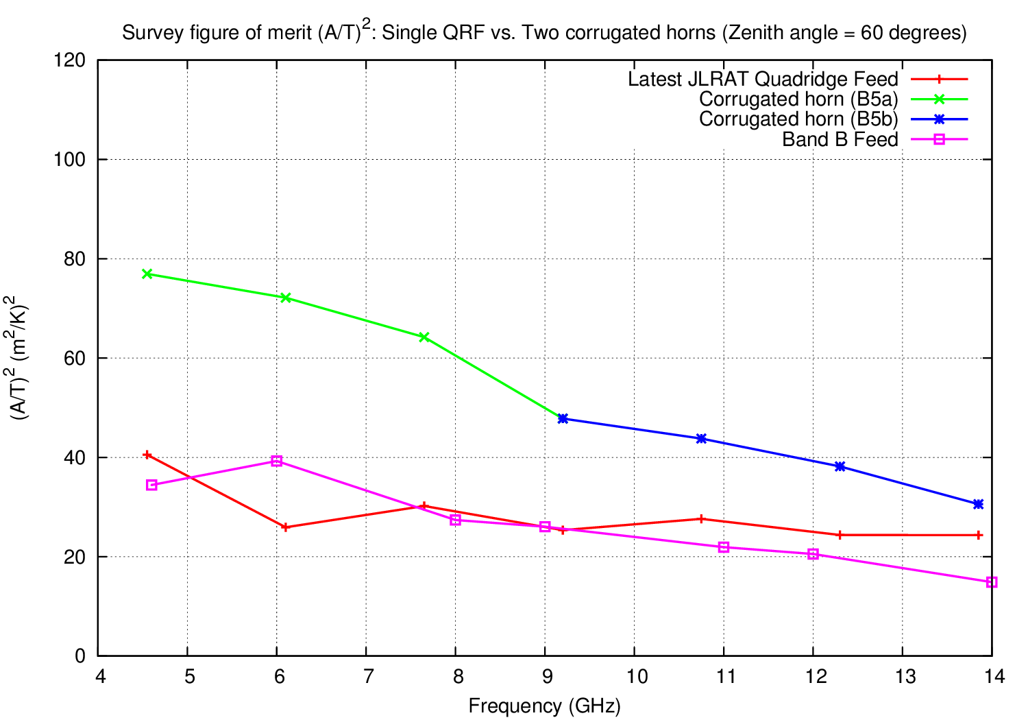
Mapping Speed – 60 degrees
Notes:
SKA is in design phase – completing detailed design by 2017. 4 areas in Oxford: Software; SKA-LOW Digital signal processing and architecture; Dish receivers; Non-imaging processing (pulsars).
Software – at OERC. Areas as listed
Dishes – picture is a Gifford McMahon cold head! Aim is to reduce power consumption by a factor of a few for SKA1, order of magnitude for SKA2

Slide 13
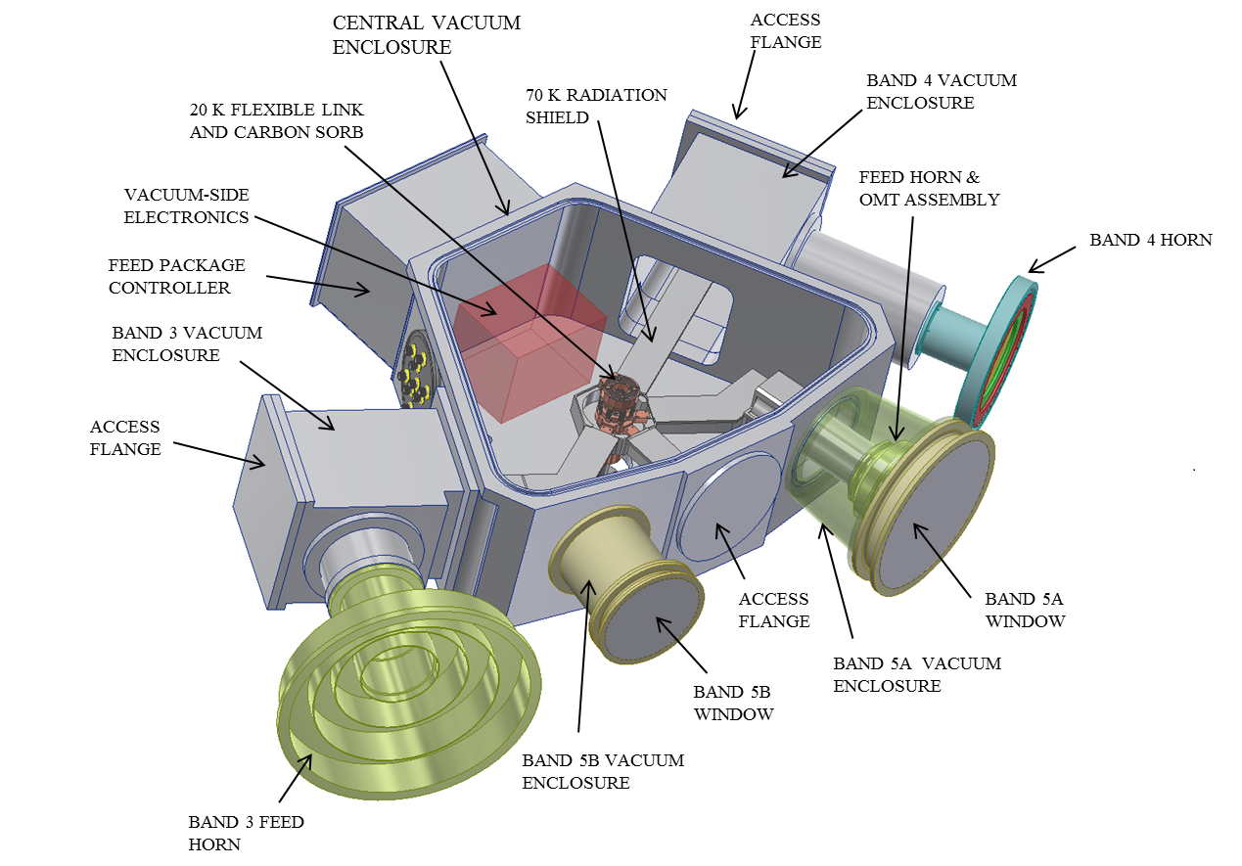
Cryostat concept
B3,4 – ambient feeds, cooled OMTs
B5a,b,6 – cooled (70 K) feeds, OMTs/LNAs @ 20 K
Single coldhead with plumbing

Slide 14
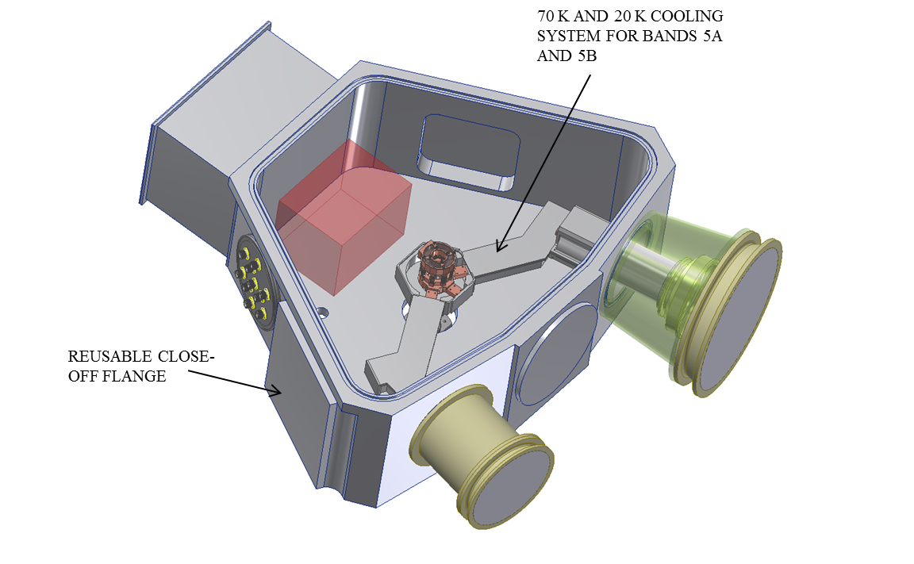
First-light configuration

Slide 15
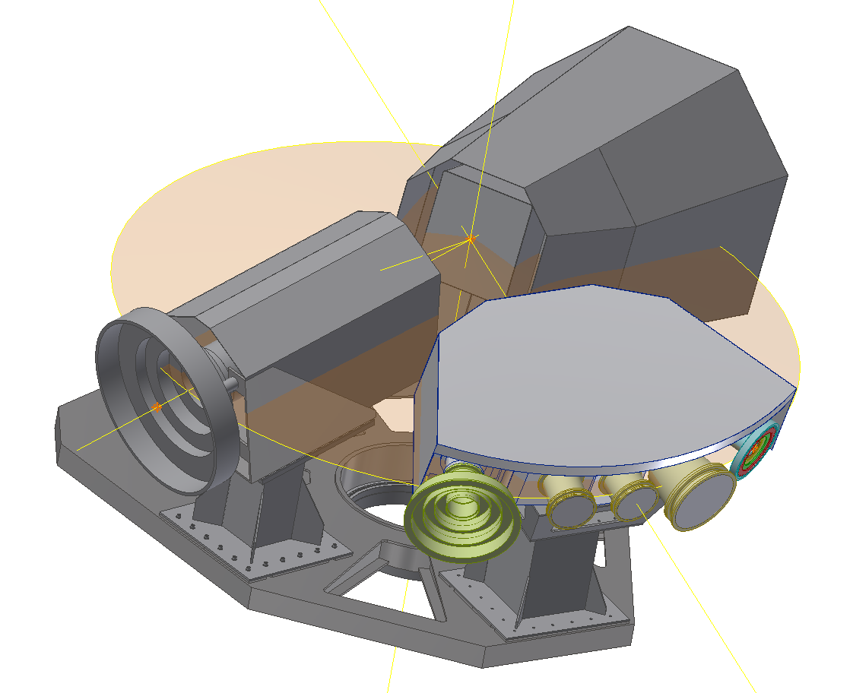
SPF B345 on the Indexer

Slide 16
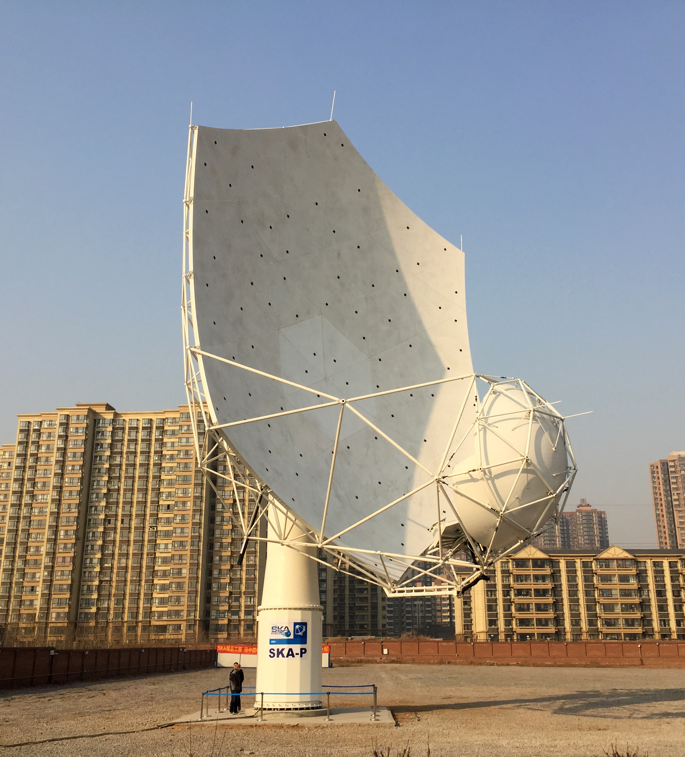
SPF B345 on the Indexer

Slide 17
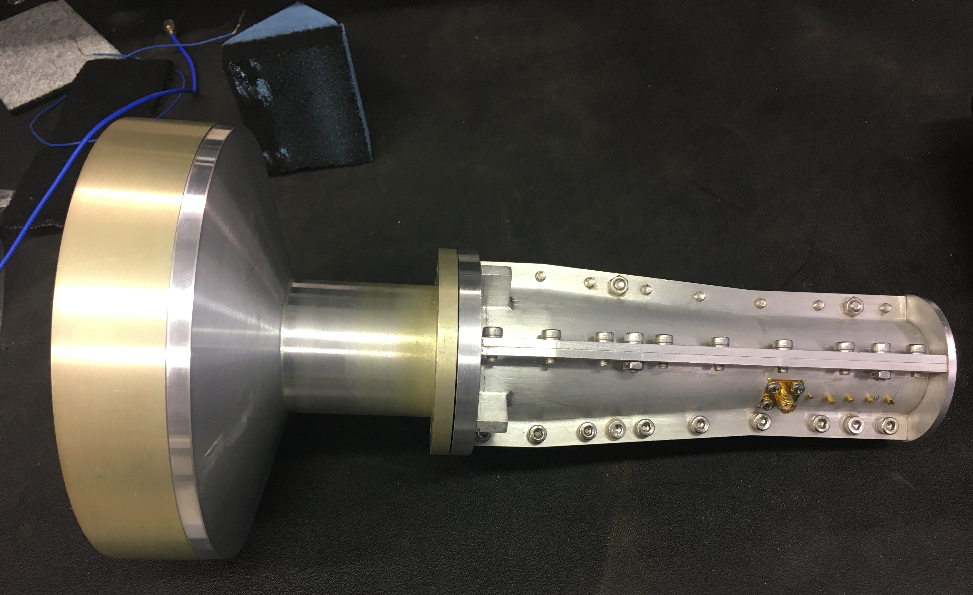
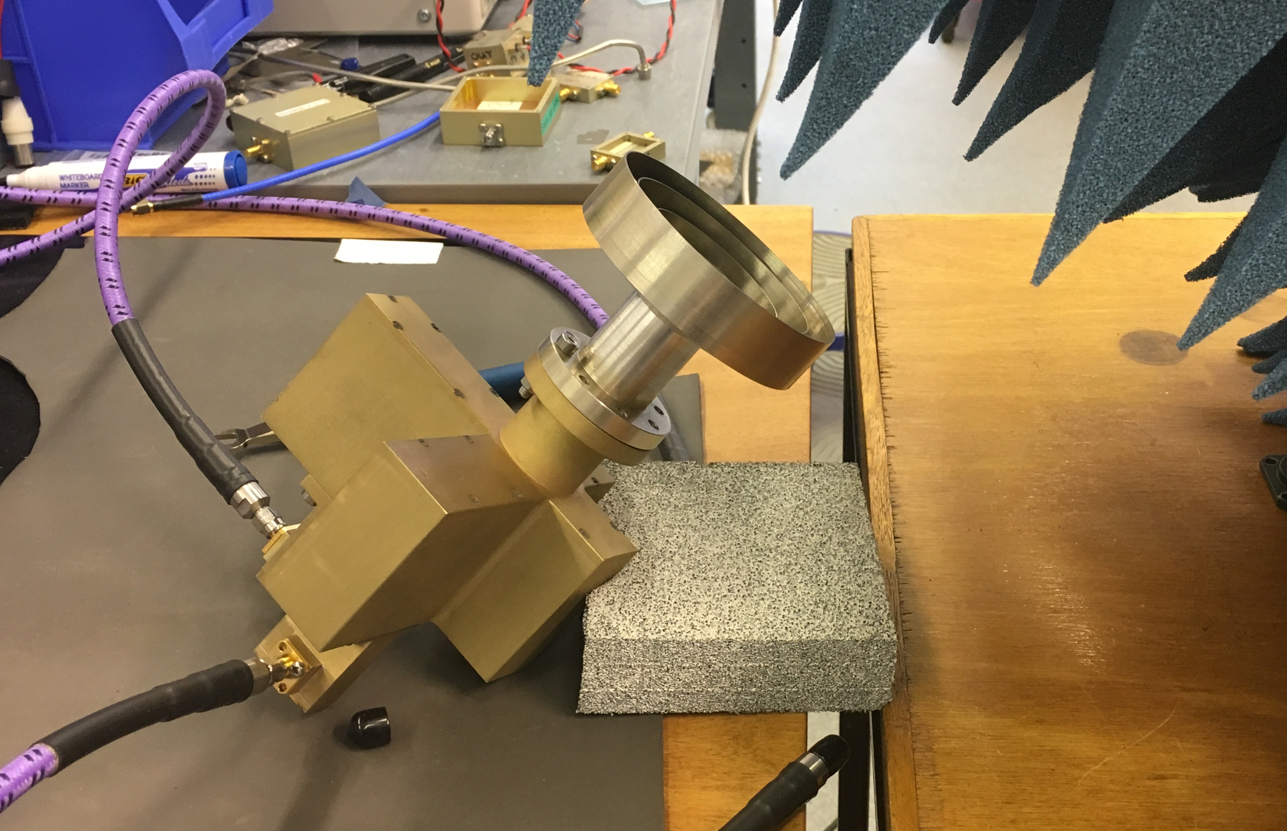
Feeds and OMTs
B5a/b feeds from JLRAT, China
Feeds: Axial corrugated/choked flange (v. similar to B2)
B5a: Quad ridge
B5b: Turnstile

Slide 18
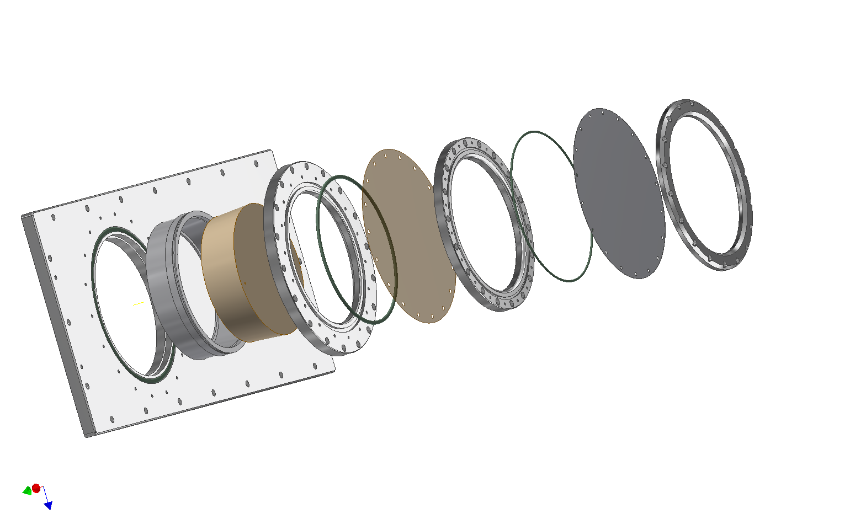
Vacuum Window Design
Mylar Clamping Ring
PTFE Membrane
Mylar Membrane
Adapter Ring
Vacuum Flange
Foam Support
Ring
PTFE Clamping Ring
O-ring
O-ring
Plastazote HD110
O-ring
WINDOW COMPONENTS FITTED TO CRYOSTAT DEVELOPMENT CHAMBER

Slide 19
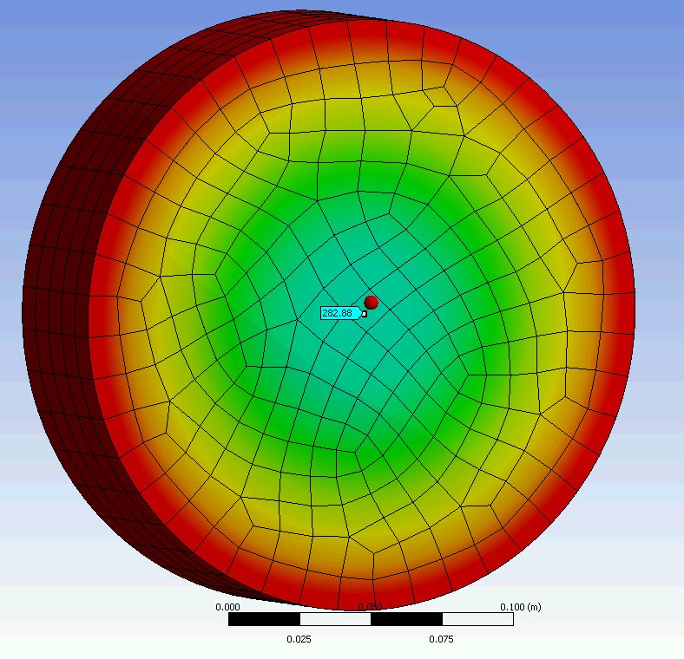
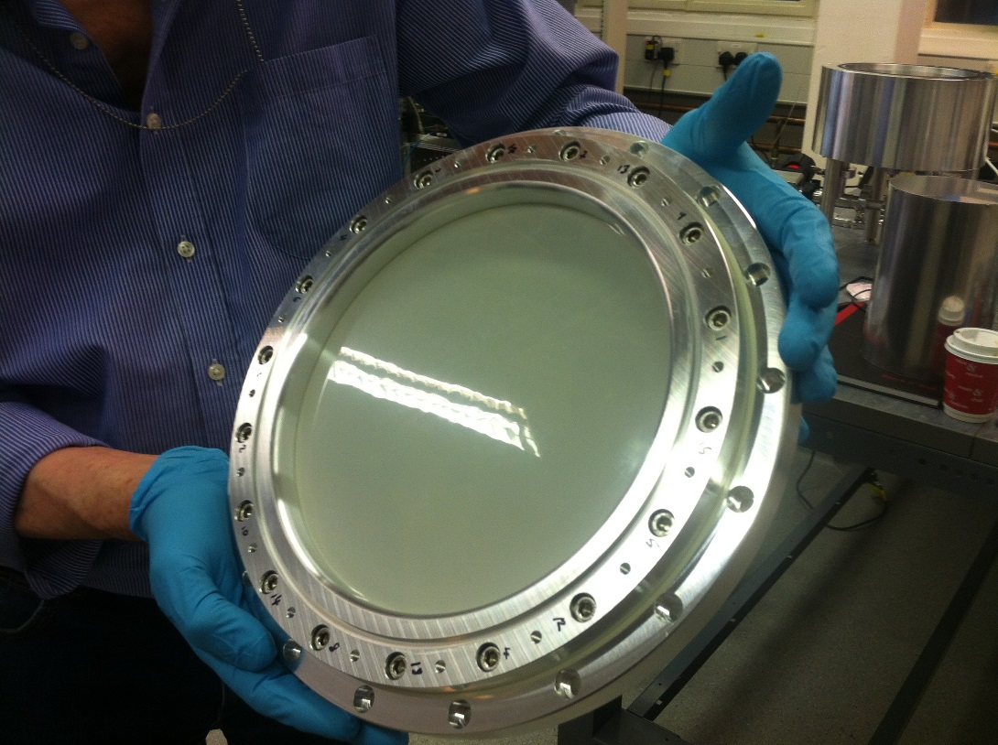
Prototype Window (B5a)
Vacuum seal is Mylar
Supported by Plastazote (polythene/N2)
Modest infra-red block (single layer) – reduces heat load x 2.
Outer PTFE weather cover.

Slide 20
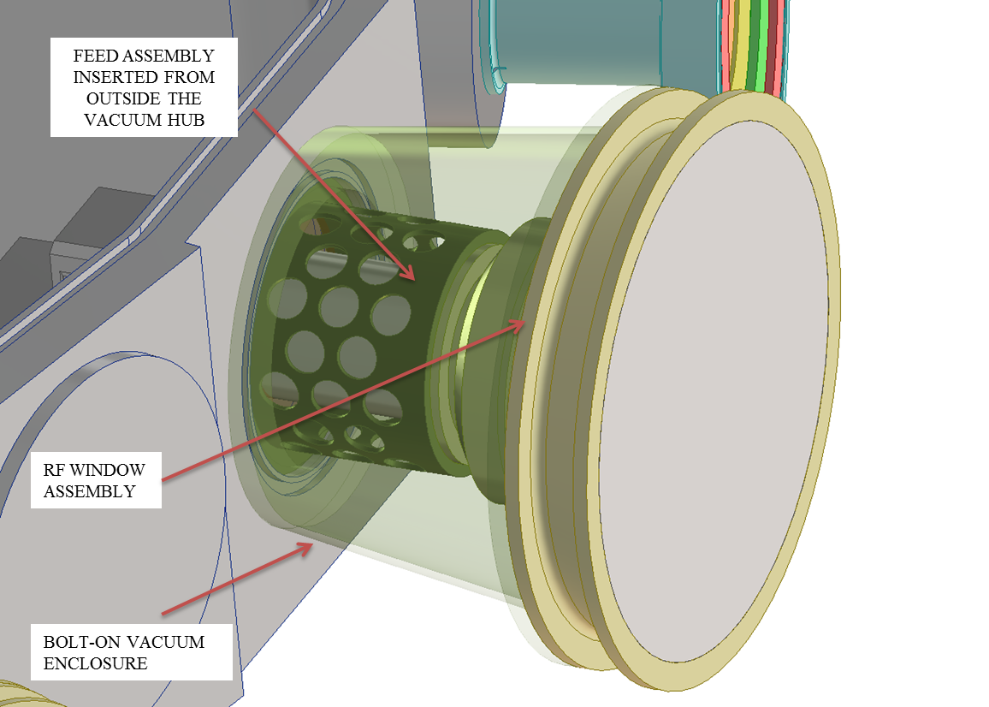
Feed Unit

Slide 21
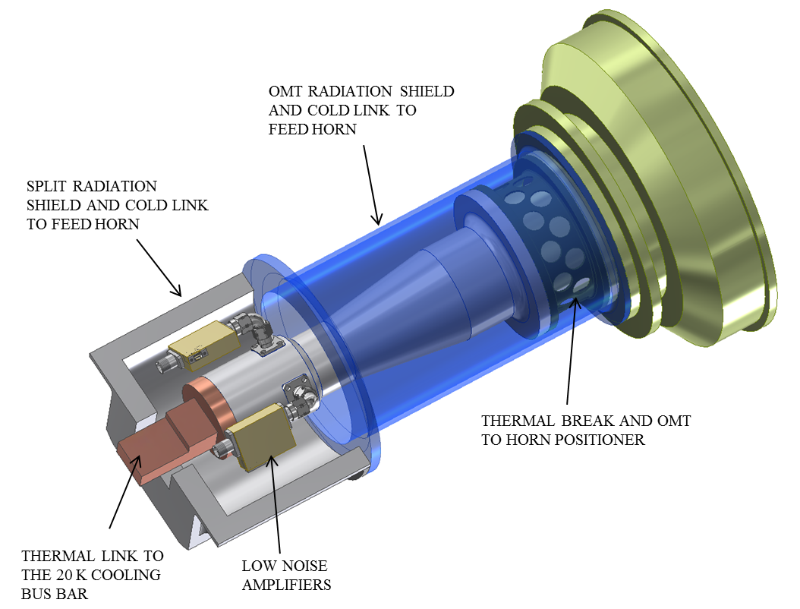
Feed Unit

Slide 22
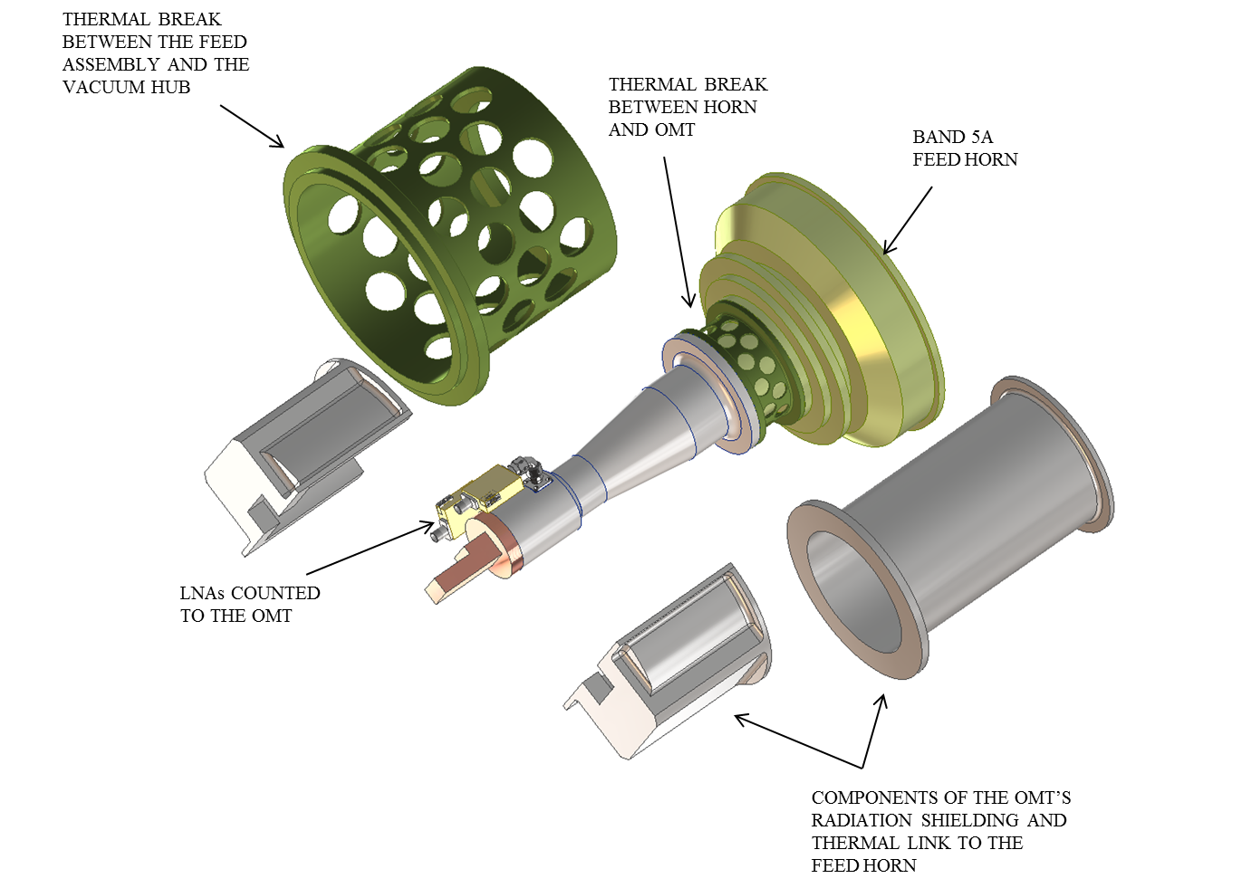
Feed unit - exploded

Slide 23
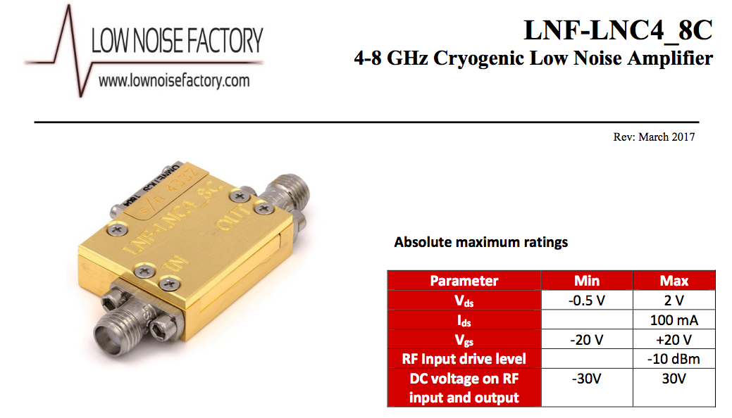
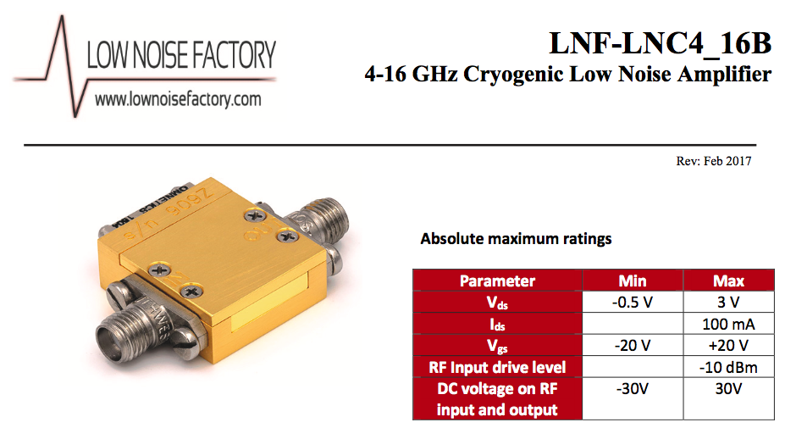
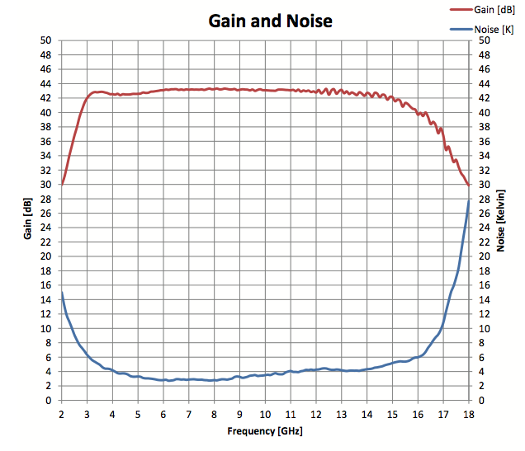
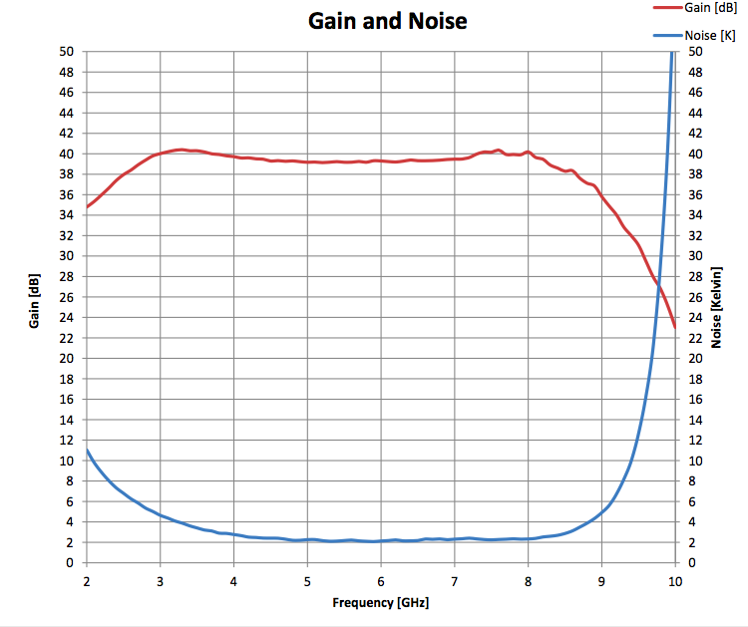
LNAs and RF chain

Slide 24
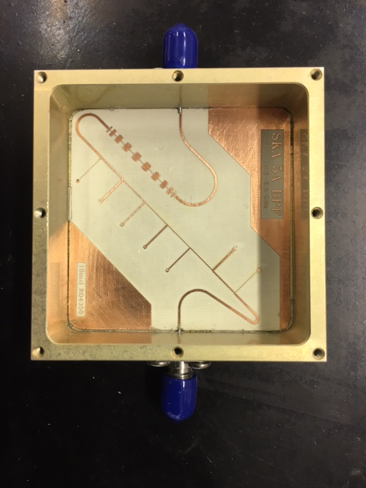
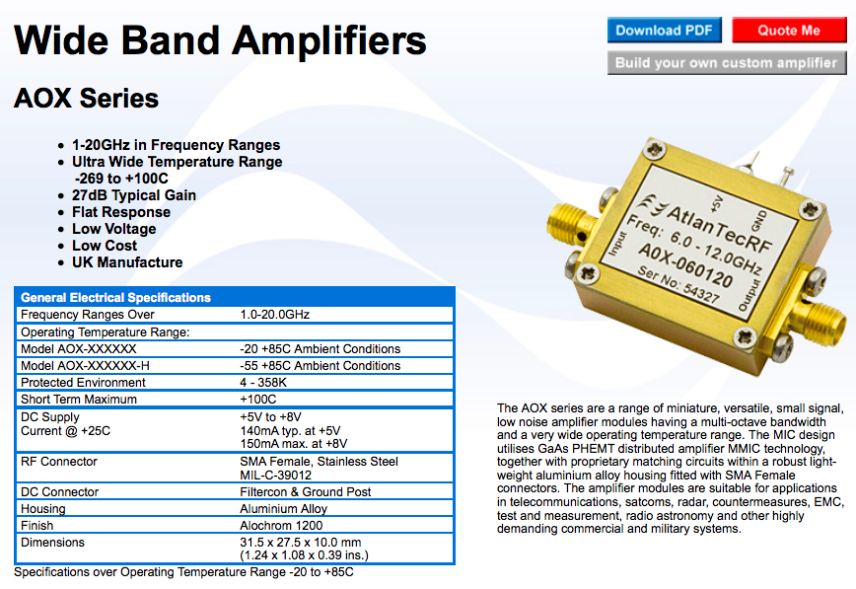
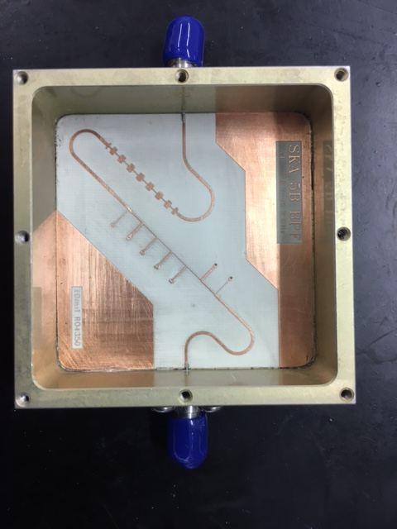
LNAs and RF chain
Very simple RF chain: LNA, filter, 2nd stage amp
1-20 GHz warm amplifiers
Custom BPFs

Slide 25
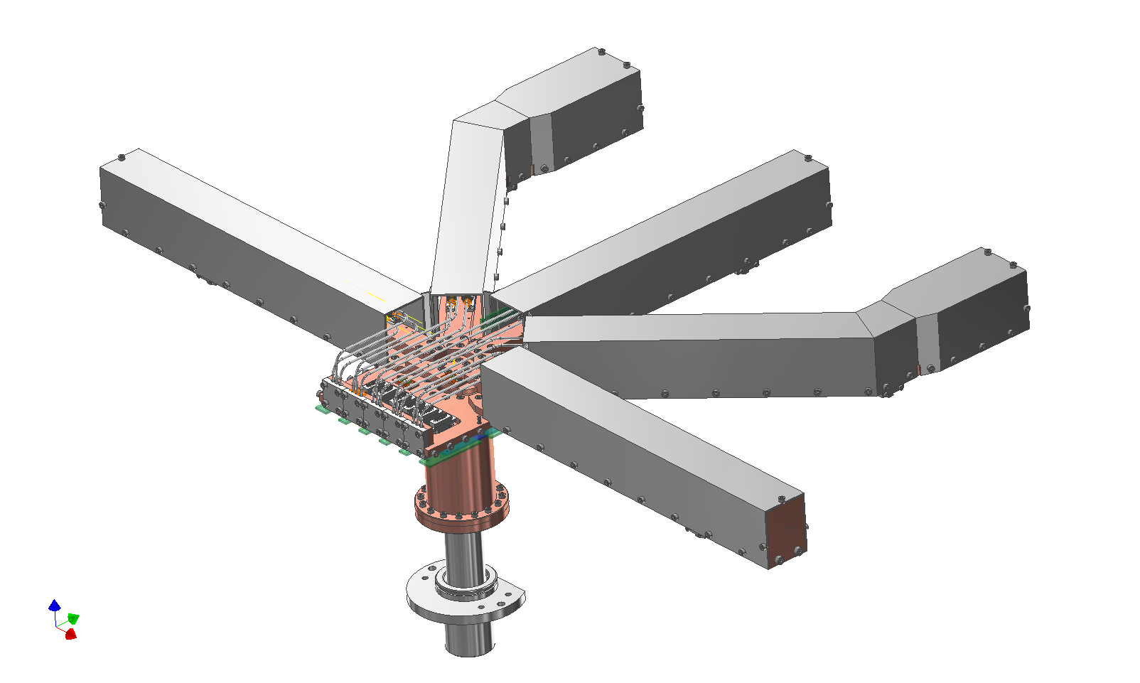
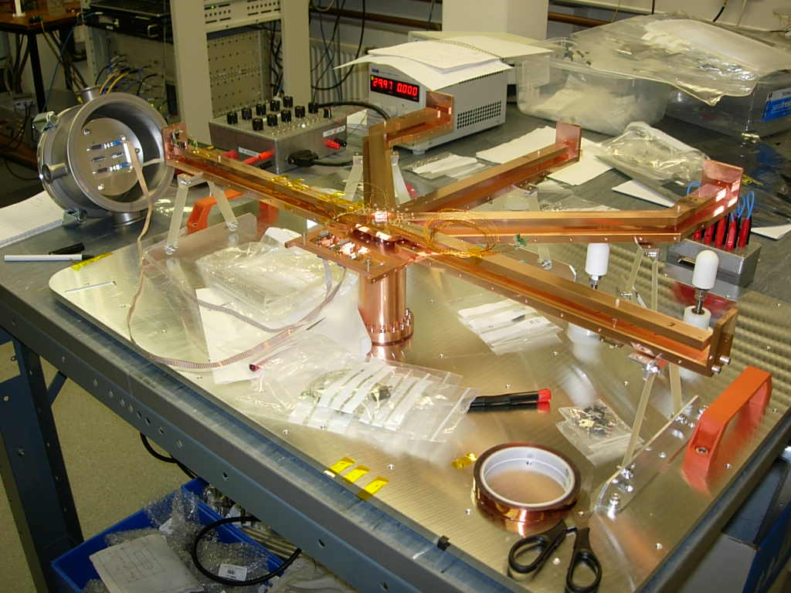
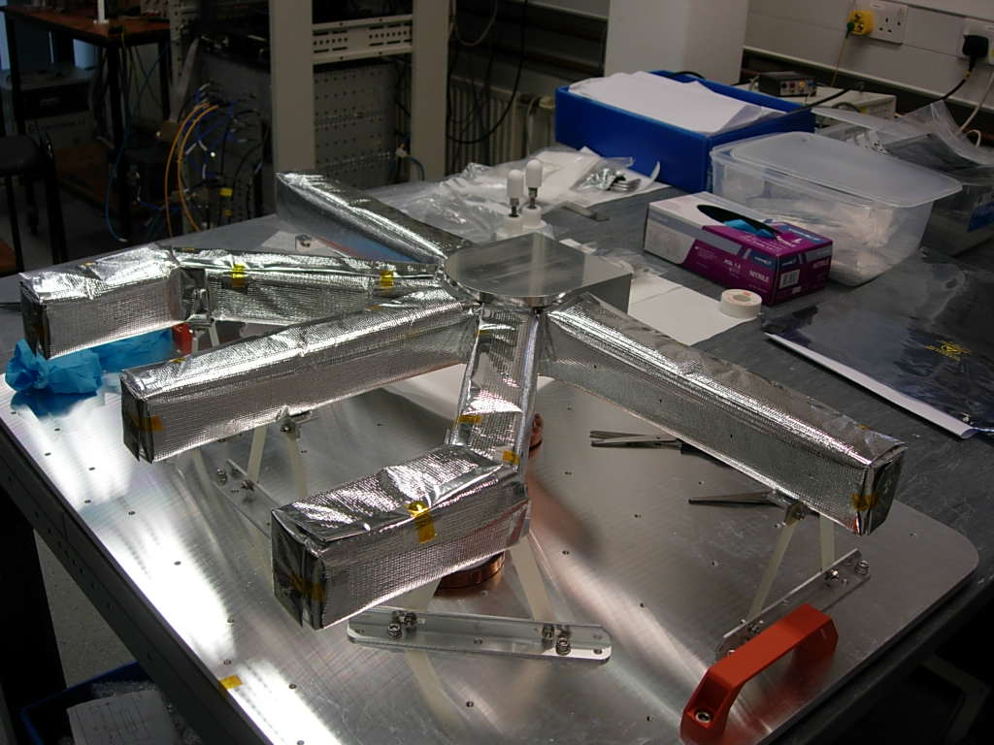
Cold plumbing

Slide 26
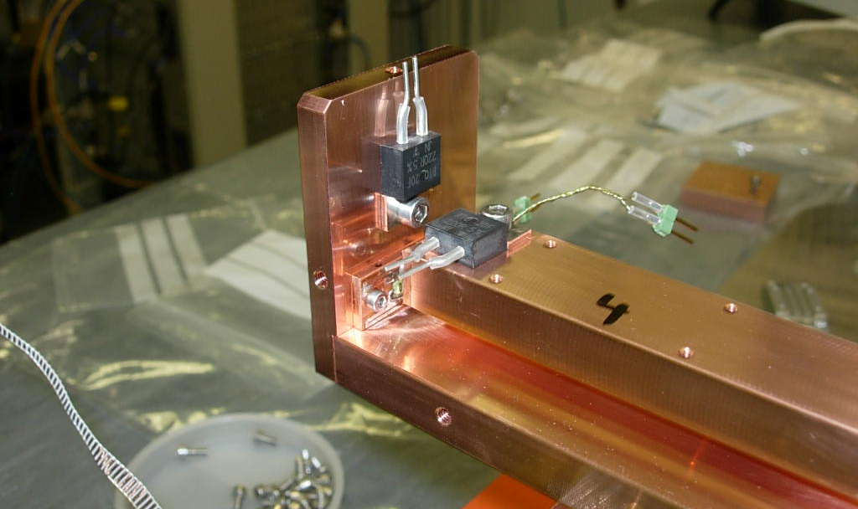
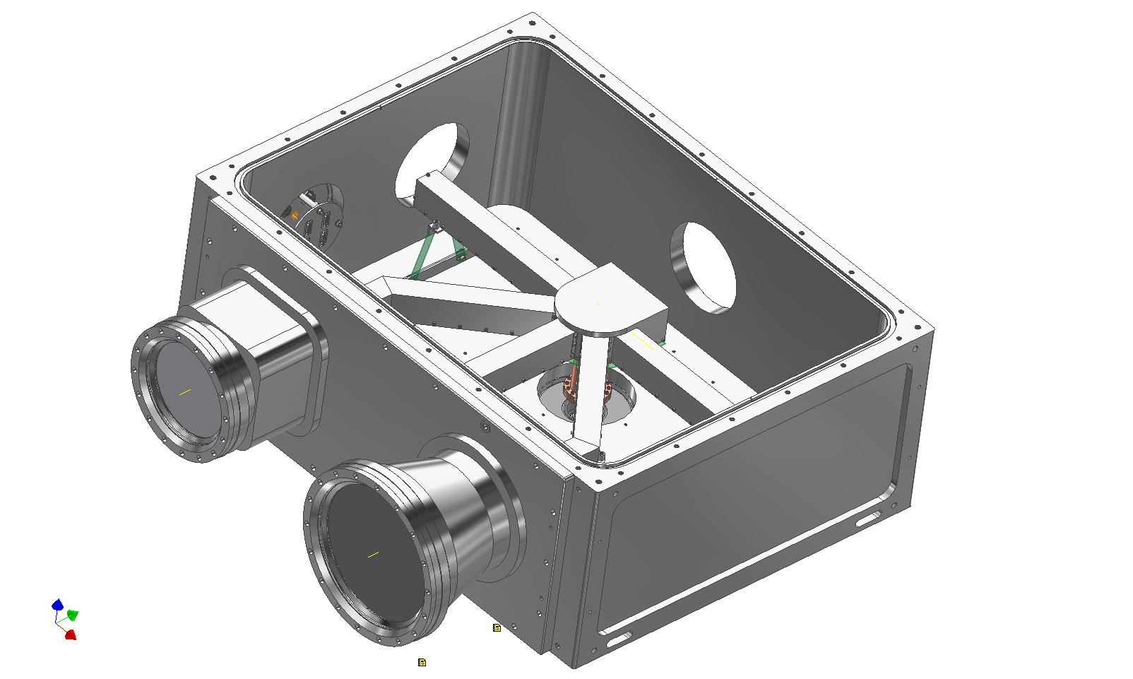
Cold plumbing

Slide 27
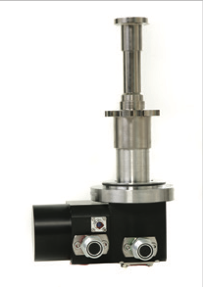
Cryogenics – cold head
Oxford Cryosystems Coolstar 2/9 and 6/30 – both variable speed (stepper motor ~20 – 90 rpm)
Initial design was 2/9 (same as MeerKAT, Band 2) – close to estimated head load.
Now baseline is 6/30 – option to run slow (20 – 90 rpm). Higher heat lift for initial cooldown, reduced wear in steady-state.
Even at full speed, within power budget (5 kW) – can run a 2/9 (Band 2) and 6/30 (B5) < 3 kW

Slide 28
Cryogenics – power control
Horrible multi-dimensional problem, but:
Best heat lift at high pressures, low coldhead speeds
Heat lift saturates or even declines at very high coldhead speeds
Power consumption declines linearly with compressor speed
Conclusion: control of both coldhead and compressor speed allows you to optimize power consumption for any required heat lift

Slide 29
Cryogenics – power control

Slide 30
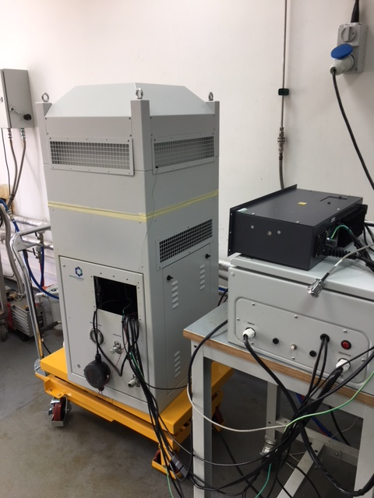
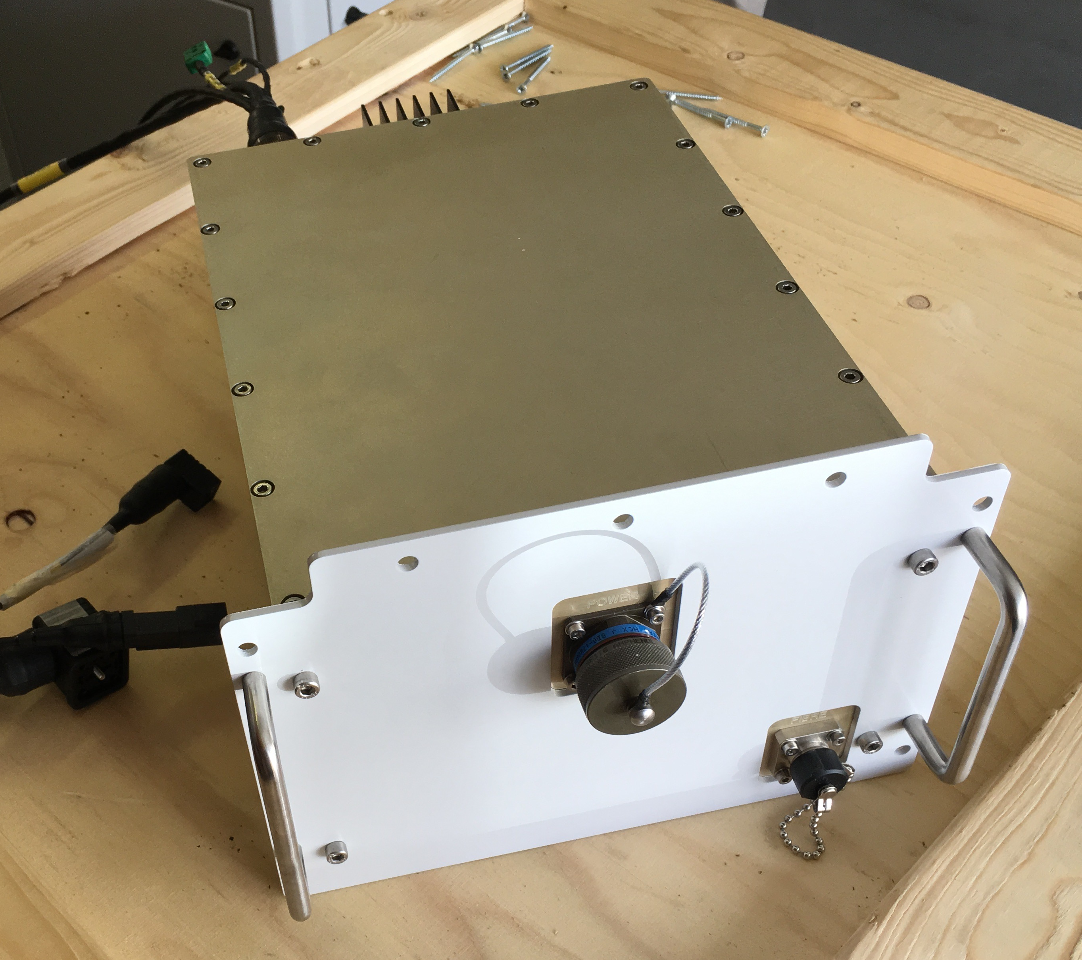
Cryogenics - compressor
Need variable flow compressor to ensure no wasted compressed He
Oxford Cryosystems developed new SKA-optimized compressor:
  Hitachi 3 kW 3-ph scroll compressor capsule
  EMSS MeerKAT RFI-tight control/monitoring module
  External variable-speed 3-ph x 240V variable freq drive
  Rugged housing for outdoor use
  Zero-maintenance air-cooled heat exchanger
  ~30,000h adsorber lifetime

Slide 31
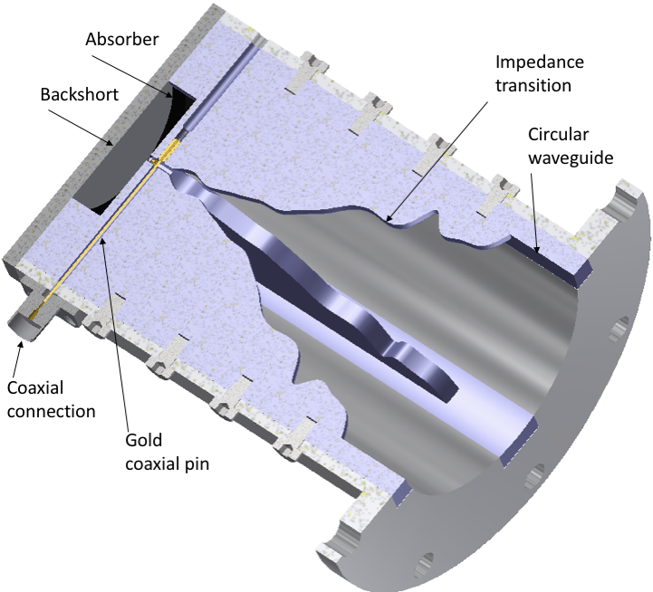
Goonhilly-3 4-8.5 GHz receiver
C/X band receiver for eMerlin,single-dish and satcoms
Compact 2.2:1 OMT
CW stabilized for total power observations

Slide 32
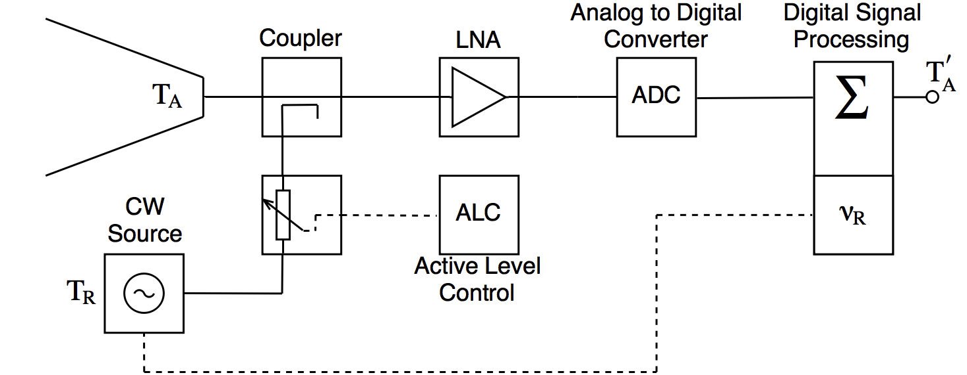
CW stabilization
Total power observations need suppression of 1/f noise
Continuous-comparison architecture (e.g. Planck LFI, C-BASS) needs 4xRF channels
Noise stabilization takes up sensitivity
CW stabilization takes up small fraction of bandwidth, can use strong cal signal
Measurements show 1/f fluctuations highly correlated across band

Slide 33
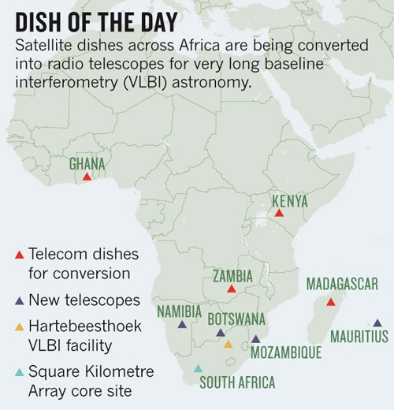
AVN demonstration Rx
PhD project to build demonstration Rx covering SKA Band 5 with new technology:
Wide-band tri-ridge-transducer
Flared corrugated horn
RFSOC-based digital backend with arbitrary calibration signal generation

Slide 34


Feed horn design
Cross section of Feed Horn Design
Corrugated wall: ensures TE11 & TM11 (HE11) propagates to aperture
TE11
TE11
HE11
+
Linear polarised
TM11
Smooth wall: Mode conversion and impedance matching
[5]
Chokes: lower sidelobes
TE: Transverse Electric Field
TM: Transverse Magnetic Field

Slide 35


Feed horn design
HFSS Horn Simulation Results
CHAMP Horn Simulation: Beam Pattern
Gain:
11dB
-12dB
-25dB
≈ -15dB at 58º half beamwidth
4.6 to 8.5 GHz
15dB polarisation isolation minimum
Beam Pattern measurement yet to be carried out

Slide 36

Transducer Design
Desired TE11
Unwanted TE21
For wideband operation Quad ridge Othormode transducer is widely used
  Provides wide band operation
  Imperfect Manufacturing process produce asymmetries resulting in spurious mode generation
  → loss off sensitivity at the wavelengths this occurs
  → Coupling between polarisations
Triple ridge structures have been known to provide wider bandwidth capabilities [7], But has not to date been implemented.
[6]
QROMT
Proposed TRT
TE: Transverse Electric Field
OMT: Orthomode Transducer
TRT: Triple Ridge Transducer

Slide 37





Transducer Design
Transducer Solid Model
Ridge profile of the form C+A*sin(B)²
Waveguide Diameter reduces at Coaxial transition end
→ Improves high freq. performance
Approx. 320mm total length

Slide 38

Transducer Design
Transducer HFSS S-parameter Simulation Results
X and Y polarisation couple linearly into all 3 Coaxial ports as expected
Return Loss better than -20 dB over desired band (4.6 to 8.5 GHz)
Potential for 3.47:1 -15 dB bandwidth operation

Slide 39

Transducer Design
HFSS Transducer Simulation Results
Verified that power excited at the waveguide port is transmitted into the coaxial ports

Slide 40

Noise injection

Slide 41



RECEIVER BLOCK DIAGRAM
Preliminary design likely to change to allow for greater bandwidth provided by the transducer
DAC

Slide 42
Conclusions
SKA is a multi-feed package design, one ambient, two cooled
SKA Band 3/4/5 is currently implementing a multi-feed cryostat, optimized for A/T on the SKA optics, with reduced cryogenic power consumption from a single variable-speed compressor feeding variable-speed coldheads.
Prototype bench tests Mar 2019
SKA designs are basically frozen, but interesting new technologies also being studied.

