Slide 1
Key Science Goals and Req.’s
Eric J. Murphy, ngVLA Project Scientist

Slide 2
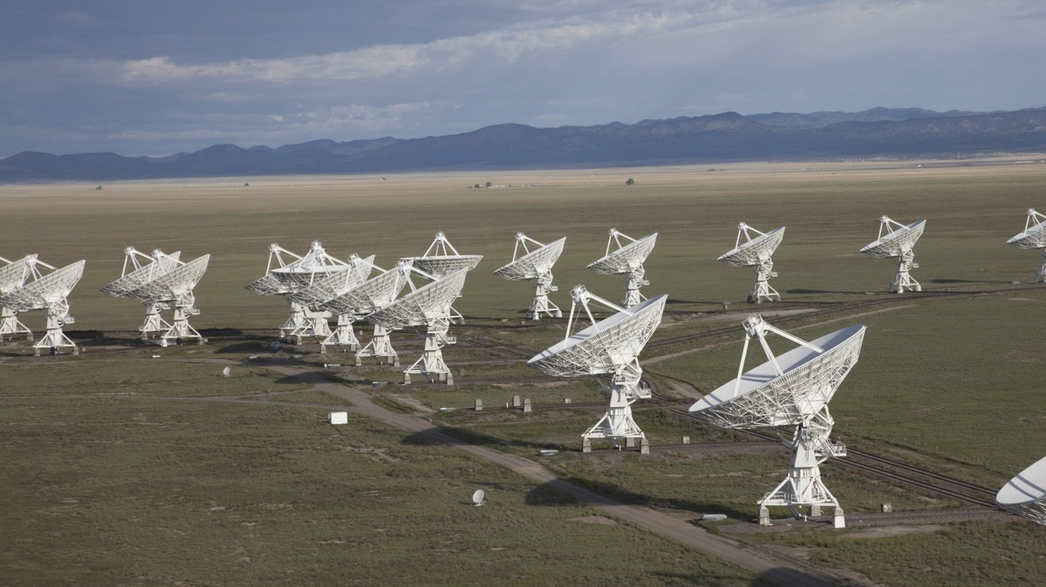
The Jansky Very Large Array
1972 – Approved by Congress
1975 – First Antenna in place
1980 – Full science operations
2001 – Complete electronics upgrade approved by NSF
2011 – Jansky VLA full science ops
Notes:
~7200 refereed papers with ~300,000 citations
~500 PhD theses
The VLA has been among the most productive telescopes ever!
Major recent science:
FRB localization of completely unknown phenomena
distance record for atomic H in emission
Investigations of solar weather.

Slide 3
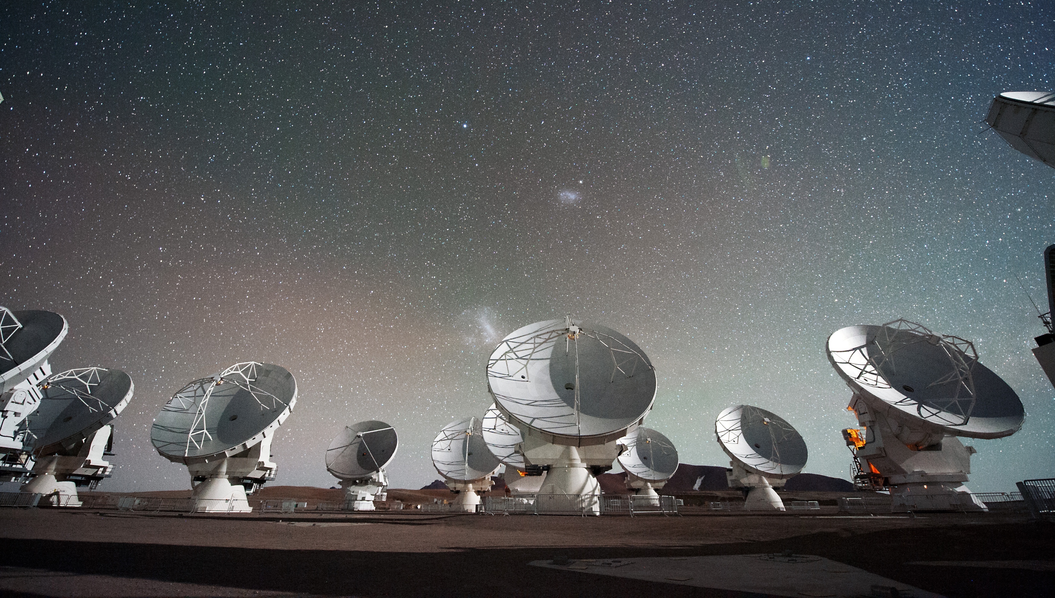
The Atacama Large Millimeter-submillimeter Array
1999 – NRAO, ESO agree on collaboration
2001 – NAOJ Joins collaboration
2004 – Construction starts
2011 – Early science observations (Cycle 0)
2013 – Full science operations

Slide 4
A next generation VLA
Scientific Frontier: Thermal imaging at milli-arcsecond scale resolution
Core Design Requirements
  10x sensitivity of JVLA and ALMA
  10x resolution of JVLA and ALMA
  Frequency range: 1.2 –116 GHz
Located in Southwest U.S. (NM+TX) & Mexico, building from JVLA site
Baseline design remains under continuous development
Low technical risk (reasonable step beyond current state of the art)
https://ngvla.nrao.edu
Notes:
Where we started… goals for the array.
Really was EVLA phase 2 (New Mexico Array) then North America Array

Slide 5
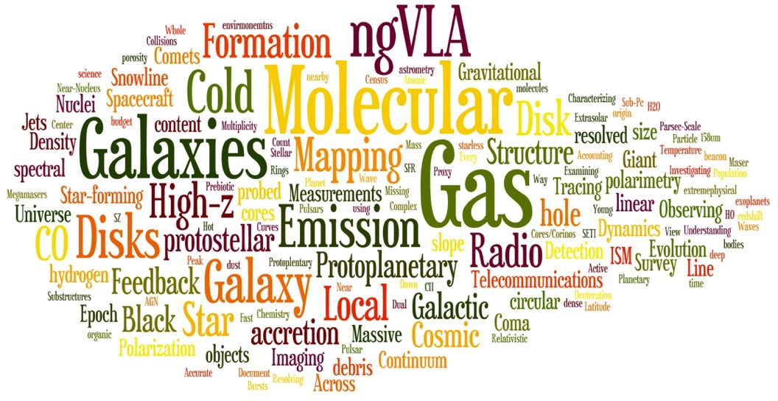
Developing the ngVLA Science Case
Community-Driven, Growing, and Evolving
Numerous Science and Technical meetings, starting from Jan 2015 AAS
Initial Science Working Group reports covering 4 broad areas, Nov .2015 (http://library.nrao.edu/ngvla.shtml)
  Cradle of Life: CoL (Isella et al): Terrestrial-zone planet formation, Massive Stars, etc.
  Galaxy Ecosystems: GEco (Leroy et al): wide field, high resolution/sensitive imaging
  Galaxy Formation: GFor (Casey et al): Dense gas history of the Universe
  Time domain, Cosmology, and Physics: TdCP (Bower et al): Plasma physics, Exo-space weather, Strong Lensing
Community Studies Program: 38 studies approved over 2 Rounds, financially supported by NRAO (http://ngvla.nrao.edu/page/commstudiesprogram)
Community-Led Science Use Cases: 80 submitted for ‘Reqs to Specs’ process (ngVLA memo # 18)
All gathered to report out and build a consensus vision June 2017 in Socorro
Notes:
Went out to the community and asked them to investigate if there was a major science case for such a facility…
Major community effort.

Slide 6
Community-Led Advisory Councils
ngVLA Science Advisory Council
ngVLA Technical Advisory Council
Interface between the science community & NRAO
Recent/Current Activities:
  Science working groups: science use cases → telescope requirements
  SOC for science meeting in June 2017/2018
  Winter 2018 AAS Special Session
  Lead Science case development → ‘science book’ & DS2020 White Papers
Interface between the engineering & computing community and NRAO
Membership covers a broad range of expertise in relevant technical areas including:
  Antennas, low-noise receiver systems, cryogenics, data transmission, correlators, and data processing
Alberto Bolatto (University of Maryland: co-Chair)
Andrea Isella (Rice University : co-Chair)
Brenda Matthews (NRC-Victoria: SWG1 Chair)
Danny Dale (University of Wyoming: SWG2 Chair)
Dominik Riechers (Cornell: SWG3 Chair)
Joseph Lazio (JPL: SWG4 Chair)
James Lamb (Caltech : co-Chair)
Melissa Soriano (JPL : co-Chair)

Slide 7









































Community Participation

Slide 8
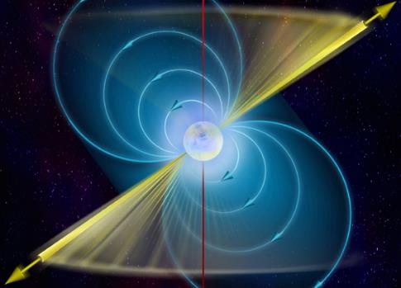
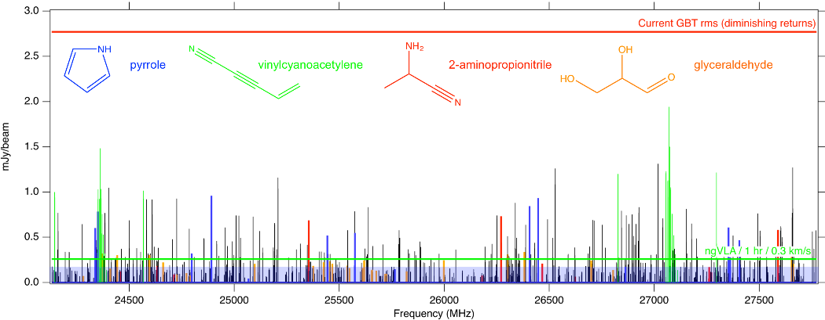
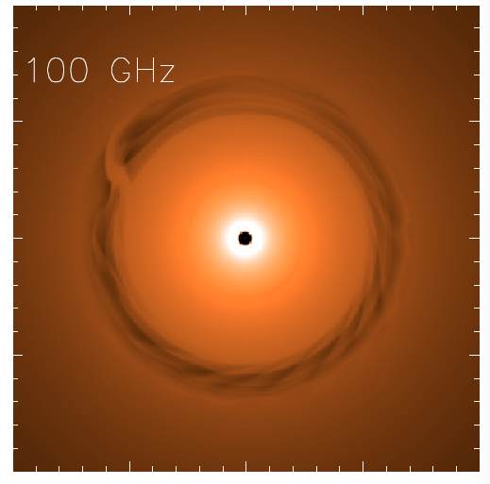
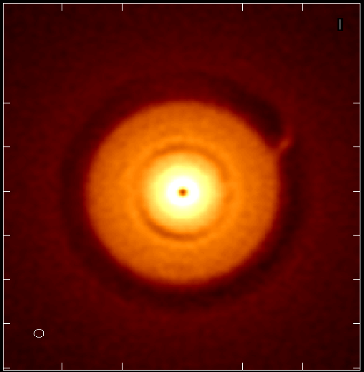
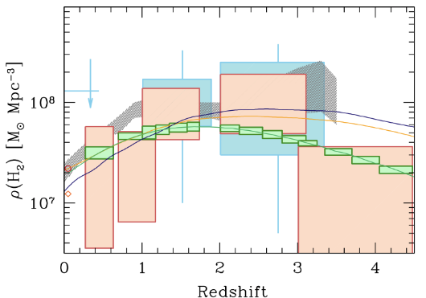
ngVLA Key Science Missions
(ngVLA memo #19)
Unveiling the Formation of Solar System Analogues
Probing the Initial Conditions for Planetary Systems and Life with Astrochemistry
Charting the Assembly, Structure, and Evolution of Galaxies Over Cosmic Time
Using Pulsars in the Galactic Center as Fundamental Tests of Gravity
Understanding the Formation and Evolution of Stellar and Supermassive
BH’s in the Era of Multi-Messenger Astronomy
Highly synergistic with next-generation ground-based OIR and NASA missions.
Jupiter @13AU
Saturn @6AU
ngVLA 100hr 25GHz 10mas
Gas
NGVLA
ALMA
Decarli+2016
0.1” = 13AU
Isella Dust Model
rms = 90nJy/bm = 1K
HI + CO(1-0)
CO(2-1)

Slide 9
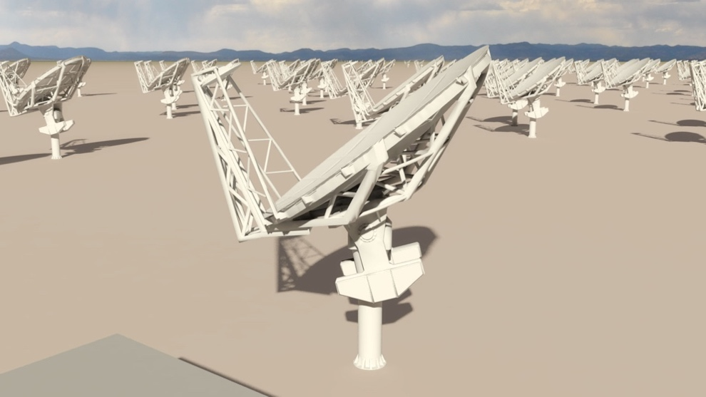
Current Reference Design Specifications
(ngVLA Memo #17)
214 18m offset Gregorian (feed-low) Antennas
  Supported by internal cost-performance analysis
Fixed antenna locations across NM, TX, AZ, MX
  ~1000 km baselines
1.2 – 50.5 GHz; 70 – 116 GHz
  Single-pixel feeds
  6 feeds / 2 dewar package
19 6m short spacing array + 4 18m in TP mode to fill in (u, v) hole.
Receiver Configuration
Band # | Dewar | f_{L} GHz | f_{M} GHz | f_{H} GHz | f_{H}: f_{L} | BW GHz
1 | A | 1.2 | 2.35 | 3.5 | 2.91 | 2.3
2 | B | 3.5 | 7.90 | 12.3 | 3.51 | 8.8
3 | B | 12.3 | 16.4 | 20.5 | 1.67 | 8.2
4 | B | 20.5 | 27.3 | 34.0 | 1.66 | 13.5
5 | B | 30.5 | 40.5 | 50.5 | 1.66 | 20.0
6 | B | 70.0 | 93.0 | 116 | 1.66 | 46.0
Continuum Sensitivity: ~0.1 uJy/bm @ 1cm, 10mas, 10hr => T_{B} ~ 1.8 K
Line sensitivity: ~20 uJy/bm @ 1cm, 10 km/s, 1”, 10hr => T_{B} ~ 25 mK
Notes:
Where we ended up based on a very successful meeting in June in Socorro.
MAIN GOAL OF ARRAY
To be flexible enough to support the breadth of scientific investigations that will be proposed by its creative scientist-users over the decades-long lifetime of the instrument.
Much different style of instrument than SKA and LSST, which is really focused on surveys.

Slide 10
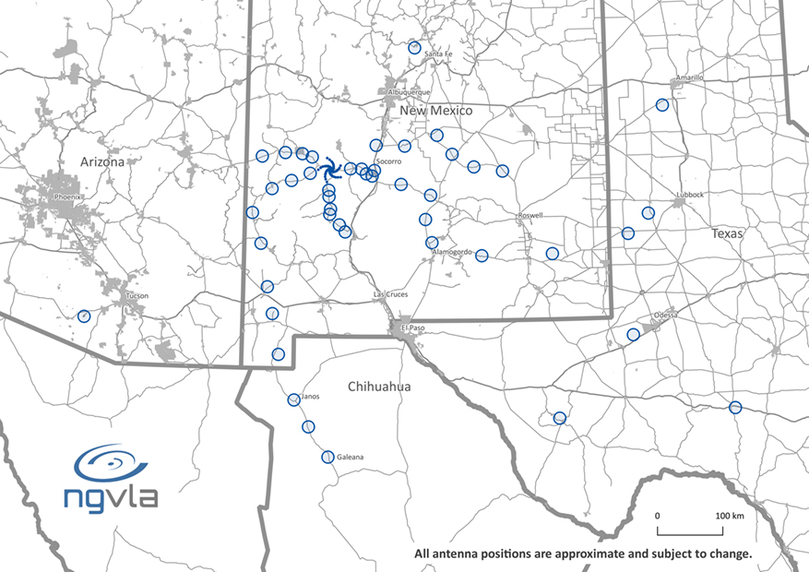
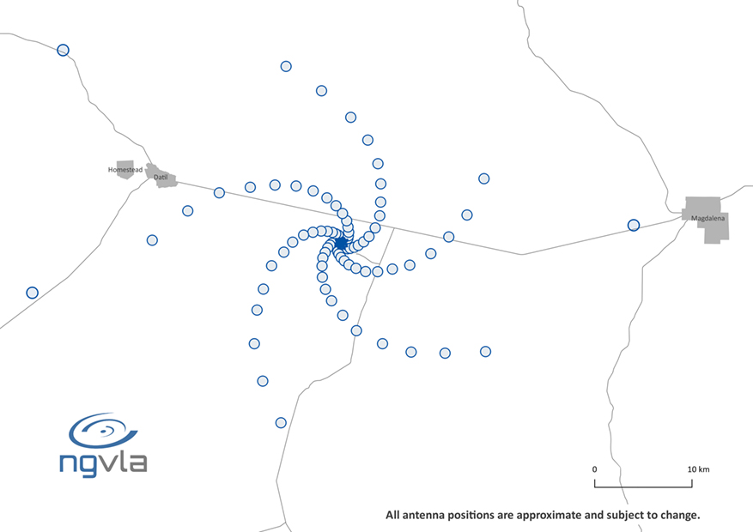
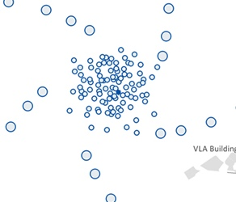
The Reference Array Configuration
Array of 214 x 18m off-axis antennas
44% core: b < 1.3 km => 1.5” at 30GHz
79% mid: b < 37 km => 0.06”
100% to long: b < 1000 km => 0.002”
350 miles
Notes:
Fixed positions
Challenge of tri-scale-array: Sensitivity vs. resolution
Short baselines: 19 x 6m array + 4 x 18m total power
Options:
5 – 10 dish array in Green Bank
Long baselines: continental VLBI

Slide 11
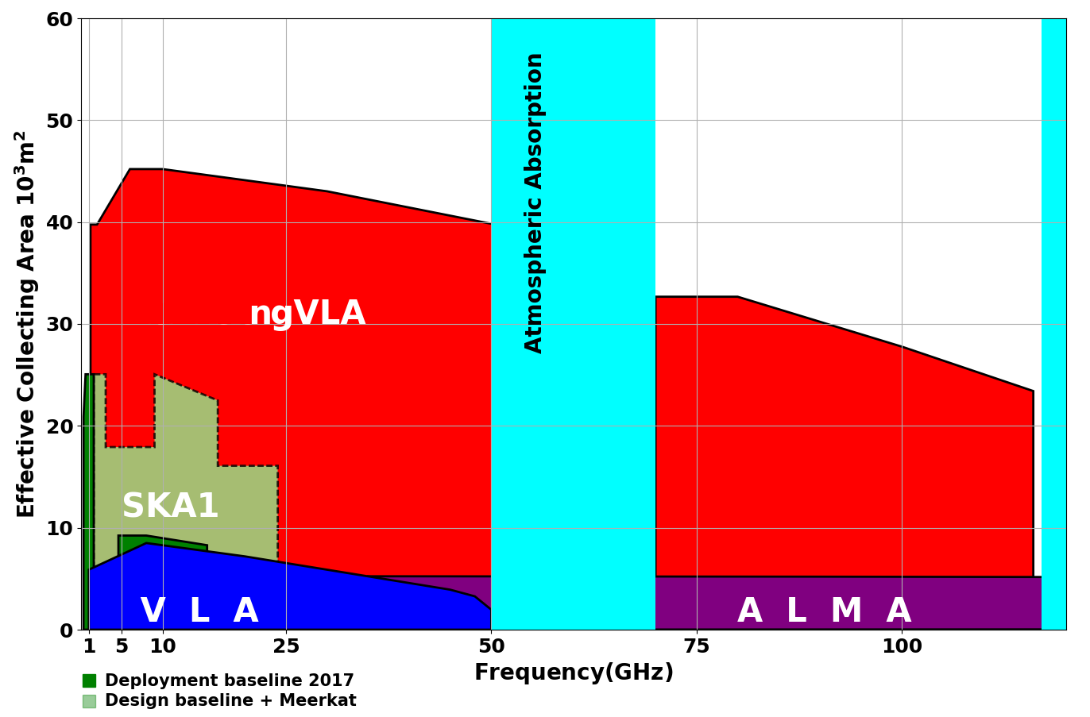
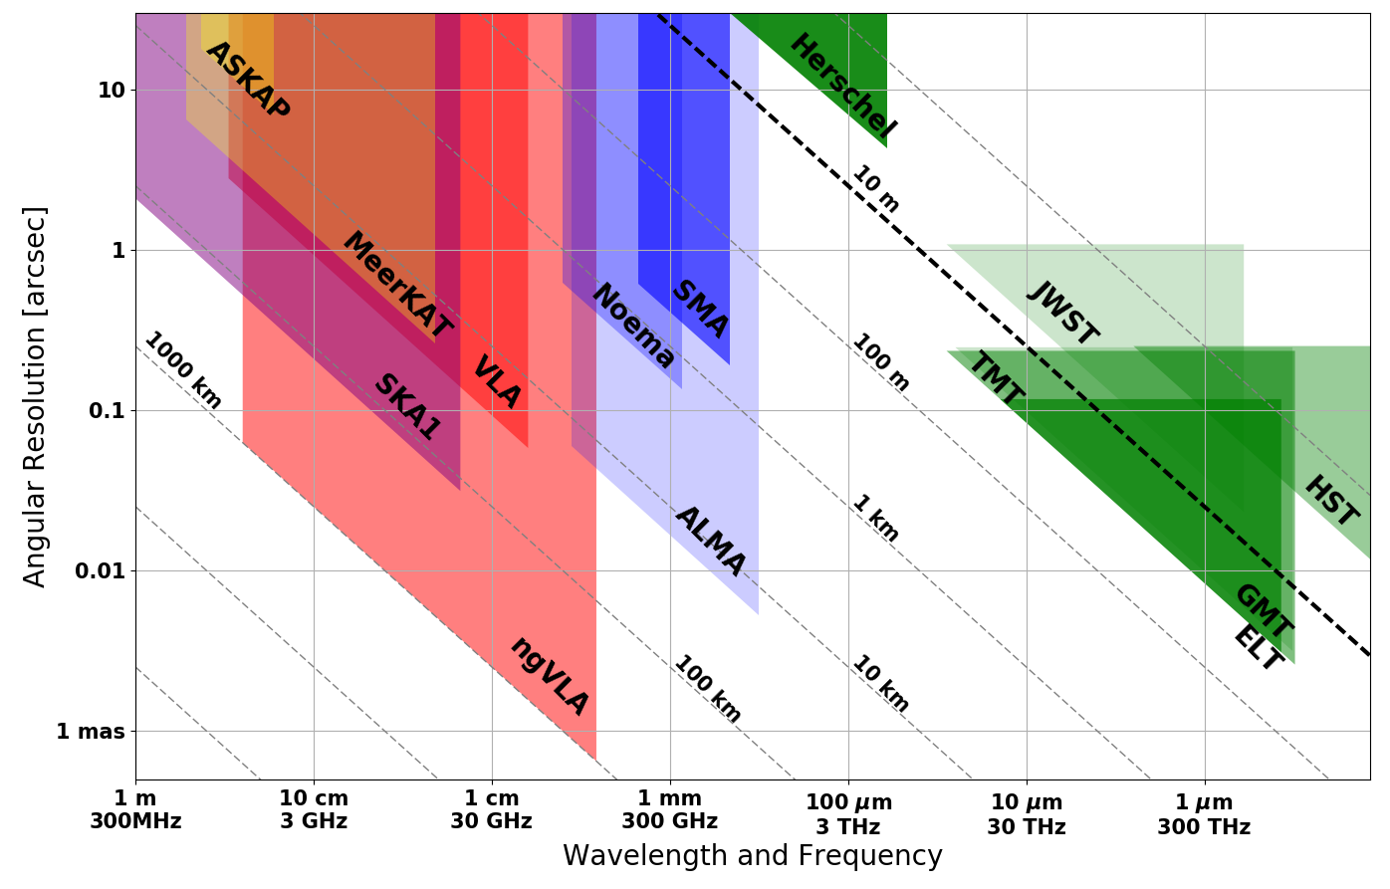
Bridging SKA & ALMA Scientifically
Thermal Imaging on mas Scales at λ ~ 0.3cm to 3cm
ngVLA Key Science Cases
Terrestrial zone planet formation: 1AU @ 140pc
Complementary suite from cm to submm arrays for the mid-21st century
< 0.3cm: ALMA 2030 superb for chemistry, dust, fine structure lines
  0.3 to 3cm: ngVLA ngVLA superb for terrestrial planet formation, dense gas history, baryon cycling
  > 3cm: SKA superb for pulsars, reionization, HI + continuum surveys
Notes:
Snapshot comparison of effective collecting area for dish-arrays expected in the 2030’s.
Assumes SKA deployment baseline (July 2017)
SKA 1
- 130 antennas, SKA bands 1, 2
- 67 antennas, SKA Band 5 a/b
MeerKAT:
- 64 antennas, bands 1, 2, 3
MeerKAT has receiver indexer with 4 slots

Slide 12
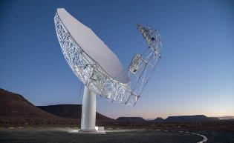
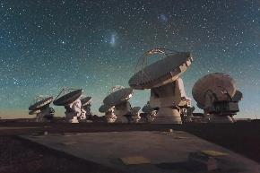
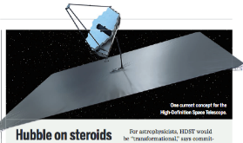
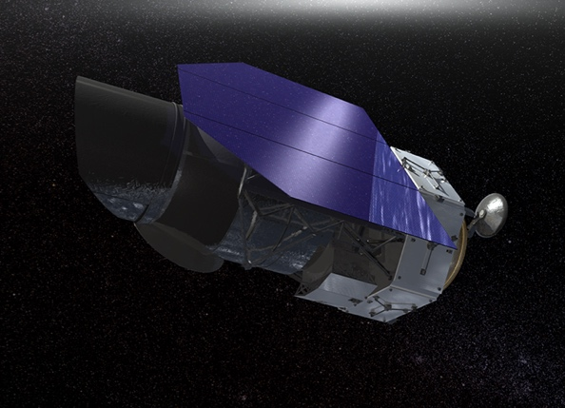
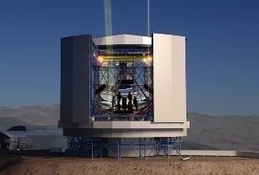
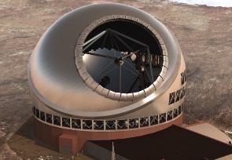
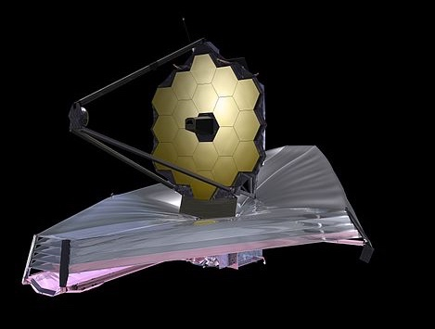
Highly Synergistic with Other Facilities on Similar Timescales
SKA/Lynx
  Atomic/non-thermal
  Molecular/thermal
ALMA
  Warm/star-forming
  Cold/dense fuel for SF
LUVOIR/HabEx
  Image earth-like planets
  Image terrestrial-zone planets forming
OST (FIR surveyor)
  C/WNM & WIM
  Cold Molecular Medium
TMT/GMT
  Stellar Mass and Unobscured SF
  Dense Gas and Obscured SF
JWST/WFIRST
  Continuing its legacy in many areas of astrophysics
Notes:
No matter which of these facilities materialize, their user-base will be ngVLA users as well.

Slide 13
Five Key Science Goals for the ngVLA
http://library.nrao.edu/public/memos/ngvla/NGVLA_19.pdf
Unveiling the Formation of Solar System Analogues
Probing the Initial Conditions for Planetary Systems and Life with Astrochemistry
Charting the Assembly, Structure, and Evolution of Galaxies from the First Billions Years to the Present
Using Pulsars in the Galactic Center as Fundamental Tests of Gravity
Understanding the Formation and Evolution of Stellar and Supermassive Black Holes in the Era of Multi-Messenger Astronomy

Slide 14
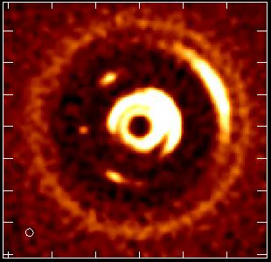
Unveiling the Formation of Solar System Analogues
  The ngVLA will measure the orbital motion of planets and related features on monthly timescales.
The ngVLA will measure the planet IMF down to ~5-10 Earth masses and unveil the formation of planetary systems similar to our own Solar System.
Simulated 100 GHz ngVLA observations of a newborn planetary system comprising a Jupiter analogue orbiting at 5 AU from a Solar type star.
Ricci et al. (2018)
Notes:
Turning planet formation science into a time-domain science!
Of the 3 blobs you see at 5 au, the one associated to the Jupiter-mass planet is the one in the middle.
The other two blobs in the movie (leading and trailing) are dust particles concentrated in the L4 and L5 Lagrangian points of the star - Jupiter-mass planet system.
Dust emission comes from the circum-planetary disk orbiting the planet, so the planet is mostly formed in that movie (I say "mostly" cause material in the circumplanetary disk will accrete onto the planet, therefore increasing its mass by some amount).

Slide 15
Unveiling the Formation of Solar System Analogues
Supporting Requirements
Continuum observations between 20 – 110 GHz with 𝜃_{S} ~ 5mas at 100 GHz, are required to study the formation of planets in the innermost 10 AU of nearby (<140 pc) proto-planetary disks.
A sensitivity of 0.2 μJy/bm at 100 GHz is required to map structures in the dust distribution created by planets down to 10 Earth-masses and orbital radius of 2.5 AU (Ricci et al. 2018).
Matching resolution (i.e., 5 mas) and sensitivity of ~0.02 μJy/bm at 30 GHz is required to map the planet-disk interactions where the disk emission is expected to be optically thin.
Full polarization capabilities with the largest possible aggregate bandwidth is desired to maximize continuum sensitivity to better constrain the properties of the dust grains.

Slide 16
Probing the Initial Conditions for Planetary Systems and Life with Astrochemistry
  The ngVLA can detect complex pre-biotic molecules and provide the chemical initial conditions in forming solar systems and individual planets
Credit: Brett McGuire (NRAO)
Notes:
This is a simulation of ~30 complex organic molecules, not currently detected in the ISM, but which are good candidates for detection. I have highlighted in colors example of these molecules which are important for understanding chemical evolution (e.g., increasingly complex carbon-nitrogen chains), probing chirality (e.g., glyceraldehyde), are part of largely unknown cyclic/aromatic chemistry (e.g. pyrrole), or are excellent candidates for being direct precursors to amino acids and other biogenic species (e.g. aminopropionitrile).
The simulation assumes that the emission is coming from a compact, 1" hot core in Sgr B2(N), from molecules with column densities of 10^12 - 10^14 cm-2, at T = 200 K, and with a linewidth of 3 km/s.
The simulation does *not* contain any currently-detected species, meaning that a real spectrum in this frequency range would have many, many bright lines off the scale of this graph.
The red horizontal line is the ~rms of the current GBT PRIMOS observations. These suffer greatly from beam dilution, as the 1" source is diluted in a 30" GBT beam. This rms is about what we can reasonably get with reasonable integration times at the GBT. Drilling deeper will take far longer than is feasible for a survey.
The green line is taken from the ngVLA tech specs page for line sensitivity at 10 km/s in 1 hr, degraded for 0.3 km/s channels.
The blue shaded region is the area in which I project, from a statistical analysis of the PRIMOS observations, we will hit line-confusion in this frequency range. There is little point in integrating more than 3 sigma deeper than this.
So what are the take-away messages here?
1) the ngVLA will almost certainly provide access to a wealth of new molecular detections of molecules similar to the representative species shown here
2) the ngVLA in reasonable integration times (say 4-20 hours) should hit line confusion in this most molecularly-rich galactic source at the 3 sigma level, something that the GBT and (J/E)VLA cannot hope to accomplish.

Slide 17
Probing the Initial Conditions for Planetary Systems and Life with Astrochemistry
Supporting Requirements
An angular resolution on the order of 50 mas is needed at 50 GHz.
An rms of 30 μJy/bm/km/s for frequencies between 16 – 50 GHz is required.
A spectral resolution of 0.1 km/s is required, preferably concurrent with broadband (4+ GHz) observations.
A spectral dynamic range better than 50 db is required to enable imaging of faint prebiotic molecules in the presence of bright line emission within the field of view.

Slide 18
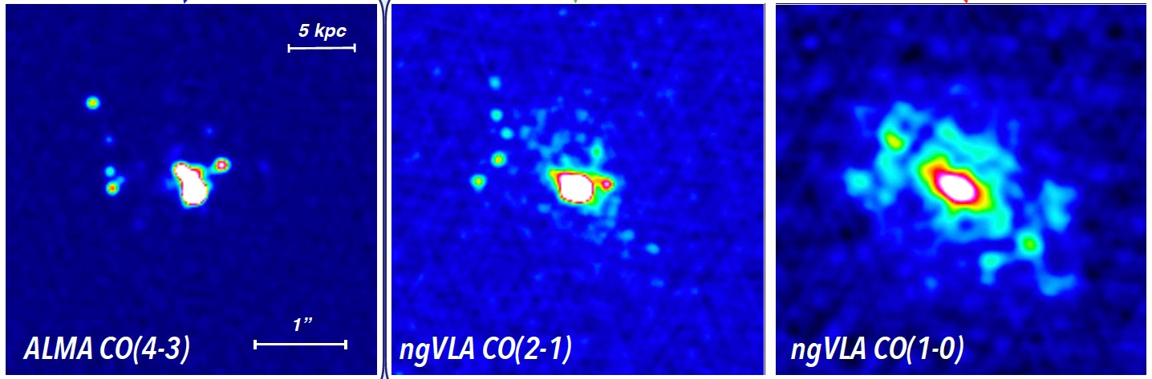
Charting the Assembly, Structure, and Evolution of Galaxies from the First Billions Years to the Present
𝜃 ≈ 0.3”
𝜃 ≈ 0.3”
𝜃 ≈ 0.5”
SMG at z = 4.4; SFR ≈ 400 M⨀ /yr
Total molecular gas content largely missed by high-J lines
Credit: Caitlin Casey (UT Austin)
Notes:
50 Mpc box cosmological hydrodynamic simulation of galaxy evolution

Slide 19
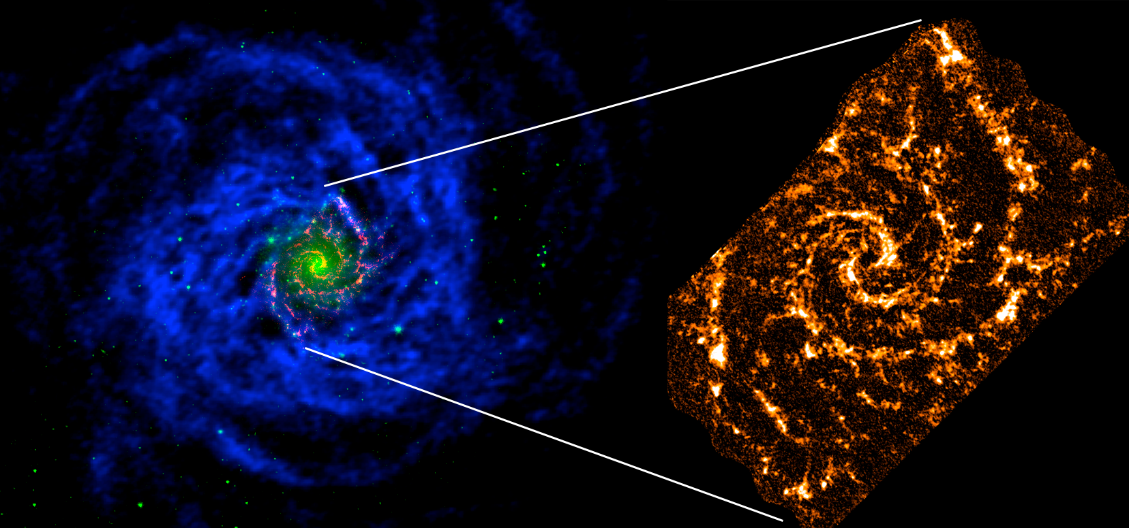
Charting the Assembly, Structure, and Evolution of Galaxies from the First Billions Years to the Present
Understanding How Galaxies Produce New Generations of Stars
  The ngVLA can study extended atomic reservoirs and large samples of GMC populations
  Unique windows into the physical and chemical properties of accretion, transport, phase change, and expulsion processes
NGC 628: THINGS HI (12”, blue), PHANGS ALMA CO (1”, red), IRAC 4.5 um (green)

Slide 20
Charting the Assembly, Structure, and Evolution of Galaxies from the First Billions Years to the Present
Supporting Requirements
A line sensitivity of ~46 μJy/bm/km/s at 0.1” and 1” angular resolution between 10 – 50 GHz with a spectral resolution of 5 km/s is required for detailed studies of CO kinematics of high-z galaxies and blind CO searches of >1000 galaxies, respectively.
A large instantaneous bandwidth (minimum 1.6:1 BW ratio, up to 20 GHz instantaneous bandwidth) to conduct wide band observations at 5 km/s resolution is required to efficiently perform blind surveys of large cosmic volumes in a single observation to provide routine access molecular species in addition to CO (e.g., HCN, HCO⁺, or N₂H⁺).
Frequency coverage between 1.2 and 116 GHz to access the transitions of formaldehyde (5 GHz and 14 GHz), ammonia (23 – 27 GHz), methanol (particularly the 36 GHz masers), deuterated molecules (~ 70 GHz), and a host of dense gas tracers (~ 90 GHz) besides CO (115 GHz) and HI (1.4 GHz) are required.

Slide 21
Charting the Assembly, Structure, and Evolution of Galaxies from the First Billions Years to the Present
Supporting Requirements
Thermal imaging of 0.1 – 0.2 K sensitivity of the CO lines (115 GHz) at 0.1” angular resolution and 1 km/s spectral resolution is required for detailed studies of CO in the nearby universe.
Thermal imaging of 1 – 5 mK sensitivity between 70 and 116 GHz at 1 – 5” angular resolution and 1 – 5 km/s spectral resolution is required to support studies of gas density across the local universe.
Angular resolutions of 0.1” – 1” for continuum imaging at all available frequencies are required.
A continuum sensitivity of 0.15 μJy/bm at 33 GHz for a 1” synthesized beam is required for robustly studying star formation within nearby, star-forming galaxies.
Accurate recovery of flux density for extended objects on arcminute scales at all.
The ability to make large mosaics or conduct on-the-fly line and/or continuum mappings.
A brightness dynamic range of 50 and 40 db is required at 10 GHz for deep field continuum studies of MW-like galaxies at Cosmic Noon to not be dynamic range limited in total and polarized intensity, respectively.

Slide 22
Using Pulsars in the Galactic Center as Fundamental Tests of Gravity
The ngVLA will search for pulsars, which are moving clocks in the space-time potential of Sgr A*
New tests of theories of gravity, constraints on exotic binaries, SF history, stellar dynamics and evolution, and ISM at the GC
Estimates are as high as 1,000 PSRs. Only known example is PSR J1745-2900 magnetar, which are extremely rare (<1%)
Credit: R. Wharton
Notes:
Fig 1: The abscissa shows the depth of the potential probed and the ordinate shows the spacetime curvature for the orbit of a test mass around a central mass
* probing as far as possible into the upper right corner is most constraining on theories of gravity beyond General Relativity
Fig 2: Shown is the current distribution of known pulsars in the GC.
Enhanced radio-wave scattering toward the inner Galaxy further decreases the effective sensitivity of searches, by increasing both the dispersion measure smearing and pulse broadening.
Effects most severe at lower frequencies.

Slide 23
Using Pulsars in the Galactic Center as Fundamental Tests of Gravity
Supporting Requirements
Pulsar search and timing observations from ~1 to 30 GHz.
Continuum sensitivity of order 50nJy/bm is desired at 20 GHz. This is a significant improvement compared to existing 100 m-class radio telescopes that have found few pulsars, indicating that substantial additional sensitivity is necessary.
The timing accuracy better than 10ns (1ns desired) over periods correctable to a known standard from 30min to 10yr.
Multiple (minimum 10) beams (i.e., phase centers within the primary beam) within a single subarray, or distributed amongst multiple subarrays.
Timing multiple pulsars within a single primary beam is desirable. Support for five or more independent de-dispersion and folding threads is desired.
Notes:
Fig 1: The abscissa shows the depth of the potential probed and the ordinate shows the spacetime curvature for the orbit of a test mass around a central mass
* probing as far as possible into the upper right corner is most constraining on theories of gravity beyond General Relativity
Fig 2: Shown is the current distribution of known pulsars in the GC.
Enhanced radio-wave scattering toward the inner Galaxy further decreases the effective sensitivity of searches, by increasing both the dispersion measure smearing and pulse broadening.
Effects most severe at lower frequencies.

Slide 24
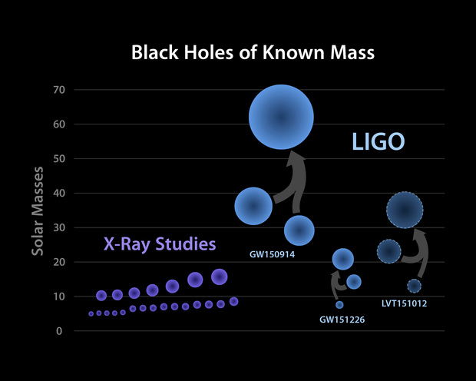
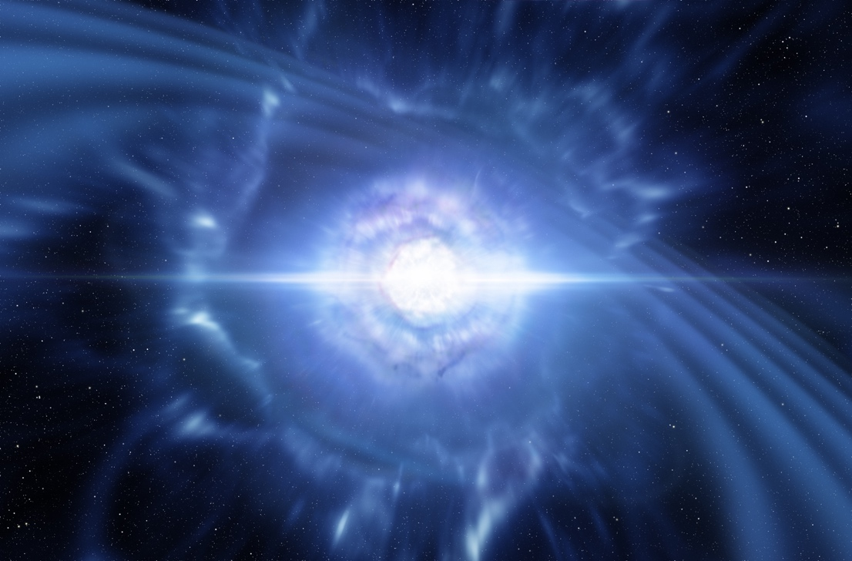
Understanding the Formation and Evolution of Stellar and Supermassive Black Holes in the Era of Multi-Messenger Astronomy
Unaffected by dust obscuration and with the angular resolution to separate Galactic sources from background objects using proper motions, the ngVLA will enable a search for accreting black holes across the entire Galaxy.
Key to understanding
GW discoveries
Notes:
Characterizing the full BH mass range will have profound implications for key parameters affecting binary BH formation.
e.g., The strength of pre-natal kicks from asymmetries in parent core-collapse.
These parameters are key inputs into a key GW astronomy question:
Do double BHs form though binary stellar evolution, or require a globular cluster formation mechanism?

Slide 25
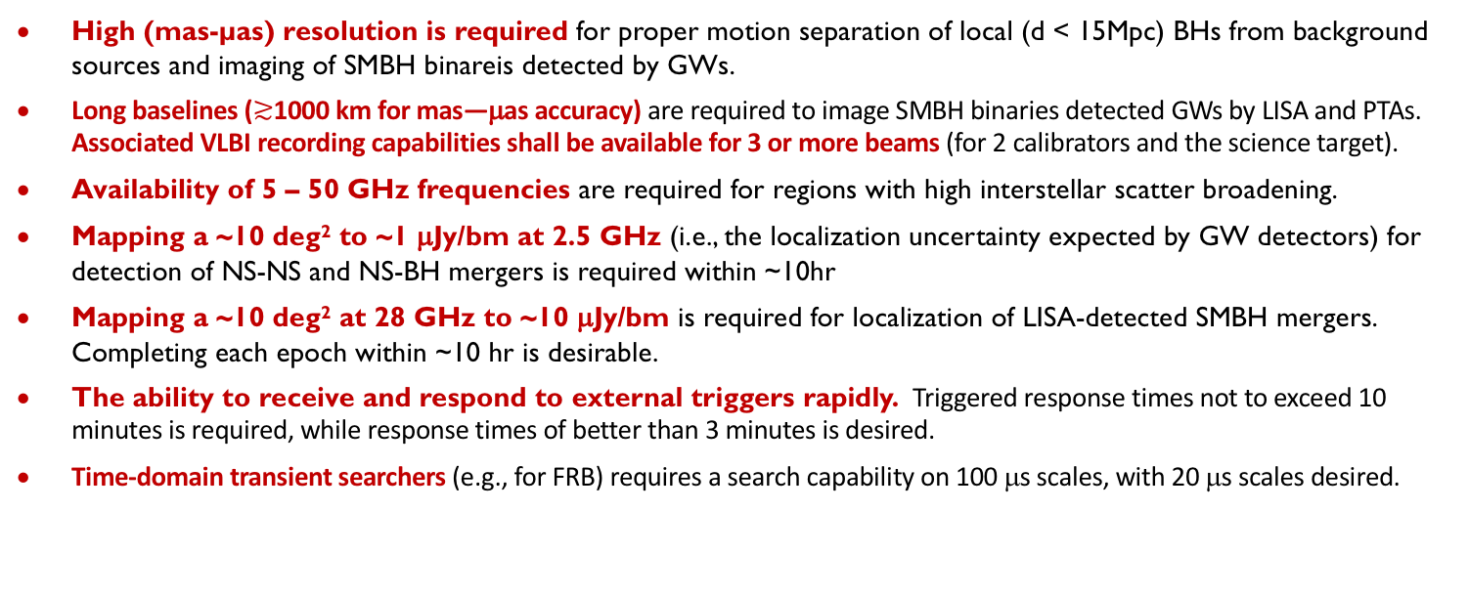
Understanding the Formation and Evolution of Stellar and Supermassive Black Holes in the Era of Multi-Messenger Astronomy
Supporting Requirements
High (mas-µas) resolution is required for proper motion separation of local (d < 15Mpc) BHs from background sources and imaging of SMBH binareis detected by GWs.
Long baselines ($≳$1000 km for mas—μas accuracy) are required to image SMBH binaries detected GWs by LISA and PTAs. Associated VLBI recording capabilities shall be available for 3 or more beams (for 2 calibrators and the science target).
Availability of 5 – 50 GHz frequencies are required for regions with high interstellar scatter broadening.
Mapping a ~10 deg² to ~1 μJy/bm at 2.5 GHz (i.e., the localization uncertainty expected by GW detectors) for detection of NS-NS and NS-BH mergers is required within ~10hr
Mapping a ~10 deg² at 28 GHz to ~10 μJy/bm is required for localization of LISA-detected SMBH mergers. Completing each epoch within ~10 hr is desirable.
The ability to receive and respond to external triggers rapidly. Triggered response times not to exceed 10 minutes is required, while response times of better than 3 minutes is desired.
Time-domain transient searchers (e.g., for FRB) requires a search capability on 100 μs scales, with 20 μs scales desired.

Slide 26
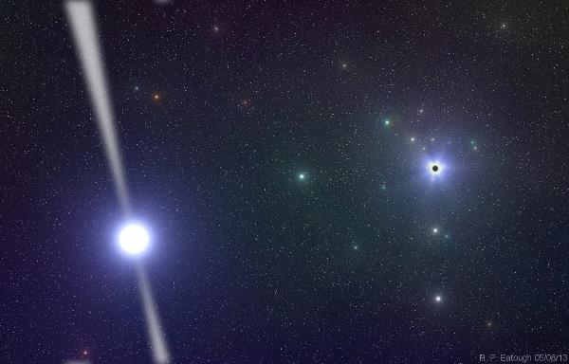
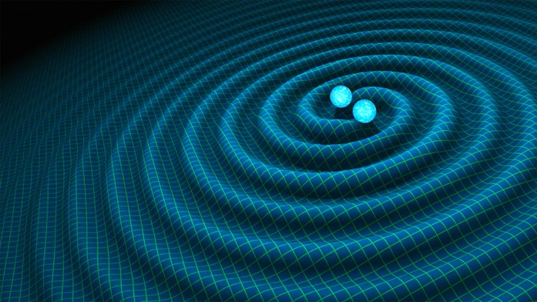
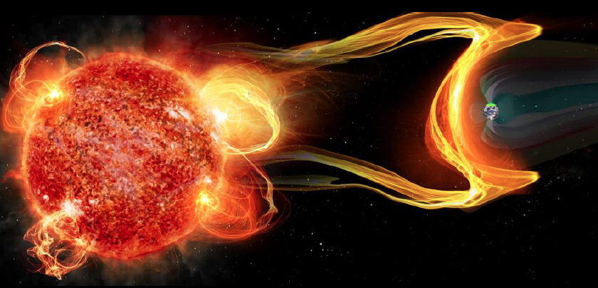
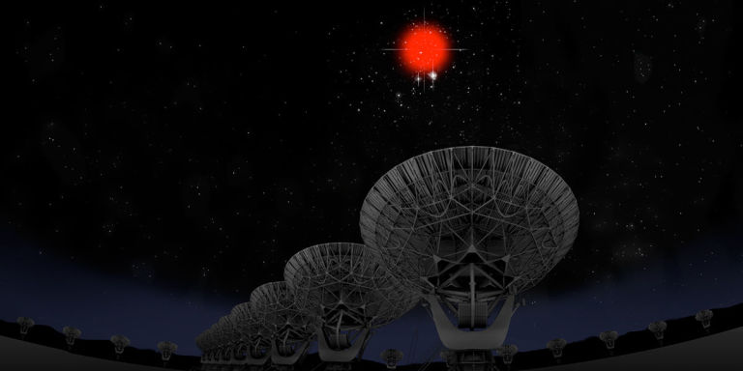
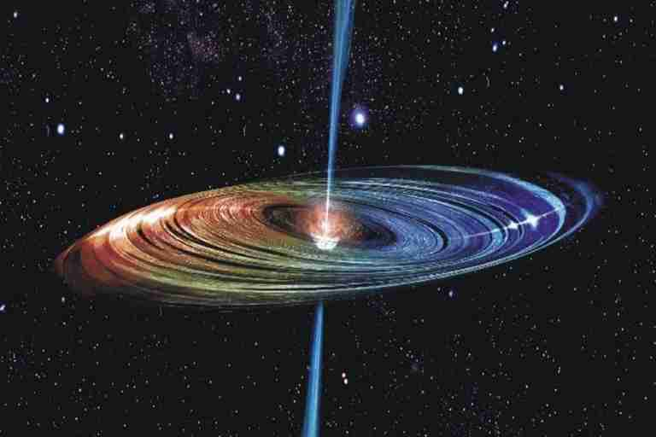
Versatility: Remarkable breadth of Science Enabled by the ngVLA
Galactic Center pulsars: testing GR
Gravitational Wave EM Follow-up
Extrasolar Space Weather
Bursting universe (FRB, GRB, TDE…)
Low surface brightness HI, CO
Obscured Black Hole Growth and AGN Physics
Quasar-Mode Feedback and the SZ Effect
Black hole masses and H_{o} with Mega-Masers
μas Astrometry: ICRF, Galactic structure…
Solar system remote sensing: passive and active radar
Spacecraft telemetry, tracking: movies from Mars

Slide 27
Estimated Price Tag
(Internal Preliminary Costing Exercise)
Target construction baseline budget ~ (2016) $1.5B
Target operations budget of < (2016) $75M (< 3x current VLA)
  Operations, maintenance, computing, archiving, etc.: optimize as part of design
Partnerships:
  Possible U.S. Multiagency Interest [including VLBI option]
    ICRF – DOD/Navy, Air Force
    Spacecraft tracking/imaging, `burst-telemetry’ (mission-critical events) – NASA, DOD
    Space situational awareness – DOD
  Strong International Partnership critical for success:
    Current International Involvement in SAC/TAC/Community Studies:
    Canada, Mexico, Japan, Germany, Netherlands, Taiwan
  Current Industrial Involvement through Community Studies:
    General Dynamics, REhnu Inc., Minex Engineering Corp, LaserLaB, Quantum Design
Notes:
Anticipating “Open Skies” policy
Is this SKA-High? Scientifically, the same direction.

Slide 28
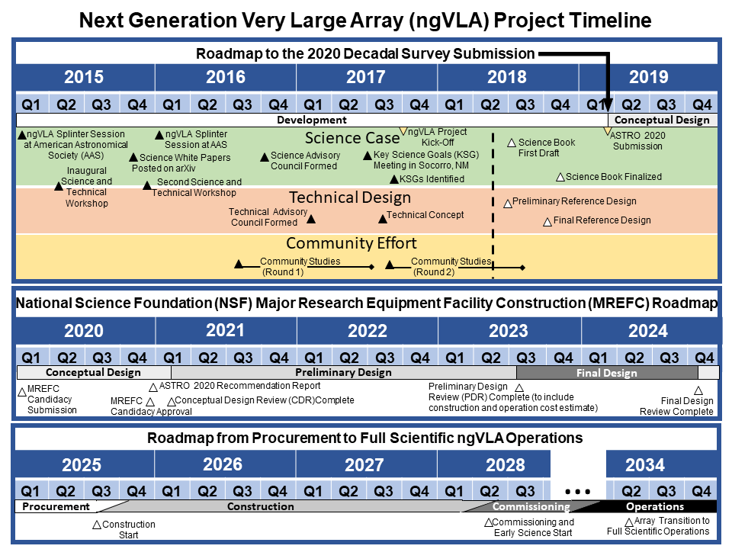

Slide 29
Over 200 Registrants!

