Slide 1
Conical Corrugated Horns - Design & Performance
Sivasankaran Srikanth
NRAO, Charlottesville, VA
Caltech ngVLA Optics Workshop
Pasadena, CA, June 19-20, 2018

Slide 2
CONTENTS
LINEAR TAPER HORNS – NARROW FLARE ANGLE
PROFILE/COMPACT HORNS
LINEAR TAPER HORNS– WIDE FLARE ANGLE

Slide 3
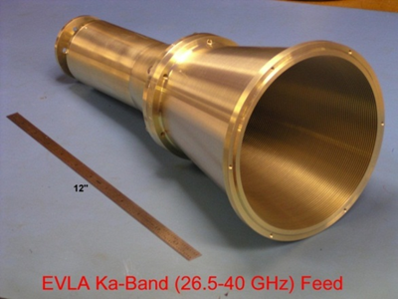
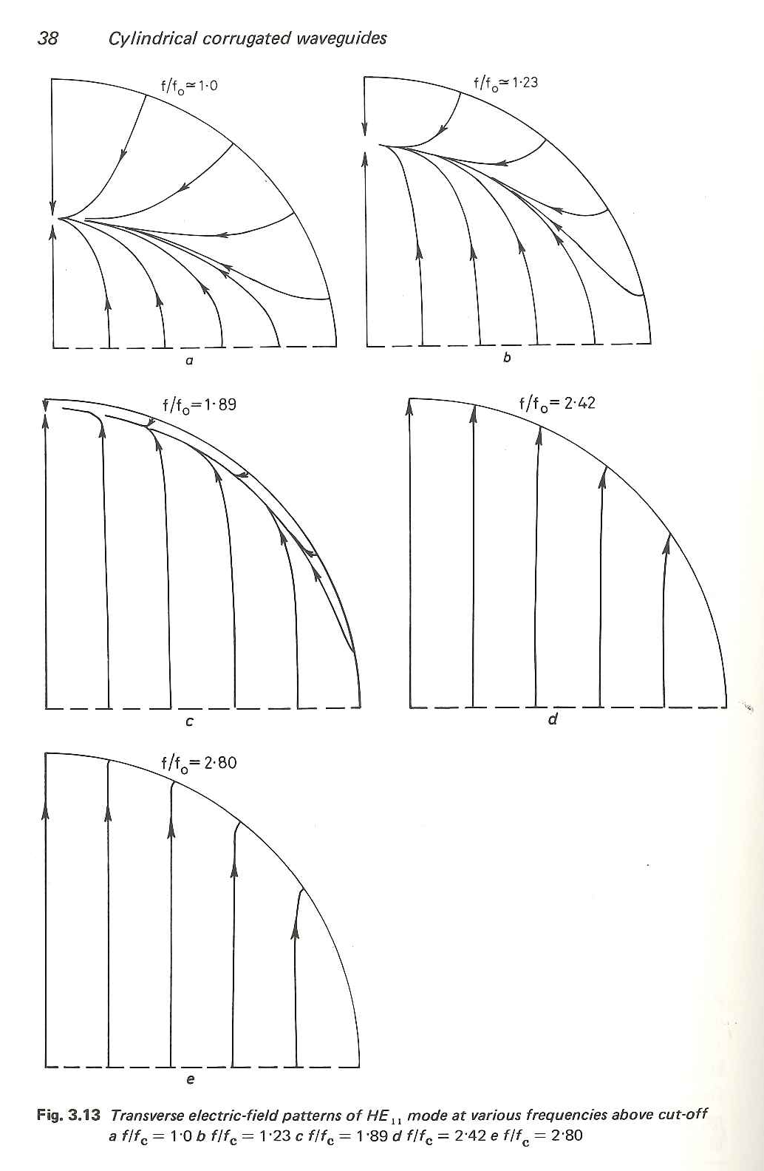
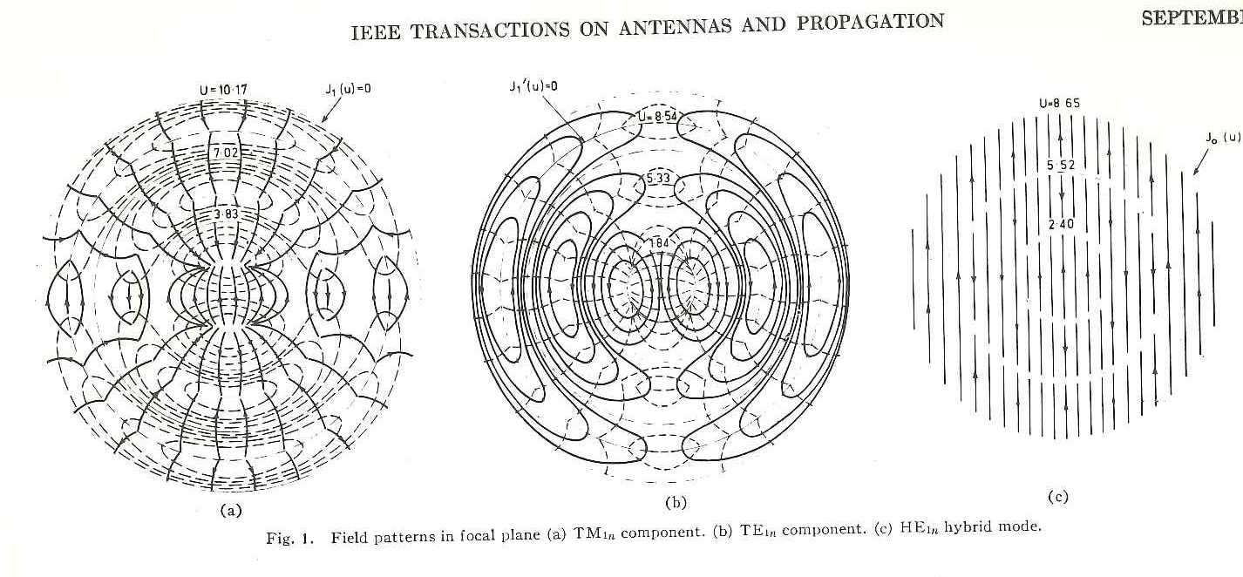
WHY CORRUGATED HORNS?
FOCAL PLANE FIELDS AND APERTURE FIELDS
SYMMETRIC E- AND H-PLANE PATTERNS
NEARLY CONSTANT BEAM WIDTH
LOW CROSSPOLARIZATION
GOOD INPUT MATCH
WIDE BANDWIDTH
LOW LOSS
WELL DEFINED PHASE CENTER
TM_{1n}
TE_{1n}
HE_{1n}

Slide 4

LINEAR TAPER CORRUGATED HORN – NARROW FLARE ANGLE
FEED | Freq (GHz) | Taper (dB) @θ_{sub} | θ_{f} | DIA ” | DIA/λ * | Δ | L/λ * | Taper **
EVLA-Ku | 12-18 | -14@9.25° | 10.38° | 12.33 | 12.5 | 0.574 | 32.3 | -14.0
SHAO-Ku | 12-18 | -15.5@13º | 13.3º | 8.53 | 8.7 | 0.505 | 17.3 | -15.6
VLBA-Ku | 12-15.4 | -14@13.25° | 14° | 8.00 | 8.1 | 0.500 | 14.7 | -14.5
GBT-Ku | 12-18 | -13@15º | 17.5º | 8.33 | 8.5 | 0.652 | 13.1 | -13.4
θ_{f}
Aperture phase error factor
Δ$=\frac{r}{λ}$tan$\frac{θ0}{2}$
* λ at low end
** Measured (dB)
DIA
L

Slide 5
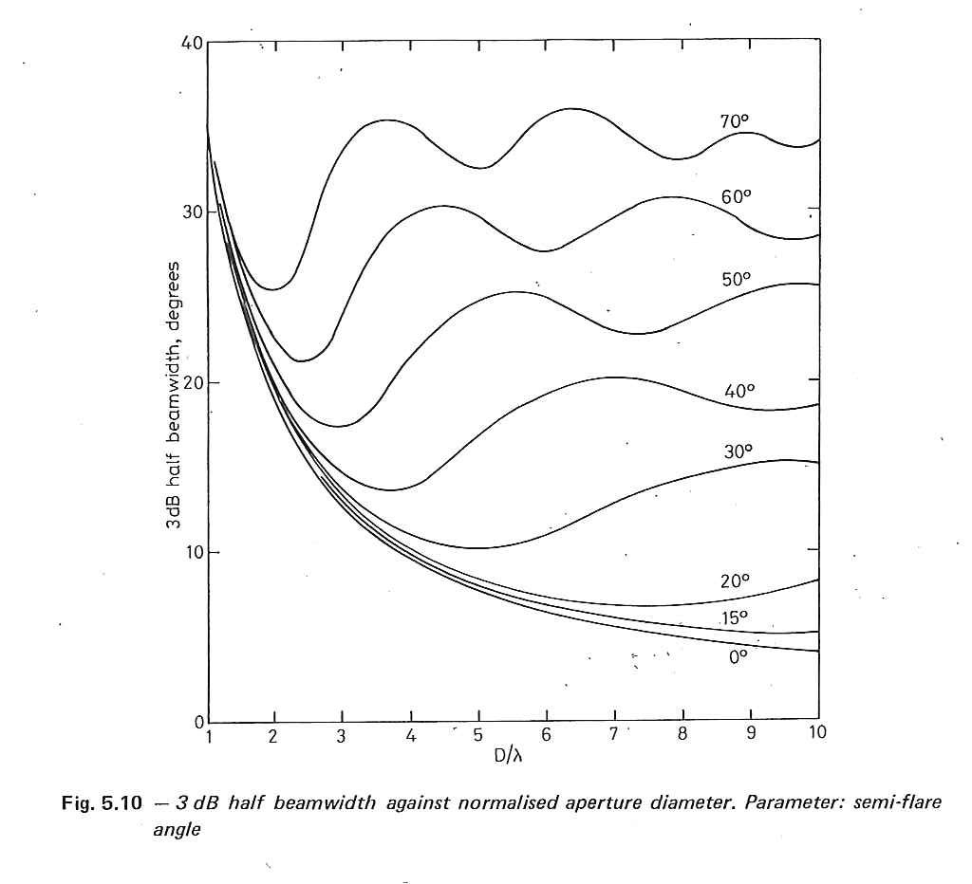
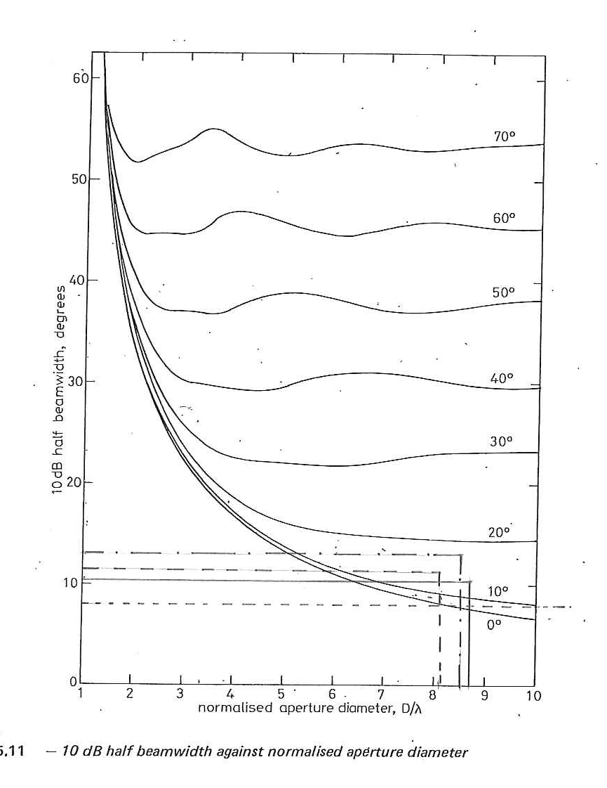
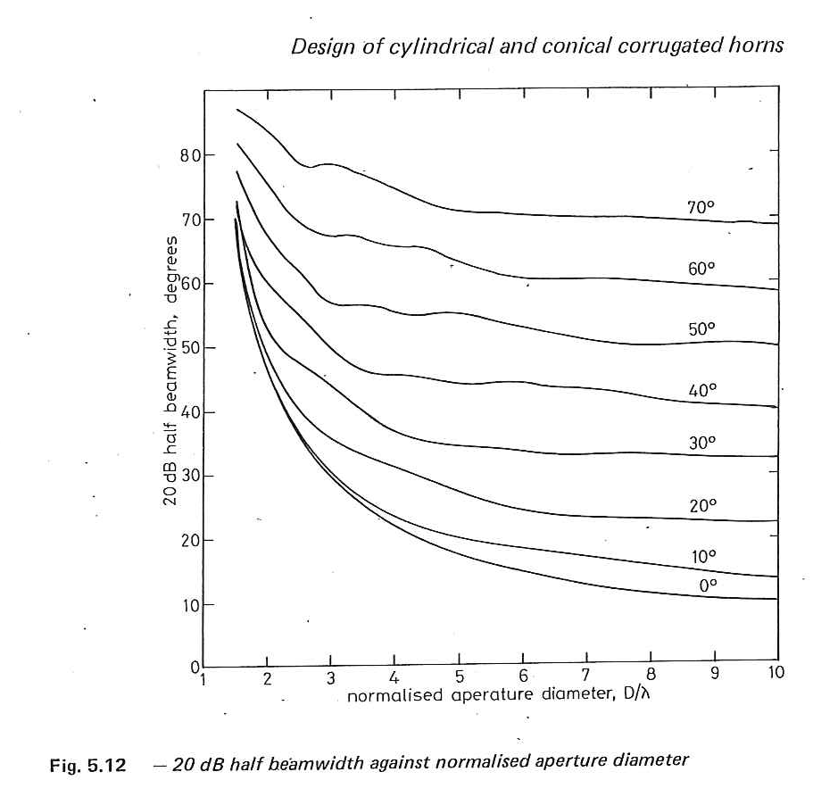
HALF BEAM WIDTH at -3, -10, -20 dB Vs D/λ
b
θ_{sub}
θ_{f}
GBT Ku (15º)
VLBA Ku (13.3º)
14⁰
17.5⁰
13.3⁰
10.4⁰
SHAO Ku (13º)
EVLA Ku (9.3º)
D/λ
8.7λ
12.5λ
8.5λ
P. J. B. Clarricoats and A. D. Olver “Corrugated horns
For microwave antennas” Peter Peregrinus Ltd. , London, UK
8.1λ

Slide 6
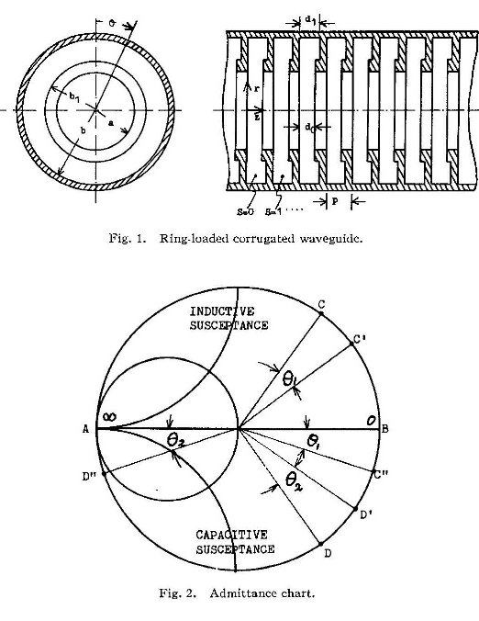
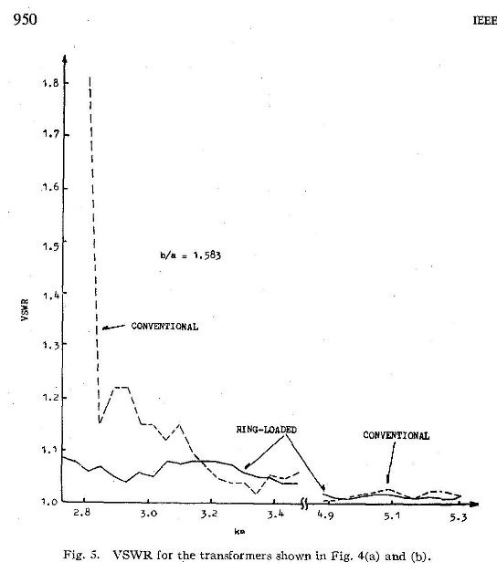
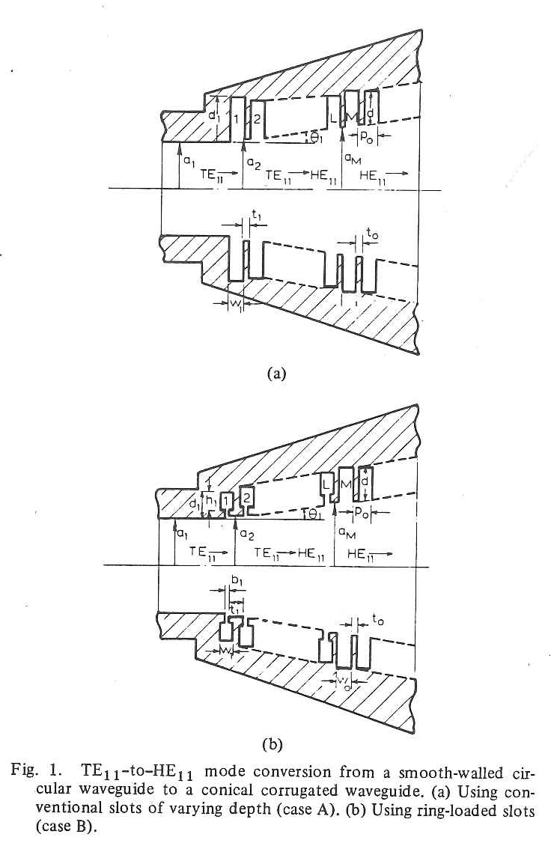
CONVENTIONAL & RING-LOADED CORRUGATIONS
0.2l_{l}
0.5l_{h}
0.2l_{l}
0.45l_{h}
f_{high}
f_{low}
Y. Takeichi, T. Hashimoto and F. Takeda, “The ring-loaded corrugated waveguide,” IEEE Trans. MTT
Vol. MTT-19, pp. 947-950, Dec. 1971.
F. Takeda and T. Hashimoto, “Broadbanding of corrugated conical horns by means of the ring-loaded
Corrugated structure,” IEEE Trans. Antennas & Propagat., vol AP-24, pp. 786-792, Nov. 1976.

Slide 7
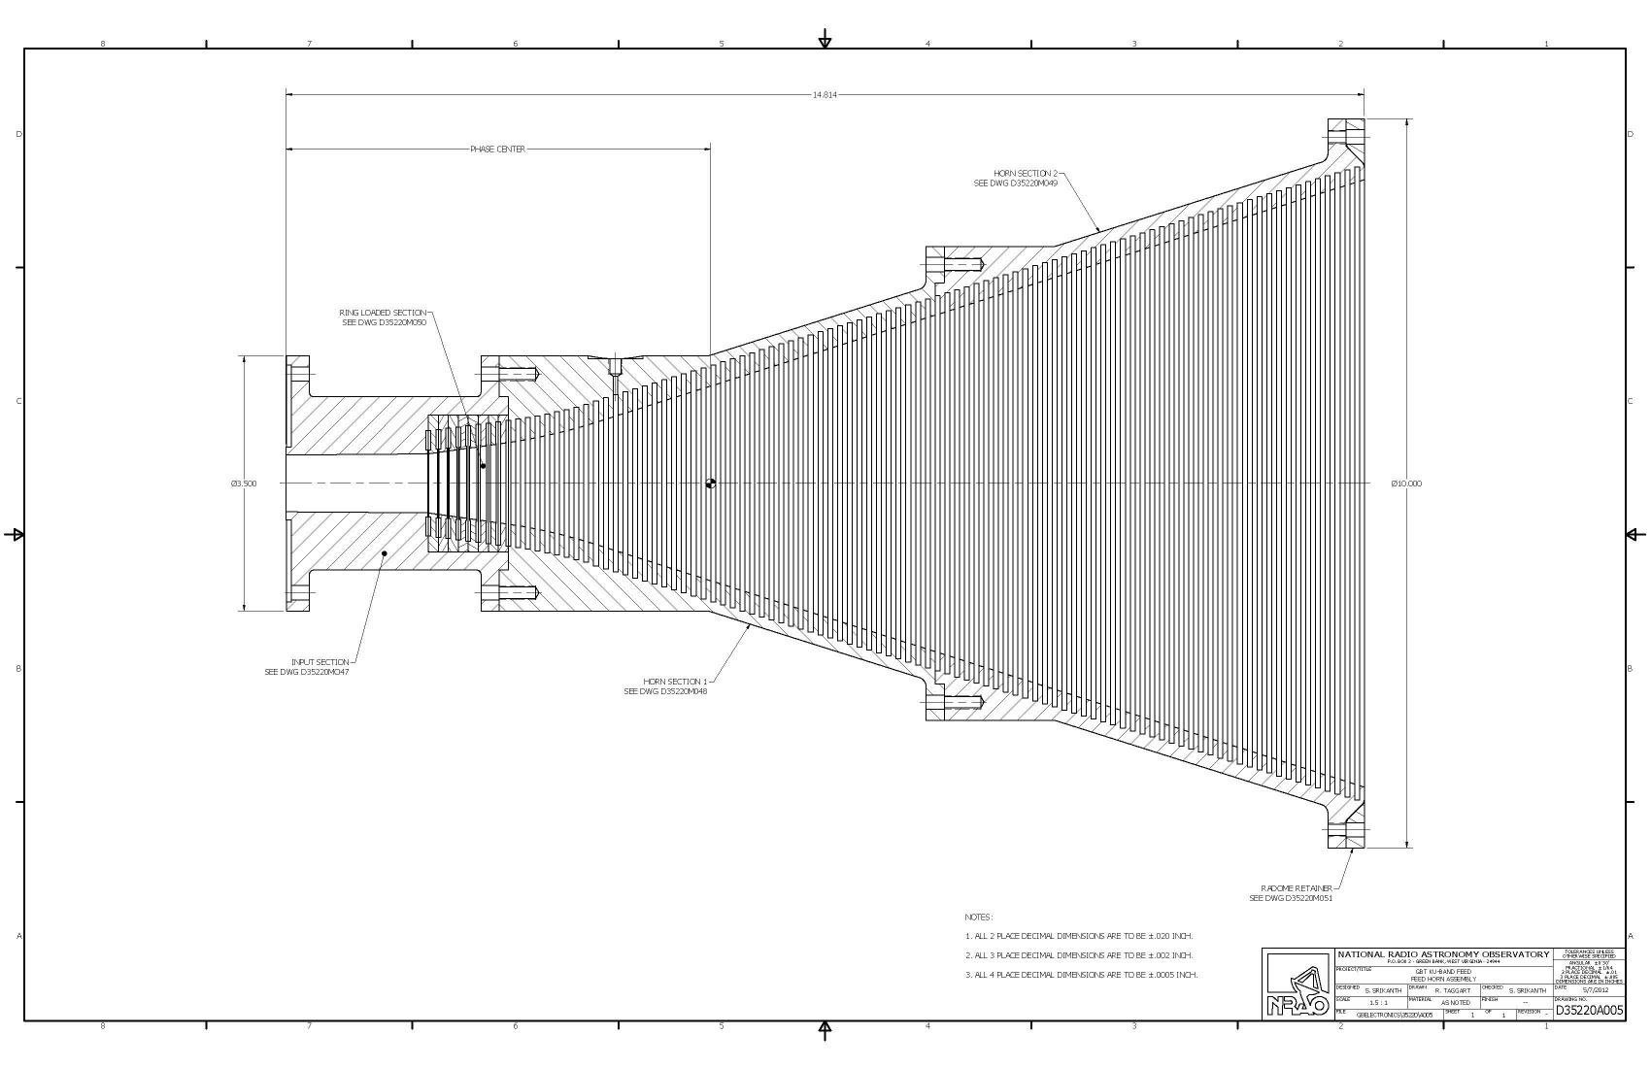
LINEAR TAPER HORN; NARROW FLARE ANGLE
GBT Ku (12-18 GHz)
17.5º
8.33”
Δ=0.65l
12.86”

Slide 8
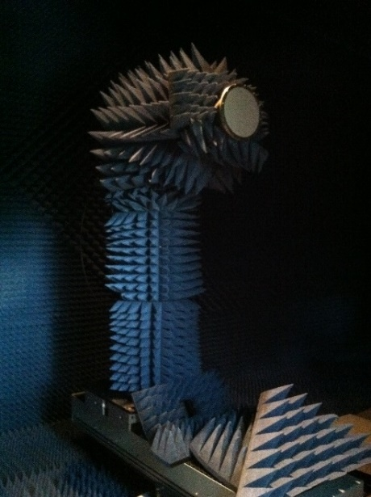
MEASURED BEAM PATTERNS E-, H-PLANES
Freq. (GHz) | E-plane @15⁰ | H-plane @15⁰ | Average
10.6 | -12.6 | -12.0 | -12.2
11.0 | -13.0 | -12.2 | -12.4
12.0 | -13.3 | -13.0 | -13.1
13.0 | -14.6 | -14.1 | -14.3
15.0 | -13.0 | -13.3 | -13.1
16.0 | -14.1 | -14.1 | -14.1
18.0 | -12.1 | -12.7 | -12.4

Slide 9
PHASE PATTERNS , PHASE CENTER LOCATION
Frequency (GHz) | PC from aperture (ins)
12 | -10.2
15 | -12.0
18 | -13.0
PC travel =3.56l_{mid}
=0.14L

Slide 10
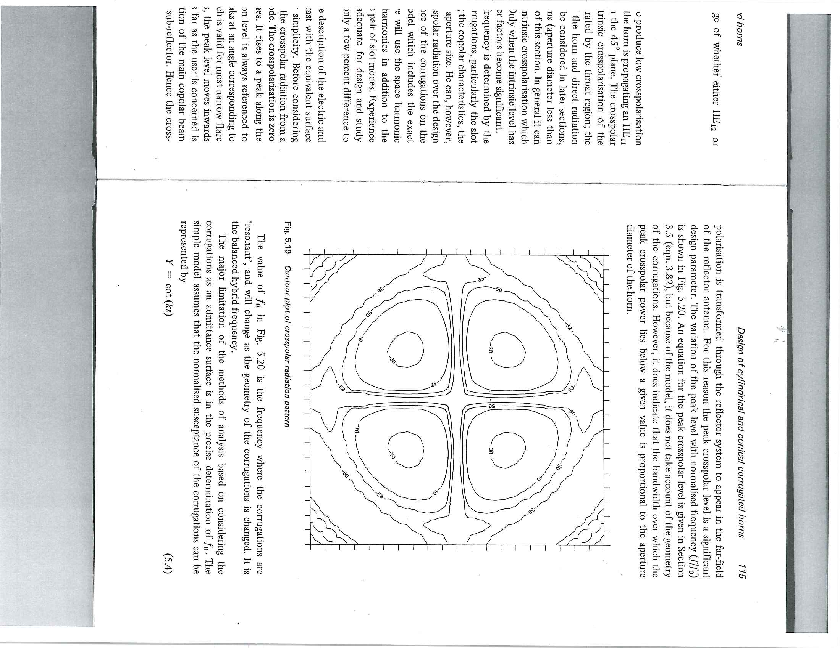
CROSS-POLAR PATTERNS IN 45º-PLANE

Slide 11
SIMULATION AND MEASUREMENT

Slide 12
MEASURED PATTERNS E-, H-PLANES

Slide 13
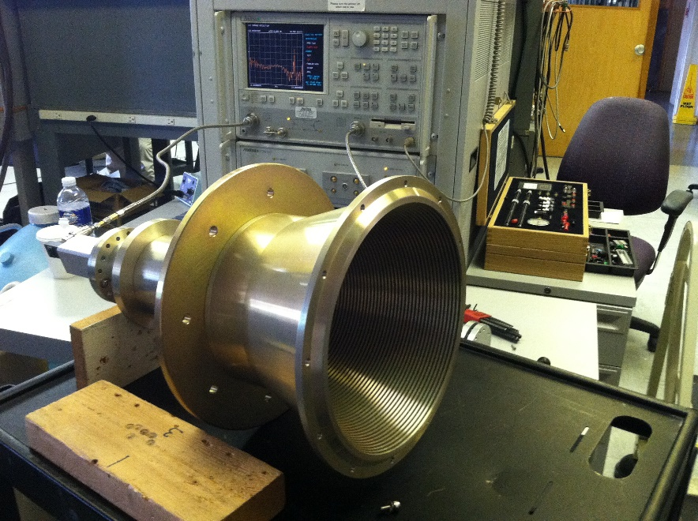
MEASURED INPUT MATCH
MEASFEED>GBTKuWide>Feed>GBTKuJULY262012>VSWR>Feed

Slide 14
APERTURE EFFICIENCY, T_{SYSTEM} ON THE GBT (4-8 GHz)
-15dB @15⁰
D=25.9” (8.8l)
L=43.3” (14.7l)
Θ_{f}=16.4⁰
Δ=0.63l
“The Proposer’s Guide for the Green Bank Telescope”,
GBT Support Staff, January 5, 2015

Slide 15
PROFILE TAPER (COMPACT) CORRUGATED HORN
FEED15.0 | Freq (GHz) | Taper (dB) @ θ_{sub} | θ_{max} | DIA” | DIA/λ * | L/λ * | Taper (dB)**
EVLA-C | 4-8 | -13@9.25° | 12.0° | 22.12 | 7.5 | 21.1 | -12.5
VLBA-C | 4-8 | -14@13.25° | 15.0° | 13.78 | 4.7 | 10.6 | -13.7
GBT-K | 18-26.5 | -13@15º | 17.0º | 2.93 | 4.5 | 8.6 | -13.3
θ_{max}
*λ at low end
** Measured (dB)
DIA
Diameter 35% smaller
Length 25% less
L

Slide 16
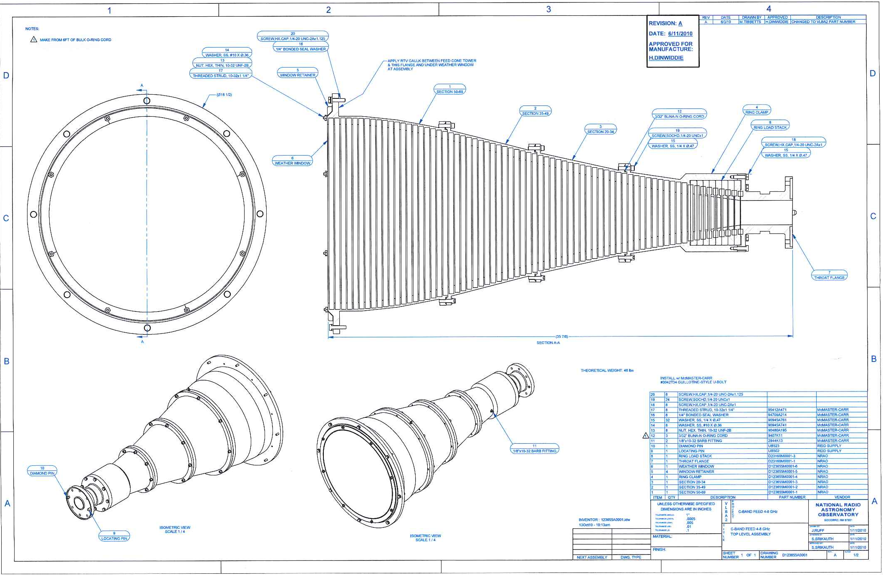
PROFILE/COMPACT HORN VLBA (4-8 GHz)
PROFILE HORNS
GBT: L, S
EVLA: L, S, C
VLABA: L, C
-14dB @ 13.3º
Aperture dia 13.8”(4.7l); Length 31.4”(10.6l); θstart =8°; θmax=15°
8 ring-loaded corrugations; Total 68 corrugations

Slide 17
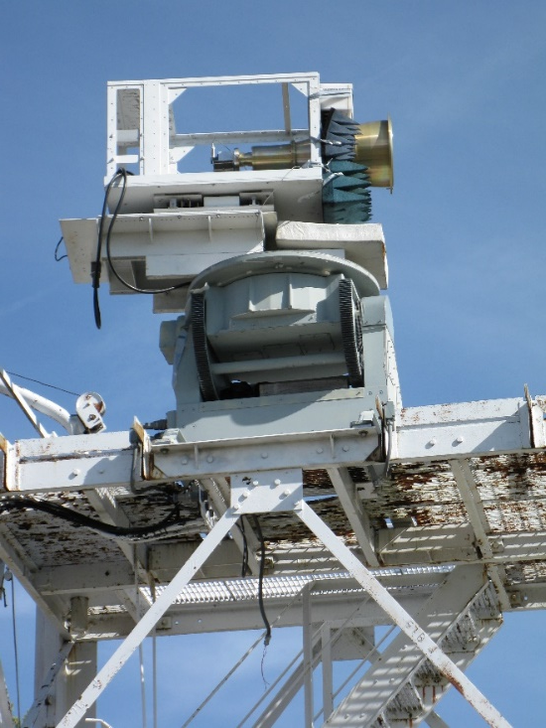
MEASURED BEAM PATTERNS E-, H-PLANES
Freq. (GHz) | E-plane @13.3⁰ | H-plane @13.3⁰ | Average
4.0 | -9.6 | -10.6 | -10.1
4.3 | -11.6 | -12.1 | -11.9
5.0 | -14.7 | -13.7 | -14.2
5.7 | -14.0 | -13.5 | -13.8
6.0 | -13.9 | -13.3 | -13.6
6.7 | -13.6 | -14.1 | -13.8
7.0 | -14.4 | -14.5 | -14.4
7.3 | -15.3 | -15.2 | -15.3
7.7 | -14.6 | -16.5 | -15.5
8.0 |  | -16.2 | -16.2

Slide 18
PHASE PATTERNS AND PHASE CENTER LOCATION
Frequency (GHz) | PC from aperture (ins)
4.0 | -9.4
5.0 | -17.6
6.0 | -21.2
7.0 | -25.3
7.7 | -29.5
8.0 | *
PC travel =10.2l_{mid}
=0.64L

Slide 19
CROSS-POLAR PATTERNS IN THE 45º-PLANE
Theory -24dB

Slide 20
SIMULATION AND MEASUREMENT

Slide 21
MEASURED PATTERNS E-, H-PLANE

Slide 22
MEASURED INPUT MATCH

Slide 23
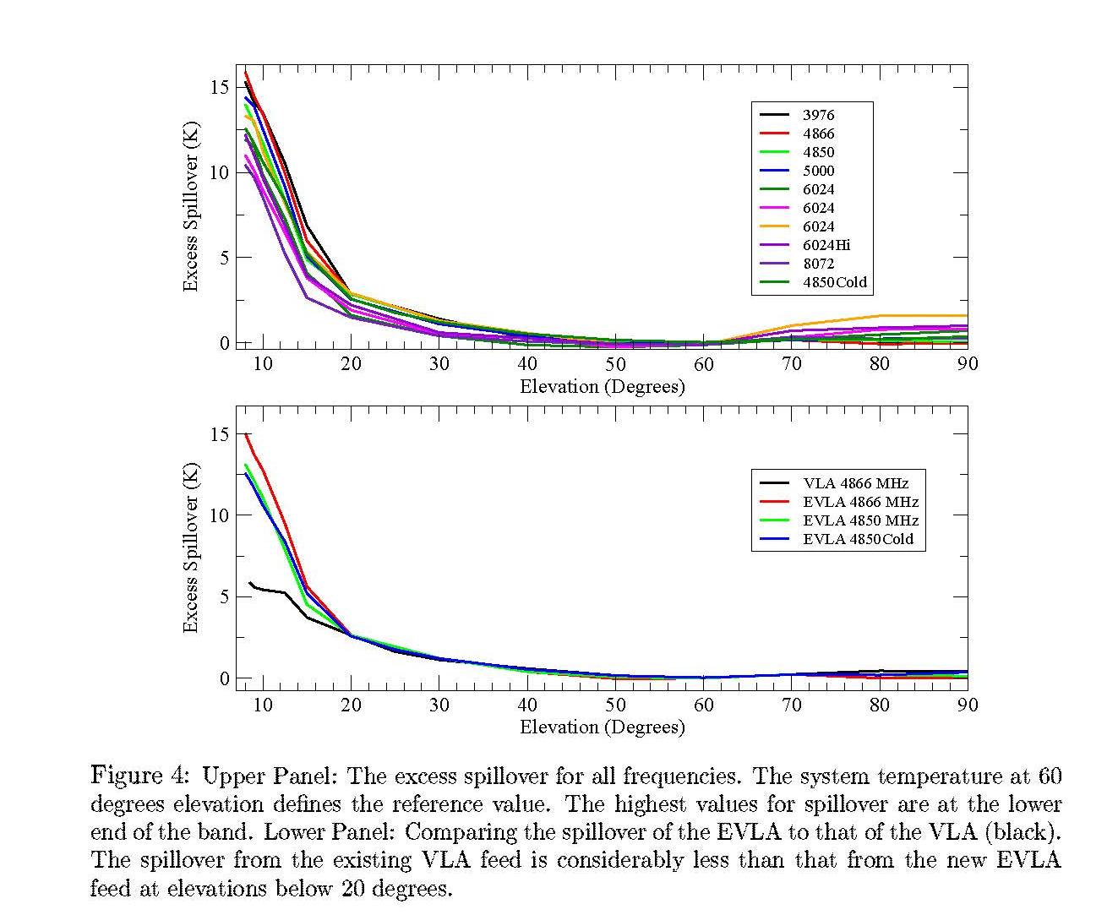

APERTURE EFFICIENCY, T_{SPILLOVER} ON EVLA (4-8 GHz) ANTENNA # 13
4.5K T_{spill} @ 60º
-13dB @9.25⁰
$\frac{ηprof}{ηlin}$= 93 to 95%
EVLA Memo 90, “Performance Tests of the EVLA C-Band Feed”,
R. Perley and R. Hayward, February 16, 2005

Slide 24
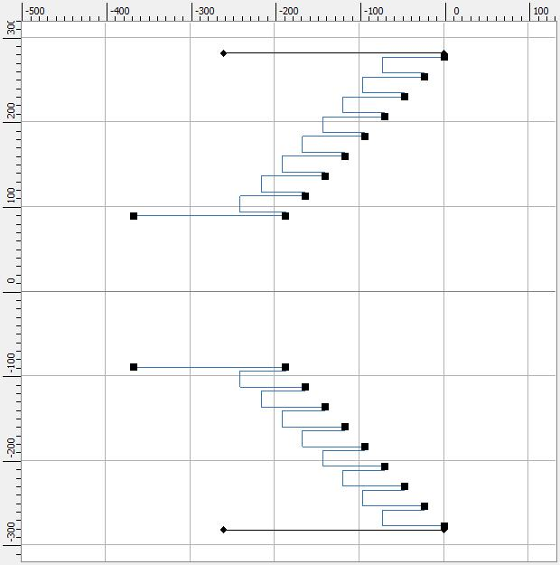
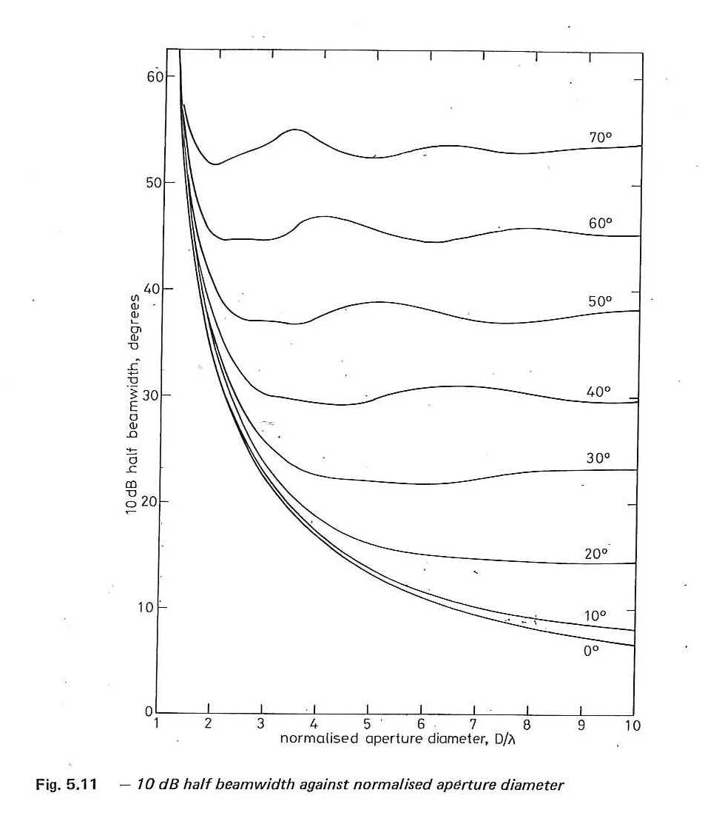
LINEAR TAPER HORN; WIDE FLARE ANGLE
12.-2.4 GHz
46º
Dia=554mm (2.2λ)
Length=187mm(0.8λ)
Θ_{f}=45⁰
Δ=0.46l
# corrg. 8
179mm
Slot depth
#1=53.7mm (0.21λ)
#8=48.8mm (0.19λ)
2.2λ
4.4λ
Taper -13 dB at 46⁰
λ-wavelength at 1.2 GHz
R. Lehmensiek, D.L. de Villiers, “Wide Flare Angle Axially Corrugated Conical Horn Design for a Classical Offset Dual-Reflector Antenna”, 6th EUCAP

Slide 25
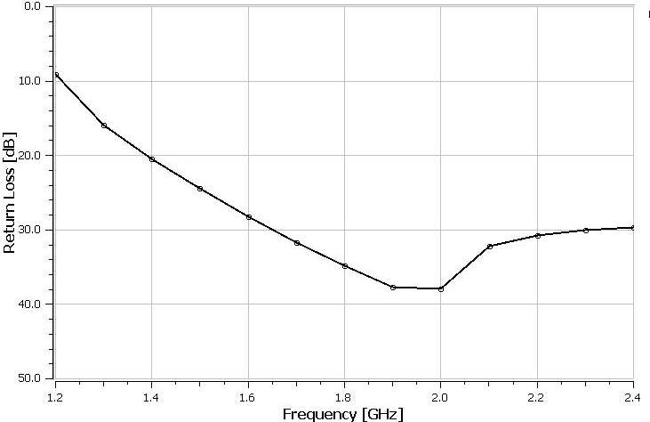
SIMULATIONS E-, H-, XPOL, S₁₁
-35dB
@46⁰
-14.3
-22.5
@46⁰
-14.2
-16.3

Slide 26
SIMULATIONS E- & H- PLANES

Slide 27
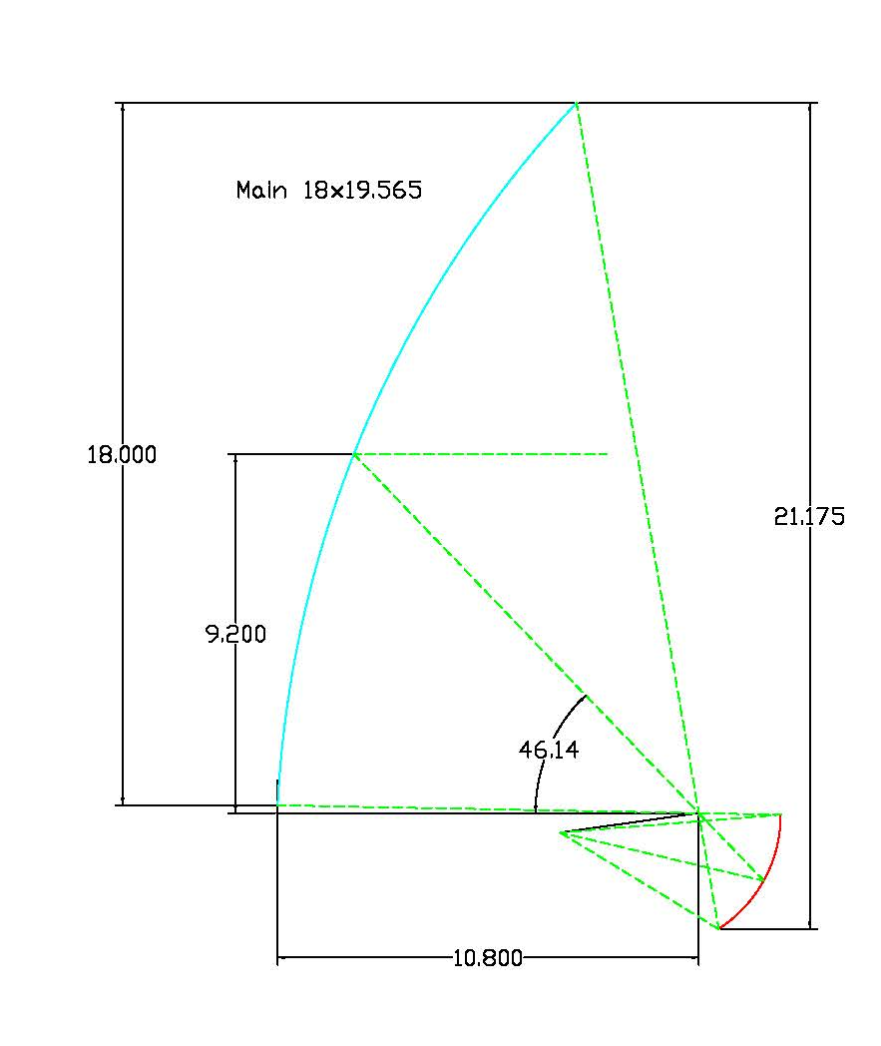
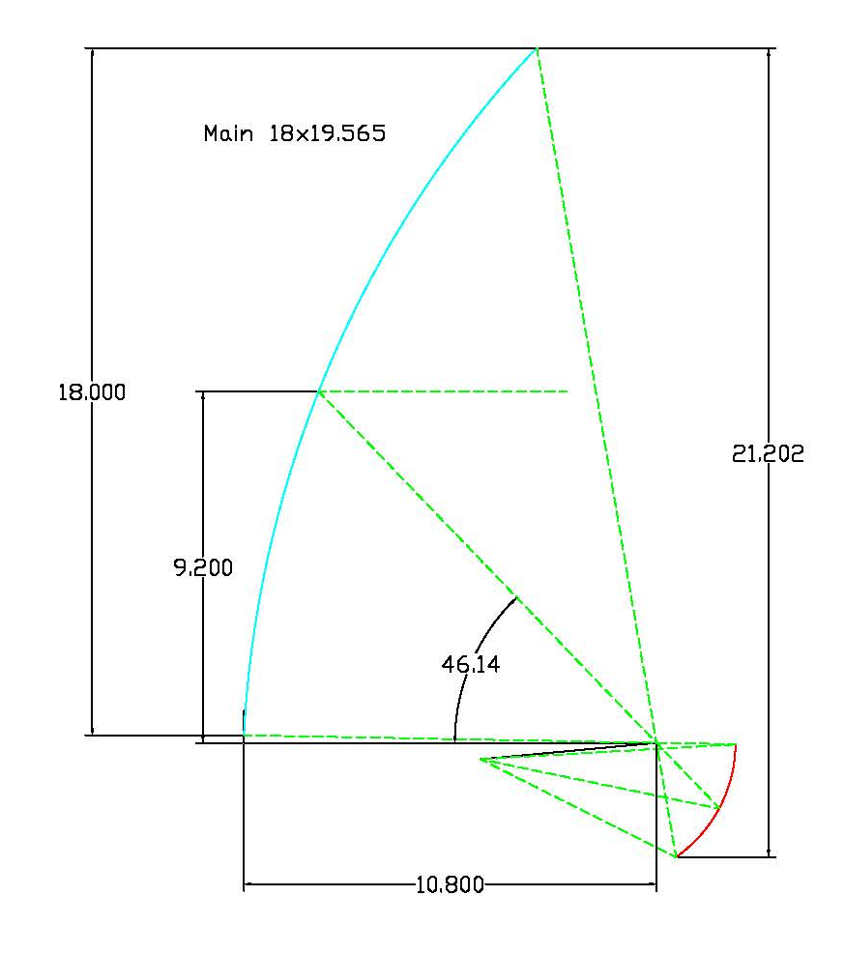



GREGORIAN ANTENNA Θ_{sub} 15º, 18º
15º
18º
$$β$$
$$α$$
$$\tan\left(β\right)=\frac{\left(1−e^{2}\right)Sin(α)}{\left(1+e^{2}\right)Cos(α)+2e}$$
Sub 3.2x3.351; θs=15º
f=4.6285
Sub 3.2x3.340; θs=18º
f=3.5870

Slide 28
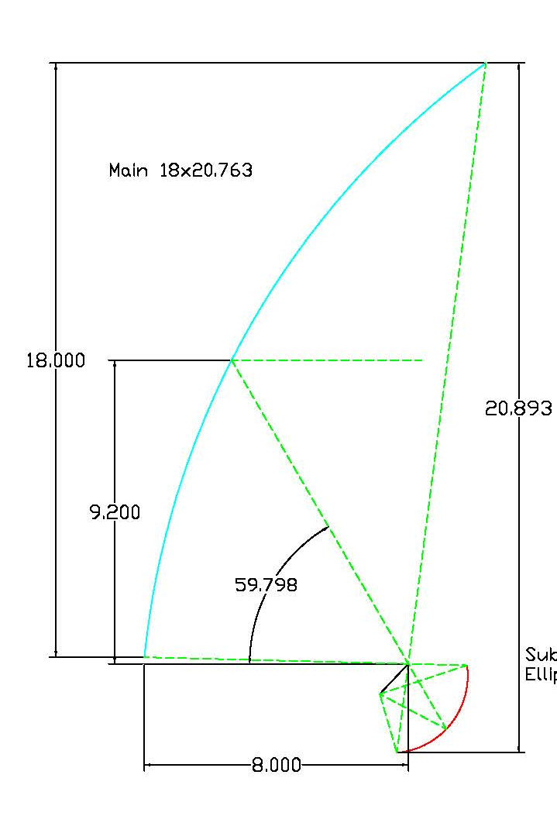
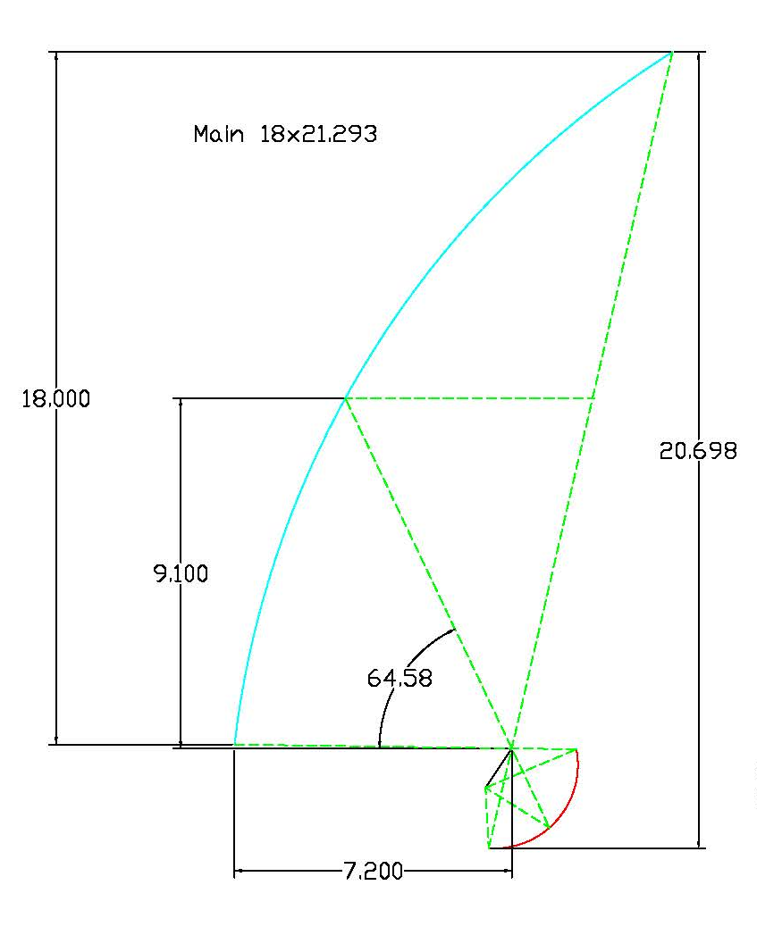
GREGORIAN ANTENNA Θ_{sub} 46º, 55º
46º
55º
Sub 3.2x3.398; θs=46º
f=1.2595
Sub 3.2x3.439; θs=55º
f=1.2290

Slide 29
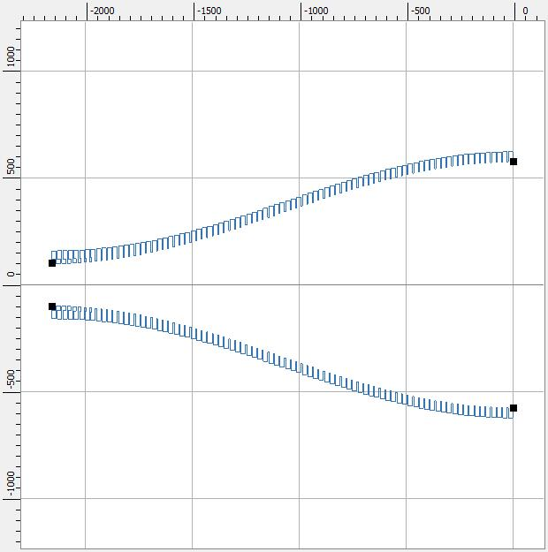
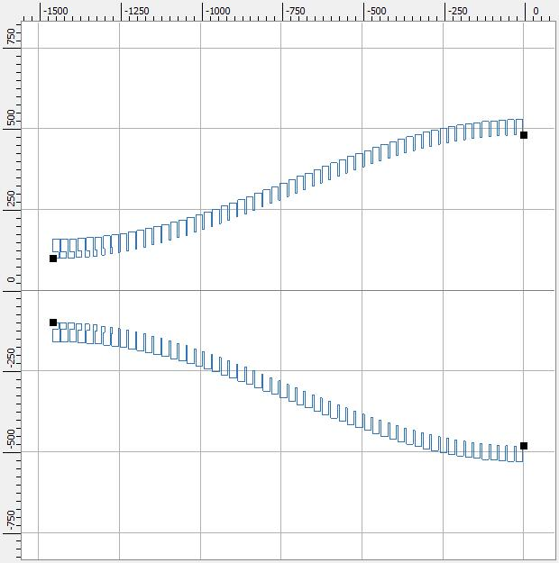
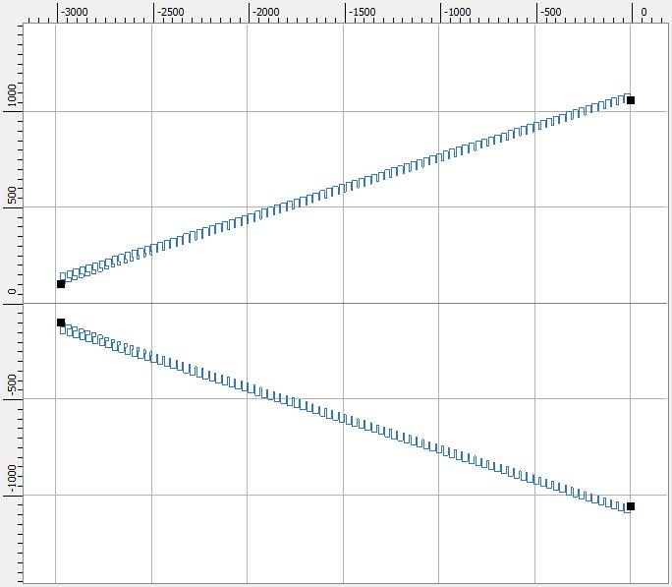
1.2 to 2.4 GHz FEED HORNS FOR θ_{sub} = 15º, 18º, 46º
15º
18º
46º
Dia=1150mm (4.6λ)
Length=2160mm(8.6λ)
Θ_{max}=18.5⁰
# corrg. 83
Dia=963mm (3.9λ)
Length=1457mm(5.8λ)
Θ_{max}=22⁰
# corrg. 56
Dia=554mm (2.2λ)
Length=187mm(0.8λ)
Θ_{f}=45⁰
# corrg. 8
15º
Frequency 1.2-2.4 GHz
Taper -13 dB
λ-wavelength at 1.2 GHz
Dia=2115mm (8.5λ)
Length=2979mm(11.9λ)
Θ_{f}=17.8⁰
# corrg. 88

Slide 30
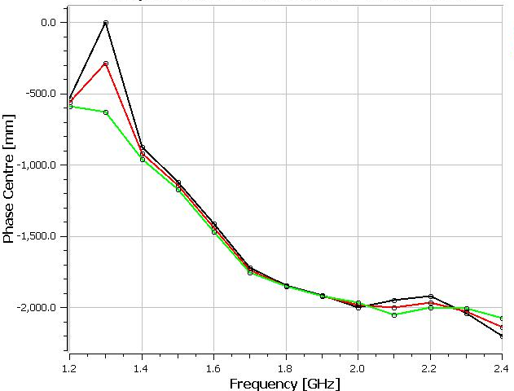
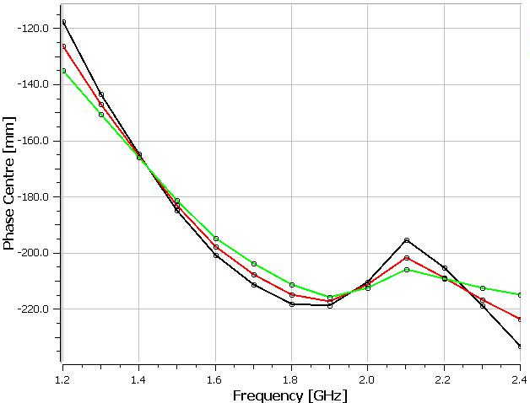
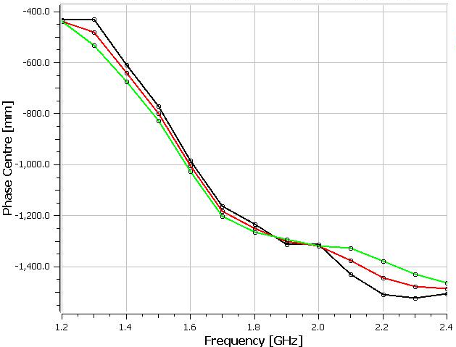
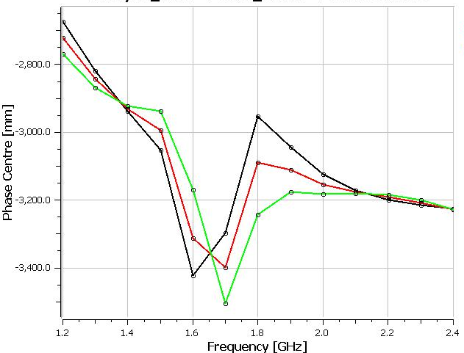
PHASE CENTER LOCATION
Profile Horn (4.6λ)
Length=2160mm
Axial Corrg. Horn (2.2λ)
Length=187mm
15º
ΔPC = 1500mm
(9λ_{mid})
46º
ΔPC = 100mm
(0.6λ_{mid})
-1925
-215
Eco – E plane
Eco - 45 degree
Eco – H plane
Profile Horn (3.9λ)
Length=1457mm
Lin. Horn (8.5λ)
Length=2979mm
ΔPC = 1050mm
(6.3λ_{mid})
ΔPC = 700mm
(4.2λ_{mid})
18º
15º
-3150
-1310

Slide 31
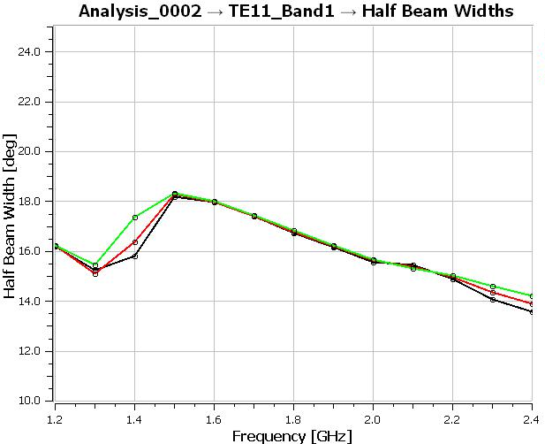
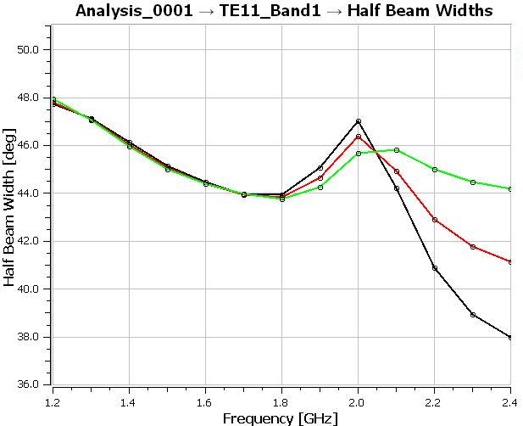
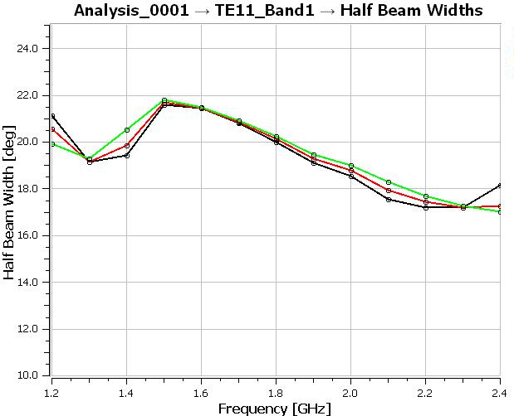
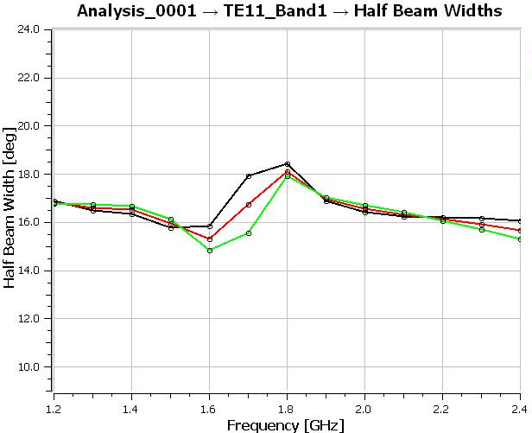
Half Beam Width at -15 dB
Profile Horn (4.6λ)
Length=2160mm
Axial Corrg. Horn (2.2λ)
Length=187mm
15º
46º
Eco :E-plane
Eco : 45 degree
Eco : H-plane
Lin. Horn (8.5λ)
Length=2979mm
Profile Horn (3.9λ)
Length=1457mm
18º
15º

Slide 32
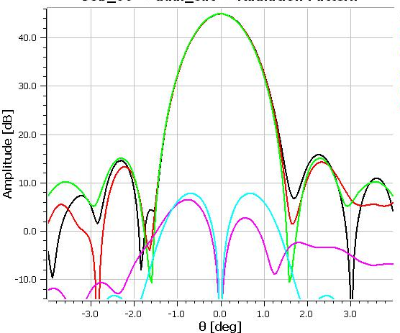
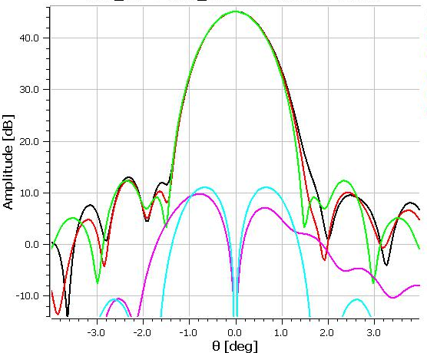
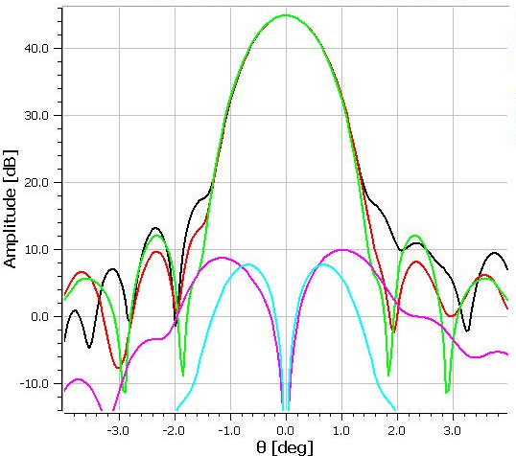
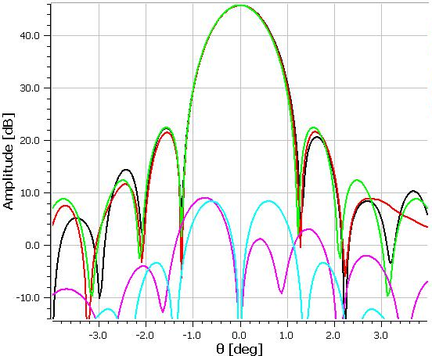
ANTENNA BEAM AT 1.2 GHz
Θ_{sub}=15º
44.91 dB
Xpol -37.1 dB
Θ_{sub}=46º
45.10 dB
Xpol -34.1 dB
Eco, Ecx -Symmetric
Eco, Ecx - 45 degree
Eco, Ecx - Asymmetric
Θ_{sub}=18º
44.84 dB
Xpol -34.9 dB
Profile Horn, Linear Taper,
Axial corrugated Horn - CHAMP
Spherical Wave Expansion Coefficients
GRASP PO/PO
Θ_{sub}=15º
45.75 dB
Xpol -36.7 dB

Slide 33
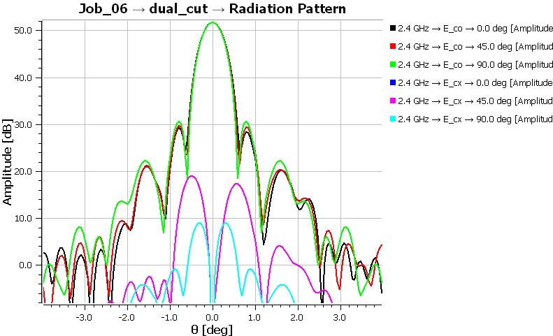
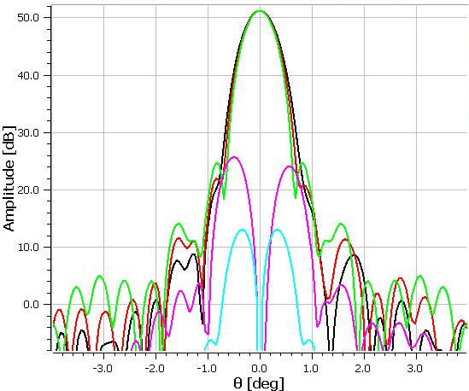
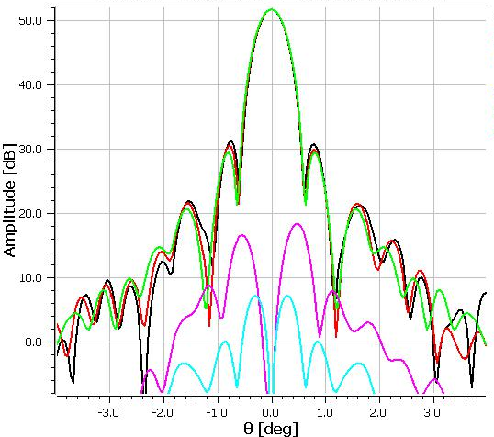
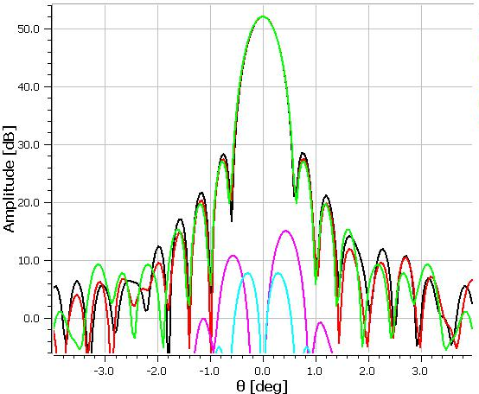
ANTENNA BEAM AT 2.4 GHz
Θ_{sub}=15º
51.67 dB
Xpol -32.7 dB
Θ_{sub}=46º
51.16 dB
Xpol -25.4 dB
Eco, Ecx -Symmetric
Eco, Ecx - 45 degree
Eco, Ecx - Asymmetric
Θ_{sub}=18º
51.73 dB
Xpol -33.5 dB
Θ_{sub}=15º
52.04 dB
Xpol -37 dB

Slide 34
η_{a} OF 18-M GREGORIAN ANTENNA
ΔEff = 11%
Profile Horn, Linear Taper, Axial corrugated Horn - CHAMP
Spherical Wave Expansion Coefficients
GRASP PO/PO

Slide 35
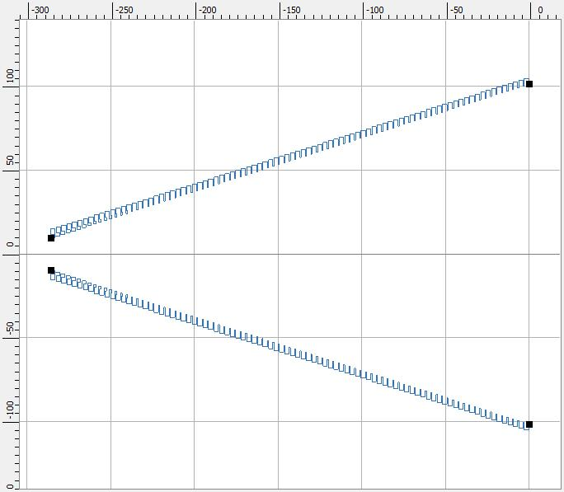
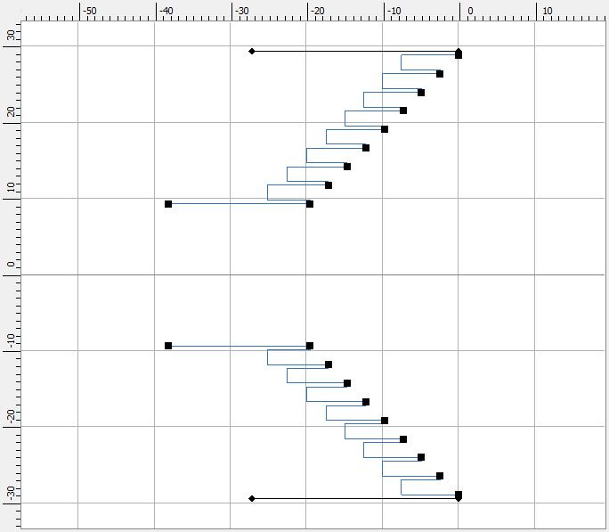
12.6-21.0 GHz FEED HORNS FOR θ_{sub} = 15º, 46º
15º
46º
Dia=58mm (2.4λ)
Length=20mm (0.9λ)
Θ_{f}=45⁰
# corrg. 8
Dia=203mm (8.5λ)
Length=286mm (12λ)
Θ_{f}=17.8⁰
# corrg. 88

Slide 36
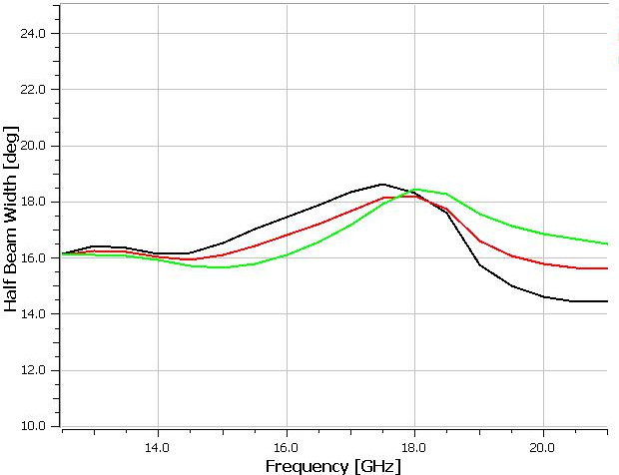
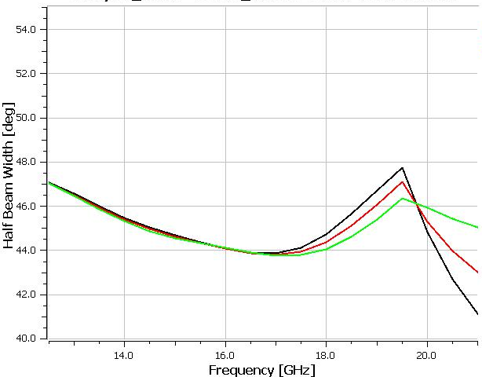
HALF BEAM WIDTH AT -15dB FOR θ_{sub} = 15º, 46º
15º
46º

Slide 37
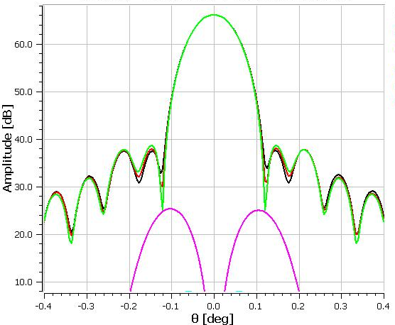
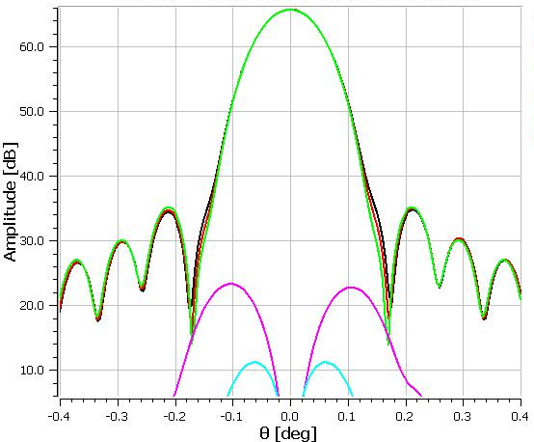
ANTENNA BEAM AT 12.5 GHz; θ_{sub} = 15º, 46º
Θ_{sub}=15º
66.11 dB
Xpol -40.8 dB
Eco, Ecx -Symmetric
Eco, Ecx - 45 degree
Eco, Ecx - Asymmetric
Θ_{sub}=46º
65.75 dB
Xpol -42.5 dB

Slide 38
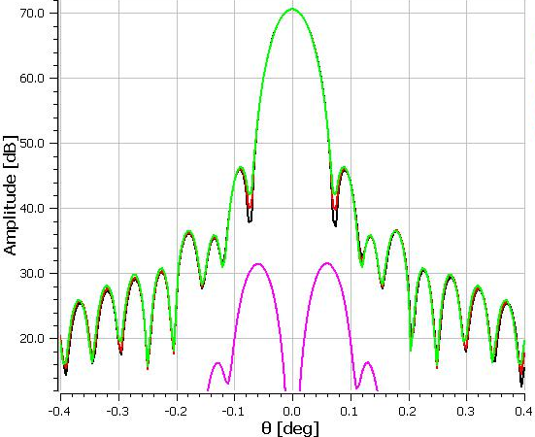

ANTENNA BEAM AT 20.5 GHz; θ_{sub} = 15º, 46º
Θ_{sub}=15º
70.64 dB
Xpol -39 dB
Θ_{sub}=46º
70.16 dB
Xpol -30.6 dB

Slide 39


h_{a} ANTENNA BEAM AT 21.5GHz; θ_{sub} = 15º, 46º
Θ_{sub}=15º
71.06 dB
Xpol -45 dB
Θ_{sub}=46º
70.45 dB
Xpol -28.8 dB

Slide 40
h_{a} 12.6-21.0 GHz FOR θ_{sub} = 15º, 46º
15º
ΔEff = 13%
ΔEff = 8%
46º
Linear Taper Horn, Axial corrugated Horn - CHAMP
Spherical Wave Expansion Coefficients
GRASP PO/PO

Slide 41
h_{a} 12.6-21.0 GHz FOR θ_{sub} = 15º, 46º (21.5 GHz)

Slide 42
CONICAL CORRUGATED HORNS

Slide 43

APERTURE PHASE ERROR FACTOR
Δ$=\frac{r}{λ}$tan$\frac{θ0}{2}$
r - radius at aperture
λ- wavelength
θ₀- taper angle of the feed horn
Aperture phase error factor

Slide 44




LINEAR TAPER HORN (12-18 GHz)
MEASFEED>GBTKuWide>Feed>GBTKuJULY262012>Feed patterns>summary2

Slide 45
4. SLIDE 24 EXCESS SPILLOVER?

