Slide 1
ngVLA Reference Front End and Cryogenics
W. Grammer, D. Urbain, S. Sturgis
ngVLA Optics Workshop
Pasadena CA, 19-20 June 2018

Slide 2
Introduction and General Requirements
Proposed ngVLA has 214 antennas, ~8 times that of the VLA
  Key requirement is to minimize operating cost to within 3 x VLA
  Reduce total number of Dewars by consolidating receiver bands
  Reduce total number of RXs by employing wideband feeds, where feasible
  Efficient cryogenic system that optimizes power consumption
“Reference” design concept for ngVLA receivers, feeds:
  A feasible design with relatively low technical risk and well-defined costs
  Maximizing sensitivity is the primary goal; wide bandwidths are secondary
  Wide-angle feeds are highly compact, can be cooled => lower overall Tsys
  Good aperture efficiency and low spillover noise, for optimum sensitivity
2

Slide 3
Reference Front End Subsystem
3

Slide 4
Specific Design Assumptions
Near-continuous frequency coverage from 1.2 – 116 GHz
  Coverage gap from 50.5 - 70 GHz (O₂ absorption band)
Feed horn has a beam half-angle of ~55 degrees.
Receivers are single-pixel, with linearly-polarized outputs
Feeds and LNAs in all bands are cryogenically cooled.
Antenna is an unblocked, offset Gregorian geometry, with shaped optics, low spillover by design, ~160um RMS surface accuracy
Nominal VLA site conditions: 6mm PWV, 45° elevation angle (1 mm PWV assumed for W-band)
4
Notes:
Surface lambda/16 for the surface accuracy 116GHz => 160um

Slide 5
ngVLA Reference Front End Configuration
Six receivers (Bands 1-6), in a pair of compact cryogenic dewars
Band 1 (1.2 – 3.5 GHz) in Dewar ‘A’:
  Almost identical to the Caltech ngVLA receiver concept [1], but without the high-frequency bands and Dewar extension. Feed cooled to 80K, LNAs to 20K
  ~3:1 bandwidth quad-ridged feed horn (QRFH) & LNAs, to cover L+S bands
Bands 2-6 (3.5 – 116 GHz) in Dewar ‘B’:
  Band 2 uses 3.5:1 QRFH & LNAs, to cover C+X bands
  Bands 3-6 use ~1.67:1 axially-corrugated feeds & LNAs, for more optimum aperture efficiency, spillover and noise performance.
  Corrugated feed design derived from NRC DVA-1 octave-band feed (0.75 – 1.5 GHz, designed by Cortes and Baker [2]
5
Notes:
With the wide angle feeds we went from 3 Dewars down to 2 Dewars
Previously the feed were not cold because of the very large size
One less refrigerator, smaller feed reduced thermal load
It’s a lot easier now to meet the ngVLA requirements for the cryogenics
Fewer cold-heads => less maintenance
Smaller compressor=> lower power consumption
Band 1 limited at 3.5GHz by the sampler, direct sampling .

Slide 6
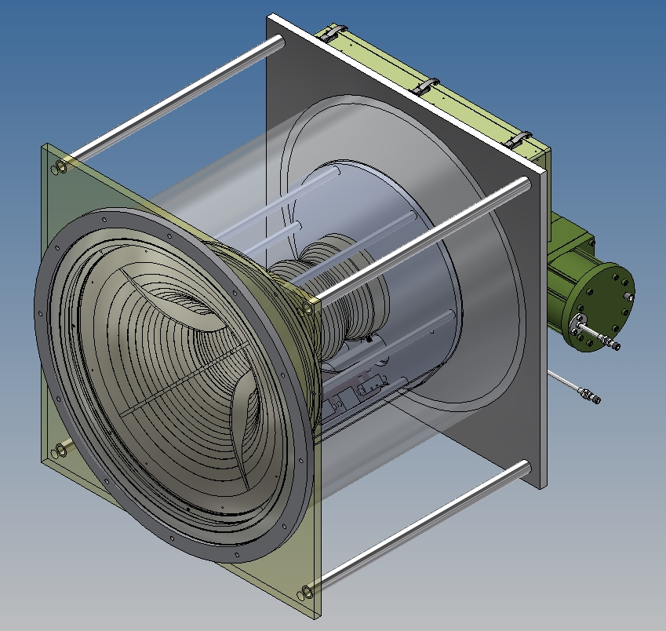
Band 1 Receiver (Dewar ‘A’) Concept
Based on design by S. Weinreb, H. Mani (Caltech/ASU)
Cylindrical Dewar houses cooled QRFH (80 K), coaxial LNAs (20 K)
Single Trillium 350CS cryocooler, variable speed
Approximate Dewar dimensions: 458 x 406 mm (Dia. x H). Cryocooler extension ~115 mm.
Approximate total mass: 60 kg
Notes:
Feed is cooled by the first stage
Feed cover/ vacuum window for the reference design is borrow from CSIRO (sandwich of Styrofoam between two layer of fiberglass)
Information provided by Alex Dunning

Slide 7
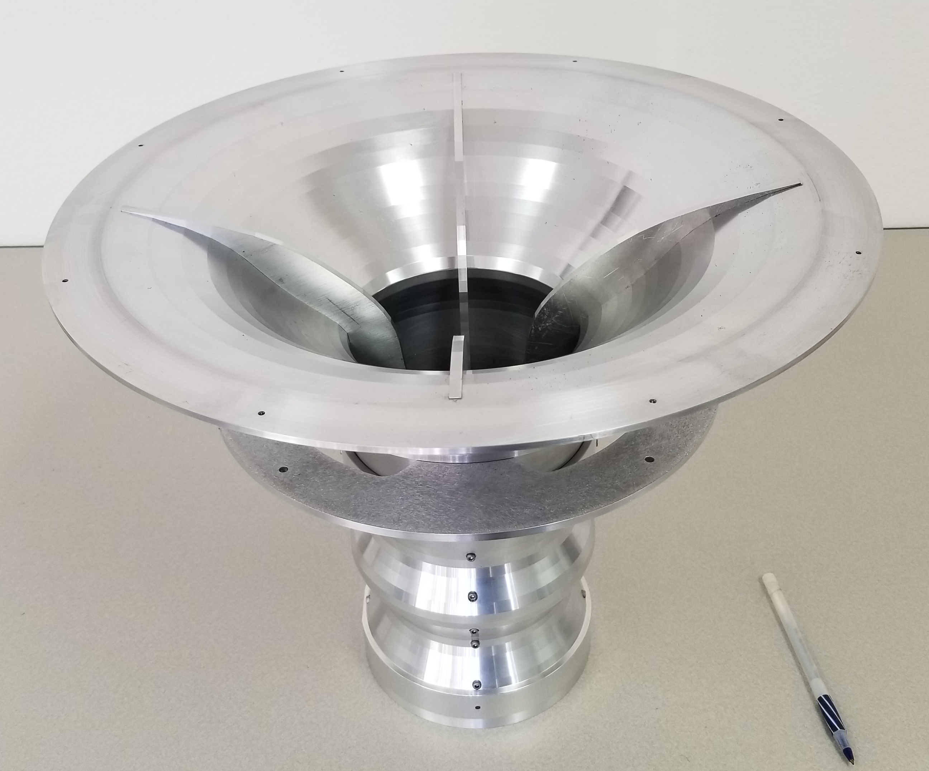
(photo courtesy S. Weinreb, Caltech, 2018)
Spillover Noise is with conservative assumption that ½ the total spillover is at 250K
7
Notes:
High spillover at the low end of the band
Drop in efficiency at the high end of the band
More optimization might be needed

Slide 8
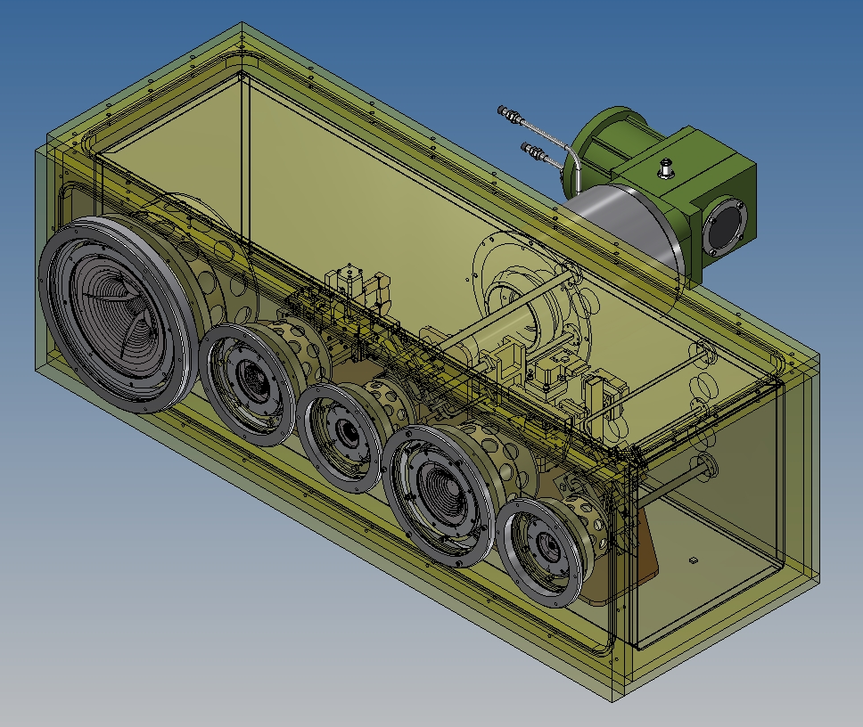
Band 2-6 Receiver (Dewar ‘B’) Concept
Rectangular Dewar, inline bands
Feed phase centers aligned on a lateral axis
Modular receiver subassemblies
Single Trillium 350CS cryocooler, variable speed
Dewar size w/o cryocooler: 725 x 260 x 300 mm (L x W x H)
Approximate total mass: 60 kg
Notes:
The thermal gap assembly is the supporting structure for each frequency band assembly
Remove the top plate and the access panel through the radiation shield to get access to the electronics
Disconnect the RF connections (coaxial cables or waveguides)
Thermal connections copper braids
Unplug the DC bias cables

Slide 9
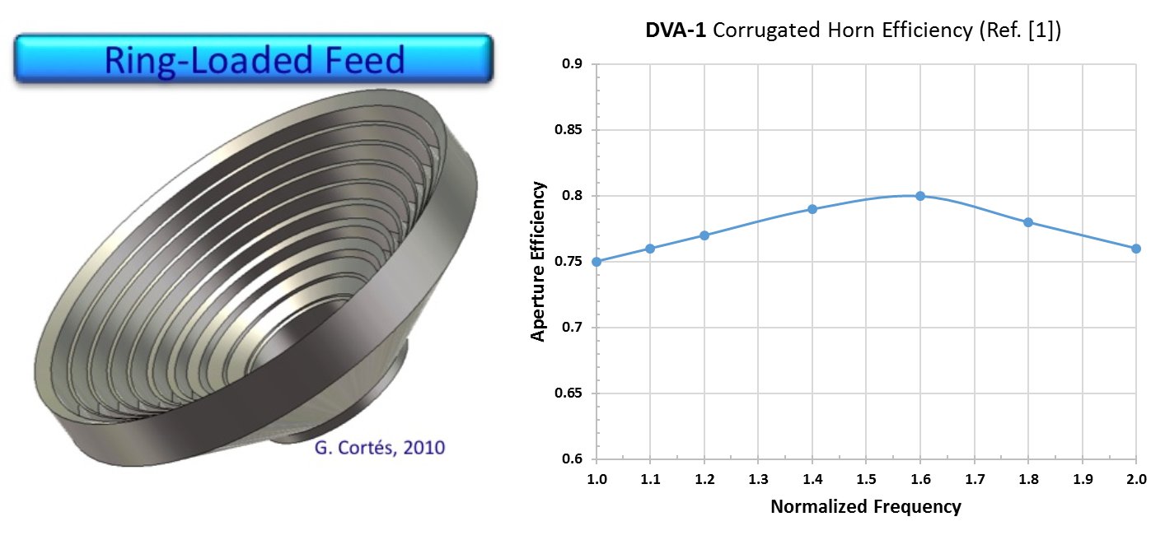
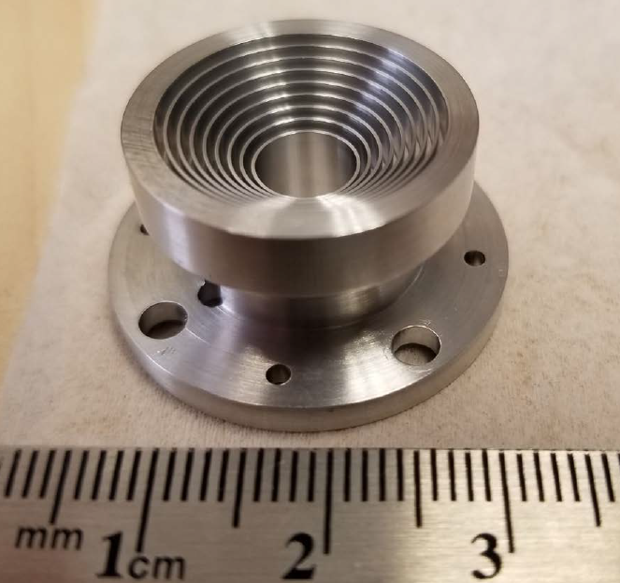
(photo courtesy L. Locke, NRC, 2017)
9
Notes:
Feed design by NRC for ALMA band1 35-50GHz
Manufacturing might be challenging for band6 (65-116GHz)

Slide 10
Front End + Optics Performance Estimates
10
Notes:
Note the high spill over for the band 1 and 2 at the low end of the band
Reduced aperture efficiency for the Band 6

Slide 11
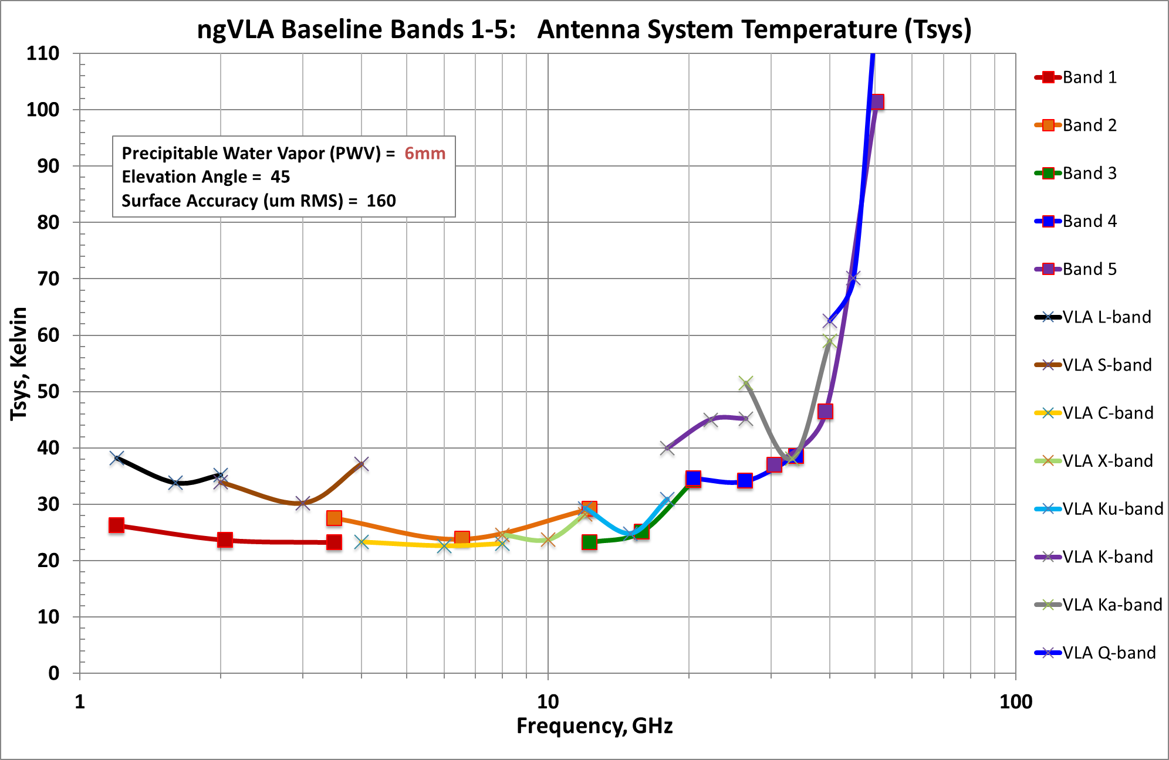
11
Notes:
ngVLA band 1 & band 2 slope because of high spill over lower part of the band. VLA higher Tsys for L & S band because of not optimum optics, diffraction and spill over.
Band 6 aperture efficiency lower because of surface accuracy and pointing accuracy compromised by the antenna cost.
Re-optimize band 1 and 2 feed to reduce spillover but might affect the aperture efficiency

Slide 12
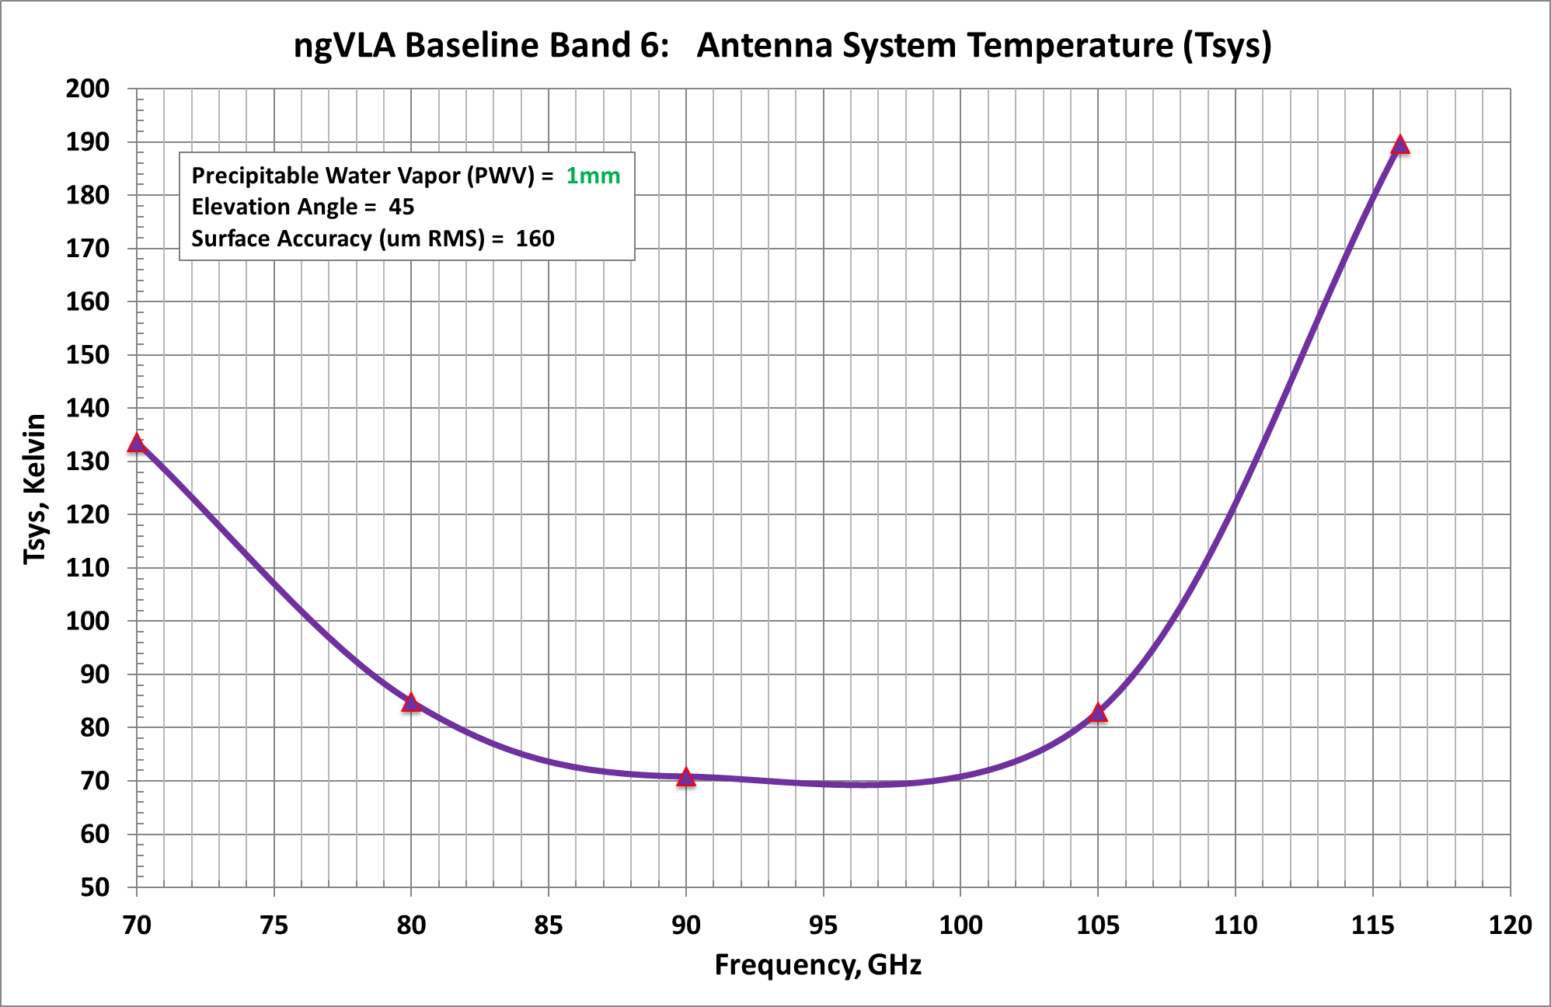
12
Notes:
T sky has a huge influence on the band pass shape
LNA also has better performance in the middle of the band
Aperture efficiency decrease rapidly has the frequency increases

Slide 13
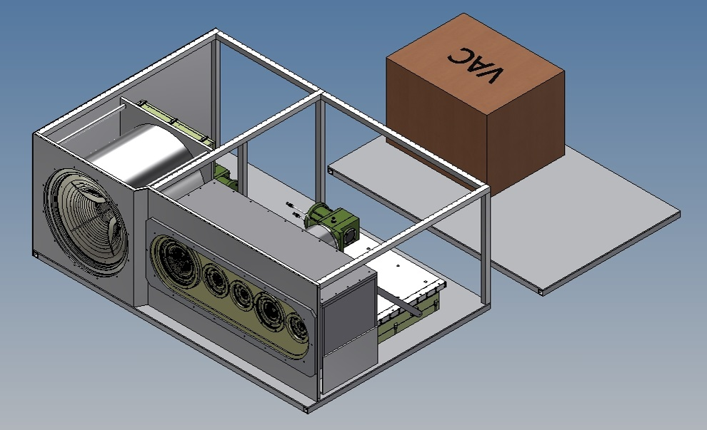
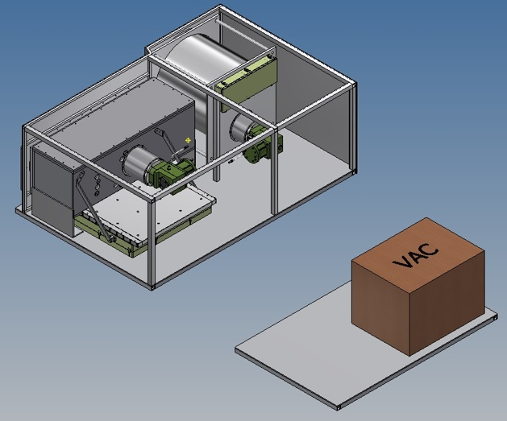
13
Notes:
2 receiver mounted on the translating antenna platform
The box under the receiver contains the post amp/digitizer assembly that Matt Morgan is working on

Slide 14
Front End Summary
Compact two-Dewar solution to achieve full 1.2-116 GHz coverage
Optimum sensitivity achieved with:
  Compact, cooled feed horns with high aperture efficiency (>75%)
  Waveguide-bandwidth receivers above X-band, for lower input losses and near-optimum LNA noise performance across the full band.
  Two-stage G-M cryocoolers to get LNA temps < 20K.
Reduction in relative operating costs through:
  Employing wideband QRFHs below X-band, to cut # of RXs by half.
  Use of modern variable-speed drives for cryocoolers and He compressors, and intelligent monitoring/control for optimizing their power usage.
14

Slide 15
Future Work
Feed horn development:
  Optimize QRFH profile for reduced back-lobe and flatter efficiency over a 3.25:1 bandwidth, for a beam half angle of 55 degrees.
  Optimize corrugated feed horn for flatter efficiency over 1.67:1 bandwidth
  Accurate pattern measurements of reference horns for both types
Conceptual designs for Band 1 and Band 2-6 Dewars:
  Development of Band 1 concept (Caltech et. al.)
  Detailed Band 2-6 mechanical design/modeling, test Dewar construction.
Integration of receiver packages with back-end and support electronics, X-Y positioner at the antenna focus – mechanical design
15

Slide 16
Reference Cryogenic Subsystem
16

Slide 17
Introduction
The ngVLA may have up to 466 cryocoolers, versus 216 for the VLA.
On the VLA, cryocoolers and compressors run at a fixed-speed
  Sized for worst-case, maximum load conditions (warm startup on all dewars)
  No provision to dial back helium flow for steady-state operation
  As power consumption is proportional to available He flow => power is being wasted by delivering more flow capacity than needed for steady-state ops.
ngVLA cryocoolers and compressors will be variable-speed
  Cryocooler & compressor speeds adjustable, to match cooling requirements.
  Operating cost savings from 30-50% possible, against a fixed-speed system
  Prototype systems in testing at NRAO (VLA Green Antenna initiative)
17
Notes:
214 (18m) antennas plus 19 (6m) antennas in the core for very short baseline and minimum shadowing
Cooling power wasted by producing more Flow that we need (compressor ate fixed speed)
Thermal design of the receiver not optimize, simple solution like MLI could save a lot of cooling power
Cold-head at fixe speed, wasting cooling power
Both combine make the VLA cryogenic system not efficient , plan to make some changes and reduce the power consumption by 30% in the future with the green antenna project.

Slide 18
VLA and ngVLA Cryogenics Comparison Table
 | VLA | ngVLA std | Rel. Cost
Antennas | 27 x 25m | 214 x 18m, 19 x 6m | n/a
He Compressors | 3 x 27 = 81 | 214 +19 = 233 | 2.88
AC Power consumption | 81 x 6 = 486kW | 233 x 5 = 1165kW | 2.40
Cryocooler Model(s) | 1 x CTI22, 6 x CTI350, 1 x CTI1050 | 2 x CTI 350 | n/a
Cryocoolers Maintenance | 8 x 27 = 216 | 233 x 2 = 466 | 2.15
Note that the relative construction and operations cost
of the ngVLA is within the factor of 3 limit over the VLA.
Notes:
By reducing the number of receivers per antenna, we are within the X3 cost factor even if the cryogenics sub-system is not optimized.
The new frontend reference design has reduce the demand on Cryogenics significantly. Even if we use the same technology as the VLA we are within the x3 budget requirement for ngVLA

Slide 19
Funded Studies & Activities - Cryogenics
Cryogenic thermal load analysis for both Reference Front End Dewars ‘A’ and ‘B’ (with CALLISTO, France).
Construction and characterization of mid-size Helium compressor with variable-speed drive (Sumitomo SHI, Allentown PA, USA)
Upgrade of the VLA Reverberation Test Chamber to 208 VAC 3-phase power, for RFI testing of ngVLA compressor prototypes.
19
Notes:
How did we spend the NSF fund to work on the reference design a give a good proposal for 2020 decadal survey.

Slide 20
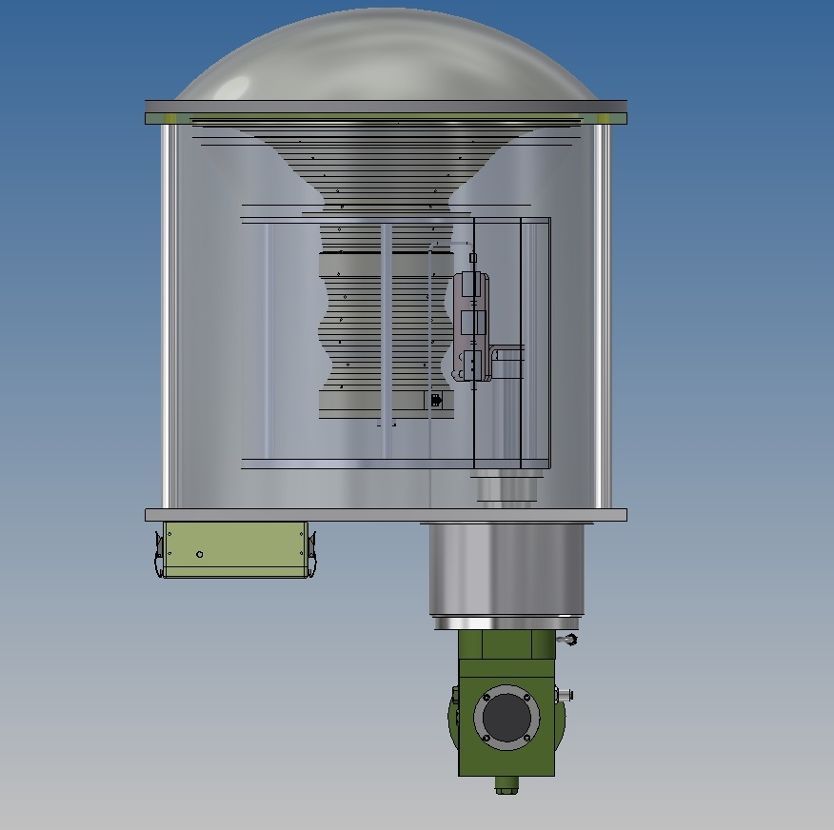
Thermal Analysis, Dewar ‘A’
Ambient Temperature 20°C, vacuum 10E-6 mbar
  1st stage 9.81W at 50°K
  2nd stage 3.14W at 15°K
Trillium 350CS cold-head
  1st stage 20W at 77°K
  2nd stage 5W at 20°K
Reference
design
20

Slide 21
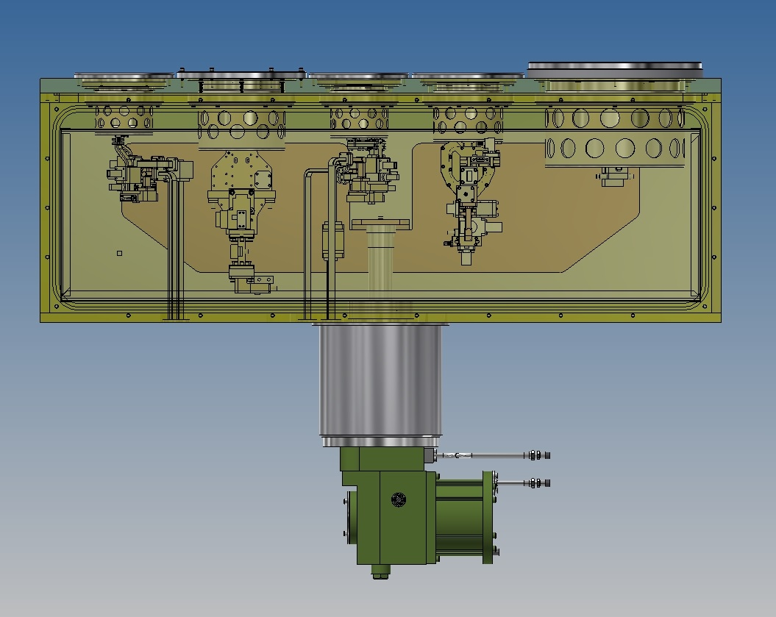
Thermal Analysis, Dewar ‘B’
Ambient Temperature 20°C, vacuum 10E-6 mbar
  1st stage 18.4W at 50°K
  2nd stage 4.3W at 15°K
Trillium 350CS cold-head
  1st stage 20W at 77°K
  2nd stage 5W at 20°K
Reference
design
21

Slide 22
Further Reductions in Thermal Loading
Conductive heat transfer through waveguides:
  Limit Au plating to 5 skin depth max, or use thermal isolators
IR filter efficiency:
  Simulation assumed single-layer 0.3mm PTFE with 60% efficiency
  Use other materials (Zitex G110, Rohacell 71HF, etc. with higher efficiency)
  Add additional layers, akin to MLI (trade-off with increased insertion loss)
Radiative load on inside section of thermal gap assembly:
  Add multilayer insulation (MLI)
Radiation shield heat conduction:
  Higher conductivity => reduced thermal gap and IR filter temperatures
  Change material from Aluminum to Nickel plated copper
  Add copper fingers to the radiation shield, one for each band
22

Slide 23
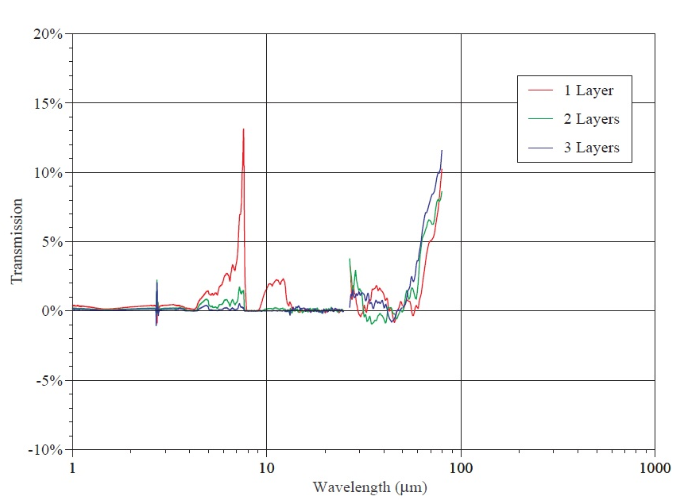
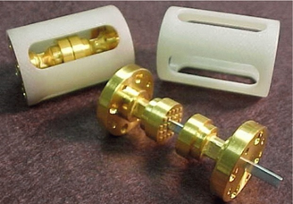
WR10 waveguide Thermal Gap Isolator
(ref. [3])
IR Filter Transmission, 1-3 Layers
(ref. [4])
23

Slide 24
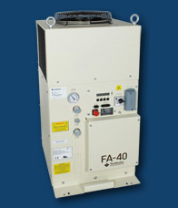
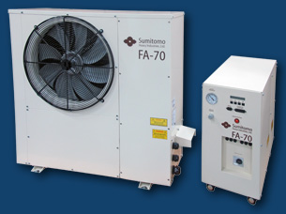
Compressor Development by Sumitomo SHI
FA40 Integration into
FA70 outdoor enclosure
Phase 1 (already funded):
  Build FA40 prototype with VFD
  Measure the performances: flow vs power
  Measure RFI and design shielded enclosure for electronics
Phase 2 (with D&D funding):
  Integrate FA40 capsule into a FA70 outdoor enclosure
  Relocate control/power electronics to an outdoor-rated RFI enclosure. (ngVLA prototype)

Slide 25
Feasible Component Choices for Reference Design
Compressor: | Sumitomo FA-40S
Capsule | Copeland ZCH48
Voltage | 3 x 230VAC, 25A
Power | 4.1kW @ 50Hz* 4.9kW @ 60Hz*
Flow | 40scfm @ 50Hz* 49scfm @ 60Hz*
VFD | 20 Hz to 75Hz
Cryocooler: | Trillium 350CS
Voltage | 2 x 170VAC, Phased 90°
Power | TBD, but not significant
Flow | 10.5scfm @ 50Hz 12.5scfm @ 60Hz
VFD | 30 Hz to 70Hz
During steady-state operation:
Compressor power consumption ≤ 3kW
Cold-head speed ≤ 40Hz
*from manufacturer date sheet

Slide 26
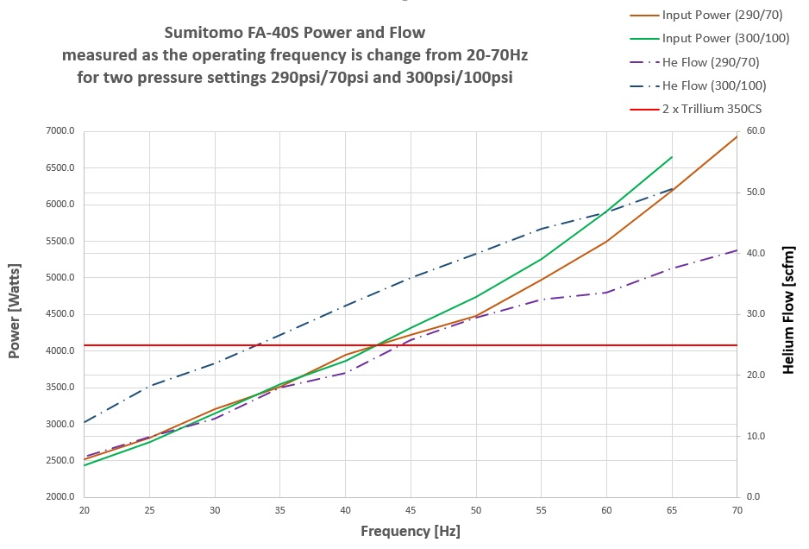
DeltaP | 300/100 | 290/70
Flow [scfm] | 25 | 25
Power[kW] | 3.3 | 4.1
Freq. [Hz] | 33 | 44
Notes:
There is a lot of information on this plot.
Almost linear dependence of the power consumption versus the operating frequency.
For a given frequency below 45Hz very small variation of the Power consumption with the pressure setting
After 45Hz the variation increases to reach 500W.
How ever regardless of the frequency strong flow variation with the delta pressure setting.
Flow highly dependent on the pressure settings which translate in important power consumption difference
Unknown at this time what would be the pressure setting with 2 cold-heads Trillium 350CS and how the pressure will change when the frequency

Slide 27
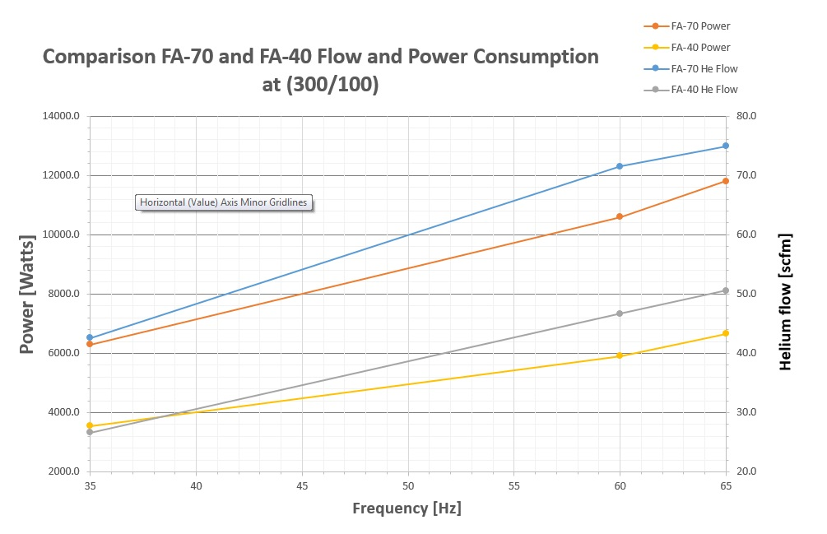
 | FA-70 | FA-40
Flow [scfm] | 42.6 | 42.6
Power [kwatts] | 6.3 | 5.3
Freq. [Hz] | 35 | 54
The FA-40 save 1kW
over the FA-70
Notes:
The large compressor has too much flow capacity to run only 2 cold-heads. We will have to run the compressor at very low frequency (20Hz)to get the flow required by two trillium 350 cold-heads. Running the compressor at such low frequency might be problematic and might affect the compressor overall performances, oil management and heat exchanger design for more oil circulation.
The Fa-40 is a much better match for the load and will save an extra 1kW of power .

Slide 28
Cryogenics Summary
The thermal analysis done on the initial receiver concept gave a heat load compatible with a refrigerator of similar size as the Trillium 350CS (20W at 80°C and 5W at 20°C). Our goal is to optimize the receiver design to reduce the estimated load by 30%.
The flow and power consumption of the compressor are highly dependent on the delta pressure Supply/Return
The FA-40 reduces the power consumption by 1kW over the FA-70 for the same pressure settings and Helium flow
The estimated flow required by two 350Cold-head at 40Hz is about 20scfm
The compressor to provide the 20scfm steady flow will have to run at approximately 30Hz and it will consume close to 3kW
28

Slide 29
VLA and ngVLA (optimized) Cryogenics
Comparison Table
 | VLA | ngVLA opt. | Rel. Cost
Antennas | 27 x 25m | 214 x 18m, 19 x 6m | n/a
He Compressors | 3 x 27 = 81 | 214 +19 = 233 | 2.88
AC Power consumption | 81 x 6 = 486kW | 233 x 3 = 699kW | 1.44
Cryocooler Model(s) | 1 x CTI22, 6 x CTI350, 1 x CTI1050 | 2 x CTI 350 | n/a
Cryocoolers maintenance | 8 x 27 = 216 | 233 x 2 x 2/3= 311 | 1.44
Notes:
The reference design proves that with well established GM technology and VFD we are well within the factor 3 required for the ngVLA operating budget. Our goal is to be 1.5 times only the VLA operating cost for cryogenics.
Well known service cost and technology, only the Scroll capsule can not be repaired. A Sterling pulse tube with lubrication free compressor is not serviceable and might not have a much lower power consumption I we add the 2 independent systems plus the water cooler to pull the heat generated by the refrigerator away from the receiver plate.

Slide 30
References
[1] Weinreb, S. and Mani, H., “Low Cost 1.2 to 116 GHz Receiver System – a Benchmark for ngVLA”, ngVLA Science Workshop presentation, June 2017. Excerpted content used with permission from the authors.
[2] Baker, L. and Veidt, B., “DVA-1 Performance With An Octave Horn From CST & GRASP Simulations”, Internal Report, March 2014. Excerpted content used with permission from the authors.
[3] Hessler, J., Kerr, A. and Horner, N., “A Broadband Waveguide Thermal Isolator”, ALMA Memo 469, May 2003.
[4] Remi Rayet, Band2-6 receiver “Initial Analysis Report” Callisto May 2018
30

Slide 32
Additional Slides
32

Slide 33
Reference Front End Band Frequencies
33

Slide 34
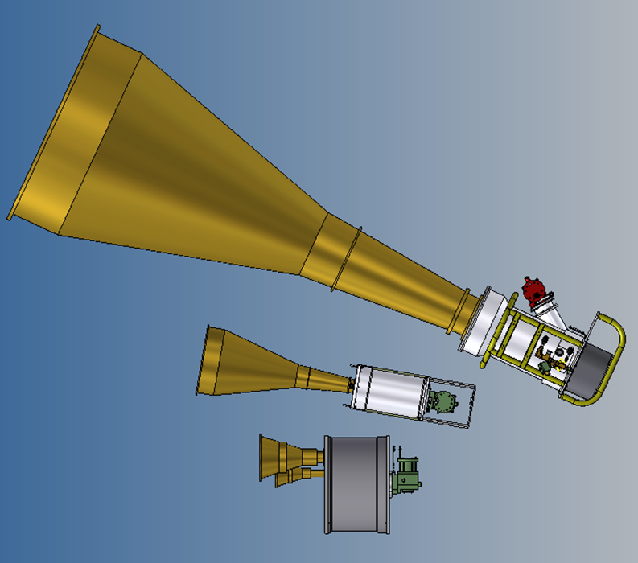
Previous version of ngVLA
with corrugated feed 15deg
half aperture angle.

